Slide 1
The ANTARES Contribution to the NT science
M. Spurio, Bologna U. and INFN

Slide 2
The ANTARES physics papers (2010→)
Atmospheric Muons
1 | MEASUREMENT OF THE ATMOSPHERIC MUON FLUX WITH A 4 GEV THRESHOLD IN THE ANTARES NEUTRINO TELESCOPE. J.A. Aguilar et al. (The ANTARES collaboration) Astropart. Phys. 33 (2010) 86-90
2 | ZENITH DISTRIBUTION AND FLUX OF ATMOSPHERIC MUONS MEASURED WITH THE 5-LINE ANTARES DETECTOR. J.A. Aguilar et al. (ANTARES Coll.) Astropart. Phys. 34 (2010) 179–184 | A. Margiotta, M. Bazzotti
3 | SEARCH FOR A DIFFUSE FLUX OF HIGH-ENERGY ν_{μ} WITH THE ANTARES NEUTRINO TELESCOPE. J. A. Aguilar et al. (The ANTARES Coll.) Phys.Lett. B696 (2011) 16-22 | M.S., S. Biagi.
4 | TIME CALIBRATION OF THE ANTARES NEUTRINO TELESCOPE. A. Aguilar et al. (The ANTARES Coll.) Astropart.Phys. 34 (2011) 539-549
5 | A FAST ALGORITHM FOR MUON TRACK RECONSTRUCTION AND ITS APPLICATION TO THE ANTARES NEUTRINO TELESCOPE. J. A. Aguilar et al. (The ANTARES Coll.) Astropart.Phys. 34 (2011) 652-662
6 | ANTARES: The first undersea neutrino telescope. M. Ageron et al. (The ANTARES Coll.) Nuclear Inst. and Methods in Physics Research, A 656 (2011) 11-38 | Tutti
7 | AMADEUS - THE ACOUSTIC NEUTRINO DETECTION TEST SYSTEM OF THE ANTARES DEEP-SEA NEUTRINO TELESCOPE. J. A. Aguilar et al. (The ANTARES Coll.) Nuclear Inst. and Methods in Physics Research, A 626-627 (2011) 128-143
8 | ACOUSTIC AND OPTICAL VARIATIONS DURING RAPID DOWNWARD MOTION EPISODES IN THE DEEP NORTH-WESTERN MEDITERRANEAN SEA. Van Haren, H., Taupier-Letage, I., Aguilar (ANTARES Coll.) Deep-Sea Research Part I: Oceanographic Research Papers 58 (2011). 875-884 | ESS
9 | FIRST SEARCH FOR POINT SOURCES OF HIGH ENERGY COSMIC NEUTRINOS WITH THE ANTARES NEUTRINO TELESCOPE. S. Adrian-Martinez et al. (The Antares Collaboration). The Astrophysical Journal Letters 743(2011) L14.
10 | THE ANTARES TELESCOPE NEUTRINO ALERT SYSTEM. M. Ageron et al. (The ANTARES Coll.) Astropart.Phys. 35 (2012) 530-536 doi:10.1016/j.astropartphys.2011.11.011
11 | MEASUREMENT OF THE GROUP VELOCITY OF LIGHT IN SEA WATER AT THE ANTARES SITE. S. Adrián-Martínez et al. (The ANTARES Coll.) Astroparticle Physics 35 (2012) 552–557. doi:10.1016/j.astropartphys.2011.12.003,
12 | A METHOD FOR DETECTION OF MUON INDUCED ELECTROMAGNETIC SHOWERS WITH THE ANTARES DETECTOR. J. A. Aguilar et al. (The ANTARES Coll.) Nuclear Inst. and Methods in Physics Research A675 (2012) 56–62
13 | SEARCH FOR RELATIVISTIC MAGNETIC MONOPOLES WITH THE ANTARES NEUTRINO TELESCOPE. S. Adrián-Martínez et al. (The ANTARES Coll.) Astroparticle Physics 35 (2012) 634–640.
14 | MEASUREMENT OF ATMOSPHERIC NEUTRINO OSCILLATIONS WITH THE ANTARES NEUTRINO TELESCOPE. Adrian-Martinez et al. (The Antares Collaboration). Physics Letters B 714 (2012) 224–230 doi: 10.1016/j.physletb.2012.07.002 | Anche tesi I. Madore
15 | THE POSITIONING SYSTEM OF THE ANTARES NEUTRINO TELESCOPE. Adrian-Martinez et al. (The Antares Collaboration) Journal of Instrumentation JINST 7 T08002. doi:10.1088/1748-0221/7/08/T08002
16 | SEARCH FOR NEUTRINO EMISSION FROM GAMMA-RAY FLARING BLAZARS WITH THE ANTARES TELESCOPE. S. Adrian-Martinez et al. (The Antares Collaboration). Astroparticle Physics 36 (2012) 204–210 doi10.1016/j.astropartphys.2012.06.001
17 | SEARCH FOR COSMIC NEUTRINO POINT SOURCES WITH FOUR YEAR DATA OF THE ANTARES TELESCOPE. S. Adrian-Martinez et al. (The Antares Collaboration). The Astrophysical Journal 760:53(2012).
Astrophysics
Detector
Astrophysics
Methods
Particle Physics
Methods
Astrophysics

Slide 3
Papers/analyses in progress
1 | GRAVITATIONAL WAVES AND HE NEUTRINO COINCIDENCES (Antares+ Ligo+ Virgo) | Submittes to ApJ
2 | AUGER AND HE NEUTRINO COINCIDENCES (Antares+Auger) | Submitted to APP
3 | GRBs AND HE NEUTRINO COINCIDENCES | Submitted to APP
4 | HIGH-FREQUENCY INTERNAL WAVE MOTIONS AT THE ANTARES SITE IN THE DEEP WESTERN MEDITERRANEAN | In preparation
5 | A TIME DEPENDENT SEARCH FOR NEUTRINO EMISSION FROM MICROQUASARS WITH THE ANTARES | In prepararion, S. Galatà, C. Distefano
6 | SEARCH FOR NUCLEARITES WITH THE ANTARES DETECTOR | In preparation
7 | 2008-2011 GRB analysis | Julia Schmid, Colas Rivière
8 | The Fermi Bubbles analysis | V. Kulikovskiy et al.
9 | Search for Showers Induced by a Diffuse Flux of Cosmic Neutrinos | Chiarusi,Ambrogi,deBonis,Qader..
10 | Update on the νμ Diffuse Flux Analysis using 2008-2011 data | S. Biagi
11 | Unfolding of the atmospheric νμ energy spectrum | L.A. Fusco, et al.
12 | Large Scale Cosmic Ray Anisotropy | A. Porelli (?)
13 | Search for dark matter from the Sun | CPPM, IFIC
14 | Search for dark matter from the Galactic Center | P. Fermani
15 | Moon shadow | C. Distefano,…
16 | UHE downgoing neutrinos (Sparking OMs identification methods) | L. Core, M. Sanguineti
 | Low energy, oscillations
3
2
5
1
4
7
6
8
9
10

Slide 4
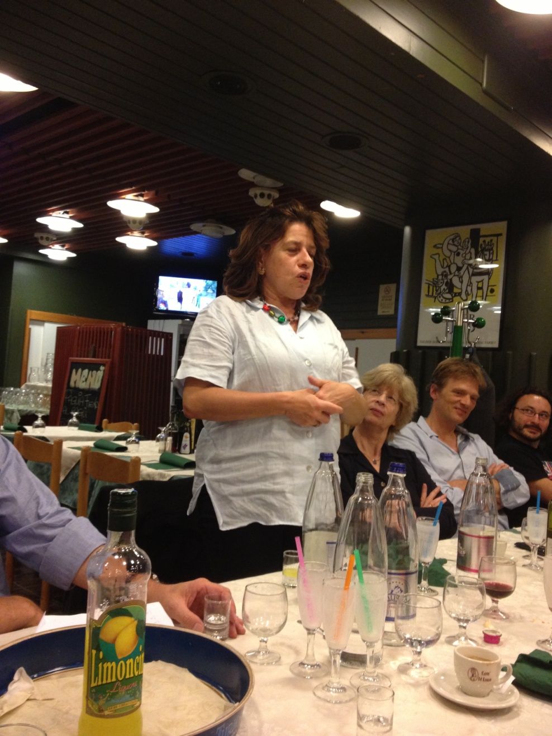
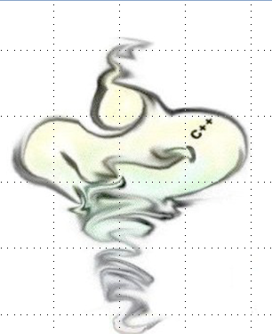
Monte Carlo
A. Margiotta
  C. Distefano
  R. Coniglione
  C. James
  L.A. Fusco
  G. de Bonis
  …
  M. de Jong
MUPAGE

Slide 5
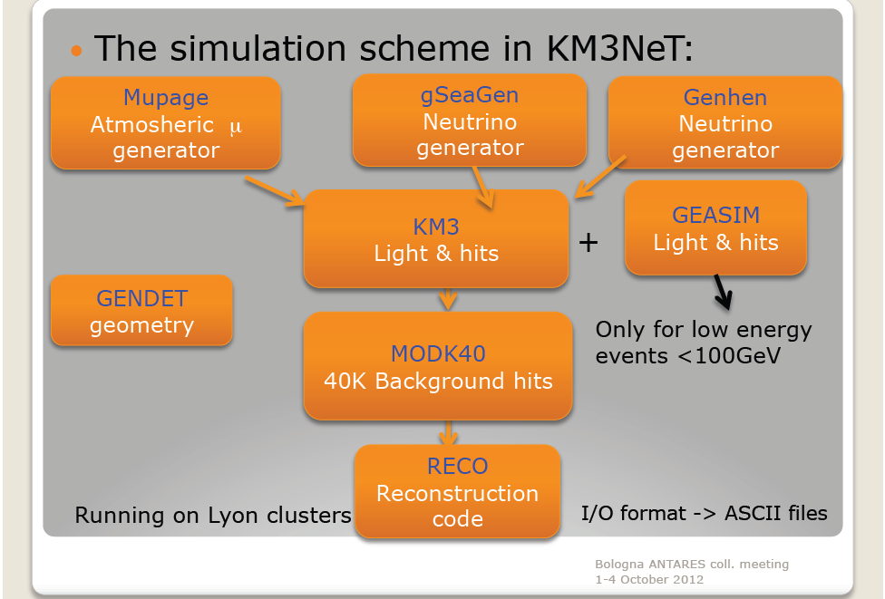
The simulation in KM3NeT
Rosa Coniglione

Slide 6
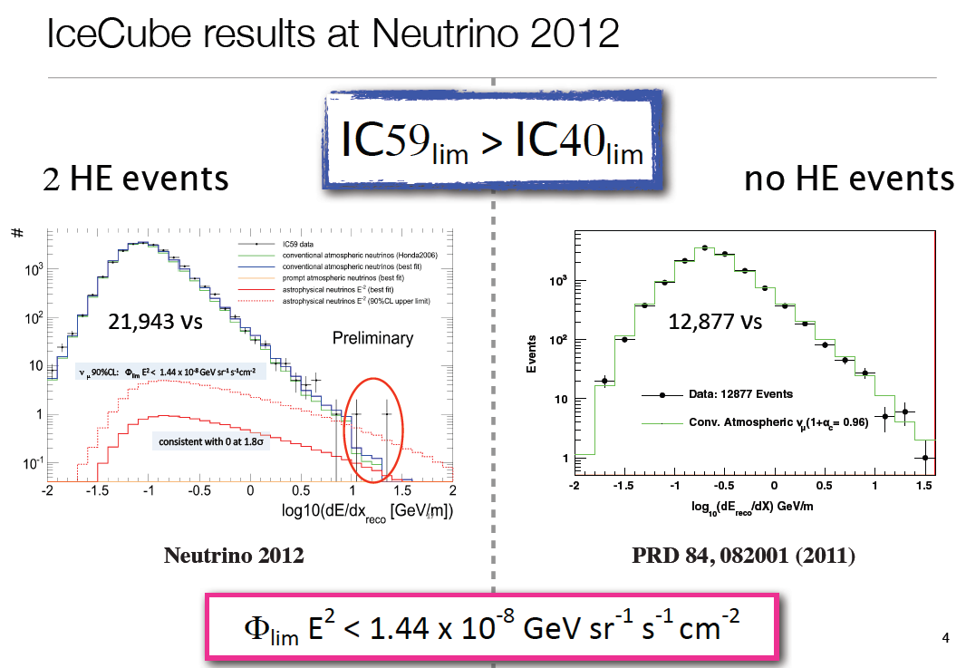
1- Diffuse flux of cosmic ν_{μ} neutrinos

Slide 7
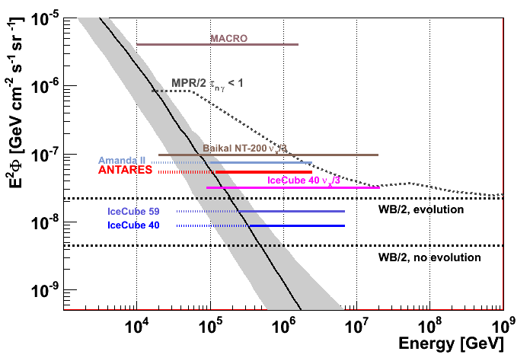
1- Diffuse flux: the ν_{μ} channel
Analisys in progress

Slide 8
Muon energy losses
Continous approximation for muon energy losses:
ionization
b(E) = b_{Brem.}(E)+b_{Pair}(E)+b_{Nucl.}(E)
Assumption: a, b constant with E:
a ~ 3 MeV cm⁻¹
in water
b ~ 3.6x10⁻⁶ cm⁻¹
[e.g. Groom, Mokhov, Striganov; 2001]

Slide 9
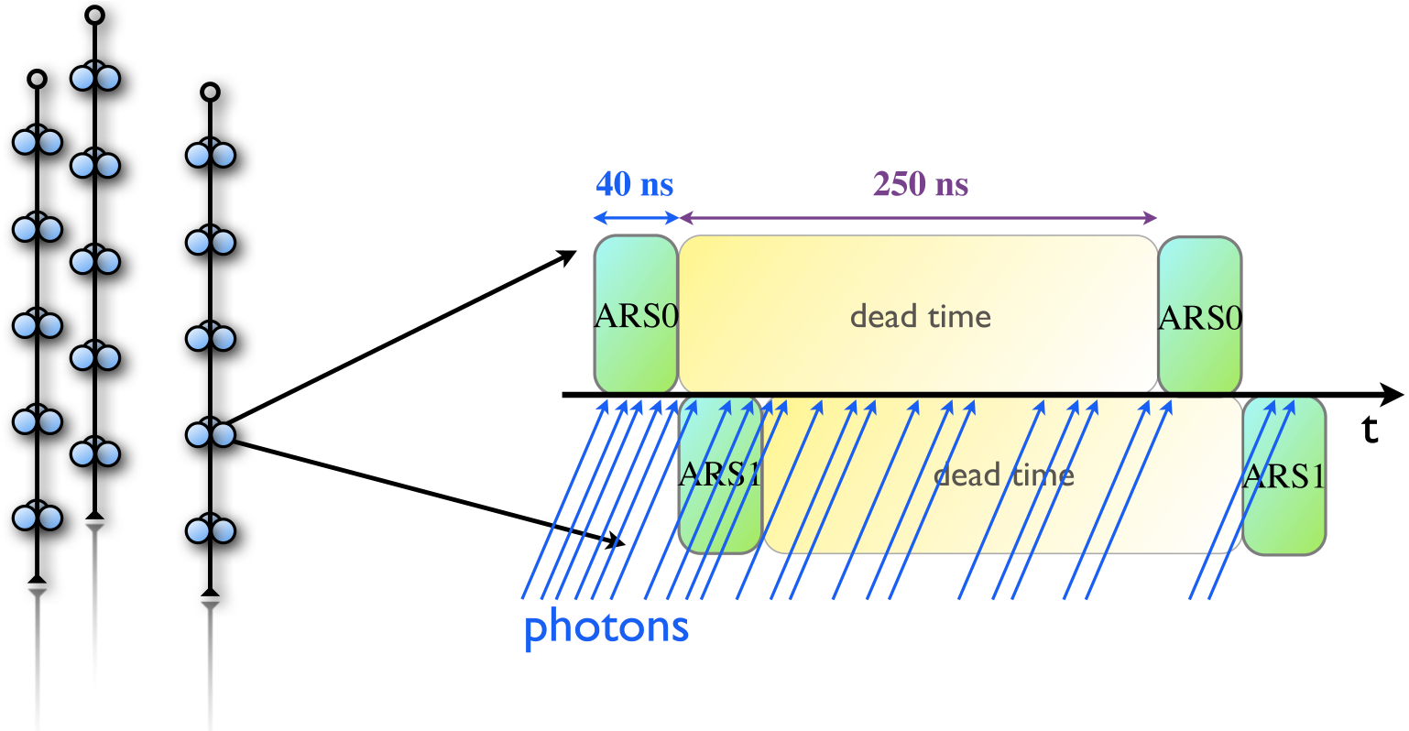
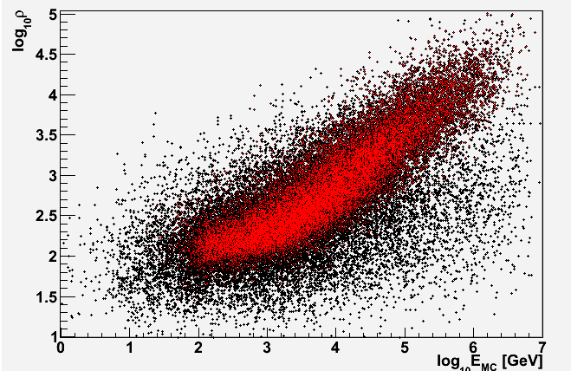
Muon energy estimators
Number of hits, N_{hit}
Direct estimation of dE/dx
  (N_{hit}, Length, charge,...)
Hit repetition counter R.
Likelihood method (all information).
Artificial neural network (all information).

Slide 10
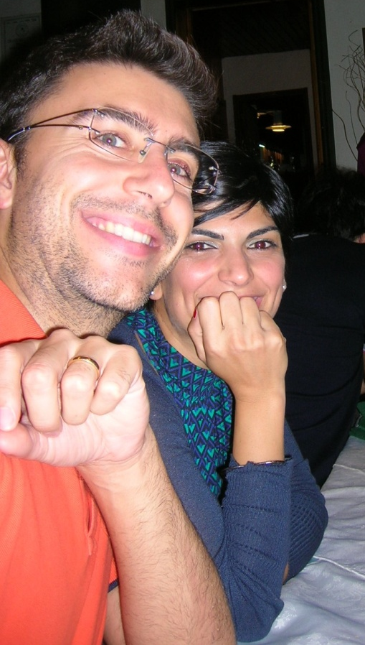
Why is so important this item?
Background= Atmospheric muons, + Atm neutrinos
IceCube:
  is at shallower depths than ANTARES
  much larger background due to atmospheric muons (1-3 kHz)
  coincidences from μ of different CRs
  →much harder cuts to remove the
  background from atm. muons
ANTARES: better relative sensitivity
Close to W&B: neutrino should be there
(Diffuse flux from the Galaxy plane)?

Slide 11

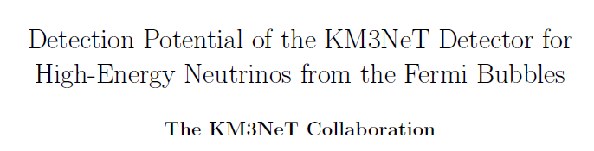
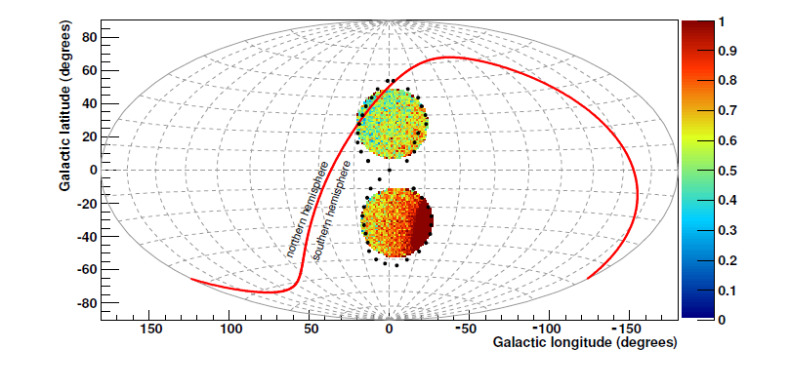
2- Fermi Bubbles

Slide 12
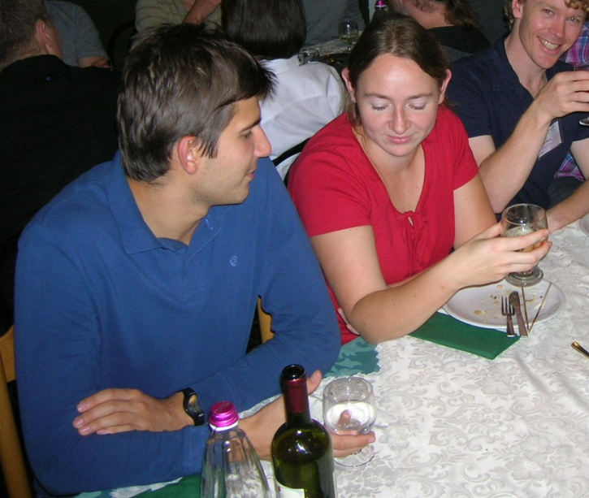
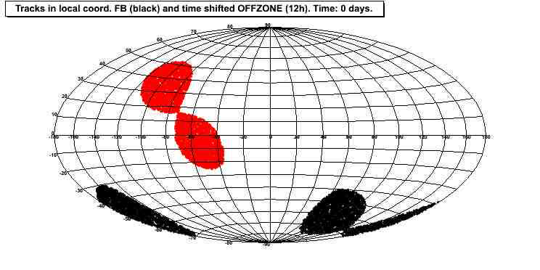
V. Kulikovskiy Analysis
FB region is ~0.8 sr in the sky – we can try to find some other region with the same efficiency/visibility for the background estimation.
A zone which follows the Fermi-Bubbles zone in the local coordinates.
OFF zone definition:
Take track time t0.
Evaluate track position at t0+12h in galactic coordinates.
If position is within FB, track accepted as OFF zone.

Slide 13
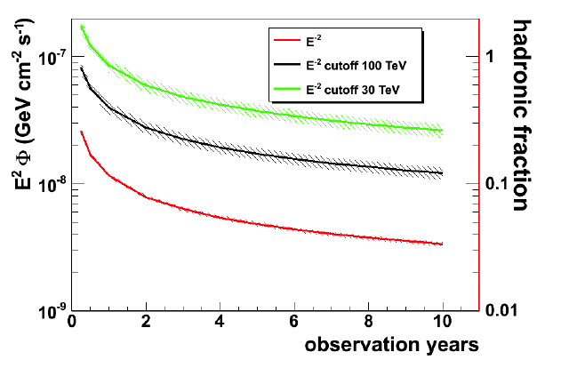
FB: Sensitivity for a KM3 NT in the Mediterranean sea
Mandatory: Energy estimator (background atm. ν_{μ})
ANTARES Neutrino 2012 (data 2008-10)
Signal Region

Slide 14
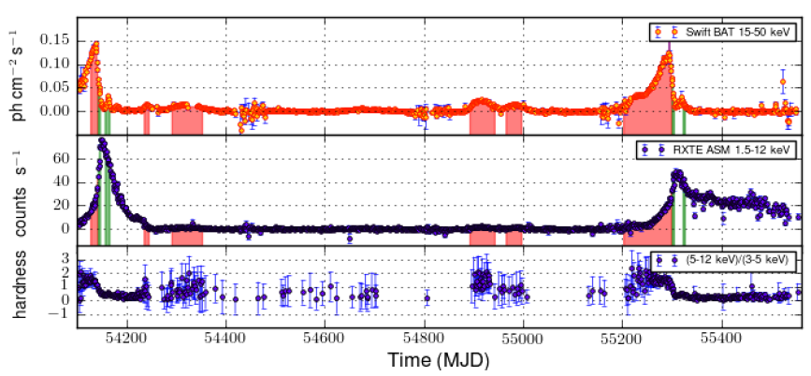
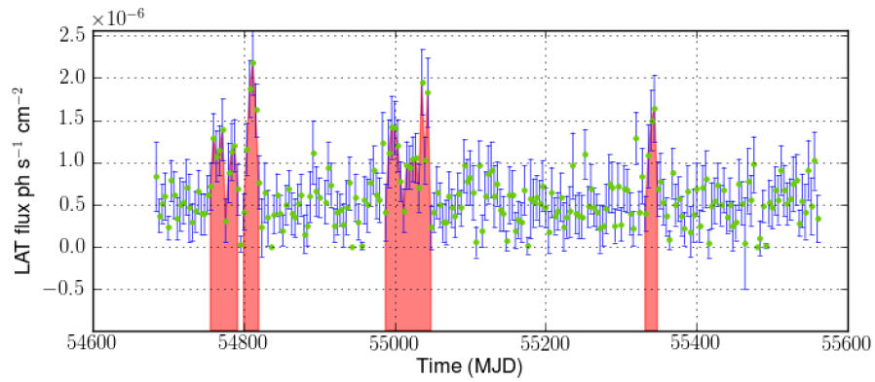
3- Time dependent search for neutrino emission from microquasars
Out of the FoV of IceCube
X-ray light curves of GX339-4 between 2007 and 2010, from Swift BAT (top) and RXTE ASM (middle). The lower panel shows the hardness ratio HR2 from ASM. The filled areas refer to the periods selected for the neutrino search: in red during the hard state and in green during the hard to soft transition.
Fermi LAT light curve of Cygnus X-3 from Aug 2008 to Dec 2010.
The red shaded area represent the periods selected for the neutrino search.

Slide 15
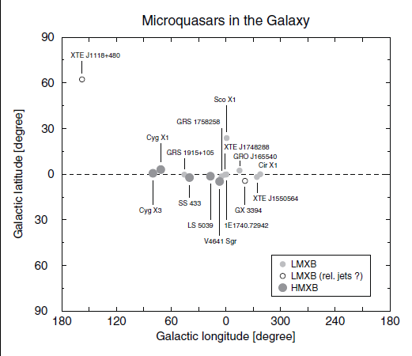
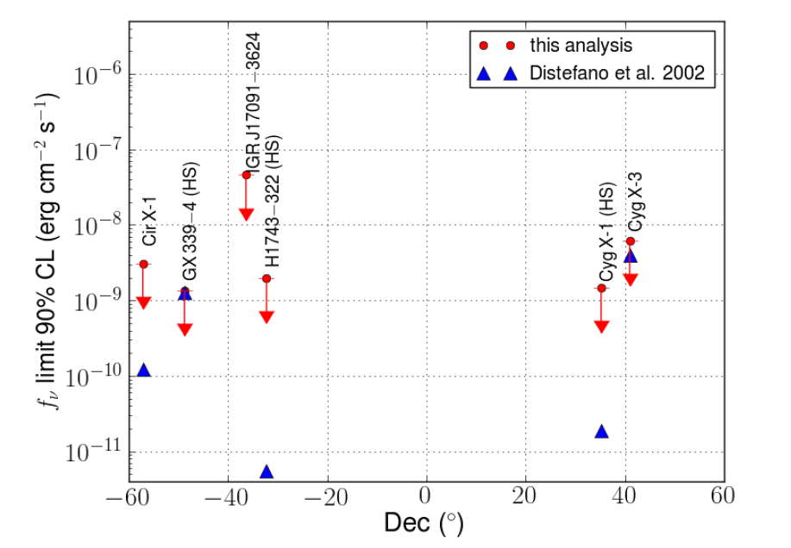
μQSRs
E⁻² spectrum
Probably cut-off
Preliminary
Distribution of known microquasars in galactic coordinates. Filled circles represent those sources where relativistic jets
have been imaged, while open circles are used for those where hints of relativistic jets have been seen or are clearly suspected.

Slide 16
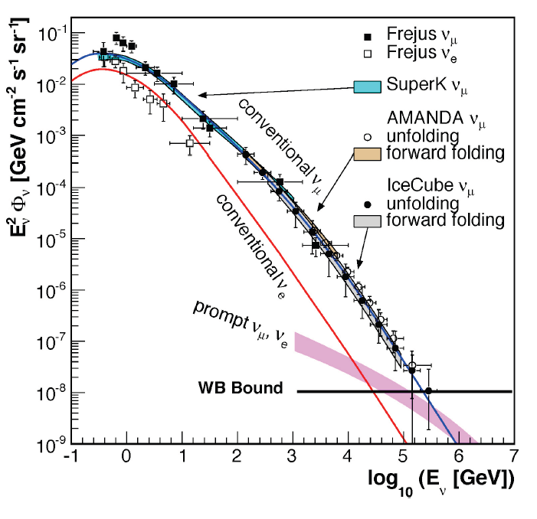
4- Unfolding of the atmospheric ν_{μ} energy spectrum
Bck for cosmic ν_{μ}
“Signal”: Lorentz invariance,…
Energy spectrum of ν_{μ} measured only on Ice
Poor information on ν_{e} flux
Again: energy estimator

Slide 17
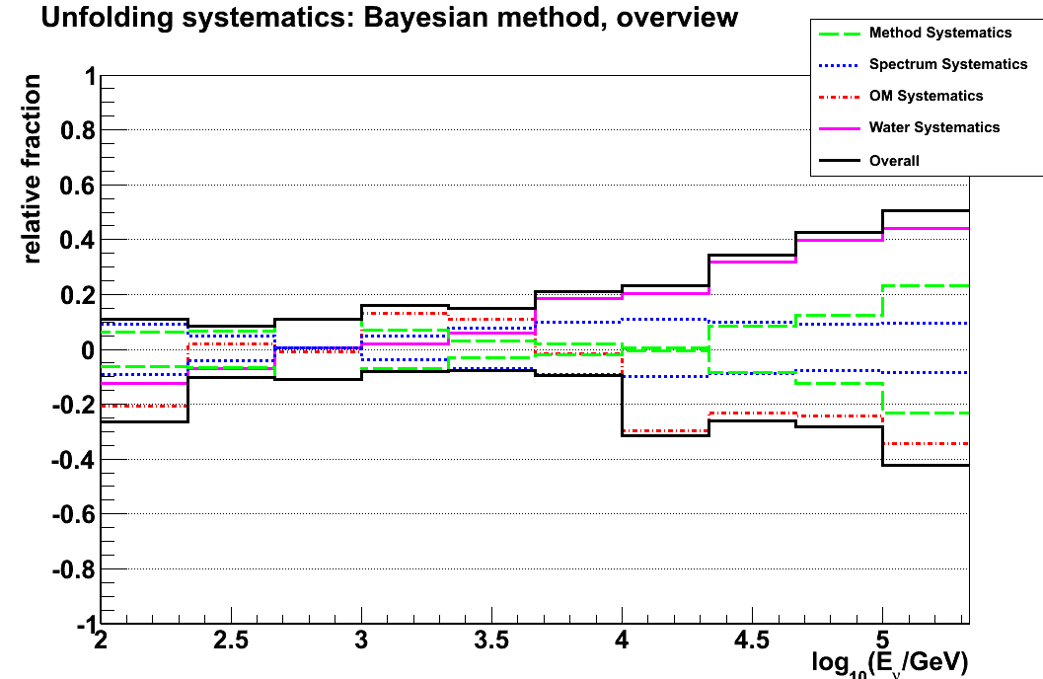
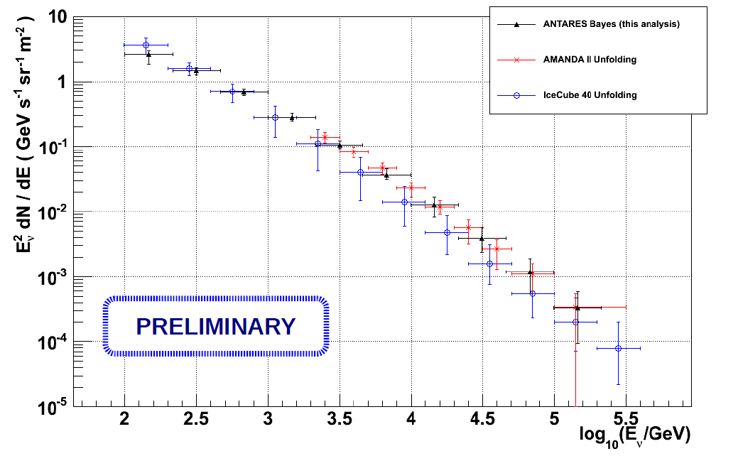
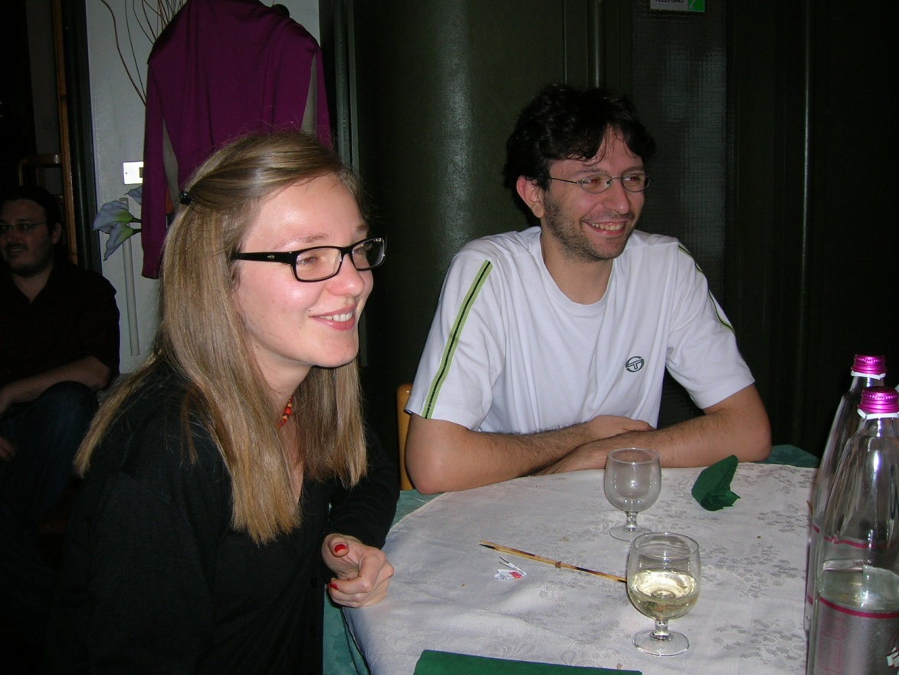
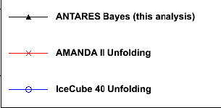
Work in progress in ANTARES
L.A. Fusco, Bologna meeting
Water

Slide 18
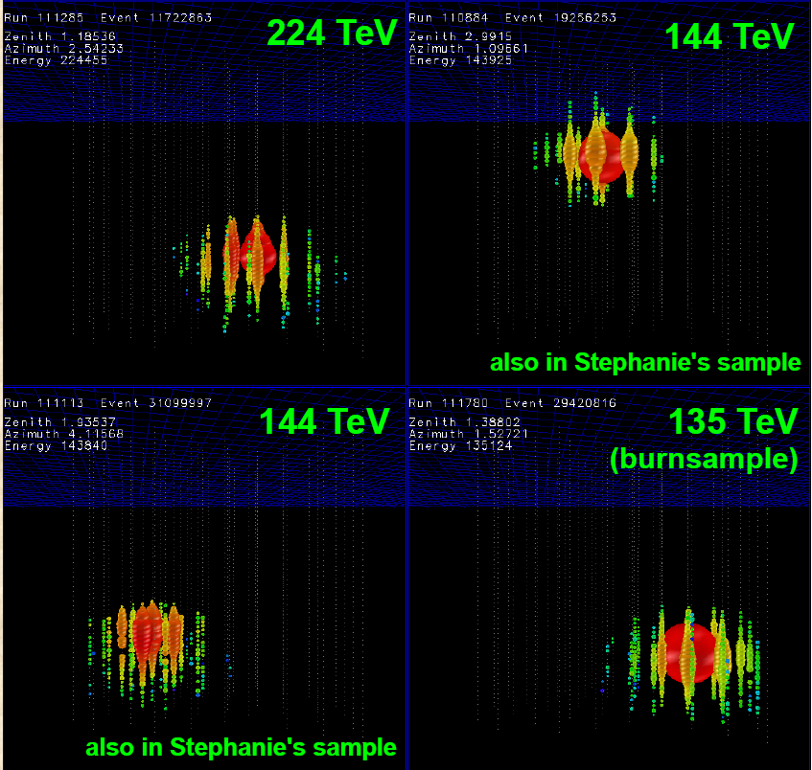
5-Search for ν_{e} Showers
Exitement from IC
Not to be quoted

Slide 19
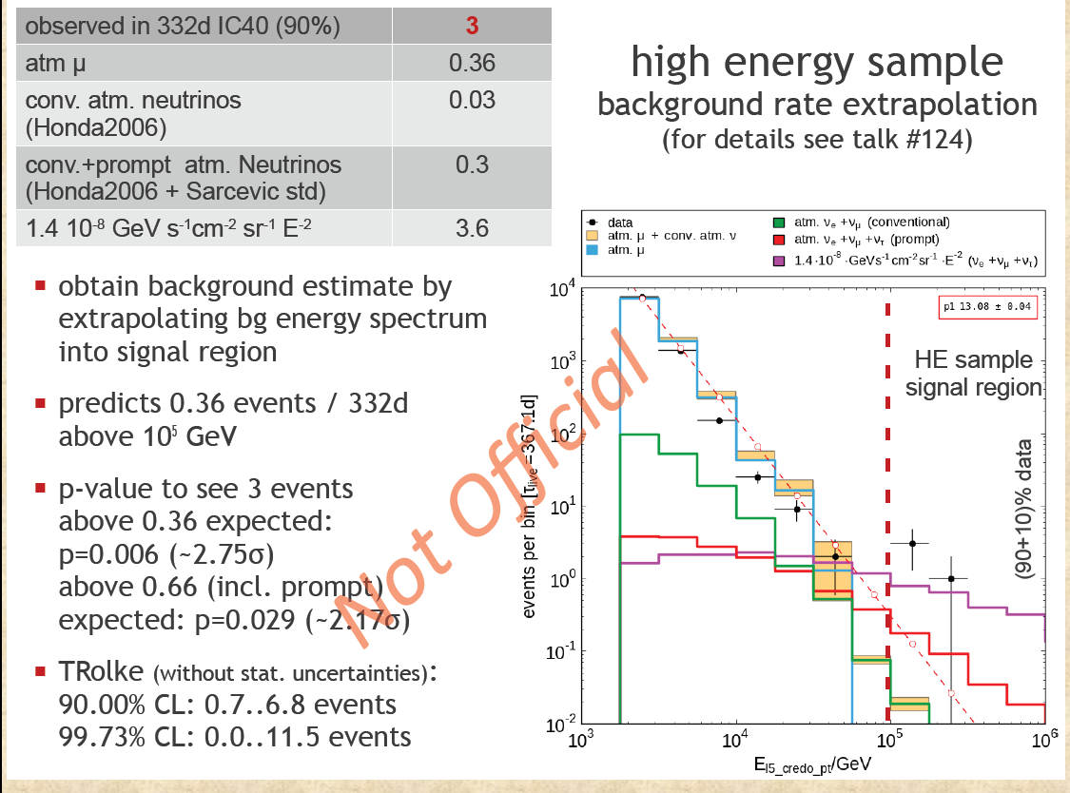

Slide 20
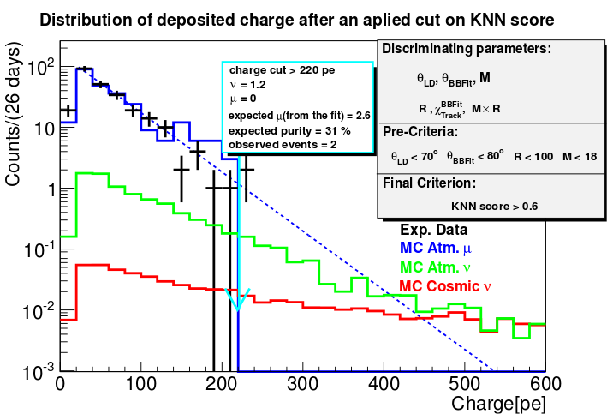
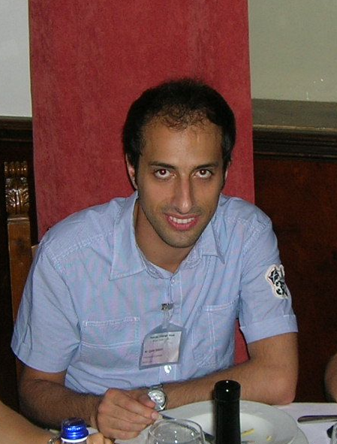
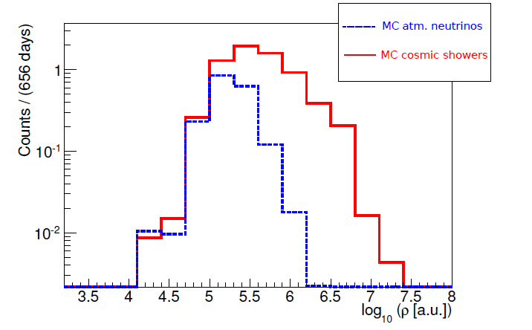

5-Search for Showers Induced by a Diffuse Flux of Cosmic Neutrinos

Slide 21
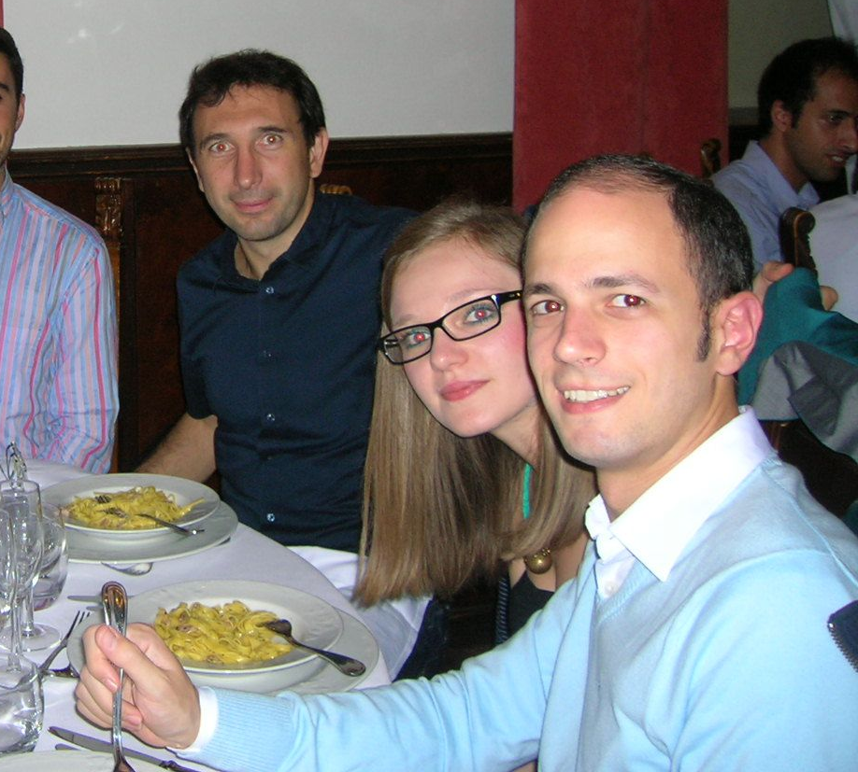
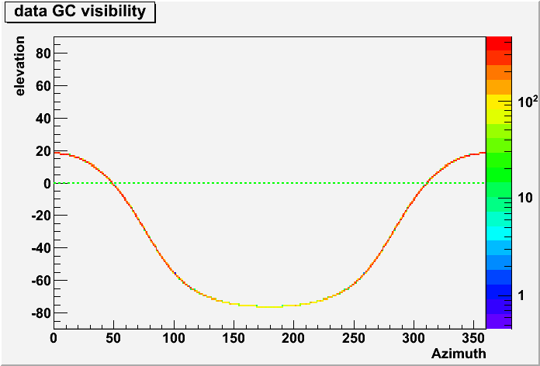
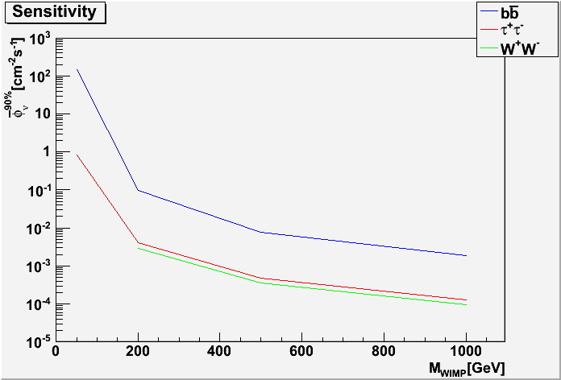
6- Search for dark matter from the Galactic Center

Slide 22
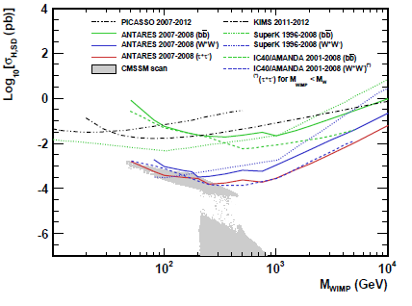
DM from the Sun direction

Slide 23
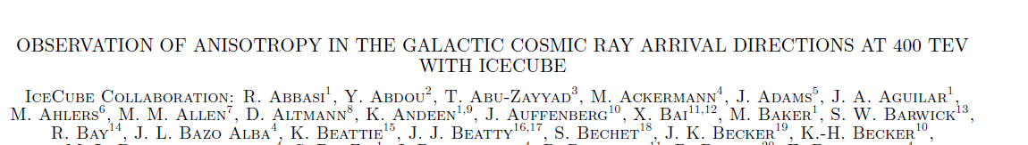
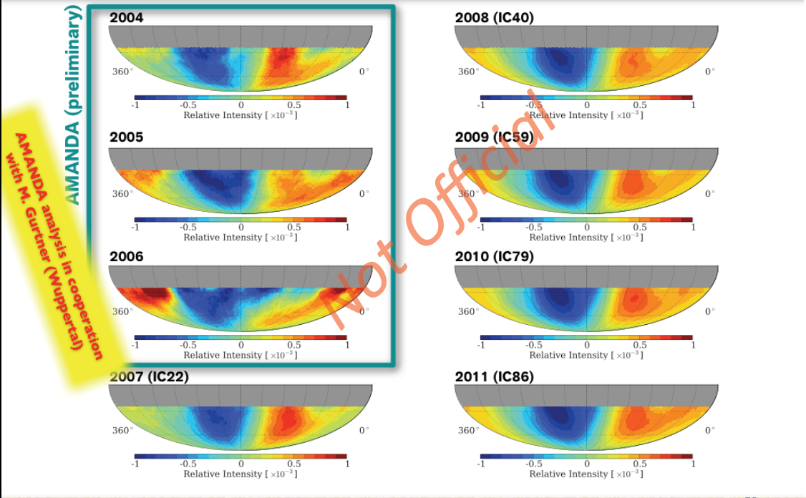
7-Large Scale Cosmic Ray Anisotropy

Slide 24
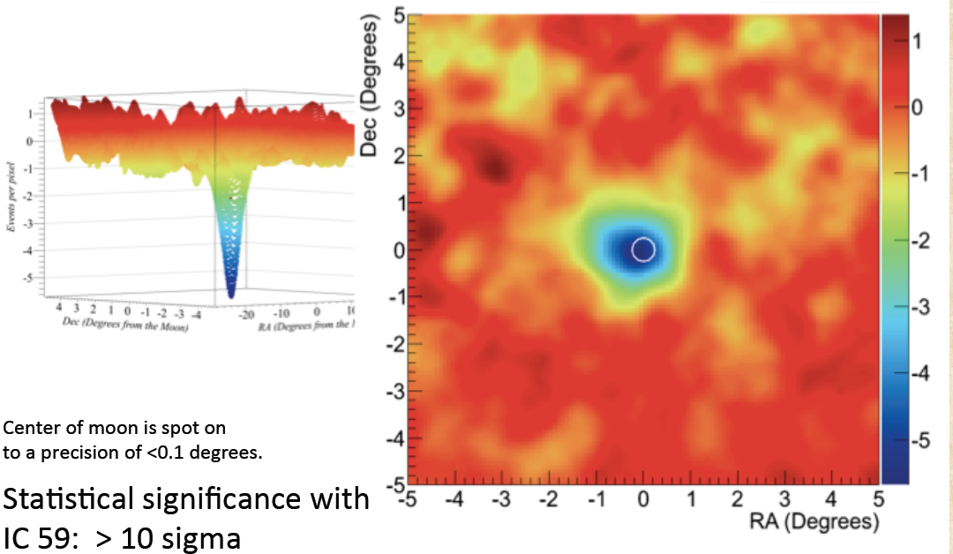
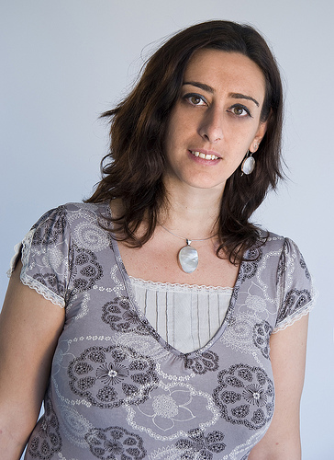
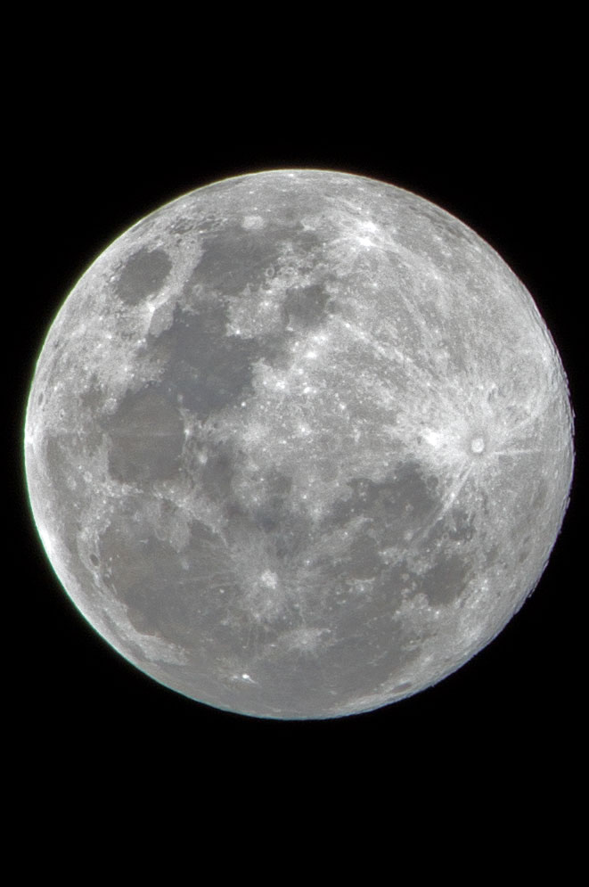
8-Moon shadow

Slide 25
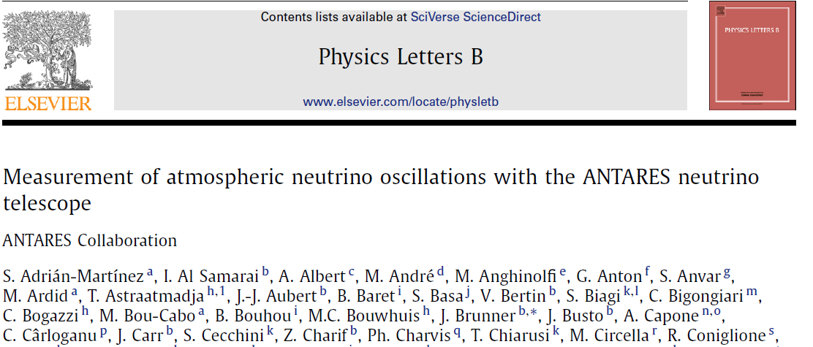
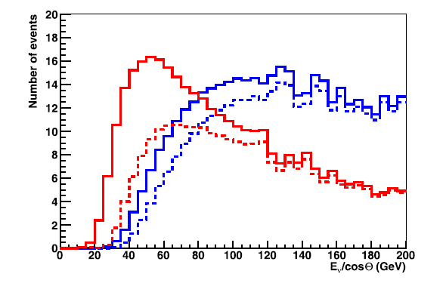
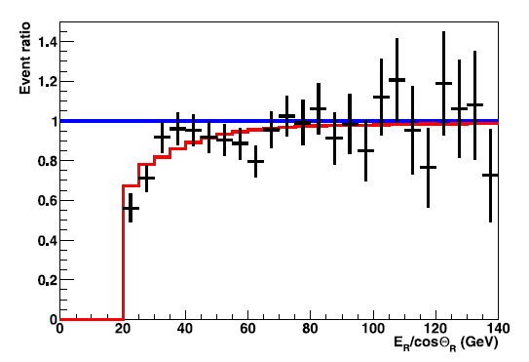
10-Neutrino Oscillations
1 line
>7 floors
multilines

Slide 26
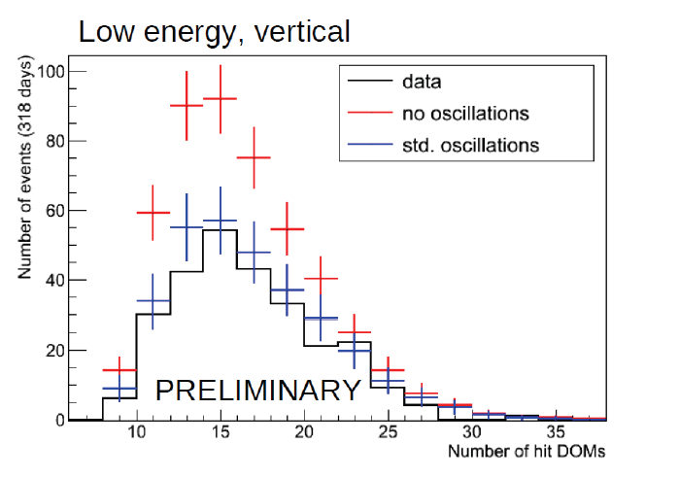
Oscillation in IceCube
Events in Deep Core
7-10 m spacing
IceCube
MANTS

Slide 27
A source candidate: RX J1713.7-3946
RX J1713.7-3946 seen by HESS (gamma rays)
10
-10
~E⁻²
]
10
-11
-1
TeV
10
-12
-1
s
-2
10
-13
Flux [cm
10
-14
10
-15
10
-16
0,1
1
10
100
Energy [TeV]

Slide 28
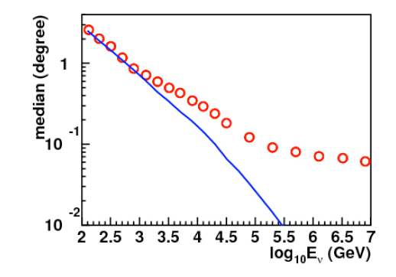
Neutrino astronomy
Nell’intervallo di energia 100 GeV- 1 TeV astronomia preclusa da una scarsa risoluzione angolare

Slide 29
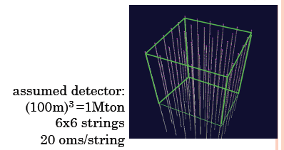
Veto for Orca
(14-1)*40 m
= 520 m
(14-1)*20 m
= 260 m
100 m

Slide 30
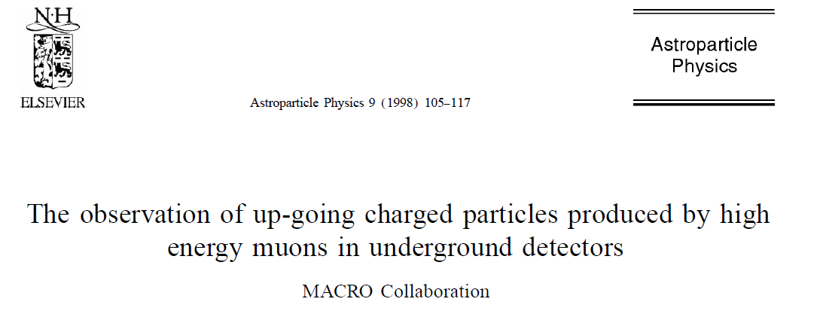
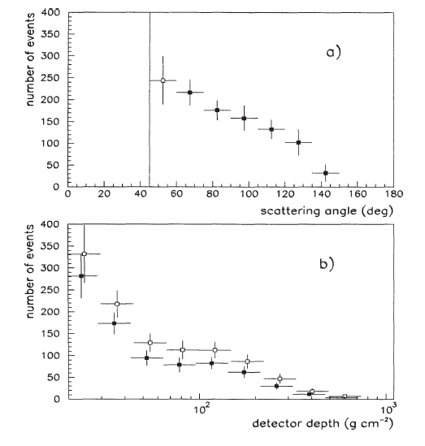
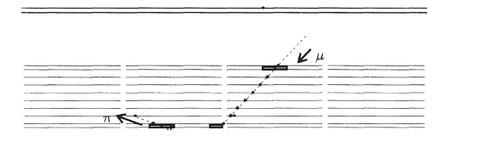
Upgoing particles produced by muons
angle
range

Slide 31
Fisica con detector 3-4 x ANTARES
A parità di costo, il volume di un rivelatore con spaziatura 40m è doppio di uno con spaziatura di 20m
Nessuna differenza di sensibilità tra 1-10 TeV
Flussi diffusi (40 vince)
Flusso diffuso dalla Galassia? (40)
Fermi Bubbles (20-40??)
Sorgenti puntiformi (microquasars) (40)
Veto per ORCA (40 !!!)

Slide 32
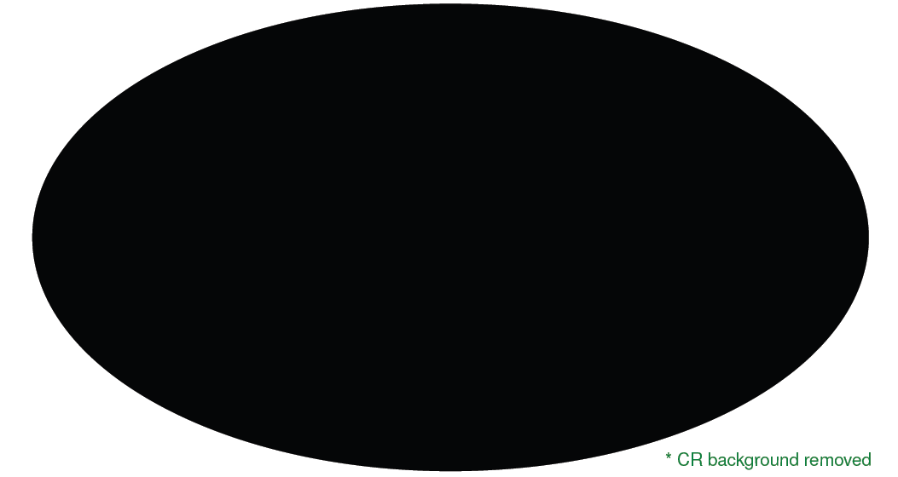
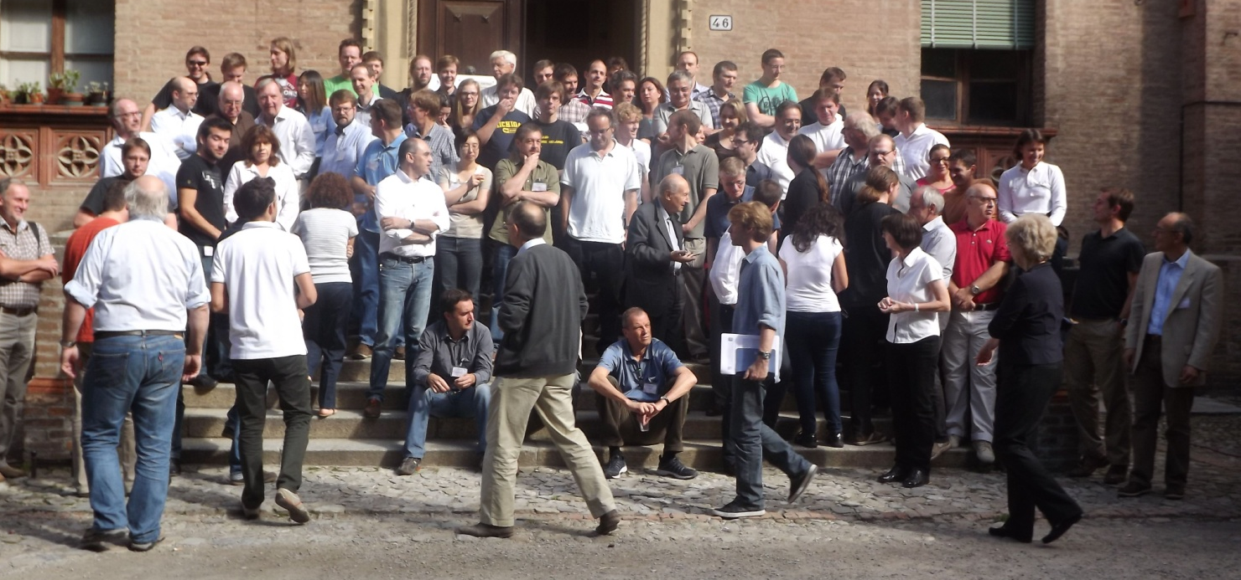
Neutrino skymap in 2012
-------- 20xx

