Slide 1
Diboson final states

Slide 2
SM diboson production with 2011 data (Analysis approved yesterday with CONF note)
SM diboson production with 2012 data
Non SM
  Anomalous TGC limit
  Exotic

Slide 3
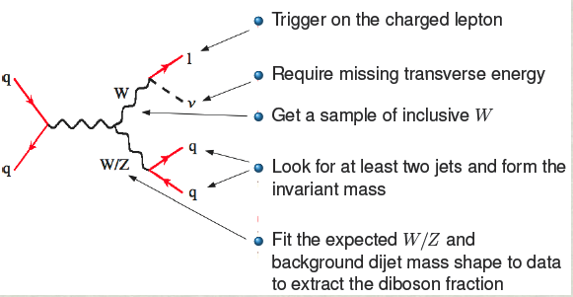
Framework
Background processes:
W+jets – largest contribution
Z+jets
ttbar → WbWbbar → lν jj bbar
QCD
single top
Challenge: semileptonic final state overwhelmed by W+jets contribution and S/B <1% to begin with
Comparison with Tevatron: increase of a factor 20 in W+2jet cross-section w.r. to increase of a factor 4 in WW/WZ cross-section

Slide 4
Signal Selection
Muon
Electron
Trigger: lowest unprescaled single mu
only 1 muon with p_{T} > 25 GeV
veto on second electron/muon
track & calo isolation
pointing to the vertex: d₀/σ(d₀) < 3
Trigger: : lowest unprescaled single e
only 1 tight++ electron p_{T} > 25 GeV
veto on second electron/muon
track and calo isolation
pointing to the vertex: d₀/σ(d₀) < 10
Leptonic W
Standard MET Cleaning + MET_RefFinal > 30 GeV+ M_{T}^{W} > 40 GeV
Preselection:
Overlap removal with e/mu ΔR=0.5
Only 2 good jets with p_{T}>20 GeV
Candidate W/Z→jj:
  p_{T}> 30 GeV/p_{T}> 25 GeV |η|<2.0 & |JVF|>0.75
  ΔR(j1,j2)>0.8 + Δη(j1,j2)<1.5 (S/B and MC description)
Hadronic W/Z

Slide 5
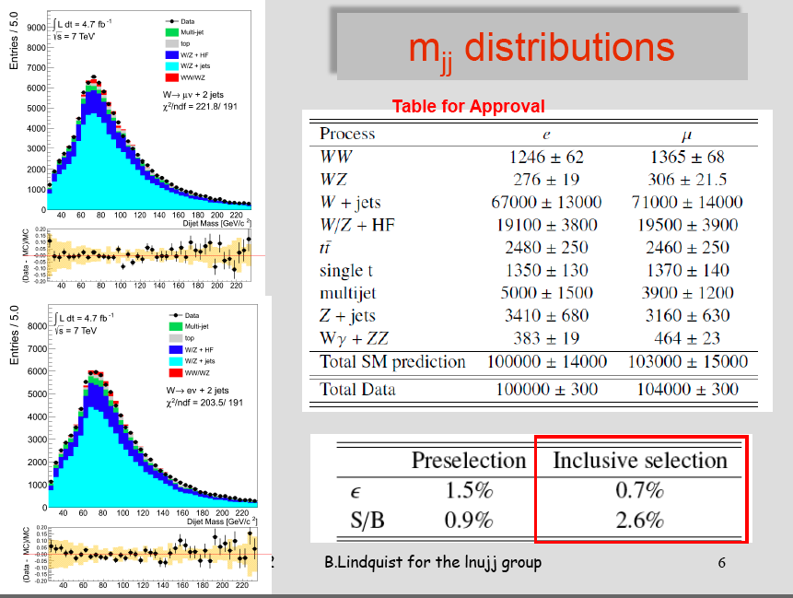

Slide 6
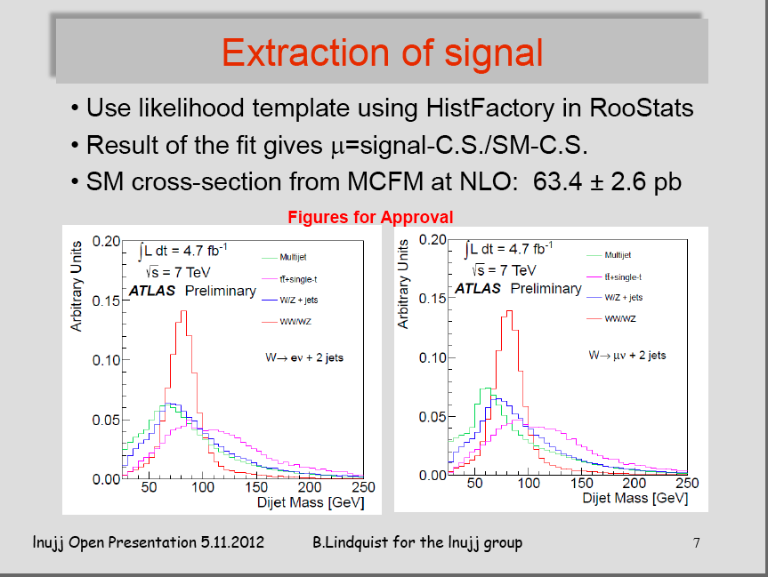

Slide 7
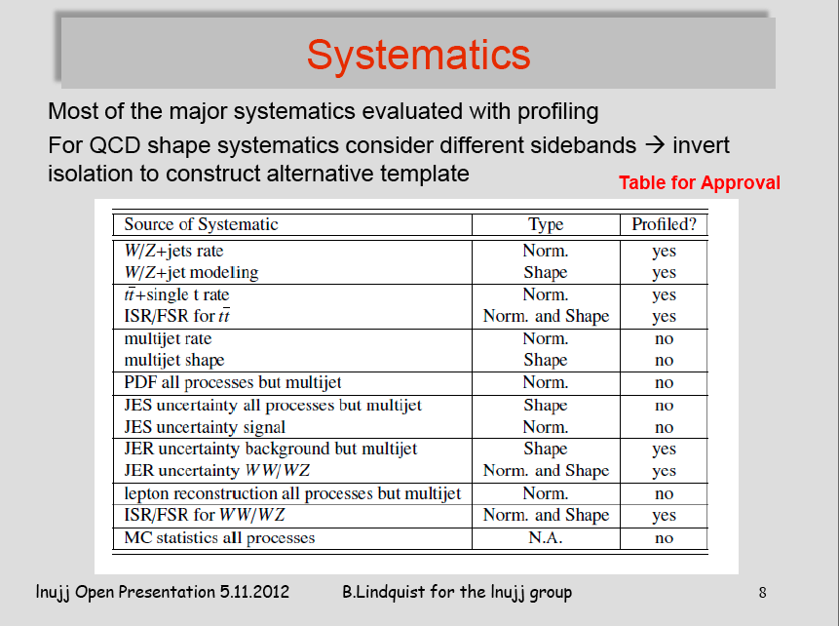

Slide 8
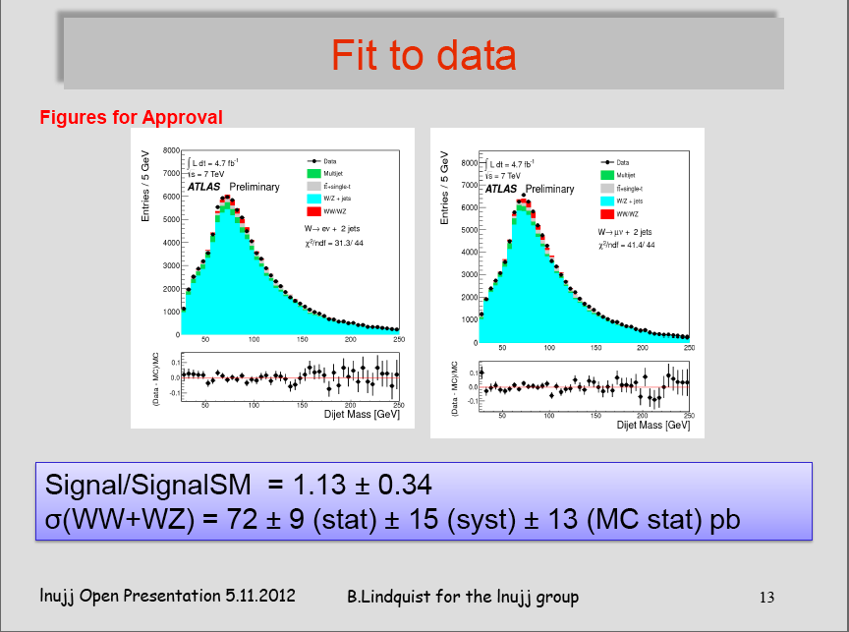

Slide 9
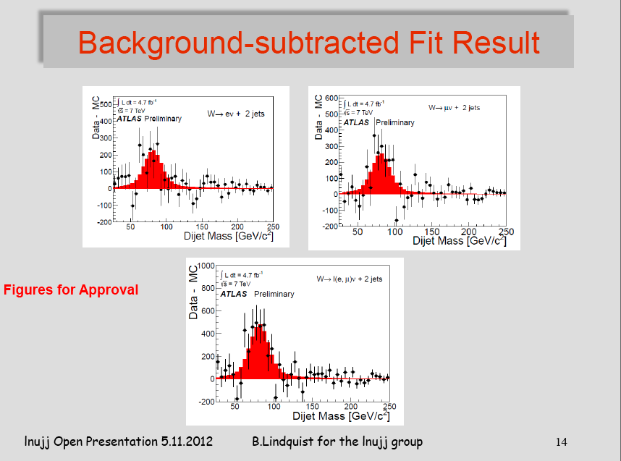

Slide 10
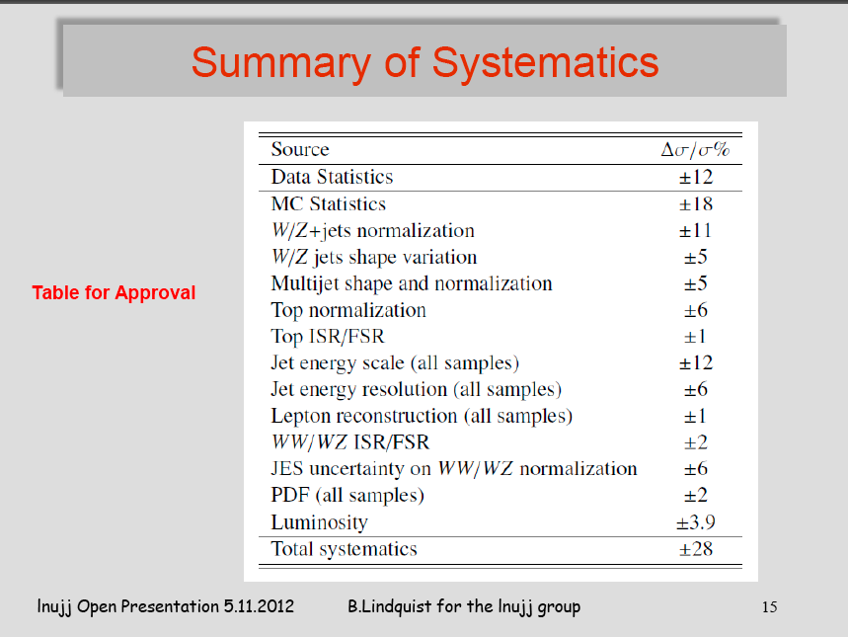

Slide 11
Draft of list to-do items for publication
- TGC limit
- JES with components for alpha
- study of efficiency at truth level
- Check MCFM vs HERWIG:
. compare MCFM distributions to Herwig
. check BR W->lnu, W->jj in Herwig
Decreasing the MC stat contribution
  Revisit the possibility to smooth?
  use of ATLFASTII → how much stat do we have
- Complete the ttbar CR

Slide 12
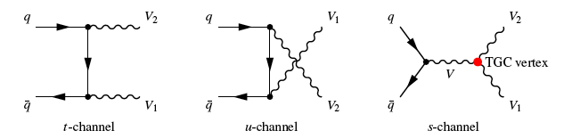
TGC
WWZ: g_{wwz}=-e*cotθ_{w}
WWγ: g_{wwγ}=
Assuming electromagnetic gauge invariance and C and P conservations, the number of independent parameters reduces to: g₁^{z}, κ_{z},κγ,λ_{z},λ_{γ}
In the SM, the coupling parameters have the following values: g₁^{z}=κ_{z}=κγ=1,λ_{z},=λ_{γ}=0
Deviations of these coupling parameters from their SM values taking them all equal to zero, would result in an increase of the production cross section and alter kinematic distributions, especially for large values of the leading lepton pT.

Slide 13
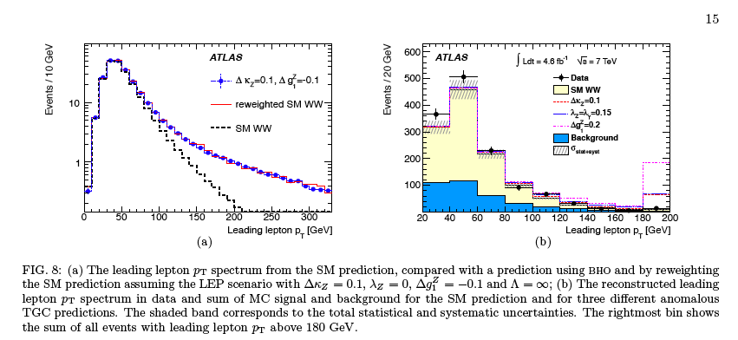
Limit on anomalous TGC in leptonic final states

Slide 14
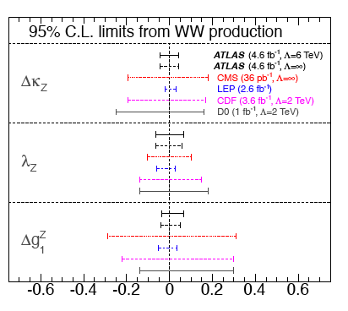
Limit on anomalous TGC in leptonic final states
Limits from semileptonic diboson are complementary: statistic is larger (about a factor 2) but larger systematics.

Slide 15
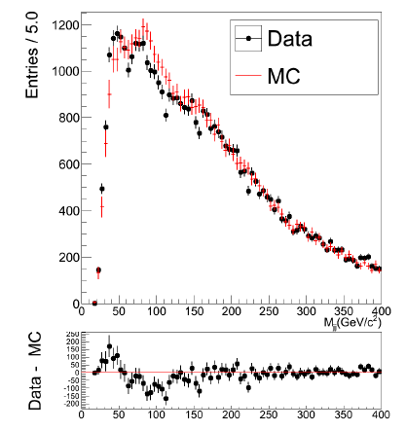
WW/WZ → lnujj with 2012 data
2011 analysis on full 201 data
Selection to see the peak on a smooth bkg ?
can we work on MC to make it work better for tighter selections ?
try WW/WZ->lnubb ?
revisit q/g tagging
Boosted study: WW/WZ->lnuJ the two quarks are reconstructed as a single fat jet
FTK for better lepton isolation

Slide 16
Heavy particle decaying to dibosons
Many extensions to the Standard Model (SM) including warped extra dimensions, grand unified theories and dynamical electroweak symmetry breaking models like Technicolor predict the existence of heavy resonances decaying to pairs of electroweak gauge bosons.
The analysis uses the Mdiboson as discriminant variable.
First analysis on lljj final state with 2011+2012 data has almost been finalized using both lljj and llj (two merged jets) final states.

Slide 17
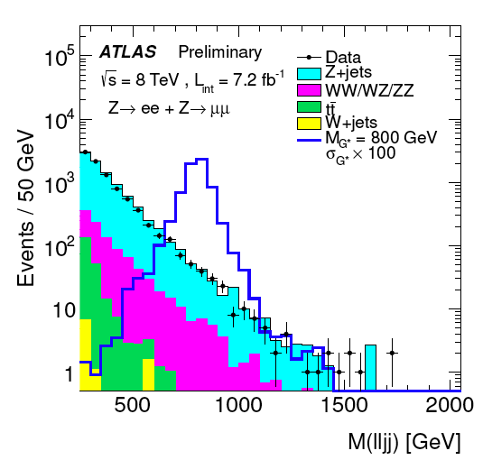
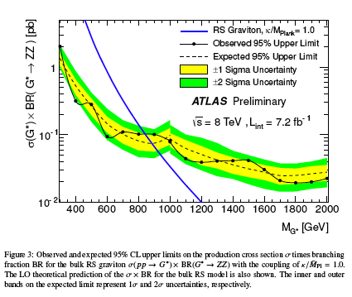
Exotic particles decaying to dibosons
Same kind of study is starting on WW/WZ→lnujj final state
We could have a student on this study

Slide 18
Back-up

Slide 19
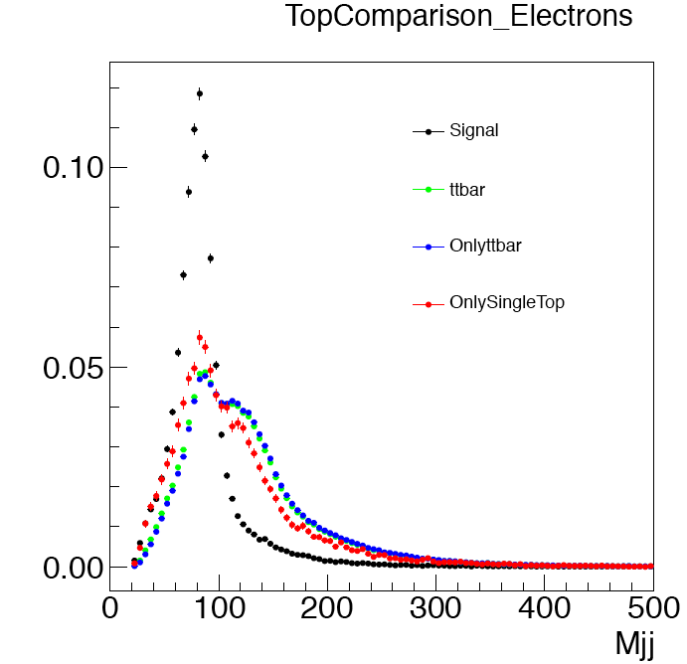
ttbar/single-top - templates
The structure of the single-top template is more peaked however the s-top shape in general is much more similar to the ttbar than to the signal.
The s-top is about 15% of the ttbar sample.
We do not think it will give a large effect but we need to check → try fit with ttbar and single-top templates separately to see the change in signal rate.

Slide 20
ttbar/single-top – cross-sections
Cross-section uncertainties
  ttbar: 166.78 +16.48 -17.76 pb → ~10%
  M. Aliev et al., HATHOR – HAdronic Top and Heavy quarks cross section calculatoR Comput. Phys. Commun.182 (2011) 1034-1046, arXiv:1007:1327 [hep-ph]
  Singletop:
  t-channel: 64.57 +2.63 -1.74 pb (Phys. Rev. D 83, 091503(R) (2011)) → 4%
  s-channel: 4.63 +0.20 -0.18 pb (Phys. Rev. D 81, 054028 (2010)) → 4%
  Wt: 15.74 + 1.17 -1.21 pb (Phys. Rev. D 82, 054018 (2010)) → 8%
  Weitghted total single top uncertainty: ~5%

Slide 21
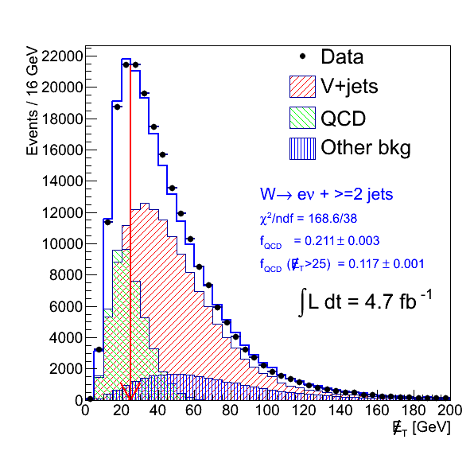
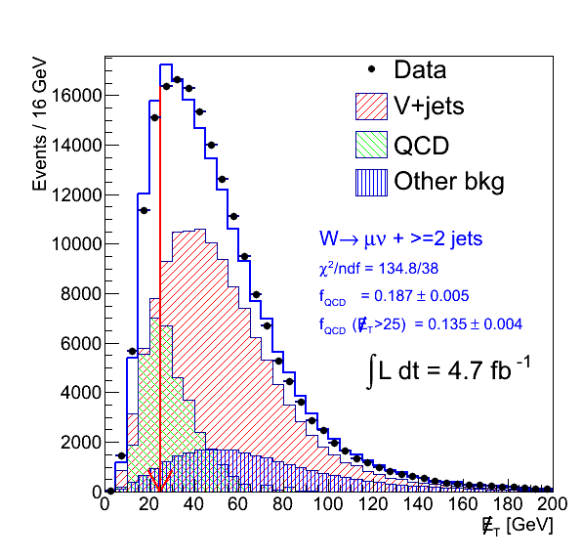
Treatment of JER systematic templates
JER uncertainty: the effect of the JER uncertainty was large, up to 20% for W+jet.
This was mainly due to the fact that the MET fit used to estimate the W+jet contribution, for the JER varied templates was not good.
Nominal
Varied
We estimate the W+jet normalization for the JER shifted template using MC + the correction obtained with the MET fit to the nominal analysis

Slide 22
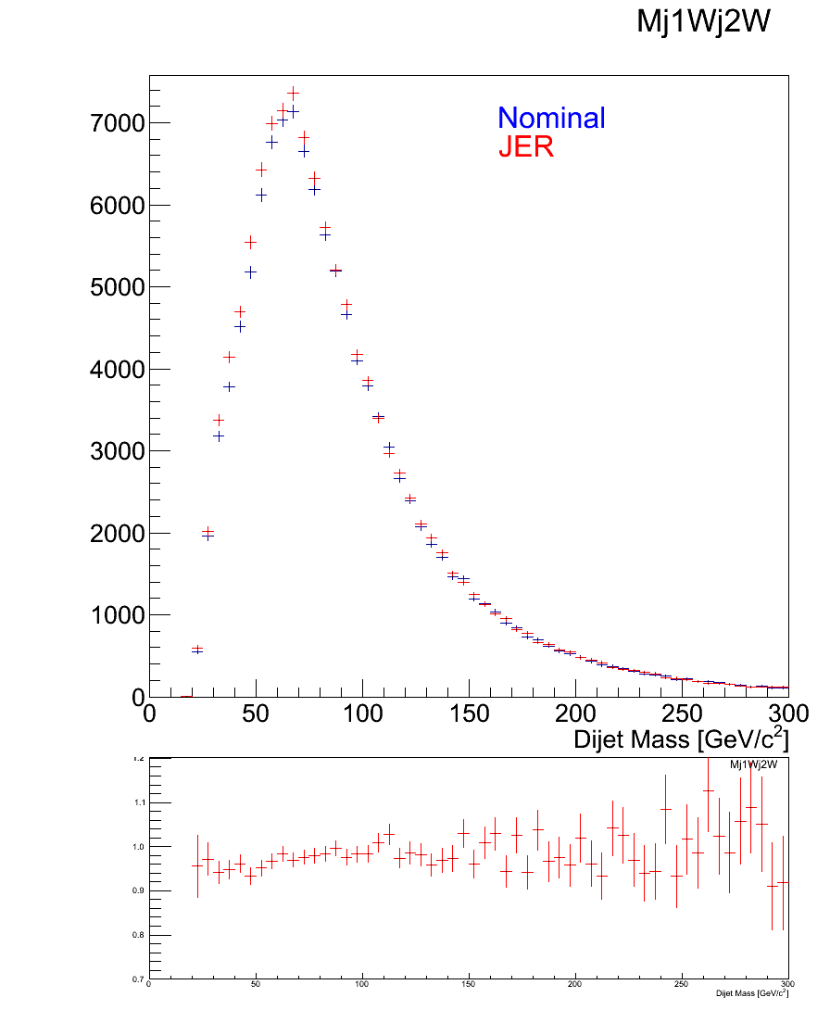
Treatment of JER systematic templates
JET templates are asymmetric: we only have nominal and more-smearing.
This asymmetry creates a problem in the use of the nuisance parameter which can only vary between 0 and 1 (instead then -1,1) → for the moment we have symmetrized the template and everything works fine.
This is clearly a temporary solution we will check what other analysis have done.
1
1.1

Slide 23
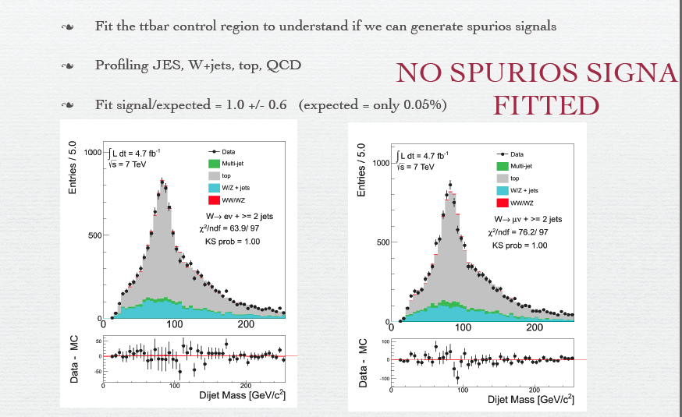
Ttbar control region fit

Slide 24
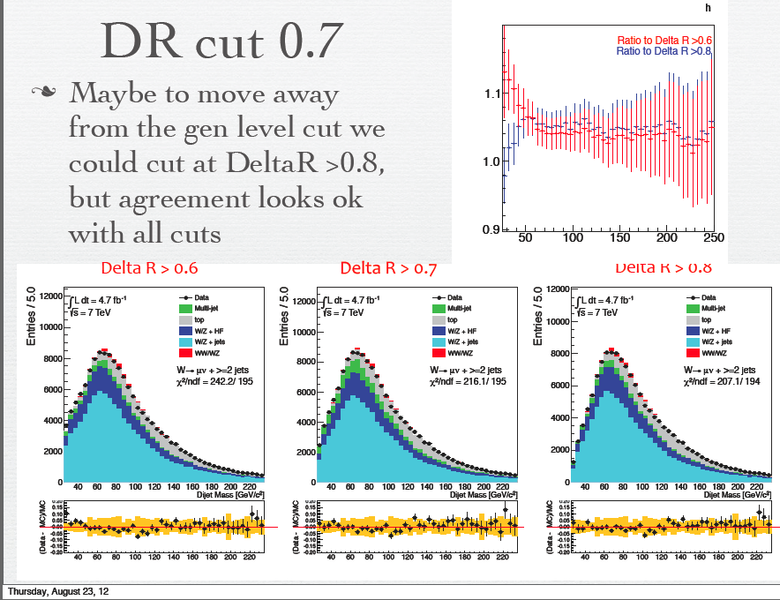

Slide 25
MC Modeling for Wjet/Zjet
Some of the cuts aims at selecting regions with good MC/Modeling. How can we be sure that the templates we obtain are trustable ? Have you considered looking at alternative MC's to Alpgen (eg McAtNLO, PowHeg+Jimmy, PowHeg+Pythia, or Sherpa) to see if the templates are consistent with Alpgen within the systematic uncertainties?
We have looked MC11-SHERPA samples (older version w.r. to what we have in mc12) and they had similar problems (for example the low Deltarj1j2 region was not well described) but the statistics was much lower. MC@NLO does not correctly describe W+2jet, all distributions with more than 1 jet are off. Zjet study here:
http://physik2.uni-goettingen.de/~ulla/public/ZjetsPaper2012/Zjets.pdf
the reason is that MC@NLO is DrellYan with virtual corrections and one additional real emission.So the second jet is already modeled by parton shower, which is too soft. For POWHEG we have not looked but I think Alpgen+Herwig is the best tested at the moment and it offers the larger statistics.

Slide 26
More checks: QCD control region
Defined as Met <25 GeV and MtW>10 GeV
Setup a fit in this region with the following nuisance parameters:
  JES
  JER
  Qfac and dr on W+jets
  shape on ttbar
The idea is to fit the the QCD Normalization with starting point the normalization obtained from the previous fit in the region MtW>40 GeV

Slide 27
Fit to the qcd control region
RESULT OF THE FIT

Slide 28
Fit to the QCD control region
SigXsecOverSM 9.9845e-01 +/- 3.66e-02
alpha_JER 2.4790e-01 +/- 1.21e-01
alpha_JES 4.3200e-01 +/- 1.43e-01
alpha_MorePS -1.3333e-01 +/- 8.07e-01
alpha_dr -9.7330e-01 +/- 8.34e-01
alpha_qcd_shape 0.2130e-01 +/- 5.61e-03
alpha_qcd_shape_mu -0.1340e-01 +/- 9.61e-02
alpha_qfac -6.1411e-01 +/- 9.36e-01
alpha_stopxs -2.9941e-02 +/- 9.96e-01
alpha_topxs -8.4067e-01 +/- 9.32e-01
alpha_wjetsxs 1.8633e-01 +/- 1.59e-01
alpha_wwxs 7.2410e-01 +/- 1.02e+00
Here the fitted value is the qcd normalization
The shape is profiled but does not move at all

Slide 29
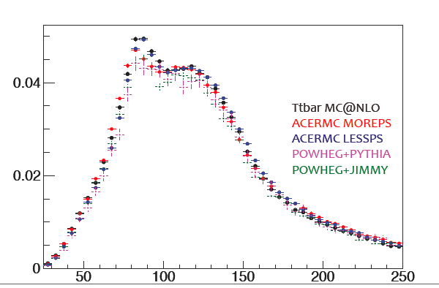
ttbar systematic
We are using ISR/FSR varied templates (MORE and LESS)
As agreed in EB meeting all other variations are within stat uncertainty of more/less ISR/FSR therefore we just keep these two. We are producing also the one for color-reconnection varied sample.
Will be updated tomorrow with new-selection and color-reconnection varied samples

Slide 30
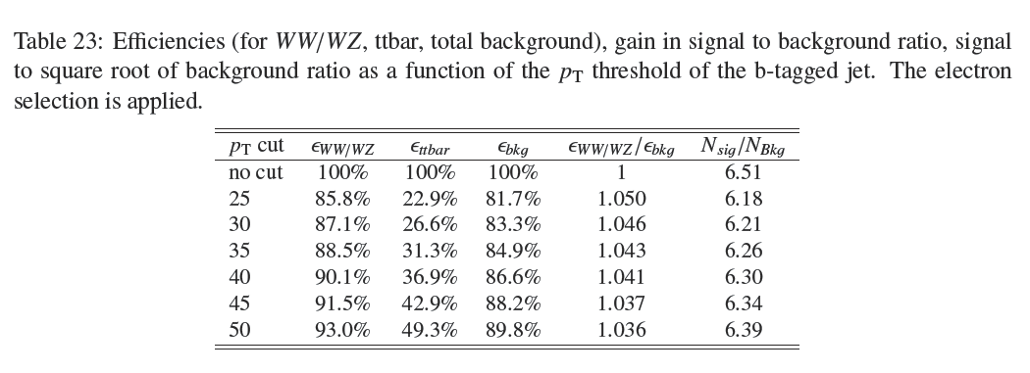
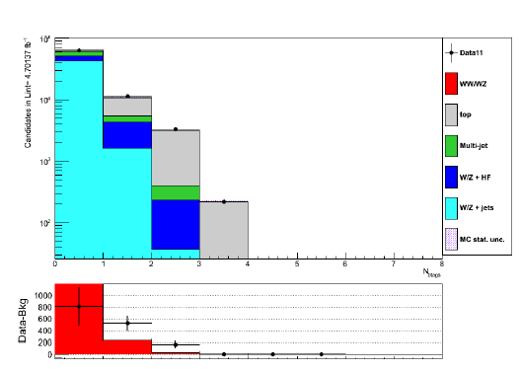
b-jet study
Study carried out on previous inclusive selection indicated:
Small improvement in signal/bgk
no improvement in S/sqrt(bkg)
introduce worse MC/modeling

Slide 31
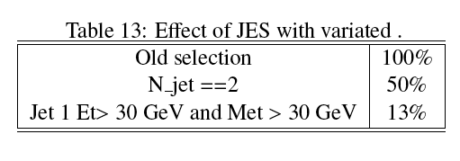
Effect of JES uncertainty on new selection
We have repeated the analysis with old selection cuts adding only njet==2 and we have checked with toys the effect of JES uncertainty on these templates.

Slide 32
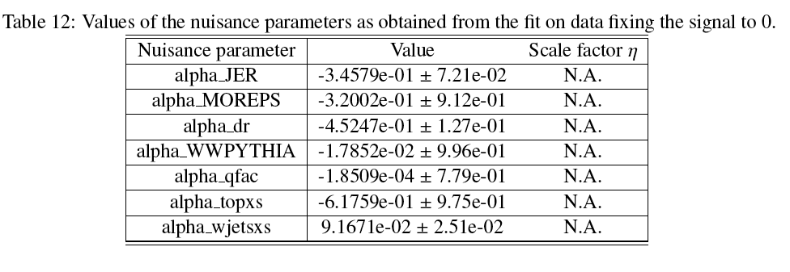
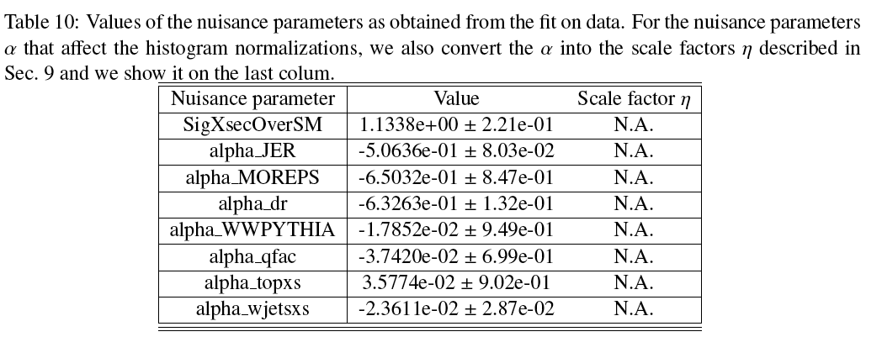
Nuisance from 0 signal
JER is constrained to the same value with or without signal.

Slide 33
Control regions
Top: at least one b-jet
W hadronic candidate with highest pT jets non b-tagged → see the peak, check JES uncertainty
W hadronic candidate with highest pT jets → same selection as in signal selection, check template of top
Zjet: remove second lepton veto and MET and require second lepton with pT>25 & Mll=[66,116] GeV
Mjj sidebands: Mjj<60 GeV or Mjj>130 GeV
Control regions are used to understand data/mc agreement of each component, help in signal selection definition.
Also used to check fitting strategy in a signal free region (top)

Slide 34
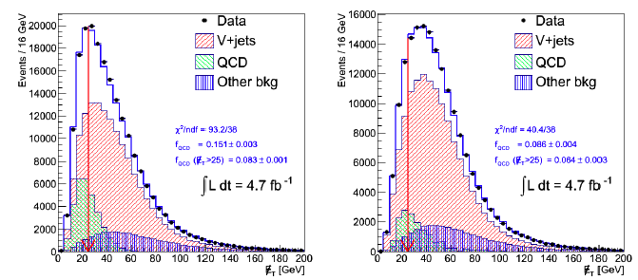
QCD Estimate
Use MET to evaluate normalization since we have a good QCD/W+jets separation.
Systematics on normalization evaluated by the difference using other methods: ABCD method, track-met method and different selection not points ele/not isolated mu.

