Slide 1
14:00 Welcome: Umberto Dosselli
14:05 Introduction: Patric Muggli
14:15 Sparc_Lab: Massimo Ferrario
15:00 FIRB: Enrica Chiadroni
15:20 LIDAR: Massimo Petrarca
15:40 Final discussion
16:00 Coffee break
16:15 SPARC_LAB visit
16:45 - 18:30 Closed Session

Slide 2
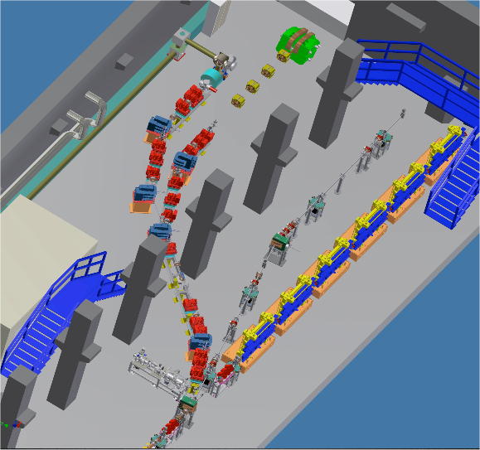
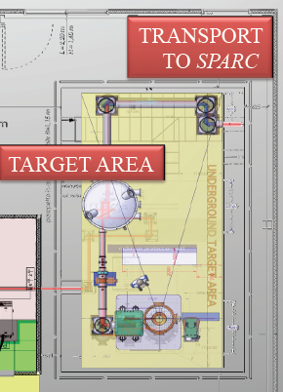

2nd SPARC_LAB PAC Meeting
Thomson source
THz source
Plasma acceleration
FEL source
Photoinjector
LNF- November 19, 2012

Slide 3
ELI_NP
FEL
THz Radiation
PWFA_COMB
SPARC
FLAME
Thomson
LWFA_Ext
γ- resist
XFEL@SuperB
LILIA

Slide 4
Outline
Past activities since PAC 1
Future activities up to PAC 3
First PAC report comments

Slide 5
Past activities since PAC 1

Slide 6
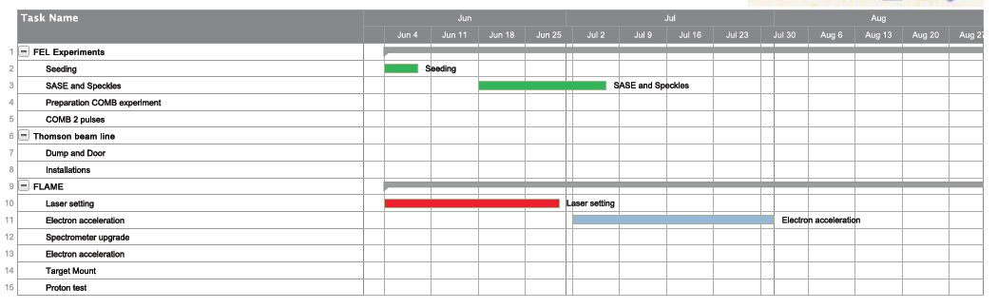

Slide 7
FEL

Slide 8
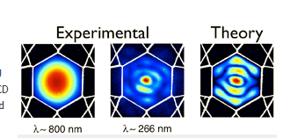
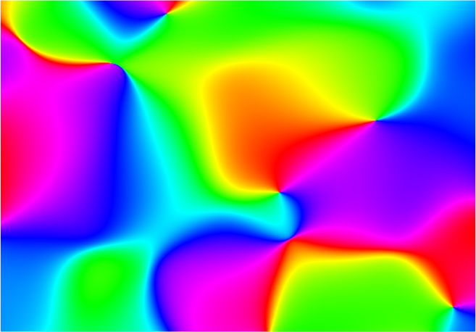
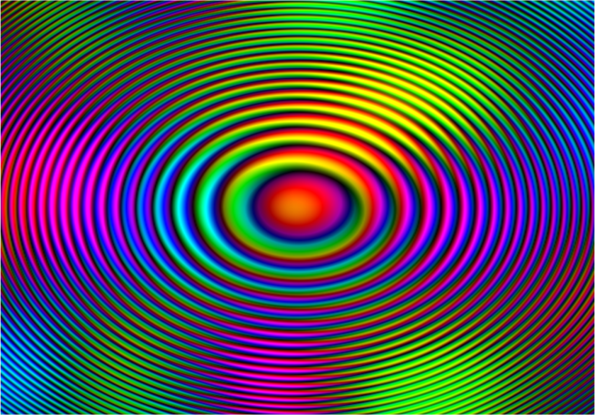
Scientific Collaborations
ALTERNATIVE SEED SOURCES: KAGOMÉ FIBERS
(N. Joly, MP – M.E. Couprie Soleil)
PROBING TRANSVERSE COHERENCE WITH THE HETERODYNE SPECKLE APPROACH
(M. Manfredda, M.D. Alaimo, M.A.C Potenza andM. Giglio)
P
Q
P₀

Slide 9
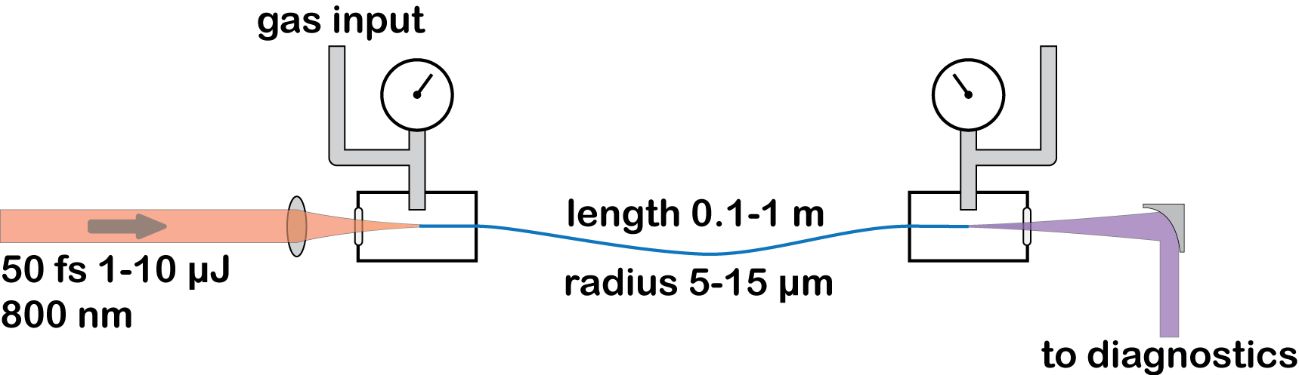
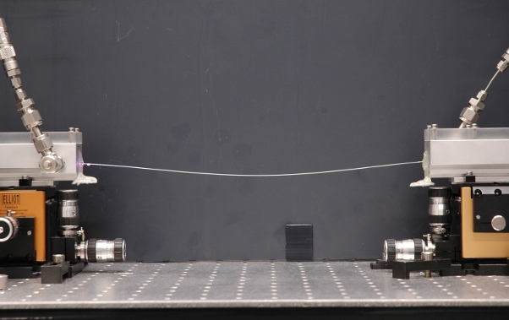
Hollow Core Photonic Crystal (Kagome’) Fiber
Propagation of self compressed Solitons
Emission of resonant dispersive wave at phase matched wavelength in the UV
Tunable emission with Ar pressure 150-320 nm

Slide 10
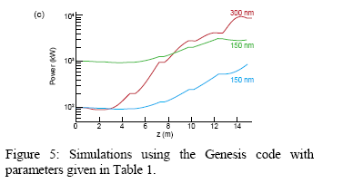
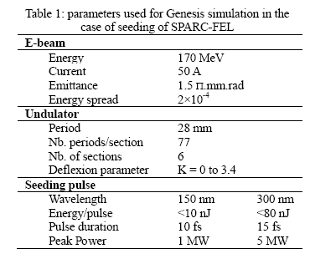
Photonic crystal fibre (HC-PCF) filled with argon is able to generate an diffraction-limited DUV pulse of 50 nJ and fs duration, continously tunable from 150 to 320 nm. This source is considered to be very attractive to seed SPARC-FEL.

Slide 11
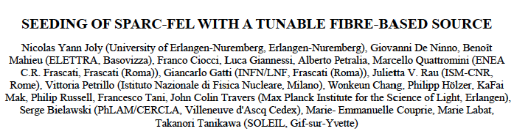
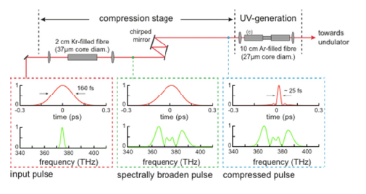
2013 FEL Conference

Slide 12

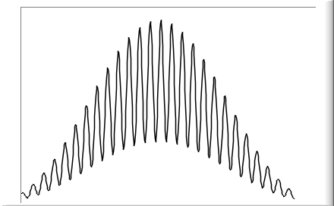
PROBING TRANSVERSE COHERENCE WITH THE HETERODYNE SPECKLE
APPROACH
Complex Coherence Factor
P₁
P₀
r₁
Q
r₀
Visibility:
Notes:
->
Vogliamo affrancarci dall’uso di manufatti ad hoc usando particelle sferiche per la produzione di un’onda di riferimento. Si ha cosìuno schema di olografia in ilena

Slide 13
Heterodyne Speckle Approach
Colloidal particles
in water
CCD Camera
Notes:
->
Vogliamo affrancarci dall’uso di manufatti ad hoc usando particelle sferiche per la produzione di un’onda di riferimento. Si ha cosìuno schema di olografia in ilena

Slide 14

Heterodyne Speckle Approach
Heterodyne Speckles
Colloidal particles
in water
CCD Camera
Probing the transverse coherence of an undulator X-ray beam using brownian particles, PRL, M.D. Alaimo & al.
Heterodyne speckle approach for two-dimensional map of SR coherence, JSR (in submission), M.Manfredda & al.
Notes:
->
Vogliamo affrancarci dall’uso di manufatti ad hoc usando particelle sferiche per la produzione di un’onda di riferimento. Si ha cosìuno schema di olografia in ilena

Slide 15
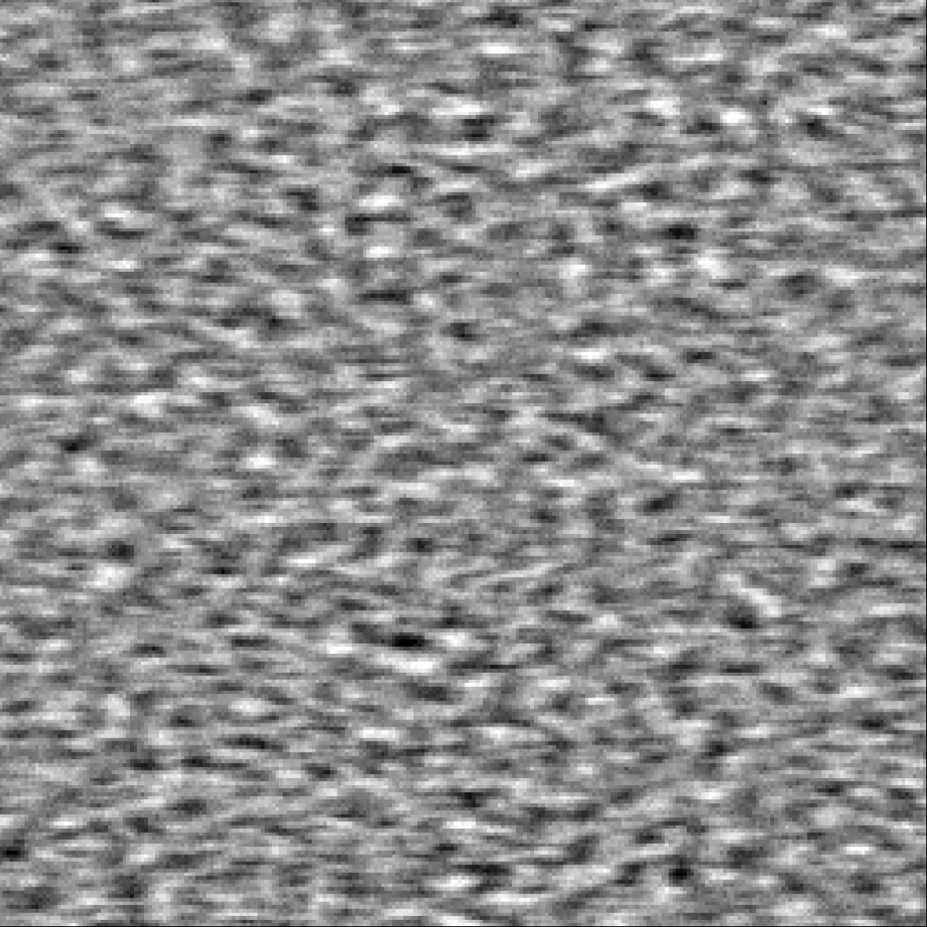
Heterodyne Speckles
Speckles (ID06 – ESRF - λ=0.1 nm)
E_{T} : transmitted field
E_{S} : scattered field
Heterodyne Term

Slide 16
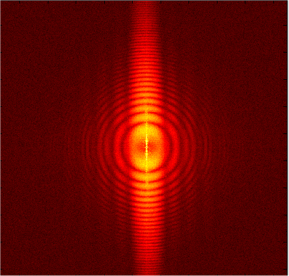
Heterodyne Speckles
Speckles (ID06 – ESRF - λ=0.1 nm)
Spatial power spectrum
F
s (r)
S(q)
I (q): particle form factor (flat)
T(q): Talbot trasfer function [ sin²(q²z/2 k) ]
H(q) = Sensor transfer function
C(r(q)) = |μ|² (µ: Complex Coherence Factor)
S(q) = I(q) T(q) H(q) C(q)

Slide 17

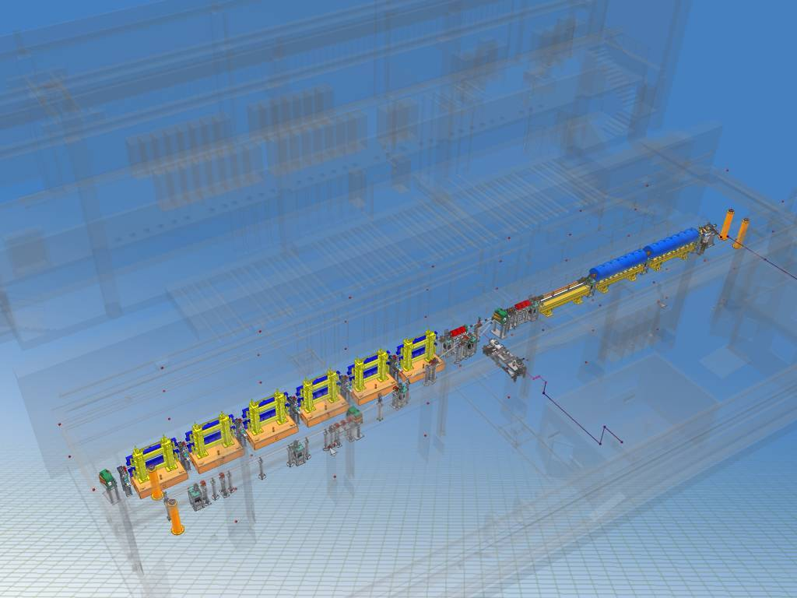
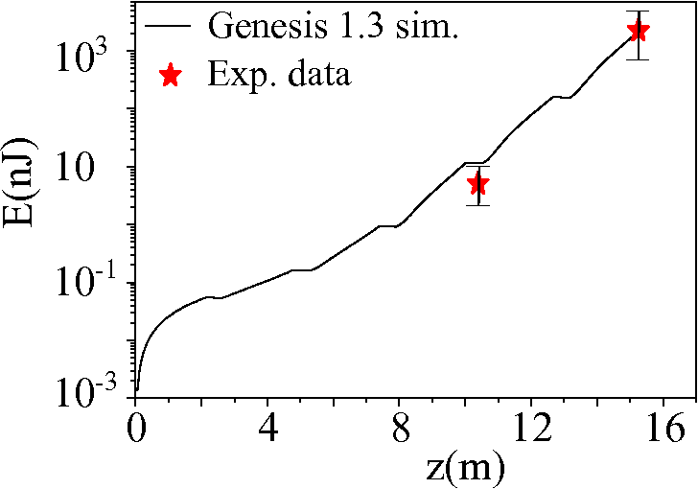
SPARC
6 sections undulator; 77 periods per section
Magnetic Length 215 cm
K factor: from 0.5 and 3
Beam energy E_{B}(MeV ) 162,5±0,27
Beam charge(pC) 312 ±16
Energy Spread (proj: %) 0,2 ± 0,015
Energy Spread (slice %) 0,050 ±0,005
Length r.m.s. (ps) 1,65 ± 0,05
Beam current I_{peak}(A) 75,63 ±3,5
Vertical Emittance 90% (mm mrad) 1,95 ± 1,0
Horizontal Emittance 90%(mm mrad) 1,74 ± 1,1
1.6 cells RF injector
UCLA/BNL/SLAC design
120 MV/m
3 SLAC type Focalization solenoids
(velocity bunching)
Undulators
SASE
Sample + CCD
E (a.u)
Degree of transverse coherence
expected ∼ 0.95 (Genesis 1.3)
z (m)

Slide 18

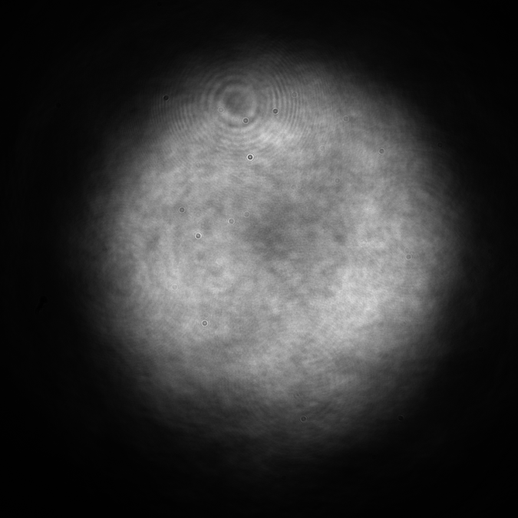

SPARC Setup (LNF – Frascati)
6 –section Undulator
Sample
2.1 um
20 cm
Camera
4m
I(t) : image
I(t)-I(t+τ): image difference
9 mm

Slide 19
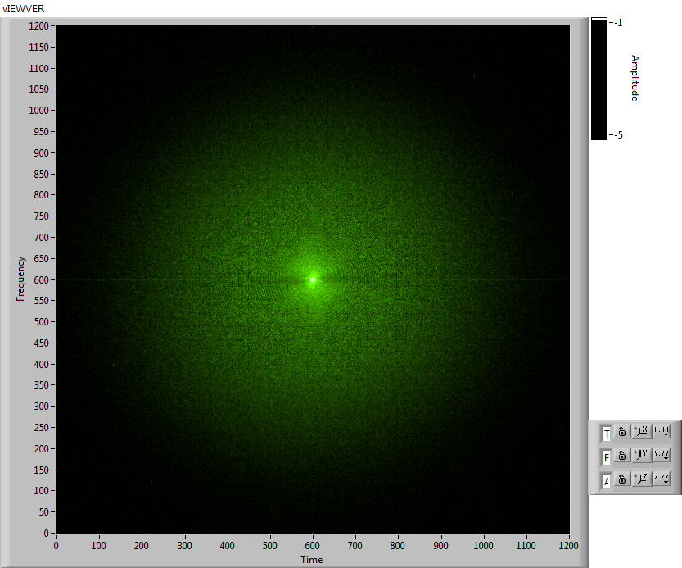
SPARC Transverse Coherence
Typical 2D Power Spectrum
Particle Convection
1200 px
600 px

Slide 20
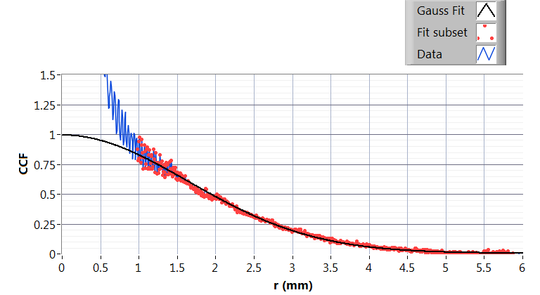
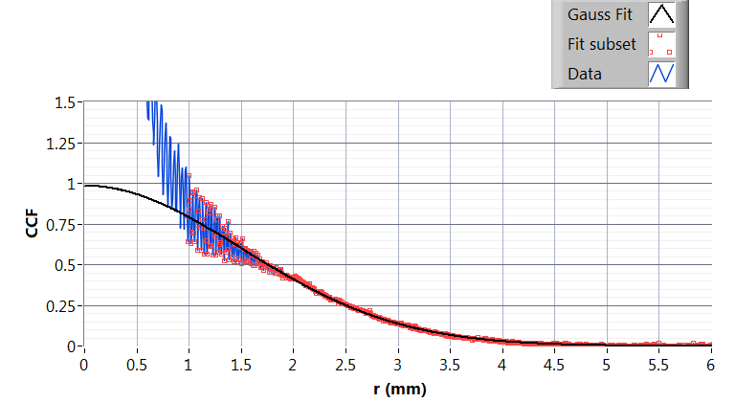
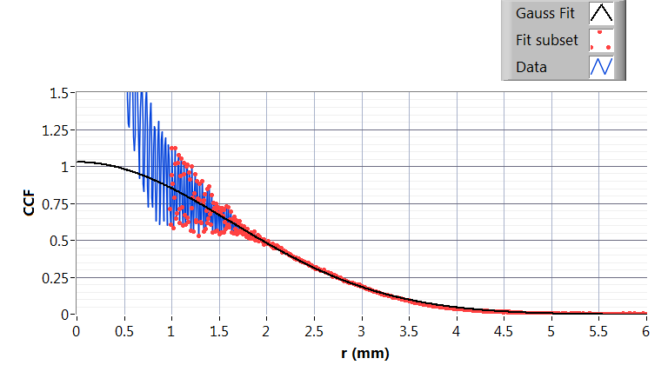
Transverse Complex Coherence Factor (CCF)
4 UD Sections
σ_{COH} σ_{COH}/σ
4U 1.64 mm 0.7
5U 1.50 mm 0.8
6U 1.62 mm 0.82
5 UD Sections
6 UD Sections

Slide 21
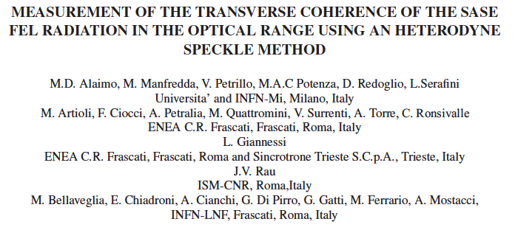
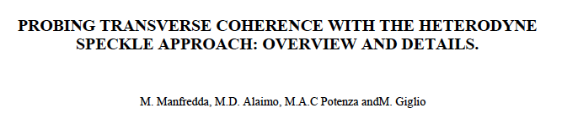
2013 FEL Conference

Slide 22
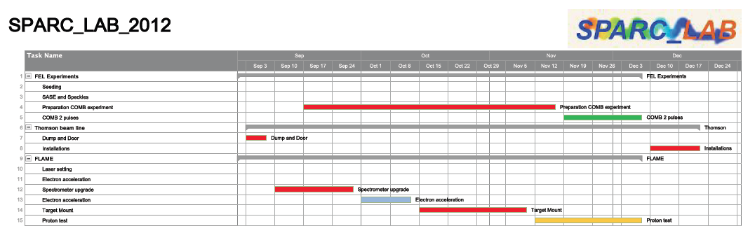

Slide 23
COMB FEL

Slide 24
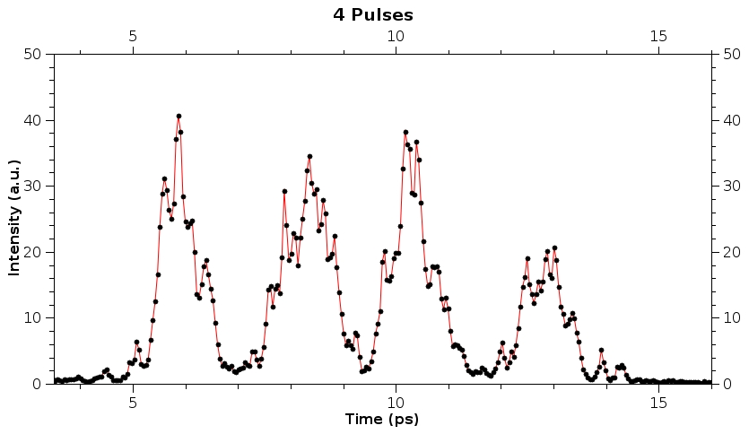
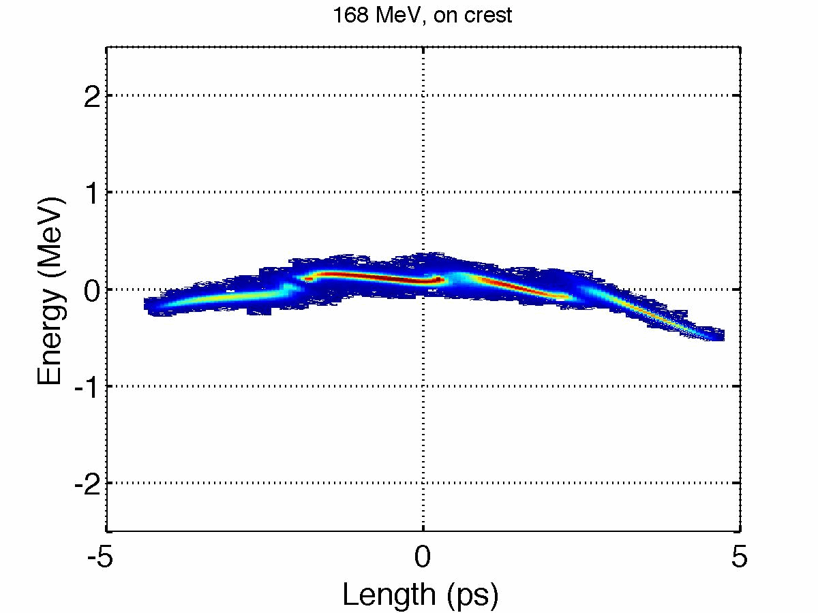
Laser COMB technique
4-pulses-time-structure
4-levels-energy-spectrum
longitudinal phase space
time
vertical dim
time
orizontal dim
energy
energy

Slide 25
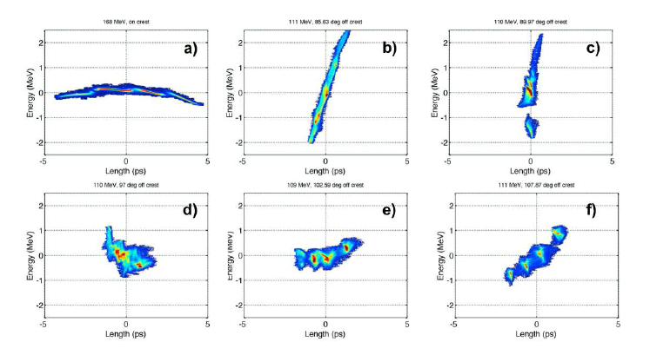
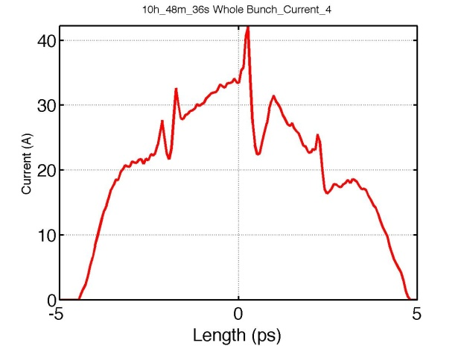
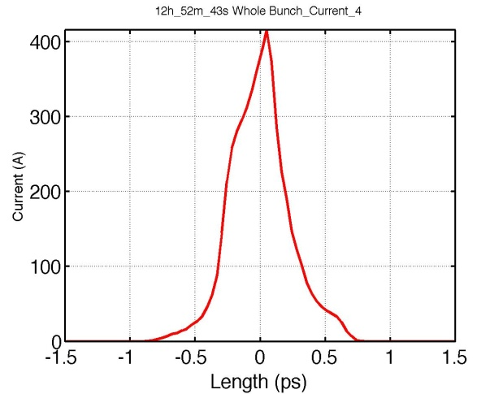
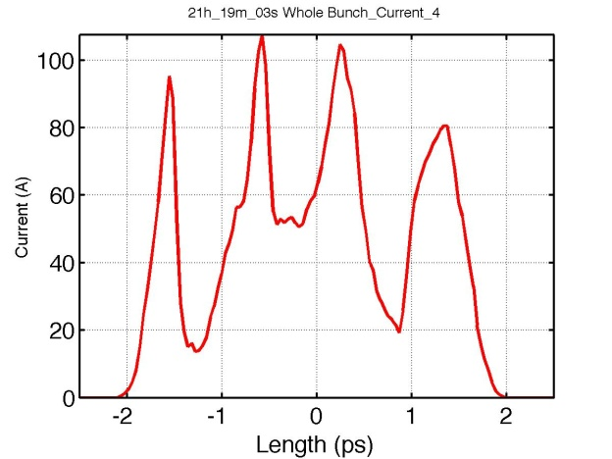

Slide 26
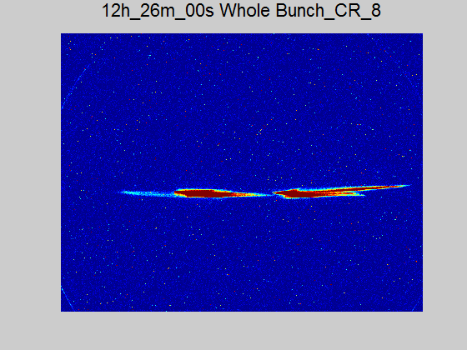
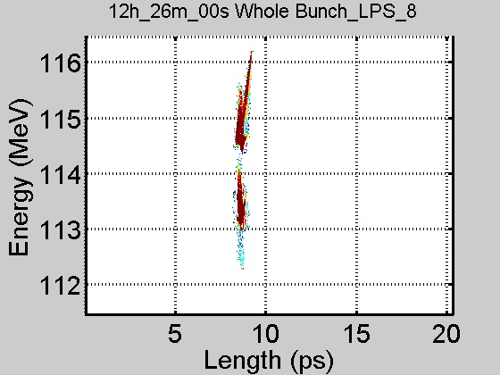
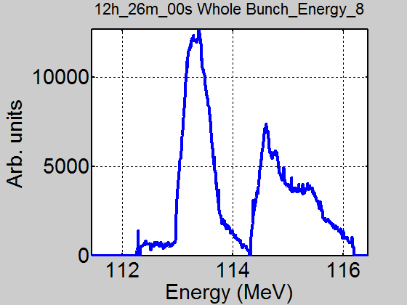
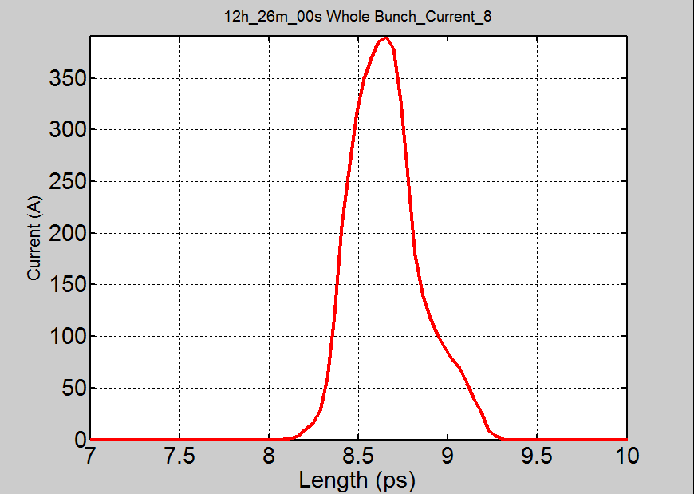
18 MAY: MAX. COMPRESSION-Q=180pC.Measurements
CONTROL ROOM
Time
Energy
Energy separation=1.672 MeV

Slide 27
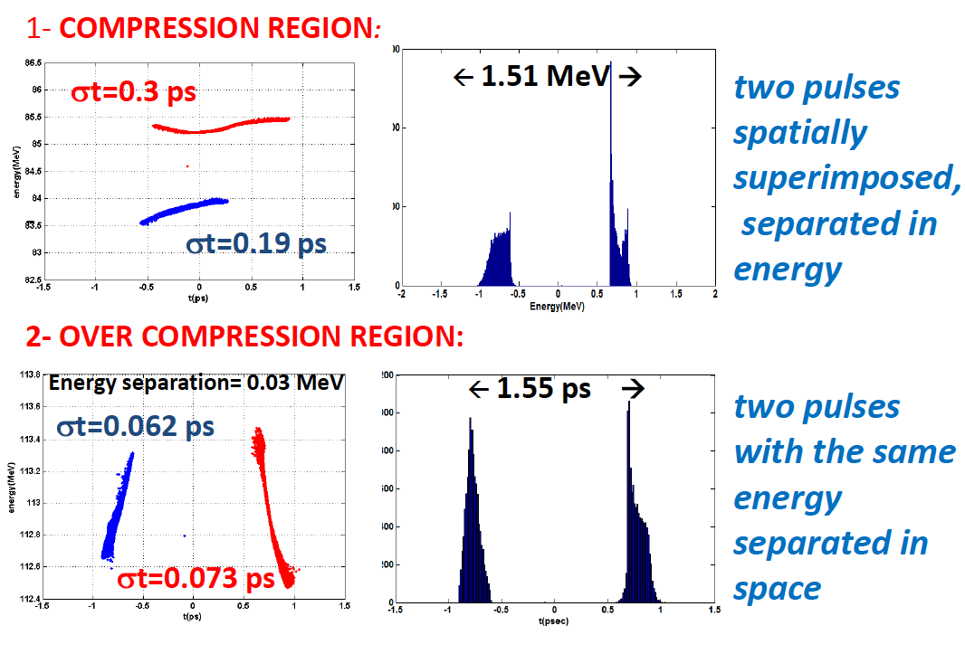

Slide 28
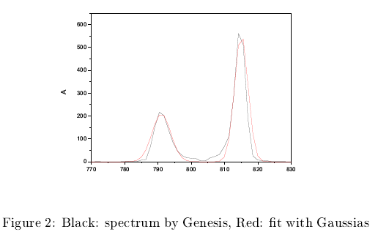

Slide 29
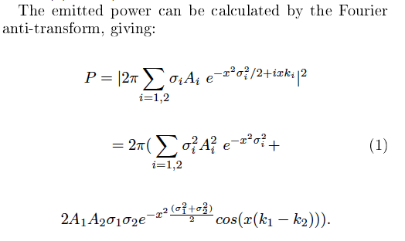
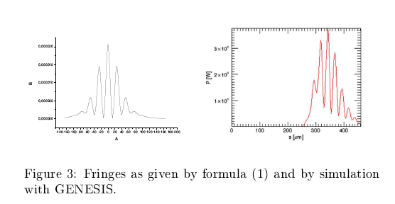

Slide 30
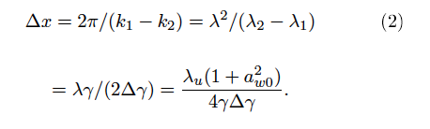
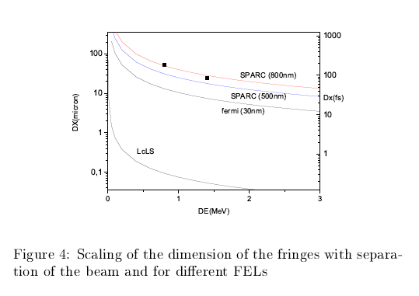

Slide 31
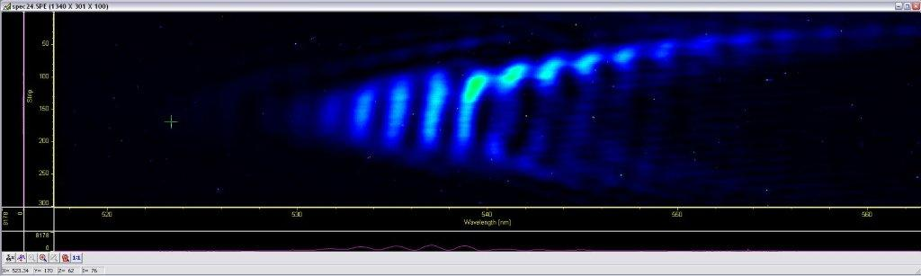
Double FEL pulse
Courtesy L. Giannessi, V. Petrillo
Notes:
31

Slide 32
COMB PWFA

Slide 33
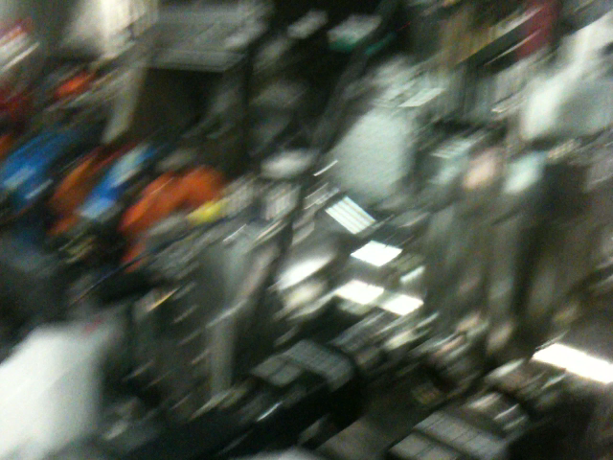
ATF-BNL Visit

Slide 34
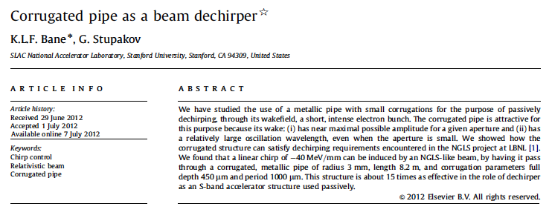

Slide 35
EOS Optics Setup

Slide 36
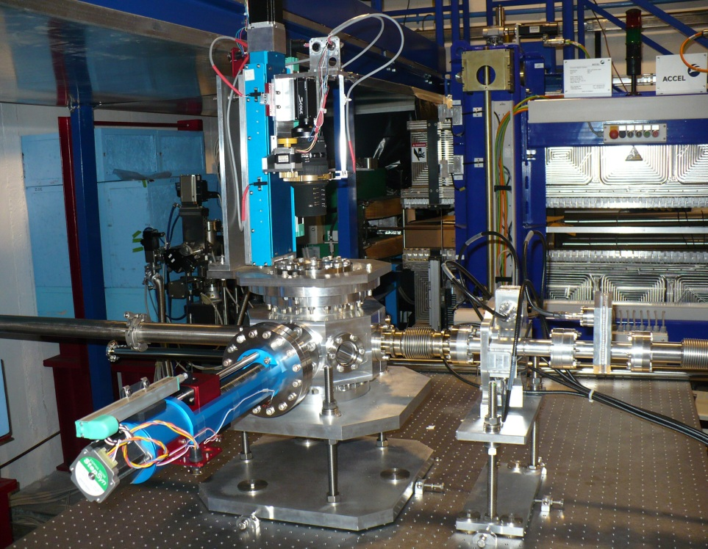
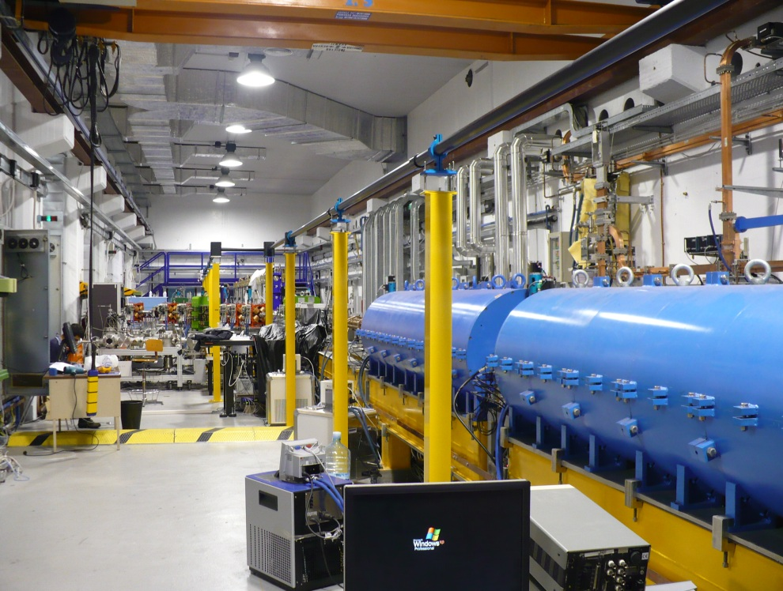
Electro-Optical Sampling
EOS Chamber realized and installed at the end of SPARC_LAB's 2nd line.
EOS actuators (target and camera's autofocus [2 axis]) installed and tested.
EOS Laser Transfer Line realized (12 columns with laser pipe) for IR 800nm.
Realization of EOS Optics Setup just started.
YAG and OTR Targets successful tested in EOS Chamber
First measure of Laser – Electrons Delay realized.

Slide 37
THOMSON – Sinchronization

Slide 38
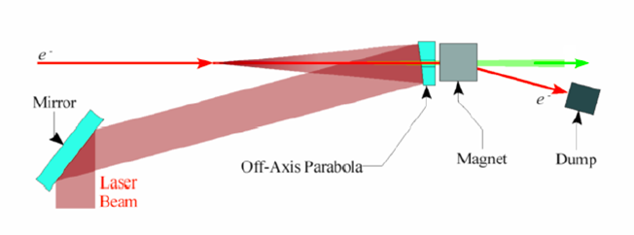
Thomson/Compton back scattering
High power laser + relativistic e-beam
Backscattered
field
λ_{L}
Laser “wiggler”
λ_{L}
λ_{r}
λ_{r}

Slide 39
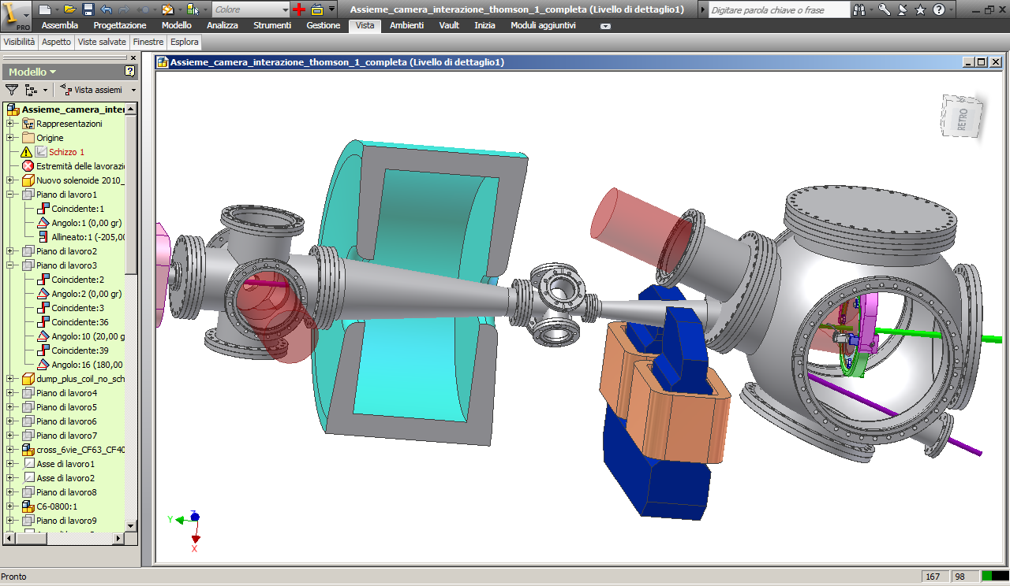
Thomson Interaction region (20-550 keV)
fascio laser
Camera di scattering
fascio X
Fascio e⁻
deflesso
(hν)_{X}=4 (hν)_{laser} ( T/ 0.511)²
Impulso laser: 6 ps, 5 J
pacchetto e⁻ : 1 nC , l: 2 mm (rms)
Impulso X: 10 ps, 10⁹ fotoni
α emissione: 12 mrad
(hν)_{laser} = 1.2 eV
T = 30.28 MeV
(hν)_{X} = 20 keV mammografia

Slide 40
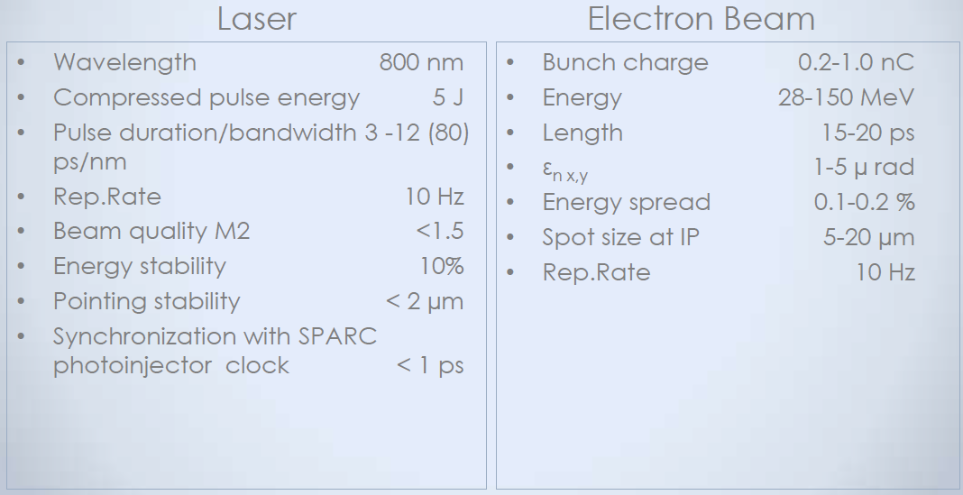

Slide 41
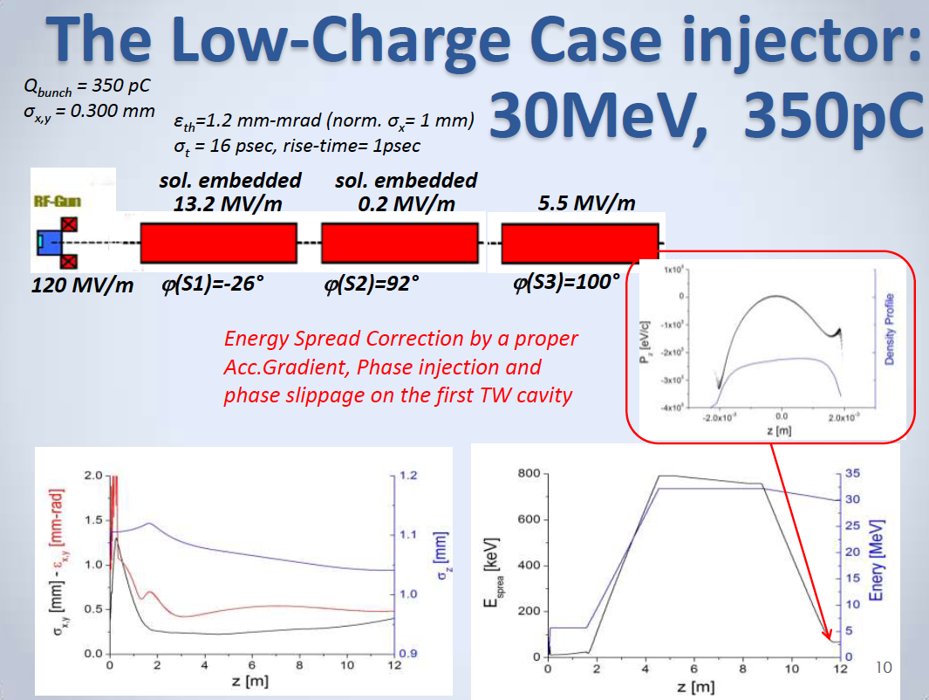

Slide 42
φ=6 mrad
φ=1 mrad
N_{tot}=1,69 10⁹
Δω/ω (FWHM)=10.5 % Δω/ω rms=5.2 %
div (FWHM)= 22 mrad div rms= 5.3 mrad
Courtesy V. Petrillo

Slide 43
Since the previous MAC:
Construction modifications completed
Vacuum closed & first alignment round
Magnet temperature sensors in place
Interaction chamber at LAB since July
Last Interaction region mechanical connections & supports by Nov end
BPM 6+3 by Jan 15th 2013
Solenoid magnet delivered on Nov 12th 2012

Slide 44



Synchronization issues
RF to laser pulses
  Example: COMB
  Multiple e-bunches injected in the same RF bucket
  Critical injection phase for RF compression
  Request: Δt_{RMS}≈100fs
e-bunch to laser
  Example: THOMSON/PLASMONX
  SPARC and Flame beams injected together
  Synchronization at the level of the plasma wave period
  Request: Δt_{RMS}<30fs

Slide 45


SPARC-FLAME synchronization
Optical reference distribution
  Fiber laser OMO (Optical Master Oscillator) installed and tested
  Fiber links to distribute the signal partially installed
  High resolution optical phase monitor (cross-correlators) in house and ready to be tested
  Sub-50fs_{RMS} relative jitter
  synchronization
FLAME AREA
FLAME oscillator
79.33MHz
SPARC HALL
PC laser
Oscillator
79.33MHz
OMO
79.33MHz
RF reference
2856MHz

Slide 47








SUMMARY OF LPA AT FLAME
WITH SELF-INJECTION ON A GAS JET
Feb. 2010: Flame Laser operations started;
Nov. 2010: 1st run with evidence on 100 MeV scale(publication in progress);
July 2012: 2nd Run with stable (3k shots) production of ultracollimated (<1mrad) bunches and high energy (≈GeV) electron bunches (analysis in progress):
Optical probing
Thomson scattering
LANEX
ELECTRON ENERGY
Laser propagation
GeV range energy over 5mm gas-jet
mrad bunch
Plasma channel
Now progressing with γ-Resist: All optical Thomson Scattering Source.

Slide 48


SL_LILIA (Laser Induced Light Ions Acceleration)
LILIA is an experiment of light ions acceleration trough laser interaction with thin metal targets to be done at the SPARC-LAB facility under operation in Frascati.
The main goal is to obtain a beam suitable for injection in other accelerating structure.
Participant Groups: Milano, Milano Bicocca, Bologna, Pisa, Lecce, LNS, LNF.
48
Notes:
48

Slide 49

Status of the experiment
In October the interaction chamber has been available :
all the mechanichal components (movable multiple target holder, radio-chromic films ) have been installed in the chamber
Movements have been checked and the system aligned
back reflection of the laser beam has been controlled
Some preliminary shots on aluminum targets have been performed at a low power level (200 mJ). GAFchromic and CR39 films have been used.
We have evidence of electron production in the GAFchromic. We are now developing the CR39 in order to see if there is evidence of accelerated protons.At this power level the expected proton energy is below 1 MeV
Solid state detectors (PIN diode) have been put in operation into the chamber, to investigate the level of noise.

Slide 50
Missing results
Thomson interaction chamber installation and beam collisions
New undulator installation andrelated FEL experiments

Slide 51
Future activities up to PAC 3

Slide 52


Slide 53
Thomson source
THz source
Plasma acceleration
FEL source
Photoinjector

Slide 54



Construction update
The new door location w safety equipment
The dumping hole
The tunnel entrance

Slide 55



Thomson Interaction region:

Slide 56


2 x 1.4 m C-band
to be
installed
1 S-band
to be
removed
λ_{u} = 1.4 cm
⬅New short period undulator to be installed (ENEA – Kyma)

Slide 57


Slide 58
Commissioning steps:
After the installation shutdown Jan-Feb 2013:
Low Power Photon beam through the photn beamline down to IR
Electron beam for Thomson IR:
  300pC, 150MeV w 0.1% energy spread, 60 μ
  300pC 80 MeV
  300pC 30 MeV
High power photon beam to the IR
Collision setup & optimization

Slide 59


X-ray beam characterization system
X Ray monitor
Wheels for
Collimators and filters
Photodiode based
X-ray fluximeter
Optical bench for test objects and imaging apparatuses X in absorption and
In phase contrast
Wheels for
Collimators and filters

Slide 60
WORK PROGRAM
Integration of the characterization system devices with the control room equipment
Back ground measuremets during the electron trasport tests
Measurement of X ray emission during the allignment of first collision
electron beam energy: 80 MeV -> X ray beam energy 90 – 140 keV
4. Measurement of X ray emission with electron beam energy of 30 MeV
20 keV X-ray yield measurement
20 keV beam energy spectrum characterization
5. Integration of X-ray imaging system with the control room equipmet
6. Measurements of X-ray image quality in absorption and in phase contrast experiment
7. Measurements of organ dose for absorption and phase contrast radiographs

Slide 62


SPARC-FEL: future developments
DELTA like undulator (end of 2012)
  λu = 14.0mm, gap g = 5mm, Br = 1.22T.
  Undulator test in two possible configuration with the actual accelerator:
  Two stage SASE-FEL cascade: 450nm to 150 nm
  Three stage seeded FEL cascade:
  400nm – 200nm – 100nm
  KYMA undulator

Slide 63


Two stages SASE-FEL cascade: 450nm - 150nm
λ=450nm
λ=150nm
Beam energy | 140 MeV
Current | 60 A
N. emitt. | 2 mm mrad
En. Spread (s) | 2 x 10⁻⁴

Slide 64


Three stages cascade – seed at 400nm – final λ=100nm
Seed
λ=400nm
λ=200nm
λ=100nm
Beam energy | 165 MeV
Current | 60 A
N. emitt. | 2 mm mrad
En. Spread | 4 x 10⁻⁴

Slide 65


Operation with C-band accelerating section
Three stages cascade: seed at 266nm – final λ=66nm
Seed
λ=266nm
λ=133nm
λ=66nm
Beam energy | 200 MeV
Current | 150 A
N. emitt. | 1.5 mm mrad
En. Spread | 4 x 10⁻⁴

Slide 66

Scientific collaboration proposals
Alternative seed sources
Kagomé fibers
(N. Joly, MP -
M.E. Couprie Soleil)
Experimental Study of New Effects of Noise Suppression in Relativistic Electron-Beam and Spontaneous Emission Sub-radiance in FEL (A. Nause, A. Gover, - Tel Aviv University)

Slide 67

Experimental Study of New Effects of Noise Suppression in Relativistic Electron-Beam and Spontaneous Emission Sub-radiance in FEL
Nause, A. Gover, - Tel Aviv University
The Research goals
- Control over electron beam noise in the optical spectral range by means of a process of Coulomb collective micro-dynamics and use of a dispersive magnetic structure, and specifically attain current-noise suppression below the classical “shot-noise limit”.
Suppression of spontaneous (incoherent) radiation emission in electron beam radiation schemes (sub-radiance in the sense of Dicke). Specifically in the context of FELs: demonstrating radiation noise suppression and coherence enhancement of seed radiation injected FEL .
REF.
A. Gover, A. Nause, E. Dyunin, M. Fedurin “Beating the shot-noise limit”, “nature physics”, published online Oct 14, DOI 10.1038/NPHYS2443, (2012).

Slide 68
If observed, the undulator radiation suppression effect would be a first demonstration of Dicke's fundamental effect of spontaneous emission sub-radiance in an FEL structure.
Since SPARC is equipped with a High Harmonic Generation seed injection laser, it will be also possible to observe the radiation noise suppression and coherence enhancement effect in SPARC's FEL.
Plan of Visit
Two visits, of 3-4 weeks each, are planned:
(1) Experiment setting, equipment use training and calibration of diagnostics.
(2) Conduction of scientific experiments.

Slide 70



Recent Activity
New THz beamline at the Linac exit collecting both Coherent Transition (CTR) and Diffraction Radiations (CDR)
CDR→Non intercepting Diagnostic
→ Use of THz radiation in
concomitance to other experiments

Slide 71
Near Future
THz activity@SPARC
THz induced Metal-to-Insulator in V₂O₃;
2) Development of Electric Optics Sampling Single shot→ Single Shot THz Spectrum;
3) CTR and CDR comb THz radiation;

Slide 73




PLAN OF LPA AT FLAME
next semester
Optical installation of full beam adaptive optics
  Increase Strehl ratio of laser beam at full power to >0.9 (currently ≈0.3)
  Control focal spot shape -> Control bubble shape in self-injection
Self-injection run with full power and tailored focal spot on a 10 mm gas jet: currently depletion occurs at >5mm
Start assembly of two-beam configuration for head-on collisions (γ-Resist)

Slide 74
SHORT TERM PROGRAM (till June 2013) : LILIA PHASE I
A parametric study of the correlation of the maximum accelerated proton energy, with respect to the following parameters:
Laser pulse intensity (in the range 10¹⁸ < I < 10²⁰ W/cm²)
Laser pulse energy (in the range 0.1-4 J)
Laser pulse length (in the range 25 fs-1ps)
Metallic target thickness (in the range 1-10 microns).
In such a frame we would like to deeply investigate the experimental scale rules within the possibilities offered by the FLAME facility. Moreover, this will provide the opportunity to get experience in the development of diagnostic techniques and in target optimization.
74
Notes:
:

Slide 75
Helmoltz Virtual Institute

Slide 76
Helmholtz Virtual Institute for Plasma Wakefield Acceleration
“A Helmholtz Virtual Institute brings together
the key competencies of one or more
Helmholtz Centres with those of one or more
universities to create a centre of excellence of
international standing. This serves to create a
new quality of cooperation strengthening
scientific excellence and increasing
international competitiveness. Other national
or international partners may be involved as
associated partners.”

Slide 77
What is a VI?
Over a three to five year period,
Virtual Institutes receive up to a maximum
of 600,000 euros per year. Matching funds
and other schemes can increase this.
New institutions can join as associate
members. Although they do not get a direct
travel allocation from the VI, we have other
sources to ensure that associate members
can take part in VI programmes.

Slide 78
Added value
VI gives excellent framework for collaboration
with world-leading institutions including
John Adams Institute (JAI) (Oxford, RHUL,
Imperial London), Stanford, Berkeley, together
with CERN and MPI Munich and SPARC_LAB.
E.g., FACET leading facility for PWA
investigations – after closure FLASH II facilities
should be available – obvious synergy brokered
by VI – collaborate first on FACET then
FLASH II.

Slide 79
First PAC report comments

Slide 80



Slide 81



Slide 82

Ph.D. program 2013

Slide 83



Slide 84


Slide 85



Slide 86



Slide 87



Slide 88


Slide 89

Thank you

Slide 91



PROBING TRANSVERSE COHERENCE WITH THE HETERODYNE SPECKLE APPROACH
Simulated Time-Averaged Distribution
Q
P
P₀
Resulting Intensity
Complex Coherence Factor
Visibility:
Resulting Intensity
k_{s}
θ
q
k₀
Notes:
The Spatial Coherence ultimately is the ability of radiation of Writing Interference Fringes. Let’s see how we can measure it.
Here we have a double slit experiment, in which light is selected by two Pinholes and is let interfere on a screen at a certain distance.
The Degree of Mutual Coherence of the Fields at the points P0 and P1 can be measured by measuring the Fringe Visibility [defined as the Dark-Light difference divided by the average intensity]. A more sophisticated object can be used, that is the Complex Coherence Factor, defined as [the normalized Two Point Field Correlatior]. In fact these two object are strictly related since It is possible to show that Visibility is proportional to the modulus of complex coherence factor, and, since we have a convolutionm for the FT properties V can be related to the squared Power Spectrum,too. This means that information about Visibility is contained in the Power Spectrum.
Varying Pinhole separation one would observe Fringes with different Period and Visibility. So, ideally, we could measure the coherence by spanning all the possibile distances. However, the same information about visibility can be obtained by Measuring the corresponding Fourier Component in the Power Spectrum of a Near Field Speckle System produced by small Particles.
[1’45’’-2’] Lunga

Slide 92


Coherence measurement: heterodyne speckle approach
CCD Camera
Sample
Mirror
13 cm
Sample:
Colloidal particles in water suspension
Polystyrene (n=1,59)
d= 2,1μm
Undulator
Camera:
1600x1200
dpx = 7,4 μm
14bit
heterodyne speckles
k
θ
q

Slide 93




Coherence measurement at SPARC
SASE (λ=400nm)
Beam + weak scattered field
Heterodyne speckles
Background subtraction
Radiation at the end
of the undulator
6 mm
Coherence length:
FWHM = 4 mm
Fourier analysis
4 UM 5 UM 6 UM
Energy exp. 5.4+2.8 nJ - 2.4+1.9μ J
Energy sim. 11 nJ 156 nJ 2.2 μJ
TC exp. 0.7 0.8 0.82
TC sim. 0.61-0.73 0.68 0.8-0.92-0.8
TC spectrometer 0.88 0.96 0.96
Data + TF
CCF (a.u)
Gaussian fit
R (mm)

Slide 94
2013 | 2014 | 2015 | 2016
X-ray Thomson+Synchronization |  | Plasma | Plasma+FEL
FEL | Thomson
C-band | Plasma
Plasma | C-band

Slide 95

Laser COMB technique

Slide 96

Laser to RF phase lock upgrade
Figure shows phase noise spectrum of the reference RF (blue) and laser (red) oscillator together with the associated absolute jitters
The two locked oscillators have a spectrum very similar in the low frequency offset region (the most important to keep the laser phase noise low)
The relative jitter has
to be measured but is
estimated to be well
below 50fs_{RMS}
Old locking system
allowed a relative jitter
of 350fs_{RMS}

Slide 97
SPARC-FLAME synchronization
FLAME AREA
Electrical reference distribution
  Coaxial cable distribution
  installed
  Present phase detection resolution ≈40fs
  Whole system will be tested during next machine shut down
  100fs_{RMS} relative jitter synchoniztion
FLAME oscillator
In 2856MHz
Out 79.33MHz
RF reference
2856MHz
PC laser
Oscillator
79.33MHz
SPARC HALL
RF reference
2856MHz

Slide 98
Thomson X-ray beam spectra obtained shaping with filters a W anode X-ray tube
Photodiode based X-ray fluximeter
calibration
Thomson X-ray beam spectra obtained with k-edge subtration method

Slide 99




Pulse/spectrum at the end of the two stages
1° stage
2° stage

Slide 100







Pulse/spectrum at the end of the three stages
1° stage
2° stage
3° stage
Less than 30 fs pulse length (fwhm) @ 100nm

Slide 101

Many Applications for the Metal to Insulator Transition (MIT) in Oxides
‘

Slide 102
THz may induce a fast Metal-to-Insulator in V₂O₃
Broad band THz
at variable intensity
Transmitted
THz intensity
Film of V₂O₃
in the insulating
state
Insulating State =Localized Charge in a potential well
T(ω)≈1 in the insulating state
Tω)≈0 in the metallic state
→ MIT for I_{THz}>I^{T}_{THz}(threshold Intensity)
E
A THz Electric Field may induce a charge delocalization
E≈MV/cm → CTR Field @SPARC

Slide 103
Compton backscattering shift
Electron rest frame: (1)
Lab frame: (2)
Compton shift parameter:
Å

