Slide 1
Generation of high brightness electron beams from plasma-based accelerators
Laboratori Nazionali di Frascati
2nd PAC Meeting
November 19th, 2012
FIRB: Project of research funded by the Italian Government (2013-2015)
Enrica Chiadroni

Slide 2
Motivations
Plasma Acceleration has been already demonstrated
  I. Blumenfeld et al., Nature 445, p. 741 (2007)
  W. P. Leemans, Nature Physics vol. 2, p.696-699 (2006)
  P. Muggli et al, in Proc. of 2011 Particle Acc. Conf., New York, NY, USA, TUOBN3
  …
The main issue is now on the beam quality
  High peak current, low emittance, small energy spread, stability, repeatability
Future applications
  FELs
  Multi-staging compact colliders
  Advanced radiation sources

Slide 3
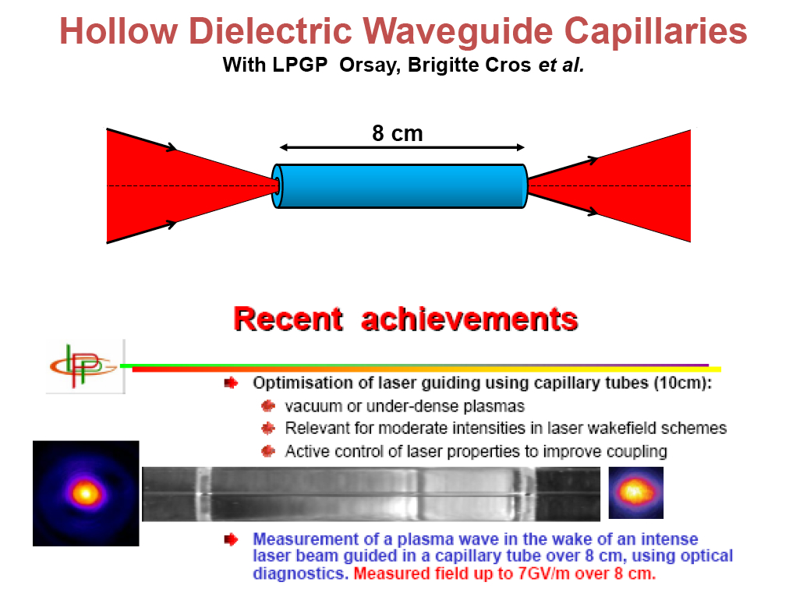
Method
External injection of electrons to be accelerated in the plasma
Laser Wakefield Acceleration
  Laser Pulse Energy: 3 J
  Laser Pulse Length: 35 fs (FWHM)
  Bunch length: < 100 fs
  Δγ/γ : 0.1%
  ε_{n} = 1 mm mrad
  Initial Beam energy: 160 MeV
Plasma Wakefield Acceleration
  Single bunch or comb beam
    Bunch length < 100 fs
    200 pC
    ε_{n} = 1 mm mrad
  …
Hollow Dielectric Waveguide Capillaries, with LPGP Orsay, B. Cros et al.

Slide 4
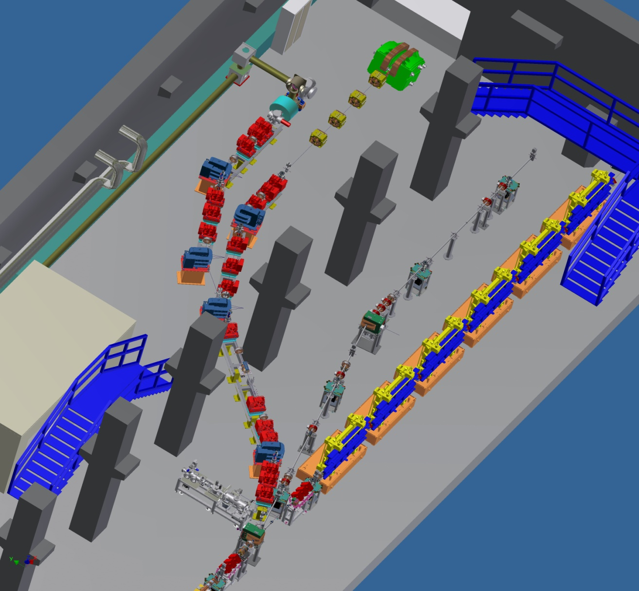

Plasma Acceleration Beamline
Plasma capillary
laser input line
300 TW, < 25 fs
Ti:Sa laser

Slide 5
Milestones
Start-to-end simulations
Generation and transport of HBEBs down to the plasma capillary
Plasma interaction chamber
Diagnostics
  HBEBs
  Plasma

Slide 6
Resources
FLAME laser
Electron source
(Photo-cathode)
LWFA
--------------
PWFA
Diagnostics: electrons and plasma
RF photo-injector
LNF
Univ. La Sapienza (A. Mostacci)
Univ. of Milan
(C. A. Potenza)
LNF
Univ. La Sapienza
(A. Mostacci)
Univ. of Milan
(C. A. Potenza)
Univ. of Lecce (A. Lorusso)
LNF
LNF
Univ. La Sapienza
(A. Mostacci)
Univ. of Milan
(C. A. Potenza)
Collaborations
CNR (L. Gizzi)
CNRS
(J. Fuchs, K. Ta Phuoch, J.R. Marques)
ENEA (C. Ronsivalle)
Univ. of Tor Vergata
(A. Cianchi)
RAS (A.E. Nikolay)
IST (L.O. Silva)
CNRS (B. Cros)
2 Post-Docs and 2 Fix-term researchers

Slide 7
Tasks
FLAME laser
Electron source
(Photo-cathode)
LWFA
--------------
PWFA
Diagnostics: electrons and plasma
RF photo-injector
LNF
- S2E simulations
beamlines installations
Study and design of the plasma chamber
Generation, acceleration and transport of HBEBs up to the IC
Laser transport up to the IC
Synchronization
Electron diagnostics (EOS, DR, etc..)
Univ. of La Sapienza
- Electron beam transport and measurement
- Study of beam dynamics in the plasma
Study and development of plasma diagnostics
Data analysis
Univ. of Lecce
- Study and development of novel metallic photocathodes based on thin layers of Mg, Yt and Pb
Univ. of Milan
- Simulations of laser/beam plasma interaction (Qfluid and Aladyn)
- Characterization of betatron radiation for transverse electron beam diagnostics

Slide 8
Tasks
FLAME laser
Electron source
(Photo-cathode)
LWFA
--------------
PWFA
Diagnostics: electrons and plasma
RF photo-injector
LNF | Univ. of La Sapienza | Univ. of Lecce | Univ. of Milan
S2E simulations | Electron beam transport and measurement | Study and development of novel metallic photo-cathodes based on thin layers of Mg, Yt and Pb | Simulations of laser/beam plasma interaction (Qfluid and Aladyn)
Beam lines installation
Study and design of the plasma chamber | Study of beam dynamics in the plasma
Generation, acceleration and transport of HBEBs up to the IC
 |  |  | Characterization of betatron radiation for transverse electron beam diagnostics
Laser transport up to the IC | Study and development of plasma diagnostics
Electron and laser synchronization
Electron diagnostics (EOS, DR, etc..) | Data analysis

Slide 9
Time Schedule
1 y
2 y
3 y
t
Start-to-end simulations
Laser/electron beams transport to IC
Electron beam diagnostics
Study and design of IC | IC machining and installation
 | Plasma diagnostics
Study and design of new cathodes | Cathodes test at LNF
 | LWFA EXPERIMENT PWFA

Slide 10
Impact on SPARC_LAB Activities
Our project has not destructive interferences with other activities at SPARC_LAB
  Plasma acceleration beamline already exists => External Injection Beamline
  FLAME already exists and works: our project will benefit of
    laser transport experience for Thomson back-scattering
    Laser and electron beams synchronization studies
  Commissioning of the beamline is in common with Thomson experiment
  Beam time request only the second and third year

Slide 11
Thanks!

Slide 12
The SPARC_LAB Activities
Laser/Plasma physics (High gradient acceleration)
  Particle Beam driven Plasma Acceleration => COMB
  External injection (EXIN)
  Self-Injection (=> γ-RESIST)
FEL physics
  4-pulses comb beam
  Three stages superradiant cascade
  Seed sources: Kagome’ fibers (N. Joly, M. E. Couprie)
Advanced radiation sources and applications
  X-ray Thomson backscattering (ELI-NP, THOMSON)
  Broad band and narrow band THz radiation (TERASPARC)
Advanced beam physics and accelerator technology
  ELI-NP
  COMB
Laser/Plasma based ion sources (LILIA)
Positron source (POSSO)
1st PAC Meeting, June 6th, 2012

Slide 13
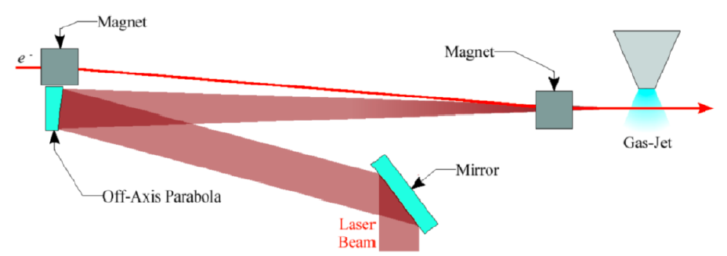
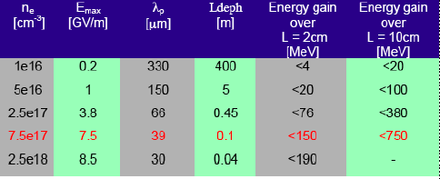
Plasma Acceleration Beamline: EXternal INjection
Gas capillary
Complete Simulations for injection and acceleration in capillary (SEP. 2012)
Start Acquisition Procedure for magnets of diagnostic transport line (OCT. 2012)
Complete Design of Interaction Chamber (DEC. 2012)
44th LNF SC Meeting, June 4th, 2012

Slide 14
Plasma Acceleration Beamline: EXternal INjection
Hollow Dielectric Waveguide Capillaries, with LPGP Orsay, B. Cros et al.
44th LNF SC Meeting, June 4th, 2012

Slide 15
Plasma Acceleration Beamline: COMB
Resonant plasma Oscillations by Multiple electron Bunches
Weak blowout regime with resonant amplification of plasma wave by a train of high brightness electron bunches produced by Laser Comb technique ➔ 5 GV/m with a train of 3 bunches, 100 pC/bunch, 50 μm long, 20 μm spot size, in a plasma of density 10²² e⁻/m³ at λ_{p}=300 μm ?
Ramped bunch train configuration to enhance transformer ratio?
High quality bunch preservation during acceleration and transport?
Strong blowout regime with pC/fs bunches ➔ TV/m regime ?
44th LNF SC Meeting, June 4th, 2012

Slide 16
Simulation parameters (by A.R. Rossi)
Laser parameters
Energy: 3 J (both realistic and conservative);
Length: 35 fs (FWHM);
w₀: 64.5 um;
Rayleigh range: ~ 16.6 cm;
Gaussian profiles;
Guided by transverse plasma density tapering;
Acceleration length: ~ 22 cm.
In - Beam parameters
Charge: 5 pC
σ_{tr}: ~ 10 um;
σ_{z}: 3.5 um;
ε_{n}: 1.2 mm – mrad;
δγ/γ: 10⁻³;
Energy: 160 MeV
In the code, the laser is guided by a transverse density tapering since the presence of a capillary tube needs to be implemented (work in progress). However the transverse mode in the capillary, if the laser is well matched (w₀=0.645 R_{cap}), should not be too different from the TEM₀₀ of free space [1]. Moreover, the leakage of energy from the capillary boundary has been implemented by multiplying the laser intensity by [1]:
Exp[-s/L_{d}] with L_{d}~ 7.4 m for R_{cap}= 100 um
which allows for a long accelerating plasma channel, since the laser parameter is less than 1 and the plasma wave is linear and slippage is not critical. The main yet unanswered question is what happens to the plasma wave when 2R_{cap} λ_{p} (work in progress), which however is not our case for now. Moreover, the capillary radius has been take quite large in order to simulate an easier experimental setting (as regards laser pointing).
In the following the plasma channel is composed of a 2 cm long matching ramp, with linearly increasing density from an initial value n₀=5x10¹⁵ cm^{-3,} and an accelerating stage with n₀=10¹⁷ cm⁻³. The subsequent matching from plasma to vacuum is still missing due to numerical instabilities. The two simulations differ in the injection phase dz₀, measured as the distance from the laser and witness.
[1] B. Cross et al., Phys. Rev. E, 65 026405 (2002).

Slide 17
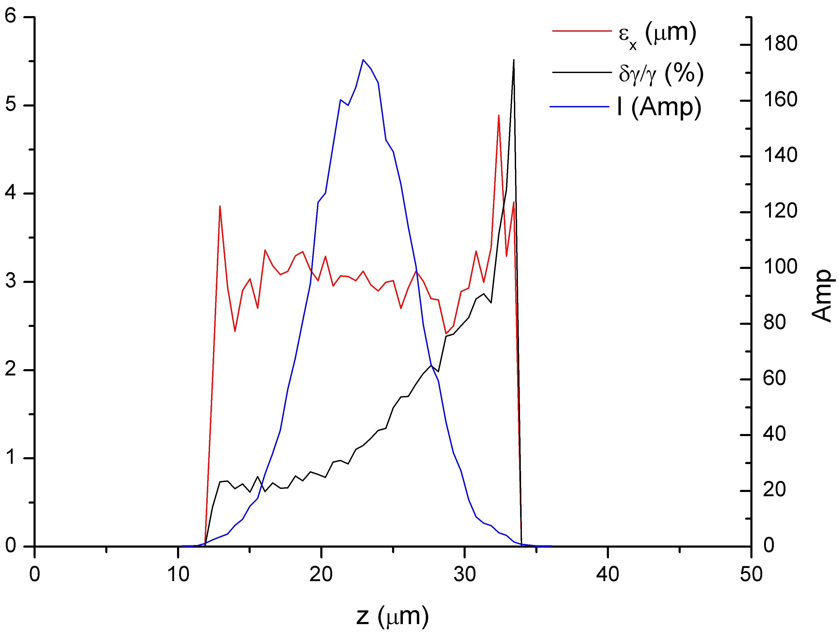
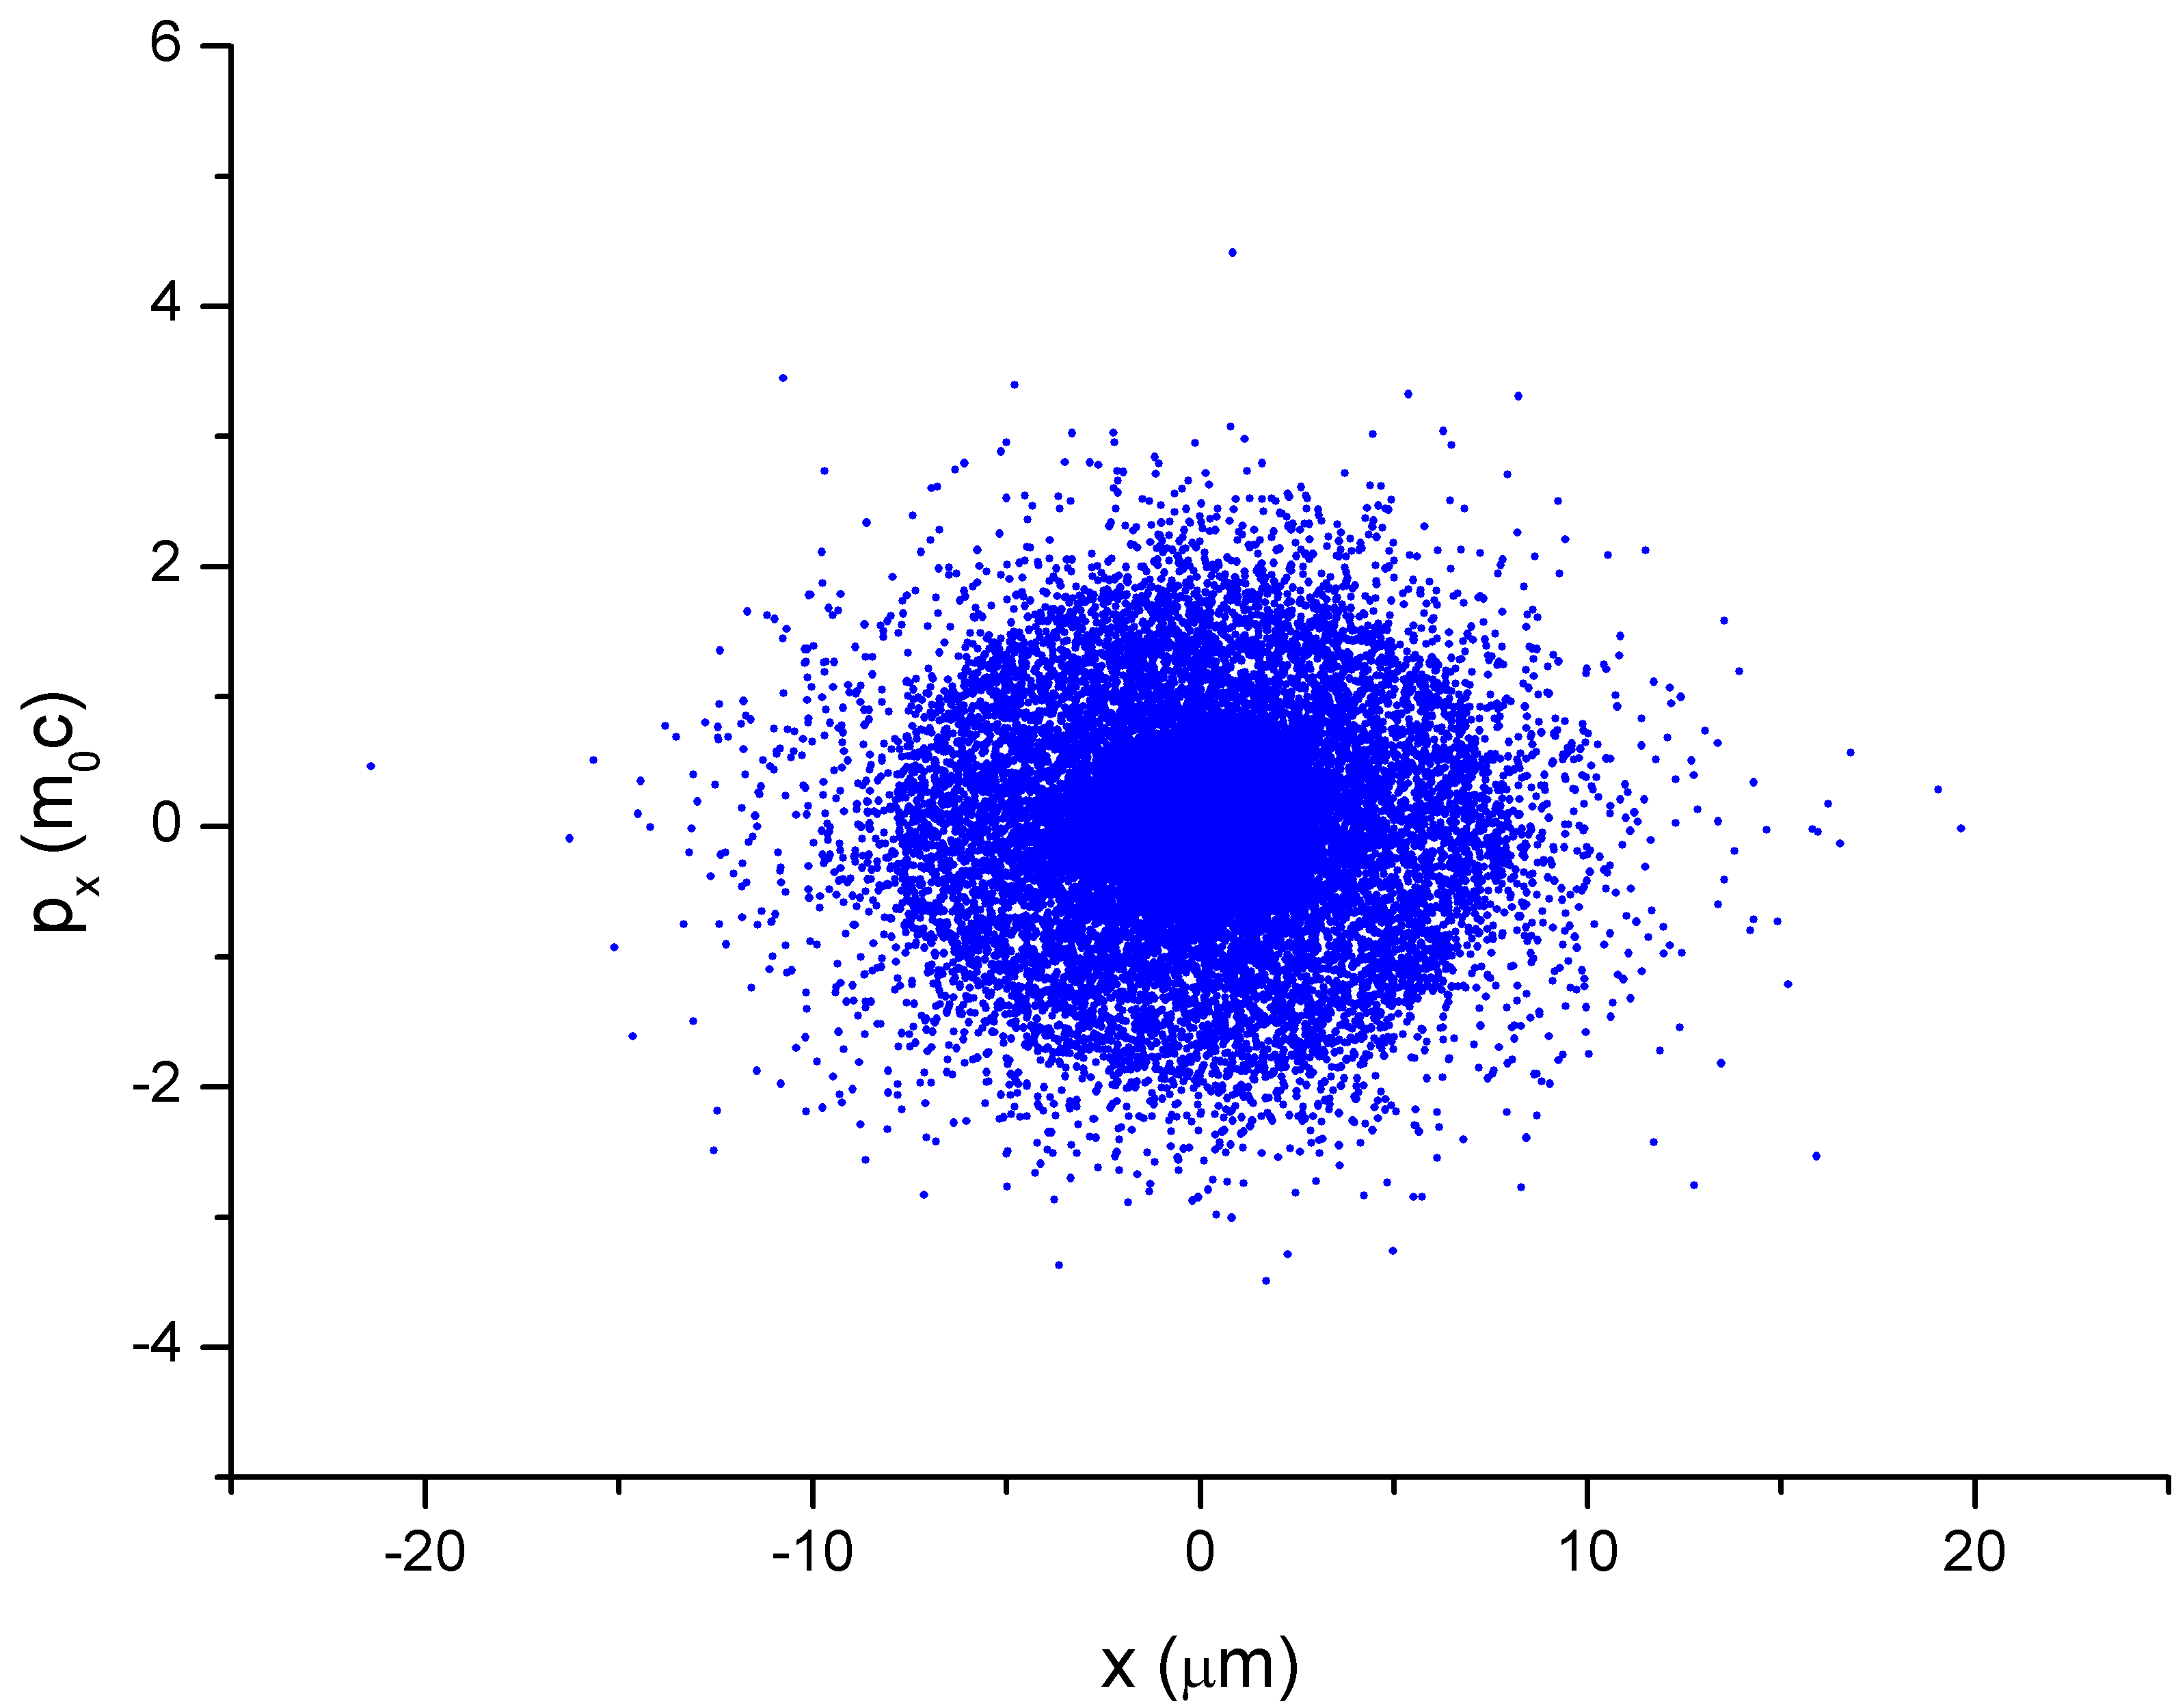
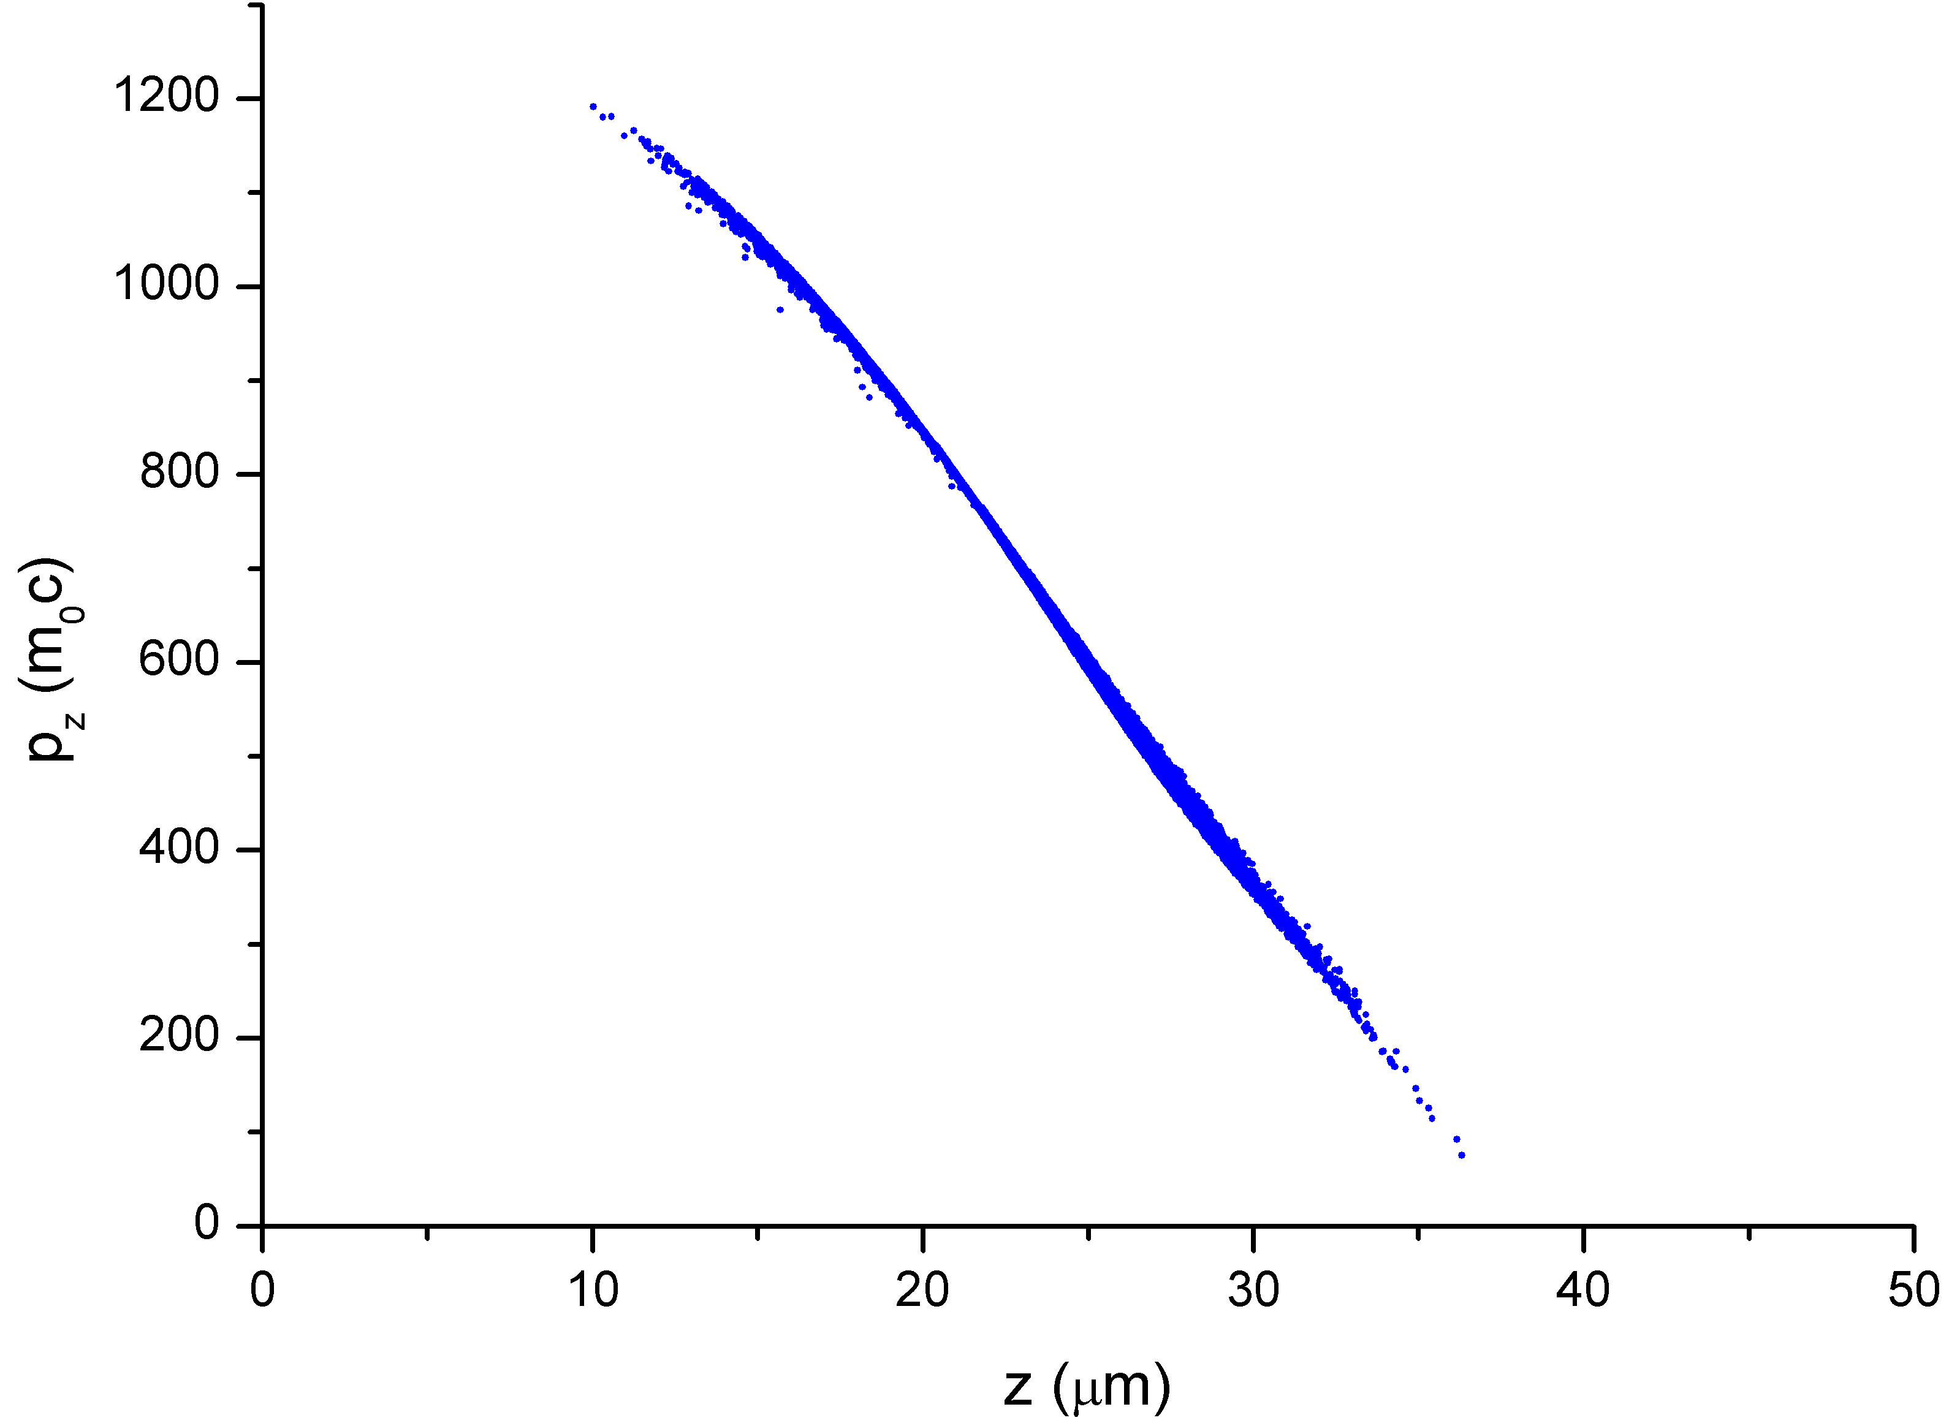
Setting 1: dz₀=110 fs (by A.R. Rossi)
Out - Beam parameters
σ_{tr}: ~ 3.6 um;
σ_{z}: 3.5 um;
Ε_{n}: 3.1 mm – mrad;
δγ/γ: 0.24 (!!) but mostly linear;
Energy: 351 MeV
<Ez>=0.87 GV/m

Slide 18
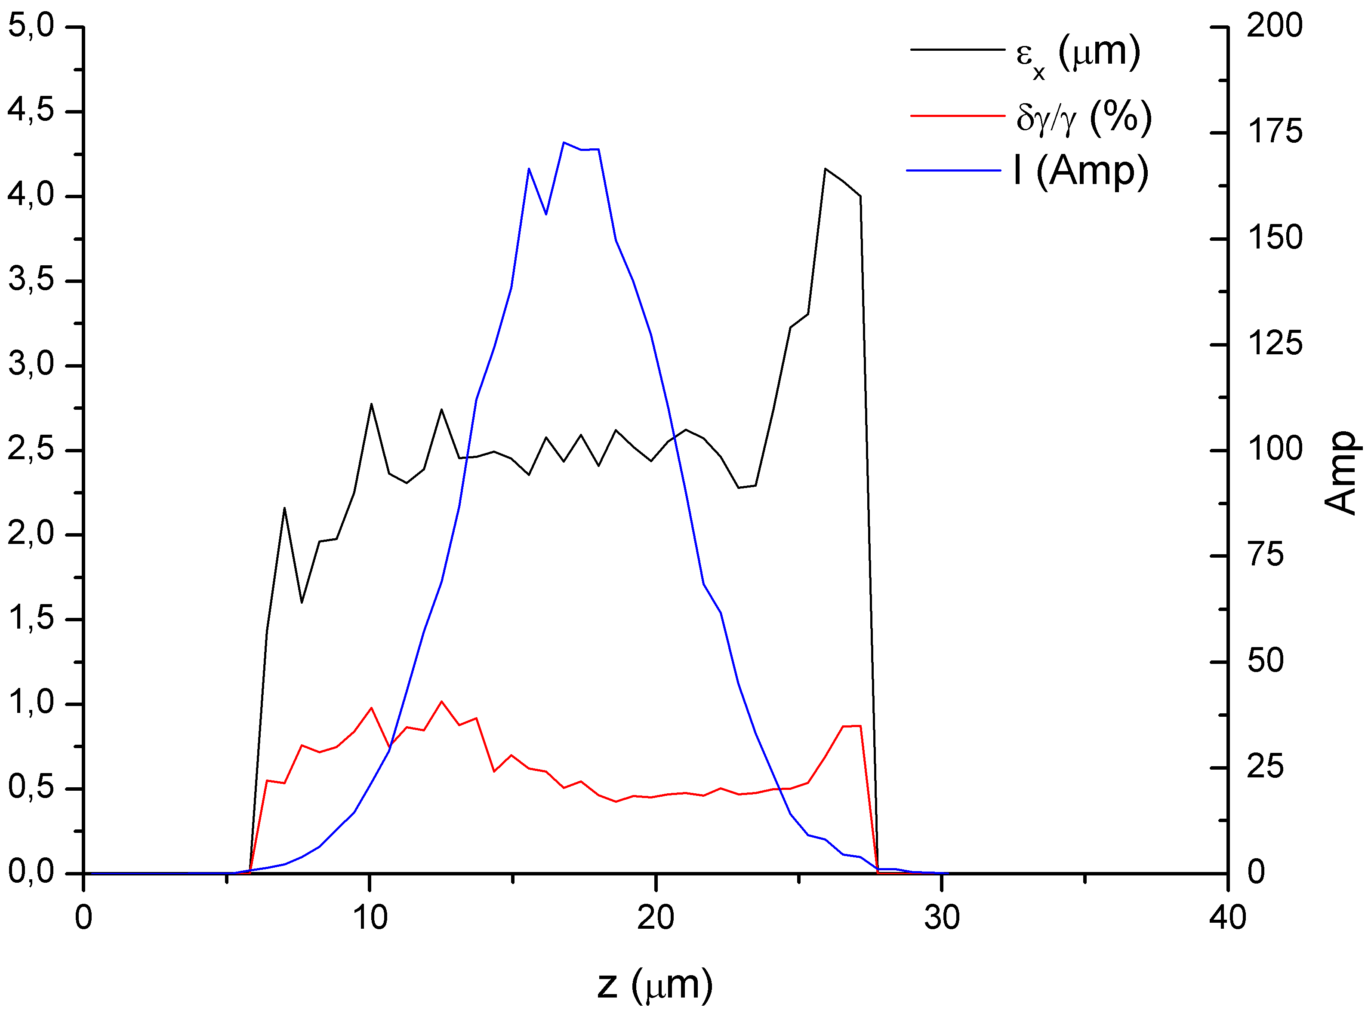
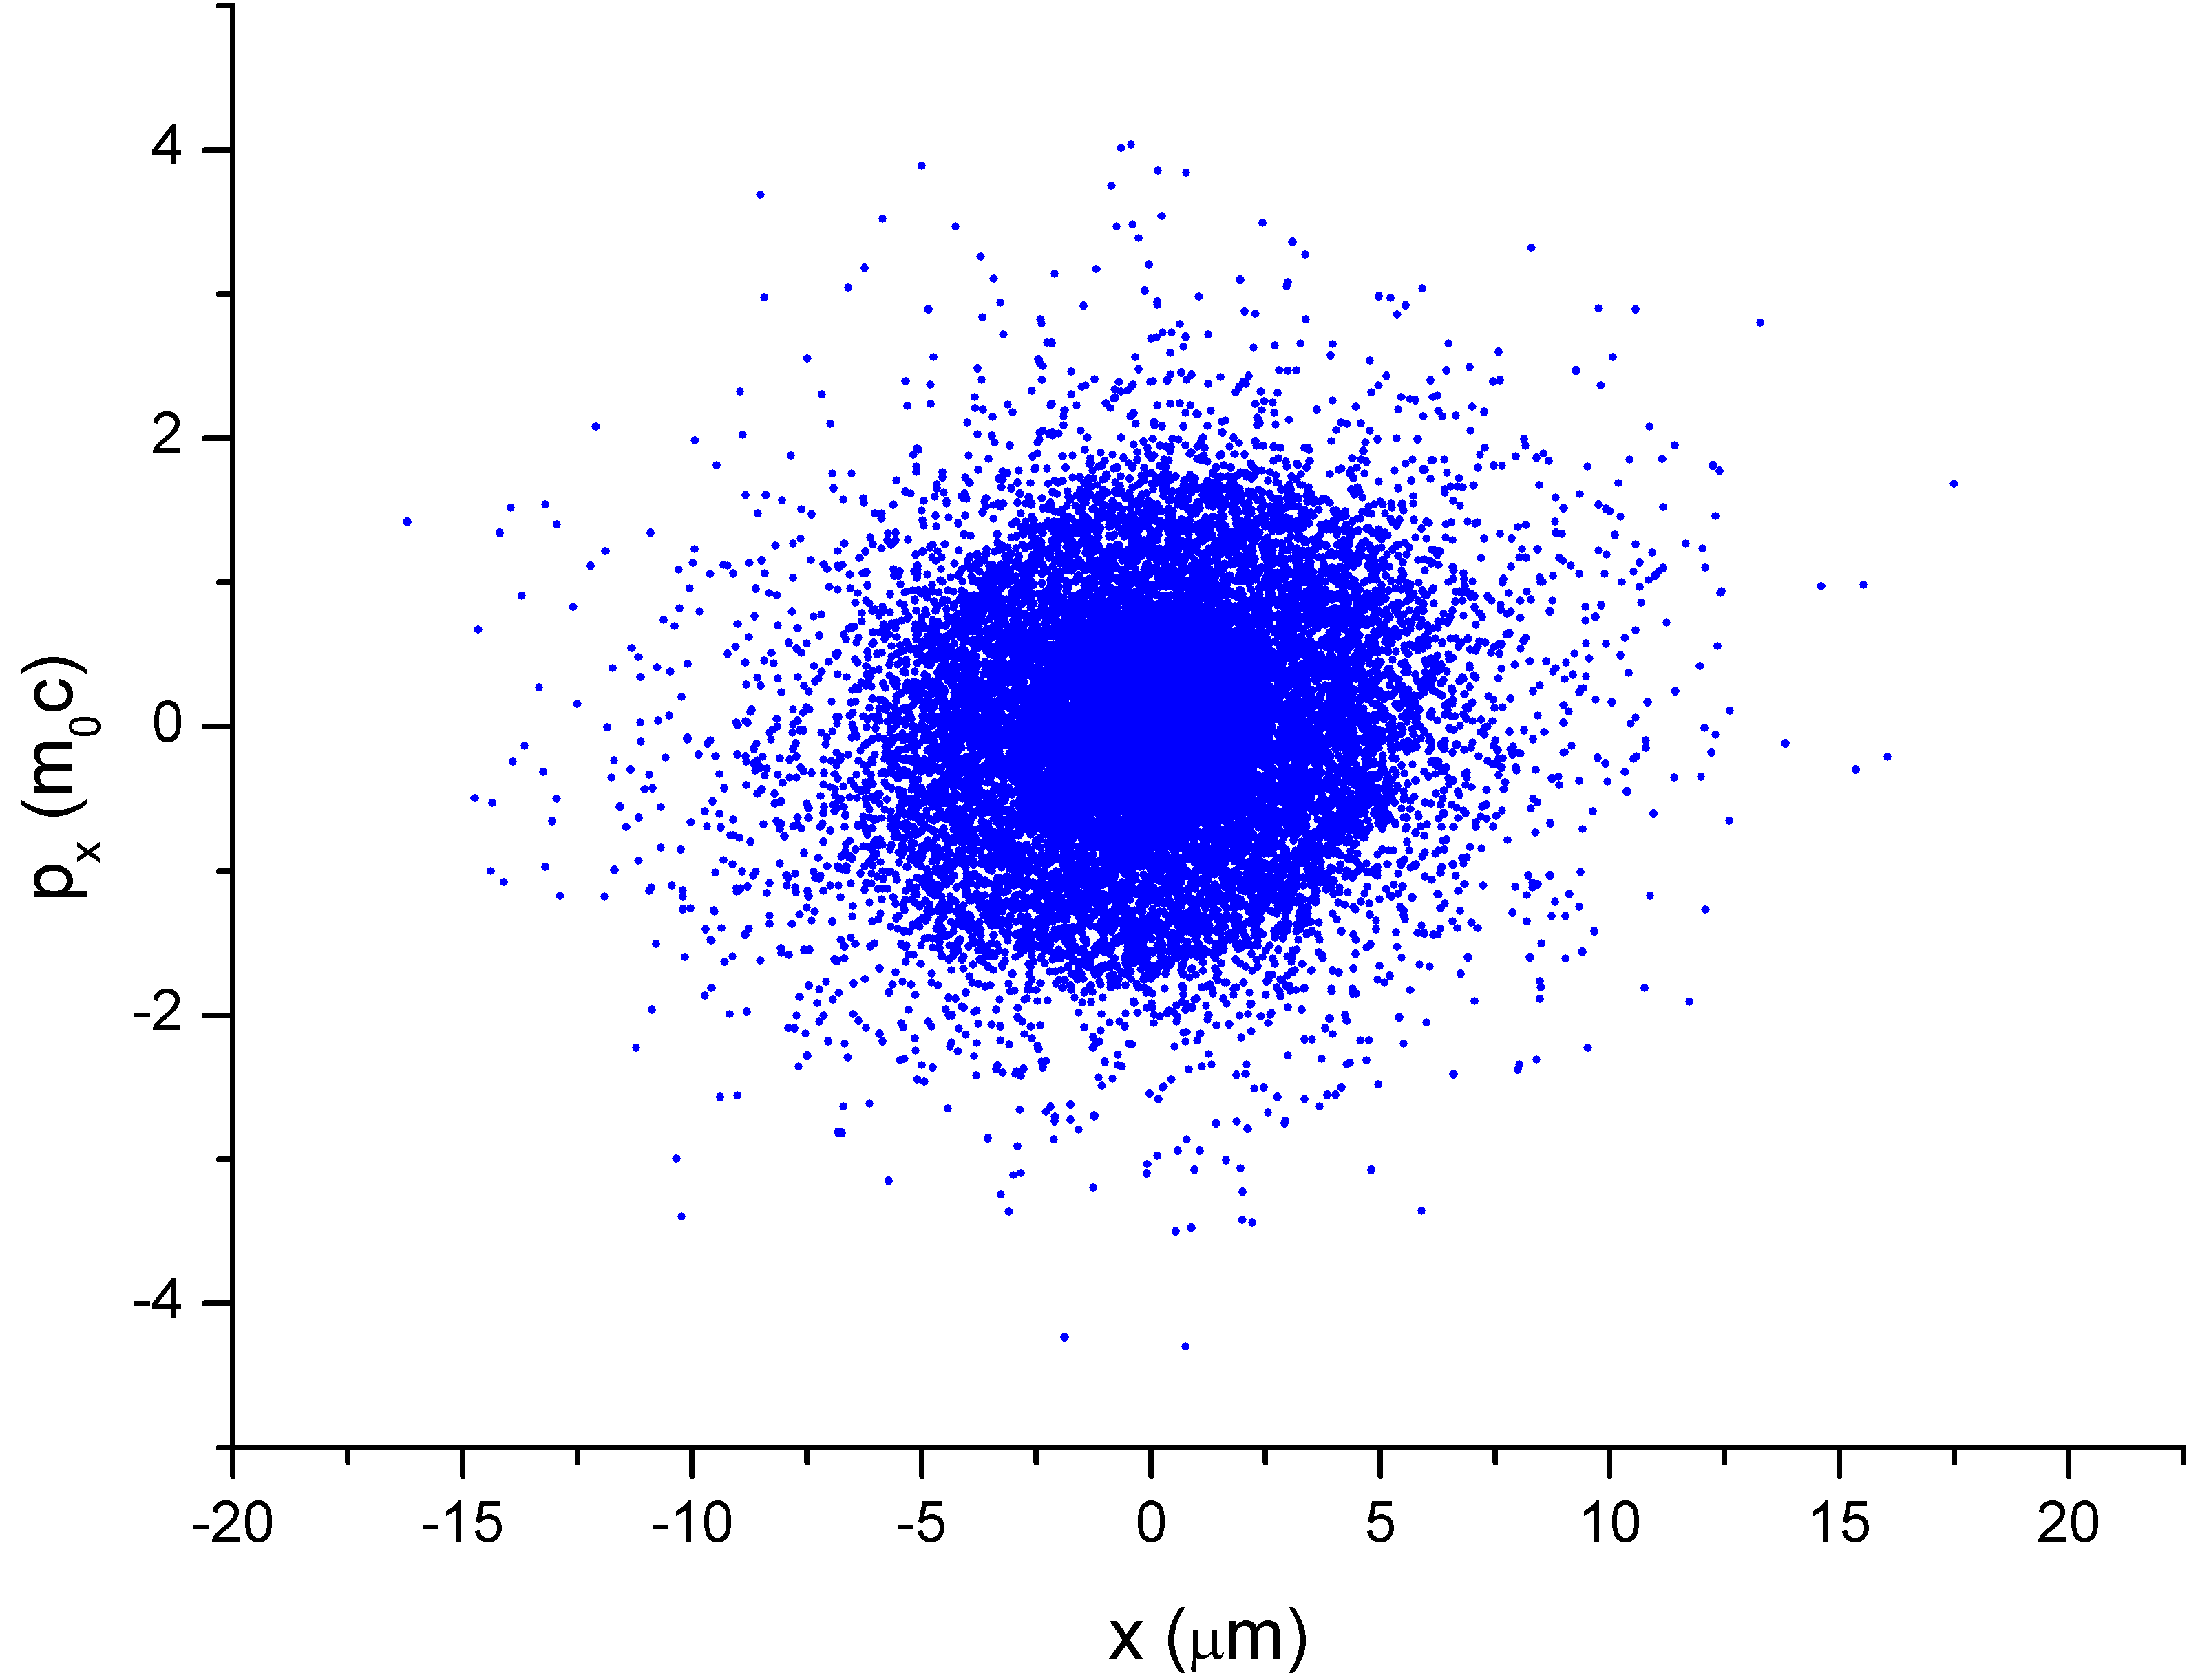
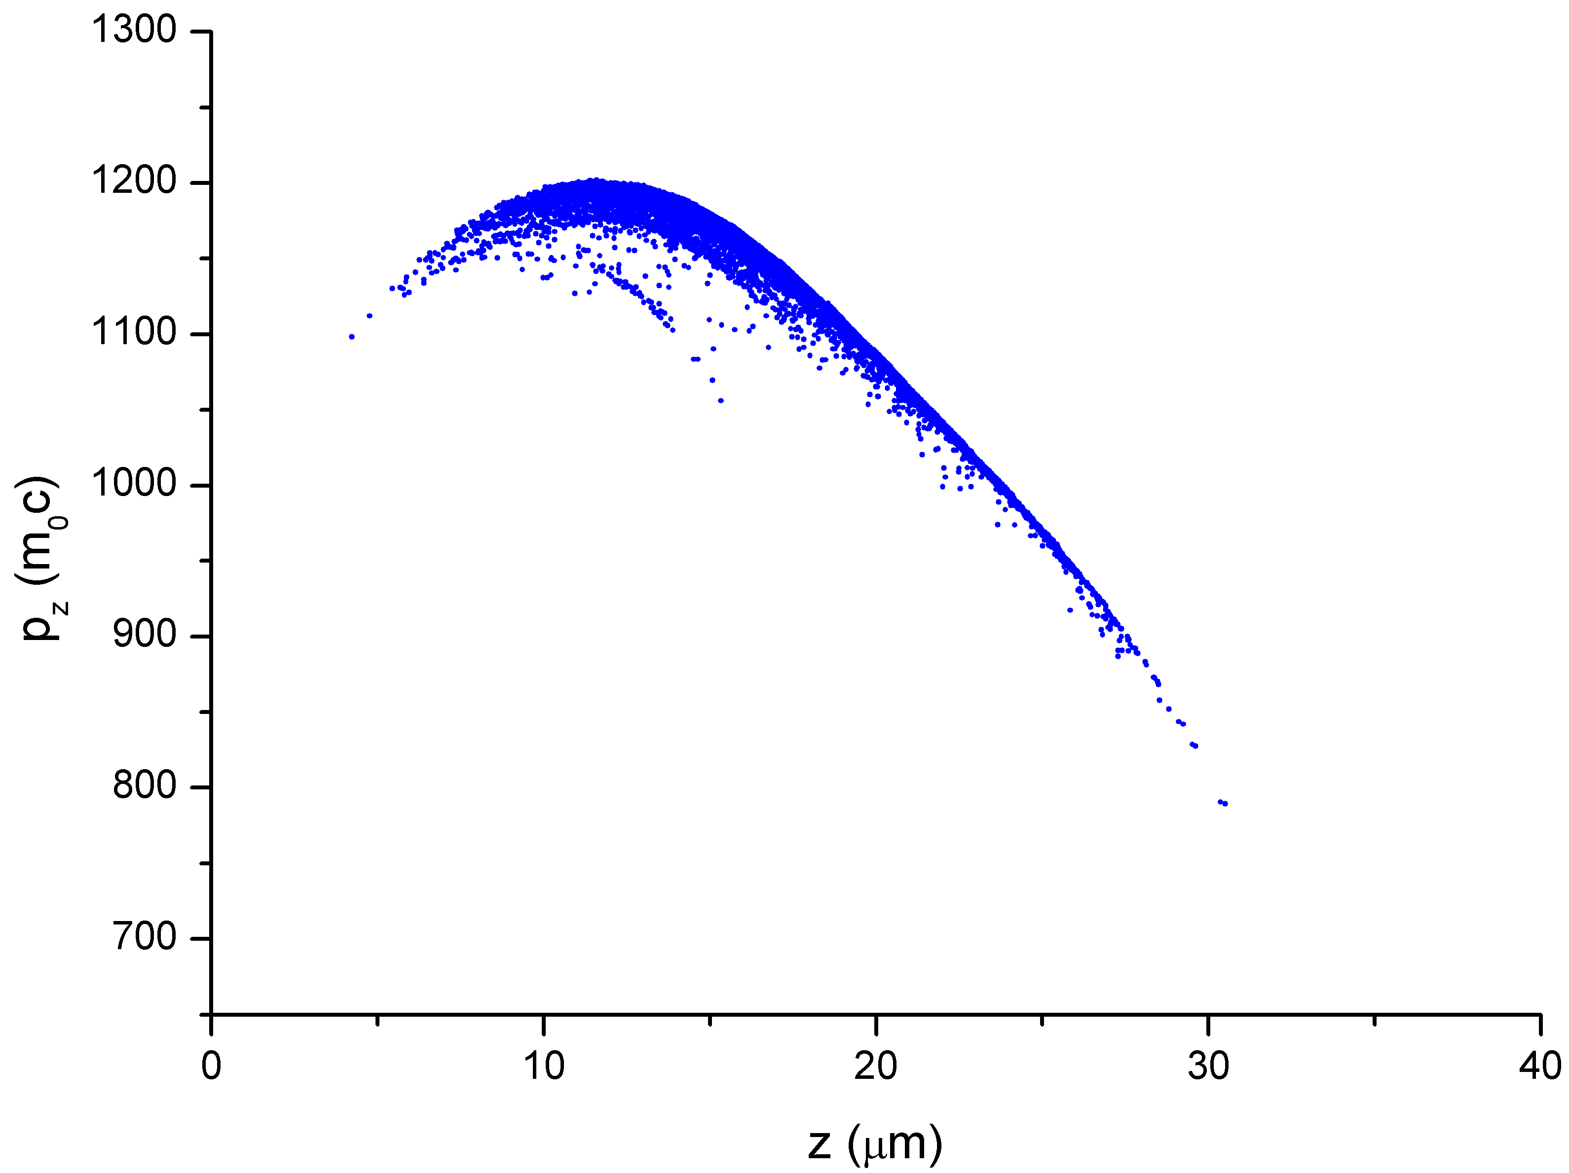
Setting 2: dz₀=156 fs (by A.R. Rossi)
Out - Beam parameters
(not including 68 “out of bucket” lost particles)
σ_{tr}: ~ 3.6 um;
σ_{z}: 3.5 um;
ε_{n}: 2.5 mm – mrad;
δγ/γ: 5 x 10⁻² (no significant beam loading);
Energy: 565 MeV
<E_{z}>= 1.84 GV/m
These particles have a significant portion of their total energy in transverse momenta. Eventually, they are doomed to leave the bucket.

Slide 19
Setting 2: dz₀=156 fs (by A.R. Rossi)
Out - Beam parameters
σ_{tr}: ~ 3.6 um;
σ_{z}: 3.5 um;
Ε_{n}: 3.1 mm – mrad;
δγ/γ: 0.24 (!!) but mostly linear;
Energy: 351 MeV
<Ez>=0.87 GV/m
Further optimization needed!
These particles have a significant portion of their total energy in transverse momenta. Eventually, they are doomed to leave the bucket.

Slide 20
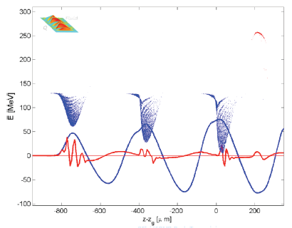
Preliminary QFLUID simulations
A train of 3 electron drive bunches,
each of them 25 μm long, with 200 pC at 150 MeV, 1 μm rms normalized emittance, could accelerate up to 250 MeV a 20 pC, 10 μm long witness bunch, injected at the same initial energy in a 10 cm long plasma of wavelength 383 μm.
The drive bunches will loose energy to excite the plasma accelerating field up to 1 GV/m in favour of the witness bunch.
Simulations show also that the witness bunch can preserve a high quality with a final energy spread less than 1 % and 1.6 μm rms normalized emittance.

