Slide 1
KLOE: present status and upgrades
Danilo Domenici – LNF
On behalf of the KLOE-2 Collaboration

Slide 2
Report Overview
KLOE present Status:
  Detector
  Data Taking
  Data Analysis
KLOE Upgrades Status:
  Crystal Calorimeter - CCAL
  Quadrupole Calorimeter - QCAL
  Inner Tracker - IT

Slide 3
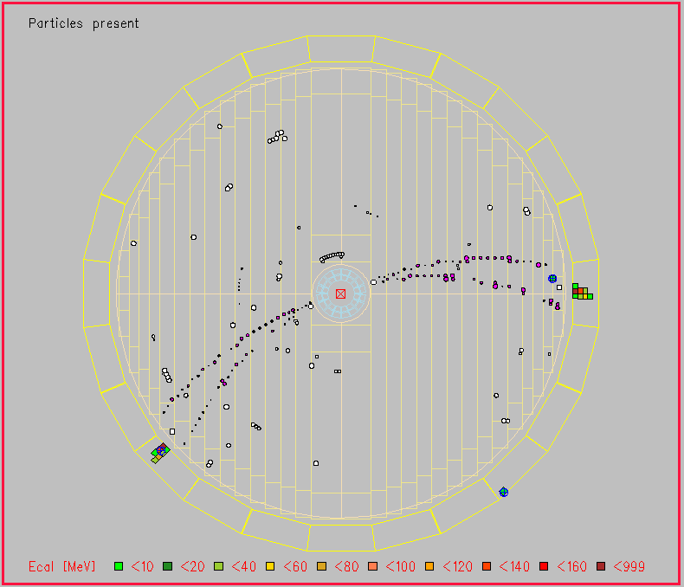
KLOE Apparatus Today
Detector Status
EMC is fully functional
  Calibration with cosmics completed
  Calibration with Bhabha and γγ in progress
DC is fully functional
  Two TDC boards under repair (3% of total channels)
  Calibration with cosmics completed
Trigger is fully functional
  Two dish boards to be repaired
Data Taking / Monitoring / Offline
Online monitoring and DAQ are performing well
  Few 10’ stops given by daq busy related to beam losses
L3 processes working
  Online Bhabha selection has a reduced rate due to machine background. New code fixing this problem under test
Night & week-end data taking dedicated to collect data for Amadeus collaboration up to the end of this run
  Motivation: make some physics out of this data-taking, test data storage to CNAF, training shifts, DAQ and Offline analysis

Slide 4
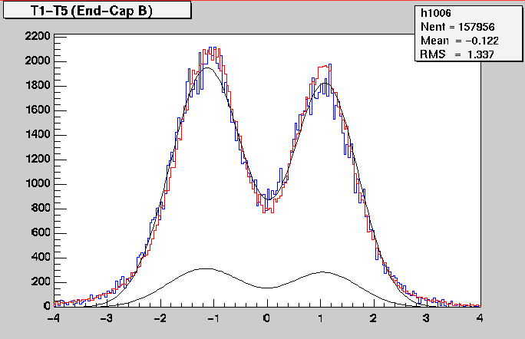
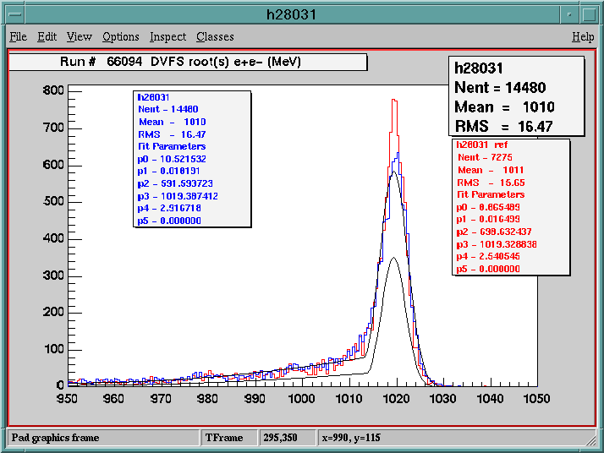
Example of Data Quality
T1 – T5 (ns) crossing time of innermost – outermost ECAL layers for cosmic muons
Reconstruction of CM Energy for Bhabha events with the DC

Slide 5
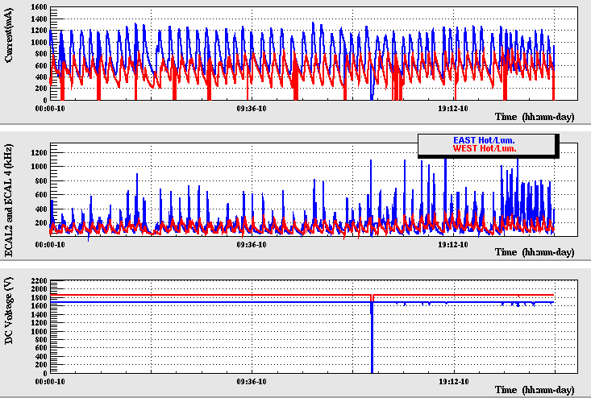
EMC/DC vs Background
DC hard enough to survive 600 kHz bkg as counted by the EMC
400 kHz of EMC background corresponds to a 30% accidental counts in 100 ns window → 1% fakes in a prompt time window

Slide 6
Data Analysis Progress since last SC
Γ(η→π⁺π⁻γ) / Γ(η→π⁺π⁻π⁰) | arXiv:1209.4611 Accepted for publication (PLB) DOI 10.1016/j.physletb.2012.11.032
UL(φ→ηU, η→π⁰π⁰π⁰) | arXiv:1210.3927 Submitted to PLB
γγ→η and Γ (η→γγ) | arXiv:1211.1845 Submitted to JHEP
a_{µ} ^{had,ππ} with σ(π⁺π⁻γ)/σ (μ⁺μ⁻γ) | Final result Draft under review of the collaboration
UL( K_{S}→π⁰π⁰π⁰) | Final result Draft in progress
φ→K_{S}K_{L}→π⁺π⁻π⁺π⁻: CPT and Lorentz invariance | Preliminary (almost final) result
UL(e⁺e⁻→Uγ) | Preliminary result
UL(e⁺e⁻→Uh′) | Preliminary result

Slide 7
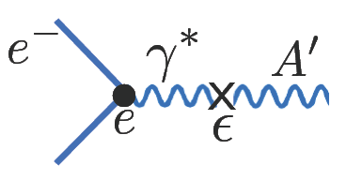
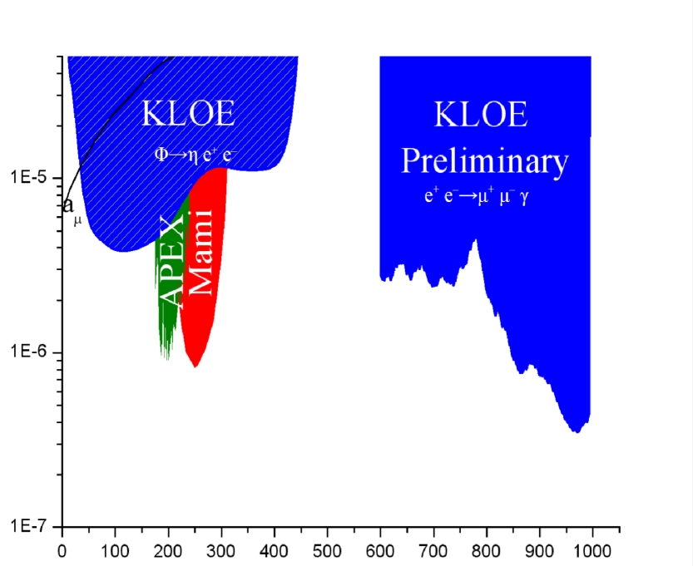
Search for Dark Forces
Hypothesis: existence of a hidden gauge sector, able to
explain several unexpected astrophysical observations,
weakly coupled with SM through a mixing mechanism of
a new gauge boson U with the photon
U
e⁺
φ→ηU
e⁺e⁻→Uγ
ε²
ε²
e⁺e⁻→Uh′
α_{D}ε²
ε²α_{D}
KLOE
preliminary
M_{U} (MeV)
M_{U} (MeV)

Slide 8
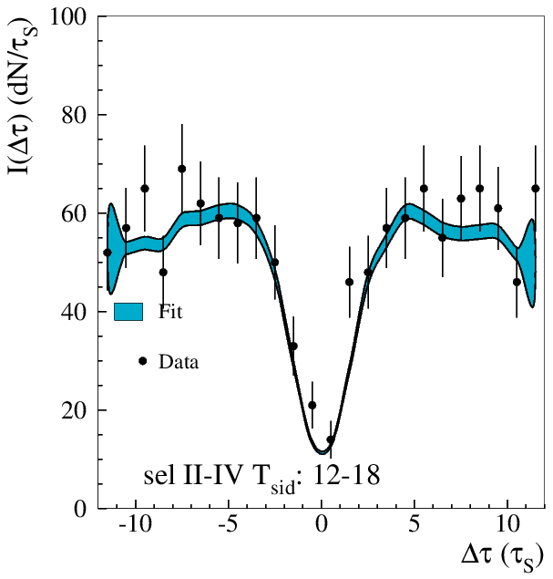
CPT & Lorentz Invariance Test
Neutral kaon interferometry based analysis with π⁺π⁻π⁺π⁻ final state
Search for asymmetry in distribution of decay time difference between the two kaons in the kaon flight direction andevent sidereal time (SME framework)
KLOE-2 preliminary
Δa₀ = (-6.2 ± 8.2_{stat} ± 3.3_{sys} ) 10⁻¹⁸ GeV
Δa_{X} = ( 3.3 ± 1.6_{stat} ± 1.5_{sys} ) 10⁻¹⁸ GeV
Δa_{Y} = (-0.7 ± 1.3_{stat} ± 1.5_{sys} ) 10⁻¹⁸ GeV
Δa_{Z} = (-0.7 ± 1.0_{stat} ± 0.3_{sys} ) 10⁻¹⁸ GeV

Slide 9
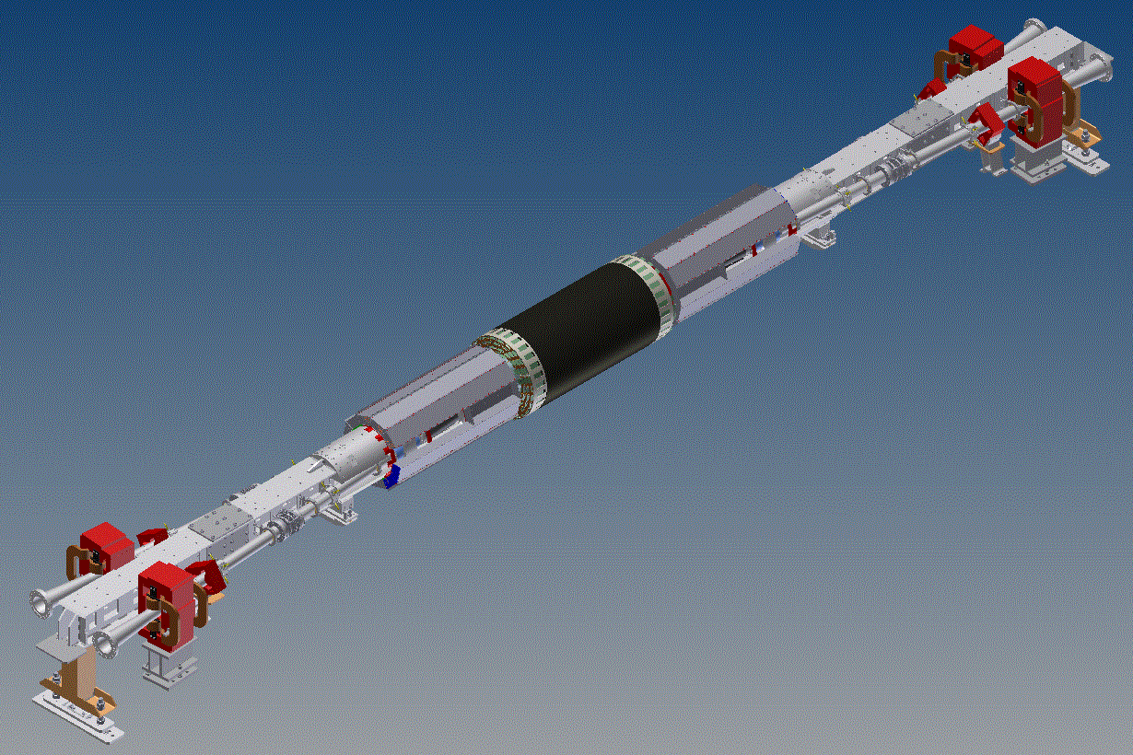
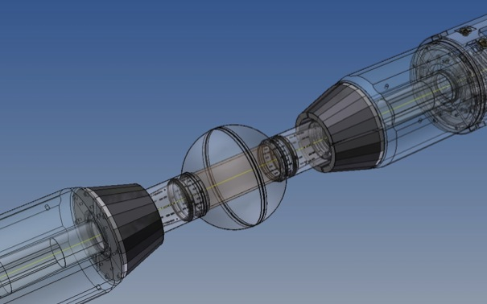
Detector Upgrades Overview
QCAL
Inner Tracker
CCAL

Slide 10
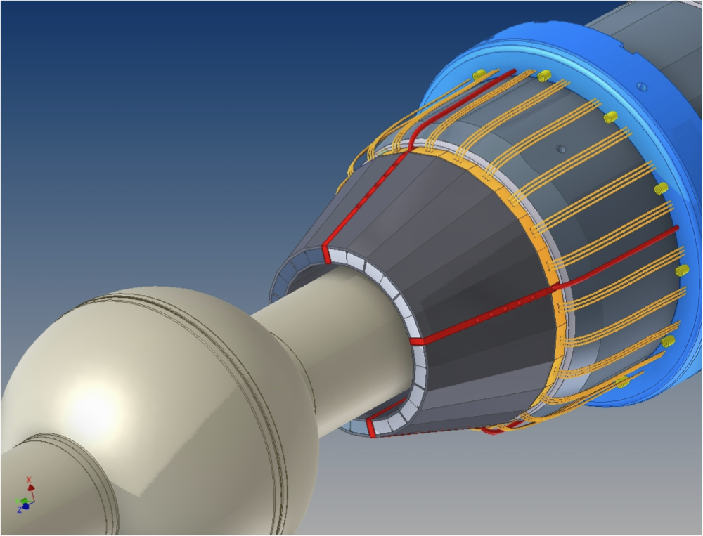
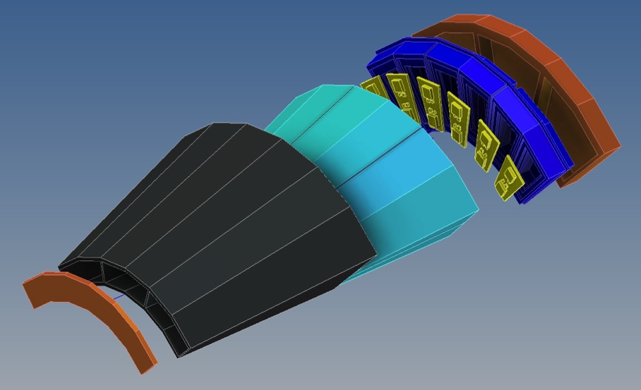
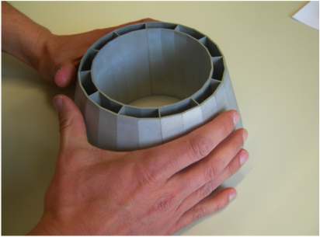
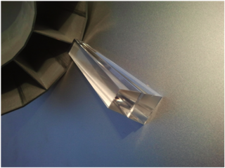
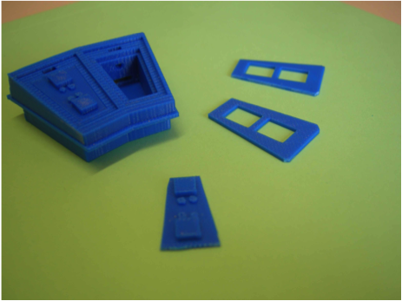
CCALT Layout
1 calorimeter/side, 4 shells/calo,
3 modules/shell, 4 crystals/module
PCB housing SiPM and calibration LED
QD0
coupling plate
8 aluminum shells
shell and PCB
holder
LYSO crystals produced by SICCAS
forward plate

Slide 11
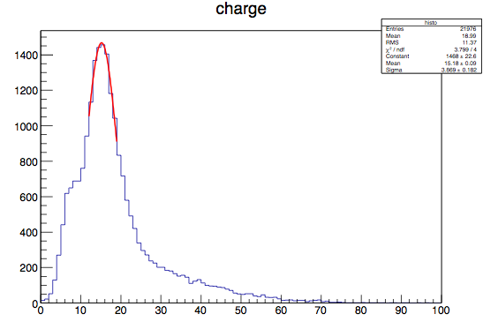
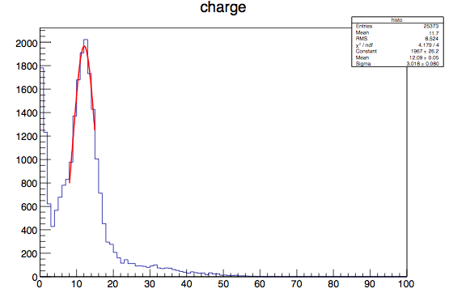
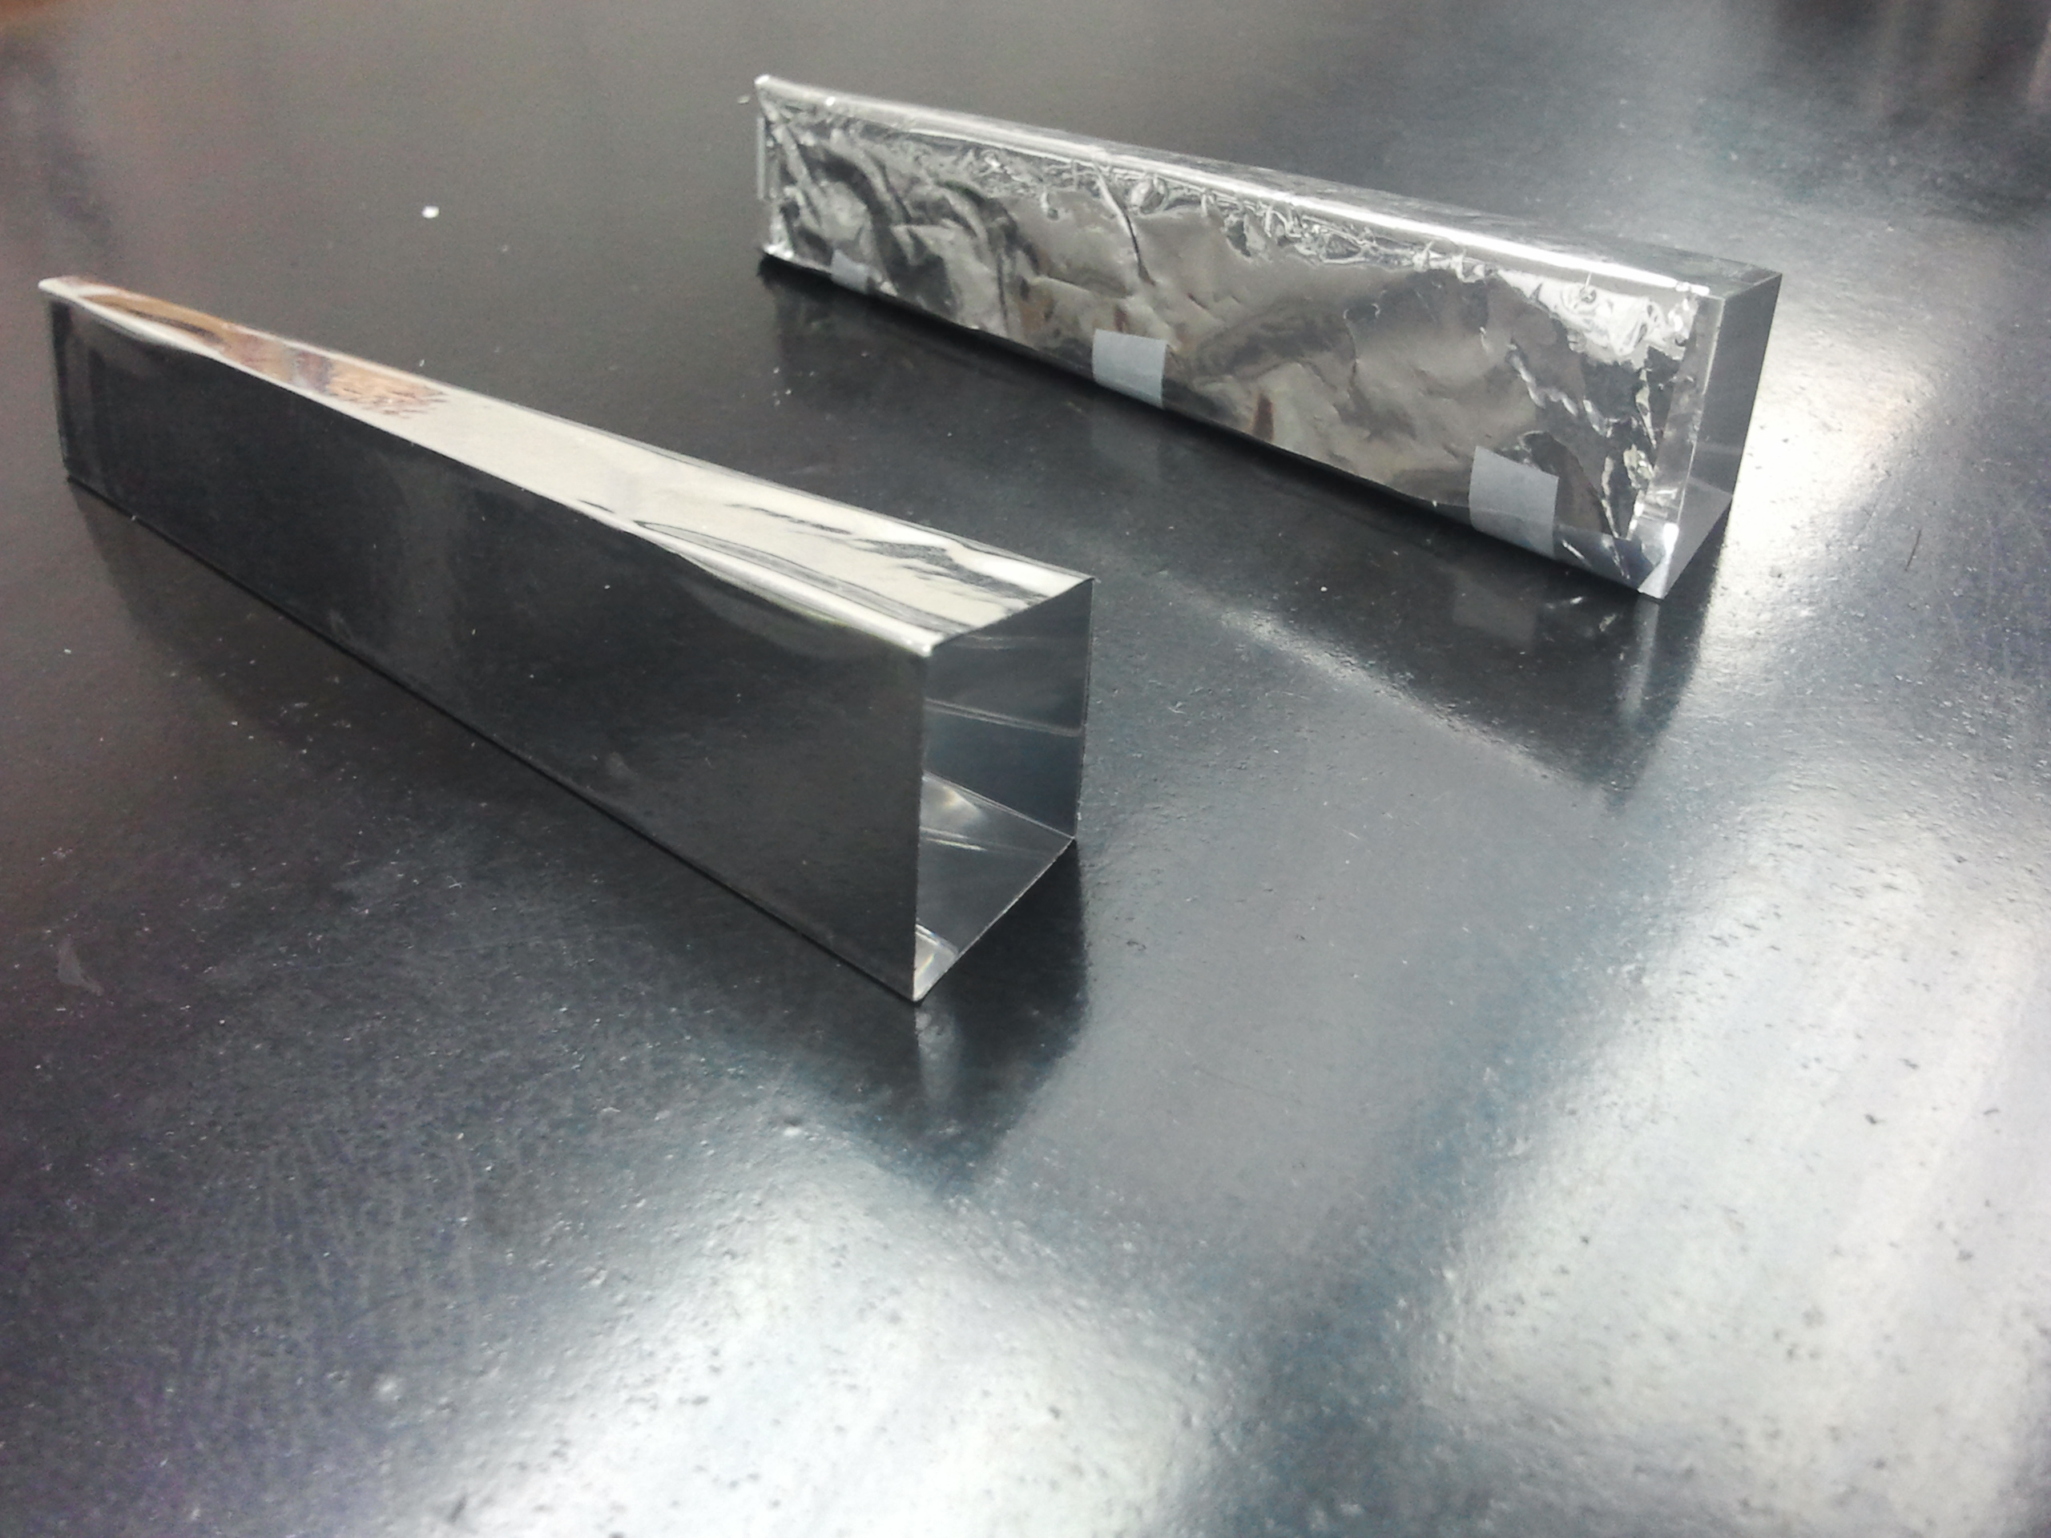
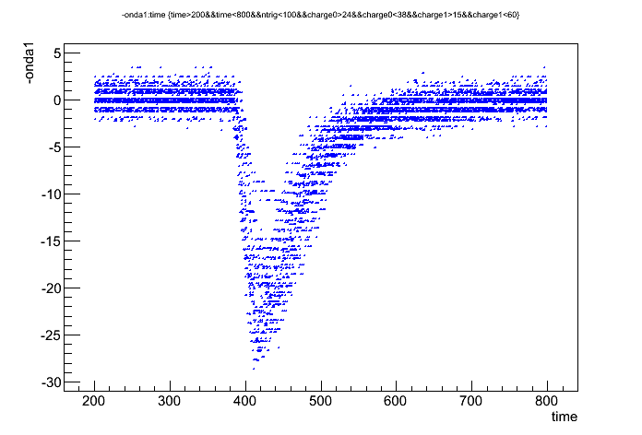
CCALT Components and Tests
Tests in progress
Energy resolution = 10-15 % at 511 keV measured for all crystals with ²²Na source and 1Gs/s digitizer
Crystal wrapping: adhesive mylar is chosen
Testbeam @BTF of single crystal σ_{t} ~ 450 ps @150 MeV
Performance at high rates to be tested with a pulsed UV-LED
²²Na Spectra
with Mylar
<Q> = 15 pC
Q (pC)
w/o Mylar
<Q> = 12 pC
SiPM Signal

Slide 12
CCALT Schedule
November
Production of forward plates
Production of photodetectors holder plates (3D print in ABS)
Finalization of the design of the QD0 coupling plate
Production of PCB and mounting and test of SiPM
December
Production of QD0 coupling plates
Anodization of aluminum parts
Completion of crystals characterization with ²²Na
Wrapping of all crystals
Assembly of all modules
Test of the final FEE chain with cosmics

Slide 13
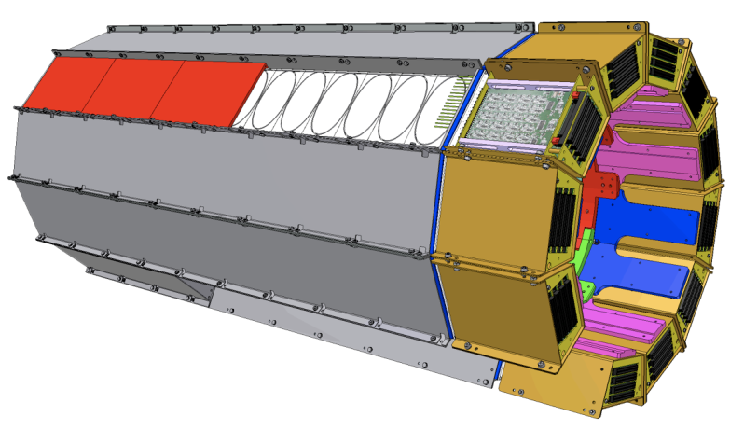
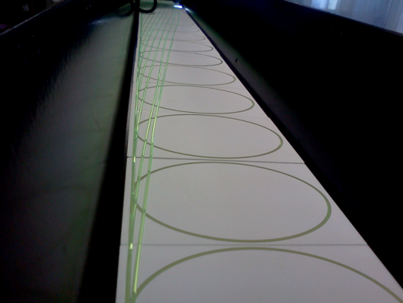
QCALT: detector
QCALT calorimeter consists of 2 dodecagonal structures, covering the region close to IP
Each calorimeter is build in 2 halves to be coupled during insertion to the beam pipe.
Each module (1/12), consists of a sampling calorimeter with 16 towers, each composed by 5 layers of scintillator tiles and 5 layers of W/Cu absorbers
Light from tiles is routed outside using multicladding WLS fibers readout using circular 1.2 mm Ø SiPM
The total number of TDC channels is about 2000

Slide 14
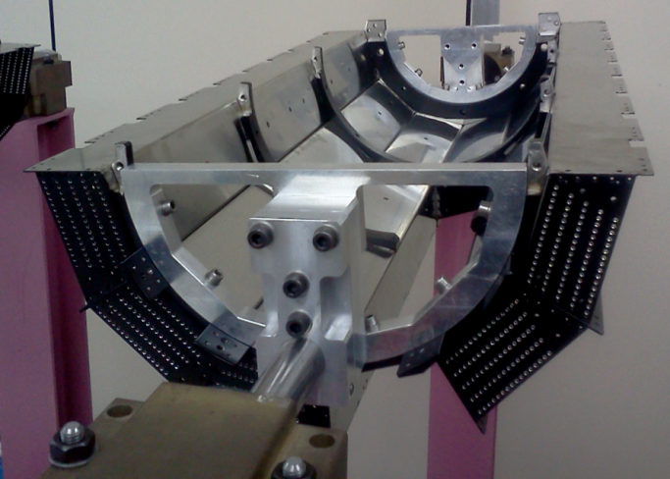
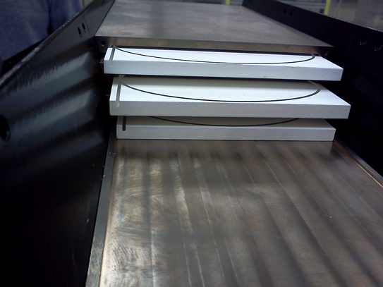
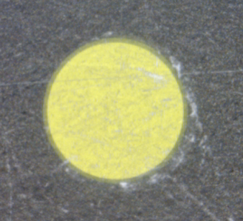
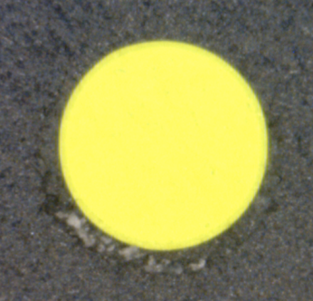
QCALT: detector
First QCALT already assembled
Each tile tested using ⁹⁰Sr source to check fiber-tile coupling
LY of towers measured with cosmic rays
Plastic fiber holder already polished and ready to be coupled to SiPM
All materials (tiles, fibers, tungsten) for second QCALT ready
Mechanical preparation of steel structure and painting done
Tiles grooved, installation in progress
Half QCALT with W/Cu shielding
Fiber holder
Before polishing
After polishing
Tiles/WLS stack

Slide 15
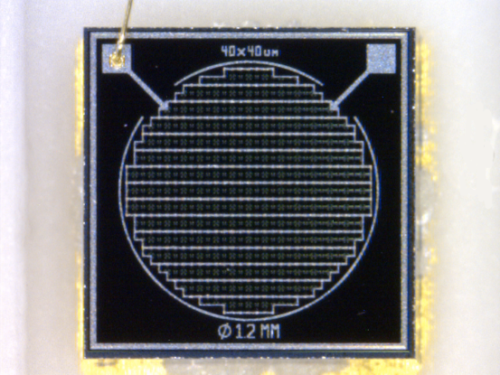
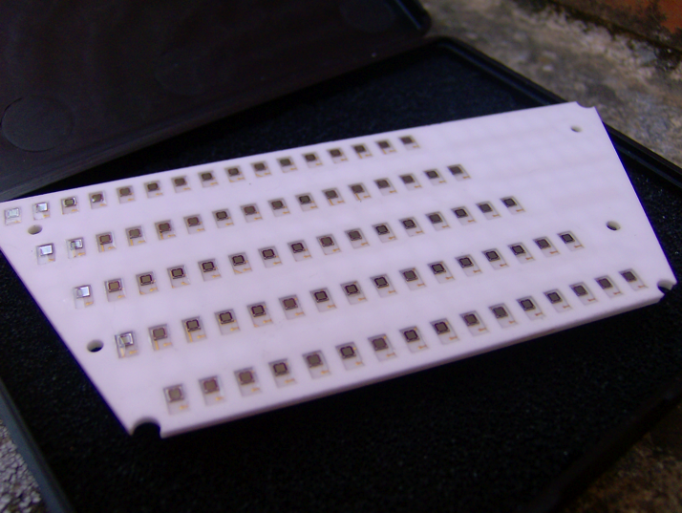
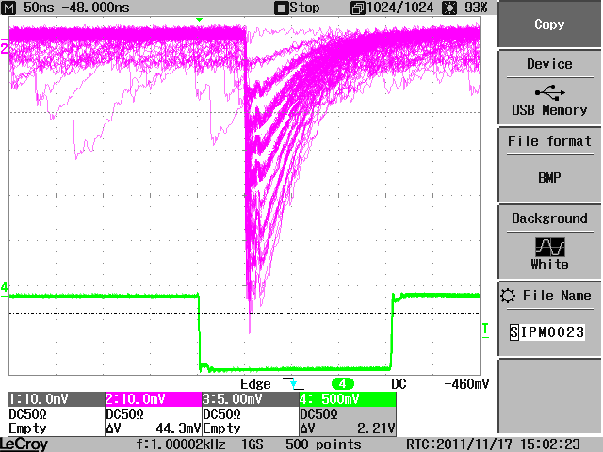
QCALT: SiPM
Final PCB produced and sent to FBK for SiPM bonding
Final SiPM production (round 1.2 mm diameter) completed
Bonding and resining in progress
Test on preliminary PCB satisfying (optical properties, HV working point, gain)
Test of final PCB with cosmics and final FEE chain in progress

Slide 16
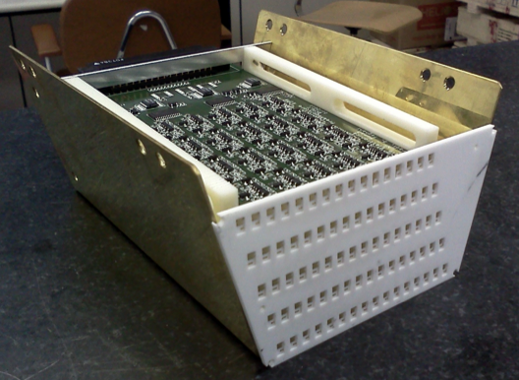
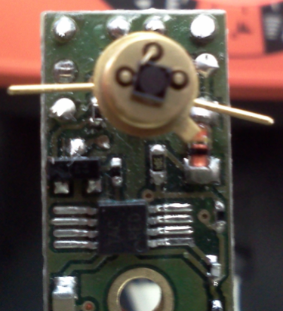
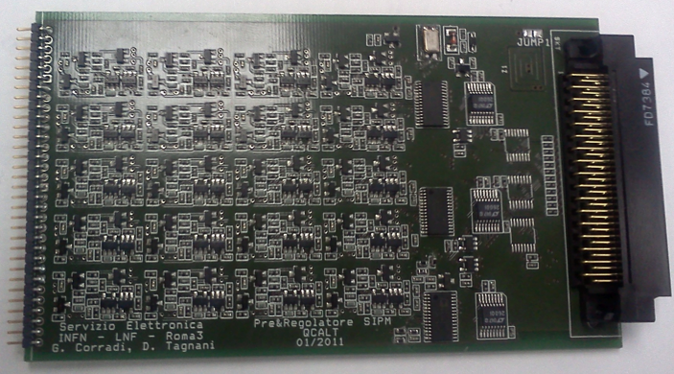
QCALT: FEE
Assembled FEE module
Full FEE chain electrically tested
Readout based on TDC
No charge measurement needed →
SiPM calibration done by measuring dark rate
Cooling by flushing air in each PCB box → tested
Test board for single SiPM
Preamp and HV regulator board

Slide 17
QCALT Schedule
November-End: final test of FEE chain
December-Mid: assembly of PCB SiPM on the existing modules
December-End: gain calibration of all SiPM
January-Mid: completion of mechanical assembly
January-End: cosmic rays test

Slide 18
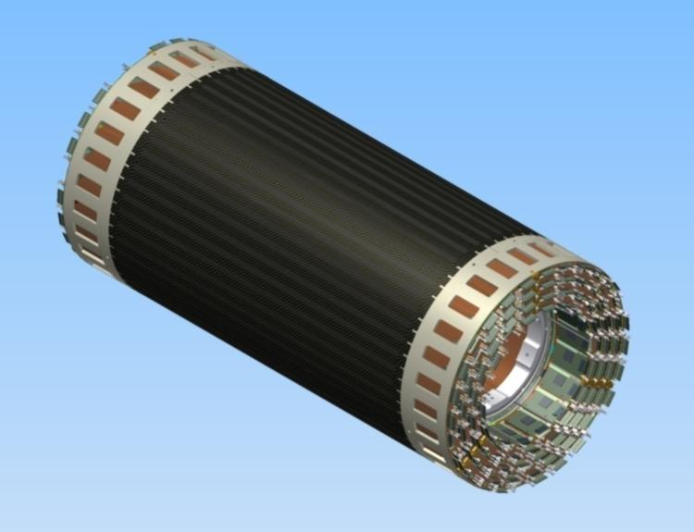
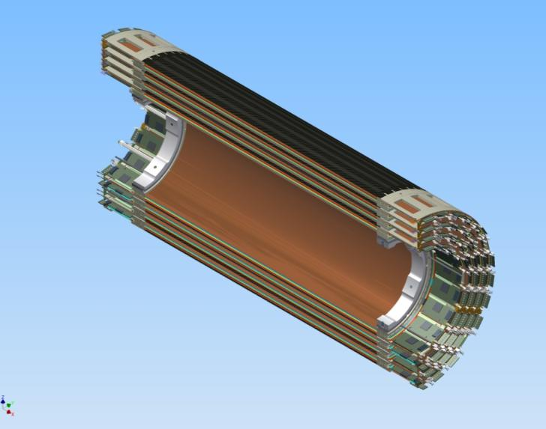
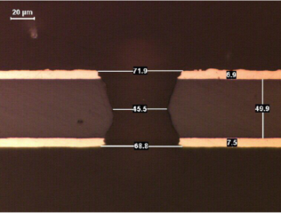
Cylindrical-GEM Inner Tracker
Cylindrical Triple GEM
FEE boards
Read-out
Induction
Transfer 2
Anode
2 mm
Transfer 1
GEM 3
2 mm
GEM 2
2 mm
Conversion & Drift
GEM 1
3 mm
Cathode
4 layers at 13/15.5/18/20.5 cm from IP and 700 mm active length
σ_{rφ} ∼ 250 µm and σ_{z} ∼ 400 µm
XV strips-pads readout (20º÷30º stereo angle)
2% X₀ total radiation length in the active region

Slide 19
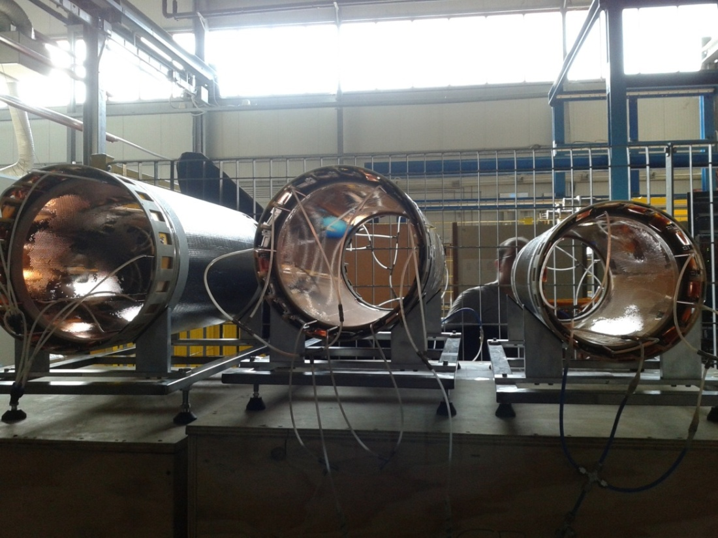
IT Status
We have already shown in previous meetings the construction procedure of the Cylindrical-GEM detectors
At the last SC we reported on the successful creation of the first 2 Layers of the IT
Since then the third detector Layer has been completed
Tests with β source and cosmic rays have been accomplished
Layer 3
Layer 2
Layer 1

Slide 20
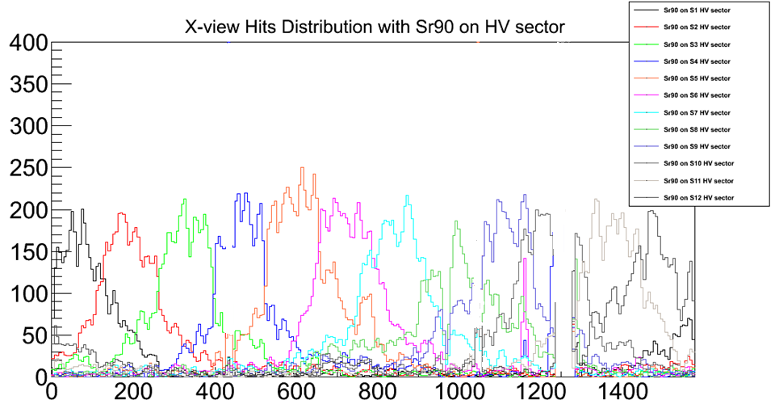
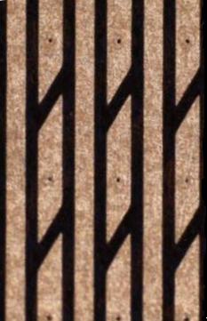
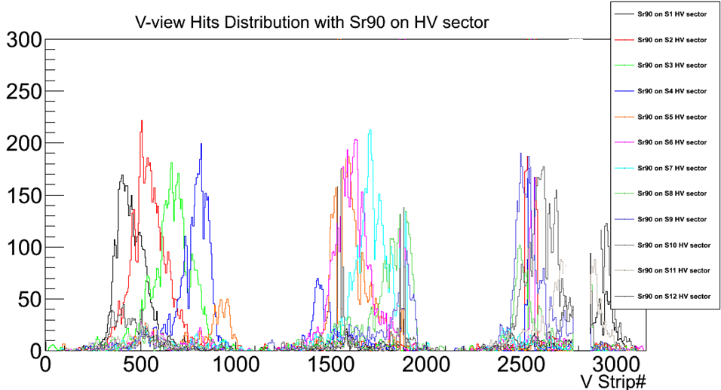
⁹⁰Sr Source Scan
X-view Hits distribution
FEE
FEE
V-view Hits distribution
V strips
not illuminated
FEE
FEE

Slide 21
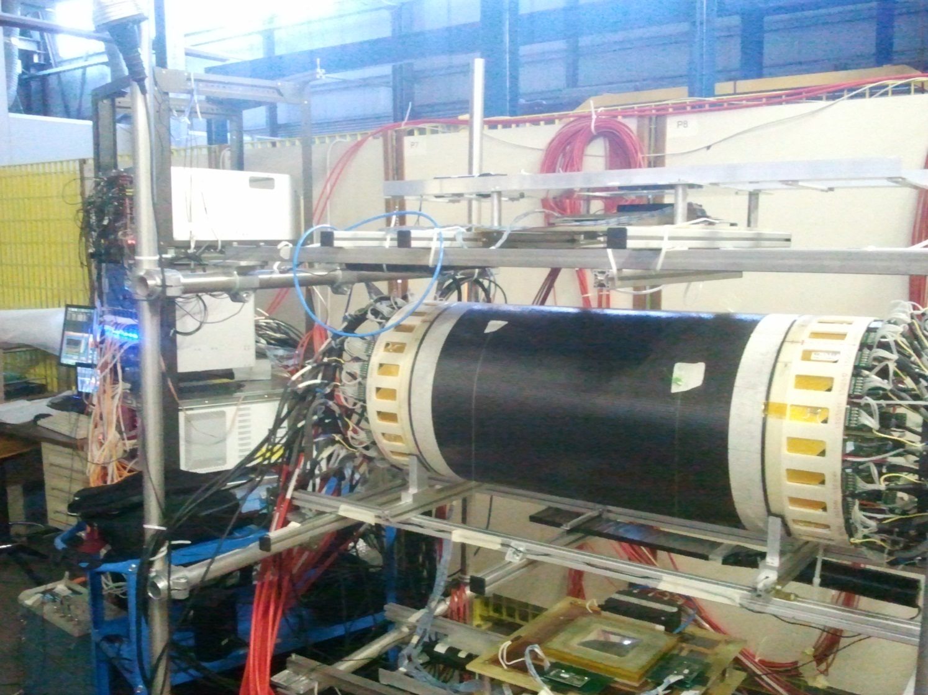
Cosmic rays Test
Test with final HV cables and distributors, final FEE and DAQ system
top/bottom scintillators for trigger
tracking provided by external 10x10 cm² Triple-GEM

Slide 22
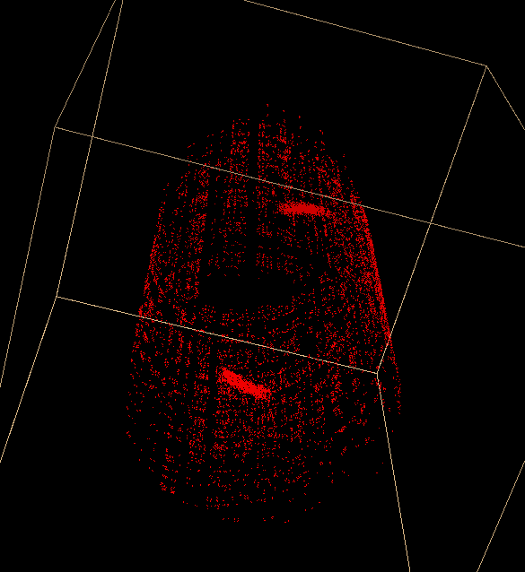
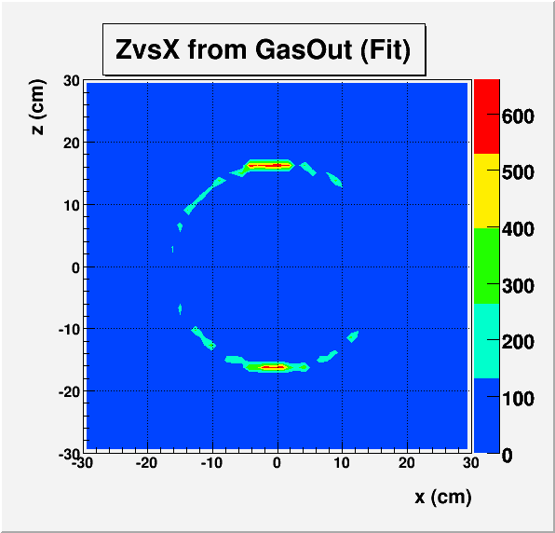
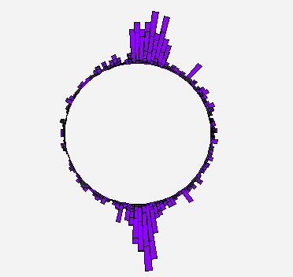
Cosmic rays Test
3D view
Z vs X
(Lego View)
noise
cosmic tracks

Slide 23
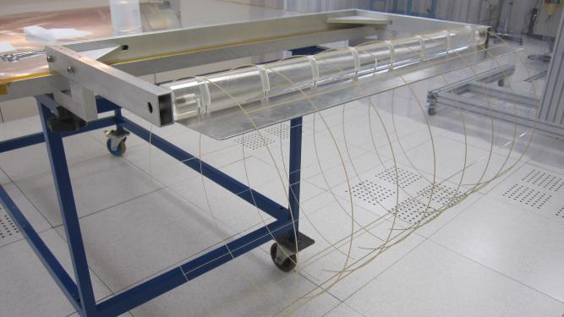
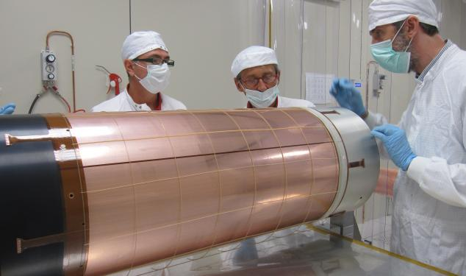
IT Operation at High Temperature
DAFNE has recorded beam pipe temperatures higher than those foreseen (up to 50 °C)
Temperature tests on Layer2 showed some operation instability for T > 35-40 °C due to the mechanical “relaxation” of the GEM foils
To cope with this problem:
The DAFNE Interaction Point will be cooled: mock-up tests indicate that the operation temperature can be kept under 30 °C
We introduced a 300 µm thick spacing grid between GEM electrodes for L3 and L4
PEEK grid assembled
grid placed around the GEM

Slide 24
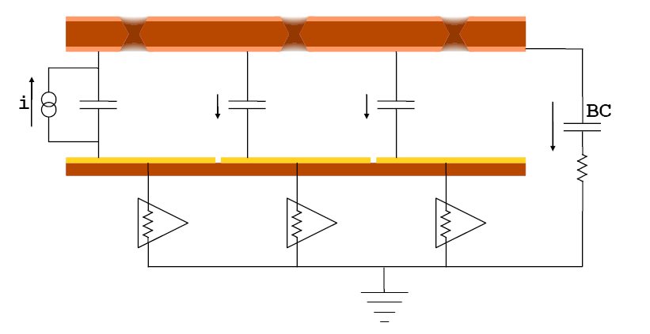
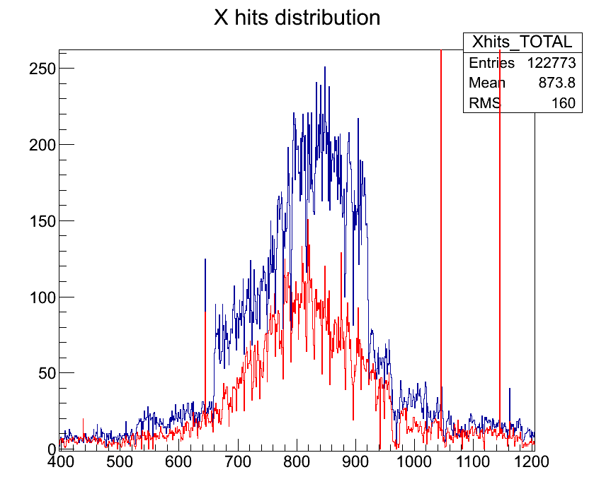
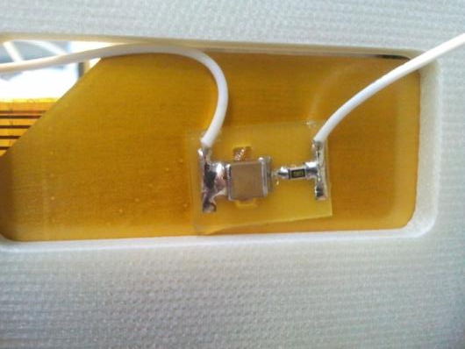
Blocking Capacitor
During the β source tests we have observed «splash events» with large hit multiplicity
The effect can be explained as X-talk due to capacitive coupling between GEM3Bottom and the Readout plane
Splash events are strongly suppressed by the insertion of a Blocking Capacitor circuit (BC): the current induced on G3Bottom flows to ground rather than into the detector
without BC
C = 2.2 nF
R = 10 Ω
BC-PCB

Slide 25
IT Time Schedule
Layer 4
  Cathode already done
  This week: GEM and readout delivery
  Up to December-End: GEM test and cylindrical gluings
  November-End: Readout connector soldering
  December-Mid: Readout cylindrical gluing
  December-End: Readout CF lamination
  January-End: Assembling and sealing
February-Mid: General assembling of 4 IT Layers and test

Slide 26
Conclusions
KLOE is operating properly with a smooth data taking
Analysis of old KLOE data still provides interesting results
All detector upgrades are proceding steadily
Expected completion foreseen for middle of February 2013

Slide 27
Spares

Slide 28
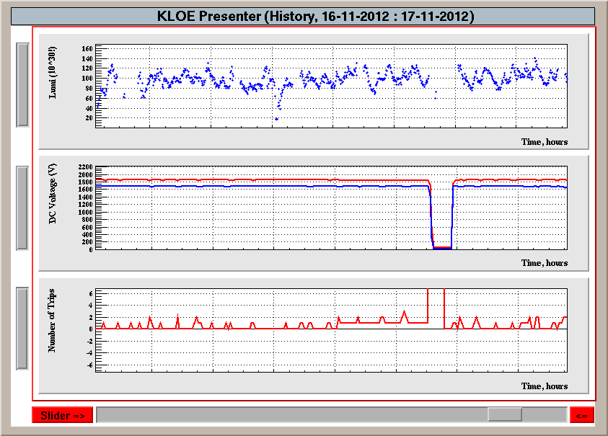
DC Trips

Slide 29
Layout of a GEM
Bottom side of the active area is divided in 4 Macro-Sectors (MS), each with its own HV connection tail
Top side of MS is furthermore divided in 10 Sectors, all independentely supplied
HV tails have 11 connections (1 bottom MS + 10 top S) ending on 0.8 mm fiberglass stiffener
Sectorization is for minimizing damage in case of discharge
Sector HV independance is for minimizing loss in case of damage: just a single Sector can be turned off
3 mm overlap reagion
HV tails
fiberglass stiffener
pinholes

Slide 30
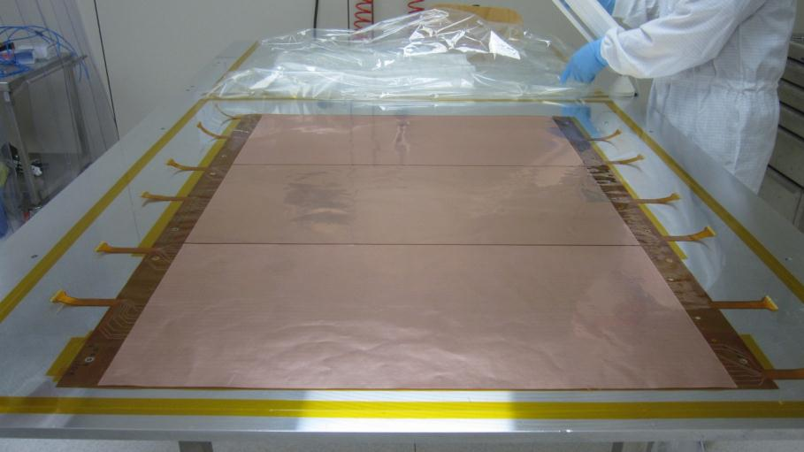
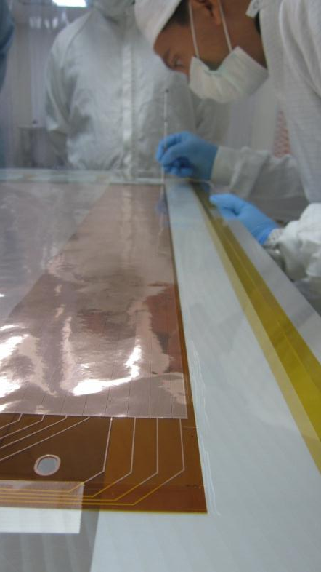
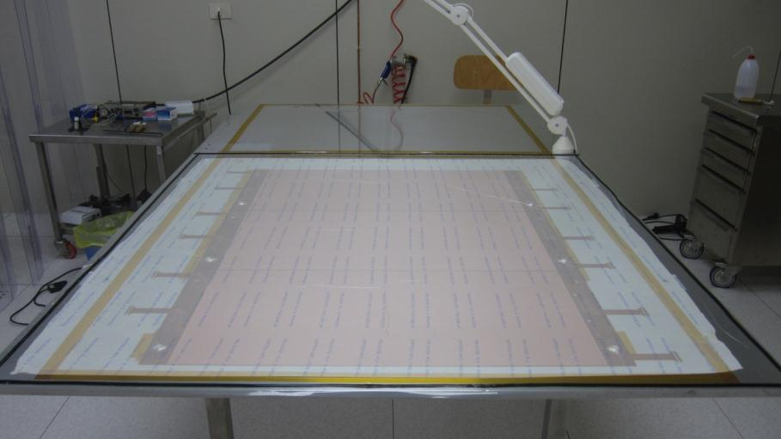
Manufacturing a C-GEM
Alignement pinholes
Vacuum holes
3 GEM foils are spliced together with a 3 mm overlap and closed in a vacuum bag (0.9 bar)
Epoxy glue (Araldite 2011) is distributed by hand on a 2 mm wide line

Slide 31




Manufacturing a C-GEM
GEM is protected with a Mylar sheet and wrapped on the cylindrical mold
Transpirant tissue (PeelPly from RiBa) is placed around to distribute vacuum
Final cylindrical GEM with internal and external rings
Vacuum bag envelope

Slide 32



Readout Plane
Readout plane is realized at CERN TE-MPE-EM
It is a kapton/copper multilayer flexible circuit
Provides 2-dimensional readout with XV strips on the same plane
X are realized as longitudinal strips
V are realized by connection of pad through conductive holes and a common backplane
Pitch is 650 µm for both
X strip
V strip
X pitch 650µm → X res 190µm
V pitch 650µm → Y res 350µm

Slide 33





Readout CF Lamination
The readout is shielded with a very ligth Carbon fiber composite structure realized by RiBa Composites, Faenza, IT
The shield is composed by a sandwich of two 90 µm thick carbon foils prepreg with epoxy (Carbon-Epoxy 90g/m2 58% Fibra T300) spaced by a 5 mm thick Nomex honeycomb (ECA-I 4.8-48 3/16-3.0)
first 90µm CF skin
5mm HC
second 90µm CF skin
final readout electrode
curing 24h in autoclave

Slide 34



Assembling a triple-GEM
The second electrode (GEM3) is placed on the machine with its mold and
Fixed to the bottom plate
The top flange with Readout is moved down around the GEM

Slide 35

Blocking Capacitor

Slide 36
Material Budget
 | Thickness (µm) | Radiation Length (%)
Copper | 3 | 1,68E-04
Polyimide | 50 | 1,40E-04
Copper | 3 | 1,68E-04
GEM foil | 56 | 4,76E-04
Copper | 3 | 2,10E-04
Polyimide | 50 | 1,75E-04
Honeycomb | 3000 | 2,40E-04
Polyimide | 50 | 1,75E-04
Copper | 3 | 2,10E-04
Cathode foil | 3106 | 1,01E-03
Material | Radiation Length (cm)
Copper | 1,43
Polyimide - Kapton | 28,6
Carbon fiber | 28
Argon | 14000
Isobuthane | 17000
Epoxy - Araldite 2011 | 33,5
Honeycomb - Nomex | 1250
Fiberglass - FR4 | 16
Air | 30500
Aluminum | 8
Gold | 0,33
Gold | 0,1 | 3,03E-05
Copper | 5 | 2,45E-04
Polyimide | 50 | 1,75E-04
Copper | 5 | 1,05E-04
Epoxy | 12,5 | 3,73E-05
Polyimide | 125 | 4,37E-04
Epoxy | 12,5 | 3,73E-05
Polyimide | 50 | 1,75E-04
Copper | 3 | 2,10E-04
Gold | 0,1 | 3,03E-05
Anode Foil | 263 | 1,48E-03
The KLOE-2 requirement of X0 < 2% is fulfilled
Carbon fiber | 90 | 3,21E-04
Honeycomb | 5000 | 2,40E-04
Carbon fiber | 90 | 3,21E-04
CF Shield | 3200 | 9,54E-04
Total 1 Layer |  | 4,87E-03
Total 4 Layers |  | 1,95E-02

