Slide 1
GEM , Micromegas , Sparks and protections.
Rui De Oliveira, Cosimo Cantini, Antonio Teixeira, Olivier Pizzirusso, Julien Burnens
Frascati 10/2012

Slide 2
CERN PCB workshop
20 persons
Building :1000 sqr meters
Making PCBs since 1960
-PCB
-Rigid
-Flex
-Flex-rigid
-Microvias
-fine line (10um)
-large size (up to 2m)
-Thick film Hybrids
-Thin film Hybrids
-Chemical milling
-Cu, Fe, Al, Au, Ag, W, Mb, Ti, Cr, Ni
-MPGD
-GEM/thinGEM/THGEM/RETHGEM -MSHP/Cobra
-MICROMEGA/ Bulk/ Micro-BULK -RES BULK
-Resistive MSGC
-Low mass circuits
-Multilayer flexes with aluminum strips
-embedded heat sinks (carbon, graphite, metals, diamon)
-Embedded components
-passive
-Active

Slide 3
CERN PCB Workshop MPGD history
‘96: GEM 50 x 50mm with a gain of 10.
‘97: GEM 100 x 100mm with gain of 1000.
‘98: GEM 400 x 400mm; 1D and 2D readouts; micro-groove and micro-well detectors.
‘00: 3D GEM readout; 1D readout for Micromegas in COMPASS.
‘01: PIXEL GEM readout; 2D Micromegas readout.
‘03: PIXEL Micromegas readout.
‘04: Bulk Micromegas detector 100mm x 100mm.
‘06: Half cylindrical GEM detector.
’08: first large GEM 1.2m x 0.4m.
‘09: first large BULK Micromegas 1.5m x 0.5m
‘11: First resistive Bulk Micromegas 100mm x 100mm
‘12: First 1m2 Resistive Micromegas
‘12: First 2m2 Resistive Micromegas ??
‘12: First full GEM detector 1.2m x 0.5m

Slide 4
OUTLINE
  GEM
    Large size situation
    Detector without spacers
  Micromegas
    BULK
    BULK resistive
    STD resistive
    Resistor by photolithography or printed
  Spark study
  Resistive Bulk model

Slide 5
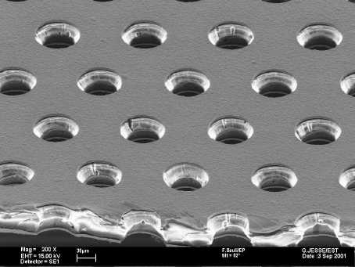
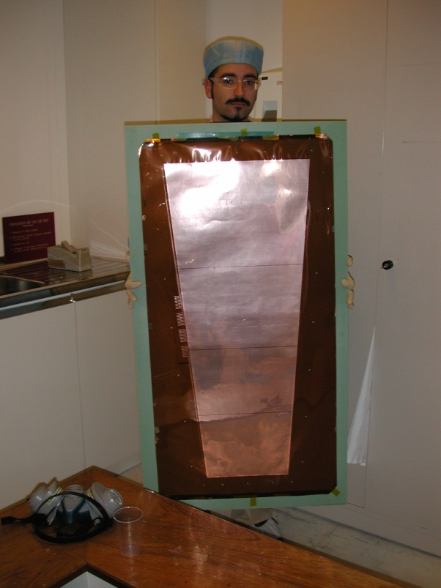
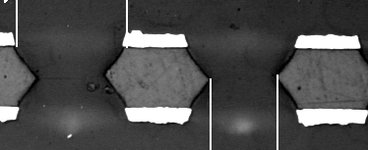
GEM Foil
Present size 1.2m x 0.6m
Future max size 2m x 0.6m
Std pattern 140um pitch/70um holes

Slide 6
GEM double mask Vs GEM single Mask
Base material : Polyimide 50um + 5um on both sides
Polyimide : Apical NP from company Kaneka (Japan)
Supplier of the copper clad material : Nippon Mining (Japan)
Double mask
Single mask
Same base material
Hole patterning in Cu
Polyimide etch
Bottom electro etch
Second Polyimide Etch
Limited to 40cm x 40cm due to
  Mask precision and alignment
Limited to 2m x 60cm due to
  Base material
  Equipment

Slide 7
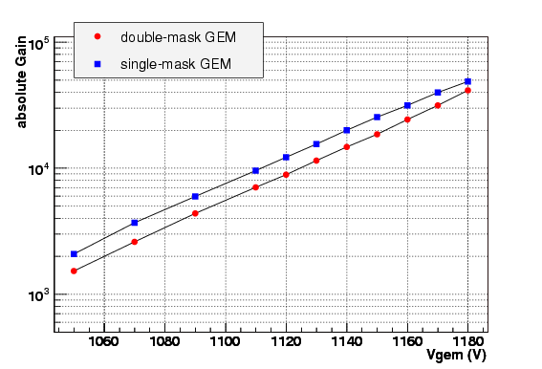
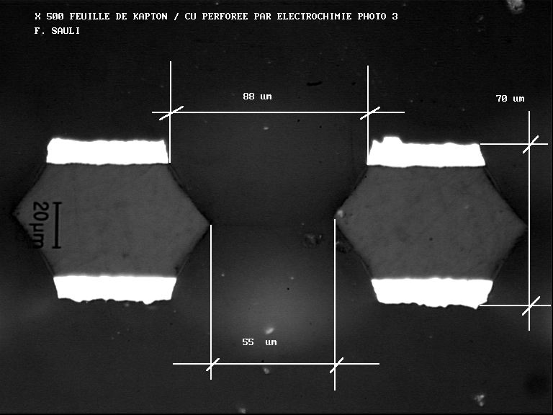
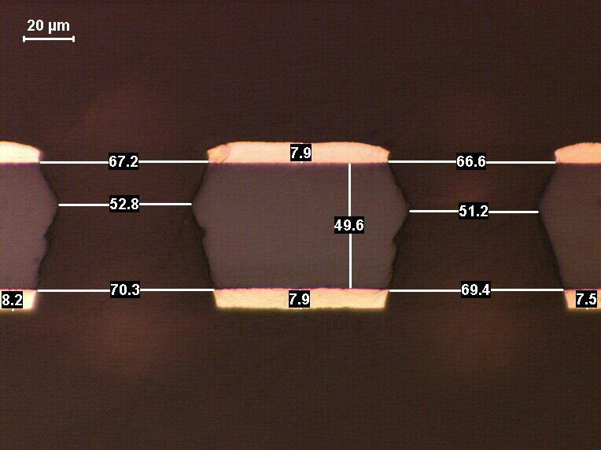
GEM Double mask Vs GEM
single Mask
Similar patterns , similar behavior, same material.
Angles can be adjusted in both structure (Typ value : 70um copper hole , 50um polyimide hole)
  Steeper angles gives lower gain but also lower charging up

Slide 8
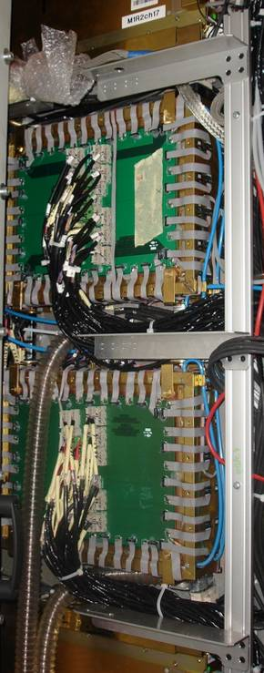
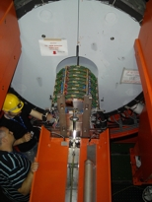
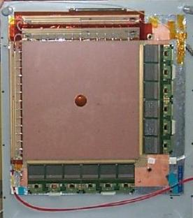
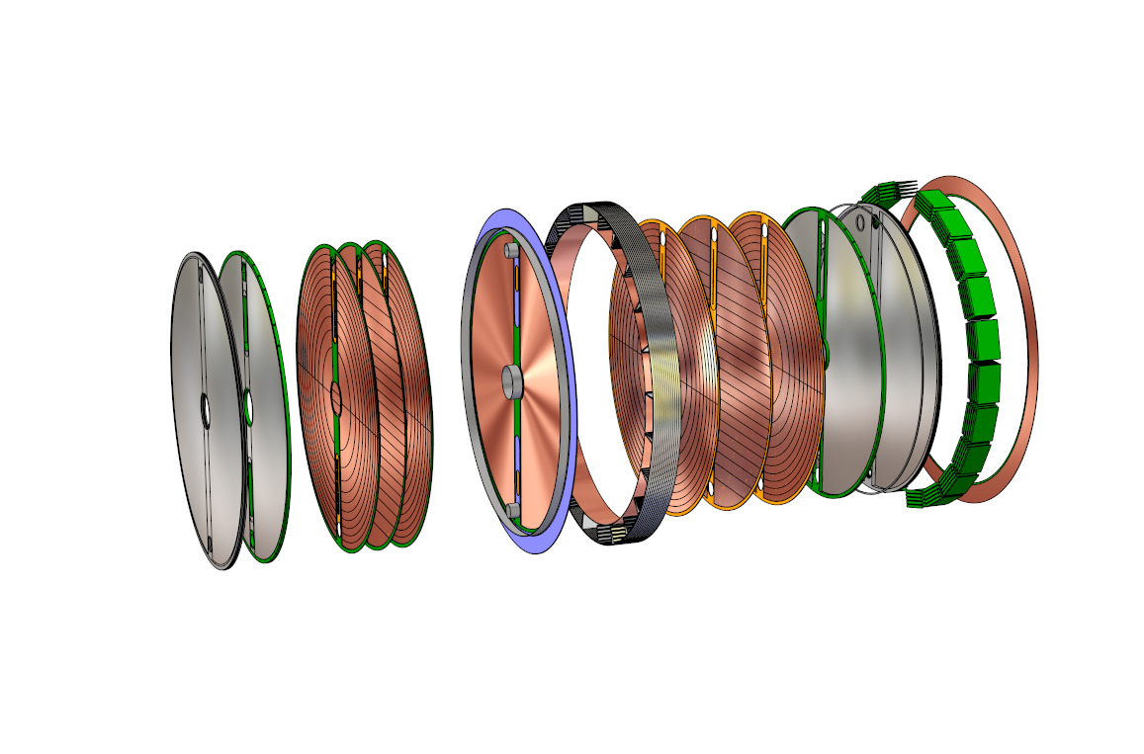
GEM double mask examples
COMPASS (CERN)
TOTEM (CERN)
LHCb-Muon trigger (CERN)
Present double mask production quantities : around 500 GEMs/ year in average
Max size: 40cm x 40cm
Window
GEM stack
Pad Plane Support & Media-Distribution
Cooling Support & LV- Distribution
Front-End Electronic
Drift electrode
Shielding Cover
&
Read-out Plane
STAR experiment (US)

Slide 9
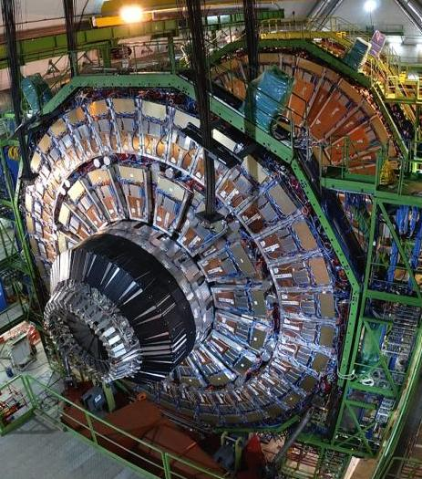
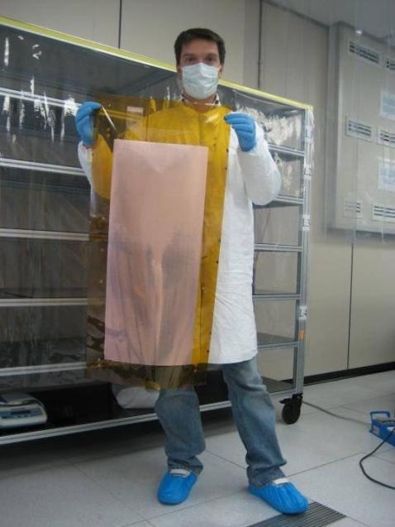
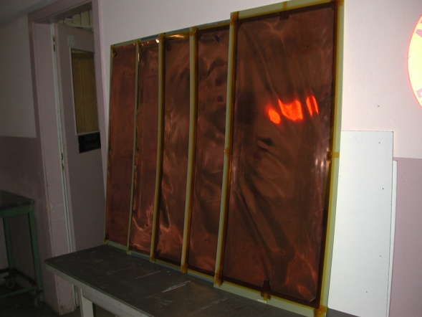
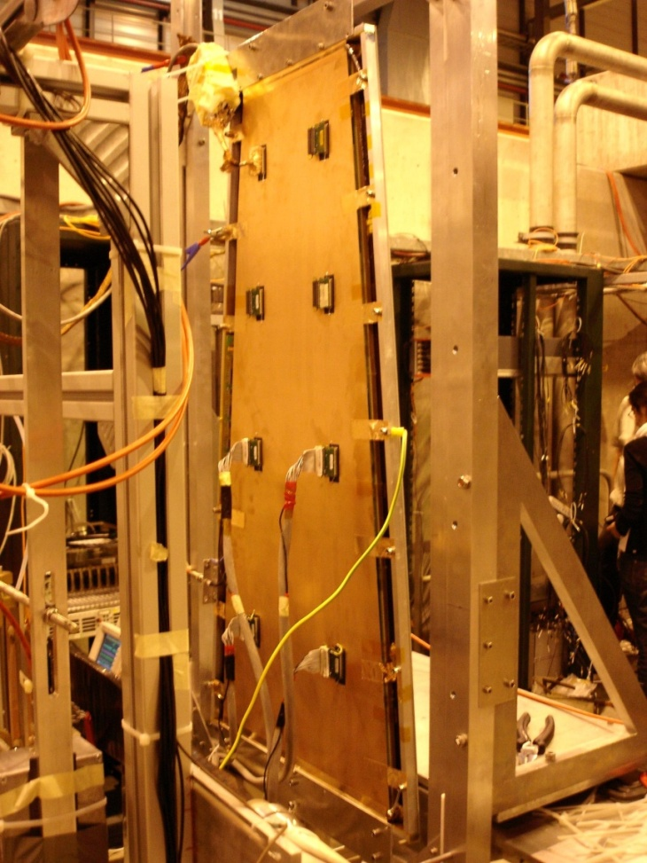
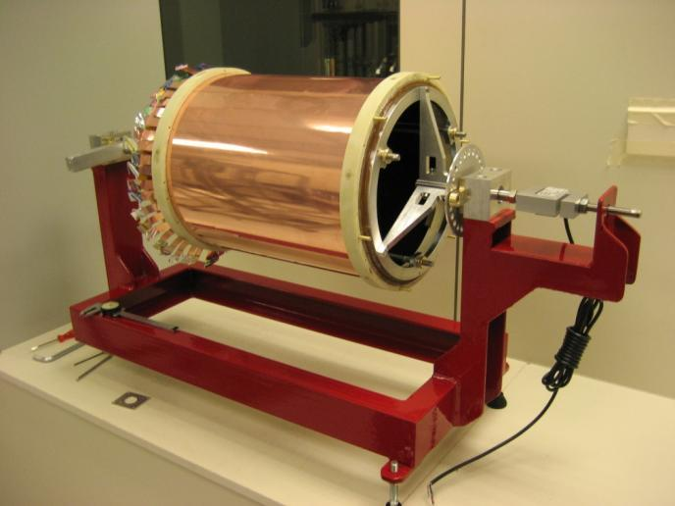
GEM Single mask examples
CMS RPC possible upgrade
GEM 1.1m x 500mm
KLOE – Cylindrical 3 GEM Detector
GEM 800mm x 500mm
Read-out 2D : 800mmx 500mm
Present production rate : 100 Gem /year (1.2mx0.6m)
Expected rate for 2013 : 250 GEM/Year/technician

Slide 10
OUTLINE
  GEM
    Large size situation
    Detector without spacers
  Micromegas
    BULK
    BULK resistive
    STD resistive
    Resistor by photolithography or printed
  Spark study
  Resistive Bulk model

Slide 11
NS2
10 to 15mm
Readout connector
O-ring
GND
Free to slide
GND
Drift electrode
External screws to adjust
stretching
GEM attaching structure
(4 pieces defining gaps)
Embedded nut
O-ring
Not yet implemented

Slide 12
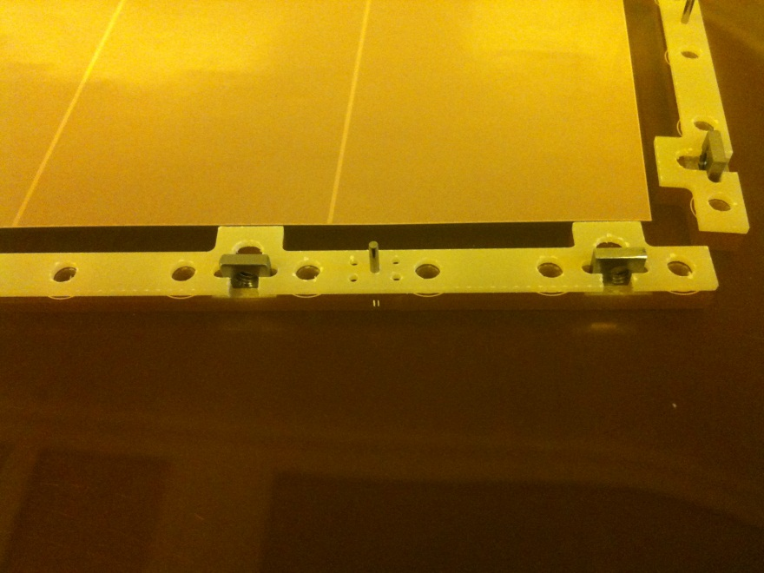
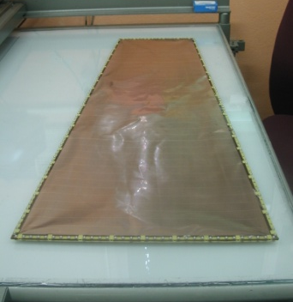
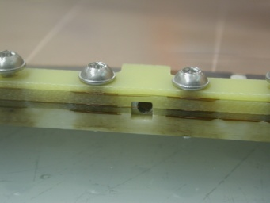
Gem Stack
Resistor are directly soldered
On the GEM before final clean

Slide 13
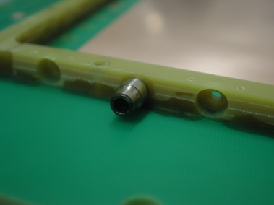
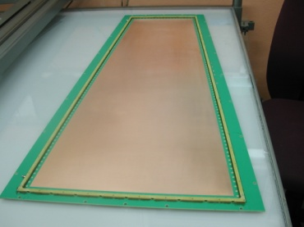
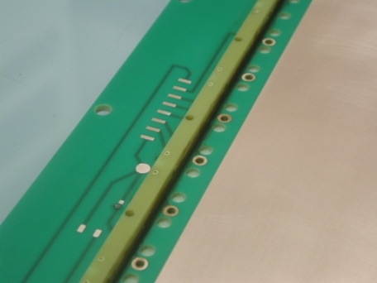
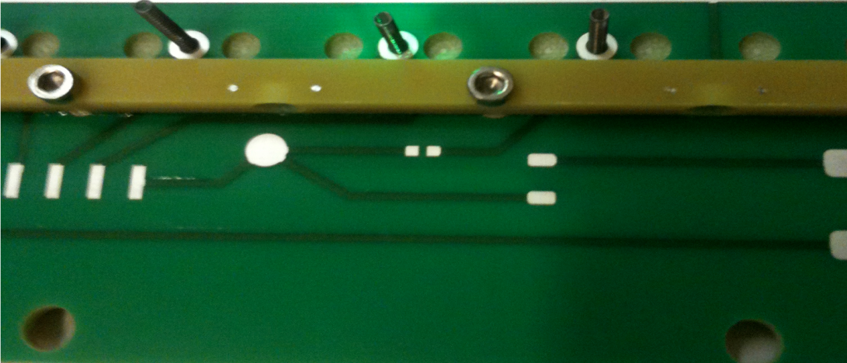
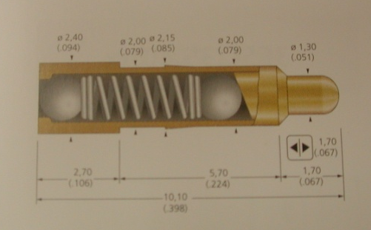
Drift board
Springs

Slide 14
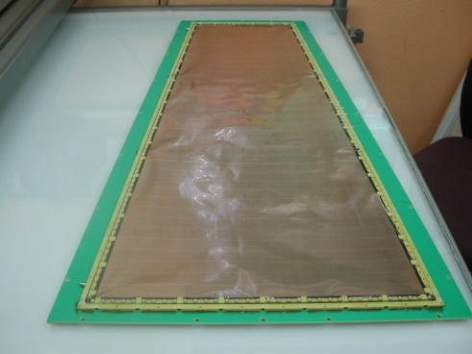
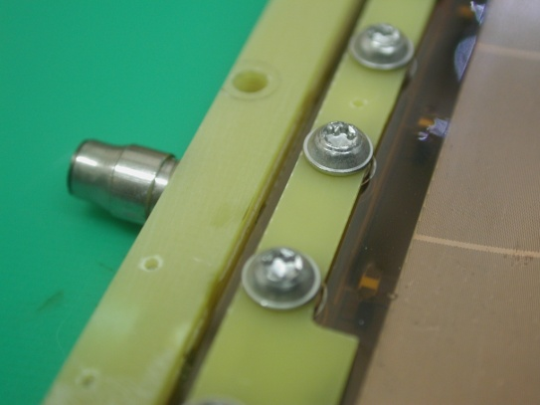
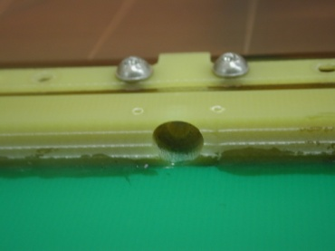
Gem stack introduction

Slide 15
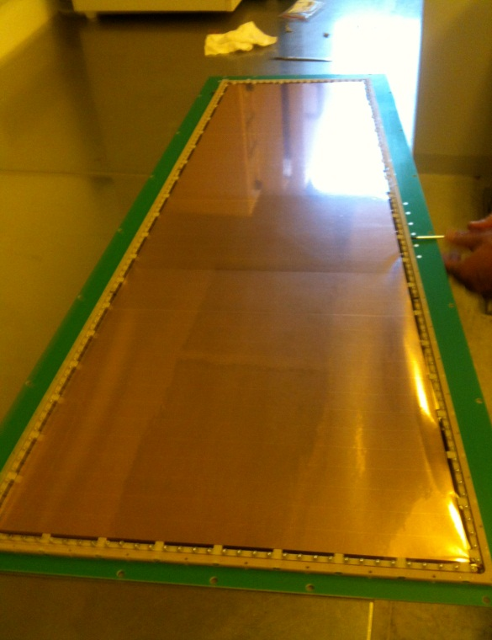
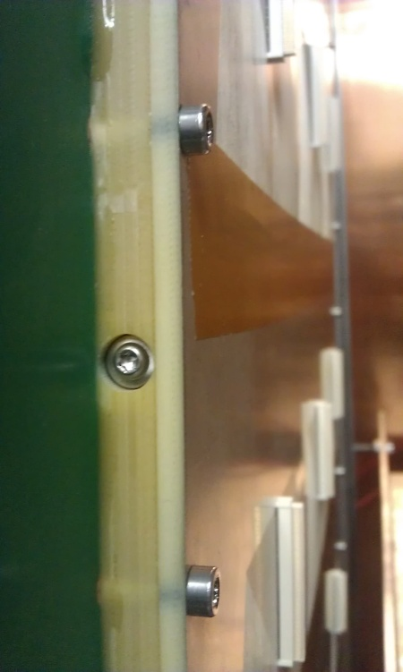
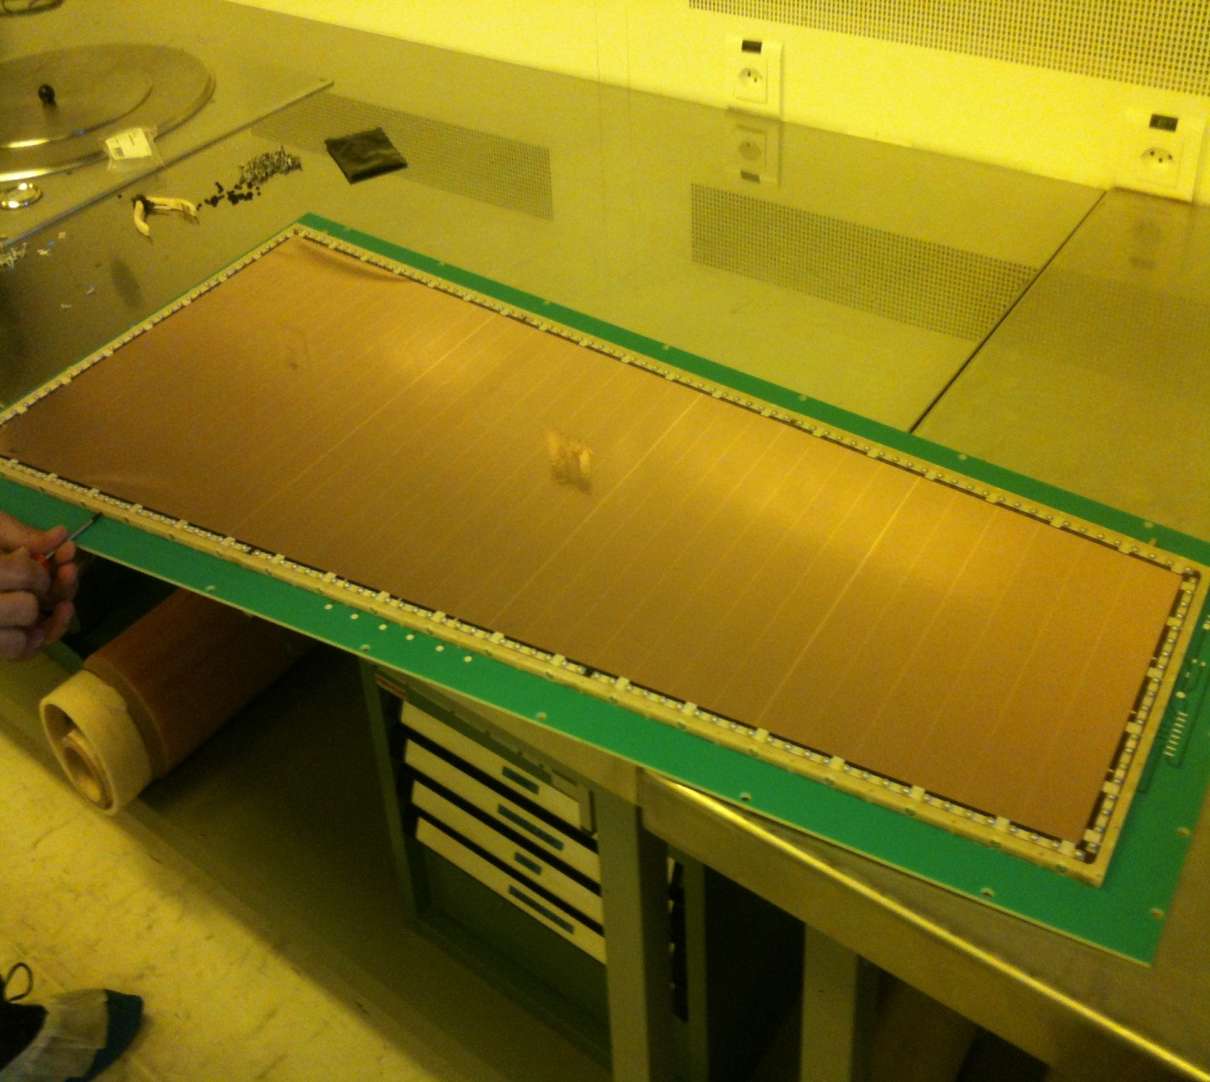
Stretch
Visual stretching
Breakdown voltage in between GEM check

Slide 16
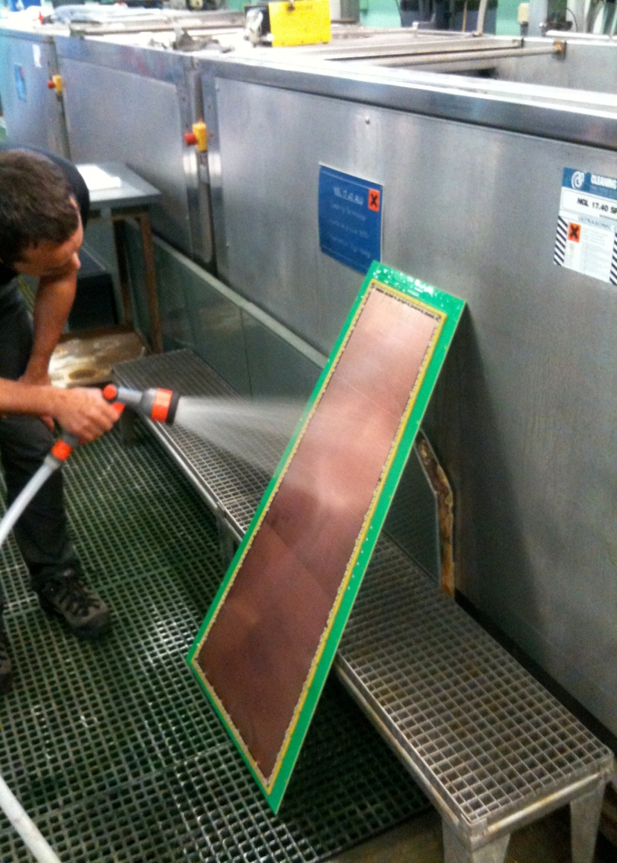
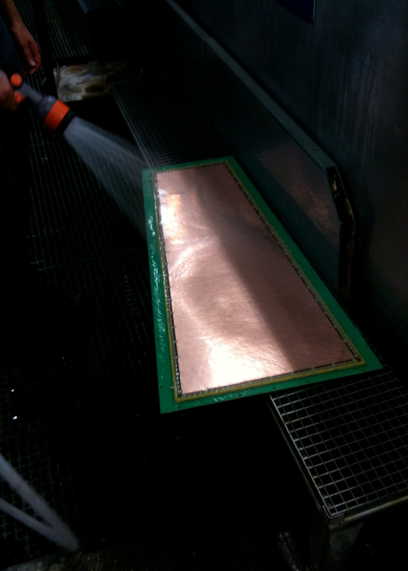
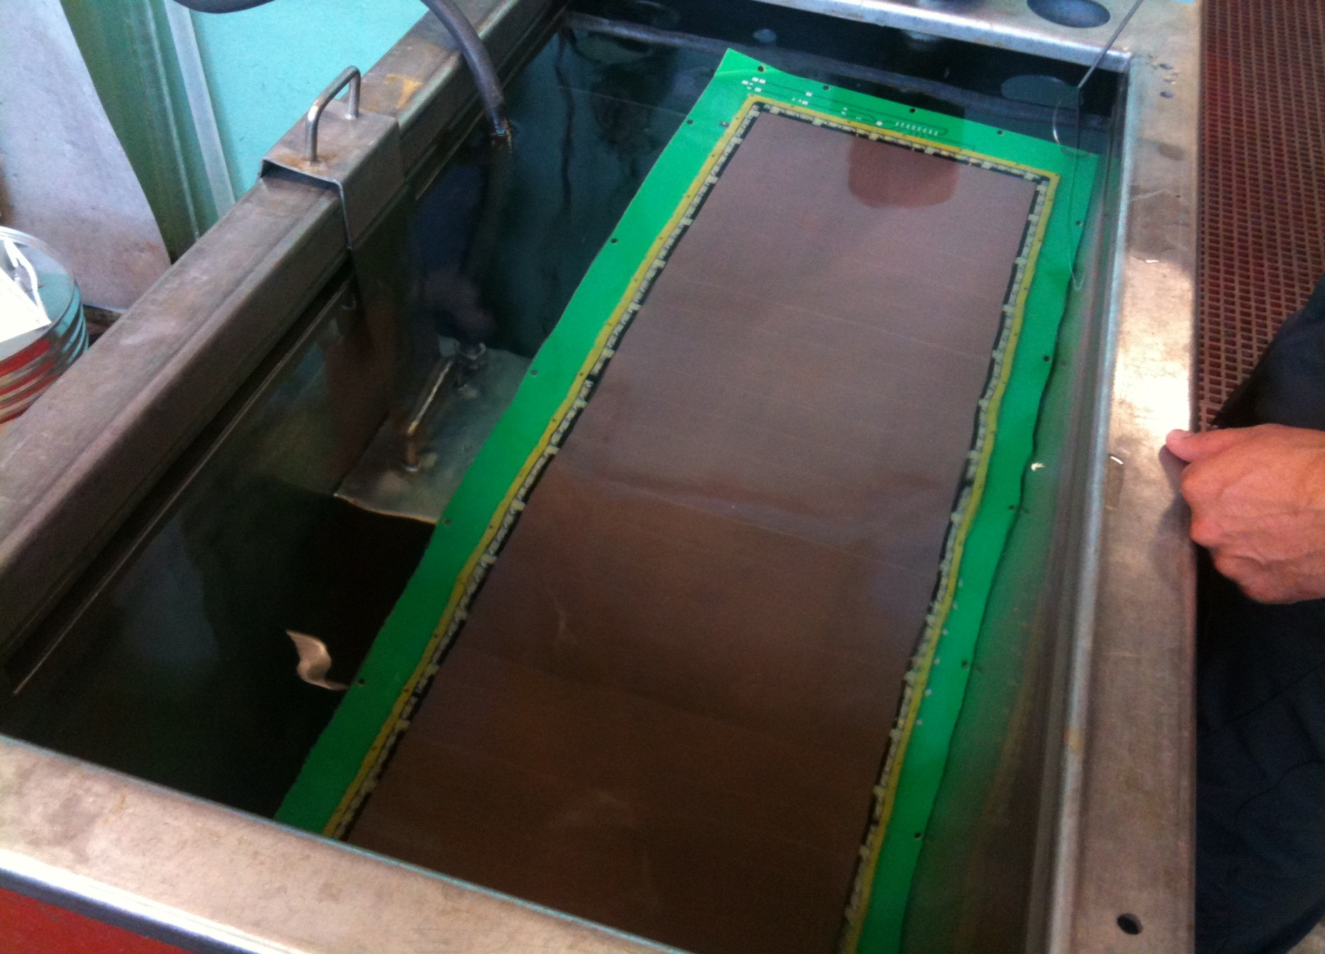
Cleaning
Cleaning if necessary

Slide 17
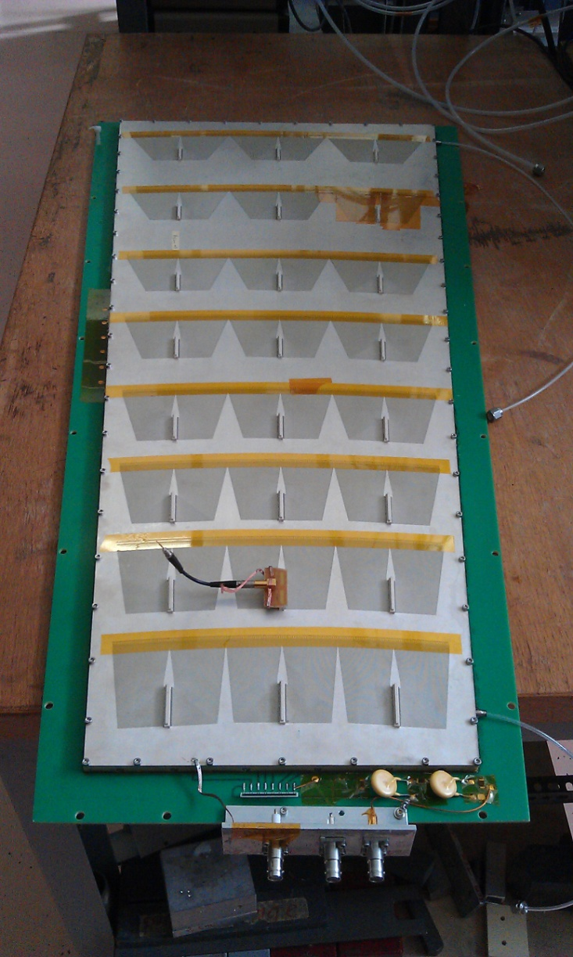
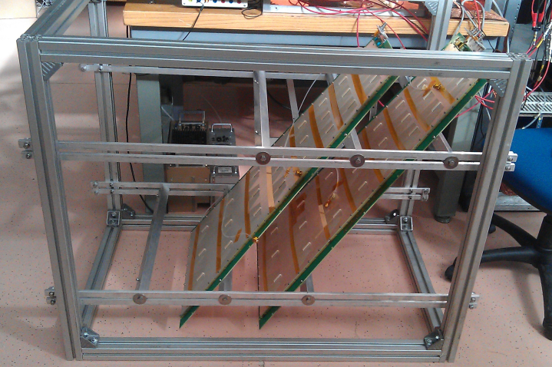
Closing with read-out

Slide 18
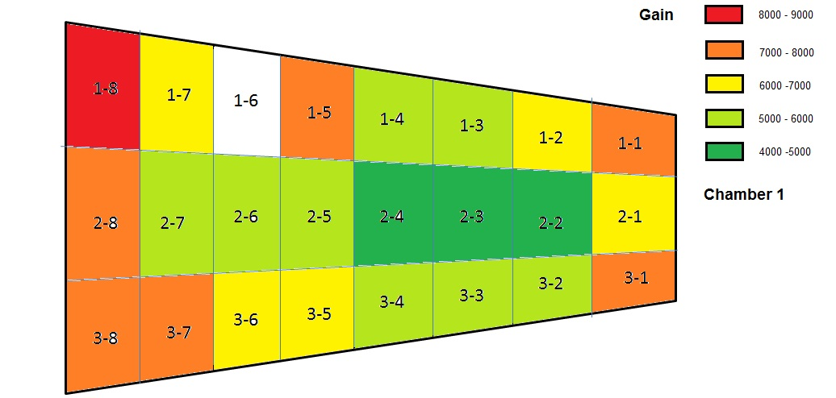

Slide 19
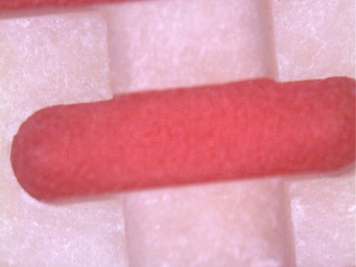
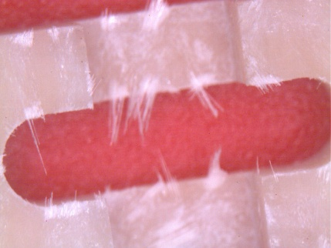
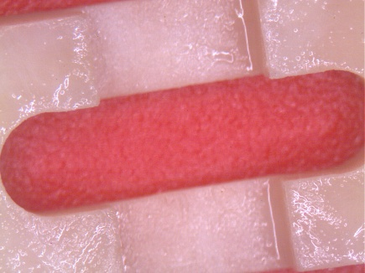
Dust problem
After sand blast
Frame after machining
After PU coating

Slide 20
Dust problem
A lot of dust was released during the screwing in FR4 frame
We have replaced FR4 by PEEK
PEEK is one of the best polymer in tern of:
-radiation tolerance
-mechanical properties
-out gassing
-chemical resistance

Slide 21
Improvements for the next production:
    Outer Frame in one piece and screwed , the gluing needs too much care and time..
    Inner spacer in 4 pieces not 8 (even if they are longer).
    Replace the springs for GEM connection
    Modify the play in the fixing holes of the read-out board to avoid any stress in order to keep it flat. (the 2 last detectors are already modified in this way).

Slide 22
NS2 detector advantages:
    No dead zone in active area
    Assembly time
      ½ hour for 10cm x 10cm detector (1 technician)
      2 hours for 1m x 0.6m detector (1 technician)
    No gluing , no soldering (still 1 gluing to be removed)
    Re opening possible
    GEM exchange possible→ tested OK
    Full detector Re-cleaning possible → tested OK
    No intermediate test needed
      final test :High voltage test of GEMs and between GEMs
      → send for calibration and endurance tests
    Upgradable.
      The read-out board can be upgraded at any time
      Production can start before final electronic design

Slide 23
OUTLINE
  GEM
    Large size situation
    Detector without spacers
  Micromegas
    BULK
    BULK resistive
    STD resistive
    Resistor by photolithography or printed
  Spark study
  Resistive Bulk model

Slide 24
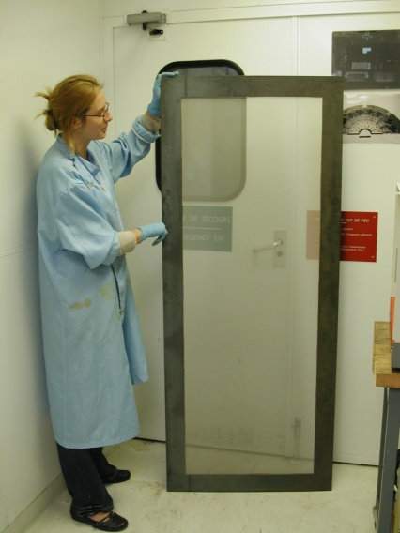
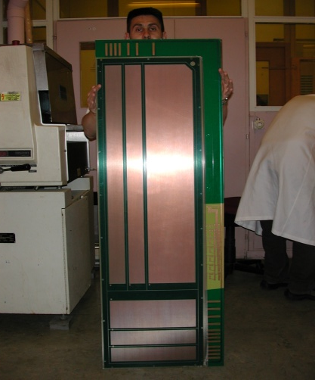
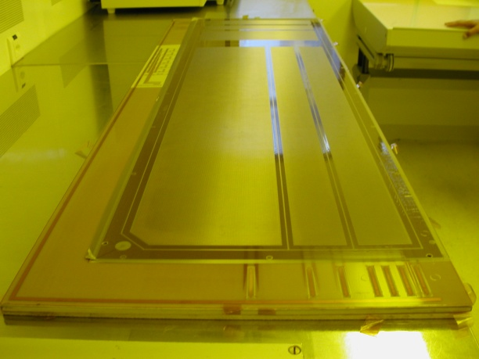
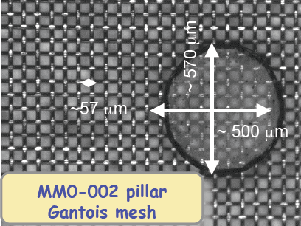
Bulk
BULK Technology
DUPONT PC 1025 coverlay
BOPP Meshes
SERITEC stretching
Largest size produced:
1.5m x 0.6m
Limited by equipment
PCB
lamination
Mesh deposit
lamination
development

Slide 25
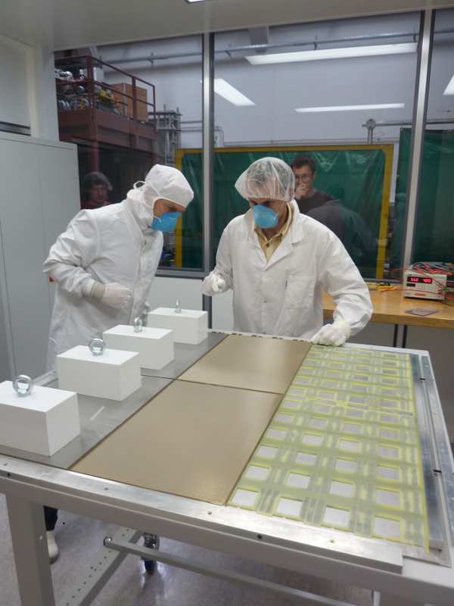
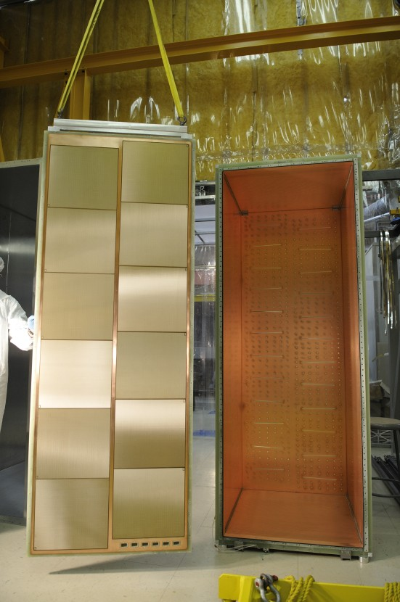
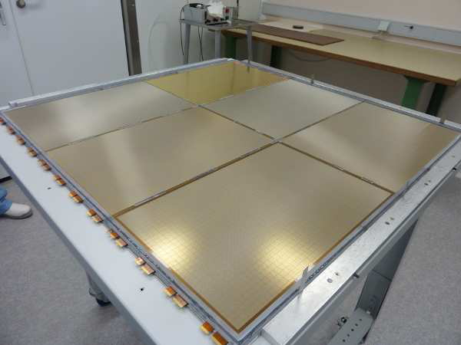
Pad read-out large TPC
Neutrino detector
10 sqr meter in service
Pad read-out 1cm², thickness 8mm for ILC Hadronic calorimetry
Tested in the RD51 1 kHz beam.
The BULK is made on a populated PCB
T2K experiment
Japan (CEA Saclay)
Bulk Micromegas ILC DHCAL first m²
LAPP Annecy
25

Slide 26
OUTLINE
  GEM
    Large size situation
    Detector without spacers
  Micromegas
    BULK
    BULK resistive
    STD resistive
    Resistor by photolithography or printed
  Spark study
  Resistive Bulk model

Slide 27
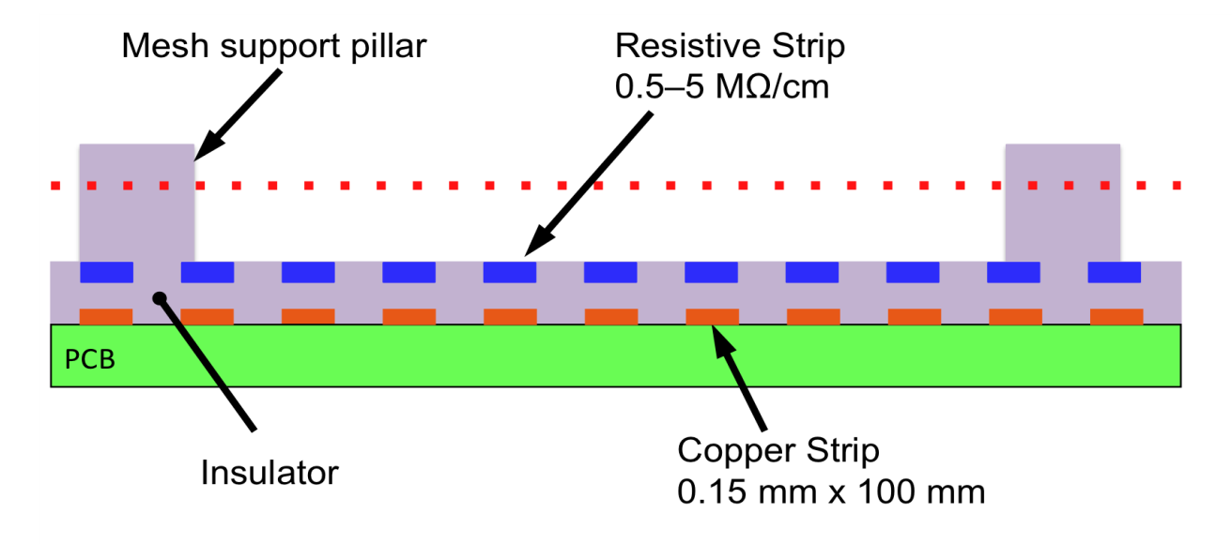
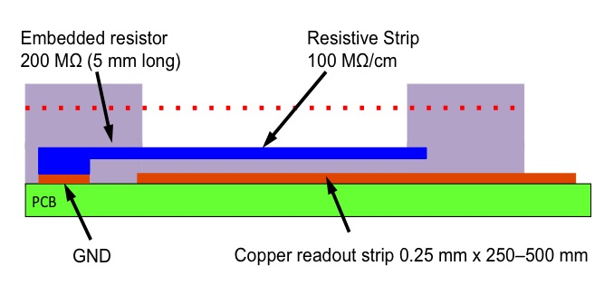
Resistive Bulk MicroMegas

Slide 28
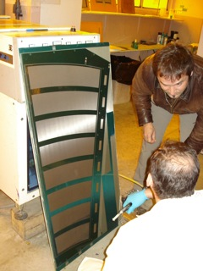
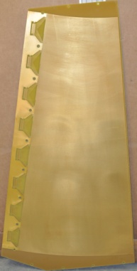
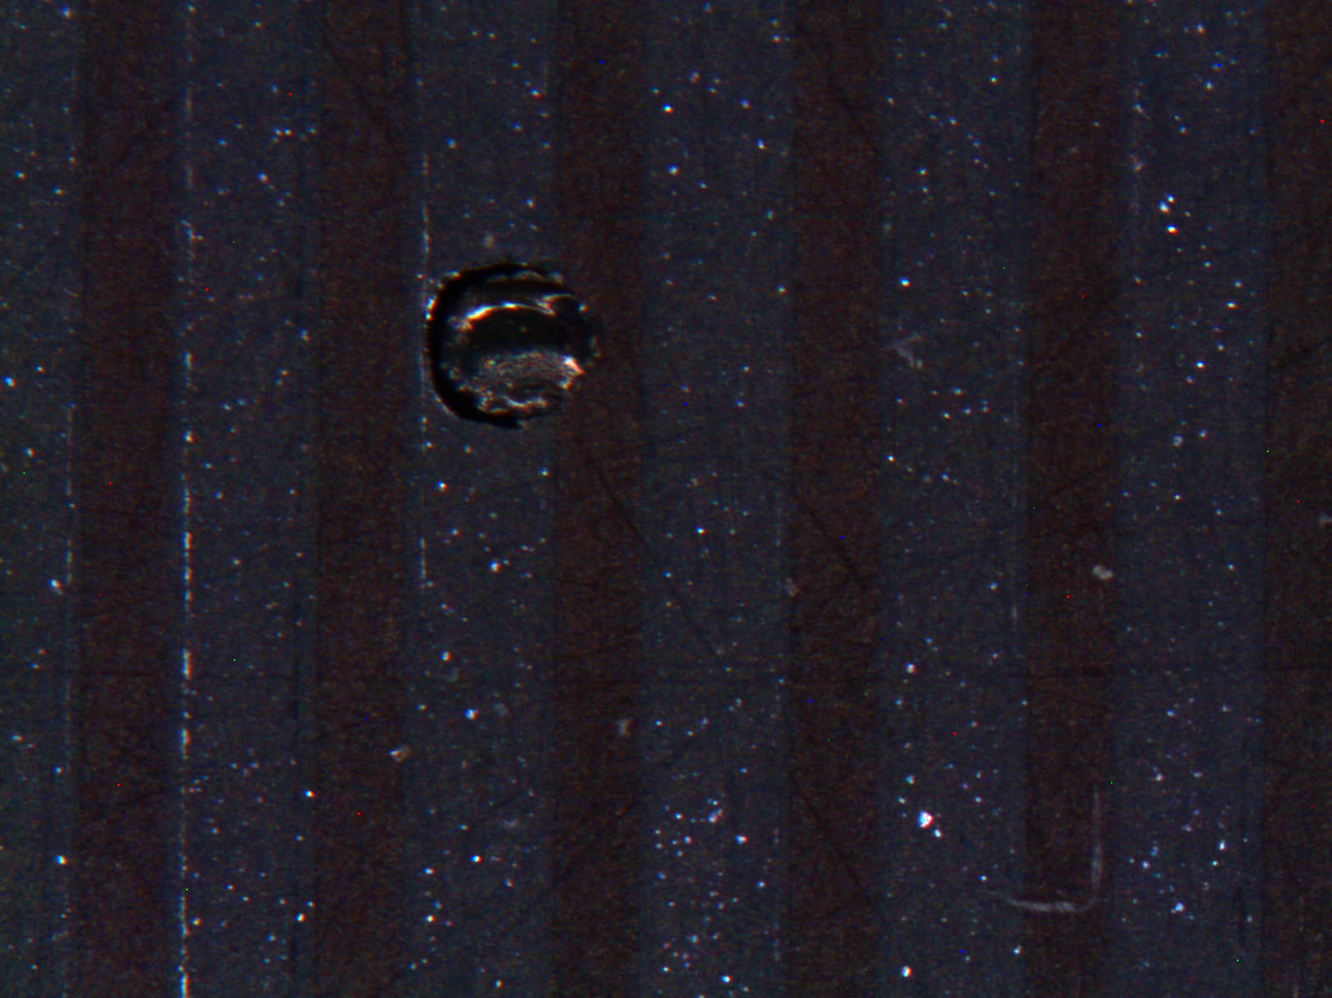


Bulking
Double sided Board
Resistive strip deposit
Closing
Test before closing

Slide 29
OUTLINE
  GEM
    Large size situation
    Detector without spacers
  Micromegas
    BULK
    BULK resistive
    STD resistive
    Resistor by photolithography or printed
  Spark study
  Resistive Bulk model

Slide 30
Resistive MicroMegas
1 x 1m2 not to scale detector opened
Stiffening panel
Drift electrode
Pillars (128 µm)
PCB1
PCB2
Aluminum support plate
Rohacell

Slide 31
1 x 1m2 not to scale detector closed
Stiffening panel
5.00
PCB1
PCB2
Aluminum support plate
Rohacell

Slide 32






flat gluing
< 10um error
Mesh on drift (10Ncm )
Flat board < 30um error

Slide 33
OUTLINE
  GEM
    Large size situation
    Detector without spacers
  Micromegas
    BULK
    BULK resistive
    STD resistive
    Resistor by photolithography or printed
  Spark study
  Resistive Bulk model

Slide 34

Screen printing or Photolithography for the resistive strips?
Screen printing
Photolithography
-Possibility to go down to 0.1mm
pitch
-Not compatible with pitches
smaller than 0.4mm
-Paste not tixotropic enough
PCB
PCB
PCB
PCB
PCB
PCB
PCB
PCB
-1 board/2day/technician
-20 boards/day/technician

Slide 35


Semi automatic machine
10 to 20 boards/hour
Printing area 1.5m x 0.9m

Slide 36
Situation and on going productions
STD BULK production
  Up to 5 detectors (1.5m x 0.6m max) produced →all good (5 to 10nA @ 500V)
Resistive BULK production
  4 CSC type (1.2m x 0.6m) 1D produced → only 1 good (20nA @ 500V)
    Physical parameters OK , leakage current out of tolerance (uA)
  4 MSW type (1.2m x 0.6m) 2D produced →only 1 nearly good (100nA @ 500V)
    Physical parameters OK , leakage current out of tolerance (others at 200-300 not stable))
  Yield →25% not acceptable
Large resistive Micromegas (not BULK)
  1 detector 1 m x 1m produced→ working perfectly (below the nA @ 500V)
Large resistive Micromegas (not BULK)
  1 detector 2m x 1m in progress, ready for Christmas

Slide 37
Why not a BULK for large size :
The best yield obtained with resistive BULK technology in large size detector up to now is 25%
Reason of this yield?
  Resistivity introduced by larger quantity of pillars?
    No → we should measure a resistor behavior
  Bad development of pillars trapping some chemistry?
    No → we have change the pillar shape and exposure time and we have exactly the same result
  Bad cleaning?
    No → we have used many different chemistries (Acid , solvents , alkaline) with same result.
  Dust trapped in the structure?
    Perhaps →When we blow the detector the leakage current fluctuates a lot in particular areas
    We have produces a 1.2m x 0.5m detector with separated mesh. First measure →similar as before but after a simple dry cleaning with tacky rollers the problem disappear.
    The problem is dust!
What is the size of the dust?
  The maximum theoretical breakdown voltage in a good detector is 950 V in air.
  The leakage currents in bad detectors starts to increase around 600v in air
  a dust of 40 um (1/3 of the gap) can create exactly this problem.
  In a conventional Micromegas a spark will immediately evaporate the dust, but unfortunately we have remove this option in protected detectors.
We will build our next BULK detectors only in clean rooms

Slide 38
OUTLINE
  GEM
    Large size situation
    Detector without spacers
  Micromegas
    BULK
    BULK resistive
    STD resistive
    Resistor by photolithography or printed
  Spark study
  Resistive Bulk model

Slide 39


Spark study
Strong ionizing particles produces sparks.
Spark damages the electrodes and are responsible of a low degradation of the gain.
The active element then drains steadily a DC current from the power supply.
Existing solutions
But what is exactly apening during sparks?
The following study was started in order to clarify a bit the sparks

Slide 40



Voltage/current characteristics of the DC electrical
discharges
triggered
Self maintained
Gas Discharge Physics, Yuri P. Raizer
DC pulse-powered micro-discharges on planar electrodes, Yogesh B. Gianchandani

Slide 41







Working point : the load line method
+
$$Vg=f\left(I\right)$$

Slide 42






Sparks between two metallic tips in air
AIR, 1 atm
Low inter tips C
$$10 kΩ$$
$100 MΩ$
HV
+
$50 Ω$
O-scope
-
-No change is observed.
-The system is stably in one of
the regions of the I-V characteristic.
-We can notice a little erosion of the Copper

Slide 43












Sparks between copper lines on a PCB
AIR, 1 atm
$$10 kΩ$$
$100 MΩ$
HV
Cathode erosion
Anode
Cathode
+
At the end a DC current$\sim$μΑ
$50 Ω$
O-scope
-
-During the sparks the growth of a layer is observed all around the impact point of the discharge, especially on the anode.
We have also some erosion ofthe copper
But the blue deposit is created by the epoxy

Slide 44

Introducing R’
Before
After
R’ is created
Voltage breakdown reduced :d’

Slide 45
Large capacity system
-If the capacity of the tips is high then this capacitor becomes the power supply for the spark
it can deliver more current than the power supply with no limitation
-The spark current is then practically independent from external power supply
-The peak current only depends on: the capacitor value , R’ and C voltage
(this current can not be measured in this configuration)
-The new Voltage breakdown will be define by d’
- The external power supply and R are just refilling the capacitor after a spark (defining the spark rate only)

Slide 46


THGEM test : initial situation
-At this stage R’ is only the copper surface resistivity ( below 10 Ω)
- Working point in spark region
-High current discharge (define by C and R’)
-The system seems to be stable with repetitive sparks and average currents of few hundreds of nA (the rate of sparking is define by the capacitor value and the serial resistor after the power supply)

Slide 47



After spark → glow discharge
fig1
fig2
The repetitive sparks starts to create a deposit fig 1
-R’ is created and starts to grow (we think that the value is randomly changing)
-The working point moves in the glow discharge region but still with pulsed current with increasing rate.
-At one point the external power supply can deliver the current defined by the working point
-The system then moves in a stable mode and draws many micro amps DC current
-The DC glow discharge starts to grow a new deposit all around the hole. fig2

Slide 48


Real samples tests
List of different trials
Reduce the capacity by segmenting the THGEM
Change metal
Change dielectrics
Change the hole shape
Introduce resistive materials
R was adjusted to define a correct rate of sparks
R
HV
+
$50 Ω$
O-scope
-

Slide 49



First test : size effect
The THGEMs have been powered above the breakdown voltage in air
The number of sparks have been recorded
Regularly the voltage was decreased to check if the leakage currents were still below 5nA
The maximum accepted decrease was 0.9x the initial voltage
Standard | Small sample
100mm x 100mm
8 mm x8mm
THGEM 10cm x 10cm →1nF, HV=2KV , 5ns fall time and 400 A peak current
8mm x 8mm→ 10 A peak current

Slide 50












Material and shape effects
Creating a stack of materials which can be differently etched, in order to obtain free standing copper electrodes, to try to reproduce tips in air.
Covering copper with nickel
Resistive kapton as electrodes
INOX (more difficult to work)
After long sparking period they all failed but some structures are 1000 time better than Cu on FR4 samples

Slide 51



Resistive electrodes
We have also tested a few structures with full resistive electrodes (1 Mohms/square)
But we realized that the system is already in glow mode.
Due to the low local capacity of this system , the rate of the High current
glow discharges is really high (the external powering system can refill fastly ).
After strong periods of high rate repetitive glow discharges the device is rapidly damage and
dies before a fine segmented metallic device (can be also Joule effect damage)

Slide 52



Test results
TEST 1: copper on FR4
TEST 2: copper on epoxy glue and kapton layer not etched
TEST 3: copper on epoxy glue and kapton layer etched
TEST 4: INOX on epoxy glue and kapton layer not etched
TEST 5: INOX on epoxy glue and kapton layer etched

Slide 53
Optimal structure:
Classical shape
Particular dielectric (no glass )
Reduced area

Slide 54

Can we still improve by playing with the working point?
Glow discharge
DC current
Polymerization process
?
High energy sparks
Low spark rate
Big damages
Low energy medium rate sparks

Slide 55


Adjusting the impedance
It seems that metallic electrodes produces a too energetic spark
And the existing value of resistive materials put the device in deep glow discharge
What if metallic electrodes are added in between? Changing geometrical dimensions , we can regulate the impedance, hence the working point. (Still under test)

Slide 56
Conclusions on sparks
Every structure where 2 electrodes are maintained mechanically by a dielectric solid material show problems after long sparking periods
These problems can be reduced by reducing the capacity of the system creating less energetic discharges , and also by choosing the right dielectric
-The problems are coming from:
1/High current during discharge melting the electrodes
2/Polymerization phenomenon du to dielectric degassing during glow discharge

Slide 57
OUTLINE
  GEM
    Large size situation
    Detector without spacers
  Micromegas
    BULK
    BULK resistive
    STD resistive
    Resistor by photolithography or printed
  Spark study
  Resistive Bulk protection

Slide 58




Resistive material
Materials available from industrie
Polymer paste
From 100 ohms/SQR to 1MOhms/SQR
Screen printing
Painting
Spray
Gap filling
Ruthenium oxyde paste
From 1 ohms/SQR to 1GOhms/SQR
Ceramic substrate
Screen printing
Painting
Thin film
From 1ohms/SQR to 250 ohms/SQR
OMEGA PLY
Graphite sprays.

Slide 59
Direct resistive layer approach
Good:
-Simplest to produce
-C1 can be in the range of 0.1pF
Bad:
R1 to low with resistive polymers (a few kOhms)
C1 and R1 should have a breakdown voltage in the range of 1000V for 50um thickness (seems impossible with polymers)
R2 should be really high to avoid crosstalk
R1 x C1 is to fast → self triggered sparks
Conclusions : this version may be interesting when we will find a material with a high controlled resistivity with high dielectric breakdown voltage. (some type of glass may have this behavior). RPC principle
PCB
PCB
R1
c1
R2
PCB
Line connected to amplifier

Slide 60
Second approach isolated full resistive layer
Resistive layer 25 um thick
Available resistivity from a few kOhms to 10 Mohms/square
Good:
Dielectric breakdown of C1 can be really high (4kV for 25um Kapton).
Dielectric breakdown of R1 OK
Spreading effect due to full resistive layer
Fast signals
Bad:
-C1 and R1 are connected together by principle → difficult to change R1*C1 constant .
-The R1C1 constant time is usually too fast to avoid completely self triggered sparks (Joule effects in R1).
-Spreading effect
-Spreading effect precision directly related to the uniformity of the resistive layer.
Observations : It’s still possible in some exceptional cases to damage the detector
PCB
PCB
PCB
R1
C1
PCB
connected to amplifier

Slide 61
Third approach isolated segmented resistive layer
Resistive layer 25 to 50 um thick
Available resistivity from a few kOhms to 10 Mohms/square
Good:
Perfect protection against sparks
Dielectric breakdown of C1 OK
Dielectric breakdown of R1 OK
Minor Spreading effect
Fast signals
-R1 value defined by layout
C1xR1 constant can be easily adjusted
No self triggered sparks
PCB
PCB
PCB
R1
C1
C1
PCB
PCB
connected to amplifier

Slide 62

Selected option
0.15mm strip 0.25 mm Pitch
PCB
Cross section
Embedded resistor
15 to 50 MOhms 5mm long
PCB
GND
Resistive Strip
10M to 100MOhms /cm
Copper Strip 0.15mm x 100mm

Slide 63
Simplified schematic
Drift
Mesh
Resistive strip 10 to 100Mohms/cm
oscilloscope
50
R
15 to 50 MOhms
GND

Slide 64

Measured sparks
10us
V on the 50Ohms
0.35V
Time
Sparks can be triggered by :
Over voltage or highly ionizing particles
No protections needed
For the amplifiers

Slide 65


Neutron irradiation

Slide 66
Bulk detector equivalent model
-580V
Mesh
Induced charge
Gas gap 130um
c2
Strip 0.1mm x 10cm
c4
c1
R1
PCB 3mm
R2
c3
0 ohms
GND
C2 : in the range of 5pF Parasitic capacitor mesh to strip
C3 : in the range of 1.5pF Parasitic capacitor strip to GND
C4 : in the range of 1nF Parasitic capacitor mesh to GND
R1 : 1M0hms Resistor to discharge strip
R2 : 10 ohms Resistor for spark current limiting
C1 : 200pF Spark current limiting capacitor

Slide 67
Resistive BULK equivalent model
-580V
c6
Induced charge
Strip 0.1mm x 10cm
Copper
c2
Resistive strip
c5
c4
Amp
c3
R1
GND
C2 : in the range of 5pF Parasitic capacitor mesh to strip
C3 : in the range of 1.5pF Parasitic capacitor strip to GND
C4 : in the range of few nF Parasitic capacitor mesh to GND
C5: ? Parasitic capacitor R-strip to read strip
C6: ? Parasitic capacitor R-strip to mesh
R1 : in the range of 50 MOhms Resistor to discharge R-strip

Slide 68

Signal and sparks:
“Fast signal“ 20nS (electrons)
In the range of 100 MHz
“spark“ 2nS
In the range of 1 GHz
“Slow signal” 100ns (Ions)
In the range of 10 MHz
All the signals are above 10 MHz

Slide 69
BULK at frequencies above 10 Mhz
Z2
-580V
Z1
5pF
1nF
C1
R1
R2
1.5 pF
Amp
GND
Z1 is competing with Z2 to ground the signal
Low Z1 → good collection to the Amp
Low Z2 → less charges for the Amp
Let’s simplify the scheme for signals above 10 Mhz

Slide 70
Z2
Z1
5pF
C1
R1
R2
1.5 pF
Amp

Slide 71
Z2
Z1
C1
R1
R2
5pF
1.5 pF
Amp

Slide 72
Z2
Z1
C1
R1
R2
6.5pF
Amp
Impedance of 6.5pF above 10Mhz < 2500 Ohms
R1 is above 1Mohms → negligible influence

Slide 73
Z2
Z1
C1
6.5pF
R2
Amp
Z2 is dominated by the capacity of the strips
Let’s look now at Z1 and Z2 above 10 Mhz

Slide 74

Parasitic impedance of Z2 →Mainly follows a capacitor behaviour

Slide 75

230
150
100
Amplifier impedance Ex: MICROROC Chip input impedance
(Thanks to Renaud Gaglionne LAPP)

Slide 76

Typical Capacitor impedance
at High frequencies
Ceramic capacitors NPO
@ 10Mhz 100pF → 200 Ohms
@ 100Mhz 100pF → 20 Ohms
@ 1Ghz 100pf → 4 Ohms
C1 impedance → Murata capacitor catalog

Slide 77
10 Mhz ion signal
Z2
Z1
C1
6.5pF
R2
Amp
2500 Ohms
260 Ohms

Slide 78
10 Mhz ion signal
Z2
Z1
C1
10%
90%
6.5pF
R2
Amp
2500 Ohms
260 Ohms

Slide 79
100 Mhz electron signal
Z2
Z1
C1
50%
50%
6.5pF
R2
Amp
250 Ohms
250 Ohms

Slide 80
Sparks (1 Ghz)
-580V
spark
Z1
c2
c4
c1
R1
R2
c3
Amp
GND
C4 is the generator
R1 is to high to drive any significant current

Slide 81
Sparks (1Ghz)
-580V
spark
Z1
-C1 =200pF → 2 Ohms
-R3 = 10 Ohms
-Diodes → less than 1 Ohms
Total : 13 Ohms
C4
C1
C3
150Ohms
R2
GND
-Peak current → Q=C1x 580 V during a few ns → around 100 Amps
- During spark the charging of C1 defines the spark current for 1 line
- The neighboring line start to spark taking charges from C4
-When lots of lines have sparked the voltage of C4 is low enough to stop the spark mechanism
-C4 is then refilled by the external power supply
Increasing C4 → increase the number of sparking lines

Slide 82
10m mm x 100mm BULK conclusion
C1 (decoupling the amplifier) in the range of 100 to 200pf
  Smaller : less efficiency for ions signal but increase protection
  Higher or no capacitor → increase spark current
R3 (serial resistor with amplifier) in the range of 10 to 20 Ohms
  Higher : less efficiency for electrons signal
  Less : higher spark current
Amp
  Can we improve its impedance !
  Need protections for peaks currents in the range of 20 to 100 Amps during a few ns
Capacitance of the mesh
  As low as possible ???
Parasitic capacitance of lines
  As low as possible ???

Slide 83
Resistive Bulk

Slide 84
Resistive BULK model
-580V
c6
Induced charge
c2
Read-Strip
Resistive strip
c5
c4
Amp
c3
R1
GND
C2 : in the range of 5pF Parasitic capacitor mesh to read-strip
C3 : in the range of 1.5pF Parasitic capacitor read-strip to GND
C4 : in the range of few nF Parasitic capacitor mesh to GND
C5: ? Parasitic capacitor R-strip to read-strip
C6: ? Parasitic capacitor R-strip to mesh
R1 : around 50 MOhms Resistor to discharge R-strip
No components in front of the Amplifier

Slide 85
Resistive BULK Model
-580V
C6
Induced charge
Strip 0.1mm x 10cm
Copper
C2
R strip
C5
C4
Amp
C3
R1
GND
-C5 and C6 are unknown but they are only a small part of C3 and C2
- In this case we can consider that C5 and C6 are grounded at High frequency
C6 on the mesh side is grounded at high frequencies with C4
C5 is grounded by the Amp and C3
- The charge can only disappear through C5 or C6. What is the ratio?

Slide 86
C5/C6 sharing?
E means dielectric
constant
mesh
Gas Er1=1
Common Area=S?
h1=128um
c6
Resistive layer
Coverlay Er2=4
h2=64um
c5
Strip
C5 and C6 are sharing a common resistive electrode in blue , the area is not known
C5= Eo x Er2 x S/h2
C6= Eo x Er1x S/h1
C5/C6= Er2 x h1 / Er1 x h2 = 8
90% of the charges will flow through C5 whatever the high frequency and S

Slide 87


10 Mhz ion signal
100 Mhz electron signal

Slide 88
Sparks (1Ghz)
-580V
c6
72 Strip 0.1mm x 10cm
c2
R strip
c5
oscilloscope
c4
V peak
0.4V
10us
c3
50
10pF
GND

Slide 89
Sparks (1Ghz)
-580V
c6
72 Strip 0.1mm x 10cm
c2
R strip
c5
oscilloscope
c4
c3
216mA
V peak
0.4V
50
10pF
8mA
20mA
GND
I peak in the 50 Ohms = 8mA
I peak in C3 x 72 = 216mA
I peak in 10 pF= 20mA
I peak in C5 = 244mA (average on 3s 0.16nA)

Slide 90
C5 Value
The impedance of 72 strips // 50ohms// 10pF (oscilloscope) is close to 1 ohm
During spark C5 nearly sees the full voltage
ZC5 @1Ghz is in the range of 580V/ 244mA → 2.5Kohms
→ C5 = 0.1 pF ?
0.1pf x 50 Mohms = 5us
decay of C5 through R1 =2.2x 5us=10.4us

Slide 91




Conclusion
STD BULK
C1= 200 pf
10 Mhz ion signal
100 Mhz electron signal
Spark energy / 2000
C5= 0.1 pf
Resistive BULK

Slide 92
Last effect , last slide : Joule effect damage
Embedded resistor R1 >15 Mohms 5mm long but why ?
PCB
In case of spark the embedded resistor will see 580 V
P=580x580/15 Mohms = 22mW
With 1.5 Mohms it will be 220mW → Burns

Slide 93
Thank you
Questions?

