Slide 1
Hadronic cross-section measurement at SND
T.V.Dimova
Novosibirsk State University
Budker Institute of Nuclear Physics

Slide 2
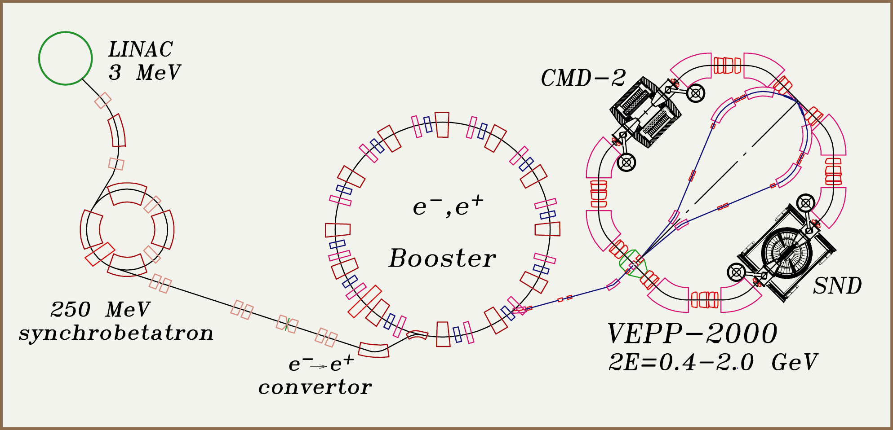
VEPP-2000 Collider
See details in Koop’s talk
Main parameters:
collision period – 82 ns
beam current – 0.2 A
bunch length – 3.3 cm
perimeter – 24.4 m
Energy spread – 0.7 MeV
β_{x}≃ β_{z} =6.3 cm
L ≃ 10³² (2E=2.0 GeV)
L=10³¹cm⁻²c⁻¹ (2E=1.0 GeV)
Achieved (2011-2013):
L~5×10³⁰cm⁻²c⁻¹ ( 2E=1.0 GeV)
L~2×10³¹cm⁻²c⁻¹ ( 2E=2.0 GeV)
designed

Slide 3
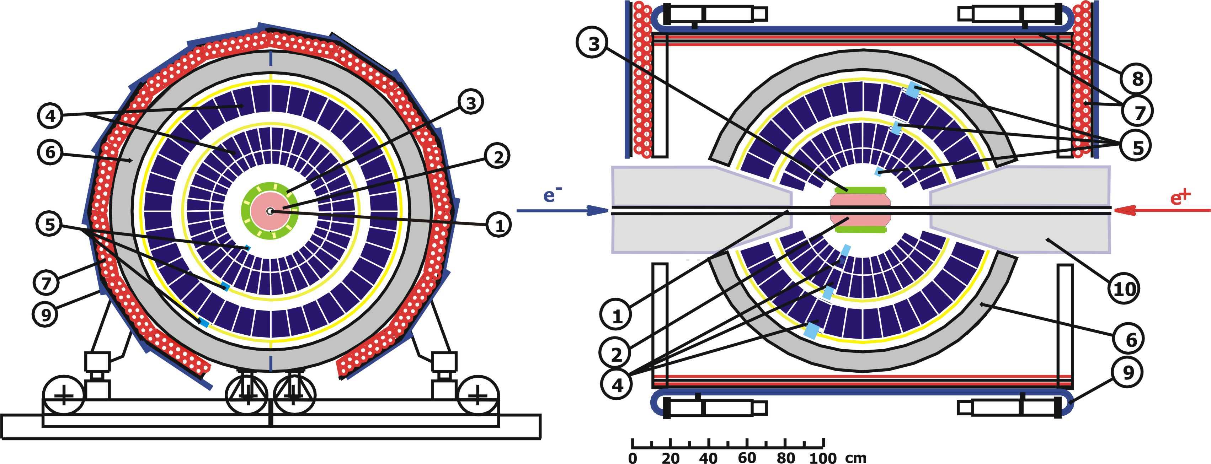
SND for VEPP-2000
NIM A449 (2000) 125-139
1 – beam pipe, 2 – tracking system, 3 – aerogel cherenkov counter , 4 – NaI(Tl) crystals, 5 – phototriodes, 6 – iron muon absorber, 7–9 – muon detector, 10 – focusing solenoids.

Slide 4
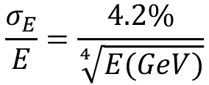

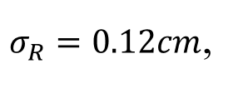

SND parameters
Calorimeter:
1632 NaI(Tl) crystals
VPT reading
13.5 X₀
solid angle - 90% from 4π
Δϕ x Δθ =9º x 9º
Cherenkov counter:
9 counters with n=1.13
PMT reading
0.09 X₀
solid angle - 60%
from 4π
Tracking system:
9-layer cylindrical drift chamber with 24 jet-type cells
solid angle - 94% from 4π
90% Ar + 10% CO₂ gas mixture particle identification at p<300 MeV/c using dE/dx
Energy resolution:
π- threshold: 300MeV/c
K- threshold: 950MeV/c
Efficiency(P=350MeV/c):
K – 7%, π – 90%
$$\frac{σ_{E}}{E}=\frac{4.2\%}{\sqrt[4]{E(GeV)}}$$
Angular resolution:
$σ_{}=0.55$, σ_{θ}=1.2°
Angular resolution:
Spatial resolution:
$σ_{R}=0.12cm$,
$$σ_{Z}=0.45cm$$

Slide 5
Current work on detector upgrade
Upgrade of calorimeter electronics
Development of time measurements in calorimeter
Increasing events readout rate
Improving particle reconstruction and ID

Slide 6
Experiments 2010 - 2012
Experiment/year (1.05 − 2.0 GeV) | Integrated luminosity | √s > 1.88 GeV
MHAD 2010 | 5 pb⁻¹ | 71 nb⁻¹
MHAD 2011 | 25 pb⁻¹ | 3.8 pb⁻¹
MHAD 2012 | 17 pb⁻¹ | 4.9 pb⁻¹
Total | 47pb⁻¹ | 8.8 pb⁻¹
Experiment 2013
Energy region (√s, GeV) | Integrated luminosity, pb ⁻¹ | ρ - ω region, pb ⁻¹ | η′ - meson region, pb⁻¹ | ϕ - meson region, pb⁻¹ | non-resonant, pb⁻¹
0.32−1.06 | 32 | 15.5 | 3.5 | 7.5 | 5.5

Slide 7
VEPP-2000 Physical program
1. Precise measurement of the quantity
R=σ(e⁺e– → hadrons) / σ(e⁺e– → μ⁺μ⁻)
2. Cross section measurements of the processes of e⁺e⁻ -annihilation into hadrons: e⁺e– → 2h, 3h, 4h …, h= π,K,η, …
3. Study of “excited” vector mesons: ρ′, ρ″, ω′, ω″ ϕ′,..
4. CVC tests: comparison of e⁺e– → hadrons cross sections and
τ → ν _{τ} + hadrons decay spectra
5. Study of nucleon - antinucleon pair production and
nucleon electromagnetic form factors, search for N anti-N
resonances
6. Hadron production in “radiative return” processes:
e⁺e– → γ*γ, γ* → hadrons
7. Two photon physics: e⁺e– → e⁺e– + hadrons
8. Test of high order QED 2→ 4, 5

Slide 8
Process e⁺e⁻→ ωπ⁰ → π⁰π⁰γ (30 pb⁻¹)
(arXiv:1303.5198[hep-ex])
Selection criteria:
≥ 5 γ; no charged particles;
total energy depos. > E_{beam};
kinematic fits:
χ²_{5γ} <30; χ²_{π0π0γ}− χ ²_{5γ} <10;
|M_{π0γ} − M_{ω}|<100 MeV
The most accurate measurement for 2E>1.4GeV
SND using CVC hypothesis:
Br(τ⁻→ωπ⁻ν_{τ})= (1.96±0.02±0.10)%
PDG:
Br(τ⁻→ωπ⁻ν_{τ}) = (1.95±0.08)%
No difference within experimental accuracy.
Systematic error: 3.4%
(2E<1.55 GeV)
Fit:
sum of ρ(770), ρ′(1450), ρ″(1700)

Slide 9
Process e⁺e⁻→ ωπ⁰ → π⁰π⁰γ (30 pb⁻¹)
(Transition form factor γ*→ωπ⁰, F_{ωπγ})
$$σ_{ωπ°}= \frac{4πα^{2} }{E^{3}}{\left|F_{ωπγ}\left(E^{2}\right)\right|}^{2}P_{f}\left(E\right),{ P}_{f}\left(E\right)−phase space factor$$
|F_{ωπγ}(q²)/ F_{ωπγ}(0)|²
Solid line – model prediction with ρ(770), ρ′(1450), ρ″(1700) parameters from the cross section fit.
Dashed line – ρ(770) contribution.
(ω→π⁰μ⁺μ⁻)

Slide 10
e⁺e– → ηγ → 7γ (32 pb⁻¹)
(first measurement for √s >1.4GeV)
Photon recoil energy
Selection criteria:
≥7γ, no charged tracks ;
energy dep. > (0.7÷1.2)2E_{beam};
Kinematic fits:
χ²_{nγ} <30; χ²_{π0π0γ} >50;
χ²_{7γ} <50;
400 MeV< M_{γ rec}<600 MeV
MC
MC
Cross section
Preliminary
Fit:
Sum of ρ(770), ρ′(1450), ρ″(1700)
Total ~60 events

Slide 11
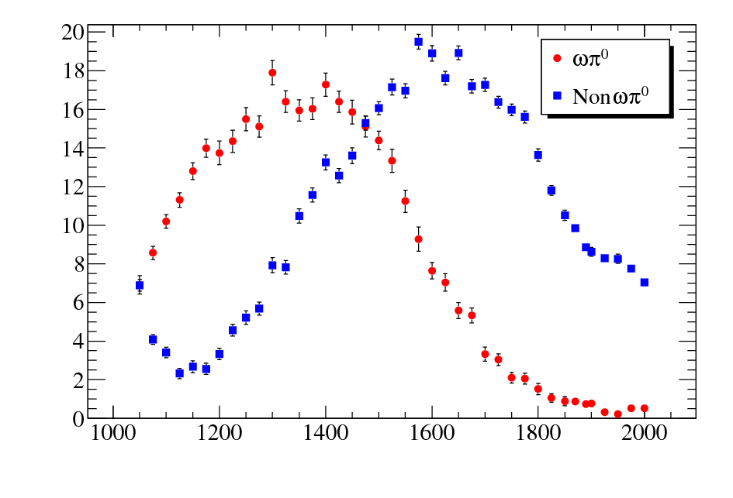
Process e⁺e⁻→ π⁺π⁻π⁰π⁰ (30pb⁻¹)
Preliminary
Selection criteria :
- at least 2 charged
particles and 4 γ’s;
2 tracks are from IP;
Kinematic fit:
χ² < 40
M_{π0} in 70-200 MeV.
ωπ⁰
non-ωπ⁰
Only statistical errors
Systematics ≤ 10%
The bump is a sum of contributions of ρ(770), ρ′(1450), ρ″(1700).
Main feature –
many intermediate states:
ωπ⁰, a₁π, ρππ, ρ⁺ρ⁻, ρf₀.

Slide 12
Process e⁺e⁻→ π⁺π⁻π⁰ (22pb⁻¹)
Cross section
Selection criteria :
– 2 central charged particles
– 2 γ’s
– Δφ_{ch..}>10°
– total energy dep. (0.3-0.8)E_{beam}
Kinematic fit:
– χ²_{R} < 40, χ²_{π+π–γ γ} < 40;
Fit to M_{π0} spectrum
(effect + background)
Preliminary
Spectrum is a sum of
contributions from ω(782), ω′(1420), ω″(1650).
Only statistical errors
Systematic: ~5%

Slide 13
Process e⁺e⁻→ ηπ⁺π⁻ (30pb⁻¹)
Selection criteria :
2 central charged particles,
2 photons,
θ_{charged} (22.5°-157.5°),
θ_{photon} (36°-144°),
kinematic fit
(π⁺π–γ γ): χ² < 20
m_{γγ}
Cross section
Fit: sum of
ρ(770), ρ′(1450), ρ″(1500)
Preliminary
CVC hypothesis:
Br(τ⁻→ηπ⁻π⁰ν_{τ})=
(0.188+0.058-0.057)%
PDG:
Br(τ⁻→ηπ⁻π⁰ν_{τ}) =
(0.139±0.01)%
Systematic error: 4.7%
(1450–1700 MeV)

Slide 14
Baryon cross sections
Details in Serednyakov’s talk
(Wednesday, 11.09)
Total cross section:
where C is the Coulomb factor, GE and GM are the electric and magnetic form factors.
For protons:
Cross section is not zero at
threshold
for neutrons: C=1
From the measured cross section, a combination of the squared form factors (G_{E},G_{M}) can be extracted.
Differential
cross section:
The ratio of the form factors |GE/GM| can be determined from the analysis of the polar-angle distribution.

Slide 15
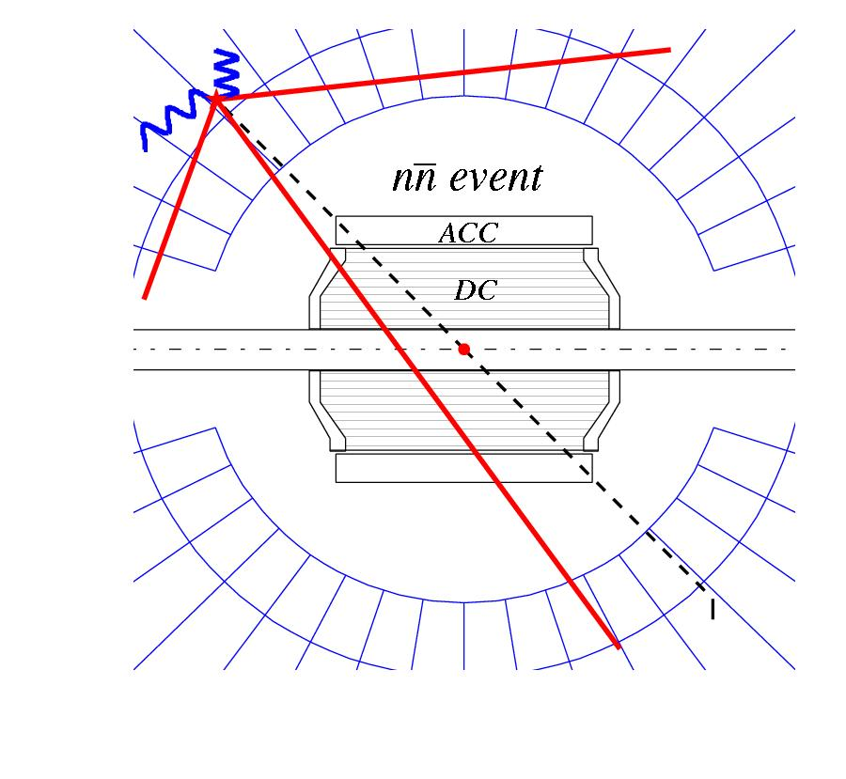
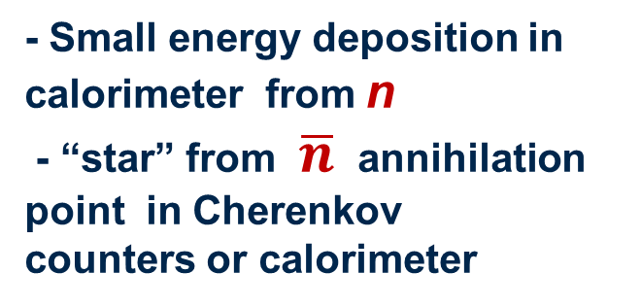
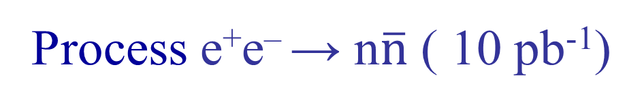
Process e⁺e– → n$\overline{n}$ ( 10 pb⁻¹)
Event signature:
- Small energy deposition in calorimeter from n
- “star” from $\overline{n}$ annihilation point in Cherenkov counters or calorimeter

Slide 16
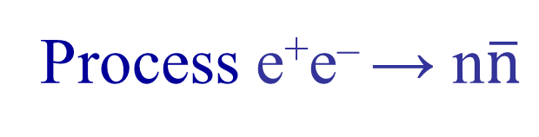
Process e⁺e– → n$\overline{n}$
Main features of the cross section:
1 – cross section has a threshold behavior,
2 – selected events are delayed on 5-10 nsec,
3 – cross section is stable under condition variations,
4 – uniform φ distribution.
Cross section
Systematics: ~0.25 nb (~30%)
Cosθ
|G^{E}/G^{M}|² = 2.6 ± 4.6
Blue – G_{M} contribution
Green – G_{E} contribution
Red – best fit
Preliminary
E_{beam}(МэВ)

Slide 17
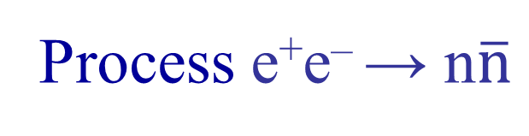
A comparison of proton and neutron FFs
Process e⁺e– → n$\overline{n}$
Effective form factor:
Neutron effective time-like form factor
Preliminary
Preliminary
Only statistical errors

Slide 18
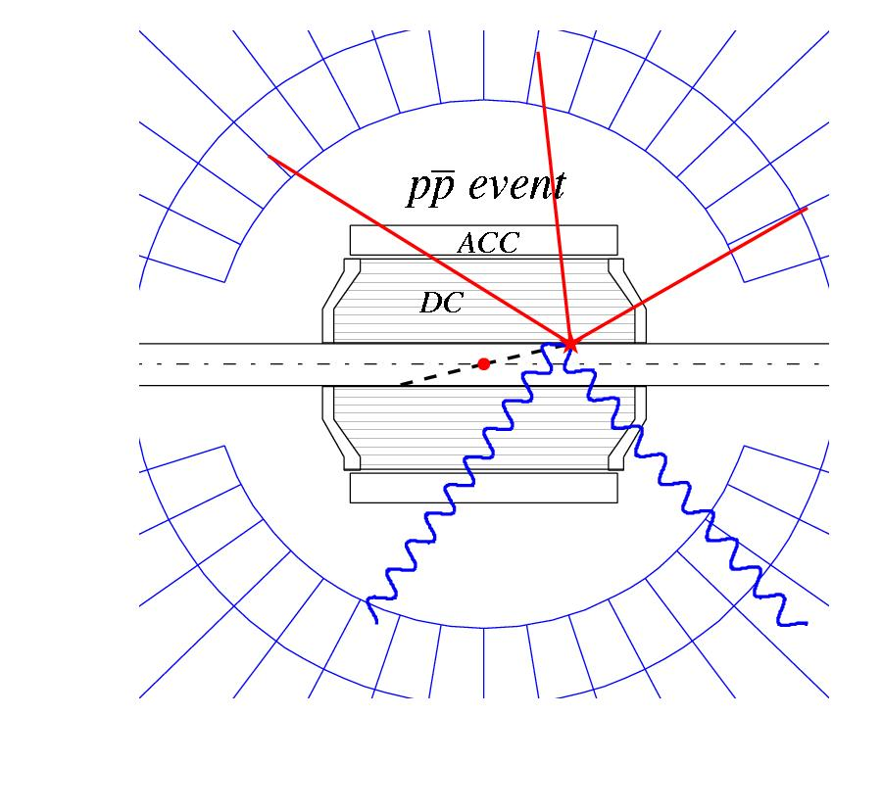
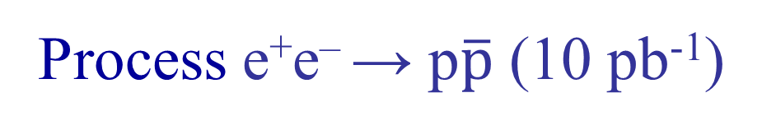
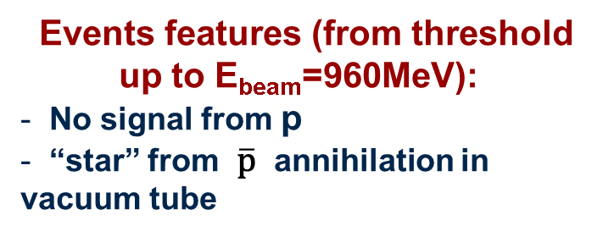
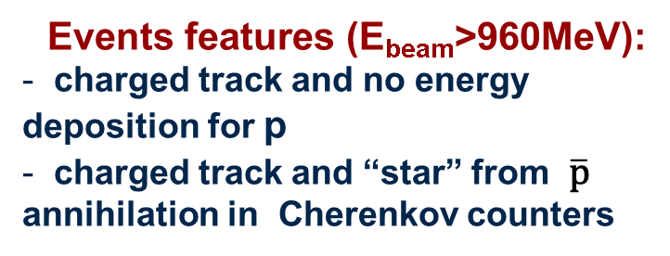
Process e⁺e– → p$\overline{\text{p}}$ (10 pb⁻¹)
Events features (from threshold up to E_{beam}=960MeV):
No signal from p
“star” from $\overline{\text{p}}$ annihilation in vacuum tube
Events features (E_{beam}>960MeV):
charged track and no energy deposition for p
charged track and “star” from $\overline{\text{p}}$
annihilation in Cherenkov counters

Slide 19
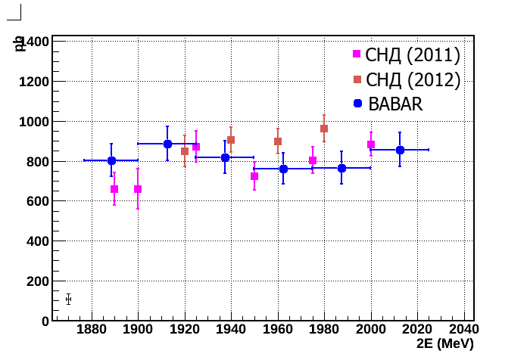
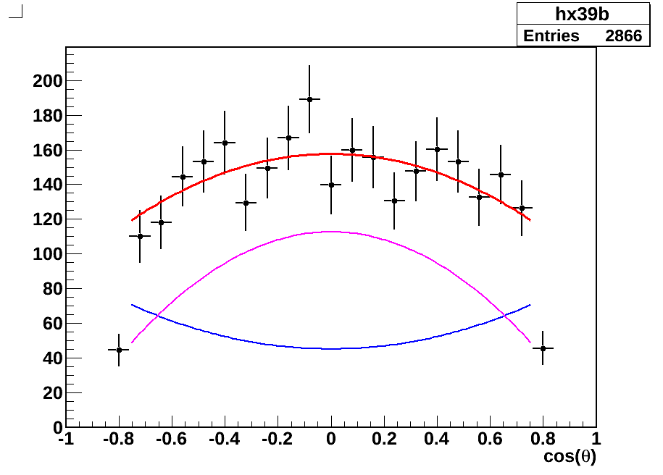
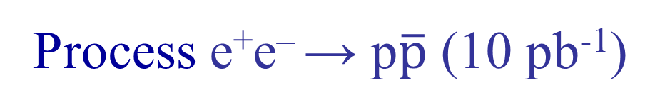
Process e⁺e– → p$\overline{\text{p}}$ (10 pb⁻¹)
Cross section
Preliminary
Cross section, pb
E_{beam}=960-1000MeV,
|G_{E}/G_{M}|= 1.64 ± 0.26
Near threshold
Cosθ
Background below threshold
Systematic error ~ 5%

Slide 20
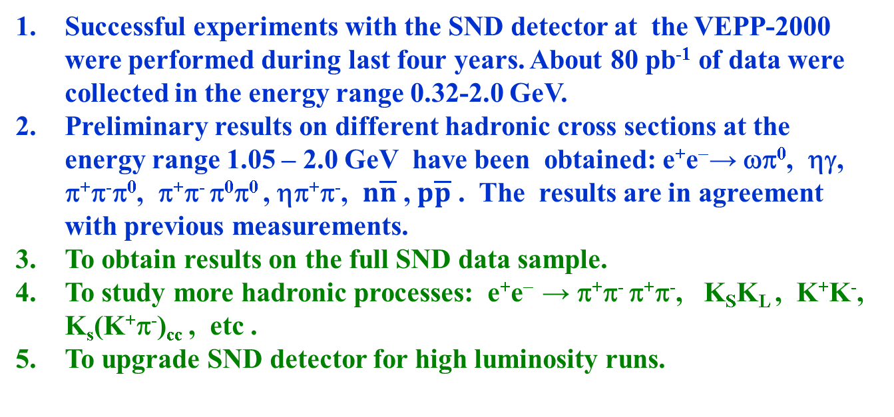
Conclusions & Plans
Successful experiments with the SND detector at the VEPP-2000 were performed during last four years. About 80 pb⁻¹ of data were collected in the energy range 0.32-2.0 GeV.
Preliminary results on different hadronic cross sections at the energy range 1.05 – 2.0 GeV have been obtained: e⁺e⁻→ ωπ⁰, ηγ, π⁺π⁻π⁰, π⁺π⁻ π⁰π⁰ , ηπ⁺π⁻, $n\overline{n}$ , $p\overline{p}$ . The results are in agreement with previous measurements.
To obtain results on the full SND data sample.
To study more hadronic processes: e⁺e⁻ → π⁺π⁻ π⁺π⁻, K_{S}K_{L} , K⁺K⁻, K_{s}(K⁺π⁻)_{cc} , etc .
To upgrade SND detector for high luminosity runs.
Thank you

Slide 21
Process e⁺e⁻→ ωπ⁰ → π⁰π⁰γ
Cuts:
- at least 5γ
- no charged particles
- total energy depos. > E_{beam}
- kinemat. reconstruction:
χ²_{5γ} <30; χ²_{π0π0γ}− χ ²_{5γ} <10;
|M_{π0γ} − M_{ω}|<100 MeV
M_{π0γ}
σ~20MeV
Fitting:
sum of ρ(770) and ρ(1450)

Slide 22
Process e⁺e⁻→ π⁺π⁻π⁰
M_{γγ}

Slide 23
Cosmic suppression using event time
N_{x}

Slide 24
CVC: Br(τ⁻→ηπ⁻π⁰ν_{τ}) =(0.188+0.058-0.057)%
PDG: Br(τ⁻→ηπ⁻π⁰ν_{τ}) =(0.139±0.01)%

Slide 25
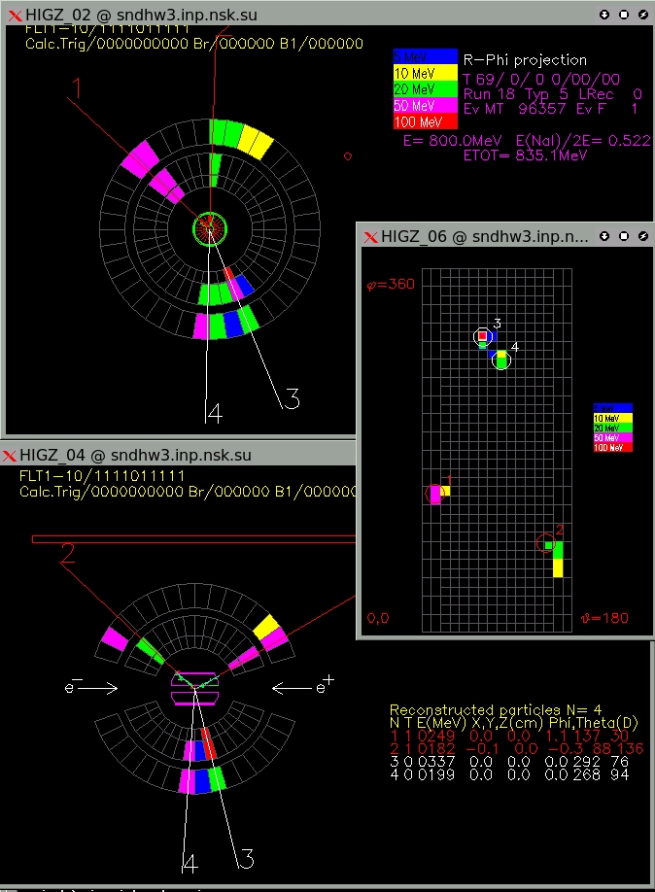
Typical view of
e⁺e⁻→ π⁺π⁻ π⁰ event

