Slide 1





Recent KLOE results on the search for dark forces
E. Graziani
INFN – Roma 3
on behalf of the KLOE and KLOE-2 Collaborations

Slide 2
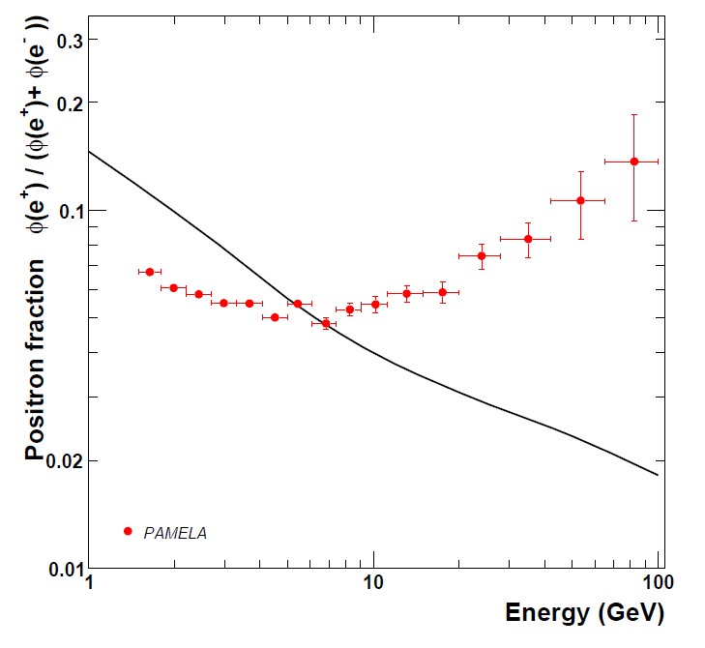
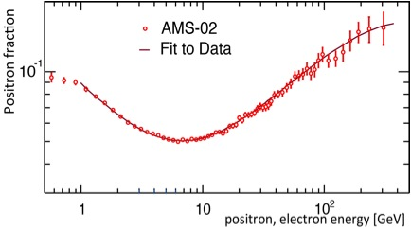
Motivations for dark forces search
Several recent (and different) astrophysical observations (Pamela, AMS, Fermi, Atic, Integral, DAMA/LIBRA, etc …) may suggest the existence of a light Gev-ish dark sector: a new low energy gauge interaction mediated by a neutral light mass vector particle, usually named the U boson (but also A’, V, …), with a small kinetic mixing ε (<10⁻³) with SM
A low mass U boson could explain the well known ∼ 3.4 σ a_{μ} discrepancy with SM
A natural hypothesis is that the new symmetry is spontaneously broken by an Higgs-like mechanism, thus introuducing the existence of an additional scalar particle, with interesting phenomenological consequences
PAMELA
There are several different experimental ways (on earth) to take a look at the dark world:
  e⁺e⁻ machines
  rare meson decays
  fixed target e-N scattering

Slide 3
Dark forces at KLOE
KLOE/KLOE2 is an a very good position to probe a light dark sector at the GeV scale, because:
It operates on DAFNE exactly at that scale: E_{cm}∼ 1 GeV
Most of the interesting dark process cross sections at e⁺e⁻ colliders scale with 1/s: a factor ∼100 wrt to B factories, which almost compensates the integrated luminosity
It’s a unique place to study some rare meson decays (it’s a Φ factory, folks!)
Outline of the talk
Decay of the Φ meson into a U boson + a pseudoscalar particle: Φ→ηU with U→e⁺e⁻, η→πππ)
Associated Uγ process, via the resonant radiative production of a U boson and its subsequent decay into a lepton pair : e⁺e⁻→Uγ→μ⁺μ⁻γ
Higgsstrahlung process, in the m_{h}<m_{U} scenario, with an invisible Higgs: e⁺e⁻→ Uh→μ⁺μ⁻ + missing energy.

Slide 4
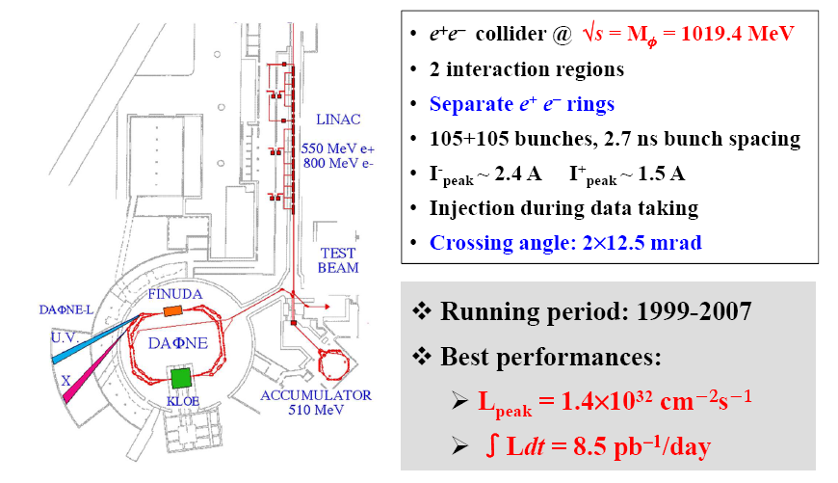
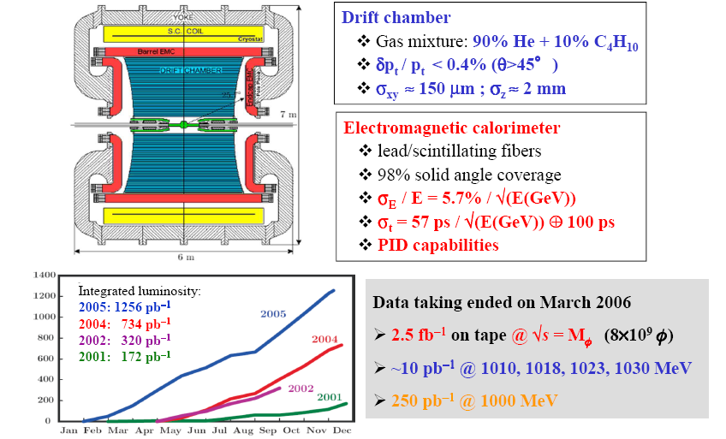
DAΦNE: the Frascati Φ factory
See A. Palladino’s talk for more details
The KLOE experiment at DAΦNE

Slide 5
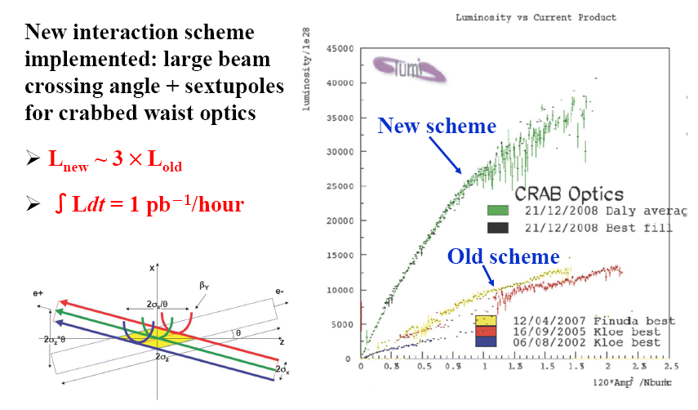
DAΦNE upgrade
We aim at an integrated luminosity ≈ 10 fb⁻¹ (≈ 3 fb⁻¹ /yr) on Φ peak
We reasonably hope in ≈ 1 fb⁻¹ off peak

Slide 6
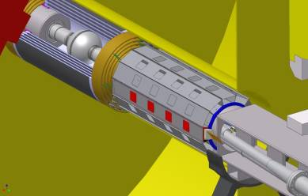
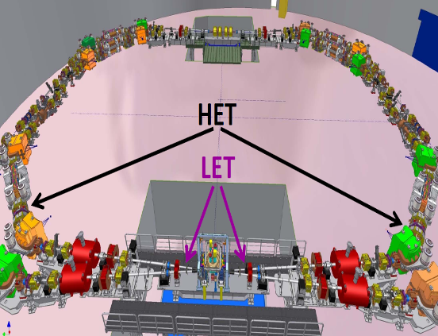
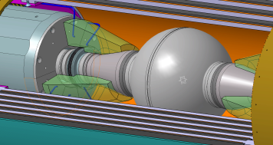
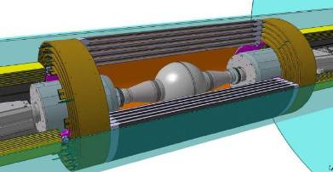
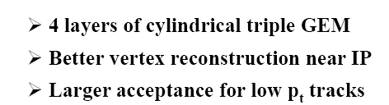
From KLOE to KLOE-2
SMALL ANGLE EMCs
2+2 gg taggers
INNER TRACKER
Accomplished!
New detectors installed
New run just started
Notes:
6
E’ possibilie aumento di accettanza da it/ccal

Slide 7
Decay of the Φ meson into a U boson + a pseudoscalar particle: Φ→ηU with U→e⁺e⁻, η→πππ)
Associated Uγ process, via the resonant radiative production of a U boson and its subsequent decay into a lepton pair : e⁺e⁻→Uγ→μ⁺μ⁻γ
Higgsstrahlung process, in the m_{h}<m_{U} scenario, with an invisible Higgs: e⁺e⁻→ Uh→μ⁺μ⁻ + missing energy.

Slide 8
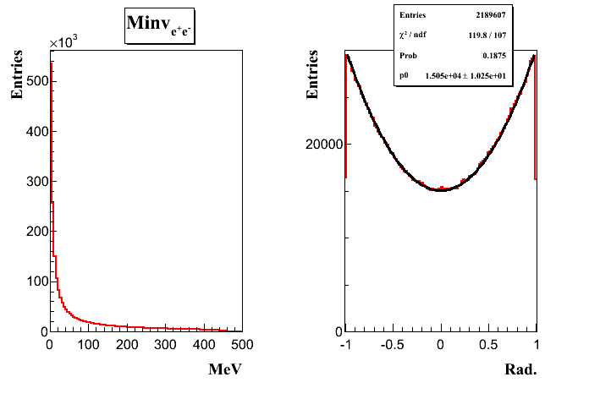
U boson search in Φ→ηl⁺l⁻ decays
Mesons undergoing radiative decays to photons could also decay to a U boson with branching fraction BR (X→YU) ∼ε² × |FF_{XYγ}|² × BR (X→Yγ)
σ (Φ→ηU )≈ 40 fb for FF_{Φη}≈1 and ε ≈10⁻³
form factor
σ(Φ→ηe⁺e⁻) = 0.7 nb
Selected decay chains:
U→e⁺e⁻ and η → π⁺ π⁻ π⁰ (BR = 22.7%)
Phys.Lett. B706 (2012) 251-255
η → π⁰ π⁰ π⁰ (BR = 32.6%)
Combined result Phys.Lett. B720 (2013) 111-115
Irreducible background: Φ → η e⁺e⁻, η → πππ
Simulated according to a Vector Meson Dominance parameterization
Signal is expected to show up as a narrow peak above the continuum background
M_{ee} (MeV)
Notes:
The φ, with a mass of 1019.3 MeV, decays to ηγ 1.3% of the time; the η (mass 547.9 MeV) decays to γγ 39% of the time.
Thus we can search for φ→ηU at KLOE, or φ→ηγ followed by γ →ηU.
Momenta of charged tracks at KLOE are measured to about 0.4% accuracy [6].

Slide 9
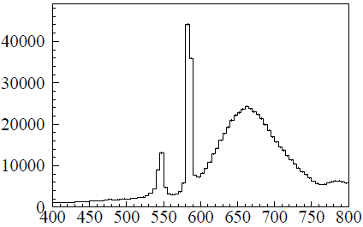
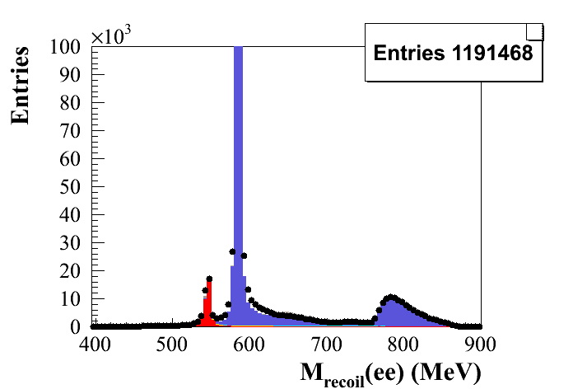
Search for Φ→ηU decays with U→e⁺e⁻ and η→3π
Selections
Recoil mass to the e⁺e⁻ pair
4 tracks in a cylinder around IP
+ 2 photon candidates
Best π⁺π⁻γγ match to the η mass
+ other 2 tracks assigned to e⁺e⁻
495 < M_{ππγγ} < 600 MeV
70 < M_{γγ} < 200 MeV
535 < M_{recoil}(ee) < 560 MeV
γ conversion + K_{L}K_{S} rejection (ToF)
L= 1.5 fb⁻¹
η→π⁺π⁻π⁰
η→π⁺π⁻π⁰
η peak
M_{recoil}(ee) (MeV)
2 opposite sign tracks in a cylinder
around IP
Six prompt photon candidates:
E_{γ}>7 MeV, | cos θ_{γ}| < 0.92, time
window |T_{γ} − R_{γ}/c| < min(3σ_{T}, 2 ns)
400 < M_{6γ} < 700 MeV
γ conversion + K_{L}K_{S} rejection (ToF)
η→3π⁰
L= 1.7 fb⁻¹
Data
Φ→ηe⁺e⁻
e⁺e⁻→ ωπ⁰
Φ→K⁺K⁻
Φ→K_{S}K_{L}
Φ→ρπ
Φ→ηγ
η→π⁰π⁰π⁰
η peak
M_{recoil}(ee) (MeV)
Notes:
9
Signal simulation with dG(f→he+e-)/dmee weighted according to…

Slide 10
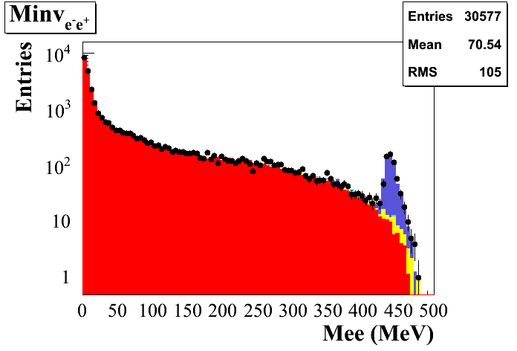
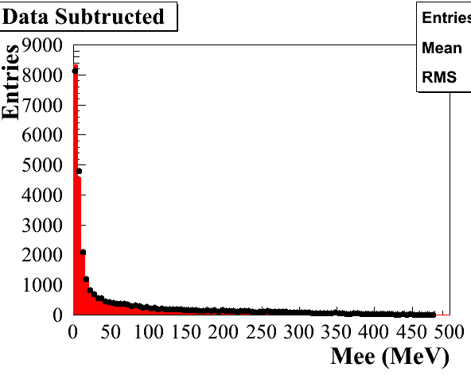
Φ→ηU, η→3π⁰ final sample
Entries
30577
M_{recoil} cut:
536.5 < M_{recoil}(ee) < 554.5
(3 σ around the η peak)
Data
Φ→ηe⁺e⁻
e⁺e⁻→ ωπ⁰
Φ→K⁺K⁻
Φ→K_{S}K_{L}
Φ→ρπ
Φ→ηγ
Entries
29625
M_{ee} (data – bkg)
− Φ→ηe⁺e⁻
Very small residual bakground contamination from Φ→ηγ and Φ→K_{S}K_{L}(<3%)
M_{ee}(MeV)
Notes:
10
Mc signal: vmd with ff slope from snd

Slide 11
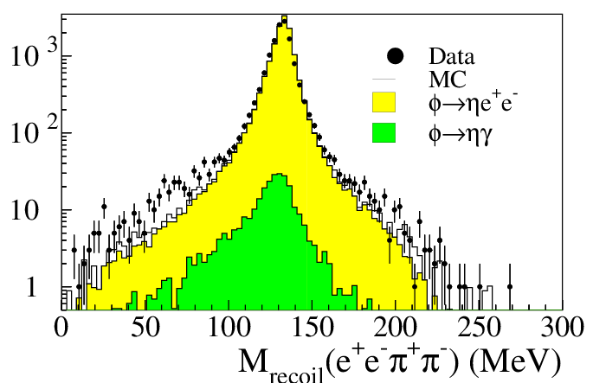
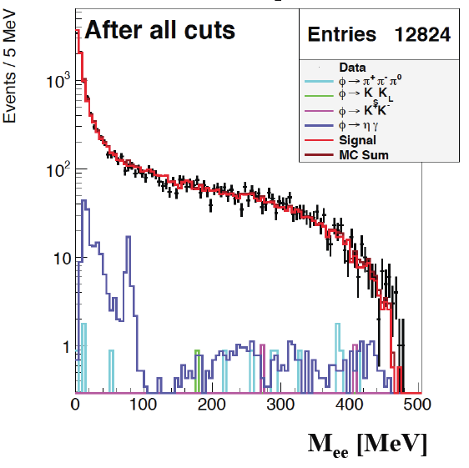
Update of the η→π⁺π⁻π⁰ channel
We already published a search of
Φ→ηU, η→π⁺π⁻π⁰ decay
(Phys.Lett. B706 (2012) 251-255)
Background rejection improved
by adding a cut on the recoil mass to the eeπ⁺π⁻ system (π⁰):
100 < M_{recoil}(eeππ) < 160 MeV

Slide 12
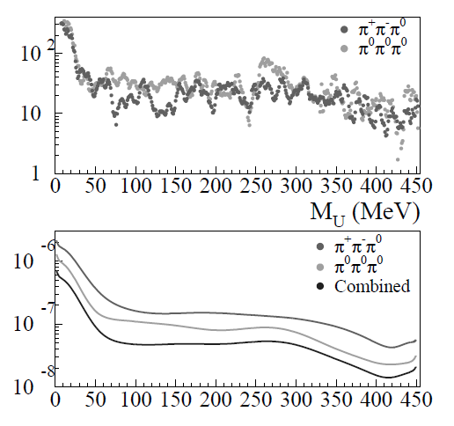




Φ→ηU: upper limits
No clear signal structure observed above background → UL evaluation
Φ→ηU MC sample divided in subsamples of 1 MeV width in 5< M_{U} < 456 MeV
background → fit of the M_{ee} distribution excluding the 5 bins around M_{U}
For each M_{U} value the 90% C.L. exclusion using the CL_{S} method (error on bkg included)
UL on N. of ev. (Φ→ηU, U→e⁺e⁻) @ 90% CL
UL on BR (Φ→ηU, U→e⁺e⁻) @ 90% CL
π⁺π⁻π⁰
• π⁰π⁰π⁰
To express these limits in terms of ε² we need a form factor
FF slope:
… but SND: b_{fh}= (3.8±1.8) GeV⁻²
Notes:
12

Slide 13
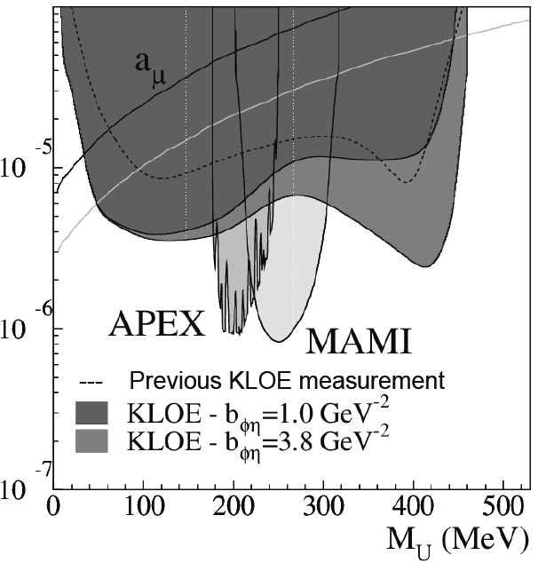

Φ→ηU: combined exclusion plot on α'/α = ε²
U→only ee,μμ with equal couplings
Evaluated with both theoretical (VMD) and measured (SND) value of the FF slope
We use the FF slope VMD prediction (in agreement with our result) to quote limits
A factor 2 enhancement in sensitivity expected from KLOE2 experiment
--- Previous KLOE measurement
α'/α = ε² ≤ 1.7×10⁻⁵ @ 90% C.L. for 30<M_{U}<400 MeV
α'/α = ε² ≤ 8.0×10⁻⁶ @ 90% C.L. for 50<M_{U}<210 MeV
Phys.Lett. B720 (2013) 111-115
60<M_{U}<435 MeV mass range ruled out, if U explains a_{μ} discrepancy
Notes:
13

Slide 14
Decay of the Φ meson into a U boson + a pseudoscalar particle: Φ→ηU with U→e⁺e⁻, η→πππ)
Associated Uγ process, via the resonant radiative production of a U boson and its subsequent decay into a lepton pair : e⁺e⁻→Uγ→μ⁺μ⁻γ
Higgsstrahlung process, in the m_{h}<m_{U} scenario, with an invisible Higgs: e⁺e⁻→ Uh→μ⁺μ⁻ + missing energy.

Slide 15
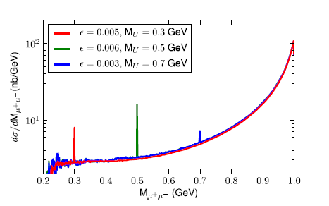
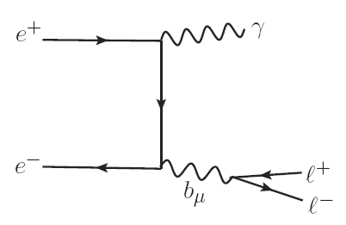
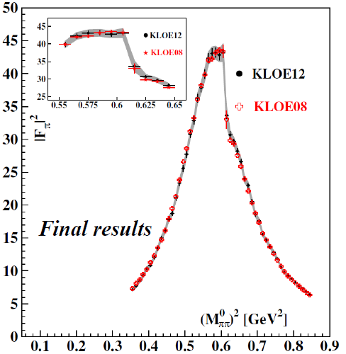
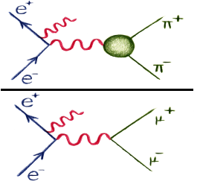
U boson search in e⁺e⁻→μ⁺μ⁻γ
Production of a photon plus an U boson and decay in a lepton pairs: e⁺ e–→Uγ→l⁺ l– γ, l= e,μ
Expect a narrow Breit-Wigner peak above the continuum
We use the μ⁺μ⁻γ final state only.
This measurement is in fact directly derived from our measurement of |F_{π}|² by the bin by bin ratio of pion over muon yields
√s=1.02GeV
Statistical sample:
240 pb⁻¹ 2002 data

Slide 16
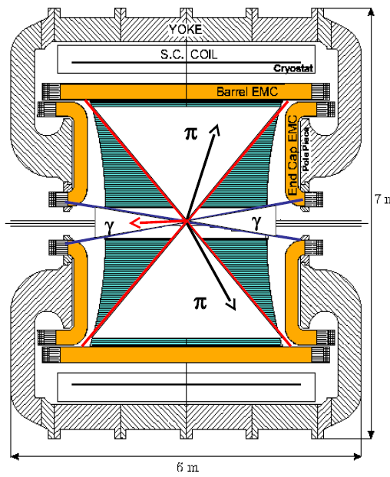
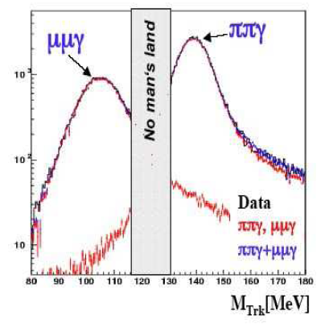
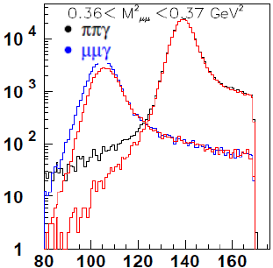
e⁺e⁻→μ⁺μ⁻γ: small angle analysis
undetected small angle photon θ_{γ}<15°, θ_{γ}>165°
two opposite sign charged tracks 50°<θ_{μ}<130°
M²_{μμ}≥∼0.35 GeV²
high statistics ISR
low FSR contribution
significant suppression of Φ → π⁺ π⁻ π⁰
π/μ separation
M_{TRK} → track mass assuming two equal mass charged particles and 1 γ in the final state
μ→M_{TRK} <115 MeV
π→M_{TRK} >130 MeV
σ(M_{TRK})<3 MeV

Slide 17
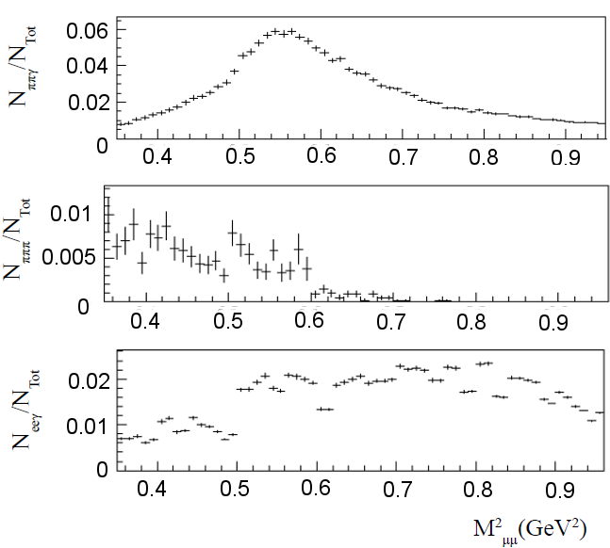
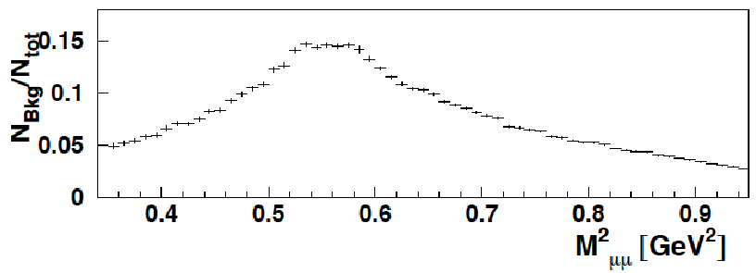
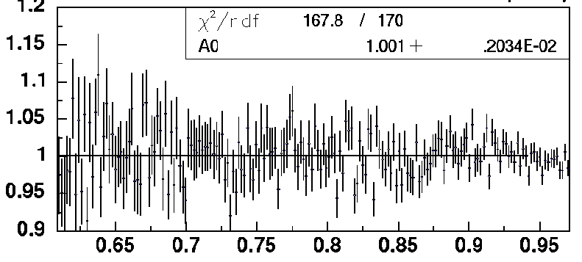
e⁺e⁻→μ⁺μ⁻γ: SA analysis
MC
Three main sources of background:
e⁺ e⁻ → π⁺ π⁻ γ(γ)
e⁺ e⁻ → e⁺ e⁻ γ(γ)
Φ → π⁺ π⁻ π⁰
MC
MC
Background subtraction →absolute μμγ cross section
M²_{μμ}(GeV²)
Total background (MC)
comparison of the computed cross section with the NLO QED prediction of PHOKHARA
excellent Data/MC
agreement

Slide 18
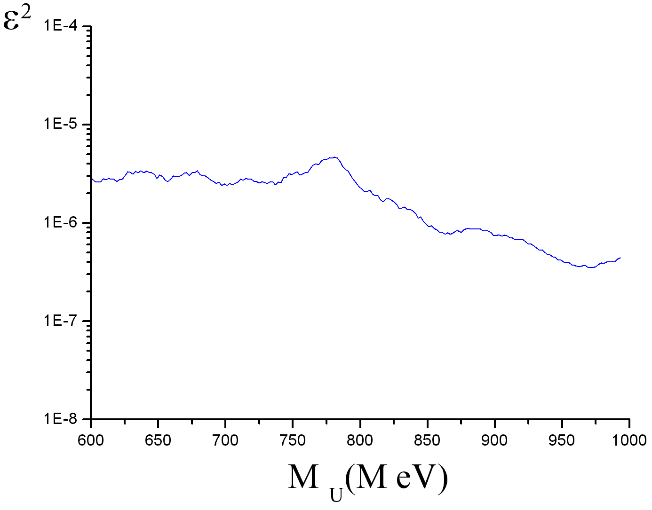
e⁺e⁻→μ⁺μ⁻γ: spectrum and upper limits
2 MeV bins
Use Phokhara prediction as background estimate (2% syst error) to evaluate upper limits
CLS technique
observed μ⁺μ⁻ spectrum
90% CL upper limit on N_{ev}
N_{CLS}
90% CL upper limit on ε²
KLOE PRELIMINARY
KLOE PRELIMINARY

Slide 19
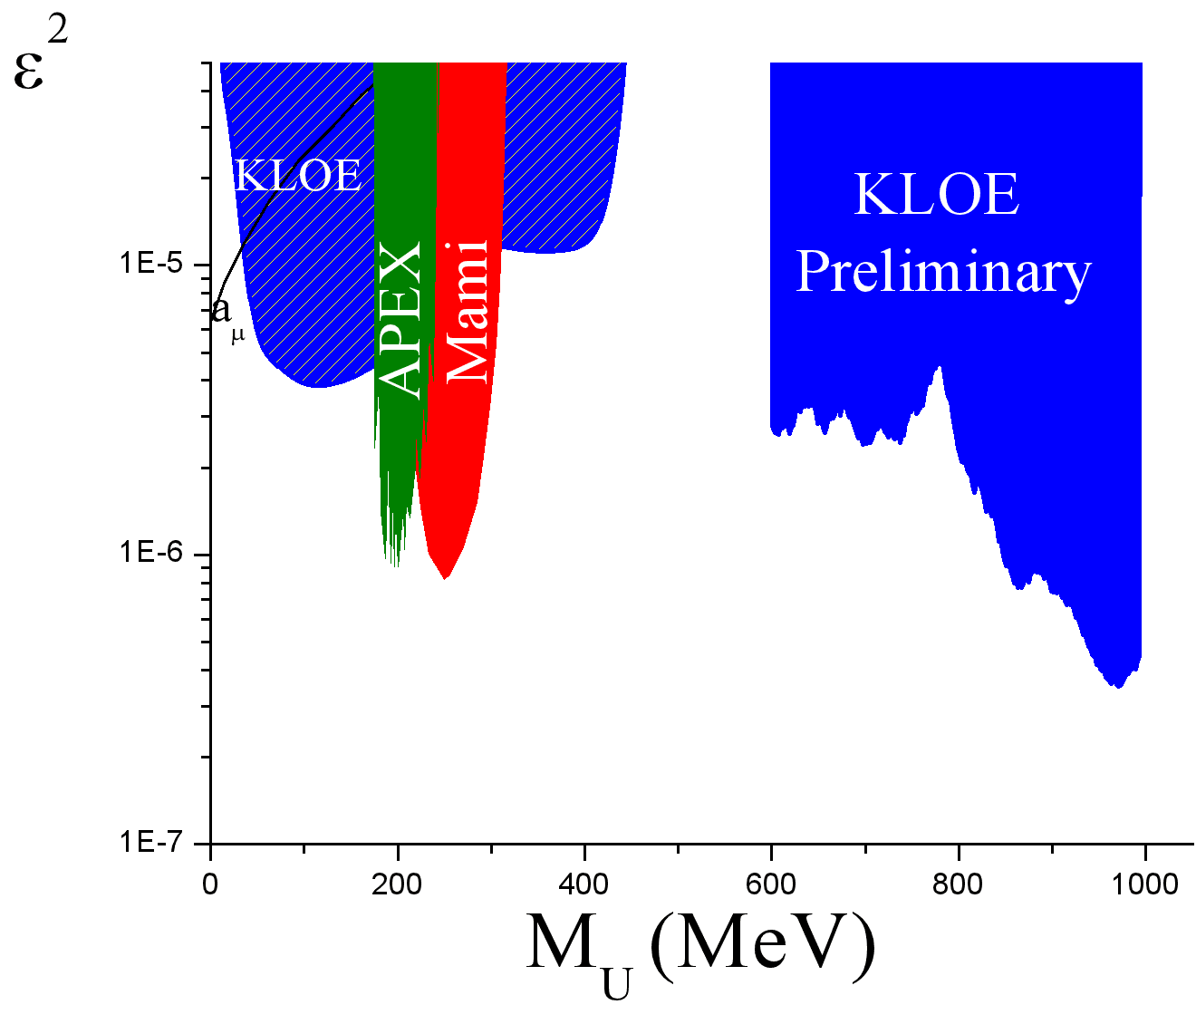
e⁺e⁻→μ⁺μ⁻γ: 90% CL upper limits
U. L. between 2.8·10⁻⁶ and 4.9·10⁻⁷ in the energy range 600-1000 MeV
Results based on 240 pb⁻¹ small angle γ analysis
Using the 2.5 fb⁻¹ full KLOE data set improves the sensitivity by a factor ∼ 3
Changing the μ acceptance selections and including the offpeak sample may allow to check the low (∼threshold) invariant mass region. An analysis going down to ∼ 500 MeV is already in progress.
A further factor 2 in sensitivity expected from KLOE2 experiment

Slide 20
Decay of the Φ meson into a U boson + a pseudoscalar particle: Φ→ηU with U→e⁺e⁻, η→πππ)
Associated Uγ process, via the resonant radiative production of a U boson and its subsequent decay into a lepton pair : e⁺e⁻→Uγ→μ⁺μ⁻γ
Higgsstrahlung process, in the m_{h}<m_{U} scenario, with an invisible Higgs: e⁺e⁻→ Uh→μ⁺μ⁻ + missing energy.

Slide 21
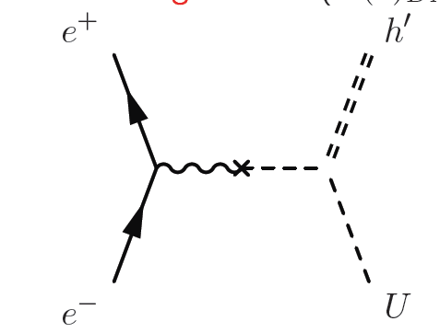
The e⁺e⁻→hU higgsstrahlung process
Very different scenarios depending on
m_{h}<m_{U} ⇒ “invisible”
m_{h}>m_{U}⇒ h→ uu → 4l,π+2l,π
∼ α_{D}ε²
ε = 10⁻³
α_{D}= α_{em}
m_{U,h}∼100 MeV
τ_{h}>5 µs → βγcτ > 100 m
invisible up to ε ≈ 10⁻²÷10⁻¹ depending on m_{h}
U
rapidly increasing with decreasing ε
We studied only the muon case m_{h}<m_{U}: e+e⁻ → µ+µ⁻ + missing energy
σ(e⁺e⁻→hU) α_{D}= α, ε = 10⁻³, s=1 GeV²
fb
BR (u → µµ,ππ)
Batell, Pospelov, Ritz ,
Phys. Rev. D 79,
115008 (2009)
ππ
µµ
≈0.5
m_{U}

Slide 22
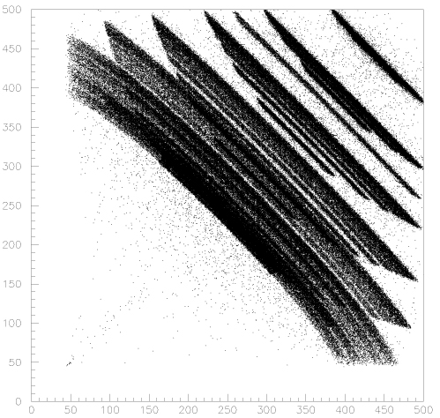
e⁺e⁻→hU: selections
two charged tracks, q₁+q₂=0
vertex in a cylinder around IP
p_{1,2}< 460 MeV
cosθ_{miss} < 0.75 , cosθ_{1,2} < 0.8
p₁ + p₂ > 450 MeV
E_{miss}: calorimeter veto
PID: two muons
vtx-IP cut (anti K⁺K⁻)
p₁
K⁺K⁻→μ⁺μ⁻νν decaying in the IP region
hU, U→μμ
IP
K⁻
μ⁻
K⁺
m_{u}
μ⁺
m_{U},m_{h} → bands
p₂
sinθ distribution!
1-ε_{veto}
e ─
µ ─
eeγ(γ) data
cosθ_{miss} < 0.75
hU, U→μμ
hU, U→ μμ, m_{U}< 300 MeV
µµγ
ππγ
cosθ_{miss}
NN output
P_{miss} (MeV)

Slide 23
e⁺e⁻→hU results: on peak + off peak data
L=1.65 fb⁻¹
on peak data, √s=M_{Φ}
L=0.2 fb⁻¹
off peak data, √s=1 GeV
M_{miss}
ee→eeμ⁺μ⁻
ee→eeπ⁺π⁻
M_{miss}
ee→eeμ⁺μ⁻
ee→eeπ⁺π⁻
K⁺K⁻→μ⁺μ⁻νν
π⁺π–π⁰
μ⁺μ⁻γ
μ⁺μ⁻γ
π⁺π⁻γ
π⁺π⁻γ
M_{μμ}
M_{μμ}
Backgrounds
Binning such as to keep 90-95% of the signal in one bin:
M_{µµ} → 5 MeV, M_{miss} →15÷50 MeV
Φ → K⁺ K⁻ , K±→μ±ν
Φ → π⁺π–π⁰
e⁺e⁻→ μ⁺μ⁻ γ
e⁺e⁻→ π⁺π⁻ γ
e⁺e⁻→e⁺e⁻μ⁺μ⁻
e⁺e⁻→e⁺e⁻π⁺π⁻
Φ decays
The background is estimated directly on the data distributions
On the M_{μμ} –M_{miss} plane, counts are averaged over a sliding 5x5 bin matrix excluding the central one (regarded as a possible signal) and considered as an estimate of the background
continuum

Slide 24
e⁺e⁻→hU Results: 90% CL limits
Limits are in terms of α_{D}ε² vs M_{U}M_{h}
Bayesian approach: statistical fluctuations of signal candidate+background and systematic uncertainties on signal efficiency fully kept into account
KLOE PRELIMINARY
N_{up}= 90% CL limit on N_{ev}
On Φ peak
α_{D}ε²
Off peak
α_{D}ε²
L=1.65 fb⁻¹
L=0.2 fb⁻¹

Slide 25
e⁺e⁻→hU results: 90% CL limits combined (projections)
α_{D}ε²
α_{D}ε²
KLOE PRELIMINARY
smoothed results
smoothed results
m_{U}
m_{h}
Limits ∼ 10⁻⁸÷10⁻⁹ in α_{D}ε², which translate in10⁻³÷ some 10⁻⁴ in ε, if α_{D}= α_{em}
Search complementary with BaBar/Belle one (same process , different final state and phase space)
Expect a ≈ 2.5 improvement on the limits in KLOE2 because of luminosity + suppression of the K⁺K⁻ background due to the Inner Tracker insertion → full study of the ε ≈ 10⁻⁴ region

Slide 26
Dark forces at KLOE: summary and conclusions
KLOE searched for a dark gauge U boson in three different processes:
  Φ meson decay: Φ→ηU with U→e⁺e⁻, η→πππ
  Uγ associate production: e⁺e⁻→Uγ→μ⁺μ⁻γ
  Higgsstrahlung, in the invisible Higgs scenario: e⁺e⁻→ Uh→μ⁺μ⁻ + missing energy
We found no evidence and set upper limits on the mixing parameter ε² of the dark sector with the Standard Model, as a function of the U mass, in the range 10⁻⁵÷10⁻⁷, depending on the process.
The upgraded DAFNE2 luminosity and the insertion of the new detectors in KLOE2 are expected to improve these limits by a factor ∼2 or better .
New run has just started. Stay tuned!

Slide 27
SPARE SLIDES

Slide 28
DAΦNE: the Frascati Φ factory

Slide 29
The KLOE experiment at DAΦNE

Slide 30
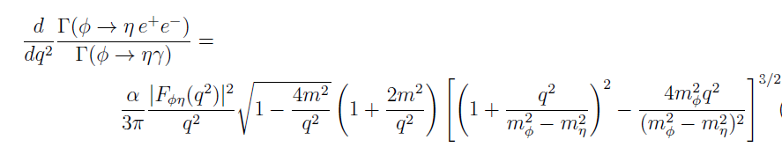

Φ→ηU, η→3π : dalitz decay simulation
The irreducible background Φ → η e⁺e⁻, η → πππ, has been simulated according to a Vector Meson Dominance parameterization:
with,

Slide 31
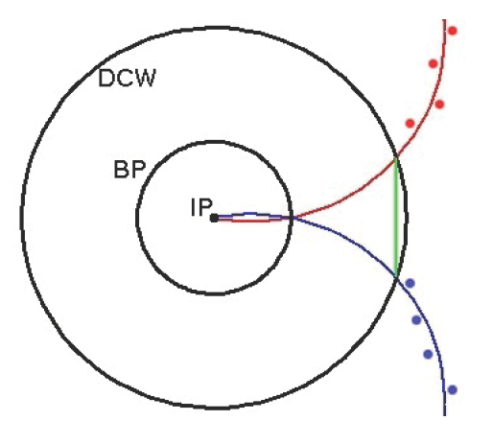
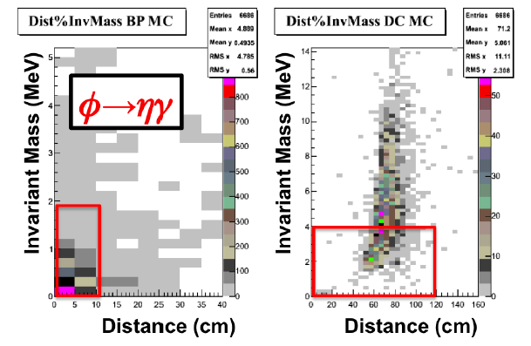
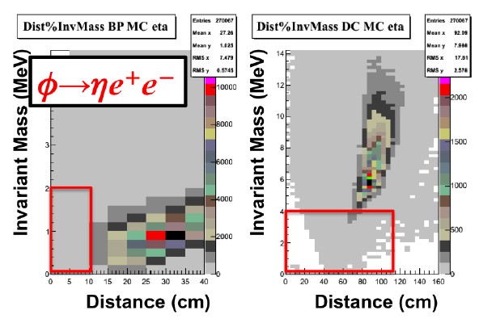
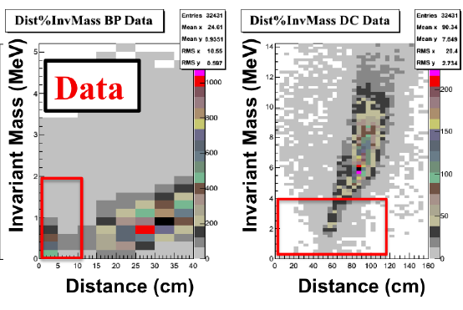
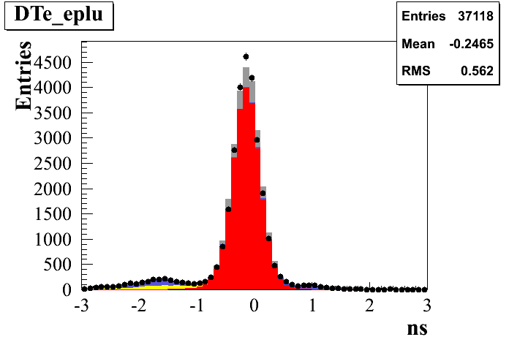
Φ→ηU: γ conversions + K_{S}K_{L} backgrounds
Photon conversions, mainly on the beam pipe (BP) and on the drift chamber wall (DCW), can simulate an e⁺e⁻ pair from the interaction point
Track back to BP/DCW and reconstruct M_{ee} and distance D_{ee} (both small if γ conversion)
M_{ee} < 10 MeV &D_{ee} < 2 cm on BP
M_{ee} < 120 MeV &D_{ee} < 4 cm on DCW
true vertex
rec. vertex
Φ→K_{L}K_{S}, K_{S}→π⁺π⁻ rejected with ToF technique:
measured time on EMC (T_{EMC}) – expected time in electron
hypothesis (T_{track} = L_{track}/β_{e}c): DT_{e}= T_{EMC}- T_{track}
3σ cut
DTe (ns)

Slide 32
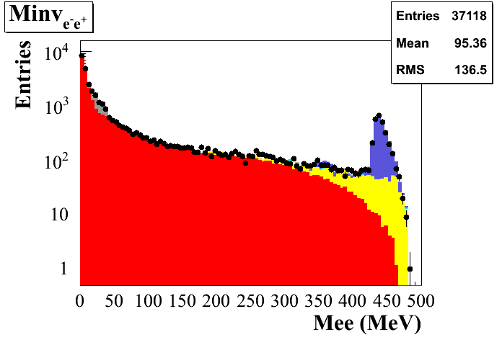
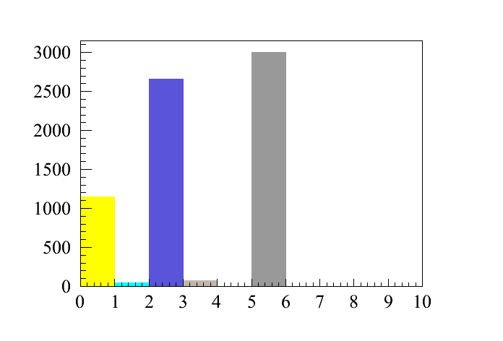
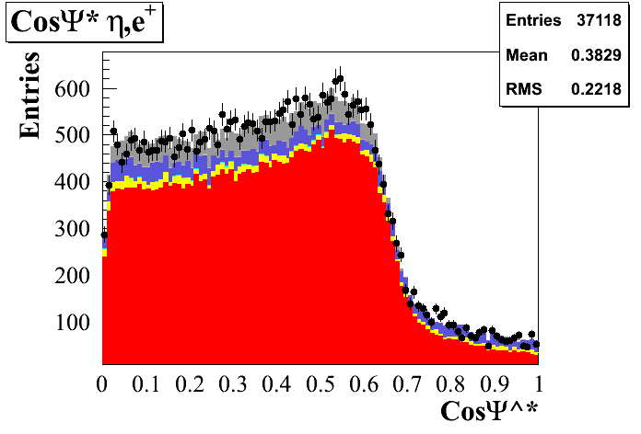
Φ→ηU, η→3π⁰
Entries
37118
e⁺e⁻→ ωπ⁰
Φ→K⁺K⁻
Φ→K_{S}K_{L}
Φ→ρπ
Φ→ηγ
Bkg events
ηγ
K_{S}K_{L}
Data
f→he⁺e⁻
e⁺e⁻→ω p⁰
f→K⁺K⁻
f→K_{S}K_{L}
f→ρπ
f→hg
ωπ⁰
Data
Φ→ηe⁺e⁻
e⁺e⁻→ ωπ⁰
Φ→K⁺K⁻
Φ→K_{S}K_{L}
Φ→ηγ
ηe⁺e⁻
Ψ∗: the angle between the η and the e⁺
in the e⁺ e⁻ rest frame
Entries
37118
M_{recoil} cut:
536.5 < M_{rec} < 554.5 (3 σ around the η peak)
Background contamination ~ 20%
[PLB504(2001) 275]
cosΨ*
Notes:
32
Mc signal: vmd with ff slope from snd

Slide 33
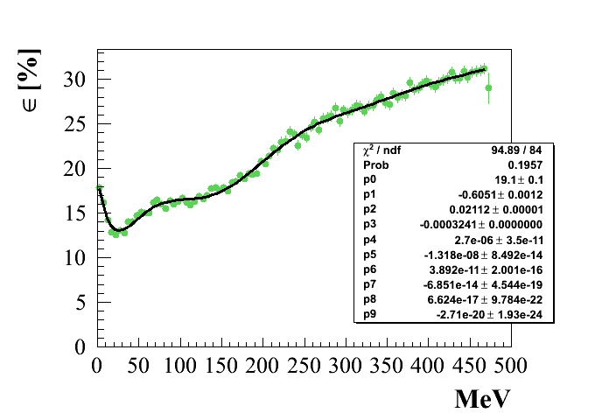
Φ→ηU: efficiency and background
Efficiency and mass resolution (1÷2 MeV) as a function of M_{ee} in the interval 6÷460 MeV taken from specific Monte Carlo simulation
η→π⁰π⁰π⁰
For each M_{U} value, the expectation of Φ→ηe⁺e⁻ background is obtained by fitting the M_{ee} distribution, excluding 5 bins centered around M_{U} .

Slide 34
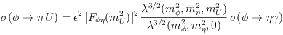
Φ→ηU: upper limits
No clear signal structure observed above background → UL evaluation
Φ→ηU MC sample divided in subsamples of 1 MeV width in 5< M_{U} < 456 MeV
background → fit of the M_{ee} distribution excluding the 5 bins around M_{U}
For each M_{U} value the 90% C.L. exclusion using the CL_{S} method (error on bkg included)
UL on N. of ev. (Φ→ηU, U→e⁺e⁻) @ 90% CL
UL on BR (Φ→ηU, U→e⁺e⁻) @ 90% CL
π⁺π⁻π⁰
• π⁰π⁰π⁰
Reece, Wang JHEP 07 (2009):
FF slope:
SND: b_{fh}= (3.8±1.8) GeV⁻²
VMD
Notes:
34

Slide 35
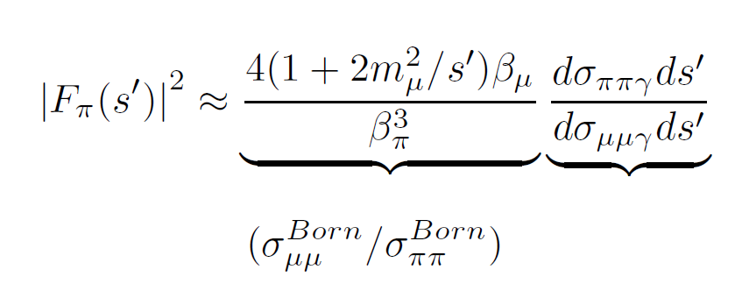
U boson search in e⁺e⁻→μ⁺μ⁻γ
Measure of |F_{π}|² by the bin by bin ratio of pions over muons yields
High precision measurement
Statistics: 240 pb⁻¹ data taken on 2002

Slide 36
The e⁺e⁻→ hu signal in MC
u→μμ + inv. Higgs generated grid
KLOE full simulation detector description
m_{h}
m_{u}=500 MeV
m_{h}=300 MeV
μ mass hypothesis → M_{μμ}, M_{miss}
M_{µµ}
m_{u}=500 MeV
m_{h}=300 MeV
m_{u}
σ(M_{µµ}) = 0.5 ÷ 2 MeV
σ(M_{miss}) = 3 ÷ 17 MeV
m_{h}=400 MeV
m_{h}=20 MeV
M_{miss}
Signal would show up as a narrow peak in the M_{µµ}- M_{miss} plane

Slide 37
e⁺e⁻→hU: Particle IDentification
Set of Neural Networks in p and cosθ bins (9x4)
Trained to perform μ/e discrimination
Input: 5 variables ( energies in calorimeter planes, E/P, β)
Output: 1 variable
Based on the excellent energy and time resolutions of the KLOE calorimeter
Asymmetries in plane energy depositions
a_{i}=(E_{i}-E_{i}+1)/(E_{i}+E_{i}+1)
200 MeV
e ─
µ ─
Plane asymmetries
Δβ_{e}
Notes:
37

Slide 38
e⁺e⁻→hU: PID input variables
e ─
µ ─
e ─
µ ─
e ─
µ ─
a₁
a₂
a_{last-1}
e ─
µ ─
e ─
µ ─
E/p
Δβ_{e}
Notes:
38

Slide 39
e⁺e⁻→hU: selections
Signal efficiency η
two charged tracks, q₁+q₂=0
vertex in a 8(ρ)x30(z) cm cylinder around IP
p_{1,2}< 460 MeV
cosθ_{1,2} < 0.8
cosθ_{miss} < 0.75
p₁ + p₂ > 450 MeV
p_{miss}> 40 MeV
calorimeter veto
PID: two muons
vtx – IP cut
cut | η (hu, u→µµ)
presel. | 80 %
barrel | 65%
p_{1,2} < 460 | 58%
p₁+p₂ > 450 | 58%
veto cal | 53%
p_{miss} > 40 | 53%
PID | 45%
vtx cut | 30%
Binning such as to keep 90-95% of the signal in one bin
m_{h}=100 MeV
5 MeV bin in m_{u} (M_{µµ})
15÷50 MeV variable bin in m_{h} (M_{miss})

Slide 40
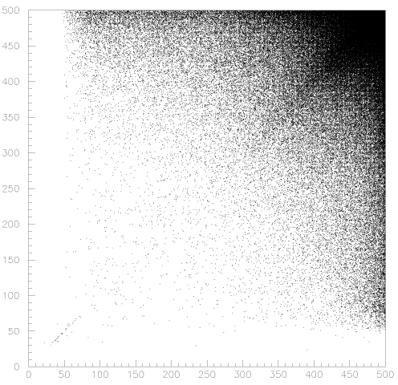
e⁺e⁻→hU, selection 0: kinematics
p₁
two charged tracks, q₁+q₂=0
vertex in a 8(ρ)x30(z) cm cylinder around IP
p_{1,2}< 460 MeV
cosθ_{1,2} < 0.8
cosθ_{miss} < 0.75
p₁ + p₂ > 450 MeV
p_{miss}> 40 MeV
hU, U→μμ
m_{u}
m_{U},m_{h} → bands
p₂
sinθ distribution!
p₁
hu, u→μμ
μμγ
hU, U→μμ
hU, U→ μμ, m_{U}< 300 MeV
µµγ
ππγ
μμγ
not normalised!
cosθ_{1,2}
cosθ_{miss}
p₂

Slide 41
e⁺e⁻→hU, further selections
Missing energy: no unassociated energy depositions on EMC
PID: e/μ (energies in calorimeter planes, E/P, β)
1-ε_{veto}
e ─
µ ─
eeγ(γ) data
cosθ_{miss} < 0.75
P_{miss} with DC only
P_{miss} (MeV)
NN output
Vertex cut to suppress K⁺K⁻ background
ρ_{vtx}
K⁺K⁻→μ⁺μ⁻νν decaying in the IP region
Typical signal efficiency ≈ 20%, with a 10% relative syst. error.
IP
K⁻
μ⁻
hu, u→µµ
K⁺K⁻
K⁺
cut
μ⁺
z_{vtx}

Slide 42
e⁺e⁻→hU: signal efficiency: from MC to data
η_{data}/η_{MC}
ee→μμγ
η_{data}/η_{MC}
ee→μμγ
PID
vtx
cal veto
η_{data}/η_{MC}=0.96 ± 0.01
cosθ_{μμ}
p
K⁺K⁻→μ⁺μ⁻νν
data
MC
Results used to correct the efficiency as from MC and to quote systematic uncertainties
2% difference
EMC unassociated hits

Slide 43
e⁺e⁻→hU: signal efficiency
Efficiency
η
Efficiency for a generic M_{µµ} - M_{miss} combination: interpolation between the two closest available generated points.
PID, vertex and calorimeter veto corrections included
Correction for the fraction of signal outside the central bin included.
Systematics
PID: 8%
Vtx cut: 3%
EMC veto: 2%
Binning effect & interpolation: 5%
Total: 10%

Slide 44
Bayesian limits
n= counts in central bin
m = counts in 24 surrounding bins
Posterior probability for signal
β(b)=1 for b>0
prior for signal and background
g(η,σ_{η}) gaussian, σ_{η}=10%
π(s)=1 for s>0
f = fraction of signal outside the central bin
s_{up}
takes into full account signal+background statistical fluctuations and systematic uncertainties on signal efficiency at the same time

Slide 45

e⁺e⁻→hU, U→e⁺e⁻ ?
During a traffic jam on a Bos(t)on highway
≡ low U mass → electrons

