Slide 1
Status of LHAASO
Updates from ARGO-YBJ
Zhen Cao, IHEP, China
Facility and its scientific goals
Proposing status and Site
Schedule and prototyping
Results from ARGO-YBJ + prototype Ds
4th RICAP, Rome, Italy, 2013

Slide 2
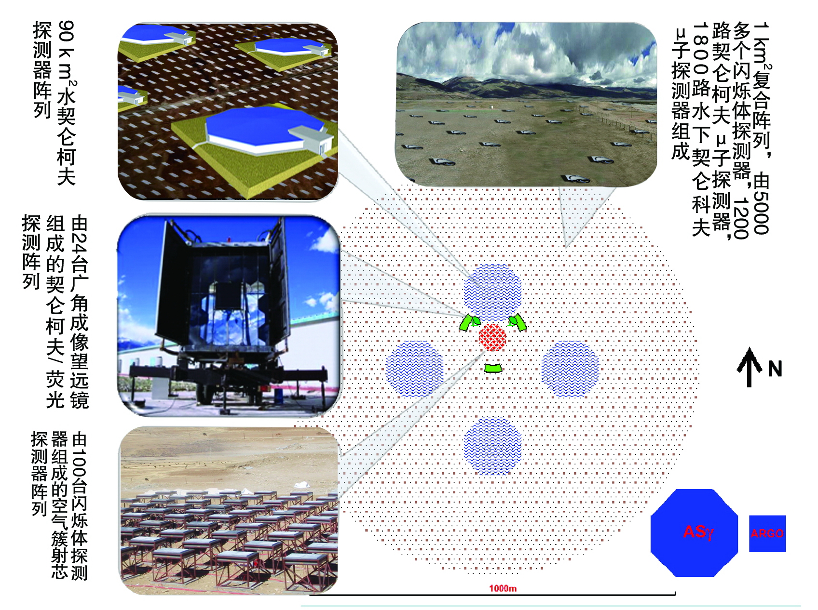
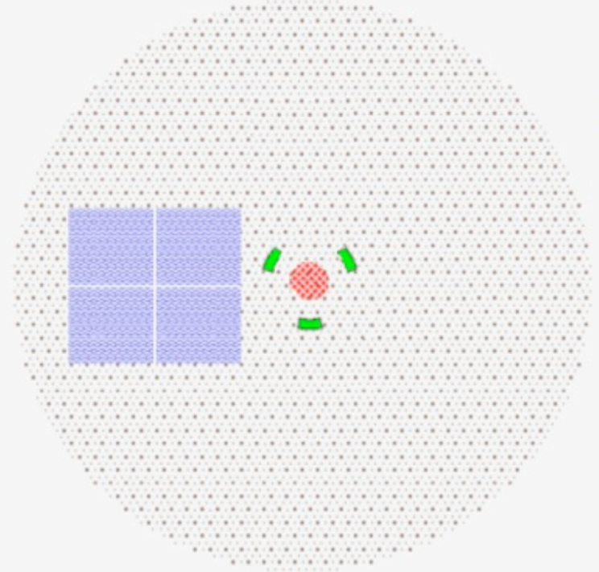
LHAASO——The third generation of survey facility for VHE γray sources
90k square meter
Water Cherenkov
Deter array. Each
one has a size of
HAWC
6100
scintillator
detectors
and 1200
μdetectors
form an
array covering
1 km²
LHAASO Layout in 1 km² at 4300m a.s.l.
24 Wide FOV air
Cherenkov image
Telescopes. For
Air Fluorescence
measurement
above 0.1 EeV also
425 burst detectors
For high energy
Secondary particles
Near the core of air
showers

Slide 3
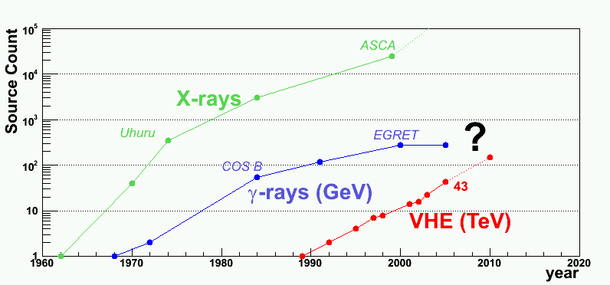
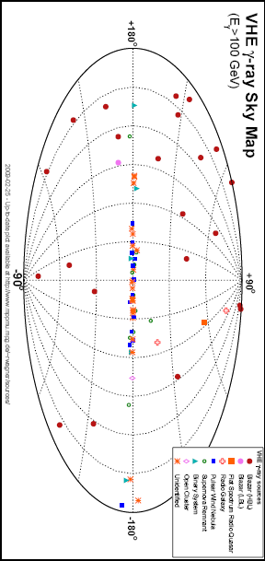
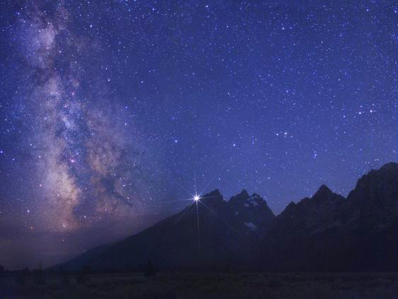
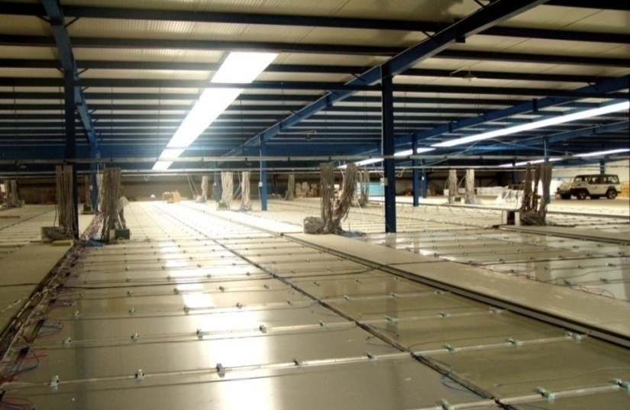
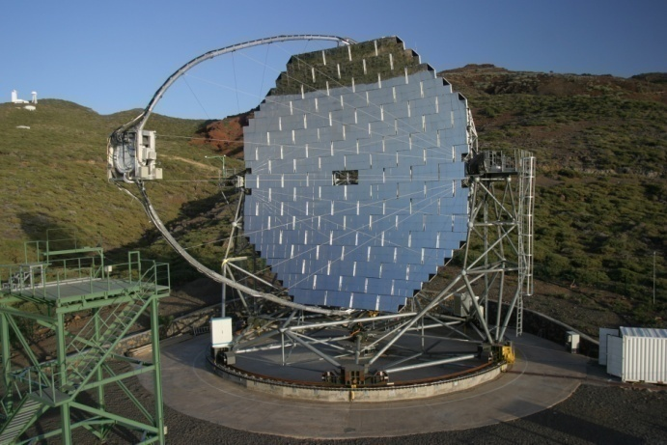
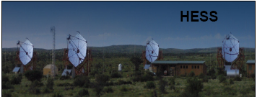
Driven force
FERMI ？
>140 VHE γ sources are discovered in 20 yrs
  HESS, MAGIC and VERITAS
  are major players
CTA is one of the major players in
the future using pointing device
All sky survey is other way to play
Very deep field
Survey
mode

Slide 4
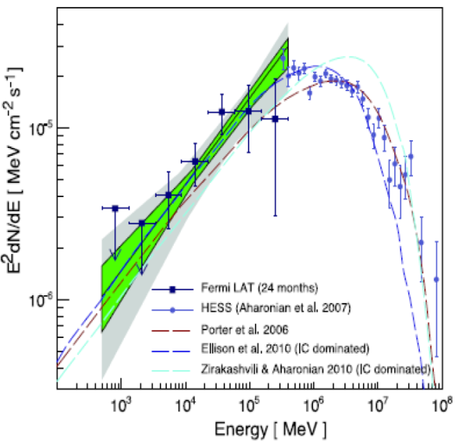
Survey for γ-sources very detailed spectroscopy investigation
( a few hundred extra-galactic sources are expected )
？

Slide 5
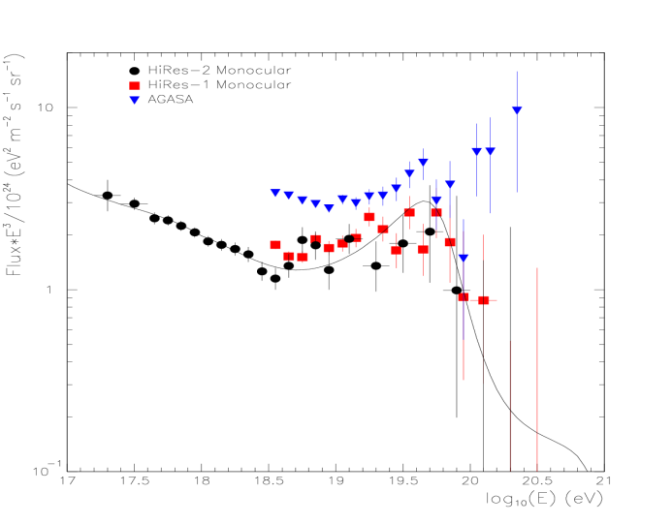
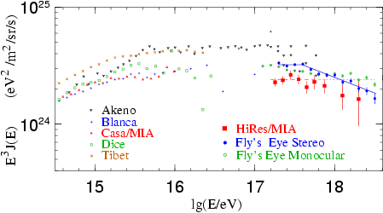
CR spectra of individual spices over two knees with uniform energy scale and direct measured composition in the space
Tower CT: 16
μ : 100x400m²
Side Trigger CT: 2x4
W S
C C
D D
A A
+
W
F
C
T
A
K
M
2
A
+
T
U
N
K
A
K T
M U
2 N
A K
A
+
F
T
A
A
R
G
O
+
W
F
C
T
A
A
R
G
O
Multi-parameter hybrid
observation of showers

Slide 6
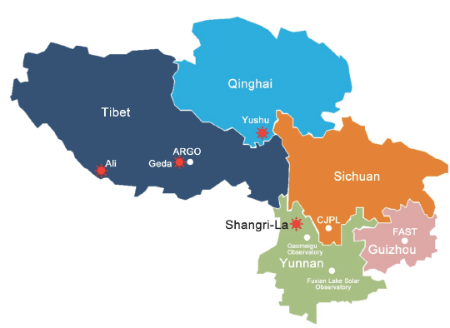
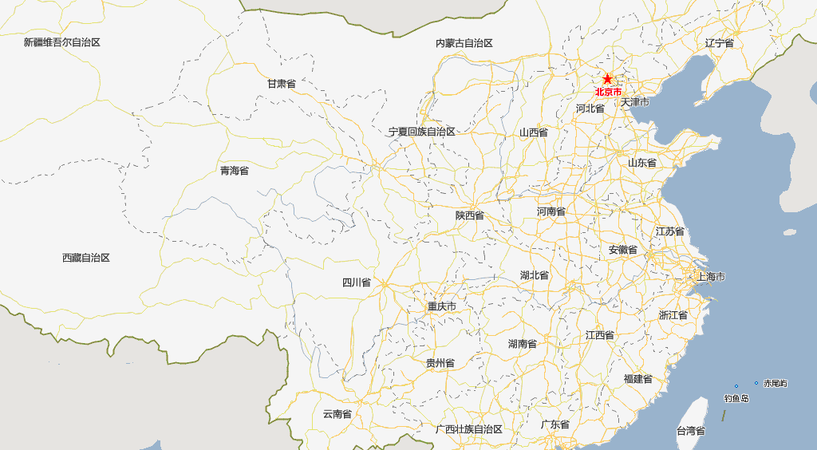
The Best Candidate Sites
ARGO-YBJ
site
LHAASO
site
O-Tele Ф2.4m at ~200km
Solar Tele Ф2m at ~700km
JP Underground Lab at ~400km
FAST-Radio Tele Ф500m

Slide 7
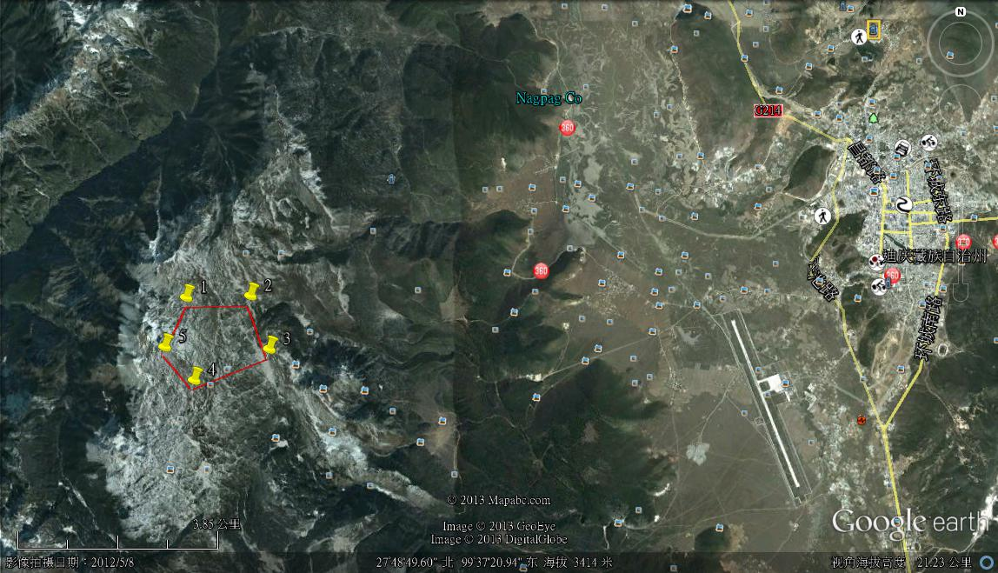
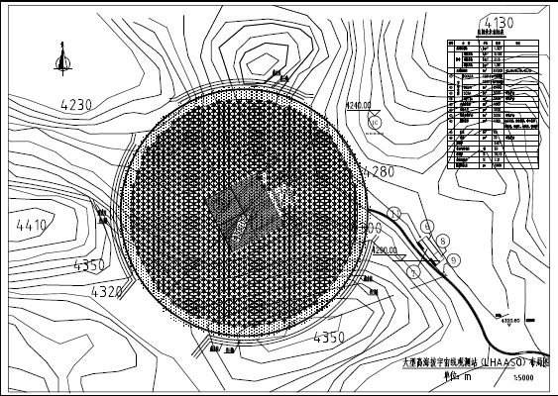
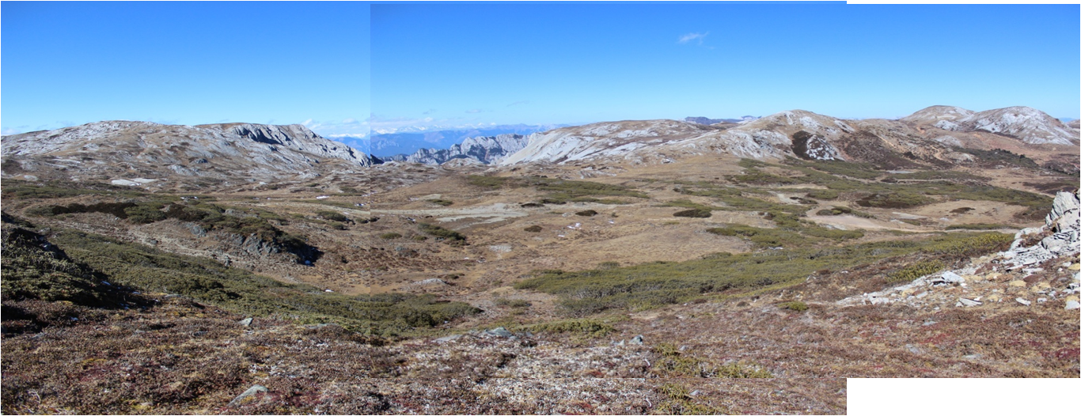
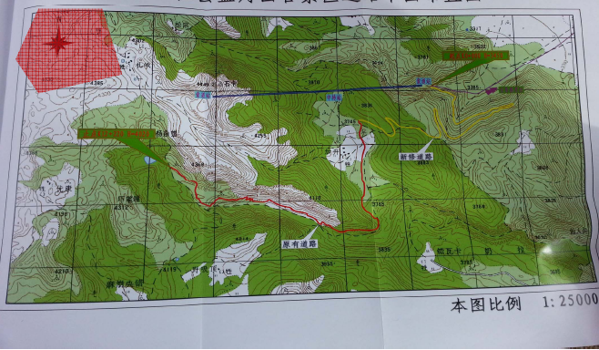
Geo-location of the Shika site
13km
10km
Decided by IHEP and local gov in 2012-12

Slide 8
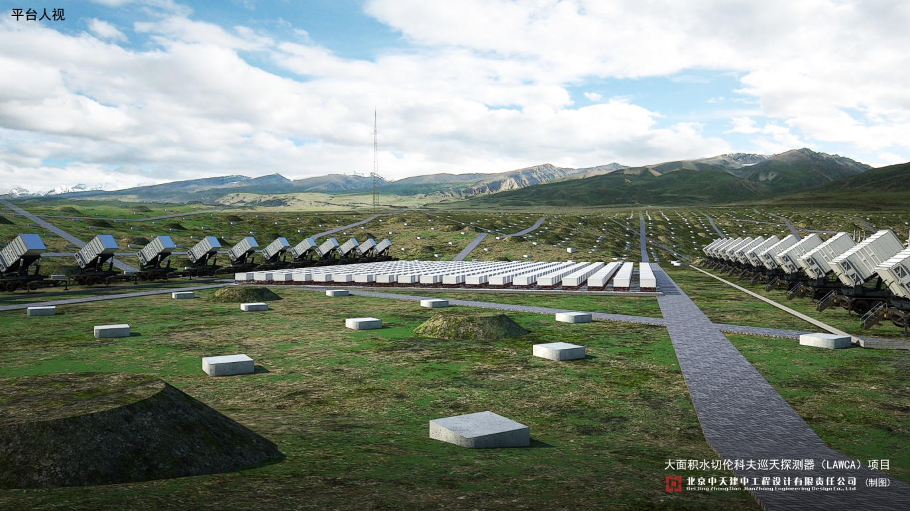
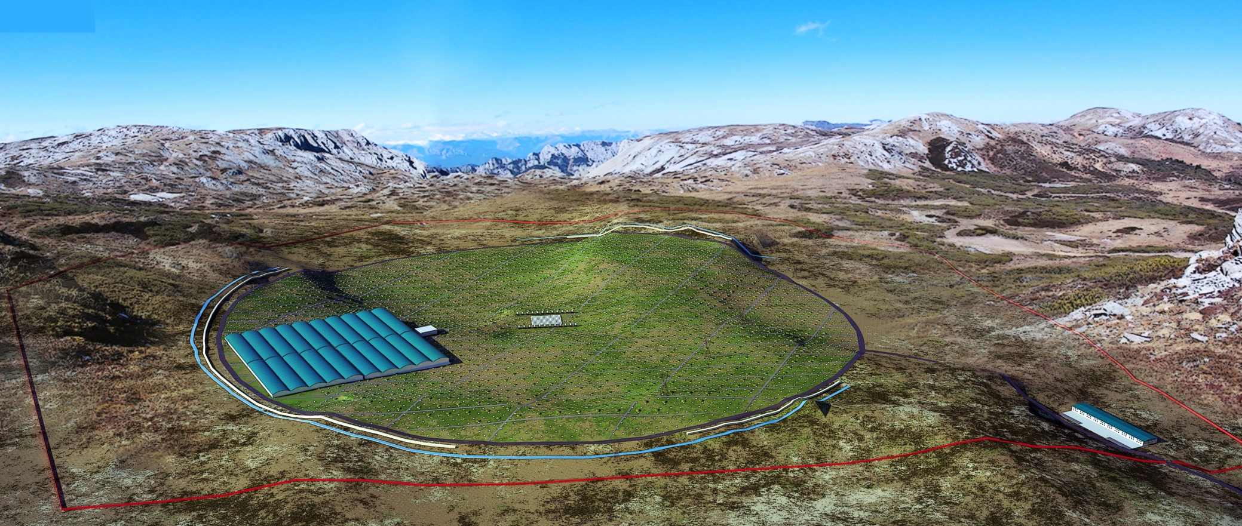
LHAASO layout
Central detector
array for
cosmic rays
90k m² gamma ray survey telescope
1M m² surface EAS detector array

Slide 9
Status of LHAASO
16 projects for 5 years as a package has been formally approved by the council of state 2 weeks ago
The formal proposal to CCDR is ready to submit in weeks
A couple of steps ahead: environment impact evaluation, feasibility reviewing, TDR reviewing
Selected site has been approved by the local land management. Trade negotiation is under going with province government
Construction is expected to start next year
All technologies are tested

Slide 10
Observatory Construction
It is planned for a construction of 5-6 years
yrs
Detector R/D： 1.5
FEE R/D: 2
FEE Production: 1.5
DAQ & installation: 0.5
Detector deployment: 4
1% array test run: 1
6 yrs
now
All technology that will be used in LHAASO are
tested with engineering arrays at scales of
1%-10% of the full project

Slide 11
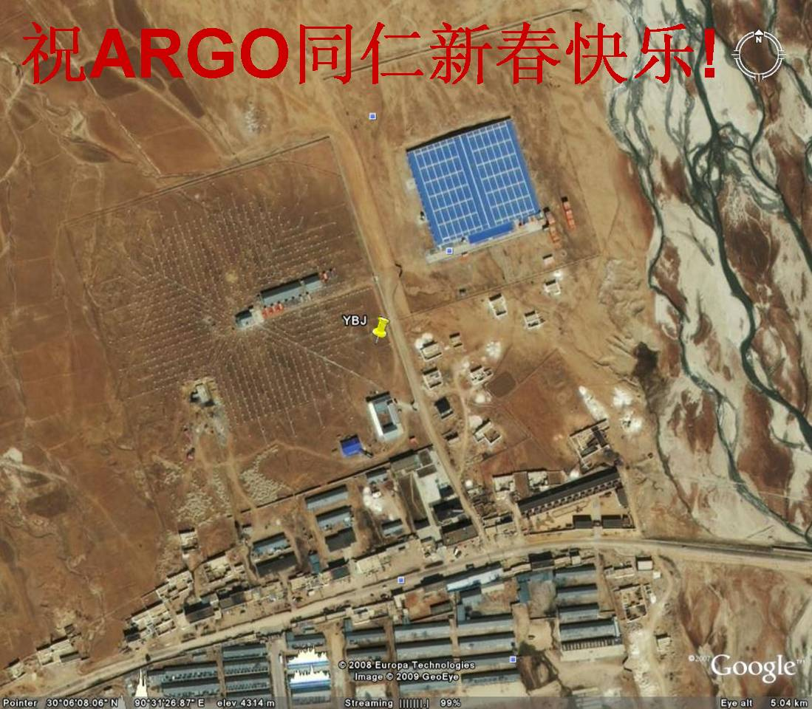
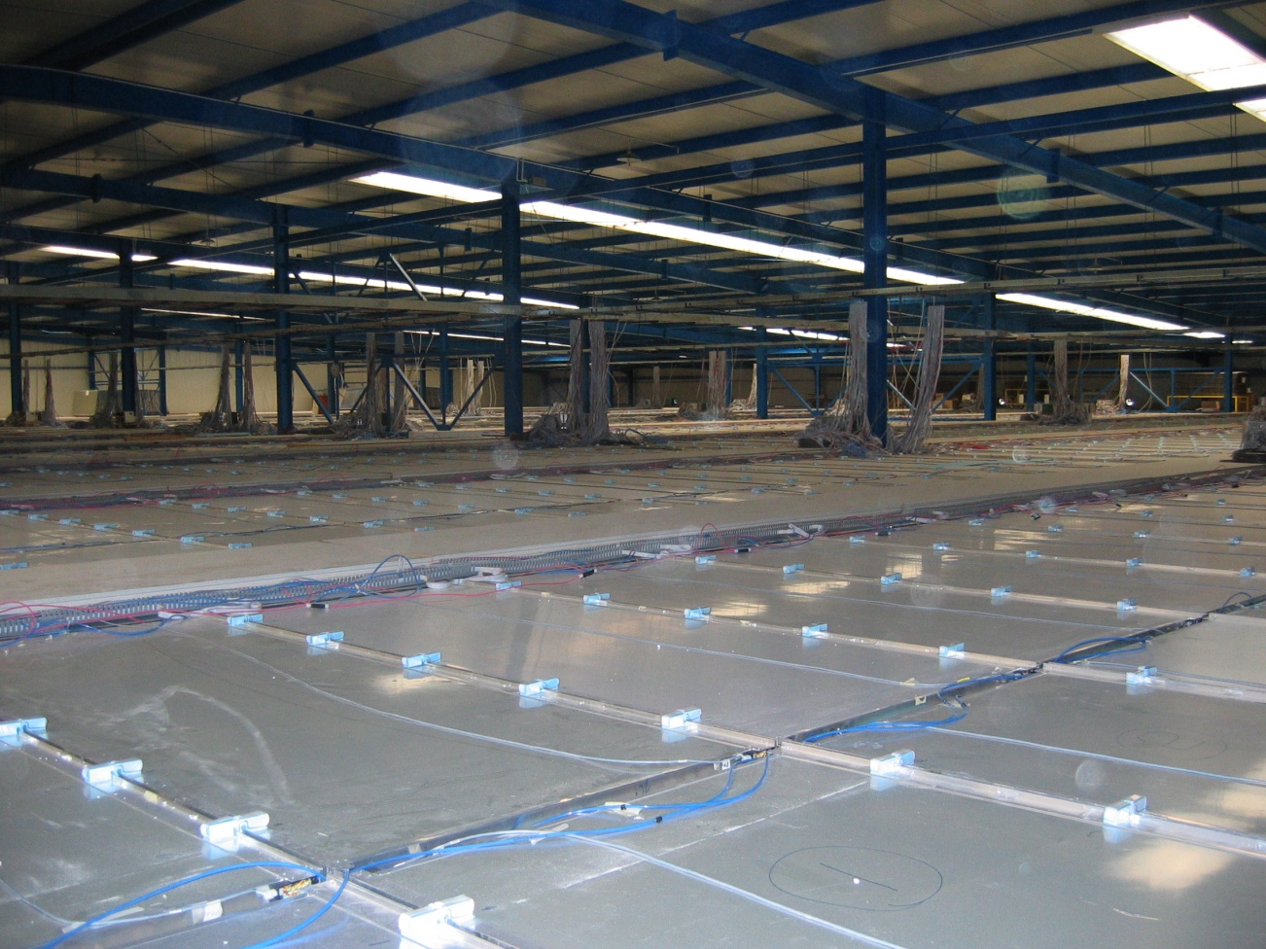




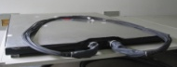


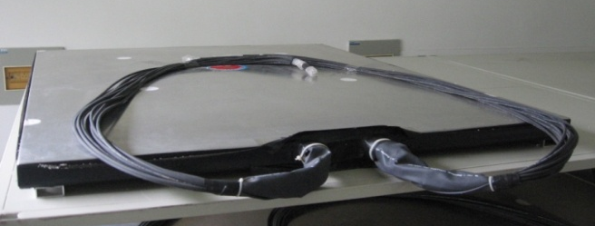
Prototype of LHAASO at Tibet site
1% engineering array near the ARGO detector with a budget of ~1M euro since 2009
μ

Slide 12
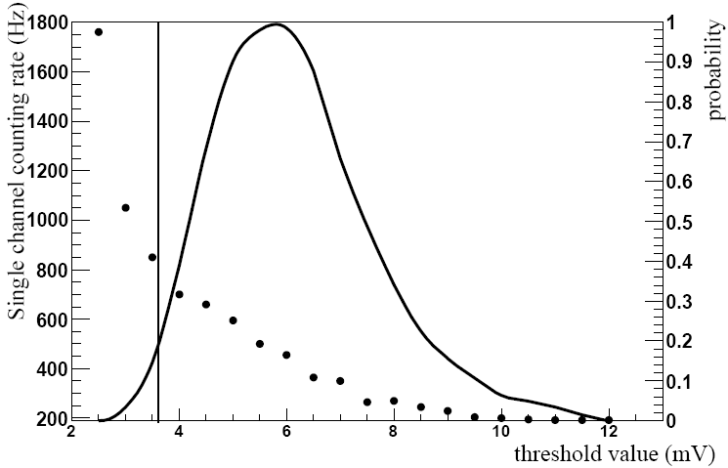
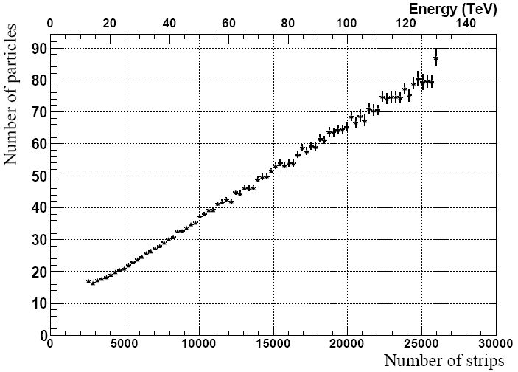
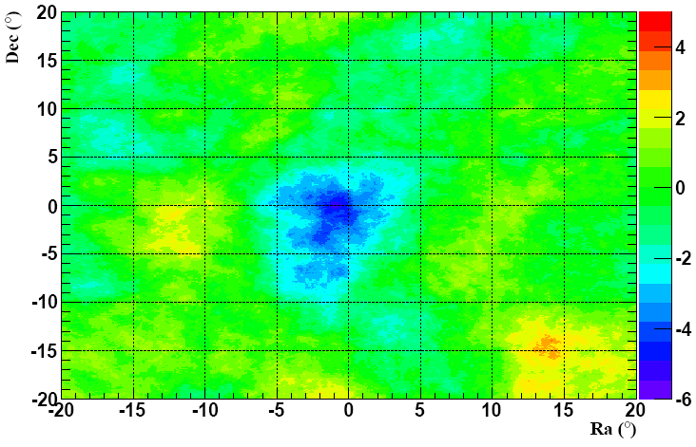
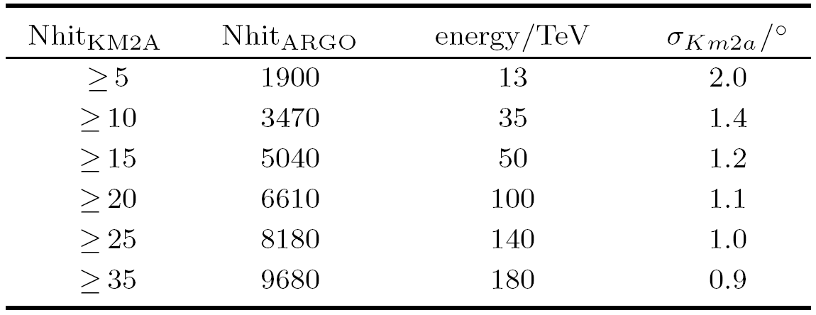
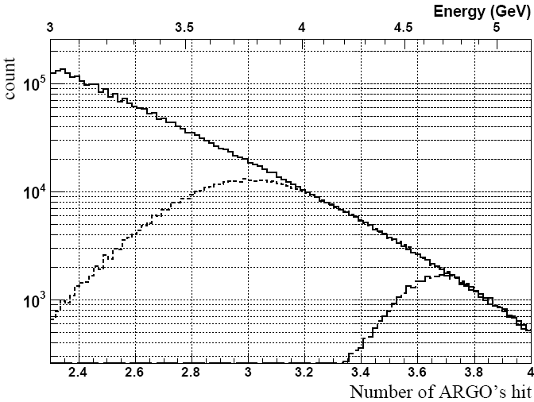
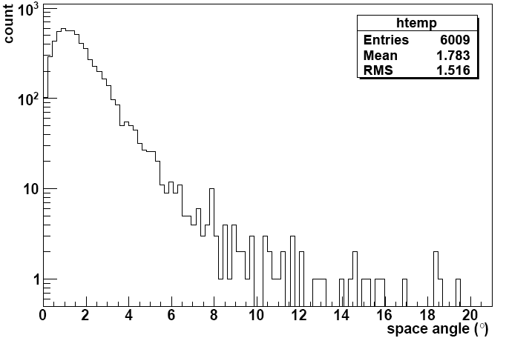

Slide 13
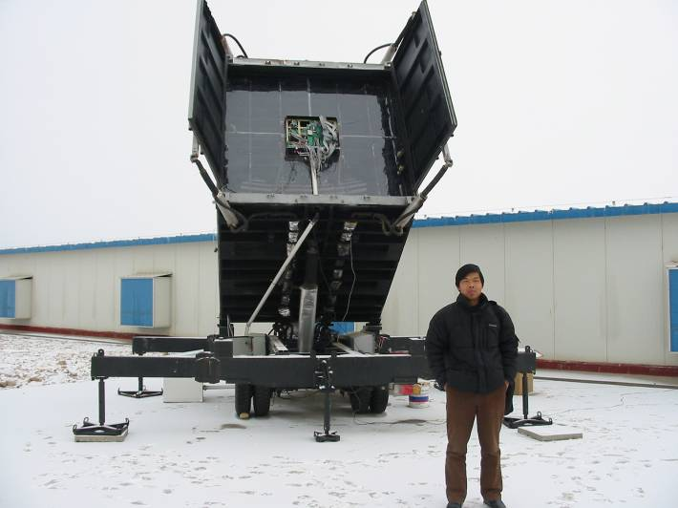
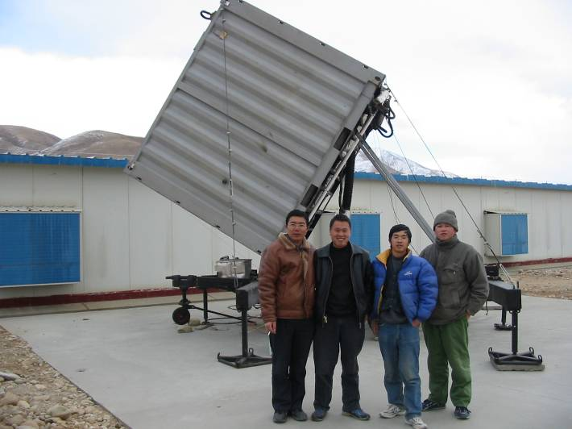
Prototype of LHAASO at Tibet site
1% engineering array near the ARGO detector with a budget of ~1M euro since 2009
μ

Slide 14
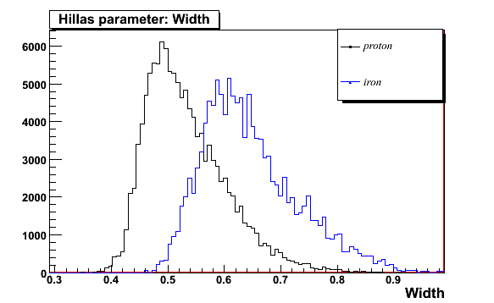
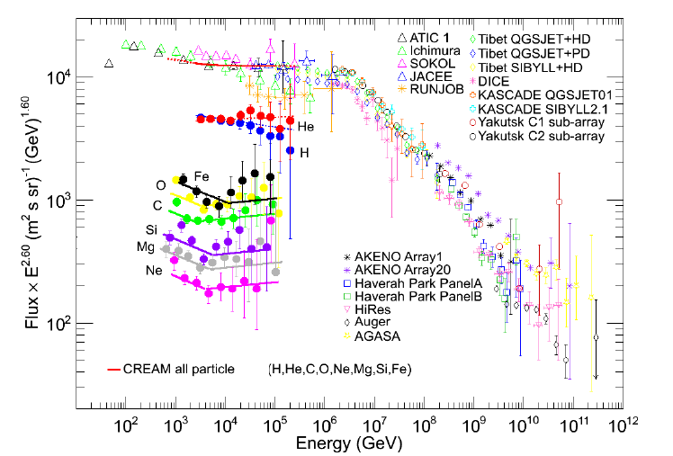
Spectrum for Individual specie
Non-bias for every specie
High resolution detection

Slide 15
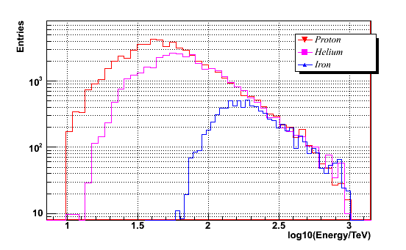
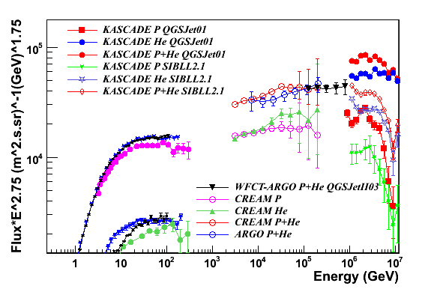
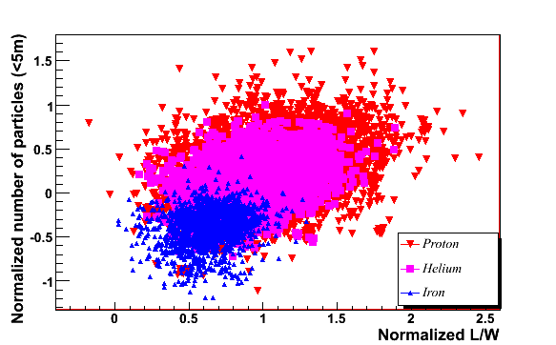
  100TeV – 800 TeV, with contamination
  of heavy component less than 7.2%
 | proton | helium | iron
primary | 33.3% | 33.3% | 33.3%
trigger | 36.0% | 35.9% | 28.1%
After cut | 55.7% | 43.3% | 1.0%
100TeV-1peV
After cut:
Left: proton 82%
Helium 74.7%
To be sent to Astrophys.J. (2012)

Slide 16
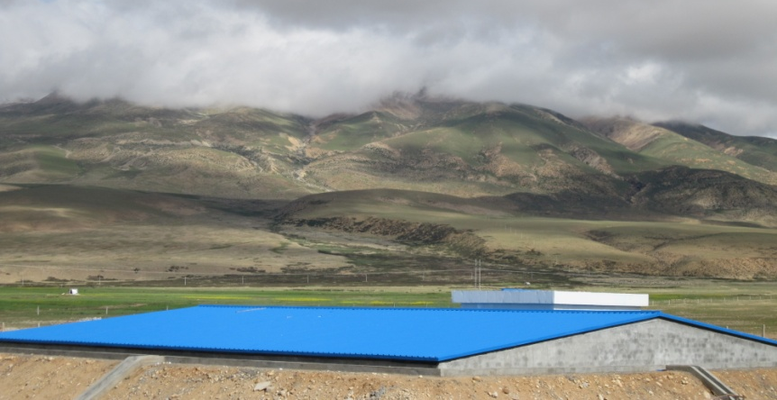
Prototype of LHAASO at Tibet site
1% engineering array near the ARGO detector with a budget of ~1M euro since 2009
μ

Slide 17
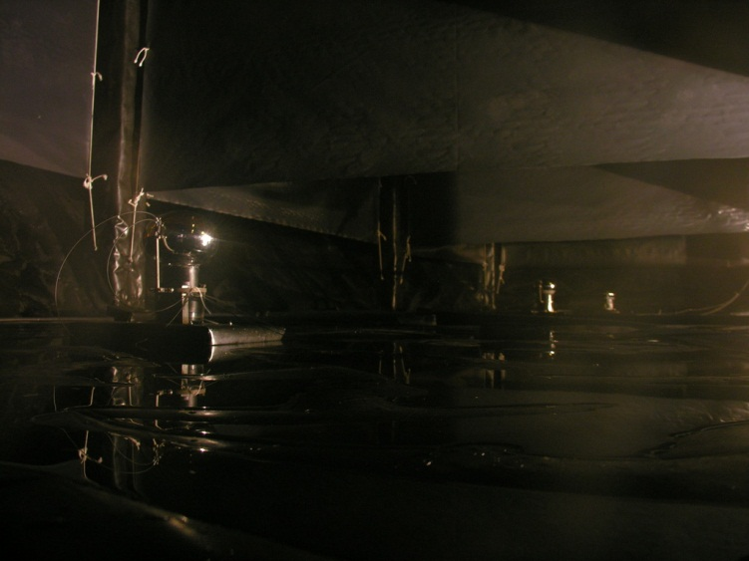
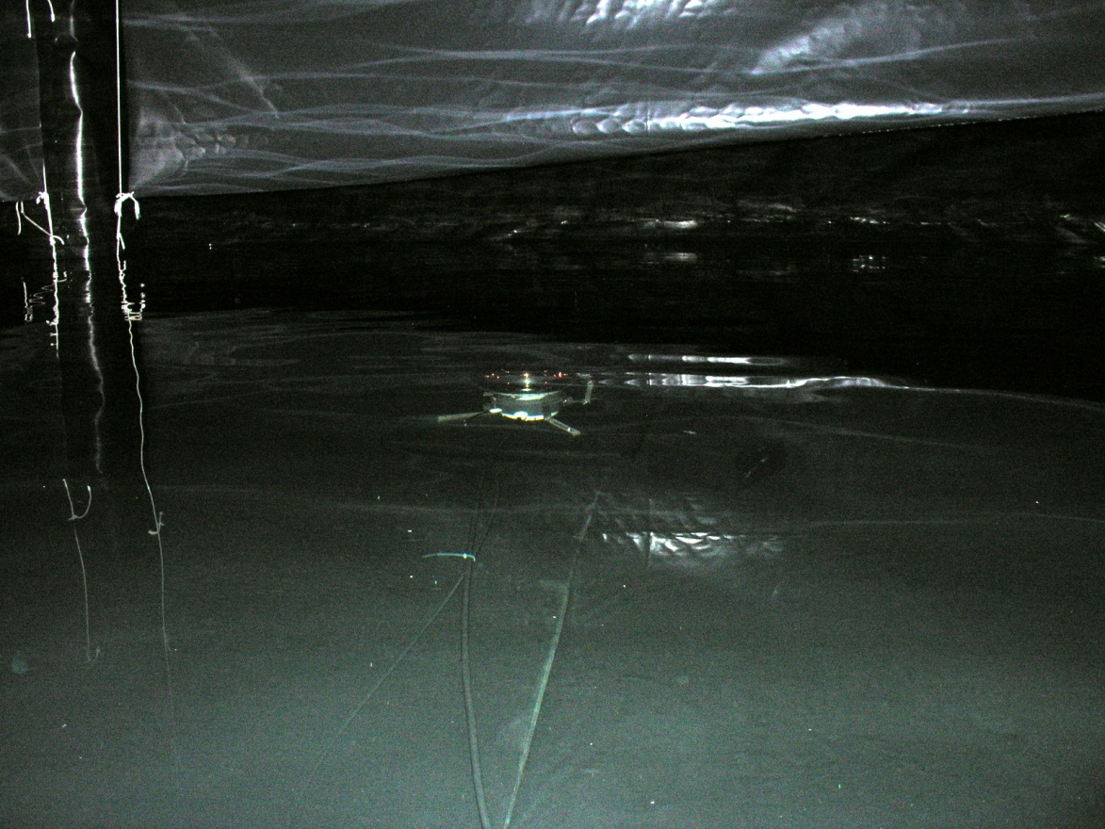

Slide 18
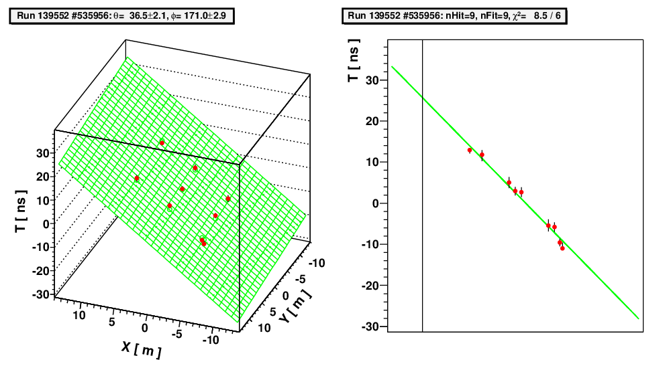
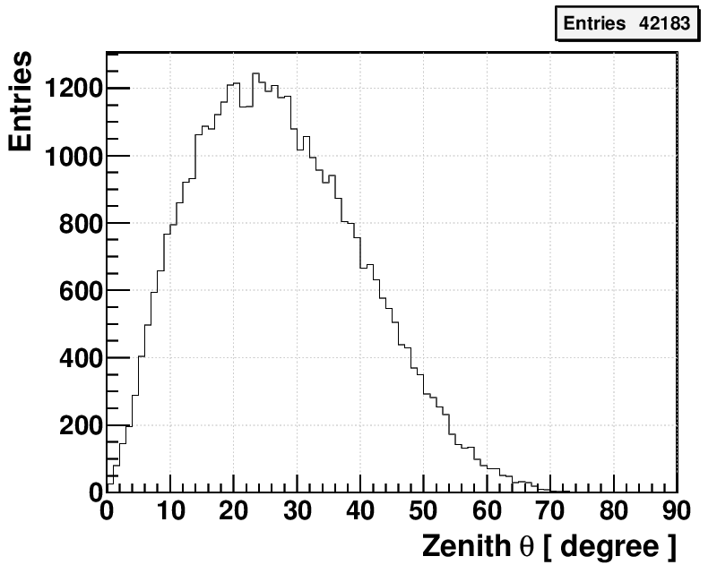
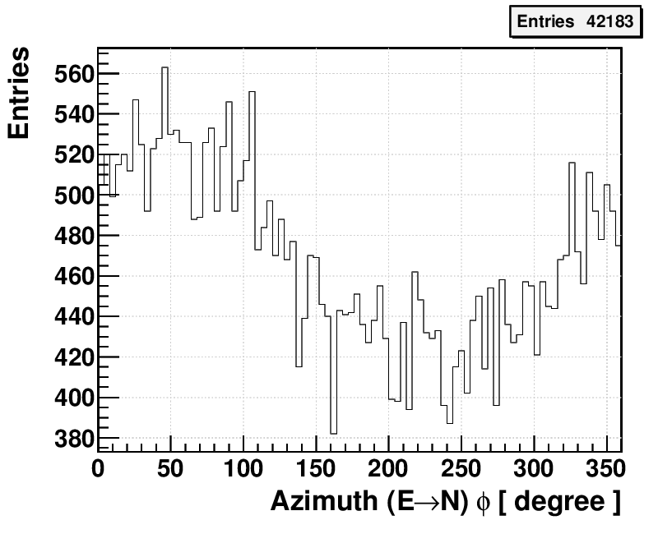
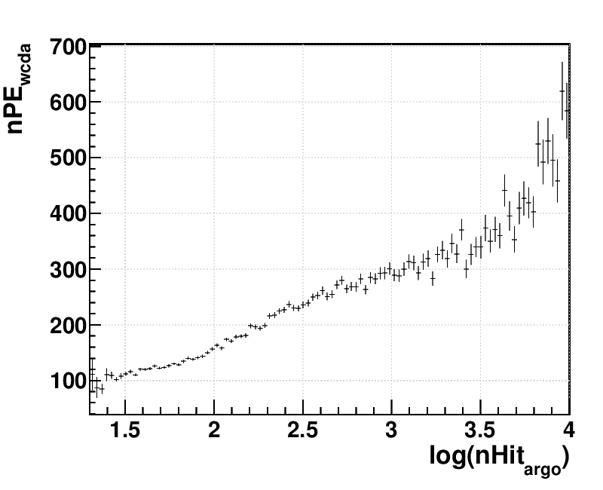
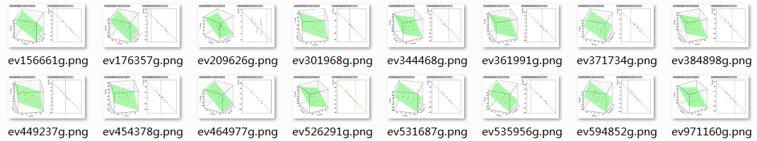
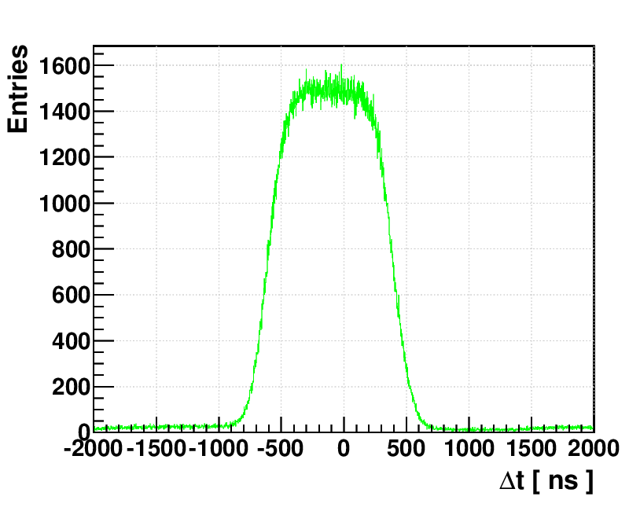
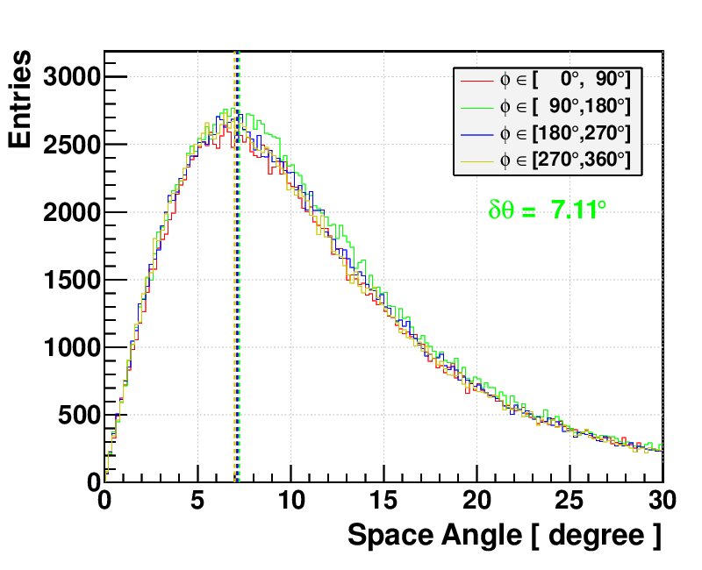
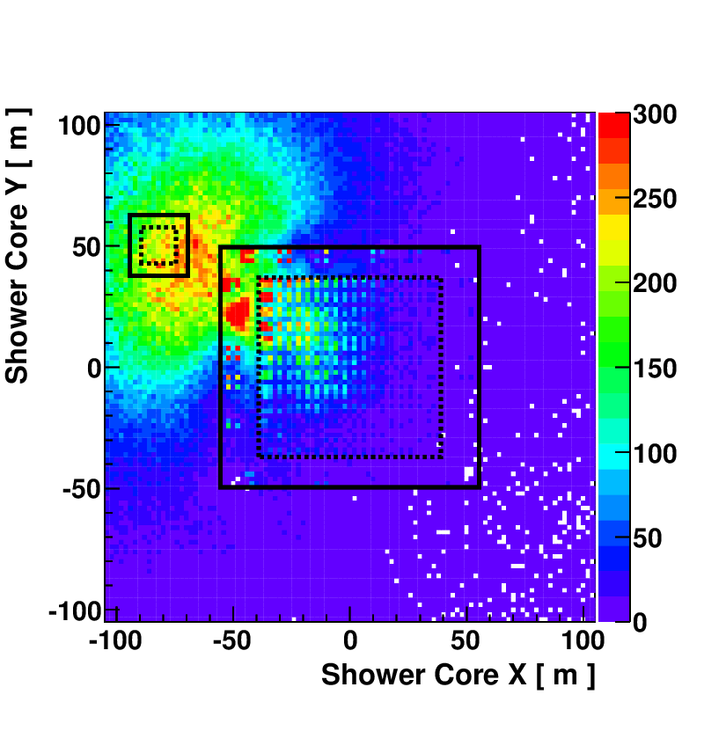
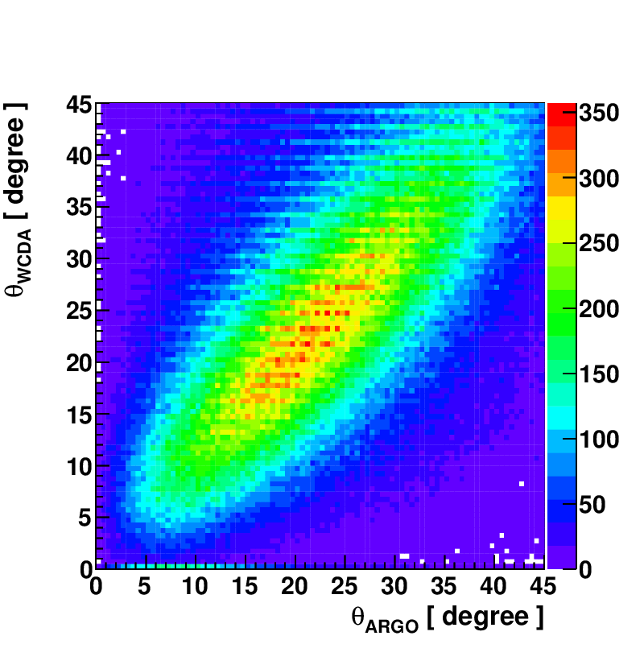
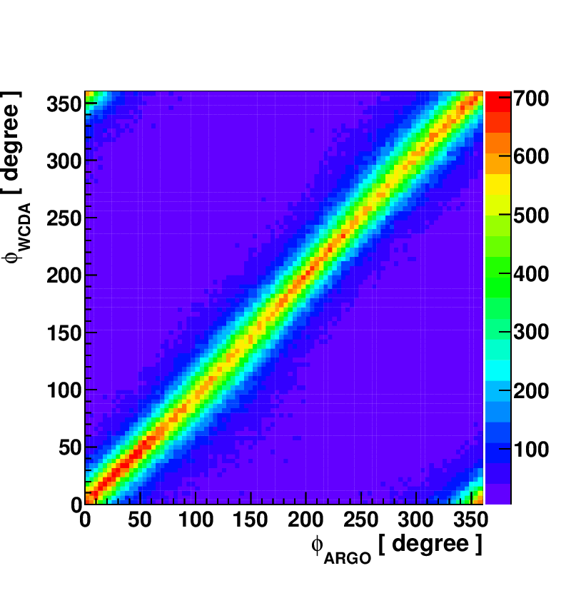
Event Reconstruction and
Offline Coincidence with ARGO-YBJ

Slide 19
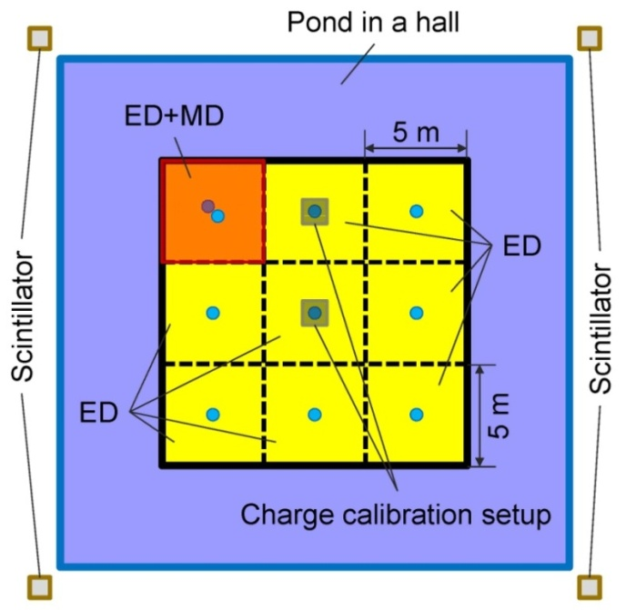
Status of LAWCA
NSFC is reviewing on the project
The final review is scheduled on June 17th
9-unit prototype has been running at YBJ for 2yr
Construction will start next month if approved
900 units
22,500m²

Slide 20



LAWCA: Detector Layout
An L-shaped water pool:
  North-East of ARGO-YBJ hall;
  23,000 m²;
  4.5 m depth;
  900 cells, with an 8” PMT in each cell;
  Cells are partitioned with black curtains.

Slide 21


Water Pool
Requirements:
  water-proof: loss <1/1000 volume/day;
  light-proof: luminous flux (300-650 nm) <100k photons/m²/s;
  tolerance to snow, rain, wind, dust, earth-quake;
  anti-icing;
  clean water compatible;

Slide 22


Effective Area & Sensitivity
Effective area:
  500 m² @ 100 GeV;
  30,000 m² @ 1 TeV;
  60,000 m² @ 5 TeV.
Sensitivity:
  0.1 CRAB @ 1 TeV;
  0.06 CRAB @ 5 TeV。
  ~10x better than ARGO-YBJ.
4个¼ 阵列

Slide 23





ARGO-YBJ Experiment
5600m²
full coverage RPC at 4300m a.s.l.
3.6K Hz event rate
E_{th} ~ 300GeV
0.8° @ M>100
Sens ~ 0.6I_{Crab}

Slide 24

Improvements by ARGO
Improvement in sensitivity:
  ARGO will become a standard (even better) “water Cherenkov detector” with an area of >5500m² (a Q factor of >1.2 for LAWCA), a Q factor of >10 for ARGO@1.6TeV→~0.07 I_{crab}.

Slide 25



France: IPNO/LAL/Omega collaboration on ASIC FEE
PARISROC-II based currently
LHAASOROC in future
Simulation for water Cherenkov muon detectors
Simulation for shower measurement using KM2A
ASIC development
PMT base design and tests

Slide 26






Russia：EAS Detection using thermal neutrons is tested @YBJ
ARGO-bigpad
PRISMA-YBJ: pulses
PRISMA-YBJ: Ne
PRISMA-YBJ: neutrons

Slide 27
Conclusion
A ground based large and complexγ/CR observatory at high altitude (4300m a.s.l.) within 5years
  Complementary to CTA in γastronomy
  Unique for CR measurements at the knees
  Useful for exploring for new physics
Engineering prototype at Tibet site is running
The construction of the mega-project is expected to start in next year, LAWCA is on its way this year

