Slide 1
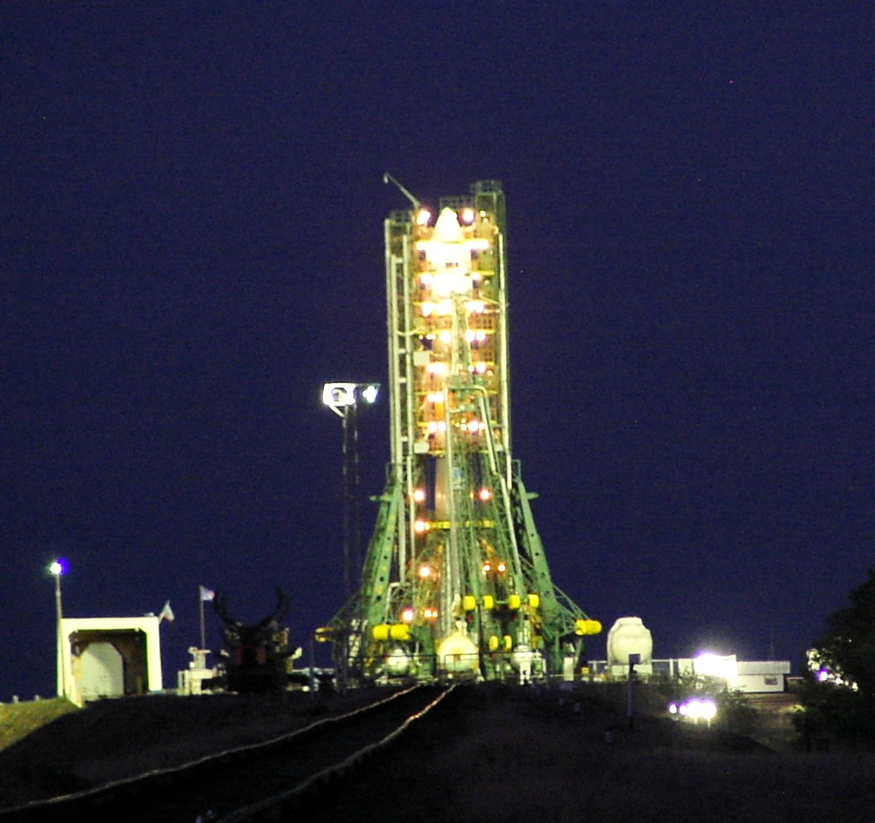



The Pamela cosmic ray observatory for high precision measurements at 1 AU
M. Casolino
INFN & University of Rome Tor Vergata
RIKEN
on behalf of the PAMELA collaboration
15/8/2011

Slide 2

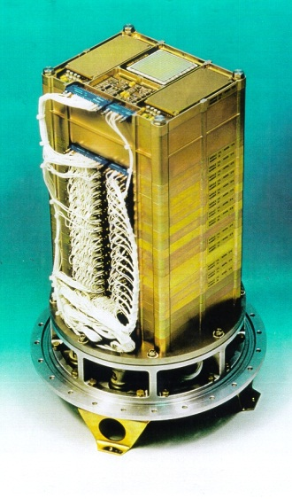
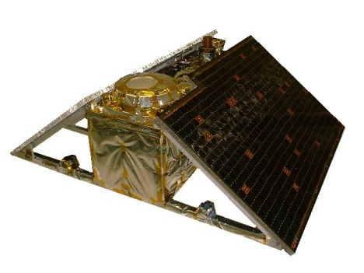
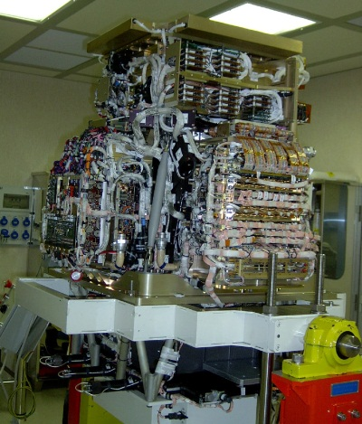
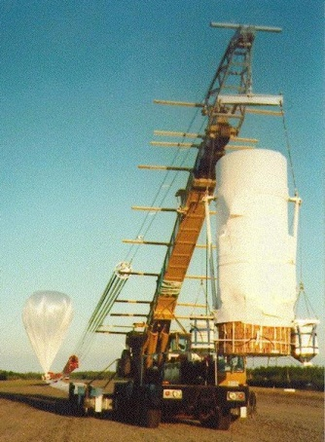
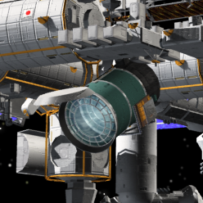
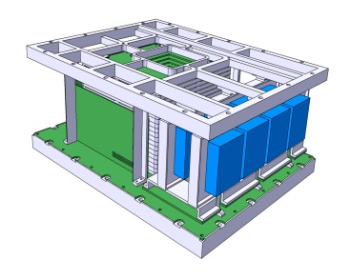
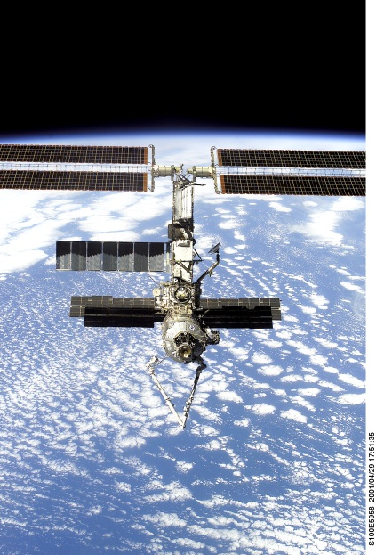
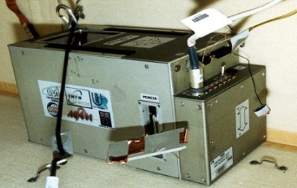
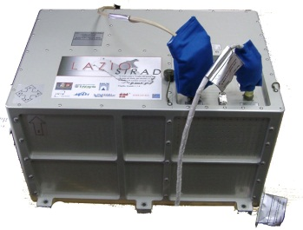
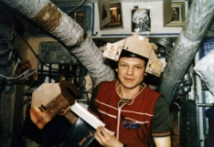
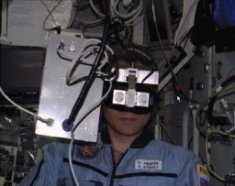
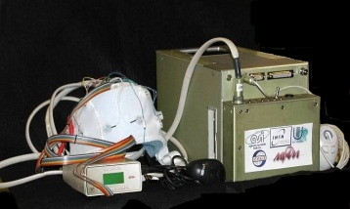
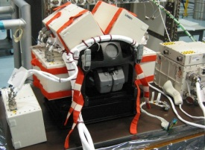
Past, present and future experiments
MASS-89, 91, TS-93, CAPRICE 94-97-98
PAMELA
NINA-2
JEM-EUSO
NINA-1
M 89
M 91
TS 93
C 94
C 97
C 98
PAMELA
… 1989 1990 1991 1992 1993 1994 1995 1996 1997 1998 1999 2000 2001 2002 2003 2004 2005 2006 ...
LAZIO-SIRAD
NINA-1
NINA-2
SILEYE-1
SILEYE-2
SILEYE-3
ALTEA
SILEYE-3/ ALTEINO:
LAZIO-SIRAD
SILEYE-4/ALTEA
SILEYE-1
SILEYE-2

Slide 3
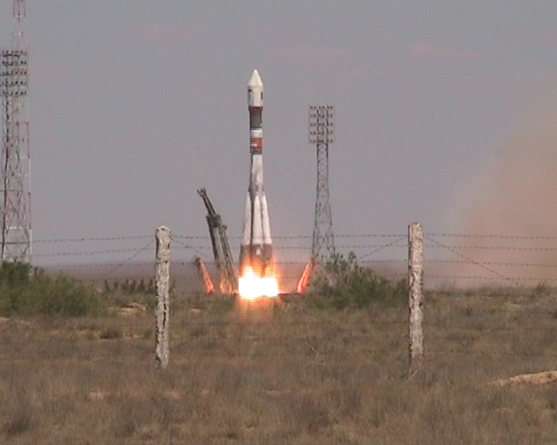
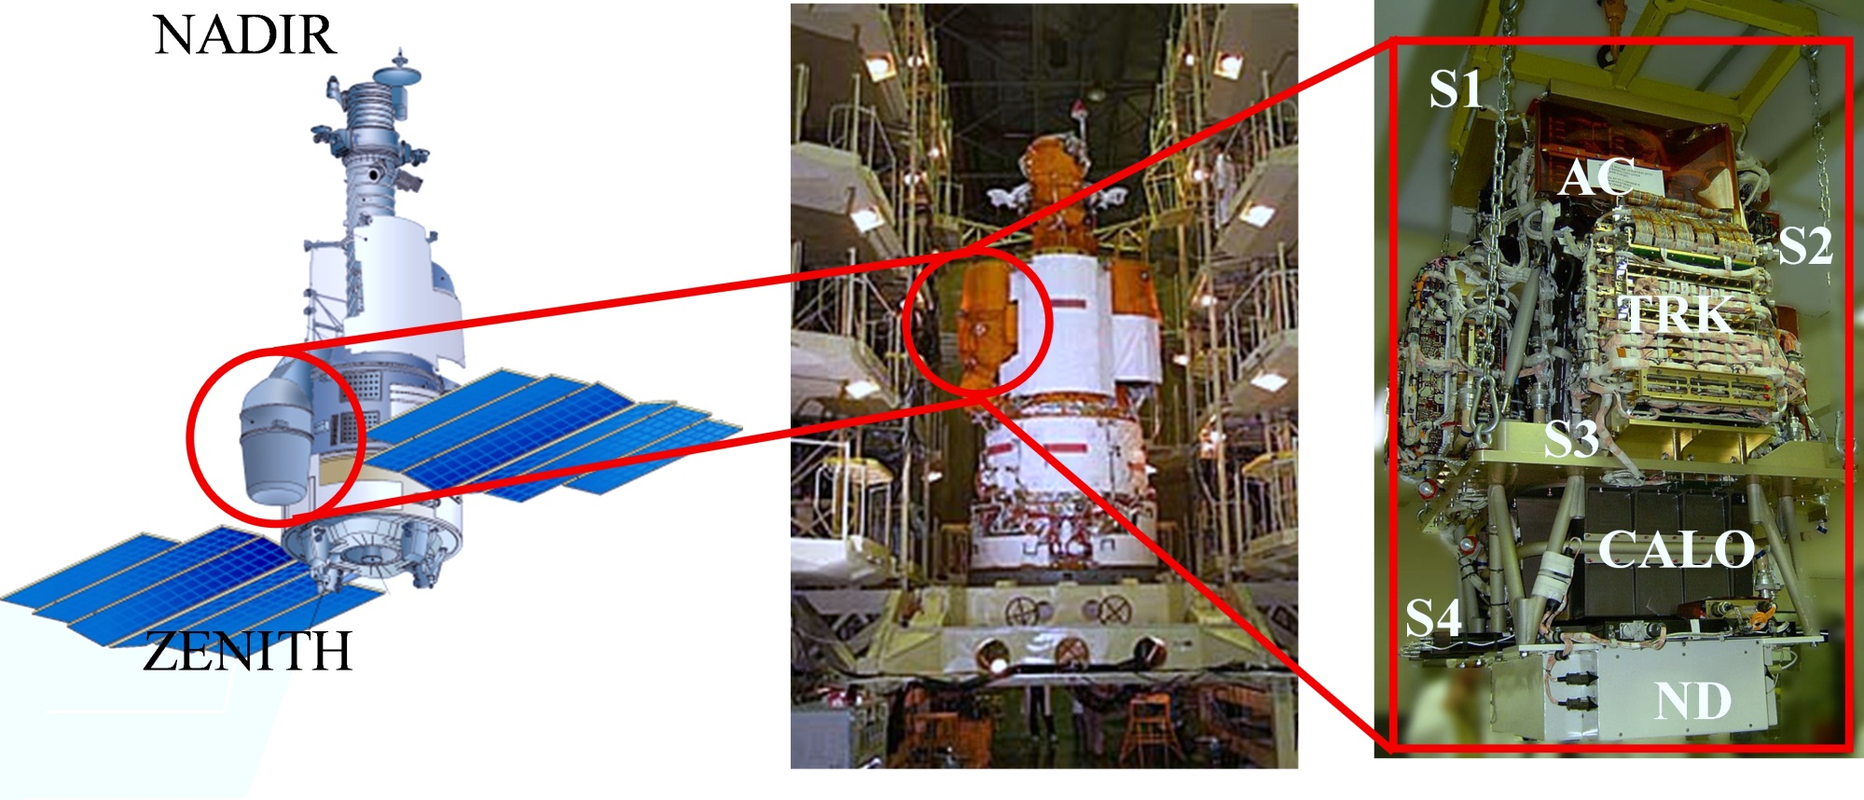
PAMELA, launched on June 15th 2006 Soyuz-U rocket
6.9 years out of 3 originally foreseen

Slide 4
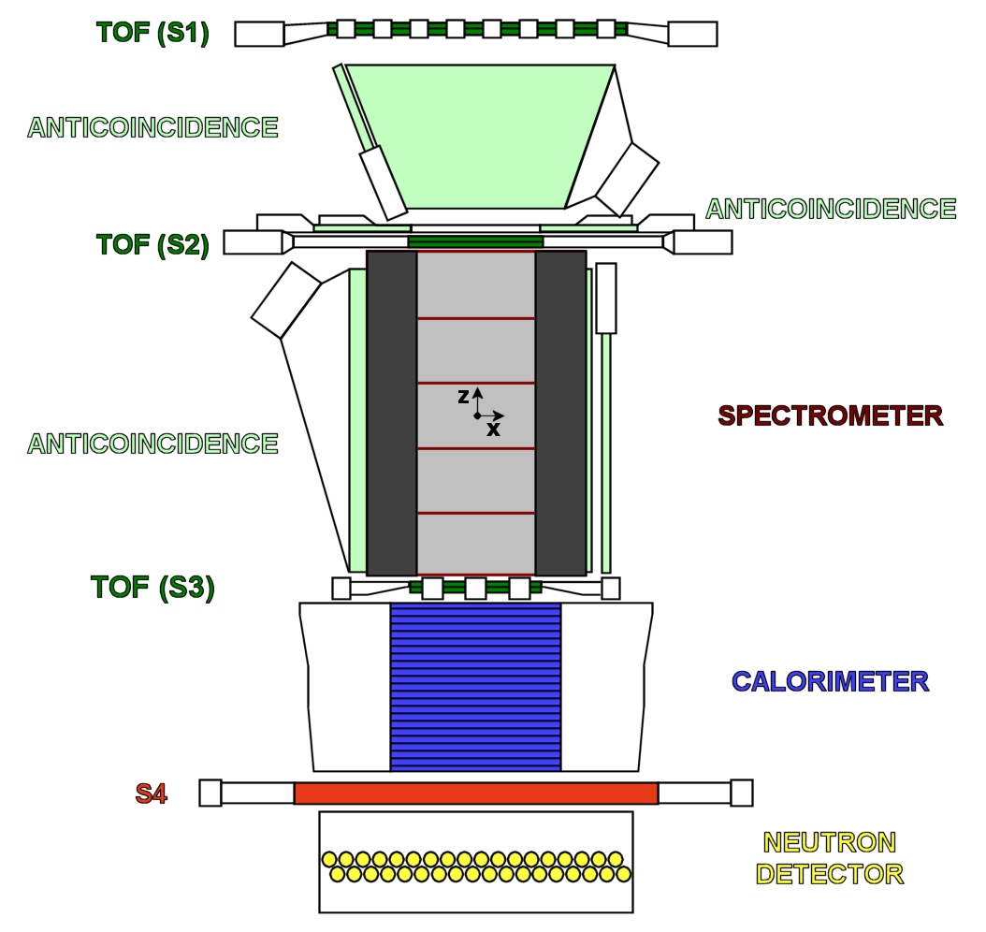
The PAMELA apparatus
Spatial Resolution
≅ 2.8 μm bending view
≅ 13.1 μm non-bending view
MDR from test beam data ≅ 1 TV
Calorimeter Performances:
p/e⁺ selection eff. ∼ 90%
p rejection factor ∼ 10⁵
e⁻ rejection factor > 10⁴
GF ~20.5 cm²sr
Mass: 470 kg
Size: 120x40x45 cm³
Power Budget: 360 W
ND p/e separation capabilities >10
above 10 GeV/c, increasing with energy

Slide 5
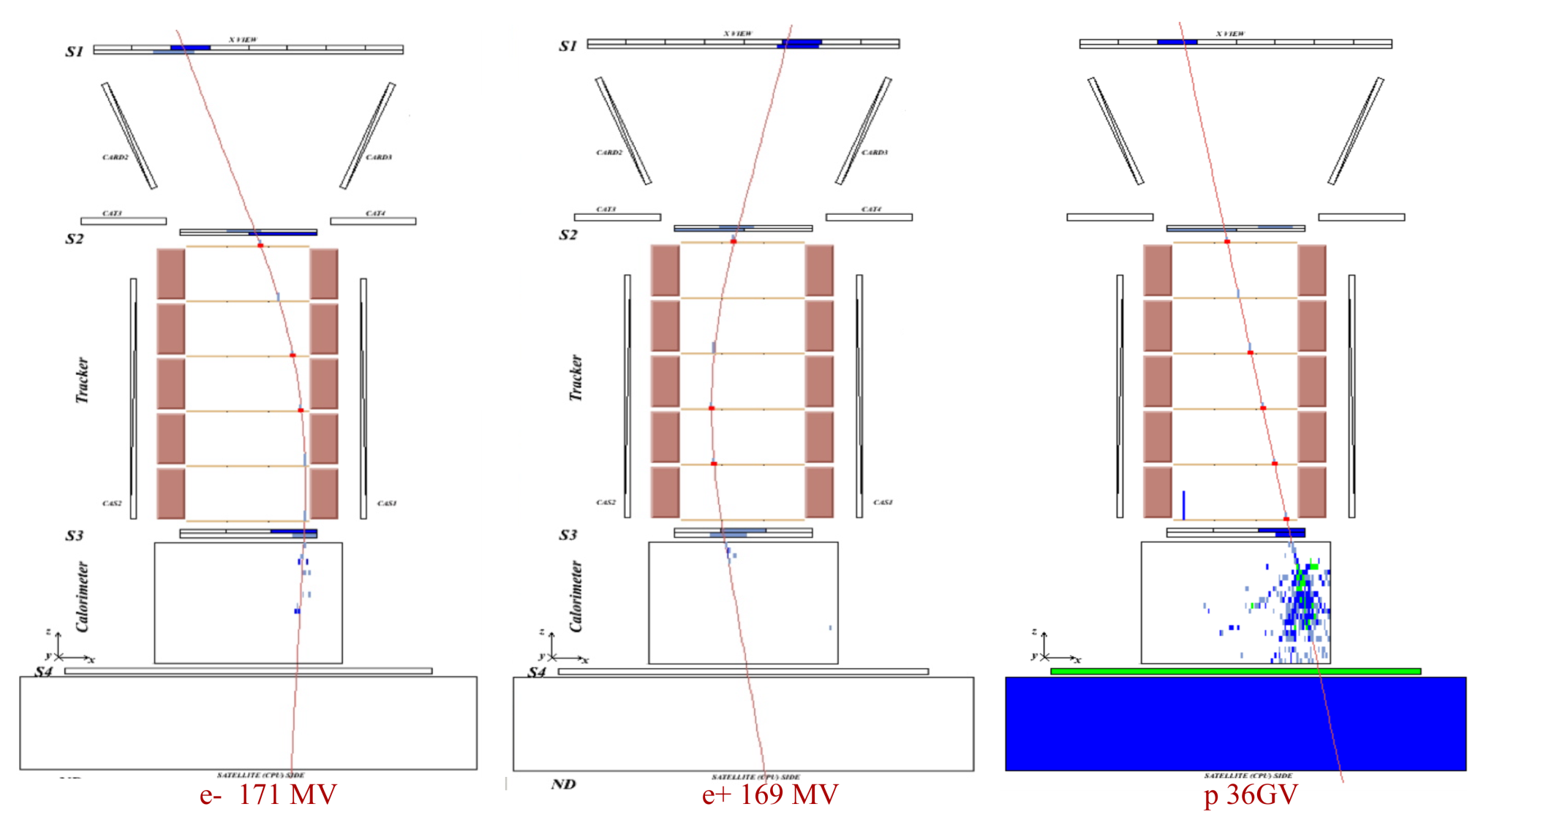
Electrons
Positrons
Protons

Slide 6
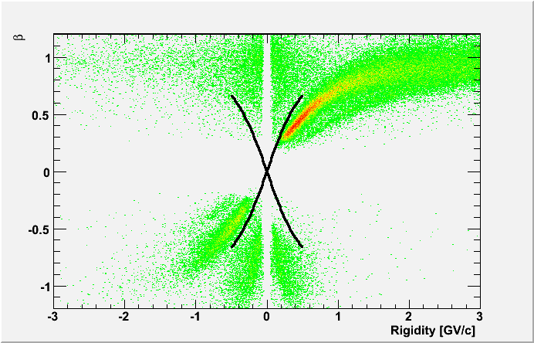
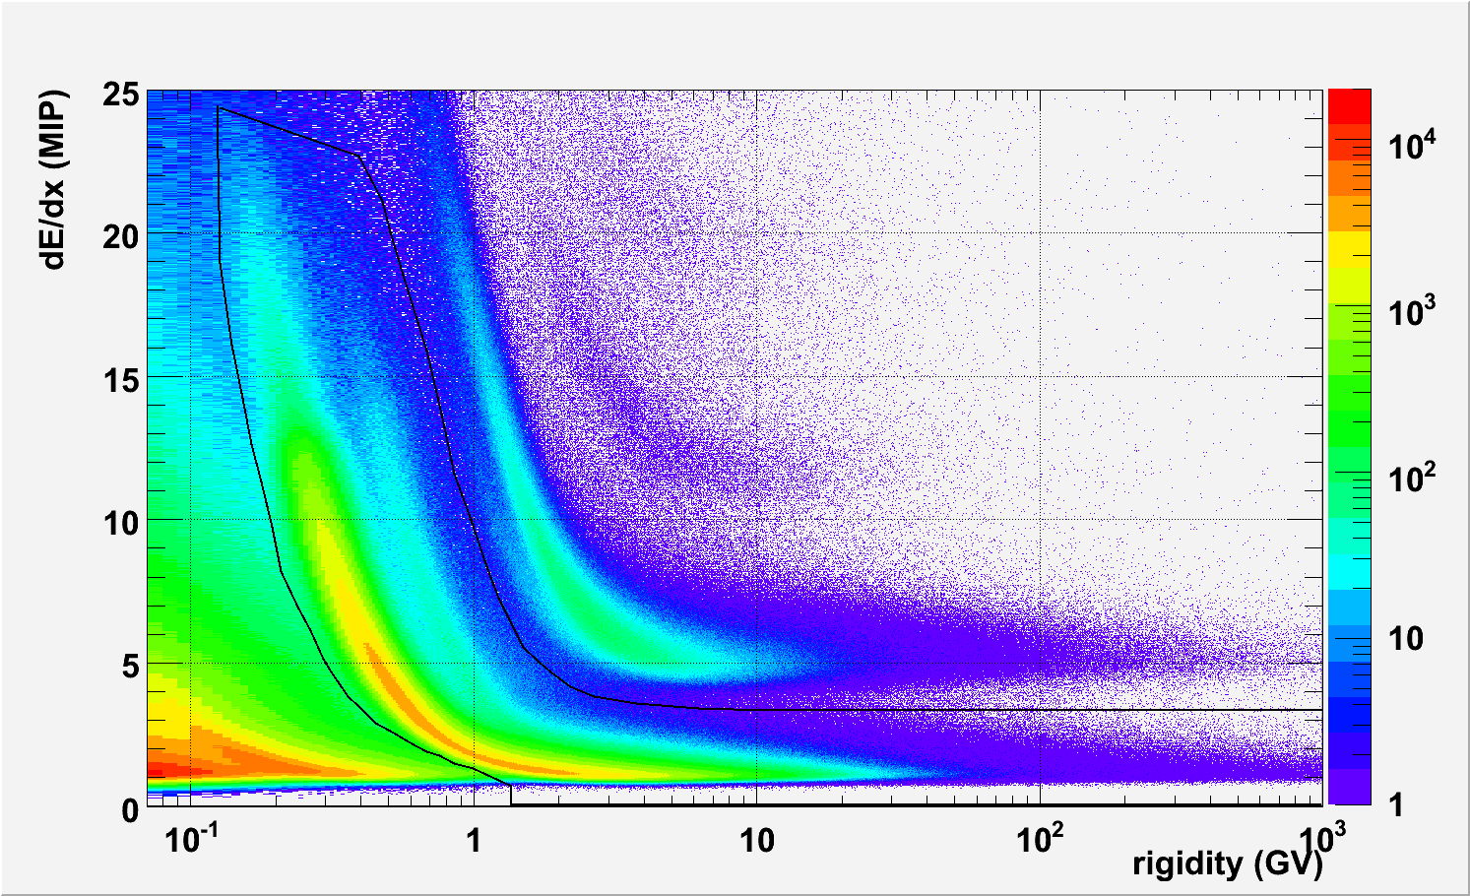
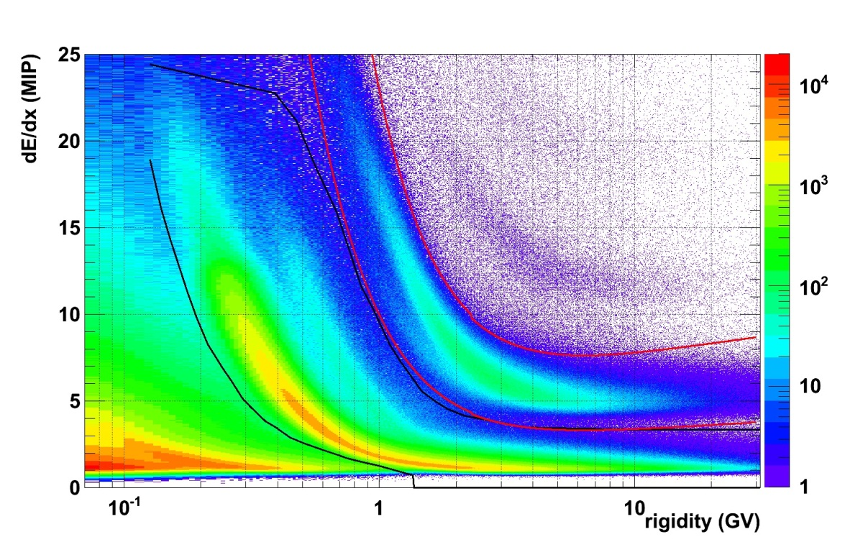
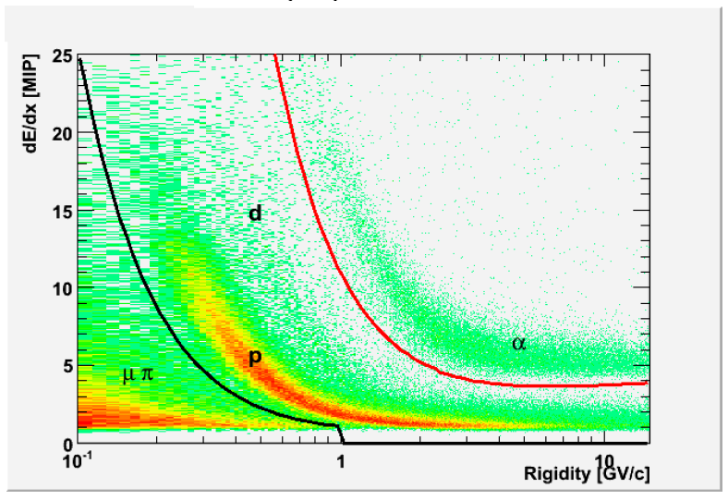
Proton and Helium Absolute flux
Montecarlo efficency for cuts
Trigger efficiency
Tracking efficiency
Multiple Scattering
Correction for energy loss in det
Back scattering…
Systematics under close investigation, currently
about 1-2% uncertainty on abs flux.
antiparticles
particles
Beta = v/c (from TOF)
albedo
albedo
particles
antiparticles
Rigidity (from Tracker)
Selection criteria
Fitted, single track
High lever arm, Nx
Rigidity R>0
Beta>.2
No anti
p
d
Energy loss from tracker
Li
He
p
He
Rigidity (from Tracker)

Slide 7
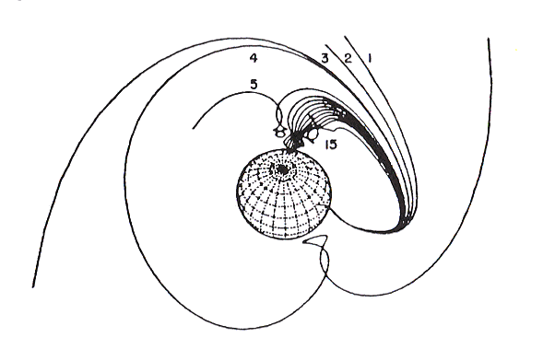
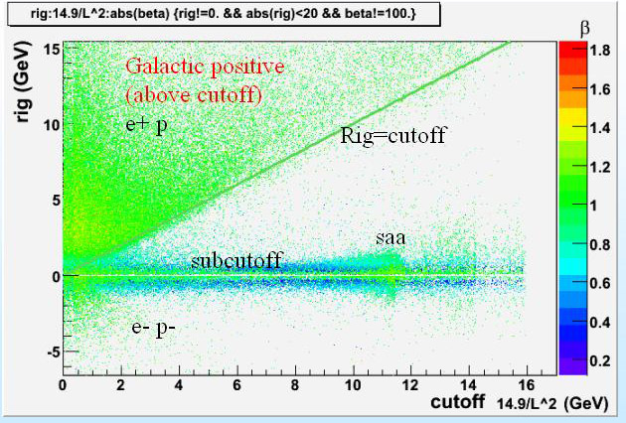
Selection of galactic component according to geomagnetic cutoff
R_{cutoff}=14.9GV/L²

Slide 8
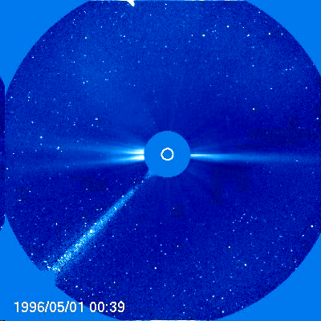
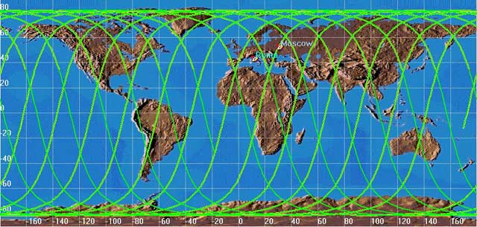
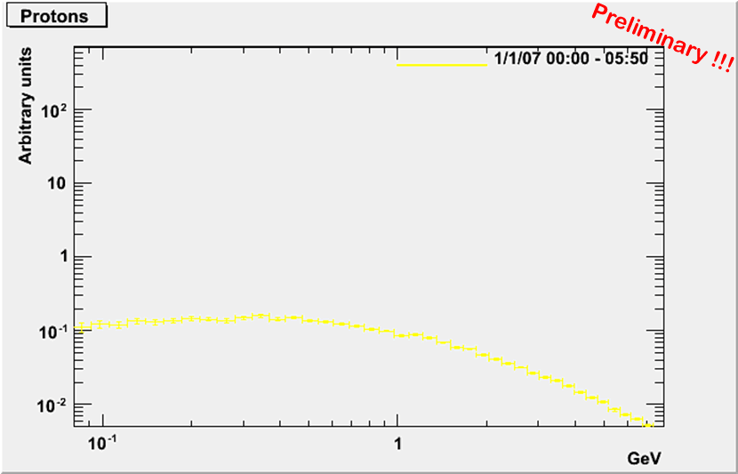
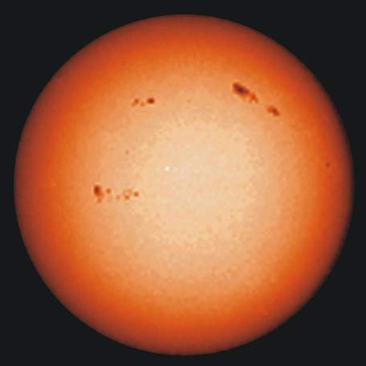
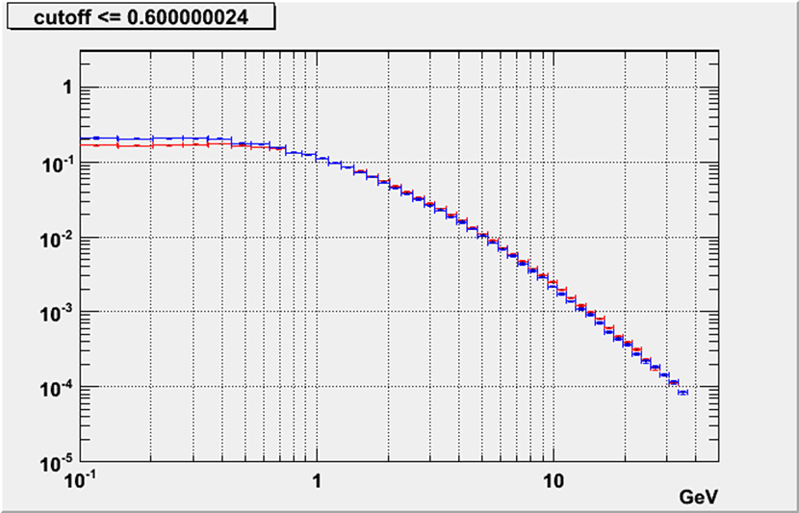
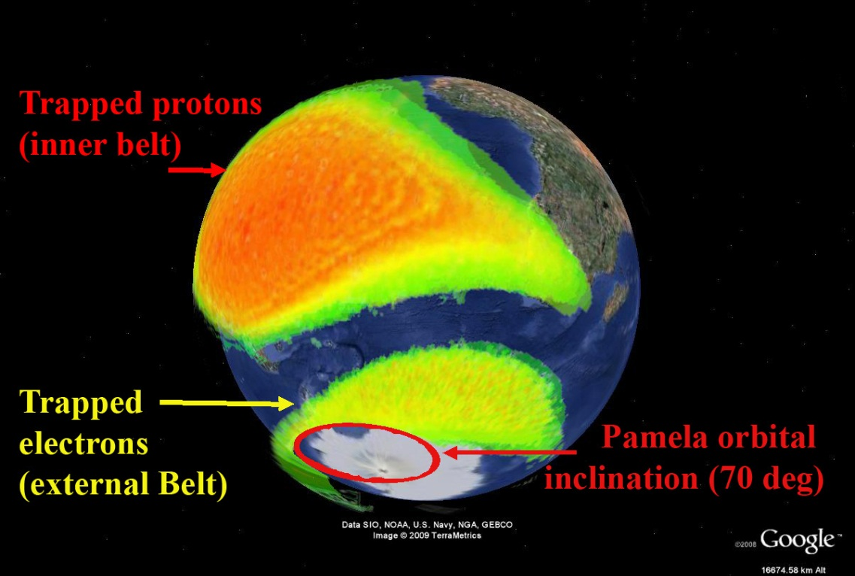
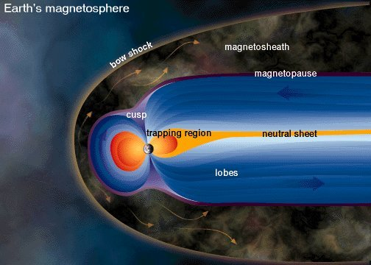
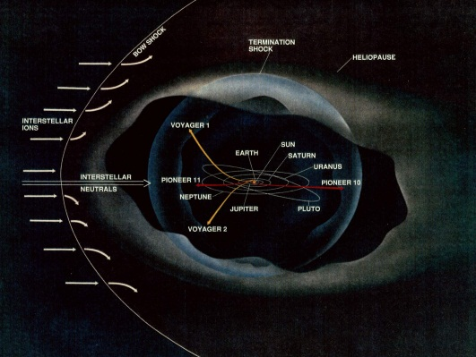
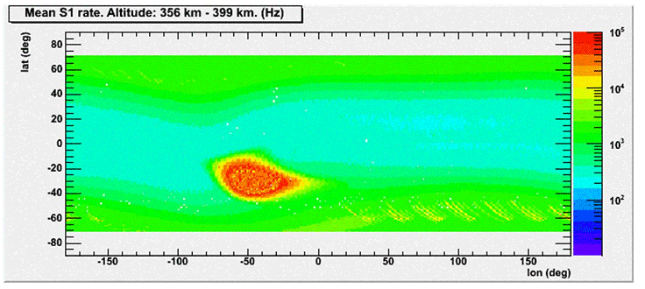
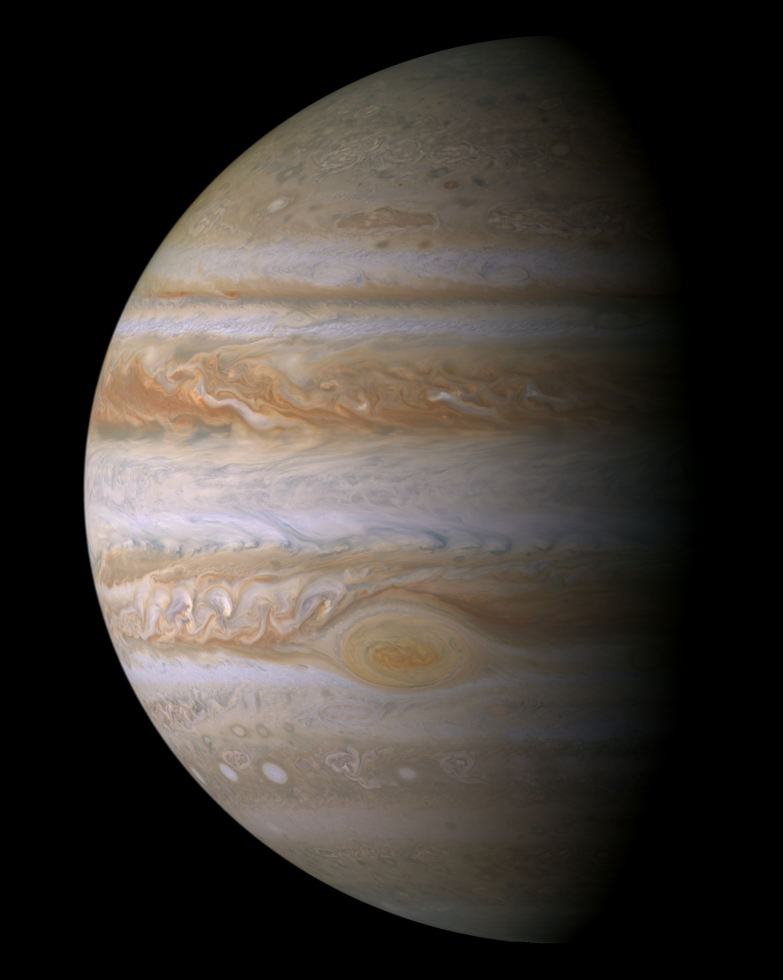
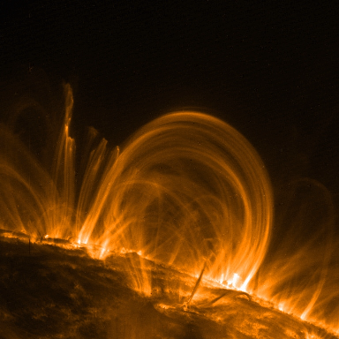
PAMELA, a Space observatory at 1AU
Solar Energetic particles
High Inclination Orbit
70.0º
Galactic cosmic ray
Matter / Antimatter
/ Dark Matter
Gradients in the
heliosphere
Solar Modulation
Interplanetary Physics,
Solar Wind Termination Shock
Magnetospheric physics
SAA, Albedo, secondary particle

Slide 9
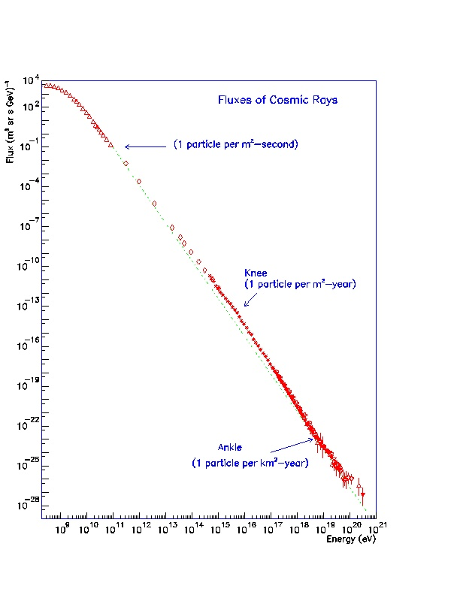
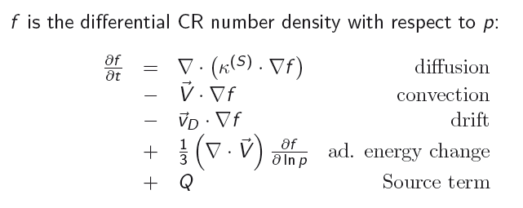
Cosmic ray transport equation and magnetohydrodynamics valid at all scales
Featureless spectra at Gev-TeV scale
Adapted from Simpson 1983 in PDG by M. Casolino

Slide 10
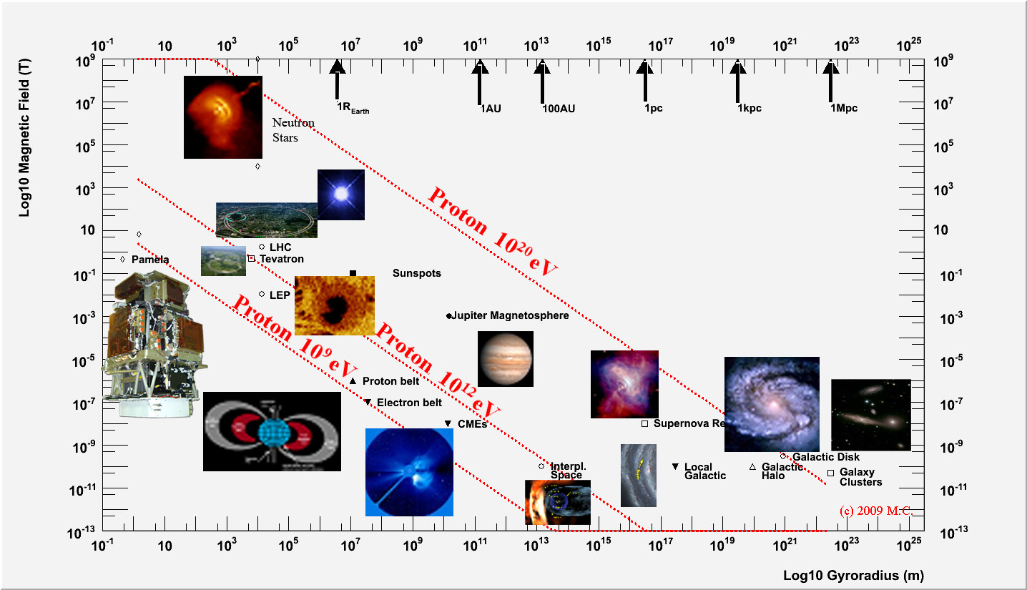
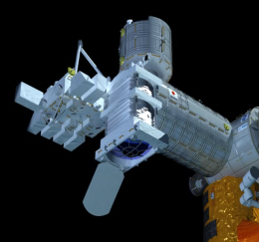
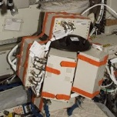
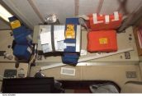
Cosmic rays and radiation environment in the Hillas Plot
Direct
e⁺ / e⁻
P / P⁻
γ
Jem-Euso

Slide 11
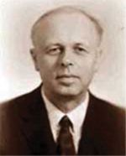
Cosmological scale,
beyond Cosmic Microwave Background
Matter / Antimatter Asymmetry in the Universe
1) Direct violation of baryonic number
particle “X” decays breaking barion symmetry
2) CP violation
to avoid specular antiparticle decay
3) Non thermal equilibrium at a given time
To avoid barion compensation through inverse processes
Sakharov, A.D. 1967, J. of Exper. and Theo. Phys. Letters, 5, 24-28,
“Violation of CP Invariance, C Asymmetry, and Baryon Asymmetry of the Universe”
Sakharov conditions
(Russian: Андре́й Дми́триевич Са́харов) (May 21, 1921 – December 14, 1989)

Slide 12
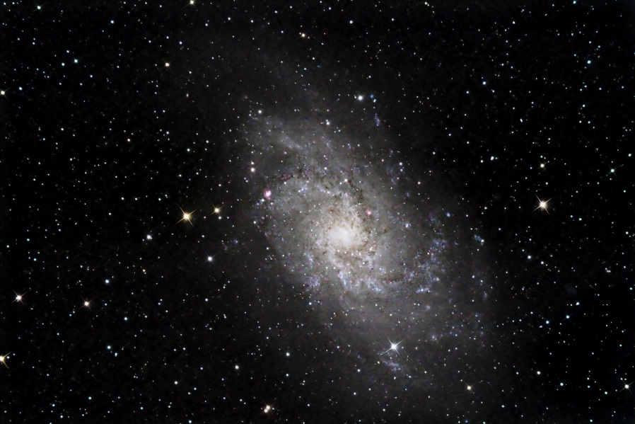
Matter – Antimatter domain separation?
Antihelium and antinuclei search
γ-ray ≈ 0.1 GeV from annihilation in Antihelium search boundary regions
Current limit: separation above cluster of galaxy (> 10 Mpc)
Steigman, G. 1976, Ann. Rev. Astron. Astrophys. 14, 339,
“Observational tests of antimatter cosmologies”
Observable?
Magnetic fields ?
Survival probability?
Ahlen, S.P. et al. 1982, ApJ, 260, 20,
“Can we detect antimatter from other galaxies?”
M33

Slide 13
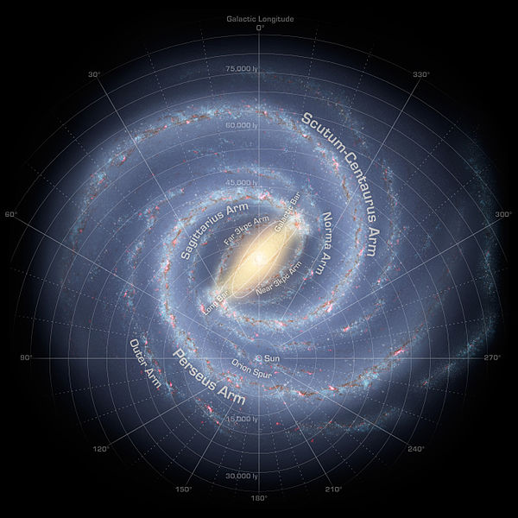
Cosmic rays on Galactic scale: protons and antiprotons

Slide 14
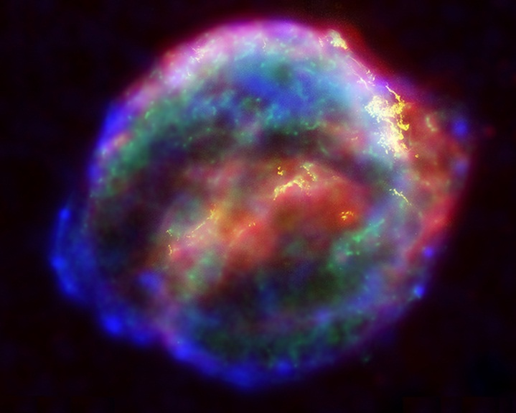
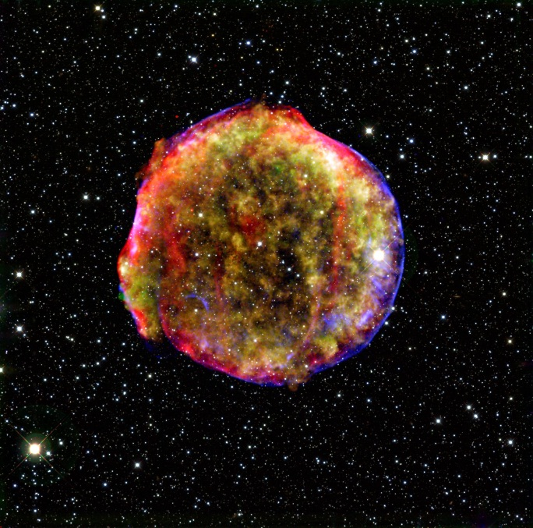
Cosmic rays are accelerated in Supernova explosions
(probably)
Meet energy criteria
First order Fermi shock acceleration produces power law spectrum
Observed in gamma by Agile and Fermi
Keplers’ supernova
Tycho’s’ supernova

Slide 15
Evidence for SN(also) origin of cosmic rays is mounting
  HESS TeV emision from SNR RX J1713.7-3946 → hadronic inter. Of cr. E>10^14eV F. Aharonian, et al., Astron. Astrophys. 464, 235 (2007).
  X-ray measurements of the same SNR → evidence that protons and nuclei can be accelerated E>10^15 eV in young SNR Uchiyama, et al., Nature 449, 576 (2007).
  AGILE: diffuse gamma-ray (100 MeV – 1 GeV) SNR IC 443 outer shock → hadronic acceleration M. Tavani, et al., ApJL 710, L151 (2010).
  Fermi: Shell of SNR W44 have → decay of pi0 produced in the interaction of hadrons accelerated in the shock region with the interstellar medium A. Abdo, et al., Science 327, 1103 (2010).
  Starburst galaxies (SG), where the SN rate in the galactic center is much higher than in our own, the density of cosmic rays in TeV gamma-rays (H.E.S.S infers cosmic rays density in SG NGC 253 three orders of magnitude higher than in our galaxy F. Acero, et al., Science 326, 1080 (2009).
  VERITAS: SG M82 cosmic rays density is reported to be 500 times higher than in the Milky Way VERITAS Collaboration, et al., Nature 462, 770 (2009

Slide 16
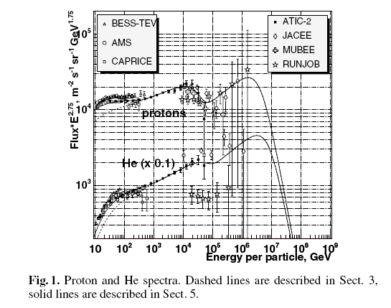
However, supernova-only model has been challenged many times
Multiple origin of cosmic rays:
  SN explosions of various sizes in either the interstellar medium or in a pre-existing stellar wind, WR stars P. L. Biermann, Space Science Reviews 74, 385 (1995); L. Biermann, Astron. Astrophys. 271, 649 (1993)
Nova stars and explosions in superbubbles, V. I. Zatsepin, N. V. Sokolskaya, Astron. Astrophys. 458, 1 (2006))
Different acceleration processes such as nonlinear shock acceleration
  D. C. Ellison, International Cosmic Ray Conference (1993), vol. 2 of International Cosmic Ray Conference, pp. 219
  DSA, diffusive shock acceleration, V. I. Zatsepin, N. V. Sokolskaya, Astron. Astrophys. 458, 1 (2006).
  M. Ahlers, P. Mertsch, S. Sarkar, Physical Review D 80, 123017 (2009).

Slide 17
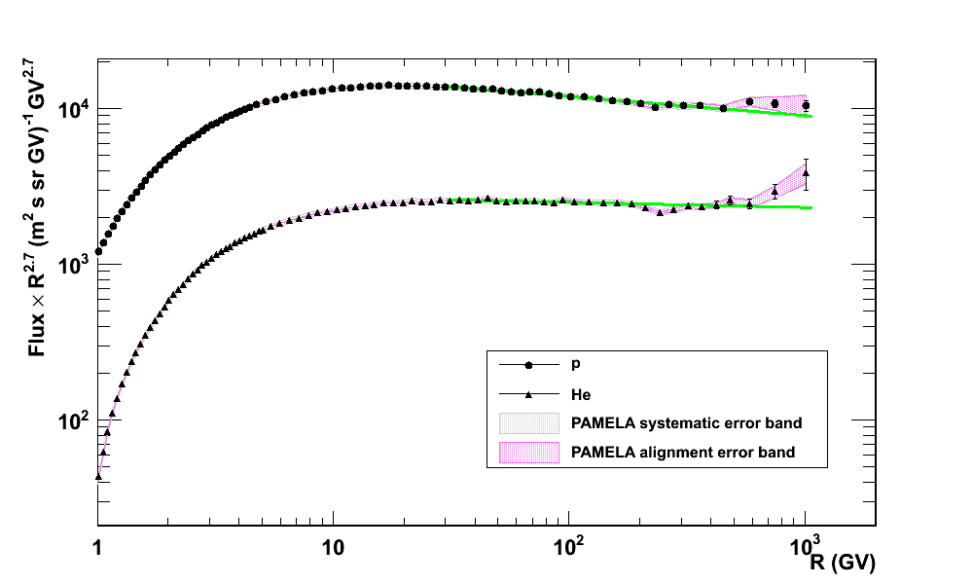
Pamela galactic proton and He
Different spectral index for proton and helium.
Helium percentage is growing with rigidity
Challenges Supernova only origin of cosmic ray.
2006-2008
γ_{30- 1000GV, p} = 2.820 +- 0.003 (stat) +- 0.005 (syst)
γ_{30- 1000GV, he} = 2.732 +- 0.005 (stat)
+ 0.008 -0.003 (syst)
Science 2011, 332 no. 6025 pp. 69-72

Slide 18
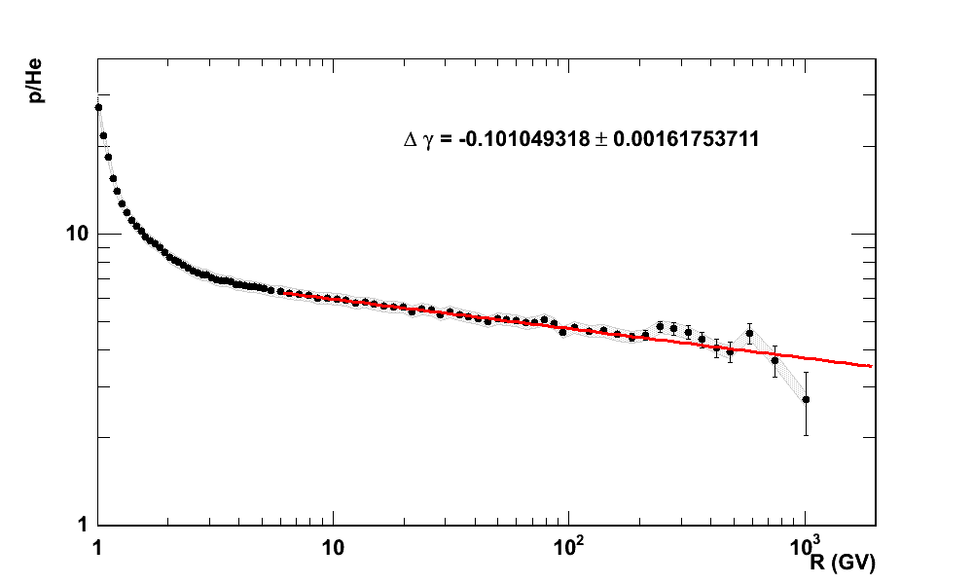
Ratio P/He: Rigidity
Acceleration is a rigidity dependent effect
The ratio decreases→ More He at high energies → Acceleration mechanisms or sources are different
Measurement valid also below the (low) solar modulation
-0.101+-0.002
Solar modulation
230-240GV

Slide 19
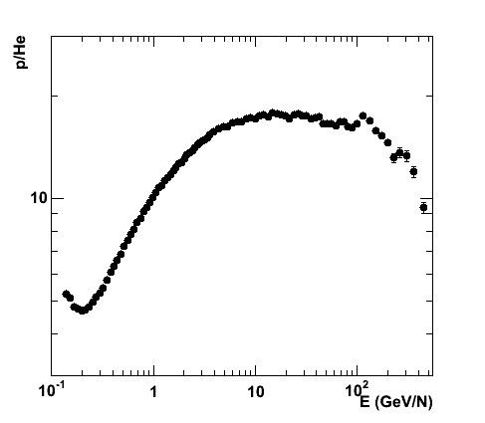
P/HE RATIO:
KINETIC ENERGY/NUCLEON
Ratio has lower systematic
Less dependent from solar modulation

Slide 20

RATIO P/HE
TOTAL KINETIC ENERGY

Slide 21

Deviations from the power law: >230-240 GV
γ_{>240 GV;he}
2.48 +- 0.06
γ_{80- 232GV, p}
2.85 +- 0.015
γ_{80- 240GV, he}
2.77 +- 0.01
γ_{>232GV;p}
2.67 +- 0.03

Slide 22


Different (lower, not exact) indexes if expressed in kinetic energy
Break in the spectral index at 240 GV seems to point at additional component
γ_{30- 1000GeV, p} = 2.782 +- 0.003 (stat)
+- 0.004 (syst)
γ_{15-6 00GeV/n, he} = 2.71 +- 0.01 (stat)
+- 0.007 (syst)

Slide 23
At higher energies:
CREAM balloon data
ApJL 2010
200 GeV/n (PAMELA at 120 GeV/n)
Indirect p, He Direct C-Fe

Slide 24
Conclusion from Proton and Helium
Proton and Helium undergo different processes even in GeV-TeV scale
Change in spectral index
Various hypotesis to explain Pamela data
Additional Sources Wolfendale 2011
Spallation Blasi & Amato 2011
Weak local component
(+ others) Vladimirov, Johanesson, Moskalenko 2011

Slide 25

Antiprotons
Secondary production
Galactic scale

Slide 26

Antiproton/proton ratio
Low Energy→ Confirms charge dependent solar modulation
High Energy → Consistent with models (Galprop, Donato…) at high energy
PRL. 105, 121101, September 13,2010)
PRL 102:051101,2009

Slide 27

Antiproton absolute flux
Confirms charge dependent solar modulation
Consistent with models (galprop, donato…) at high energy
PRL. 105, 121101, September 13,2010)
PRL 102:051101,2009

Slide 28



Propagation in the Galaxy
B/C ratio
Isotope ratio

Slide 29
Galactic neighborhood: e+/e-

Slide 30


Positrons and electrons
Where do positrons and electrons come from?
Mostly locally within 1-2 Kpc, due to the energy losses by Synchrotron Radiation and Inverse Compton
They sample the neighborhood of the Galaxy
Protons and antiptotons the whole Galaxy
Typical lifetime

Slide 31

Pamela positron fraction
July 2006 – February 2008 (~500 days)
Collected triggers ~10⁸
Identified ~ 150 10³ electrons and ~ 9 10³ positrons between 1.5 and 100 GeV (180 positrons above 20 GeV )
Charge dependent solar modulation
increase over background
arXiv:0810.4995v1 [astro-ph] 28 Oct 2008
Nature 458, 607-609 (2 April 2009)

Slide 32

Pamela positron fraction:
comparison with other data
Nature 458, 607-609 (2 April 2009)

Slide 33
Pamela positron fraction
Additional source in the positron channel has been considered due to:
Dark Matter
SN acceleration
Propagation in the galaxy
Nature 458, 607-609 (2 April 2009)

Slide 34
Pamela positron fraction
July 2006 – February 2008 (~500 days)
Collected triggers ~10⁸
Identified ~ 150 10³ electrons and ~ 9 10³ positrons between 1.5 and 100 GeV (180 positrons above 20 GeV )
Charge dependent solar modulation
increase over background
Nature 458, 607-609 ( 2009)

Slide 35


AMS & FERMI confirm PAMELA data
Anomalous source at high energy
Charge dependet Solar modulation at low energy
→ Need 3D model of helisphere
Increase over background:
Dark matter annihilation
Pulsar
Propagation
.
Electrons
antiprotons
Charge dependent solar modulation
L. Maccione, PRL 110 (2013) 081101
Sun
Protons
positrons

Slide 36





Secondary production
Dark Matter Annihilation
Astrophysical sources,
SNR…

Slide 37






Search (and constrain) Dark Matter
PAMELA
LHC
FERMI
Adapted from P. Lipari
UNDERGROUND

Slide 38

Electron spectrum
e- only
e⁻
e+ + e-
e⁺ + e⁻
From E. Mocchiutti
Notes:
38

Slide 39

PAMELA e- spectrum
Solid line GALPROP calculation for a diffusion reacceleration model; the
dotted line is a single power-law fit to the data above 30 GeV; the dashed-dotted line is a GALPROP calculation including a component from additional cosmic-ray electron sources. Bottom:
the PAMELA positron fraction compared with the previous GALPROP calculations with no
(solid line) and with additional e− and e+ components (dashed-dotted line).
PRL 106, 201101 (2011)

Slide 40
Conclusion on positrons and electrons
More than 1000 papers
Various explanations for the postiron excelss
Mostly new sources
Strongly constrain (with antiprotons)
Dark Matter models

Slide 41
Pamela positron fraction:
comparison with other data
Nature 458, 607-609 (2 April 2009)

Slide 42

Heliosphere and solar system

Slide 43



Solar modulation at minimum of solar cycle 23-24: 2006-2013
A-
A+
A-
A+
A+
A-
Pamela
AMS-01
Wizard-Balloon
Caprice / Mass /TS93
Note different shape of proton
→ Charge dependent solar modulation
BESS
PAMELA

Slide 44


Solar modulation of galactic protons and nuclei
Very long and peculiar solar minimum.
Current solar cycle (24) late and weak.
Closer to interstellar medium.
Good reference field for interstellar flux
ApJ 765, 2, 91, (2013)
From V. Formato

Slide 45


Solar modulation at minimum of solar cycle XXIII-XXIV
F_{is} = 1.54 β_{is}^{0.7} R _{is} ^{-2.76}
p/(cm² s sr GV)
Spectral index
2.76 ±0.01
Solar modulation parameter
φ(GV)
JUL06 5.81-01 ± 2e-03
DEC07 5.00-01 ± 2-03
dec08 4.82-01 ± 3-03
However spherical approximation is not sufficient. E.g. charge dependent solar modulation
ApJ 765, 2, 91, (2013)

Slide 46

Charge dependent solar modulation of low energy positrons
Charge dependent solar modulation
Separate qA>0 with qA<0 solar cycles
Evident in the proton flux
Observed in the antiproton channel by BESS
Full 3D solution of the Parker equation – drift term depends on sign of the charge
A<0 (now) p-,e-
Miyake, Yanagita, 2008
A<0 (now) p,e+

Slide 47



GRADIENTS IN THE HELIOSPHERE (5 AU scale)
Ulysses – Pamela
N. DeSimone, V. Di Felice
Notes:
47
Another interesting measurement to do is the measure of radial and latitudinal gradients in the heliosphere.

Slide 48







December 2006 Solar particle events
Dec 13th largest CME since 2003, anomalous at sol min

Slide 49








December 13th 2006 event
No simple modeling of acceleration and propagation
ApJ 742, 2, 102, 11, 2011.

Slide 50


Slide 51


Slide 52

Time and rigidity dependence of Forbush decrease
From Mergè Martucci Sotgiu

Slide 53

GEOMAGNETOSPHERE, VAN ALLEN BELTS
PAMELA

Slide 54


Radiation Belts
Trapped particle population in the SAA
(different altitudes: 300 – 600 km)
Trapped electrons
Geomagnetic cutoff shifts due to solar events
Albedo particles
Secondary particles produced in the atmosphere…

Slide 55


Pamela maps at various altitudes
http://www.youtube.com/watch?v=OaoiPw5Pqbg

Slide 56




Trapped proton flux in the Van Allen belt
(South Atlantic Anomaly)
Arxiv 0810.4980v1
po p1 p2 e0 e1 e2 chi2 prob
Trapped
Turquoise 0.3 G < B
Yellow 0.22 G < B < 0.23 G
Blue 0.21 G < B < 0.22 G
Green 0.20 G < B < 0.21 G
Red 0.19 G < B < 0.20 G
Black B<0.19 G
po p1 p2 e0 e1 e2 chi2 prob
P/(cm^2 sr GeV s)
Galactic
| 0 | 1 | 2 | 3 | 4 |
----------------------------------------------------------------------
0 | 0.1154 6.103 3.193 0.01591 0.4153
1 | 0.02368 5.969 2.625 0.003686 0.4678
2 | 0.0005424 8.195 4.732 0.000337 1.84
3 | 0 0 0 0 0
4 | 0 0 0 0 0
5 | 0 0 0 0 0
Integral Pamela flux
(E>35 MeV)
(PSB97 plot by SPENVIS project, model by BIRA-IASB)
GeV
 | A | γ₀ | γ₁ | χ²/ndf
nero | 0.11±0.01 | 6.0±0.4 | 3.1±0.5 | 7.1
rosso | (2.3±0.3) 10⁻² | 5.9±0.5 | 2.6±0.6 | 6.8
verde | (5±3) 10⁻⁴ | 8.1±1.8 | 4.7±1.8 | 10.
| 5 | 6 | 7 |
-------------------------------------------
0 | 0.5222 7.163 0.97
1 | 0.6212 6.823 0.9765
2 | 1.849 10.01 0.8663

Slide 57

Trapped proton flux in the Van Allen belt
Comparison with models
po p1 p2 e0 e1 e2 chi2 prob
po p1 p2 e0 e1 e2 chi2 prob
-6 –18 S –50 –70 W
Pamela 540-560
(M. Peroni’s thesis)
Model (Selesnick ’07)
| 0 | 1 | 2 | 3 | 4 |
----------------------------------------------------------------------
0 | 0.1154 6.103 3.193 0.01591 0.4153
1 | 0.02368 5.969 2.625 0.003686 0.4678
2 | 0.0005424 8.195 4.732 0.000337 1.84
3 | 0 0 0 0 0
4 | 0 0 0 0 0
5 | 0 0 0 0 0
Integral Pamela flux
(E>35 MeV)
(PSB97 plot by SPENVIS project, model by BIRA-IASB)
Selesnick, Looper, Mewaldt, Sp Weath 5, S04003, 2007
| 5 | 6 | 7 |
-------------------------------------------
0 | 0.5222 7.163 0.97
1 | 0.6212 6.823 0.9765
2 | 1.849 10.01 0.8663

Slide 58

Stably trapped antiprotons in Earth’s radiation belt
Trapped antiprotons
Galactic antiprotons
Secondary (reentrant albedo) antiprotons
O. Adriani et al. 2011 ApJ 737 L29

Slide 59

High precision cosmic ray measurements challenge current models of production, acceleration and propagation
At all different scales
Modeling
Dose and risk estimation
arXiv:0708.2587
2008AdSpR..41..168C
2008AdSpR..41.2037D
2008AdSpR..41.2043C
Pamela results
Science 2011
arXiv:1103.4055
Prl --
arXiv:0810.4995,
Nature, Astrop. Phys
ApJ 457, L 103 1996
ApJ 532, 653, 2000
arXiv:0810.4994, PRL,
NJP11,105023

Slide 60

Pamela is operating successfully in space
Expected three years of operations – survived almost seven!
Mission prolonged 1 more year
Hope to continue measure in the 24th solar cycle
http://pamela.roma2.infn.it
http://www.casolino.it

Slide 62


LET: Altea Alteino Padles CR39 comparison
Possible to estimate various components:
Low (<40MeV/n) component
High Z
Change with location and time
Effectiveness of shiellding
See Oscar’s poster on LET with Alteino →1101
Chiara’s talk tomorrow

Slide 63


Slide 64


Slide 66

Antiproton ratio measured with Pamela:
Comparison with experimental data
Highest energy up to now
Coherent with secondary production
Uncertainties of Galactic Propagation
Would favour Moskalenko 2002 (except highest energy)
ApJ 457, L 103 1996
ApJ 532, 653, 2000
arXiv:0810.4994v1 [astro-ph] 28 Oct 2008 PRL

Slide 67

Preliminary antiproton spectrum
F. Donato et al., Ap.J. 536 172 (2001), Φ=500MV, with indeterminacy of the diffusion (black line) and nuclear (blue line) parameters.

Slide 71


Fitting p and He spectra

Slide 72

Proton and Helium Flux up to 1.2TV

Slide 73
P/HE RATIO:
KINETIC ENERGY/NUCLEON
Ratio has lower systematic
Less dependent from solar modulation

Slide 74
RATIO P/HE
TOTAL KINETIC ENERGY

Slide 75

Brasilian Astronaut
Marcos Pontes, 5/4/2006

Slide 76

Christer Fuglesang, STS-116 Dec, 2006

Slide 77









Pamela/Hillas plot
Neutron
Stars
Accelerazione raggi cosmici
p, p⁻ He
B/C
Ricerca materia oscura
p⁻
10¹² eV protons
White Dwarfs
.
10²⁰ eV protons
10⁹ eV protons

Slide 78

Pamela/Hillas plot
Neutron
Stars
Propagazione nel
Sistema locale
e+/e-
Ricerca materia oscura (e+)
10¹² eV protons
White Dwarfs
.
10²⁰ eV protons
10⁹ eV protons

Slide 79

Pamela/Hillas plot
Neutron
Stars
Fenomeni eliosferici: modulazione solare dipendente dalla carica
e+/e- p-/p+
Raggi cosmici anomali
P, He, C
10¹² eV protons
White Dwarfs
.
10²⁰ eV protons
10⁹ eV protons

Slide 80


Pamela/Hillas plot
Neutron
Stars
Eventi solari Accelerazione da solar flare
Shock acceleration da emissioni di massa coronale
P, He, CNO e-
10¹² eV protons
White Dwarfs
.
10²⁰ eV protons
10⁹ eV protons

Slide 81


Pamela/Hillas plot
Neutron
Stars
Magnetosfere:
Terra
fasce Van Allen
p, e-
Giove
e- interpl.
10¹² eV protons
White Dwarfs
.
10²⁰ eV protons
10⁹ eV protons

Slide 82

Cosmic rays on Galactic scale: protons and antiprotons
Grand Spiral Galaxy M81 and Arp's Loop

Slide 83


Robert L. Golden

Slide 84


Need a magnetic spectrometer for antiparticles: Discovery of antiprotons in cr, 1979
p/p ratio
6 x 10⁻⁴
2-5 GeV
From
Robert E. Streitmatter
Bogomolov, E.A. et al. 1979, Proc. 16th ICRC, Kyoto, 1, 330,
“A Stratospheric Magnetic Spectrometer Investigation of the Singly Charged Component
Spectra and Composition of the Primary and Secondary Cosmic Radiation”

Slide 85


Slide 86


Primary (galactic) spectra:
polar measurements
P/(cm^2 sr GeV s)
M. Honda, 2008
Galactic protons
RED: JULY 2006
BLUE: AUGUST 2007

Slide 87




Primary and secondary spectra:
Intermediate latitudes
Penumbra
P/(cm^2 sr GeV s)
M. Honda, 2008
Secondary particles (reentrant albedo)
RED: JULY 2006
BLUE: AUGUST 2007

Slide 88


Primary and secondary spectra:
Magnetic equator
Penumbra
P/(cm^2 sr GeV s)
M. Honda, 2008
Secondary particles
RED: JULY 2006
BLUE: AUGUST 2007

Slide 89


Proton Flux at various cutoff
Subcutoff (secondary albedo)
Particles
P, e-,e+, P-
Grigorov, Sov. Phys. Dokl. 22, 305 1977
NINA results:
  ApJ Supp.132 365, 2001
AMS results:
  Phys. Lett. B 472 2000.215,
  Phys. Lett. B 484 2000.10–22
G. Esposito PhD
+calculations
Lipari, Astrop. Ph. 14, 171, 2000
Huang et al, Pys Rev. D 68, 053008 2003
Sanuki et al, Phys Rev D75 043005 2007
Honda et al, Phys Rev D75 043006 2007
AUGUST 2007
JULY 2006
P/(cm^2 sr GeV s)

Slide 90




Secondary (reentrant albedo) proton flux at various cutoffs
AUGUST 2007
JULY 2006
Subcutoff (secondary albedo)
Particles
P, e-,e+, P-
→Atmospheric neutrino contribution
→Astronaut dose on board International Space Station
Indirect measurement of cross section in the atmosphere
P/(cm^2 sr GeV s)
July 2006
--- M. Honda, 2008
Glast
Green: Pamela 10<Cutoff<14
Black: AMS 98, theta<.2
ISS
Arxiv 0810.4980v1
P/(cm^2 sr GeV s)
GeV

Slide 92
Primary (galactic) spectra:
polar measurements
P/(cm^2 sr GeV s)
M. Honda, 2008
Galactic protons
RED: JULY 2006
BLUE: AUGUST 2007

Slide 93
Primary and secondary spectra:
Intermediate latitudes
Penumbra
P/(cm^2 sr GeV s)
M. Honda, 2008
Secondary particles (reentrant albedo)
RED: JULY 2006
BLUE: AUGUST 2007

Slide 94
Primary and secondary spectra:
Magnetic equator
Penumbra
P/(cm^2 sr GeV s)
M. Honda, 2008
Secondary particles
RED: JULY 2006
BLUE: AUGUST 2007

Slide 95
Proton Flux at various cutoff
Subcutoff (secondary albedo)
Particles
P, e-,e+, P-
Grigorov, Sov. Phys. Dokl. 22, 305 1977
NINA results:
  ApJ Supp.132 365, 2001
AMS results:
  Phys. Lett. B 472 2000.215,
  Phys. Lett. B 484 2000.10–22
G. Esposito PhD
+calculations
Lipari, Astrop. Ph. 14, 171, 2000
Huang et al, Pys Rev. D 68, 053008 2003
Sanuki et al, Phys Rev D75 043005 2007
Honda et al, Phys Rev D75 043006 2007
AUGUST 2007
JULY 2006
P/(cm^2 sr GeV s)

Slide 96
Secondary (reentrant albedo) proton flux at various cutoffs
AUGUST 2007
JULY 2006
Subcutoff (secondary albedo)
Particles
P, e-,e+, P-
→Atmospheric neutrino contribution
→Astronaut dose on board International Space Station
Indirect measurement of cross section in the atmosphere
P/(cm^2 sr GeV s)
July 2006
--- M. Honda, 2008
Glast
Green: Pamela 10<Cutoff<14
Black: AMS 98, theta<.2
ISS
Arxiv 0810.4980v1
P/(cm^2 sr GeV s)
GeV

Slide 98
Primary (galactic) spectra:
polar measurements
P/(cm^2 sr GeV s)
M. Honda, 2008
Galactic protons
RED: JULY 2006
BLUE: AUGUST 2007

Slide 99
Primary and secondary spectra:
Intermediate latitudes
Penumbra
P/(cm^2 sr GeV s)
M. Honda, 2008
Secondary particles (reentrant albedo)
RED: JULY 2006
BLUE: AUGUST 2007

Slide 100
Primary and secondary spectra:
Magnetic equator
Penumbra
P/(cm^2 sr GeV s)
M. Honda, 2008
Secondary particles
RED: JULY 2006
BLUE: AUGUST 2007

Slide 101
Proton Flux at various cutoff
Subcutoff (secondary albedo)
Particles
P, e-,e+, P-
Grigorov, Sov. Phys. Dokl. 22, 305 1977
NINA results:
  ApJ Supp.132 365, 2001
AMS results:
  Phys. Lett. B 472 2000.215,
  Phys. Lett. B 484 2000.10–22
G. Esposito PhD
+calculations
Lipari, Astrop. Ph. 14, 171, 2000
Huang et al, Pys Rev. D 68, 053008 2003
Sanuki et al, Phys Rev D75 043005 2007
Honda et al, Phys Rev D75 043006 2007
AUGUST 2007
JULY 2006
P/(cm^2 sr GeV s)

Slide 102
Secondary (reentrant albedo) proton flux at various cutoffs
AUGUST 2007
JULY 2006
Subcutoff (secondary albedo)
Particles
P, e-,e+, P-
→Atmospheric neutrino contribution
→Astronaut dose on board International Space Station
Indirect measurement of cross section in the atmosphere
P/(cm^2 sr GeV s)
July 2006
--- M. Honda, 2008
Glast
Green: Pamela 10<Cutoff<14
Black: AMS 98, theta<.2
ISS
Arxiv 0810.4980v1
P/(cm^2 sr GeV s)
GeV

Slide 103



Summary
✓
✓
Radial and latitudinal gradients of protons achieved
Latitudinal dependence of the e/p-ratio achieved.
Pamela and Ulysses/KET show similar time profiles and support each other
A < 0
Negative particles
A < 0
Positive particles
Notes:
103

Slide 104

Charge dependent solar modulation of low energy positrons
Charge dependent solar modulation
Separate qA>0 with qA<0 solar cycles
Evident in the proton flux
Observed in the antiproton channel by BESS
Full 3D solution of the Parker equation – drift term depends on sign of the charge
Pamela
AMS-01
Caprice / Mass /TS93
BESS
A<0 (now) p-,e-
Miyake, Yanagita, 2008
A<0 (now) p,e+
A⁺
A⁻

Slide 105
Expected intensity contours for the A>0
and A<0-magnetic epoch
✓
✓
The combined analysis of Ulysses and Pamela data contributes essentially to our understanding of galactic cosmic ray propagation in the heliosphere.
This could become the first publication by the two consortia
Notes:
105

Slide 106

Altea & Pamela:
Solar Event of Dec 2013
Propagation in the ISS is not straightforward
Geomagnetic field
Lowering of geomagnetic cutoff
See Livio’s flares with Altea poster (1102)
GOES
ALTEA

Slide 107

Neutron monitor (Vashenyuk) 03:20 UT
IceTop 03:18 – 03:29 UT
GOES 10 prot. 03:20 UT
GOES 11 prot. 03:20 UT
PAMELA 03:18 – 03:29 UT

Slide 108

Neutron monitors (Vashenyuk) 04:00 UT
IceTop 04:06 – 04:18 UT
GOES 10 prot. 04:05 UT
GOES 11 prot. 04:05 UT
PAMELA 04:06 – 04:18 UT

Slide 109

Neutron monitors (Vashenyuk) 05:00 UT
GOES 10 prot. 04:55 UT
GOES 11 prot. 04:55 UT
PAMELA 04:53 – 04:59 UT

Slide 110

LPI Balloon (Mirny, Antartica) 09:46 – 10:46 UT
GOES 10 prot. 09:30 – 10:45 UT
GOES 11 prot. 09:30 – 10:45 UT
PAMELA 09:32 – 09:34 UT

Slide 111



Time
of Flight
(three scintillators,
6 planes, 48 phototubes)
Anticounter
System
Magnetic (0.46T)
Spectrometer
Microstrip
detector
(6 double sided
microstrip planes)
RESURS DK1 SATELLITE (6.65T)
Silicon
Tungsten
Tracking
Calorimeter
(44 planes of 96 strip)
Shower
Catcher
Scintillator
Neutron
Detector

Slide 112




Coupling to Soyuz
Pamela during integration in Baikonur
Resurs DK integrated

Slide 113

PHYSICAL QUANTITIES MEASURED BY PAMELA
DEDX
(scintillators, tracker, calo)
  Z of the particle
2. DEFLECTION = 1/Rigidity
  Impulse (4-6 planes)
3. Time of flight = 1/Beta
(12 betas)
4.Shower (No, Hadronic, Electromagnetic)
→ lepton/hadron
5. Number of neutrons
→ lepton/hadron
5% to 10% precision

Slide 114

e+ 0.171 GV Bending view
e- 0.169 GV Bending view

Slide 115


Radiation Belts
Discovery of Van Allen radiation belts – Explorer 1, 1958
Trapped protons & electrons, spatial distribution (2-7 R_{E}), energy (~MeV)
outer belt slot region inner belt
J. Goldstein
Notes:
Relativistic electrons
Our focus is the outer zone electrons, which has extreme temporal and spatial variability and is an extremely important source of space weather effect.

Slide 116


Slide 117


Time evolution of Pamela
low energy proton flux
Dec 2006 event
Pamela 400-800MV

Slide 118
Deviations from the power law: a) 30-240 GV
Additional source(s) above 240 GV
Fisher and T student test reject single power law to better than 99.7 CL
γ_{30- 80GV, p} = 2.800 +- 0.007
γ_{80- 232GV, p} = 2.85 +- 0.01

Slide 119



Deviations from the power law: b) 30-240 GV
protons
The spectrum softens at 30-240 GV
Single power law is also ruled out at lower rigidities
helium
γ_{30- 232GV, he} = 2.68 +- 0.02
α_{80- 232GV, he}= (1.2 +- 0.5)*10⁻⁴
γ_{30- 232GV, p} = 2.28 +- 0.01
α_{80- 232GV, p} = (1.1 +- 0.3)*10⁻⁴

Slide 120


Fitting the p/he ratio

Slide 121

Proton spectral indexes

Slide 122

Helium spectral indexes

Slide 123

Proton and helium comparison

