Slide 1
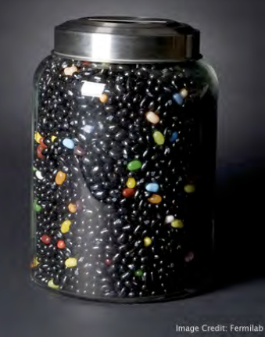
Enter the DarkSide
Stefano Davini
University of Houston
RICAP-13

Slide 2
The DarkSide Experiment @ LNGS
Direct WIMP search
in low background
Argon detector
NULL background strategy
unambiguos discovery
with few WIMP-candidate events

Slide 3
The DarkSide Project
DS-10 kg
Tech. prototype – no DM goal
Operated, Success
DS-50 kg
GOAL: σ ≅10⁻⁴⁵ cm²
Under Commissioning
DS-50 ton
GOAL: σ ≅ 10⁻⁴⁷ cm²
Future (G2)

Slide 4
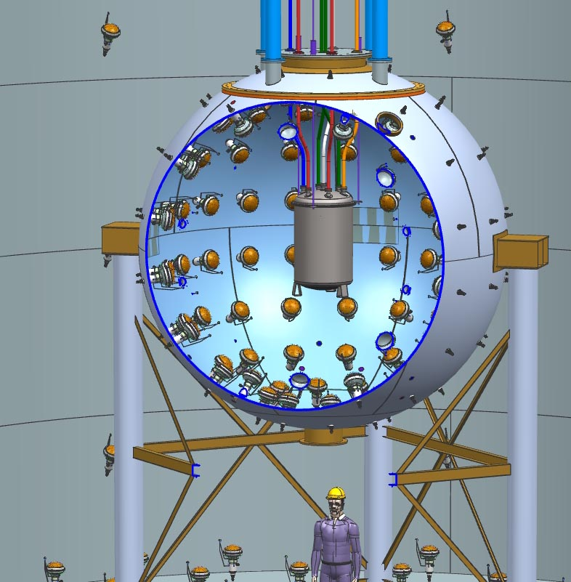
The DarkSide detector
TARGET
underground Argon depleted in ³⁹Ar
DETECTOR
two-phase Argon Time Projection Chamber
VETO & SHIELD
Borated Liquid Scintillator VETO
combined with Water Cherenkov detector
to kill neutron background

Slide 5
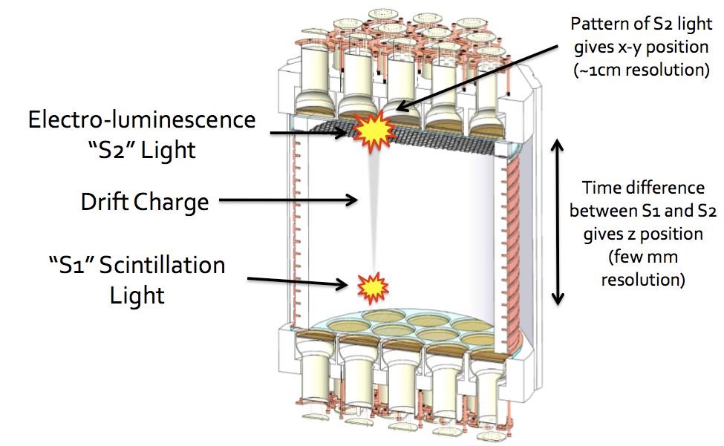
Two Phase Argon TPC

Slide 6
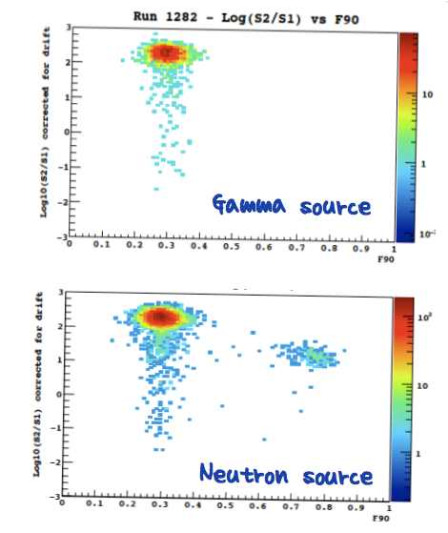
Towards Null Background (1)
Shape of the scintillation signal
(PSD)
Ratio between
ionization and scintillation
(S2/S1)
3D localization of the event
(fiducialization)
Rejection of
electron/gamma background

Slide 7
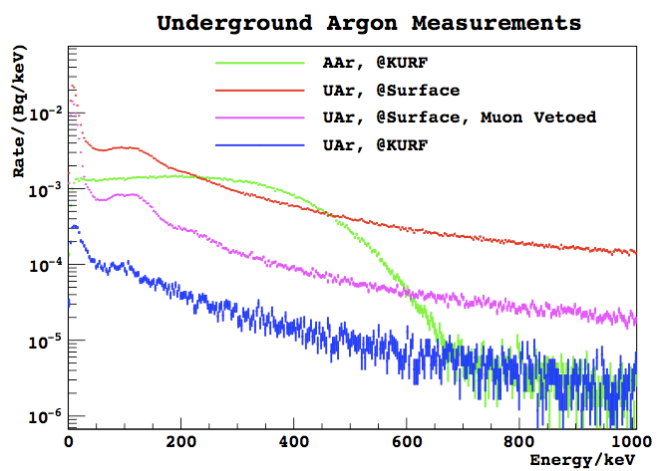
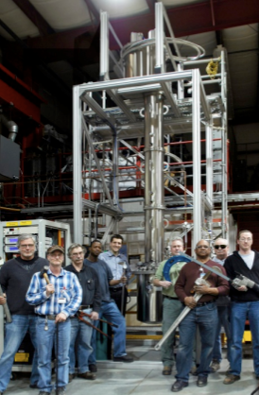
Towards Null Background (2)
Underground Argon depleted in ³⁹Ar
150 times more radiopure than atm Ar
( < 6.5 mBq/kg)

Slide 8
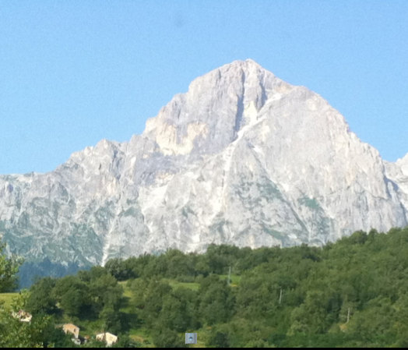
Towards Null Background (3)
DarkSide
detector

Slide 9
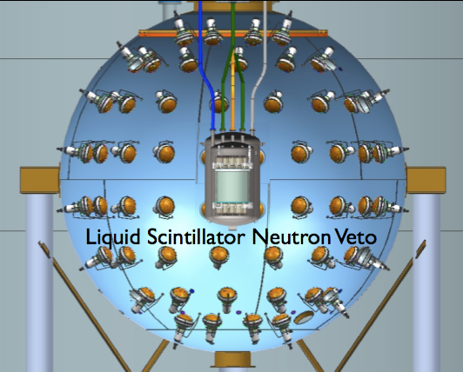
Towards Null Background (4)
¹⁰B(n, α)⁷Li
Active Neutron Veto,
gets rid of neutron background

Slide 10
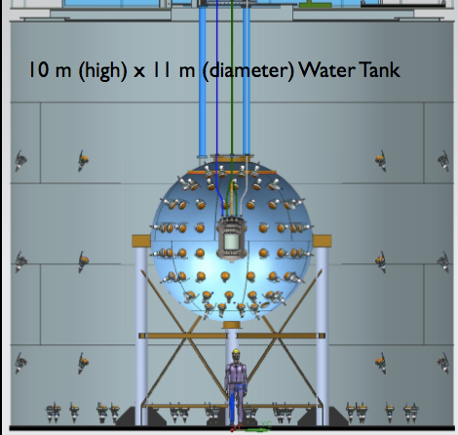
Towards Null Background (5)
Detection of muons, shield external neutron,
Get rid of muon-induced backgrounds.

Slide 11
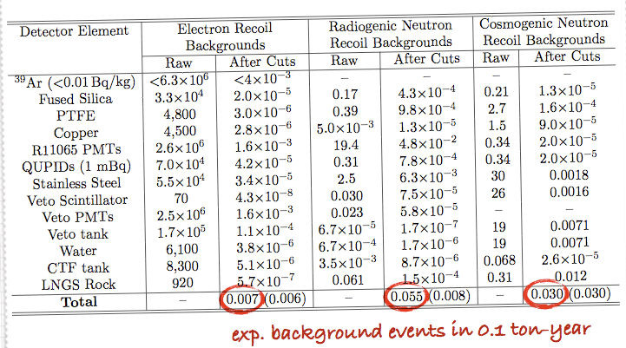
DarkSide-50 Expected Background
“Null” Background
Unambiguos discovery with few WIMP-candidate events

Slide 12
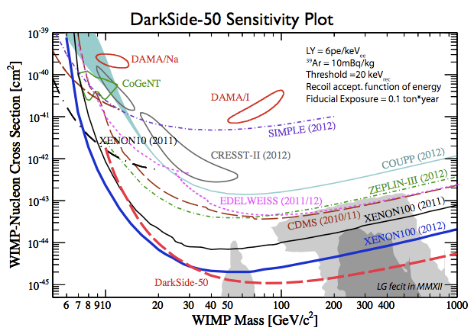
DarkSide-50 Sensitivity

Slide 13
Recent Milestones
DS-10
Prototype operated for 1 year
DS-50
All facilities are built
2 Rn-free clean rooms, Ar recirculation, purification, recovery systems
Time Projection Chamber
Assembled and deployed in the Neutron Veto Sphere.
Filling with natural Argon completed.
Now Under Commissioning
Neutron Veto
Construction and assembly of the Sphere completed,
Reflectors (Tyvek) installed, 110/110 PMTs installed,
Cameras installed
Water Tank (CTF)
Existing facility (Borexino-CTF)
Installation of Reflectors (Tyvek) almost completed

Slide 14
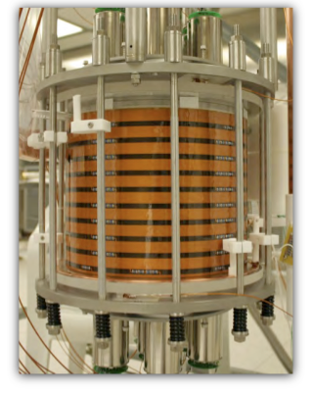
DarkSide-10 Activities and Results
Prototype, not physics capable
Record Light Yield: 8.9 pe/keVee
Pulse Shape Discrimination:
Development of model for PSD
HHV System:
Long-term test succesful

Slide 15
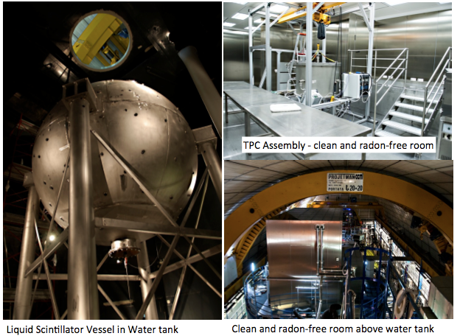
DarkSide-50

Slide 16
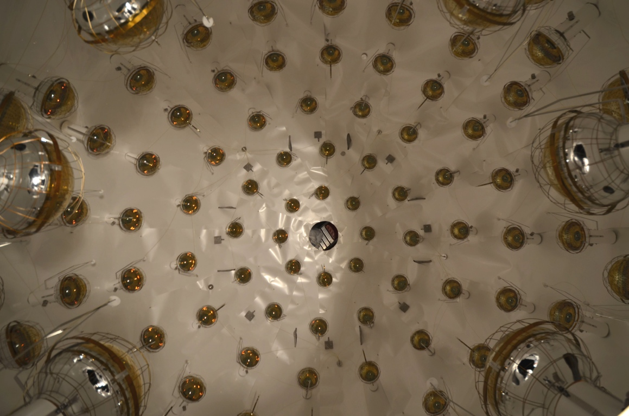
DarkSide-50
Reflectors and PMTs installed inside the Neutron Veto Sphere

Slide 17
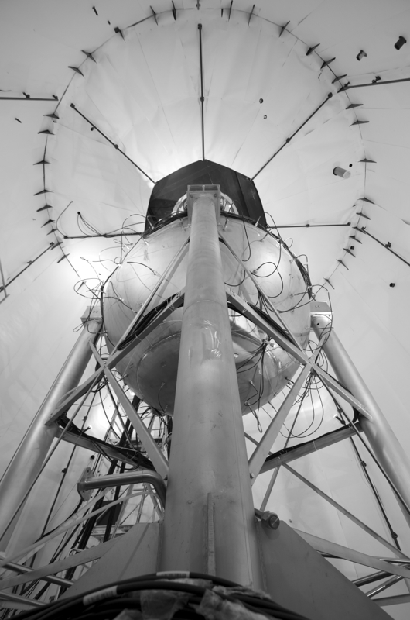
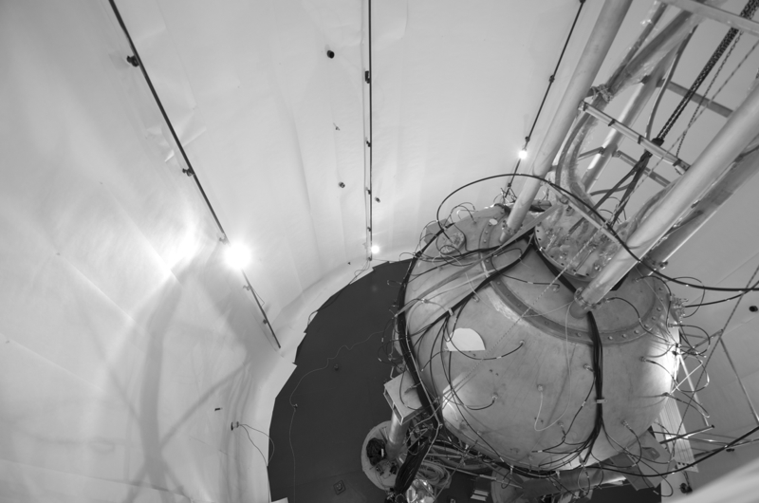
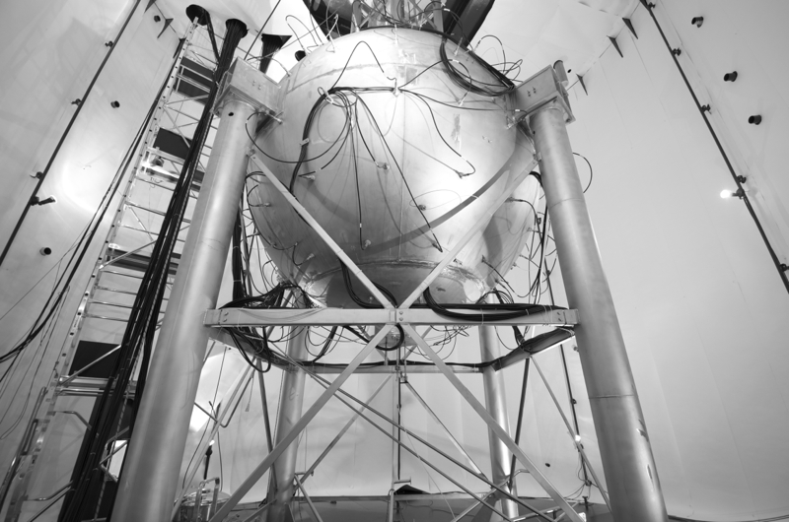
DarkSide-50
View of Neutron Veto Sphere from the Water Tank
After installation of reflector (Tyvek)

Slide 18
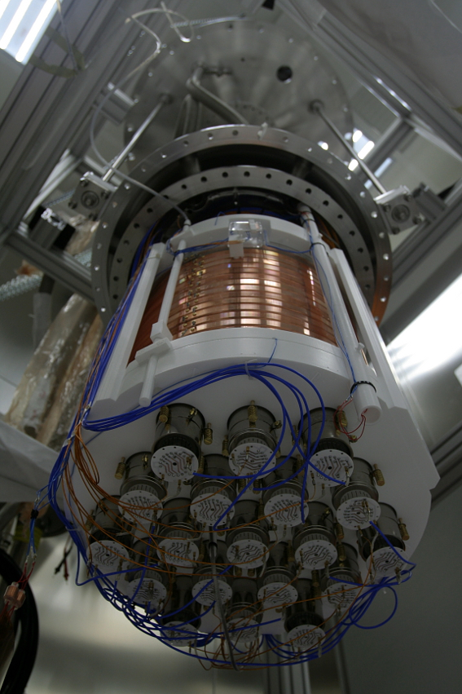
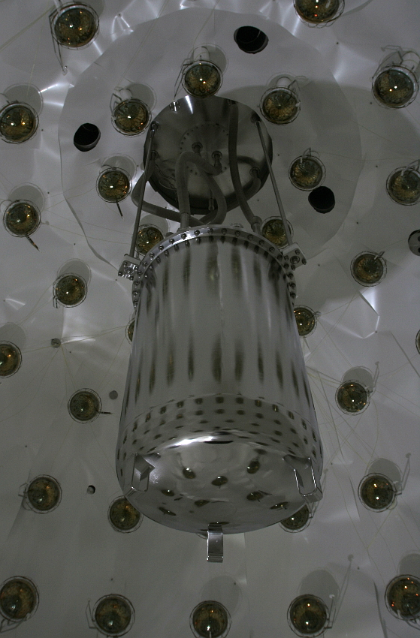
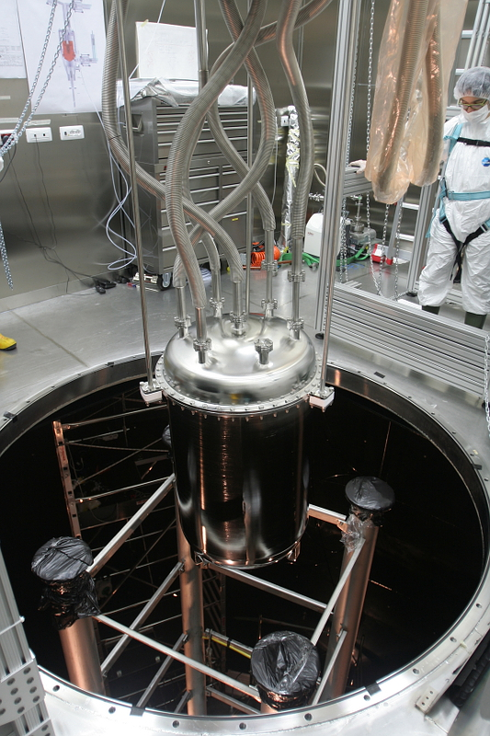
DarkSide-50
TPC Assembled,
Deployed

Slide 19
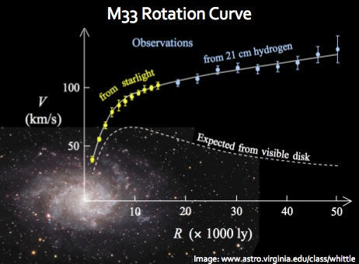
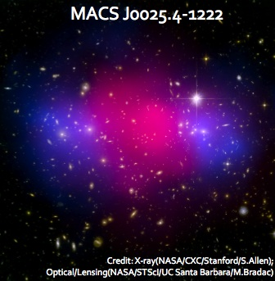
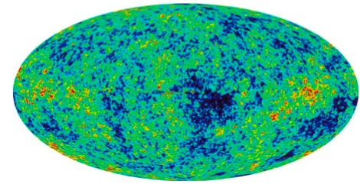
Conclusions and outlook
We are entering the dark age.
Depleted Argon is a reality.
Argon 2-phase technology combined with
Borexino liquid scintillator technology looks
very promising for dark matter detection.

Slide 20
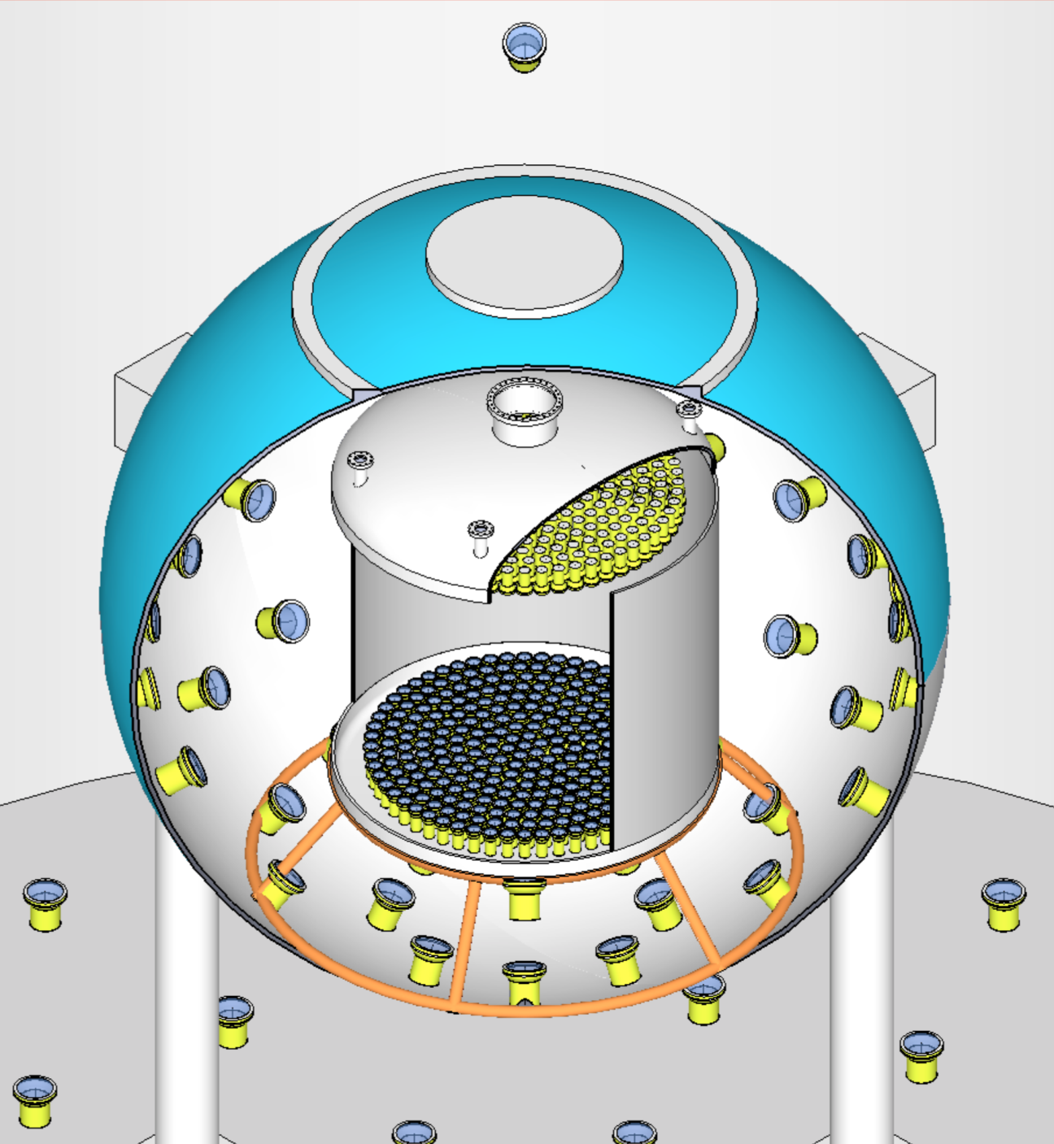
The DarkSide Collaboration
Augustana College, USA
APC Paris, France
Black Hills State University, USA
Fermilab, USA
IHEP, China
INFN Laboratori Nazionali del Gran Sasso, Italy
INFN and Università degli Studi Genova, Italy
INFN and Università degli Studi Milano, Italy
INFN and Università degli Studi Napoli, Italy
INFN and Università degli Studi Perugia, Italy
INFN and Università degli Studi Roma 3, Italy
IPHC Strasbourg, France
Jagiellonian University, Poland
Joint Institute for Nuclear Research, Russia
Princeton University, USA
RRC Kurchatov Institute, Russia
SLAC, USA
St. Petersburg Nuclear Physics Institute, Russia
Moscow University, Russia
Institute for Theoretical and Experimental Physics, Russia
Institute of Nuclear Research, Ukraine
Temple University, USA
University College London, UK
University of Arkansas, USA
University of California at Los Angeles, USA
University of Chicago, USA
University of Hawaii, USA
University of Houston, USA
University of Massachusetts at Amherst, USA
Virginia Tech, USA
University of Virginia, USA

