Slide 1
Riunione ATLAS Pisa
3 October 2012
SM Higgs -> tau tau had had
2012 analysis
Z. Zinonos
V. Cavasinni

Slide 2
News
Tau hadronic analysis:
A new ATLAS document for the 2012 SM tau-tau had-had analysis is now available
cds:
ATL-COM-PHYS-2012-1202
svn area:
https://svnweb.cern.ch/trac/atlasphys/browser/Physics/Higgs/HSG4/ReOptimized2011/SM_HadHad_ReOptimized2011/branch_2012/
HSG4 convener:
Trevor Vickey is substituted by 3 new people
Sasha Pranko
Stan Lai
Nikos Rompotis (MSSM)

Slide 3
Plans
We have the following schedule:
Technical Stop - September 17
Full blinded draft to EB board Oct. 1
Full blinded draft to Higgs WG Oct. 8 ←
Higgs WG approval to unblind Oct. 12
Higgs WG unblinded approval Oct. 18
ATLAS circulation Oct. 19
HCP Japan - November 12
Meetings: twice per week on Monday and Friday

Slide 4
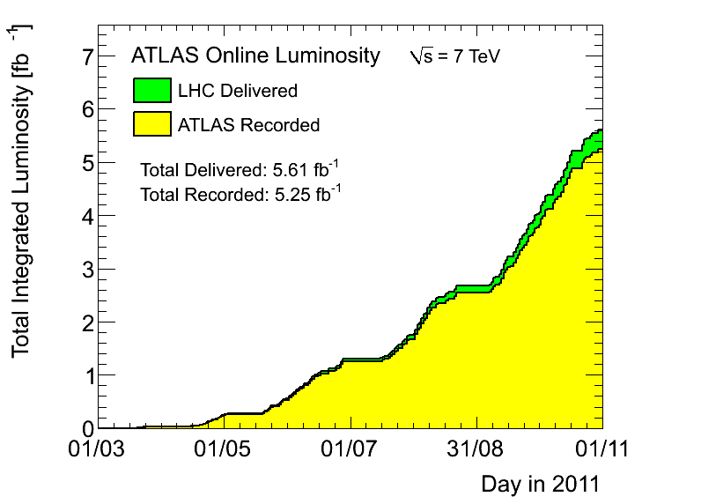
Analyzed (GRL)
on the tapes
2011

Slide 5
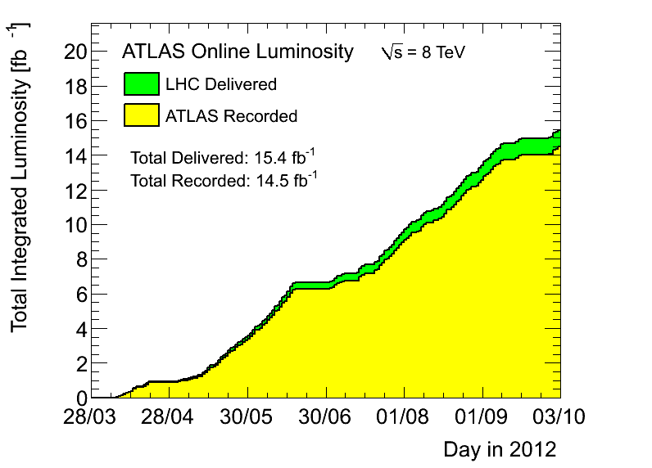
processed
analyzed
on the tapes
2012

Slide 6
2012 Triggers
Primary trigger for
the double-hadronic tau analyses
in 2012

Slide 7
Di-tau trigger
L1_2TAU11I_TAU15
L2_tau29Ti_medium1_tau20T20i_medium1
EF_tau29Ti_medium1_tau20Ti_medium1
leading tau
pT threshold at EF
0 ≤ tracks ≤ 4
in δR <0.2
subleading tau
pT threshold at EF
L1 isolation
EF BDT tau ID
requirement
higher (higher)
pT threshold at L1

Slide 8
Trigger Scale Factors
tau20 / BDT tight
tau29 / BDT tight
So far, data periods A-B have been use for the trigger SF measurements.
SFs should be updated using the full dataset (B-D) and add new SF for period E, separately
pT, ID score, prongs, e-Veto parametrization
eta parameterization too: Barrel and End-Cap separately

Slide 9
Tau reco+id
Applying a new
Track Counting Method
pT lead > 40 GeV
pT sublead > 25 GeV
Reduce QCD jet fakes
Track multiplicity templates for 2D fit:
QCD background
Zττ background
+ New track counting in 0.2 < δR < 0.6
normalization

Slide 10
Event Selection
We have the following categories
Event preselection
VBF CR and SR
1-jet Boosted CR and SR
Non-Boosted (only in 2011, dropped in 2012)
CRs: derive normalizations for the main backgrounds and to study validation distributions
Further cuts are applied to the CRs to obtain the SRs
events with two identified and trigger-matched hadronic taus
Optimized for VBF Higgs
Optimized for gg fusionHiggs

Slide 11
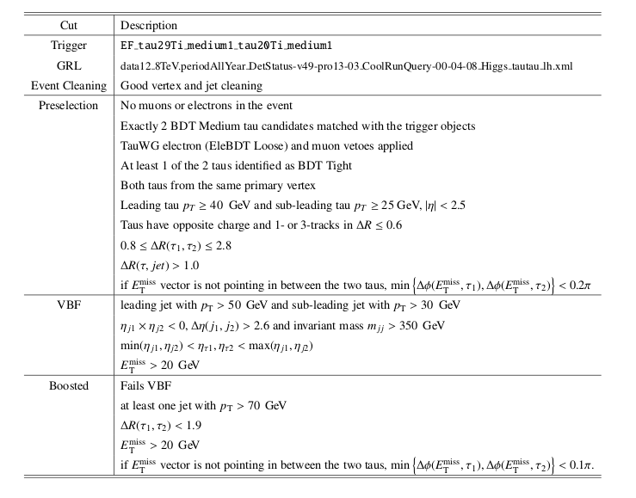
Selection Flow-Chart

Slide 12
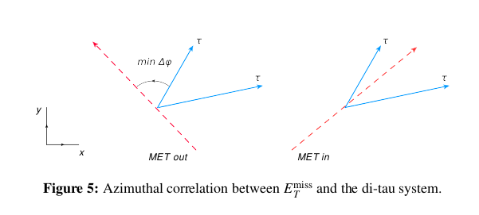
Preselection

Slide 13
VBF category
Require two tagging jets (forward-backward)
Disentangle VBF and ggF processes at maximum possible

Slide 14
Boosted category
Fails the VBF selection
Favors ggF signal events

Slide 15
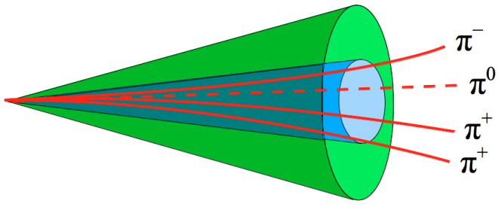
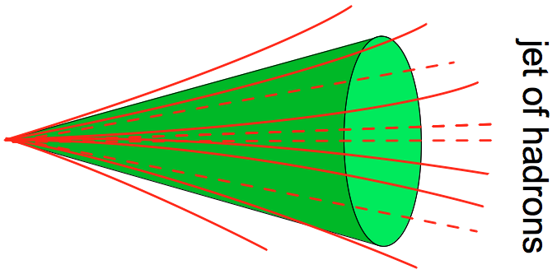
Extended Track Counting
Hadronic tau ID: tacks up to δR<0.2 are considered (1, 3 charged pions)
Track counting in a wider cone 0.2 < δR < 0.6: increased probability to find more tracks associated to mis-identified tau jets
QCD jets: tracks are pT-corellated
Real hadronic taus: tracks are collimated in a narrow cone
Counting procedure:
For each outer track 0.2 < δR < 0.6 passing quality criteria a ratio quantity is calculated with each inner track δR < 0.2 in the core
Threshold D is a tuning parameter to be less sensitive to UE and PileUp

Slide 16
Track Multiplicity Fit
Estimate the normalization of the QCS jet and Zττ+jets backgrounds
2D fit of the tau track distributions
Performed in each data region (VBF, Boosted)
Two fake taus -> QCD multi-jets
Higher track multiplicity than the real taus
3 templates are obtained:
Real taus (Zττ and Hττ from MC)
QCD events (from SS events and after EWK subtraction)
OS describe well the SS events, OS and SS yields are similar
Other: top, single top, Wτν+jets, dibosons

Slide 17
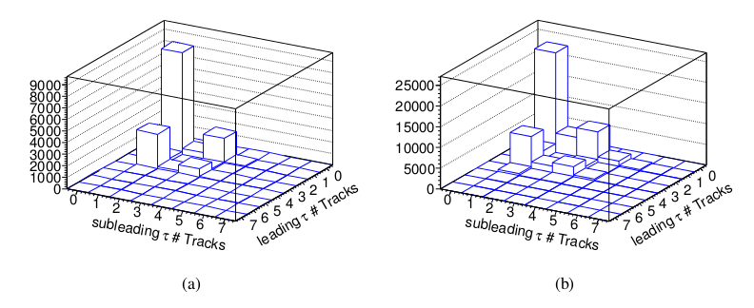
Track-Fit Templates
Templates of the 2-dimensional track multiplicity distribution of leading and sub-leading τ candidates for
(a) opposite-signed Alpgen Z → ττ and
(b) same-signed multijet events used for the fit of the preselected event
A LLH is used for the fit maximizing -2logL (see note)

Slide 18
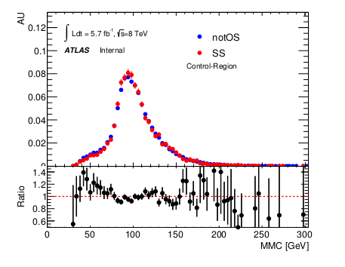
QCD Shape
Options:
OS events (similar to SS)
notOS events
Q1 x Q2 ≠ -1
(includes SS events as well
or ttaus with null charge)
after EWK background subtraction
Facts:
Different flavor compositions in the notOS and SS (gluon- and quark-dominated samples)
This difference is assigned as a systematic uncertainty

Slide 19
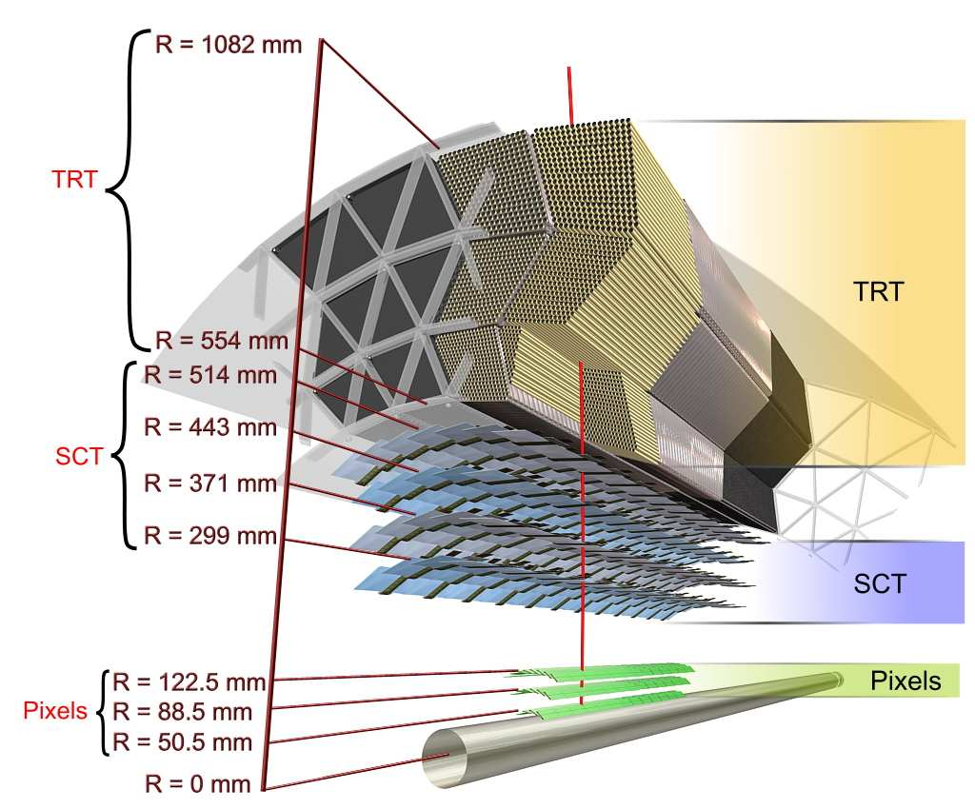
Z τ τ
The greatest dilemma for the HCP analyses
“To be or not to be?”
Here what’s going on: Alpgen+Herwig is buggy
A Herwig job option
bug affects jets and MET
Events must be removed
if the contain long-lived
particles (Ks, Σ+-, Λ, Χ⁰, Ω-)
In jets within ΔR < 0.4
Carry > 10% of the jet pT
Decay more than 1
meter from (0, 0)
Ks
Affects the 5% of the events in the CRs
At least 5% shift in MET

Slide 20
Embedded Ζμμ
Embedding Tools
Old production is BUGGY
group.phys-higgs. data12_8TeV.periodXX.DESD_SGLMU.pro13.embedding-02-42.Ztautau_hh_isol_mfsim_rereco_p1131_EXT0/
Input : DESD_SGLMU
What is it? https://twiki.cern.ch/twiki/bin/viewauth/AtlasProtected/PerformanceDPD#DESD_SGLMU
Periods: A, B
Jet multiplicities are wrong
New production
group.phys-higgs.data12_8TeV.periodXX.DESD_ZMUMU.pro13.embedding-02-46.Ztautau_xx_isol_mfsim_filter_taureco_p1131_EXT0/
Started last week
New Input: DESD_ZMUMU
Periods: A, B, C, D, E
The base on the selection of exactlytwo combined muons with pT 1,2 > 25, 25 GeV and M(µµ)>60 GeV, triggered with EF_mu18_tight_mu8_EFFS || EF_mu24i_tight from the DESD_ZMUMU stream.
Another set of orthogonal samples with low pT 1, 2 >20, 15 GeV and M(µμ)>40 GeV is produced in parallel from a DESD_SGLMU filter with a prescale of 3 and has to be weighted with this factor relative to the high pT sample.
Sample for HCP 2012.
The DESD_ZMUMU embedding production has tighter cuts than the DESD_SGLMU one.

Slide 21
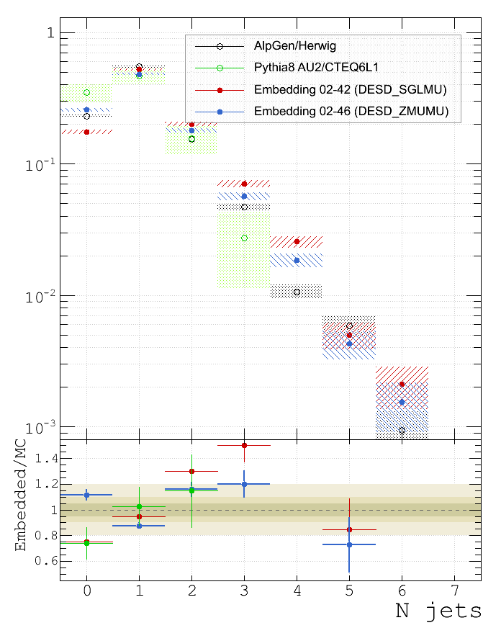
Embedding: Jet Multiplicity
Di-tau selection
pT > 25 GeV, |η| < 4.5
Preselection

Slide 22
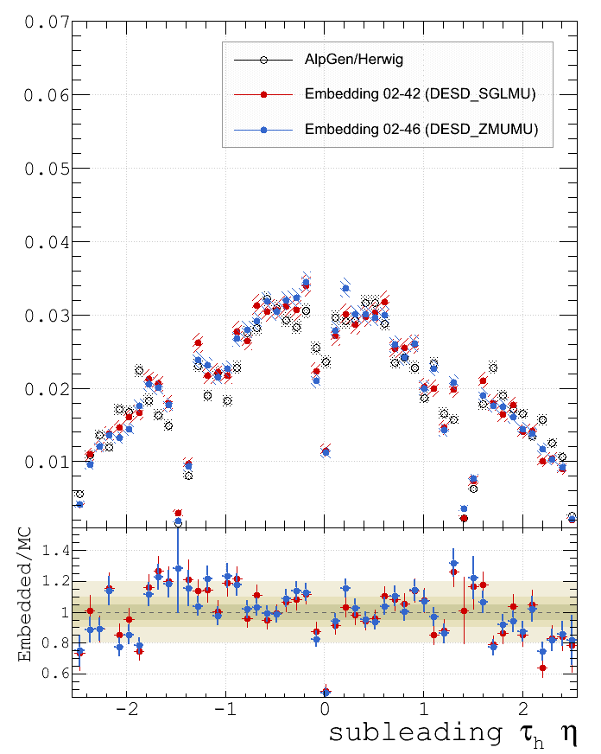
Embedding: Tau η _{@di-tau selection}
Known issue
Very similar behaviors, the point 0 is still not well reproduced by the Z-embedded events

Slide 23
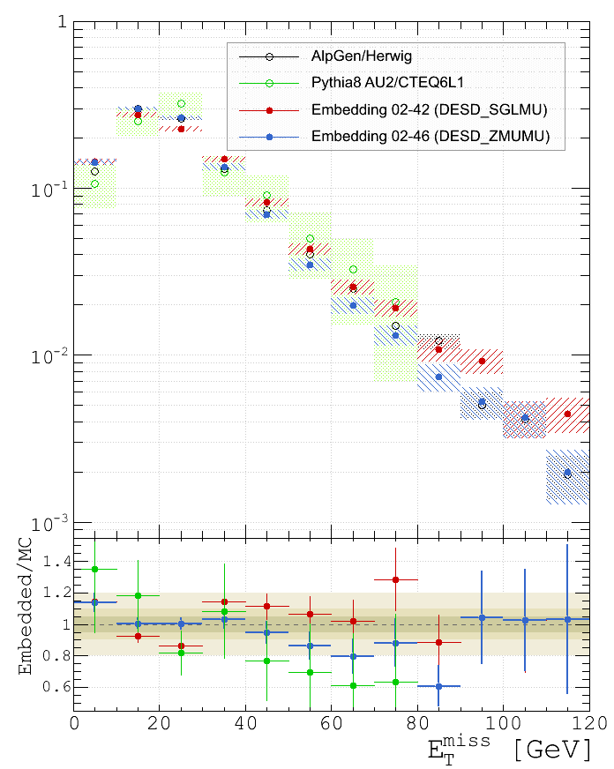
Embedding: MET
Di-tau selection
Preselection
Up to MET ~ 70 GeV the old embedding and
AlpGen are in agreement within 15% 
New trend for the new embedding:
MET is not well-described at high values

Slide 24
Some Results

Slide 25
To do soon
Urgent and still open issues:
Full embedding production and validation
Finalization of the trigger parametrization for the embedded events
Embedding systematics samples are absent
Tau ID and tau trigger SF for period E
Tau FRs and SFs for all periods
Final recommendations for the Hetwig bug
Decide the QCD shape method (current is the notOS events QCD model)

Slide 26
Recap from 2011
Expected and observed exclusion limits for neutral Higgs boson production in the SM as a function of mH.
The region above the solid limit curve is excluded at the 95% confidence level.
The expected limit in CLs is shown as the black dashed line.
The horizontal dashed line represents the SM Higgs production rate.
ATL-COM-PHYS-2012-166

