Slide 1
Status of FTK
& requests 2013
Status of FTK work
IMOU
NEWS & Future steps
TDR with tested prototypes June 2013
University of Geneva joined FTK. Integration/commis./LAMB project
LPNHE and University of Tessaloniki show interest – will sign IMOU
Heidelberg got few funds (25 keuros x 4 years)- will sign the IMOU
FTK IAPP project negotiated@FP7 - manpower support
CAEN & PRISMA ELECTRONINCS joining with IAPP
Paola Giannetti, INFN Pisa, for the FTK Group
ATLAS Italia, Sep 5, 2012

Slide 2
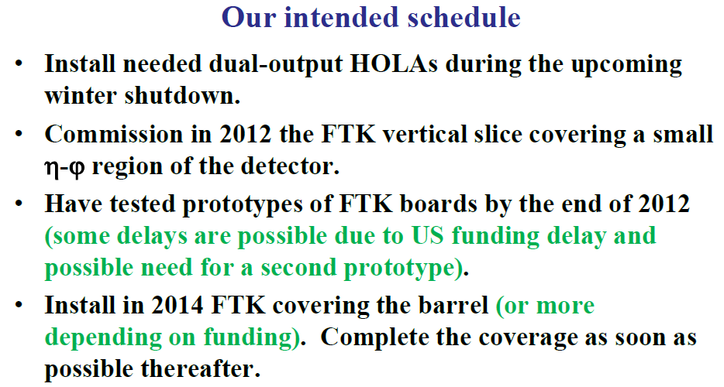
DONE January 2012
September 2012
2013
As much as possible with 8 PUs

Slide 3
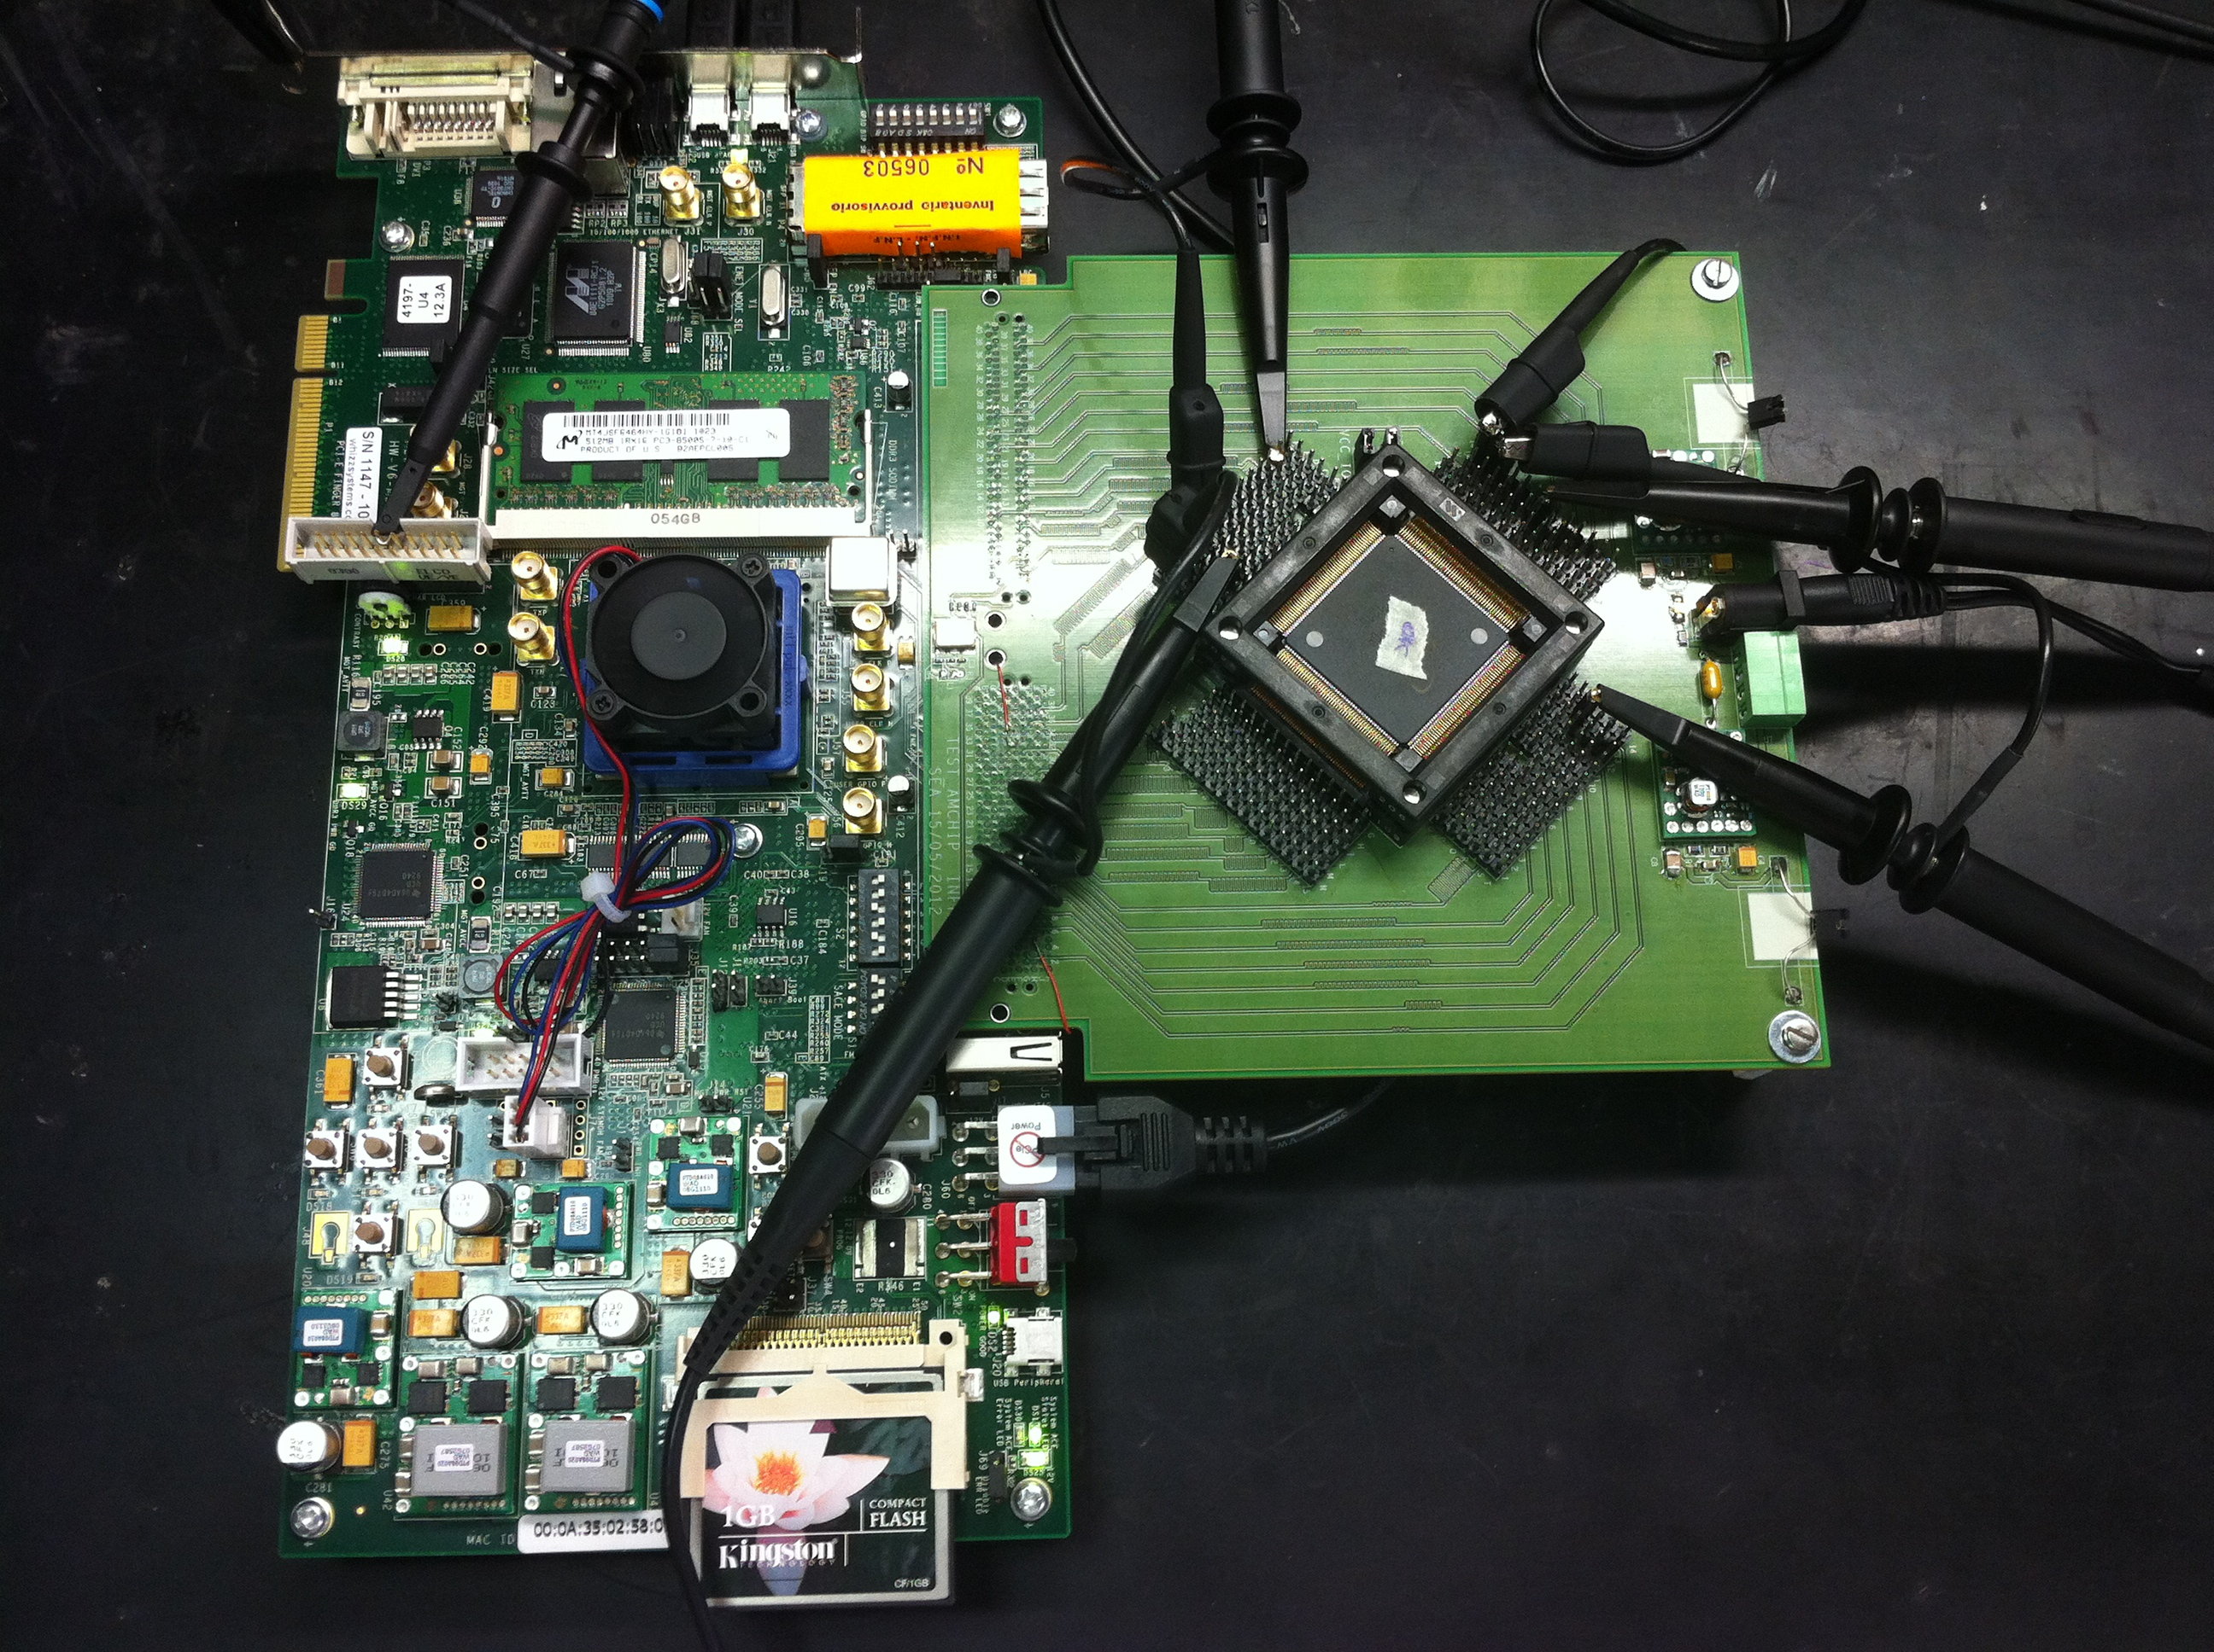
MILESTONEs 2012
Patterns firing correctly @100 MHz
Consumption ok, refined measurements ongoing
Yield measurement ongoing, seems good –
100% expected at 30/09
During the September Technical Stop the VS will be
Installed at Point 1.
Data taking expected in Novemeber
100% expected at 31/12

Slide 4
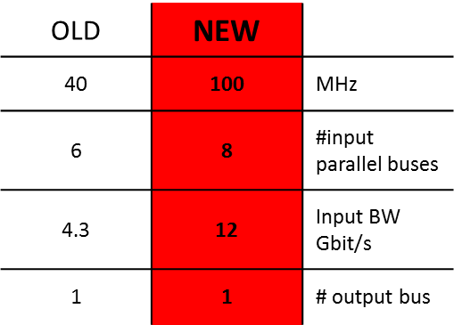
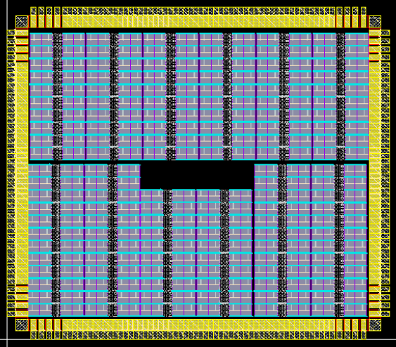

AMCHIP04 big Jump in technology!
(LNF, Pisa, Milano + ideas from USA)
Annovi, Beretta, Crescioli,
Liberali, Sacco, Stabile, Hoff
Consumption & perfomances OK Yield under Measurement
NEW AMCHIP
3.80 mm
65
nm
Next step:
32 kpatt instead of 8kp
Serial links
New package Flip BGA
3.31 mm
2011-12
64 patterns= 2 full custum cells

Slide 5
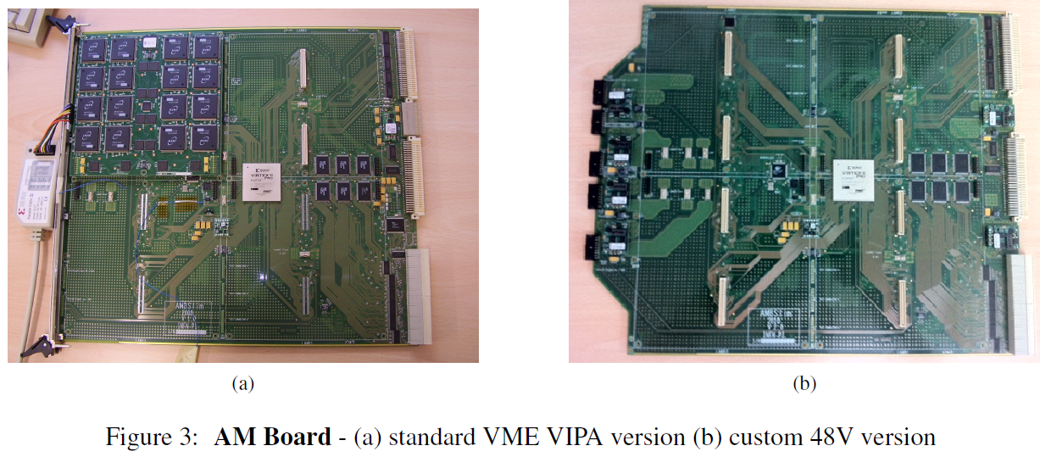
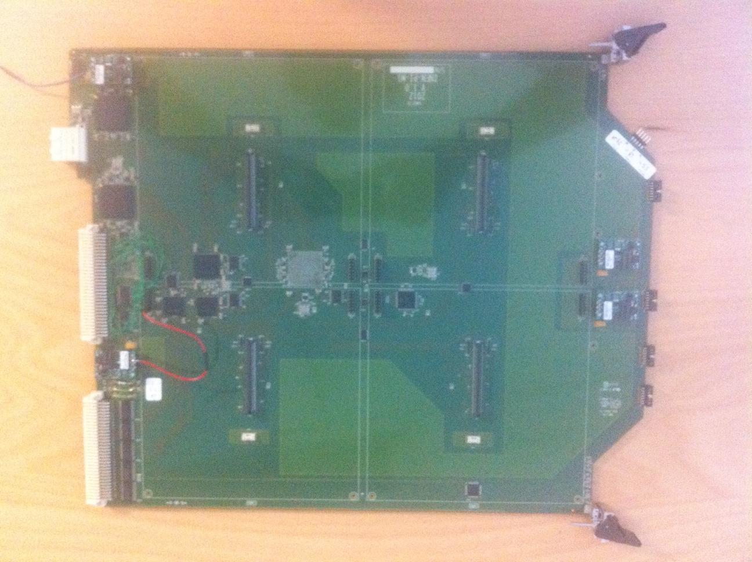
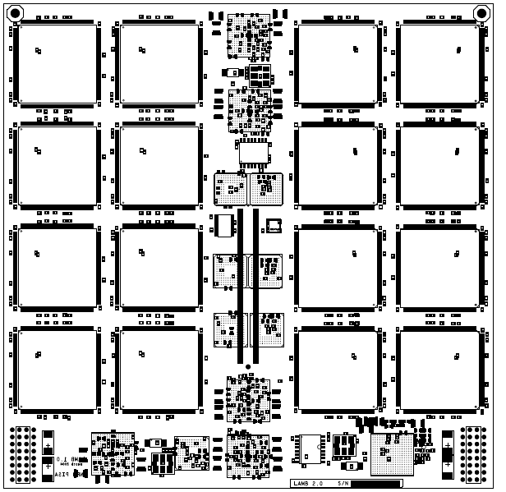
AMBoard generations & tests
AMBslim5 for
standard test stands
NEW:AMBFTK
for 2015 (PI-MI)
AMBslim5++ for cooling tests
New – 128 AMchips
6 A @ 48 Volts
270 Watts@1,8 V
Old – CDF like
64 AMchips
Under test in Pisa
Final crate – Wiener - @CERN
LAMBFTK to be assembled
(PG-PI-PV)
PI-PV
5V / 345A,
3,3V /115A,
48V /81A,

Slide 6
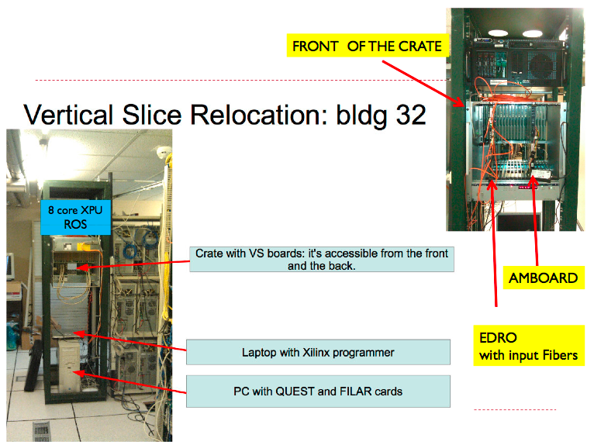
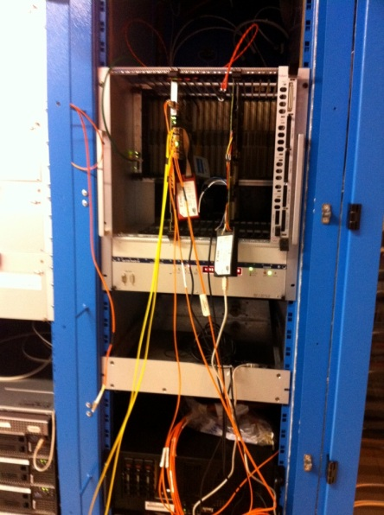
ACTIVITY @CERN 2013
VERTICAL SLICE @Point 1
for TDAQ Integration tests – all involved

Slide 7
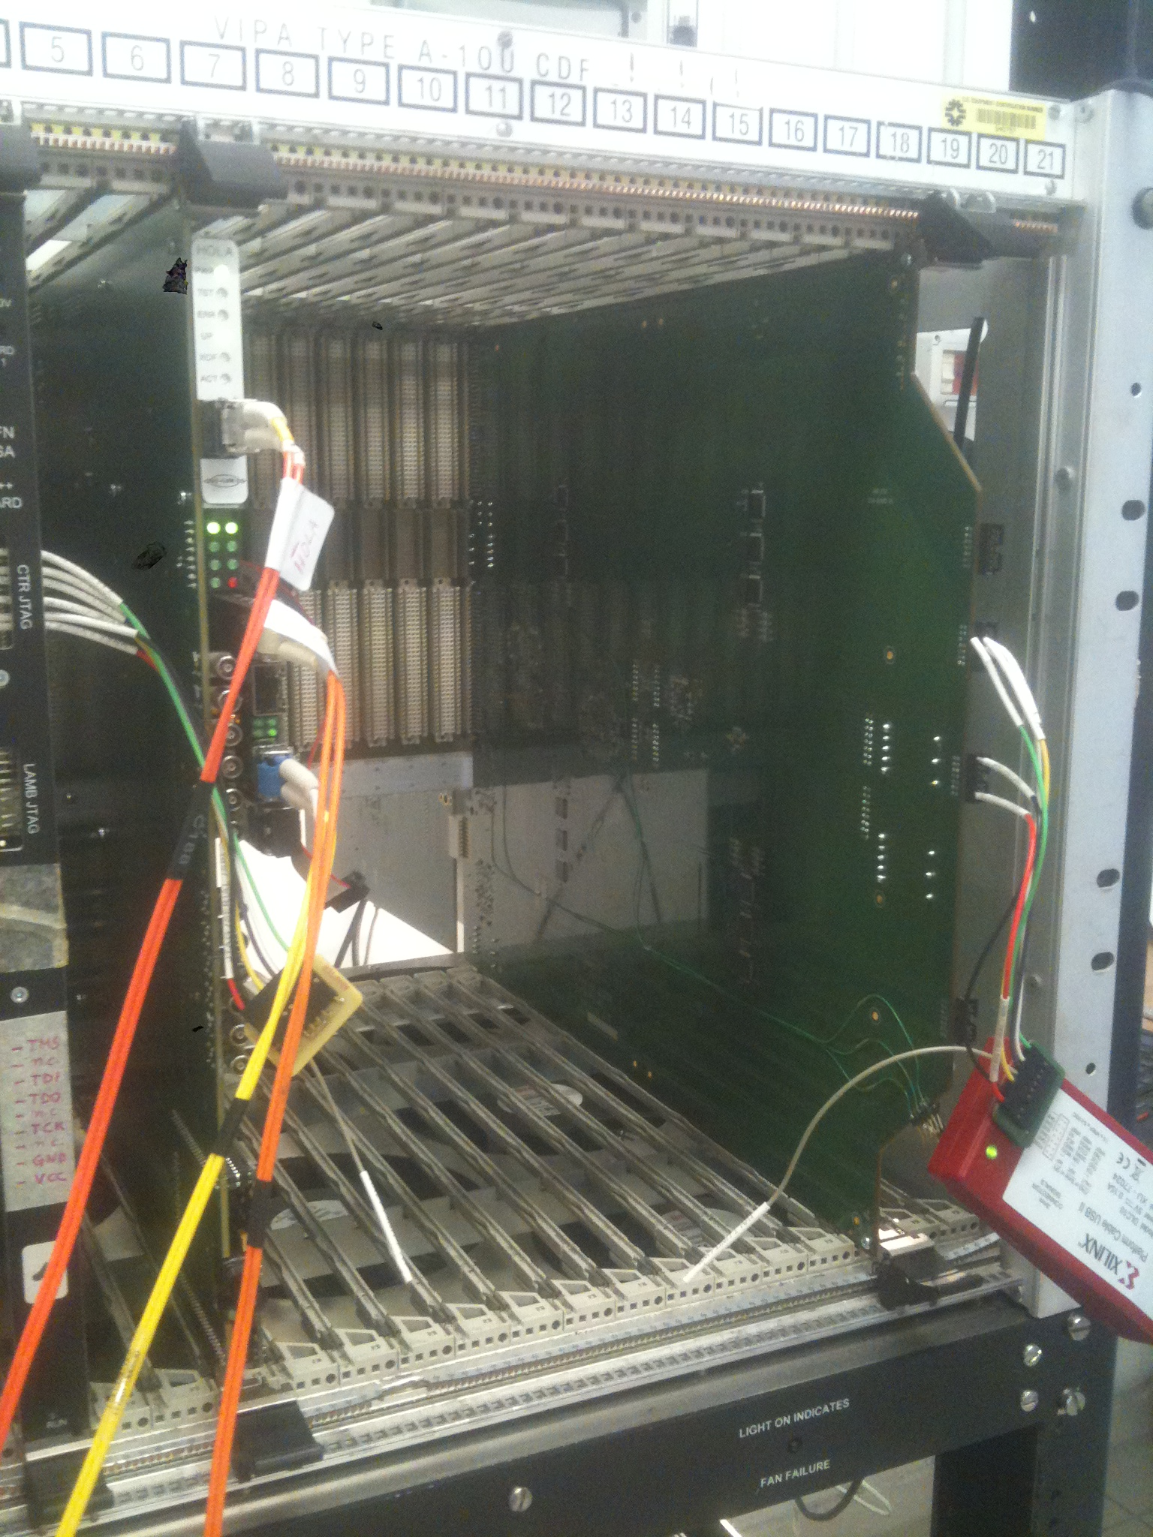
Cooling tests @Pavia first, point 1 after
ACTIVITY @CERN 2013
Final crate – Wiener versus CDF crate arrived from Fermilab
PI-PV
Wiener Crate
5V / 345A,
3,3V /115A,
48V /81A,
Fermilab
CDF Crate
We will put in the crate AMBoard+EDro
together with boards full of resistors
able to sink current
Powerful 1U FAN

Slide 8
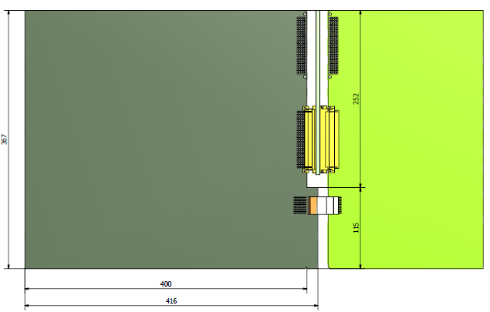
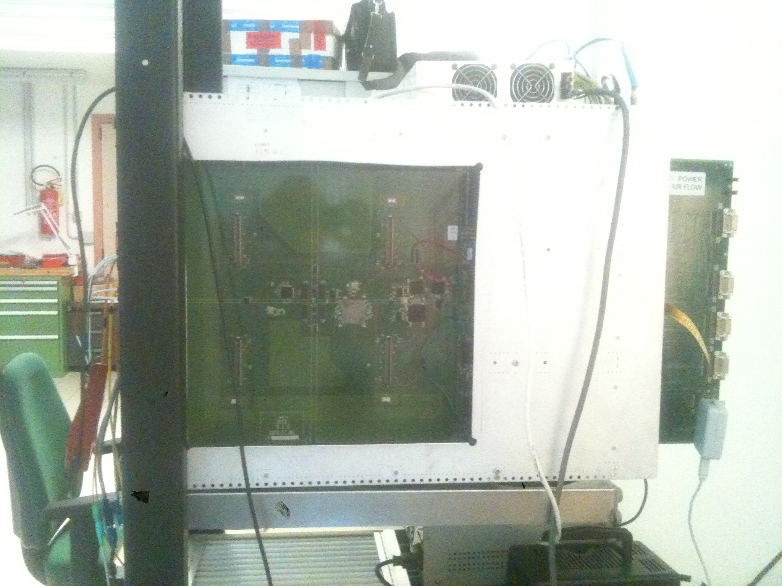
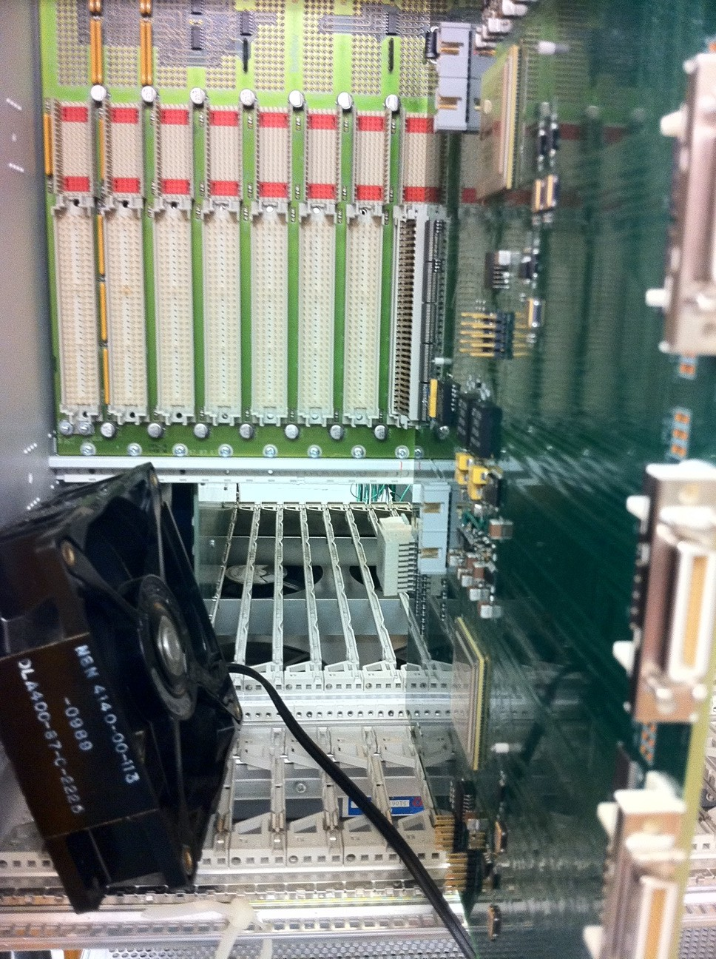
Integration, tests[Italy-Japan-USA]: AMBFTK + FTK_IM + [AUXFTK + DF + FLIC + …. From USA]
ACTIVITY @CERN 2014
Proto
AMBoard
Proto
AUX
The Processing
Unit (PU) project
The reality:
AMBFTK + ProtoAUX
in the crate today
Proto-PU
2014: 10 AMBFTK+
40 LAMBFTK + 80
FTK_IM @point 1

Slide 9
Summary
Milano: 5 k€ TS + AMchip05, 200 k€ 200 SJ su Pisa
Pisa: 10 k€ new AMBFTK + 10 SJ CUT 7+7 SJ
Pavia: 20 k€: LAMBFTK (small prod) + Test board LAMB
CUT 7+7 SJ
LNF: 20 k€ FTK_IM CUT 7+7 SJ
Bologna: 5 k€ (spese di laboratorio)
Tot: 260 keuro + 10 SJ 21 + 221 SJ
DIMENTICATI

Slide 10
Conclusions
We are working hard for both the Final FTK
& the intermediate versions (vertical slice and demonstrator)
First prototypes (chip and boards) under tests.
the AMchip seems ok.
the vertical slice plan has been reduced (LHC schedule).
the TDR in 2013 should start final approvals
A demonstrator expected in 2015, production will start after.

