Slide 1
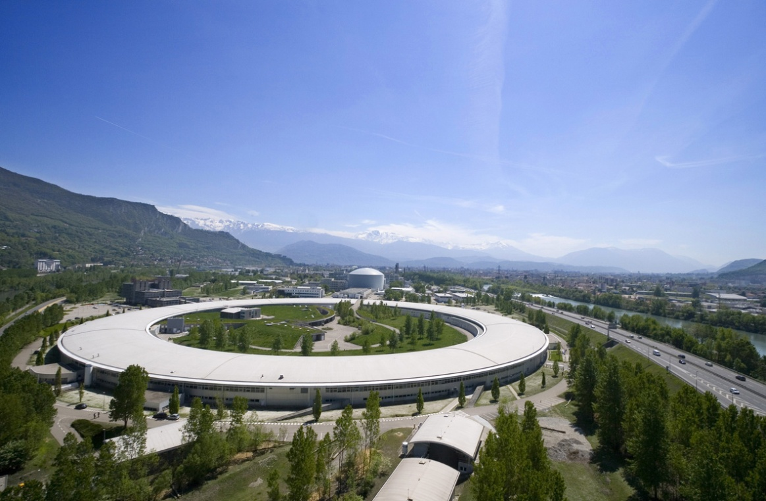
Upgrade of the ESRF Light Source:
Achievements and Perspectives
P. Raimondi
On behalf of the
Accelerator & Source Division

Slide 2
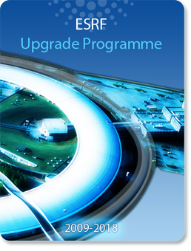
The Upgrade Programme
ESRF Upgrade 2009-2018
@ Funding for Phase1(from 2009 to 2015) secured to deliver:
Eight new beamlines, with an extension of the experimental hall
Refurbishment of many existing beamlines
Developments in synchrotron radiation instrumentation
Upgrade of the X ray source for
availability, stability and brilliance
While maintaining an
operational facility
@ Phase 2 under study

Slide 3
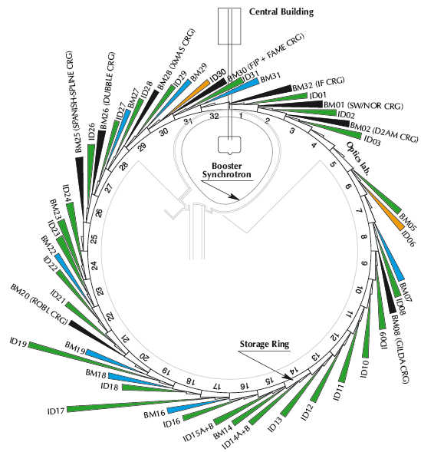
The ESRF today
Storage ring
6GeV, 844 m
Energy | GeV | 6.04
Multibunch Current | mA | 200
Horizontal emittance | nm | 4
Vertical emittance | pm | 3.5
Booster synchrotron
200 MeV ➔ 6 GeV
300m, 10 Hz
32 straight sections
DBA lattice
42 Beamlines
12 on dipoles
30 on insertion devices
72 insertion devices:
55 in-air undulators, 6 wigglers,
11 in-vacuum undulators, including 2 cryogenic
E- Linac
200 MeV

Slide 4
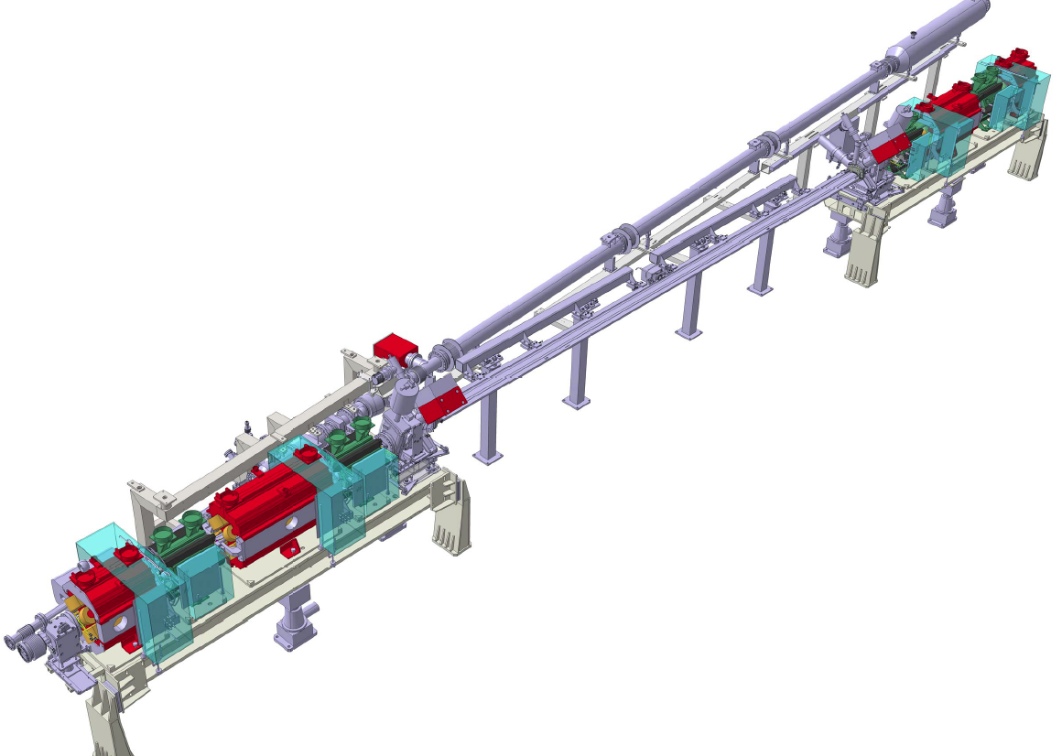
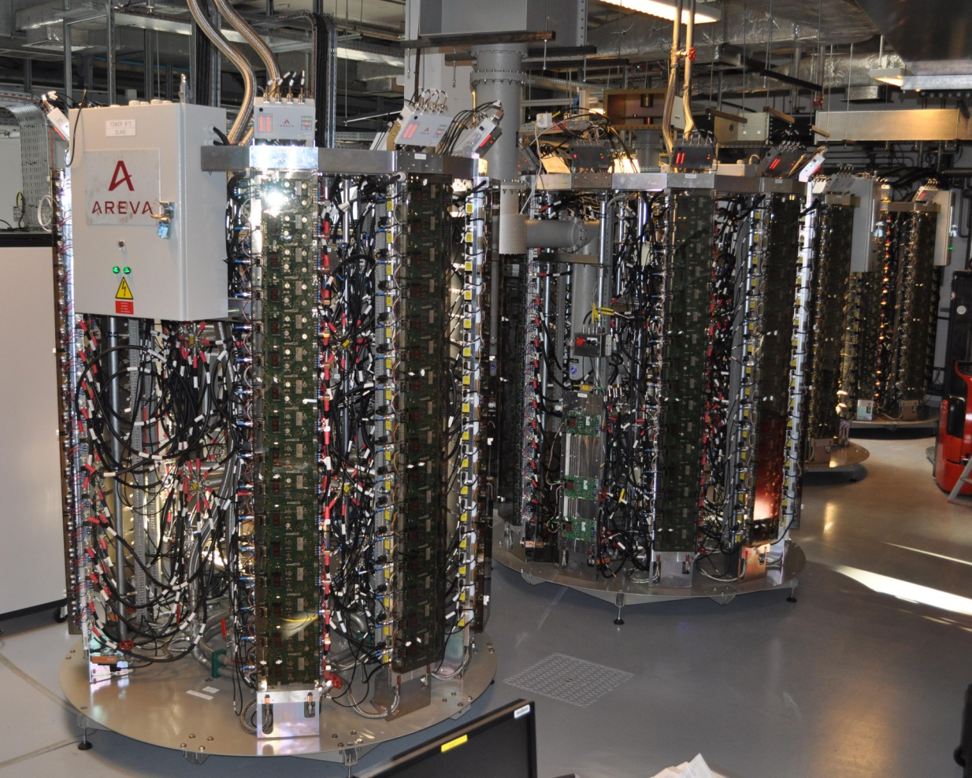
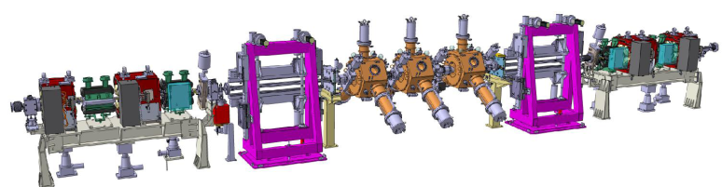
Accelerator Upgrade Phase 1
Upgrade of BPM electronics
  Improvement of the beam position stability
  Coupling reduction
6 m long straight sections
  No change in magnet lattice
  Canted undulators
7 m straight sections
  Lattice symmetry breaking
  New magnets necessary
Cryogenic in-vacuum undulators (see Chavanne talk)
Diagnostics developments
New RF Transmitters
New RF Cavities

Slide 5
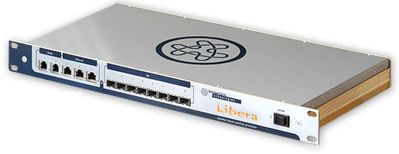
Upgrade of BPM Electronics
Slow Acquisition
(10 Hz, orbit correction)
Turn by Turn
(355 kHz, for lattice studies)
First Turn mode
(For injection tuning)
224 Libera
Brillance
Post-Mortem
(Data loging on trigger)
Fast Acquisition (10 kHz)
For fast global orbit correction
Sum signal of the 4 buttons:
  Lifetime monitor
  Instant Fractional-Beamloss monitor

Slide 6
Coupling reduction
Achieving lower coupling
  Better resolution of the response matrices ➔ improved model
  New correction method: minimization of Resonance Driving Terms
  Increased number of skew quad correctors: 32 ➔ 64
  Down to 3.5 pm
Maintaining small coupling
  ID gap variations with magnetic field errors induce varying contributions to coupling
  Local correction of ID magnetic field errors
    2 skew quad correctors, lookup table
  Automatic periodic retuning of the correction
  ε_{z} < 5 pm on medium term (1 week)

Slide 7
Coupling reduction
Maintaining low emittance during USM: 1 week delivery
Current
200 mA
Vertical emittance
3.5 pm
50 hours
Lifetime
@ Vertical Diffraction Limit reached routinely

Slide 8
New orbit feedback
Previous
  Slow feedback: 224 BPMs, 96 steerers, every 30 s
  Fast feedback: 32 dedicated BPMs, 32 dedicated steerers
  Combination of the 2 systems is delicate
From this run
  Single system from DC to 200 Hz
    224 Libera BPMs
    96 standard steerers up to 200 Hz (integrated in the sextupoles)
    New power supplies
    10 kHz operation
  Much better correction of the orbit distortion induced by IDs

Slide 9
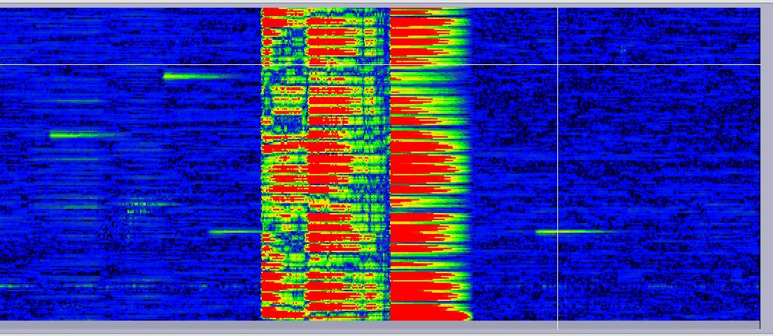
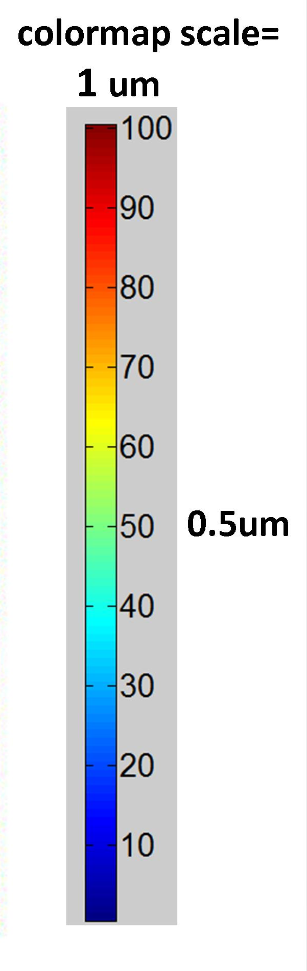
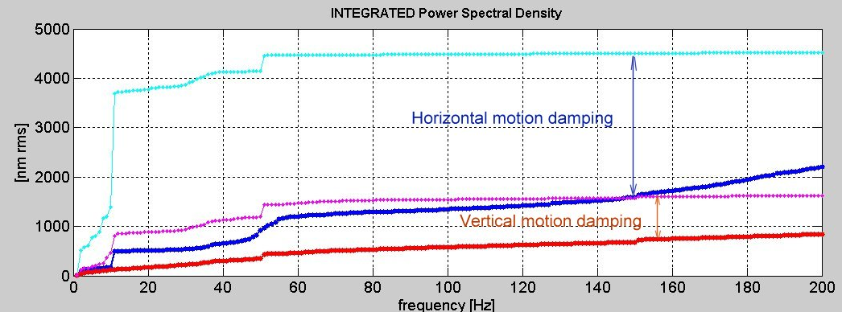
New orbit feedback
Cell1
rms
ID11
ID17
224 BPM
Feedback OFF
ID27
Cell32
8 mn
Horizontal OFF
Horizontal ON
Vertical OFF
Vertical ON
2.5 μm
0.9 μm
@ sub μm stability routinely achieved in V
@ μm stability routinely achieved in H

Slide 10
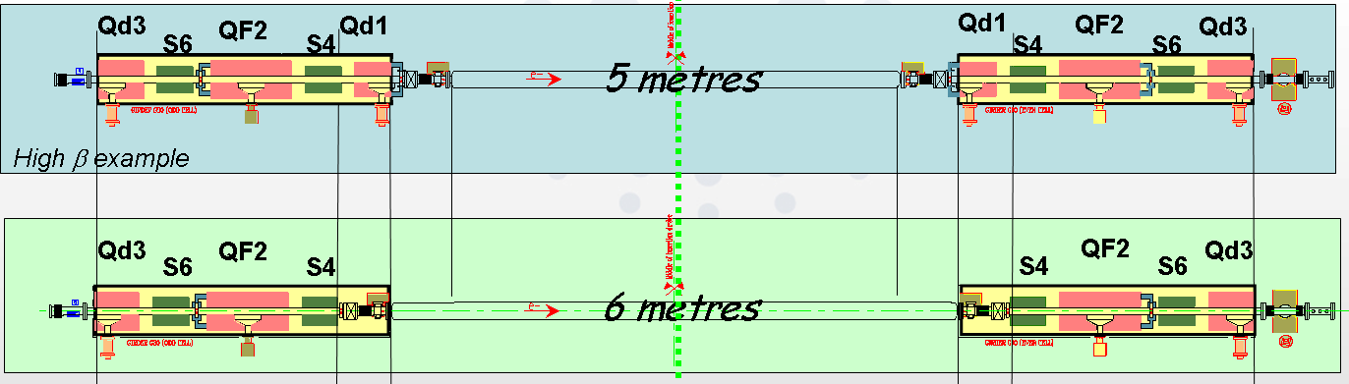
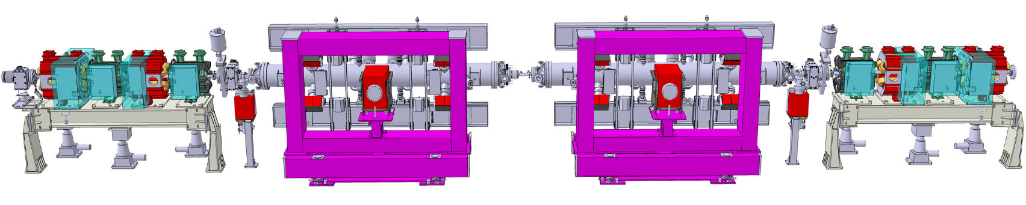
6 m sections
6 m section no canting
    ID18, ID20 , ID14, ID1, ID31, ID15
    ID 24 full 6m operational with 4 carriages
No change in optics
New vacuum chambers
Cabling & piping modification
Front End modification for canting
6 m Large Angle canting
    ID30 (±2.2 mrad )
    ID16 (±2.7 mrad )

Slide 11
7 m ID straight Sections
bpm
Qd8
QF7
Qd6
S24
S22
Qd8
C
C
C
bpm
Qd6
S22
QF7
S24
5 metres
7 metres
Infra Red beam port
bpm
bpm
bpm
bpm
C
C
ID 1.6 m
Mini beta test
C
ID 1.6 m
C
QD6_HG
QF7_HG
QD_low
QF7_HG
QD6_HG
S22_IR
S24_200
3 single cell cavities
S24_200
S22
7 metre
New girders
New quadrupoles
Individual power supplies
New vacuum chambers
1st symmetry breaking
Goal:
Redistribute RF cavities to install undulators in the present dedicated RFstraight sections
Create 2 lower vertical beta points to reduce the in-vacuum undulator gap from 6 to 4 mm

Slide 12
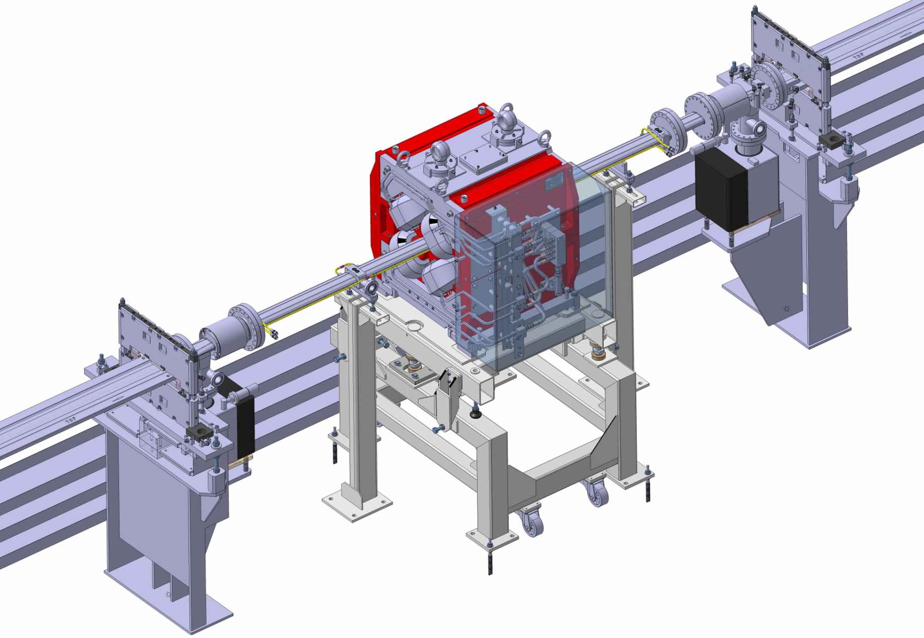
6&7 m straight sections
5 metre standard Section
7 straight sections already converted to 6 metres
First large canting installation this summer
6 metre Section (6173 mm)
7 metre Section
First 7 m straight section next winter shutdown
Test of mini beta optics during first half 2013
Installation of the RF cavities during second half 2013

Slide 13
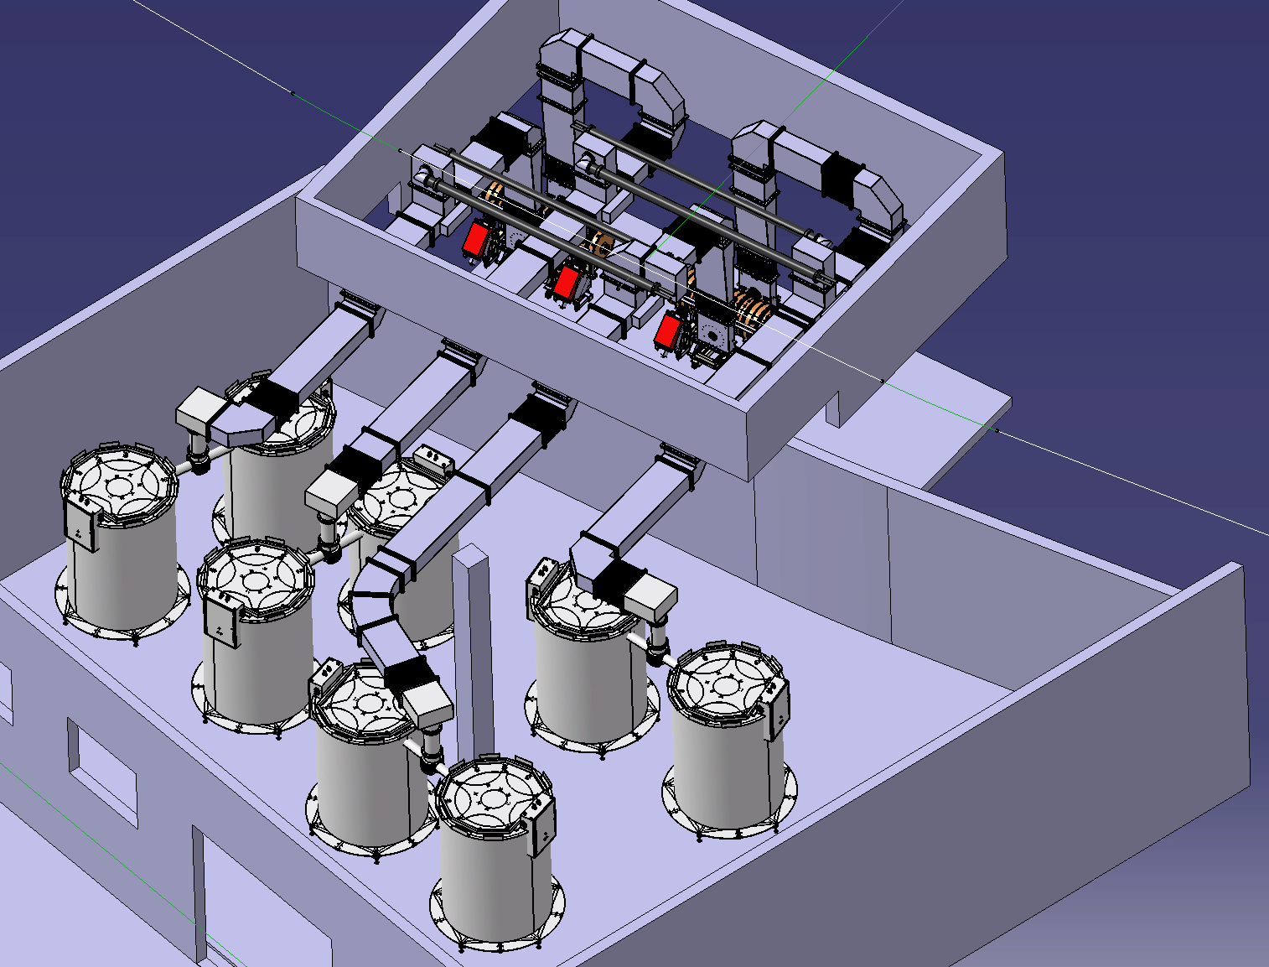
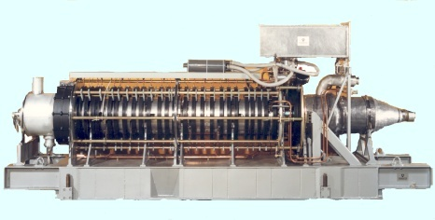
Solid State RF transmitters
Klystrons at l’ESRF
2 five-cell cavities
x 2 couplers
1.3 MW -352MHz
4 Waveguide switches to
4 water loads
Goal:
Prevent klystron obsolescence
Prepare future upgrades
SY: Booster Synchrotron
75 kW tower of
128 RF modules
Booster RF :
Four 150 kW amplifiers in operation
Replacing one 352.2 MHz 1.3 MW
klystron booster transmitter
SYRF now ready for TopUp operation,
(Electrical power reduced from 1200 to 400 kW).

Slide 14
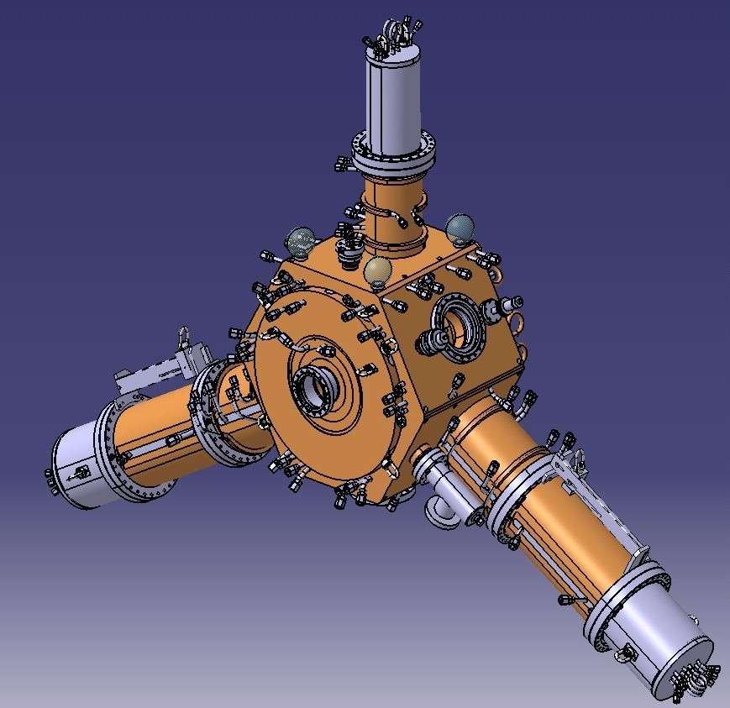
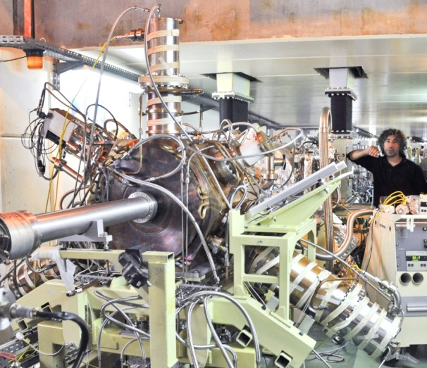
Single cell NC HOM damped cavity
9 MV with 12 to 18 cavities (4.7 ± 0.4 MΩ)
Planned operation at 300 mA
Power capability to sustain up to 500 mA
No HOM up to 1 A
Goal:
RF distribution to create a new experimental station
Prepare future upgrades
HOM absorbers:
Ferrite loaded tapered ridges
3 power prototypes
under test at ESRF
352 MHz
HOM dampers = ridge waveguides
Based on 500 MHz BESSY, MLS, ALBA design [E. Weihreter et al.]
ESRF 352.2 MHz design: several improvements

Slide 15
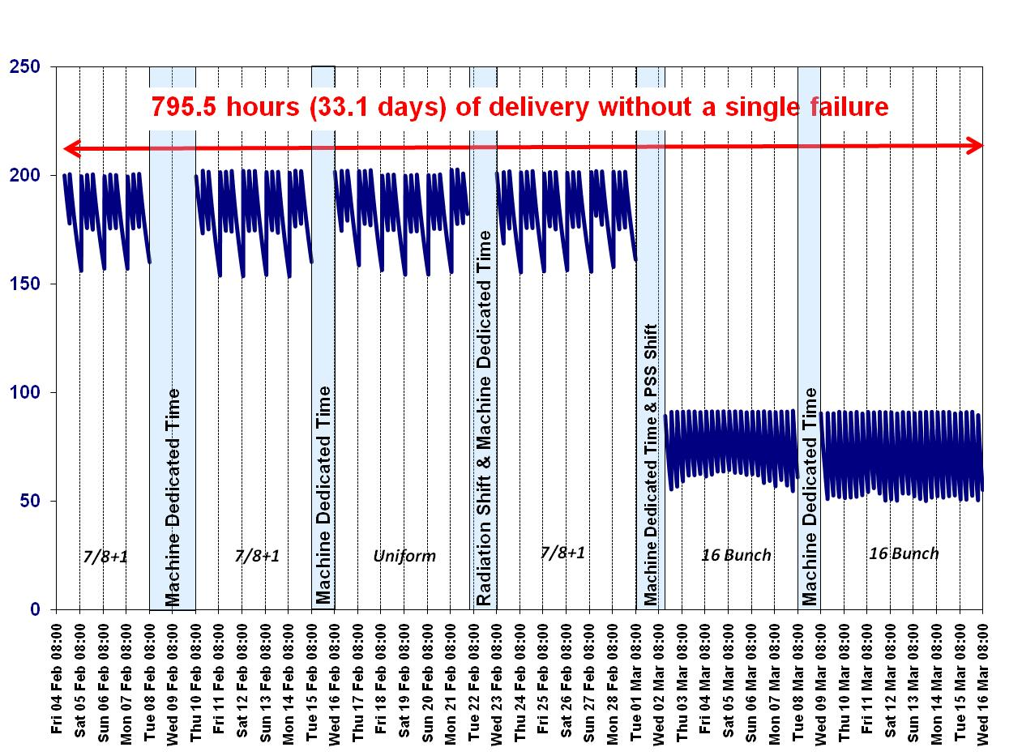
But while preparing the upgrade…
The priority is still machine operation:

Slide 16
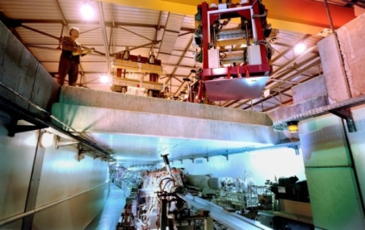
  Operation: Accelerator and Source
Machine Statistics for 2009-2012
ESRF: the most stable and bright SR source
2009 2010 2011 2012
( 4 weeks only !)
Availability (%)
Mean time between failures (hrs)
Mean duration of a failure (hrs)
99.04 98.78 98.91 98.34
75.80 67.50 107.8 46
0.73 0.82 1.18 0.76
ESRF Record
Accelerator and Source Division
Notes:
16

Slide 17
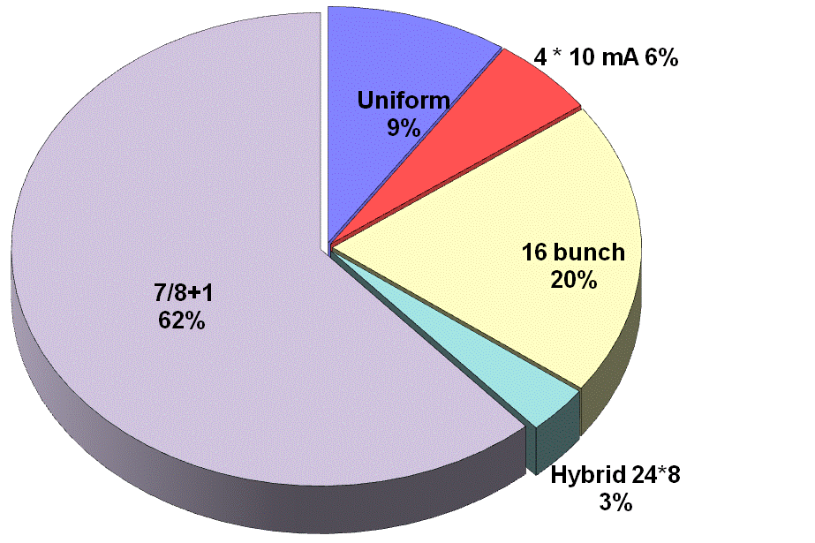
Filling modes in 2011
Mode 7/8+1: 200 mA
Energy | GeV | 6.04
Multibunch Current in 7/8+1 | mA | 200 4 (single)
Horizontal emittance | nm | 4
Vertical emittance | pm | 3.5
91 % of Beamtime available for Timing Experiments

Slide 18
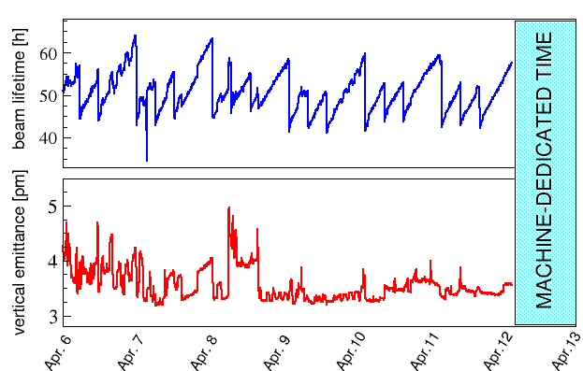
Lifetime evolution
Lifetime maintained in excess of 45 hours in multibunch (7/8+1)
45 hours
1 week of delivery to users
4 pm
Reduction of the lifetime in multibunch limited to less than 10 hours
despite a reduction of the coupling by an order of magnitude
==> Still no topping-up envisaged
The other modes do not benefit from the coupling reduction because the emittance is
vertically blown up to get a reasonable lifetime
    ==> Topping up would be valuable

Slide 19
Top Up Project
@ Most facilities operate in Top Up mode, except ESRF
Pro: Reduced heat load variation on the beamline optics.
➔ Improves stability
Con: Increased number of injections.
➔ Disturbs stability
@ Survey of Top Up operation at
ESRF/ APS/ SPRing8/ PETRA/ SOLEIL/ DIAMOND/ BESSY/ ELETTRA/ ALBA /SLS
Top Up is multi parameter with discrepancies between institutes!
@ ESRF has developed a lot of expertise in the design of the optics and in the layout of beamlines to manage heat load variation,
especially for the UPBLs, which should be less sensitive to refills.
    Could we still gain (a lot) by reducing the current variation ?
    What would be the (maximum) current variation which would make a refill transparent?

Slide 20
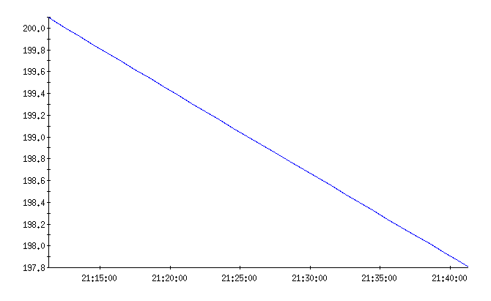
Top Up Project
Possible Top-UP scheme
Standard decay
2mA
30mn
Mode 7/8 200 mA, 45h, 5pm vertical emittance:
Δt= 30 mn ➔ ΔI<≈ 2 mA instead of 40 mA today with an injection every 12hours
Mode 16 bunch 90 mA, 6h, 6pm vertical emittance:
Δt= 30 mn ➔ ΔI<≈ 10 mA instead of 30 mA today with an injection every 6 hours and vertical emittance *10
@ 15-30mn Top-Up cycle seems reasonable
@ We are doing tests and studies during MDTs
(including feedback from Users)
@ We are upgrading our injector to improve reliability and operation
20

Slide 21
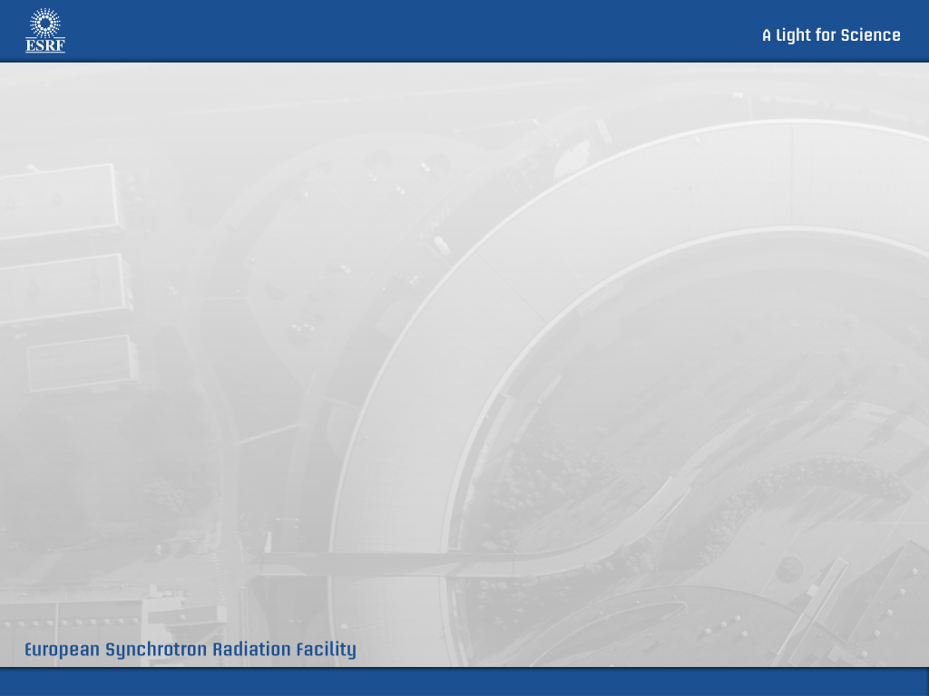
The Quest for 4th Generation SR
The last few years have been characterize by a World-Wide R&D carried on by Accelerator Engineers to find solutions to improve the SR beam parameters.
The Science in general benefits by any of this improvements:
- Horizontal Emittance
- Vertical Emittance => Diffraction Limit reached routinely everywhere
- Bunch Length => Very costly solutions (e.g. SC Crab Cavities)
- Energy Spread => No solutions exists for a significant decrease
(< 0.05-0.1%) in SR
- Beam Current => Close to the limits imposed by the BL

Slide 22
Progress of the ESRF Brilliance
Free electron laser
Diffraction limit
Progress of X ray light sources are summarized in the evolution of the brilliance
ESRF (2008)
Troisième
génération
Brillance
(photons/s/mm²/mrad²/0.1%BW)
ESRF (1994)
Brilliance =
photons /s / mm² /mrad² /0.1% bandwidth
Deuxième génération
Synchrotron radiation
Number of photons per second
Première génération
Size
horizontal*vertical
Tubes à
rayons X
Divergence
horizontal *vertical
In a bandwith of 0.1 %
around the considered energy.
1900 1920 1940 1960 1980 2000

Slide 23
Low Horizontal Emittance SR
The most immediate advantages of such machines are:
- Brigthness Increase while maintaining the same flux
- Spacial Resolution Increase
- Transverse Coherence
The first two points improve almost linearly for an emittance decrease from 2-4nm down to 50-100pm. For lower emittance the gain become less than linear due to:
- the diffraction limit
- mismatch of the electron beam with the X-Ray beam
The coherence starts to be of significance for emittances below 5-10pm. For example: @10KeV 80% coherence needs about 1pm emittance.

Slide 24
Brilliance at lower horizontal emittance
~ x 5
Electron beam:
6.039 GeV
I=0.2 A
~ x 25
Hor. Emittance [nm] | 4 | 0.15 | 0.01
Vert. Emittance [pm] | 3 | 2 | 2
Energy spread [%] | 0.1 | 0.09 | 0.09
Betax[m]/Betaz [m] | 37/3 | 6/2 | 6/2

Slide 25
USRs – Coherent Fraction

Slide 26
ESRF toward a 4th Generation SR
The world wide effort in lattice design and technology developments has paved the road the possibility of studying options to upgrade the ESRF storage ring lattice in order to significantly lower (by a factor 20-40) the equilibrium horizontal, within the constraints underlined in the ESRF “purple book” (par. 3.1.8), in particular:
- Maintain as much as possible unchanged the existing Straight Sections and BeamLines
- Maintain the present Injection Scheme and Injection Complex
- Reuse as much as possible the existing ARCs hardware (Power Supplies, Vacuum System, Diagnostic etc…)
- Reduce Operation Costs, specifically Wall-Plug Power.
These constraints pose limits to the ultimate ring performances and raise technical and logistic challenges. On the other end they are consistent with the following crucial points:
- Cost comparable with a “Phase II” budget expenditure
- Upgrade to be completed by beginning of next decade (2020)
- Less than 1 year ShutDown for installation and commissioning

Slide 27
The present Double Bend Achromat (left) should be replaced by a New lattice (example on the right)
DBA
7-bend achromat
Cell packed with magnets
Stronger focusing: tunes 36.44/13.39 → 75.66/27.60
  Chromaticity: -130/-58 → -102/-75
Smaller 𝛽 functions Chromaticity correction needs
Smaller dispersion stronger sextupoles
Less radiated power (x2 less)
} ⇒ {

Slide 28
New Lattice Engineering
The complexity of the problem is relatively contained, since it is limited only to the design of a 25m long Arc (*32). However the technical aspects are very challenging:
- High gradients magnets (4 times more)
- Tight tolerances (2 times more)
- Small vacuum chamber (2 times less)
- Very compact design
It should be stressed that the 4th Generation SRs take advantage of all the R&D and Know-How accumulated in the last 20 years at ESRF and the rest of the world:
- Lattice design
- Vacuum technologies (e.g. NEG coating that allows the use of smaller vacuum chambers)
- Magnet technologies (better modeling and manufacturing)
- Diagnostic (e.g. Libera BPMs)
- Controls
- Operations
- …

Slide 29
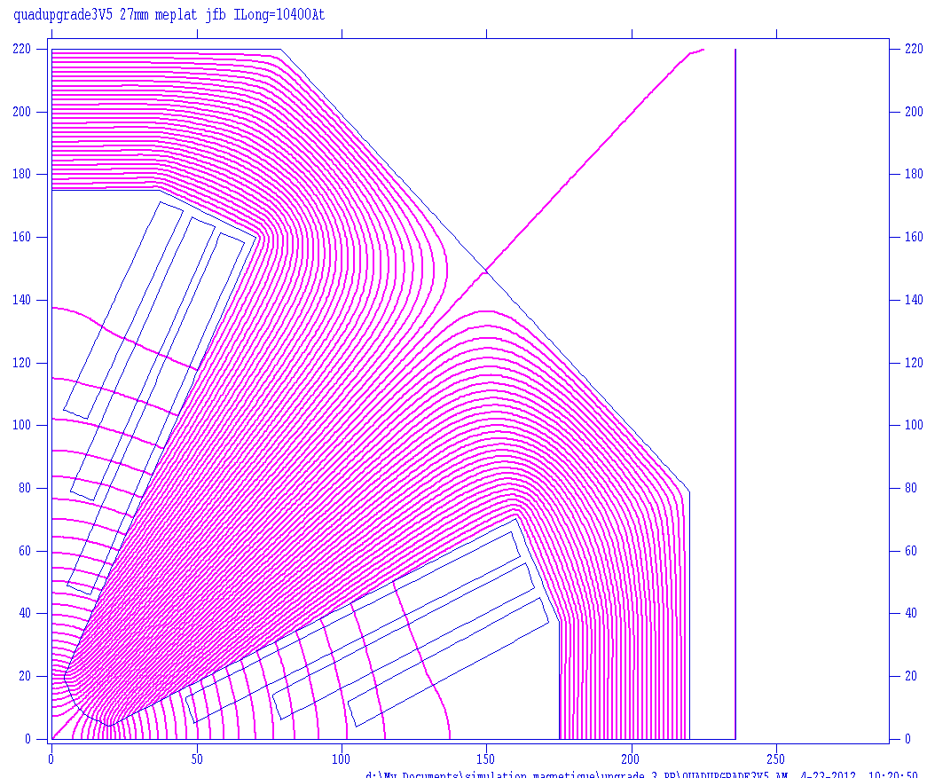
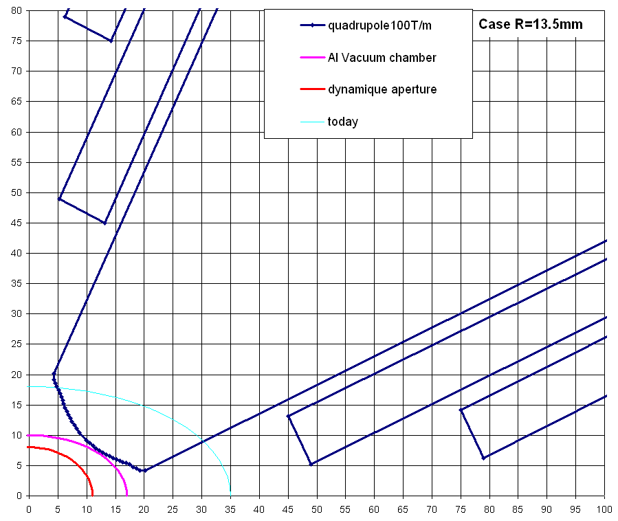
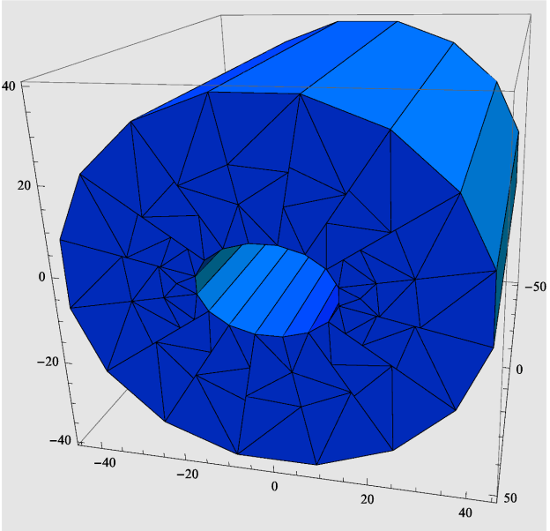
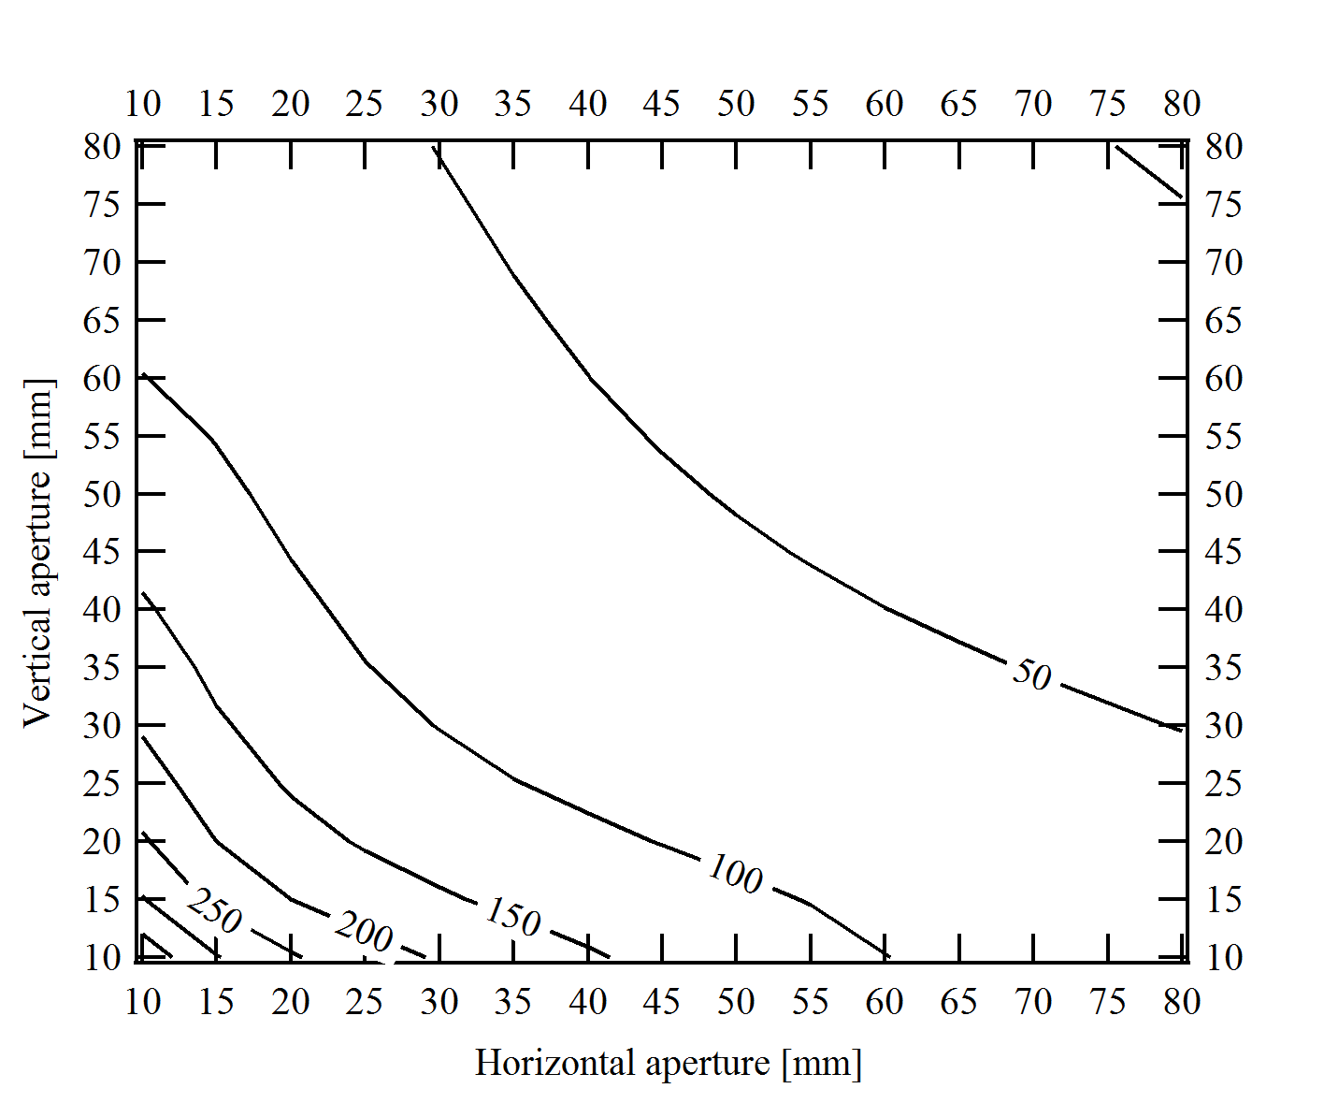
Quadrupole Magnet Design G> 100T/m
EM quadrupole
PM quadrupole
Solutions Compatible with a
“Soleil-type Vacuum Chamber”

Slide 30
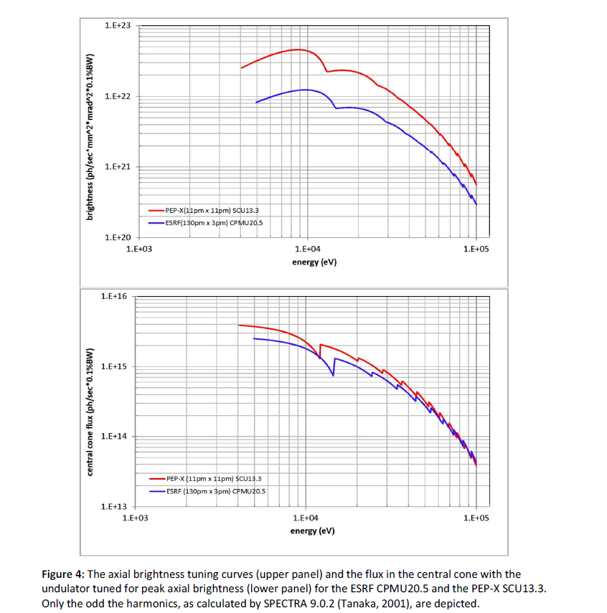
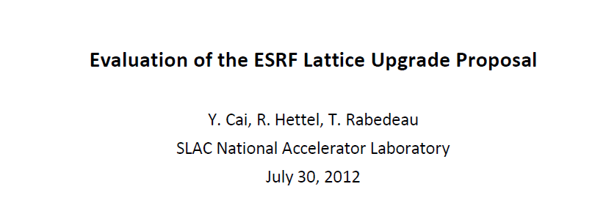
Upgrade performances have been benchmarked by SLAC w.r.t. the Pep-X 10pm storage ring proposal

Slide 31
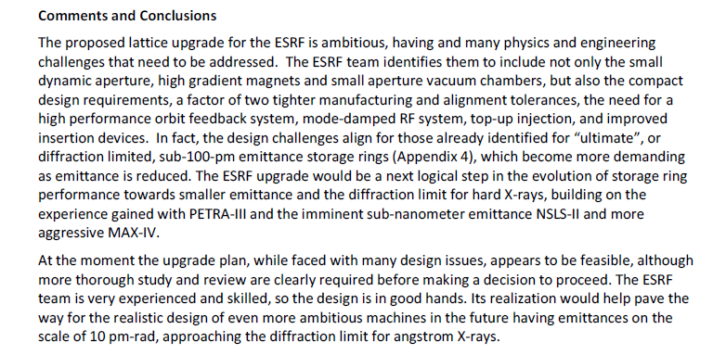

Slide 32
Phase II Upgrade could be an excellent opportunity to:
- Improve and Expand the Science Reach of the SR-based Light Sources
- Enabling New Technologies
- Realize a World-Class SR, we might expect an overall 100 fold increase in brightness of a SR-Based Light Source
- Provide Invaluable Know-How to:
Continue the push for higher perfomances SR-based Light Sources

Slide 33
New lattice project schedule and budget evaluation
The budget evaluation is divided in 2 parts. The first part contains all what is need in term of R&D and prototyping and all what can used be anyhow on the present machine (Top-Up, RF, Upgrade of the injector, IDs,..) (mostly be paid with the money of phase 1). The second part is the fresh capital money needed to implement the new lattice (No other improvements included!).
This budget evaluation will be use to evaluate the cost but also mostly to get all the tasks to perform.
It should contains all items even if the cost is low. ➔ Please add the missing items.
The price evaluation is mostly based on the cost evaluation of the 6 metre and 7 metre projects.The prices are in 2012 euros. The estimation of the inflation willbe done by finance.
The preliminary budget profile covering 2013-2018 for each item is based on the planning.
We should not inflate too much the individual the price, but be realistic. We have anticipated a contingency of 10 % that could be re-distributed.
The cost of the building corresponds to the construction of the Vercors building (4400 square metre total) (taken out of the EX2 project phase 1).
External manpower should be evaluated in the cost (Drafting, engineering, and installation).
The evaluation suppose that we re-use the existing Ids and mostly the FE
The evaluation of the resources profile could be done as soon as the tasks and planning are evaluated.
The cost of the cabling, diagnostics & control could be underestimate. It depends on what is re-used.

Slide 34
New lattice project schedule and budget evaluation
"DRAFT Very Preliminary"

Slide 35
New lattice project schedule and budget evaluation
"DRAFT Very Preliminary"

Slide 36
New lattice project schedule and budget evaluation
"DRAFT Very Preliminary"

Slide 37
New lattice project schedule and budget evaluation
"DRAFT Very Preliminary"
Warning:
The budget exercise is based on estimation and is still be not exhaustive (few items not included).
There is no large over cost.
It does not include other activities or development required for the existing machine.
Should we add additional margin ?

Slide 38
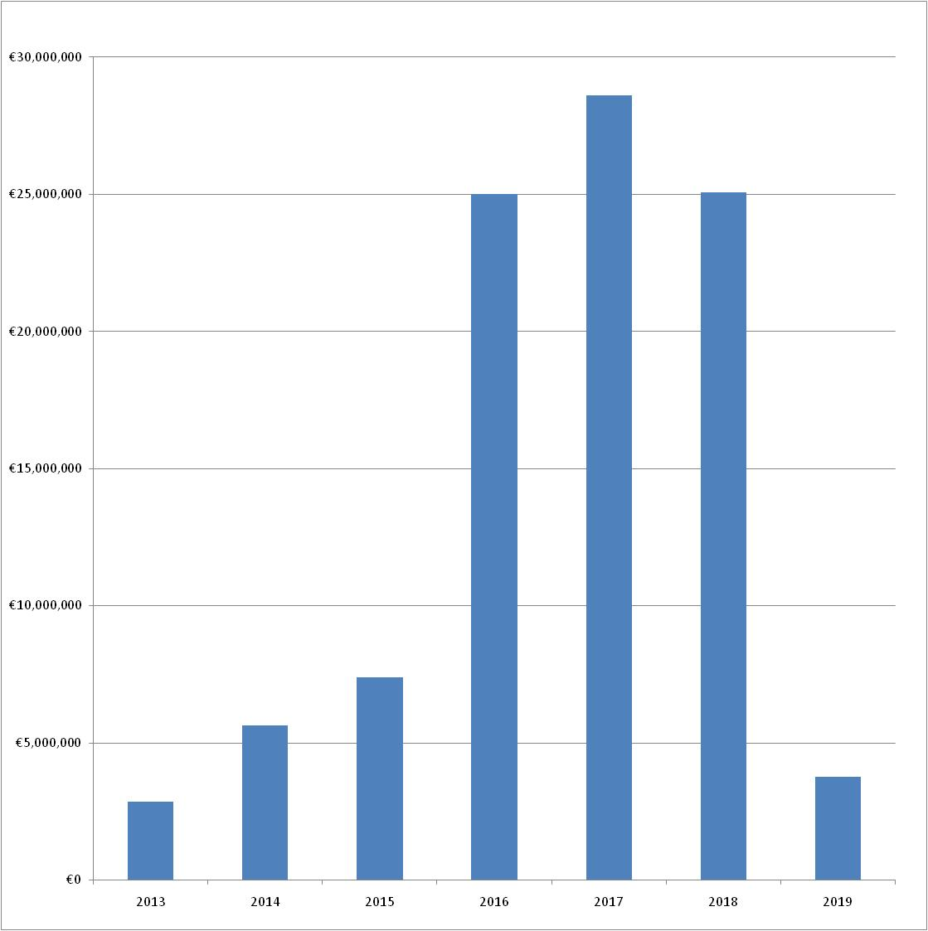
New lattice project schedule and budget evaluation
"DRAFT Very Preliminary"

Slide 39
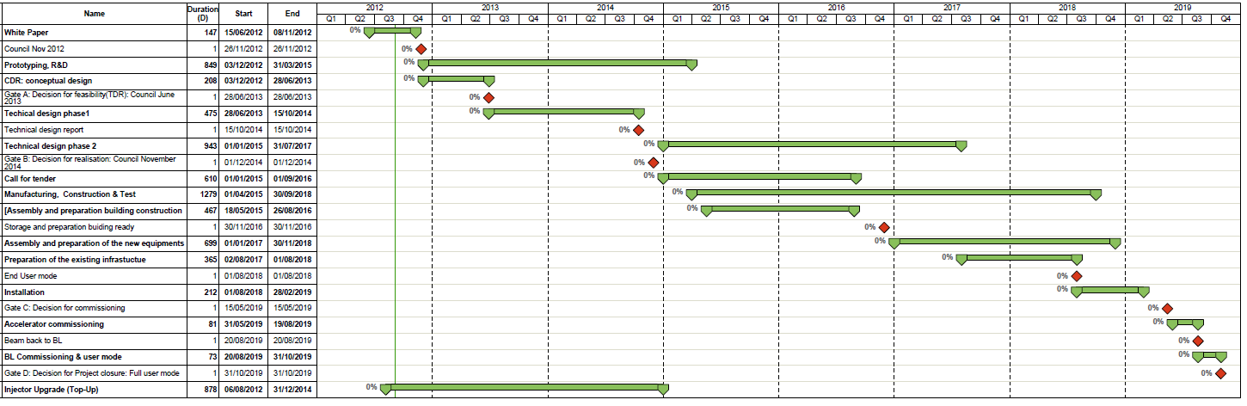
New lattice project schedule and budget evaluation
"DRAFT Very Preliminary"
ECAPS Planning

Slide 40
Short and Mid Term path
The ASD has been working very hard in all the machine subsystems in order to improve the performances and reliability of the source.
There are a lot of tasks planned for the next few years that, together with what already done will virtually complete most of the envised “Phase-I” upgrades.
In order to define a mid term strategy we must consider that a big extend of what has been done so far for Phase-I and the remaining activities are synergic and/or essential for a more radical upgrade of the SR. In particular, the much more demanding SR parameters do require:
- High level of control/diagnostic/stabilization (e.g.: Libera-BPMs, FOC etc)
- HOM-damped RF-Cavities (to allow operation with shorter bunches: 5-10ps)
- TOP-UP (even with the same Dynamic-Aperture of the present ring Tau<2-5hrs)
- Improved reliability
- Smaller Gap/shorter period Undulators (to take full advantage of the increased vertical stay-clear
- ...

Slide 41
Short and Mid Term path
In the next 2-4 years we will continue all the already foreseen activities.
In particular:
- TopUp
- HOM-Damped Cavities
- 7m/Low-Beta Section are an essential part of the ESRF upgrade path and of any possible SR Lattice Upgrade.
The amount of effort/FTEs/Budget to be dedicated to a New Lattice Design and related R&D, remains to be defined. Anyway the ESRF-Divisions/Groups have enough resources to progress on the studies, without impacting the present activities, at least up to a white-paper stage (by end of 2012).

Slide 42
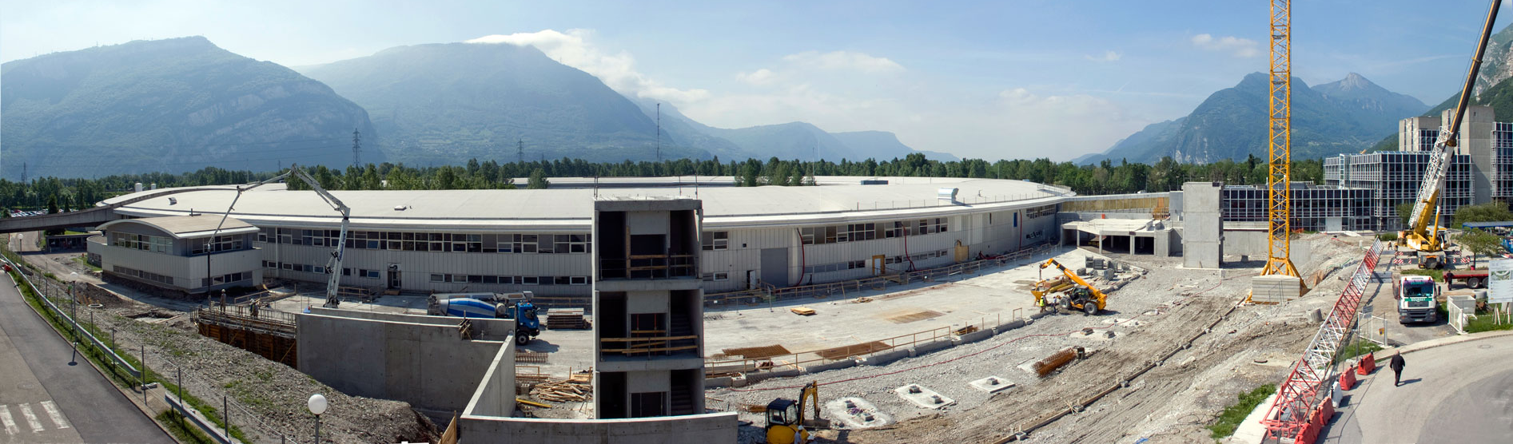
Experimental hall extension May 2012
MANY thanks
for your attention

