Slide 1
TDR end game

Slide 2
Timeline constraints
We need to use the current momentum to conclude the TDR work
Needed by all funding agencies to support funding requests
There is another use of this document for italians in carrier advancement
To be usable it needs to be published, with an ISBN number, before Nov 20.
This is not a live or die deadline, but it would be good if we could do it.
Let’s make a plan that matches that date.
“Better” is the enemy of “good enough”.

Slide 3
Roles of editors/readers
General editors: F.Forti, B.Ratcliff
Technical editor: A.Lusiani – help in ensure TeX usage, uniformity, figure placement, references, etc.
Subsys chapters. Editors: system conveners
Subsys final readershttps://docs.google.com/spreadsheet/ccc?key=0AnzCAynrojavdFFRWEdueTVZM19TbDVsVFF0OHMxWUE
Subsystem chapters should be finished and reviewed individually by the subsys final readers. To be checked:
Complete, Not too many repetitions
Reasonably uniform and correct english style
Good quality figures (readable, with scale, etc.)
Global final readers: C.Hearty, D.Hitlin, M.Rama, P.Lubrano
Take a global look at the document
Check content and style across chapters
Signal things that fell in the cracks
Try to identify inconsistencies among chapters

Slide 4
Mechanics of editing
If possible, direct editing of tex is recommended, especially for minor changes
Everything in SVN, be considerate and prudent, but we can always recover previous versions
PDF Markup is the next option, sending the pages to the relevant editor
Contact me if you have technical problems in doing this.
Of course also line by line commenting can be used, but the \lineno option does not really work with our style and it cumbersome.

Slide 5
Chapters with significant missing text
Accelerator
Integration
Magnet
Budget and Schedule
ES&H → Decided to remove it

Slide 6
Details…
…that need to be remembered

Slide 7
Bibliography
Originally intended to move everything to bibtex
Will check with Alberto if he can do it
Otherwise keep it as is (mixed)

Slide 8
Authors
Initial list extracted from list of collaboration members
Policy of openness (we only gain by having more authors)
To be checked and verified by:
Sys conveners
Council
Will send email with initial list to conveners and Pis. Lucia will manage the author list. At the end we will extract the Latex.

Slide 9
Cover
CDR cover required quite a bit of work
We could re-use it with minor modifications
Unless there is someone willing to take this on

Slide 10
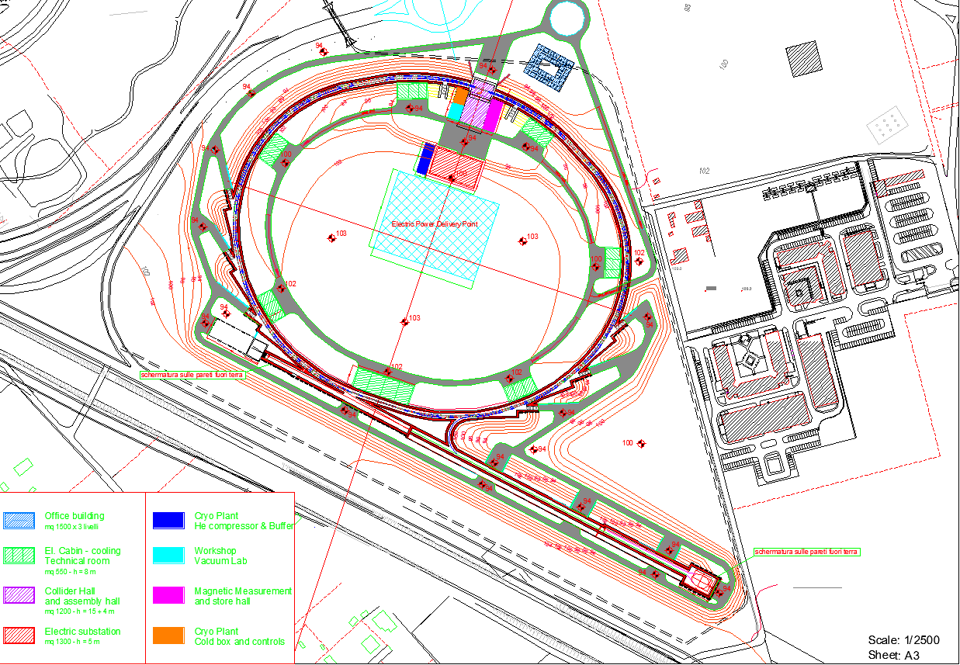
Back cover
The back of course needs some more extensive changes, but could still be a site picture

Slide 11
Timeline of milestones
Sync’ed with Thursday meetings
October 4 (two weeks):
All subsystem chapter completed and ready for review
All subsystem input to budget and schedule completed
October 11
Subsys chapters reviewed
V1 of global budget and schedule
October 18
Global reading report and suggestions
V1 of Author list and cover
October 25
V2 of global budget and schedule
Finalize bibliography, figure placement, table style
Finalize author list and cover
Nov 1 (all saints – vacation)
Nov 8
Complete walkthrough
Out the door to the publisher

