Slide 1
FARCOS
Femtoscope Array for Correlations & Spectroscopy
Overview of project and physics inputs
Present status (mechanics, electronics) and perspectives
G. Verde, INFN-Catania
EXOCHIM collaboration, INFN (LNS-CT-MI-NA), Un. Messina, GANIL, GEM-UHU, open collaboration

Slide 2
Physics topics
Heavy-ion collisions (stable and RI beams)
  Dynamics (HBT, Femtoscopy)
    Low & Intermediate energies: fusion, fission, DIC, Symmetry energy, Emission time-scales, probes of reaction models
    Multi-particle correlation spectroscopy (MPCS) → cluster states
Direct reactions with RIBs
  Inverse and direct kinematics
    Nuclei close to drip lines

Slide 3
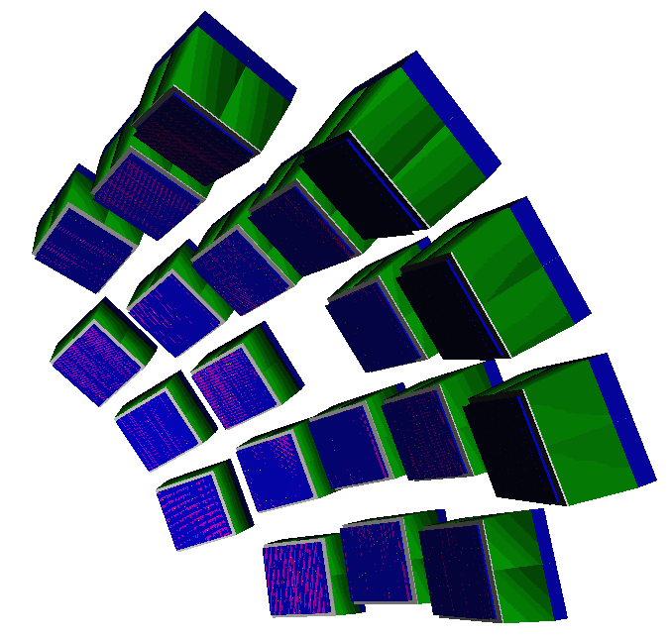
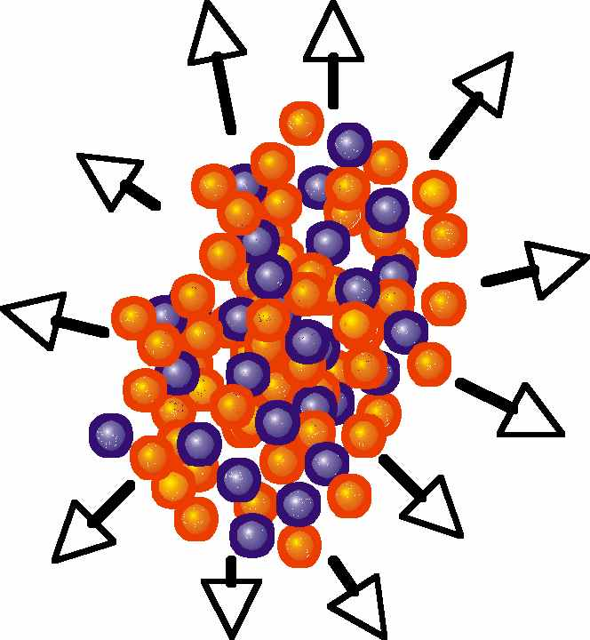
Relevance of angular resolution
deuteron-alpha
⁶Li
1+R(q)
High angular resolution required:
Measurements at low q and sharp resonances
… also for neutron detection…
q (MeV/c)

Slide 4
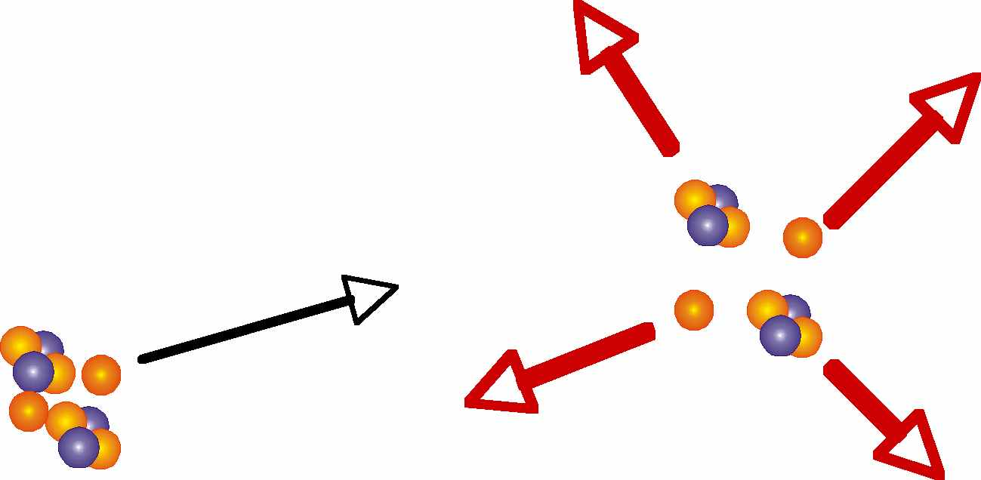
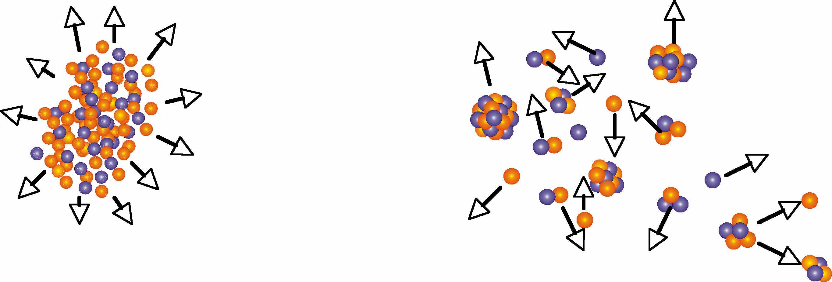
Multi-particle decay spectroscopy
Using heavy-ion collisions as an explorative spectroscopy tool: several unbound species in one single experiment
p
Dedicated RIB experiment
¹⁰C*
α
α
p
Not only EoS…
α
¹²C*
α
α
p
Expansion
⁵Li*
⁸B*
α
⁷Be
p
4π Coverage + High angular resolution

Slide 5
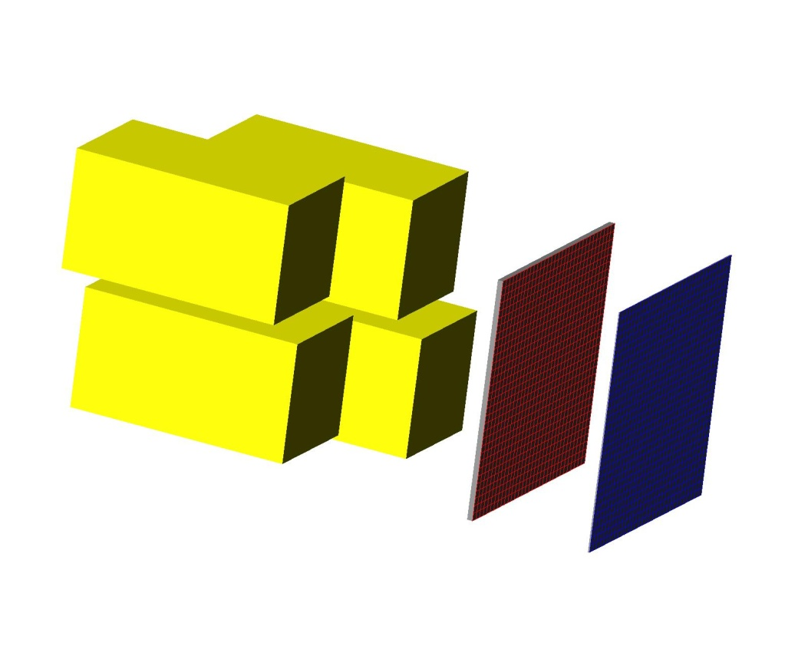
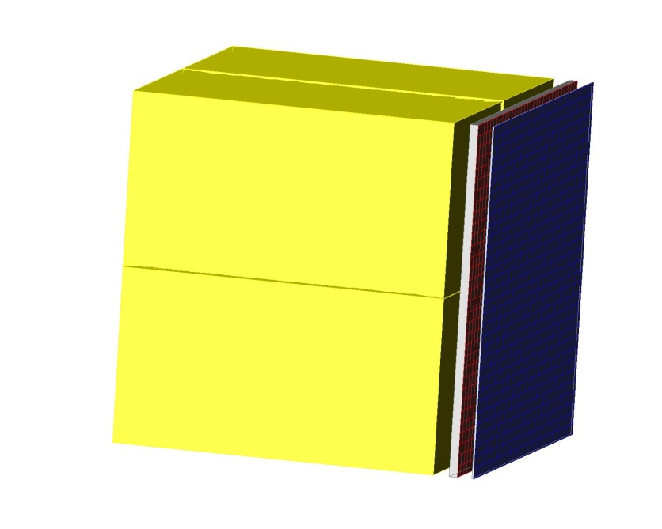
FARCOS TELESCOPE – phase 1
Based on (62x64x64 mm³) clusters
1 square (0.3x62x62 mm³) DSSSD 32+32 strips
1 square (1.5x62x62 mm³) DSSSD 32+32 strips
4 60x32x32 mm³ CsI(Tl) crystals
4 CsI(Tl) crystals (3rd stage)
DSSSD 1500 μm (2nd stage)
Assembly
cluster
DSSSD 300 μm (1st stage)
132 channels by each cluster
Fully reconfigurable (more Si layers, neutron detection, …)

Slide 6
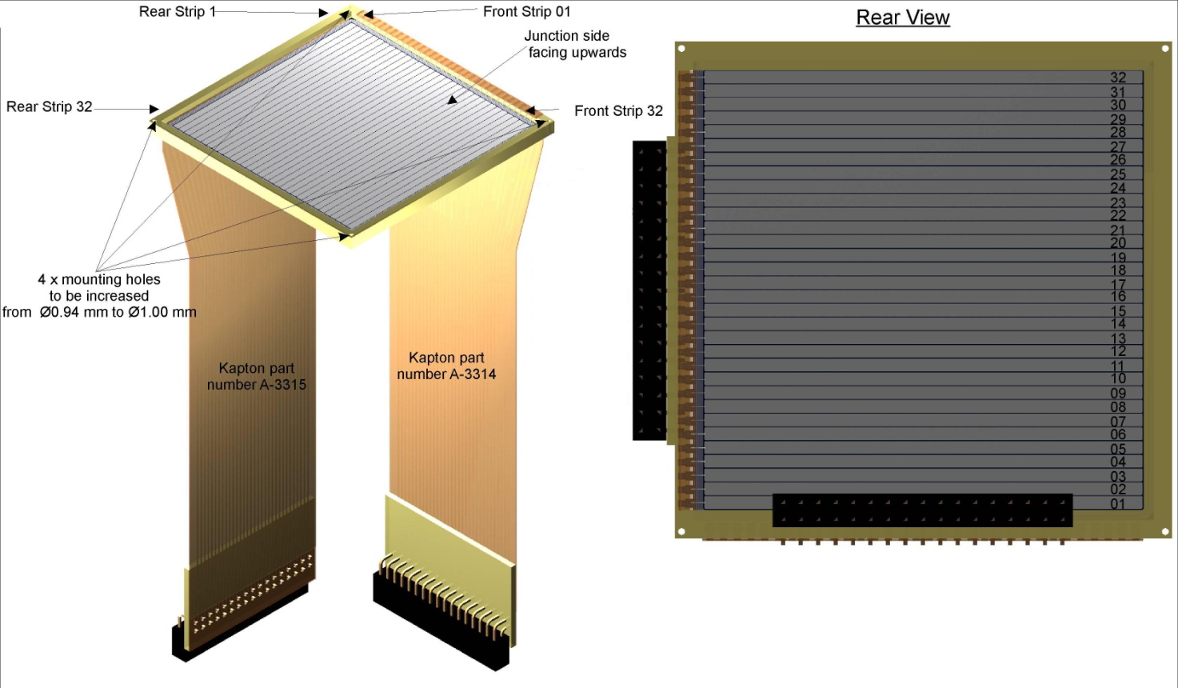
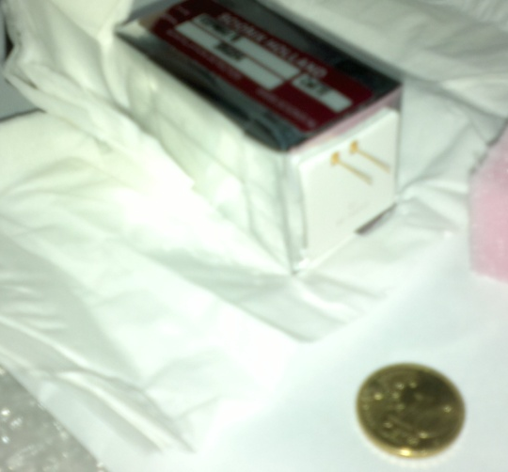
FARCOS detectors
Double-Sided Silicon Strip Detectors
300 μm and 1500 μm
Capton cable and 2x32pin connectors
Highly homogenous CsI(Tl) crystals
Wrapping: 0.12mm thick white reflector +50μm aluminized Mylar.
2μm thick aluminized Mylar window at the entrance (0.29 g/cm²)
Read-out by photo-diodes (300μm)

Slide 7
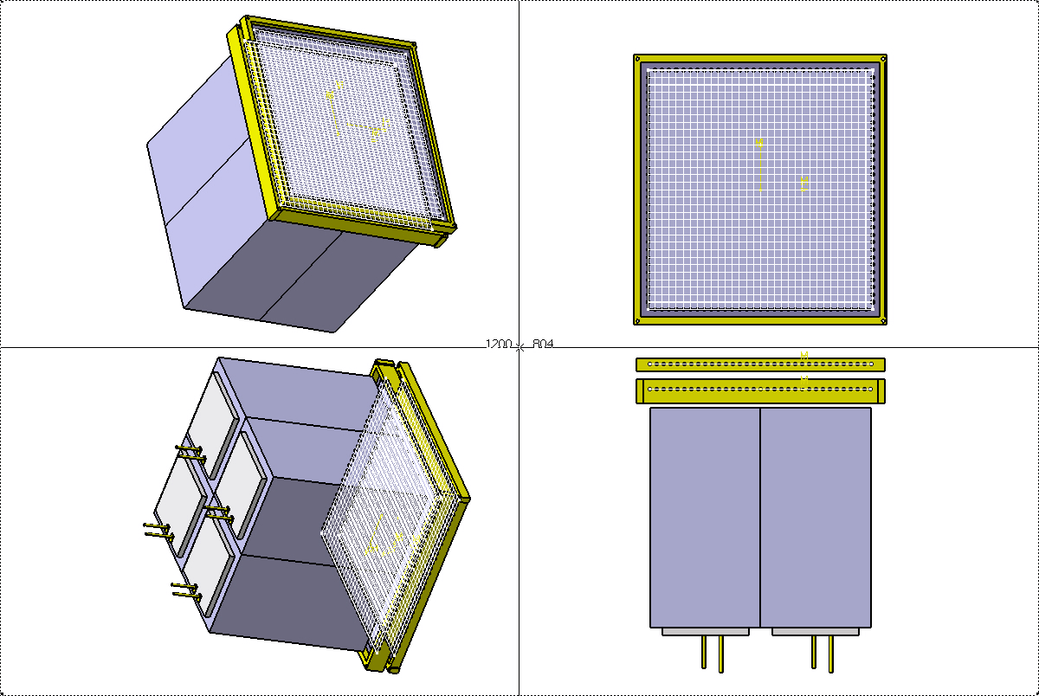
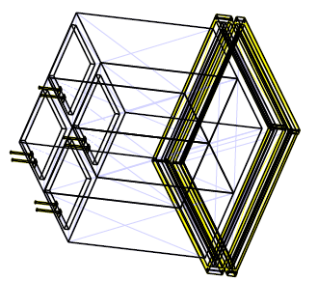
Single cluster
DSSSD 300 μm (1st stage)
DSSSD 1500 μm (2nd stage)
photodiodes
4 CsI(Tl) crystals (3rd stage)
Mounting allows for addition of other detectors and neutron “transparency”…

Slide 8
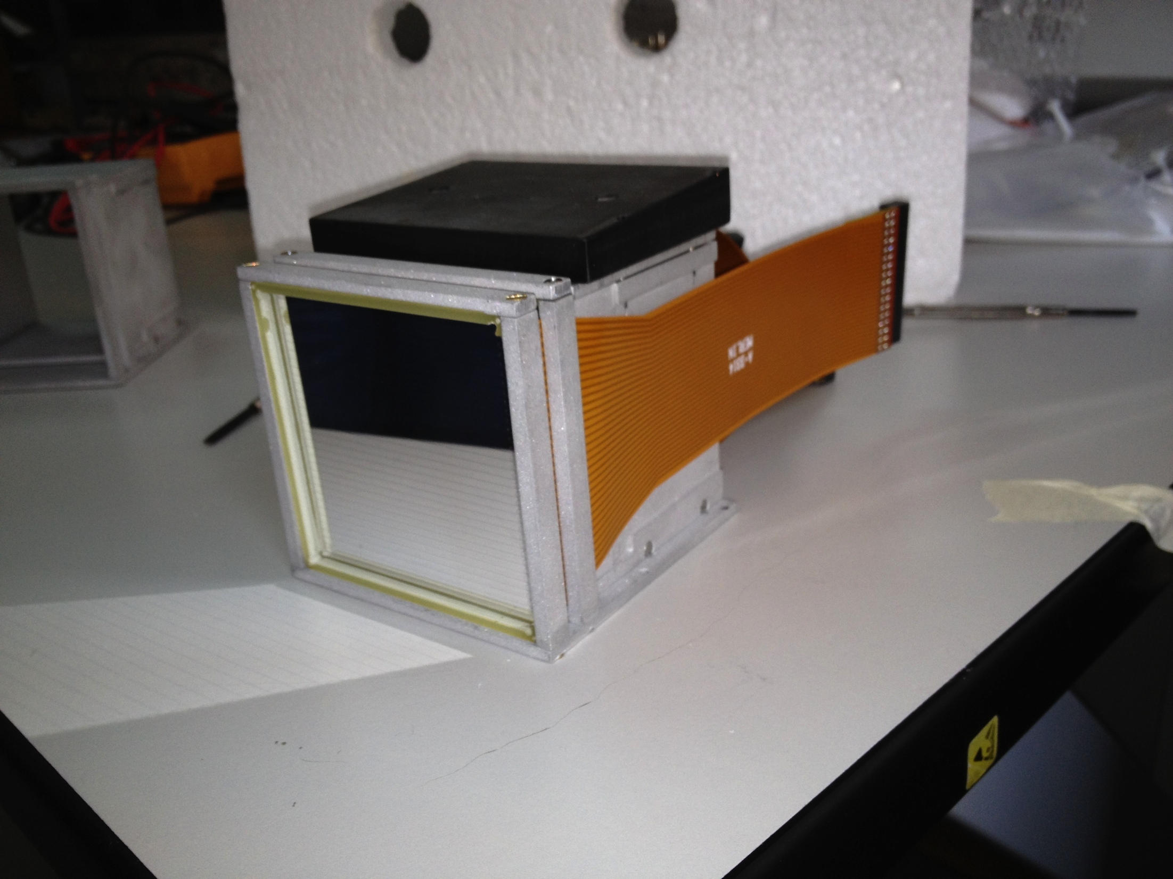
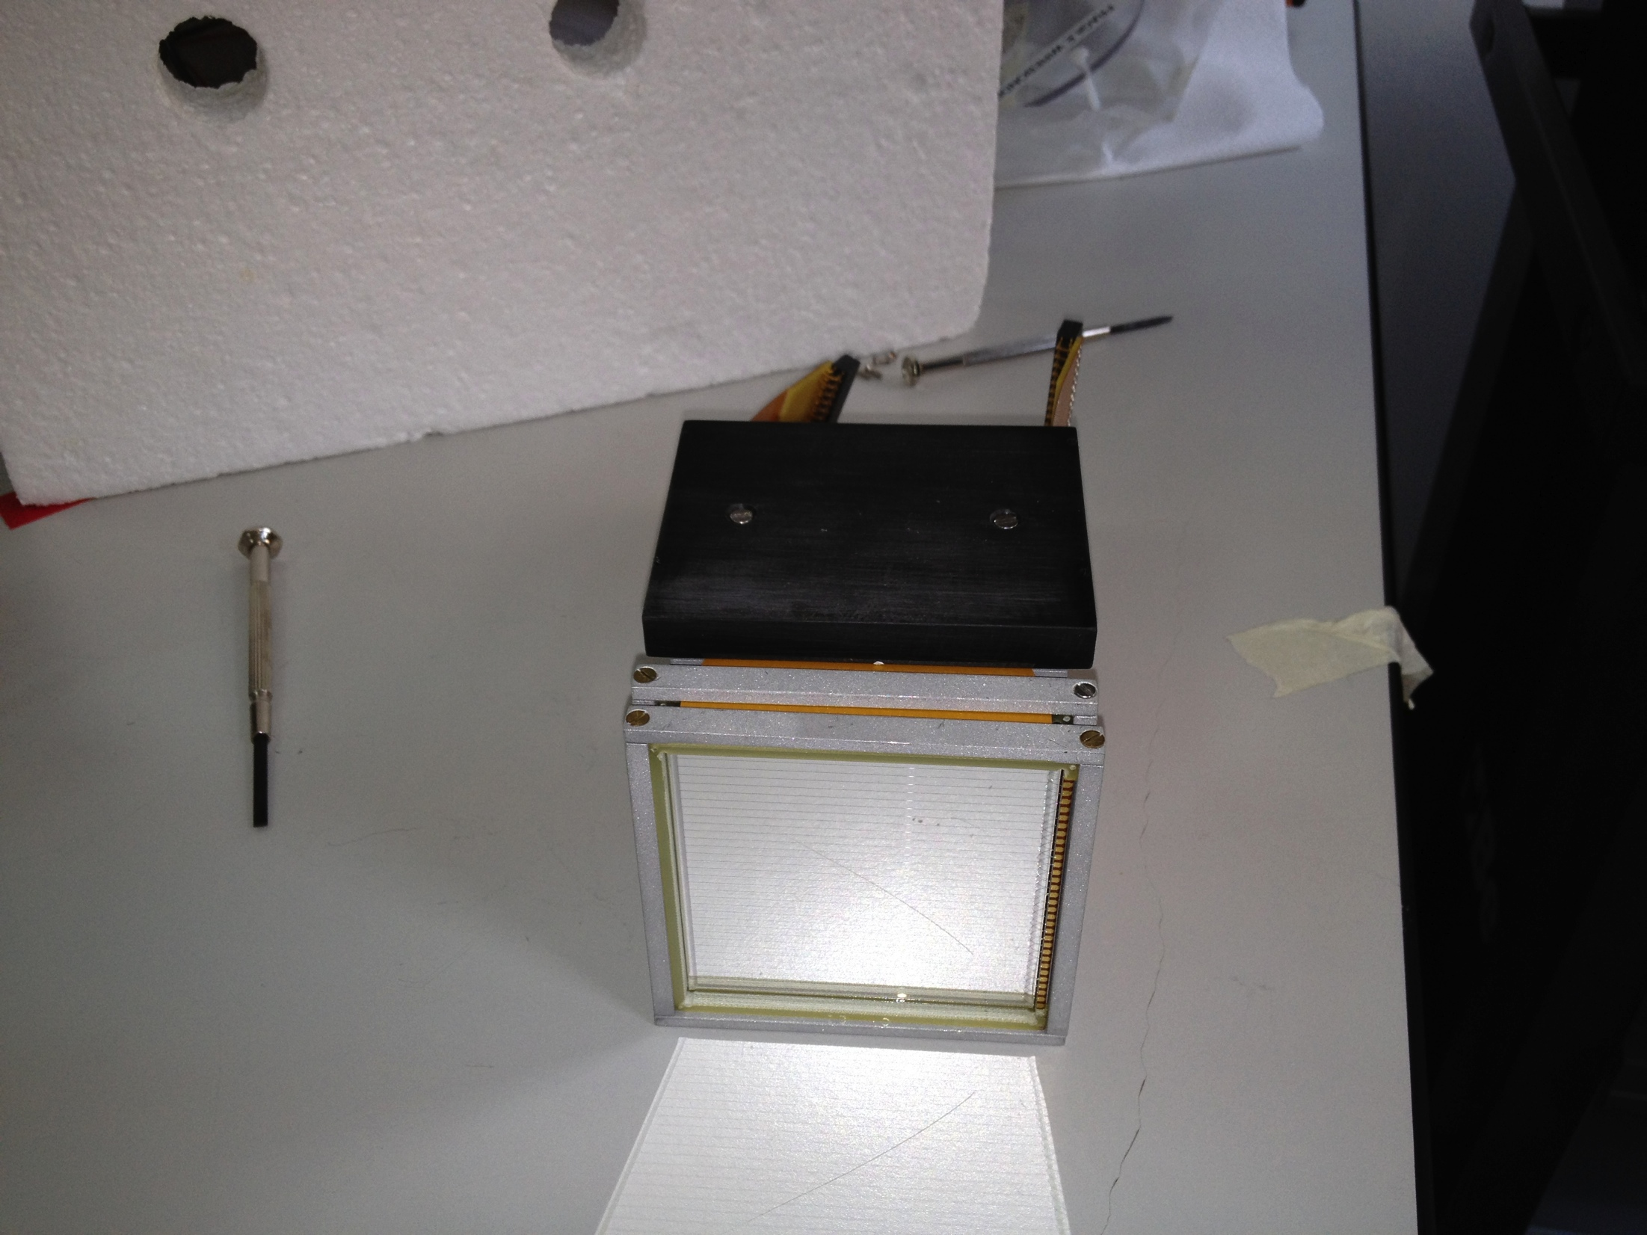
First prototype modules built
4 clusters expected ready by Jan/Feb 2013 → Experiments in Spring 2013 at LNS approved
March-April 2012

Slide 9
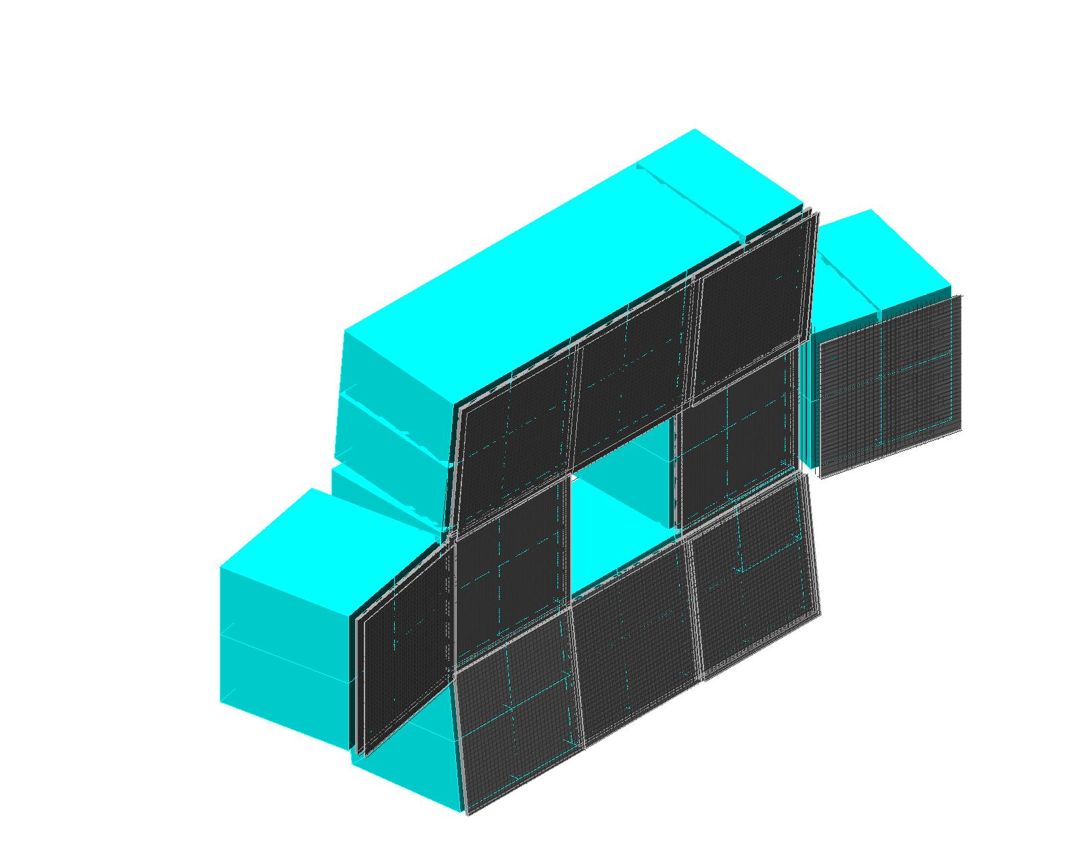
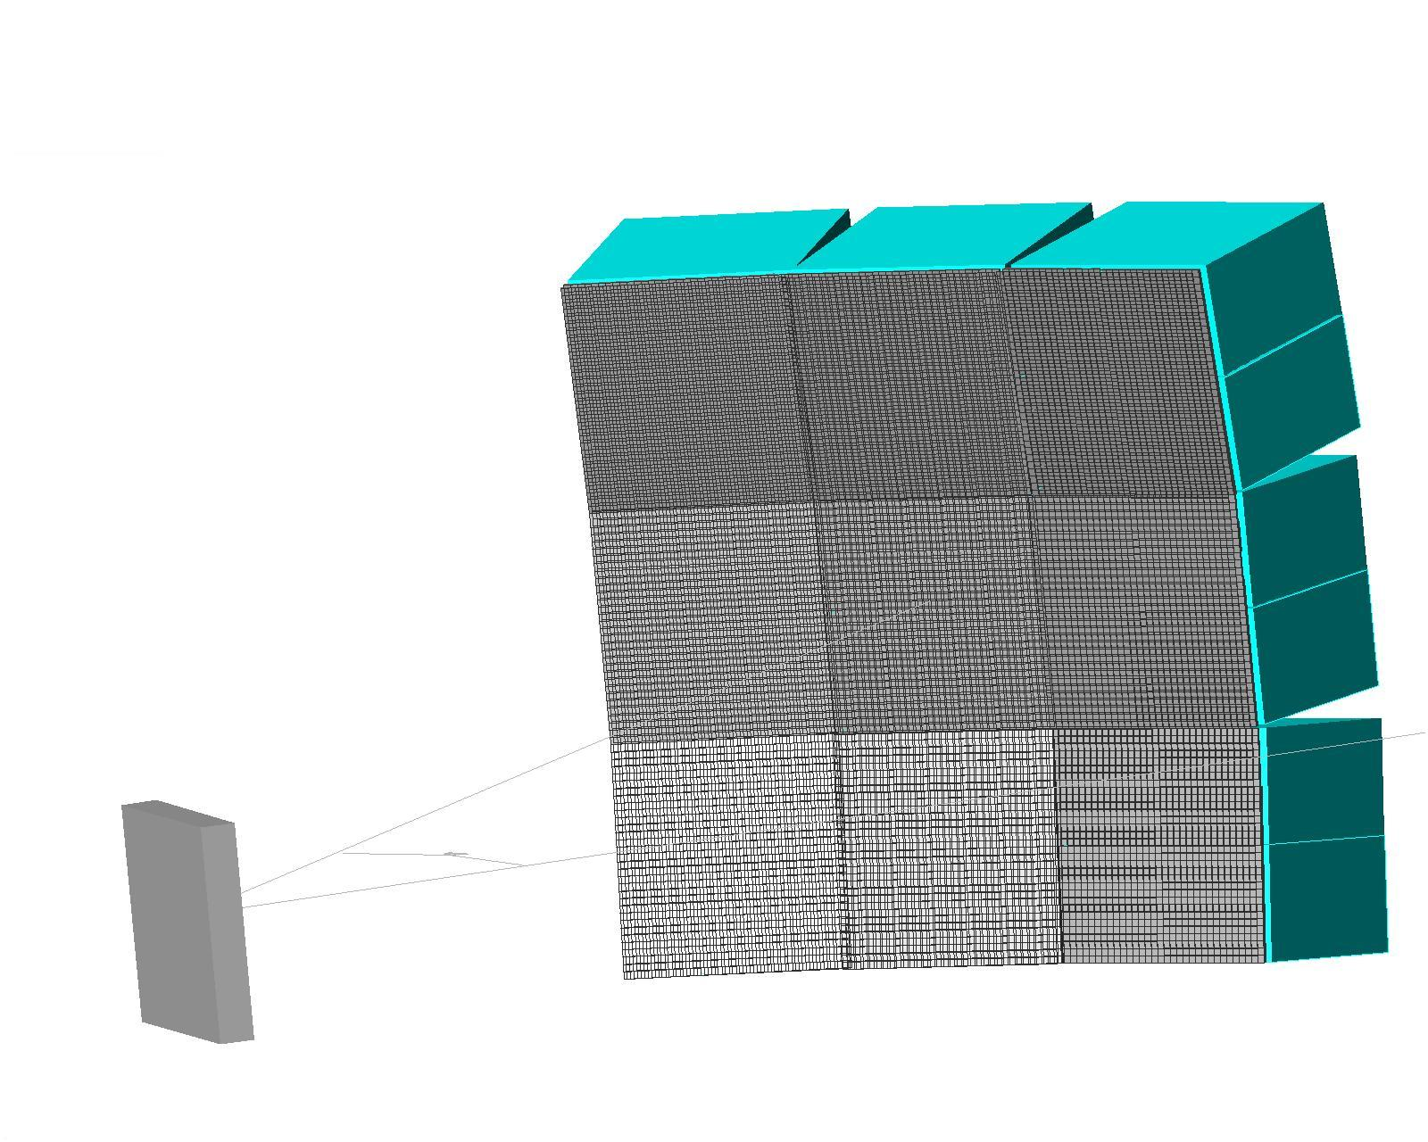
Geometric flexibility
Cross geometry centered on the beam axis (10 clusters)
Wall geometry placed at 45° from beam axis (9 clusters)
beam
45°
beam
Transportability
Modularity

Slide 10
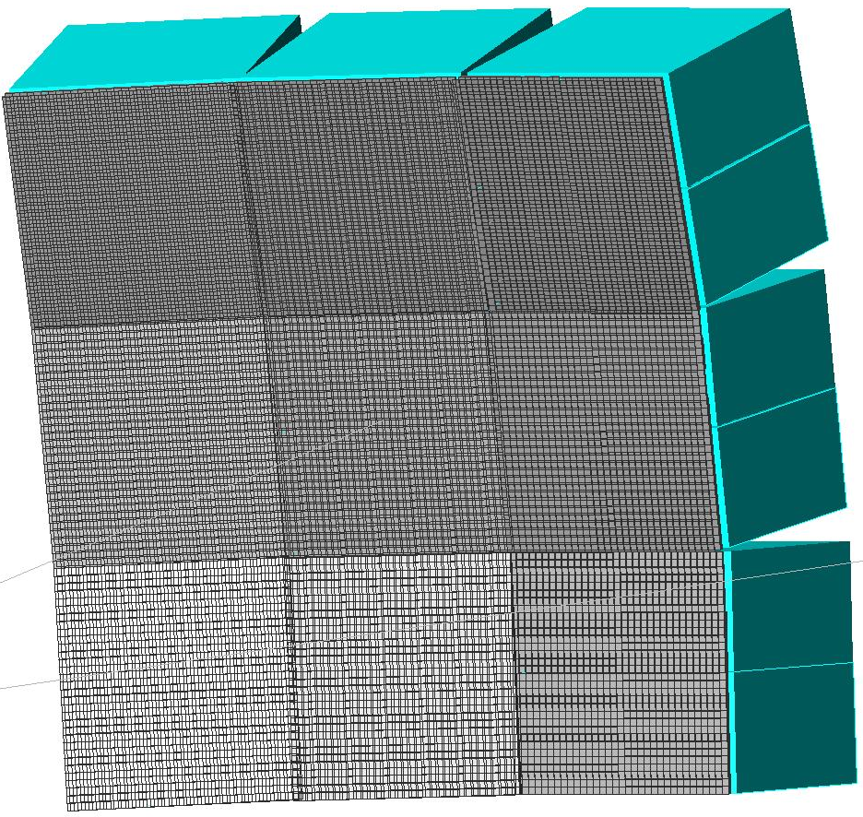
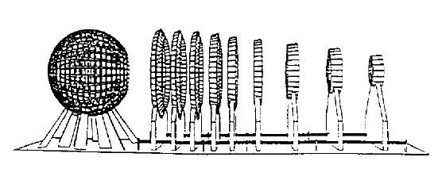
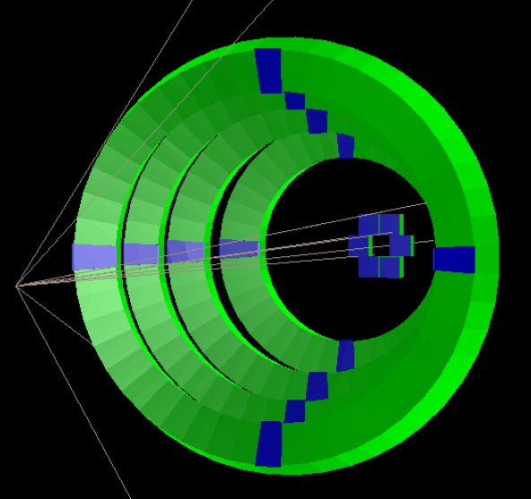
Planned geometries
Farcos
Chimera
Correlations in central collisions (cluster states, HBT, Asy-EoS)
Correlations in Quasi-Projectile breakup
Spectroscopy with radioactive beams
Chimera rings

Slide 11
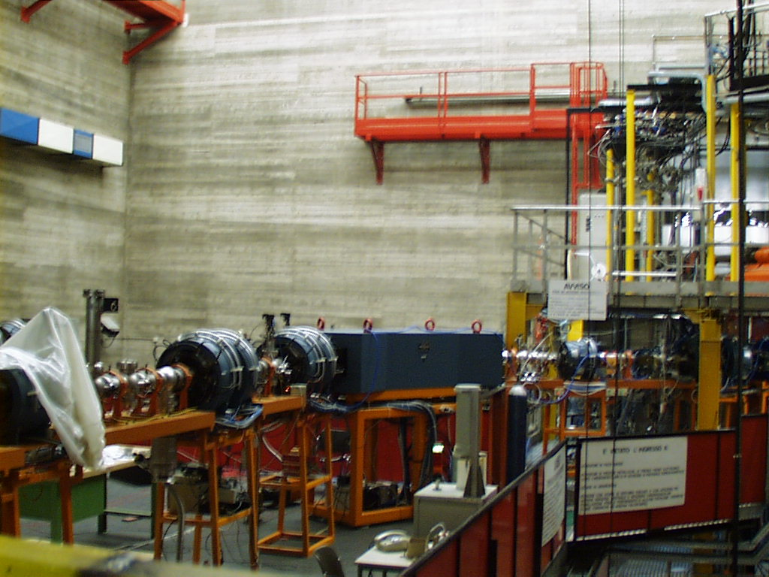
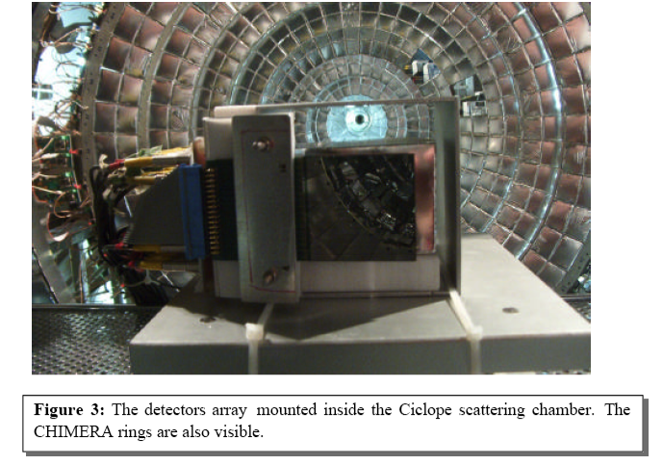
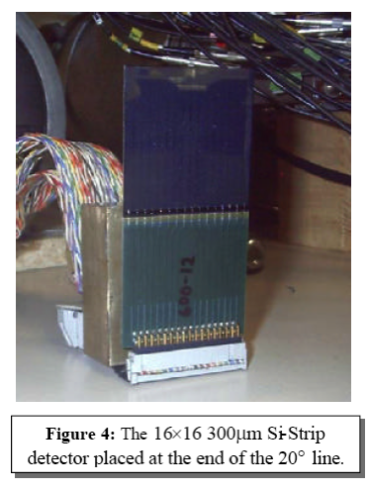
Experiments with exotic beams
Projectile fragmentation beams
Ex: Primary beam: ²⁰Ne E/A=45 MeV/A
Production target: ⁹Be (500 μm)
Fragments transported and tagged event-by-event by ΔE-ToF
Di-proton decay from excited ¹⁸Ne states G. Raciti et al., PRL (2008)
DSSD Tagging detector

Slide 12
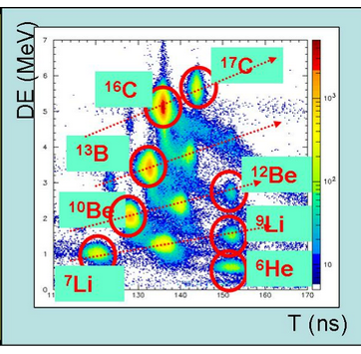
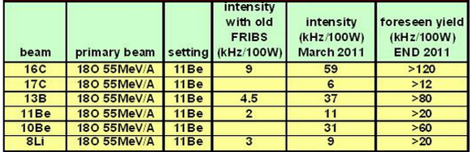
Beam production
G. Cardella et al.
Primary beam : ¹⁸O at 55 MeV/A, I~5x10¹¹ part/sec
Production target: ⁹Be (1.5 mm)
Tagged Projectile fragmentation secondary beams

Slide 13
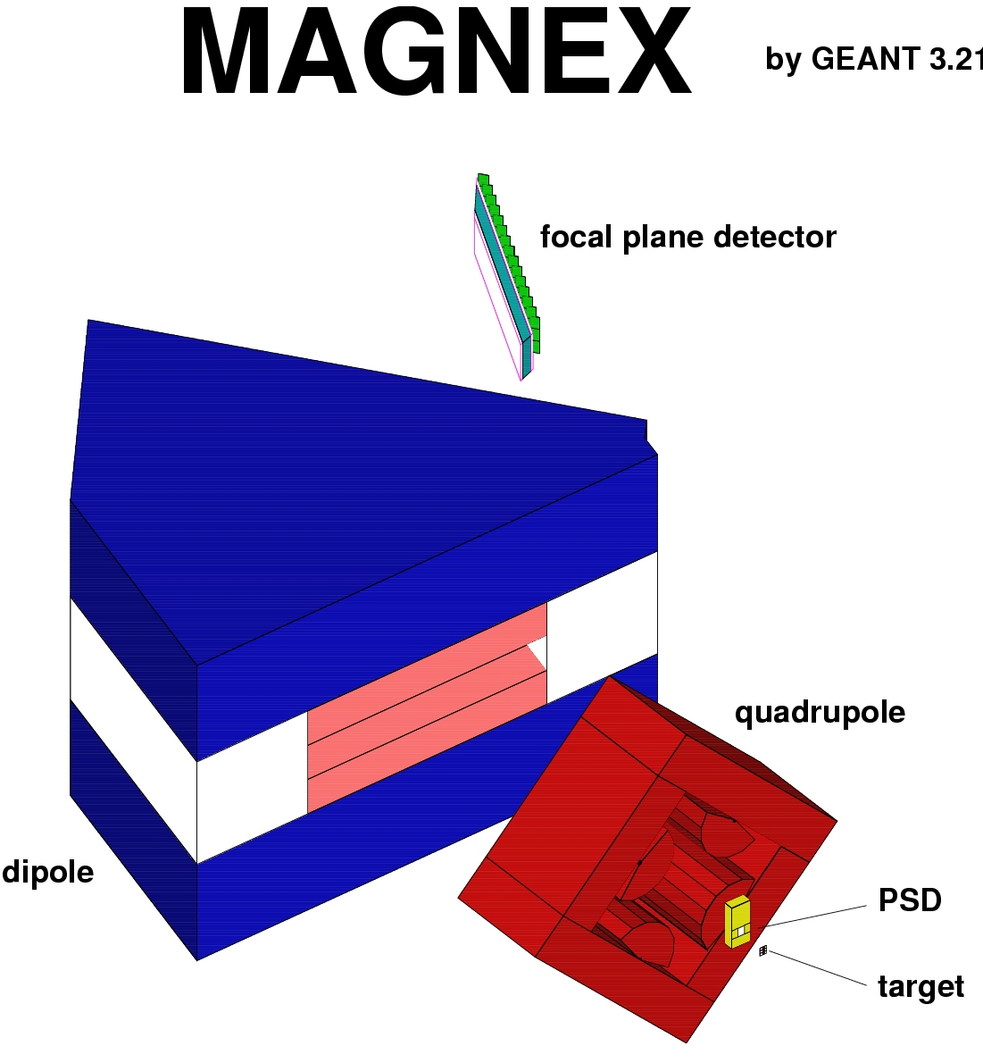
Direct reactions with exotic beams
Chimera (d)
Farcos (³³Ar residue)
FRIBS exotic beams
d
³⁴Ar
³³Ar
Coupling to spectrometers
Farcos
Neutron detectors

Slide 14
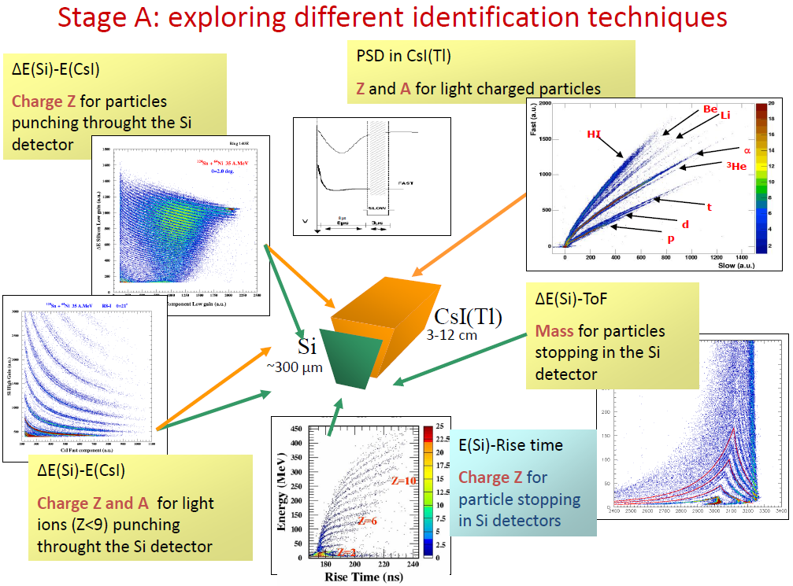
Required identification performances (Chimera-like)

Slide 15
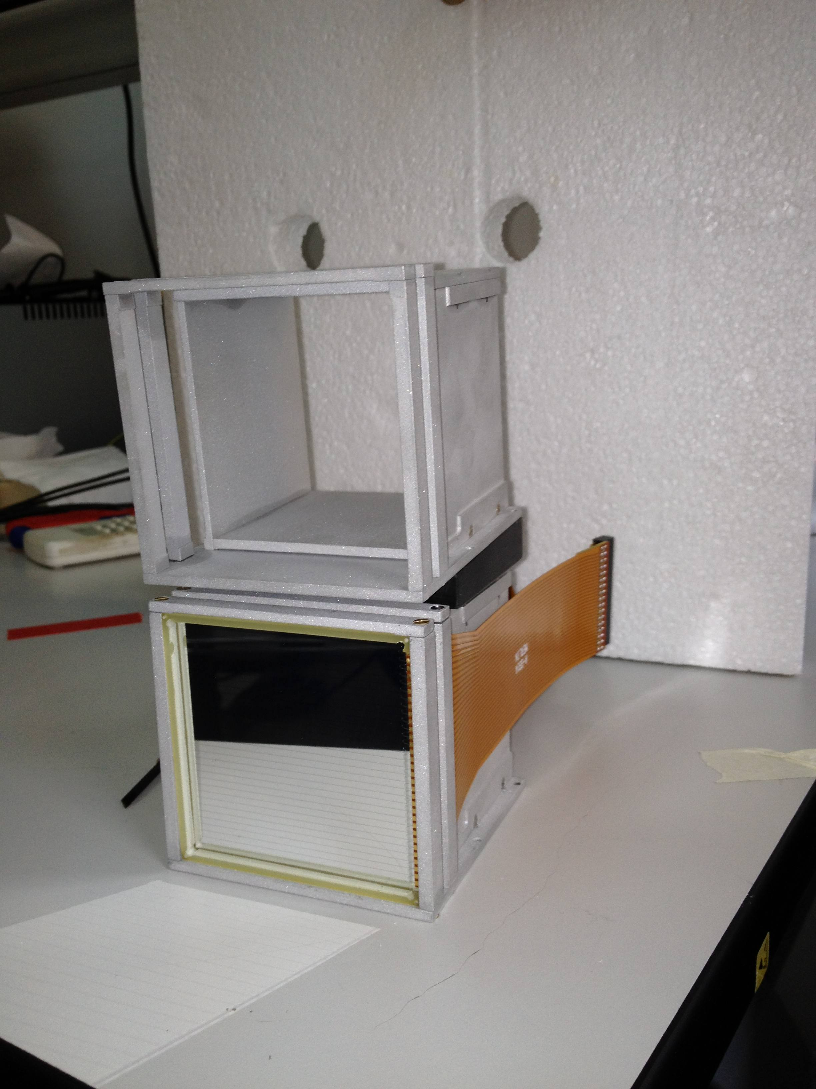
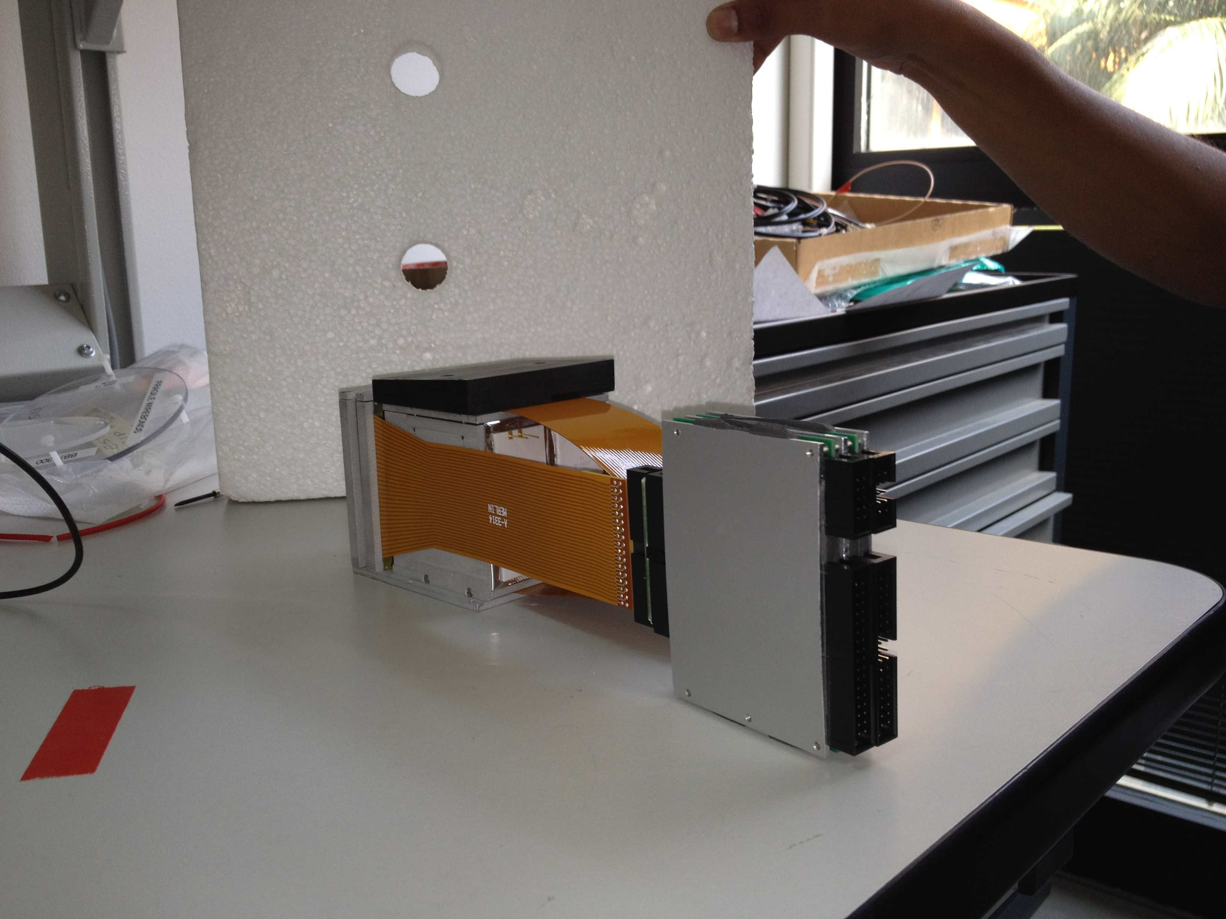
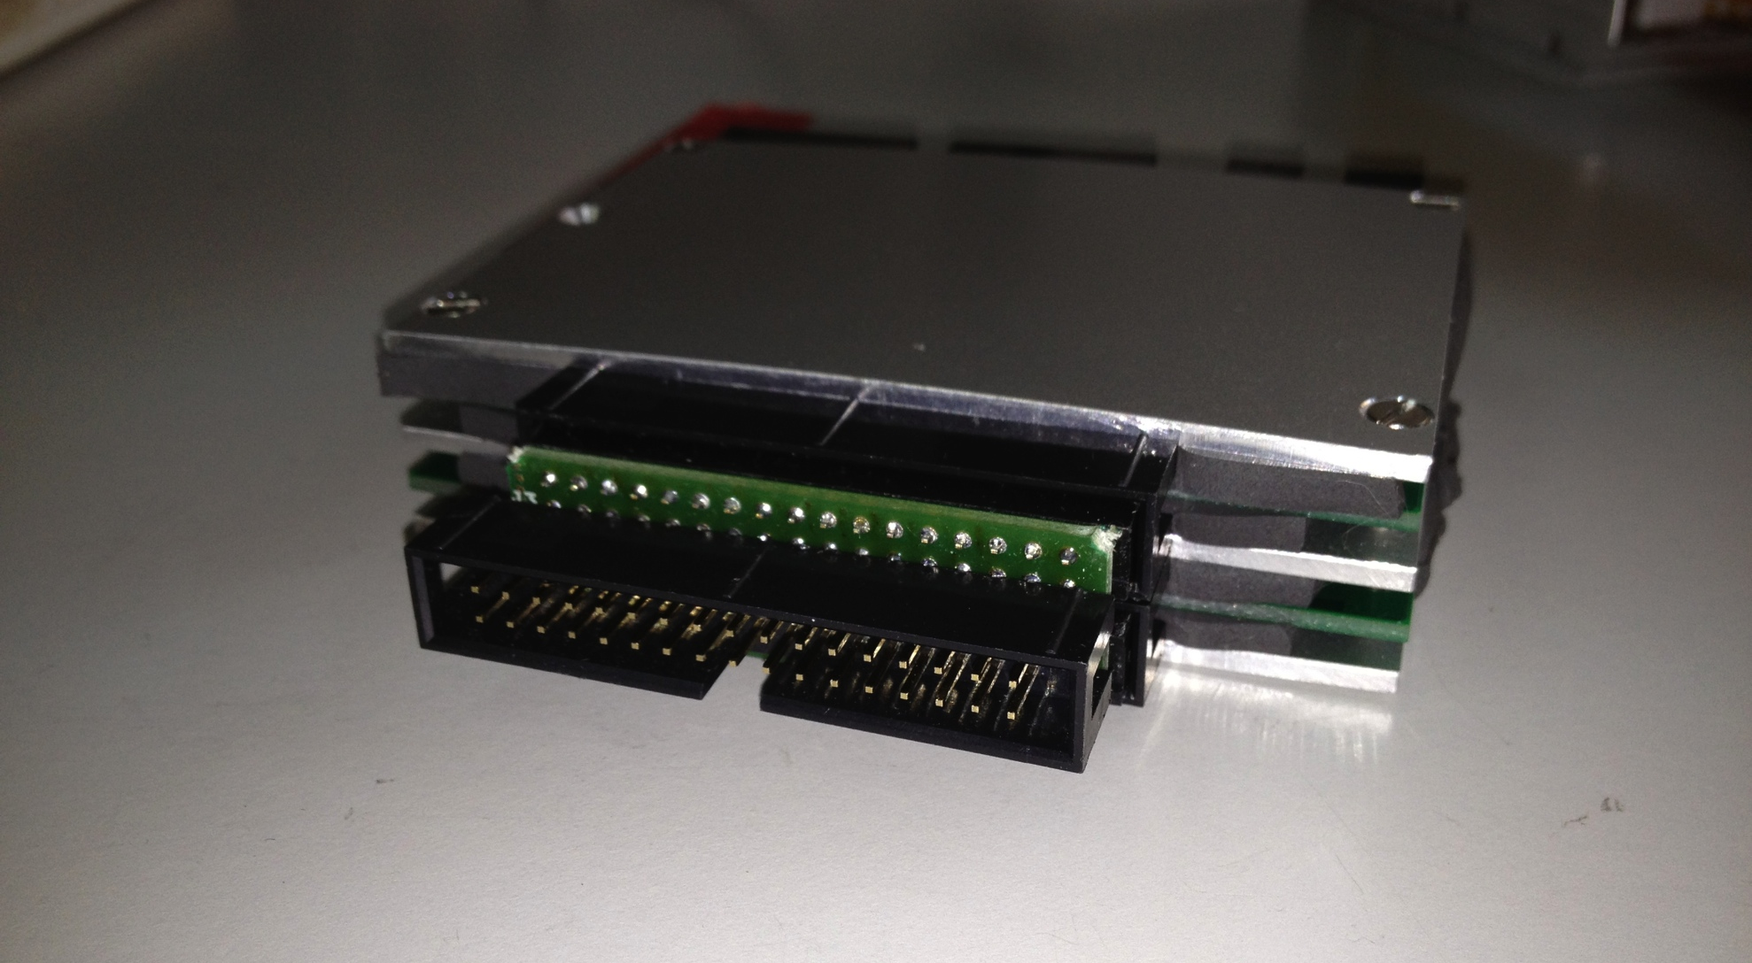
Compact preamplifiers – Phase 1
32 channels Hybrid charge preamplifiers in a volume of
about 8cm x 10cm x 2mmm
Low power consumption: ~750 mW pwe 32 channels (simplify cooling operations)
Rise-Time (pulser): ~ 3-7 nsec for C_{input}=0-100pF
Energy resolution (pulser) ~ 4-5 KeV for C_{input}=0-100pF
Available with several sensitivities (5, 10, 45, 100 mV/MeV…)
INFN, Milano – C. Boiano, R. Bassini

Slide 16
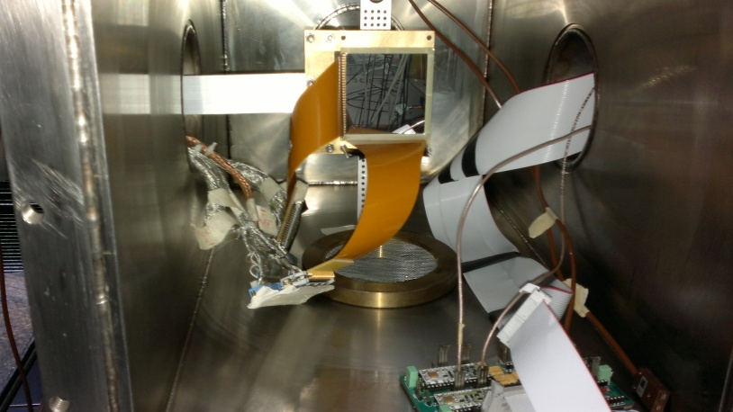
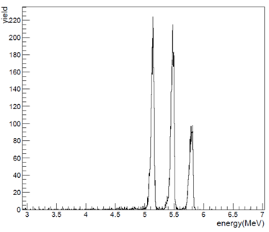
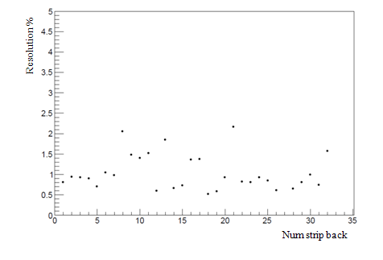
Si-strips α-source tests
INFN-preamplifiers and Mesytec provide comparable E resolution (about 1%)
INFN more compact, faster, less power consumption
α-source spectra
Energy resolution (%) vs injection position

Slide 17
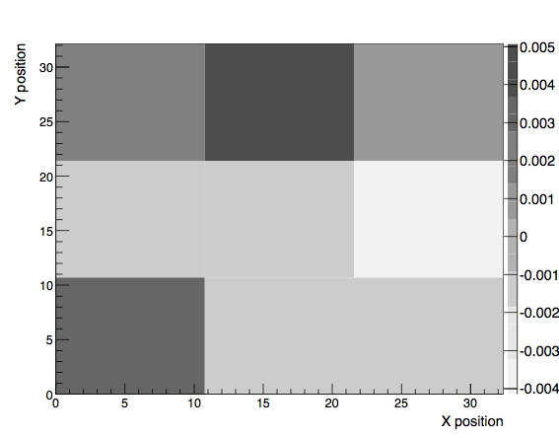
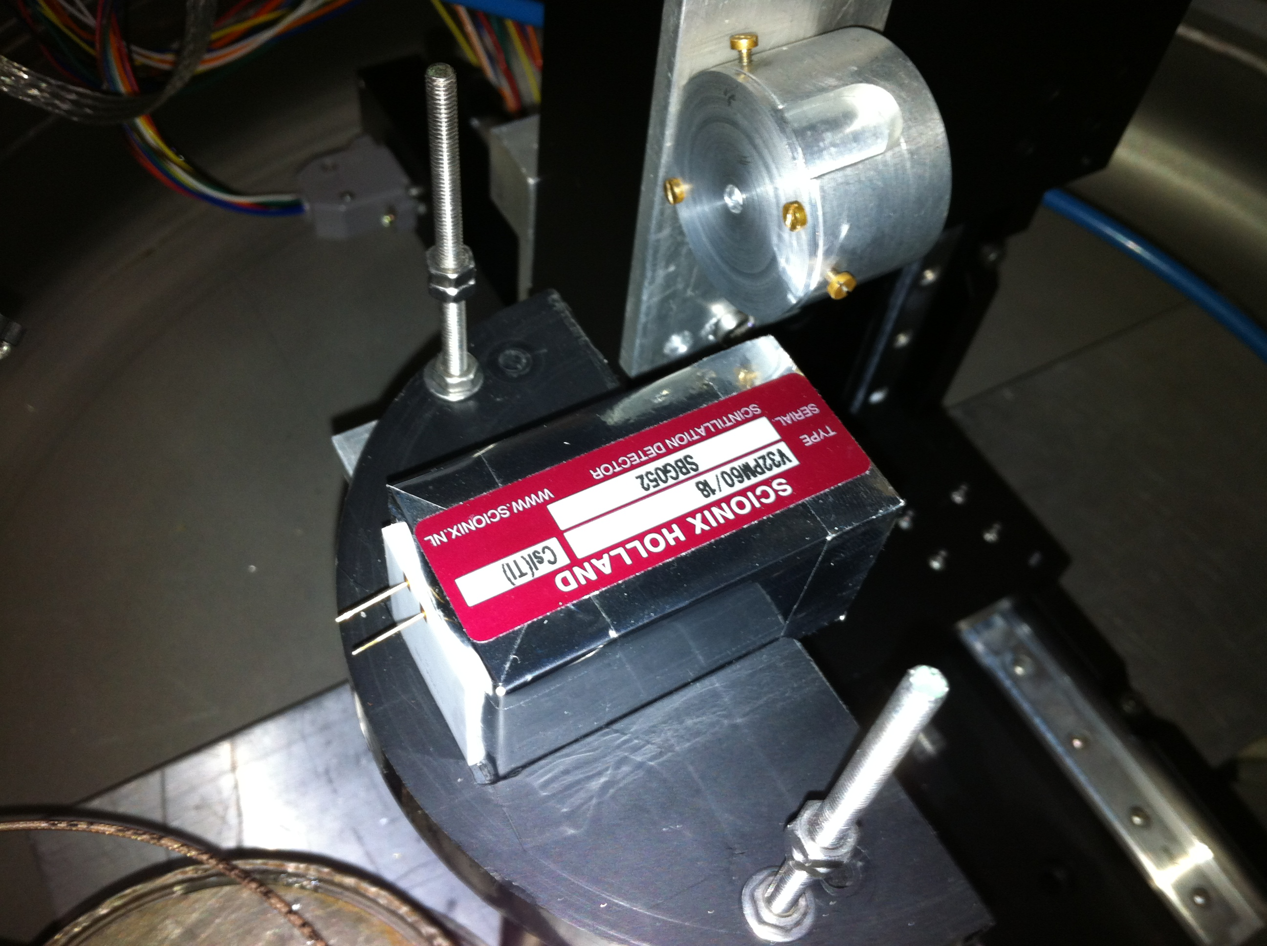
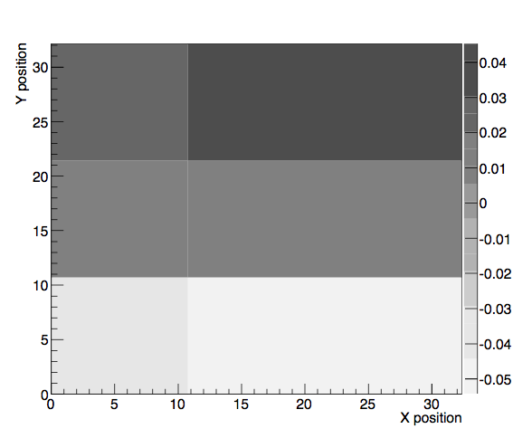
CsI(Tl) uniformity tests with α-source
Source moved along silicon face (front and back)
“Good” crystal: statistical fluctuations < 1%
“Bad” crystal: statistical fluctuations < 10% gradient
Non-uniformities (if systematic) can be corrected thanks to position sensitivity of silicon strips (for higher energy particles)
Improve resolution in beam experiments

Slide 18
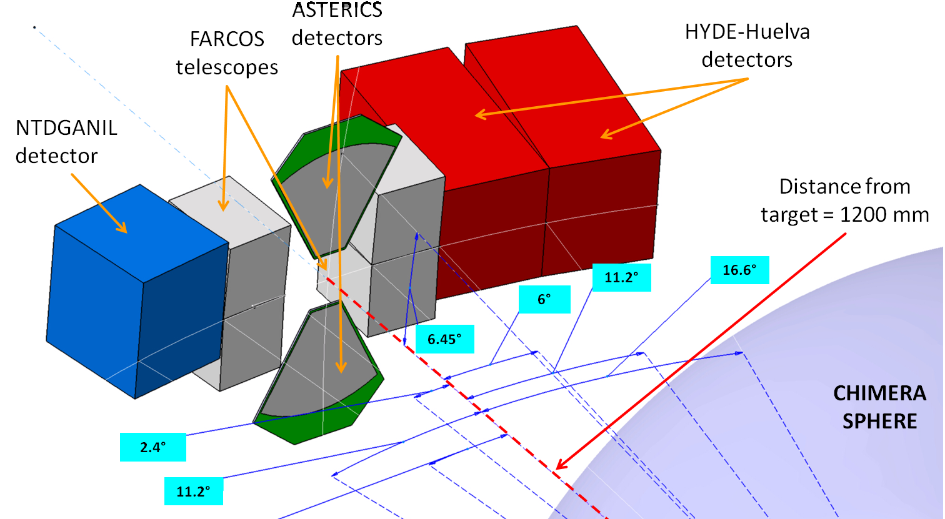
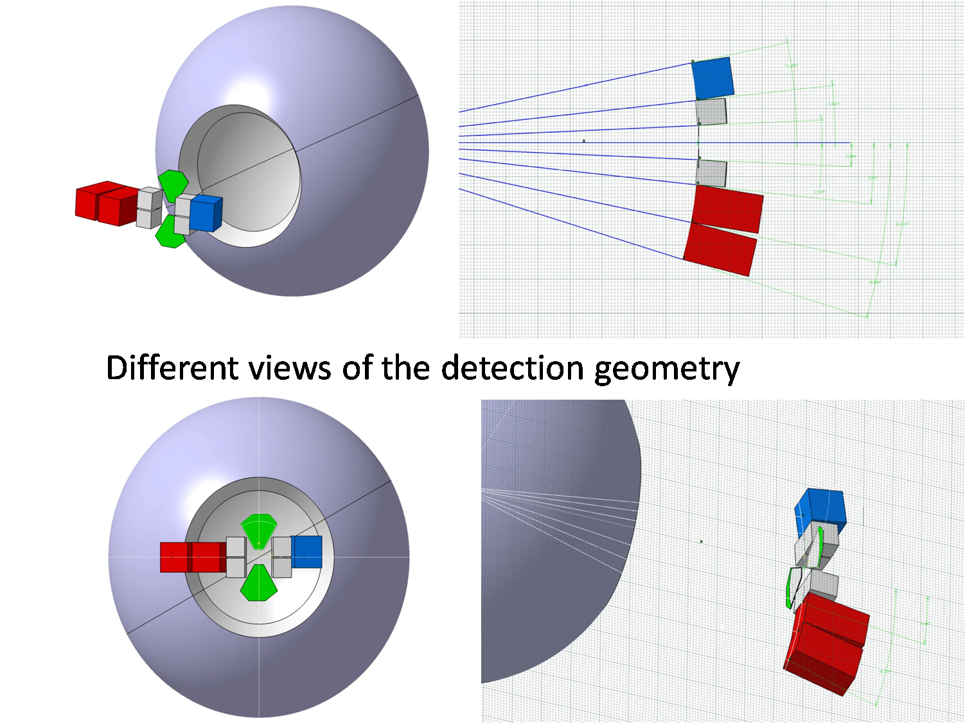
First test beams – July2012 @ LNS
Chimera sphere view
Rochester
p,α + p, d, C E/A=40, 80 MeV - Elastic scattering and Transfer reactions
CsI(Tl) uniformity
Silicon resolution
Integrating DAQ into Chimera system

Slide 19
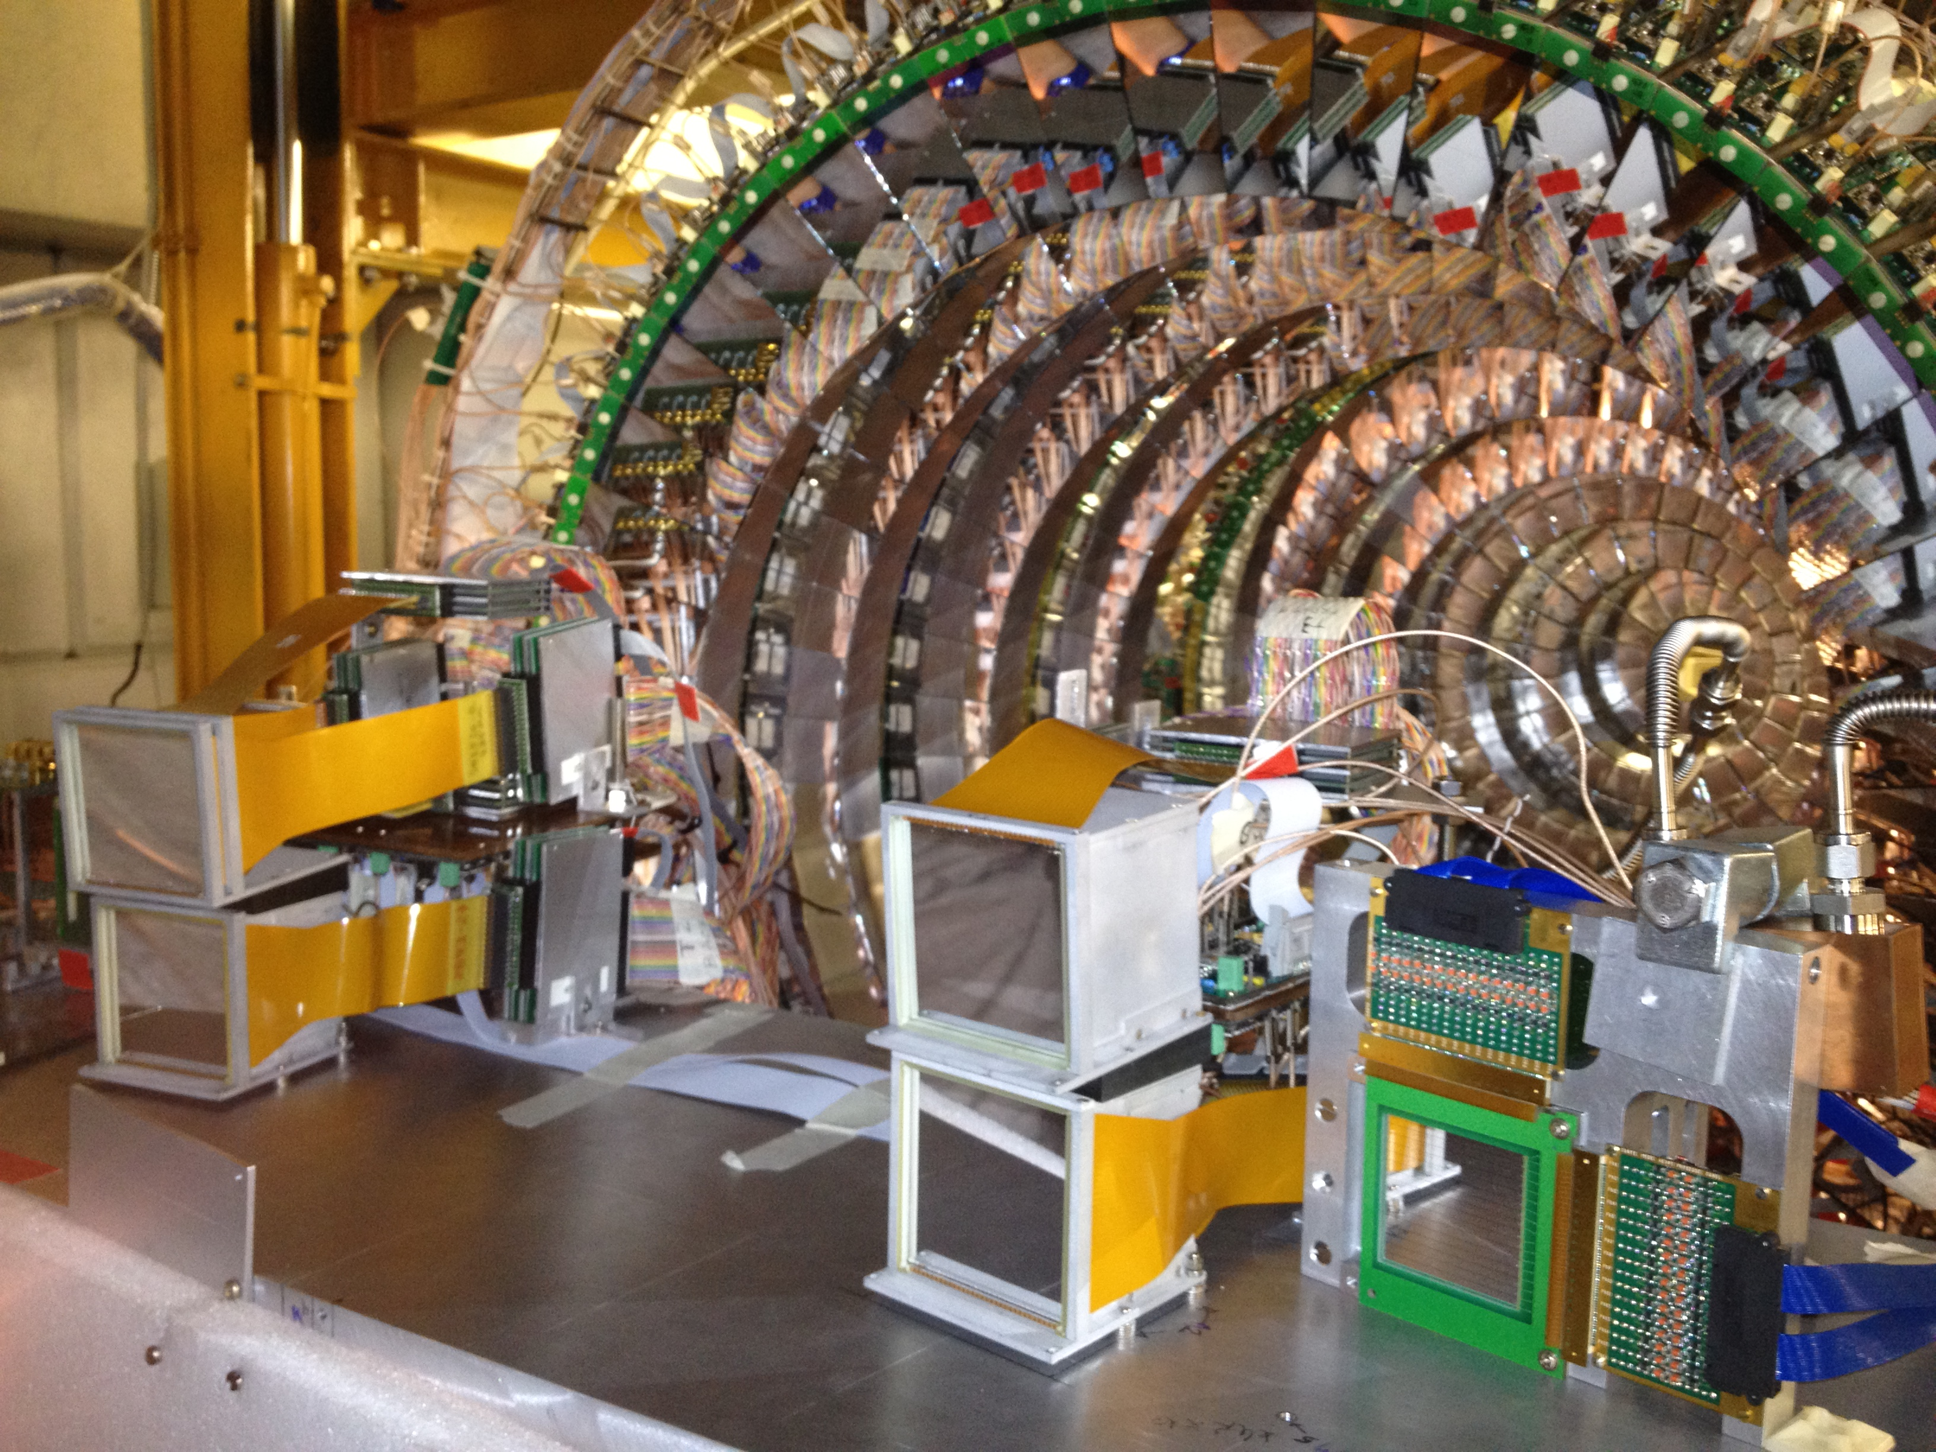
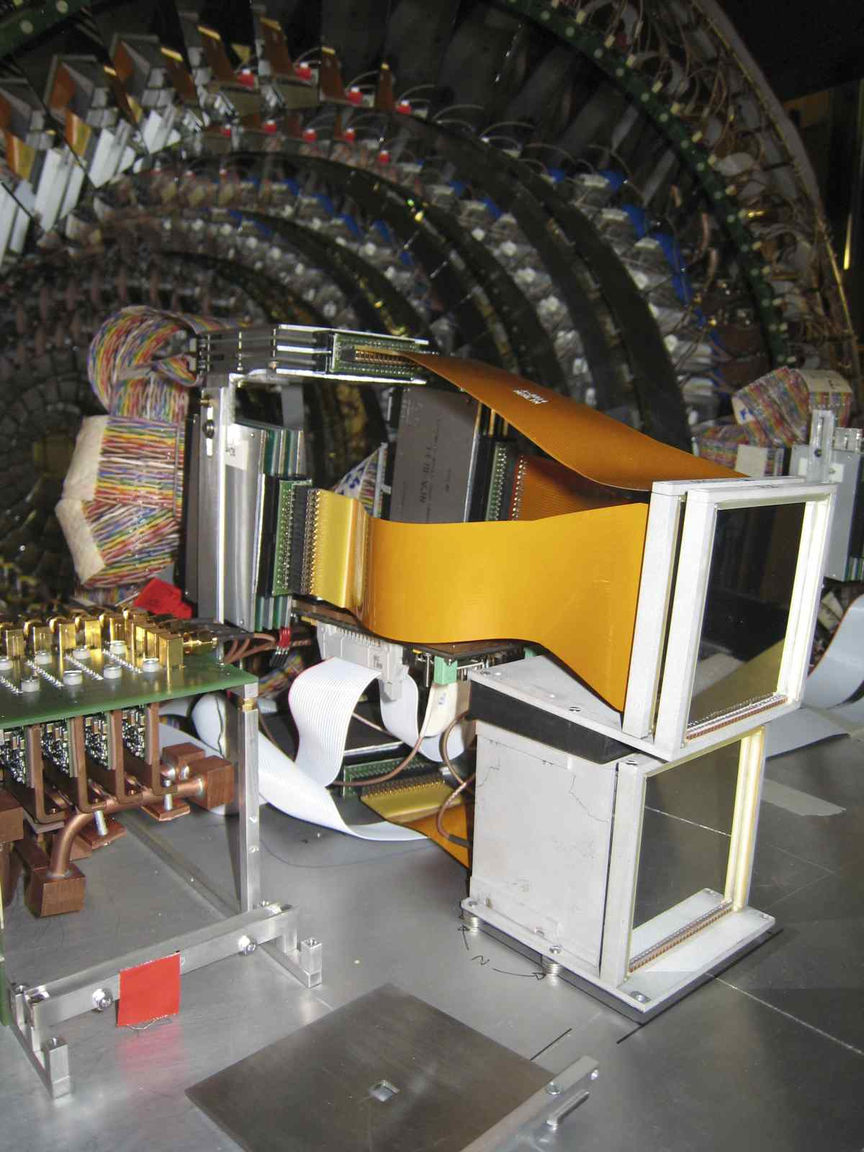
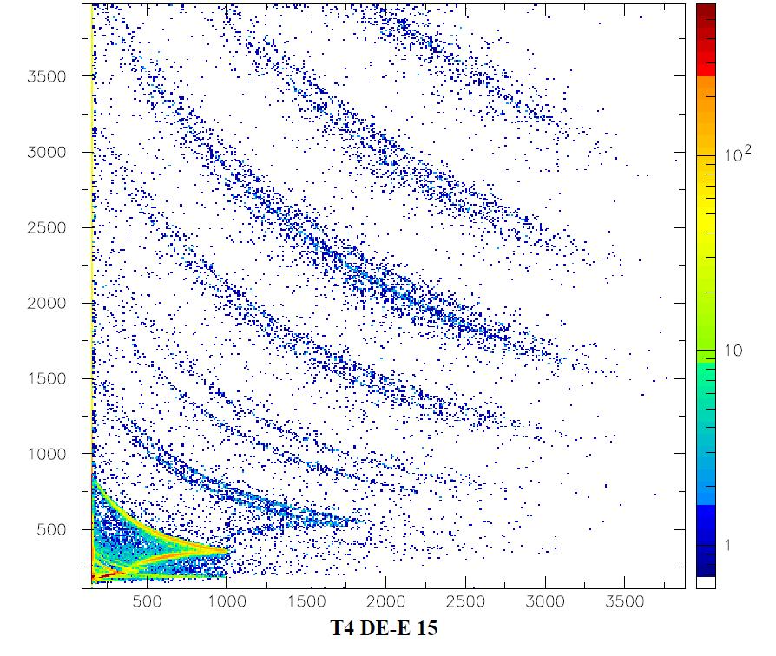
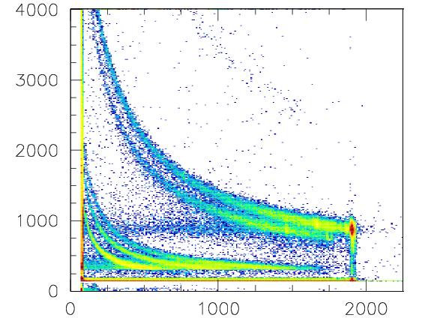
Mounting of prototype telescopes
Pre-amplifier boxes
Si-Si matrix
Si-CsI(Tl) matrix
Preliminary results… analysis underway
Ne + CH₂ → Multifragmentation

Slide 20
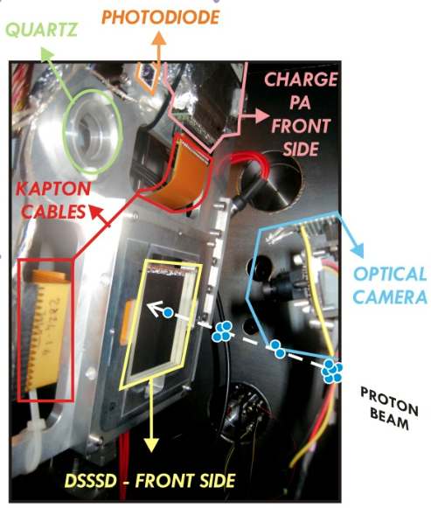
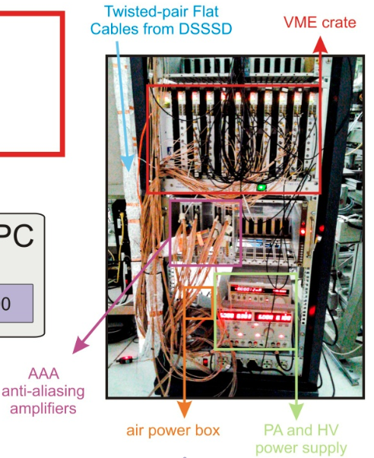
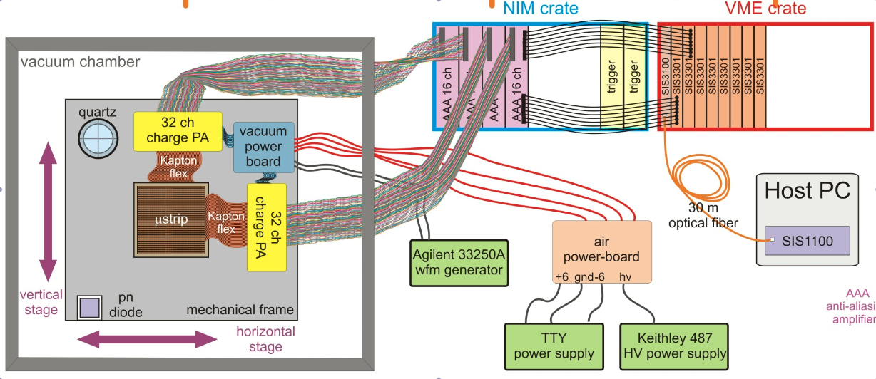
Silicon strips @ Labec (INFN-FI)
INFN and Politecnico of Milan and Farcos collaboration
Fast pulsed beamline DEFEL: variable and controllable number of particles/pulse
Energy changed between 1 and 6 MeV
Position resolution: 100μm x 100μm: scanning of strips and inter-strip regions
Digitalization of silicon signals with commercial VME SIS 3301
100 MHz – 14bit
8 channels/module
Opt. Link to PCI

Slide 21
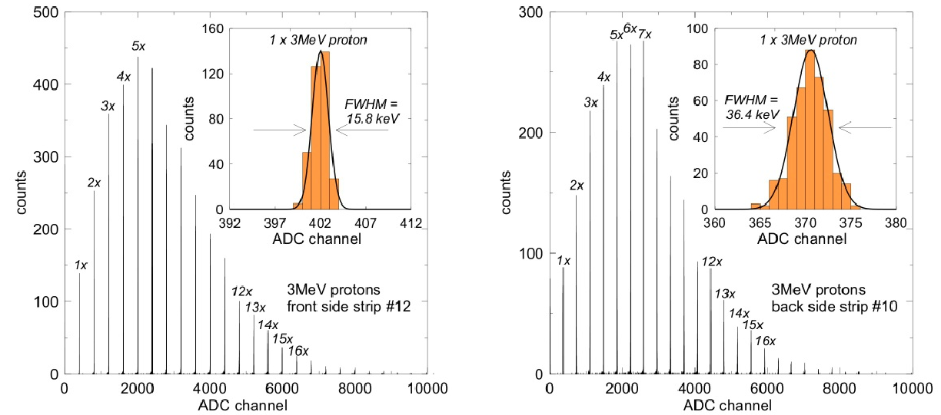
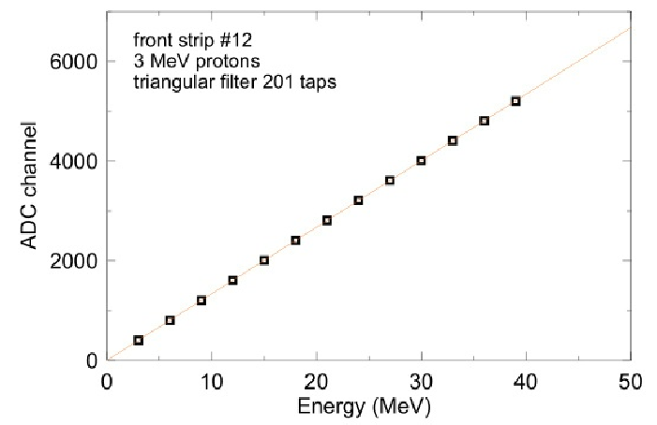
n-proton injection and resolution
Proton bunch multiplicity (deposited energy)
Resolution: 0.5% Front - 1.2% Back
Test of linearity for
Silicon+Preamplifier system
INFN and Politecnico, Milano for Farcos Collaboration

Slide 22
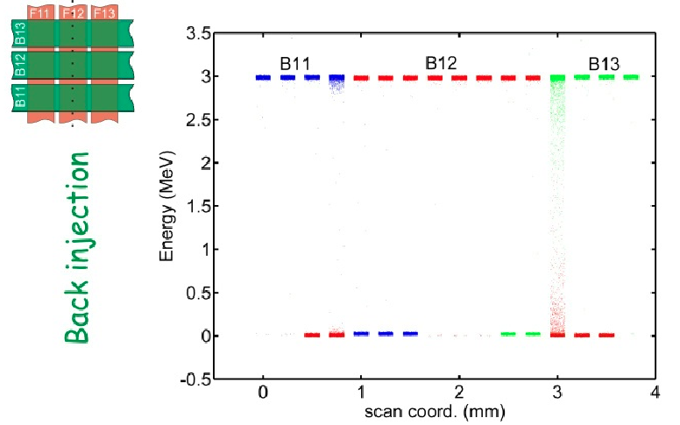
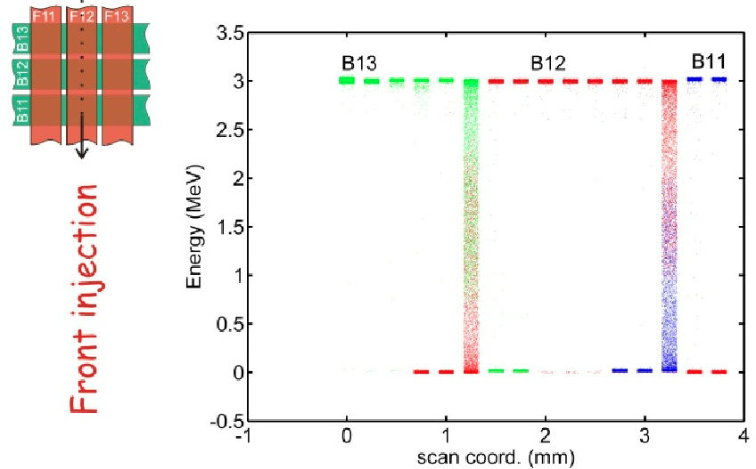
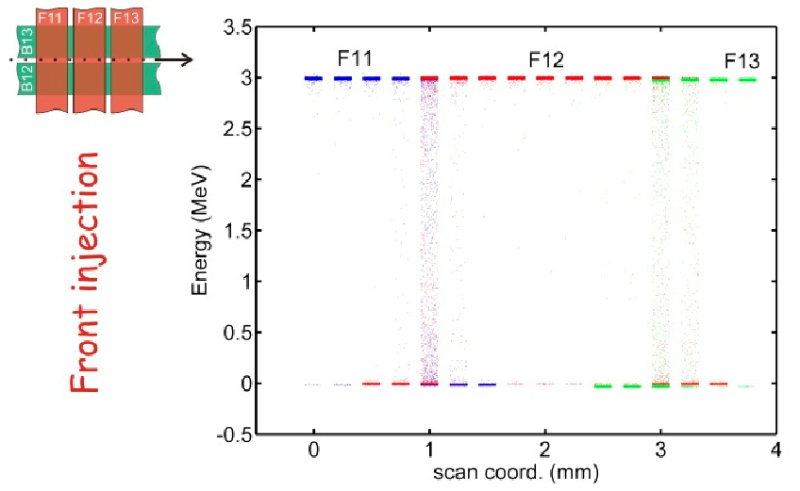
Interstrip energy sharing
Back injection + Back strip/interstrip spanning
Front injection + Back strip/interstrip spanning
Front injection + Back interstrip spanning
Data analysis under way
      Study of energy sharing between neighboring strips
INFN and Politecnico, Milano for Farcos Collaboration

Slide 23
Experiments in 2013 @ LNS
CLIR: Clustering in Light Ion Reactions
16C + 12C→ 10Be + 6He
→ 12Be + 4He
16C from tagged FRIBS projectile fragmentation → 120 kHz
FARCOS

Slide 24
Electronics hopes for phase 2
Pre-amplifiers with multiple gains and large dynamic range (MeV to GeV)
VSLI, configurability, low power… oriented towards physics!
Pulse-shape capabilities
  Low identification thresholds for low energy experiments
Digitalization of detector signals
Update possibilities
  Solid angle increase
  Coupling to different detectors (in different laboratories)

Slide 25
Neutron detection
“Transparency” of materials and electronics boards to incoming neutrons
Secondary stages for neutron detection – under study at the moment… (????)
Electronics
P
P
P
P
P
CsI(Tl)
…..
CsI(Tl)
DSSSD1
DSSSD2
Si

Slide 26
Status and… coming up…!
Farcos has a preliminary configuration allowing for experiments at LNS and other laboratories (ex. GANIL)
  Compact Preamplifiers, shapers, etc. for about 800 channels
  Limited digitalization capabilities already available
The array is going to increase in size… need for integrated technology
  GET solution after the front-end; new integrated front-end (GET, INFN Milan-Politecnico, …)
Working group in neutron detection capabilities (under vacuum): simulations under way

