Slide 1
News from
e+e- colliders in Novosibirsk
E.Solodov
(CMD-3 collaboration)
Budker Institute of Nuclear Physics,
SB RAS, Novosibirsk, Russia
September 2012

Slide 2
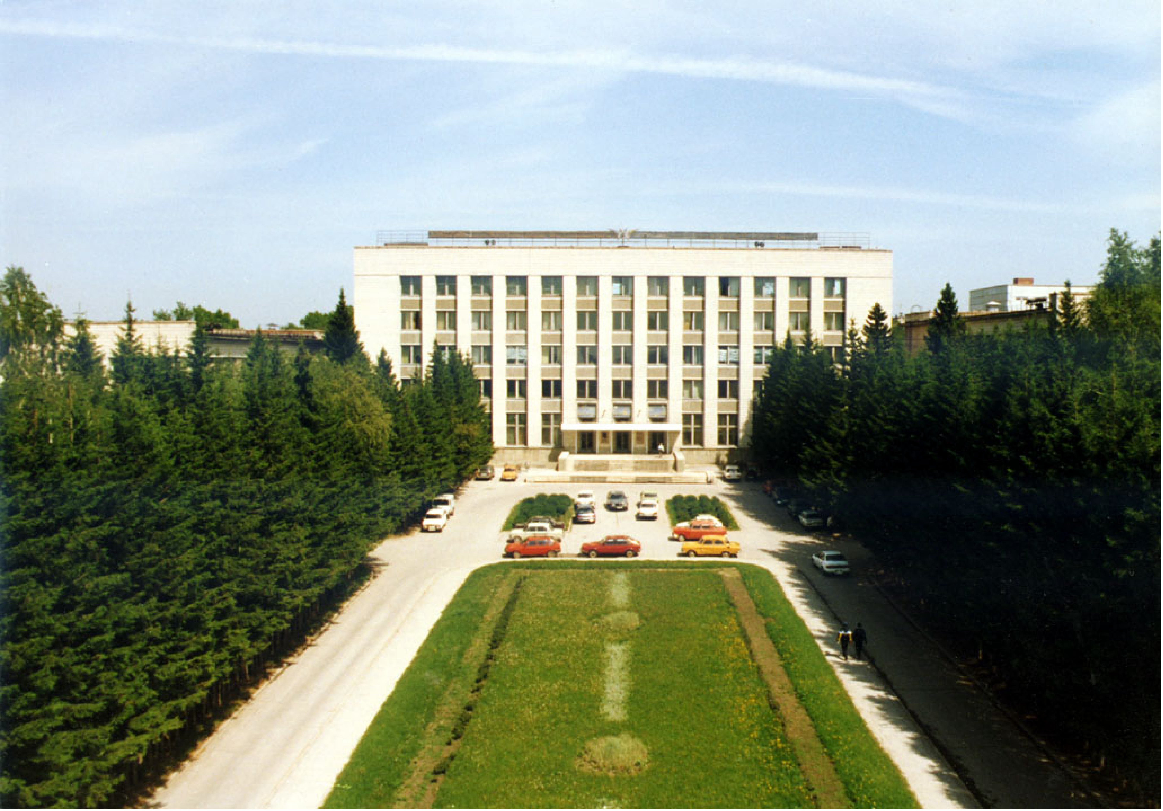
OUTLINE
1 – VEPP4M – latest measurements
2 - VEPP-2000 collider, motivation, construction, performance
3 - Physics program
4 - SND and CMD-3 detectors
5 – first physics runs
6 – First preliminary results

Slide 4
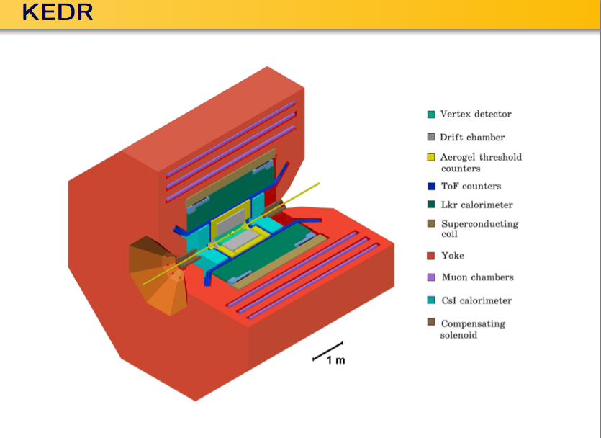

Slide 9
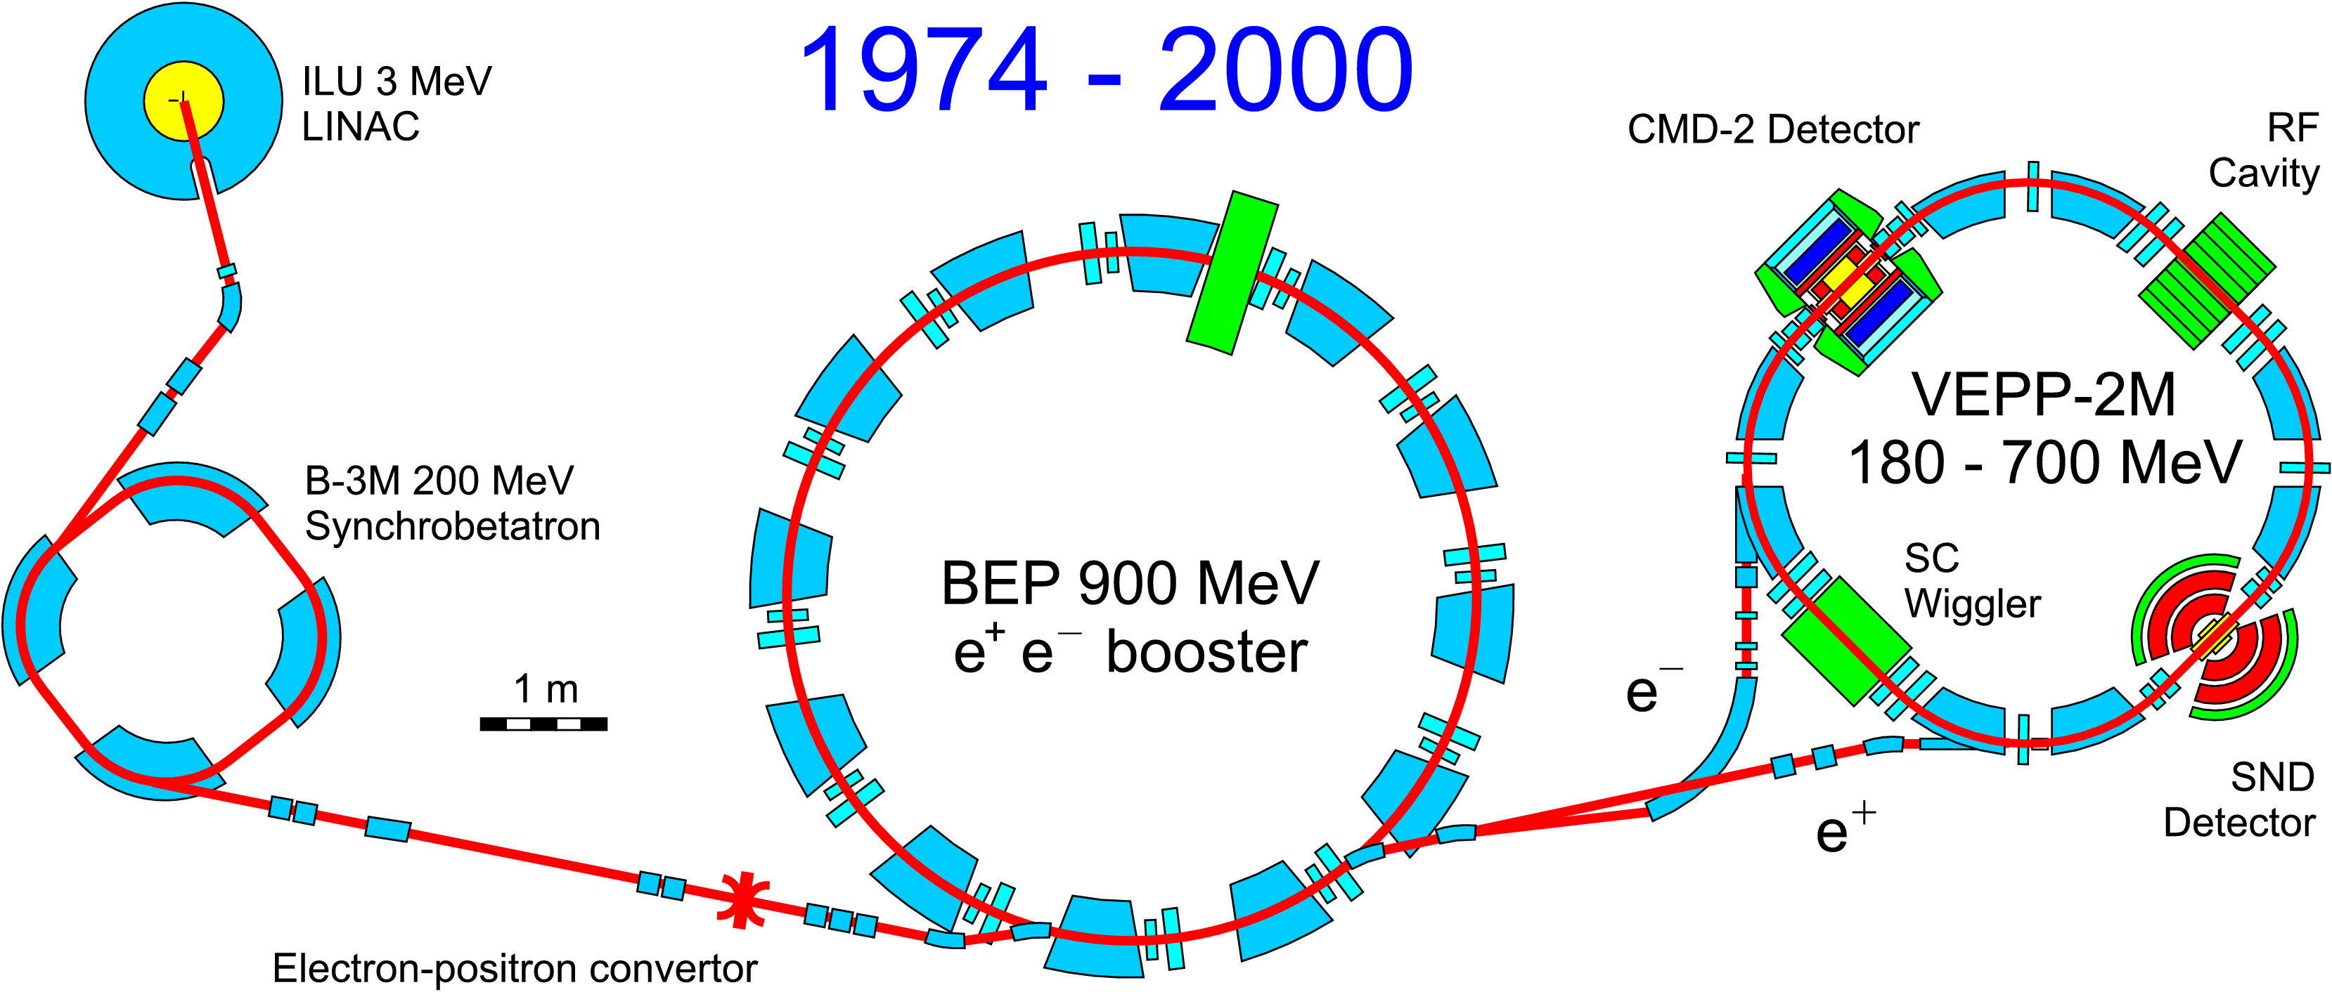
VEPP-2M collider complex (1974-2000)
High luminosity: L=5×10³⁰cm⁻²s⁻¹:
Radiative polarization
Spin precession frequency measurements
mass measurements
e⁺e⁻ anomalous magnetic moment comparison (10⁻¹¹)

Slide 10
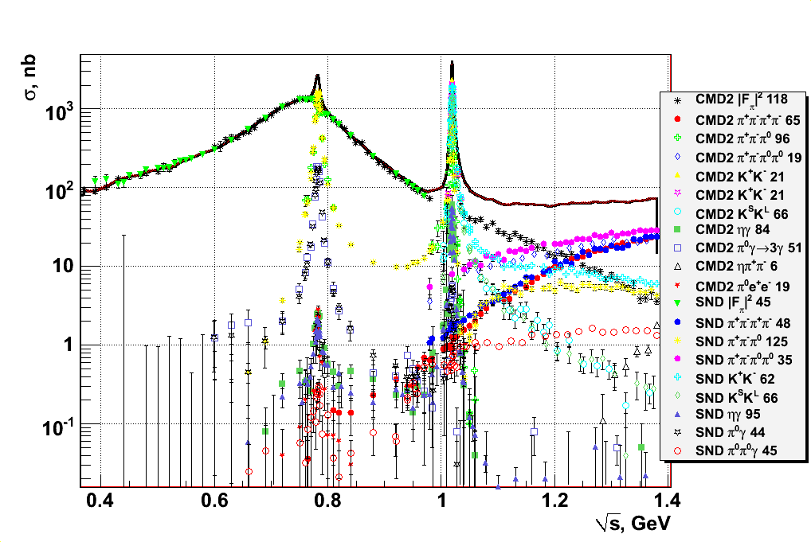
Overview of VEPP-2M results
1-5% systematic error for major channels

Slide 11
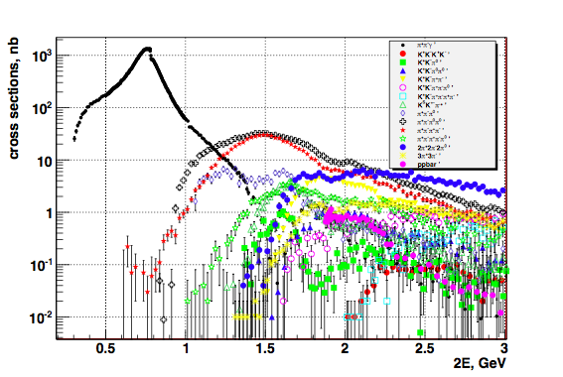
More BaBar data are available
1-5% systematic
errors
to obtain R in the energy range 1-2 GeV the processes
π⁺π⁻3π⁰, π⁺π⁻4π⁰, K⁺K⁻, K_{S}K_{L}, K_{S}K_{L}ππ, K_{S}K⁺ π⁻π⁰
remain to be measured

Slide 12
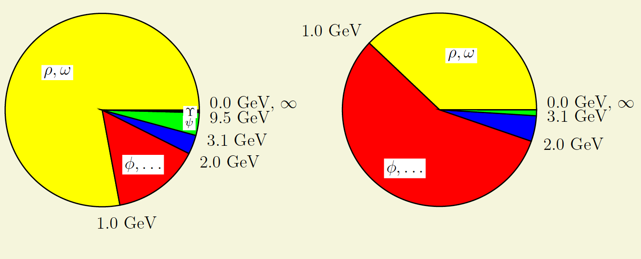
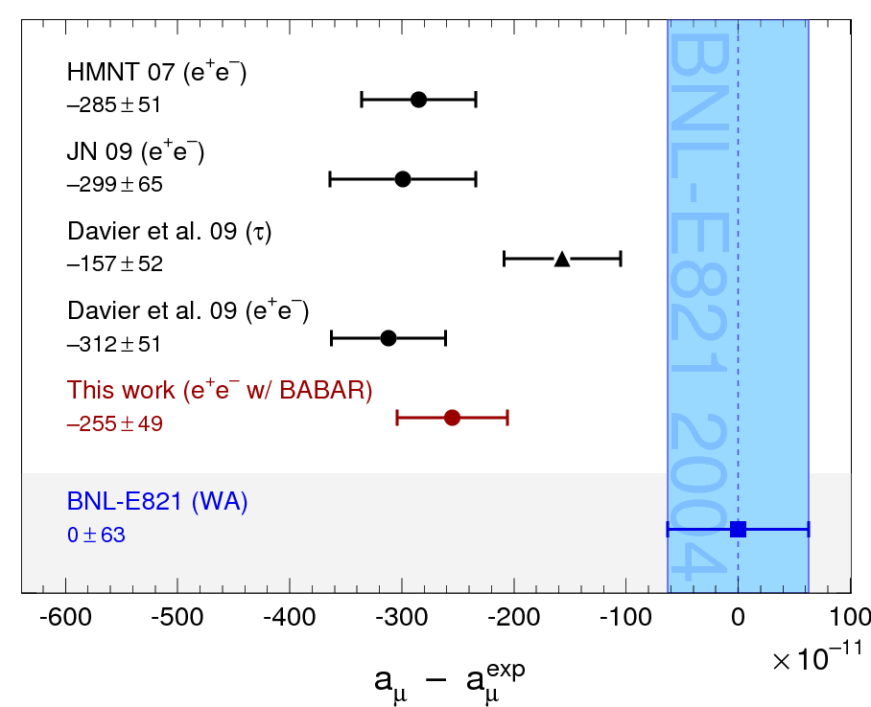
Hadronic contribution to muon g-2
(from F. Jegerlehner)
error²
contribution
VEPP-2M, BaBar, KLOE significantly reduced errors
Additional KLOE data (?)
BaBar will provide more multihadrons, perhaps Belle
< 1% systematic error for most of the channels is needed!
Δ ∼ 3.2σ

Slide 13
VEPP-2M VEPP-2000
(2000-2007)
ILU
ILU
CMD
-3
3 MeV
3 MeV
RF cavity
Linac
Linac
CMD
-2
–+
e,e
VEPP-2000
B
-3M
VEPP-2M
B
-3M
BEP
200 M
eV
BEP
200 M
eV
SC
–+
–+
e,e
synchro-
e,e
synchro-
wiggler
booster
betatron
booster
betatron
900 M
eV
e
–
900 M
eV
SND
SND
e
+
2 m
180–700 M
2 m
eV
→
–
→
+
–
+
ee
ee
convertor
convertor
♦ E ≈ 1 GeV (per beam)
♦ L ≈ 1×10³² cm⁻² sec⁻¹ (1×1 bunch)

Slide 14
Increasing of Luminosity
Number of bunches (i.e. collision frequency)
Bunch-by-bunch luminosity
Round Beams:
Geometric factor (gain=4)
Beam-beam limit enhancement (gain~4)
IBS for low energy? worth life time!
(V.V.Danilov et al., EPAC’96, Barcelona, p.1149, (1996))

Slide 15
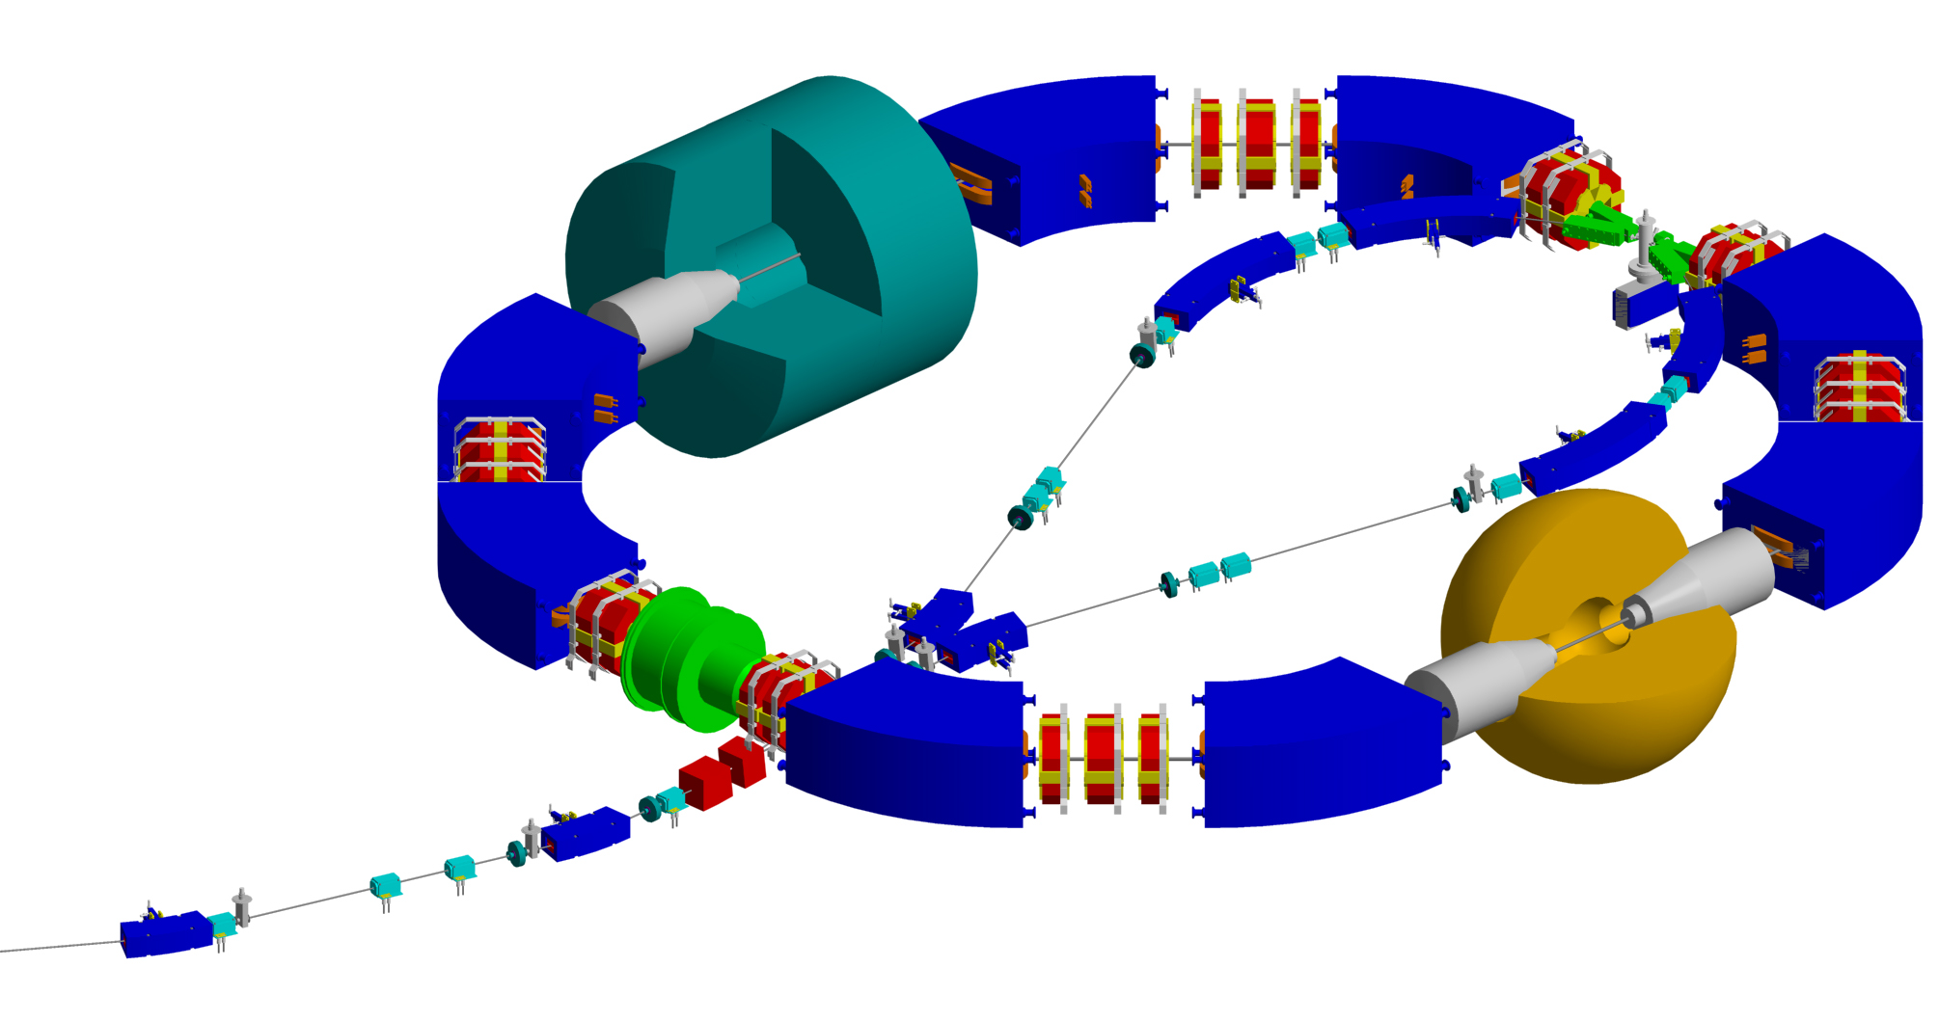
VEPP-2000
Integrated luminosity ~ 100 pb⁻¹ per detector/year
CMD-3
SND
Total integrated luminosity with all detectors on VEPP-2M ~ 70 pb⁻¹

Slide 16
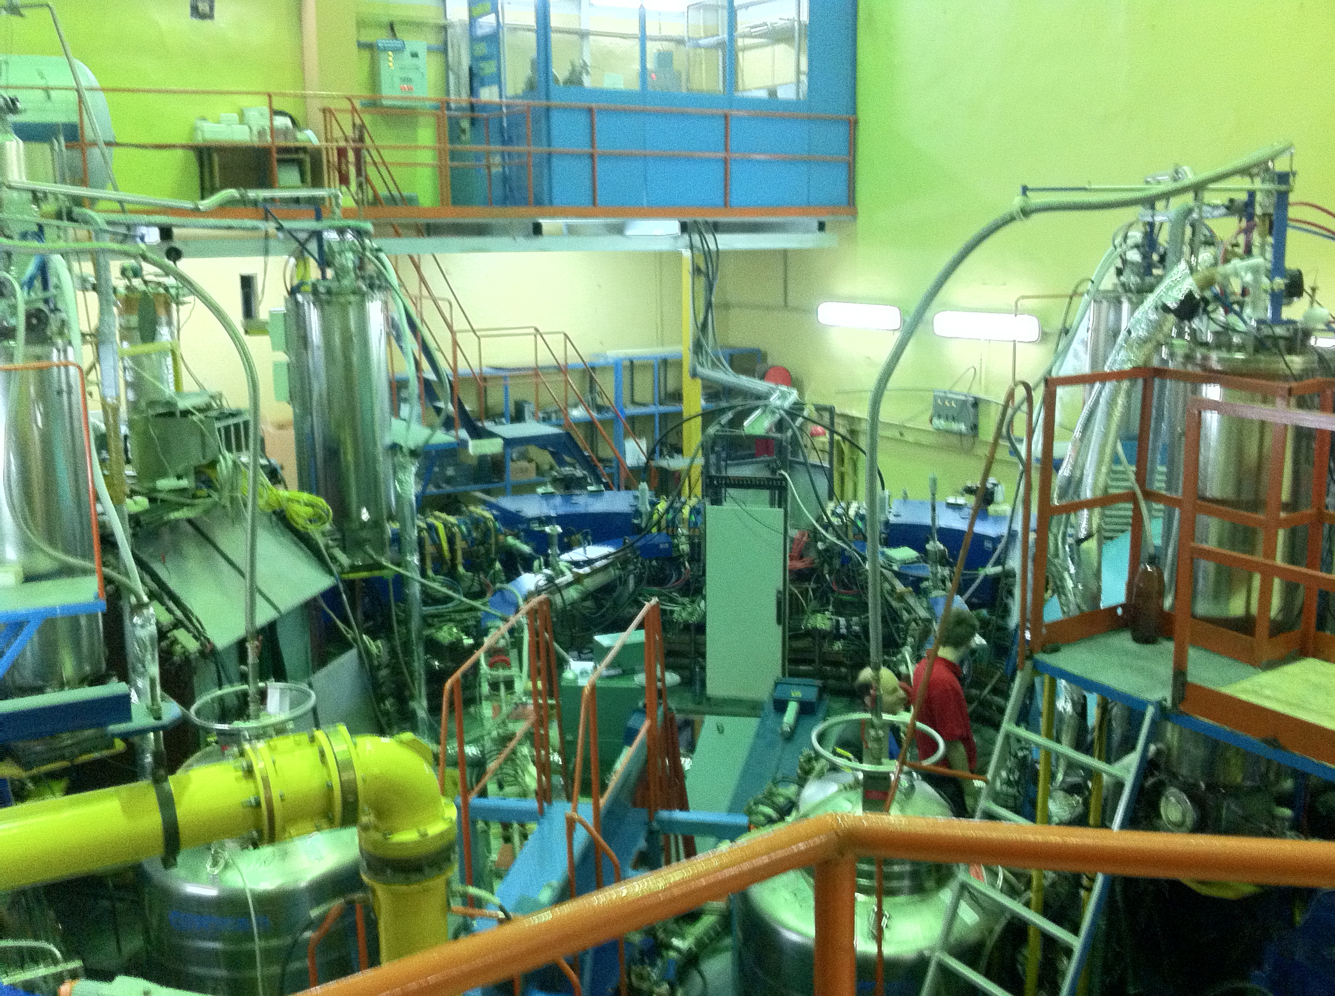
First “mile stones” of VEPP-2000 (14.05.2001)
NOW

Slide 17
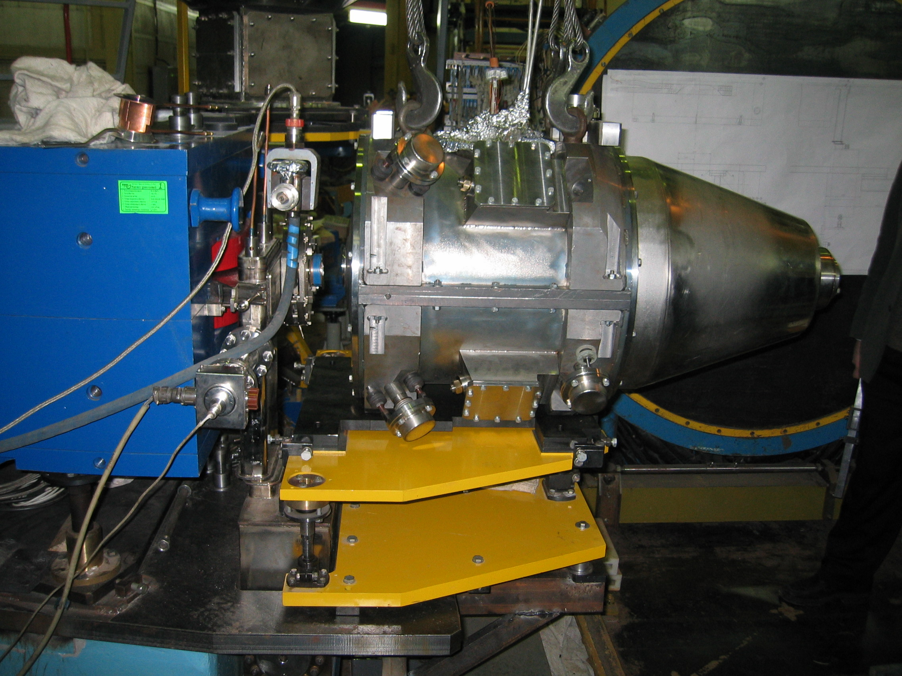
Solenoid 13.0 T at VEPP-2000

Slide 18
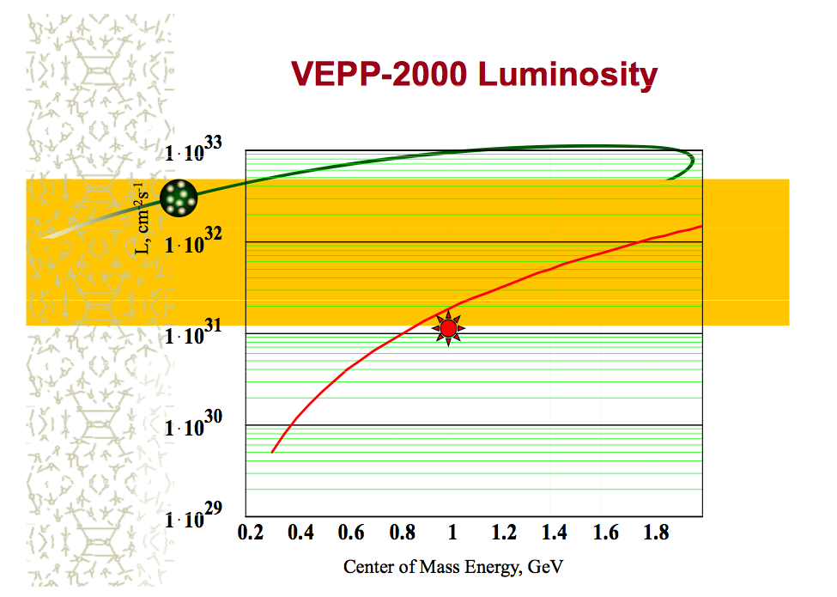
Round beams
#1 (1M2)
#1
Experimentally achieved
Positrons limited

Slide 19
Beam energy measurement for VEPP-2000
Spectrum measurement
Mirror inside
vacuum chamber
Beam in
VEPP-2000
HPGe
Windows
Output to
detectors
CO₂ laser
Mirror with
step motor
Linux
storage
Test runs are right now
Beam energy accuracy ~0.05-0.1 MeV
Still hope to perform the resonance de-polarization with 0.005 MeV accuracy

Slide 20
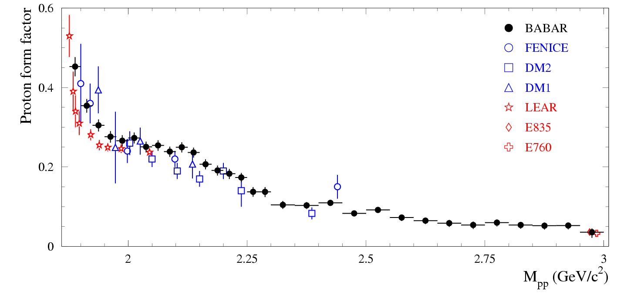
Physics program at VEPP-2000
1. Precise measurement of the quantity
R=σ(e+e⁻⁻ > hadrons)/ σ(e+e⁻⁻>μ+μ⁻⁻) – GOAL <1% systematic for major channels
2. Study of hadronic channels:
e+e⁻⁻ > 2h, 3h, 4h …, h= π,K,η
3. Study of ‘excited’ vector mesons: ρ’, ρ’’, ω’, ϕ’,..
4. CVC tests: comparison of e+e⁻⁻ > hadr. (T=1)
cross section with τ-decay spectra
5. Study of nucleon-antinucleon pair production –
nucleon electromagnetic form factors,
search for NNbar resonances, ..
6. Hadron production in ‘radiative return’
(ISR) processes
7. Two photon physics
8. Test of the QED high order processes 2->4,5
< vepp2000>
Two detectors have been build for the study

Slide 21
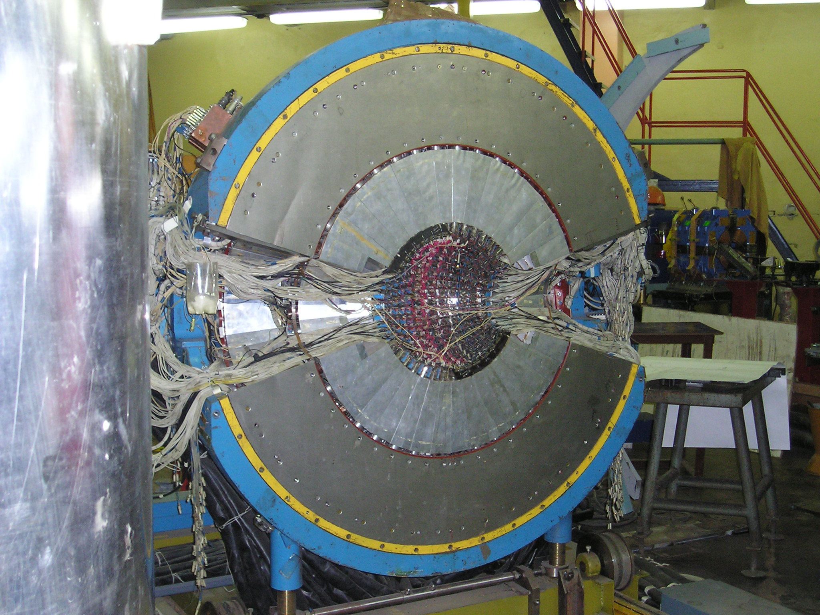
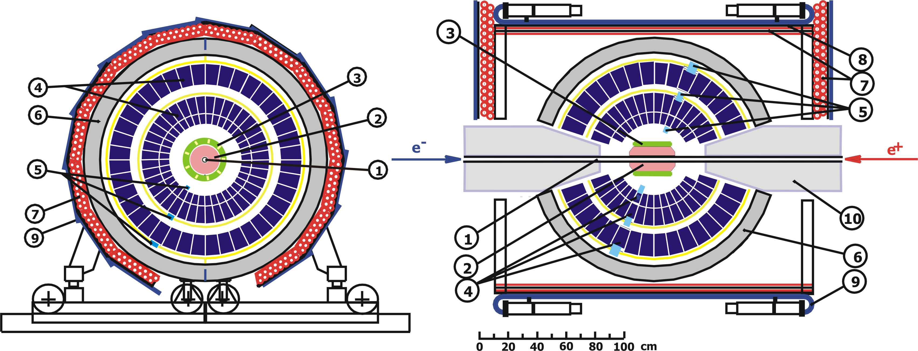
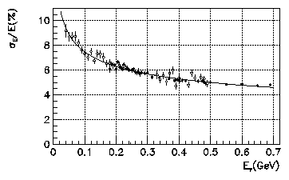
Spherical Neutral Detector
Energy resolution
1 – VEPP-2000 vacuum chamber, 2 – tracking system,
3 – aerogel counters, 4 – electromagnetic calorimeter NaI(Tl), 5 – vacuum phototriodes, 6 – absorber, 7-9 – muon system,
10 – VEPP-2000 phocusing solenoid

Slide 22
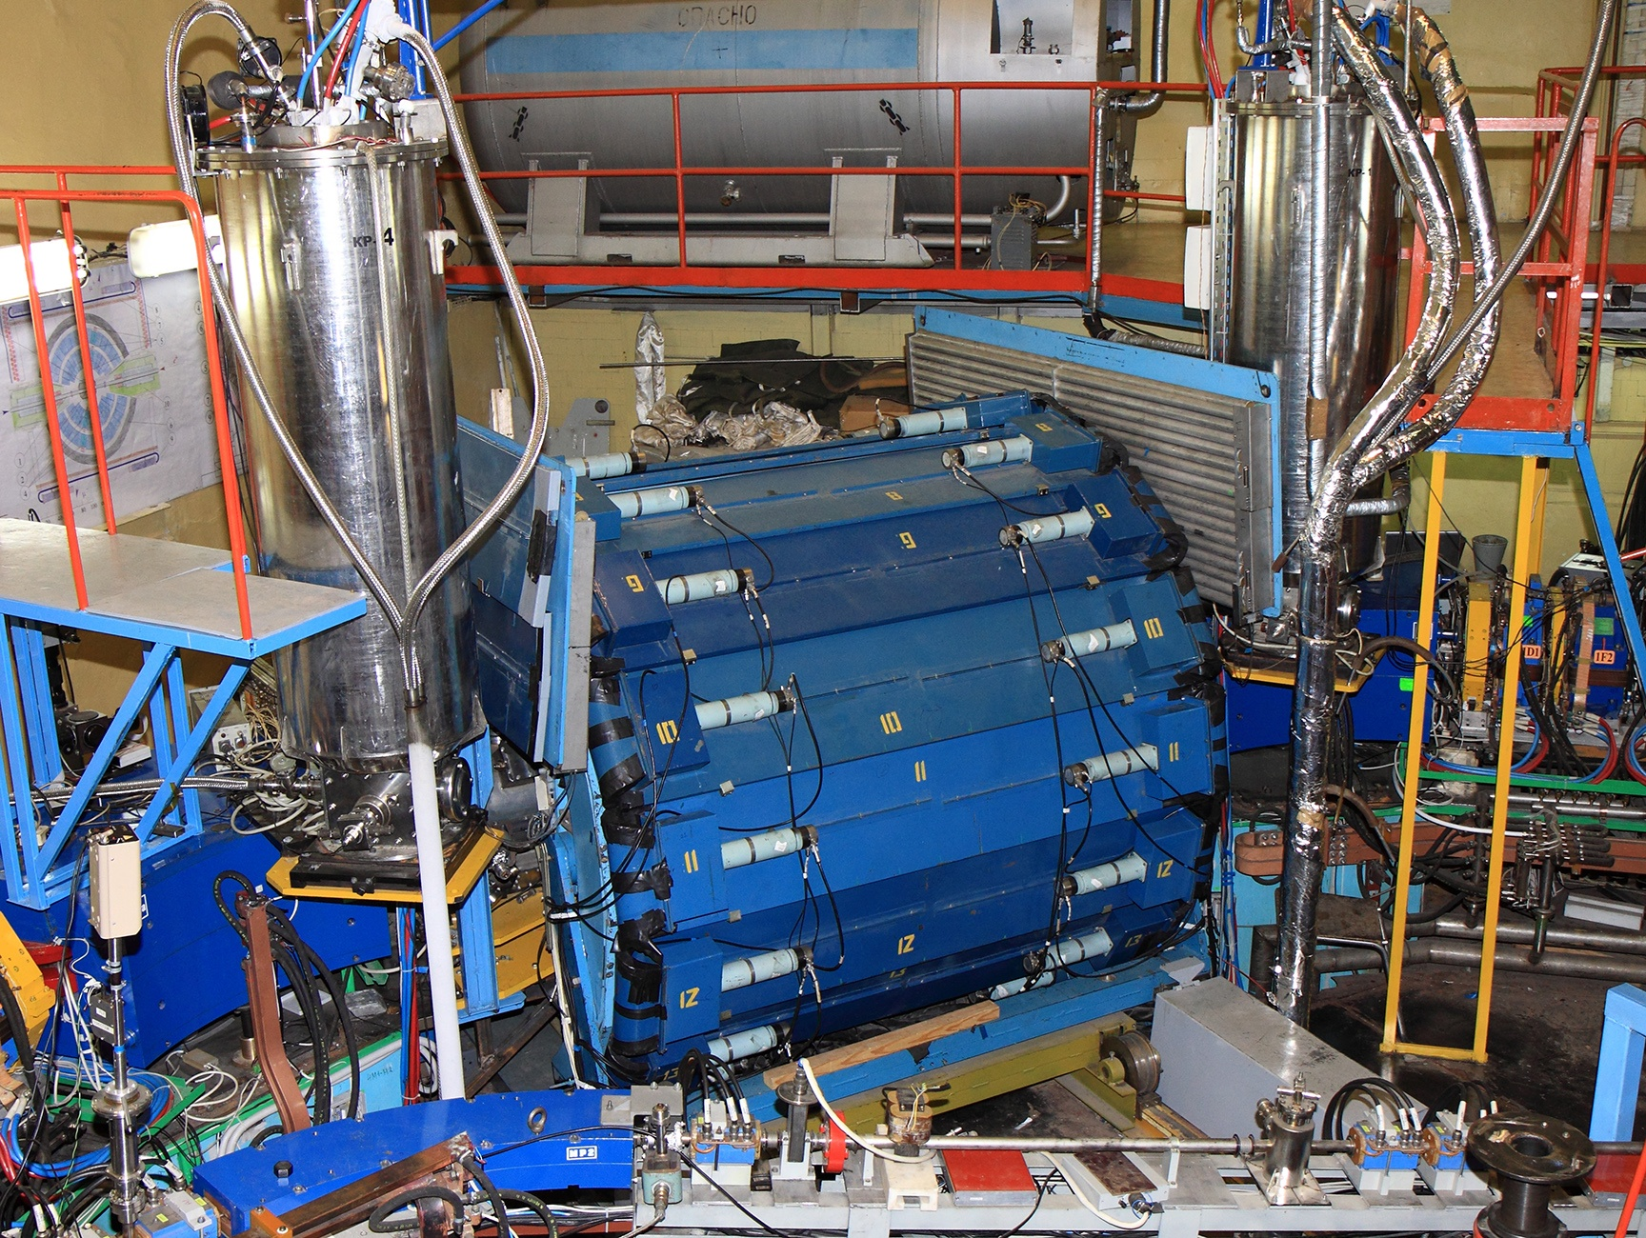
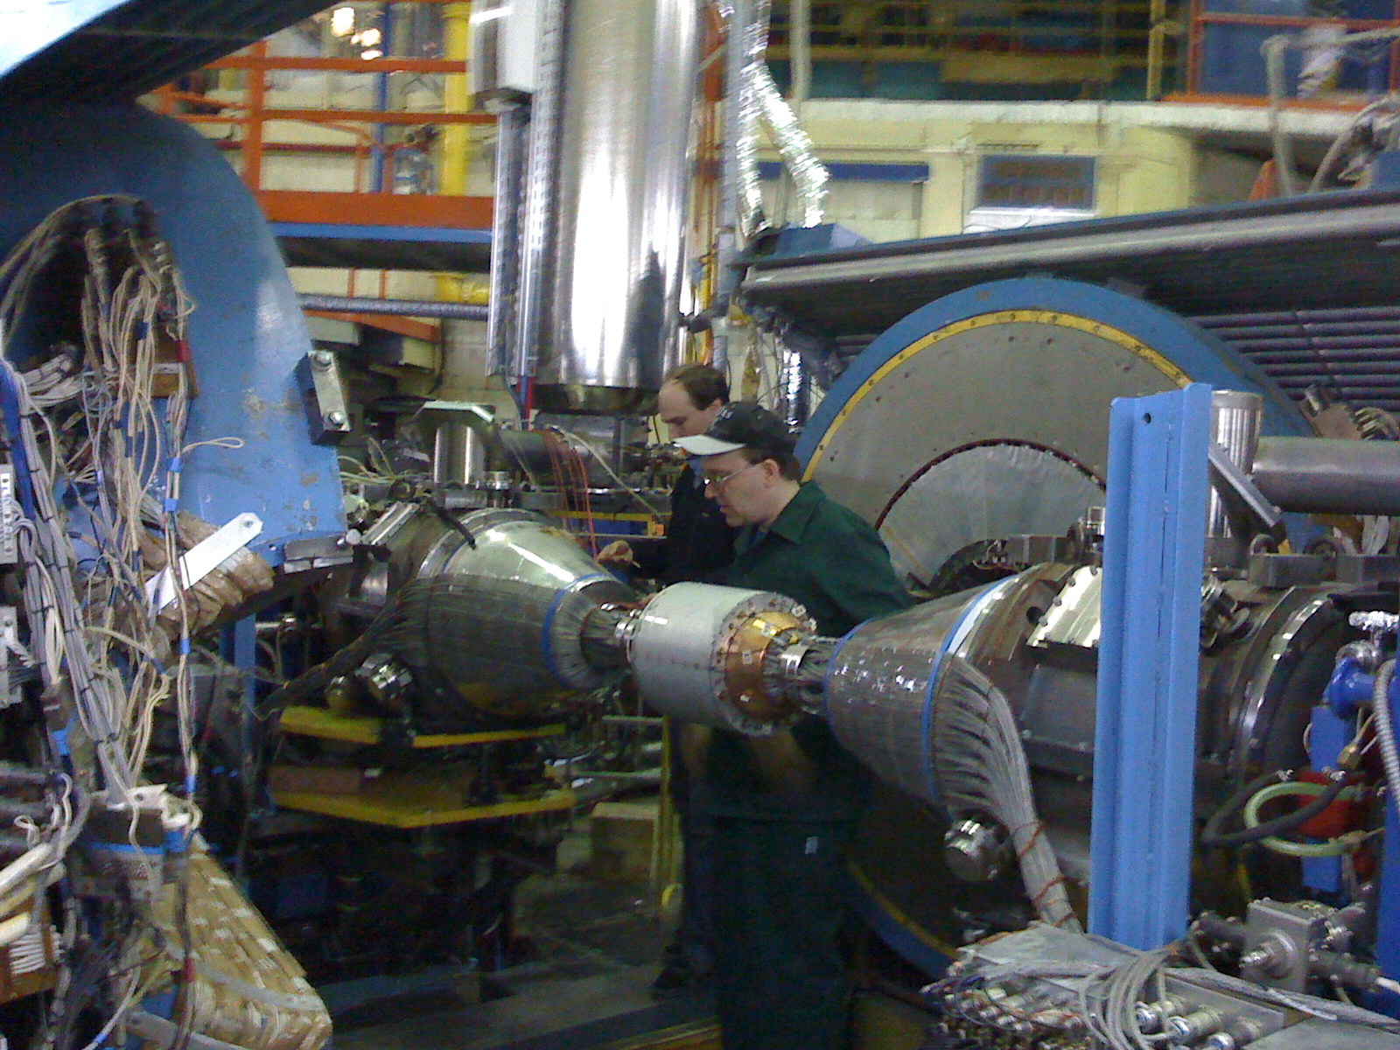
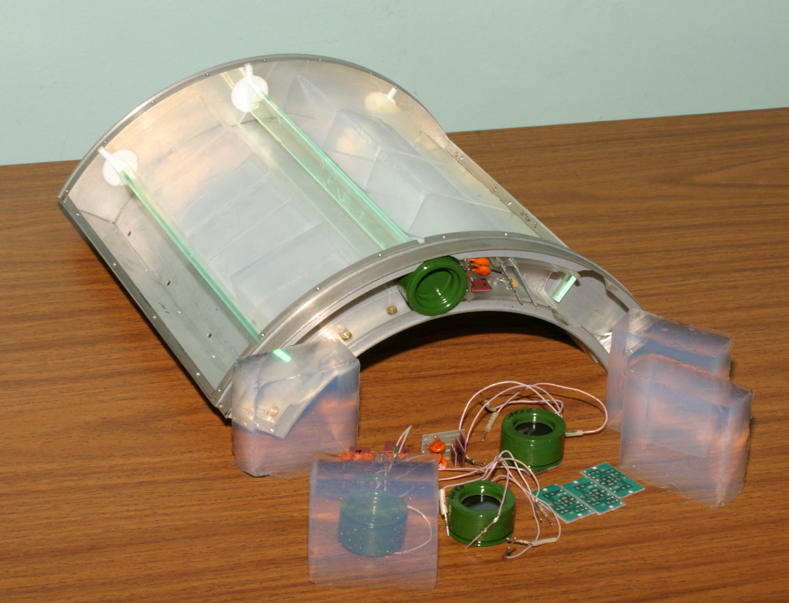
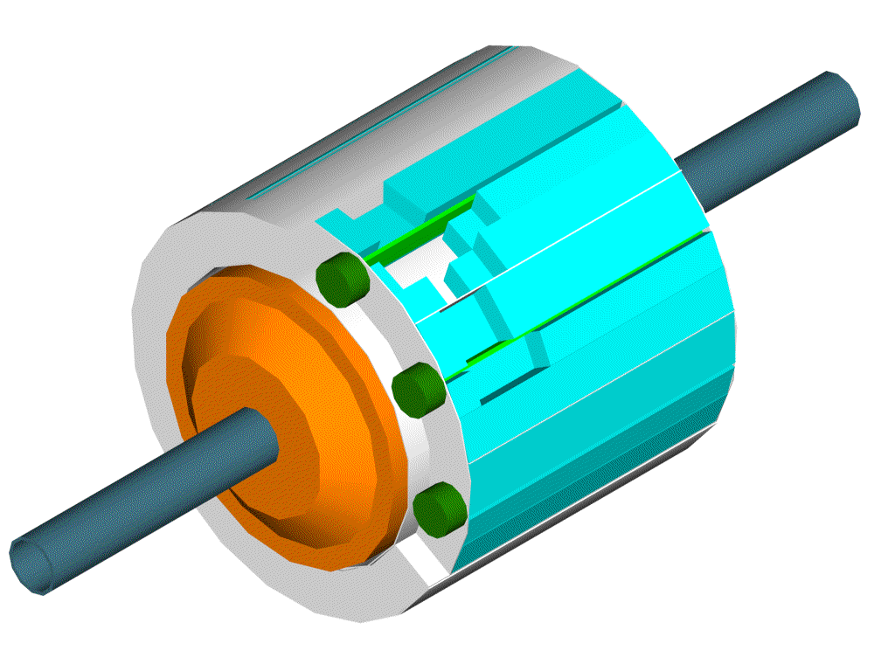
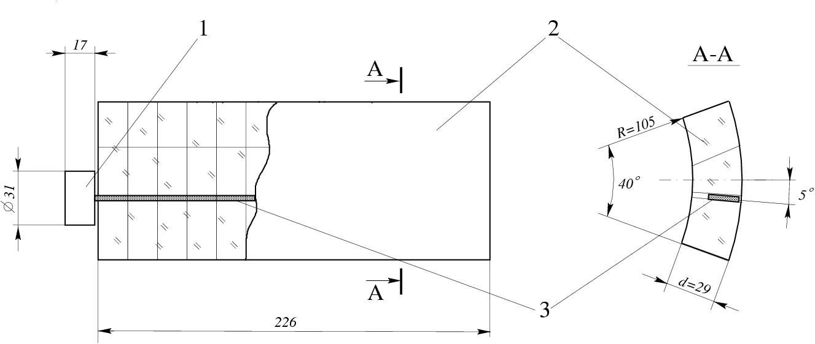
Particle ID Aerogel Counters
e/π, π/K separation
μ₀=10ph.e.
μ₀=5ph.e.
Prototype with
cosmic events
π
K
n
1,14
1,12
Counter efficiency
Aerogel + shifter + PMT
Aerogel thickness 31 mm
Shifter turned by 5˚
Teflon coverage (R=0.98)
Nucl.Instrum.Meth.A315:517-520,1992

Slide 23
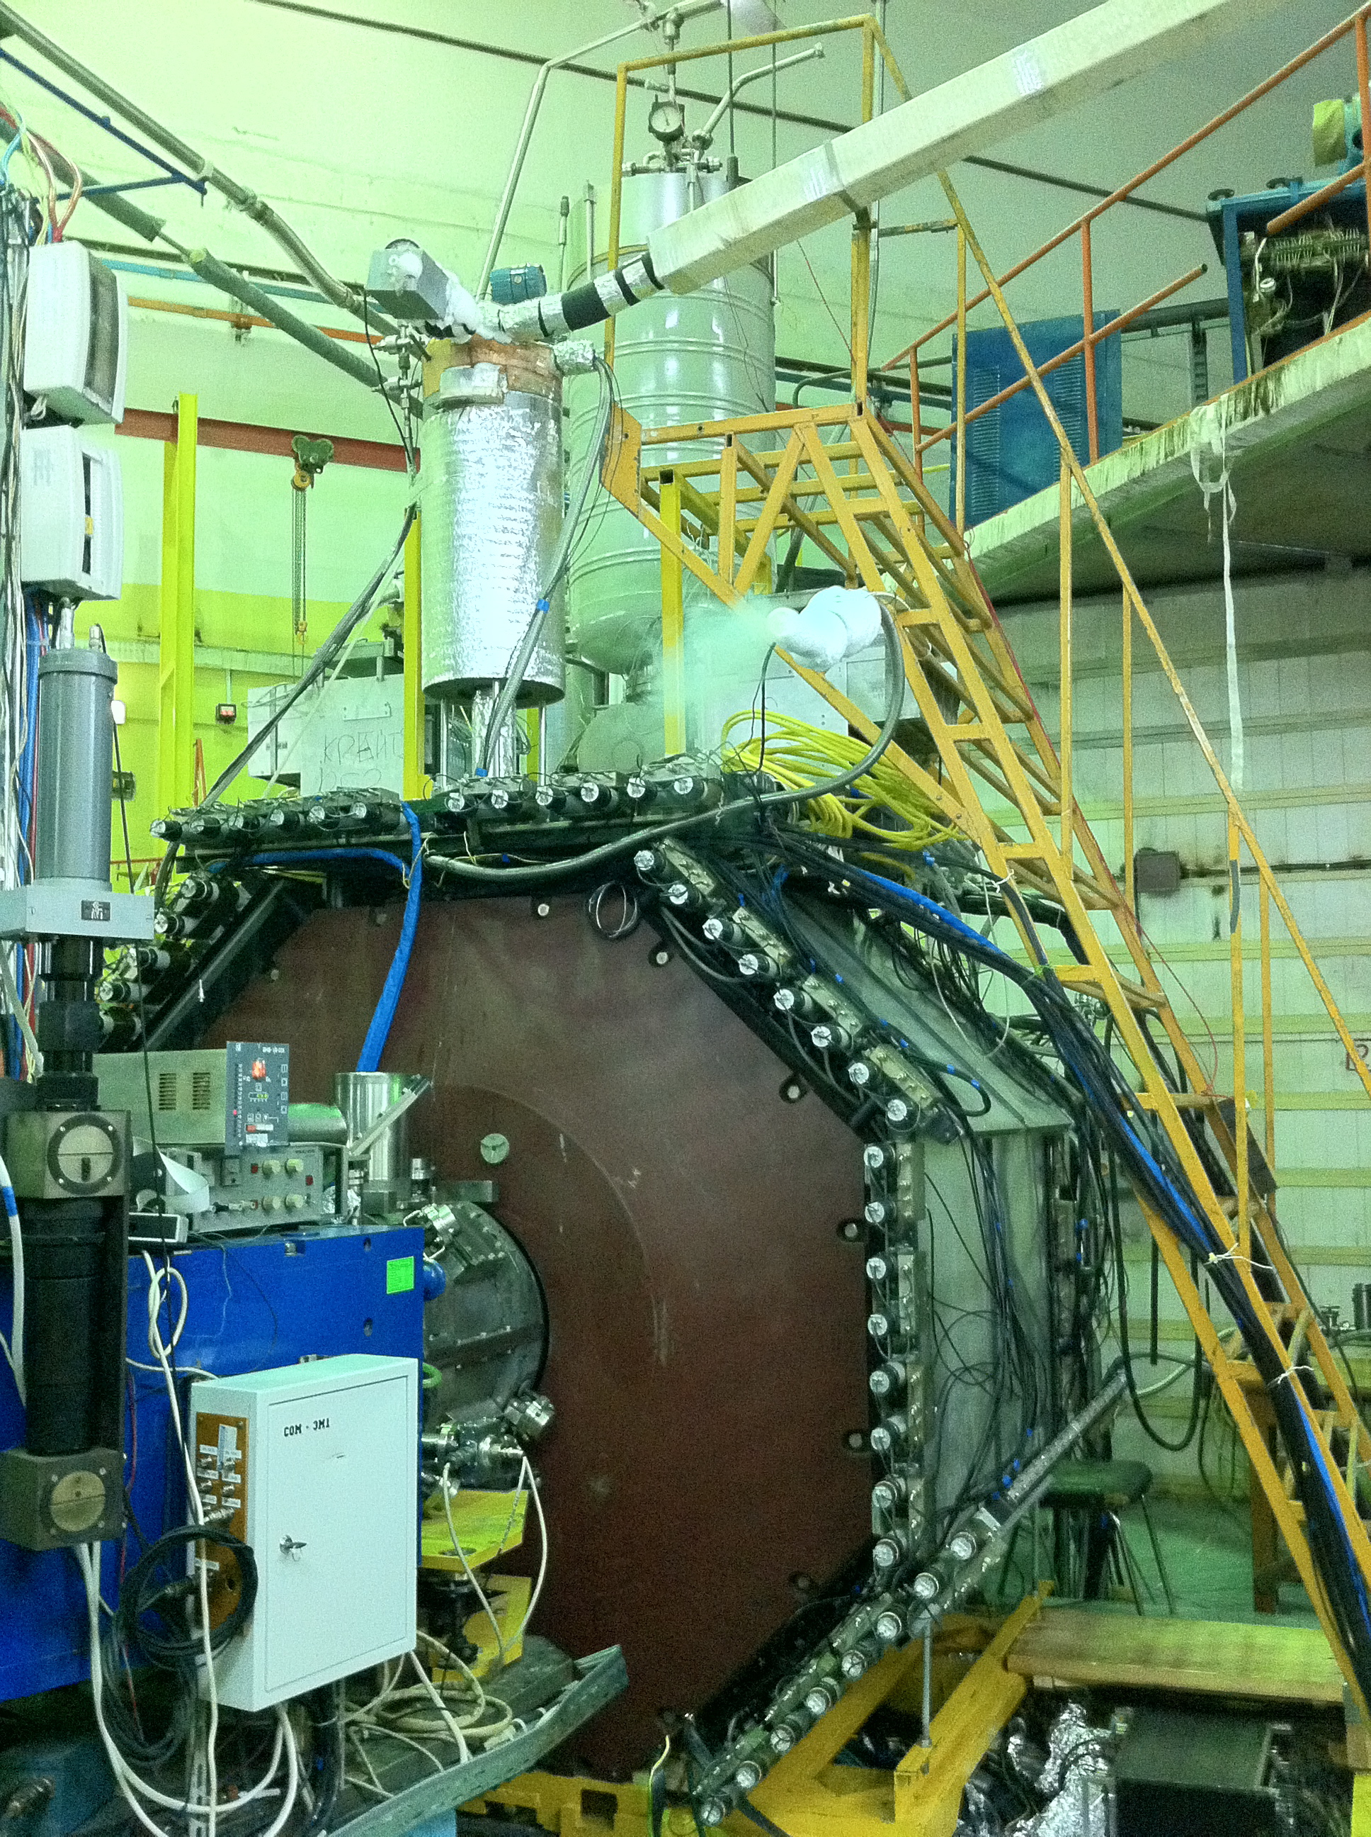
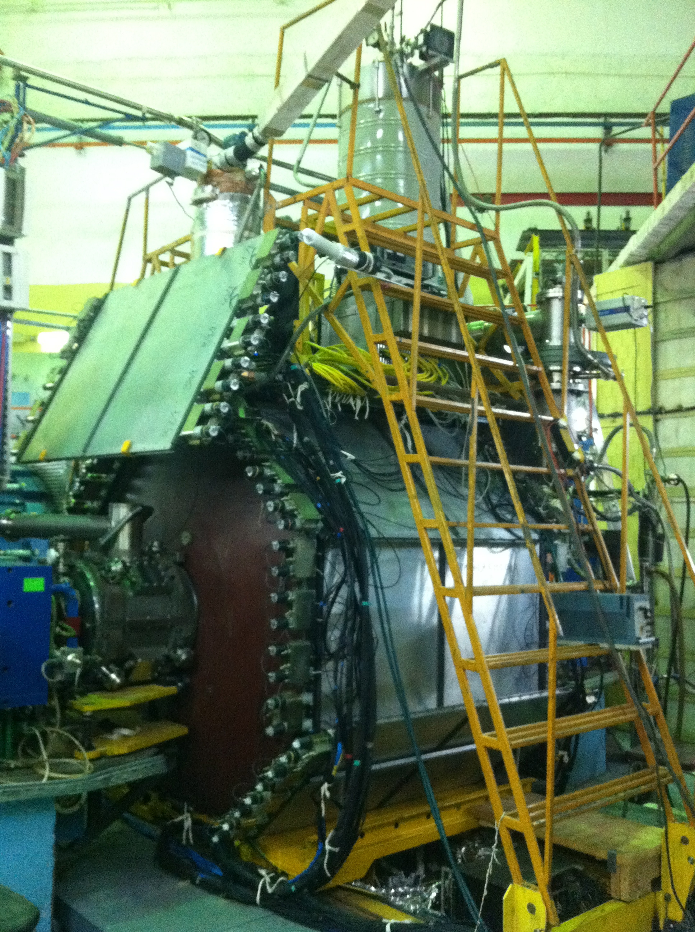
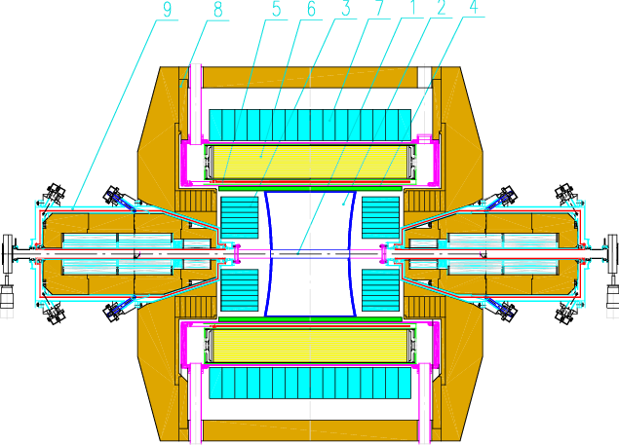
Cryogenic Magnetic Detector-3
1 – vacuum chamber
2 – drift chamber
3 – electromagnetic calorimeter BGO
4 – Z – chamber
5 – CMD SC solenoid
6 – electromagnetic calorimeter LXe
7 – electromagnetic calorimeter CsI
8 – yoke
9 – VEPP-2000 solenoid

Slide 24
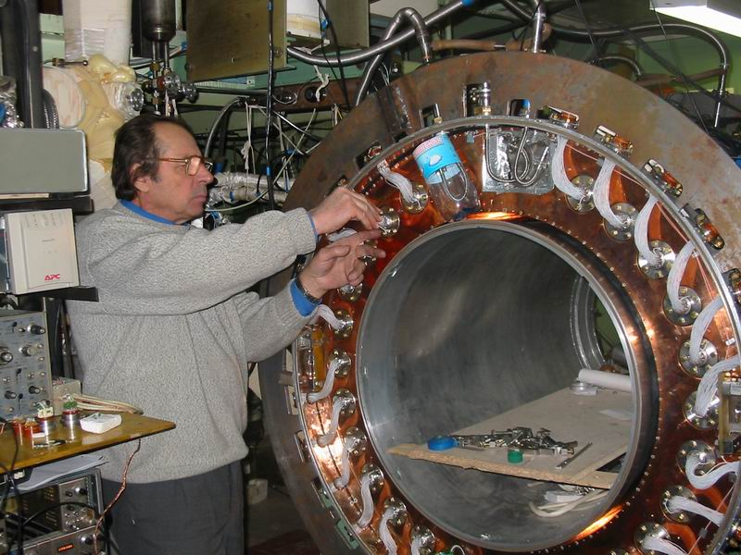
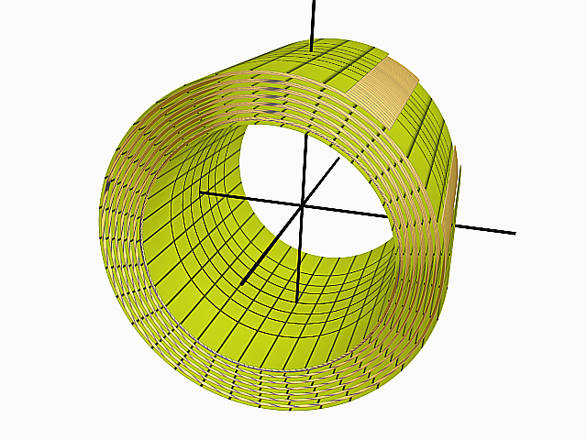
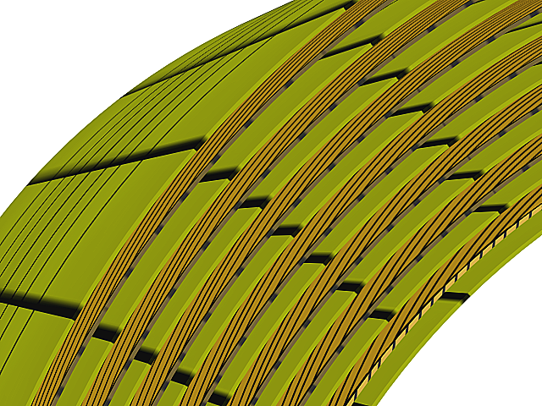
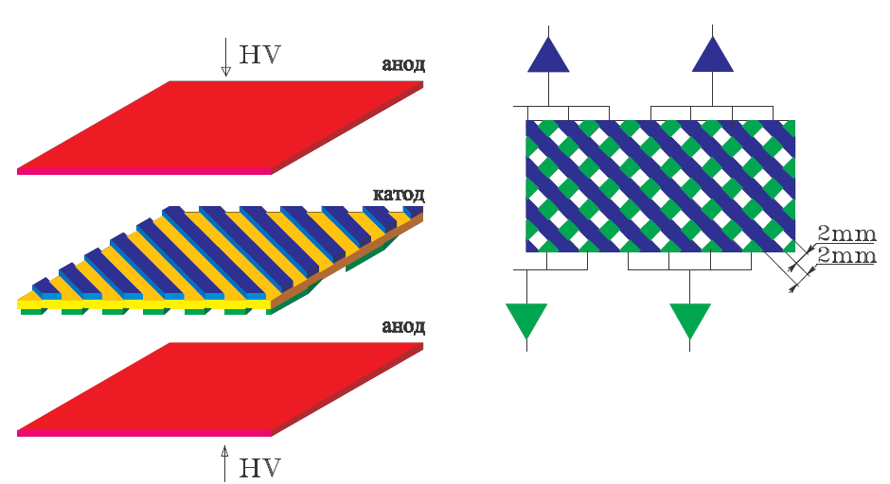
Calorimeter LXe
anode
5.7 X₀ of LXe (400 liters, 1.2 tons)
14 gaps by 10.2 mm
2124 coordinate strips
264 towers
cathode
anode

Slide 25
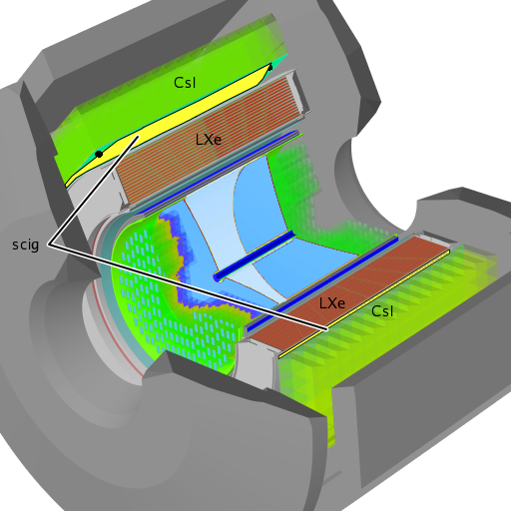
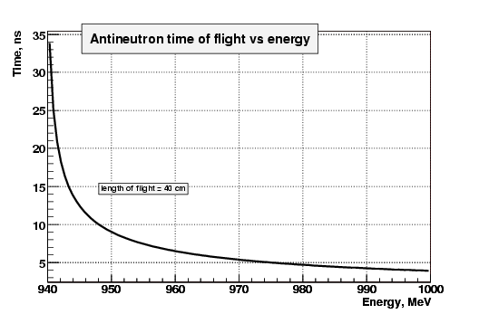
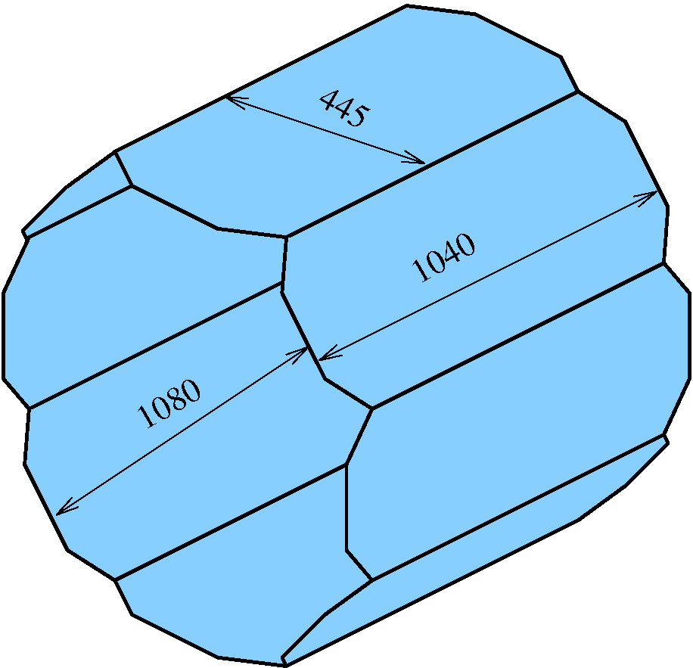
Particle ID: Timing Counter (SCiG)
Antineutron identification
in e⁺e⁻→n n bar
e⁺e⁻
σ = 0.75 ns
Ec.m. =1.925 GeV
PbarP

Slide 26
Experiments at VEPP2000, 2010, 2011, 20012
 | Energy Region, GeV | Energy step, MeV | Integrated luminosity, pb⁻¹ (per detector)
scan2010 | 1.1-1.9 | 100 | 5
scan2011 | 1.05-2.0 | 25 | 25
scan2012 | 1.4-2.0 | 10 | 60–plan (15 now)

Slide 27
e⁺e⁻→ π⁺π⁻π⁰π , scan 2010
e⁺e⁻ -> π⁺π⁻π⁺π⁻ candidate

Slide 28
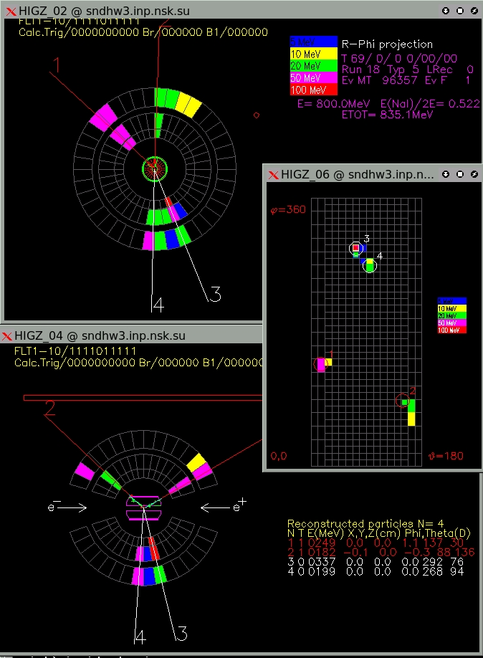
e⁺e⁻→ π⁺π⁻π⁰, π⁺π⁻η
2010 scan
e⁺e⁻→ π⁺π⁻ π⁰ event
π
η
M_{γγ}, MeV

Slide 29
SCAN 2010
e⁺e⁻ → π⁰π⁺π⁻
e⁺e⁻ → η π⁺π⁻ → ηρ
ρ/
ω/
ω//
ρ
М_{ππ}

Slide 30
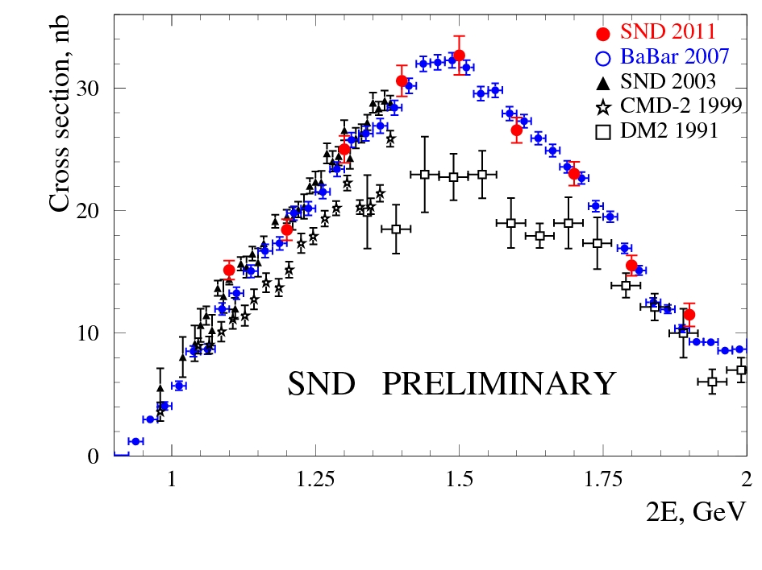
e⁺e⁻→ π⁺π⁻π⁰π⁰
scan 2010
ρ/+ρ/ /
Intermediate states:
ωπ⁰
a₁π
ρ⁺ρ⁻
ρf₀
ρf₂
Only statistical errors are shown

Slide 31
e⁺e⁻→ ωπ⁰ → π⁰π⁰γ, 2010+2011 scan
M_{π0γ}
Fit: sum of
ρ(770) and ρ(1450)
contributions

Slide 32
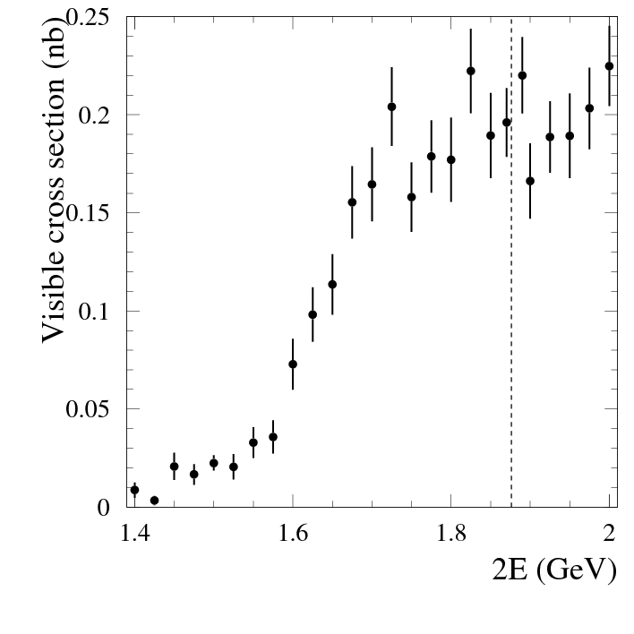
e⁺e⁻→ π⁺π⁻π⁰π⁰π⁰π⁰ → π⁺π⁻ 8γ scan 2011
Preliminary
e⁺e⁻→ π⁺π⁻π⁰η (ωη,φη)
η
p bar-p threshold
First observation !

Slide 33
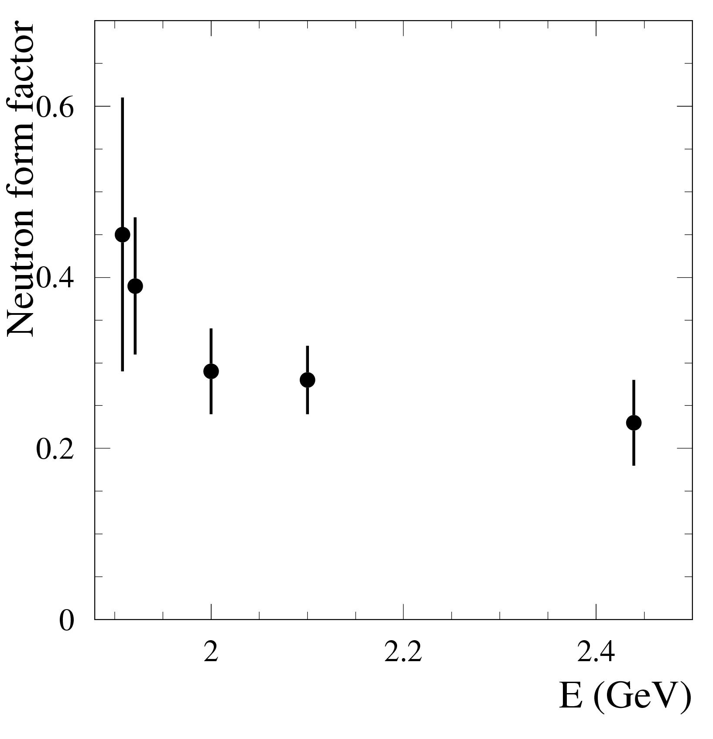
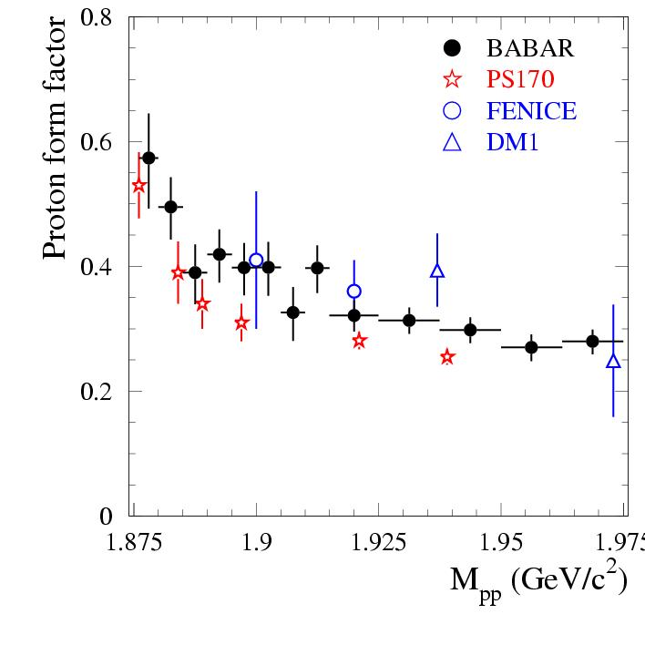
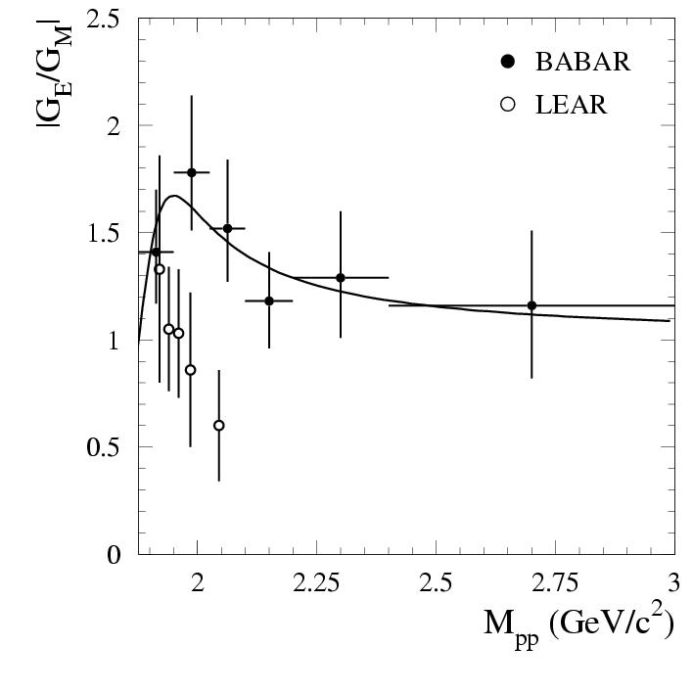
C~1 at T.~1 MeV
At s=4M_{N}² G_{E}=G_{M}
At s->∞ G_{M} falls as q⁻⁴

Slide 34
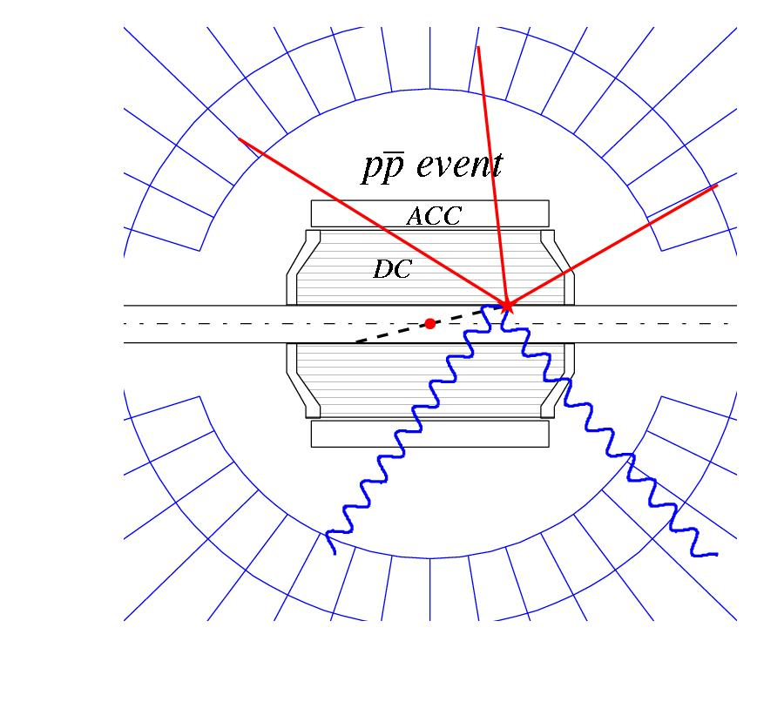
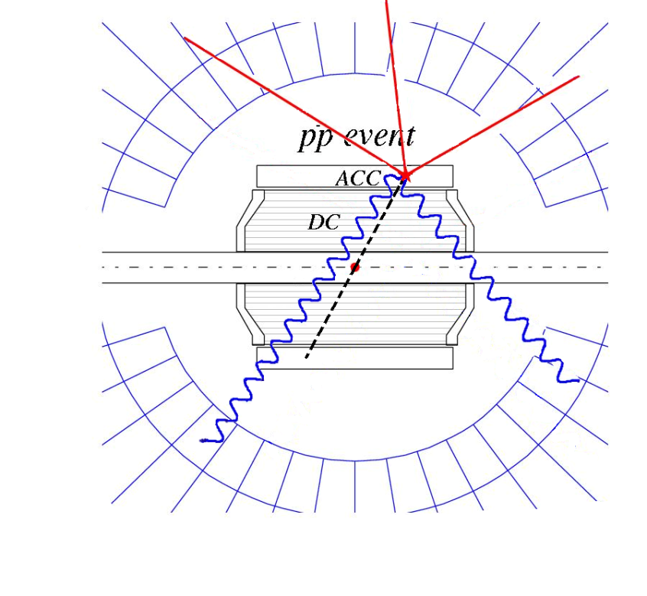
e⁺e⁻→pp
Event topology
E<1905 MeV
E>1910 MeV
Protons stop in vacuum chamber
Protons hit DC

Slide 35
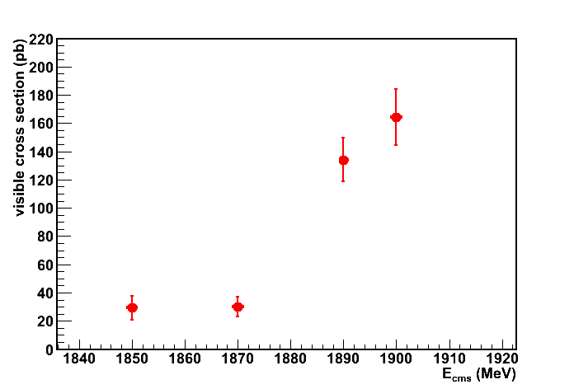
e⁺e⁻→pp
>3 tracks from vacuum chamber wall
>650 MeV in calorimeter
Candidate event
threshold

Slide 36
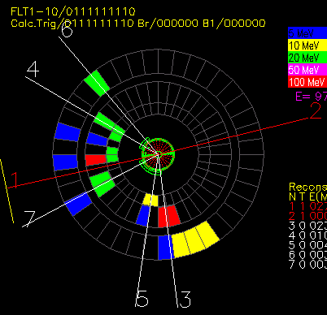
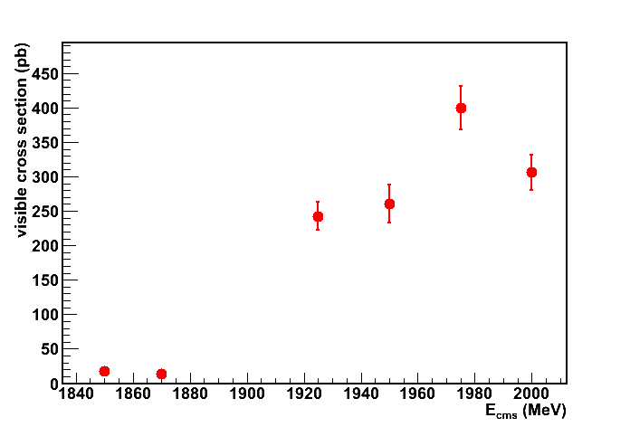
e⁺e⁻→ p pbar, 2011 scan
Candidate event
Selection:
2 collinear tracks with large dE/dx,
energy deposition >650 МэВ
no clusters on one of the track
threshold

Slide 37
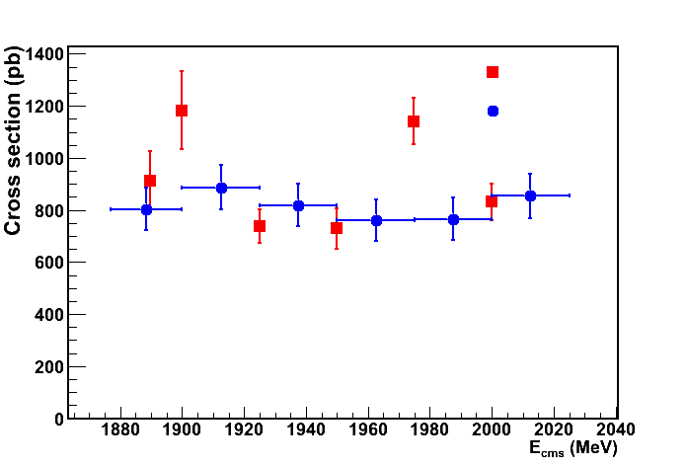
e⁺e⁻→pp
Scan 2011
− SND
− BaBar¹
Plans:
Angular distributions
Systematics
SND preliminary
[1] B.Aubert et al., Phys.Rev.D73 (2006) 012005

Slide 38
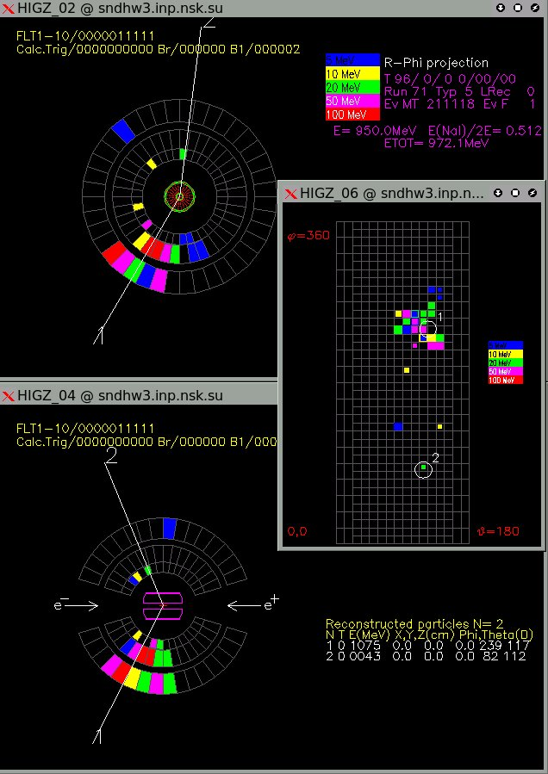
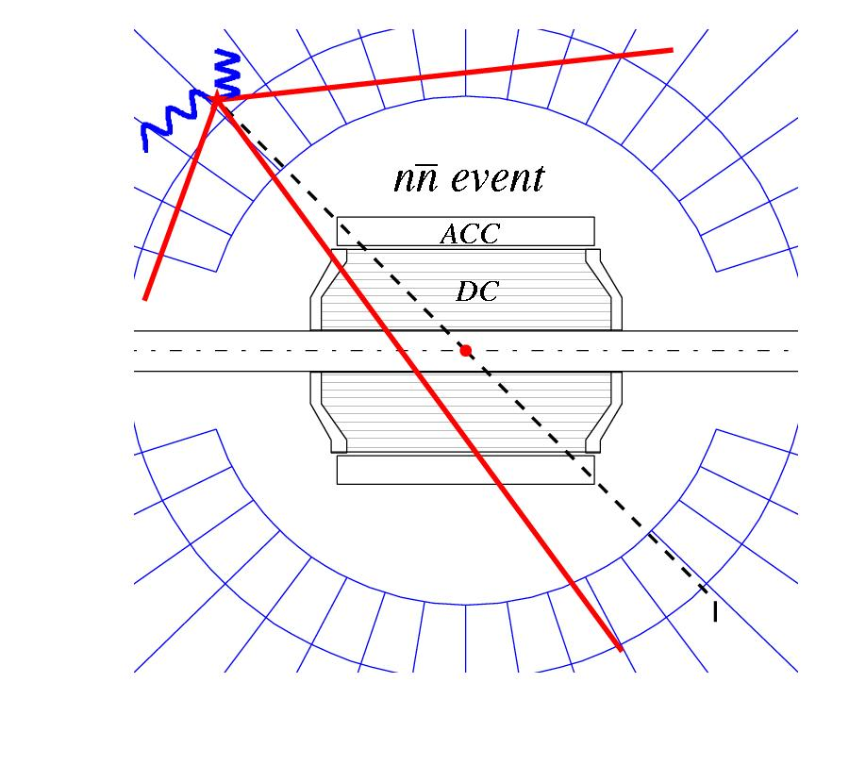
e⁺e⁻→ nn
Event topology
Even signature:
no signal from neutron
“star” from anti-neutron

Slide 39
e⁺e⁻→ n nbar, 2011 scan
Suppression of background
Type of bkgd
Source of bkgd
Suppression cuts
Cosmic bkgd | Muon tracks in EMC, showers In EMC | Muon system veto, r.f. time, Signature in EMC
Beam bkgd | Beam scattering on residial gas, Toushek effect | High EMC threshold, Signature in EMC, ΔE=1000-1800 MeV
Physical bkgd | e⁺e⁻→2γ, nγ, e⁺e⁻→ e⁺e⁻(γ), e⁺e⁻→hadrons, | No tracks in DCH, No central γ in EMC, No E-P conservation,
NNbar detection efficiency ~ 20-30%

Slide 40
e⁺e⁻→nn
Cosmic background subtraction
Scan 2011
0.1+-0.2
0.8+-0.2
β_{e}=n_{1/}n₀
β₀=nc₁/nc₀
N_{x}=(1+β_{e})(β₀N₀-N₁)/(β₀-β_{e})

Slide 41
Conclusions & Plans for SND
First data taking runs have been performed with SND at VEPP-2000 in the range 1.0 − 2.0 GeV with ~ 30 inv. pb
Preliminary results on hadron cross sections have been obtained ( e⁺e⁻→ ωπ⁰, π⁺π⁻ π⁰, π⁺π⁻ π⁰ π⁰, η π⁺π⁻, ppbar, nnbar)
To analyze the full recorded statistics
To upgrade the SND electronics and reconstruction procedure
To continue data taking runs

Slide 42
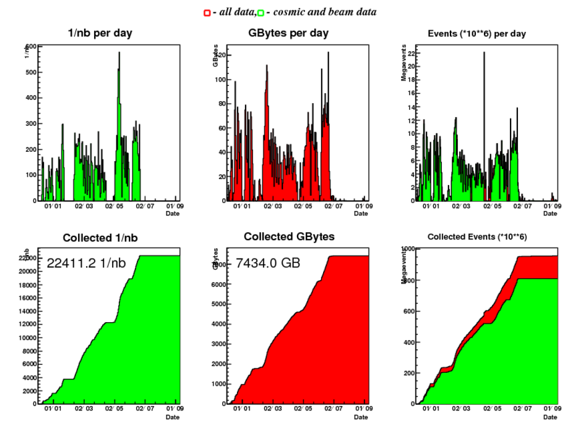
Machine is running well, and detectors are taking data
CMD-3 data collection
We already have
~40-45 pb-1/detector
~20 times to previous e⁺e⁻ experiments, and comparable to ISR data from B-factories.
!!

Slide 43
CMD-3 on-line monitor

Slide 44
Collinear events in CMD-3 (E_{c.m.} = 1.95 GeV)
e⁺e⁻
e⁺e⁻ - used for
luminosity meas.
Currently ~1% syst.
(goal ~0.1%)
cosmic
μ+μ−
π⁺π⁻
P⁻P⁺
K⁺K⁻
We plan precision measurements of the e⁺e⁻ -> P⁻P⁺, K⁺K⁻, π⁺π⁻ processes in all energy range

Slide 45
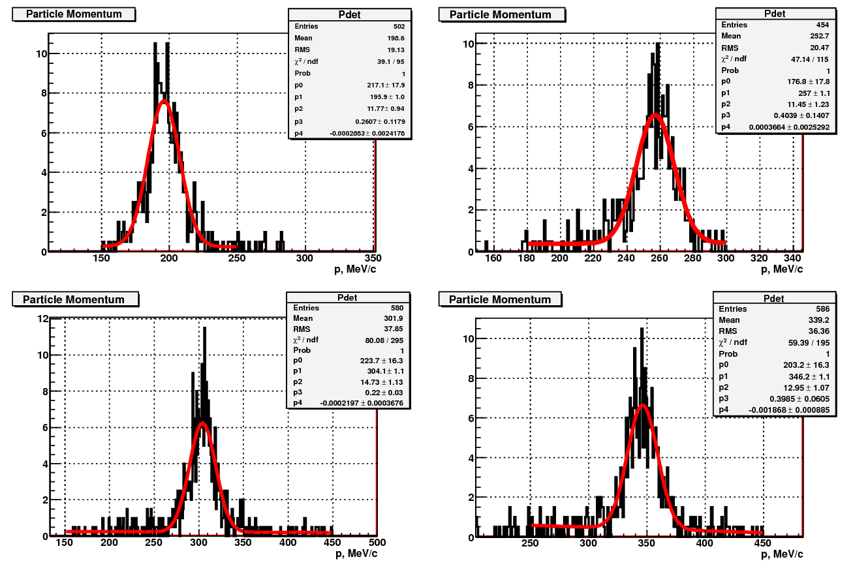
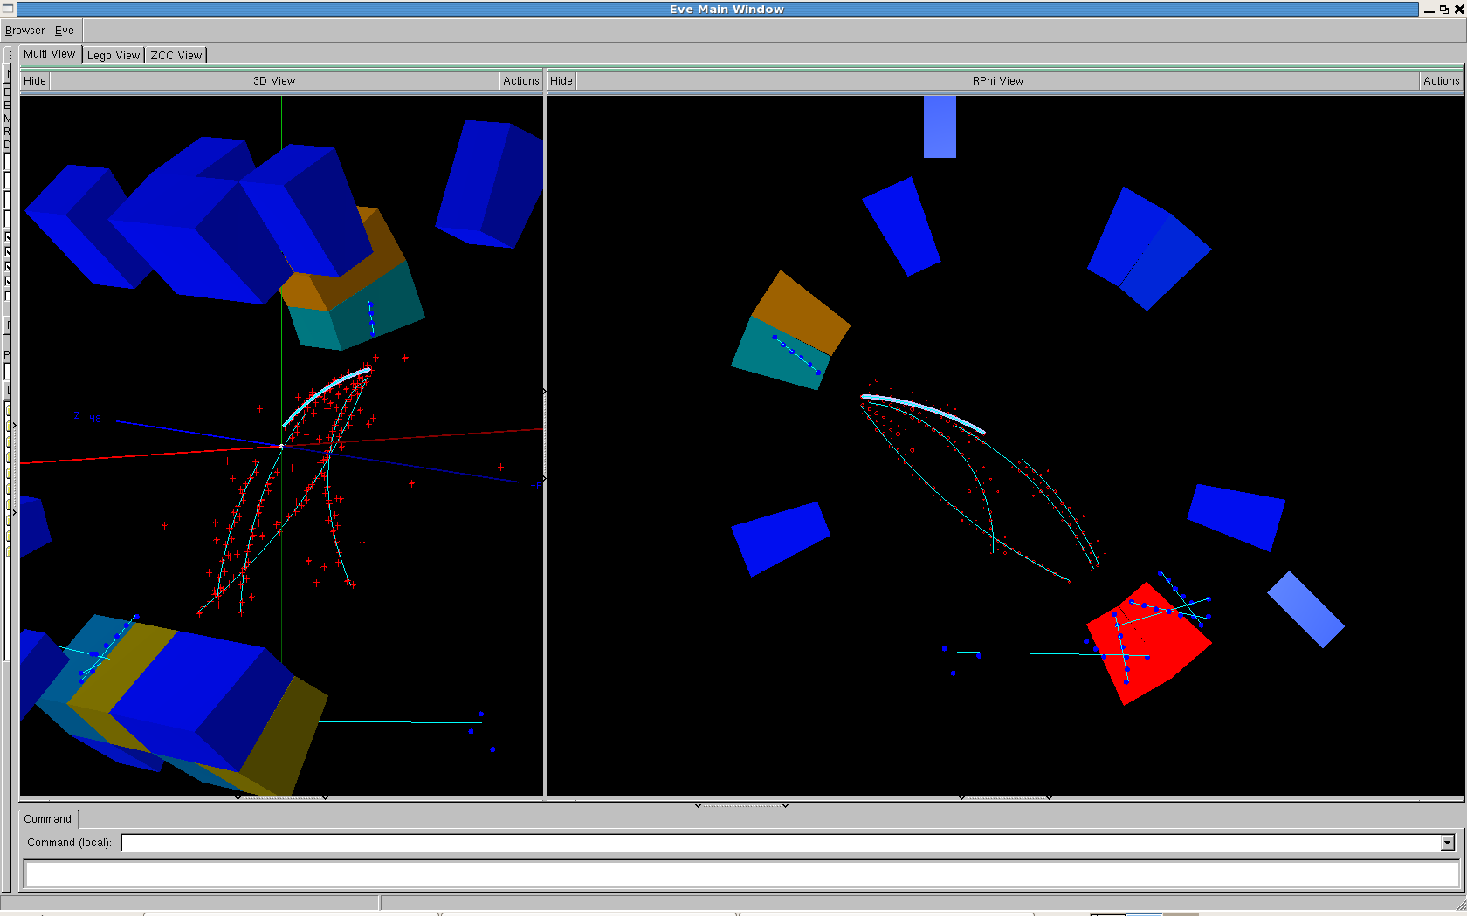
Preliminary results for the e⁺e⁻ -> PbarP study (1)
Number of events from momentum distributions
Clear signature of the PbarP events
Ec.m.=1.95 GeV
Ec.m.=1.925 GeV
Ec.m.=1.975 GeV
Ec.m.=2.0 GeV

Slide 46
Preliminary results for the e⁺e⁻ -> PbarP study (2)
Angular distributions give information for the |GE/GM| ratio:
E=1.93 GeV
E=1.98 GeV
We hope to have more than factor of 10 in statistic

Slide 47
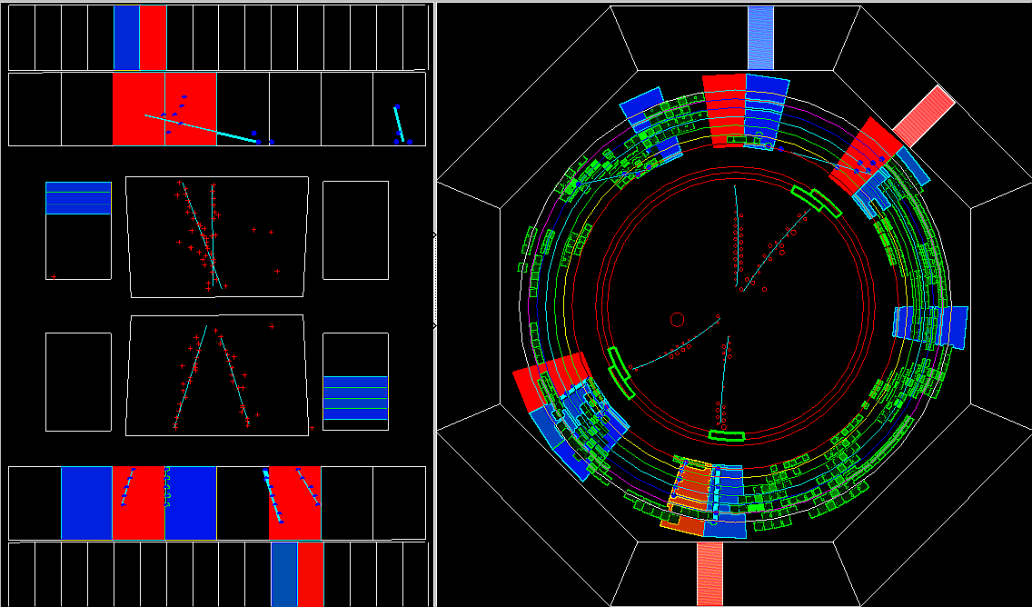
Example of e⁺e⁻ -> 4 charged tracks in CMD-3
Ec.m. = 1.8 GeV
2(π⁺π⁻)(γ)
2(π⁺π⁻)π⁰
K⁺K⁻π⁺π⁻
2(π⁺π⁻)2π⁰

Slide 48
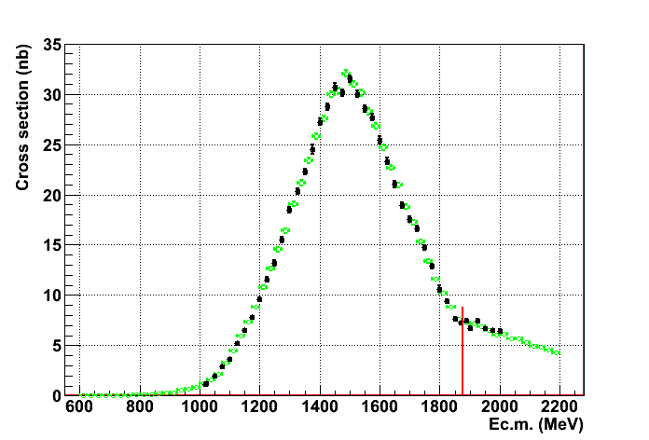
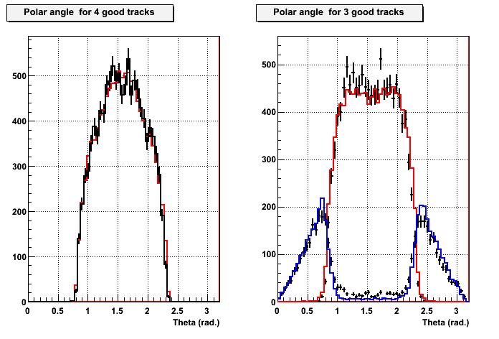
Preliminary results for the e⁺e⁻ -> 2(π⁺π⁻) study
We have relatively clean selection of 4 and 3 charged pions
BaBar
CMD-3
Detected
tracks
PbarP threshold
Missing tracks
Statistical errors are at the level of 1-2% per point.
Systematical errors are under investigation.

Slide 49
Preliminary study of the e⁺e⁻ -> π⁺π⁻π⁺π⁻ process
Preliminary mass distributions study:
E_{c.m.}= 1400 MeV
E_{c.m.}= 1600 MeV
We confirm a₁(1260)π dominance. Some other
states (ρ(770)f₀(600), ρ(770)f₀(980)) are seen,
but small.
E_{c.m.}= 1800 MeV
E_{c.m.}= 2000 MeV
a₁(1260), a₂(1320) ?
ρ(770)

Slide 50
Preliminary study of the e⁺e⁻ -> π⁺π⁻π⁰π⁰ process
Looking for two π⁰ in addition to two charged tracks. The π⁰ efficiency is under investigation.
Preliminary mass distributions study:
f₀(980)
a₁(1260)
ρ(770)
ω(782)
ρ⁻
In addition to dominant ωπ⁰ and a₁π
we see
ρ⁺ρ⁻, ρ(770)f₀(600)?, ρ(770)f₀(980)
ρ⁺
We have statistical errors at the level of 1-2% per point.
Systematical errors are under investigation.

Slide 51
First look to the e⁺e⁻ -> 2(π⁺π⁻)π⁰ process
We look for the π⁰ in addition to four “good” tracks satisfying energy-momentum conservation
f₀(980)
Example of ωf₀(980) signal
In ωπ⁺π⁻ final state.
η(545)
ω(782)
π⁰
Detailed analysis is coming….

Slide 52
Preliminary results for the e⁺e⁻ -> K⁺K⁻π⁺π⁻study
We have very clean selection of the Κ⁺Κ⁻π⁺π⁻ channel.
Ec.m. = 1.8 GeV
πK separation by dEdX in DC
K⁺K⁻π⁺π⁻
ρ(770)
K*(892)
BaBar
CMD-3
Systematical errors are under investigation.

Slide 53
Example of e⁺e⁻ -> π⁺π⁻π⁺π⁻π⁺π⁻ from CMD-3

Slide 54
Preliminary results for the e⁺e⁻ -> 3(π⁺π⁻) study
We have very clean selection of 6 and 5 pions

Slide 55
Preliminary results for the e⁺e⁻ -> 3(π⁺π⁻) study
Preliminary dynamics study: Our acceptance is not 100% and detection efficiency from MC depends on angular distributions of pions. We developed primary generators for few models (talk by P. Lukin) and passed them via CMD-3 simulation and reconstruction procedure.
The have tested: e+e- -> Phase Space,
ρ(1420,1700)f₀(600), (ρ(1240,1700)-> a1(1260)π -> ρ(770)2π)
ρ(770)2(π+π−),
ρ(770)f₀(1370,1500), f₀-> 2(π+π−),
ρ(770)f₂(1270) , f₂-> 2(π+π−),
…..
Examples:
ρ(1420,1700)f₀(600)
ρ(770)f₀(1370,1500)
ρ(770)f₂(1270)

Slide 56
Preliminary results for the e⁺e⁻ -> 3(π⁺π⁻) study
Preliminary dynamics study:
We found that “simple” ρ(770)2(π+π−) or ρ(770)f₀(1370,1500) models well describe observed angular distributions and give correct acceptance. But first describes well mass distributions for Ec.m.=1.6 and 2.0 GeV, but at 1.8 GeV a resonance in 4 pions is needed. (!?)
Production dynamic changes
in 1700-1900 MeV range!

Slide 57
Preliminary results for the e⁺e⁻ -> 3(π⁺π⁻) study
BaBar
CMD-3
Other data for e⁺e⁻ -> 3(π⁺π⁻)
PbarP threshold
Systematic error is 10%

Slide 58
Preliminary results for the e⁺e⁻ -> 2(π⁺π⁻π⁰) study
We have relatively clean selection of 2 and 1 π⁰ in addition to four charged tracks
#1
#2
m_{γγ}, MeV
ωη, φη, ρ4π intermediate states are seen, systematic errors are under study.

Slide 59
Summary
VEPP-4M and KEDR detector continue deliver
precision measurements.
New generation of detectors perfectly matches
the rich physics potential of VEPP-2000.
L~2x10³¹ cm⁻¹sec⁻² has been reached so far – positrons limited. “Unlimited” positron source is in preparation. Hope for X10 in luminosity and statistic.
Both detectors are on the beams and are taking
data: first scan from 1 GeV to 2 GeV with 25 MeV step with ~0.5 pb⁻¹/point was completed in 2011. We scan this region again with smaller step and 1 pb⁻¹/point in 2012. The ρ region scan with precision energy measurement is planned later this year..
First preliminary results are demonstrated.
More results should come soon.

