Slide 1
Bologna meeting 17/7/2012
Front End chip and DAQ Chain
Attendee:
Roberto Beccherle, Mauro Citterio, Filippo Giorgi, Mauro Villa
Goals:
To define the DAQ chain from INSIDE the FE chips to FEB; discussions on options and next steps

Slide 2
Presentations
Filippo: The current digital logic of the chip is shown, together with the simulation results (slides attached down here).
  Critical points: at the moment, the chip requires 6 input lines for programming (3 are actual clock lines); Data output is in parallel (no serialization); there is a 3 bit chip ID, while 4 are needed for HDI with 10 chips.

Slide 3
Presentations II
Mauro V: actual conceptual DAQ chain scheme is shown (slides at the end); ROS geometry is recalled (# of FE chips /HDI); ROS hit rates and chip hit rates are recalled to understand the consequences on the number of serial lines to use.
  Critical points: small dimensions for HDI-TC connections (MC); keep the whole SVT system in sync on critical lines (clock, trigger); we need to have several checks running in background during data taking; data transmission from FEB to FE chips have to be at fixed latency (again clock & trigger).

Slide 4
Discussion and action items
The number of input lines (6) is manageable at the TC level. Reduction to two lines (as in ATLAS FE) therefore is not a priority. It would be interesting to go in that direction together with a redundancy on input lines (raising to 4).
The real priority on the FE chip is therefore the data output serialisation on 1 or 2 lines. RB will study solutions based on the 8b/10b protocol (trying to minimize the changes in the current code).
Chip registers have to be cross checked again: we must ensure that the sync state of the chip can be checked remotely (mandatory for a 2 input line solution).

Slide 5
Discussion and action items II
Possibility to use just one fast clock line is discussed. It will be studied after the serial data transmission (needs interactions with other people and availability of PLL or similar blocks)
Tests on fixed latency protocols will start in september in BO. The system might evolve to a full hardware simulation of few ROS sections (including FEB, TC, HDI and FE chips).
Discussion on optical link type: SFP or SNAP12? While SFP is well suitable for TC, SNAP12 helps to have a compact system at the FEB level. Investigations (MV & MC with F. Bosi) will be performed to understand if there is a possibility to have the two systems.
Power distribution (to HDI) is still an open question. MC will look for solutions.

Slide 8
Strip Chip SuperB
Technical Meeting
Peripheral Logic
F. Giorgi 17-07-2012

Slide 9
Outline
Chip Overview
Clock Domains
Fundamental Blocks
  Trigger Logic
  Sparsifiers
  Barrels
  Concentrators
  Output Stage
Slow Control Interface
Register List

Slide 10
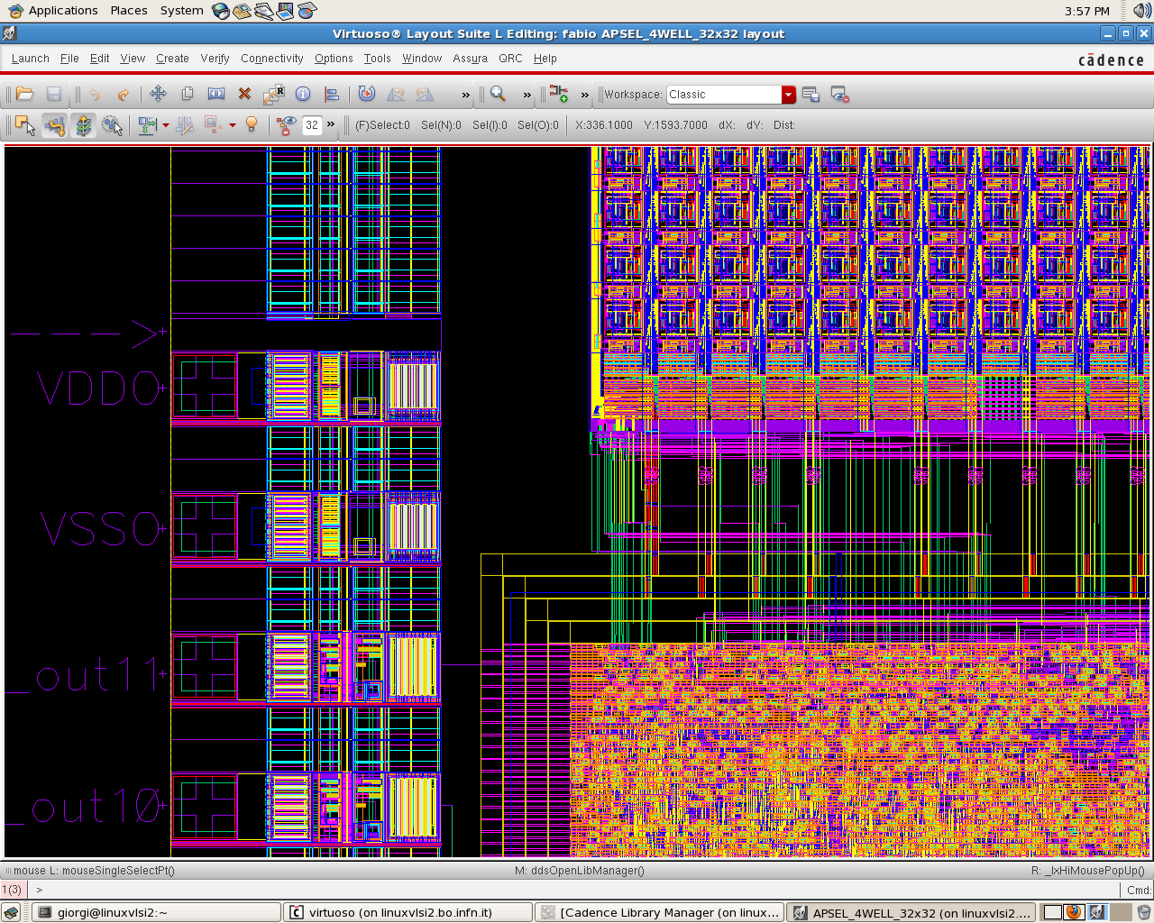

Chip Overview
128 input channels
Analog Front-End:
Pre-amplification
Discrimination
A/D conversion
A
A
A
A
A
A
A
A
A
A
- - - - - - - - - - - - - - - - - - - - - Analog / Digital boundary
D
D
D
D
D
D
D
D
D
D
Digital Hit buffers
Time Stamp
ToT
- - - - - - - - - - - - - - - - - - - - - Trigger0 Selection
Digital Readout:
Control logic
Trigger handling
Hit encoding
Formatted output
Digital output / control pads

Slide 11
Clock List
Real Clocks
  Fast Clock (200 MHz)
  Read Clock (100 MHz)
Pseudo Clocks
  SCL (I2C interface) (~ MHz)
  Bunch Crossing Clock (Time Stamp Clock) (30 MHz)
  ToT clock

Slide 12
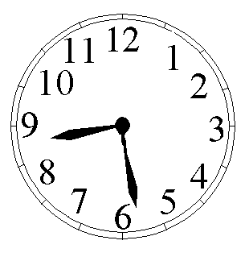

Clock Domains
RDclk
FastClk
Barrel Level 2
Barrel Level 1
32 channels
smart concentrator
Trigger Logic
Sparsifiers
Barrel Level 2
Barrel Level 1
32 channels
Round Robin
smart concentrator
Trigger Logic
Sparsifiers
Barrel Level 2
Barrel Level 1
16 bit
32 channels
smart concentrator
Trigger Logic
Sparsifiers
Barrel Level 2
Common output stage
Barrel Level 1
32 channels
smart concentrator
Trigger Logic
Sparsifiers
Time counter

Slide 13
Fundamental Blocks: Trigger Logic
Trigger Logic
Tasks
  External trigger handling
  Polls pre-trigger buffers for hits at a given Time Stamp
  Read/Delete hits in pre-trigger buffers (depending on ext. trigger)
  Generate Test Stimuli
Technical details
  Fan-in: ext. Trigger, TS, Trig. Latency,
  Fan-out:
    to sparsifiers : Start of Scan interrupt
    To pre-trigger buffers: Requested TS, read enable, clear
Working principle:
  Polls continuously pre-trigger buffers with consecutive TS. Each TS is demanded with a delay = Trig. Latency w.r.t current TS.
  If a TS was triggered → relative hits are read out
  Else → relative hits are cleared

Slide 14
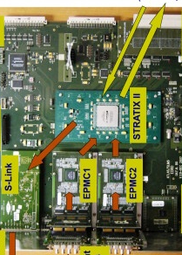
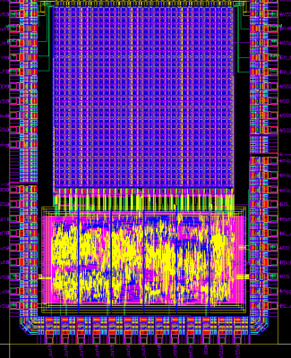
Trigger handling
External electronic boards process primary trigger signals.
Pre-processed triggers are sent to front-end electronics.
  Fixed trig. latency on chip → configured at start-up
  → Simpler on-chip trigger logic
  Rely on re-configurable logic on external boards for more complicate algorithms.
One-wire trigger to FE chips.
BC
Trigger
Close triggers
DAQ boards
TS
TS0
TS1
TS2
TS3
TS4
TS5
TS6
TS7
TS8
TS9
TS10
BC
Chip trigger synchronous to BC clock.
TS
TS0
TS1
TS2
TS3
TS4
TS5
TS6
TS7
TS8
TS9
TS10
FE chips
TS-LATENCY
TS0
TS1
TS2
TS3
TS4
TS5
TS6
TS7
TS8
e.g. latency = 2 BC
Pre-proc. trig.
Data out ……
TS1
TS2
TS3
TS5
TS6
TS7
TS8

Slide 15
Fundamental Blocks: Sparsifier
Tasks
  Encode hit address / ToT
  Add Time Stamp Words in the data-stream
Technical details
  Fan-in: 8 Strip channels (8-bit/channel + Start of Scan interrupt)
  Fan-out: 8-word bus (+ handshake)
  Latency: 1 RDclk period
Working principle:
  If Start of Scan interrupt is asserted
  → insert in data-stream a Time Stamp Word
  Else
    → if at least 1 bit in any channel is active
      → Puts the 8-bit of those channels & encoded strip address in output

Slide 16
Fundamental Blocks: Barrel
Tasks
  Check-in all encoded words produced by sparsifier simultaneously
  Keep them stored until requested by next block (concentrator)
Technical details
  Fan-in: 8 word data bus (+ handshake)
  Fan-out: 1 word bus (+ handshake)
Working principle:
  FIFO memory with 8 write pointers and 1 read pointer.

Slide 17
Fundamental Blocks: Concentrator
Tasks
  Read in parallel the words from level 2 barrels
  Add further address bits to extracted hit words
  Merge 4 Time Stamp Words (same TS) into 1
  Store words in next level 1 barrel preserving TS order.
Technical details
  Fan-in: 4 word data bus (+ handshake)
  Fan-out: 1 word bus (+ handshake)
Working principle:
  Concentrate data streams from level-2 barrels into level-1 barrels.

Slide 18
Fundamental Blocks: Output Stage
Tasks
  Read in round robin the words from level 1 barrels
  Add readout addr. to extracted Time Stamp words
  Put words on the parallel output bus.
Technical details
  Fan-in: 4 word data bus (+ handshake)
  Fan-out: 1 word bus (+ handshake)
Working principle:
  Read all the hit words related to a Time Stamp from 1st channel, then move to next channel with a round robin algorithm.

Slide 19
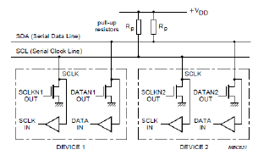
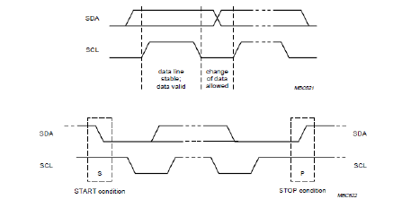
Slow Control Interface (1)
2–wire control (I2C-like)
  SDA + SCL

Slide 20
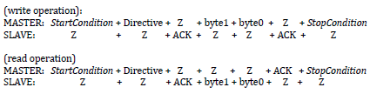
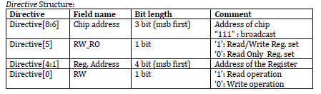
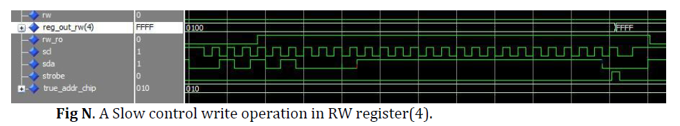
Slow Control Interface (2)
ACK = pull down the line

Slide 21
Register List: Read Only
Address | Name | Code Name | Used bits
0x00 | RESERVED | MSK_COUNTER1_0 | -
0x01 | RESERVED | MSK_COUNTER3_2 | -
0x02 | Error Flags | ERROR_FLAGS | [see details]
0x03 | Hit Rate | HIT_RATE | [15:0]
0x04 | B2_full_latch0 | BCLOST_COUNT0 | [3:0]
0x05 | B2_full_latch1 | BCLOST_COUNT1 | [3:0]
0x06 | B2_full_latch2 | BCLOST_COUNT2 | [3:0]
0x07 | B2_full_latch3 | BCLOST_COUNT3 | [3:0]
0x08 | B1_fill_level0 | B1_FILL_LEVEL0 | [7:0]
0x09 | B1_fill_level1 | B1_FILL_LEVEL1 | [7:0]
0x0A | B1_fill_level2 | B1_FILL_LEVEL2 | [7:0]
0x0B | B1_fill_level3 | B1_FILL_LEVEL3 | [7:0]
0x0C | B1_mean_fill0 | B1_MEAN_FILL0 | [15:0]
0x0D | B1_mean_fill0 | B1_MEAN_FILL1 | [15:0]
0x0E | B1_mean_fill0 | B1_MEAN_FILL2 | [15:0]
0x0F | B1_mean_fill0 | B1_MEAN_FILL3 | [15:0]
bits | meaning
[1:0] | Output Stage Err.
[5:2] | B1s overflow
[7:6] | Concentrator0 Err.
[9:8] | Concentrator1 Err.
[11:10] | Concentrator2 Err.
[13:12] | Concentrator3 Err.

Slide 22
Register List: Read /Write
Address | Name | Code Name | Used bits
0x00 | Command Register | COMMAND_REGISTER | [15:0]
0x01 | Operand | OPERAND | [15:0]
0x02 | Configurations 0 | CONFIG0 | [see details]
0x03 | UNUSED | CONFIG1 | -
0x04 | Out. Stage Timeout | FLUSH_TIMEOUT | [15:0]
0x05 | Trigger latency (BC units) | TRIGGER_LAT | [7:0]
0x06 | UNUSED | - | -
0x07 | UNUSED | - | -
0x08 | UNUSED | - | -
0x09 | UNUSED | - | -
0x0A | UNUSED | - | -
0x0B | UNUSED | - | -
0x0C | UNUSED | - | -
0x0D | UNUSED | - | -
0x0E | UNUSED | - | -
0x0F | UNUSED | - | -
bits | meaning
[1:0] | Unused
[3:2] | Clk ratio (fast/read -1)
[5:4] | Keep set to 0.
[9:6] | Rate range
[11:10] | Clk phase sel.
[12] | Enable TC
[13] | Trig. mode (set 1)

Slide 23
Missing:
Serial output
IO pins reduction?

Slide 25
Bologna meeting
17/7/2012
M. Villa

Slide 26
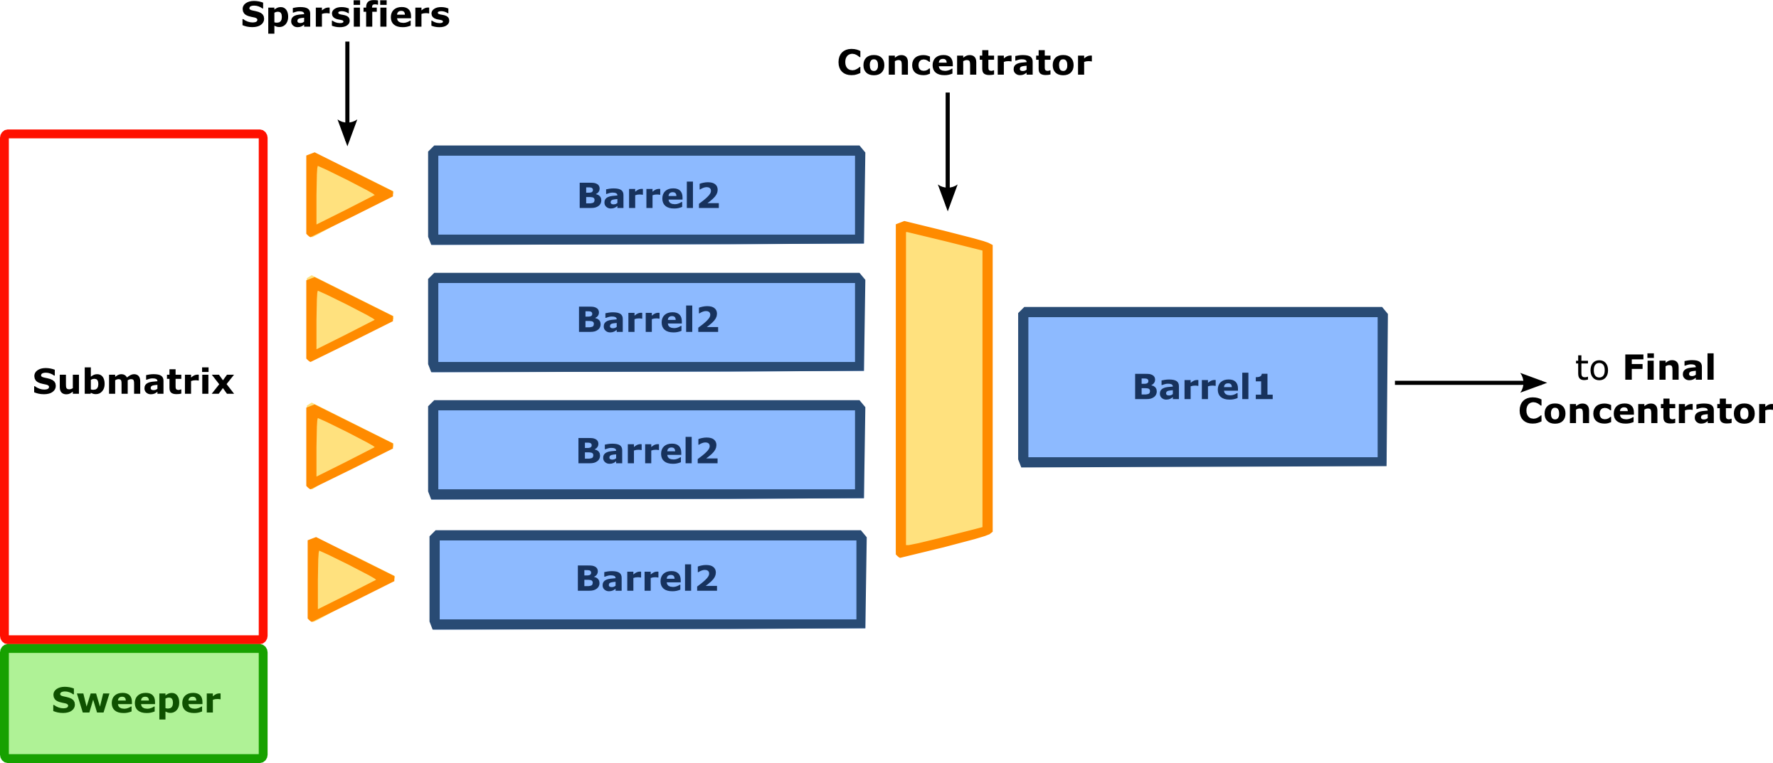
Strip readout architecture under development
BOLOGNA pixel-like hit extraction architecture
Pre-trigger buffer array
PISA
Sparsifiers
strip #127
FE
4 bit
ToT
Ctrl
logic
Buf
#k
...
Buf
#1
~hit_rate * trig_latency
strip #0
FE
4 bit
ToT
Ctrl
logic
Buf
#k
...
Buf
#1
BUF #1
Triggered hits only
readout/slow control
How many buffers?
How many barrels?
Asynchronous logic assumed:
Triggered event size not known a-priori
(thus readout time as well)
3/21/2012
F. Giorgi – 3rd SuperB Collaboration Meeting - Frascati
26

Slide 27
Strip readout chip simulations
Strip FE architecture defined, modeled and simulated.
Digital readout efficiency measured value (simulations)
  ~100% with buffer depth = 32
2 MHz/strip : Layer 0
buffer size | 16 | 32 | 64
buffered hits | 3.8 M | 12.9 M | 12.9 M
of which triggered | 23363 | 76850 | 23363
output triggered hits | 14679 | 76849 | 23363
triggered hit lost | 8684 | 1 | 0
Efficiency (%) | 62.8 | 99.9987 | 100
Buffer Depth Scan
760 kHz/strip : Layer 1
buffer size | 8 | 16 | 32
buffered hits | 1.4 M | 7 M | 7 M
of which triggered | 8748 | 28829 | 28829
output triggered hits | 6788 | 28825 | 28829
triggered hit lost | 1960 | 4 | 0
Efficiency (%) | 77.6 | 99.986 | 100
F. Giorgi

Slide 28
Digital periferical logic blocks
Progs, Triggers, clocks:
  Embedded in the readout architecture and actually part of it. It allows the trigger latency control, clock handling, channel masking, running
Serializer Interface:
  Sends out data (16 bits wide) on a programmable number of lines (1, 2, 4, 6)
  Protocol (8b/10b?) and implementation to be defined.
Analog and buffers
Barrels and
readout
✔
Progs,
Triggers
clocks
Serializer

Slide 29
Clock, Trigger, Registers
Current set-up is flexible → 7 I/O programming lines
6 inputs: Reset, Clock (60MHz), FastClock (180 MHz?),Timestamp, Trigger, RegIn
1 Output: RegOut
NB: SuperB trigger protocol not yet defined
Contr: no redundancy
Minimal number of lines:
  2 inputs: FastClock (180 MHz?), RegIn
  1 output: RegOut
Requires assumptions on trigger protocol
Clock, Timestamp and triggers have to be in sync on the whole system!

Slide 30
Two line command implementation
A fast clock line (180 MHz) and a programming line
Slow clock (60 MHz) produced internally with known phase
I2C like commands sent with the programming line to
  Reset & smart reset the chips
  Fine-tune the 60 MHz phase
  Program masks and internal registers
  Define the timestamp period (slow clock period units)
  Define the start of the time stamp clock
  Define the trigger latency
  Monitor phases of clocks, time-stamps, rates, statuses
  define the acquisition window in time-stamp units
  (start and lenght variable) for each FTCS trigger.

Slide 31
Two line command implementation -cnd
Need a feedback for phase alignments:
  A broadcast command to freeze a time-stamp, clock, phase
  A single chip command to read the frozen data.
  Commands to restart the time-stamp, clock, phase, … whatever without stopping the DAQ
  Smart resets
    to cleanup the FSM but not the programming registers;
    To cleanup the daq fifos….

Slide 32
Trigger handling in SVT
Absolute time
0 2 4 6 8
10 12 14 16 18
20 22 24 26 28
30 32 34 36 38
FTCS trigger
time stamping
time stamping after trigger latency
FTCS trigger
TS 3 to 8
TS 21 to 26
Trigger to chip
0 2 4 6 8
10 12 14 16 18
20 22 24 26 28
30 32
Hits acquired
Shipping the trigger to FE chips require the knowledge of the time stamp

Slide 33
Layer | layer Type | Chip/ROS | Avai chans | back. rate MHz/ cm2 (safety = 5) | Hits in BCO | Occupancy in BCO | Grouping | Triggered Gbit/s/GROS | FE Boards | Event Size (hits)
0 | Striplet u | 6 | 768 | 230 | 50.2 | 6.54% | 1 | 1.51 | 3 | 8037
0 | Striplet v | 6 | 768 | 230 | 50.2 | 6.54% | 1 | 1.51 | 3 | 8037
1 | Strip z | 7 | 896 | 10.31 | 13.6 | 1.52% | 1 | 0.41 | 1 | 1637
1 | Strip phi | 7 | 896 | 14.97 | 19.8 | 2.21% | 1 | 0.59 | 1 | 2377
2 | Strip z | 7 | 896 | 6.88 | 12.9 | 1.44% | 1 | 0.39 | 1 | 1550
2 | Strip phi | 7 | 896 | 8.81 | 16.5 | 1.85% | 1 | 0.50 | 1 | 1985
3 | Strip z | 10 | 1280 | 2.994 | 12.0 | 0.94% | 1 | 0.36 | 1 | 1438
3 | Strip phi | 6 | 768 | 2.35 | 9.4 | 1.22% | 1 | 0.28 | 1 | 1129
4a | Strip z | 5 | 640 | 0.218 | 1.0 | 0.15% | 2 | 0.20 | 1 | 1038
4a | Strip phi | 4 | 512 | 0.337 | 1.5 | 0.30% | 2 | 0.30 | 1 | 1605
4b | Strip z | 5 | 640 | 0.218 | 1.0 | 0.16% | 2 | 0.20 | 1 | 1075
4b | Strip phi | 4 | 512 | 0.337 | 1.6 | 0.31% | 2 | 0.31 | 1 | 1662
5a | Strip z | 5 | 640 | 0.114 | 0.6 | 0.10% | 2 | 0.13 | 1 | 769
5a | Strip phi | 4 | 512 | 0.159 | 0.9 | 0.18% | 2 | 0.18 | 1 | 1073
5b | Strip z | 5 | 640 | 0.114 | 0.7 | 0.10% | 2 | 0.13 | 1 | 793
5b | Strip phi | 4 | 512 | 0.159 | 0.9 | 0.18% | 2 | 0.18 | 1 | 1106
172 GROS, 204 1-Gbps links, 20 FEBoards, <88 kB/evento

Slide 34
Maximum data lines per chip
 |  | Max HIT strip rate (kHz) | DAQ Time window (us) | Hits/ chip per Trig. | Words per chip per trigger | Bits per chip per trig. | bandwidth (Mbit/s) | Lines at 60 MHz | Lines at 120 MHz | Lines at 180 MHz | Chip/ROS
L0 | U | 2000 | 0.3 | 76.8 | 86.8 | 1736.0 | 260.4 | 6 | 3 | 2 | 6
L0 | V | 2000 | 0.3 | 76.8 | 86.8 | 1736.0 | 260.4 | 6 | 3 | 2 | 6
L1 | Z | 727 | 0.3 | 27.9 | 37.9 | 758.3 | 113.8 | 3 | 2 | 1 | 7
L1 | PHI | 1445 | 0.3 | 55.5 | 65.5 | 1309.8 | 196.5 | 4 | 2 | 2 | 7
L2 | Z | 697 | 0.3 | 26.8 | 36.8 | 735.3 | 110.3 | 3 | 2 | 1 | 7
L2 | PHI | 960 | 0.3 | 36.9 | 46.9 | 937.3 | 140.6 | 3 | 2 | 1 | 7
L3 | Z | 676 | 0.3 | 26.0 | 36.0 | 719.2 | 107.9 | 3 | 2 | 1 | 10
L3 | PHI | 775 | 0.3 | 29.8 | 39.8 | 795.2 | 119.3 | 3 | 2 | 1 | 6
L4 | Z | 204 | 1 | 26.1 | 36.1 | 722.2 | 108.3 | 3 | 2 | 1 | 5
L4 | PHI | 195 | 1 | 25.0 | 35.0 | 699.2 | 104.9 | 3 | 2 | 1 | 4
L5 | Z | 133 | 1 | 17.0 | 27.0 | 540.5 | 81.1 | 2 | 1 | 1 | 5
L5 | PHI | 135 | 1 | 17.3 | 27.3 | 545.6 | 81.8 | 2 | 1 | 1 | 4
Lines/ROS at 180 MHz
12
12
7
14
7
7
10
6
5
4
5
4
1,2,4 lines per chip usable at 120 MHz on all SVT
14 lines per module max at 180 MHz (16 bits serializers)

Slide 35
DAQ reading chain for L0-L5
DAQ chain independent on the chosen FE options
Optical 1 Gbit/s
Example of a read-out section
Front-end chips
Optical Link
2.5 Gbit/s to ROM
UPILEX+Cu (?)
FEB
C
Copper bus
Serdes
or FPGA
ROM
Detector
fibers
HDIs
~1-2 m
Transition card
LV1
High rad area 15Mrad/year
Off detector
low rad area
Counting room
Std electronics
Data Encoder IC .... Specs are under discussion
Rad-hard serializer to be finalized
→ looking into a low power/low speed version
Copper tail: lenght vs data transfer to be studied
35

Slide 36
FEB Board functionalities
36
FE chip clock, timestamp and trigger signals distribution
  Check and keep FE chips (>1600) in sync !
Configure FE chips (MB of data to upload), provide calibration mechanisms
Convert SuperB LVL1 signal to SVT trigger signal (timestamp aware)
Acquire FE hits, provide a first data compression
  TS stripping, hit packing (clusterization?)
Send data to ROM
HW monitoring of data

Slide 37
SuperB-FEB Board schematics
Gb ethernet
Large FPGA
DAQ link 2.5 Gbit/s
VME FPGA
Or uCPU
VME!
L1/Spare DAQ link
4x1 Gbit/s FE links
FCTS interface
Small FPGA
4x1 Gbit/s FE links
ECS interface
Memory
Small FPGA
Planning
For changes
And extensions
4x1 Gbit/s FE links
Small FPGA
FCTS protocol to be decided experiment-wide
Large FPGA for data shipping and monitoring
VME FPGA or uCPU might be included in the large FPGA.
37

Slide 38
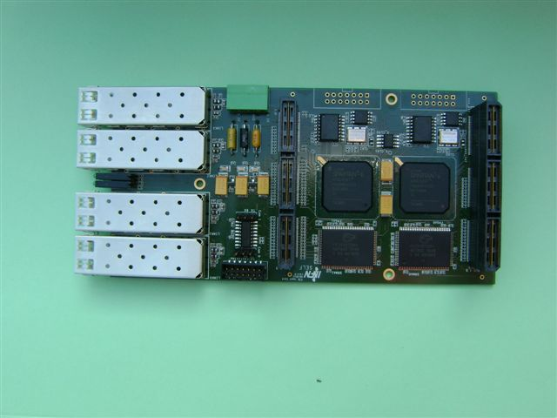
Input mezzanines
Input optical links on mezzanines to easy future upgrades
4 1-Gbps optical link mezzanine compatible with EDRO available for tests
2 Small FPGA (spartan) and memory on board
38

Slide 39
Hardware simulations ??
TC+ROS
TC+ROS
FEB1
FEB2
Prototype DAQ
Board
TC+ROS
TC+ROS
Risposte su:
Protocollo trasmissione clock,
TS, trigger
Tests slow control chip FE
Simulazioni Chips e TC
39

