Slide 1
Hit time resolution study
L. Ratti
Università degli Studi di Pavia
INFN Pavia
SVT-TDR phone meeting, 13/07/2012

Slide 2
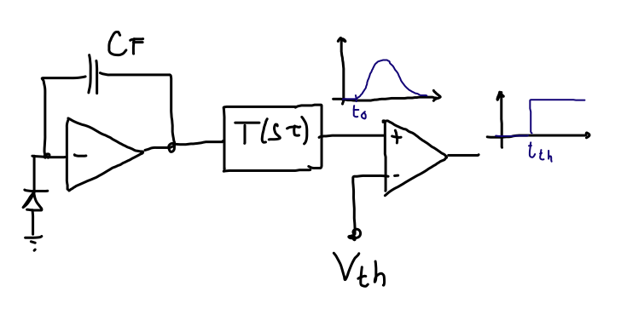
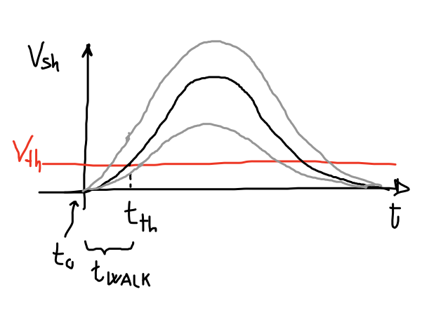
Hit time estimation
Consider a readout channel with threshold discrimination
The time of arrival of a particle, t₀ (corresponding to the signal start time, drift time of the charge in the detector is considered negligible), can be estimated if t_{th} and t_{walk} are known
with t_{th} the threshold crossing time and t_{walk} the time needed by the signal to reach the threshold (depending on the signal amplitude and, in turn, on the input charge). Actually
t_{th} can be measured with the sensitivity provided by the time stamp clock
t_{walk} can be estimated based on the amplitude measurement, whose accuracy depends on the TOT clock and on the shaping function
both measurements are affected by noise sources in the system

Slide 3
Time resolution simulations
Simulations performed with Wolfram Mathematica by means of purely statistical methods (no time transients involved)
Simulation input:
delta response of the channel + peaking time
discriminator threshold
time stamp clock period (T_{CK,TS})
TOT clock period (T_{CK,TOT})
event energy distribution (MPV and sigma for a Landau distribution)
noise

Slide 4
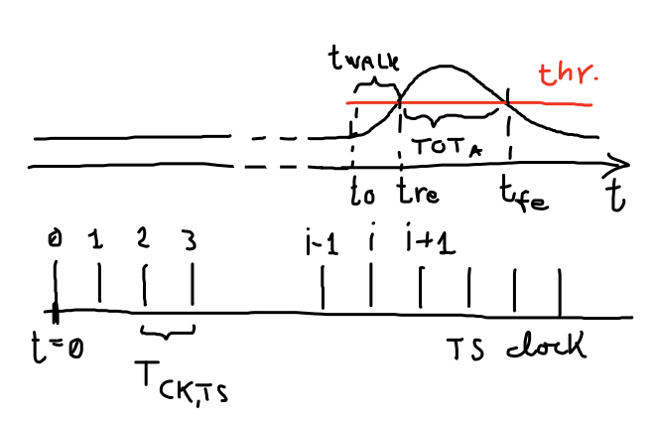
Time resolution simulations – time stamp
A random charge signal with Landau distribution is generated
The TS clock is assumed to start at t=0
t₀ is a uniformly distributed random time
If t_{re} (rising edge time of the discriminator) falls between the i-th and the (i+1)-th TS clock pulse, then TS=i=IntegerPart[t_{re}/T_{CK,TS}] and the best estimate of the time stamp is (i+0.5)xT_{CK,TS}

Slide 5
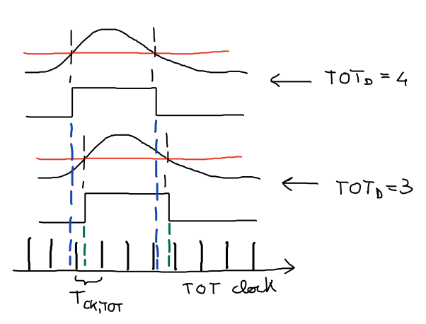
Time resolution simulations – TOT counts
The same TOT interval (TOT_{A}) may result in the count TOT_{D} of j or j+1 TOT clock pulses, depending on the relative position of the signal with respect to the TOT clock (TOT_{A}=3.1T_{CK,TOT} is more likely to result in 3 counts than in 4, TOT_{A}=3.9T_{Ck,TOT} is more likely to result in 4 counts than in 3)
A sort of acceptance-rejection method is applied to account for the effect of the random phase on TOT_{D}:
  a random number 0<r<1 is generated
  if FractionalPart[TOT_{A}/T_{CK,TOT}]<r →TOT_{D}=IntegerPart[TOT_{A}/T_{CK,TOT}], else TOT_{D}=IntegerPart[TOT_{A}/T_{CK,TOT}+1]

Slide 6
Distribution of TOT_{A} contributing to TOT_{D}=j
Only (j-1)T_{tot}<TOT_{A}<(j+1)T_{tot} can contribute to TOT_{D}=j
TOT_{A} close to (j-1)T_{CK,TOT} and (j+1) T_{CK,TOT} are much less likely to contribute to TOT_{D}=j
TOT_{A} close to jT_{CK,TOT} have probability close to 1 to result in j TOT counts
This was not accounted for correctly in previous studies, leading to an overestimation of the time walk contribution to hit time resolution

Slide 7
Time resolution definition
For the k-th of the N total simulated events, given the time stamp TS_{k} and the TOT count TOT_{D,k}, the error Δt_{err,k} in t₀ reconstruction is defined as
where
t_{0,est,k} is the estimated hit time for the k-th event
t_{walk}(TOT_{D,k}) is the estimated time walk as a function of the TOT count for the k-th event
The hit time resolution is defined as the standard deviation of the distribution of the errors Δt_{err,k}, k=1,…,N

Slide 8
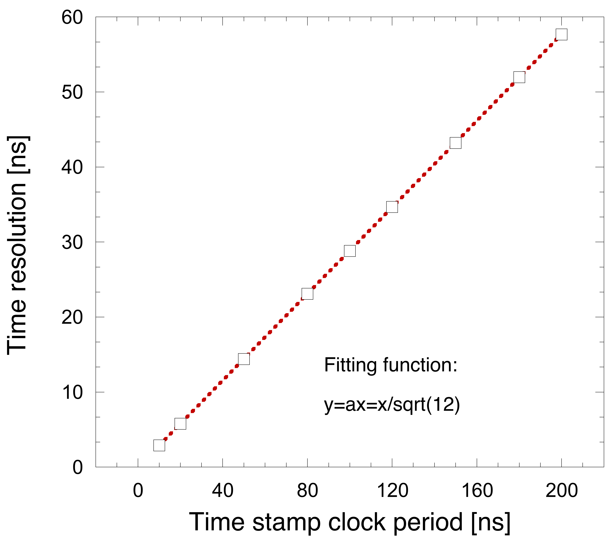
TS contribution to time resolution
Case of a TS frequency of 25 MHz; the event time reconstruction error is uniformly distributed between -20 ns and 20 ns
σ_{t0}=11.5 ns
Not surprisingly, the TS contribution to hit time resolution is T_{CK,TS}/sqrt(12)

Slide 9
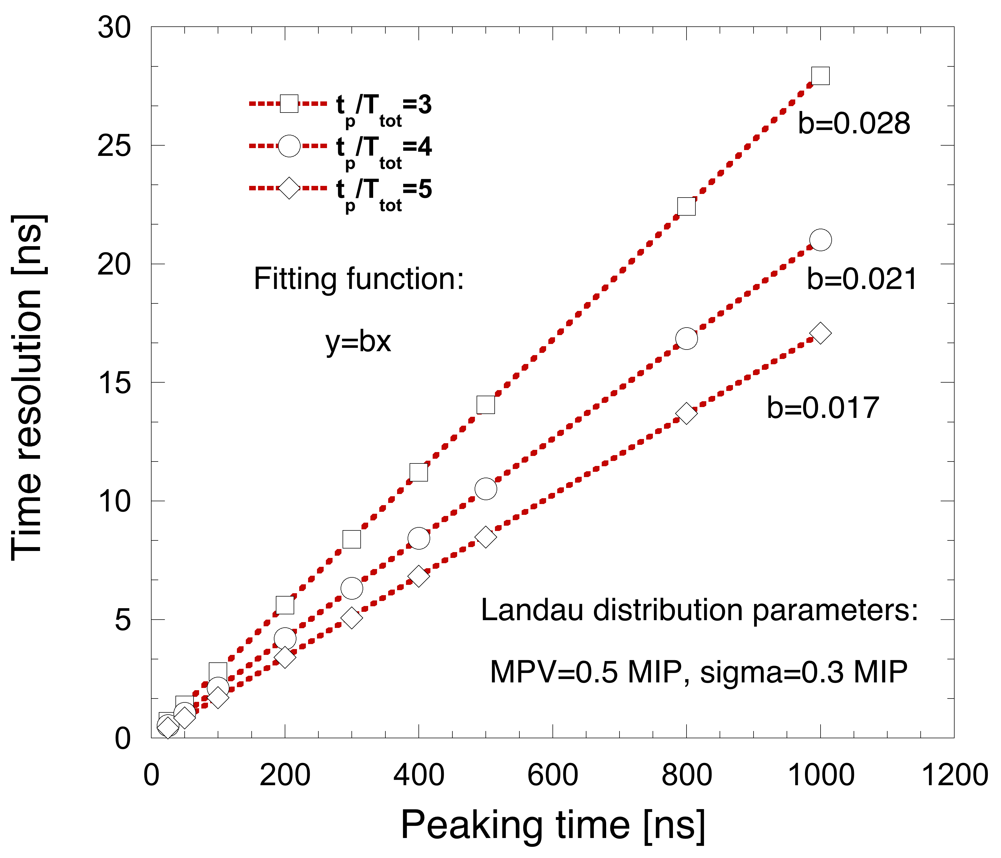
Time walk contribution to hit time resolution
Distribution of the event time reconstruction error in the case of t_{p}=100 ns and t_{p}/T_{CK,TOT}=4
σ_{t0}=2.1 ns
If represented as a function of the peaking time, the time walk contribution to time resolution depends on the t_{p}/T_{CK,TOT} ratio

Slide 10
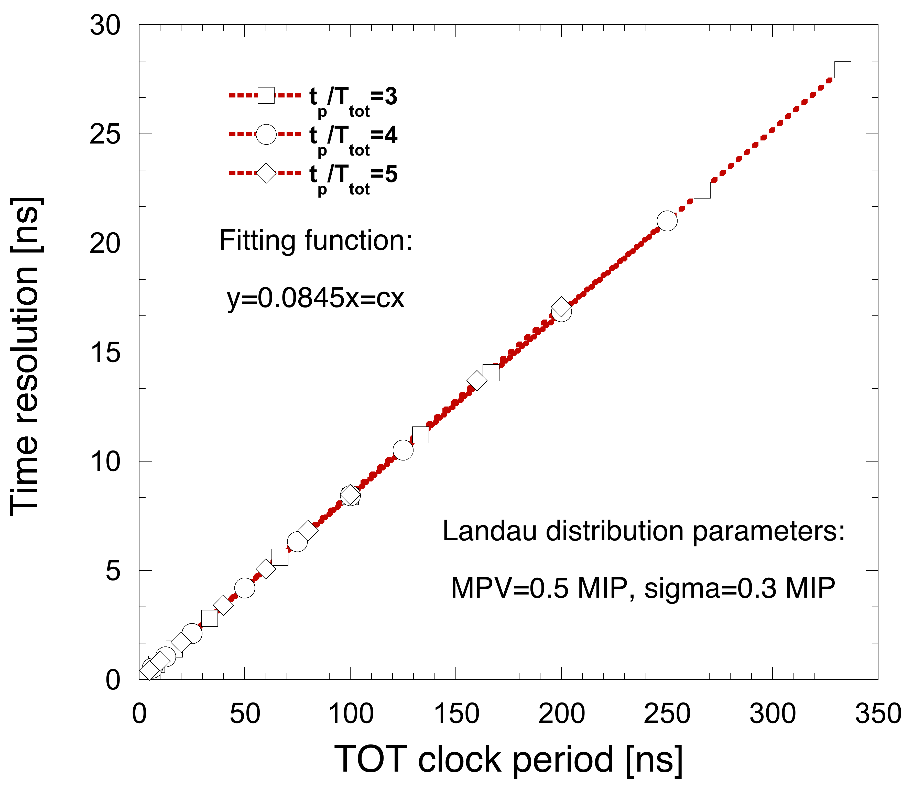
Time walk contribution to hit time resolution
If represented as a function of the TOT clock period (T_{Ck,TOT}), the time walk contribution to time resolution does not depend on the t_{p}/T_{CK,TOT} ratio

Slide 11
Hit time resolution (TS and time walk)
The following equation
is found to be consistent with results from simulations including contributions from both time stamp and time walk
σ_{t0}=21 ns
Distribution of the event time reconstruction error in the case of t_{p}=400 ns, t_{p}/T_{CK,TOT} =4 and TS=40 ns

Slide 12
Noise contribution to hit time resolution
Simulations have also been performed including noise effects
for each event, two random charge samples with Gaussian distribution and sigma=ENC are generated (fully uncorrelated noise); one sample is subtracted from the threshold when calculating t_{re}, the other when calculating t_{fe}
Distribution of the event time reconstruction error in the case of t_{p}=400 ns, t_{p}/T_{CK,TOT} =3 and TS=66 ns

Slide 13
Hit time resolution including noise effects
Layer | t_{p} [ns] | t_{p}/T_{CK,TOT} | f_{CK,TS} [MHz] | ENC (no rad effects) [e⁻ rms] | σ_{t0} (w/o noise) [ns] | σ_{t0} [ns]
0 u | 25 | 4 | 30 | 892 | 9.6 | 9.8
0 v | 25 | 4 | 30 | 893 | 9.6 | 9.8
1 z | 75 | 4 | 30 | 1106 | 9.8 | 10.6
1 phi | 75 | 4 | 30 | 697 | 9.8 | 10
2 z | 100 | 4 | 30 | 1070 | 9.9 | 11.1
2 phi | 100 | 4 | 30 | 660 | 9.9 | 10.3
3 z | 150 | 4 | 30 | 864 | 10.1 | 11.9
3 phi | 150 | 4 | 30 | 669 | 10.1 | 11.2

Slide 14
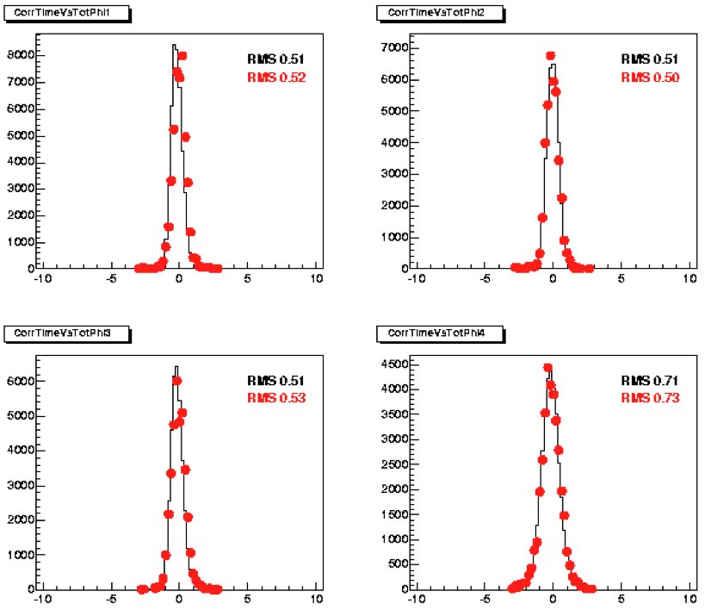
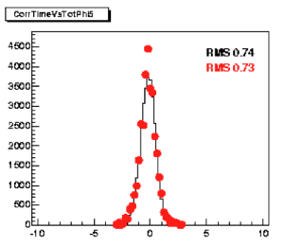
BaBar data (phi layers)

Slide 15
Comparison with BaBar results
Layer | t_{p} [ns] | t_{p}/T_{CK,TOT} | f_{CK,TS} [MHz] | ENC (no rad effects) [e⁻ rms] | σ_{t0} (w/o noise) [ns] | simulated σ_{t0} [ns] | measured σ_{t0} [ns]
3 phi | 200 | 3 | 15 | 1700 | 20.1 | 24.5 | ~35
5 phi | 400 | 3 | 15 | 1200 | 22.3 | 30.8 | ~50
To reproduce time resolution measurements in BaBar (holds also for SuperB SVT)
event energy distribution (MPV and sigma in the case of a Landau distribution)
actual threshold during detector operation
some numbers for the noise in the different layers (found several, slightly different figures), possibly from measurements; noise may depend from the absorbed dose, so numbers may change significantly depending on the time spent in the experiment
real TOT vs Q relationship, accounting for output range limitations in the shaper and non linearities in the transconductors (look up table, or empirical interpolating function)

