Slide 1
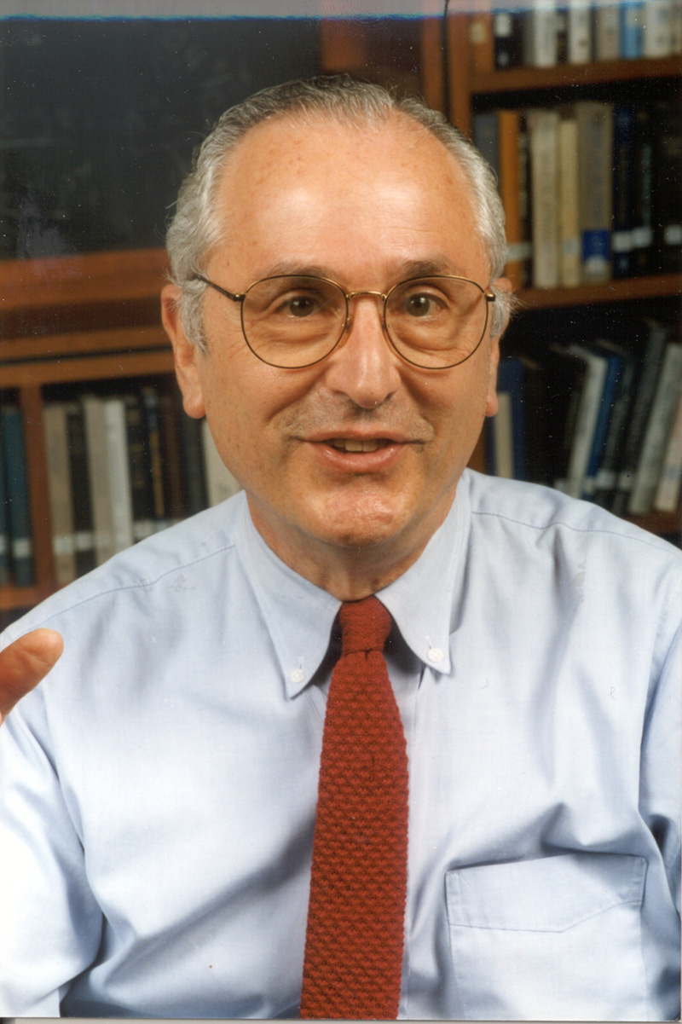

Slide 2
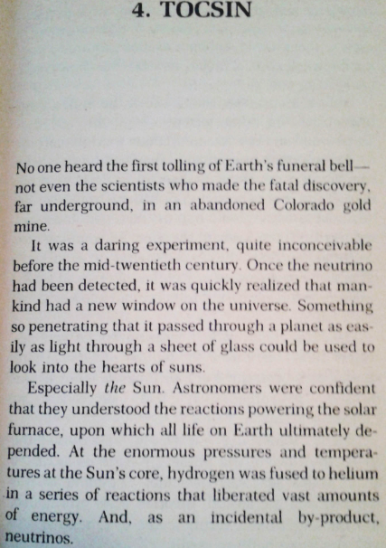
My first contact with John’s work in
the early 90s
No one heard the first tolling of Earth’s funeral bell – not even the scientists who made the fatal discovery, far underground, in an abandoned Colorado gold mine.
Especially the Sun. Astronomers were confident that they understood the reactions powering the solar furnace, upon which all life on Earth ultimately depended.
“The Songs of the Distant Earth”
by Arthur C. Clarke

Slide 3
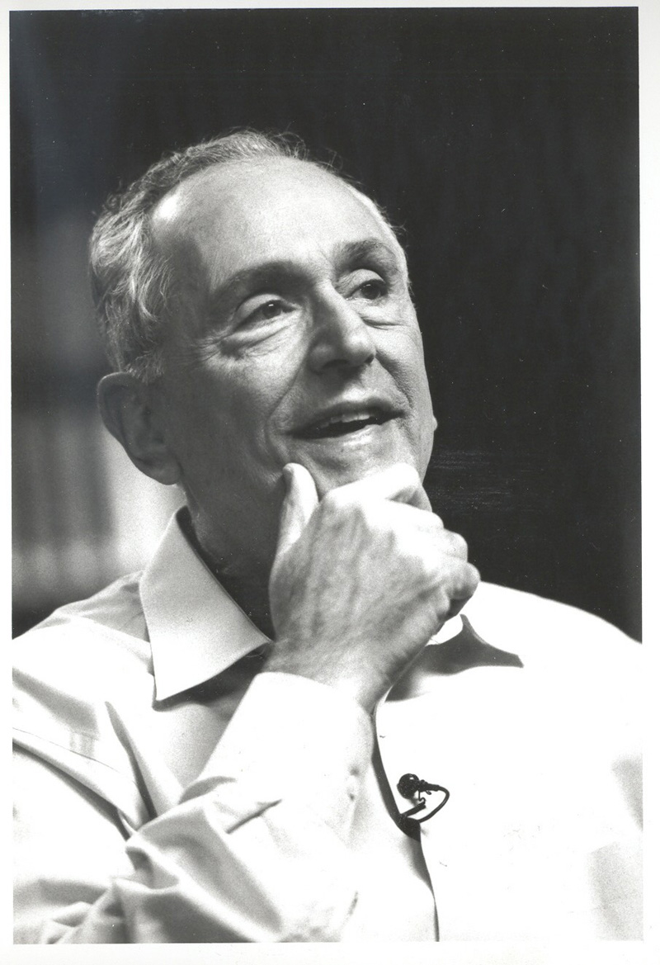
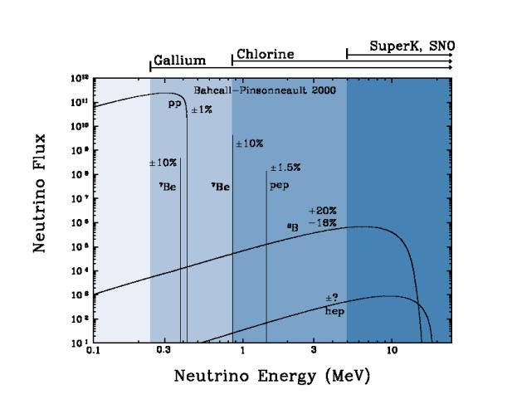
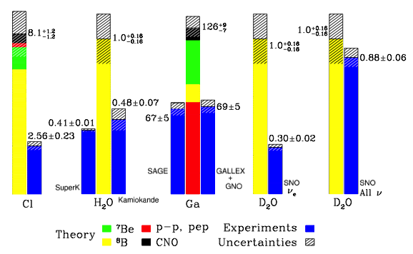
Direct contact with John’s work at his ESO colloquium in 2003
The Earth had been saved and...
by the way, theory of stellar evolution confirmed and
neutrino oscillations discovered
Bahcall – Pinsonneault 2000 & SNO

Slide 4
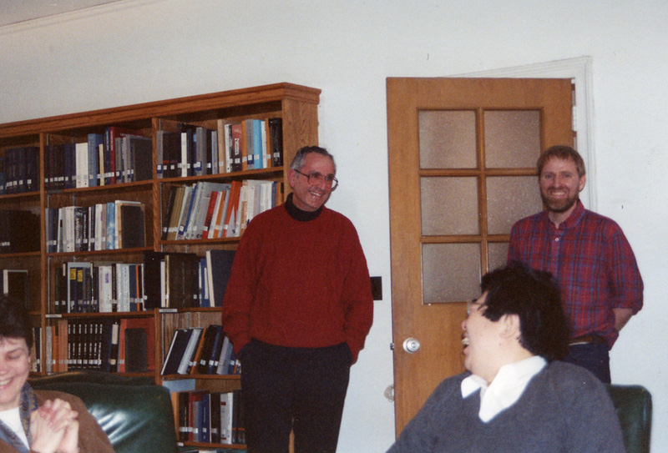
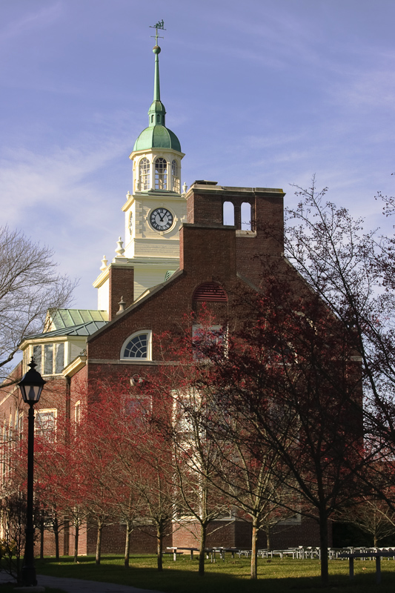
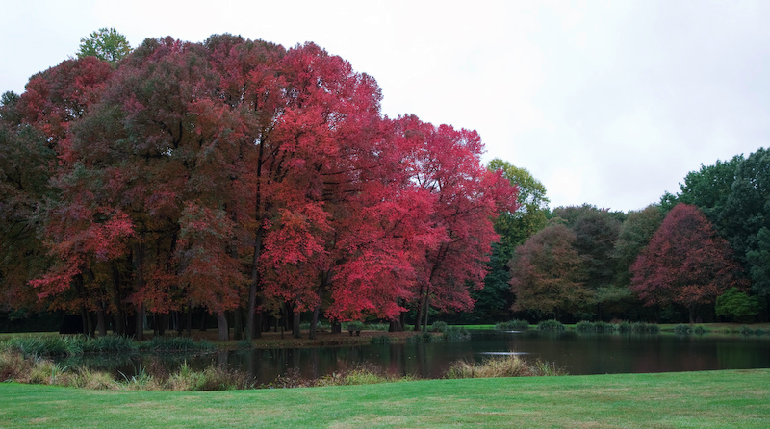
IAS – an innocent looking paradise

Slide 5
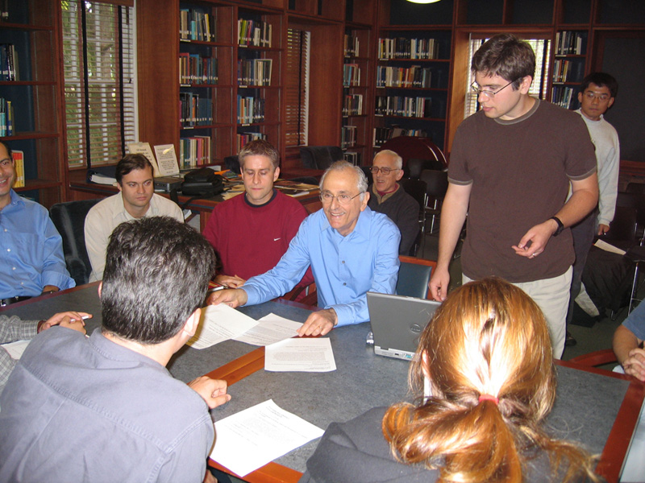
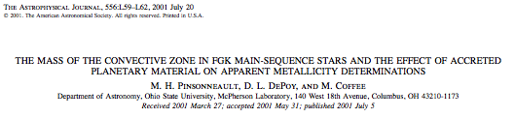
Astro-ph coffee at IAS
It came to life, literally, in other institutions

Slide 6
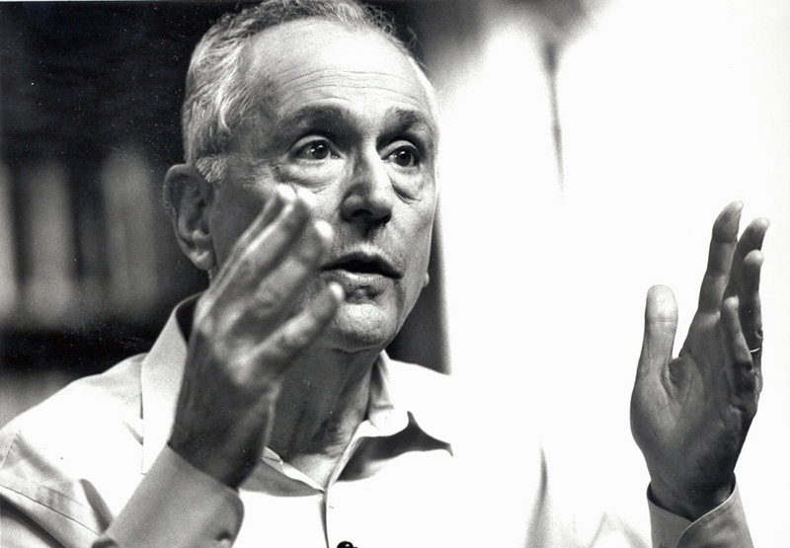
Many top range astrophysics Departments & Faculties in USA are populated by
former SNS-IAS members
John’s hand was everywhere: in the selection of the members, in contributing to
their scientific development, and in helping them find good positions afterwards
It was his scientific “family” he was taking care off. In this, too, he is irreplaceable

Slide 7
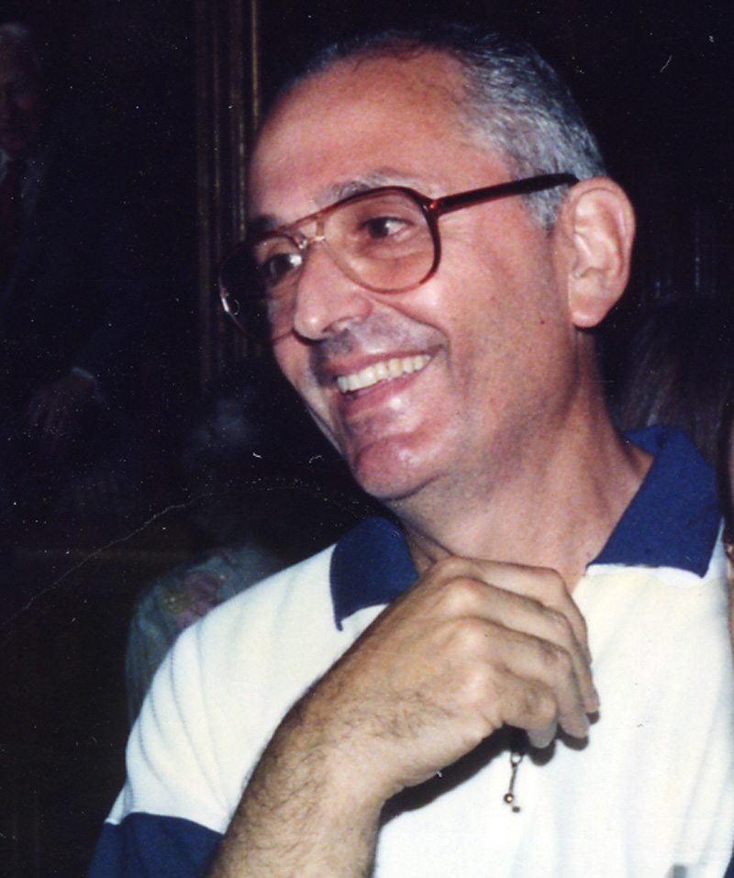
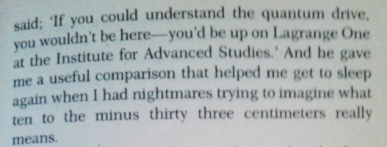
Many top range astrophysics Departments & Faculties in USA are populated by
former SNS-IAS members
John’s work was everywhere: in the selection of the members, in contributing to
their scientific development, and in helping them find good positions afterwards
It was his scientific “family” he was taking care off. In this, too, he is irreplaceable
John, not less than any other, has contributed to the prestige of the IAS
“The Songs of the Distant Earth” by Arthur C. Clarke

Slide 8
300 1st author papers – covering a huge range of disimilar topics
solar (& stellar) physics
galactic structure
quasars
x-ray binaries
extragalactic x-ray sources
dark matter
ultrahigh-energy neutrinos
neutron stars
black holes
dynamics of stellar systems
John tried to bridge some gaps
Unique ability to bring people from different fields together to work for a common goal – as NG noted yesterday, not easy to do
He taught astrophysicists to take a more scientific approach: uncertainties are of fundamental importance, also for models.

Slide 9
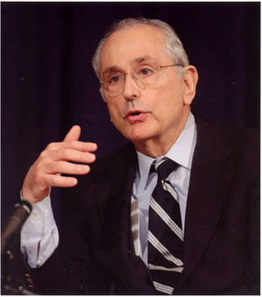
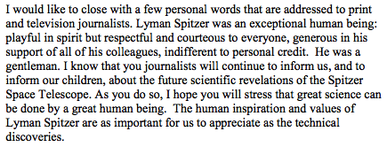
Extracted from the “Remarks at the Inaugural Press
Conference for the Lyman Spitzer Space Telescope”

Slide 10
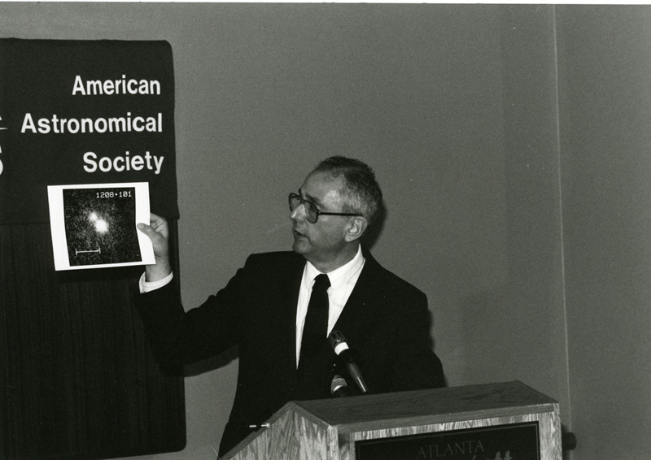
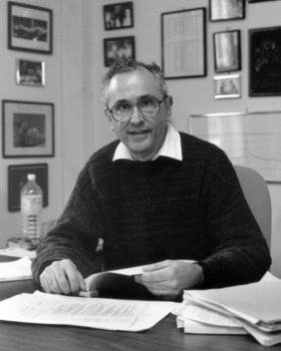
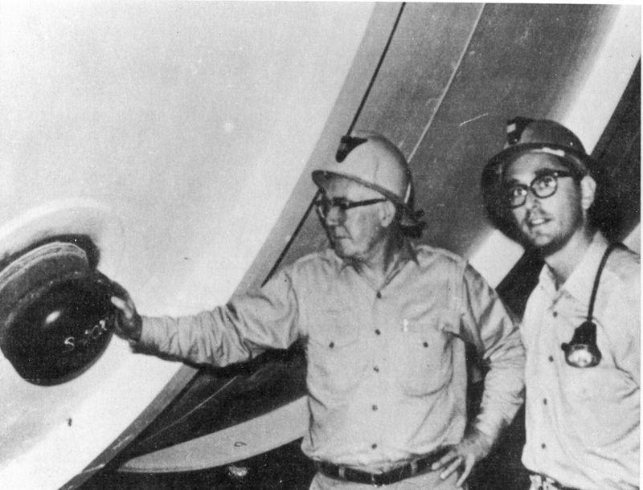
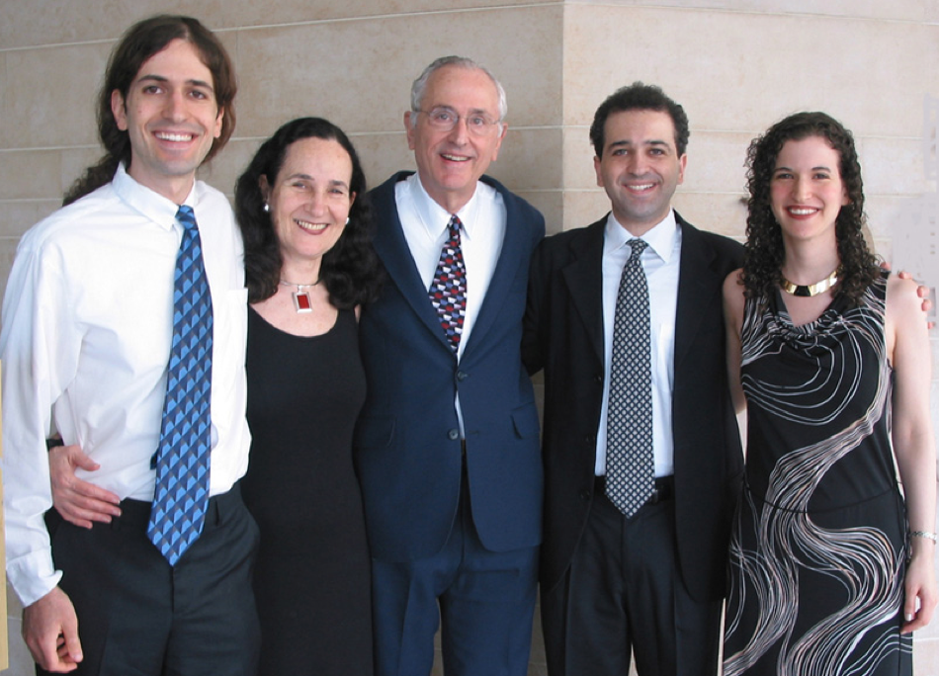
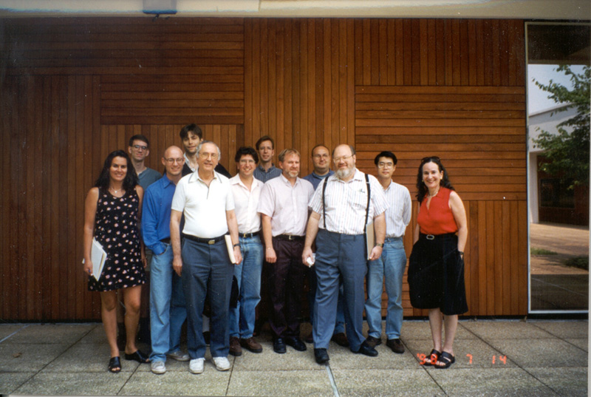
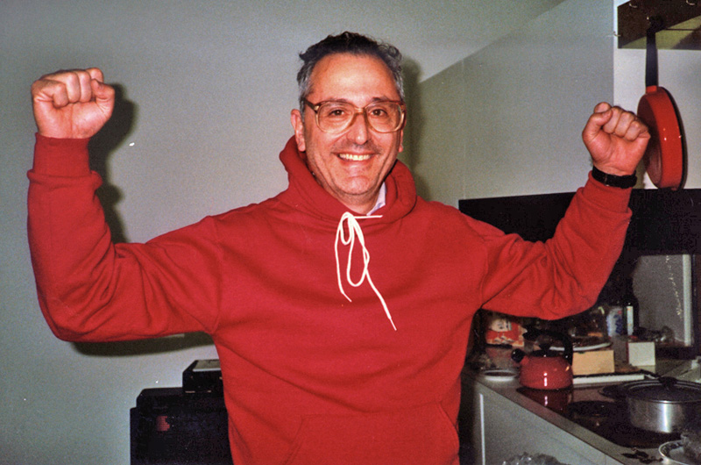
The Many Lives of John N. Bahcall

