Slide 1
PHYSUN 2012
The physics of the Sun and the solar neutrinos:3rd
October 8th–10th 2012 – LNGS-Assergi, ITALY
V.Antonelli – Milano University and I.N.F.N. Milano
Recent advancements and future perspectives of solar neutrino physics
Mainly based on ‘‘Solar Neutrinos’’,
by V. Antonelli1, L. Miramonti1, C. Pena Garay2, A. Serenelli3,
will appear on Advances in High Energy Physics , Guest Editors: J. Bernabeu, G. L. Fogli, A. B. McDonald, and K. Nishikawa (arXIV: 1208.1356)
(1Università degli Studi di Milano e I.N.F.N. Sezione di Milano; 2Instituto de Fisica Corpuscolar, CSIC-UVEG, Valencia; 3Instituto de Ciencias del Espacio (CSIC-IEEC), Facultad de Ciencias, Campus UAB, Bellaterra, Spain)

Slide 2
Historical role and future of solar neutrinos
Solar neutrinos since ever fundamental for elementary particle physics and astrophysics and in creating a connection between the two.
Historical view helps in understanding present situation and future outlooks of solar neutrino physics
Long standing solar neutrino puzzle (radiochem. exp., SuperKamiokande), and its solution (SNO and the confirmation by KL reactor exp): contribution to the proof of neutrino mass and oscillation first clear indication of the need to go beyond
the Standard Model.
Change of paradigm in neutrino physics: focus on appearance exp. and artificial sources (reactors, accelerators, SBL and LBL and superbeams).
Solar ν experiments: still many open questions: improve the knowledge of mass and mixing framework, study the low E part of the spectrum and look for possible ‘‘anomalies’’ in the oscillation pattern. -> Impact on solar models (high and low Z..., problem of solar abundancies)

Slide 3
The 2002 situation
2002 annus mirabilis:
April: SNO data including also NC (in addition to ES and CC).
1st direct measurement of total solar ν flux: proof of the Standard Solar Model
and (in combination with SK and previous solar experiments) of the validity
of the oscillation hypothesis.
December: 1st data from reactor experiment KamLand: cristal clear confirmation of the LMA solution of Solar Neutrino Puzzle
e
… and what next ?

Slide 4
The SNO and SK legacy
‘‘SNO II’’ (July 2001-September 2003): the salt phase.
Enhancement of the neutron capture efficiency and the energy of γ ray emission; better discrimination NC-CC (also thanks to different isotropy of multiple γ ray emission from neutron capture on ³⁵Cl) . Rejection (at more than 5 σ) of maximal mixing hypothesis.
Day-night asymmetry in NC rate consistent with zero (no indication of oscillation to sterile ν or non standard interaction with matter).
‘‘SNO III’’ (November 2004-Nov. 2006): addition of ³He proportional chambers
- Reduction of fluxes correlation and improvement of mixing angle determination.
- Total ⁸B ν flux: ${5.54}_{−0.31}^{+0.33}(stat){}_{−0.34}^{+0.36}{\left(syst.\right)×{10}^{6}{cm}^{−2} s^{−1}}$
in agreement with previous measurements and SSMs.
- Ratio of ⁸B flux measured with CC and NC: $\frac{{Flusso}_{SNO}^{CC}}{{Flusso}_{SNO }^{NC}}$ = 0.301$±$0.033
Global analysis, including the first Borexino results (PRL 101(2008) 091302) and KL data gave:
Δ $m_{12}^{2}$= ${7.59}_{−0.21}^{+0.19}×{10}^{−5}$; $\tan^{2}$θ₁₂ =${0.469}_{−0.041}^{+0.047}$. KL: improved accuracy and higher Δ$m_{12}^{2}$
S
S

Slide 5
The SNO and SK legacy - 2
Subsequent analysis of SNO I and II data: LETA (Phys. Rev. C 81(2010)055504 )
Reconstructed E_thr. lowered (Teff=3.5 MeV). Reduction of bckg and systematic; increased statistics (mainly NC). Total ⁸B ν flux: ${5.14}_{−0.20}^{+0.21} ×{10}^{6}{cm}^{−2} s^{−1 }.$
SNO only analysis (LETA+SNOIII): best fit point moved to LOW region; but including KL data previous results confirmed for Δ$m_{12}^{2}$with better accuracy for $\tan^{2}$θ₁₂
SuperKamiokande.
- Day-night asymmetry already from the analysis of ES data above 5 MeV in SK-I (Phys. Rev. D 69(2004)011104): $A_{DN}=−0.021±0.020{(stat)}_{−0 .012}^{+0.013} (syst.)$, consistent with zero (0.9 σ) and in agreement with LMA.
SK also studied electron energy spectrum: consistent with undistorted ⁸B ν spectrum;
no anomalous time variation.
Agreement with SNO, with slightly larger values of $\tan^{2}$θ₁₂ for SK.
SK II (Dec.02-Oct.05) and SK III (July06-Aug.08): (PRD 78(2008)032002 and 83(2011)052010). Reduced sensitivity, but improved data collection (vertex reconstruction, angular resolution and bckg. Reduction) and analysis. General confirmation of SK-I
Since Sept. 2008: SK-IV running (hep-ex:1110012 and ‘‘Neutrino 2012’’ ). Faster data acq. system (DAQ). Present E_thr (linked to computing system): around 4.2 MeV. Total systematic error on total flux 1.7%

Slide 6
Recent progresses
May 2012
Update live time:
2008/10-2012/03 SK-IV 1069 days (cf. SK-I 1496 days)
All the conventional event selection criteria are optimized in SK-IV
Introduced a new event selection parameter
Multiple Scattering Goodness
Systematic uncertainties are updated in SK-IV
Obtained SK-IV initial preliminary results
Carried out an oscillation analysis with SK-IV data
Fixed a mistake in SK-III flux calculation
Preparing a paper on SK-IV solar ν results

Slide 7
Impact of KamLAND results
The 2002-2004 campaign. For events above 2.6 MeV: anti-ν survival probability 0.658±0.044(stat)±0.047(syst). No oscillation hypothesis excluded at 99.6% statistcal significance. Need to combine with solar ν experiments to discriminate in LMA region the right solution from another one.
Following analysis: data up to May 2007. Enlarging of the fiducial volume, reduction of systematic uncertainties and radioactive bckg. Results:
Δ$m_{12}^{2}$=${7.58}_{−0.13}^{+0.14}{\left(stat\right)}_{−0.15}^{+0.15}(sys)×{10}^{−5}{eV}^{2}$ ; $\tan^{2}$ θ₁₂$={0.56}_{−0.07}^{+0.10}{(stat)}_{−0.06}^{+0.10}$ (sys), for $\tan^{2}$θ <1
Extension to 3 ν oscillation analysis: enlarging of θ₁₂ , small effect on Δ$m_{12}^{2}$
Good agreement with the solar neutrino exp. results, slight tension of KL toward
higher values of Δ$m_{12}^{2}$ and $\tan^{2}$θ₁₂

Slide 8
Allowed region in the mixing parameter space from a global analysis of KL and solar n experiments, together with Δχ2 profiles, for KL (dashed), solar (dotted) and combined (solid). Taken from PRL100(2008)221803.

Slide 9
Recent advancements
SNO 3 phases combined analysis: (arXiV:1109.0763)
- article identification through pulse shape analysis of NCD data ;
- Data fitted to MC derived PDFs for signals and bckg. ;
- New way to parametrize ⁸B ν signal.
From combined analysis of all SNO data: better determination of ⁸B solar ν flux:
$${5.25±0.16(stat.)}_{−0.13}^{+0.11}(syst.) ×{10}^{6}{cm}^{−2} s^{−1 }.$$
Consistent both with SSMs high-Z BPS09(GS), Φ=5.88±0.65 $×{10}^{6}{cm}^{−2} s^{−1 }$
and low-Z BPS09 (AGSS09), Φ=4.85±0.58 $×{10}^{6}{cm}^{−2}$.
Global analysis
- In 2 flavor oscillation model SNO dominates the θ₁₂ determination, but SNO alone not sufficient to exclude LOW solution. It’s definitely removed including the results of previous solar ν exp., the ⁷Be solar ν rate (PRL 107(2011)141302) and the ⁸B ν spectra (PRD 82(2010)033006) by Borexino and the same with KamLAND.
- Slight tension between solar ν exp. and KL strongly reduced in 3 flavor oscill. case.
.

Slide 10
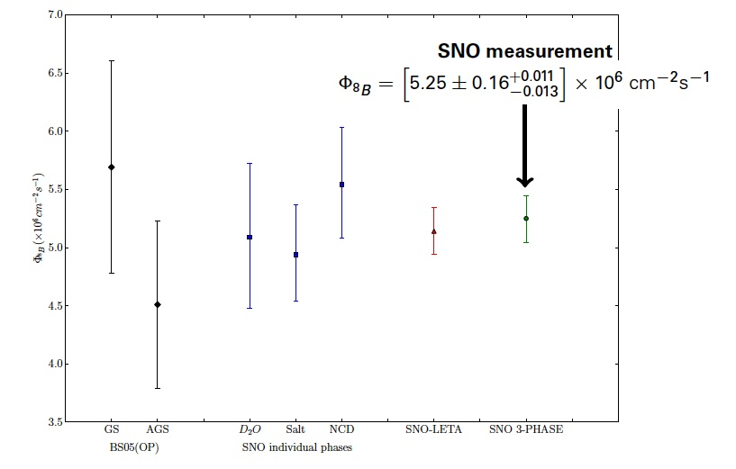

Slide 11
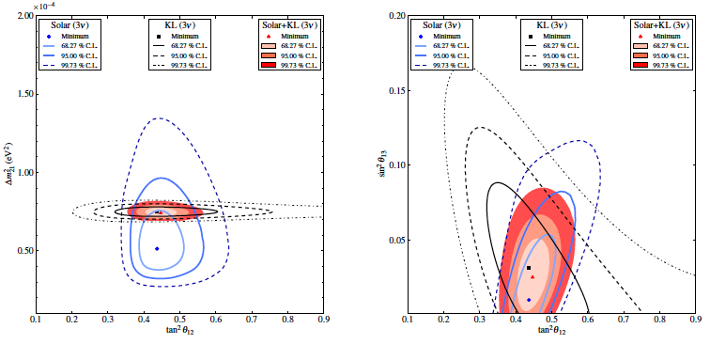
Tension between solar ν exp. and KL strongly reduced in 3 flavor oscill. case.
Sensitivity on θ₁₂ improved by the combination of solar and KL data. Preferredθ₁₃≠ 0. Agree with LBL(T2K and MINOS), combined analysis (PRD 84(2011)053007, and mainly with recent SBL reactor DOUBLE-CHOOZ, DAYA-BAY, RENO: 0.020 ≤ sin2θ₁₃ ≤0.030 (≠0 at > 5σ).

Slide 12
Toward the sub-MeV analysis: Borexino
SK, SNO and KL obtained important results, but they investigated only the high energy part of solar ν spectrum (above 4-5 MeV). Up to 4 years ago the low energy part (main component) of the spectrum studied only by radiochemical exp.
Borexino: first real time exp. exploring the sub-MeV region and isolating the monochromatic Berillium line.
Measurement of ⁷Be line (and ⁸B spectrum)
- ⁷Be signal after 9 months from an analysis of 192 live days (May ’07-April ’08), corresponding to 41.3 ton∙yr fiducial exposure to solar neutrinos.
-Value for 0.862 MeV ⁷Be solar ν interac. rate: 49±3(stat)±4(syst) counts/(day∙100 tons)
No oscill. excluded at 4σ C.L.; good agreement with LMA: 48±4 counts/(day∙100 tons)
- 2009 Calibration campaign. Different radioactive sources (α, β, γ and neutrons) of various E introduced in different positions inside Borexino detector and studied to reduce systematic uncertainties and tune reconstruction algorithm and MC simulations.
Significant reduction of uncertainties on the E scale and fiducial volume: from a 6% for both factors to a global uncertainty of 2.7%.
⁷Be Interaction Rate:46.0±1.5(stat)±1.3(syst) counts/(day∙100 tons). Cannot discriminate between high and low Z.
⁸B , with low E_thresh. (T_e > 3 MeV): compatible but les stringent

Slide 13
Borexino: pep and CNO ν measurements
In SSM, the solar luminosity and the link to pp ν constraint the pep ν flux, with
a small uncertainty (1.2%): ideal probe (after pp) to test SSM.
Neutrinos from CNO cycle essential to determine solar core metallicity and important to fuel different stars in various evolution phases 3 continous spectra, with endpoints among 1.19 and 1.74 MeV (N, O, F).
Despite their relevance….
until 2011 no direct detection of pep and CNO neutrinos.
Electron recoil E spectrum from pep ν: Compton like shoulder with 1.22 MeV end point. Bckg reduction even more challenging than in ⁷Be case (inter. rates at least 10 times lower).
New analysis techniques. TFC Three-Fold Coincidence (space and time veto following coincidences between muon signals, cosmogenic neutron and ¹¹C decay ) to reduce main bckg source (for 1<E<2 MeV), that is the β+ emitter ¹¹C produced in scintillator by μ and ¹²C nuclei interactions. Data: Jan ’08- May’10. Addition of pulse shape discrimination. Results (PRL 108 (2012)051302): CNO : φ < 7.7x10⁸cm⁻²s⁻¹
pep: rate=3.1±0.6(stat)±0.3(syst) [c/(day∙100tons] ; φ =(1.6 ±0.3)x10⁸cm⁻²s⁻¹
May 10-Aug 11 purification: very low levels of ⁸⁶Kr and factor 4 reduction of ²¹⁰ Bi

Slide 14
Present situation: ν flux determination
Data analysis can be modified by varying also the values of solar ν fluxes, imposing the luminosity constraint (conservation of the total E in nuclear fusion among the different light elements) each ν flux is associated with a percentage (accurately computed) of the E provided to the star by nuclear fusion reaction.
From solar ν data: quite accurate predictions for some of the solar ν fluxes and their correlations consistent global comparison of SSM fluxes with the values inferred from solar ν data. Precision on ⁷Be and ⁸B driven by Borexino and SNO (SK), while the pp and pep determination mainly comes from luminosity contraint.
Sun shines by the pp chain and the CNO cycle contribues only at the percent level.

Slide 15
Estimates for different solar ν fluxes
Flux | SFII – GS98 | SFII – AGSS09 | Solar
pp | 5.98∙(1±0.006) | 6.03∙(1±0.006) | $${6.05\text{∙}(1}_{−0.011}^{+0.003} )$$
pep | 1.44∙(1±0.012) | 1.47∙(1±0.012) | $${1.46\text{∙}(1}_{−0.014}^{+0.010} )$$
⁷Be | 5.00∙(1±0.07) | 4.56∙(1±0.07) | ${4.82\text{∙}(1}_{−0.04}^{+0..05}$)
⁸B | 5.58∙(1±0.13) | 4.59∙(1±0.13) | 5.00∙(1±0.03)
¹³N | 2.96∙(1±0.15) | 2.17∙(1±0.13) | ≤ 6.7
¹⁵O | 2.23∙(1±0.16) | 1.56∙(1±0.15) | ≤ 3.2
¹⁷F | 5.52∙(1±0.18) | 3.40∙(1±0.16) | ≤ 5.9
Units in cm-2 s-1: 1010 (pp), 109 (7Be), 108 (pep,13N,15O),106 (8B, 17F)

Slide 16
Present situation: spectrum consistency
Fundamental steps forward in ⁸B and ⁷Be ν study, however some key features of oscillation mechanism still must be tested.
Example:
- the transition between the vacuum dominated and the ‘‘matter enhanced’’ spectrum
regions. Partial deficit of low energy ⁸B neutrinos (explanations?)
Theoretical uncertainties on ⁸B, ⁷Be and hep ν large. Predictions on pp and pep fluxes,instead, strongly constrained by their correlation and by the SSM prediction that pp chain responsible of more than 99% of the Sun energy. Measurement of pp or significant improvements on pep would reduce the indetermination on total luminosity and would be a stringent test of SSM hypothesis.
Water Cerenkov (low photon yield): can detect only medium and higher part of the
spectrum; Radiochemical exp. measure only integrated ν rate above threshold.
Important contribution should come from organic scintillators
High light yield, large masses and high radiopurity (example Bx):can perform low E solar neutrino spectroscopy.
In near future: expected improvements from Borexino (possible also from purification
campaign and new signal extraction techniques, like ²¹⁰Bi bckg reduction) and SNO+

Slide 17
SNO+
New experiment in SNOLAB.
Idea: re-use SNO replacing deuterium with liquid scintillator.
Improvements in:
- electronics and DAQ; α−β separation; Scintillator developments (10000 γ/MeV); purification
SNO+ advantages:
- mass larger and 2 times deeper than Bx (6080 mwe against 3500 for B and 2700 for KL): better signal/bckg ratio for pep (less ¹¹C); expected 5% uncertainty on pep
Physics program
- 0ν ββ decay ; - reactor ν and geoneutrinos ; SN ν ;
− Solar neutrinos:
- Precision pep flux ; Low E ⁸B; Day-night asimmetry;
CNO measurement: solve solar metallicity problem (together with 8B from SNO)?

Slide 18
The far future
Aim: experiments with LOW E threshold (low signal and radioactive bckg); usually multiporpose devices also for 0ν−ββ and dark matter searches.
Large mass detector and high levels of radiopurity: next generation scintillators, varying from traditional organic scintillators with new technological devices to new materials (noble gases).
LENA (Low Energy Neutrino Astronomy)
- Next generation liquid scintillator detector (about 50 ktons) (cylindrical detector: d= 30m ; h=100m) . Will be hosted in Pyhsalmi underground laboratories.
- Multipurpose detector: study of galactic and diffuse SN; geoneutrinos; reactor ν;
IDM search; proton decay; LBL oscillations; solar neutrinos
- ES ν-e (as in Bx and SNO+) and CC: νe +¹³C ¹³N+e⁻ )
Very precise measurement of ⁷Be: search for signal modulation; ⁸B ν detection (possible
low E: < 3 MeV) ; pep and CNO ν difficult, but probably feasible.

Slide 19
Noble liquid scintillators
Scintillators with noble gases (Xe, Ar, Ne)
- Relatively inexpensive, easy to obtain, dense: large homogeneous detectors;
- ‘‘Easily’’ purified, high scintillation yield (30-40 photons/keV), no autoabsorption.
CLEAN/DEAP (LNe)
- Scaleable technology; Prototypes in SNOLAB (From Pico-CLEAN…to CLEAN/DEAP).
- Aim: Dark matter search and real time measurement of pp solar ν flux (from elastic ν−e and ν-nucleus scattering)
- Expected: 15000 photons/MeV and 1% statistical uncertainty on pp
-Test of SSM, better determination of θ₁₂, study of LMA consistency (in transition region);
Try to measure CNO flux with 10-15% accuracy.
Alternative LXe (high stopping power and ionization and scint. yields)

Slide 20
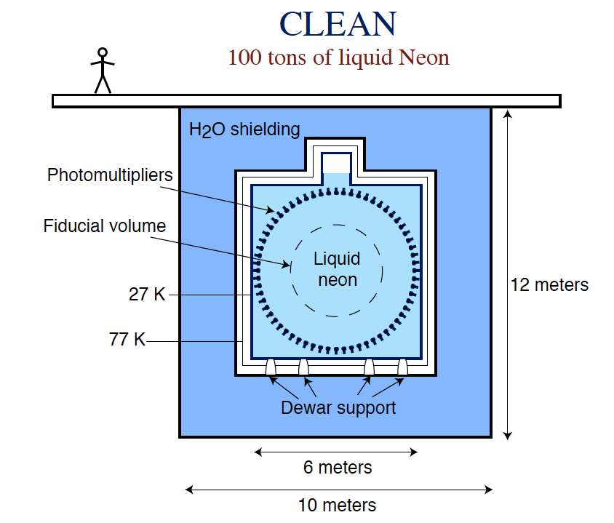
CLEAN

Slide 21
Noble liquid scintillators: 2
XMASS
- Large massive LXe detector; - Goals:
a) look for WIMPs (dark matter candidates);
b) search for 0ν ββ decay; c) study pp and ⁷Be solar neutrinos.
- 2 preliminary phases with prototypes in Kamioka;
full detector 20 metric tons (FV 10 tons).;
-Issues: lower the bckg (reducing radioactive bckg, large pure water active shield (mainly for μ, neutrons and γ), distillation system for Xe, reduce ⁸⁵Kr)
DARWIN (DARk matter Wimp search with Noble liquids)
EU-US group working on future multi-ton scale LAr and LXe dark matter search facility in Europe (multiple different target measurements).
Nuclear recoil E region (< 200 keV) interesting also for pp ν studies (low E ν−e
ES one of main bckg for WIMP searches in LXe).
(technical design study 2013; first physics run 2017)

Slide 23
LENS (Low Energy Neutrino Spectroscopy)
Real time ‘‘differential’’ measurement of solar neutrinos as function of E.
Particular attention to low E part of the spectrum (mainly pp ν).
CC process:
νe +¹¹⁵In ¹¹⁵Sn* + e⁻ (E = E -114 keV); ¹¹⁵Sn*(τ=4.76μs) ¹¹⁵Sn+γ(498keV)+γ(116keV)
CNO measurements: basically bckg free; resolution is the main issue.
pep and ⁷Be peaks also visible.
Experiment is going forward

Slide 24
CONCLUSIONS
Since oscillation discovery and solution of SNP, solar ν physics evolved quickly, taking advantage from data from many experiments (SNO, SK, KL) and recently the 1st real time low E exp. Borexino.
Picture emerging,‘‘driving’’ parameters Δ$m_{12}^{2}$ and θ₁₂ known quite well and MSW-LMA solution well established….
….however important aspects still to clarify: as vacuum to matter transition regime.
Meanwhile: θ₁₃ ≠ 0 . Interesting for future exp. (as CP violation).
For astrophysics Bahcall’s original dream is coming real.Using luminosity contraint, ⁷Be largest uncertainty (≈ 4.5%) in pp chain and general agreement with SSMs
Unlikely the pp chain fluxes alone will be sufficient to discriminate between different Sun compositions … fundamental role of CNO (complemented with 8B)
Important hopes and possibilities for Borexino and SNO+
Future exp.: LENA, liquid scintillators with noble gases,LENS

Slide 25
Borexino characteristic
- ES scattering ν-e : contribution from νe 5-6 times larger (CC in addition to NC)
- Monoergetic (0.862 MeV) Be line: Compton-like edge of recoil electrons at 665 keV
- High light yield (liquid scintillator): low E threshold and good resolution (5% at 1 MeV) and α−β discrimination, but no directionality and therefore no distinction with e-e from radioactivity. Bckg: β decay from 14C (endpoint 156 keV) -> limit E_neutrino 200 keV
- CTF : 4 tons ; Borexino graded shielding: Scintillator (300 tons) contained in a thin nylon Inner Vessel (IV), of radius 4.25 m, at the center of a set of concentric shells of increasing radiopurity and it is surrounded by an outer vessel (OV), led with PC
- Contaminants from dust (U, Th, K), air (39Ar, 85Kr) and cosmogenically produced isotopes (7Be), dierent purication techniques were applied, such as distillation, water extraction, nitrogen stripping and ultra-fine filtration.
- Fiducial spherical volume, corresponding approximately to 1/3 (i.e. about 100 tons) of the scintillator
volume in order to reject external γ background. The others 2/3 of the scintillator act as an active shield.

Slide 26
SK-IV solar neutrino flux
May 2012
Preliminary
Total live time : 1069.3 days (2008/10-2012/03)
Energy region for flux: E_{kinetic} = 4.0 – 19.5 MeV
Winter06 ⁸B spectrum is used.
⁸B Flux in ES reaction, without ν oscillation:
SK-IV: 2.34+/-0.03(stat.)+/-0.04(syst.) [x10⁶/cm²/s]
SK-I: 2.38+/-0.02(stat.)+/-0.08(syst.)
SK-II: 2.41+/-0.05(stat.)+0.16/-0.15(syst.)
SK-III: 2.40+/-0.04(stat.)+/-0.05(syst.) (SK-I,II are recalculated with the Winter06 ⁸B spectrum.) (The problem in SK-III is fixed.)
3.5-4.0MeV(kin) in SK-IV is used for oscillation analysis.
Energy threshold is lowest in SK-IV
SK-I: PRD73, 112001
SK-II: PRD78, 032002
SK-III: PRD83, 052010
4.5 – 19.5 MeV(kin)
6.5 – 19.5 MeV(kin)
4.5 – 19.5 MeV(kin)

Slide 27
Summary
SK-IV is running with the lowest energy threshold in SK
Trigger efficiency: >99%@4.0MeV(kin), ~86%@3.5MeV(kin)
The energy threshold will be lowered in near future.
The initial results from SK-IV are obtained in May 2012.
Observed ⁸B fluxes are consistent among SK phases
~7 sigma signal in 3.5-4.0MeV(kin) region
Performed an oscillation analysis with SK-IV data
Possible spectrum distortion: 1.1 sigma to 1.9 sigma
Day-Night asymmetry: consistent with zero at 2.3 sigma
Δm₂₁² : some tension between solar global and KamLAND
Preliminary
Solar global:
Solar global + KamLAND:
Δm2 = (4.9+1.4/-0.5) [×10-5eV2] sin2θ₁₂ = 0.310+0.014-0.015
Δm2 = (7.4+/-0.2) [×10-5eV2] sin2θ₁₂ = 0.304+/-0.013

