Slide 1
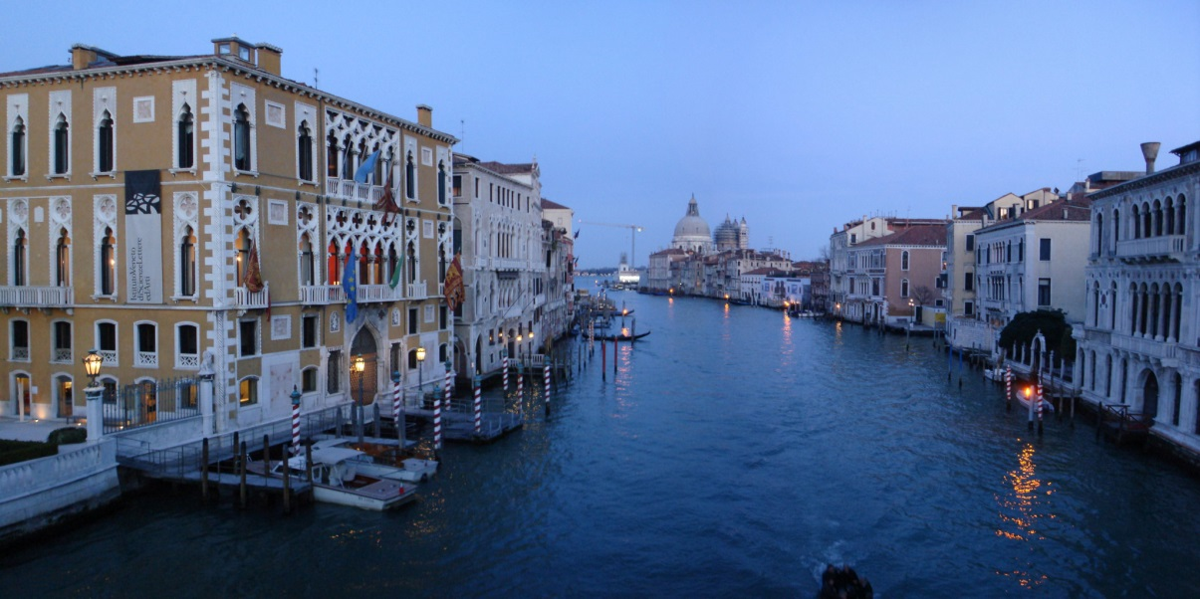
The LNGS Scientific Programme
XV International Workshop on Neutrino Telescopes
14th March 2013, Venice
Ken Peach*
JAI, Oxford
There is something so different in Venice from any other place in the world, that you leave at once all accustomed habits and everyday sights to enter an enchanted garden.
Mary Shelley (1797-1851)
* Chair,
LNGS Scientific Committee

Slide 2
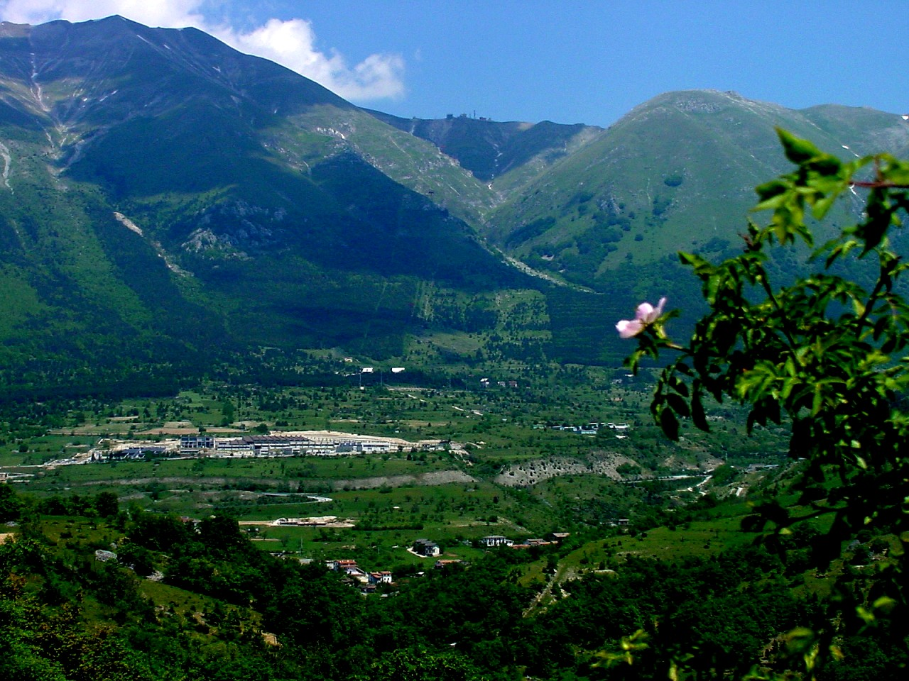
Laboratori Naztionali del Gran Sasso

Slide 3
Outline
Introduction
Neutrino Physics
  High Energy
  Solar and cosmogenic
  Double Beta Decay
Dark Matter
Tests of Fundamental Principles
Other Science
Summary
    Many thanks to all who supplied information
      I hope that I have accurately transcribed it …

Slide 4
Introduction
Notes:
N Borexino
N COBRA
- COSMIC-SILENCE
Y CRESST
Y CUORE
Y DAMA-LIBRA
Y DarkSide
- ERMES-WORLD/ERMES
N GERDA
Y GINGER
N ICARUS
Y LUCIFER
Y LUNA/LUNA-MV
N LVD
N OPERA
Y VIP
N XENON/XENON 1 ton

Slide 5
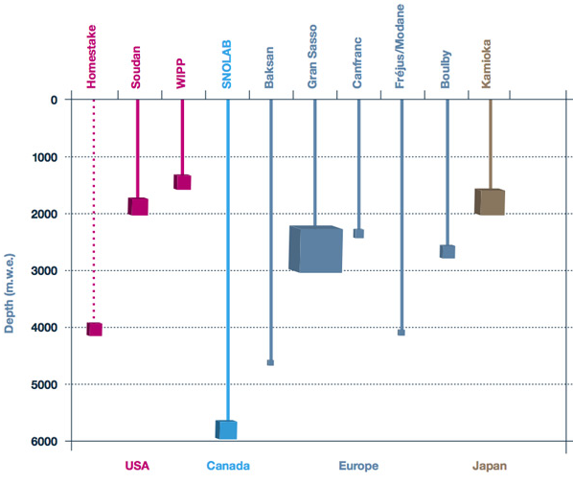
Underground Science Laboratories
LNGS
  Largest
Plot adapted from http://www.deepscience.org/contents/facilities.shtml

Slide 6
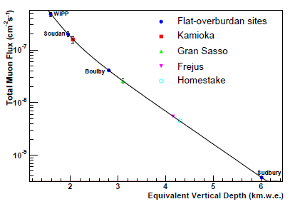
Muon Flux versus depth
Hime and Mei, Phys.Rev. D73 (2006) 053004

Slide 7
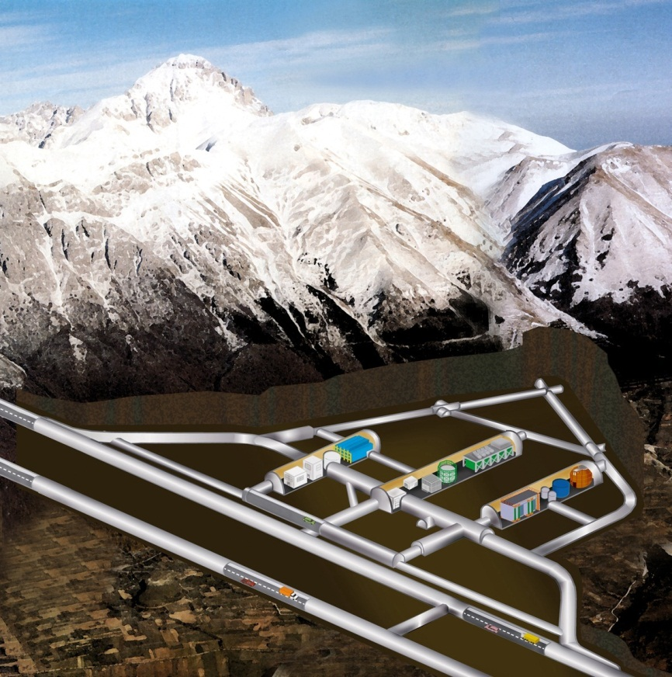
The LNGS Laboratory
3400 m.w.e.
1.1 μ / (m² h)

Slide 8
Important Questions in Physics
Experiments at the precision frontier
  Test our skill as experimentalists
  Test our ingenuity as theorists
  An “each way” bet
    Make a discovery
      New Physics
    Find what was expected
      Constrain the new physics
  For the congnoscenti

Slide 9
Neutrino Physics
High Energy Neutrinos
Solar and Cosmogenic Neutrinos
Double β decay

Slide 10
The Neutrino’s colourful history!
1950’s and early 60’s
  Nature (and existence) of the neutrino
    (Reines & Cowan, Lederman, Schwartz and Steinberger)
Late 1960s, 1970s, 1980s
  Structure of the nucleon
    F₂, xF₃ etc
  Structure of the weak current
    Neutral currents, sin₂θ_{w} etc
Now, and future
  Nature of the neutrino
    Neutrino Mass and Neutrino Oscillations
    Standard Model assumption of massless neutrinos is wrong!
      Note: difficult to add neutrino mass to SM a la Higgs
      Lack of Charge → additional mass-like (Majorana) terms
New Physics at last!!!!
New
facilities
allow
old
physics
to be
done
much
better

Slide 11
ν_{μ}→ν_{τ} oscillations
Neutrino Oscillations now
  well established
  consistent with 3-flavour mixing
    with caveats
      LSND, MiniBoone …
Neutrinos history of revolution
  need to measure all possible channels

Slide 12
What can be measured?
Neutrinos
ν_{e} disappearance
ν_{e} → ν_{μ} appearance
ν_{e} → ν_{τ} appearance
ν_{μ} disappearance
ν_{μ} → ν_{e} appearance
ν_{μ} → ν_{τ} appearance
… and the corresponding antineutrino interactions
Note: the beam requirements for these experiments are:
high intensity known flux
known spectrum known composition (preferably no background)

Slide 13
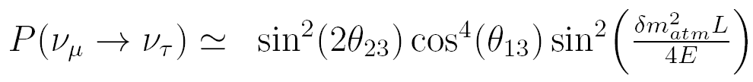
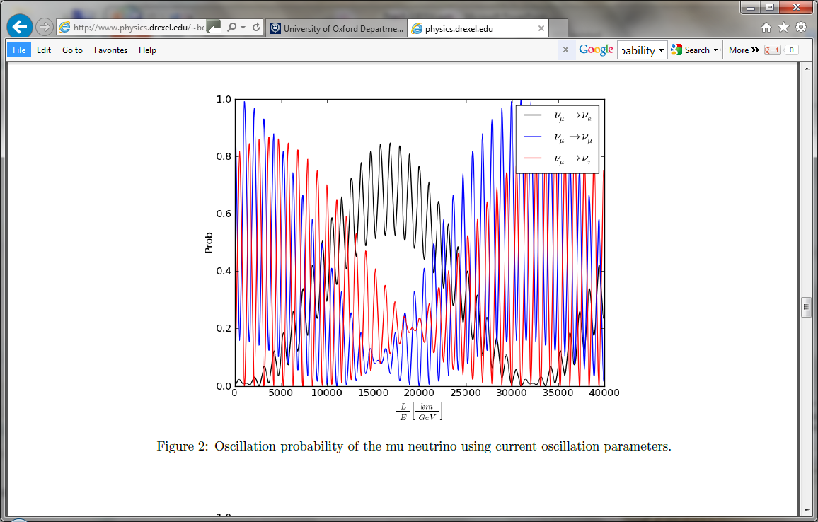

ν_{μ}→ν_{τ} oscillations
Erica Smith
$$\frac{L}{E}≈1100 [\frac{km}{GeV}]$$

Slide 14
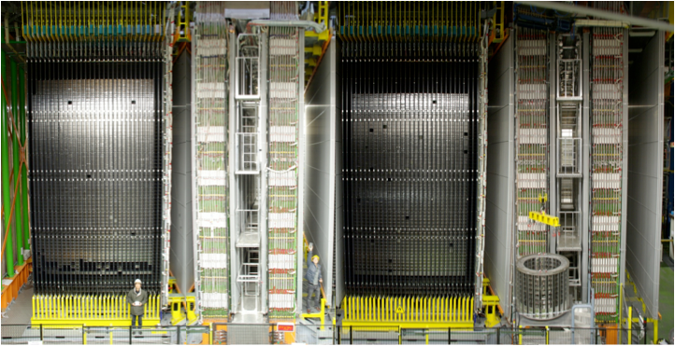
OPERA
SM-1 SM-2
Target Target
brick walls+ Taget Tracker brick walls+ Target Tracker
Spectrometer Spectrometer
RPC+Drift Tubes RPC+Drift Tubes

Slide 15
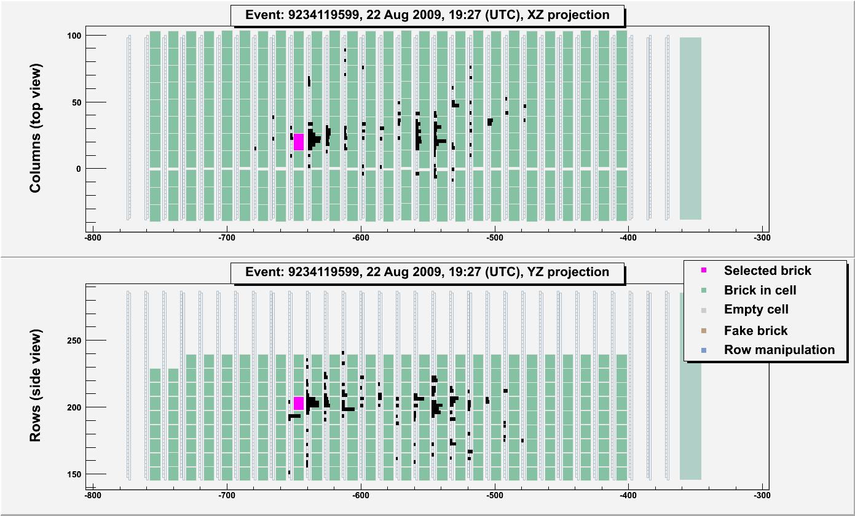
First tau neutrino candidate event
Muonless event 9234119599, taken on 22nd August 2009

Slide 16
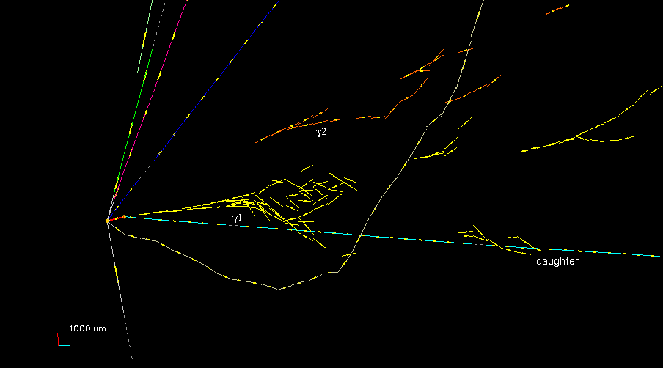
Event reconstruction in the brick
τ⁻→ρ⁻ ν_{τ}
ρ⁻→π⁰ π⁻
π⁰ → γ γ

Slide 17
Interpretation
PL17
PL18
PL19
PL20
PL21
5
1
7
3
Primary vertex
γ1
kink point
4
8
careful visual inspection of the films behind/in front of the secondary vertex:
no “black” or “evaporation” tracks. Support topological hypothesis of a particle decay
2
6
1mm lead

Slide 18
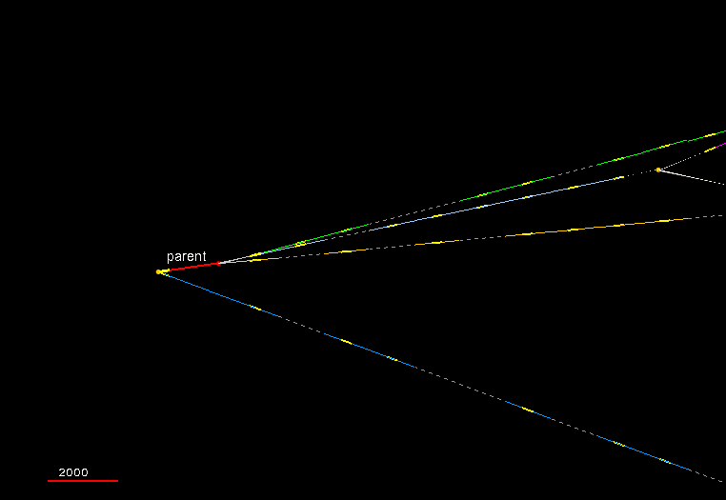
Second ν_{τ} candidate event: topology
2000 μm

Slide 19
Electron neutrino search
A ν_{e} candidate event with a π⁰ as seen in the brick
Interface
films

Slide 20
Search for non-standard oscillations
preliminary exclusion plot in the sin²(θ_{new})- Δm²_{new} plane

Slide 21
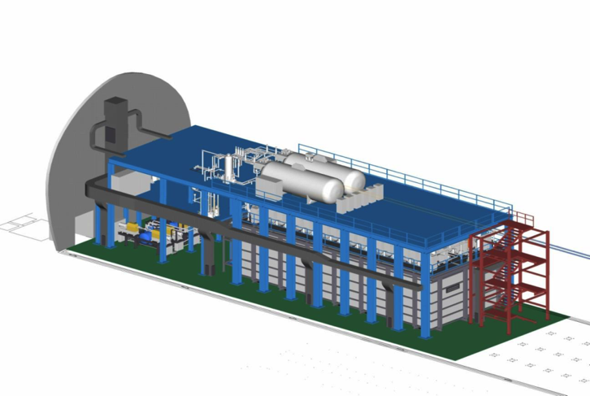
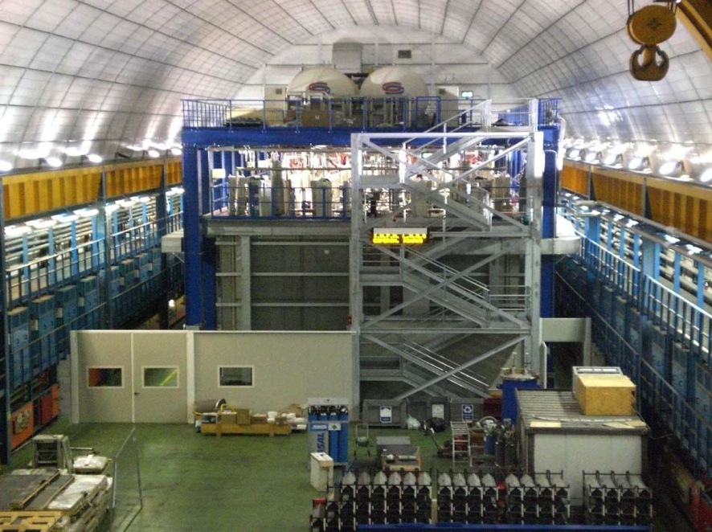
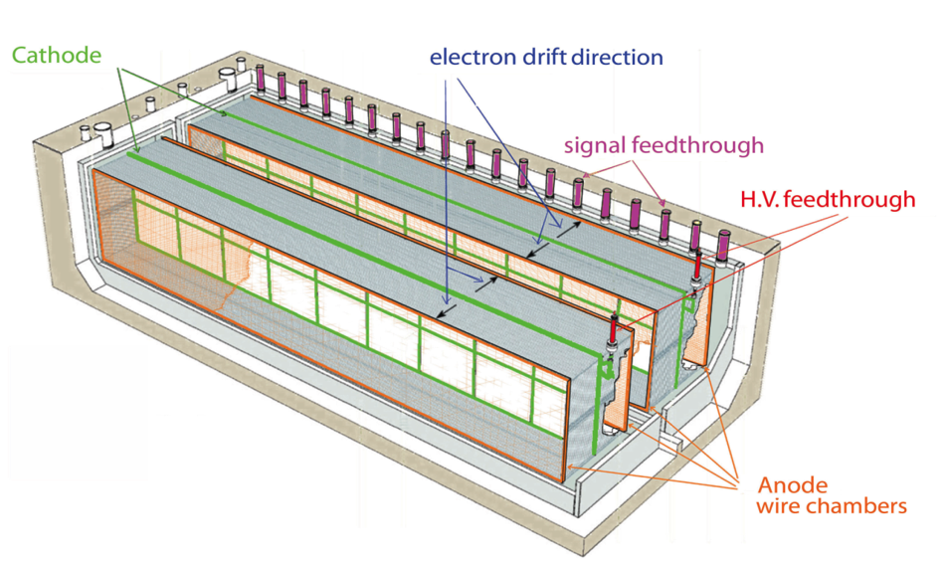
ICARUS-T600 @ LNGS
0.77 kton LAr-TPC

Slide 22
ICARUS T600 timeline
2010: Successful assembly and commissioning of ICARUS-T600:
  May 28th : first CNGS neutrino
  October: start of physics runs
2011 – Dec 3rd, 2012:
  T600 data-taking with CNGS beam and cosmic rays
    2800 CC + 900 NC
    Muons from upstream GS rock ≈ 12000 ev (≈ 8200 on TPC front face)
    Intrinsic beam νe CC ≈ 26 ev
    ν_{μ} -> ν_{τ} with kinematic ν_{τ} -selection (~2 event τ ->e ) ν_{μ} -> ν_{e} ( θ₁₃) from e-like CC events
    excess at E < 20 GeV (~5 events CC)
    Search for ν_{s} in LSND parameter space, studying e-like CC events at E > 10 GeV
  Nov. 2011 & March 2012: bunched beam for v velocity measurement
Dec.2012 – June 2013:
  Data-taking with cosmic rays
  From June: decommissioning
2014 onward
  Sterile neutrino search at the new CERN SPS neutrino beam

Slide 23
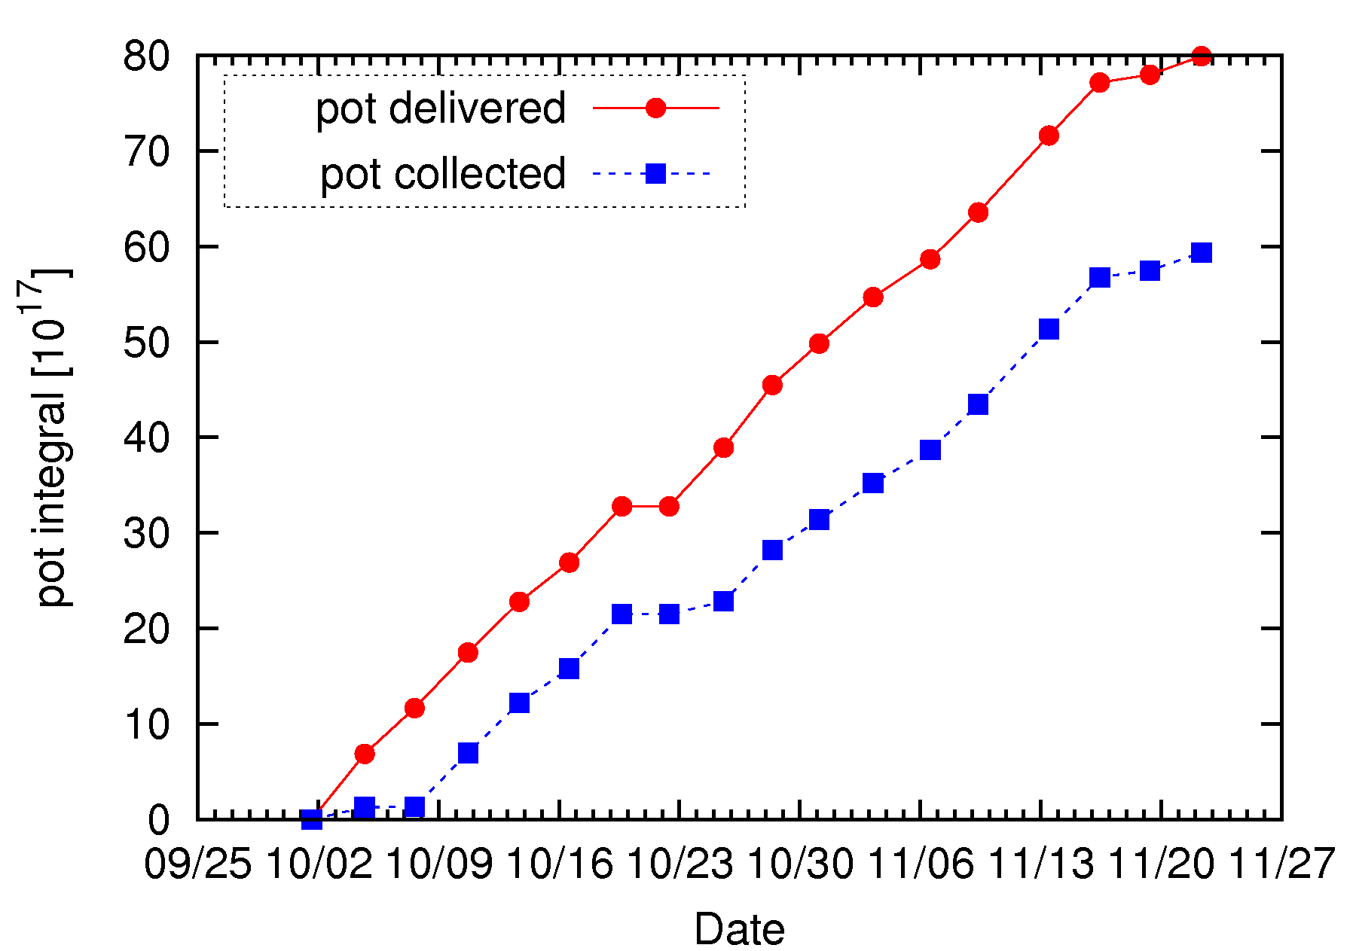
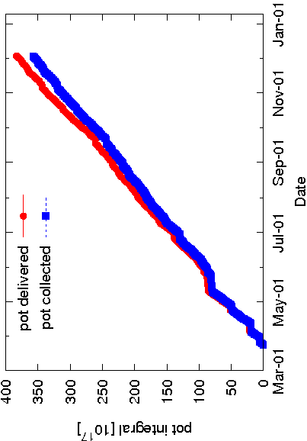
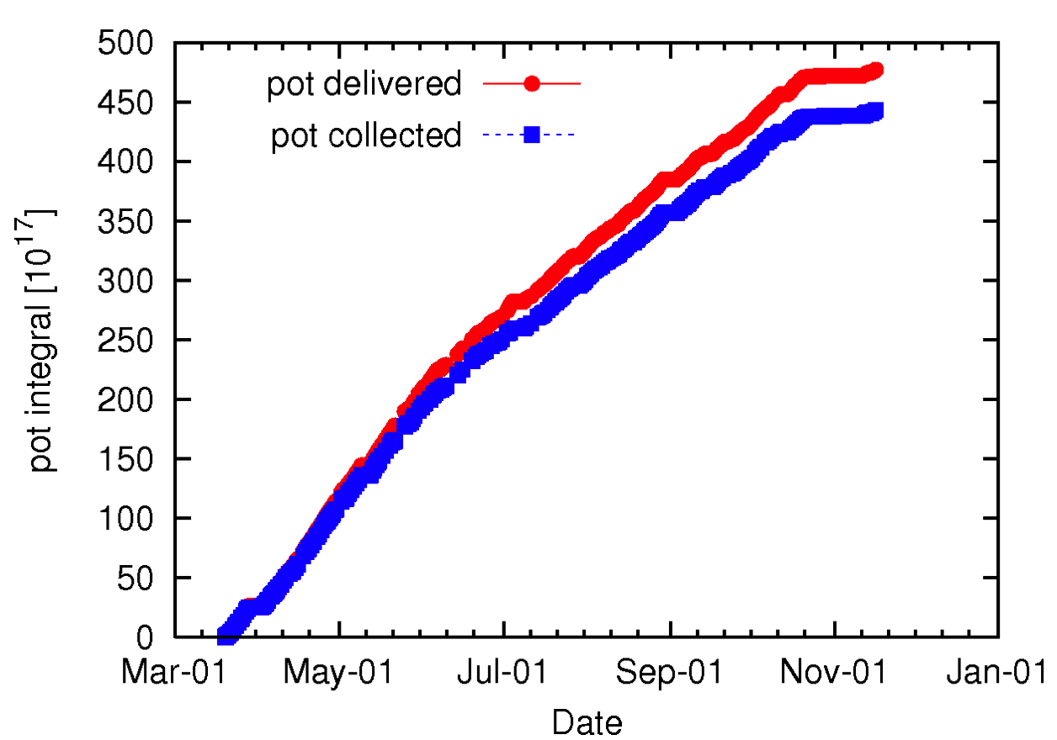
ICARUS (CNGS2) data collection
2010: Oct. 1st ÷ Nov. 22nd
2011: Mar. 19th ÷ Nov. 14th
5.8 10¹⁸ pot
4.44 10¹⁹ pot
2012 :Mar. 23th ÷ Dec. 3th
Detector live-time > 93% in 2011 and 2012
Globally: 8.6 10¹⁹ pot collected
Analysed to date: 3.3 10¹⁹ pot (1091 contained events)
≈ 1/3 of “ultimate” sample
3.54 10¹⁹ pot

Slide 24
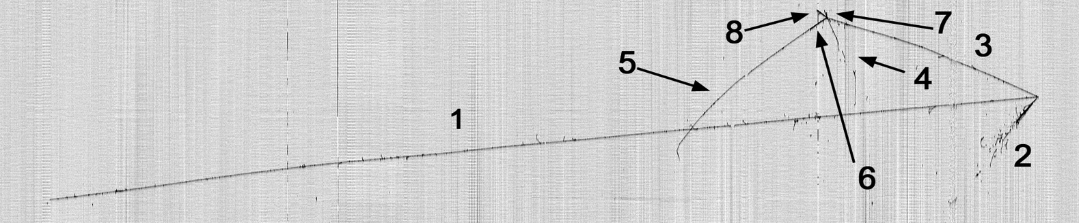
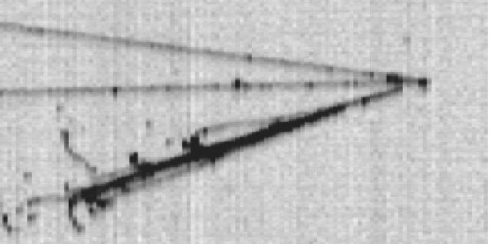
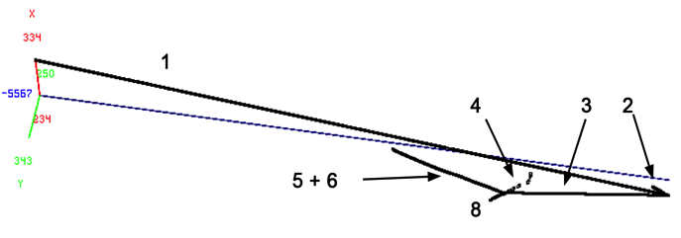
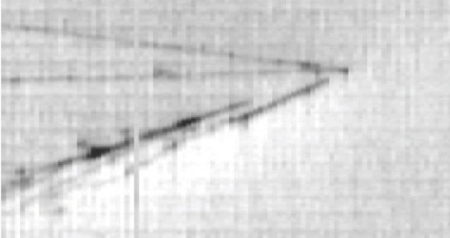
The LAR-TPC: the electronic bubble chamber
Total visible energy 4.5 GeV
close-up of two e.m. showers
3D
B
A
Collection
Primary vertex (A):
very long μ (1), e.m.cascades( 2), π (3)
Secondary vertex (B):
longest track (5) is a μ from stopping K (6)
μ decay is observed
Induction
π⁰
Conversion distances
6.9 cm, 2.3 cm

Slide 25
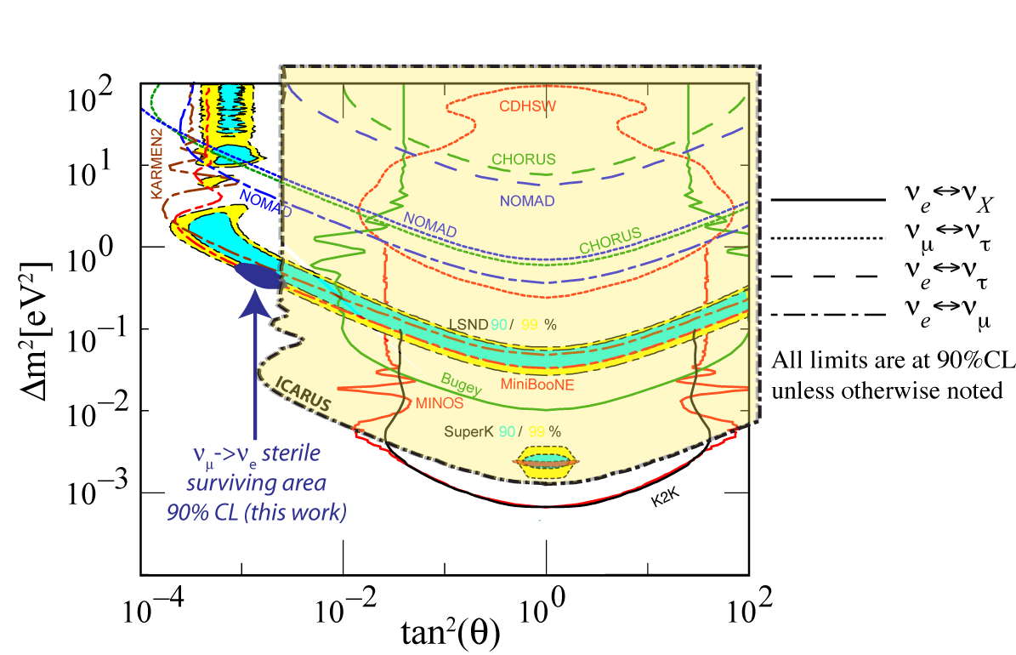
LSND-like exclusion
Allowed by
LSND/MiniBooNE
New exclusion
area from ICARUS
ICARUS result strongly limits parameters for LSND anomaly
  (Δm²–sin²2θ) = (0.5 eV²-0.005)
overall agreement (90 % CL) between:
  - ICARUS, KARMEN and “signals” of LSND and MiniBooNE

Slide 26
Solar and Cosmogenic Neutrinos

Slide 27
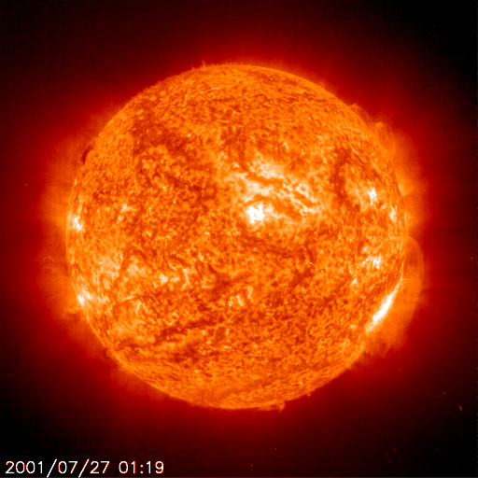
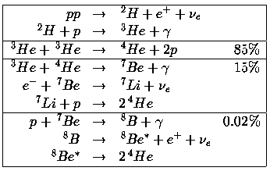
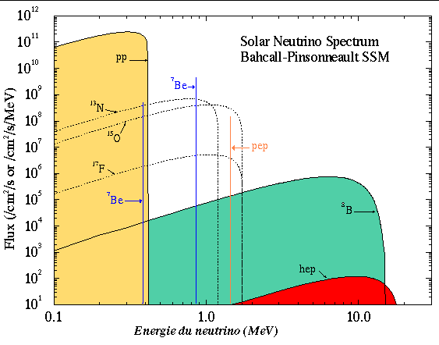
Solar Neutrinos
neutrinos are produced in the sun
Of the 3 types of neutrino
  electron, muon, tau
only electron neutrinos come from the sun
Can we detect them?
YES!
Do they all reach the earth?
Apparently NO!

Slide 28
Solar Neutrinos
Solar Neutrino oscillations
  Well established
    Many experiments
  What still to learn?
    (recall) neutrinos history of revolution
    Check everything
  Use neutrinos to probe the sun
    The traditional role of the neutrino
      First use to study the neutrino properties
      Then use neutrinos special properties to measure
        Something else!

Slide 29
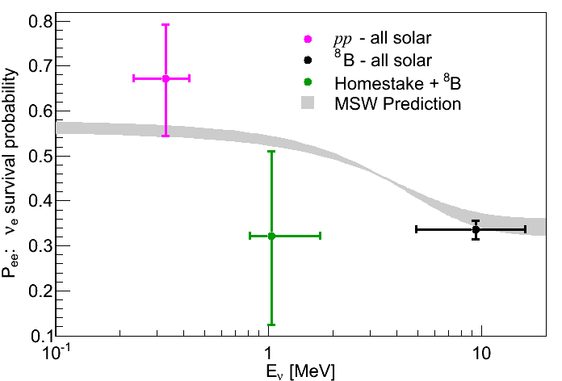
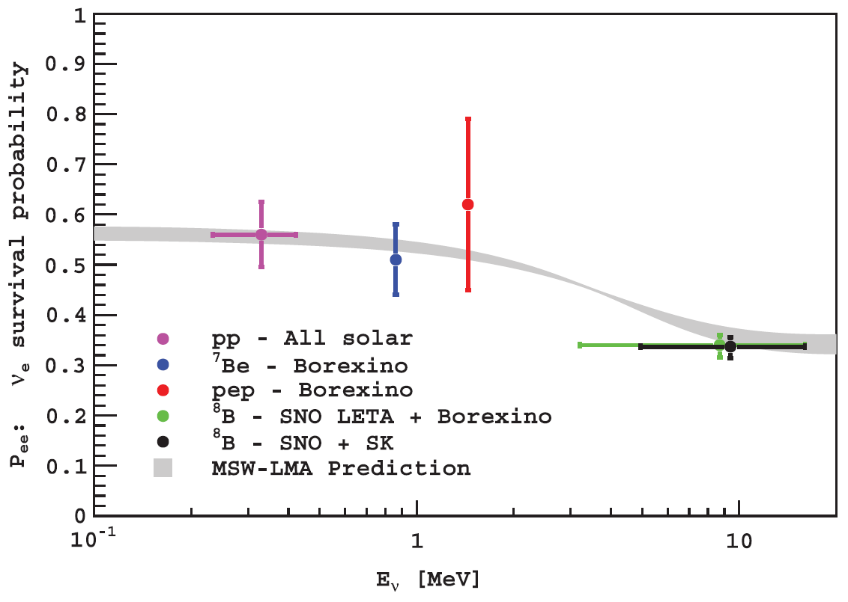
Borexino solar ν results
Neutrino Survival Probability P_{ee}(E)
G. Bellini et al., Borexino Collaboration, Phys. Rev. Lett. 108 (2012) 051302..
Pep rate= 3.1 ±0.6 (stat) ±0.3 (sys) cpd/100t
G. Bellini et al., Borexino Collaboration, Phys. Rev. Lett. 107 (2011) 141362.
⁷Be rate(0.862 MeV)=46.0± 1.5 (stat) ^{+1.5} _{-1.6} (sys) cpd/100 t
Before Borexino
Combined analysis
Borexino&solar
G. Bellini et al., Borexino Collaboration, Phys. Rev. D82 (2010) 033006.
⁸B rate(E>3 MeV)= 0.22 ±0.04(stat) ±0.01 (sys) cpd/100t
Best upper limit on CNO n flux
CNO< 7.9 cpd/100t
Data/SSM<1.5 (with pep result)
Absence of ⁷Be day night asymmetry
0.001 ± 0.012(stat) ± 0.007(sys)
G. Bellini et al., Borexino Collaboration, Phys. Lett. B707 (2012) 22.

Slide 30
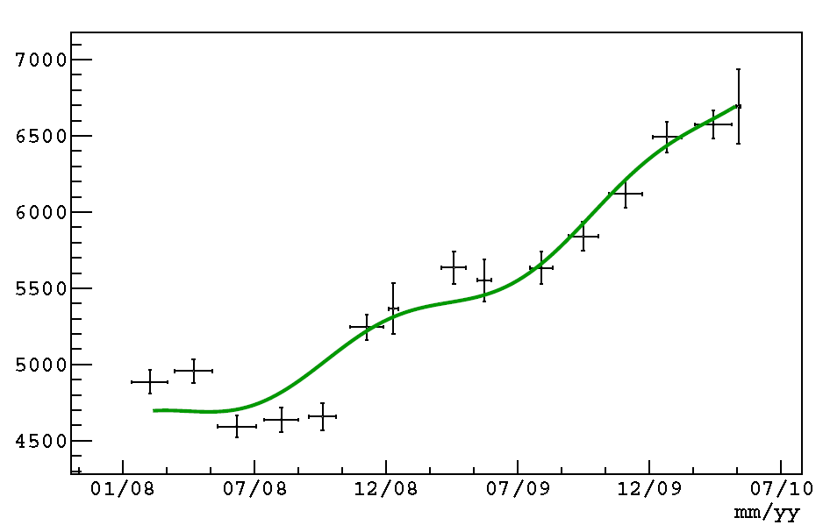
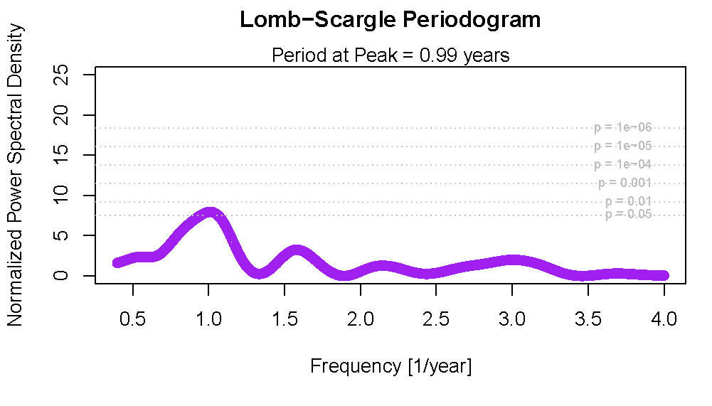
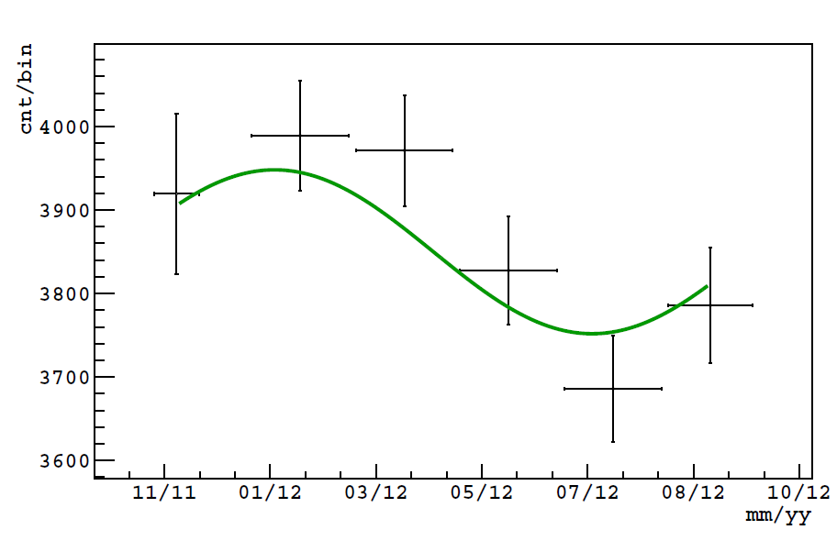
Seasonal modulation of the ⁷Be signal
6.7% effect
Counts in the ⁷Be energy region vs time
PHASE 1 (before scintillator purification)
Period and eccentricity
consistent with nominal values
within 2 σ
Peak at period 0.979 Year
Spectral power density: 7.96
PRELIMINARY: counts during PHASE 2
after purification
Frequency (year)
Phase 1 tresults consistent with expectation
No modulation rejected at more than 3 σ

Slide 31
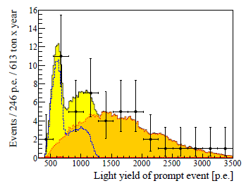
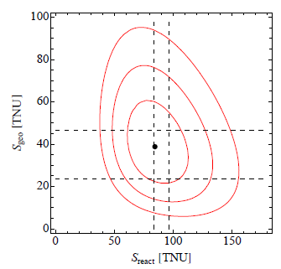
Geo Neutrinos
N_{reactor} Expected with osc. | N_{reactor} Expected no osc. | Others back. | N_{geo} measured | N_{reactor} measured | N_{geo} measured | N_{reactor} measured
events | Events | events | events | events | TNU | TNU
33.3±2.4 | 60.4±2.4 | 0.70±0.18 | 14.3±4.4 | 31.2_{-6.1}⁺⁷ | 38.8±12.0 | 84.5^{+19.3}_{-16.9}
Exposure 613 ± 26 ton year
(3.69 ± 0.16) 10³¹ proton year
No signal: rejecte at 4.5 σ C.L.
1MeV ≈ 500 p.e.
geoν
reactor
2.4 times data more than in Phys. Lett. B 687 (2010) 299 (Borexino Coll.)

Slide 32
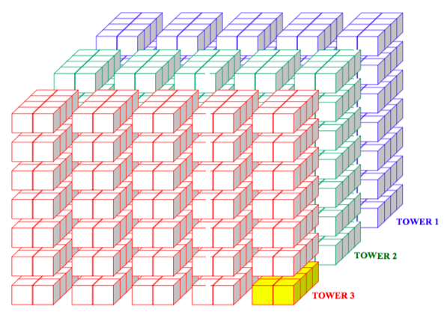
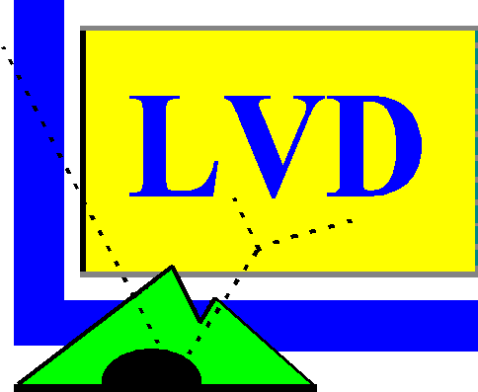
LVD
Search for ν from Core Collapse Supernovae
  LVD live since 1992.
  90% c.l. upper limit of gravitational stellar collapses (D ≤ 20 kpc)
  R < 0.12 events/year

Slide 33
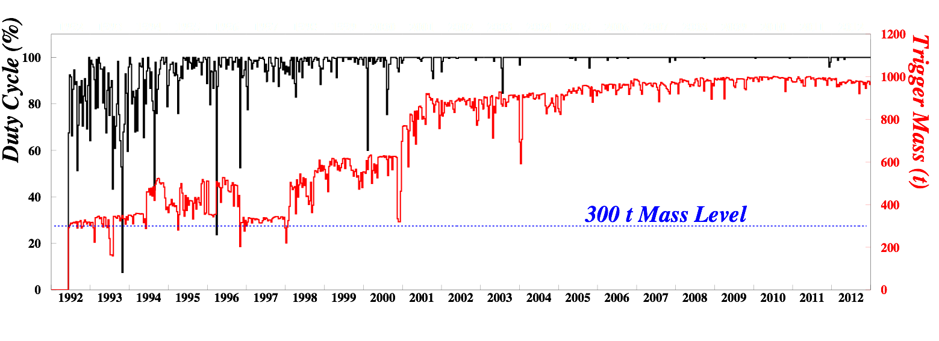
Duty factor
Need large mass
  1 kT
Need high availability
  ~100%

Slide 34
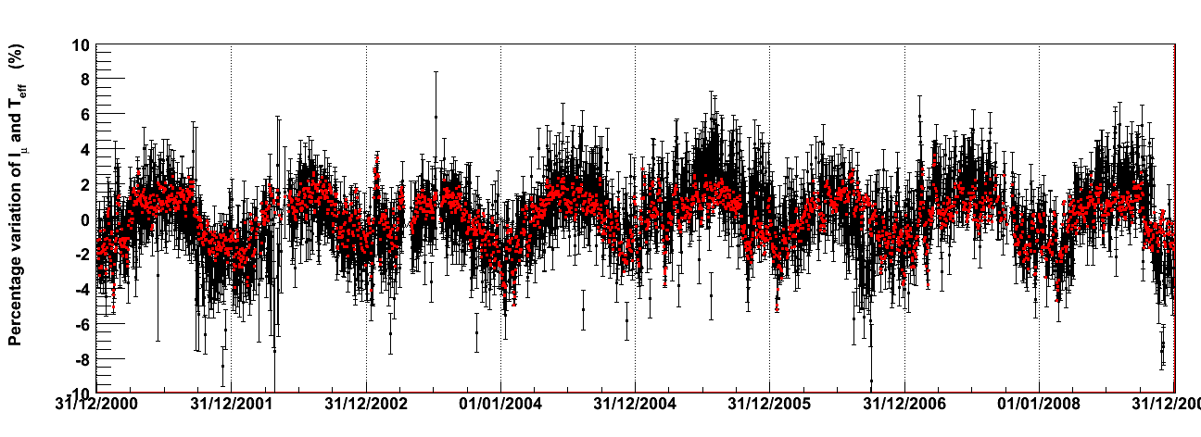
Seasonal modulation of muon flux
2001-2008.

Slide 35
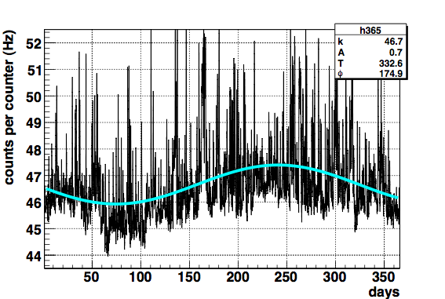
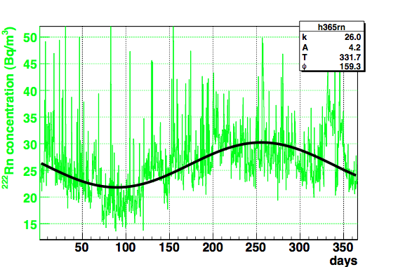
Long-term low energy counting rate
Low threshold count rate
  averaged (1997-2002)
Rn concentration
Fit: k + A sin(2π/T (x+φ))
Single count rate at the low energy threshold (LTCR)
Measured for 10s every 10 min
  Dedicated trigger designed for monitoring purpose
Rate per counter is around 50 counts/s
  Mainly γ
    from material radioactivity
    & from Radon product decays
Notes:
In LVD, signals coming from each pmt are discriminated at two different thresholds (L and H), corresponding to the energies EL ~ 0.5 MeV and EH ~ 4 MeV.
The single counter rate at the low energy threshold (LTCR) is measured by a system of scalers enabled, every 10 min for 10 s, by a dedicated trigger designed for monitoring purpose.The rate per counter is around 50 counts/s, and it is mainly due to gammas from material radioactivity and decays of Radon products.
The analysis carried out shows evidence of a seasonal variation. To better visualize the modulation we plot the yearly rate averaged over 6 years (1997-2002).
The seasonal modulation shows the maximum at day 241 ± 32.
The same procedure, applied to the Rn-meter data set, supports the previous result.

Slide 36
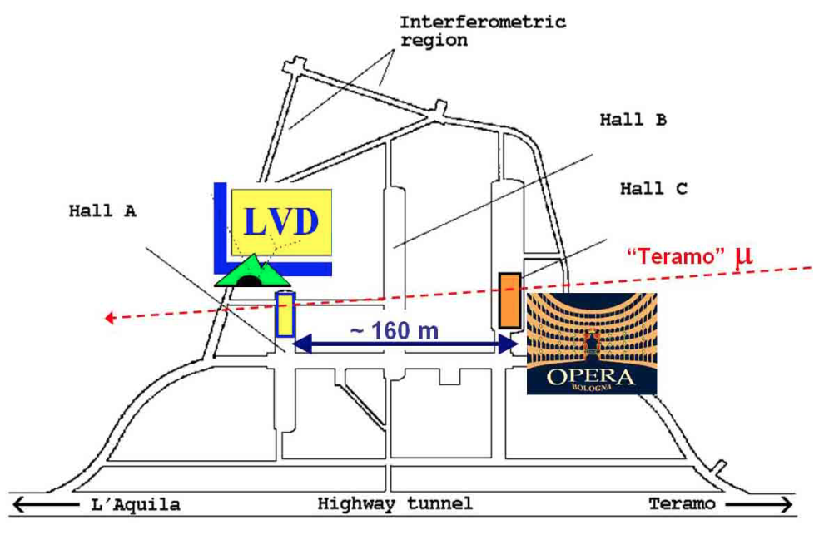
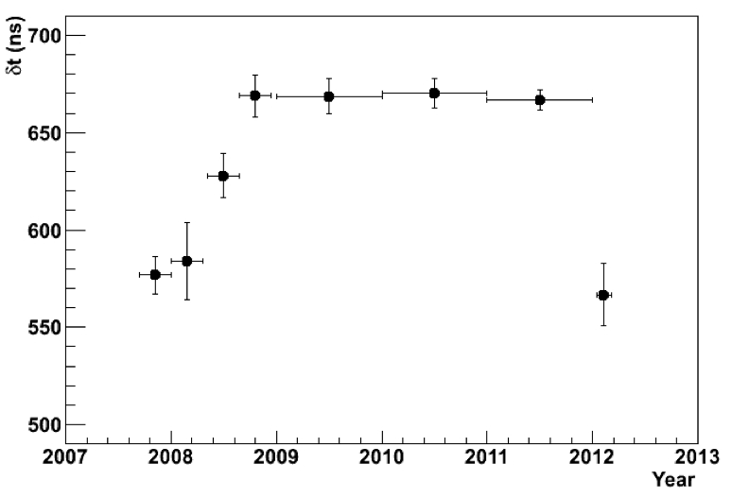
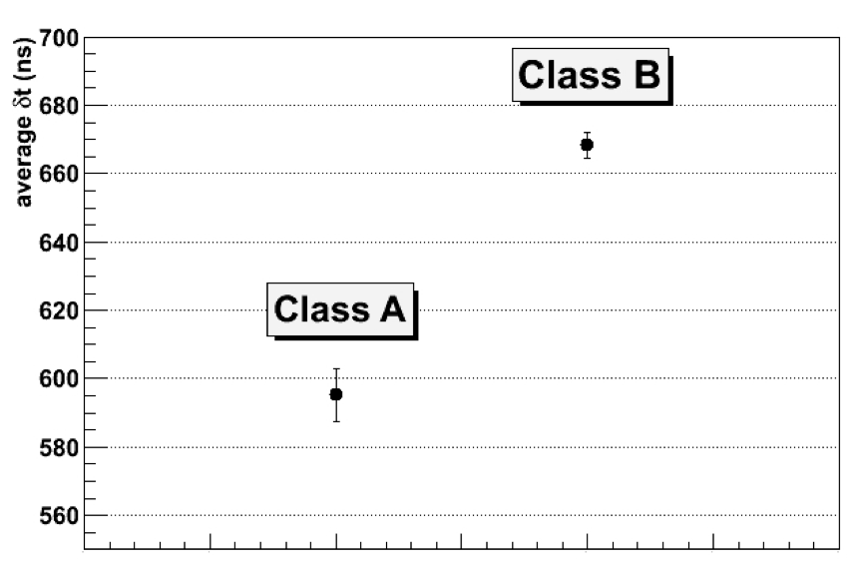
OPERA-LVD muons
Time-shift in OPERA set-up
high energy horizontal μ
both LVD & OPERA
Eur.Phys.J.Plus 127 (2012) 71
Class B
Class A
Class A

Slide 37
…. and for the future
Continue data taking trying to keep the experiment as much performing as it was since the past 21 years!!!!

Slide 38
More neutrinos?
.
Controversy? (Good – interesting)
  Are sterile neutrinos needed?
    (Rubbia … resolve experimental inconsistency)
  Has the impossible been eliminated?
  Short baseline intense neutrino sources
    In Borexino … SoX
      Short Oscillations with BoreXino
When you have eliminated the impossible, whatever remains, however improbable, must be the truth
Arthur Conan Doyle (Sherlock Holmes)
The Sign of the Four

Slide 39
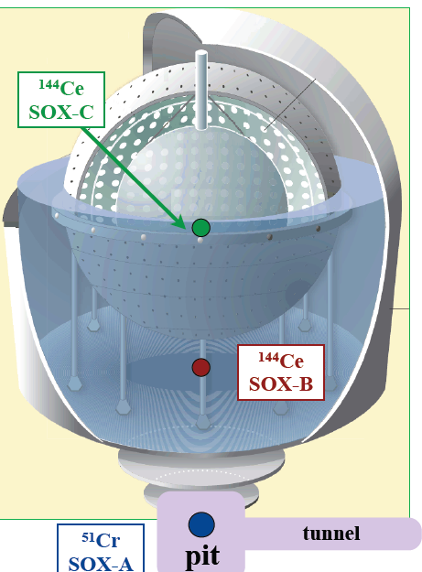
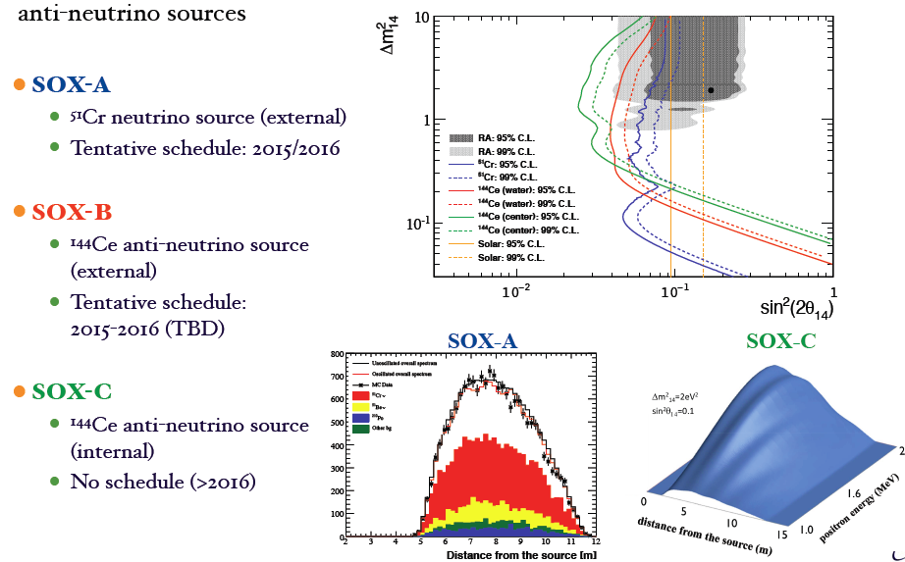
SOX

Slide 40
0νββ

Slide 41
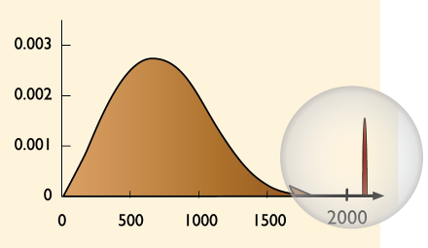

Introduction: 0νββ
Expected decay rate:
Phase space integral
Nuclear matrix element
Effective neutrino mass
Elements of (complex) PMNS mixing matrix
Example ⁷⁶Ge
Experimental signatures:
peak at Q_{ββ} = m(A,Z)-m(A,Z+2)-2m_{e}
two electrons from vertex
Discovery would imply:
lepton number violation ΔL = 2
ν’s are Majorana type
mass scale & hierarchy
physics beyond the standard model
2νββ
Q_{ββ}=2039 keV
arbitrary units
0νββ
Introductory slide credit
Energy (keV)

Slide 42
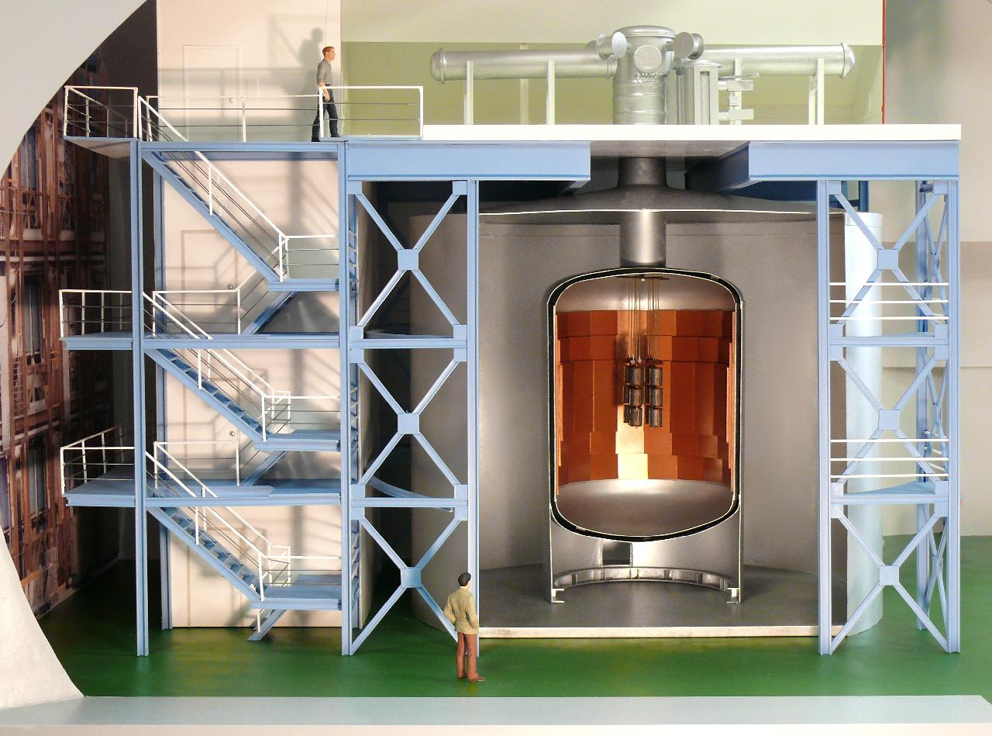
GERDA
plastic μ-veto
clean room with lock
muon & cryogenic
infrastructure
cryostat, Ø4m,
with internal
Cu shield
control rooms
Ge-detector array
(enriched in ⁷⁶Ge)
water plant &
radon monitor
water tank, Ø10m,
part of muon-veto detector
Eur. Phys. J. C (2013) 73:2330

Slide 43
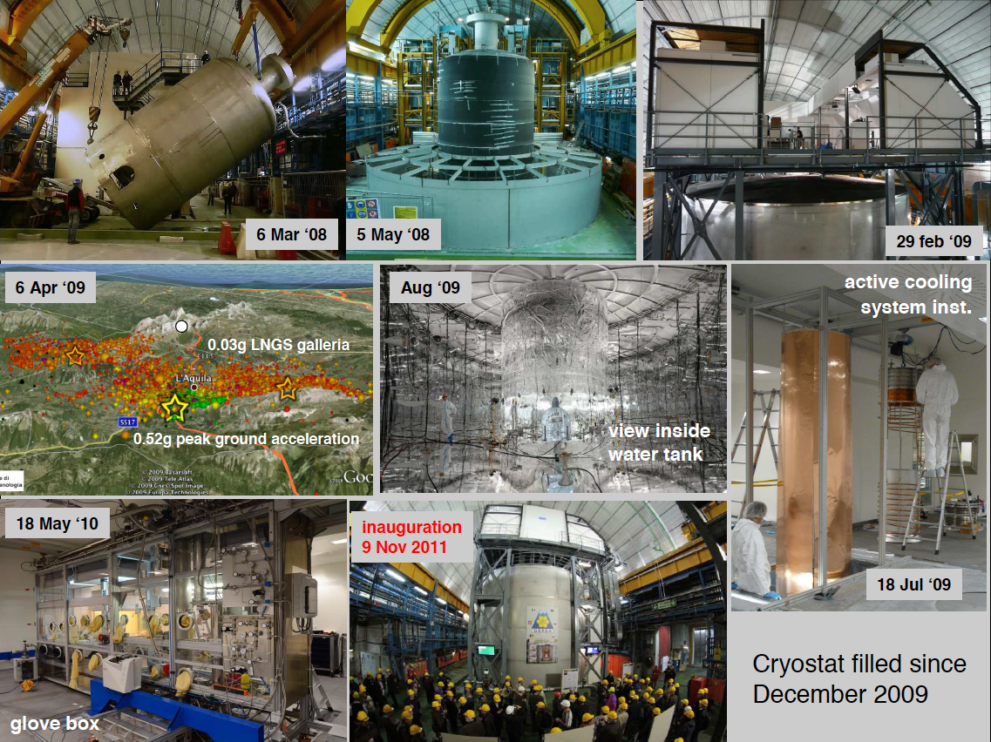
GERDA construction phase 2008-2010
2010

Slide 44
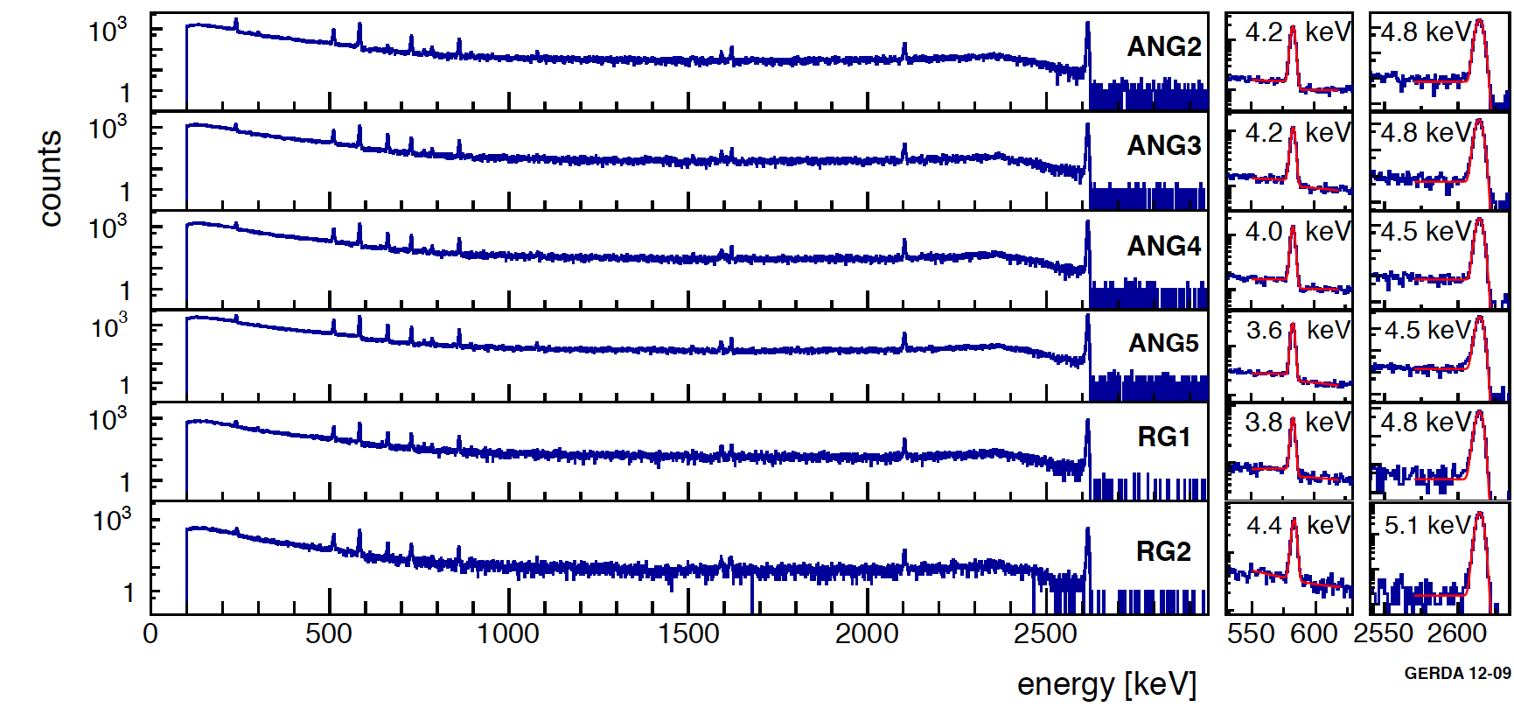
²²⁸Th calibration spectra
energy resolution
Energy resolution at Q_{ββ} (FWHM, mass weighted average):
  4.5 keV for coaxial detectors
  3 keV for BEGe detectors

Slide 45
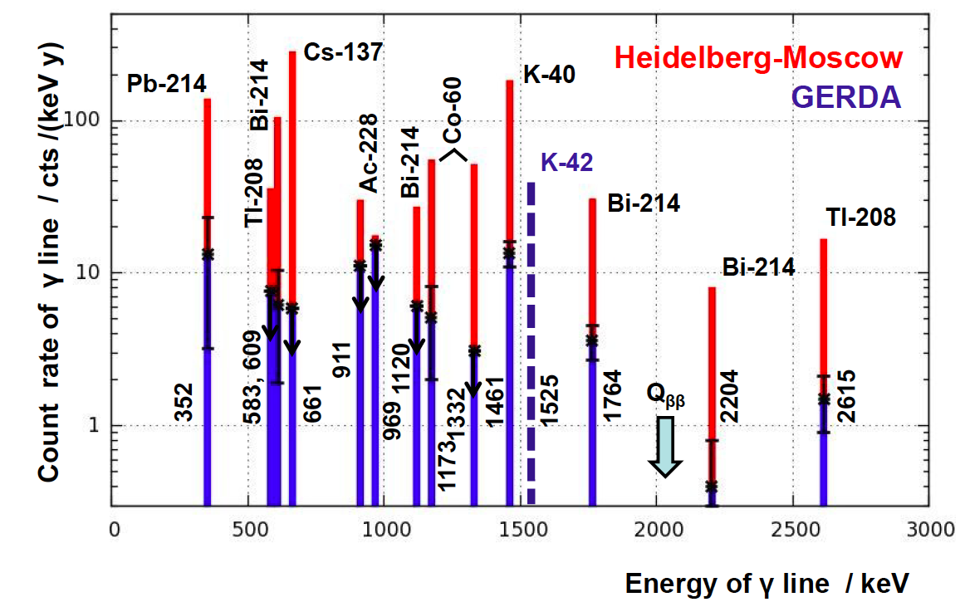
Phase I ongoing (preliminary)
GERDA backgrounds are ~ 1/10th Heidelberg-Moscow experiment

Slide 46
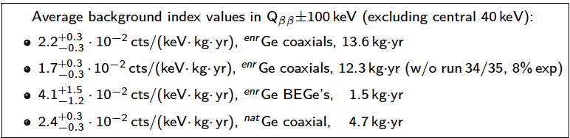



Phase I background index at Q_{ββ}:

Slide 47



GERDA 2νββ spectrum from first 5.04 kg-y
Precursor Heidelberg-Moscow experiment
H.V. Klapdor-Kleingrothaus et al.
Eur. Phys. J. A 12, 147–154 (2001)
S/B ~ 1/1
GERDA collaboration, J. Phys. G: Nucl. Part. Phys. 40 (2013) 035110

Slide 48


Conclusions
Phase 1 started Nov 2011
  more than 15kg.y exposure collected
  background order of magnitude lower
    ~ 0.02cts/(keV kg y) @ Q_{ββ}
  Measured 2νββ half-life
    reduced of systematics
  Phase 1 ~ complete
    0νββ sensitivity
  Phase 2
    in preparation
    goal <0.001cts/(keV kg y)

Slide 49


CUORE
Cryogenic Underground Observatory for Rare Events
Searching for neutrinoless double beta decay of ¹³⁰Te
¹³⁰Te good DBD candidate: high natural abundance (34.2 %), reasonably high Q-value (2528 keV)
TeO₂ is a compound with good mechanical and thermal properties containing ¹³⁰Te
5x5x5 cm³ TeO₂ crystals have a high detection efficiency for 0νββ events: ~87.4%
setup
988 TeO₂ 5x5x5 cm³ crystals (750 g each)
Detector Mass: 741 kg TeO₂
¹³⁰Te mass (natural i.a.) : 206 kg of ¹³⁰Te
Array: 19 towers
CUORE Hut
CUORE-0 Hut
background goal: 0.01 counts/kg keV y

Slide 50


CUORE status
low-noise, cryogen-free, low-activity cryostat
~ 6 mK
6 nested copper vessels (300 K to 10 mK)
Cryogen free (better duty cycle)
Independent Detector suspension
  less vibrational noise from refrigerator
Material selection
  low radioactivity
Neutron and External+Internal Pb shields
Crystals: 95% stored underground at LNGS
Thermistors: final delivering in early 2013

Slide 51




CUORE first phase – CUORE-0
1 CUORE-like tower of 13 planes - 4 crystals each
52 TeO₂ 5x5x5 cm³ crystals
Detector Mass: 39 kg TeO₂
¹³⁰Te mass (natural i.a.): 11 kg of ¹³⁰Te
Assembled in N₂ atmosphere
uses equipment developed for CUORE
e.g. new CUORE gluing semi-automatic machine
CTAL (CUORE Tower Assembly Line)
radioactivity control
reproducible protocols
Ch. # 45 calibration spectrum
(²³²Th source)
E (@2615 keV) = 5.3 keV (FWHM)

Slide 52

CUORE sensitivity

Slide 53











COBRA: The idea
Use large amount of CdZnTe Semiconductor Detectors
Source = detector
• Focus on ¹¹⁶Cd
Q-value = 2813.50 ±0.13 keV
Semiconductor
Good energy resolution, clean
Room temperature
Modular design
Coincidences
Tracking/Pixelisation
“Solid state TPC”
K. Zuber, Phys. Lett. B 519,1 (2001)

Slide 54





Setup at Gran Sasso Lab
Upgrade to 64 detectors soon
Current spectrum (32 detectors), 51.1 kg*days
Background at 2813 keV about 1 ct/keV/kg/yr
Preliminary
¹¹⁶Cd peak region
22Na, 40K peaks
Indication of
2νββ-decay
(after cuts)
Very preliminary
Published half-life

Slide 55





The pixel option – Semiconductor tracker
Idea: Massive background reduction by particle identification
According to Monte Carlo simulation this reduce background by 2-3 orders of magnitude
Alpha
200 μm pixel simulation
Bi-214 =
Time coincidence of both
Electron 3 MeV
55 μm pixel real event
alpha
electron
alpha
electron
200 μm pixel simulation
Real event!

Slide 56




Particle identification works !!!
Preselected samples
256x256 pixels, 55μm
Alphas
Electrons
Muons
4 new detectors (110 μm pitch, 2mm thick)
in back-to-back configuration with several
new low background components
installed at LNGS in December 2012

Slide 57

LUCIFER

Slide 58

LUCIFER

Slide 59
Dark Matter Searches

Slide 60



Rotation curves

Slide 61

Dark versus “Light” Matter Distributions
Normal Matter
Dark Matter

Slide 62
More Dark Matter

Slide 63
Dark Matter
Dark Matter
  (cosmologically)
should exist
and so it should be detectable
  with sensitive searches
  @ LNGS
    DAMA/LIBRA
    CRESST
    XENON
    DarkSide

Slide 64




DAMA/LIBRA
Ultrapure Na(Tl)
  Residual contamination
    ²³²Th, ²³⁸U and ⁴⁰K at level of 10⁻¹² g/g

Slide 65


DAMA/LIBRA – annual modulation
Comparison between single hit residual rate (red points) and
multiple hit residual rate (green points);
A=-(0.0006±0.0004) cpd/kg/keV
Multiple hits events = Dark Matter particle “switched off”
Power spectrum

Slide 66


DAMA: Model Independent Annual Modulation
T=2π/ω=1 yr and t₀= 152.5 day
ΔE = 0.5 keV bins
No modulation above 6 keV
No modulation in the whole energy spectrum
No modulation in the 2-6 keV multiple-hit events
Systematics or other processes do not explain quantitatively
the measured modulation amplitude and simultaneously satisfy the signal characteristics.
DAMA/LIBRA - phase 1 concluded:
the data of the last annual cycle will be released soon
New investigations on other rare processes in progress
DAMA/NaI (7 years) + DAMA/LIBRA (6 years) Total exposure: 425428 kg×day = 1.17 ton×yr
EPJC 56(2008)333, EPJC 67(2010)39
Notes:
66

Slide 67


CRESST-II
light detector
“light channel”
W sensor
neutron test latest run
β+γ
300g scintillating
CaWO₄ crstal
O
W sensor
“phonon channel”
light reflector
which also scintillates
→ phonon channel provides precise measurement of deposited energy
→ Light channel distinguishes types of interaction
→ Types of recoiling nuclei distinguished by different slopes in light energy plane

Slide 68


The latest CRESST run
From June 2009 to April 2011
– 18 modules installed
→ 10 complete modules operated (9 CaWO₄+1 ZnWO₄ )
→ 8 CaWO₄ modules used for analysis
Acceptance region:
O, Ca and W bands
E_{max}=40 keV,
E_{min}: e/γ leakage = 1 event per module in whole data set
(module specific)
Net exposure after cuts: 730 kg days
67 accepted events in 730 kg days
Results from Likelihood Fit
Assumes missing events due to WIMPs
Notes:
Likelihood ratio test to obtain a statistical measure if something else than the considered backgrounds is needed to explain the observation
Significance that signal is not produced by statistical fluctuation of backgrounds: 4.7σ (M1)/4.2σ (M2)
Additional source of events is needed at high statistical significance. WIMPs would be such a source with suitable energy and yield distribution.
Background contributions still relatively large. For ultimate clarification reduction is necessary to reduce possible uncertainties in modeling of these backgrounds.
Goal of the next run is a reduction of backgrounds to clarify the nature of the signal

Slide 69
XENON
DM Search with sensitivity 10⁻⁴⁷ cm²
Phased programme
  increased fiducial mass 0.01T → 0.1T → 1T
  decreased background
XeTPC detector
  two phase (liquid/gas)
  charge and light detection
    signal identification
      energy and position reconstructed
    & background rejection
      Liquid Xe self shielding
      Fiducial Volume Selection
      Multiple scattering and nuclear/electron event discrimination
XENON100 taking data
XENON1T in construction

Slide 70

The XENON Family of TPCs

Slide 71

XENON100 SI results

Slide 72

XENON100 SD results

Slide 73

XENON1T Sensitivity
Limit after 2T-years

Slide 74


Darkside (LAr Dark Matter Search)

Slide 75
DarkSide Program: Status
DarkSide-50 (2×10⁻⁴⁵ cm²)
  Funded by DOE, INFN, NSF
DarkSide-G2 (2×10⁻⁴⁷ cm²)
  R&D funded by NSF (May 1 2012)
Detector requirements
  Low energy nuclear recoils (< 100 keV)
  Low rate (~1 event/ton/yr for 10⁻⁴⁷ cm²)
  Background, background, background
Detector designed for discovery

Slide 76


Darkside inner chambers

Slide 77

Scalable, zero-background
Pulse shape Discrimination
  Primary Scintillation
Ionization/scintillation Ratio
Sub-cm Spatial Resolution
Underground argon
DS-10 Results
  LY=8.9 pe/keVee

Slide 78


DarkSide-10 Run#4
Background
Am-Be Source
³⁹Ar β’s
LY down to 7.0 pe/keVee with HR-PTFE reflector
Stainless steel-cryo HDPE HHV feed-through
  reached required 36 kV
  operated stably for over 8 months

Slide 79

“Underground” Argon
<6.5 mBq/kg
  125 of 150 kg collected
  stable production at 1/2 kg/day
  expansion up to 50 kg/day

Slide 80
Need for “ugly facts”
The great tragedy of Science: the slaying of a beautiful hypothesis by an ugly fact
TH Huxley (1825-1895)

Slide 81
Tests of Fundamental Principles
VIP (Test of the Pauli Principle)
GINGER (Test of General Relativity)

Slide 82

VIP
Test Pauli Exclusion Principle
      (PEP)
electrons
clean environment (LNGS)
atomic physics
PEP prohibited transitions
electrons in copper circulating a current
    2p -1s transition
    1s level already occupied by 2 electrons

Slide 83
VIP Experimental method
Search for anomalous X-ray transitions
n=2
n=2
n=1
n=1
2p –>1s PEP violating transition
Energy 7.7 keV
Normal 2p –>1s transition
Energy 8.04 keV
Respecting the Messiah Greenberg superselection rule

Slide 84
Violation of Spin Statistics
Possible motivations for PEP violation
  violation of CPT
  violation of locality
  violation of Lorentz invariance
  extra space dimensions
  discrete space and/or time
  noncommutative spacetime.
See, for example, O.W. Greenberg (AIP Conf.Proc.545:113-127,2004)

Slide 85



VIP setup at LNGS

Slide 86
VIP limit at LNGS
Probability of PEP violation
(Foundation of Physics 41 (2011) 282)
... Already in my original paper I stressed the circumstance that I was unable to give a logical reason for the exclusion principle or to deduce it from more general assumptions.
I had always the feeling and I still have it today, that this is a deficiency.
... The impression that the shadow of some incompleteness [falls] here on the bright light of success of the new quantum mechanics seems to me unavoidable.
W. Pauli, Nobel lecture 1945

Slide 87

Next steps
Use of new detectors
  triggerable SDD
A new setup
  more compact;
  higher acceptance
  lower background
gain a factor 100
  3-4 years data taking

Slide 88



GINGER
Gyroscopes IN GEneral Relativity
  use light to probe
    de Sitter and Lense–Thirring relativistic effects
    Uses the Sagnac effect
      2 light beams counter-propagating in a ring radius R

Slide 89



Requirements: Lense-Thirring measurement

Slide 90



Arrangement of (3) ring lasers
GINGER
  Preliminary measurements
    Underground
    On the surface
Underground location needed
  Atmospheric variation
    Wind, pressure
    temperature

Slide 91
Other Science

Slide 92


The LUNA experiment
nuclear fusion reaction cross sections
  Stars powered by nuclear reactions
  Key parameters to model stars
    chemical composition, opacity…
    reactions cross sections
      determine the origin of elements
      stellar evolution and dynamics
    Many reactions need high precision data.

Slide 93


LUNA site
Laboratory for Underground
Nuclear Astrophysics
LNGS
(1400 m rock shielding ≡ 4000 m w.e.)
LUNA MV
(2012->...)
LUNA 1
(1992-2001)
50 kV
LUNA 2
(2000→…)
400 kV
Radiation | LNGS/surface
Muons Neutrons | 10⁻⁶ 10⁻³

Slide 94
LUNA astrophysical motivation
Solar neutrinos:
  ³He(³He,2p)⁴He, ³He(⁴He,γ)⁷Be, ¹⁴N(p,γ)¹⁵O
Age of globular cluster:
  ¹⁴N(p,γ)¹⁵O
Light nuclei nucleosynthesis
    (¹⁷/¹⁸O abundances, ¹⁹F production, ²⁶Mg excess,...):
  ¹⁵N(p,γ)¹⁶O, ¹⁷N(p,γ)¹⁸O, ²⁵Mg(p,γ)²⁶Al
Big Bang Nucleosynthesis:
  ²H(α,γ)⁶Li, ³He(⁴He,γ)⁷Be, ²H(p,γ)³He
Next:
Light nuclei nucleosynthesis:
  ¹⁷O(p,α)¹⁴N, ²²Ne(p,γ)²³Na, ²³Na(p,γ)²⁴Mg, ¹⁸O(p,γ)¹⁹F, ¹⁸O(p,α)¹⁵N
He burning and stellar evolution:
  ¹²C(α,γ)¹⁶O
s process nucleosynthesis:
  ¹³C(α,n)¹⁶O, ²²Ne(α,n)²⁵Mg

Slide 95
LUNA MV Project
Higher energy machine
  3.5 MV single ended positive ion accelerator
  Now funded by Italian Research Ministry
    2,8 Million of Euros!
    New collaborations highly welcome
Aim
key s-process reactions
  Helium burning
  neutron sources
    ¹²C(α,γ)¹⁶O
    ¹³C(α,n)¹⁶O
    ²²Ne(α,n)²⁵Mg
    (α,γ) reactions on ^{14,15}N and ¹⁸O
  Relevant at higher temperatures than hydrogen-burning

Slide 96


ERMES(-WORLD) proposal
Environmental Sciences encompass complex processes
  Climate Change
  Earth’s interior and its
  global geodynamic processes,
  primary resources e.g. water, etc.
characterization through radionuclide markers
modelling needs accurate experimental data
  ultra-low level background environment
  underground laboratory
Notes:
Environmental radioactivity
Solid and Fluid Earth Dynamics
Neutrino and Dark Matter detection
Nuclear Metrology,
Health Safety, Nuclear Safety,
Cosmogenic, primordial, radiogenic and anthropogenic radionuclides are powerful tracers in Environmental Sciences for better characterisation of the Earth’s atmosphere, oceans, and overall hydrological processes (water vapour dynamics, meteoric precipitations, groundwater, etc.).
Primordial radionuclides are also fundamental probes for studying Earth’s interior, opening new scenarios in the Earth’s heat flow modelling as well as geodynamical processes in upper mantle and lithosphere.
Environmental radioactivity represents itself as a synergy crossover in space and time from all Environmental Sciences:
Radionuclides and radioactive decays are bridging past, present and future processes, and linking Earth’s environmental dynamics. Therefore, a comprehensive understanding of Earth’s climate, geodynamics,

Slide 97
Low background radiation
Test the “Linear No Threshold” model
  No point in doubling the dose
  Need to lower the dose
    Is the damage to cells (DNA) ∝ dose
      at low dose
    or are low doses of radiation
      more damaging ….. or ….
      less damaging
    than expected from the LNT model
  in vitro studies done
    with tantalising results
  in vivo ??????

Slide 98
Summary
The Scientific Programme at Gran Sasso is
  World-leading
  Addresses important scientific issues
  Neutrino physics
    neutrino oscillations
    solar physics
    double beta decay
    cosmogenic & geo neutrinos
  Dark Matter
  Foundations of physics and cosmology
  potentially Environment and health
A national lab & international asset

