Slide 1
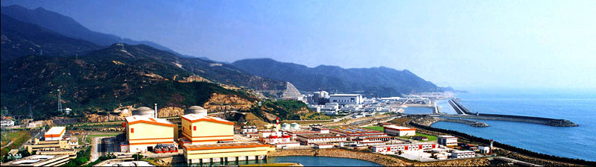
Daya Bay: Results and Future
Jun Cao （IHEP）
On Behalf of the Daya Bay Collaboration
XV International Workshop on Neutrino Telescopes
11-15 March 2013, Palazzo Franchetti, Istituto Veneto di Scienze, Venice

Slide 2
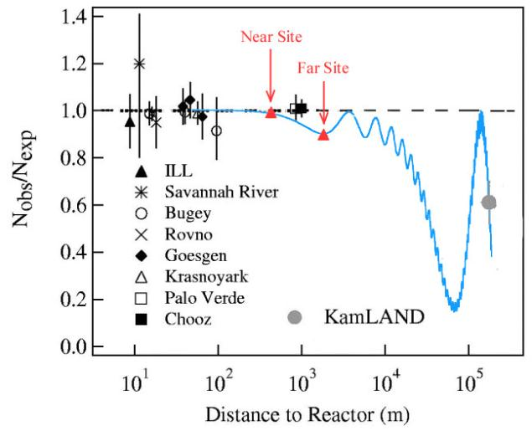
Measure θ₁₃ with reactors
Daya Bay is a reactor neutrino experiment designed to measure sin²2θ₁₃ to 0.01 at 90% CL
Precision experiment with
Near-far relative measurement
Major uncertainties:
Reactor related
~2% → 0.1%
Detector related
~2% → 0.18-0.38%
Background (shielding)
1~3% → 0.5%
4MeV ͞ν_{e}

Slide 3
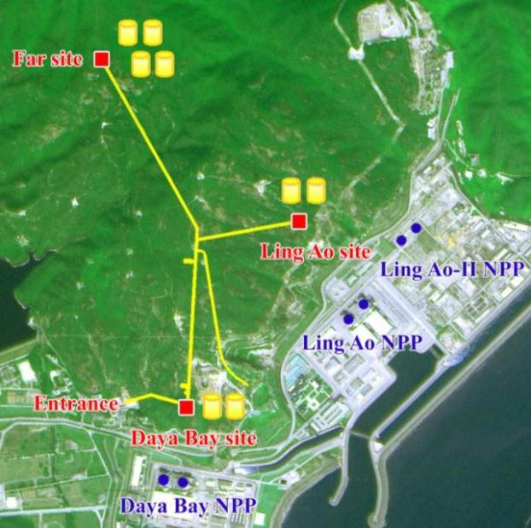
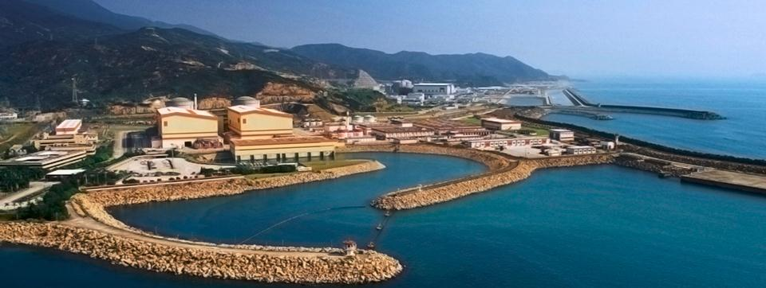
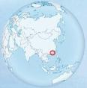
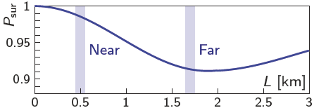
The Daya Bay Experiment
6 reactor cores, 17.4 GW_{th}
Relative measurement
  2 near sites, 1 far site
Multiple detector modules
Good cosmic shielding
  250 m.w.e @ near sites
  860 m.w.e @ far site
  Redundancy
3km tunnel

Slide 4
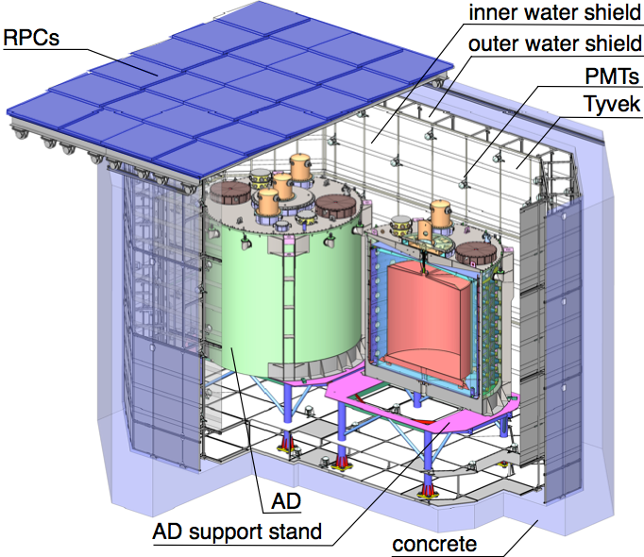
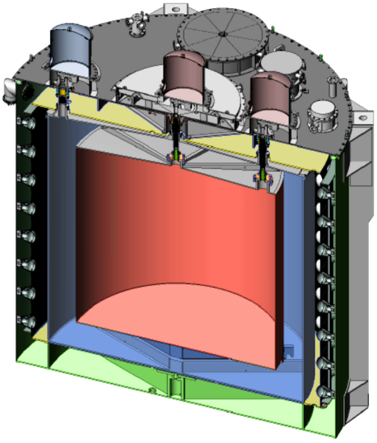
The Daya Bay Detectors
Automated Calibration Units (ACU)
reflector
40 t MO
20 t LS
20 t Target
reflector
Multiple AD modules at each site to check uncorr. syst. err.
  Far: 4 modules，near: 2 modules
Multiple muon detectors to reduce veto eff. uncertainties
  Water Cherenkov： 2 layers
  RPC： 4 layers at the top + telescopes

Slide 5
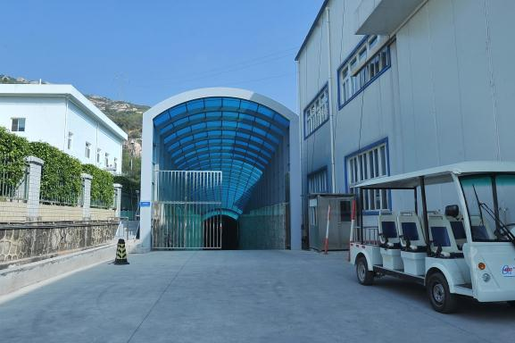
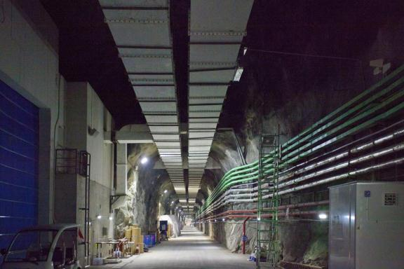
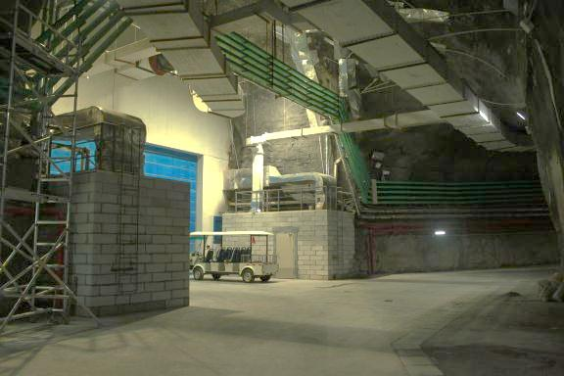
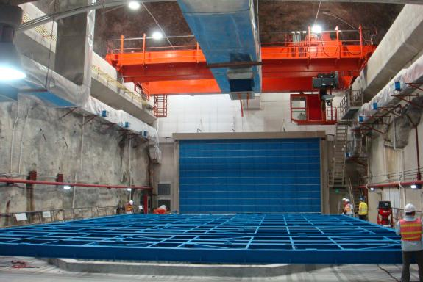
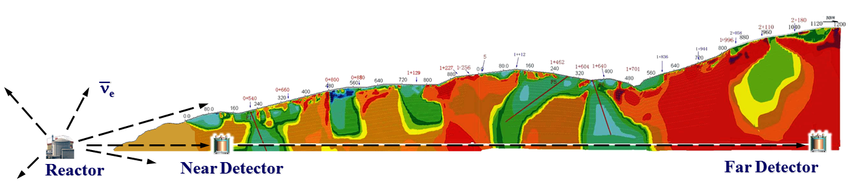
Tunnel and Underground Lab.

Slide 6
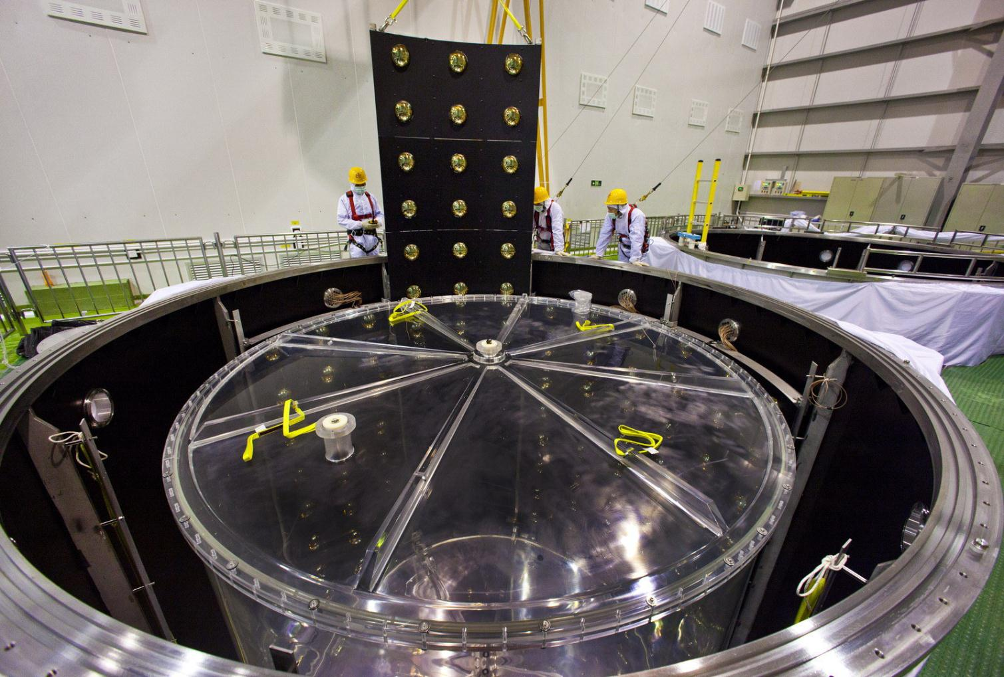
Antineutrino Detector

Slide 7
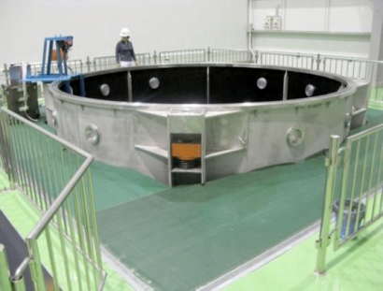
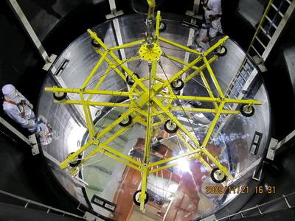
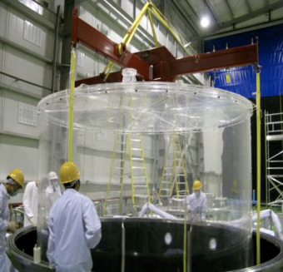
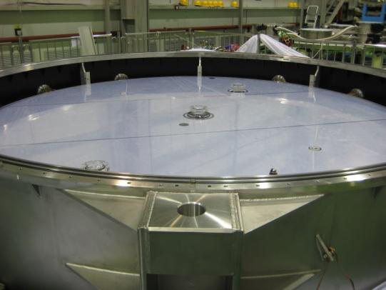
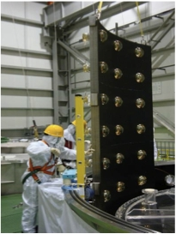
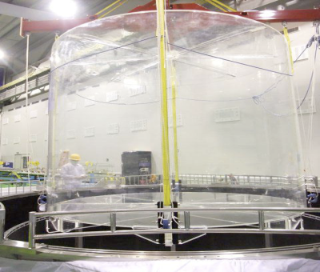
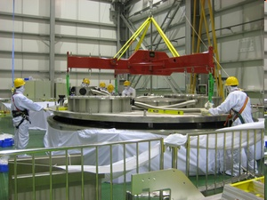
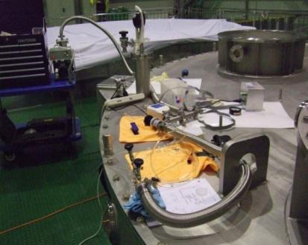
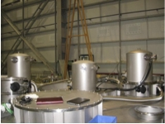
Antineutrino Detector Assembly
Stainless steel tank
Reflector
Outer Acrylic
Relector
PMT
Inner Acrylic
Lid
Leak Check
Auto Calib.

Slide 8
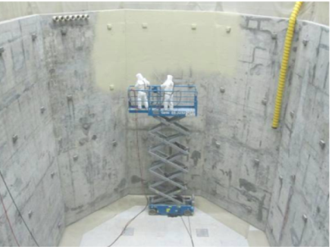
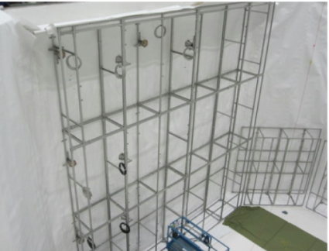
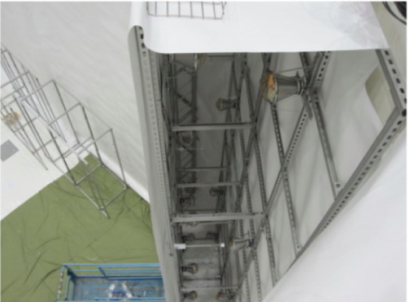
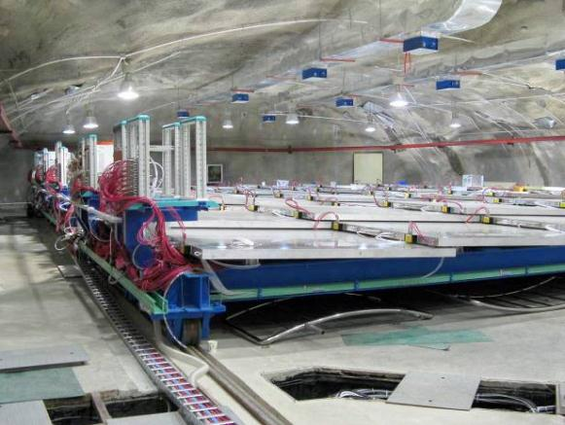
Muon System Installation
OWS
IWS

Slide 9
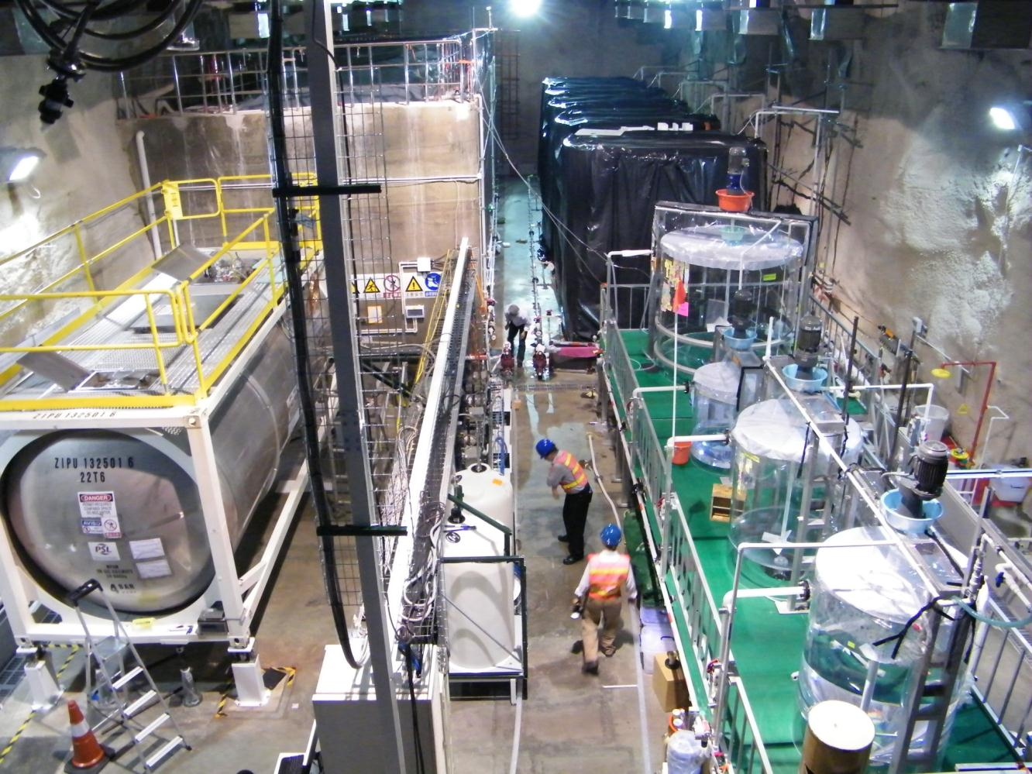
Liquid Scintillator Hall
Mineral Oil
185 ton 0.1% Gd-LS
Liquid Scintillator
Filling Equipment
LS mixing equipment
ISO tank equiped with load cell. Target mass errorr ~0.03%

Slide 10
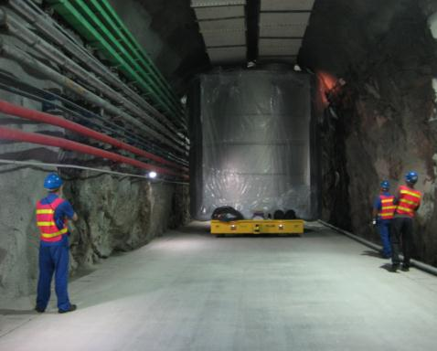
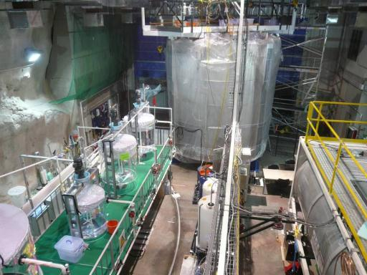
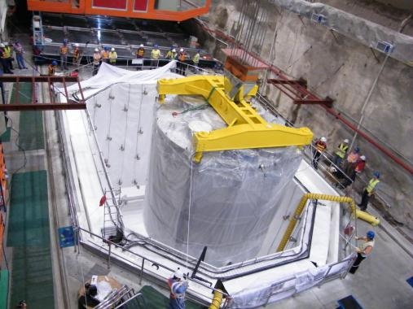
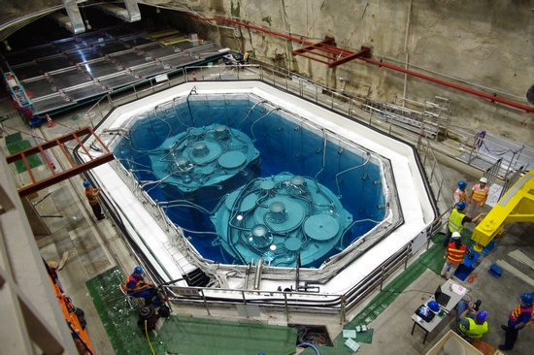
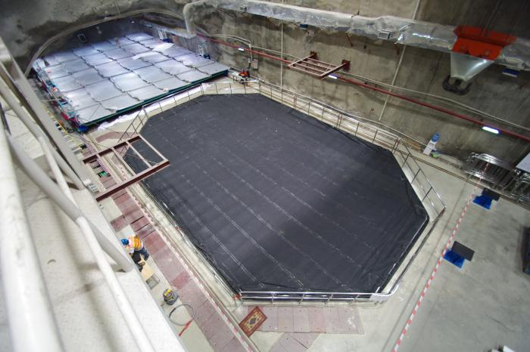
Detector Filling and Installation

Slide 11
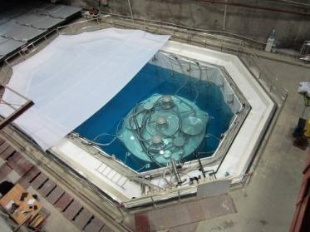
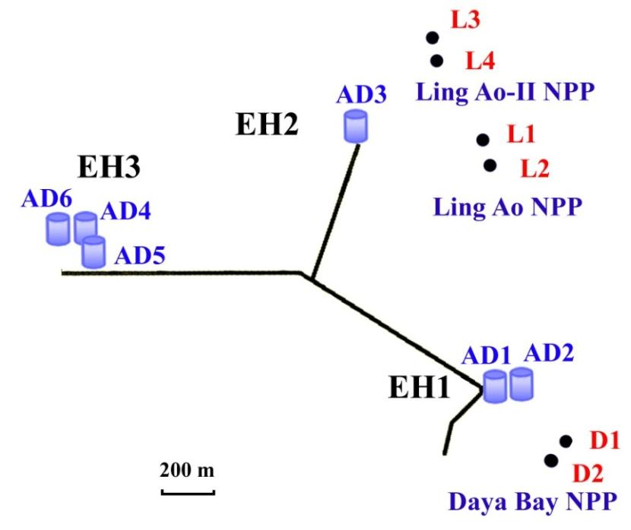
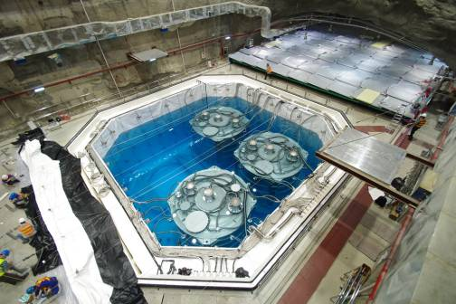
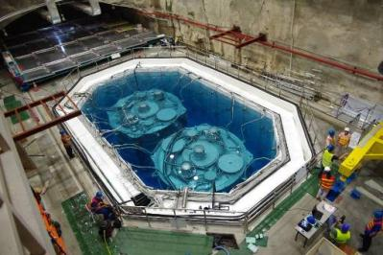
Three Underground Experiment Halls
2011-11-5
2011-12-24
2011-8-15

Slide 12
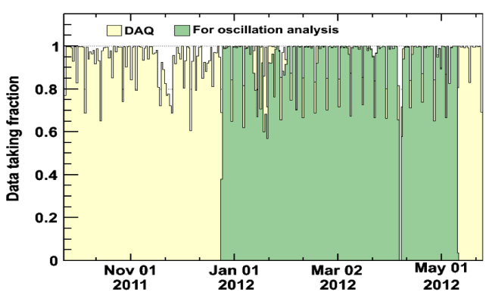
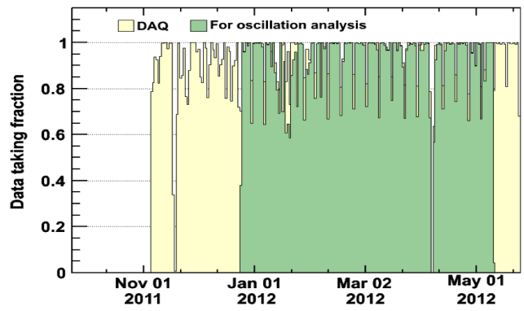
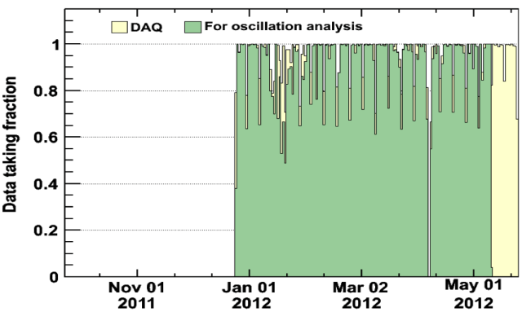
Data Period
A→Two Detector Comparison: Sep. 23, 2011 – Dec. 23, 2011
Nucl. Inst. and Meth. A 685, 78 (2012)
B→First Oscillation Result:
Dec. 24, 2011 – Feb. 17, 2012
Phys. Rev. Lett. 108, 171803 (2012)
C→Updated analysis:
Dec. 24, 2011 – May 11, 2012
Chinese Physics C37, 011001 (2013)
  Data volume: 40TB
  DAQ eff. ~ 96%
  Eff. for physics: ~ 94%
A
Hall 1
B
C
Hall 2
Hall 3

Slide 13

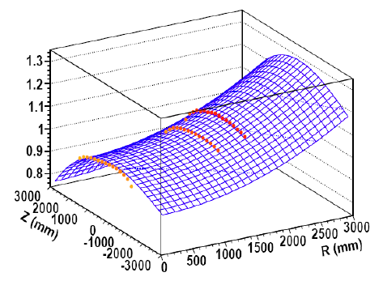
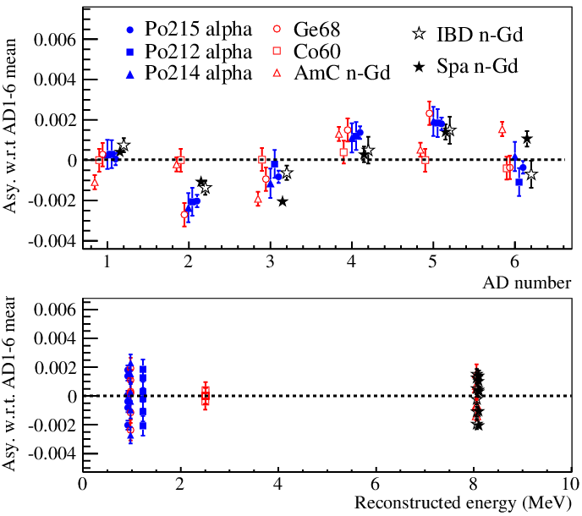
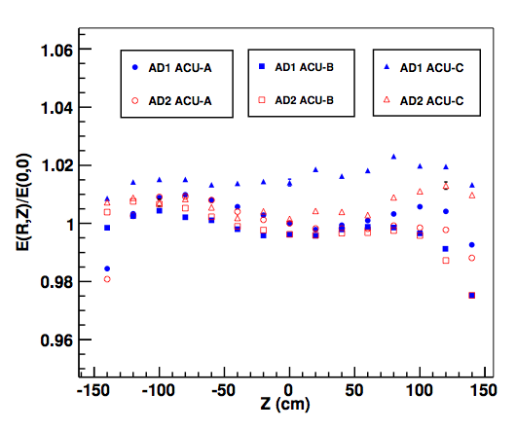
Energy calibration & reconstruction
Low-intensity LED → PMT gains are stable to 0.3%
⁶⁰Co at the detector center → raw energies
  Correct small (0.2%) time dependence
⁶⁰Co at different positions in detector
  Correct vertex dependence
  Common correction for all the ADs
  Calibrate energy scale using neutron capture peak
The same non-linearity for all detectors
~2% level residual non-uniformities
→ 0.12% efficiency difference among detectors

Slide 14
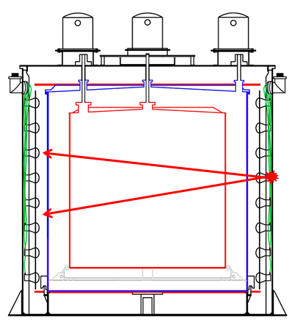
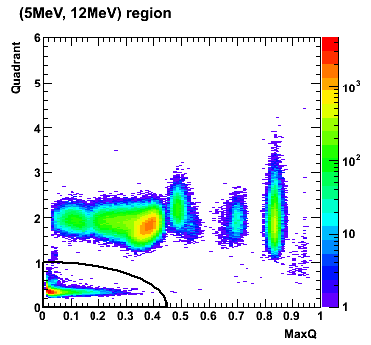
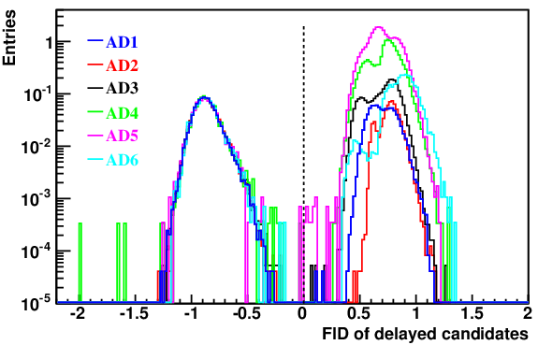
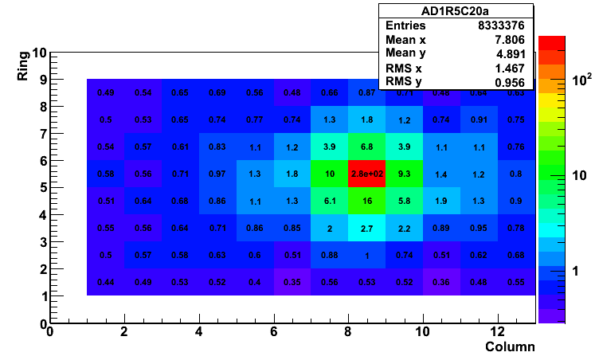
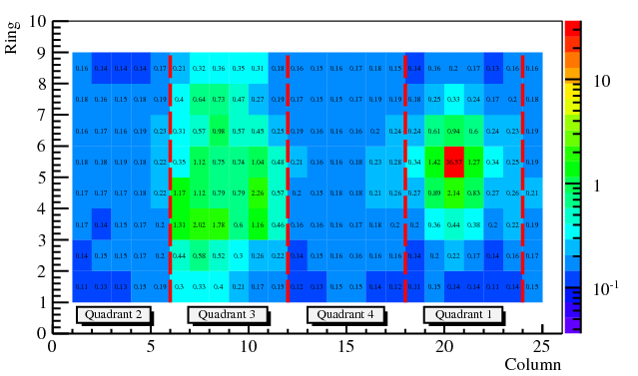
PMT Flasher
PMT spontaneous light, rejected by hit pattern discriminator
Efficiency 99.98%
Uncertainty 0.01%
signal
Flasher

Slide 15
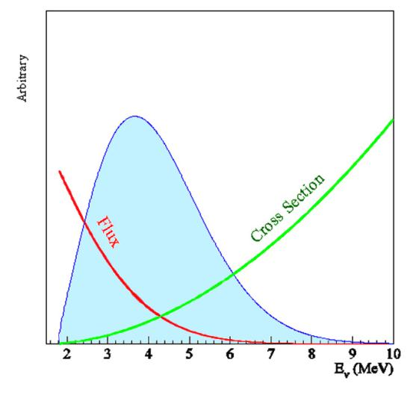
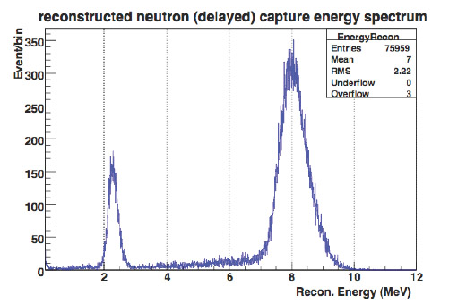
Detecting Reactor Antineutrino
Inverse beta decay
Prompt signal
Peak at ~4 MeV
Delayed signal, Capture on H (2.2 MeV) or Gd (8 MeV), ~30μs
0.1% Gd by weight
Backgrounds:
Cosmogenic neutron/isotopes
  ⁸He/⁹Li
  fast neutron
Ambient radioactivity
  accidental coincidence
(alpha,n)
Am-C source
Capture on H
Capture on Gd
Geant4 simulation

Slide 16





Anti-neutrino Selections
0.7-12 MeV
6-12 MeV
Prompt candidate
Delayed candidate
Reactor Neutrinos
(Prompt)
Neutrons (Delayed )
Correlated Events in 1-200 μs

Slide 17



Selection Cuts
0.7 MeV < E_{p} < 12.0 MeV
6.0 MeV < E_{d} < 12.0 MeV
1 μs < Δt_{p-d} < 200 μs
Muon Veto: 0.6 ms after a Pool muon (reject fast neutron), 1 ms after an AD muon (reject double neutron), 1 s after an AD shower muon (reject ⁹Li/⁸He)
Multiplicity cut: No other >0.7 MeV trigger in (t_{p}-200 μs , t_{d}+200 μs)
Neutrino Sample
Delayed energy
Prompt energy
Time between prompt-delayed

Slide 18



Backgrounds：Accidentals
0.7-12 MeV
6-12 MeV
Prompt candidate
Delayed candidate
Evaluated by coincidence probability
Cross checked by 1) off-windows coincidence; 2) vertex distance distribution

Slide 19



Backgrounds: ⁹Li/⁸He
Cosmic μ produced ⁹Li/⁸He in LS
⁹Li yield
β-decay + neutron emitter
Measurement:
  Time-since-last-muon fit method
  Improve the precision by preparing muon samples w/ and w/o followed neutrons
  Set a lower limit ⇒ Muons with small visible energy also produce ⁹Li/⁸He
B/S uncertainty:
B/S @ EH1/2 ~ 0.4%, B/S @ EH3 ~ 0.3%
ΔB/B ~ 50%

Slide 20

Backgrounds: Fast neutrons
Cosmogenic neutron:
proton recoil: prompt signal
neutron capture: delayed signal
Tagged fast-n spectrum
Evaluated by extraploation
Spectrum and rate cross checked with fast-n tagged by water pool
efficiency of IWS muon
efficiency of OWS ONLY muons
B/S @ EH1/2 ~ 0.12%, B/S @ EH3 ~ 0.07%
ΔB/B ~ 40%

Slide 21



Backgrounds: ²⁴¹Am-¹³C source & ¹³C(α,n)¹⁶O
Correlated backgrounds from ²⁴¹Am-¹³C source inside ACUs :
  Neutron inelastic scattering with ⁵⁶Fe + neutron capture on ⁵⁷Fe
  Simulation shows that correlated background is 0.2 events/day/AD
¹³C(α,n)¹⁶O correlated backgrounds
  Identified α sources(²³⁸U, ²³²Th, ²²⁷Ac, ²¹⁰Po) and rates from cascade decays and spatial distribution
  Calculate backgrounds from α rate + (α,n) cross sections
B/S @ EH1/2 ~ 0.03%, B/S @ EH3 ~ 0.3%, ΔB/B ~ 100%
B/S @ EH1/2 ~ 0.01%, B/S @ EH3 ~ 0.05%, ΔB/B ~ 50%
ΔB/B ~ 50%
(1μs, 3μs)
²³⁸U
²³²Th
(10μs, 160μs)
²²⁷Ac
Prompt energy (MeV)
(1ms, 2ms)
Total
²²⁷Ac
n-like singles
Delayed energy (MeV)
Time correlations of the cascade decays

Slide 22
Backgrounds summary
 | Near Halls |  | Far Hall
 | B/S(%) | σ_{B/S}(%) | B/S(%) | σ_{B/S}(%) | ΔB/B
Accidentals | 1.5 | 0.02 | 4.0 | 0.05 | ~1%
Fast neutrons | 0.12 | 0.05 | 0.07 | 0.03 | ~40%
⁹Li/⁸He | 0.4 | 0.2 | 0.3 | 0.2 | ~50%
²⁴¹Am-¹³C | 0.03 | 0.03 | 0.3 | 0.3 | ~100%
¹³C(α, n)¹⁶O | 0.01 | 0.006 | 0.05 | 0.03 | ~50%
Sum | 2.1 | 0.21 | 4.7 | 0.37 | ~10%
Due to Am-C neutron source, reduced after shutdown
Total backgrounds are 5% (2%) in far (near) halls
Background uncertainties are 0.4% (0.2%) in far (near) halls

Slide 23




Side-by-side Comparison (1)
Relative uncertainties: difference between detectors
Two ADs in EH1
nGd 8 MeV peak
NIMA 685, 78 (2012)
n capture time
AD spectra

Slide 24



Efficiency and Uncertainties
Functionally idential detectors: no detector-by-detector corrections. Asymmetries taken as uncorrelated uncertanties.
within 0.5%
Uncorrelated uncertainties are all evaluated with data.
Similar comparison for all 6 ADs

Slide 25

Side-by-side Comparison (2)
Expected ratio of neutrino events: R(AD1/AD2) = 0.982
  The ratio is not 1 because of target mass, baseline, etc.
Measured ratio: 0.987 ± 0.004(stat.) ± 0.003(syst.)
Neutrino Enery spectra
Data set: 2011.9 to 2012.5
This check shows that syst. are under control, and will eventually "measure" the total syst. error

Slide 26


Daily Rate
Predictions are absolute, multiplied by a global normalization factor from the fitting, to account for the absolute ν flux and absolute detection eff. uncertainty.
Relative measurement: The global normalization factor was not constrained during fitting.

Slide 27



Observation of‾ν_{e} Disappearance (2012.3)
sin²2θ₁₃=0.092±0.016(stat)±0.005(syst)
R = 0.940 ± 0.011 (stat) ± 0.004 (syst)
A clear observation of far site deficit with the first 55 days’ data.
5.2 σ for non-zero value of θ₁₃
Phys. Rev. Lett. 108, 171803 (2012)

Slide 28


Daya Bay Improved Results (2012.6)
sin²2θ₁₃=0.089±0.010(stat)±0.005(syst)
R = 0.944 ± 0.007 (stat) ± 0.003 (syst)
With 2.5x more statistics, an improved measurement to θ₁₃
7.7 σ for non-zero value of θ₁₃
EH1 | 140 000 events
EH2 | 66 000 events
EH3 | 30 000 events
Chinese Physics C, Vol. 37, No. 1 (2013) 011001
Still dominated by statistics

Slide 29



Another 2 ADs Installed
8 AD data taking on Oct. 19, 2012
AD8
AD7

Slide 30



4π Calibration and Special Calibration
Weekly calibration
  LED, Ge, Co, ²⁴¹Am-¹³C (0.5 Hz)
Special ACU
  Cs, Mn, K, Am-Be, ²³⁸Pu-¹³C
  (and Am-C, Co)
Manual (4π)
  Co / ²³⁸Pu-¹³C (4% 6 MeV gamma)
ACU-B
ACU-A
ACU-C

Slide 31


Projected Daya Bay Sensitivity
8 AD run
sin²2θ₁₃
Δm²_{ee} vs sin²2θ₁₃
Similar precision as current accelerator exp. (3 years)

Slide 32
Summary & Outlook
Daya Bay has unambiguously observed reactor electron-antineutrino disappearance using 139 days of data
In a 3-neutrino framework, the observed disappearance leads to a mixing angle
All 8 antineutrino detectors have been installed.
Comprehensive calibration during summer shutdown.
Full 6 AD data set (40% more data) with rate+shape analysis in preparation.
In 3 years, Daya Bay will measure sin²2θ₁₃ to ~4% precision .
Pursue other physics, such as precise reactor ν_{e} flux and spectrum, and measurement of Δm²_{ee} (~ 4% precision).
R = 0.944 ± 0.007 (stat) ± 0.003 (syst)
sin²2θ₁₃ = 0.089 ± 0.010 (stat) ± 0.005 (syst)

Slide 33

The Daya Bay Collaboration
Europe (2)
JINR, Dubna, Russia
Charles University, Czech Republic
Asia (22)
IHEP, Beijing Normal Univ., Chengdu Univ.
of Sci. and Tech., CGNPG, CIAE, Dongguan
Polytech. Univ., Nanjing Univ., Nankai Univ.,
NCEPU, NUDT, Shandong Univ., Shanghai Jiao Tong Univ., Shenzhen Univ., Tsinghua Univ., USTC, Xi'an Jiaotong Univ., Zhongshan Univ.,
Univ. of Hong Kong, Chinese Univ. of Hong Kong,
National Taiwan Univ., National Chiao Tung Univ., National United Univ.
North America (16)
BNL, Caltech, LBNL, Iowa State Univ.,
Illinois Inst. Tech., Princeton, RPI,
UC-Berkeley, UCLA, Univ. of Cincinnati,
Univ. of Houston, Univ. of Wisconsin,
William & Marry, Virginia Tech.,
Univ. of Illinois-Urbana-Champaign, Siena
~230 Collaborators
Thanks !

Slide 34
Backup

Slide 35



Signal and Backgorunds
 | AD1 | AD2 | AD3 | AD4 | AD5 | AD6
Antineutrino candidates | 69121 | 69714 | 66473 | 9788 | 9669 | 9452
DAQ live time (day) | 127.5470 |  | 127.3763 | 126.2646
Efficiency ε_{μ}∗ε_{m} | 0.8015 | 0.7986 | 0.8364 | 0.9555 | 0.9552 | 0.9547
Accidentals (/day) | 9.73±0.10 | 9.61±0.10 | 7.55±0.08 | 3.05±0.04 | 3.04±0.04 | 2.93±0.03
Fast neutron (/day) | 0.77±0.24 | 0.77±0.24 | 0.58±0.33 | 0.05±0.02 | 0.05±0.02 | 0.05±0.02
⁸He/⁹Li (/day) | 2.9±1.5 |  | 2.0±1.1 | 0.22±0.12
Am-C corr. (/day) | 0.2±0.2
¹³C(α, n)¹⁶O (/day) | 0.08±0.04 | 0.07±0.04 | 0.05±0.03 | 0.04±0.02 | 0.04±0.02 | 0.04±0.02
Antineutrino rate (/day) | 662.47 ±3.00 | 670.87 ±3.01 | 613.53 ±2.69 | 77.57 ±0.85 | 76.62 ±0.85 | 74.97 ±0.84

Slide 36


Signal+Backgound Spectrum
EH1
138835 signal candidates
66473 signal candidates
 | Near Halls |  | Far Hall
 | B/S % | σ_{B/S} % | B/S % | σ_{B/S} % | ΔB/B
Accidentals | 1.5 | 0.02 | 4.0 | 0.05 | ~1%
Fast neutrons | 0.12 | 0.05 | 0.07 | 0.03 | ~40%
⁹Li/⁸He | 0.4 | 0.2 | 0.3 | 0.2 | ~50%
²⁴¹Am-¹³C | 0.03 | 0.03 | 0.3 | 0.3 | ~100%
¹³C(α, n)¹⁶O | 0.01 | 0.006 | 0.05 | 0.03 | ~50%
EH3
28909 signal
candidates

Slide 37
Baseline
Survey:
  Methods: GPS, Total Station, laser tracker, level instruments, …
  Results are compared with design values, and NPP coordinates
  Data processed by three independent software
Results: sum of all the difference less than 28 mm
Uncertainty of the fission center from reactor simulation:
  2 cm horizontally
  20 cm vertically
The combined baseline
error is 35mm,
corresponding to a
negligible reactor flux
uncertainty (<0.02%)
By Total station
By GPS

Slide 38


Target Mass & No. of Protons
Target mass during the filling measured by the load cell, precision ~ 3kg ➔ 0.015%
Checked by Coriolis flow meters, precision ~ 0.1%
Actually target mass:
M_{target} = M_{fill} – M_{overflow} - M_{bellow}
M_{overflow} and M_{bellows} are determined by geometry
M_{overflow} is monitored by sensors
bellows
Overflow tank
One batch LAB
Target Mass Variation
Quantity | Relative | Absolute
Free protons/Kg | neg. | 0.47%
Density | neg. | 0.0002%
Total mass | 0.015% | 0.015%
Bellows | 0.0025% | 0.0025
Overflow tank | 0.02% | 0.02%
Total | 0.03% | 0.47%

