Slide 1
KM3NeT multi-km³ neutrino telescope: perspectives
P. Sapienza LNS, INFN
for the KM3NeT collaboration

Slide 2
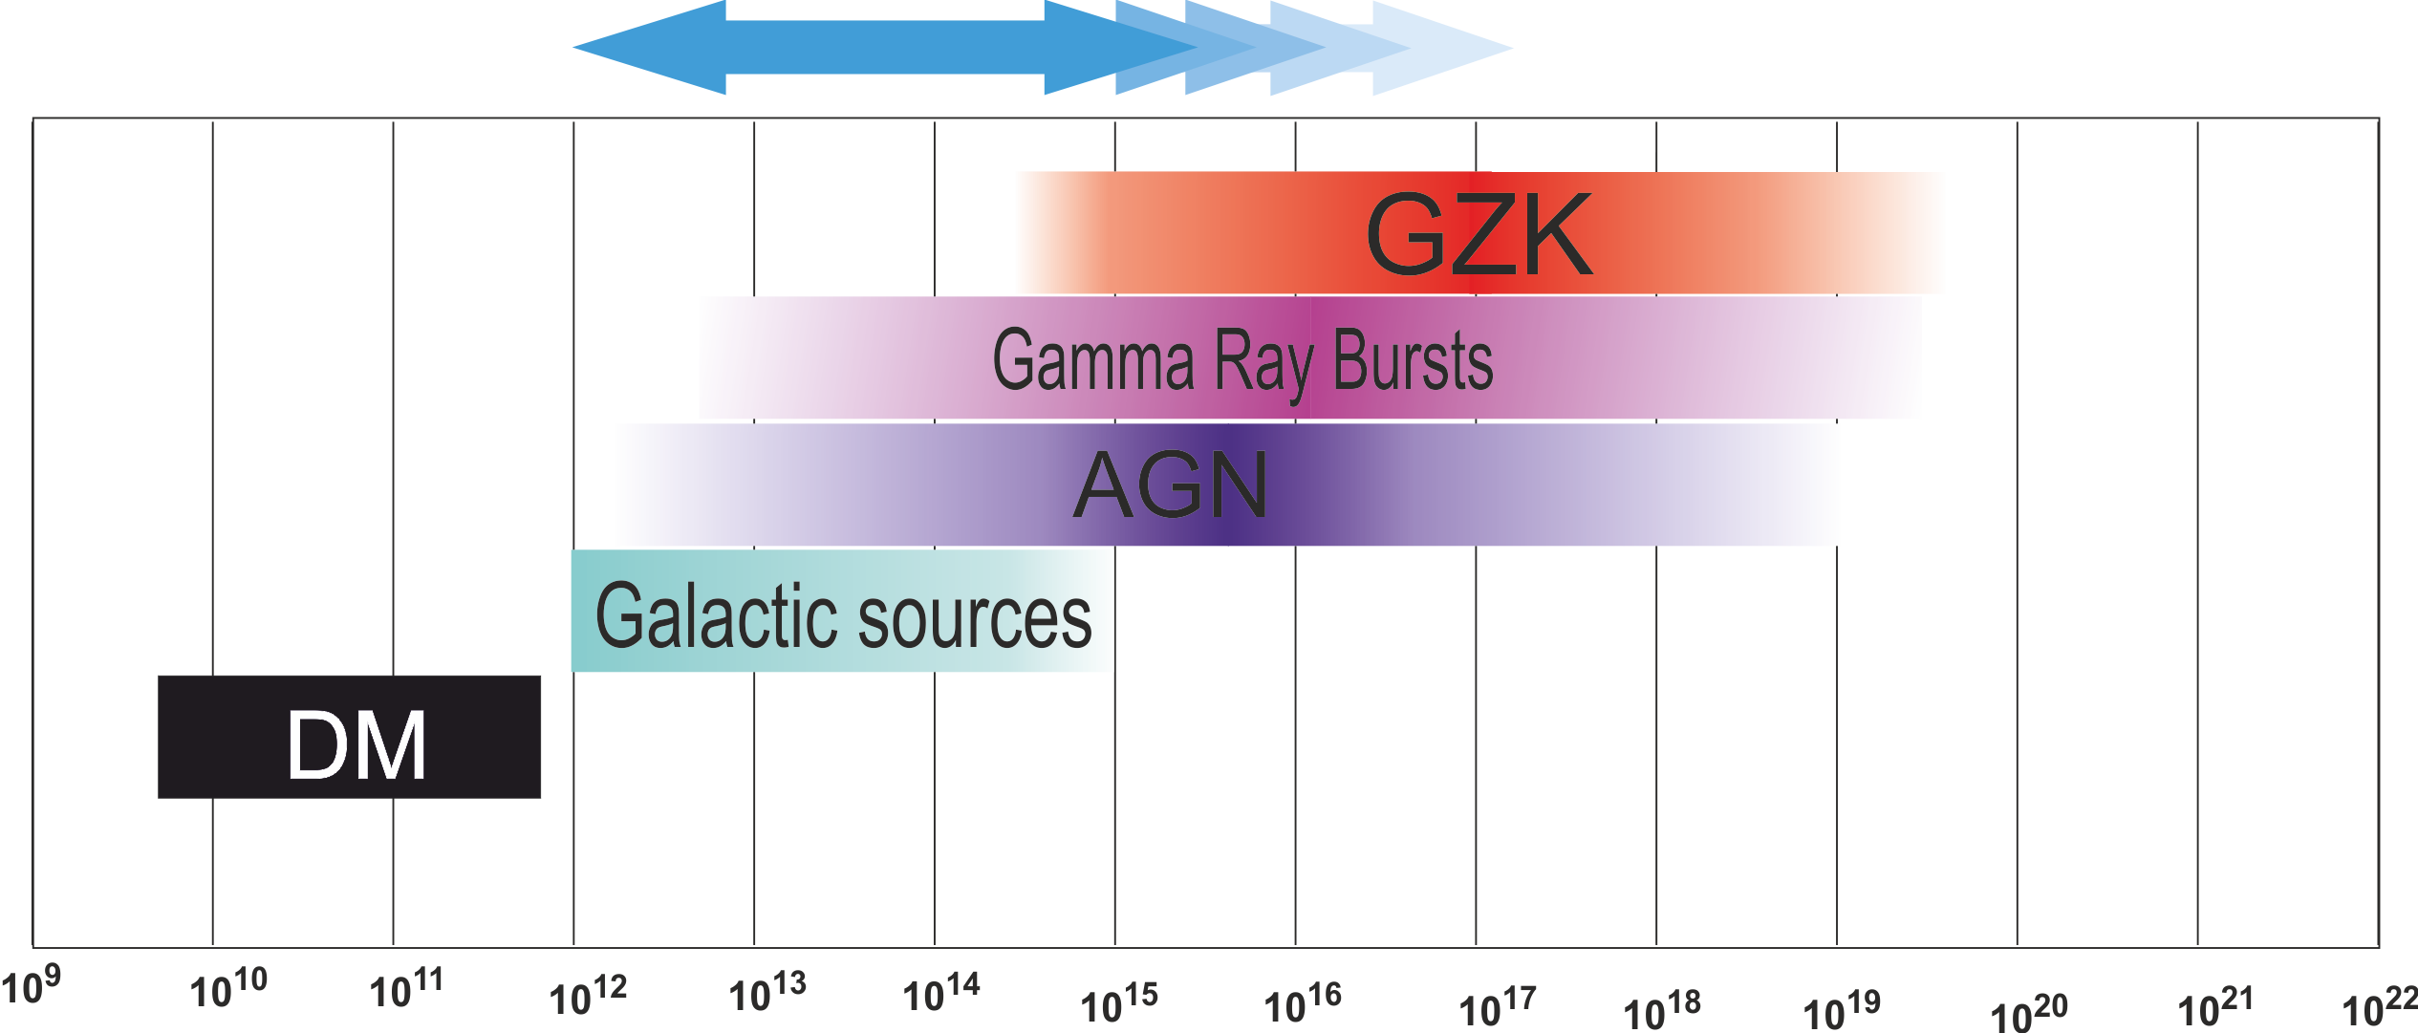
Neutrinos from the Cosmos
E [eV]
In addition to the search of cosmic neutrinos, the study of atmospheric neutrinos can provide very interesting pieces of information on neutrino physics => Mass Hierarchy
For fixed budget sensitivity can be optimized for different sources
This depends on sensor density

Slide 3
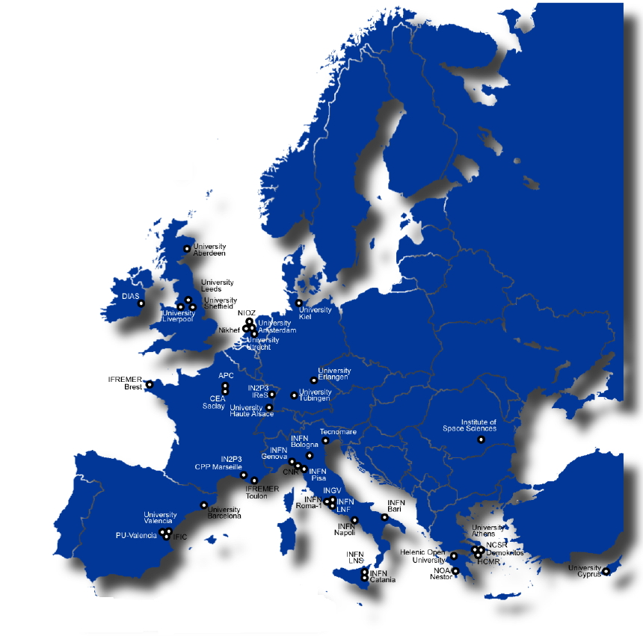
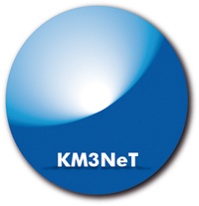
KM3NeT
International Collaboration involving more than 200 scientists from 10 EU countries (CY, DE, ES, FR, GR, IE, IT, NL, RO, UK)
Common objective: build the most sensitive high energy neutrino telescope in the Northern hemisphere (Mediterranean sea)
Total foreseen budget
about 220 M€

Slide 4
The KM3NeT collaboration
KM3NeT was Funded by EU under the 6° and 7° EU Frame Program with a Design Study and a Preparatory Phase
KM3NeT is included in the ESFRI and ASPERA roadmaps
The new KM3NeT collaboration Management and Organigram were appointed in the Marseille meeting in January 2013

Slide 5
Sky view of a Mediterranean Sea telescope (up-going neutrinos)
From Mediterranean 24h per day visibility up to δ ~-50°
>25%
>75%
KM3NeT coverage of most of the sky including the Galactic Centre

Slide 6
Technical Challenges and Design of a km³-scale underwater neutrino telescope
Technical design
Objective: Build, deploy and operate a km³-scale 3D-array of photosensors connected to shore (power, slow control, data)
@ 2500 – 5200 m depth undersea
  Optical modules (DOM)
  Mechanical structures (DU)
  Data transmission, information technology and electronics
  Deep-sea infrastructure
  Deployment
  Calibration
Builds on the experience gained with ANTARES, NEMO and NESTOR

Slide 7
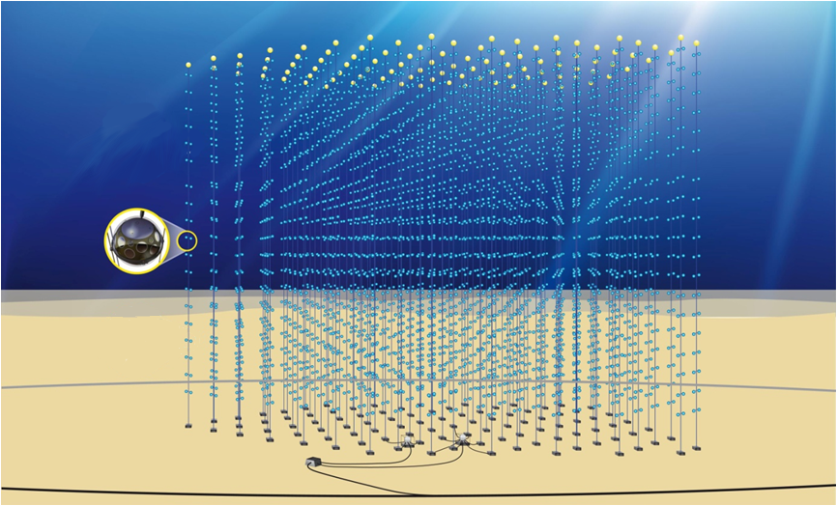
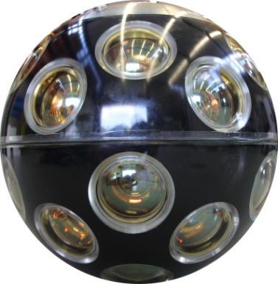
An artist impression of KM3NeT
(≈ 1/6 of the full detector)
Array of about 10000 optical sensors in the deep sea
KM3NeT in numbers
(full detector)
12200 DOM
~620 DU
20 DOM/DU
~ 40m DOM spacing
~1 km DU height
~100m DU distance
~ 5 km³ volume
Detection Units
Primary Junction box
Secondary Junction boxes
Electro-optical cable
Optical Module (DOM) = pressure resistant glass sphere containing PMTs and electronics
Detection Unit (DU) = mechanical structure holding OMs, envirormental sensors,…
DU is the building element of the telescope
Construction in several blocks => Multi-site option

Slide 8
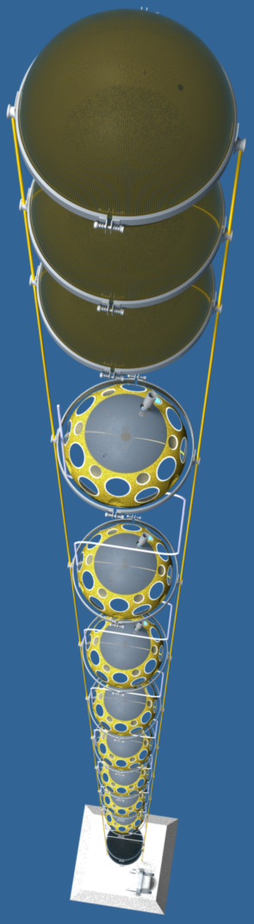
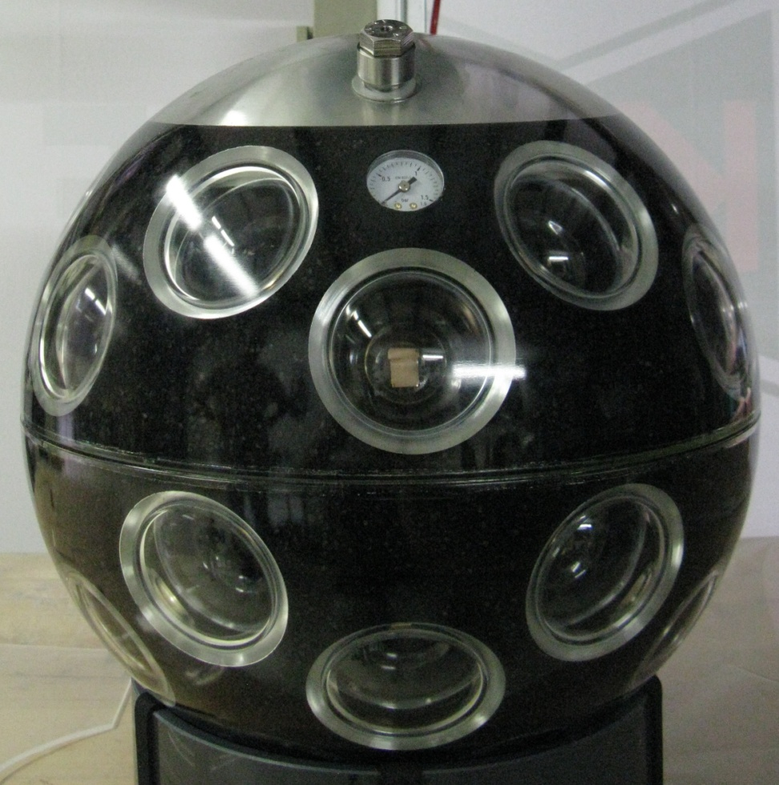
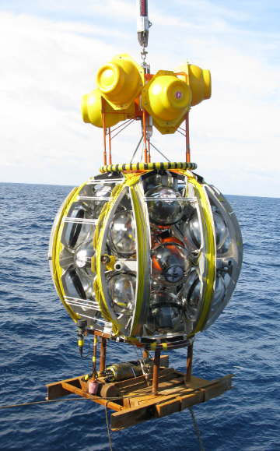
The string technology
Multi PMT Digital Optical Module
31 3” PMT/DOM
Photon counting
All electronic inside
Detection Unit with 20 storeys
40 m inter-storey distance
COMPACT DEPLOYMENT
ALL-DATA-TO-SHORE

Slide 9
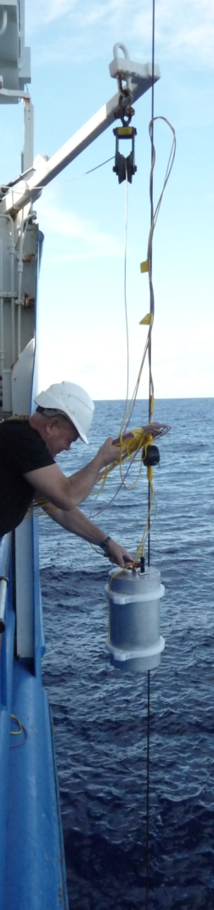
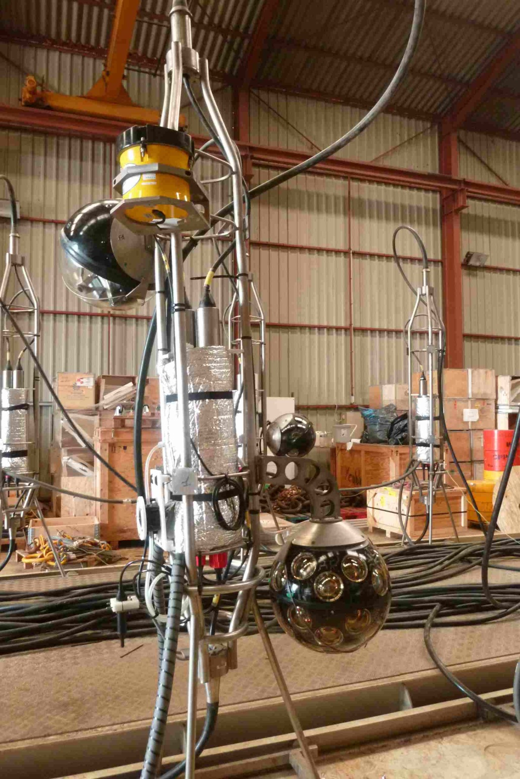
Prototyping and validation
A fully equipped DOM mounted in the Antares Instrumentation Line, test on shore successful, in-situ test to be performed in March 2013
Backbone test performed in Nov 2012 at 5000 m, the campaign was encouraging with minor problems. New test with several deployments foreseen April 2013
After DOM and DU validation a Pre Production Model DU with several DOMs will be built and deployed by the end of 2013

Slide 10
Galactic Candidate ν Sources
Detection of high energy neutrino from galactic sources is the main KM3NeT objective. If Cosmic Rays are produced by Super Nova Remnants both VHE gamma and neutrinos (from pion decay) should be emitted
Neutrinos are the smoking gun for hadron production mechanisms and point back to the source thus allowing its identification
Several hints from VHE gamma measurements in particular the recent results by Fermi-LAT on IC443 and W44 (Science 2013)
In case of hadronic mechanisms the neutrino spectrum can be calculated from VHE gamma spectrum
In the Southern hemisphere several promising sources have been identified

Slide 11
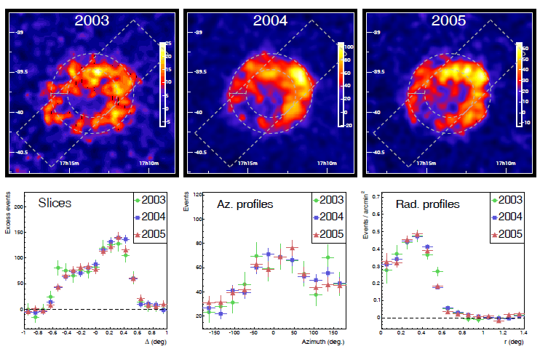
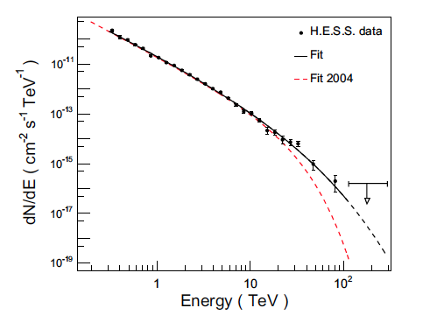
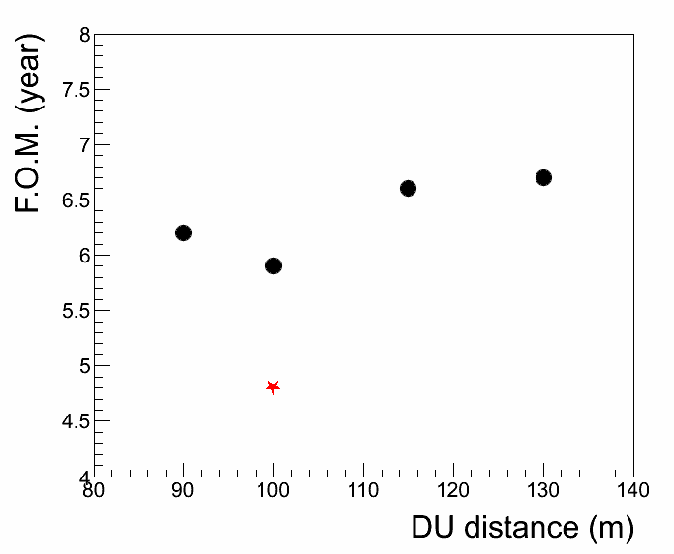
RXJ1713
H.E.S.S. Aharonian et al. Astronomy and Astrophys. 2008
RXJ1713 as a reference for detector performance
1.6 years for 3σ and 4.8 years for 5σ with unbinned analysis
FoM = discovery at 5σ
  dots binned
  star unbinned

Slide 12
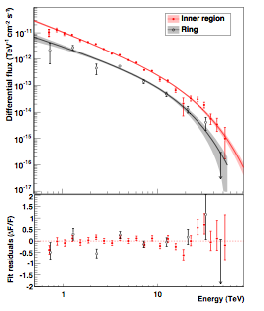
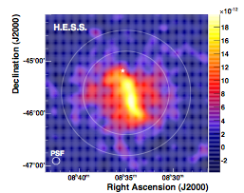
Vela X
2012 data
Studied by H.E.S.S. in two campaigns: 2006 and 2012
H.E.S.S. Collaboration, Astronomy & Astrophysics L43 (2006) 448
H.E.S.S. Collaboration, Astronomy & Astrophysics, in press
If fully hadronic KM3NeT discovery from new data in 1 year for 3σ and 3 years for 5σ with binned analysis

Slide 13
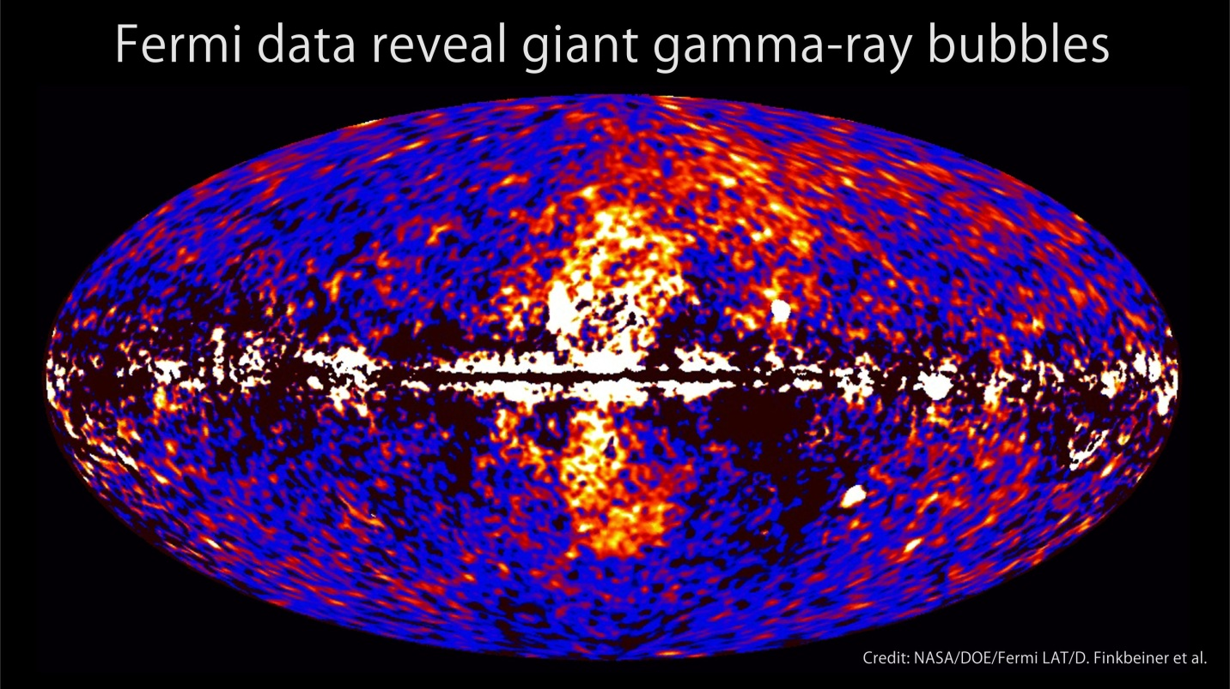
The Fermi bubbles
gamma emission measured up to hundreds of GeV from two bubbles with large extension (50° lat. 40° long. around the Galactic Centre) observed in several wavelengths
no spatial variation in the γ spectrum
Leptonic vs Hadronic => If hadronic (M. Crocker and F. Aharonian PRL106 (2011) 11102) from γ ray flux => E⁻² F_{ν}(TeV) ~ 1÷2 10⁻⁷ [GeV cm⁻² s⁻¹ ]
KM3NeT detection capability- Astroparticle Physics 42(2013)714
  Few months for 3 sigma discovery (E⁻² 100 TeV cutoff spectrum)
  About 1 year for 5 sigma discovery (E⁻² 100 TeV cutoff spectrum)
Good detection perspective also for a staged construction phase of the detector

Slide 14
Other topics not covered in the present talk
Search for Extragalactic sources (AGN, GRB, …)
Sensitivity for indirect search of Dark Matter from Galactic Center
Mass Hierachy with atmospheric neutrinos at low energy (few GeV detection threshold)
  ORCA: Feasibility study of a small (Mton scale) denser detector => see U.Katz talk

Slide 15
Funding
Funds for about 40 M€ are available in Italy, France, The Netherlands and Romania. This allows for the start-up of a first phase of the construction
Expansion of the infrastructures in Capo Passero and Toulon
Construction and deployment of about 60 DUs in Capo Passero and Toulon
Will allow for a complete verification of all the aspects related to the Research Infrastructure construction, operation and data analysis in a “real”-scale
Agreement of the partners for a MoU to cover this first phase

Slide 16
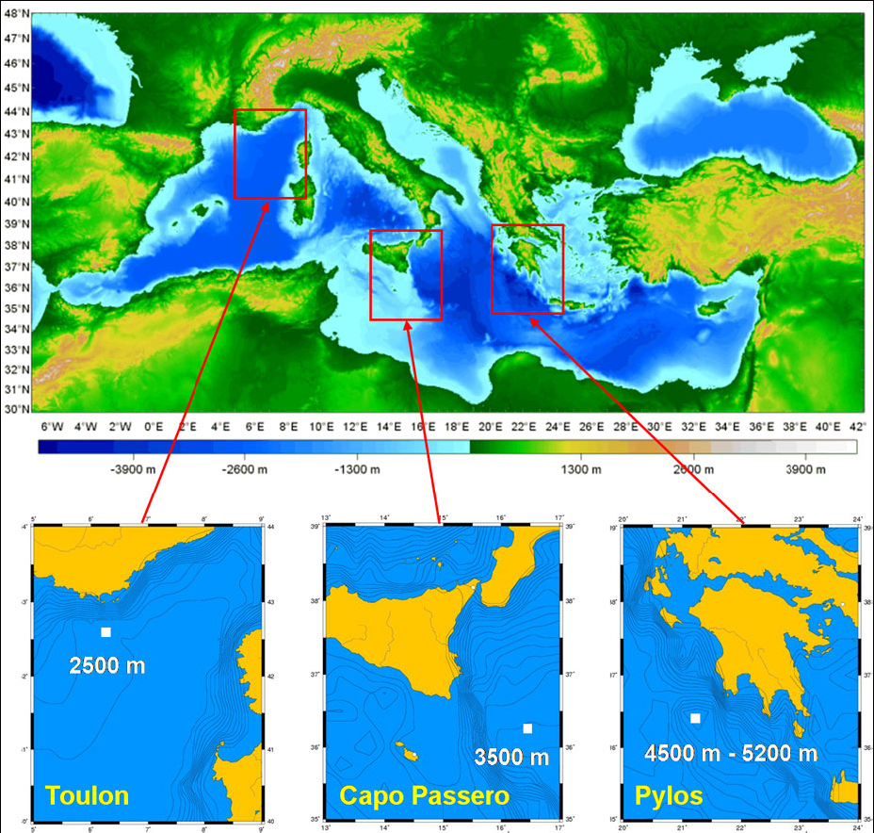
Siting
Three sites
  Toulon (France)
  Capo Passero (Italy)
  Pylos (Greece)
Long-term site characterization measurements performed

Slide 17
Distributed-site option
Verified not to impact on detector performance
  Telescope composed of independent building blocks
Significant advantages in funding through regional funds and in human resources
Small (<5%) impact on costs, mostly due to the shore infrastructure
Shore infrastructure already exists (Capo Passero) or is under construction with dedicated regional fundings (Toulon)
  More effective for Earth and Sea science activities
Agreement for the implementation of an ERIC with headquarters in Amsterdam

Slide 18
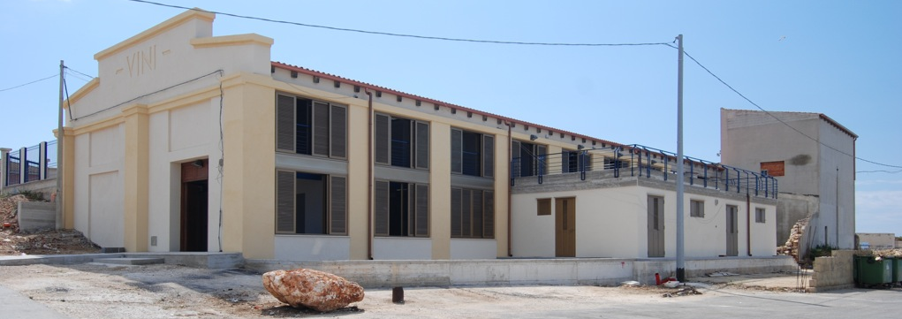
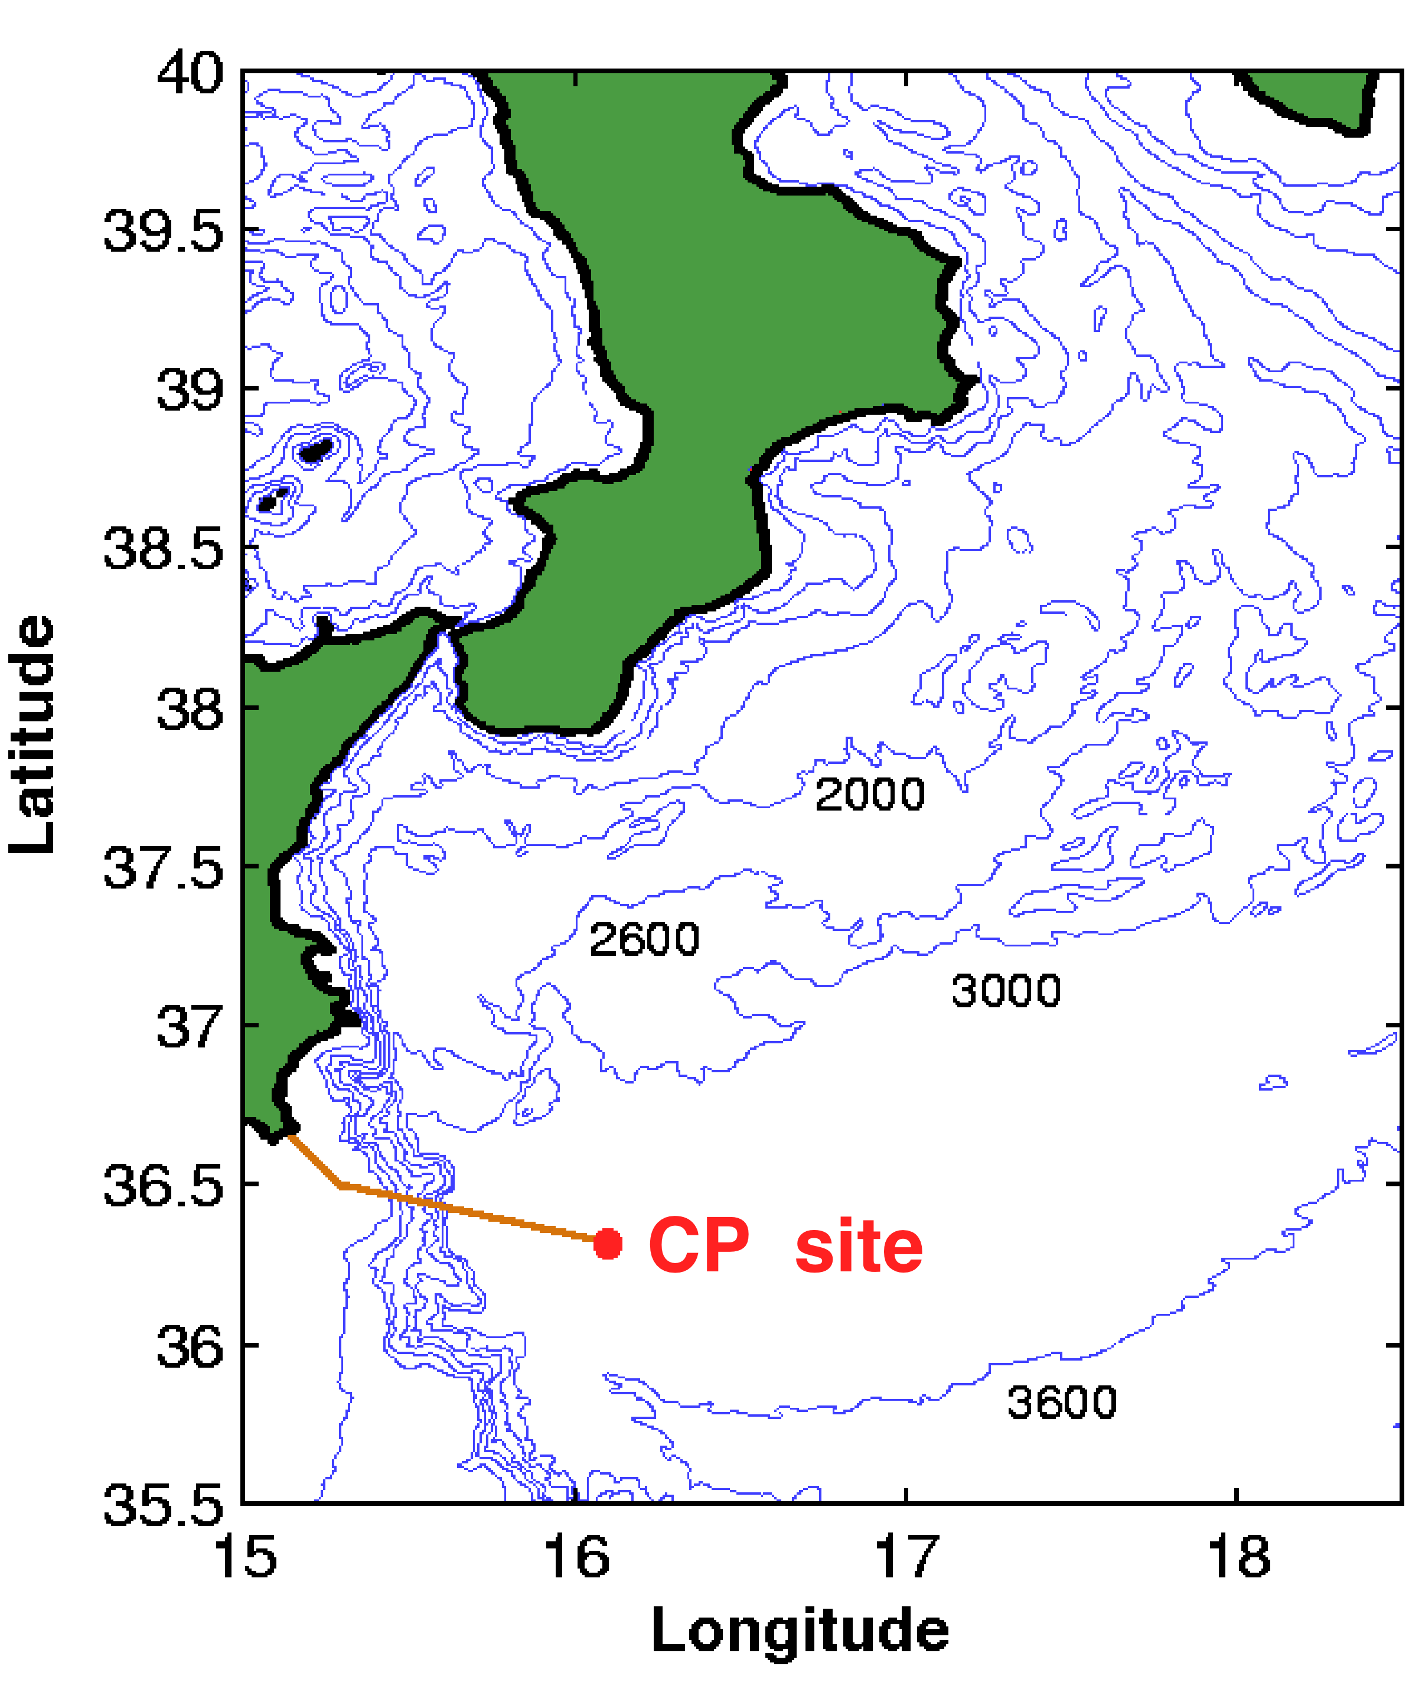
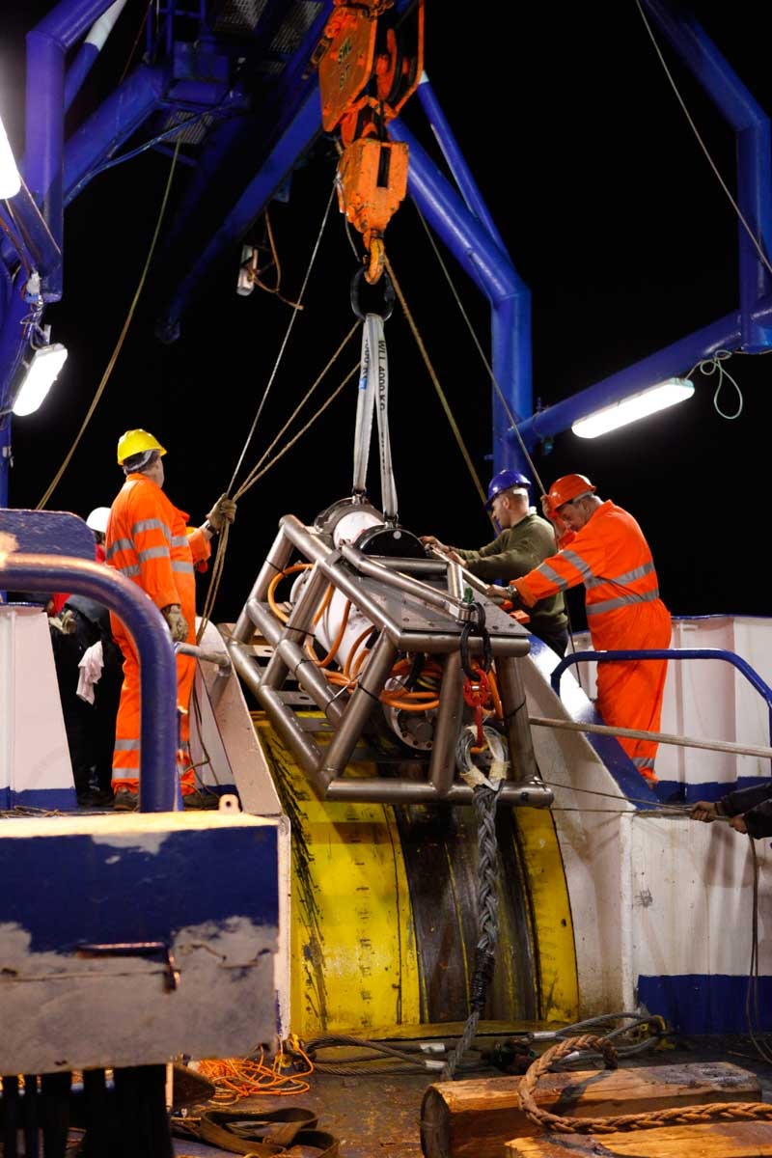
The Capo Passero site
  Site characterized by the NEMO collaboration
  Infrastructure will be upgraded with the Italian funding (regional structural funds)
  Existing infrastructures
  Deep-sea 10 kW DC/DC power converter
  100 km electro-optical cable
  Power feeding system (up to 50 kW)
  Shore station
  High bandwidth (10 Gbps) connection with LNS

Slide 19
KM3NeT-phase1 at Capo Passero
Rigid time constraints (< 2014) on the spending profile of the regional fundings
  A first batch of Detection Units (8) at the Capo Passero site will be built with the technology developed by the Nemo collaboration and already available (towers with 10” PMTs)
  Following DUs will be built with the string design

Slide 20
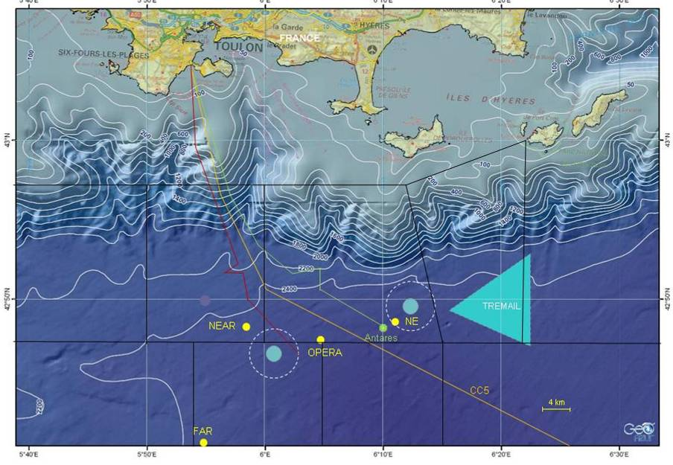
Shore station construction started
Ready and equipped in spring 2013
KM3NeT-Fr / MEUST SITE (Toulon)
MEOC ordered
to ALCATEL
(36 fibers)
To be deployed
by FT-Marine
In spring 2013
Submarine site selected after intensive evaluation campaigns
Same latitude and more western than Antares
Antares MEOC (48 fibers) can be redirected to KM3NeT-Fr in the future
20

Slide 21
KM3NeT-Fr SEA FLOOR
Modular (6 nodes 2 cables), extendable to ~200 DUs (~1 KM3NeT Building Block), industrial components for cables and connectors
First node under final design and operational end 2013

Slide 22
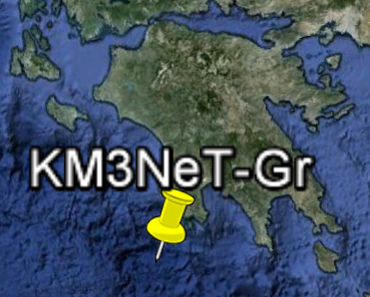
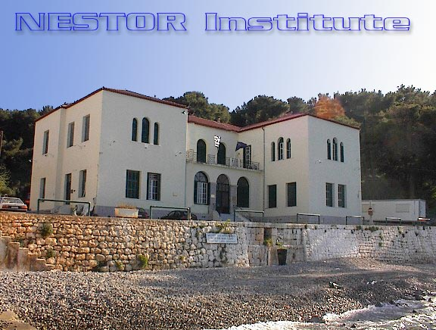
Pylos site
National collaboration with new partners being formed
Several off-shore possible sites at different depths for a KM3NeT-Gr

Slide 23
Conclusions
KM3NeT has a robust physics case with several galactic sources at reach in few years of operation
KM3NeT technology has been developed
  Validation process of DOM and DUs ongoing
  Detection Units will be deployed at the KM3NeT sites near Capo Passero and Toulon
Funding presently available (about 40 M€) allows to step to the implementation of a first phase of KM3NeT with the construction of about 60 string DUs

Slide 24
Conclusions
The legal entity of the experiment will be an ERIC with headquarters in Amsterdam
Option of a small denser detector (ORCA) for neutrino properties studies under evaluation

