Slide 1



ANTARES Results
Neutrino Telescopes
Venice, March 2013
Juan de Dios Zornoza (IFIC - Valencia)
on behalf of the ANTARES collaboration

Slide 2
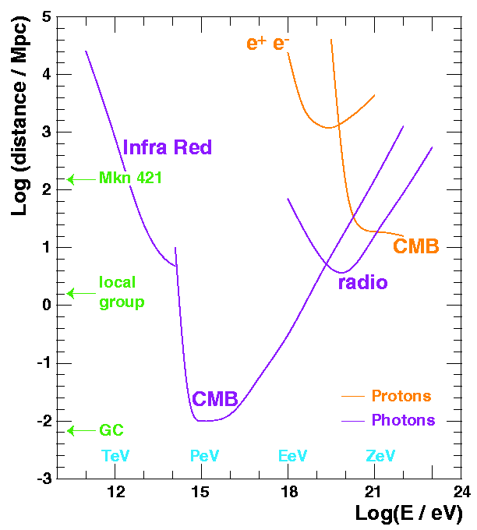
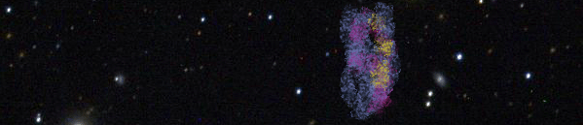
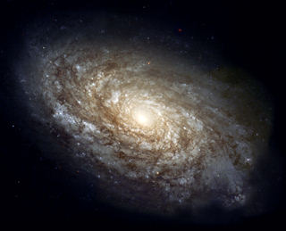
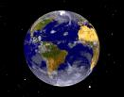
Neutrino Astronomy
Photon and proton mean free range path
Advantages w.r.t. other messengers:
  Photons: interact with CMB and matter
  Protons: interact with CMB and are deflected by magnetic fields
Drawback: large detectors (~GTon) are needed.
γ
n
ν
p

Slide 3
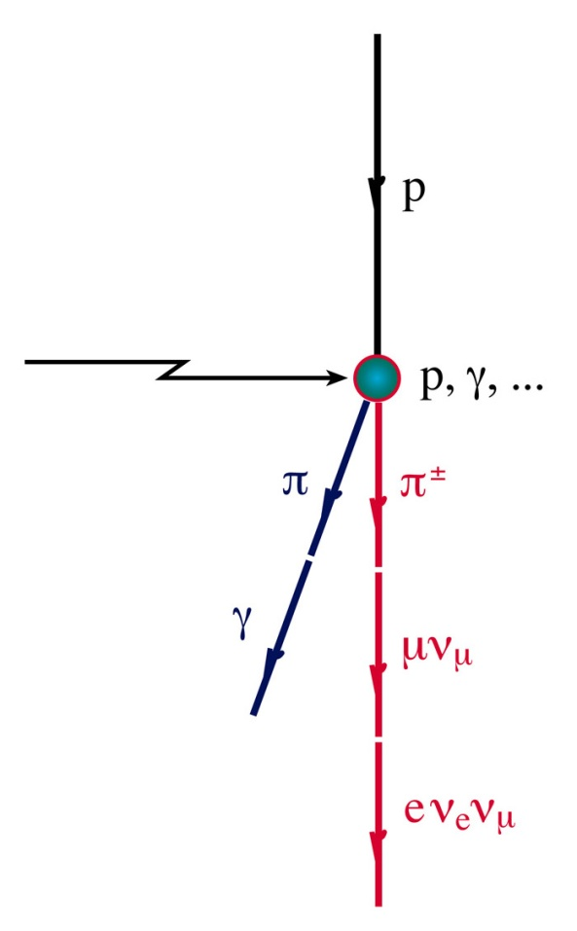
Production mechanism
Neutrinos are expected to be produced in the interaction of high energy nucleons with matter or radiation:
Cosmic rays
Moreover, gammas are also produced in this scenario:
Gamma ray astronomy

Slide 4
Scientific scope
Origin of cosmic rays
Hadronic vs. leptonic signatures
Dark matter
Detector size
Supernovae
Oscillations
Limitation at high energies:
Fast decreasing fluxes E⁻², E⁻³
Limitation at low energies:
-Short muon range
-Low light yield
-⁴⁰K (in water)
Dark matter (neutralinos, KK)
Astrophysical neutrinos
GZK
MeV
GeV
TeV
PeV
EeV
Detector density
Other physics: monopoles, nuclearites, Lorentz invariance, etc...

Slide 5
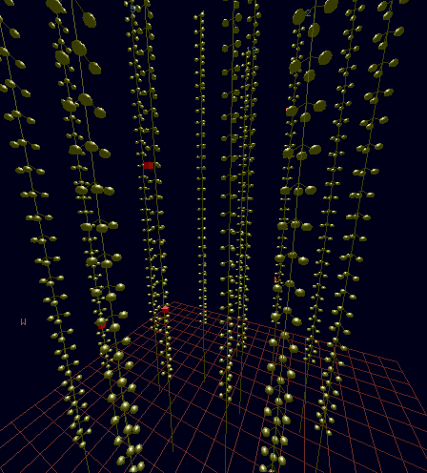
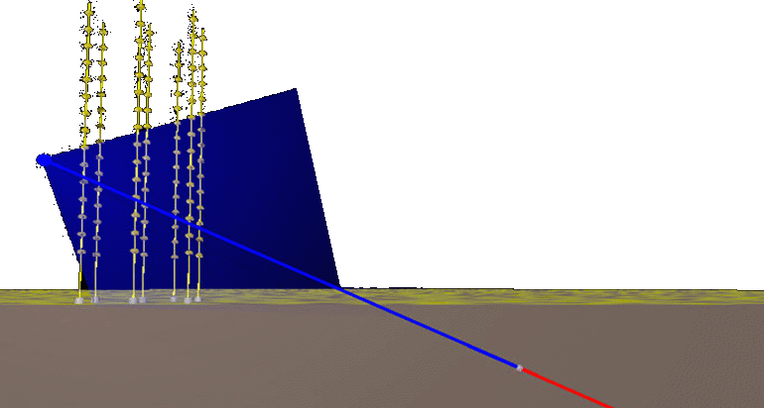
Detection principle
The neutrino is detected by the Cherenkov light emitted by the muon produced in the CC interaction.
ν_{μ}
μ
W
N
X
μ
ν_{μ}
1.2 TeV muon traversing ANTARES

Slide 6
Other signatures
Cascades are an important alternative signature: detection of electron and tau neutrinos.
Also neutral interaction contribute (only hadronic cascade)
Clear signature of oscillations.
ANTARES & AMANDA are too small to detect double bang signature (they are too rare)
However, cubic-kilometer telescopes could detect them.
Maximum sensitivity at 1-10 PeV
track
cascade
double bang
τ
ν_{τ}
1 km at 300 GeV
25 km at 1 PeV
5-10 m long
diameter ~ 10 cm

Slide 7
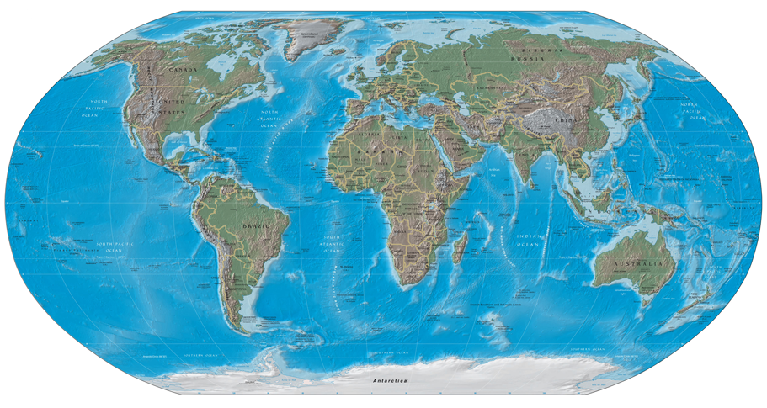
Neutrino telescopes in the world
Several projects are working/planned, both in ice and ocean and lakes.
ANTARES
NESTOR
NEMO
KM3NeT
Baikal
(AMANDA)
IceCube

Slide 8
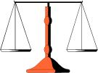


Water vs Ice
Very large volumes of medium transparent to Cherenkov light are needed:
  Ocean, lakes…
  Antarctic ice
Advantages of oceans:
  Larger scattering length → better angular resolution
  Weaker depth-dependence of optical parameters
  Possibility of recovery
  Changeable detector geometry
Advantages of ice:
  Larger absorption length
  No bioluminescence, no ⁴⁰K background, no biofouling
  Easier deployment
  Lower risk of point-failure
Anyway, a detector in the Northern Hemisphere in necessary for complete sky coverage (Galactic Center!), and it is only feasible in the ocean.

Slide 9
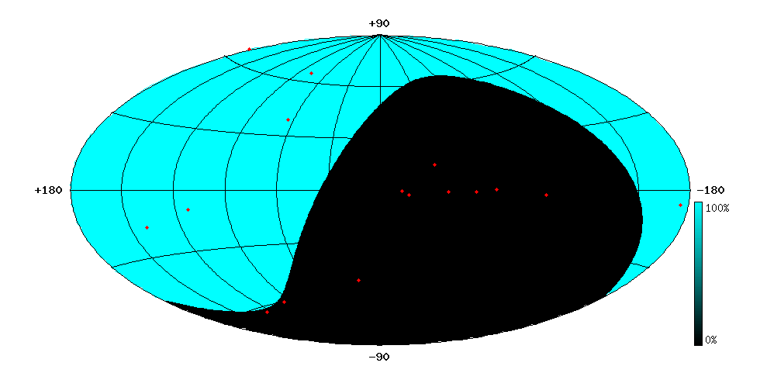
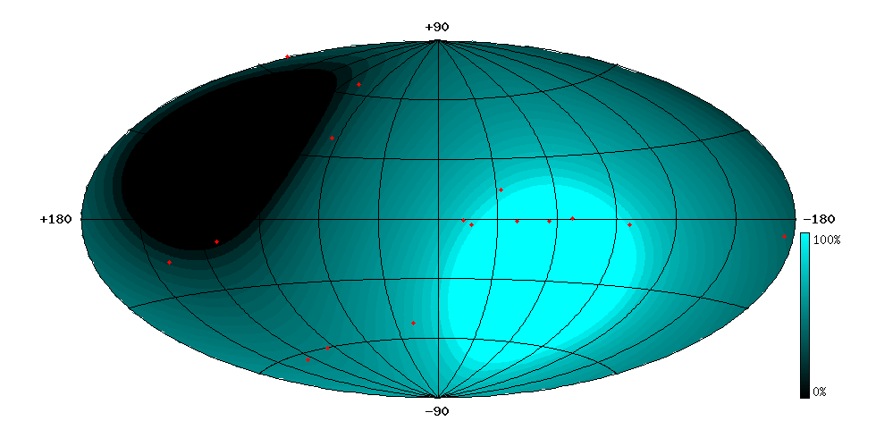
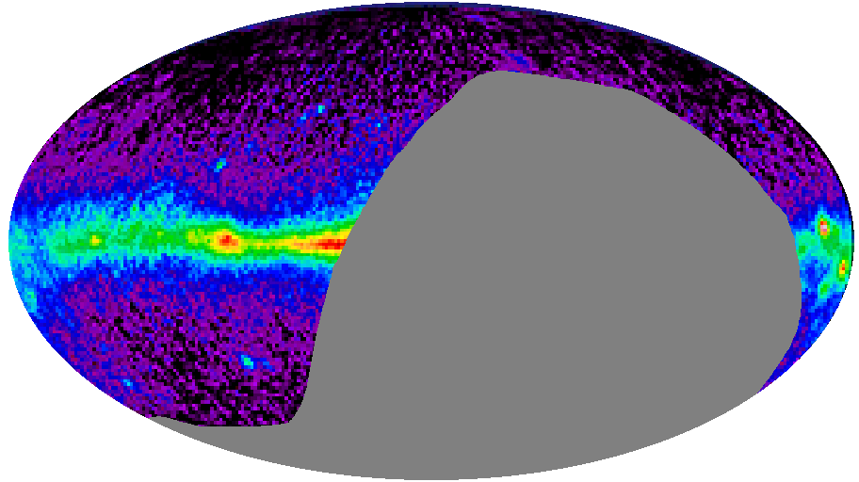
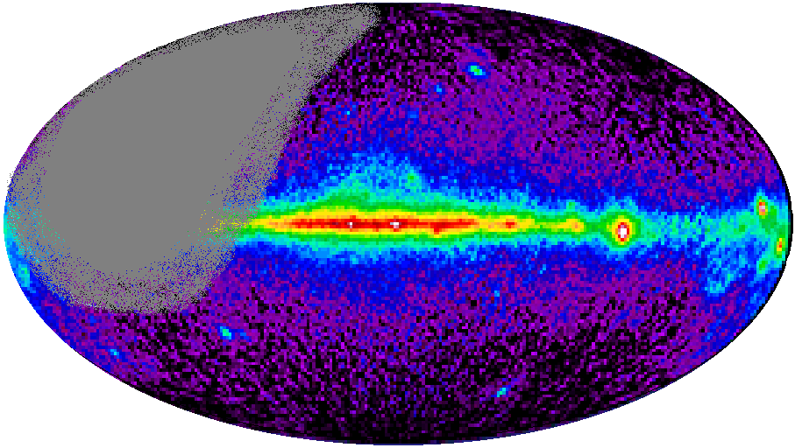
North vs South
AMANDA/IceCube (South Pole)
(ang. res.: ~2°/0.6°)
ANTARES (43° North)
(ang. res.: ~0.3°/0.1°)
Mkn 421
Mkn 501
Mkn 501
CRAB
RX J1713.7-39
CRAB
SS433
SS433
GX339-4
VELA
Galactic
Centre

Slide 10
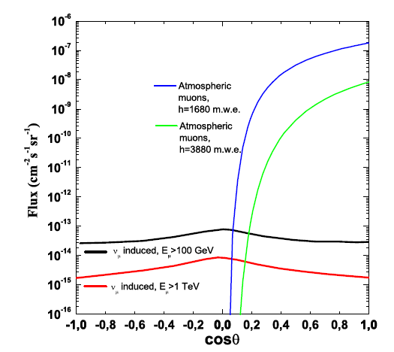
Background
There are two kinds of background:
  Muons produced by cosmic rays in the atmosphere (detector deep in the sea and selection of up-going events)
  Atmospheric neutrinos (clustering, cut in the energy…)
p
μ
ν
ν
p

Slide 11
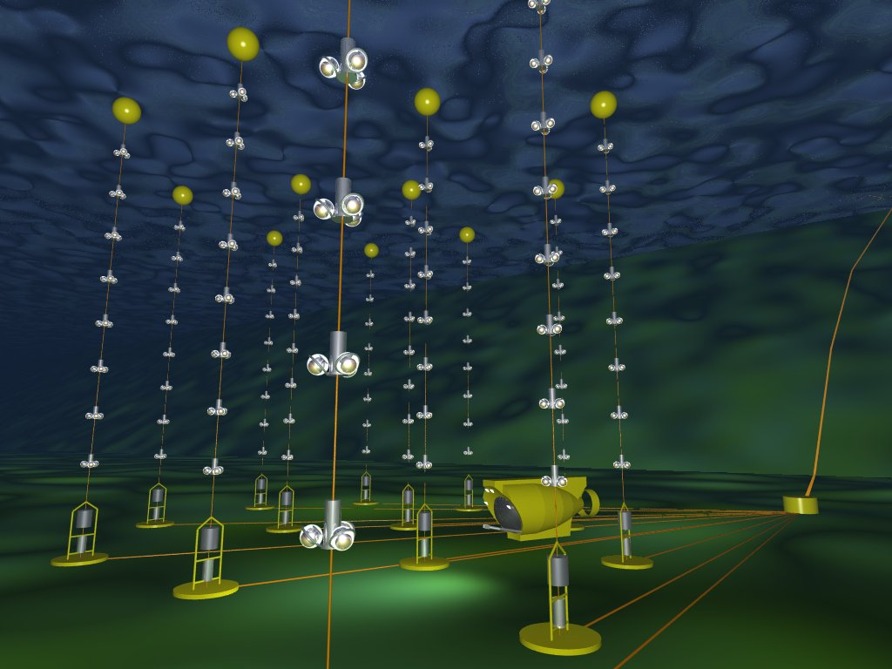
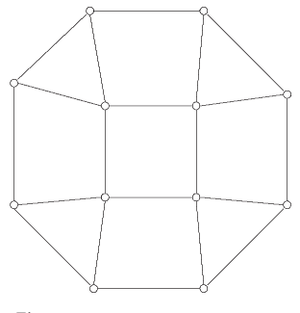
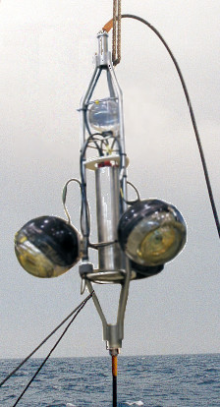
The ANTARES detector
12 lines (885 PMTs)
25 storeys / line
3 PMT / storey
Buoy
14.5 m
Storey
Horizontal layout
Detector completed in 2008
350 m
Junction
box
100 m
Electro-optical cable
~60-75 m
Readout cables

Slide 12
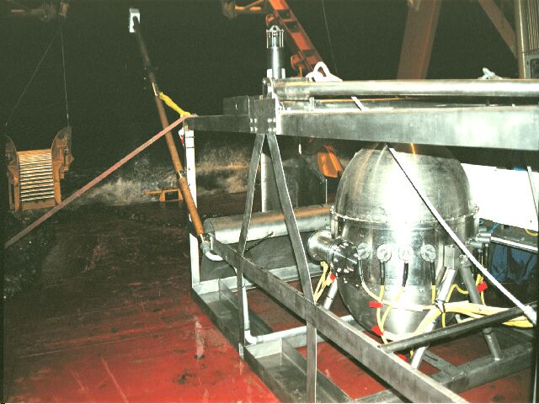
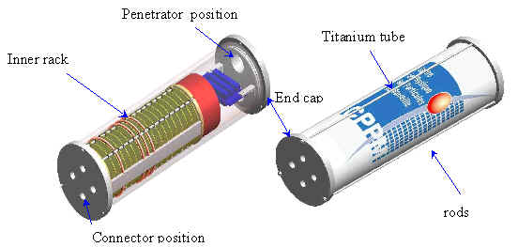
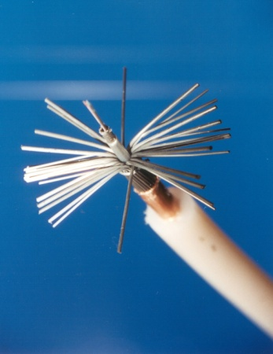
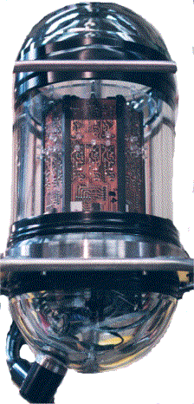
Detector elements
The Optical Module contains a 10” PMT and its electronics
The Optical Beacons allows timing calibration and water properties measurements
It receives power from shore station and distributes it to the lines. Data and control signals are also transmitted via the JB.
The Local Control Module contains
electronics for signal processing
It provides power and data link between the shore station and the detector (40 km long)

Slide 13
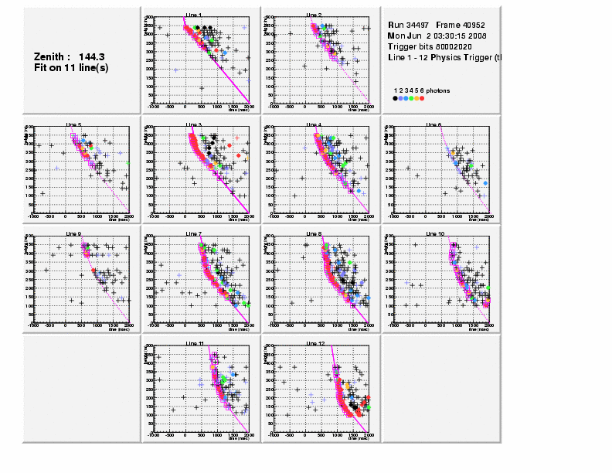
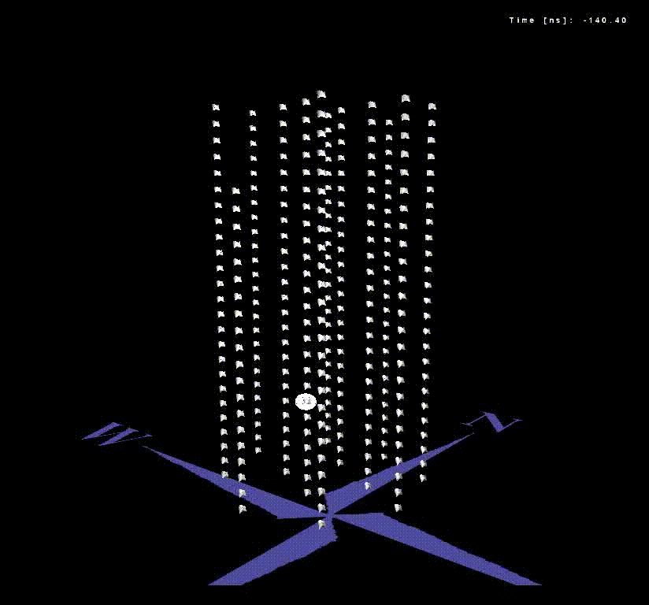
Multi-muon event
Example of a reconstructed down-going muon, detected in all 12 detector lines:

Slide 14
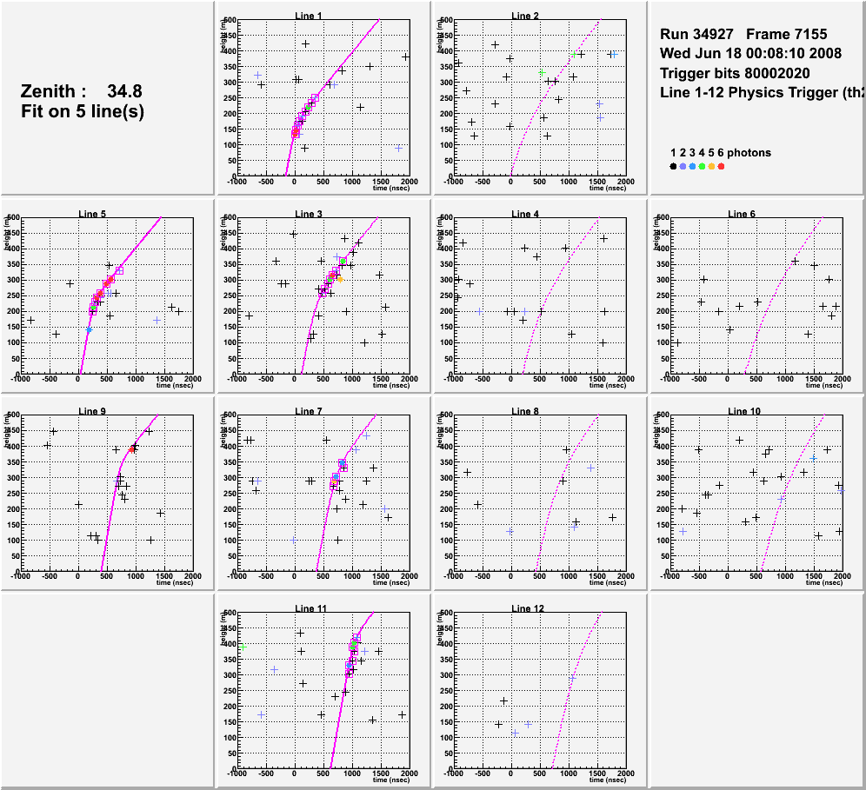
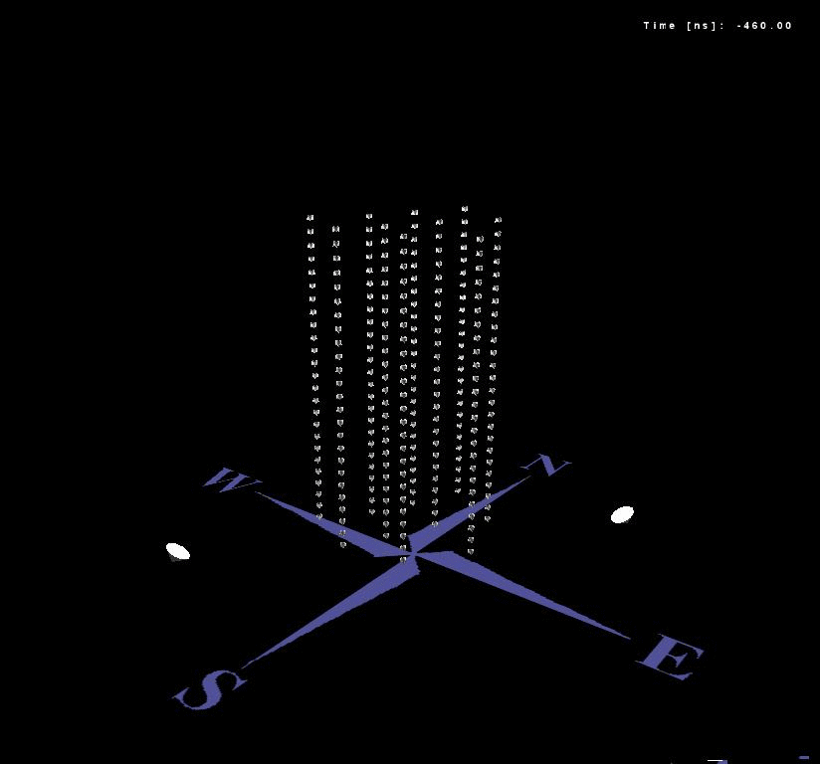
Neutrino candidate
Example of a reconstructed up-going muon (i.e. a neutrino candidate) detected in 6/12 detector lines:

Slide 15
Oscillations: method
No azimuth information is needed → single-line reconstruction is enough → lower energy threshold (20 GeV) →
oscillation effect observable!
multi-line
single line
solid: no osc
dashed: osc
red: single-line
blue: multi-line

Slide 16
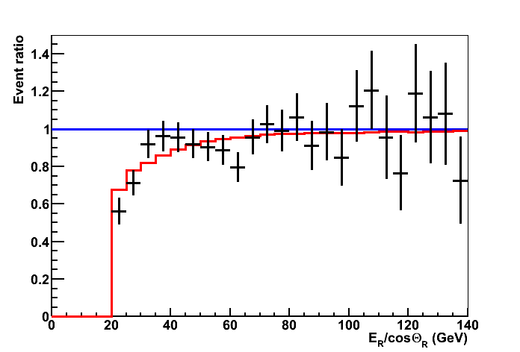
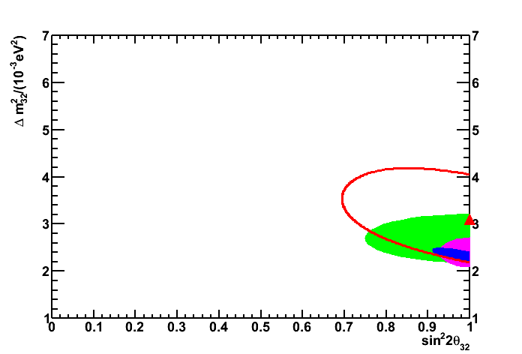
Oscillations: result
Systematic uncertainties:
Absorption length: ±10%
Detector efficiency: ±10%
OM angular acceptance
Spectral index of ν flux: ±0.03%
5% error on slope vs E_{R}/cosΘ_{R}
Physics Letters B 714 (2012), arXiv:1206.0645
68%CL contours
no osc
ANTARES
K2K
Super-K
MINOS
data (863 days)
best fit
Δm²=(3.1±0.9) 10⁻³ eV²
(assuming maximal mixing)

Slide 17
Point source search:
selection cuts
Good agreement between data and Monte Carlo (detector understood!)
For PS analysis, selection based on
  Zenith angle (upgoing events)
  Quality of reconstruction
  Estimated angular error in reconstructed track
Energy information (number of hits) used in the PDF

Slide 18
Point source search:
detector performance
Effective area
For E_{ν}<10 PeV, A_{eff} grows with energy due to the increase of the interaction cross section and the muon range.
For E_{ν}>10 PeV the Earth becomes opaque to neutrinos.
Angular resolution
For E_{ν} < 10 TeV, the angular resolution is dominated by the ν-μ angle.
For E_{ν} > 10 TeV, the resolution is limited by track reconstruction errors
For E⁻²: median=0.46 ± 0.10 deg

Slide 19
Point source search:
skymap
2007-2010 data
3058 events
ApJ 760:53 (2012), arXiv:1207.3105
pretrial p-value
Most significant
cluster at:
RA = ‒46.5°
δ = ‒65.0°
N_{sig} = 5
Q = 13.02
p-value = 0.026
Significance = 2.2 σ

Slide 20
Point source search:
list of candidates
We look in the direction of a list of 51 candidate sources.
Selection criteria: mostly based on γ-ray flux + visibility)
Result compatible with only-background hypothesis
Flux upper limit on E⁻² spectrum
(in 10⁻⁸ GeV⁻¹ cm⁻² s⁻¹ units)
Sources with lhte owest p-values
Most significant case: HESSJ1023-575 (p-value=41%)

Slide 21
Point source search:
flux limits
Best limits in TeV-PeV for the Southern Hemisphere
Note: IceCube threshold for SH ~1 PeV
By 2016, limits expected to improve by a factor 2.5

Slide 22
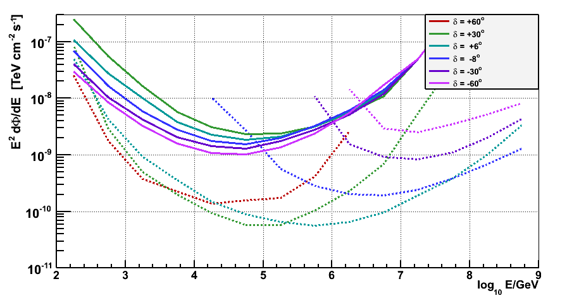
Limits vs Energy
Full: ANTARES (2007-2008)
Dashed: IceCube (IC22)
RXJ1713.7-3946

Slide 23
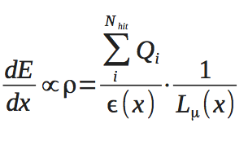

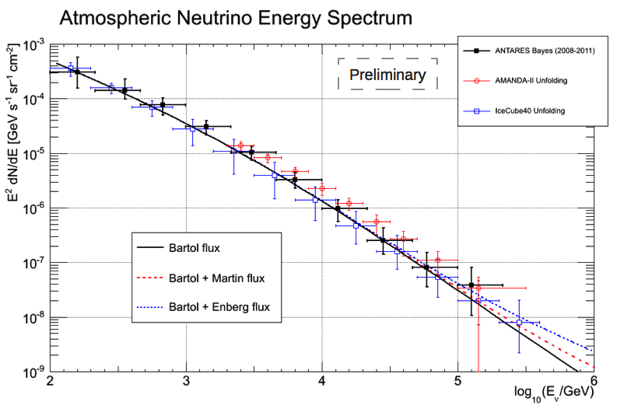
Atmospheric spectrum deconvolution
Two independent analysis have been developed,
with compatible results. Here we show one of them.

Slide 24
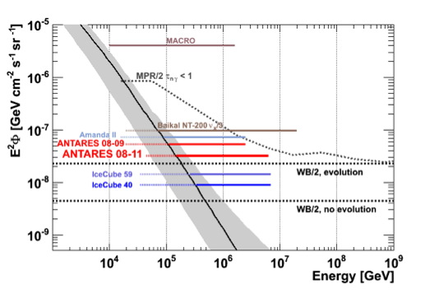
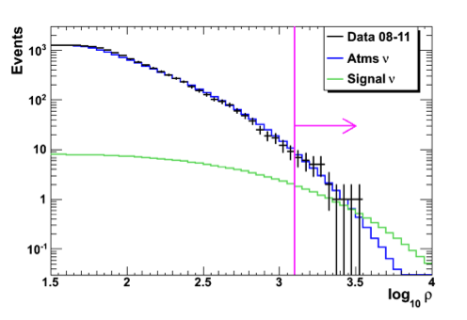
Cosmic diffuse fluxes
Energy-dependent variable used for selecting signal: ρ α dE/dx
Preliminary
E²Φ(E)_{90%}= 3.2×10⁻⁸ GeV cm⁻² s⁻¹ sr⁻¹
45 TeV<E<6.3 PeV
Data 2008-2011:
Previous analysis (07-09)
Phys. Lett. B 696 (2011)

Slide 25
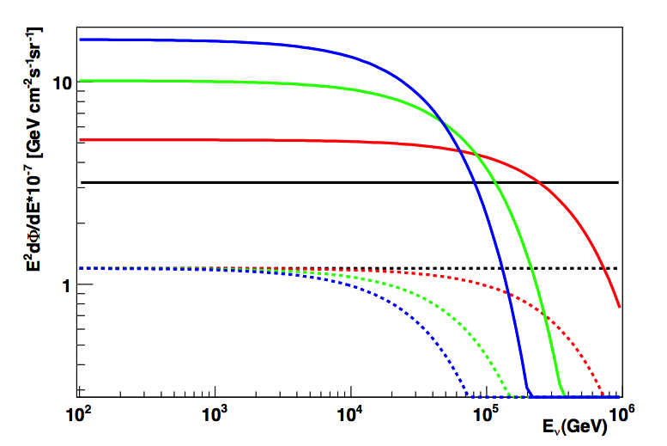
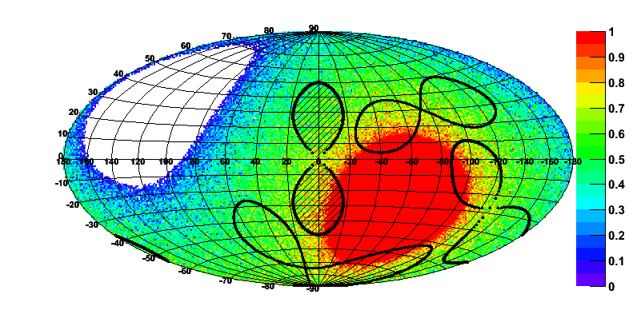
Fermi Bubbles
According to Villante & Vissani [Phys. Rev. D 78 (2008) 103007]
Ф_{nu}~1/2.5Ф_{gamma} ~ E⁻²1.2*10⁻⁷GeV cm⁻² s⁻¹ sr⁻¹
Neutrino cutoff may be obtained from the proton cut off x_{ν}≈x_{p}/20 (50 TeV-500 TeV)
preliminary
50 TeV cutoff
100 TeV cutoff
500 TeV cutoff
no cutoff
On/OFF source analysis: background estimated from average of three “bubbles” shifted in time
solid: flux limits
dotted: predicted flux
Nback (OFF) = 33/3=11 events
N_{obs} = 16 events
Data 2008-2011:

Slide 26
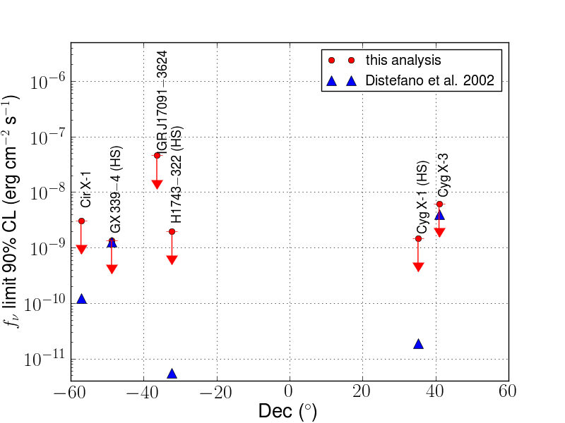
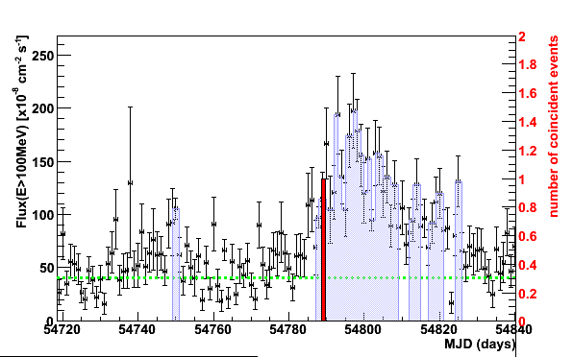
Correlations with γ and X-ray flares
Blazars: AGNs with a jet pointing to us
Microquasars: Binary system of compact star + normal star accreting to the former
10 flaring blazars in 2008: PKS0208-512, AO0235+164, PKS1510-089, 3C273, 3C279, 3C454.3, OJ287, PKS0454-234, Wcomae, PKS2155-304
For 9 sources: 0 events
3C279: 1 event compatible with the source direction (Δα=0.56⁰) and time distribution
Post trial value 10%
Upper-limit on the neutrino fluence
6 flaring microquasars in 2007-2010: Circinus X-1, GX339-4, H 1743-322, IGRJ17091-3624, Cygnus X-1, Cygnus X-3
No neutrinos found in coincidence with outbursts
preliminary
Astropart. Phys. 36 (2012), arXiv:1111.3473

Slide 27
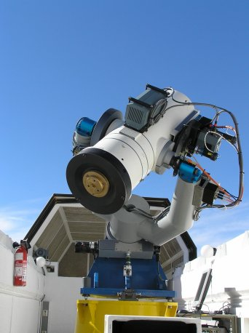
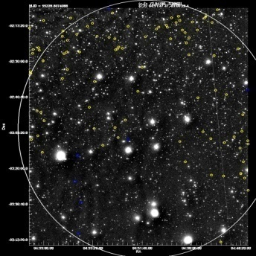
TaToO: Telescopes and ANTARES
Target of Opportunity
TAToO: optical follow-up of neutrino alerts in order to search for transient sources (GRBs, choked GRBs, AGN flares…)
Astropart. Phys. 35 (2012), arXiv:1103.4477
Reconstruction “on-line” (<10ms)
-Doublet (15 min, 3 deg)
- HE singlet (E>5-10 TeV)
- Directional (Δ_{GWGC}<0.33 deg)
Neutrino alert (GCN)
ANTARES
ν
Real time
send <10s
Large sky coverage (>2π sr) + high duty cycle
Improved sensitivity (1 neutrino⇒ 3 sigma discovery)
No hypothesis on the nature of the source
Independent of availability of external triggers
Telescopes: TAROT, ROTSE, ZADKO Satellites: SWIFT
1.9° x 1.9°

Slide 28
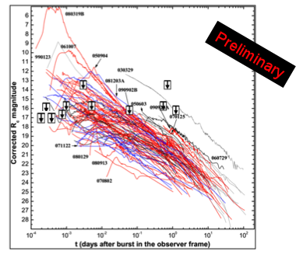
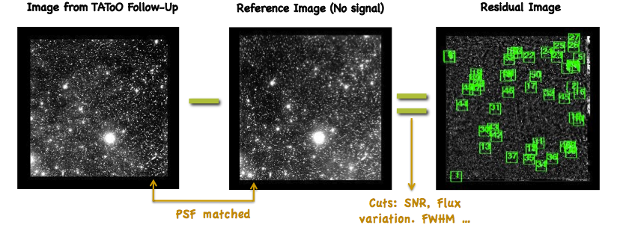
TAToO: GRB analysis
  For each neutrino alert -> search for counterpart in optical
  originating from GRB (83 alerts sent since mid 2009)

Slide 29
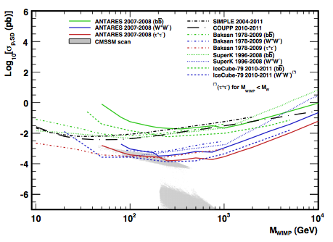
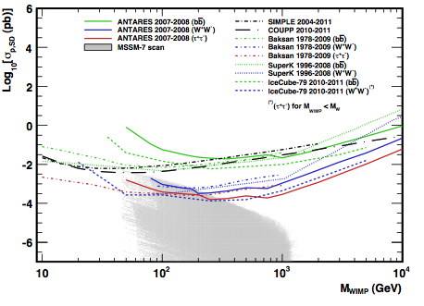
Dark matter
WIMPs (neutralinos, KK particles) accumulate in massive objects like the Sun, the Galactic Center, dwarf galaxies…
The products of such annihilations would yield “high energy” neutrinos, which can be detected by neutrino telescopes
A signal would be a clean indication of DM (no plausible astrophysical explanation)
CMSSM
MSSM-7
arxiv: 1302.6516

Slide 30
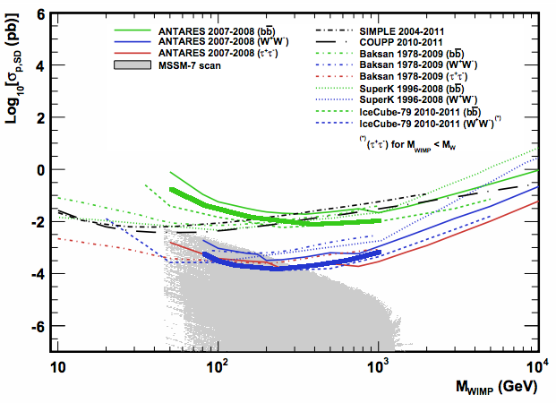
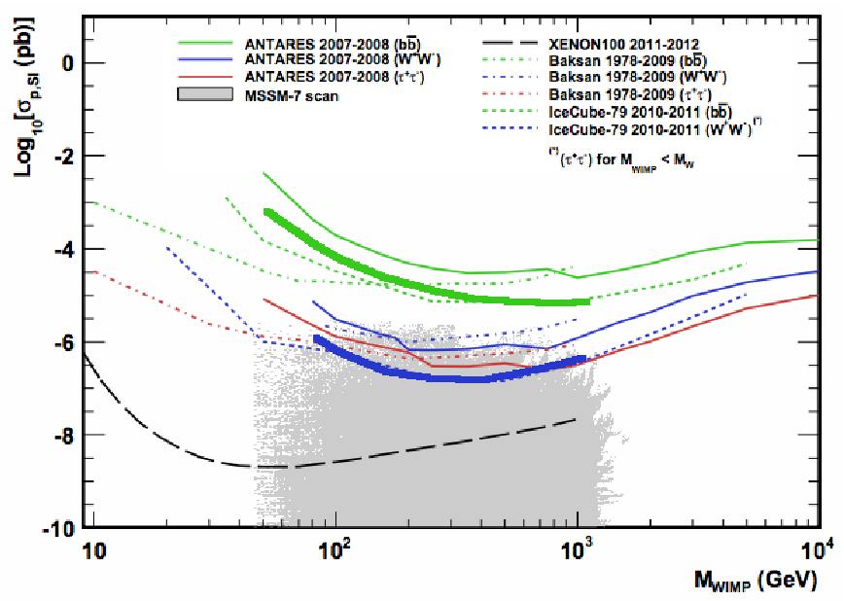
Dark matter
Soon more data will be unblinded:
2007-2008
2007-2008
2007-2011
2007-2011

Slide 31
Summary
Neutrino astronomy is becoming a powerful tool for Astrophysics and Particle Physics
ANTARES has already been completed and is taking data for almost five years.
Rich physics output already here: search for point-like sources, diffuse fluxes, dark matter, GRBs, flaring sources, monopoles, nuclearites, correlations with GWs, correlations with UHECRs…)
The technical success of ANTARES paves the way for the cubic kilometer detector in the Mediterranean Sea: KM3NeT

Slide 32
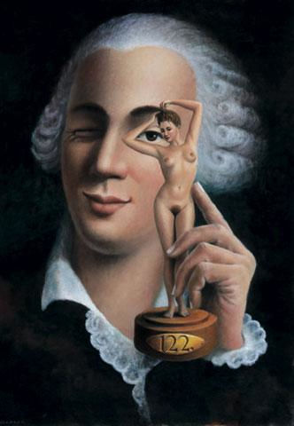
Conclusion
“The discovery of new pleasures worths any effort”
G. Casanova
“The pleasure of new discoveries worths any effort”
Giacomo Casanova
(se non è vero, è ben trovato)

