Slide 1
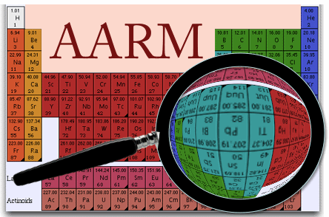
Toward a coherent program in
Assay and Related Technologies
Priscilla Cushman LRT2013
University of Minnesota LNGS April 10, 2013

Slide 2
Introducing: Assay and Acquisition of Radiopure Materials
The AARM Scientific collaboration is open to all interested parties
Original Goals were tied to DUSEL: A 3 year NSF grant to
Characterize backgrounds at all levels of Homestake
Design a common low background counting facility: FAARM
Develop common screening tools (R&D as needed)
Current Goal is to forge an alliance between experiments searching for rare
events, to help understand and mitigate backgrounds.
Simulation recognized as a major “infrastructure”
Validate and improve current simulation tools
Background characterization more broadly defined as
Community Materials Assay Database
Neutron benchmarking (data vs sim)
Integration of existing assay resources around the world
and the development of a unified plan to increase availability
FAARM (A 3rd generation counting facility) needs to be re-imagined

Slide 3
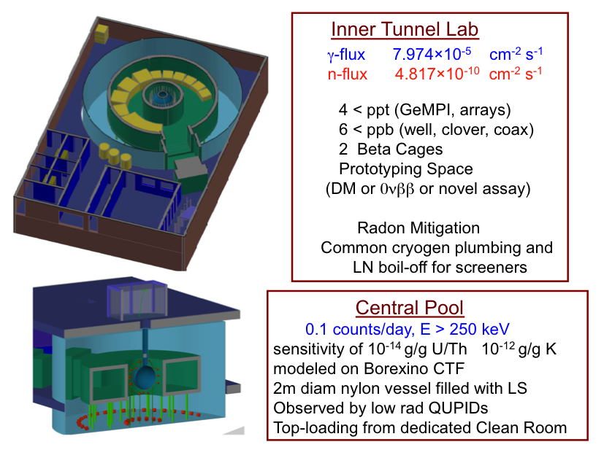
FAARM:
Facility for Assay and Acquisition of Radiopure Materials
Original Design fit into Lab Module 2 in the DUSEL
plans at Homestake

Slide 4
FAARM:
Facility for Assay and Acquisition of Radiopure Materials
Re-engineered original DUSEL plan for a new non-site-specific location
But kept the principles and lessons learned
Dedicated facility, class 10,000 clean room, < 20 Bq/m³
Labs, Clean machine shop, offices, several class 1000 clean rooms
Radon-mitigated zones (<1 Bq/m³) and assembly areas (<0.1 Bq/m³)
Radon-free storage and unified LN system
Instrumented common water shield with toroidal interior acrylic room
individual lead shields too expensive and not radiopure
neutron shielding requires hydrogenous materials
muon rejection is easily added with photodetectors
upgrades could include LS or Gd/Li/B loading to create a true neutron veto.
Top-loading Immersion Tank
Cost-effective design with ultra-sensitive central location
Complete drawings and a new cost estimate:
Final deliverable from AARM grant - Ready for a proposal if space is identified
https://zzz.physics.umn.edu/lowrad/newfaarm

Slide 10
“Integrative Tools for Underground Science”
Principle Investigators
Priscilla Cushman (University of Minnesota)
Jodi Cooley (Southern Methodist University)
Toni Empl (University of Arkansas, Little Rock)
Angela Reisetter (Evansville University)
Richard Schnee (Syracuse University)
A new 2-year proposal starting last October to continue AARM work in following areas
1. Development of community-wide simulation tools,
2. Confirmation of simulation physics models and cross sections relevant to
underground science by comparing to data worldwide and supporting specific
efforts in neutron benchmarking,
3. Establishment of a community materials database, and
4. Continuation of the integration workshops centered around
simulation, material screening, and underground physics.

Slide 11
Organization of AARM
We are split into Working Groups with very specific tasks
You can always go to the Group Wiki to learn about it and to join meetings
http://zzz.physics.umn.edu/lowrad/#working_group_wiki_pages
Depth Task Force
Cosmogenic Simulation Group
Universal Materials Database
Radiogenic Cross Section Working Group
FLUKA-Geant4 Comparative Study Group
Neutron Benchmarking Data Group

Slide 17
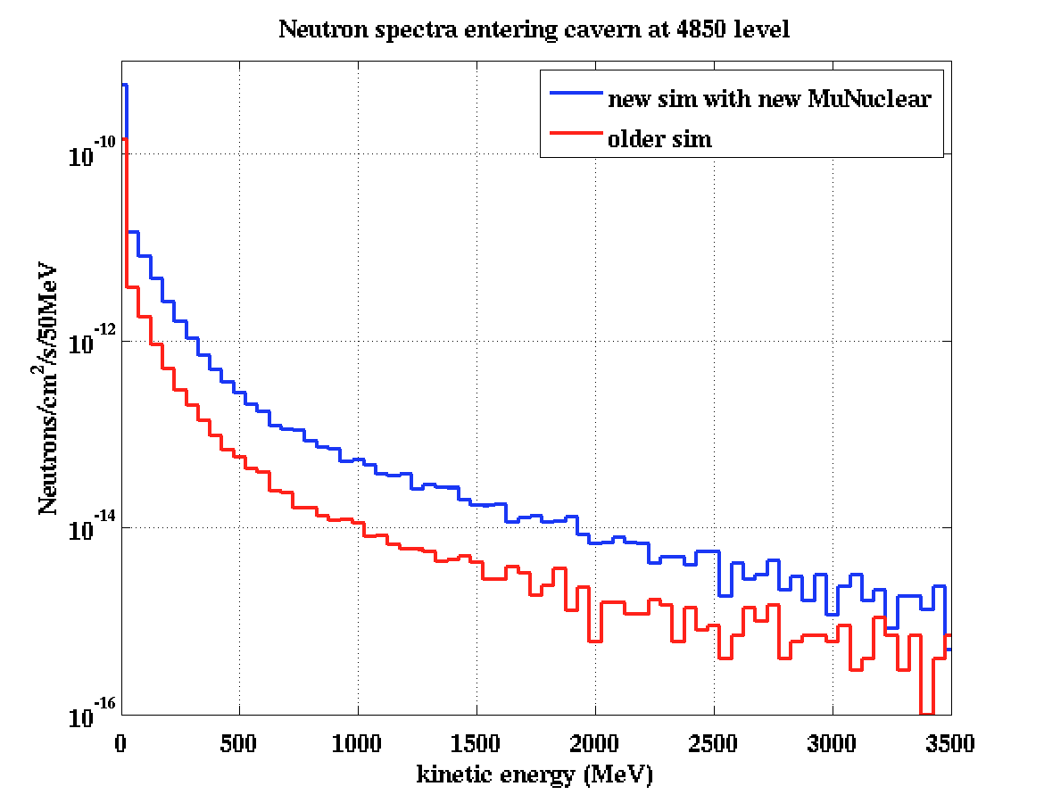
New Physics processes and cross sections – in collaboration with
SLAC GEANT4 Collaboration (esp. Dennis Wright) Study by A. Reisetter
The new cross sections raised overall rate by 0.2%
But 31% for KE > 1 MeV
and 55% for KE > 100 MeV
The new muon nuclear process raised overall rate by 21%
at all energies

Slide 18
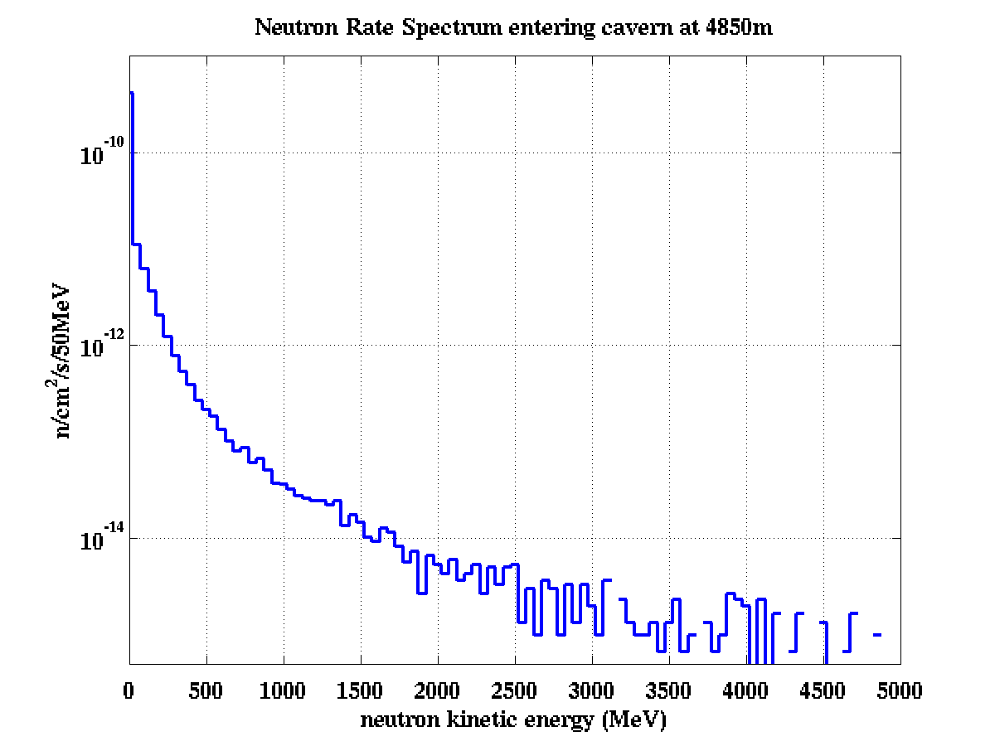
Lower energy depends on the details of the rock composition and slant path
n x10^{‐9}/cm²/s | Total | >1MeV | >10MeV | >100MeV
M&H rates Homestake | 0.46 | 0.14 | 0.05 | 0.034
New GEANT4 Muons at 4850 | 0.45 | 0.12 | 0.036 | 0.013
Mei & Hime generally higher than Geant4 for what we used to call the high energy tail
but ~ 15% can be due to Muon Spectrum Parameterization choice
Mei&Hime @ 4850
Mei & Hime do not have the really high end tails we now care about at depth
GEANT4

Slide 19
Depth Task Force White Paper
Present our best understanding of Simulation and Measurement of cosmic muon-induced neutron background in underground labs.
Define what restrictions that places on depth as a function of technology and shielding.
Identify the remaining systematic errors and suggest means for reducing them
Introduction
Existing Measurements of Underground Neutron Backgrounds
LSD, LVD, Borexino, Kamland, Zeplin II/Boulby, Edelweiss/LSM, SNO, Soudan NMM
The Simulation Challenge
  Simulation Overview
  Muon Flux Estimations
  Muon-induced Secondaries
Implications for Dark Matter experiments at Homestake 4850
Direct Comparison of LAr, LXe, Ge with the same input muons and same shield
Scaling to Different Depths
Conclusion

Slide 20
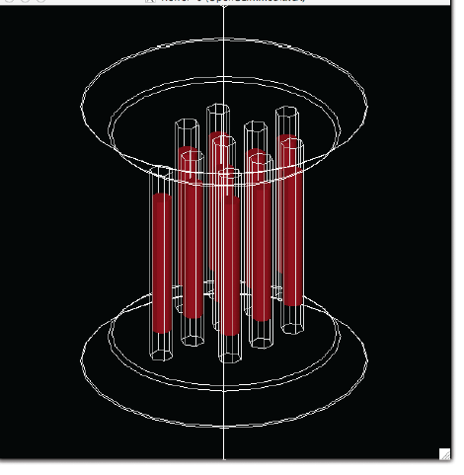
Compare Different Technologies
Start with a common water shield based on the LZ20 design:
12 m diameter, 12 m high cylindrical water tank
Inside, place a 2 m diameter, 2 m tall experiment
Detailed geometry moving from the outside in to the detector volume as follows:
L Ar
2.5 cm thick SS Outer Vessel of 4 m diam + vac
2.5 cm thick SS Inner Vessel of 3 m diam + vac
0.5 cm thick PMT shell + 1.0 cm of Acrylic
2m x 2m Liquid Argon Volume
L Xe
75 cm thick Liquid Scintillator
3 mm thick Titanium shell
2m x 2m Liquid Xenon Volume
Ge 1.5 Ton Payload
1 cm thick SS outer Vessel of 2.2 m diam
20 cm thick poly
3 cm thick Cu cryostat
10 Towers of 30 detectors each
Each detector is
6” diam, 2” thick

Slide 21
Workshops a.k.a. AARM Collaboration Meetings
Two 3-day Workshops per year continue under the new proposal.
Find previous talks at http://zzz.physics.umn.edu/lowrad/meetingn (n=1➔6)
This Spring it was a little different.
1-day meeting at Snowmass Cosmic Frontier Workshop (March 4)
Travel fellowships to LRT2013 to increase US attendance (13 awardees).
Presentations of AARM work at LRT2013
At LRT2013 we would like to expand the AARM Collaboration
Invite participation in our Working Groups
Explore Cooperative Agreements between Europe and North America
Formalize collaboration and programs between AARM and LRT
and a European/Asian counterpart?
If there is interest here, we propose a 4 day workshop this Autumn with time to coordinate international strategies, incl. tighter coordination with LRT2015
Notice:
Thursday Lunch Meeting to discuss contributions to the Community Database

Slide 22
So what about screening and Low Background Facilities?
Dark Matter Double Beta Decay Solar and Astro physics Nucleon Decay
They all need ever more sensitive radiopurity measurements and products
As well as more throughput at existing sensitivities
But a FAARM needs up-front money
Perhaps we can create a Multi-site Low Background Facility
by pooling existing resources and
creating centralized management, shared resources and common scheduling.
Proposal to NSF and DOE (very preliminary!!)
A Consortium of U.S. Centers of Excellence in Assay and Radiopurity Techniques

Slide 23
Which aspects of “Low Background” require an Underground Facility?
New highly sensitive screeners
GeMPI style gamma spectroscopy (ultralow background shielding and crystals)
R&D on new types of screeners (e.g. beta cage, XIA alpha counter, ..)
Stockpiling of materials to avoid cosmogenic activation
Prototyping new experiments: How do you stage a new experiment?
1. Prove the technique works (in a convenient lab)
2. Make it “low background”
a. decide on materials (requires use of screening detectors)
b. run it underground and get a physics results as well as proof of principle
3. Discover unexpected background sources (run underground)
4. Scale up and run for a long time (deeper underground)
Develop new active veto strategies for α-n, SF neutrons
Benchmarking Simulations to improve underlying physics in Geant4 and FLUKA

Slide 24
Counting isn’t the whole story.
Surface analysis:
Probe elemental composition, sub-micron position and depth profiles.. using ion or electron beams, X-rays, etc: RBS, XRF, FReS, NRA, Auger, PIXE …
Available in many institutions, but in-house capability provides fast turn-around and expertise
Mass Spectroscopy: ICPMS, GDMS, TIMS, SIMS, AMS
Extract and accelerate charged ions from a sample and measure the trajectory corresponding to the correct charge-to-mass ratio for the element in question.
Quoted sensitivity depends on magnetic spectrometer and sample dispersion technique
Real sensitivity depends on details of the sample prep and chemistry
Range of materials depends on R&D in digestion and dissolution techniques.
Neutron Activation Analysis
Induce neutron capture on sample and detect (via HPGe) γ-rays from de-excitation
Either prompt (usually in-situ) or delayed (ship to site).
Requires reactor > 10¹³ n cm⁻² s⁻¹ (or DT plasma generator)
Technique limited by the nuclear properties of trace element (~60% of elements activate) and substrate (activation of substrate masks lines)
ICPMS and NAA have proven their worth for HEP
Experienced Personnel (and maintaining that expertise beyond projects) is VITAL.

Slide 25
PROPOSAL
Nuclear and Particle Physics Infrastructure Funding for
Centers of Excellence in Assay and Related technologies
Assay Related technologies
HPGe, ICPMS, NAA, atom trap
α,β counting, Rn emanation, etc.
Different Depths
Required for different modalities
Irradiation facilities for NAA,
Radiochemistry for ICPMS
Location & People matter
e.g. Near to reactors,
University partners with expertise
Process
Capture the existing capability of each Assay Center (shallow and deep)
Establish centers of specific expertise
Find a mechanism to integrate these under an umbrella funding and organizational entity
Build on the collaborative work already done by
LRT (Low Radiation Techniques – Biennial International Workshop)
AARM (Assay and Acquisition of Radiopure Materials – DUSEL S4 funding)
Integrative Tools for Underground Science – NSF May 2012 Solicitation
Planning for Common Assay Infrastructure should be part of the Snowmass Process.

Slide 26
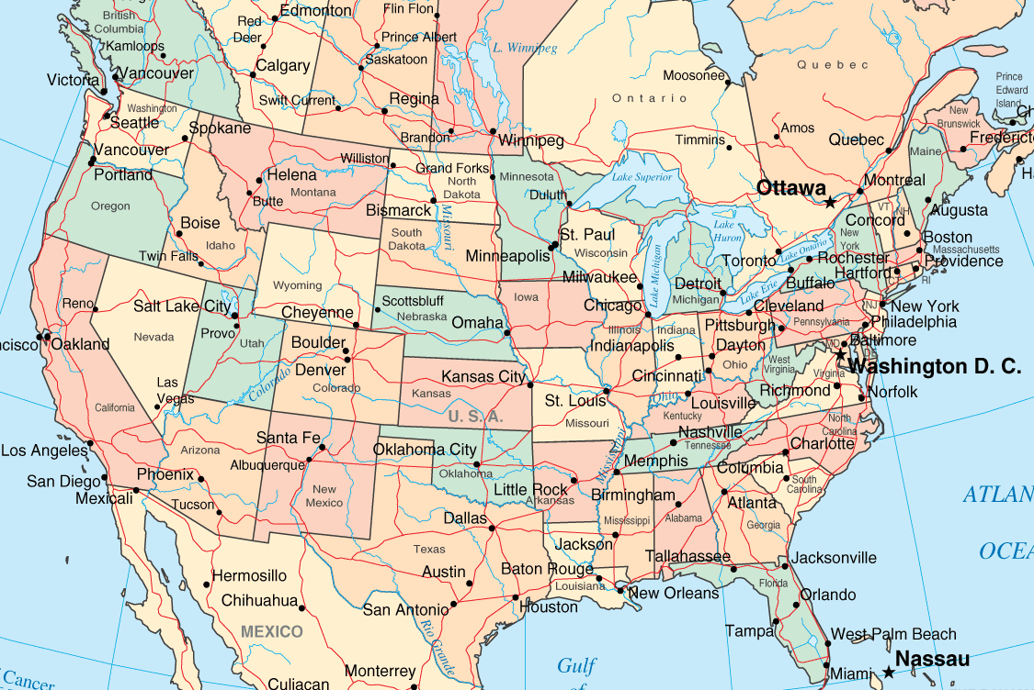
Link these sites for HEP/NP Low Background Characterization
NAAWSU
PNNL
Soudan
SNOLAB
SURF
NAA
UC Davis
KURF
LBNL/Oroville
NAA
Alabama

Slide 27
Initial Suite of Assay Centers of Excellence
PNNL (perhaps also the lead institution)
ICP-MS and electro-refinement and actinide chemistry
Gamma Counting
LBNL LBCF, SURF/CUBED, Soudan LBCF, KURF LBCF, PNNL UL
Neutron Activation Analysis
Alabama and UC Davis
Add surface alpha, RN emanation, beta counting as we identify a need.
Then add another center or add to capabilities at one of the existing centers.
Fund as DOE-SC User Facilities with budgets to cover measurements and analyses as well as facility maintenance and upgrade. R&D costs as needed (via new proposal from the Consortium) to establish capabilities needed for next-gen experiments.
Think of it as transitioning existing facilities into User Facilities to retain capabilities
Large Scale QA/QC campaigns will require their own additional project funding.
Managed by a board formed from the members. Grant renewed on a 3-yr cycle
Internal and Independent review processes established. Program Advisory Panel.

Slide 28
Conclusions
We have some structures in place already (AARM, LRT)
How can we capitalize on them to be more efficient and share resources?
Use the tools we are introducing, so they become generally useful
Contribute to the work and disseminate the results
Help us Link to partner organizations
Increase Sensitivity and Quantity of assay resources
U.S. Consortium of Centers of Excellence in Assay and Related Technologies
MOU’s with other Labs and Centers worldwide
Scheduling Tools which cross boundaries
Progress towards centralized Assay Facilities (FAARM)
GOAL:
The establishment of a Research Community centered on Low Radiation Techniques
with tools to provide
Research Direction, Information Exchange (journals and conferences)
and the ability to successfully capture funding

