Slide 1
Preventivi in sezione 29/6/2012
Gruppo I
Marcello Giorgi

Slide 2
Questa presentazione
Qualche slide di Fisica con aggiornamento
Il Cabibbolab
Il processo e la costing review

Slide 3
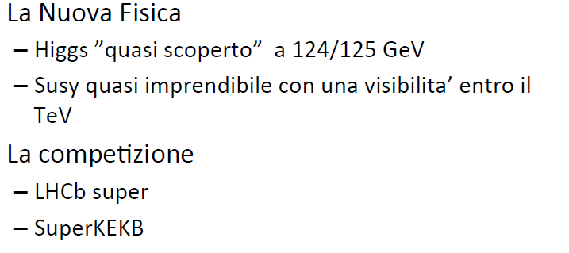
Fisica nel 2012

Slide 4
b Physics
τ Physics
PID
Issues
DC
DCH
Radius
SVT
vs
DCH
c Physics
Forward
PID
SVT
Layer0 Techn.
&
inner radius
FPID
vs
FEMC
PHYSICS
Impact of Geometry on sensitivity
+
Background related issues
B→K νν, B→τν
+ Polarimetry for
τ →μ γ
EMC
I
BEMC
Polarimeter
IFR
Ammount
Of
material
PID/EMC Material
IFR Optimisation

Slide 5
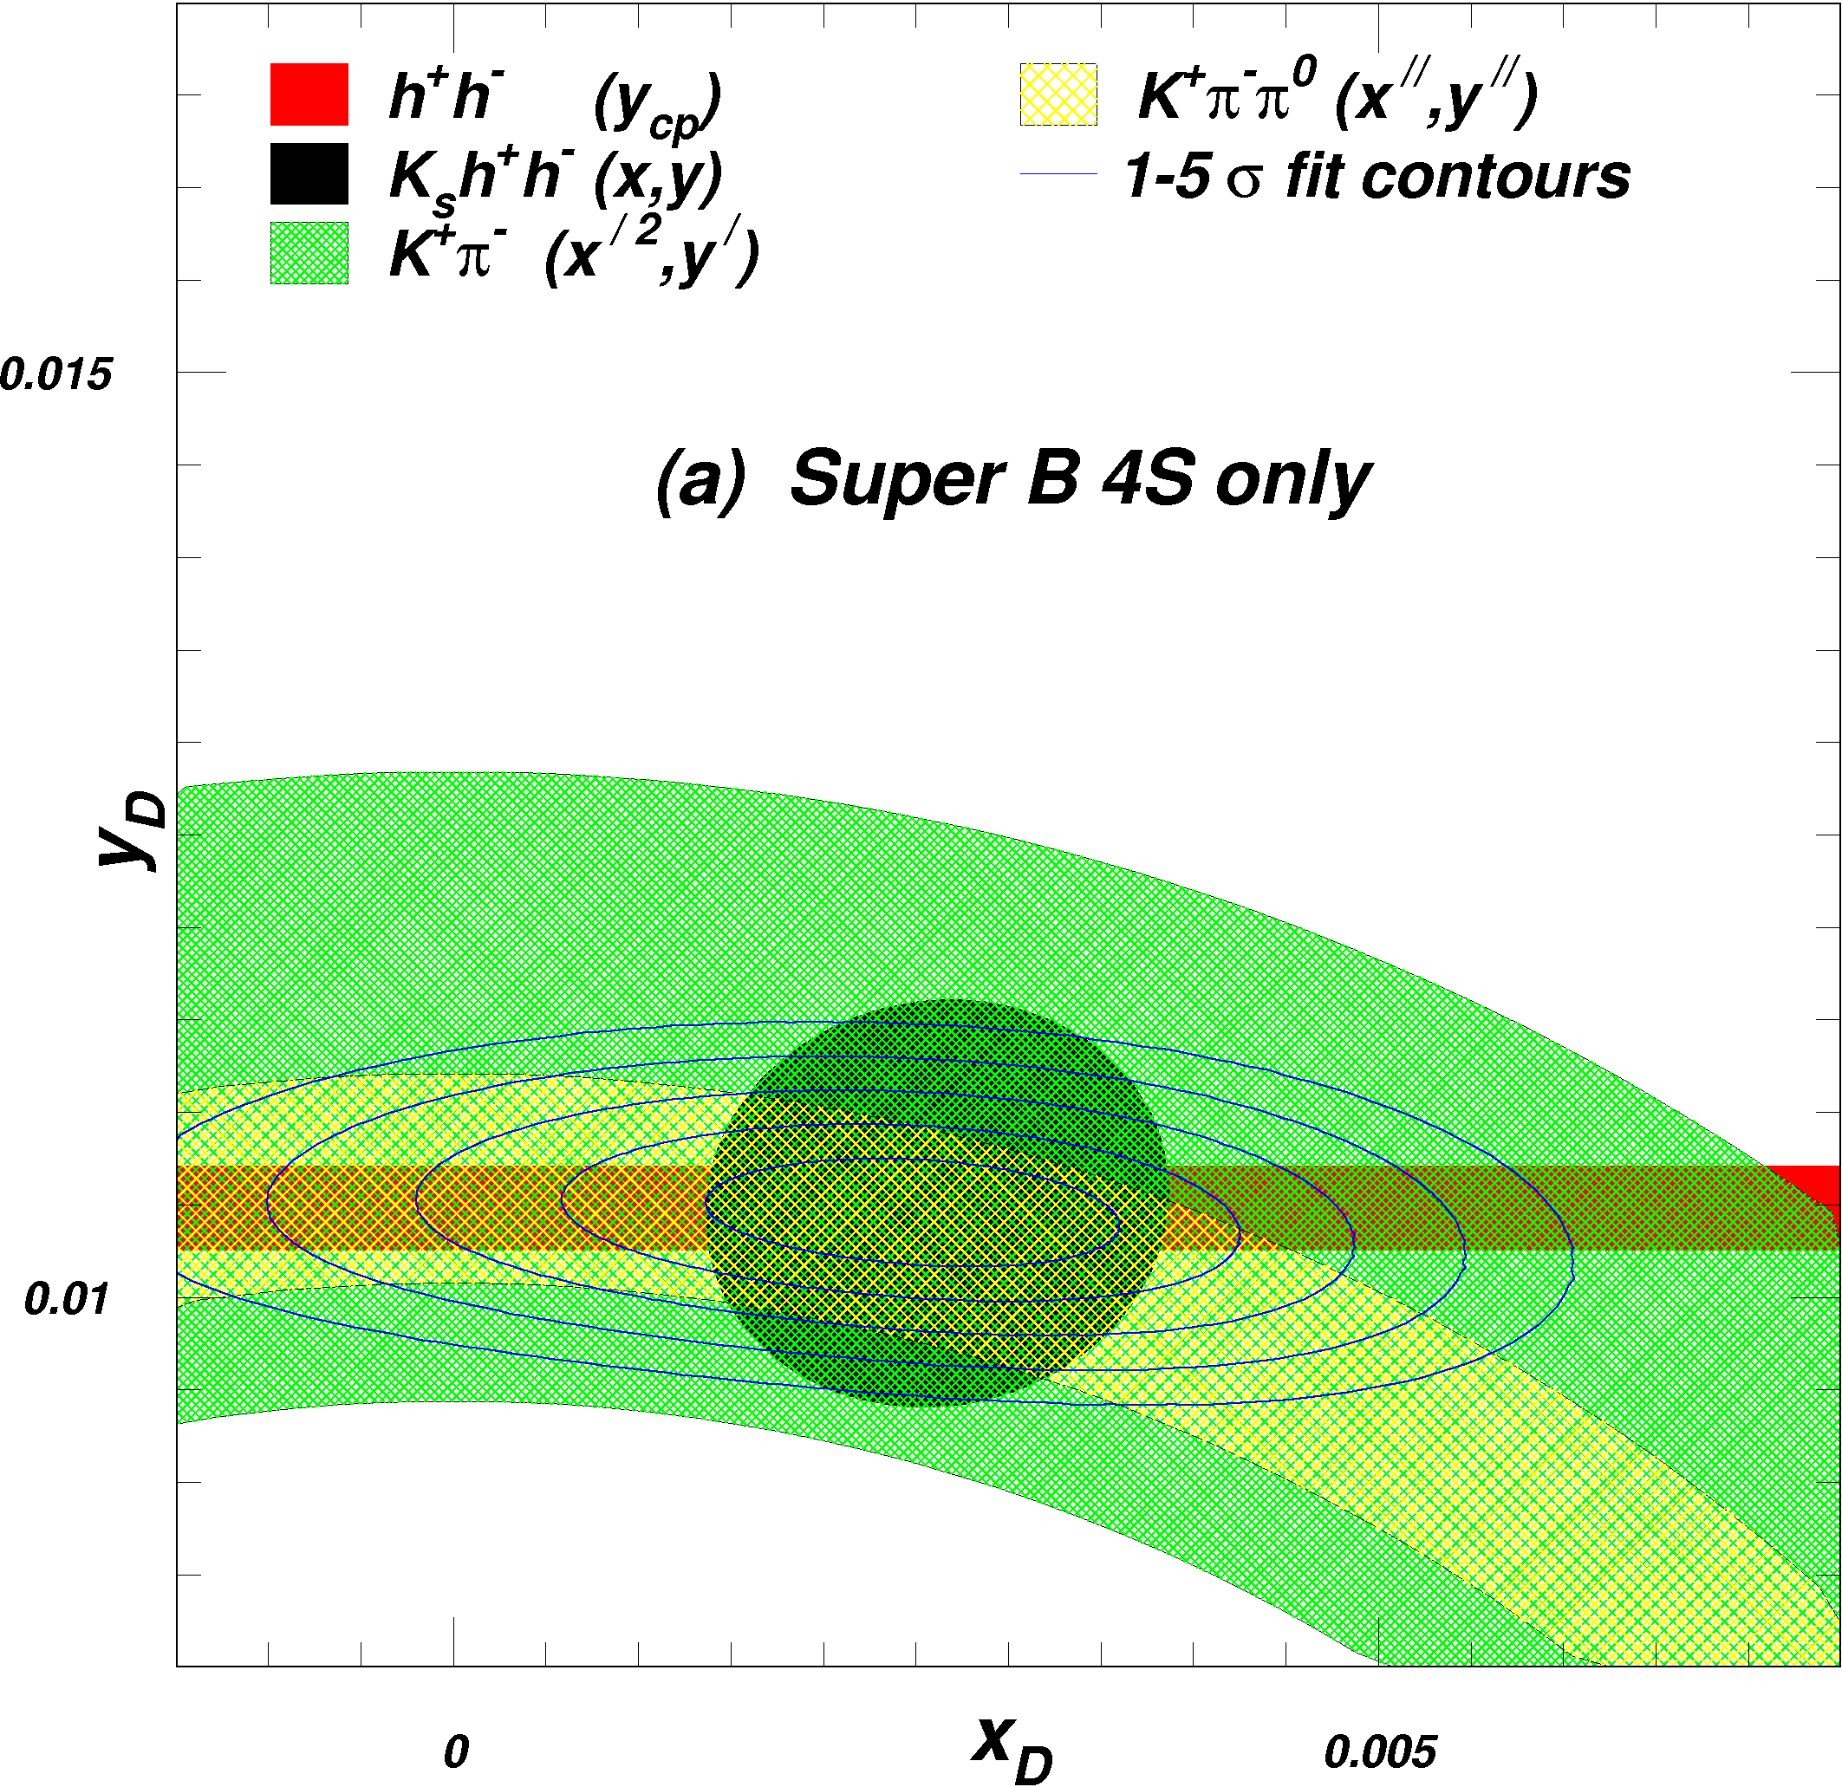
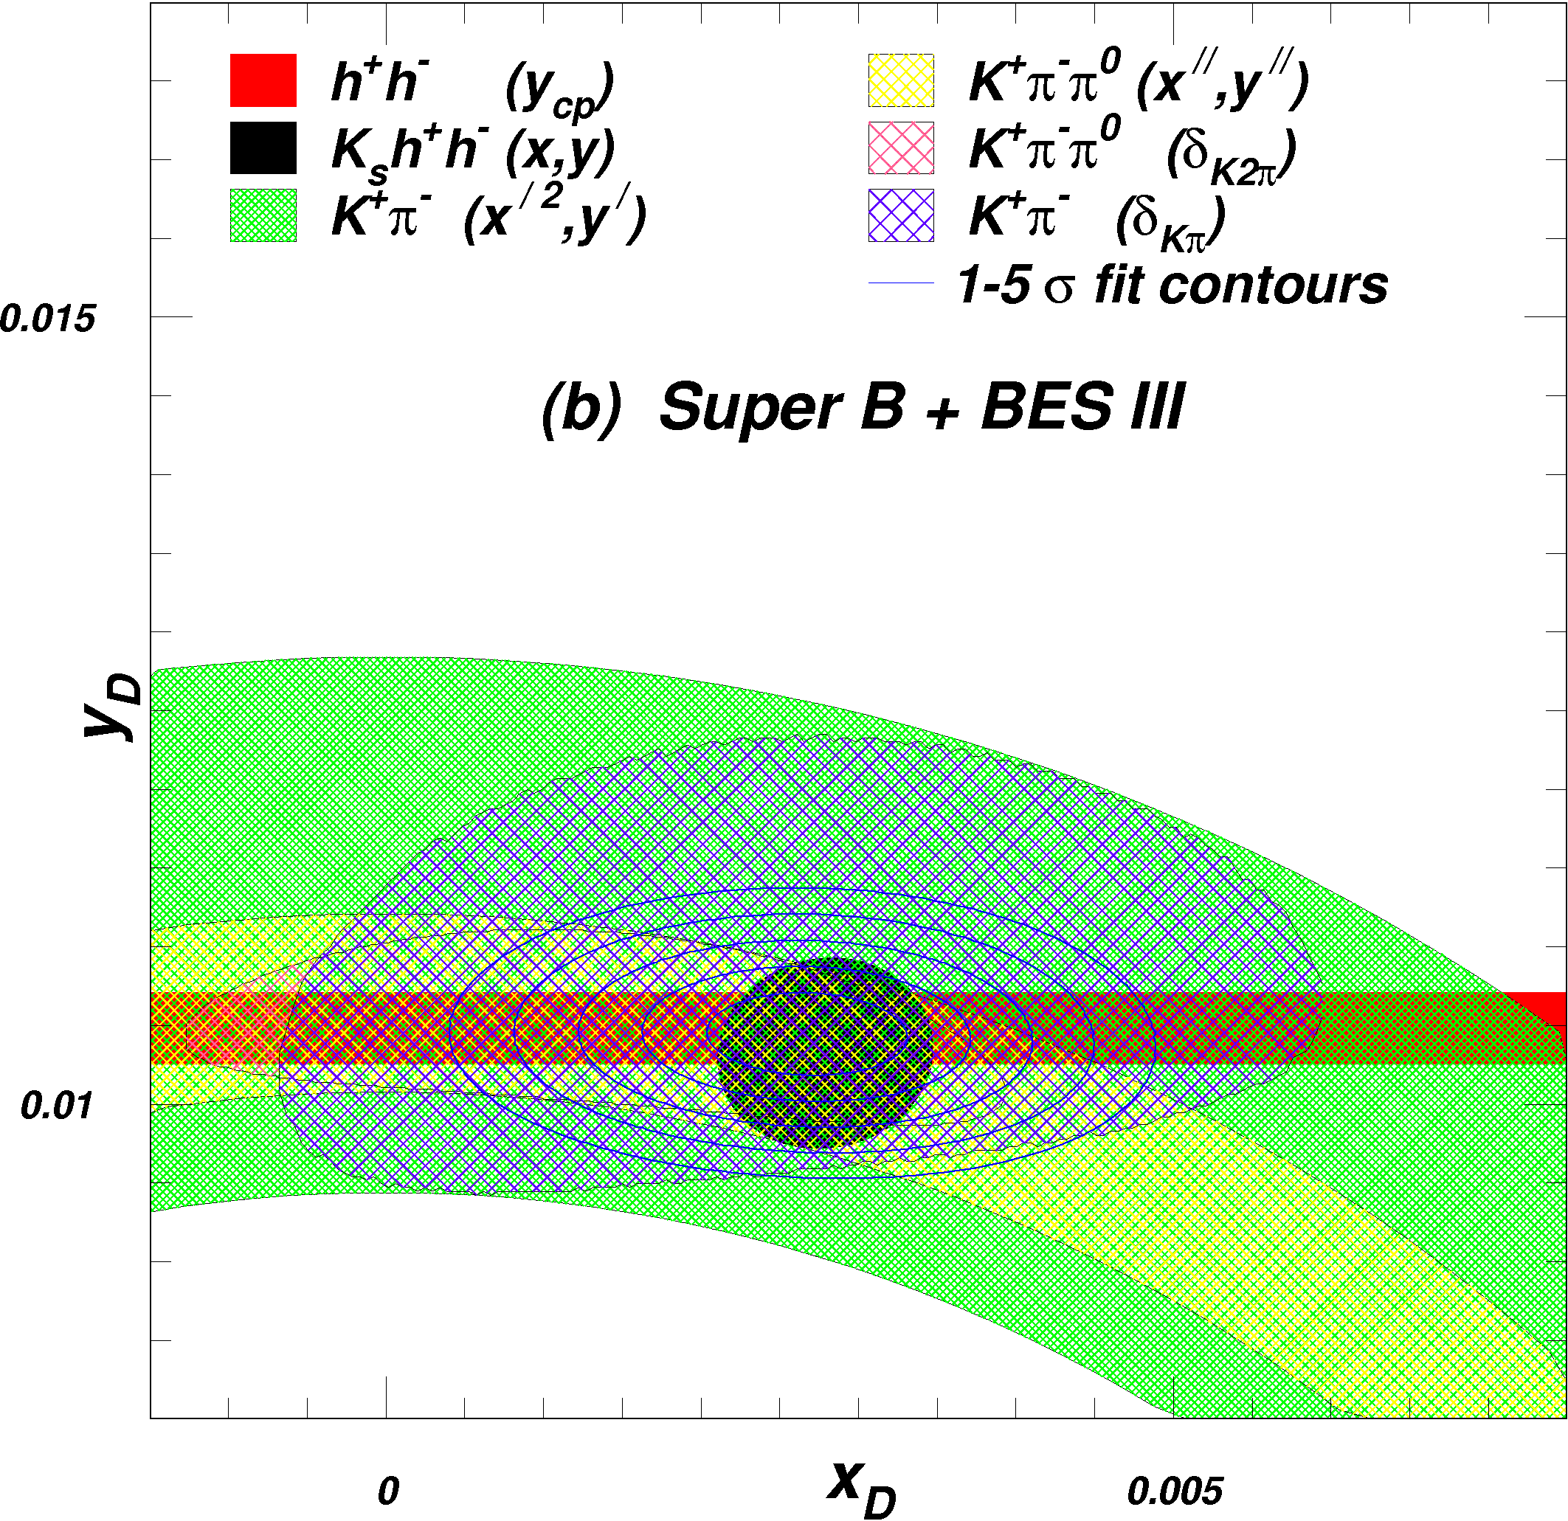
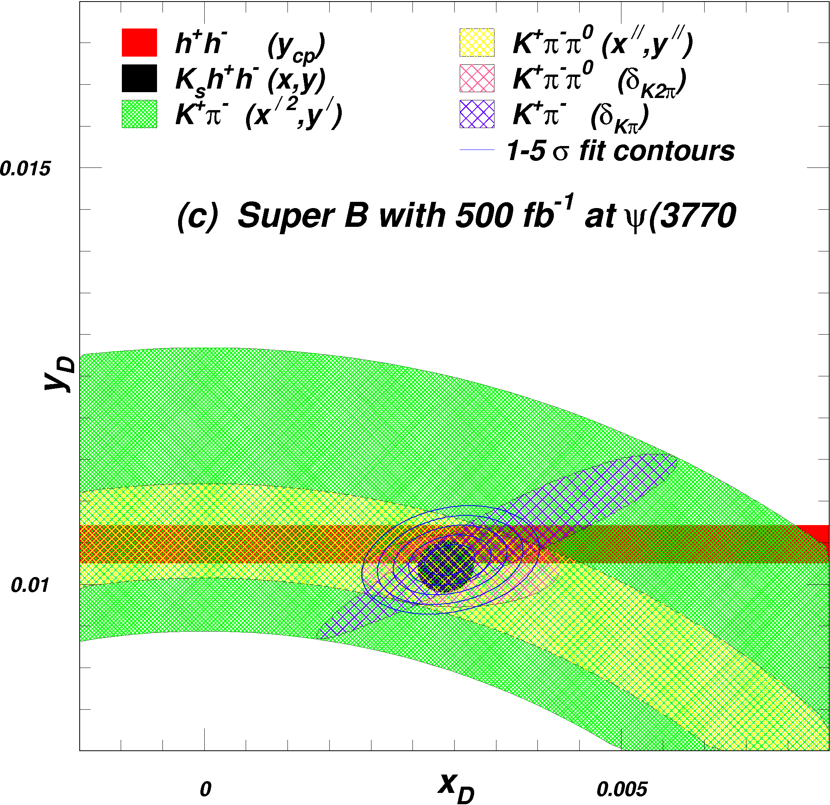
Interest of running @ threshold
500 fb-1 at ψ(3770)
Decays of ψ(3770) → D⁰D⁰ produce coherent (C=-1) pairs of D⁰’s. Quantum
correlations in their subsequent decays allow measurements of strong phases
  Required for improved measurement of CKM γ
  Also required for D⁰ mixing studies
Dalitz plot model uncertainty shrinks
Information on overall strong phase is added
Uncertainty in x_{D} improves more than that of y_{D}

Slide 6
PHYSICS
Electroweak measurement @ SuperB
POLARIZATION NEEDED
M.Roney et al.
0.5% polarization syst.
0.3% stat. error
→ 0.0021
Important point :
The L-R luminosity asymmetry
has to be very well controlled.
Possibly done using monitoring
using Bhabhas. Thought needed

Slide 7
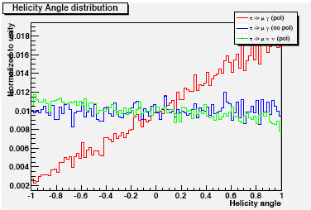
Polarized beam and tag on leptons and on hadrons
( τ→ π ν /τ→ ρ ν) reduces irreducible background!
75 ab⁻¹
A.Cervelli, A.Lusiani, M.A.G., B.Oberhof, E.Paoloni
Sensitivity improves at least by a factor 2. Equivalent to a factor 4 increase in luminosity.

Slide 8
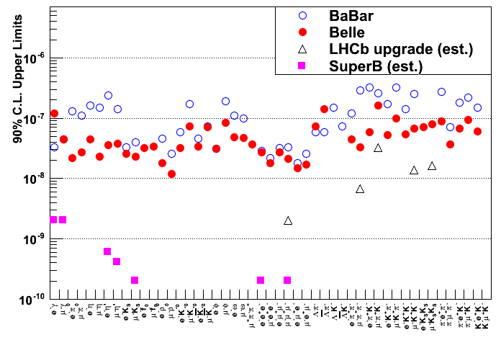
Charged Lepton Flavour Violation (LFV)
ν mixing leads to a low level of charged LFV (B~10⁻⁵⁴).
  Enhancements to observable levels are possible with new physics scenarios.
  Searching for transitions from 3rd generation to 2nd and 1st, i.e.
  and
N.B. e⁻ beam polarisation
helps suppress background.
Two orders of magnitude improvement at SuperB over current limits.
Hadron machines are not competitive with e⁺e⁻ machines for this.

Slide 9
Charged Lepton Flavour Violation (LFV)
ν mixing leads to a low level of charged LFV (B~10⁻⁵⁴).
  Enhancements to observable levels are possible with new physics scenarios.
  Searching for transitions from 3rd generation to 2nd and 1st, i.e.
  and
N.B. e⁻ beam polarisation
helps suppress background.
Two orders of magnitude improvement at SuperB over current limits.
Hadron machines are not competitive with e⁺e⁻ machines for this.

Slide 10
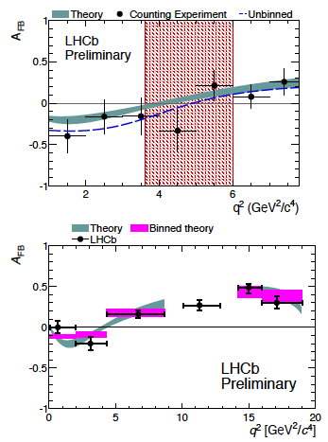

Complementarity of SuperB
SuperB physics program largely complementary to the LHCb program
SuperB will make many essential measurements not possible (or less precise) at hadron machines
Consider few examples where SuperB measurements complement and enhance measurements made at LHCb…
LHCb already making beautiful measurements of
SuperB will complement with additional precision measurements
  Isopin violating asymmetries
  fully inclusive channel
SuperB + LHCb = much greater sensitivity to NP

Slide 11
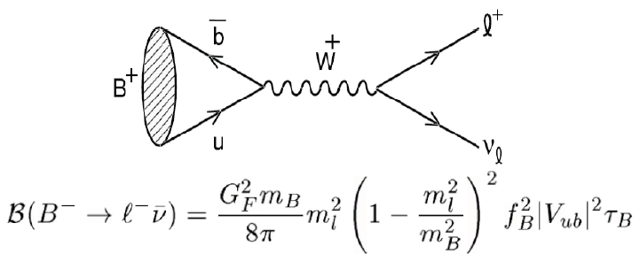
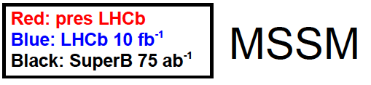
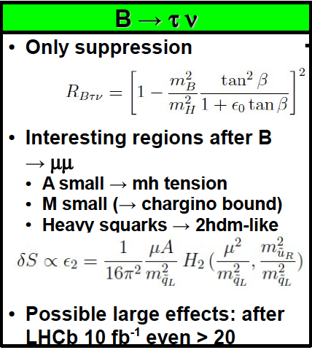
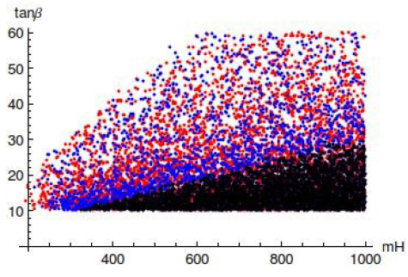
Complementarity of SuperB
Sensitive to NP: charged Higgs
Current exp. BF =
SM (from CKM fit) BF =
NP or statistical fluctuation? SuperB will answer this question.
Measurement complementary to at LHCb
From talk by Blankenburg at SuperB Physics Workshop, Elba, June 2012
(H⁺)

Slide 12
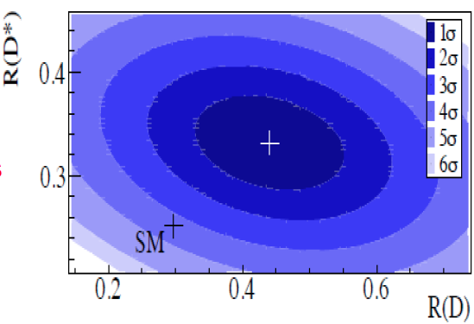
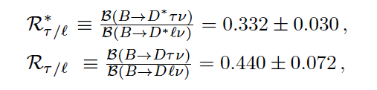

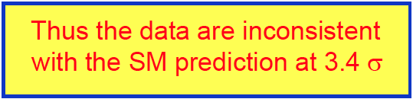
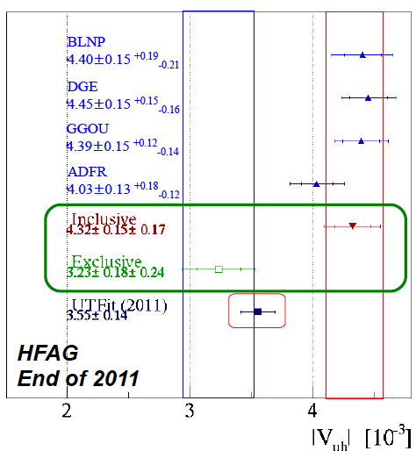
Complementarity of SuperB
Recent measurements incompatible with SM
More recent corrections (arXiv:1206.4977v1[hep-ph],
Violation of Lepton Flavour Universality?
Discrepancy: inclusive V_{ub} vs. exclusive V_{ub}
Inclusive V_{ub} in tension with sin 2β from CKM fits
BaBar (2012)
SM calc.
Together these results raise questions about possible NP (see e.g. arXiv:1206.1872, 1206.2634)
More precise experimental measurements needed ➔ SuperB

Slide 13
Complementarity of SuperB
SuperB physics program largely complementary to the LHCb program
SuperB will make many essential measurements not possible (or less precise) at hadron machines
Consider few examples where SuperB measurements complement and enhance measurements made at LHCb…
LHCb already making beautiful measurements of
SuperB will complement with additional precision measurements
  Isopin violating asymmetries
  fully inclusive channel
SuperB + LHCb = much greater sensitivity to NP

Slide 14
Complementarity of SuperB
Sensitive to NP: charged Higgs
Current exp. BF =
SM (from CKM fit) BF =
NP or statistical fluctuation? SuperB will answer this question.
Measurement complementary to at LHCb
From talk by Blankenburg at SuperB Physics Workshop, Elba, June 2012
(H⁺)

Slide 15
Complementarity of SuperB
BaBar measurements seem incompatible with SM
More recent calculations of R _{τ/l} (arXiv:1206.4977v1 [hep-ph]21Jun2012 and (arXiv:1206.4992v1[hep-ph]) move slightly higher R toward 0.31-0.316 ± O(0.02) the discrepancy is only slghtly decreased
Violation of Lepton Flavour Universality?
The BaBar result is based on the full statistics, one year run at future Super Factories can either confirm or reject this result.
BaBar (2012)
SM calc.

Slide 16
Discrepancy: inclusive V_{ub} vs. exclusive V_{ub}
Inclusive V_{ub} in tension with sin 2β from CKM fits
Together these results raise questions about possible NP (see e.g. arXiv:1206.1872, 1206.2634)
More precise experimental measurements needed ➔ SuperB

Slide 17

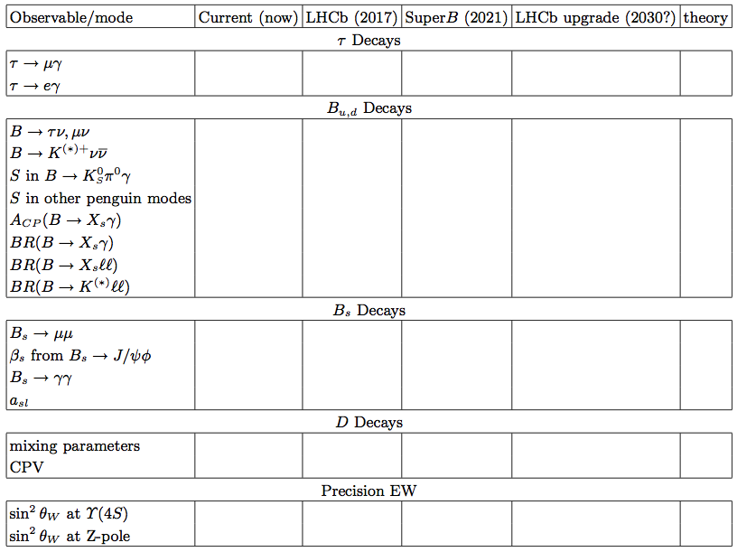
Many unique quality measurements
Experiment: No Result Moderate Precision Precise Very Precise
Theory: Moderately clean Clean Need lattice Clean
Physics Group
Benefit from polarised e⁻ beam
very precise with improved detector
Statistically limited: Ang. analysis with >75ab⁻¹
Right handed currents
SuperB measures many more modes
systematic error is main challenge
control systematic error with data
SuperB measures e mode well, LHCb does μ
Clean NP search
Theoretically clean
b fragmentation limits interpretation

Slide 18
Machine: parameter requirements from physics
Parameter | Requirement | Comment
Luminosity (top-up mode) | ≥10³⁶ cm⁻²s⁻¹ @ Υ(4S) | It can extend up to an ultimate peak luminosity of 4 10³⁶ cm⁻²s⁻¹
Integrated luminosity | 75 ab⁻¹ | Based on a “New Snowmass Year” of 1.5 x 10⁷ seconds (PEP-II experience-based)
CM energy range | τ threshold to Υ (5S)
Minimum boost | βγ = 0.28 (≈4x7 GeV) | 1 cm beampipe radius. First measurement at 1.5 cm
e⁻ Polarization | 60-85% | Enables τ CP and T violation study, measurement of τ g-2,improves sensitivity to lepton flavor-violation and/or allows the identification of the chirality of LFV interaction. Allows measurement of sin θ_{W} at Y_{4S}.

Slide 19
SuperB expected LUMI
>80ab-1 in 7th year
After 7th year integrated Luminosity can grow at rate of ∼40 ab⁻¹/year

Slide 20
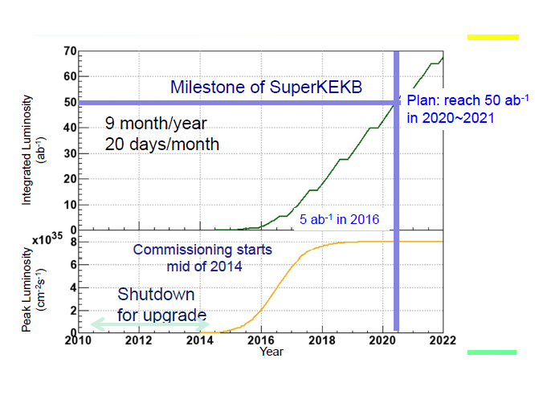

Slide 21
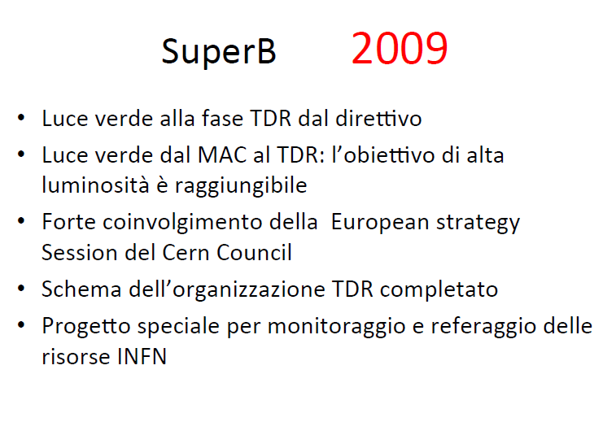

Slide 22
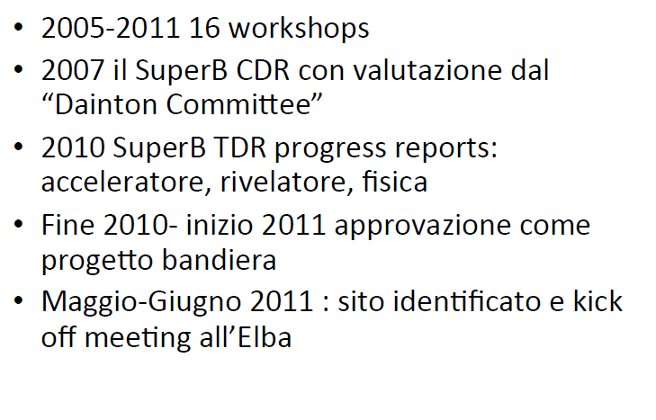

Slide 23
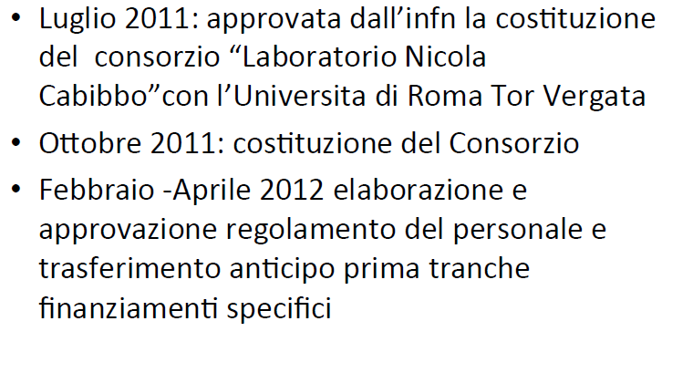

Slide 24
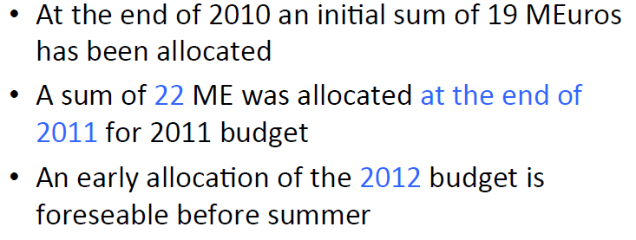

Slide 25
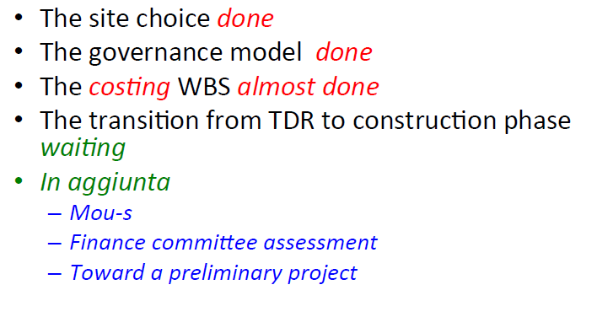
Achievements

Slide 26
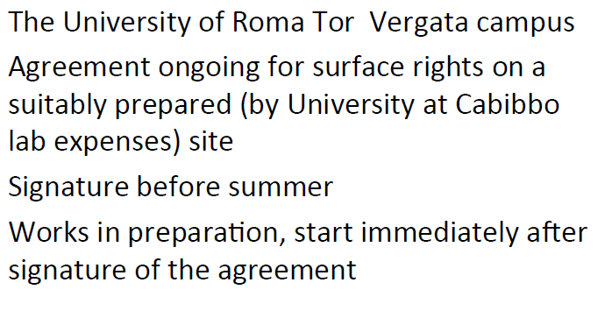
SITE

Slide 27

SITE (cost evaluation)

Slide 28
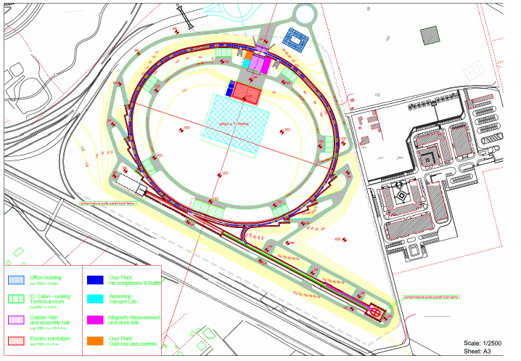
SITE

Slide 29
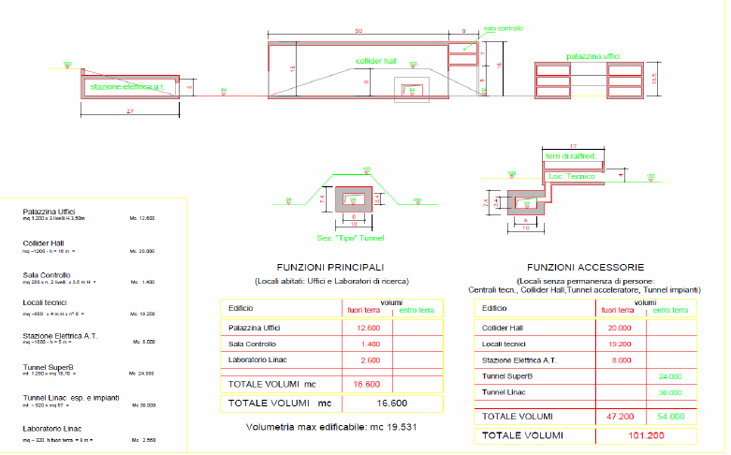
SITE

Slide 30
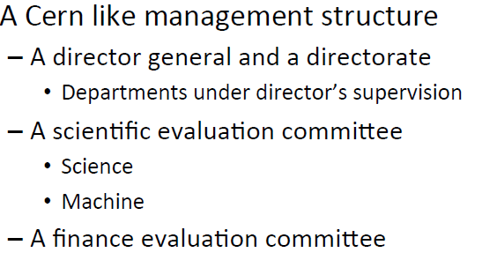
Cabibbolab Consortium governance
GOAL: Evolution to ERIC

Slide 31
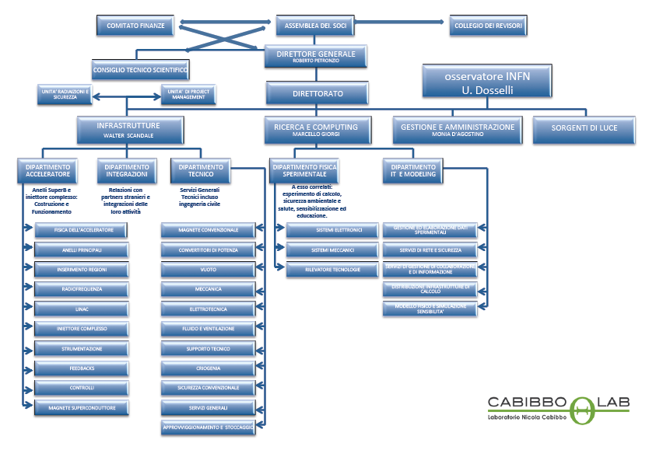
Cabibbolab

Slide 32
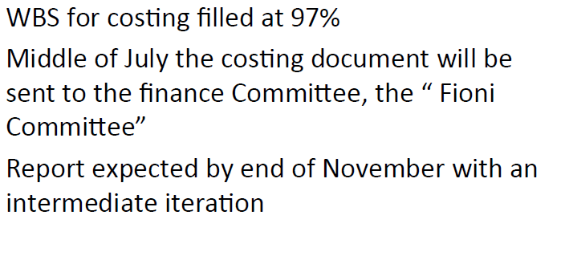
COSTING

Slide 33
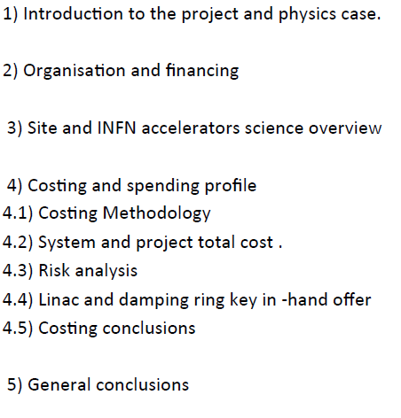
COSTING document

Slide 34
COSTING PREVIEW
VALUE: ≈ 800 M€ ( M&S +VAT +Personnel, mainly INFN + value of INFN facilities infrastructures + value of PEPII components)
COST : ≈ 500 M€ (M&S, no VAT if ERIC)
ASKED in 2010 : 500 M€
Given so far : 250 M€

