Slide 1
Status of FTK
& requests 2013
Old Milestones: we have even more relaxed our schedule
Status of FTK work
Money requests for 2013
NEWS & Future steps
TDR with tested prototypes June 2013
University of Geneva joined FTK for the LAMB project
LPNHE and University of Tessaloniki show interest
Heidelberg got few funds (25 keuros x 4 years)
However we miss manpower !
Paola Giannetti, INFN Pisa, for the FTK Group
ATLAS Italia, May 17, 2012

Slide 2
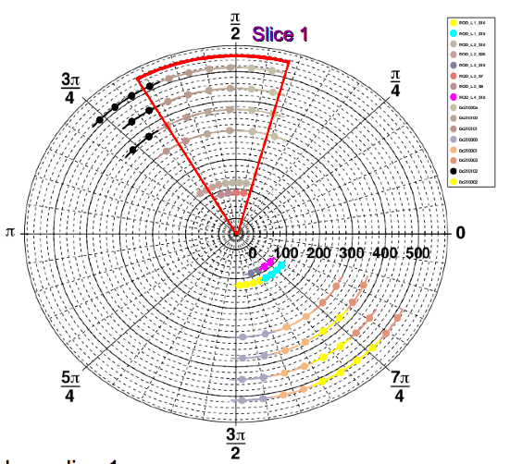
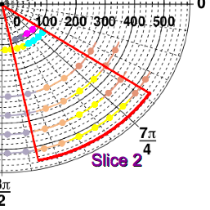
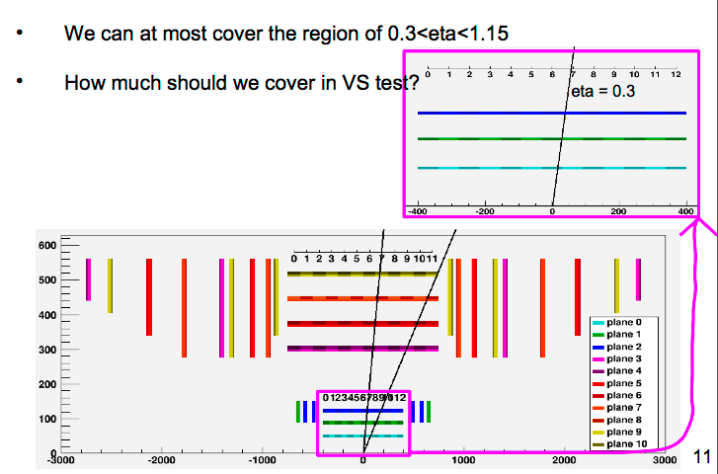
VS: 45degree phi towers (0.3<η<1.15)
4 pix links (L1, L2) + 4 SCT links
RODs per tower (0.3<η<1.15)
Total 16 ROLs for 2 towers
1 EDRO + 1AMB
=1 tower

Slide 3
VS idea born for μ~5-10 (CDF chip, 6 layers only) – now μ∼30 !
80% bank ε, μ∼20
→ no more than ~10 kHz event – a lot of fakes because 6 layers only
NO VS study for μ∼30 but certainly worse!
Take only muon triggers (use L1 ID in the header)
We will also prescale events inside FTK_IM
We will use banks with low efficiency to reduce # found roads
We will cut the Amboard output at 1000 roads.
  Events will start to be complete only when μ < ~20 (later in the store).
  NO TRACK FITTING – ONLY ROAD FINDING!
Verify integration of FTK prototypes with ATLAS TDAQ
Verify that real-time FTK output with collision data
corresponds to FTK simulation

Slide 4
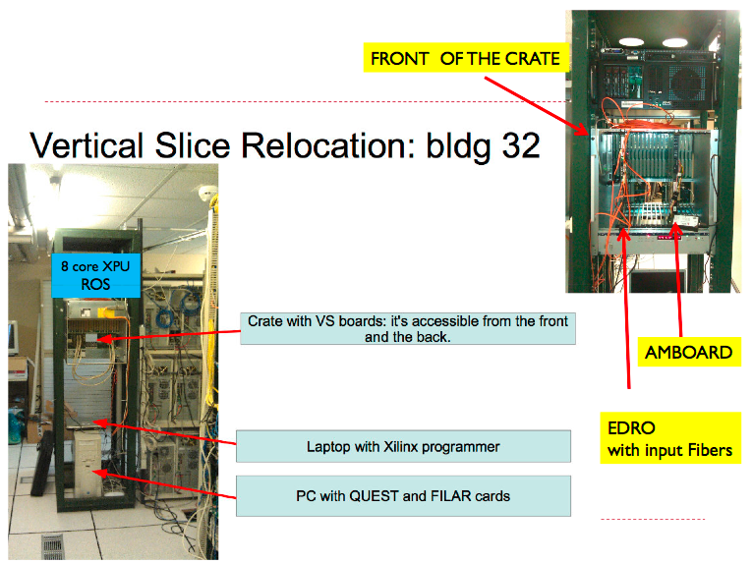
NEW crate @CERN this week for LAB 4
Extra PC + Quest needed

Slide 5
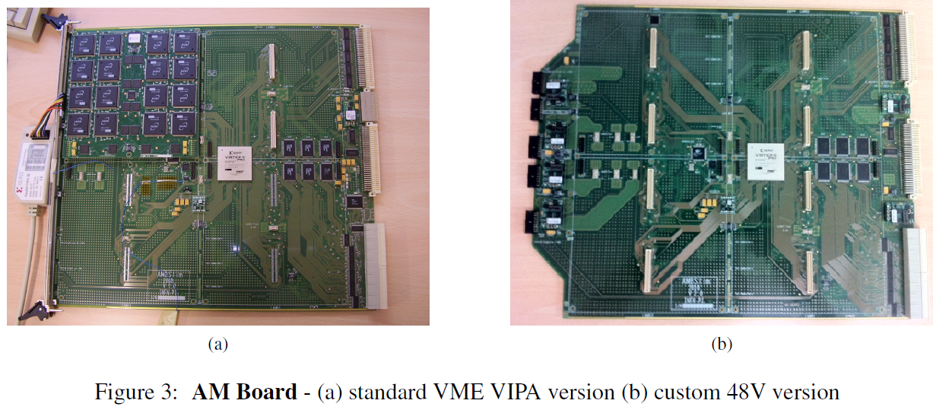
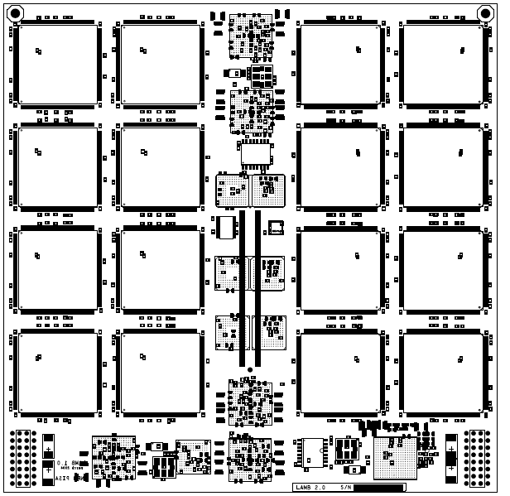
AMBoard generations & tests
AMBslim5 for
standard test stands
NEW:AMBFTK
for 2015 (PI-MI)
AMBslim5++ for cooling tests
New – 128 AMchips
6 A @ 48 Volts
270 Watts@1,8 V
Old – CDF like
64 AMchips
Just ordered the PCB
Final crate – Wiener - soon @CERN
LAMBFTK just routed
(PG-PI-PV)
PI-PV
5V / 345A,
3,3V /115A,
48V /81A,

Slide 6
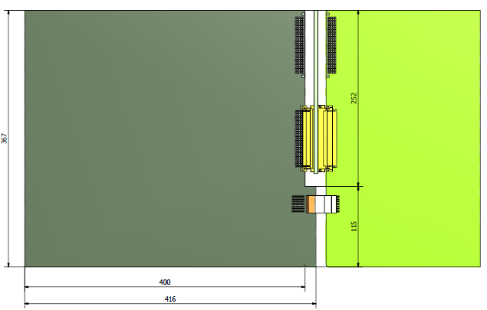
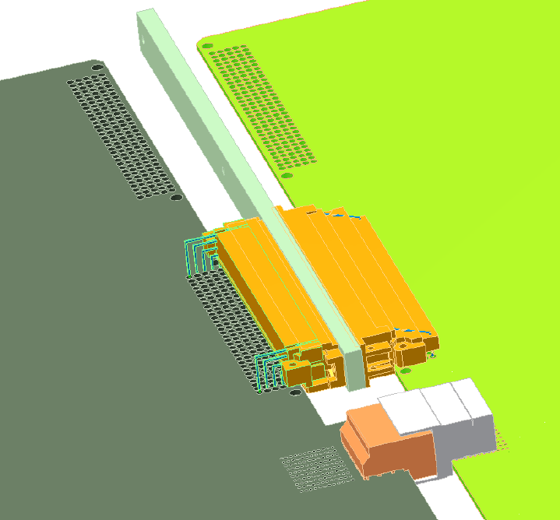
Next tests: AMBFTK and Proto-AUX
P3: 12 (1.5 GHz)+ 8 (3GHz)
= 20 serial links
TEST OF:
- Serial links
VME on Proto AUX
Compatibility with new AMchip
A lot of high frequency
Serial links
Backplane
VME
Proto
AMBoard
Proto
AUX
Milano - Pavia:
Mechanics studies
Tested OK
ISOLA per buon contatto P3

Slide 7
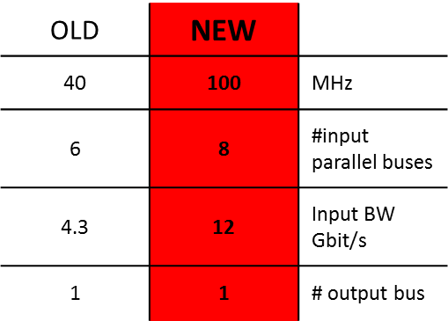
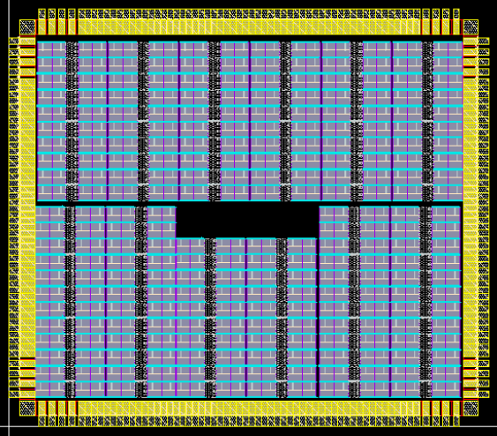

AMCHIP04 big Jump in technology!
(LNF, Pisa, Milano + ideas from USA)
NEW AMCHIP
Annovi, Beretta, Crescioli, Liberali, Sacco, Stabile, Hoff – Ongoing tests
Consumption & perfomances Measured soon!
3.80 mm
65
nm
14 mm^2 = 8192 Patterns + 228 pads
Variable Resolution: high fake rejection with smaller banks
(Talk G. Volpi Animma 2011)
3.31 mm
2011-12
64 patterns= 2 full custum cells

Slide 8
What for 2015? Small production
If we have to use the small chip (14 mm^2):
2 barrel wedges like VS or more:: 8 AMBFTKsA32 LAMBs, 1 k chips
How much costs 1kchips? 500 chips → 4 wafers, 7,765 k€/wafer
12 wafer=1500 chips 93 keuro for a 66% yield??
This is not too expensive for a demonstrator (small & modern)
After this (2015) we can do the pilot run
8 AMBoards → 20 keuro
32 LAMBs → 20 keuro
1,5 kchips → ~90 keuro
~ 130 keuro
in 2014
+ production FTK_IM

Slide 9
Richieste 2013 – linee guida
Produzione rimandata ancora
2012 si costruiscono e testano pre-prototipi
2013 prototipi finali e loro tests (Test stand=CDF Crates to be adjusted)
20 k€ a Pavia per LAMB finali – Test Stand (TS) VME
10 k€ a Pisa per AMBFTK finali
5 k€ a Milano per Test Stand (sviluppo di firmware)
20 k€ a LNF per FTK_IM finale piccola produzione.
chip AM 2013: IMPORTANTE prepararsi allo step finale costoso
  Crescita dell’area per ridurre il rischio step finale (x10)
  Input/output Serializzati per liberare pads per VCC/GND
  Multi-packaging of dies per aumentare la densita’
  → 100 k€ a Milano per 1+ 20 k€ a LNF per 2 + 20 k€ per 3
Integration test still based on EDRO in 2013:
  5 k€ a Bologna per ‘rewarking’ of EDROs e miglioramento
  test stand
  SUPER TOT 200 k€

Slide 10
Summary 2013
Milano: 5 k€ schedina chip + AMchip05, 100 k€
Pisa: 10 k€ new AMBFTK +10 k€ SJ for possible problems
Pavia: 20 k€: LAMBFTK (small prod) + Test stands
LNF: 20 k€ FTK_IM e 40 k€ Amchip
Bologna: 5 k€ (spese di laboratorio)
Tot: 200 keuro + 10 SJ
Summary schedule
Produzione rimandata ancora:
2012 si costruiscono e testano pre-prototipi
2013 prototipi finali e loro tests
2014 costruzione dimostratore (possibilmente coprire Barrel)
2015 prima presa dati

Slide 11
Backup

Slide 12
Responsabilita’ e ME
Paola G. L2 4 mesi
Marco P. L2 4 mesi
Agostino L. L2 1 mese
Andrea N. L2 1,5 mesi
Annovi A. L2 4 mesi
Volpi G. L3 2 mesi
Mauro V. L3 3 mesi
A. Stabile L3 1 mese
Valentino L. L3 1 mese
Responsabilita’ descritte a questa pagina: https://twiki.cern.ch/twiki/bin/viewauth/Atlas/FastTracKer
Integrazione di FTK con prototipi americani @CERN:
Pisa 1 mesi
Milano 1 mesi
Frascati 1 mesi
Pavia 1 mesi
Bologna 1 mesi

Slide 13
Missioni interne
4 K€ Frascati integrazione prototipi e AMchip I e II
5 K€ Pisa integrazione prototipi
4 K€ Milano AMchip I e II
4 K€ Pavia integrazione prototipi
Bologna integrazione prototipi

Slide 14
Conclusions
We are working hard for both the Final FTK
& the intermediate versions (vertical slice and demonstrator)
First prototypes (chip and boards) will be under tests in June.
the AMchip just arrived, as planned.
the vertical slice plan has been reduced (LHC schedule).
the TDR in 2013 should start final approvals
A demonstrator expected in 2015, big production will start after.

Slide 15
ANALYSIS of VS data
This task is independent of the hardware task:
If hardware produces the same roads as FTKsim →
can do everything else with FTKsim –
F. Crescioli since February: try to reconstruct top events in VS:
  apply track isolation to leptons
  measure rejection for muons from b-jets
  measure efficiency for muons from Ws
In 3 months: (a) choosing the right strategy to have FTK tracks available to trigger algorithms, (b) learning to run muComb – muIso on them.
V. Cavaliere and A. McCarn are joining Francesco’s effort now. Additional help would be welcomed from HLT experts.
Fakes will be a problem – but let’s prepare the algos

Slide 16
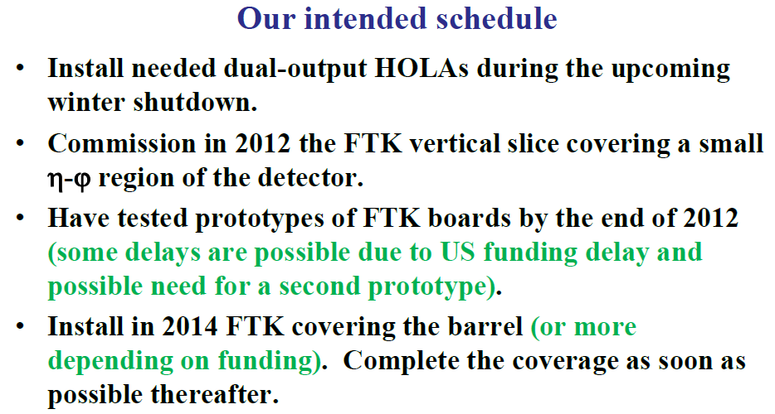
DONE
2013
A minimum of Two 45 degree wedges in the barrel
If the run is extended to 2013, enlarge the vertical slice
in 2012 for real triggering → “small demonstrator”
  primary vertex identification, beam spot calculation …….
  Track-isolated muons, highly ionizing particles …..
NO run EXTENSION

Slide 17
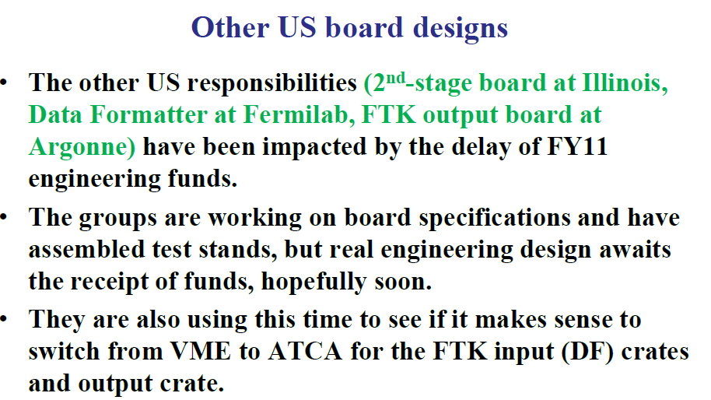

Slide 18
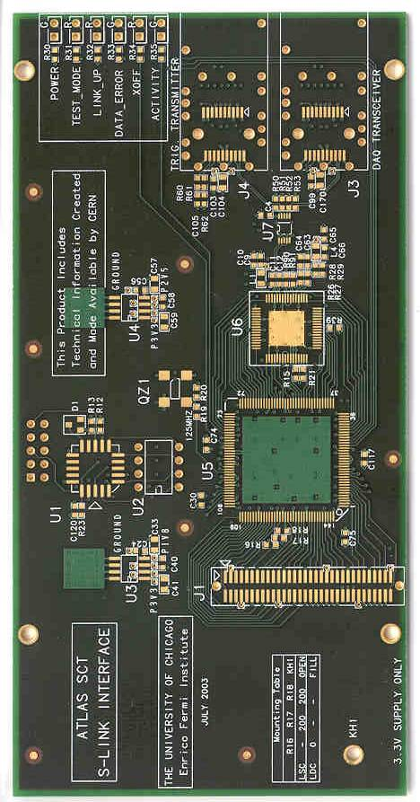
FTK: Projects to Institutions
Frascati-Waseda:
Clustering in
Pixels-SCT
mezznines
Pisa & Frascati & Fermilab
the AMChip could be 3D
USA-Italy
“2-outHola”
Pisa:
AMBoard
Pixels
& SCT
RODs
4 DF crates:
cluster finding
split by layer
8 “core” crates:
AMboard
Data Organizer
GigaFitter
Illinois:
Final board
in core crate
Fermilab:
DF motherboards
S-links
1 Readout Crate
Raw data
ROBs
Argonne
Chicago GigaFitter + Data Organizer + HW
Track data
ROB
USA+Italy: crates + links + backplanes…

Slide 19
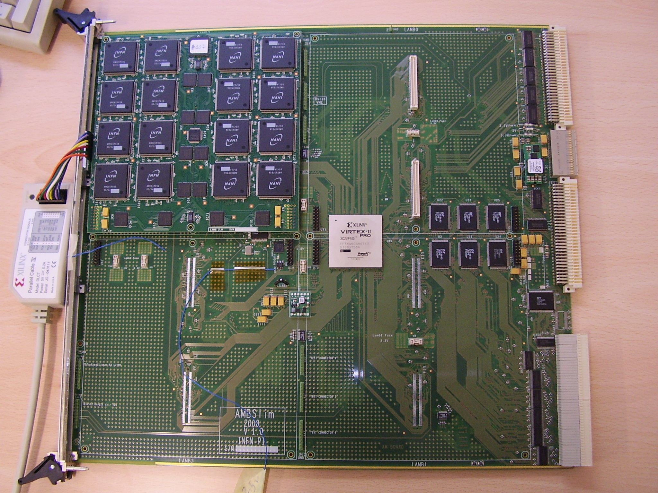
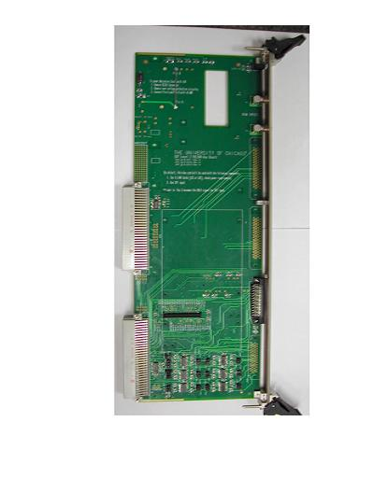
ITALIAN DUTIES for
3x10**34
OPTION A
PISA
CPU vme
DATA FORMATTER
FRASCATI
AM10+…..
AM15+…..
AM14+…..
AM9+…...
AM13+……
AM8+…..
AM11+…..
AM12+…..
AM7+TSP+DO+TF+HW
AM6+TSP+DO+TF+HW
AM4+TSP+DO+TF+HW
AM0+TSP+DO+TF+HW
AM5+TSP+DO+TF+HW
AM3+TSP+DO+TF+HW
AM2+TSP+DO+TF+HW
AM1+TSP+DO+TF+HW
11LayFit+ HW final
11LayFit+ HW final
11LayFit+HW
11LayFit+HW
Processing Unit
Pisa +Chicago
AUX card
Standard cell chip
DO+TF+HW
Interface
Connectors for
tracks output
FERMILAB
LAMB
Control
FPGA
DO
TF
HW
FPGA
for
Roads
DO
TF
HW
DO
TF
HW
Connectors for
Hits LVDS Cables
40 MHz clock
DO
TF
HW
FPGA
for
SS
Input
P3
serial
LVDS
DO
INPUT
FIFOs
SSMAP
AMBoard

