Slide 1



Nucleus-Nucleus Conference 2015,
Catania, 21-26 June 2015
The ¹²C(¹²C,α)²⁰Ne and ¹²C(¹²C,p)²³Na reactions at the Gamow peak
via the Trojan Horse Method
Aurora Tumino

Slide 2
12C+12C fusion
Great interest in a wide range of stellar burning scenarios in carbon-rich environments for stars with more than 8 M
Carbon burning temperature from 0.8 to 1.2 GK → E_{cm} from 1 to 2 MeV
Principal reactions:
¹²C(¹²C,α)²⁰Ne + 4.617 MeV
¹²C(¹²C,p)²³Na + 2.241 MeV
¹²C(¹²C,n)²³Mg - 2.599 MeV
¹²C(¹²C,g)²⁴Mg +13.933 MeV
¹²C(¹²C,2α)²⁰Ne -0.113 MeV
The most frequent results of the interaction
Considerable efforts to measure the ¹²C+¹²C cross section at astrophysical energies:
M.G. Mazarakis & W.E. Stephensen, Phys. Rev. C 7 1280 (1973)
K. U. Kettner et al., Phys. Rev. Lett. 38, 337 (1977)
H.W. Becker et al., Z. Phys. A 303, 305 (1981)
L. Barron-Palos et al., Nucl. Phys. A 779, 318 (2006)
E.F. Aguleira et al.,Phys. Rev. C 73, 064601 (2006)
T. Spillane et al., Phys. Rev. C 73, 064601 (2006)
T. Spillane et al., Phys. Rev. Lett. 98, 122501 (2007)
…. … …

Slide 3
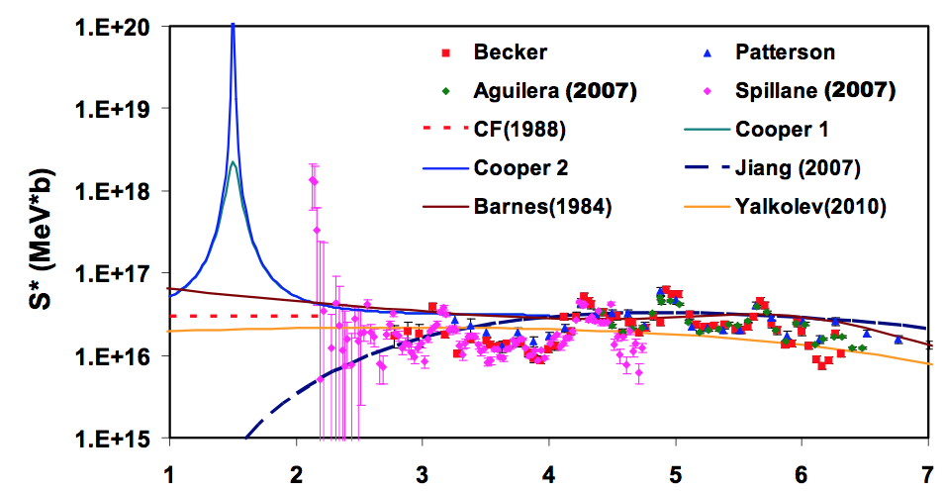
C-burning: Status of Art
Resonances at nearly every 300 keV down to E_{cm} = 2.14 MeV. They would increase the present nonresonant reaction rate of the alpha(proton) channel by a factor of 5(2) .
extrapolations differ by
3 orders of magnitude
large uncertainties
in astrophysical models
of stellar evolution
and nucleosynthesis
10⁻²² b 10⁻⁷ b
Thus, further measurements extending down to at least 1 MeV would be extremely important.

Slide 4
Our Experiment with theTHM
¹²C(¹²C,α)²⁰Ne and ¹²C(¹²C,p)²³Na reactions via the Trojan Horse Method applied to the ¹²C(¹⁴N,α²⁰Ne)²H and ¹²C(¹⁴N,p²³Na)²H three-body processes
²H from the ¹⁴N as spectator s
Observation of ¹²C cluster transfer in the ¹²C(¹⁴N,d)²⁴Mg* reaction (R.H. Zurmȗhle et al. PRC 49(1994) 5)
QUASI-FREE MECHANISM
only ¹²C - ¹²C interaction
d = spectator
Direct breakup
¹⁴N
d
¹²C
a,p
E_{14N} =30 MeV> E_{Coul}
¹²C
²⁴Mg*
NO Coulomb suppression
NO electron screening
²⁰Ne,²³Na
⇒
C. Spitaleri et al., Phys. Rev. C 63, 005801 (2001)
R. Tribble et al. Rep. Prog. Phys. 77 106901 (2014)
E_{QF} = E14N -10.27 MeV

Slide 5
Theoretical approaches to the THM
A + a → c + C + s → → → A + x → c + C
PWIA hypotheses:
A does not interact simultaneously with x and s
The presence of s does not influence the A-x
interaction
MPWBA formalism
(S. Typel and H. Wolter, Few-Body Syst. 29 (2000) 75)
distortions introduced in the c+C channel, but plane waves for the three-body entrance/exit channel
off-energy-shell effects corresponding to the suppression of the Coulomb barrier are included
KF kinematical factors
⏐φ⏐² momentum distribution of s inside a
dσ^{N}/dΩ Nuclear cross section for the A+x→C+c reaction
A. Tumino et al., Phys. Rev. Lett. 98, 252502 (2007)
but No absolute value of the cross section…normalization to available direct data

Slide 6
…for resonant reactions
When narrow resonances dominate the S-factor the reaction rate can be calculated by means of the resonance strength
Standard R-Matrix approach cannot be applied to extract the resonance parameters of the ¹²C(¹²C,α)²⁰Ne, ¹²C(¹²C,p)²³Na
→ Modified R-Matrix is introduced instead
In the case of a resonant THM reaction, the cross section takes the form
M_{i}(E) is the amplitude of the transfer reaction (upper vertex) that replaces the entrance channel partial width
The resonance parameters can be extracted and in particular the strenght
(Notice: No spectroscopic factors in the Γ_{(12C12C)} / |M_{i}|² ratio to extract the strength)
… for more details … plenary talk by Akram Mukhamedzhanov
Notes:
6

Slide 7
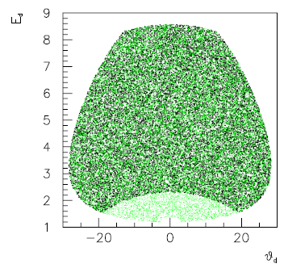
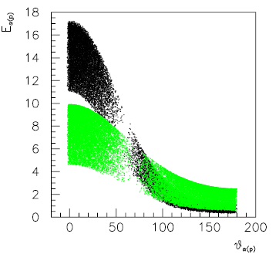
The 14N+12C experiment at LNS
E_{14N}=30 MeV
Particle identification supplied by silicon telescopes: 38 μm silicon detector as ΔE- and 1000 μm Position Sensitive Detector (PSD) as E-detector
T₁ (40° - 65°)
T₂ (7° - 35°)
¹²C
¹⁴N beam
T₃ (7° - 35°)
T₄ (40° - 65°)
²⁰Ne+α+d and ²³Na+p+d reaction channels reconstructed when detecting the ejectile of the two-body reactions (either α (black dots) or p (green dots)) in coincidence with the spectator d particle.
No detection of ²⁰Ne or ²³Na quite low energy → too high detection threshold

Slide 8
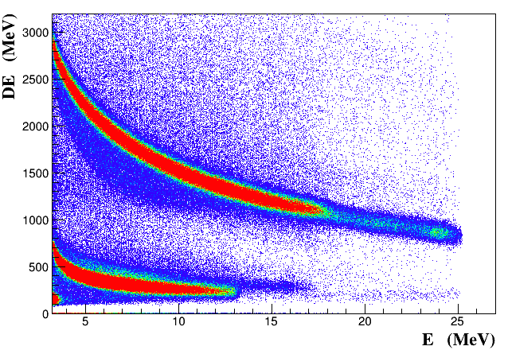
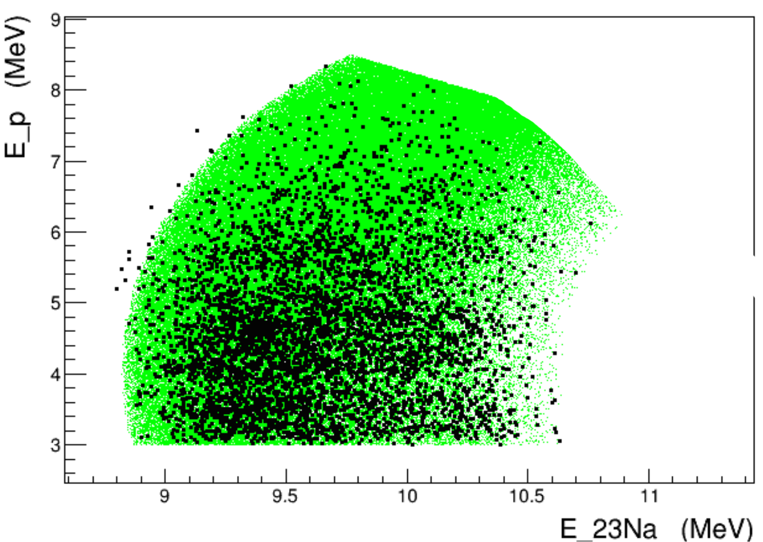
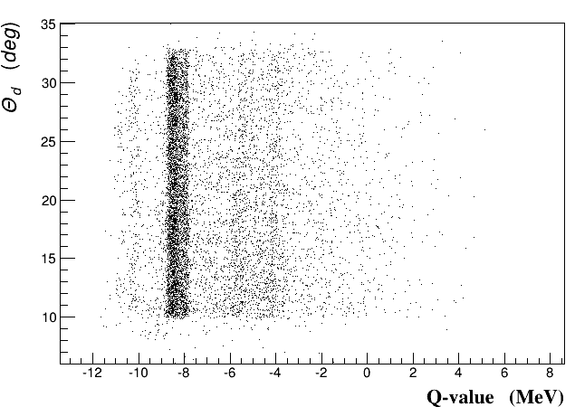
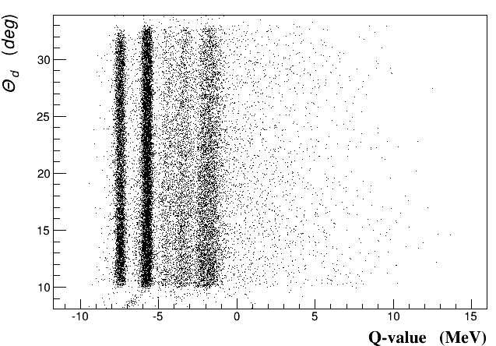
Selection of the 3-body channels
p₁+²³Na*+d
p₀+²³Na+d
α₁+²⁰Ne*+d
α₀+²⁰Ne+d

Slide 9
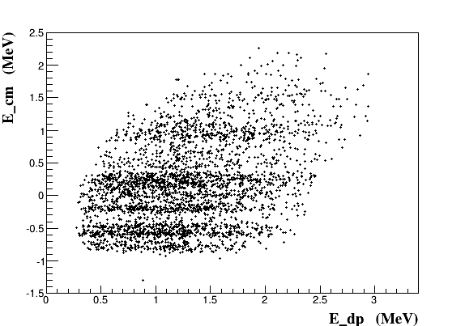
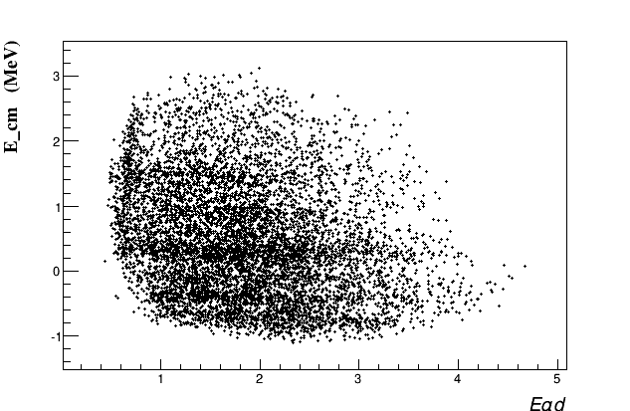
Investigating the reaction mechanism
¹⁴N+¹²C→p₁+²³Na*+d
E__{cm}=E__{(23Na-p)}-2.221-0.440 MeV
E_cm=0 corresponds to E*(²⁴Mg)=13.933 MeV
¹⁴N+¹²C→α₀+²⁰Ne+a
E__{cm}=E__{(20Ne-a)}-4.617 MeV
E_cm=0 corresponds to E*(²⁴Mg)=13.933 MeV

Slide 10
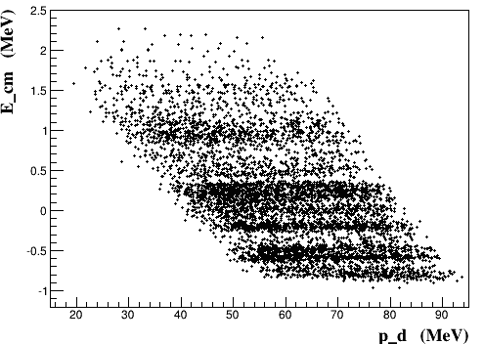
Selection of the quasi-free mechanism
Comparison between the experimental momentum distribution and the theoretical one
Momentum distribution of d inside ¹⁴N from the Wood-Saxon ¹²C-d bound state potential with standard geometrical parameters
r₀=1.25 fm, a=0.65 fm and V₀=54.427 MeV

Slide 11
Extraction of the two-body cross section
¹²C+¹²C→α₀+²⁰Ne
¹²C+¹²C→p₀+²³Na
¹²C+¹²C→p₁+²³Na*

Slide 12
Comparison between two-body cross sections
in the astrophysical region
¹²C+¹²C→α₀+²⁰Ne
¹²C+¹²C→p₀+²³Na
¹²C+¹²C→p₁+²³Na*
Relative yields in the three channels
give hints on the three branches
Next step: R-matrix fits on all channels at the same time → extraction of the S(E) factors … work in progress!!

Slide 13
Conclusions
First measurement of the ¹²C(¹²C,α)²⁰Ne and ¹²C(¹²C,p)²³Na via the Trojan Horse Method with ²H from the ¹⁴N as spectator s
First measurement of the ¹²C(¹²C,α)²⁰Ne and ¹²C(¹²C,p)²³Na in the Gamow peak
Clear evidence of the 1.5 MeV resonance conjectured by Cooper et al. at the Gamow peak. This resonance, together with the one around 900 keV will dominate the reaction rate at the Gamow peak.
Next step of data analysis: Modified R-matrix calculation to determine the strengths of the relevant resonances → S(E) factor → reaction rate!
Work in progress…!

Slide 14
THE ASFIN GROUP
C. Spitaleri, S. Cherubini,L. Guardo, M.Gulino, I. Indelicato, M. La Cognata, L.Lamia, R.G.Pizzone, S.M.R.Puglia, G.G. Rapisarda, S.Romano, M.L.Sergi, R. Spartà, A.Tumino
I N F N, Laboratori Nazionali del Sud, Università di Catania, Italy, and Università di Enna “Kore”, Italy

Slide 15


How to extract the resonant strength?
When narrow resonances dominate the S-factor the reaction rate can be calculated by means of the resonance strength:
(¹⁸O(p,α)¹⁵N case)
Where:
Ĵ=2J+1
Γ_{(AB)} is the partial width for the A+B channel
Γ_{i} is the total width of the i-th resonance
E_{Ri} is the resonance energy
What is its physical meaning?
Area of the Breit-Wigner describing the resonance
  no need to know the resonance shape
In the THM approach:
Where:
ω_{I} = Ĵ_{i} / Ĵ_{p} Ĵ_{18O} statistical factor
N_{i} = THM resonance strength
M_{i} = transfer amplitude
Advantages:
possibility to measure down to zero energy
No electron screening
No spectroscopic factors in the Γ_{(p18O)} / |M_{i}|² ratio
Notes:
15

