Slide 1
Sectoral Operational Programme
„Increase of Economic Competitiveness”
“Investments for Your Future”
Extreme Light Infrastructure – Nuclear Physics (ELI-NP) – Phase I Project co-financed by the European Regional Development Fund
EUROPEAN UNION
GOVERNMENT OF ROMANIA
Structural Instruments
2007-2013
Laser-based Acceleration for Nuclear Physics experiments at ELI-NP
Ioan Dancus, Florin Negoita, Ovidiu Tesileanu, Edmond Turcu, Daniel Ursescu, Nicolae-Victor Zamfir ovidiu.tesileanu@eli-np.ro
Nucleus-Nucleus 2015
Catania, Italy, June 21st – 26th

Slide 2
ELI-NP Infrastructure
Large equipment:
High power laser system, 2 x 10PW maximum power, ultrashort pulses <25fs
Thales Optronique SA and SC Thales System Romania
Gamma radiation beam, high intensity, tunable energy up to 20MeV, relative bandwidth 0.3%, produced by Compton scattering of a laser beam on a [max] 720 MeV electron beam produced by a warm LINAC
European Consortium EuroGammaS led by INFN Rome:
INFN (Italy), University “La Sapienza” Rome (Italy), CNRS (France), ALSYOM (France), ACP Systems S.A.S.U. (France), COMEB Srl (Italy), ScandiNova Systems (Sweden)
Buildings – one contractor, 33000sqm total – STRABAG
Experiments:
8 experimental areas, for gamma, laser, and gamma+laser
2

Slide 3
ELI-NP Facility Concept
High rep-rate laser experiments
0.1 – 1 PW
1PW block
Ti:Sapph
Flashlamp based
Oscillators
+OPCPA preamps
1PW block
Flashlamp based
10-PW block
Flashlamp based
25J/ 1Hz/ <25fs
220J/ 0.016Hz/ 22fs
Multi-PW experiments
1PW block
Ti:Sapph
Flashlamp based
Oscillators
+ OPCPA preamps
1PW block
Flashlamp based
10-PW block
Flashlamp based
Combined laser-gamma experiments
Laser
DPSSL 100Hz
Gamma beam source
Compton based
Gamma/e- experiments
e⁻ accelerator
720 MeV max
3

Slide 4
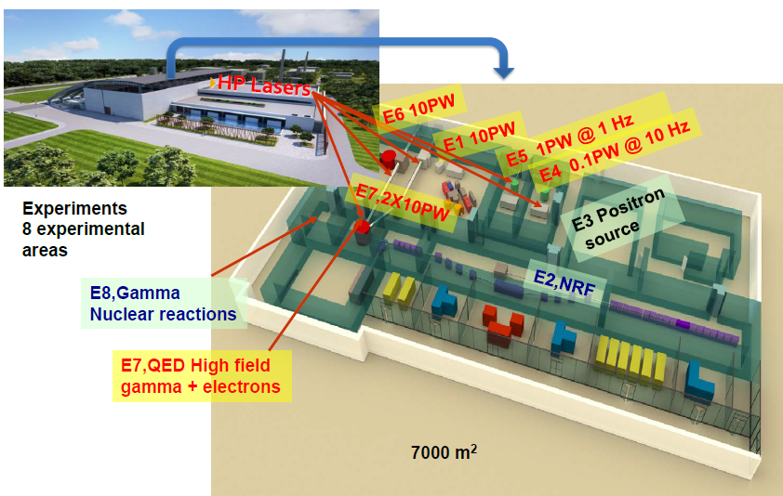
ELI-NP Experiment Building

Slide 5
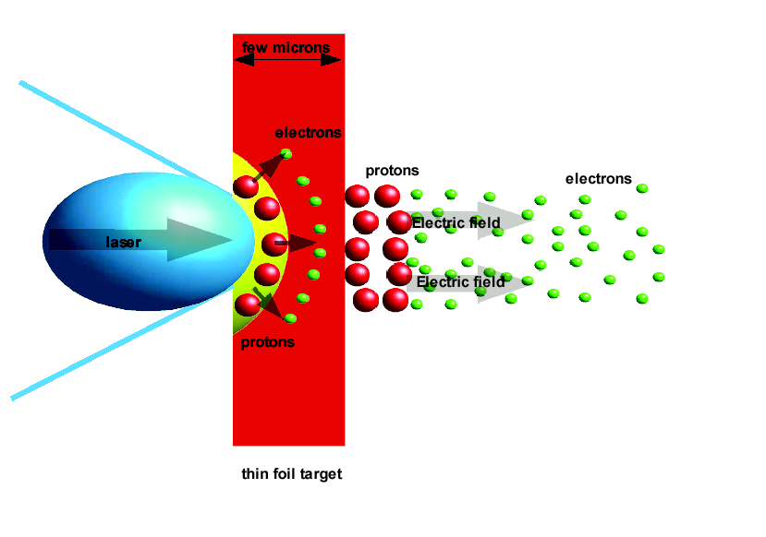
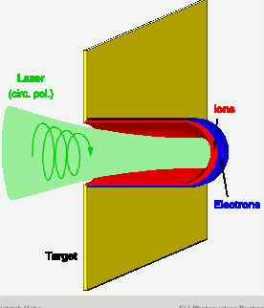
Particle acceleration by laser (Tajima, Dawson 1979)
Wake – field acceleration
Target normal sheath acceleration (TNSA)
Secondary
target
+
-
E~I_{laser}^{1/2}
pushes the electrons;
The charge separation generates an electrostatic longitudinal field: (Wake Fields or Snow Plough)
The electrostatic field:
-> secondary radiations
Radiation pressure acceleration (RPA)
E~ I _{laser}
Electrons and ions accelerated at solid state densities 10²⁴ cm⁻³
5
Notes:
5

Slide 6
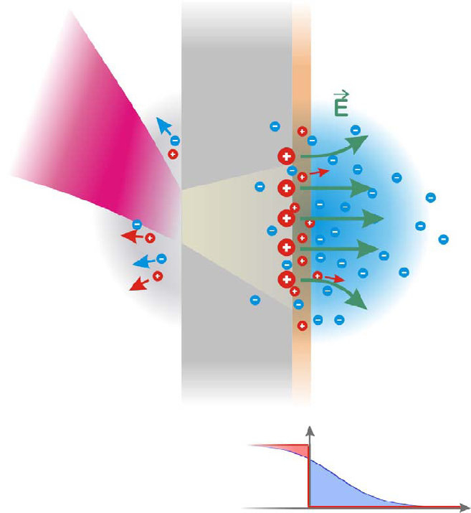
Target normal sheath acceleration (TNSA)
foil
MeV/u protons
and ions
Thick metallic foil targets (μm)
proton source: CH contamination on foil surfaces (typically ~50Å)
ion source: foil bulk material/ proton removal by heating.
Space charge E ~ 10¹² V/m
Exponential (thermal) resulting energy spectra
Energy conversion efficiency: 0.2 – 10% (depending on pulse energy)
Laser
I > 10¹⁹ W/cm²
hot electron propagation
MeV energy, μC charge
N_{e, hot}
first publications: E.L. Clark et al., PRL 84 (2000) 670
R. Snavely et al., PRL 85 (2000) 2945
Presentation by P.Thirolf at Carpathian Summer School of Physics 2014

Slide 7
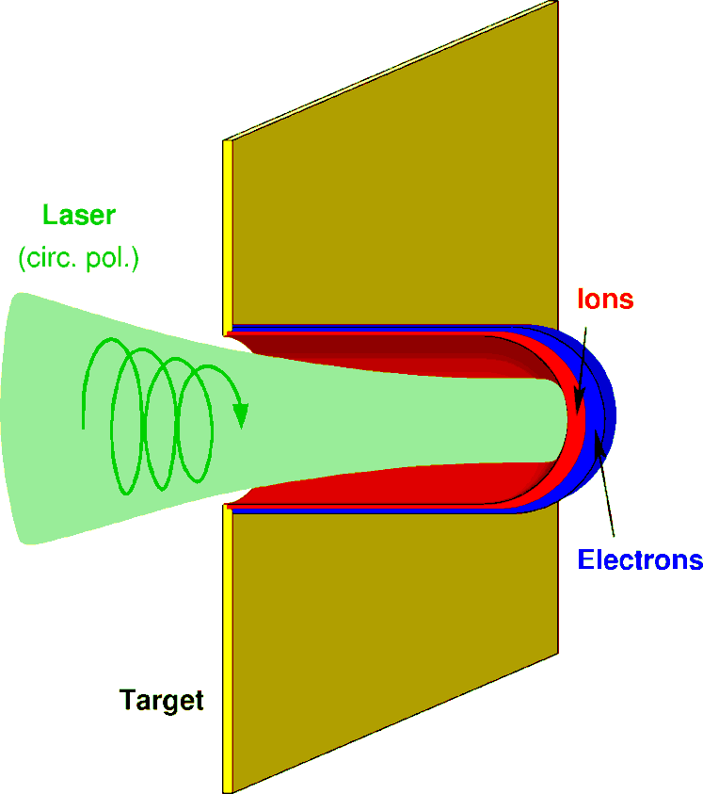
Radiation pressure acceleration (RPA)
Thin foil targets (nm)
RPA dominates for realistic intensities using circular polarization
excellent longitudinal emittance possible: ΔEΔt~ 10 MeV * 5 fs ~ 5*10⁻⁸ eV s
extremely short pulse duration: foil thickness/c ~ 100 attoseconds
At I > 10²³ W/cm²: RPA dominates over TNSA, quasi-monoenergetic GeV protons (for E_{laser} = 10 kJ)
Esirkepov et al, PRL 92,0175003 (2004)

Slide 8
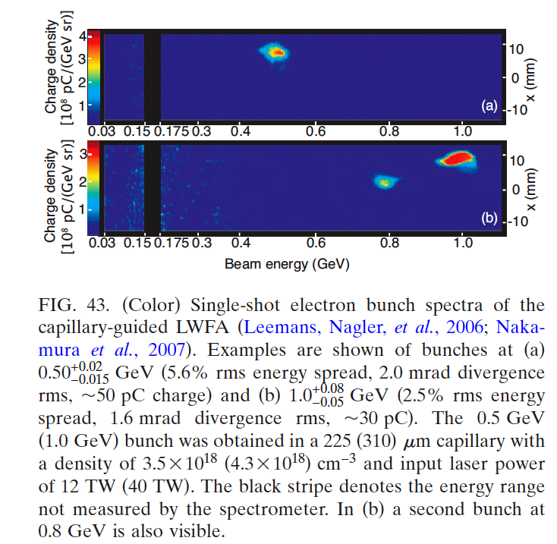
Acceleration of electrons
Laser intensity ~ 10¹⁹ W/cm²
Gas target
Collimated beams were obtained, even of the size of the incident laser beam
The energies up to hundreds of MeV at ~ 1PW lasers (VULCAN, etc.)
Intensities may go up to 10¹² particles/laser pulse
BELLA laser @ Berkeley: 16J, 40fs, 4.2GeV, Energy spread 6%, divergence 0.3 mrad, charge 6 pC PRL 113, 245002 (2014)
Esarey, Schroeder, and Leemans
Rev. Mod. Phys., Vol. 81, No. 3, 2009
8

Slide 9
Acceleration of protons, heavy ions
Heavy ion beams at LULI (France)
Laser pulses:
30 J, 300 fs, 1.05 mm => 5x10¹⁹ W/cm².
Target: 1 mm C
on rear side of 50 mm W foils
Detection: Thomson parabola spectrometers
+ CR-39 track detectors
Protons come from surface contamination
Heating the target the protons are removed and
heavy ions are better accelerated
9

Slide 10
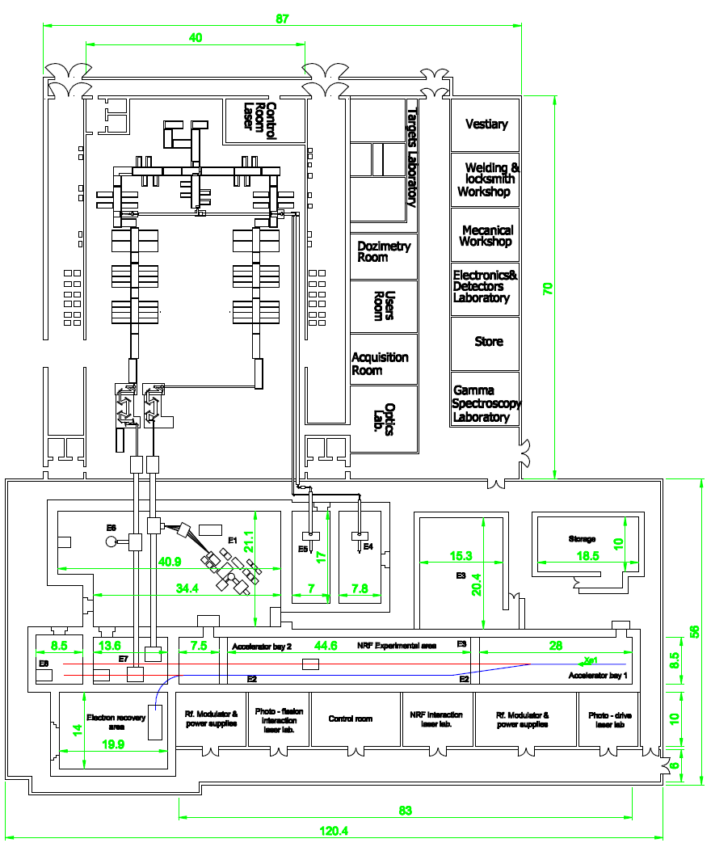
Expected beams at ELI-NP
E1: laser-induced nuclear reactions – multi-PW laser experiments
protons (RPA): E < 0.5 GeV, I > 10¹¹/pulse, div 5°, FWHM 10%
heavy ions (RPA): up to 50 MeV/A, to be defined
E6: Intense electron and gamma beams induced by high power laser:
electrons E < 40GeV, I < 10¹¹/pulse, div 1°, FWHM 1MeV
E7: Intense electron and high energy gamma beams induced by high power laser:
electrons E < 5GeV, I < 10¹⁰/pulse, div 0.1°, FWHM 1MeV
E4/E5: Accelerated particle beams induced by high power laser beams (0,1/1 PW) at high repetition rates (10/1Hz):
Protons < 60MeV, I ~ 10¹⁰ – 10¹² / pulse, div 40°, FWHM 10MeV
e⁻ 50MeV-2GeV, I < 4*10¹⁰/pulse, div 0.1°-40°
Thermal electrons, I ~ 10⁷ / pulse, div < 3°
E5
E6
E1
E3
E4
E8
E7
E2

Slide 11
Detection and diagnostics
Aim: characterization of the dense bunches and their time evolution
Needs: the detection system has to capture the reaction products emitted at different times (analogous to time of flight measurements), and measure their angular distributions
Methods:
Bunch characterization in free space; detection solid angles must be small (of the order of 10⁻⁷ sr or less)
Tracking the changes introduced by bunches passing through different materials (solid or gas) and their deceleration study

Slide 12
Detection and diagnostics
Technical implementation:
Rapid characterization (implying measurements of the emissions at different times and possibly their angular distribution):
Thomson parabola ion spectrometer
electron magnetic spectrometer
More complete analysis – diagnosis system working in real-time:
magnetic spectrometers
detection systems with high granularity or with position sensitive readout in the focal plane (e.g., stacks of ΔE-E detectors, with ionization chambers and Si or scintillation detectors)
the nuclear electronics can be triggered in the usual way.

Slide 13
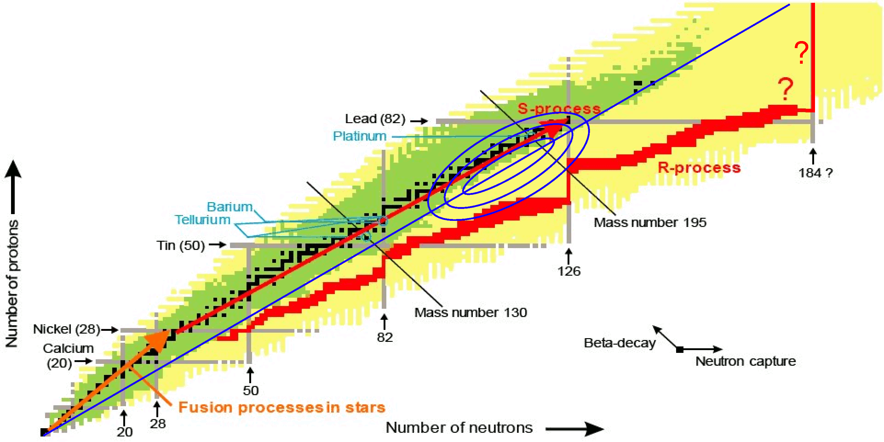
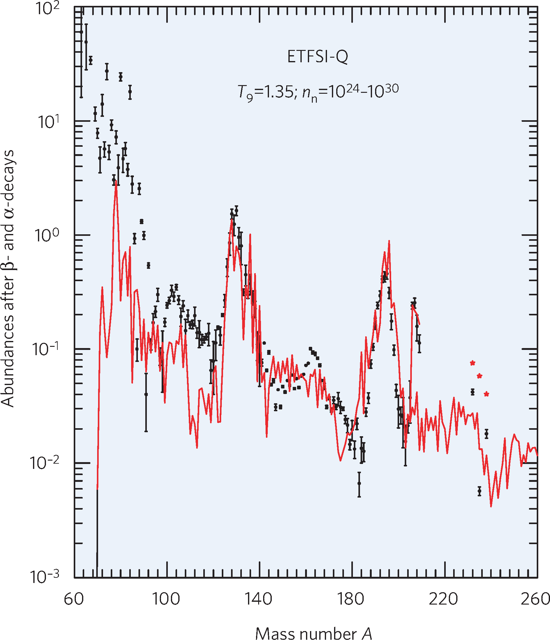
Production of Extremely Neutron-Rich Isotopes
LoI: P. Thirolf et al. (LMU Munich)
motivation:
- exploit ultra-dense laser-accelerated ion beams for novel nuclear
reaction mechanism: “fission-fusion”
- produce extremely n-rich species towards N=126
- expected production range:
Au, Pt, Ir,Os
- waiting point N=126: bottleneck for nucleosynthesis of actinides
- last region of r process ‘close’ to stability
P. Thirolf, LMU Muenchen, presentation at ELI-NP Workshop June 2013

Slide 14
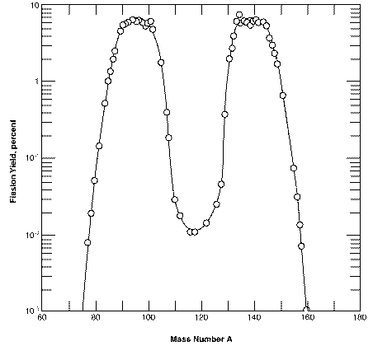
Production of Extremely Neutron-Rich Isotopes
Production target
Reaction target
high-power, high-contrast laser:
150-300 J, ~32 fs (8.5-17 PW)
²³²Th: ~ 50μm
²³²Th: 560 nm
Fission
fragments
1.2.10²³ W/cm²
< 1 mm
focal diam. ~ 3 μm
Fusion products
CD₂: 520 nm
1. Fission: beam (~ 7 MeV/u): H, C, ²³²Th
target: C, ²³²Th
CH₂ ~ 70 μm
²³²Th:
<A_{L>} ~ 91, ΔA_{L} ~ 14 amu (FWHM)
ΔAL ~ 22 amu (10%)
<Z_{L}> ~ 37.5 (Rb,Sr)
F_{L}
F_{H}
2. Fusion: light fission fragments (beam) + light fission fragments (target)
PACE-4: (Z=35,A=102) + (Z=35, A=102): E_{lab}= 270 MeV (E* = 65 MeV)
¹⁹⁰Yb (Z=70,N=126): 2.1 mb ¹⁸⁹Yb ( N=125): 15.8 mb
¹⁸⁸Yb ( N=124): 61.7 mb ¹⁸⁷Yb ( N=123): 55.6 mb
14

Slide 15
Enhanced decay of ²⁶Al in hot plasma environments
LoI: K. Spohr et al. (Glasgow) for SUPA collaboration
study the possible enhancement of the decay of the long-lived ²⁶Al radioisotope in astrophysical environments with ELI
²⁶Al – the first radioisotope detected in the interstellar medium, by the observation of the characteristic 1809 keV γ-emission associated with the decay of its ground state
the presence of this nucleus provides evidence of ongoing galactic nucleosynthesis
disintegration process of ²⁶Al further intricated by the presence of a 0+ isomer at 228 keV above the ground state
Theoretical work [Coc A. et al., Phys. Rev. C 61, 015801, 1999] based on shell-model calculations predicts the a dramatic reduction of the effective life time τ_{eff} (^{26gs}Al) by a factor of 10⁹ within the temperature range from 0.15 to 0.4 GK
The ELI laser system will deliver energetic particle and radiation bursts of sufficient intensity to create planet and stellar-like environmental conditions
15
Notes:
The γ-ray mapping of the ²⁶Al decay across the galaxy provides one of the most interesting constraints on nuclear physics parameters in astrophysical environments. The ²⁶Al nucleus was the first radioisotope detected in the interstellar medium, by the observation of the characteristic 1809 keV γ-emission associated with the decay of its ground state [b2]. As the half life ^{26gs}Al (5+) state is 7.2×10⁵ years, the presence of this nucleus provides evidence of ongoing galactic nucleosynthesis. Wolf-Rayet stars and Asymptotic Giant Branch (AGB) stars and novae [b3] have been suggested as possible sources of the origin of ²⁶Al. At a temperature of T=0.03GK, the ^{26gs}Al(p,γ)²⁷Si reaction is expected to be the main destruction mechanism for the ²⁶Al isotope. However, at these hot stellar temperatures, the dominant contribution to the ^{26gs}Al(p,γ)²⁷Si reaction rate is capture through low-lying resonances, for which the strengths have not been measured and an experimental benchmarking of theoretical studies, such as Hauser-Feshbach based calculations [b4], remains elusive. The disintegration process of ²⁶Al is further intricated by the presence of a 0+ isomer at 228 keV above the ground state. This isomer which originates like the ground state from the coupling of the two unpaired nucleons in the odd-odd ²⁶Al system, is prohibited to decay into ^{26gs}Al due to the large spin difference.^{26m}Al decays via β+ emission with T_{1/2} = 6.35 s directly to ^{26gs}Mg (0⁺). This is a very specific and complicated scenario.

Slide 16
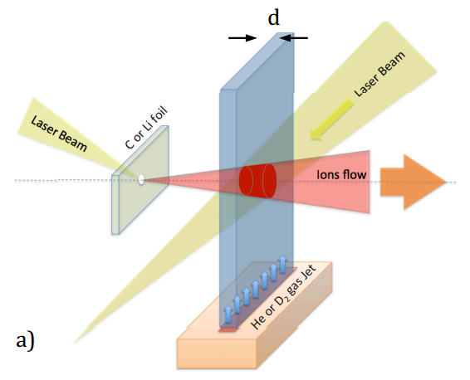
Electron Screening in Astrophysical Plasmas
LoI: F. Cappuzzello, S. Tudisco et al (INFN LNS, CNR-INO/Pisa)
thermonuclear reactions:
Coulomb potential
- T ~ 15x10⁶ K (e.g. Sun) ⇒ kT ~ 1 keV
- T ~ 10¹⁰ K (Big Bang) ⇒ kT ~ 2 MeV
E_{coul} ~ Z₁Z₂ (MeV)
E_{c}
electronic cloud
sub-barrier reactions:
E_{kin} (~ keV) <<
E_{coul} (~ MeV)
bare
Potential V(r)
E_{kin} ~ kT
tunneling probability: P ∝ exp(-2πη)
tunnel
effect
0
screened
σ (E) = 1/E exp(-2πη) S(E)
R_{n}
R_{a}
r
R_{t}
cross section increasing
non-nuclear origin:
strong energy
dependence
nuclear origin:
weak energy
dependence
nuclear well
in laboratory:
collisions: ions atoms/molecules
(projectile) (target)
σ_{s}(E)
=
S_{s}(E)
E
U_{e}
f_{lab} =
σ_{b}(E)
∝
exp
πη
16
S_{b}(E)
E+U_{e}
E
Notes:
f = enhancement factor
η = the Sommerfeld parameter
U_{e} is an electron-screening potential energy

Slide 17
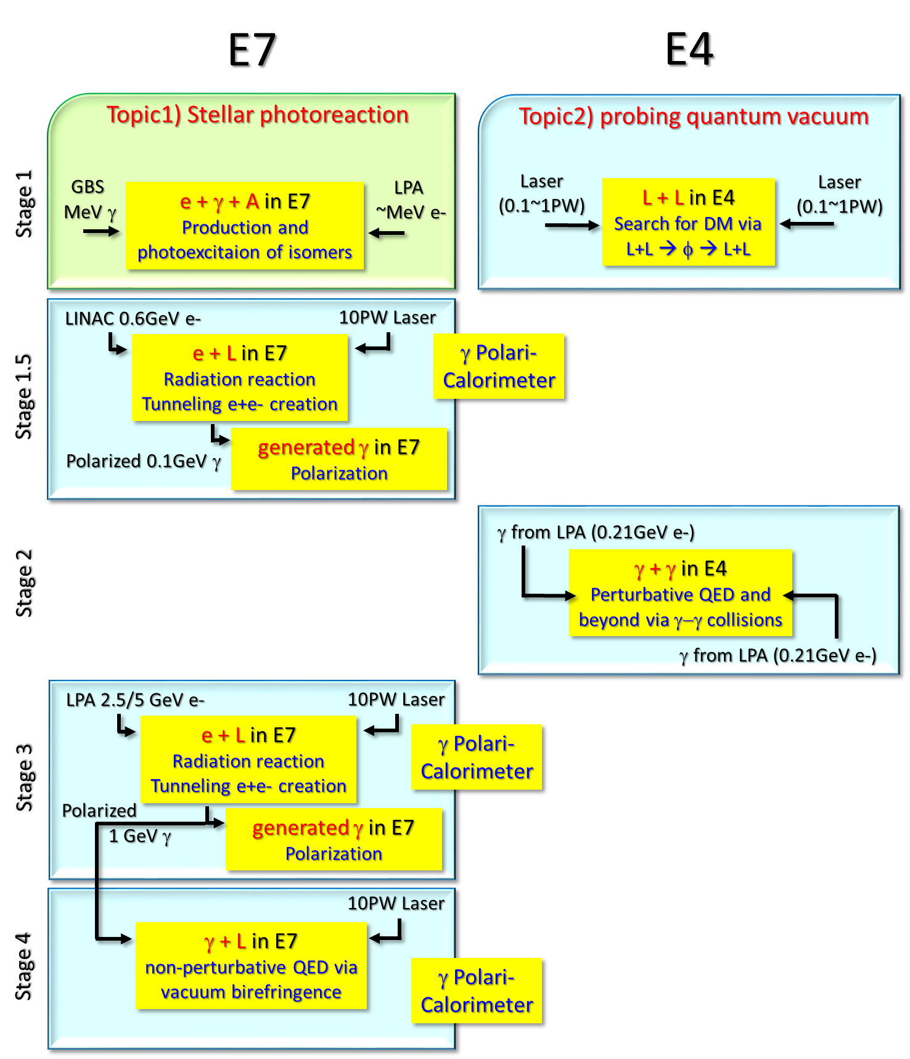
Experiments: RA5 stages
2018
2019
2020
2021

Slide 18
ELI-NP Next Steps
End 2014: TDRs experiments
December 2015: end of Phase 1 of European Funding
Spring 2016: Construction of buildings finalized
2018: End of second Phase, Beginning operation
18

Slide 19
www.eli-np.ro

