Slide 1
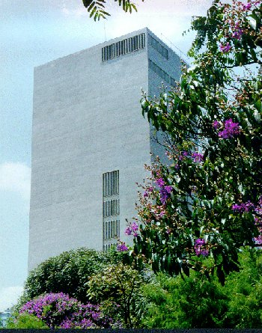

Possible existence of a four-body state in ⁹Be
through the ⁸Li(p,d)⁷Li reaction
Erich Leistenschneider,
Alinka Lépine-Szily,
Pierre Descouvemont
and
the RIBRAS collaboration
12th International Conference
on Nucleus-Nucleus Collisions
June 21- 26, 2015 Catania, Italy.

Slide 2
Outline
Description of RIBRAS – Radioactive Ion Beams in Brazil.
Reactions of the ⁸Li + p system
Experimental method and results
R-matrix analysis
Conclusions

Slide 3
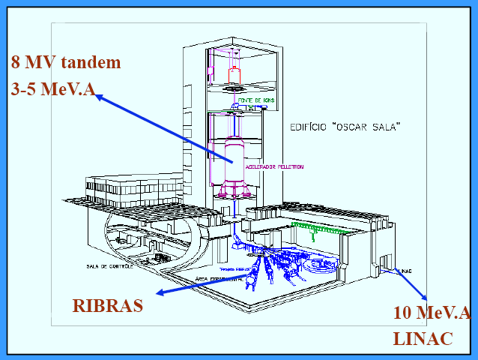
Major Facility for Nuclear Physics research in Brazil
Tandem Accelerator – Pelletron 8UD at the
University of São Paulo - Brazil
primary beams:
⁶Li, ⁷Li , ^{10,11}B, ⁹Be, ¹²C, ^{16,17,18}O, ...
3.0 – 5.0 MeV/nucleon

Slide 4
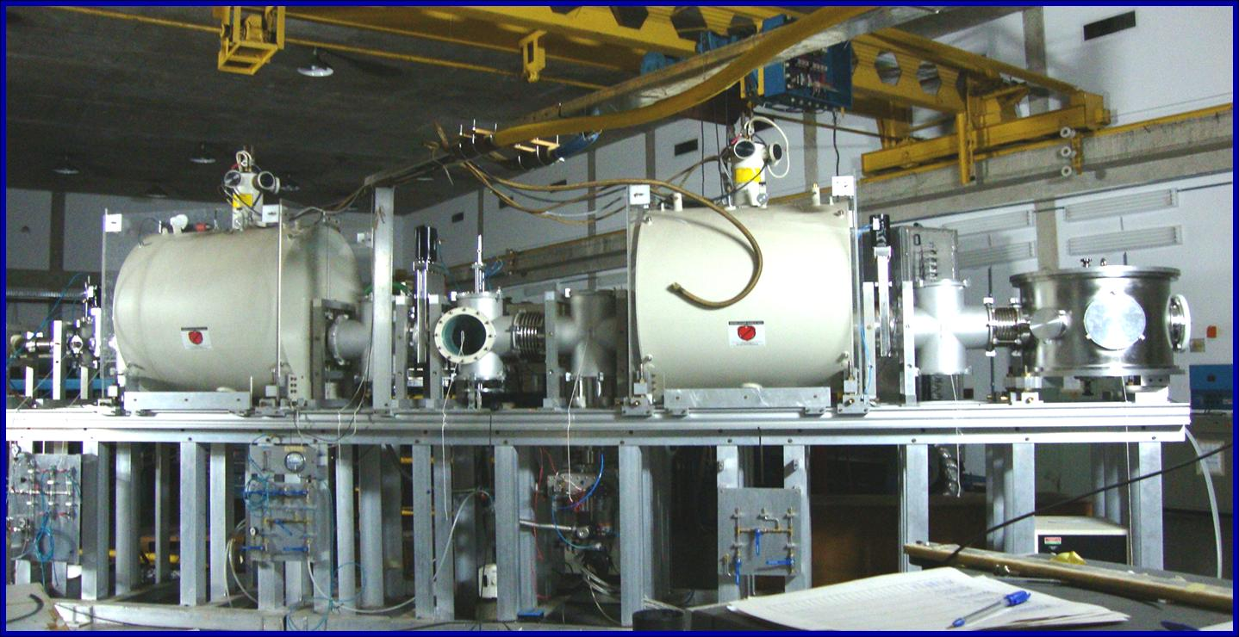
RIBRAS - Radioactive Ion Beams in Brazil
First RIB facility in the Southern Hemisphere,installed in 2004
Low energy radioactive ion beam production
with solenoid based system.
University of São Paulo – Brazil
Max field 6.5 Tesla
versatile configuration
persistent mode
low LHe and LN₂ consumption

Slide 5
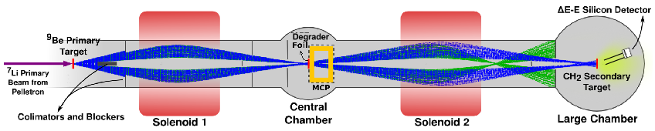
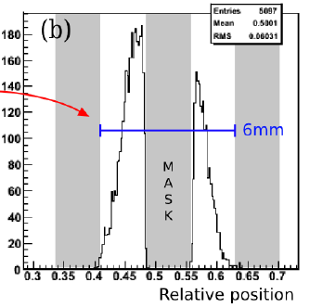
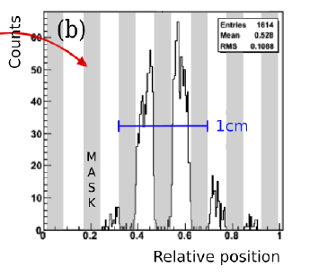
Double solenoids (cross-over mode)
Second solenoid allows the production of pure secondary beams.
Degrader/absorber between 2 solenoids, energy loss depends on Z²,
Contaminants in 2nd solenoid have different Bρ – don’t pass
First scattering
chamber
Second scattering
chamber
Solenoid -1
Solenoid - 2
Beam spot
FWHM=4,5mm
Beam spot
FWHM=7mm

Slide 6
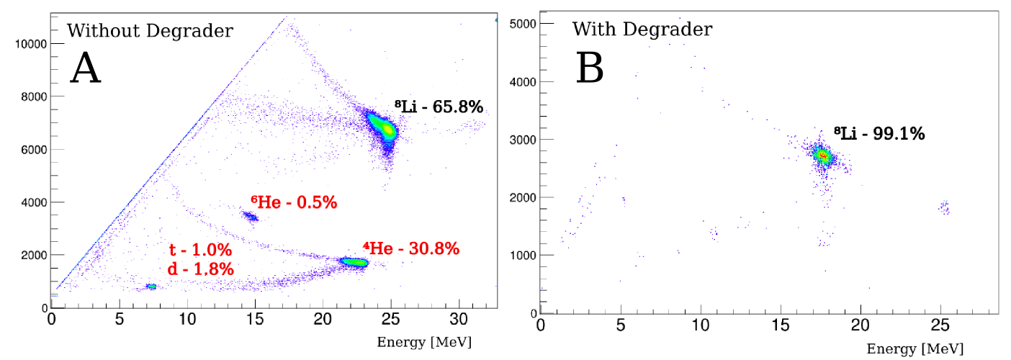
Typical identification spectrum obtained in the second scattering chamber, after the second solenoid, with ΔE-E Si telescope, without (A) and with (B) degrader : contaminant beams are eliminated.
Transmission: ~50%
ΔΕ
ΔΕ

Slide 7
Present radioactive beams at RIBRAS
secondary ion reaction intensity / 1μA of primary beam
⁶He ⁹Be(⁷Li,⁶He) 2 x 10⁵ p/s
⁸Li ⁹Be(⁷Li,⁸Li) 10⁶ p/s
⁷Be ³He(⁶Li,⁷Be) 6x10⁵ p/s
⁷Be ⁶Li(⁷Li,⁷Be) 10⁵ p/s
⁸B ³He(⁶Li,⁸B) 10⁴ p/s
¹⁸F ¹²C(¹⁷O,¹⁸F) 10⁴ p/s
¹⁷F ³He(¹⁶O,¹⁷F)d *
The production of pure secondary beams allows the study of fusion,
transfer, break-up reactions

Slide 8
Exotism in nuclei:
Halo structure in light nuclei for N/Z far from 1: ¹¹Li,⁶He,¹¹Be, ¹⁴Be, ⁸B, ¹⁷Ne.....
Nuclear states with excited cores
Nuclear states with cluster structures: 2,3..

Slide 9
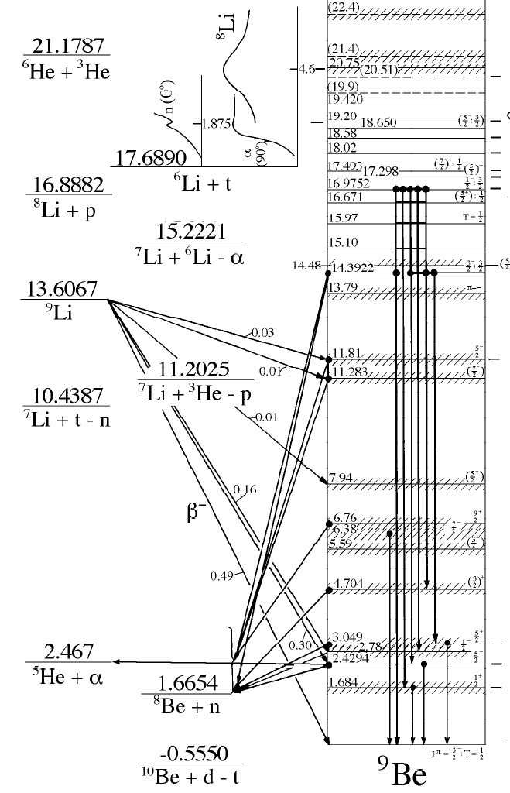

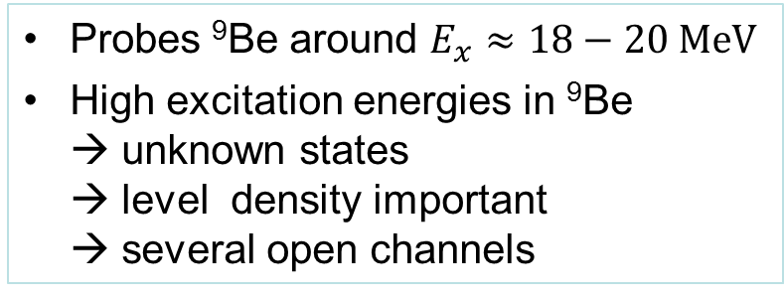
Study of ⁹Be structure
through ⁸Li+p reactions
$$E_{cm}$$
⁷Li+d
⁸Li+p
Probes ⁹Be around $E_{x}≈18−20 MeV$
High excitation energies in ⁹Be
→ unknown states
→ level density important
→ several open channels
α+α+n

Slide 10
⁸Li+p experiments at RIBRAS
-2011
⁸Li(p,α) ⁵He, one solenoid, Q=+14.42 MeV,
D.R. Mendes et al., PRC 86 (2012) 064321
Validity of 2-body reaction hypothesis for ⁸Li(p,α)⁵He
→sequential decay
.
2013-14
⁸Li(p,p)⁸Li, ⁸Li(p,d)⁷Li, ⁸Li(p,α)⁵He
2 solenoids → pure ⁸Li beam
2015
⁸Li(p,p)⁸Li, ⁸Li(p,d)⁷Li, ⁸Li(p,α)⁵He
2 solenoids →pure ⁸Li beam, better statistics, in analysis

Slide 11
Experimental method for measurement of reactions of the ⁸Li+p system using purified ⁸Li beam:
Inverse kinematics: ⁸Li beam hitting a thick [CH₂]_{n} target
Primary beam ⁷Li, accelerated by 8UD Pelletron tandem of São Paulo to 25.9 and 27.8 MeV
Production target: 16 micron ⁹Be foil
Radioactive ⁸Li beam ⁹Be(⁷Li,⁸Li)⁸Be, selected by both solenoids of RIBRAS.Degrader between the solenoids. E_{lab}= 15.8 and 18.7 MeV
Radioactive beam intensity: 3x10⁵ pps, (50% transmission from 1st to 2nd solenoid)
Detection: deltaE(50 microns)-E(1000 microns),
300 mm² silicon telescope at θ_{lab}=10º
Secondary Target – [CH₂]_{n}– Polyethylene foil 7.7mg/cm²

Slide 12
TTIK – thick target inverse kinematics method:
thick secondary target CH₂ (7.7 mg/cm²) ⁸Li beam looses energy,
stops in the target
⁸Li
beam
⁴He,p,d,t
Si-telescope
E₁
E₂
ε = stopping power
Simultaneous measurement of all incident energies: excitation function
Resonances populated in the target → peaks in energy spectrum of light ejectiles.
Energy spectrum of ⁴He, p, d → excitation function of reactions
Energy resolution: independent of beam dispersion, depends on energy
loss of light ejectiles in target

Slide 13
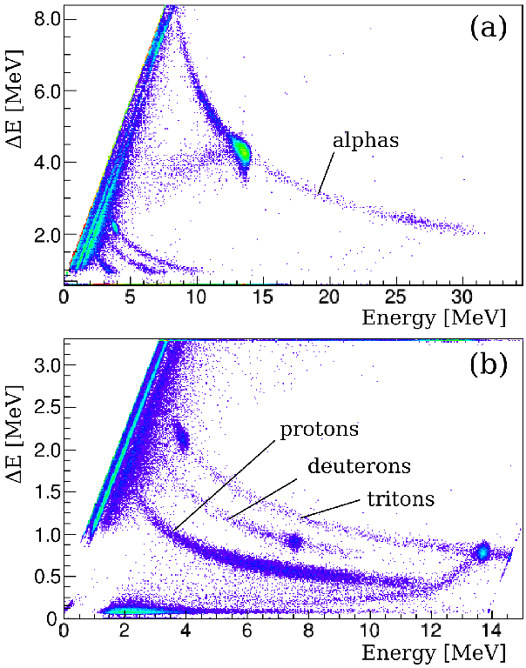
Energy spectra measured
on [CH₂]_{n} target
at E_{lab}=18.7 MeV

Slide 14
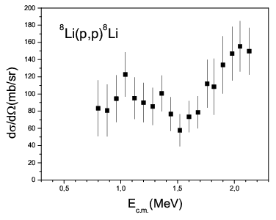
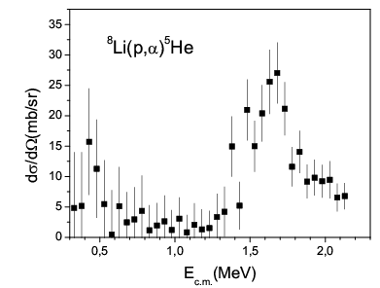
⁸Li+p
⁹Be

Slide 15
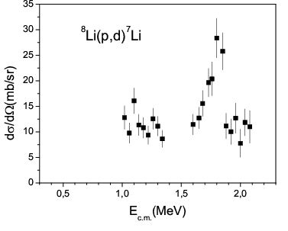
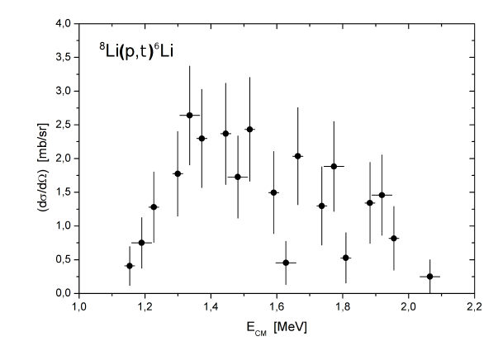
⁸Li+p
⁹Be
⁸Li(p,t) very low
cross section

Slide 16
Comparison of present ⁸Li(p,d)⁷Li cross section with previous ⁷Li(d,p)⁸Li measurements
⁸Li(p,d)⁷Li : ⁷Li(gs) and ⁷Li*(0.48, 1/2⁻) final states not separated
⁷Li(d,p)⁸Li : Integrated cross section (⁸Li β-decay) ⁸Li(gs), ⁸Li* not separated
⁷Li(d,p)⁸Li data: S. Bashkin, Phys. Rev. 95, 1012 (1954).
C. R. McClenahan, R. E. Segel, Phys. Rev. C 11, 370 (1975).
Detailed balance theorem : qualitative agreement, not isotropic
Strong peak in ⁸Li(p,d)⁷Li,
absent in ⁷Li(d,p)⁸Li →
essentially populates the
d+⁷Li* channel

Slide 17
Due to ⁷Li* excitation (E*(⁷Li,1/2⁻)=0.478 MeV) the resonance appears at lower energy in the deuteron energy spectrum (ΔE_{d} = 1.0 MeV)
E*(⁷Li,1/2⁻)=0.478 MeV
ΔE_{d} = 1.0 MeV
ΔE_{cm} = 0.225 keV

Slide 18
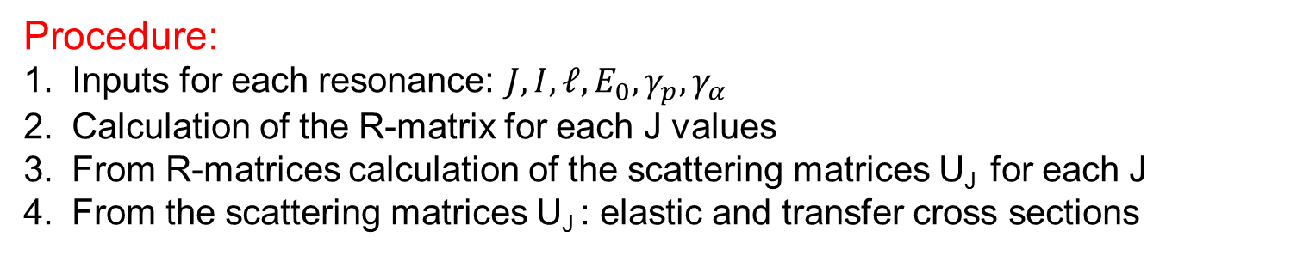
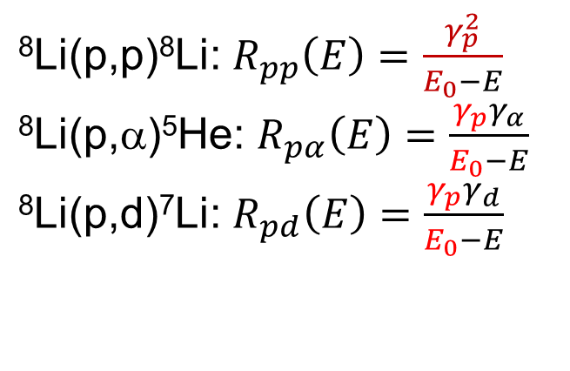
R-matrix calculation
Procedure:
Inputs for each resonance: $J,I,ℓ,E_{0},γ_{p},γ_{α}$
Calculation of the R-matrix for each J values
From R-matrices calculation of the scattering matrices U_{J} for each J
From the scattering matrices U_{J} : elastic and transfer cross sections
Several reactions with the same entrance channel → constrains
Energy $E_{0}$, proton width $γ_{p}$ are common → constrains
⁸Li(p,p)⁸Li: $R_{pp}\left(E\right)=\frac{γ_{p}^{2}}{E_{0}−E}$
⁸Li(p,α)⁵He: $R_{pα}\left(E\right)=\frac{γ_{p}γ_{α}}{E_{0}−E}$
⁸Li(p,d)⁷Li: $R_{pd}\left(E\right)=\frac{{γ_{p}γ}_{d}}{E_{0}−E}$
4-channels:
⁸Li + p
⁵He + α
⁷Li_{gs} + d
⁷Li* (1/2⁻) + d

Slide 19
Multi-channel R-matrix fits to the data (4-channel)
R-matrix fits: 5 resonances
Broad states in α and d channels
^{d=p+n}
⁷Li*=α+t
deuteron channel: large reduced width
Dominant ⁷Li*+d structure
State with excited core
→ α+t+p+n four-body state
➔ Challenge for cluster models!

Slide 20
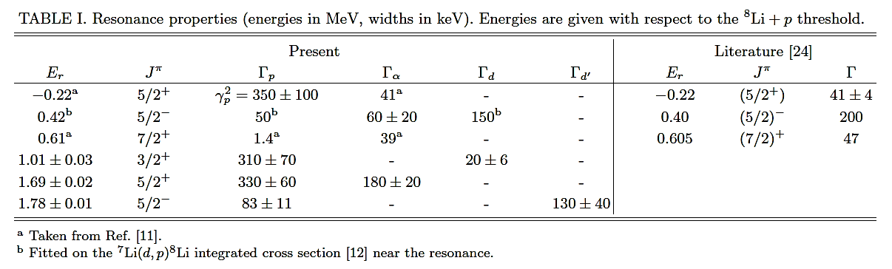
Resonance parameters obtained from the fit:
⁸𝐿𝑖(𝑝,𝑝)⁸𝐿𝑖
⁸Li(𝑝,𝛼)⁵He
⁸Li(𝑝,𝑑)⁷Li

Slide 21
Conclusions
The use of the two solenoids with a degrader makes possible the production of pure secondary beams at RIBRAS.
The simultaneous measurement of the resonant elastic scattering and other reaction channels as (p,α), (p,d) constrains the resonance parameters of ⁹Be.
New resonance with large reduced deuteron width observed in deuteron channel.
Dominant ⁷Li*+d structure
→State with excited core and possible α+t+p+n four-body state.

Slide 22
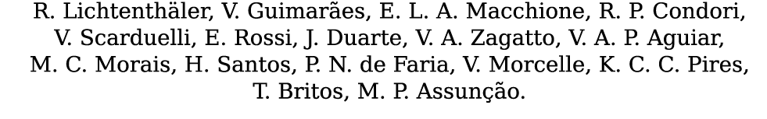
Thank you for your attention
Erich Leistenschneider, Alinka Lépine-Szily, Pierre Descouvemont , Djalma R. Mendes Jr.,
and

Slide 23
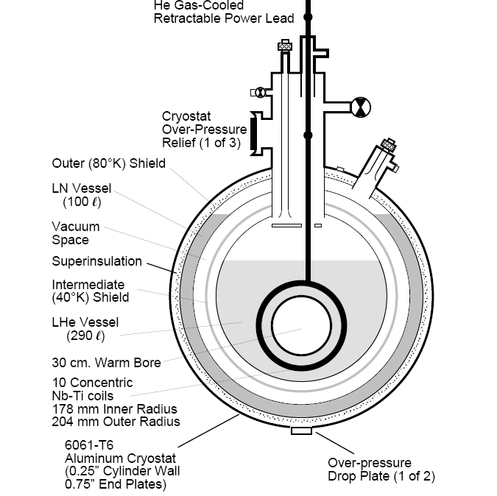
Superconducting Solenoid
Magnet – NbTi
Field integral – 5 T.m.
Max. central field – 6.52 T
Max. current – 91.86 A
Inductance – 309 H
Stored Energy – 1.3 MJ
LHe vessel 250 litros
LHe boil-off rate 3.4 liters/day
LN2 Vessel 130 Litros
LN2 – 15 liters/day
80K
73K
N₂
He
4K
40K
Fabricant: Cryomagnetics Inc, Oak Ridge USA

Slide 24

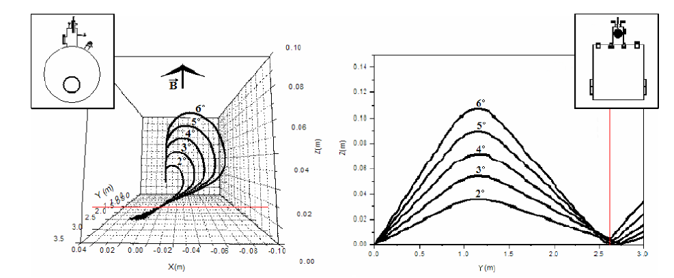
Solenoid selects by magnetic rigidity

Slide 25
Excitation functions of ⁸Li+p reactions

Slide 26
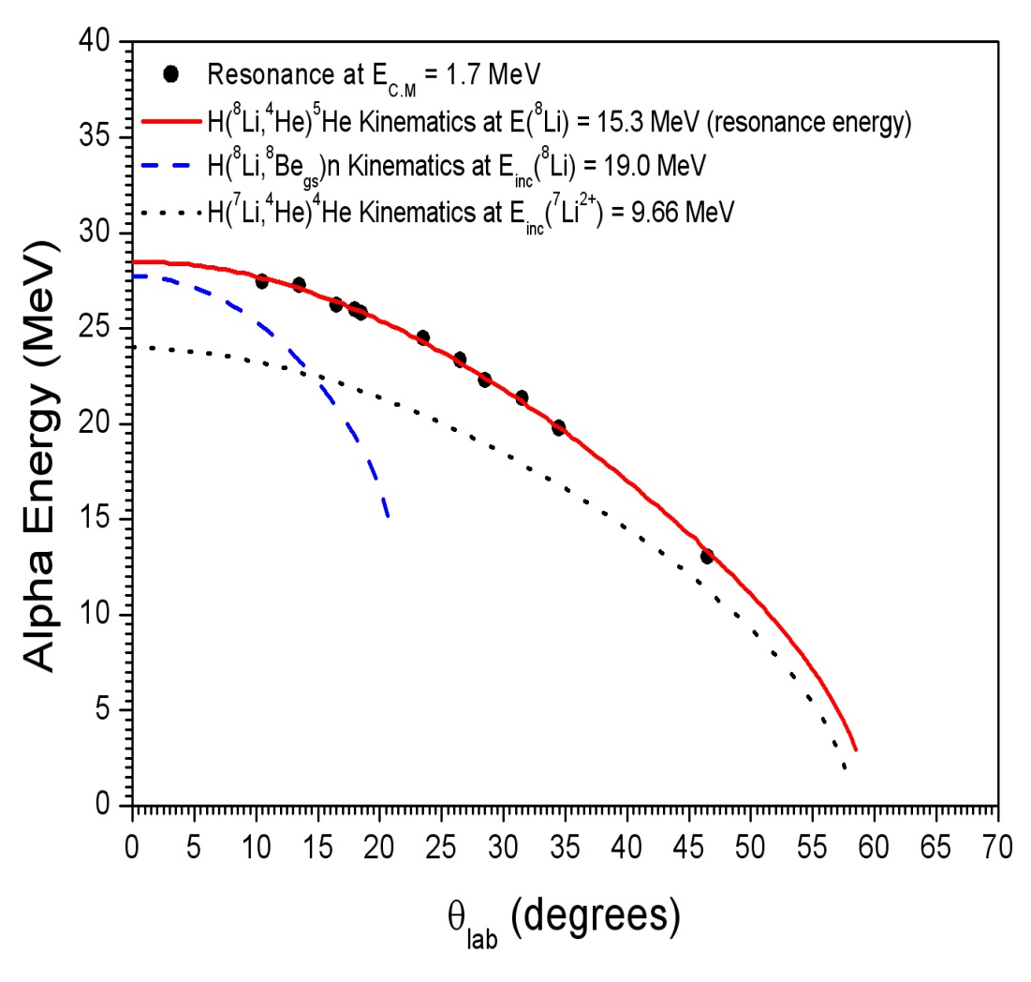
Energy spectrum measured at Elab=19.0 MeV
¹²C(α,α)¹²C
p(⁸Li,α)⁵He
Kinematic variation of energy centroids of large
peak with angle, compared to calculations
Conclusion: The large peak at E_{α}=27 MeV is due to p(8Li, α)5He

Slide 27
Resonance
with strong α
structure
Inelastic scattering
⁹Be(p,p´) with
180 MeV p beam.
Dixit et al, Phys.Rev.C43,
1758(1991)
⁸Li(𝑝,𝛼)⁵He
Resonance
with strong ⁷Li* +d
structure
⁸Li(𝑝,𝑑)⁷Li

