Slide 1

Accelerator Division Activities
Andrea Ghigo on behalf of
INFN-LNF Accelerator Division & friends
Slides from: A.Balerna, M.Biagini, E.Chiadroni, R.Cimino, M.Ferrario, C.Milardi, L.Serafini, G.Mazzitelli
Consiglio di Laboratorio Frascati 3 Luglio 2012

Slide 2
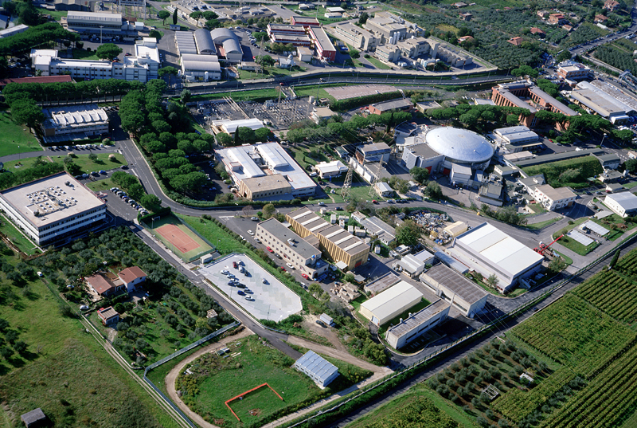
LNF
The Φ-Factory complex
DAFNE-light
DAFNE
LINAC
BTF

Slide 3
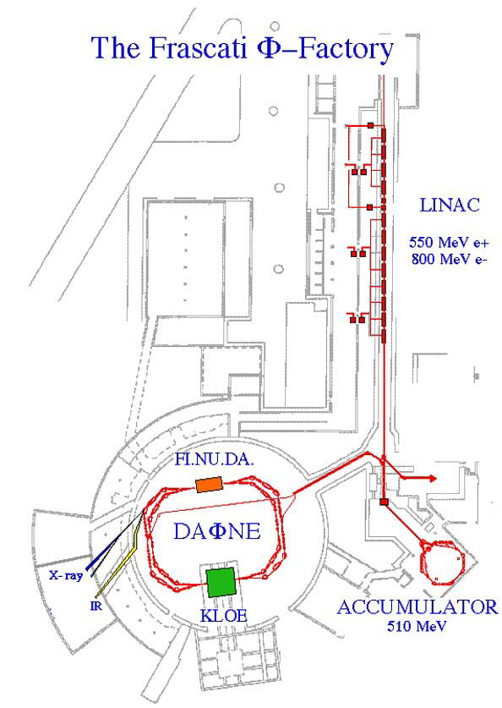
DAΦNE Status
The Φ-Factory complex
Abundant production of Φ particles coming from the annihilation of electrons and positrons at the energy of the Φ- resonance.
Syncrotron ligth from DAFNE
LNF are part of the European
Infrastructure
for syncrotron light
BTF
UV 2 - 10 eV
X-ray 900 - 3000 eV
IR 1.24 meV - 1.24 eV

Slide 4
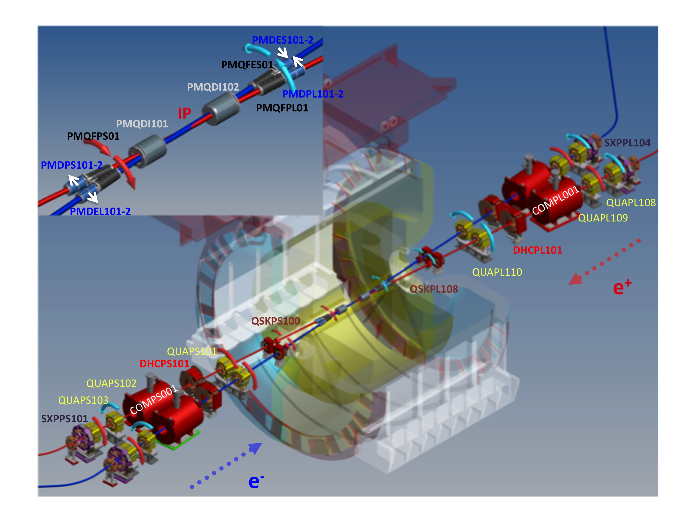
DAΦNE IR for the KLOE-2 run

Slide 5
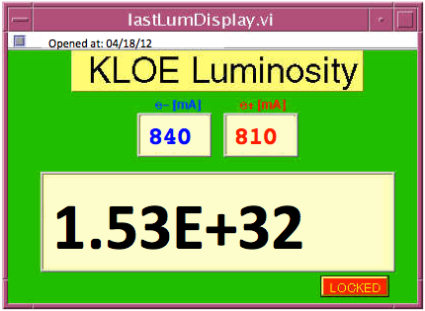
Maximum Peak Luminosity so far …
Same peak luminosity as in 2005, but
  less bunches in collision (100)
  lower currents
 | DAΦNE upgrade SIDDHARTA (2009) | DAΦNE KLOE (2005)
L_{peak} [cm⁻²s⁻¹] | 4.53•10³² (5.0•10³²) | 1.50•10³²
L_{∫day} [pb⁻¹] | 14.98 | 9.8
L_{∫1 hour} [pb⁻¹] | 1.033 | 0.44
I⁻_{MAX} in collision [A] | 1.52 | 1.4
I⁺_{MAX} in collision [A] | 1.0 | 1.2
N_{bunches} | 105 | 111
ξ_{y} | 0.044 | 0.025

Slide 6
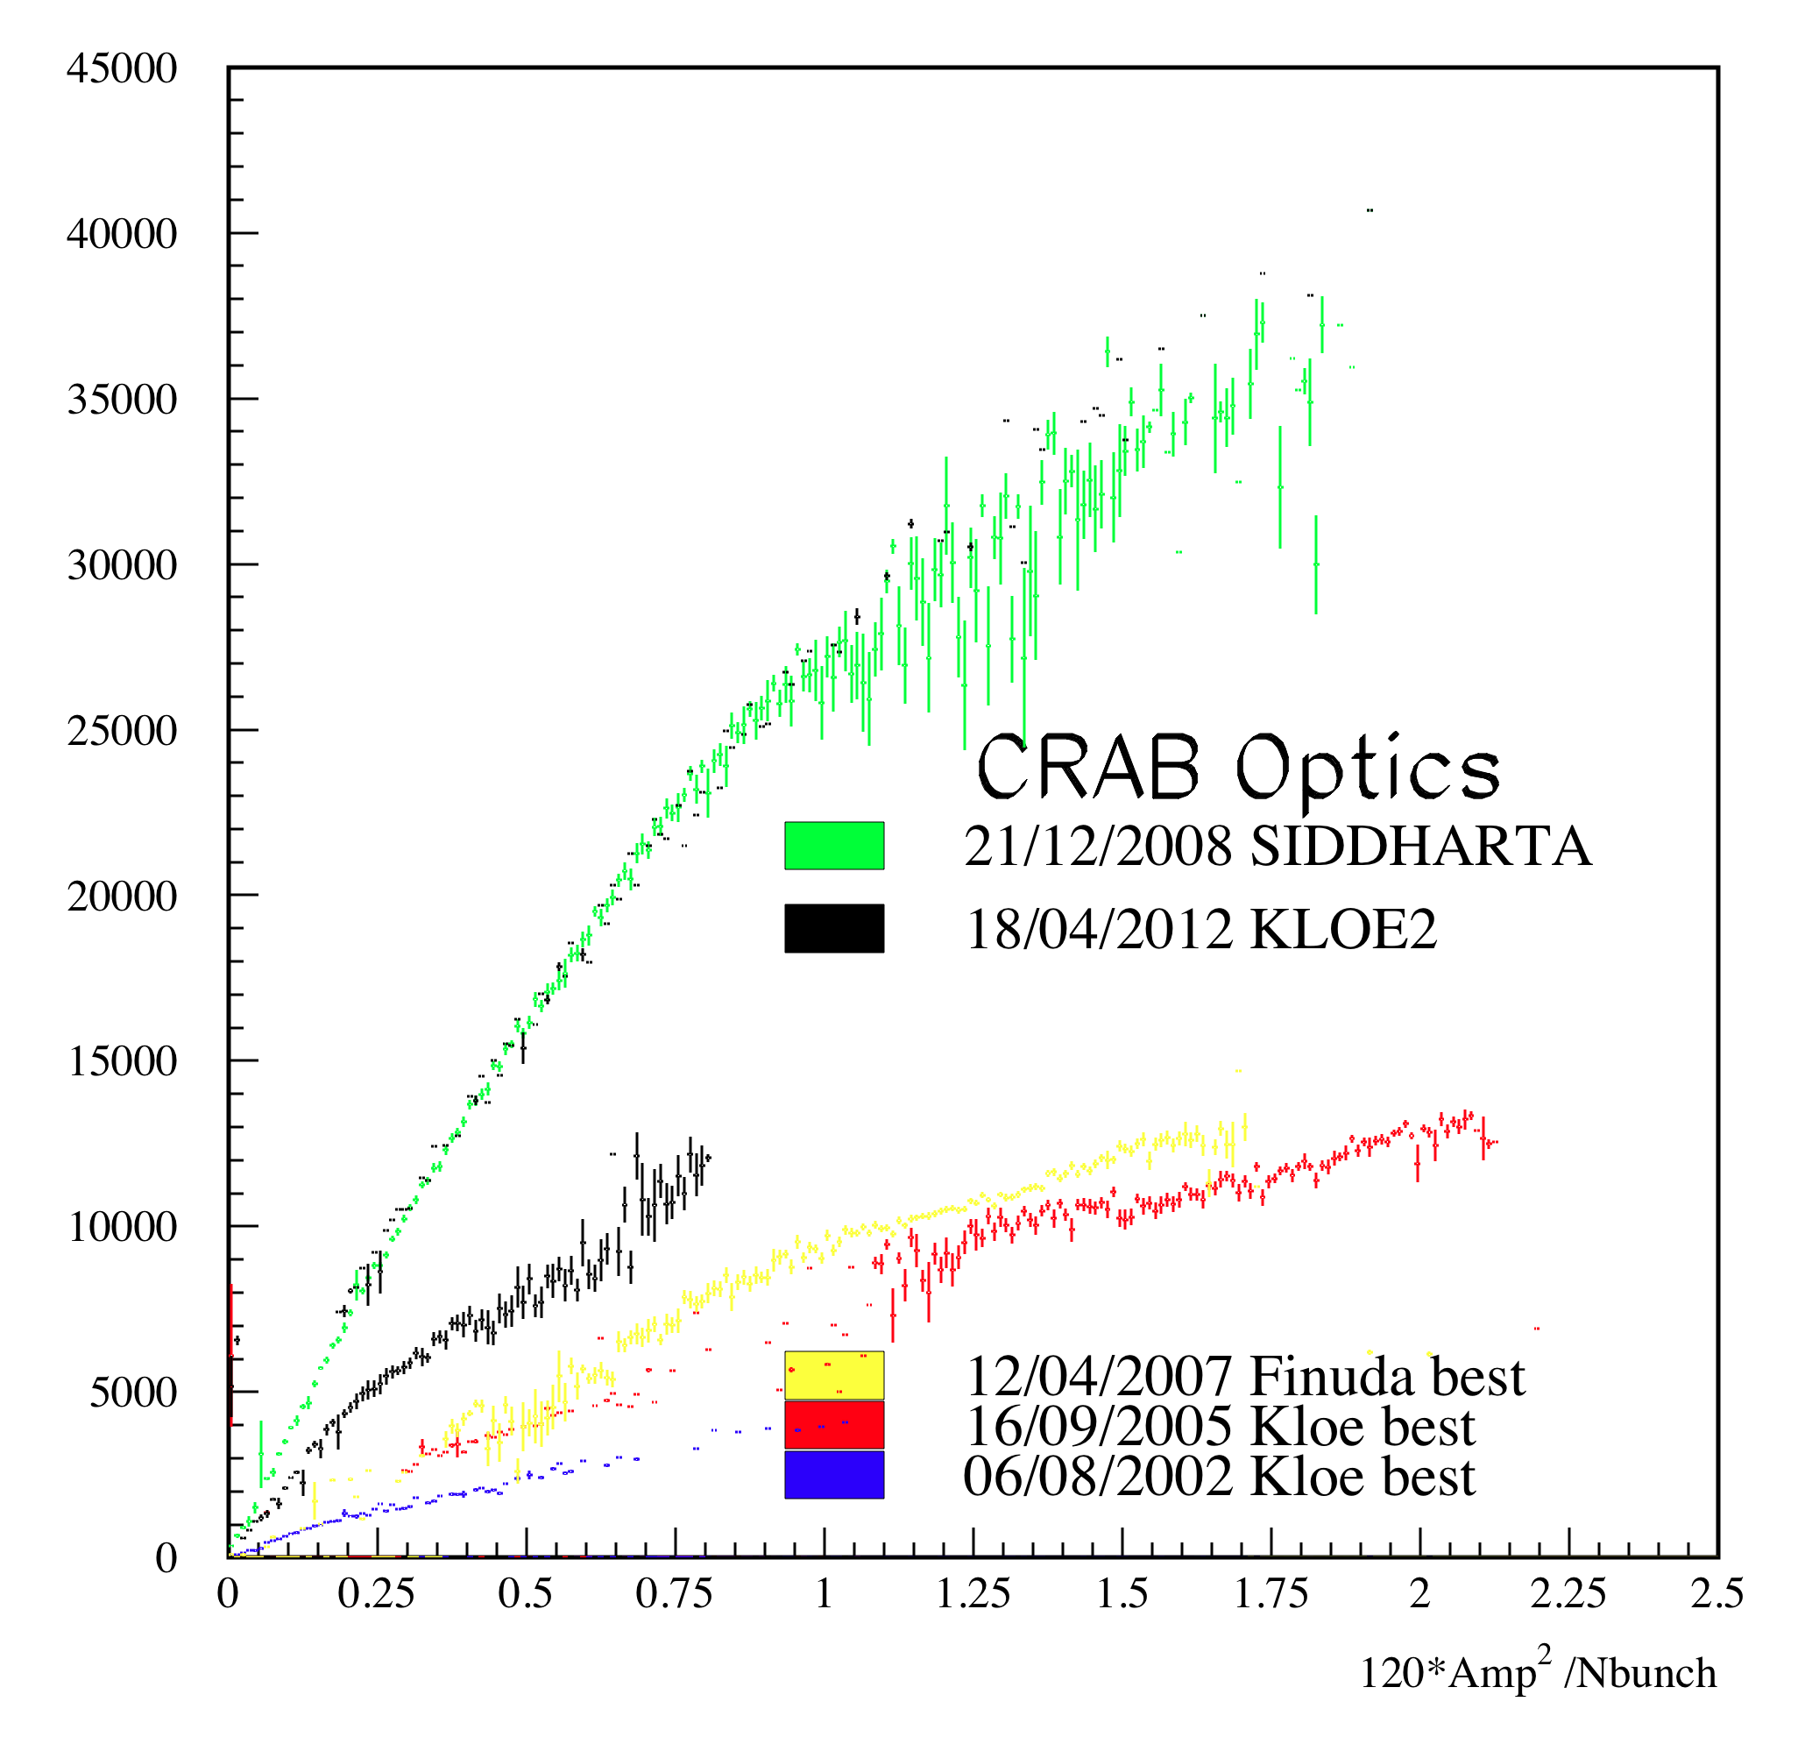
Comparison among DAΦNE best runs with and without Crab-Waist
At low currents the highest L_{s} achieved exceeds by 2÷3 times the best value measured during the past KLOE runs
Luminosity [10²⁸ cm⁻² s⁻¹]

Slide 7
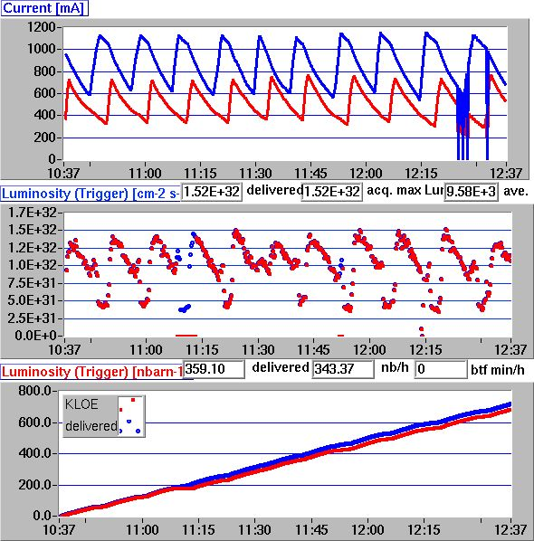
Best hourly integrated luminosity
L_{∫1 hour} = 0.359 pb⁻¹
L_{∫day} = 8.62 pb⁻¹

Slide 8
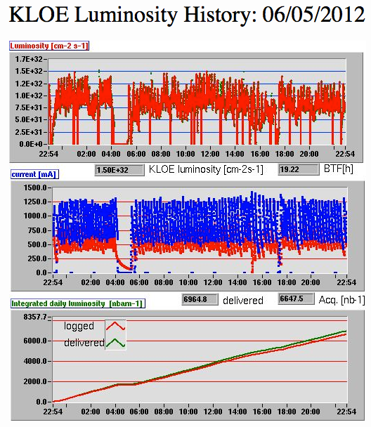
Best day
Sunday, May 6th 2012
~ 80% uptime
L_{∫day} ~ 7 pb⁻¹

Slide 9
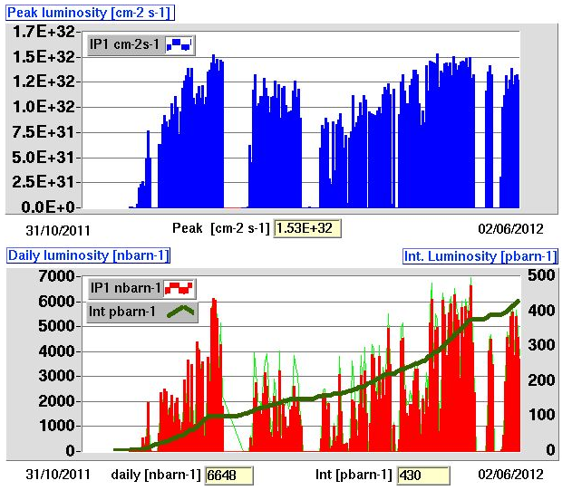
Luminosity History

Slide 10
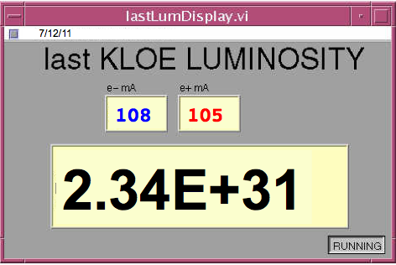
10 bunches Luminosity
10 consecutive bunches
Beam-beam is not a limiting factor
Crab-Waist sextupoles work
This result can be improved by:
  Vacuum conditioning
  Scrabbing in the MRp
  Optimizing multibunch and high current operations

Slide 11
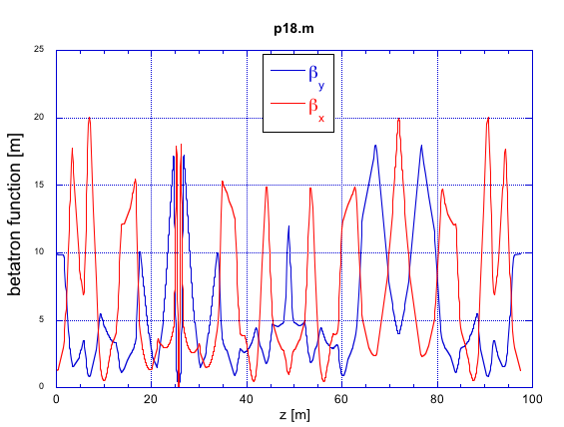
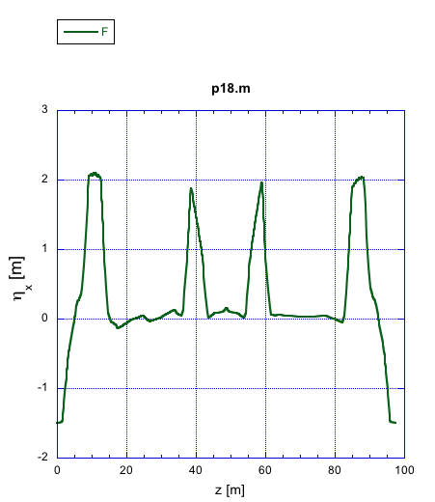
Main Rings optics
Relying on linear optics measurements (β₁, β₂, ν₁, ν₂, η_{x,} η_{x,} ξ_{x,} ξ_{y}) the Main Rings optics has been rematched (March) in order to restore:
  the required betatron function at the IP as well as at the CW sextupoles
  The proper phase advance between the injection kickers
  Symmetry in the short sections
As a consequence of the beam rematch:
  smoother injection with higher efficiency and lower radiation level
  Reduced beam blow-up with the main and the opposite beam current

Slide 12
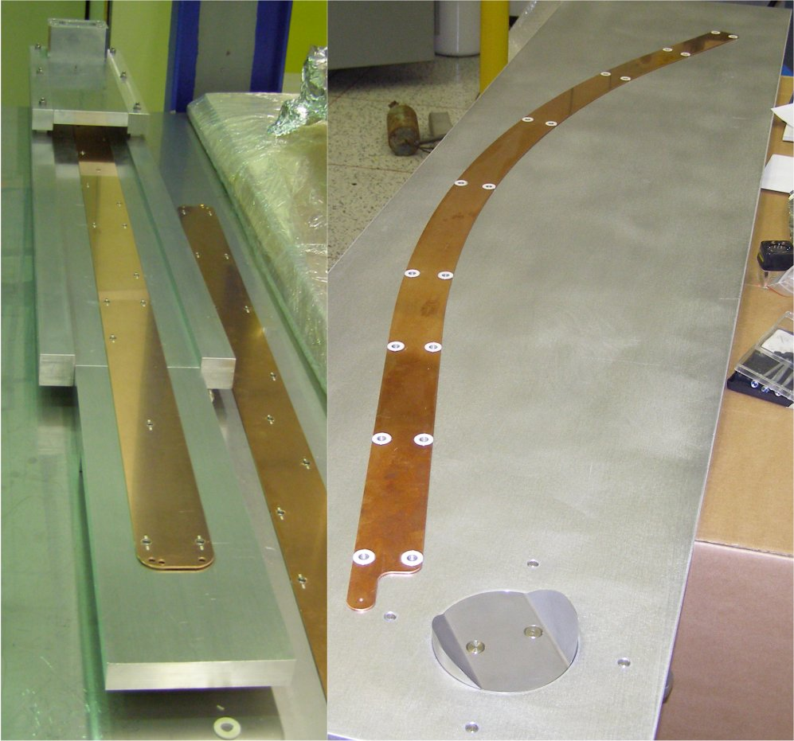
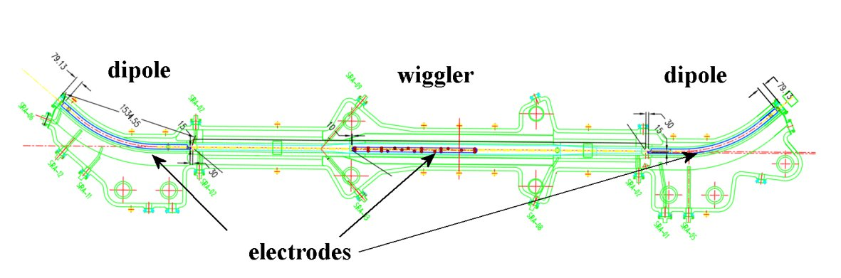
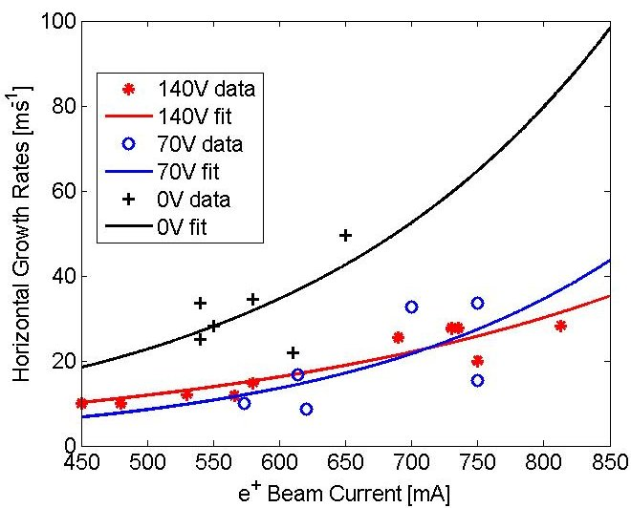
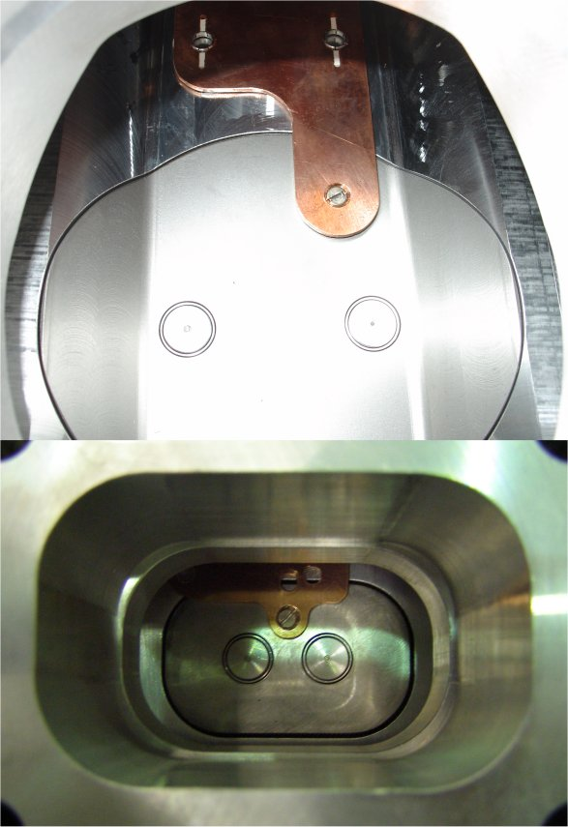
Clearing electrodes in the e+ ring
During the last shut-down, strip-line electrodes have been inserted in all dipole and wiggler vacuum chambers of the positron ring and have been connected to external dc voltage generators in order to absorb the photo-electrons overcoming the limitations in the maximum storable positron current due to the e⁻ cloud driven instabilities.

Slide 13
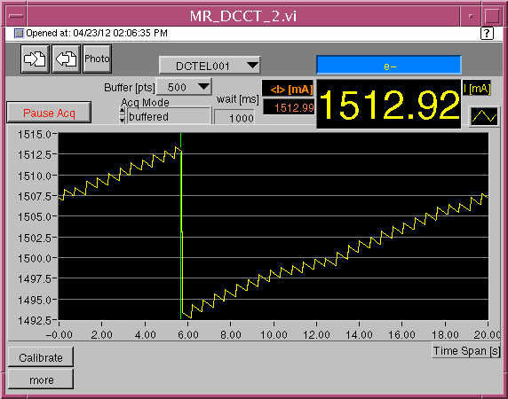
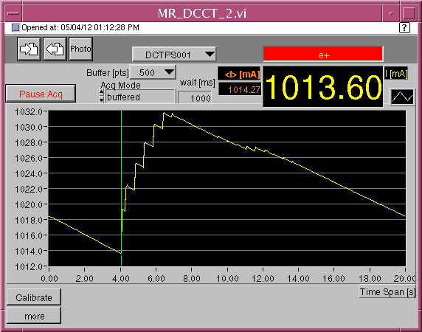
Highest currents stored by now

Slide 14
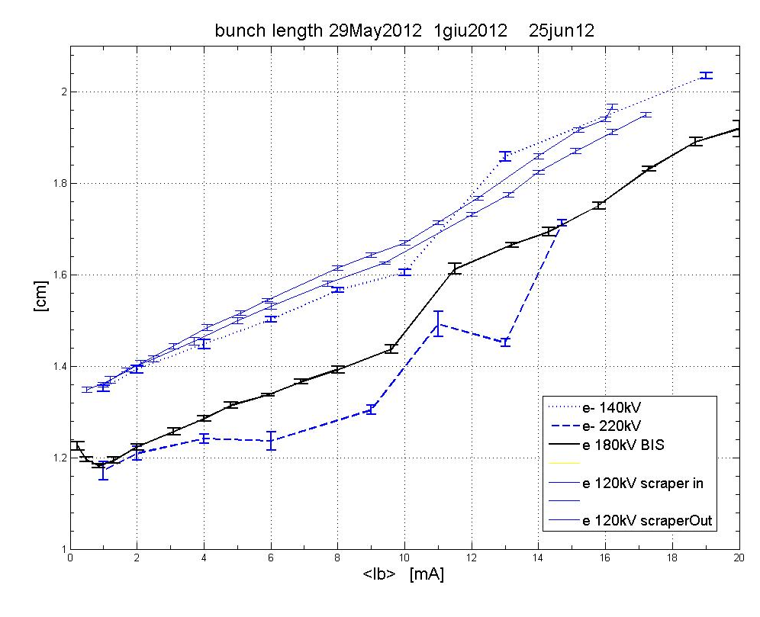
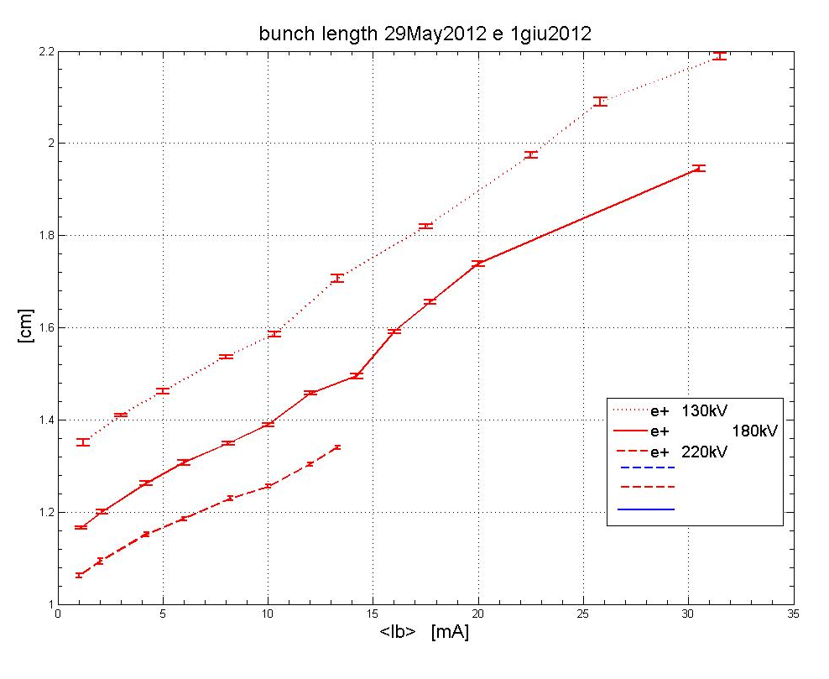
May-Jun2012 Bunch length measurements
Single bunch @ different RF voltages
Gaussian fit

Slide 15
DAFNE plans
Jun 1st – July 15th machine and luminosity studies
Jul 15th – Aug 31st shut down for ordinary maintenance
Sep 3rd – Dec machine and luminosity studies
Jan 2013 shut-down (~ 6 months) to allow the installation of the KLOE inner tracker and to undertake a general consolidation of the accelerator complex.
By now the activity on DAΦNE is scheduled for the next 5 years.

Slide 16
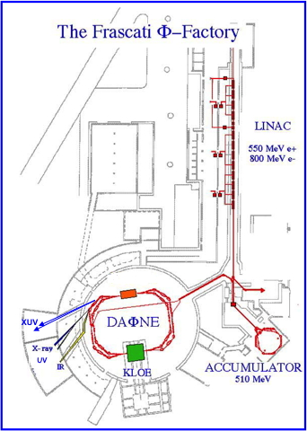
Beamlines @
DAΦNE-Light
SINBAD - IR beamline
DXR1 - Soft x-ray beamline
DXR2 - UV setup
Open to Italian and EU users
DXR2 - New VUV setup ready in 2012
2 new XUV beamlines
Low Energy Beamline (35-200 eV) commissioning in 2012;
High Energy Beamline (60-1000 eV) commissioning in 2012

Slide 17
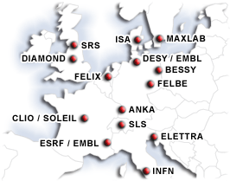
Activities at the DAΦNE-Light Beamlines
The IR ,the Soft X-ray and the UV-VIS beamlines are already open to users . Beamtime was given to Italian and EU users, in the framework of the INFN-Group V experiments, of collaborations with Italian Universities, of the Transnational Access to Research Infrastructures FP7 E.Li.S.A. program and of collaborations using F.A.I. (2011/2012).
2012 - The EU project E.Li.S.A. for transnational access ended in August 2011- A new proposal C.A.Li.P.S.O. was submitted in November 2011 –Negotiation procedure July 2012.
The new VUV setup is now completed.
The two new XUV beamlines are both ready for commissioning.

Slide 18
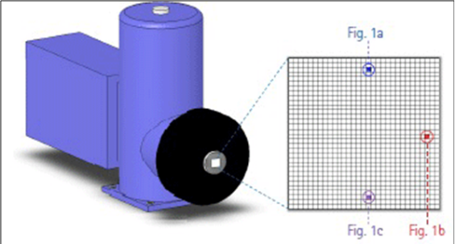
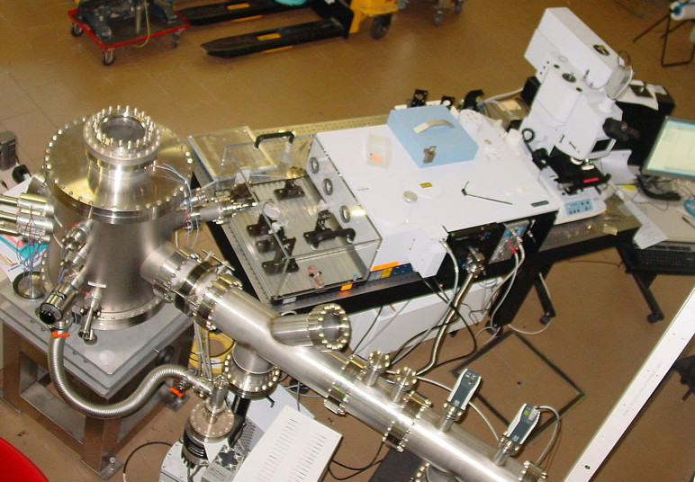
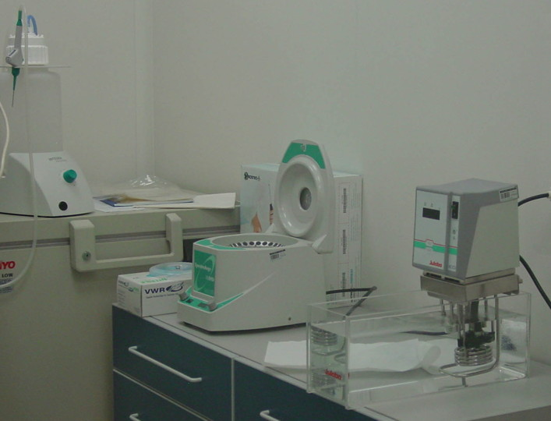
SINBAD IR beamline
Infrared domain from 10 to 10000 cm⁻¹
(1.24 meV to 1.24 eV)
Imaging array detector 64x64 pixel
Interferometer
Clean-room laboratory to support sample preparation and conservation
IR microscope
Synchrotron
IR beamline
Mariangela Cestelli-Guidi

Slide 19
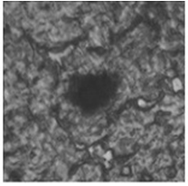
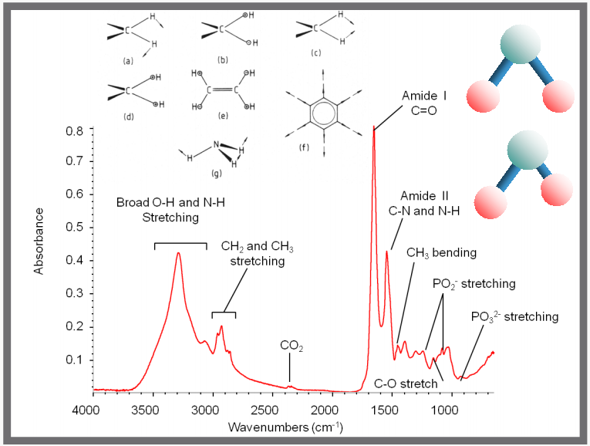
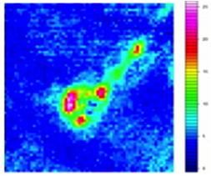
Chemical analysis of brain tumor vasculature using inorganic nanoparticles as contrast agents
(University of Bordeaux)
FTIR imaging can be used as a functional histopathological tool
for clinical applications
Visible image of mice brain tumor tissue section
Infrared image of mice brain tumor tissue section
Every molecule (lipids, proteins, DNA…) has a SPECIFIC spectral signature in the Infrared region

Slide 20
Collaborations and users of the IR beamline
ITALIAN USERS
Univ. Rm 3 - Dip. Geologia
Univ. Camerino – Dip. Mineralogia
Univ. Rm1 , Dip. Fisica
Osservatorio Arcetri
Osservatorio Palermo
Univ. Firenze - Dip. Astronomia
Enea UT BIORAD Casaccia
Univ. L a Sapienza Dip. Neurofisiologia
Emmebi-arte srl
Univ. Parthenope (Dip. Astronomia) ISMN-CNR e Museo delle origini della Sapienza
EU USERS
Univ. Bordeaux – CNRS (Fr)
Univ. Zaragoza (Spain)
Univ. Kracow (Pl)
National University of Lviv (Ukraina)
Institute of Solid State Physics, Riga (Latvia)

Slide 21
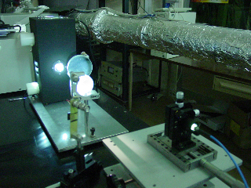
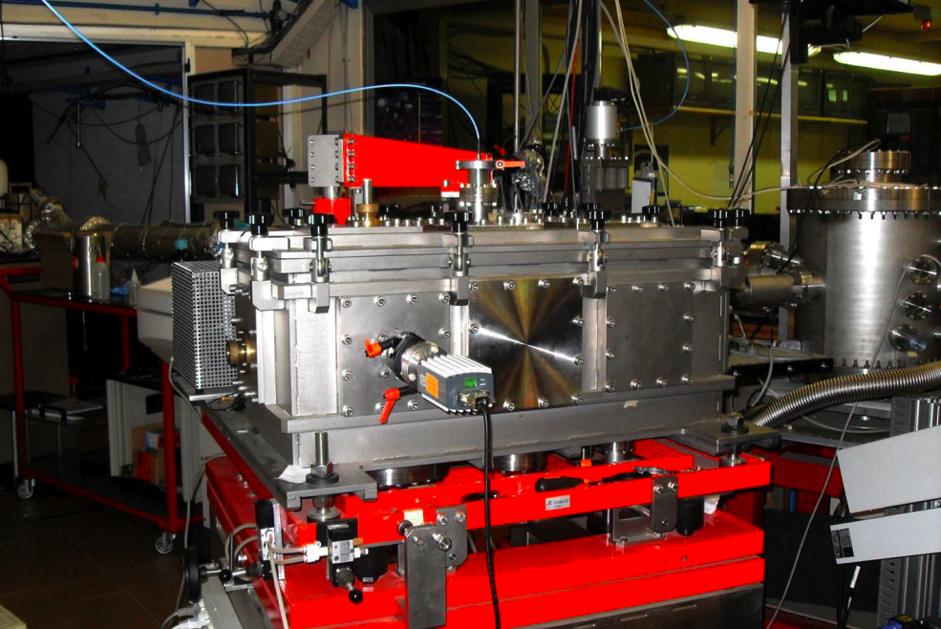
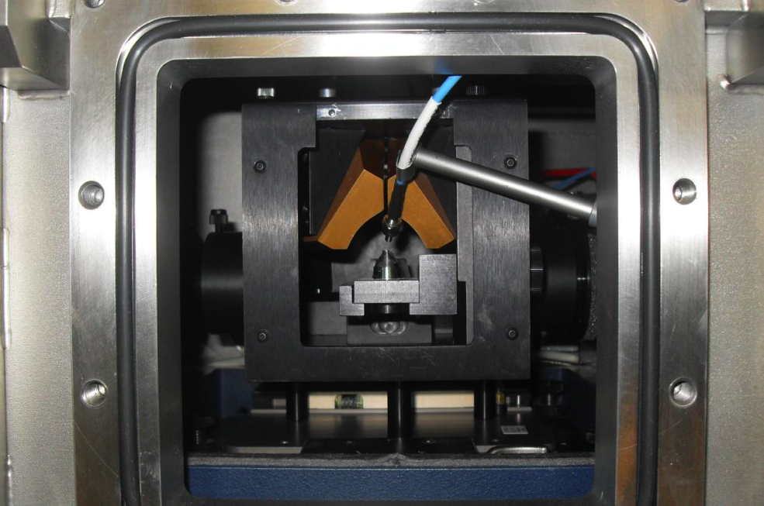
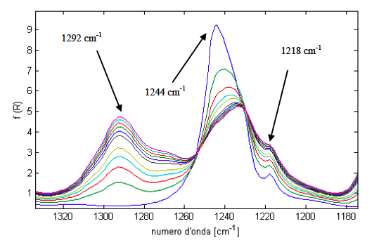
The new Infrared (IR) and UV radiobiology synchrotron facility
IR synchrotron beamline
IR imaging detector and IR microscope
Clean room to support users biology experiment
UV synchrotron source
UV monochromator
Simultaneous study of the effect of UV damage on DNA, cells, tissues and materials
UV beam
IR beam
Notes:
Mariangela Cestelli-Guidi e Emanuele Pace

Slide 22
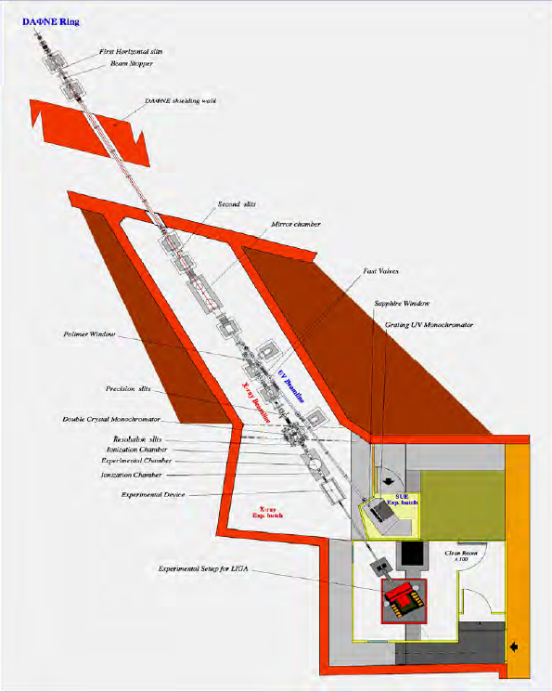
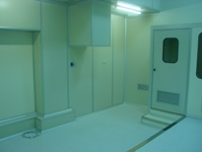
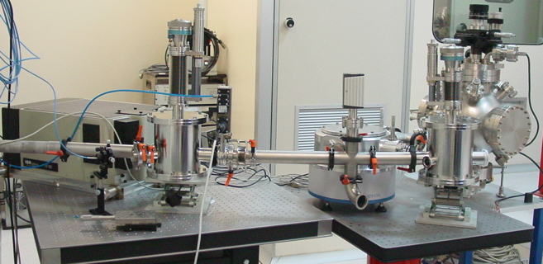
DAΦNE VUV-VIS branch line
Wiggler UV branch line-deflection by a grazing incidence gold coated mirror (about 2°)
VUV-VIS beamline new setup 2 -10 eV (650nm - 120nm)
Branch line in a 1000-class clean room
New UV-VIS facility
SUE experiment
-Space applications
-Astrobiology and photo-biology
-Optical technology
-Detector technology
-Instrumentation testing and calibration
-Optical properties of materials
Emanuele Pace
Notes:
VUV radiation source (D2 120-250 nm)
UV-VIS radiation source (Hg/Xe 200ﾖ650 nm)

Slide 23
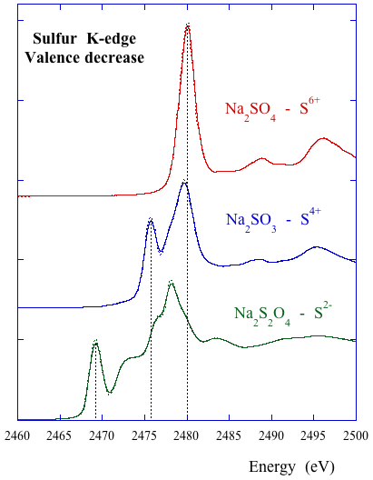
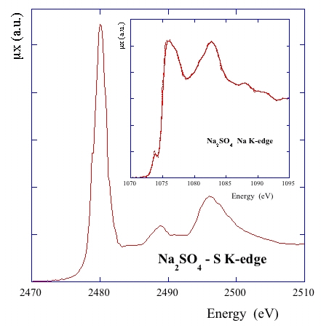
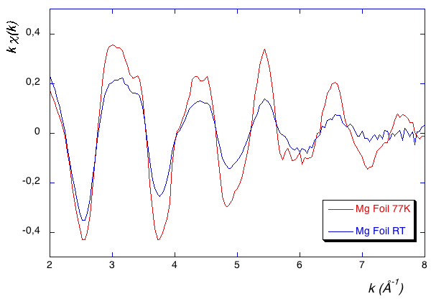
DXR1 Soft X-ray Beamline upgrade
- Wiggler soft x-ray beam line
- Critical energy E_{c} = 284 eV
- Working range 0.9 - 3.0 keV
- TOYAMA double crystal monochromator with KTP (011), Ge (111), Si (111), InSb (111) and Beryl (10-10) crystals
- Soft X-ray absorption spectroscopy and tests of soft x-ray optics and detectors.
UV-VIS branch line
Soft X-ray beamline
Antonella Balerna

Slide 24
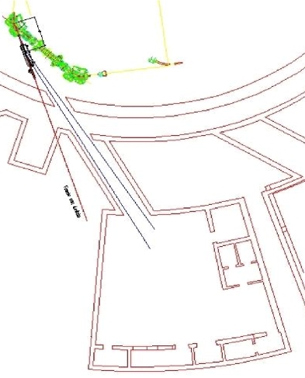
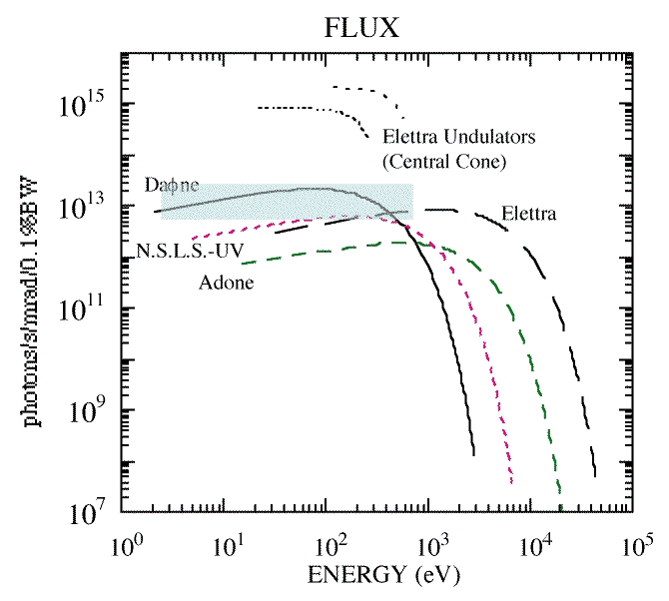
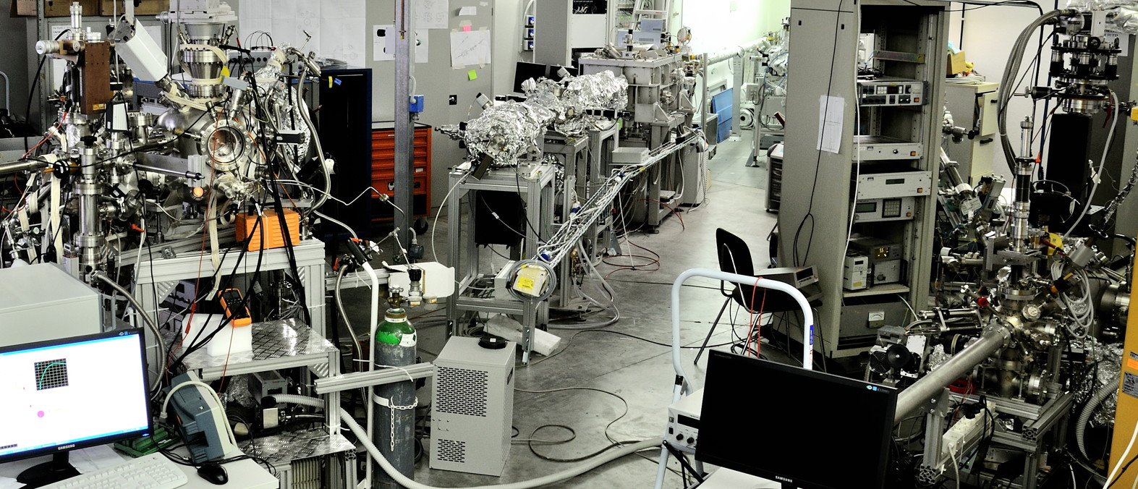
New XUV beamlines
Fields of interest:
Biology
Surface Science
Material Science
R&D studies of INFN interest
LEB (35-200 eV) ready for commissioning
HEB (60-1000 eV) commissioning in 2012
IMCA-NTA INFN project: Innovative Materials and Coatings for Accelerators
R&D of new materials and thin films useful to minimise beam instabilities due to ‘e-cloud’.
Material science and tests of relevance for e-cloud studies in collaborations with CERN, DESY (PETRA 3), Brookhaven (RICH) etc.
Roberto Cimino

Slide 25
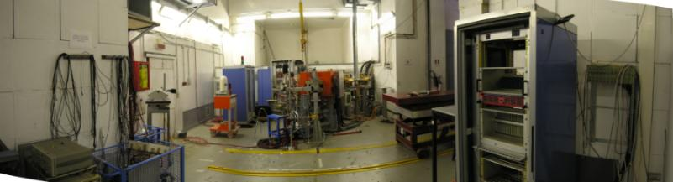
Beam Test Facility (BTF) Infrastructure
The Frascati Beam Test Facility infrastructure is a beam extraction line optimized to produce electrons, positrons, photons and neutrons mainly for HEP detector calibration purposes. The quality of the beam, energy and intensity is also of interest for experiments (~ 20% of the users) studying the electromagnetic interaction with matter

Slide 26
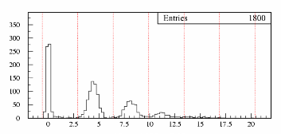
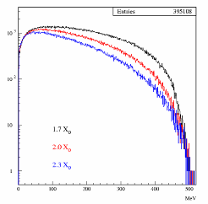
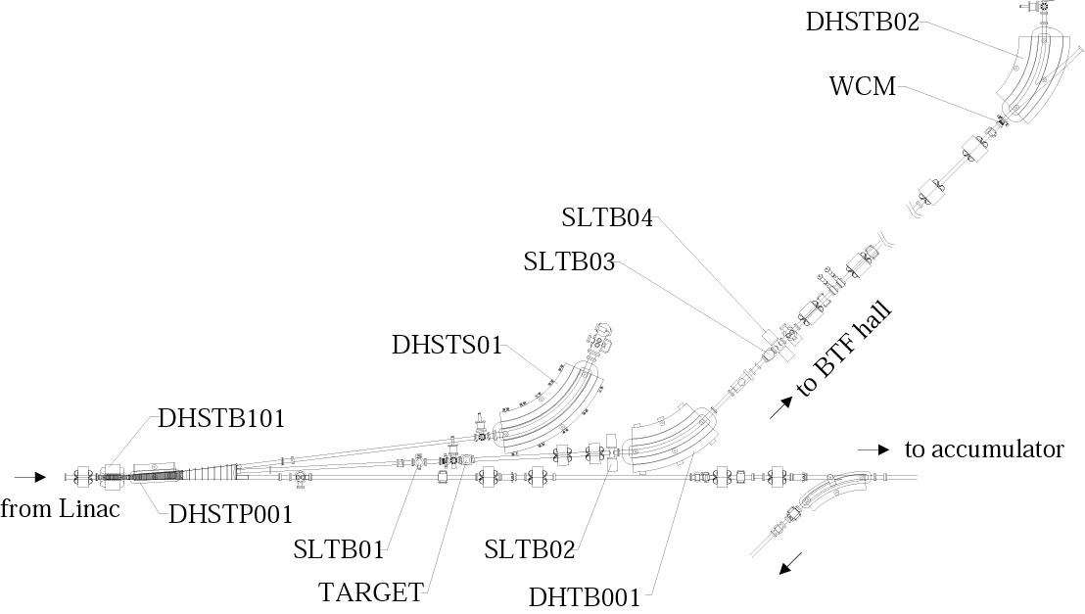
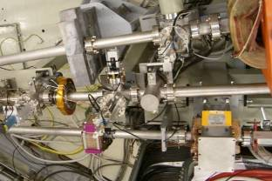
BTF layout
0
1e-
2e-
3e-
BTF Hall
Spectrum@target output
momentum
analyzer
momentum
selection
LINAC
tunnel
To main rings

Slide 27
Beam Test Facility e⁺/e⁻characteristic
parasitic dedicated
Number (particles/pulse) 1÷10⁵ 1÷10¹⁰
Energy (MeV) 25-500 25÷750
Repetition rate (Hz) 20-50 50
Pulse Duration (ns) 10 1 or 10
p resolution 1%
Spot size (mm) s_{x,y} ≈ 2 (single particle)
Divergence (mmrad) s’_{x,y} ≈ 2 (single particle)
HEP detector calibration and setup
Low energy calorimetry & resolution
Low energy electromagnetic interaction studies
High multiplicity efficiency
Detectors aging and efficiency
Beam diagnostics
Main applications

Slide 28
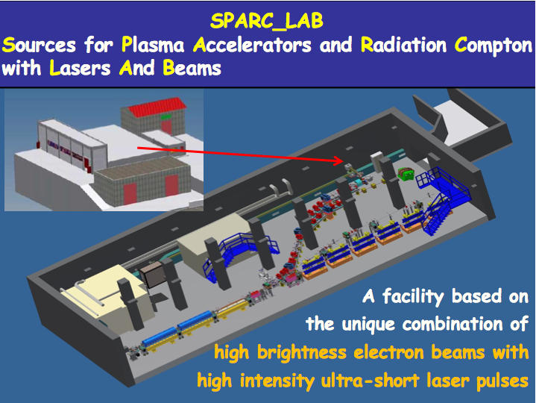

Slide 29
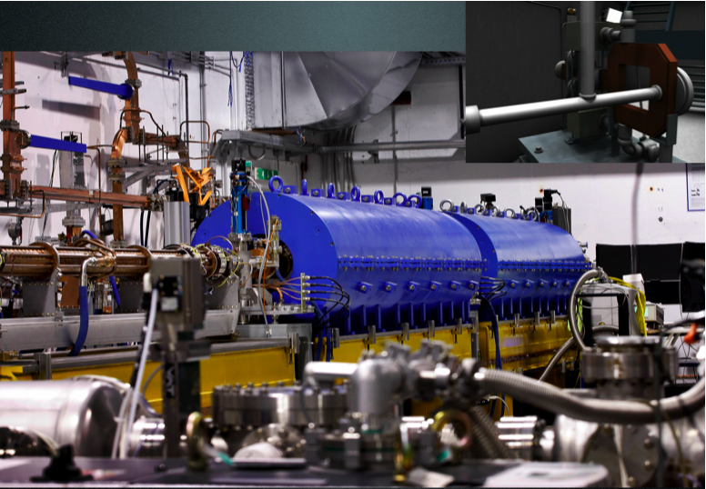
SPARC Photoinjector
E= 150 - 200 MeV
Q= .1 - 1 nC
ε_{x,y}= 1 mm*mrad

Slide 30
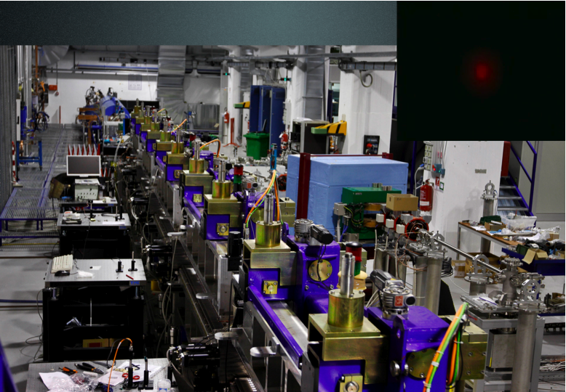
FEL undulators and THz line

Slide 31
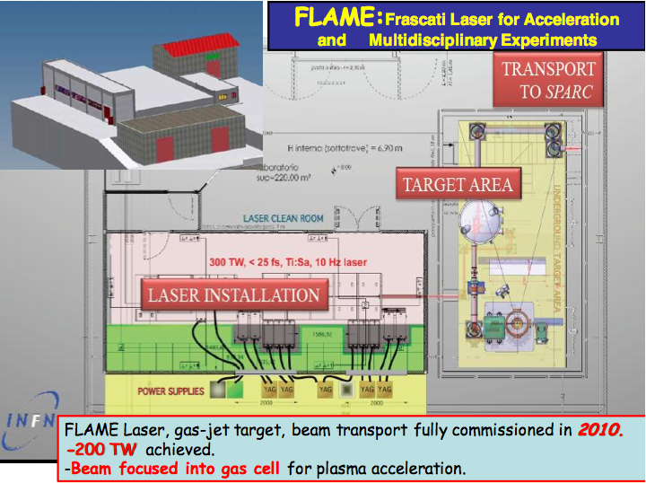

Slide 32
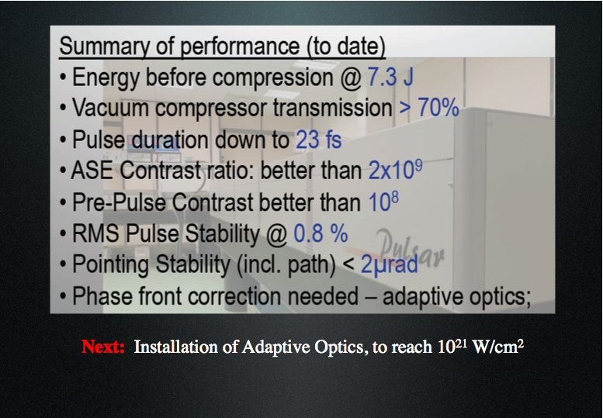

Slide 33


Slide 34


Slide 35


Slide 36


Slide 37


Slide 38


Slide 39

Scattered photons in collision
Thomson cross-section
Scattered flux
Luminosity as in HEP collisions
  Many photons, electrons
  Focus tightly
electrons
laser
σ’_{low}
x’
σ’=σ/β
σ
β
z
σ’_{high}
x
σ_{eq}

Slide 40


Slide 41


Slide 42


Slide 43


Slide 44


Slide 45


Slide 46


Slide 47


FemtoTera 2013-2015
Coordinatore nazionale: S. Lupi (Roma 1)
Sezioni proponenti:
Roma 1 (S. Lupi, O.Limaj, …),
LNF (E. Chiadroni, M. Castellano, M. Cestelli Guidi, G. Gatti, …)
Torino (B. Minetti, G. Ghigo, R. Gerbaldo, L. Gozzelino)
Catania (A. Rovelli)

Slide 48
FemtoTera 2013-2015: Scientific Motivation
Production of advanced THz sources, broad-band (0.15-5 THz) and narrow-band, featuring high peak and fs pulse duration, i.e. Coherent Transition Radiation, Coherent Diffraction Radiation, Coherent Smith-Purcell Radiation
  Longitudinal (non-intercepting) diagnostics of electron beams as accelerated at SPARC_LAB both in conventional and plasma-based accelerators
  Linear and non-linear spectroscopic applications thanks to the high electric (MV/cm) and magnetic (0.5 T) fields associated to the SPARC THz radiation
Development and tests of advanced THz materials and detectors
Development of TERA-LAB for alignment and test of optical setup and detectors
  Generation of THz radiation based on fs fiber laser

Slide 49



Femtosecond THz Radiation at SPARC_LAB
Linac-based coherent THz radiation sources
Under commissioning
Successfully in operation under TERASPARC (2010-2012)
Normalized interferogram

Slide 50


Activity 2012
The New THz Beamline
The sources are Coherent Transition Radiation (CTR) from an aluminum-coated silicon screen and Coherent Diffraction Radiation (CDR) from
a rectangular slit.
Targets holder
YAG:Ce screen
Si-Al screen (CTR)
New vacuum chamber
5 mm slit (CDR)
3 mm slit (CDR)

Slide 51



Activity 2012
Highlights
Broad Band THz Radiation
(150 GHz – 5 THz) with sub-ps high-brightness electron bunches
Velocity Bunching
0.876 ps/mm
σ_{t} = 160 fs
Time
Golay cell detector
1.389 ps/mm
σ_{t} = 2.586 ps
CTR
CDR
Charge: 300 pC
Beam energy: 140 MeV
CDR

Slide 52
SuperB
Cabibbo Laboratory, in charge of construction and operation, has now a management structure
The Accelerator and Technical departments are in place and almost all leaders of the subgroups have been identified
A cost review is in progress since April, due end of July. Many LNF AD experts are involved in this process
  In parallel, work is on-going to freeze the footprint of the accelerator and solve the most urgent issues
  R&D on some specific topics is still in progress
  MOUs with several international laboratories are in preparation
The possibility to use the SuperB Linac as an FEL facility is being studied
18 new positions, mostly for engineering, have been called and selections to be finished this month

Slide 53
Accelerator
TECHNICAL COORDINATOR
W. SCANDALE

Slide 54

Layout @ Tor Vergata University campus
Ground motion measurements performed on site showed very «solid» grounds in spite of the vicinity of the highway, just 100 m away
The highway is at higher level with respect to the site, and the traffic vibrations («cultural noise») are very well damped
IP
LER Spin Rotators
3 ID cells
3 ID cells
Injection & RF section
Linac complex

Slide 55
Main Rings
The two rings have similar geometry and layout, except for the length of dipoles
The arcs cells have a design similar to that of Synchrotron Light Sources and Damping Rings in order to achieve the very low emittances needed
Rings are hosted in the same tunnel, separated about
2 m in horizontal and 1 m in vertical (opposite to IP)
In the latest version of the lattice some cells suitable for SR Insertion Devices have been inserted. This is an open option to be exploited probably after the collider lifetime (tunnel will have possibility to extend SR beamlines from both rings)

Slide 56



Rings layout
Circumference 1200 m
Horizontal separation of arc ~2 m
Vertical separation of RF section 0.9 m
α_{tilt}=2.6 mrad
Vertical separation 0.9 m
Small tilt at IP (by small solenoids not vertical bends) provides ~1 m vertical separation at the opposite point: (a) e+e- rings separation, (b) better equipment adjustment, (c) SR beamlines from both rings is possible

Slide 57
IR design - Cryostat Magnets and PMs

Slide 58

IP doublets design
HER QD0
upstream
LER QD0
upstream
Cryo 1
Cryo 2
HER
LER
IP
LER QD0
downstream
HER QD0
downstream
With the large crossing angle a shared quadrupole layout is not viable, since the displacement of the magnetic axis with respect to the nominal trajectories will generate unmanageable backgrounds by steering off-energy particles in the detector
A new design of the first doublet with «twin» quadrupoles was then developed
They must generate a large field gradient (100 T/m) to obtain β_{y}~0.2 mm at IP
The thermal load on the QD0 beam pipe section must be evacuated at room temperature hence a cold pipe design is not feasible

Slide 59

QD0 prototype
QD0 prototype early building stage
Main goal of the prototype is to study its behavior during a quench
Magnetic design is based on the double helical concept
  Excellent field quality on almost the whole mechanical aperture
  Possibility to produce arbitrary combinations of multipolar fields by a clever design of the winding shape
NbTi SC wire for a nominal current of 2650 A
Inner bore diameter is 50 mm to accommodate for a rotating coil device to measure the generated field quality
E. Paoloni (Pisa), P. Fabbricatore, S. Farinon, R. Musenich (Genova)

Slide 60


Cold test of the QD0 prototype
Warm Prototype
An SC current transformer was built to feed the prototype
  The total energy to be dissipated during quench is the one stored in the small secondary + the quadrupole ~ 1.4 kJ
  A conventional power supply + quench detecting system and quench heathers will hardly (if ever) protect the magnet from disastrous thermal shocks
The model was successfully tested. IT WORKS!
Training process started at ~ 2300 A with the first quench. The magnet quickly improved its maximum current handling capability operating in steady state at its design current
The subsequent quenches occurred at current exceeding 2750 A. The limitation seemed to be of mechanical nature. Further test are under way for better investigate this aspect
Prototype right after one of the cold tests
Lc= 330μH
Ls= 90μH

Slide 61



FEEDBACK developments:
To start an R&D activity for the IP feedback: in May a new 14-bit hardware based on ready-made low cost board has been used to acquire long tracks of DAΦNE e+ bunch-by-bunch data. The output signal was also used to time the front end clock
A. Drago, LNF

Slide 62



Controls, Computing and
!CHAOS developing
C. Bisegni, G. Mazzitelli, A. Stecchi et al (LNF), L. Catani et al (RomaII)
The !CHAOS collaboration continues the development of the control system core, integrating the expected functionality.
A first Open Source release is available on the INFN web site
http://chaos.infn.it/
University of Cagliari and computer science department of Tor Vergata recently joint the collaboration with thesis and PhD positions
The cost estimation is going on taking into account also the networking and computing infrastructure needed to Controls and Accelerator project develop-ment and maintenance (EMDS, PMDS, etc).
Integration of standard I/O device (GPIB, LIBERA BPM) is started in order to check real performances.
Commercial partners collaborations are under study
L2/L3 Network layout
more than 2000 network device have been estimated up to now

Slide 63


New injection system layout
S. Guiducci, “Baseline design of the SuperB Factory Injection System”, THPPRo88
Polarised gun
(SLAC type)
for electrons
Positron linac
S-band or L-band
Positron Converter
BUNCH
COMPRESSOR
Main Linac
Transfer lines
Positron Source to Damping Ring (PSDR)
Damping Ring to Main Linac (PDRL)
Electron Source to Damping Ring (ESDR)
Damping Ring to Main Linac (EDRL)
Main Linac to HER (PLMR)
Main Linac to LER (ELMR)
Recent progresses:
Final design with DR for electrons too
Start-to-end simulation
Design of PSDR, ESDR and bunch compressor
Options for e+ Linac still open (S-band or L-band)
Design of Main Linac
PLMR and ELMR to be modified
R. Boni, S. Guiducci (LNF), A. Variola et al (LAL)

Slide 64

SuperB as a SASE X-FEL
The possibility to drive a SASE Hard-X FEL using the 6 GeV e⁻ linac has been recently considered
A preliminary design study, based on FEL scaling laws supported by HOMDYN and GENESIS simulations, shows that a FEL source in the range of 1-3 Ang can be implemented still preserving the compatibility with the collider operation
Linac repetition frequency is 100 Hz → accelerate a pulse for the X-FEL during the store time of e⁺ in the DR, without affecting injection rate into MR → repetition cycle of 30 ms for each beam is possible: e⁺ injection, e⁻ injection and a dedicated linac pulse for X-FEL

Slide 65


NTA-IMCA (dal 2011) ~ 6 FTE
(Innovative Material and Coatings for Accelerators)
R. Cimino (100%), S. Bini (20%), A. Balerna (30%), E. Bernieri (30 %), D. Alesini (20%)
M. Zobov(20%), A. Clozza (20%), R. Larciprete (CNR –ISC, 100%) R. Flammini (CNR-IMIP, 100%)
I. Masullo (?%) et al (INFN- Na)
Thanks to : the team of DAΦNE-L and the LNF acc. Group
Inteernational coll.:CERN, SLAC, ANKA, DESY, Cornell, RICH, SuperB, SuperKEKB.
R&D per la crescita e la caratterizzazione di nuovi materiali e film sottili per la realizzazione di acceleratori con pareti di nuova concezione, in grado di minimizzare le eventuali instabilità di fascio dovute alla creazione di una “nuvola di elettroni”, potenziale collo di bottiglia per macchine quali DAFNE, i DR del ILC, SPS, LHC, LHC upgrade Super-B, SuperKEKB etc.
Questi materiali e ricoprimenti verranno da noi (o in coll.) prodotti e da noi analizzati inserendoli nella filiera di caratterizzazione già sviluppata nel nostro laboratorio, inclusa quella, unica al mondo in questo ambito, ottenibile con l’utilizzo di Luce di Sincrotrone (a BESSY II per la riflettività e, sperabilmente, ai LNF).
Tali analisi porteranno a un “feed back” rapido per l’ottimizzazione del procedimento di crescita. Si prevedono tests atti a verificarne l’impiego su larga scala, la compatibilità con l’UHV, la stabilità etc.
R. Cimino
65

Slide 66





announcement & invitation
ECLOUD’12
La Biodola, Isola d’Elba, Italy
From 5 to 9 June 2012
ECLOUD workshop series started at CERN in 2002.
After 10 years and stops in Napa Valley/CA (2004), Daegu/Korea (2007), and Cornell University/NY (2010), ECLOUD'12 returns to Europe!
Topics: SEY models, e-cloud build & e-cloud effects in accelerators, beam induced multi-pactoring, surface properties, mitigation measures, microwave diagnostics, …
more info @ http://www.lnf.infn.it/conference/ecloud12/
Roberto Cimino (Roberto.Cimino@lnf.infn.it )
and Frank Zimmermann (frank.zimmermann@cern.ch)

Slide 67
Prospectives 2013:
Not only we start to understand what is actually happening during SEY reduction, but also using it to develop conceptually new material and coatings. So:
Continue the SEY-XPS activity with special emphasis to the planned grow by dissociation of hydrocarbons by Chemical Vapor Deposition in UHV.
Integrate our SEY-XPS understanding with μ-Raman spectroscopy.
Understand the importance of roughness on the SEY value.
Study PEY and photon reflectivity.
Study effect on machine parameters (ecloud codes Impedeance..) of the potential solutions (INFN-Na)
Other studies are necessary to optimize growth parameters, to test stability vs time, adhesion, cost effectiveness etc.. And to produce these material in large scale for accelerators: …. lot of work!!!

Slide 68
FP7 High Luminosity Large Hadron Collider Design Study (HiLumi LHC)
The Project goal is the design of the LHC upgrade configuration with luminosity of 10³⁵ cm⁻² s⁻¹
It involves participants from 20 research institutions from European Union, Russia, USA and Japan
HiLumi LHC has been approved with the highest score 15/15 and it have obtained European funding of 4.900.000,00 Euro out of 4.950.000,00 Euro requested
The INFN President has signed the Grant Preparation Form of the Collaborative Agreement (21/06/2011)
INFN has obtained the second biggest European funding (after CERN) for participation in the Project

Slide 70
LNF Participation in HL-LHC Project
Participants
(Accelerator Division)
Subjects to Study for LHC Upgrade (WP2)
Zobov Mikhail - Local Coordinator
Alesini David
Drago Alessandro
Gallo Alessandro
Marcellini Fabio
Milardi Catia
Bruno Spataro
Linear and Nonlinear Optics
Vacuum Chamber Design and Beam Impedance Evaluation
Collective Effects and Beam Instabilities (including e-Cloud)
Beam-Beam Effects

Slide 71

Scheme of the intrabunch feedback system proposed by A.Gallo

Slide 72

Broad-band kicker for SPS intrabunch feedback system
F. Marcellini
H
Frequency | 0.8GHz | 1.2 GHz
Q | 23 | 38
Vertical shunt impedance | 2.1 kΩ | 3.3 kΩ
H | ≈ 100 cm | ≈ 60 cm

Slide 73



Coupling impedance calculations for slotted kicker (M.Zobov)
Real Part
Imaginary Part

Slide 74



Study of flat beam collisions for LHC upgrade (D.Shatilov, M.Zobov)

Slide 75



Experimental study of e-cloud suppression by clearing electrodes (D.Alesini, A.Drago et al.)
Instability growth rate
Vertical beam size increase
Absorbed e-cloud current
Tune spread along bunch train

Slide 76
High Luminosity LHC
Study of the tolerances for the quadrupole strengths in the IR5
C. Milardi

Slide 77


NTA - CLIC
CTF3 Achievements – Drive Beam Generation
P
,
n
0
0
Transverse
Beam recombination
Factor 8 recombination by RF deflector injection
RF Deflector,
f
0
2
P
, 2
×
0
×
f
0
P
,
f
0
0
Deflecting
Field
CR only

Slide 78




CTF3 Achievements – Two-Beam Acceleration
Two-Beam Acceleration demonstration in CTF3 Two-Beam Test Stand
TD24
Drive beam ON
Drive beam OFF
Maximum probe beam acceleration measured: 31 MeV
⇒ Corresponding to a gradient of 145 MV/m
78

Slide 79
Drive Beam phase measurement and correction in CLIC turn around
2 kickers setup
Phase monitor
Kicker
Transverse orbit distortion in the transfer line change the longitudinal path length ->
the beam phase
Feed-forward experiment in CLIC Test Facility CTF3

Slide 80



CTF3 phase pick-up prototype
Waveguides designed to increase coupling and decrease Q -> faster rise time
Tuned pick-up
Q=41
fres=fRF=12 [GHz]
Beam pipe Φ=23mm
Detuned pick-up to decrease the voltage
Q=42
f_{res}=≠f_{RF}=12.22 [GHz]
fres=monitor resonance
notch frequency

Slide 81


Kicker mechanical design
Strip-line Internal Diameter=40mm
L_{strip}=960mm
L_{TOT=}1100mm

Slide 82
ILC Activity at LNF: Damping Rings
The possibility of making experimental observations at DAFNE offers a great opportunity to test simulation studies and prototypes
One of the critical R&D for the ILC DR is the test of electron cloud mitigation techniques: an important step has been the installation and test of electron clearing electrodes in DAFNE
Experimental measurements have shown an impressive effectiveness of these devices in mitigating the e-cloud impact on the positron beam dynamics

Slide 83
2012-2013 plans
2012: LNF coordinates the Damping Rings (DR) working group within the GDE, for the completion of the Technical Design Report (TDR), due end of 2012
The first draft will be completed within July with a relevant LNF contribution (Coordination, general issues, RF system, feedback systems, injection systems)
2013: A Low Emittance Rings Collaboration started from the ILC and CLIC damping rings working group, with strong involvment of SuperB group, with the scope to bring together scientific communities of synchrotron light sources, damping rings and lepton colliders in order to communicate, identify and promote research work on common topics affecting the design of low emittance lepton rings. A Network dedicated to low emittance rings is part of the EuCARD2 project under negotiations with EU.

Slide 84
Le Prospettive per l’INFN in ELI-NP
Fra i tre Pilastri di ELI (Hungary: Short Pulses, Praga: Secondary Sources, Bucharest: Nuclear Phyiscs) ELI-NP in Romania è il più interessante per l’INFN
Il suo caso scientifico è il più ricco per quanto riguarda la Fisica nucleare, sub-nucleare e fondamentale
Una delle sue componenti più uniche e importanti, la Compton gamma-ray Source, è basata su tecnologia (RF Linac ad alta brillanza) di cui il gruppo SPARC/SPARX/PLASMONX è leader in europa e nel mondo

Slide 85
ELI-NP “Start-up” Activities
February 2010
Workshop Scientific case
April 2010
“White Book” (100 scientists, 30 institutions) (www.eli-np.ro)
editors: D. Habs et al.
August 2010
Feasibility Study: 280 Meuro 80 Mil. Lasers and beam transport
60 Mil. γ beam
60 Mil. Construction
24 Mil. Experiments
23 Mil. Personnel
Courtesy Victor Zamfir

Slide 86



ELI-NP

Slide 87

Studiare il nucleo e le particelle sub-nucleari con la luce
Courtesy Toshi Tajima

Slide 88

Due Laser Apollon da 10 PW
Pianta
Edificio
ELI-NP
RF Linac
Da 700 MeV
e Compton-Source

Slide 89
Grazie per l’attenzione

