Slide 1


Testbeam updates
CMOS Meeting
R.Zanzottera-Testbeam updates

Slide 2
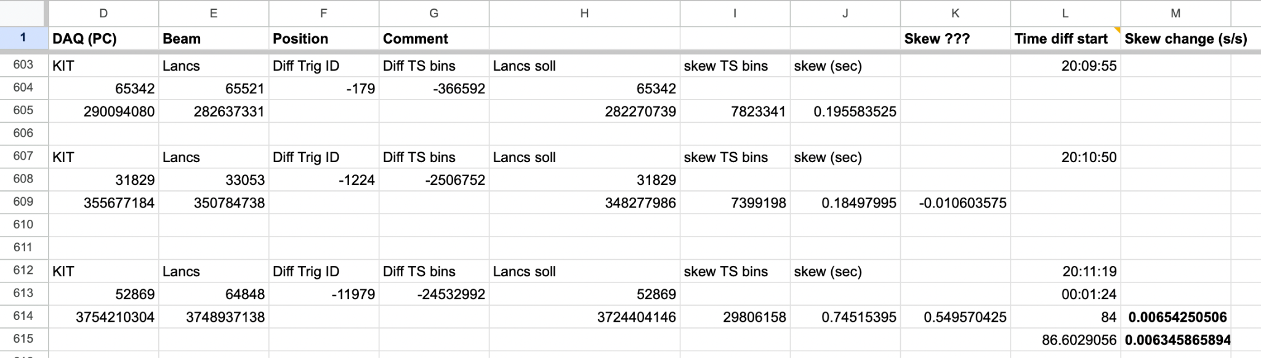
Telescopes synchronization
Timestamp skew calculated from injections using TrigID (see TB manual)
from double check the skew change is calculated (skew change in seconds for each second passed)
CMOS Meeting
R.Zanzottera-Testbeam updates

Slide 3
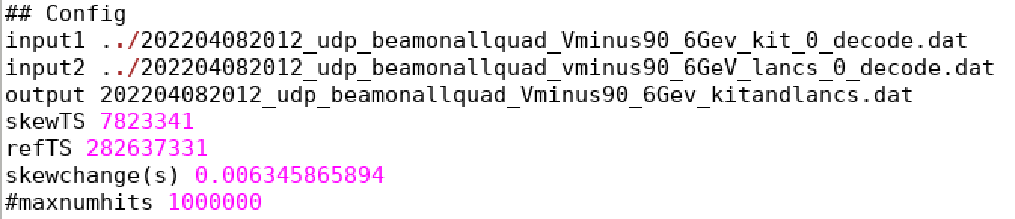
Script for synchronization
script for the synchronization takes in input a configuration file with:
the files of KIT and Lancs telescopes and merges them in the output file (order of input is not important)
parameters for the synchronization:
skew from the injection
time of the injection
skew change in seconds
CMOS Meeting
R.Zanzottera-Testbeam updates

Slide 4
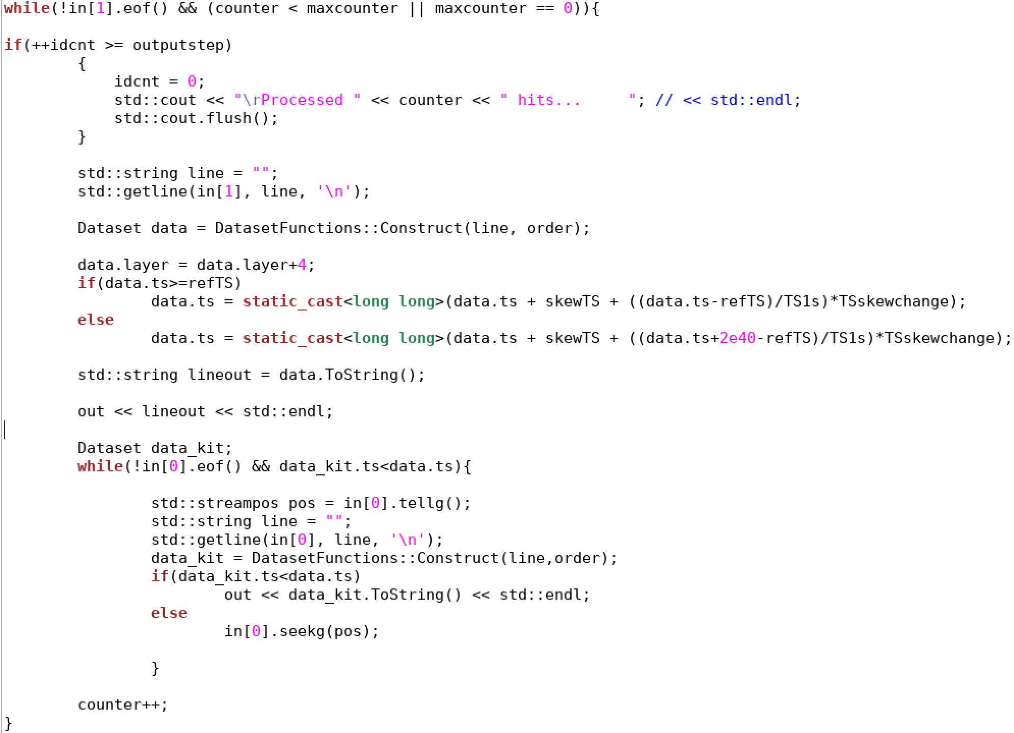
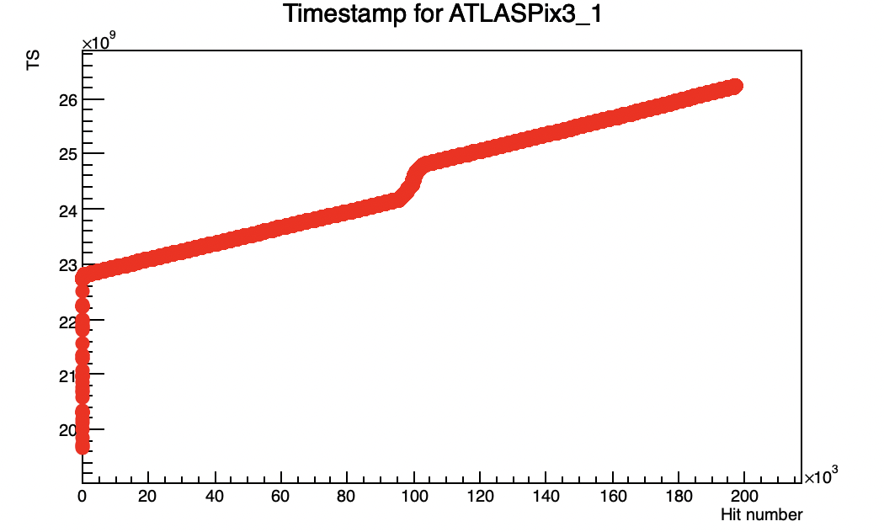
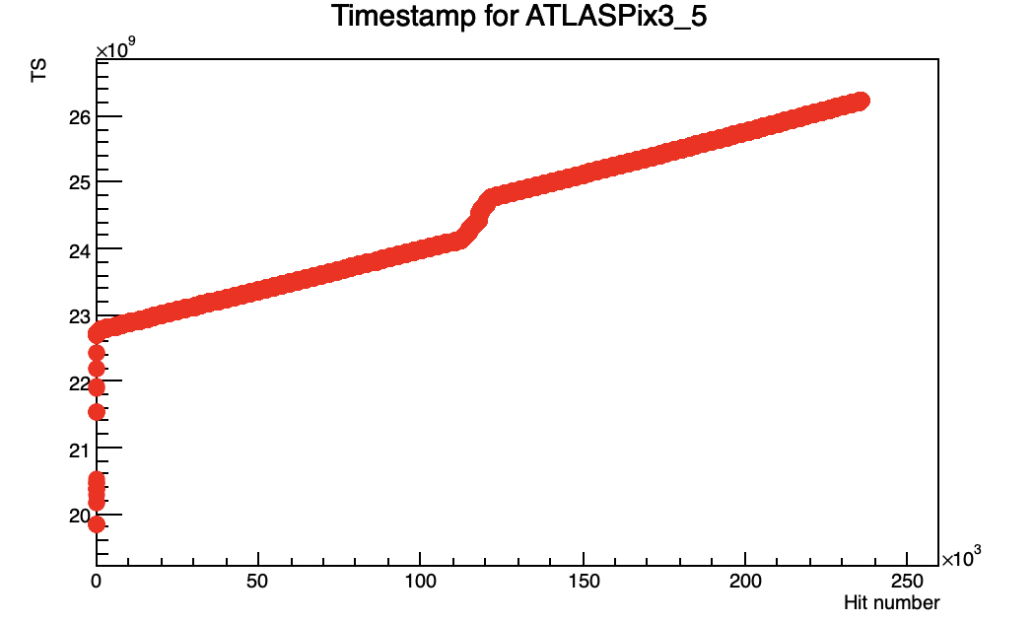
Script for synchronization
since Lancs telescope has many more hits (possible explanation later) the files cannot be merged simply by alternating the hits (see code)
formula for the synchronization
the formula should be correct anyway it doesn’t work (no correlation between hits)
anyway it is not completely wrong (steps more or less at same time, probably many ms difference)
CMOS Meeting
R.Zanzottera-Testbeam updates

Slide 5
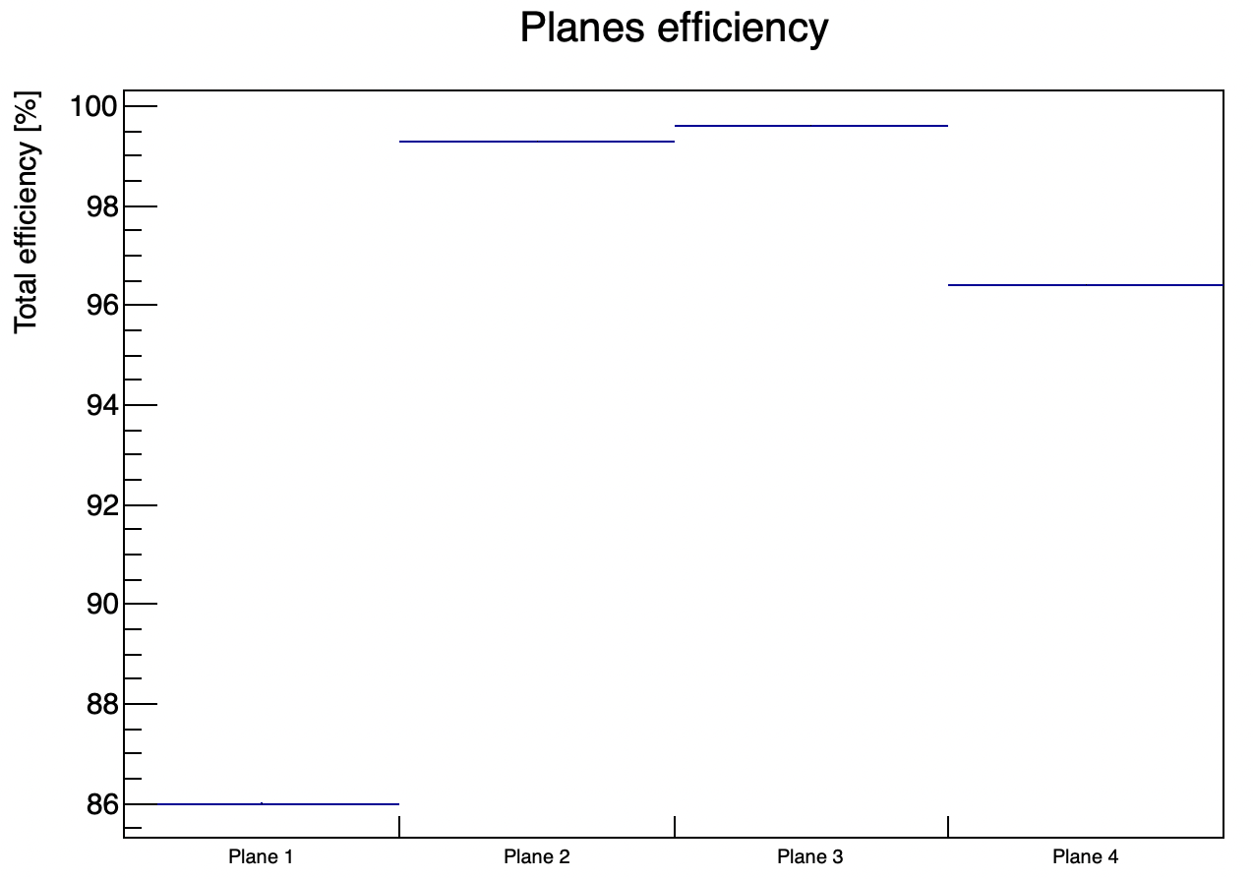
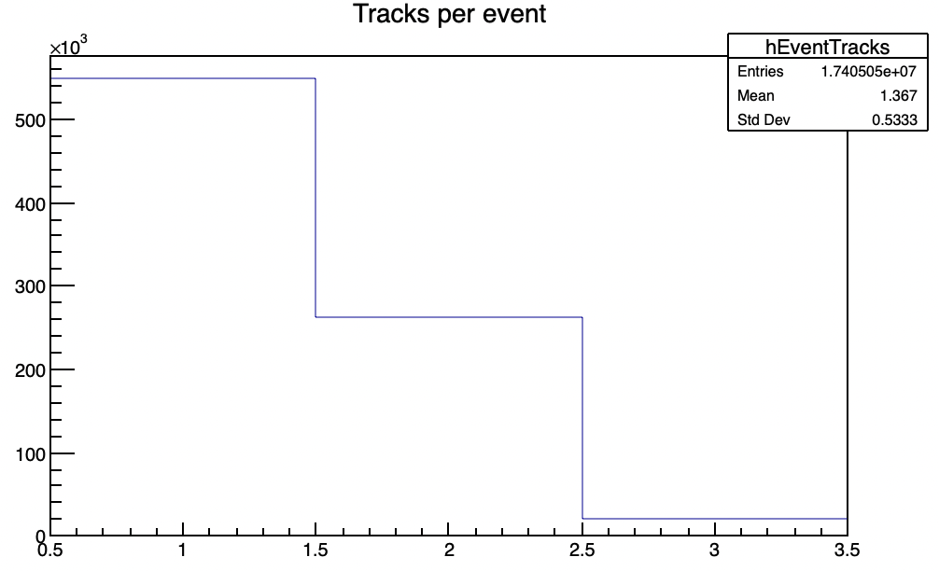
Inefficiency
last time I showed that first plane of KIT looks inefficient
from a better investigation I noticed that there are a lot of events for which there are no clusters on first plane
tracks reconstructed on the other three planes in these events
1 track or in many events also 2 tracks
CMOS Meeting
R.Zanzottera-Testbeam updates

Slide 6
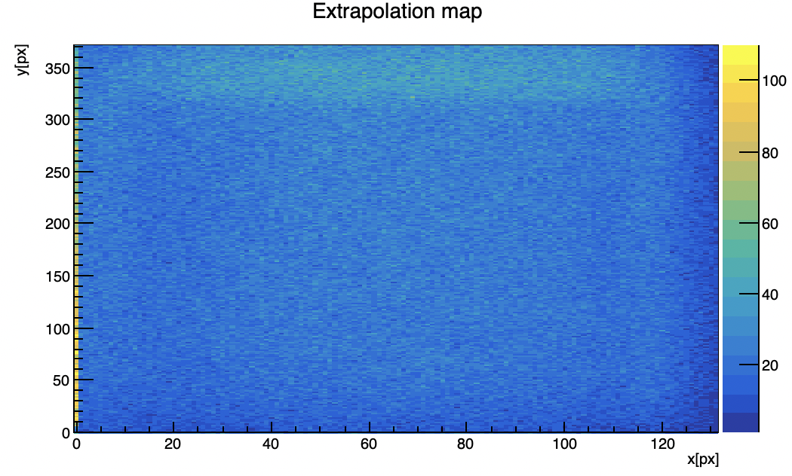
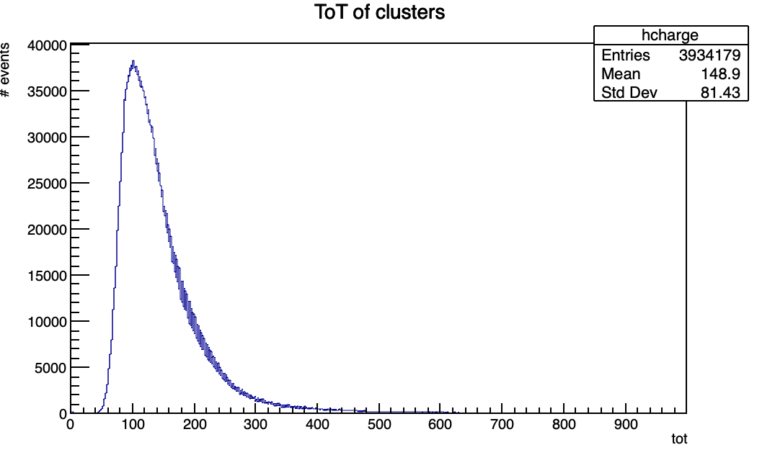
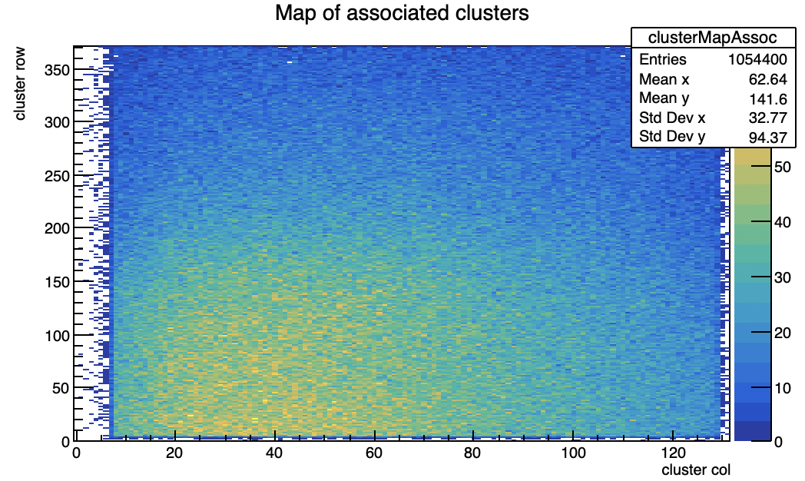
Inefficiency
extrapolations of these tracks on the first plane (concentrated on two sides)
they don’t come from the beam spot and are from MIP
CMOS Meeting
R.Zanzottera-Testbeam updates

Slide 7
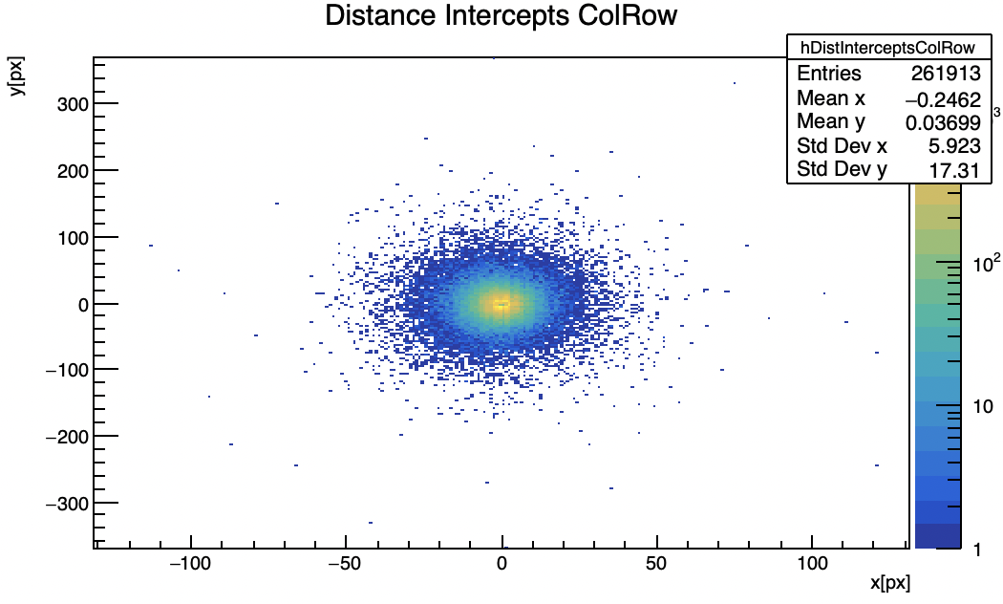
Inefficiency
considering only events with two tracks
distance between the extrapolated points
they ends up very close to each other
CMOS Meeting
R.Zanzottera-Testbeam updates

Slide 8
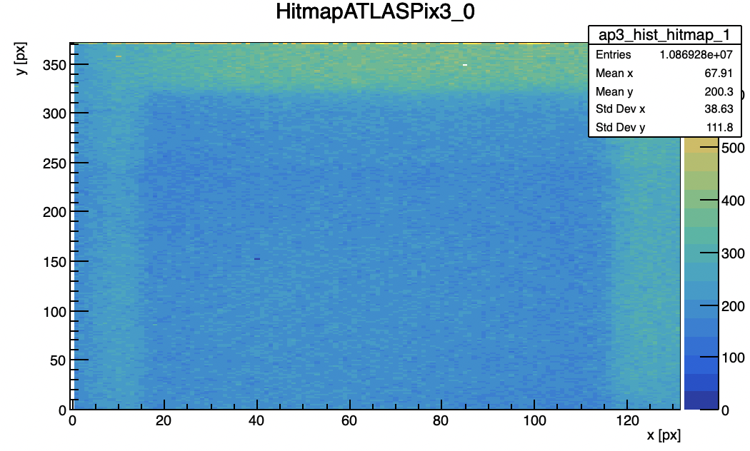
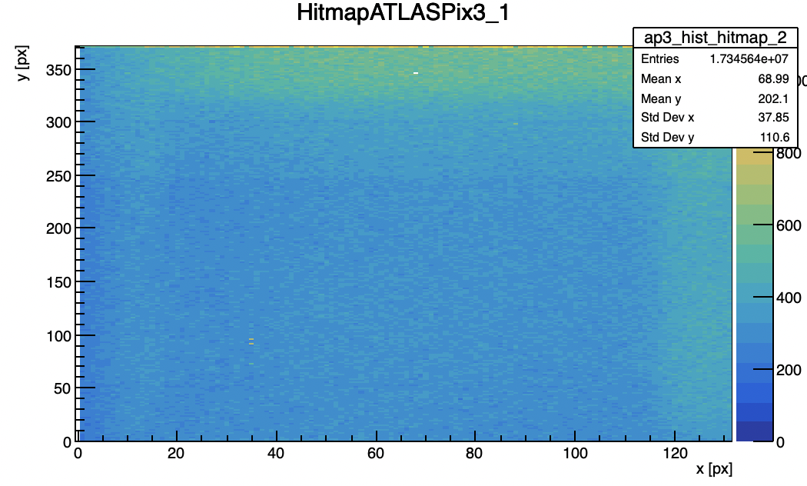
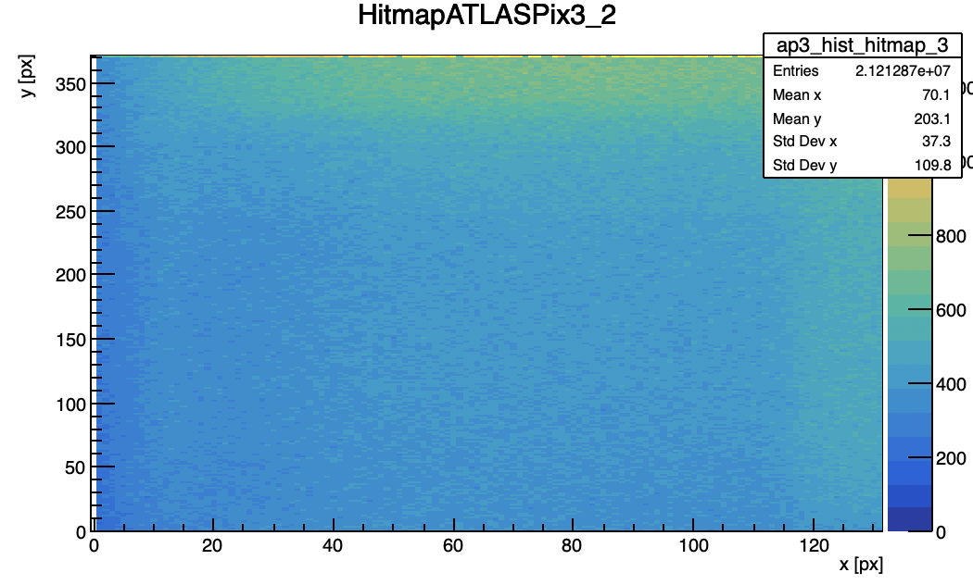
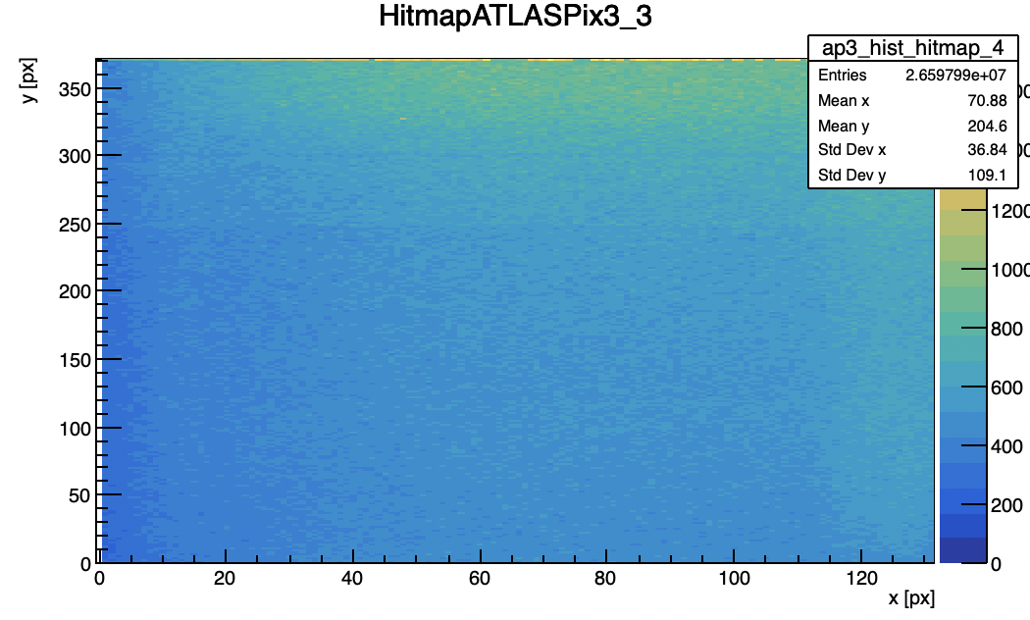
Inefficiency
the extrapolation map is compatible with the hitmaps
the beam spot is not visible but there are a lots of hits in the same regions seen in the map of extrapolated hits
number of hits increments with the plane
CMOS Meeting
R.Zanzottera-Testbeam updates

Slide 9
Possible explanation
possible background of synchrotron photons?
these photons can interact after the depletion region and produce a pair (giving 2 tracks) or via compton scattering (giving 1 track) so they are not detected in the plane with which they interact
if this happen in the first plane it can cause apparent inefficiency
maybe we can see these photon background because the beam is not well centered
CMOS Meeting
R.Zanzottera-Testbeam updates

