Slide 1


Testbeam analysis updates
CMOS Meeting
R.Zanzottera-Testbeam analysis

Slide 2
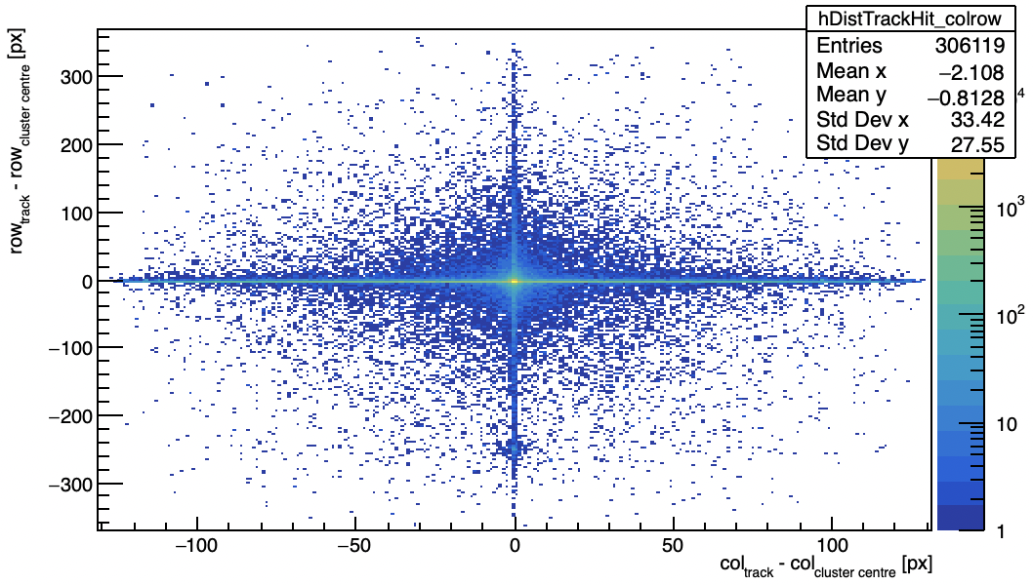
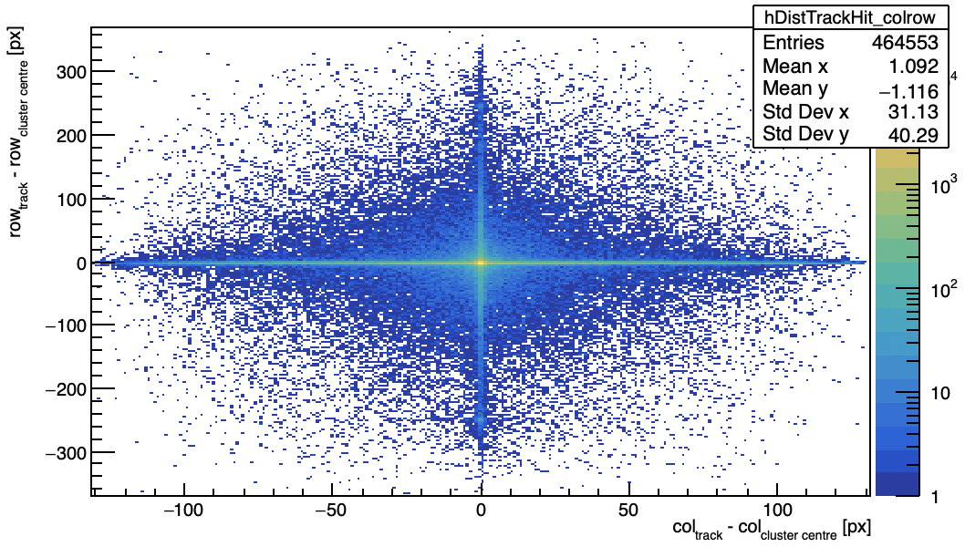
Corrupted column clusters
KIT
Lancs
distance track-hit in column and rows instead of mm
CMOS Meeting
R.Zanzottera-Testbeam analysis

Slide 3
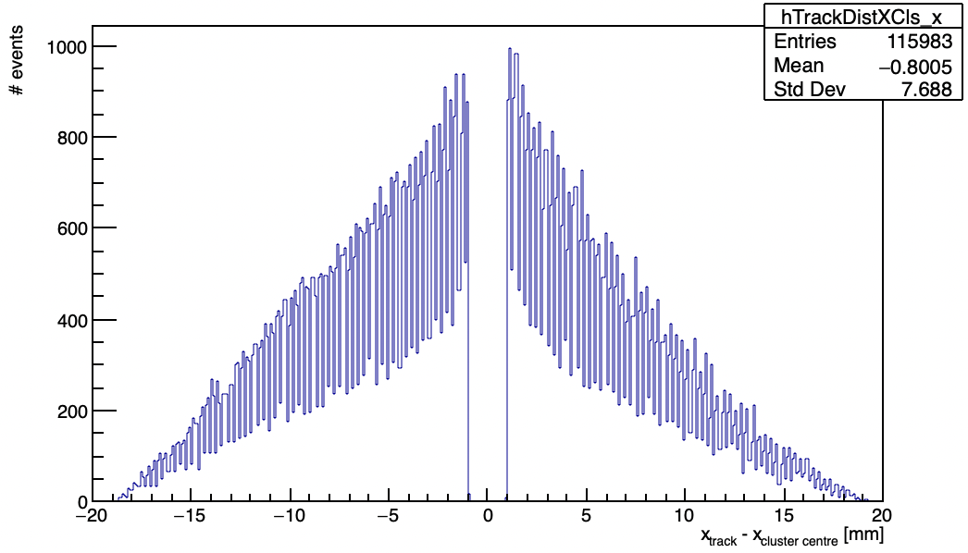
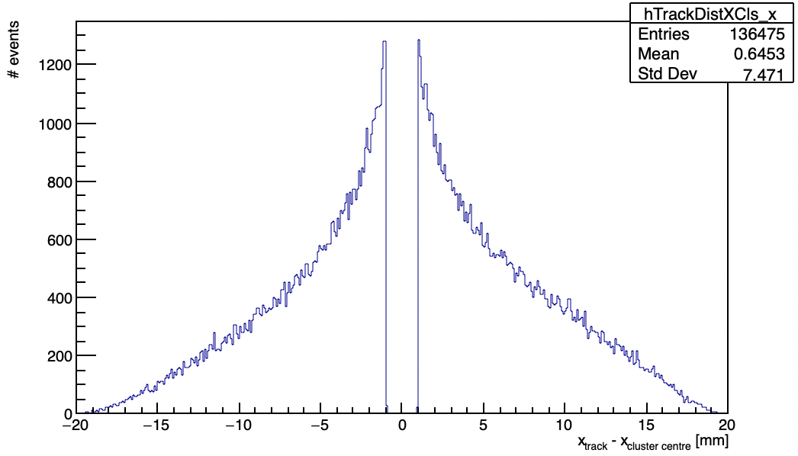
Corrupted column clusters
KIT
Lancs
distance track-hit in X in mm
CMOS Meeting
R.Zanzottera-Testbeam analysis

Slide 4
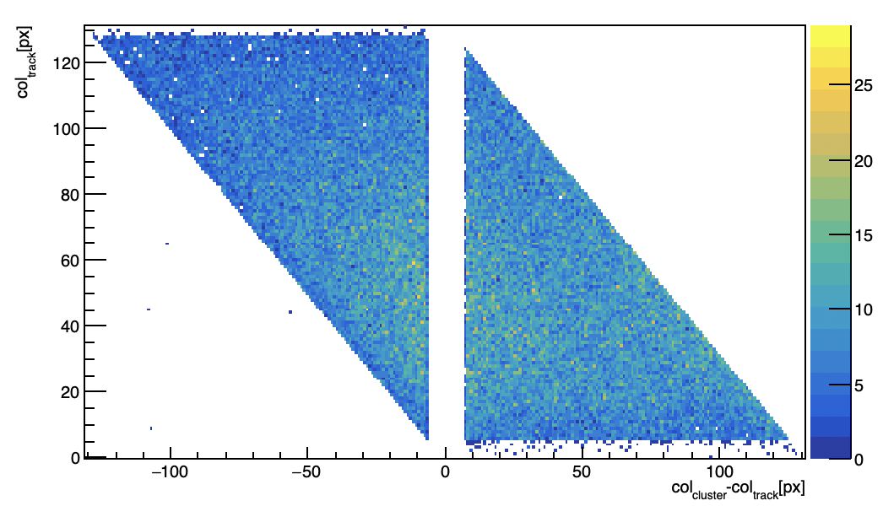
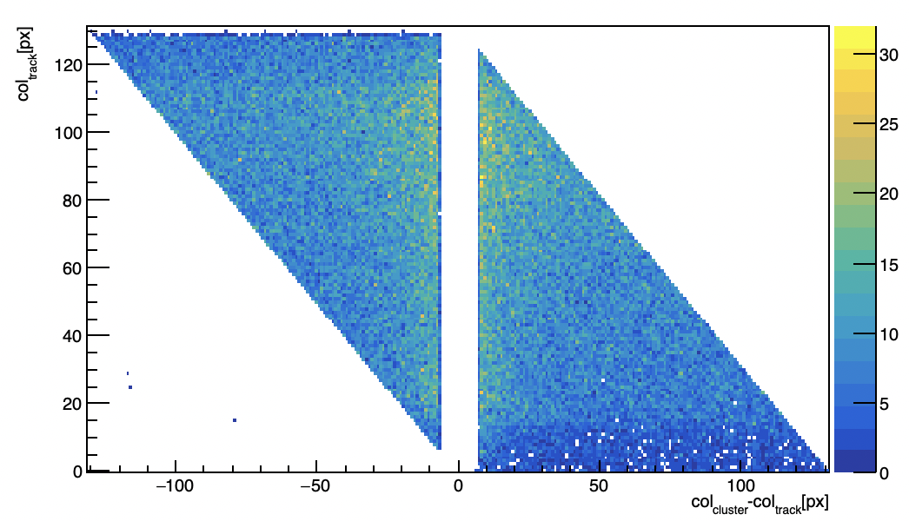
Corrupted column clusters
KIT
Lancs
track column and column difference correlation
column(cluster) - column(track) vs column(track)
CMOS Meeting
R.Zanzottera-Testbeam analysis

Slide 5
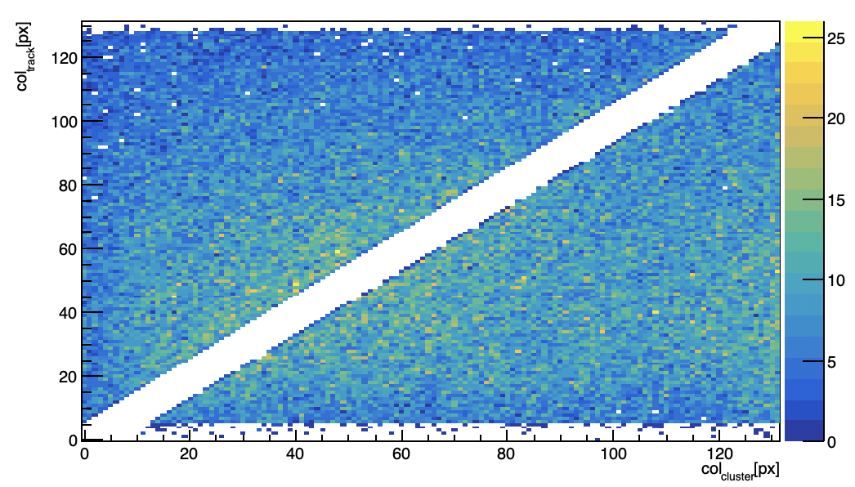
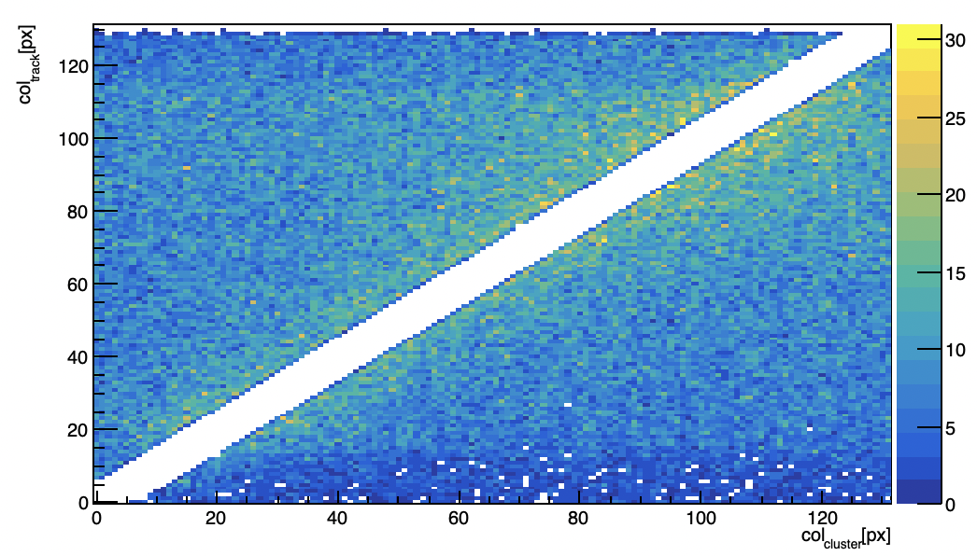
Corrupted column clusters
KIT
Lancs
track column and cluster column correlation
column(cluster) vs column(track)
from past presentation
CMOS Meeting
R.Zanzottera-Testbeam analysis

Slide 6
Runs
data file from the same run for the two telescopes
202204082012_udp_beamonallquad_Vminus90_6Gev_kit_0_decode_cut.dat
202204082012_udp_beamonallquad_vminus90_6GeV_lancs_0_decode_cut.dat
CMOS Meeting
R.Zanzottera-Testbeam analysis

