Slide 1


Testbeam analysis updates
CMOS Meeting
R.Zanzottera-Testbeam analysis

Slide 2
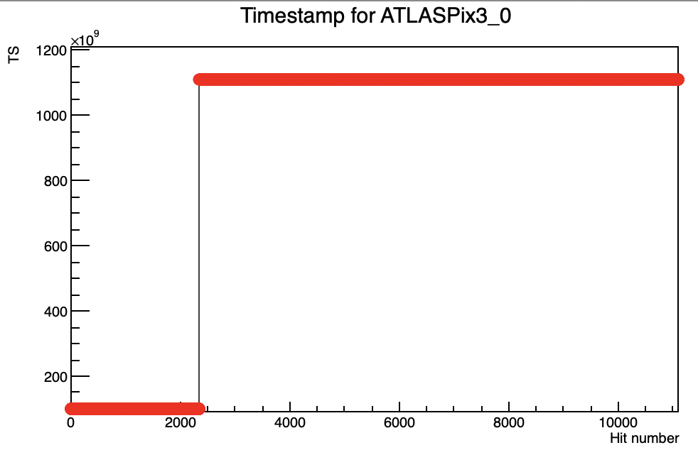
Tracking with Lancs telescope
Why it wasn’t working
202204082012_udp_beamonallquad_vminus90_6GeV_lancs_0_decode_cut.dat (it stucks->a cut is necessary as explained)
same run of 202204082012_udp_beamonallquad_Vminus90_6Gev_kit_0_decode_cut.dat
big timestamp drop 99793556821->8362955771(-91430601050) almost at the beginning
software reads it as TS counter rolling over and adds 2⁴⁰
time difference becomes too big to be stored in a double variable and at a certain point all hits times become the same
probably not a beam issue, in KIT there is a TS jump but it’s smaller and occurs at a different time
removed firsts hits for track reconstruction
example of timestamps progression for one layer as read in the software
CMOS Meeting
R.Zanzottera-Testbeam analysis

Slide 3
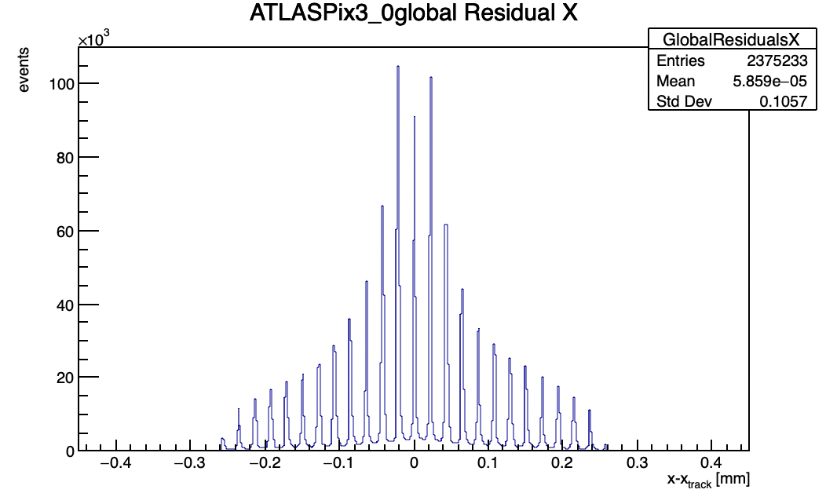
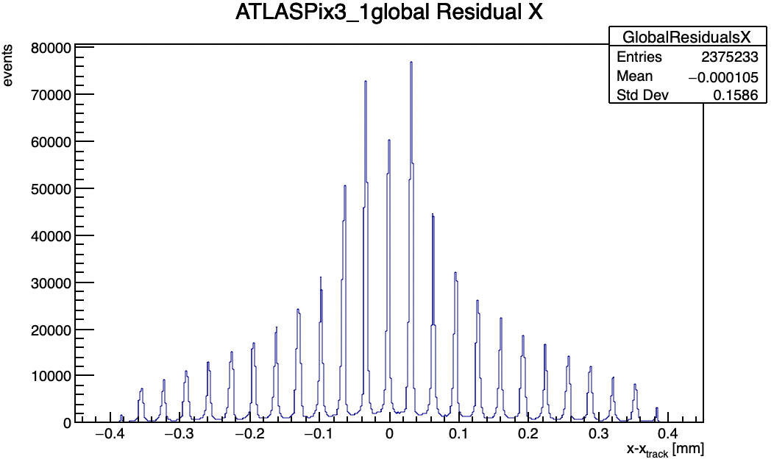
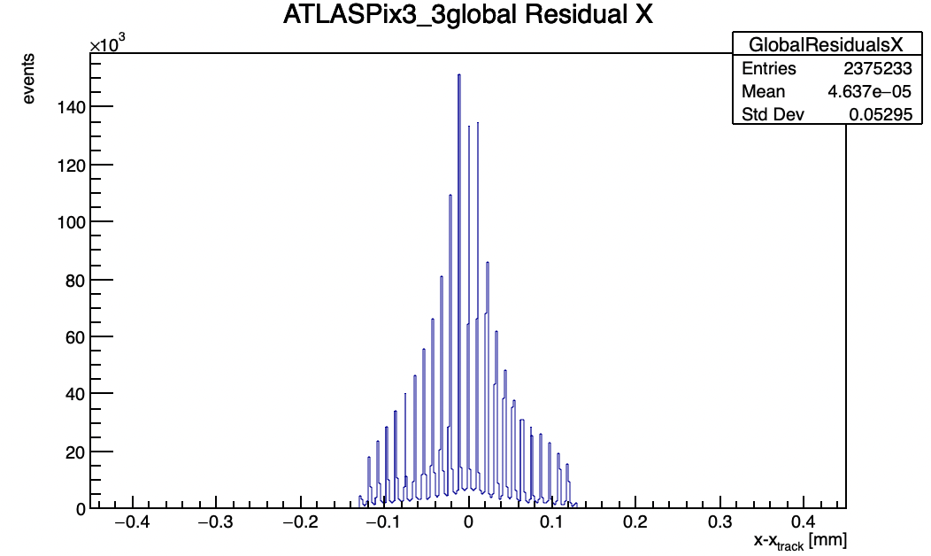
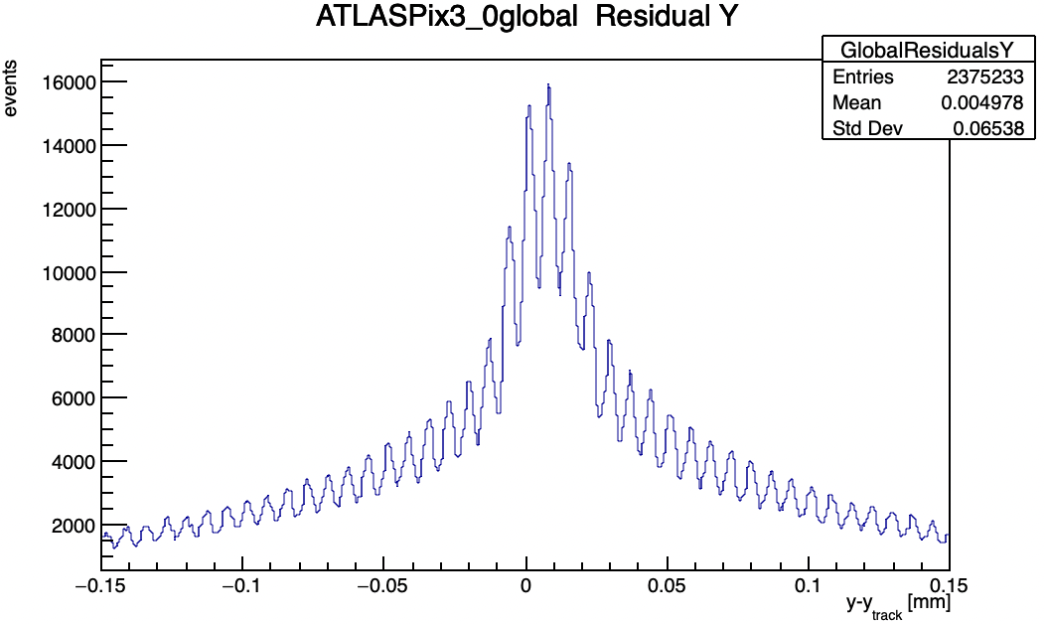
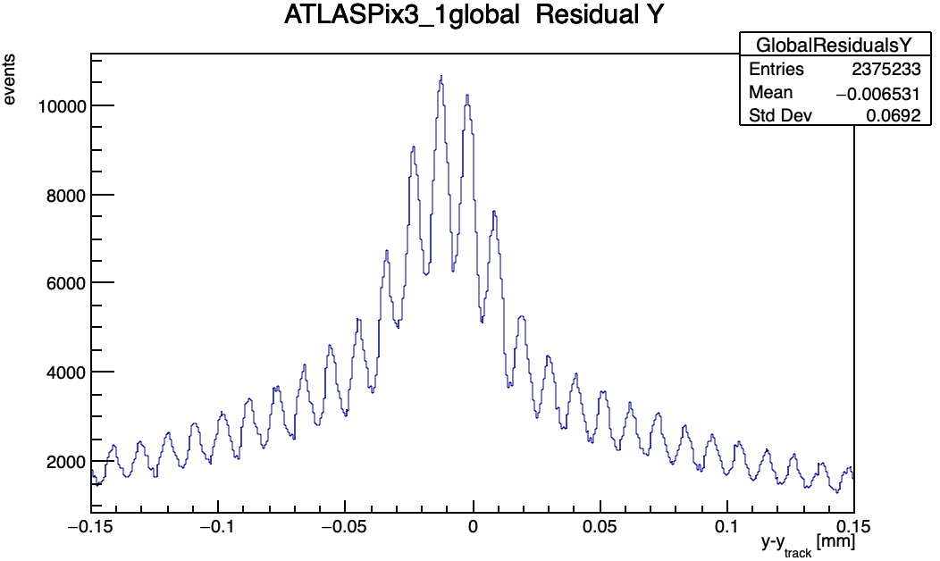
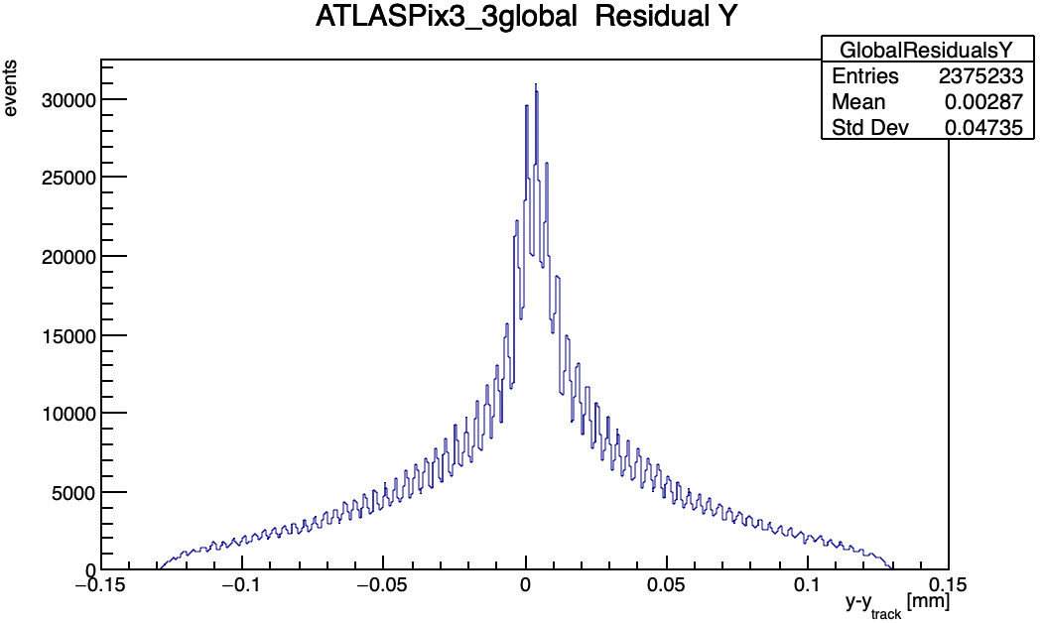
Tracks (1)
CMOS Meeting
R.Zanzottera-Testbeam analysis

Slide 4
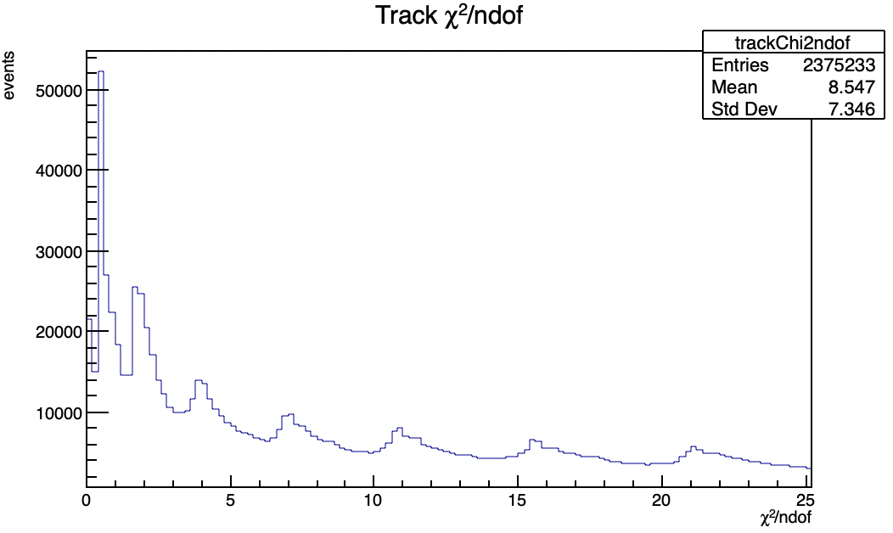
Tracks (2)
CMOS Meeting
R.Zanzottera-Testbeam analysis

Slide 5
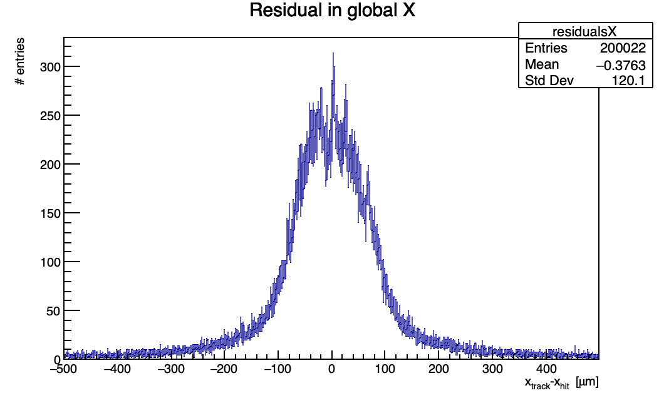
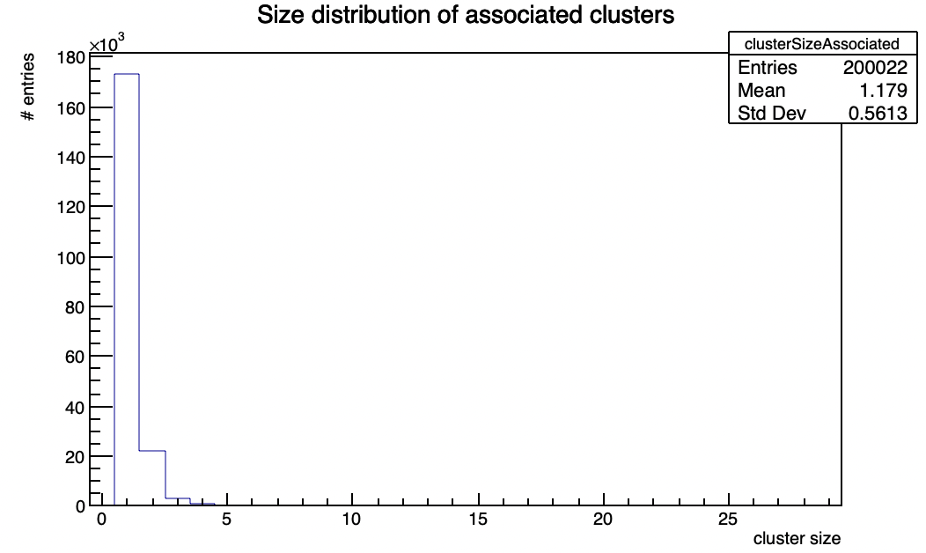
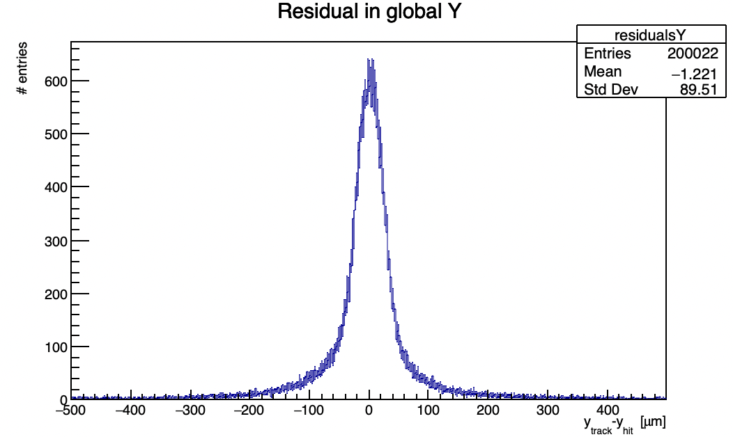
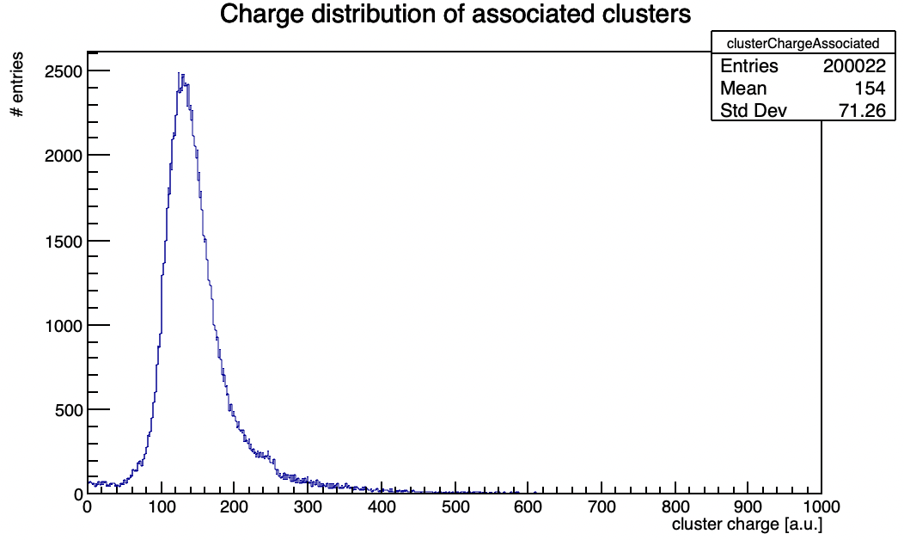
DUT analysis
similar to KIT results
residuals don’t have an evident peaked structure
the efficiency is very low also in this case
about 60% in 1mm association
CMOS Meeting
R.Zanzottera-Testbeam analysis

Slide 6
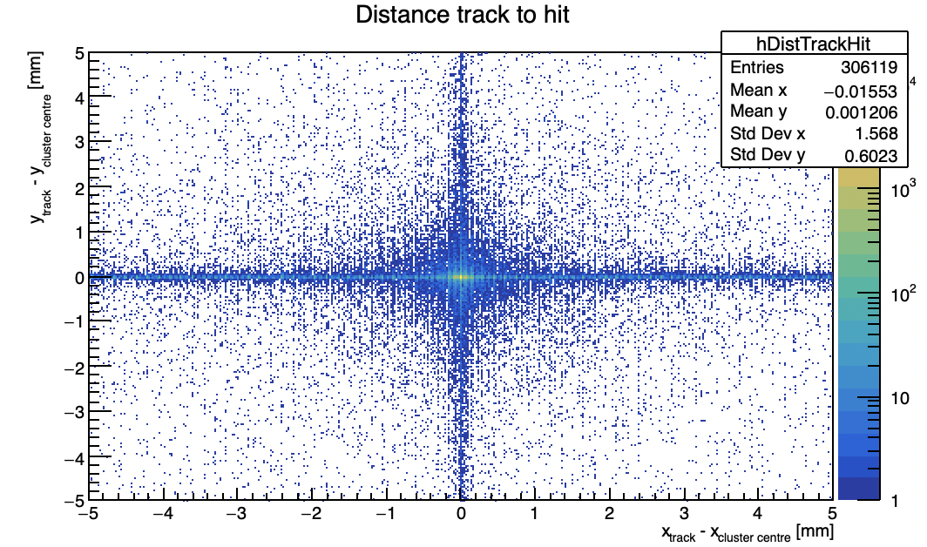
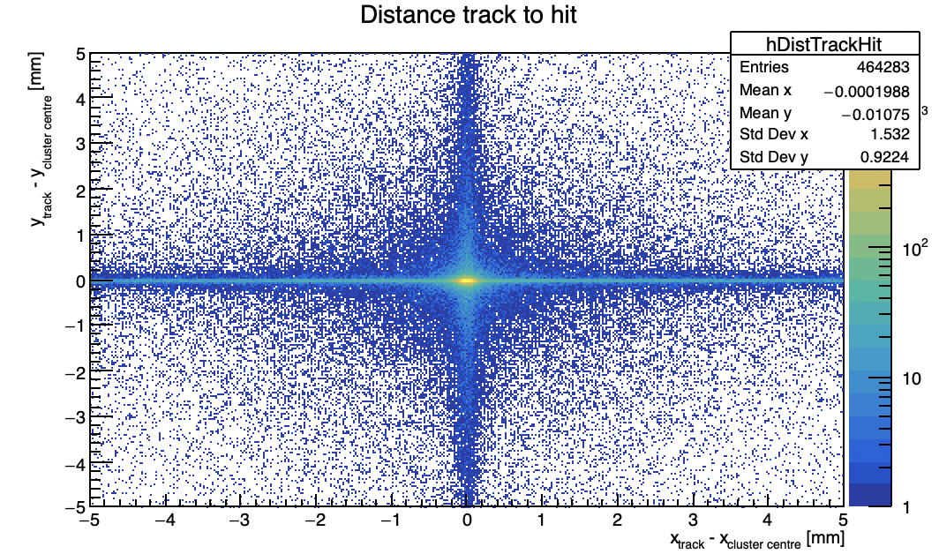
Efficiency (1)
KIT
Lancs
same issue of KIT telescope
many hits with a wrong column address but exact row (mostly single hits in the events)
CMOS Meeting
R.Zanzottera-Testbeam analysis

Slide 7
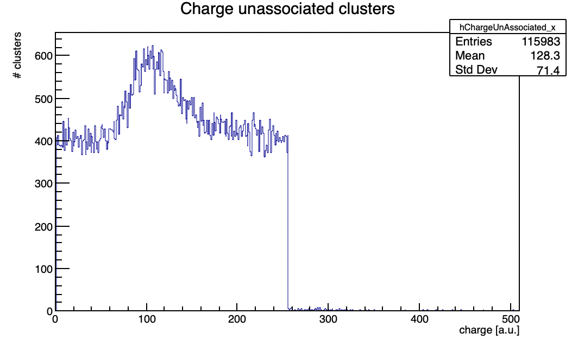
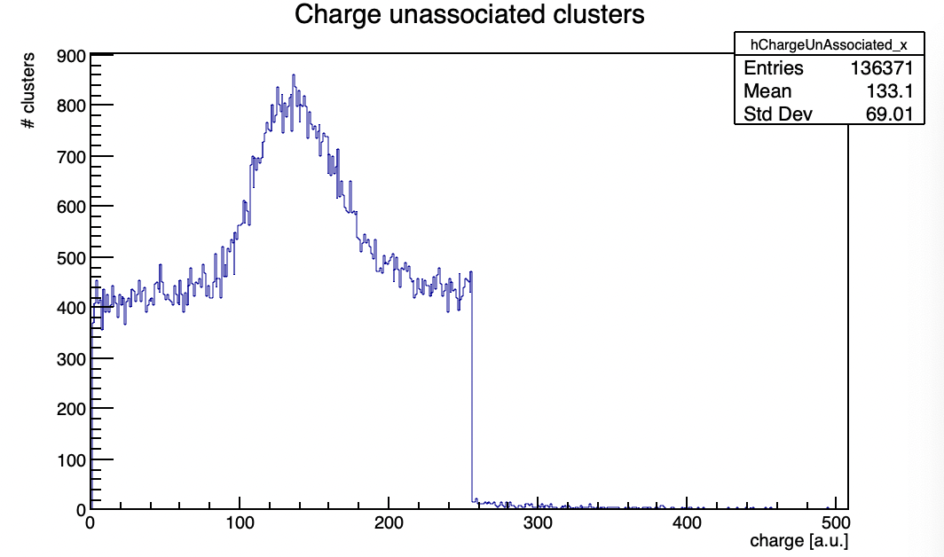
Efficiency (2)
KIT
Lancs
charge distribution of hits with a wrong column address but exact row
same as KIT
CMOS Meeting
R.Zanzottera-Testbeam analysis

Slide 8
Efficiency (3)
estimation of the real efficiency
association with “strips” around the track intercept
include all hits with a wrong column address
efficiency goes up to 97/98% for both KIT and Lancs
hits with wrong column cause the efficiency loss, including them the efficiency is restored
same exact issues for the two telescopes
  problem of the sensor itself ?
  problem of the UDP readout/decoding ?
DUT
track intercept
association range
row
column
CMOS Meeting
R.Zanzottera-Testbeam analysis

