Slide 1


Testbeam updates
CMOS Meeting
R.Zanzottera-Testbeam updates

Slide 2
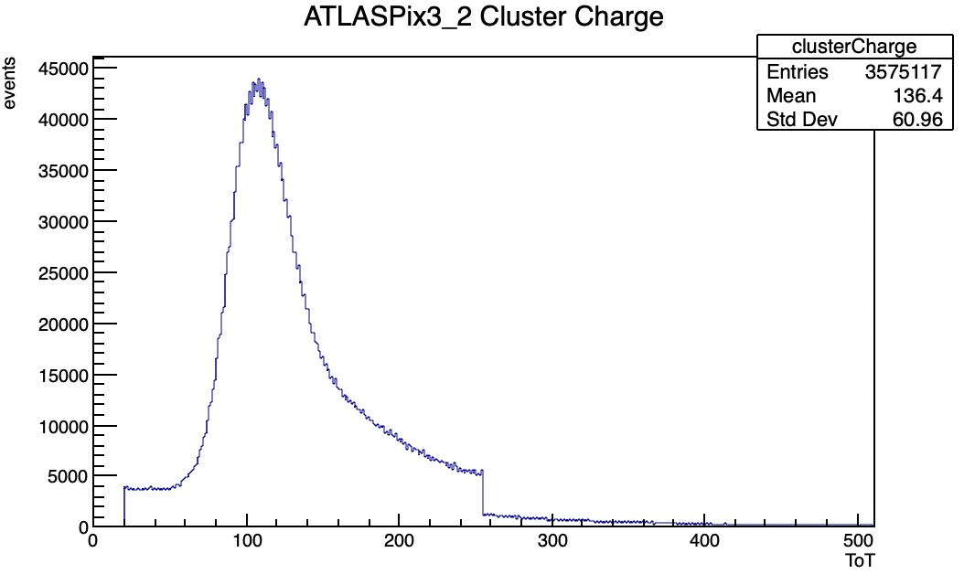
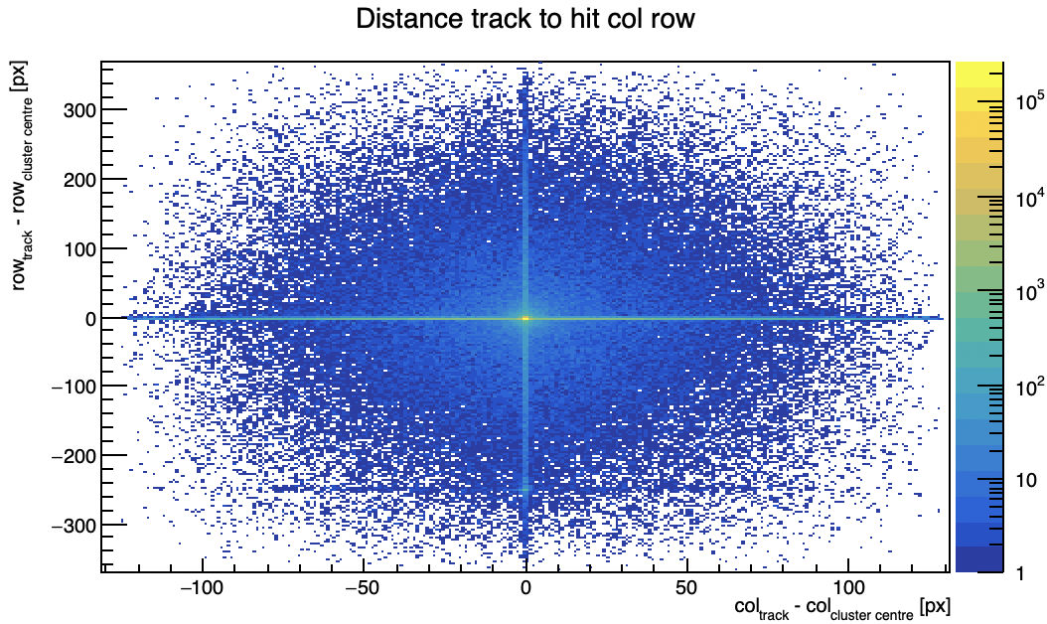
Another UDP bug
still noticed a bug in the UDP readout for 3 GeV runs (despite the correction of the UDP bug I made some month ago https://indico.ihep.ac.cn/event/19081/)
still corrupted ToT and cluster position
lower efficiency
CMOS Meeting
R.Zanzottera-Testbeam updates

Slide 3
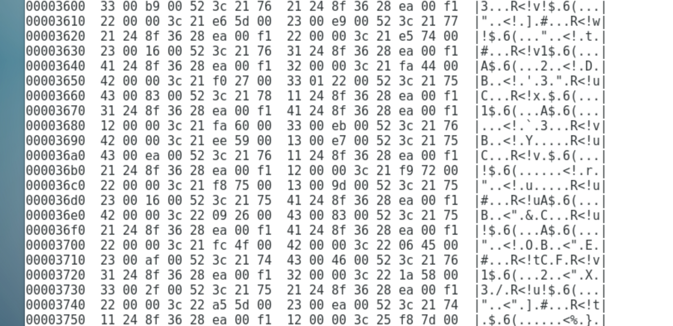
Another UDP bug
bug in the UDP
hitword #2 is missing
decoder fails and also the following hits are corrupted
only solution is to remove these hits since they can’t be recovered
this bug becomes more important with increasing rate, for 6 GeV runs it couldn’t be noticed
modified decoding software (should have updated in git)
CMOS Meeting
R.Zanzottera-Testbeam updates

Slide 4
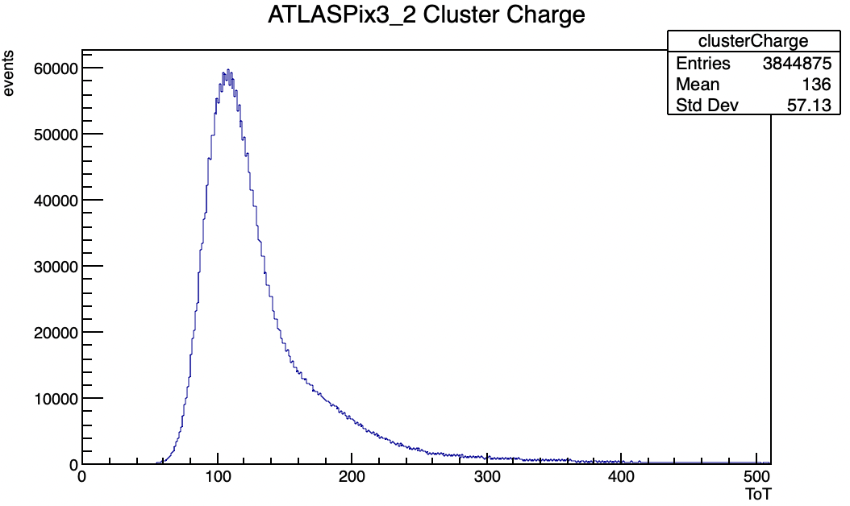
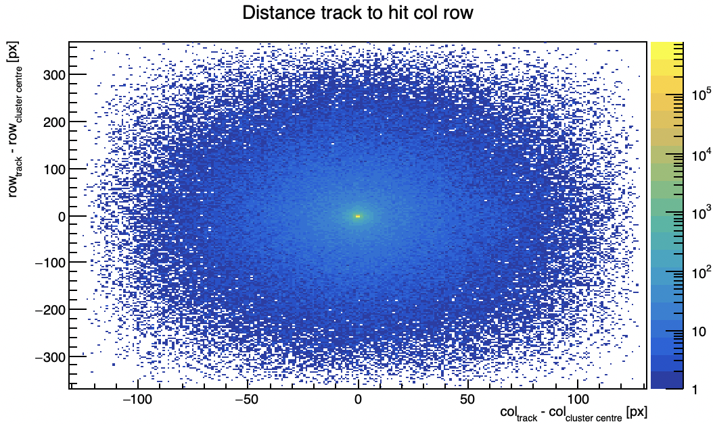
Another UDP bug - solution
correction
correction
CMOS Meeting
R.Zanzottera-Testbeam updates

