Slide 1


Testbeam analysis updates
CMOS Meeting
R.Zanzottera-Testbeam analysis

Slide 2
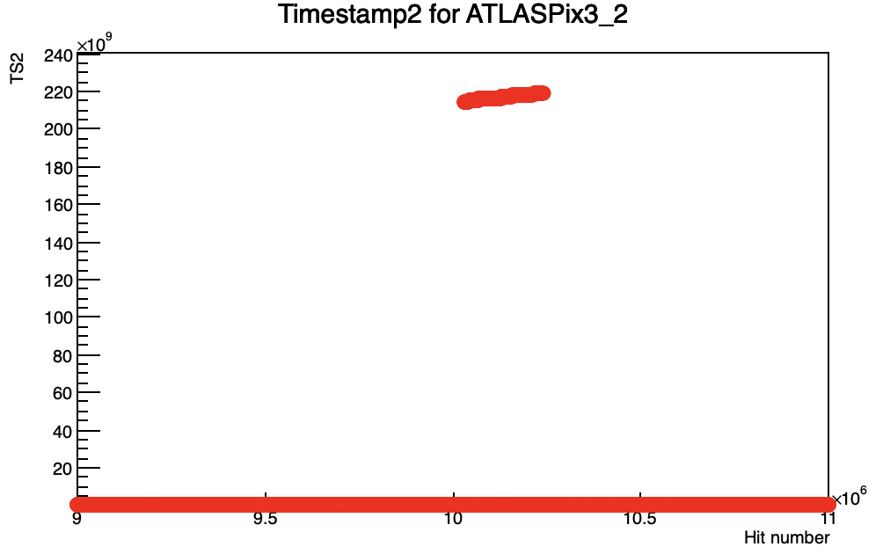
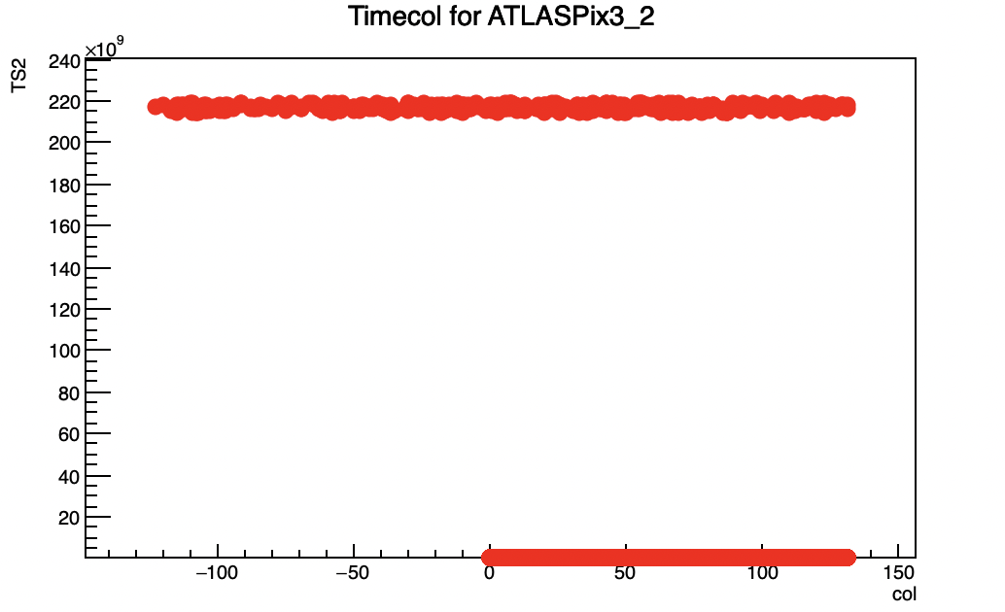
Recap
possible correlation with the ext. TS2
software modified to store the ext. TS2 information in the pixels (from which initially short TS2 is calculated as ext.TS2%128)
spotted jumps in the ext.TS2 for which it has values outside its usual range
possible correlation with corrupted columns? For column with a negative address (whose meaning is explained later) the ext.TS2 is always out of range
CMOS Meeting
R.Zanzottera-Testbeam analysis

Slide 3
FPGA data format
I have studied the data format sent off the FPGA
reconstructed from the decoding code
in white the number of bytes in the line
header of the UDP package (always the same)
PackageID (4 bytes)
HitWord1 = {Layer[4], HitWordID[4], TriggerTS[40], TriggerIndex[16]}
HitWord2 = {Layer[4], HitWordID[4], ext.TS2[40], (131-Column)[8], TriggerIndex[8]} (short TS2 calculated as ext.TS2%128 and negative column because 131-Column is positive but too big)
HitWord3 = {Layer[4], HitWordID[4], Row/FIFOFull[16], ext.TS[40]} (short TS calculated as ext.TS2%1024)
CMOS Meeting
R.Zanzottera-Testbeam analysis

Slide 4
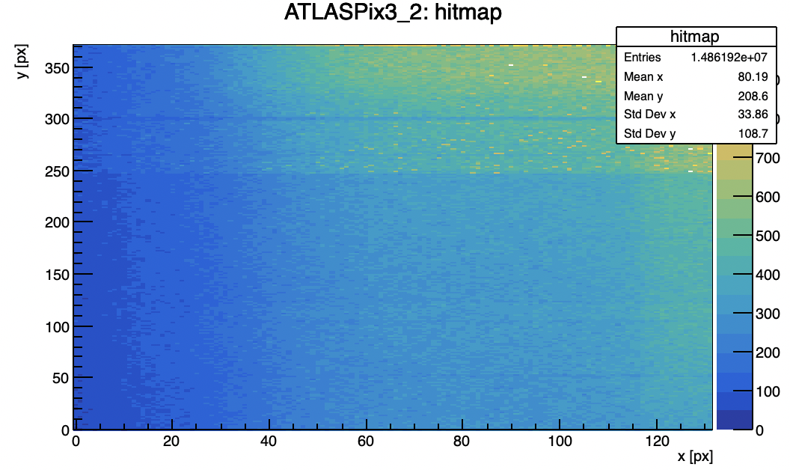

Recap
based on previous observations I have studied a run taken with both UDP and USB and compared results
basically same number of hits
many crosstalk for both, probably because this run was taken before changing telescope settings
for USB no ext.TS or ext.TS2 jumps (remember that all UDP data have been cut for timestamp jumps)
CMOS Meeting
R.Zanzottera-Testbeam analysis

Slide 5
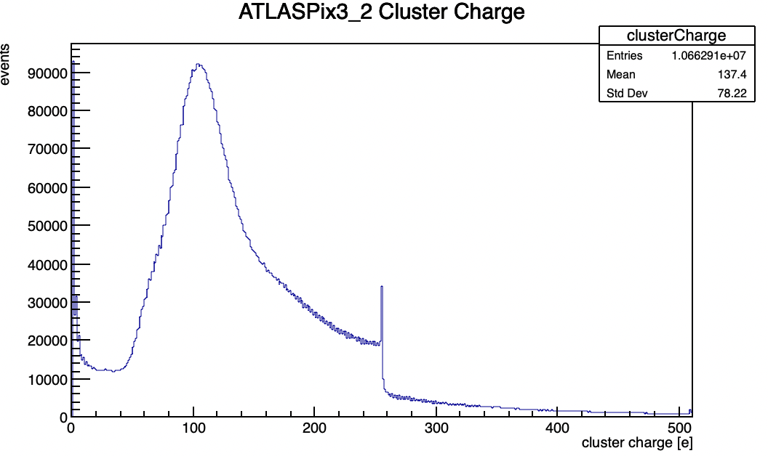
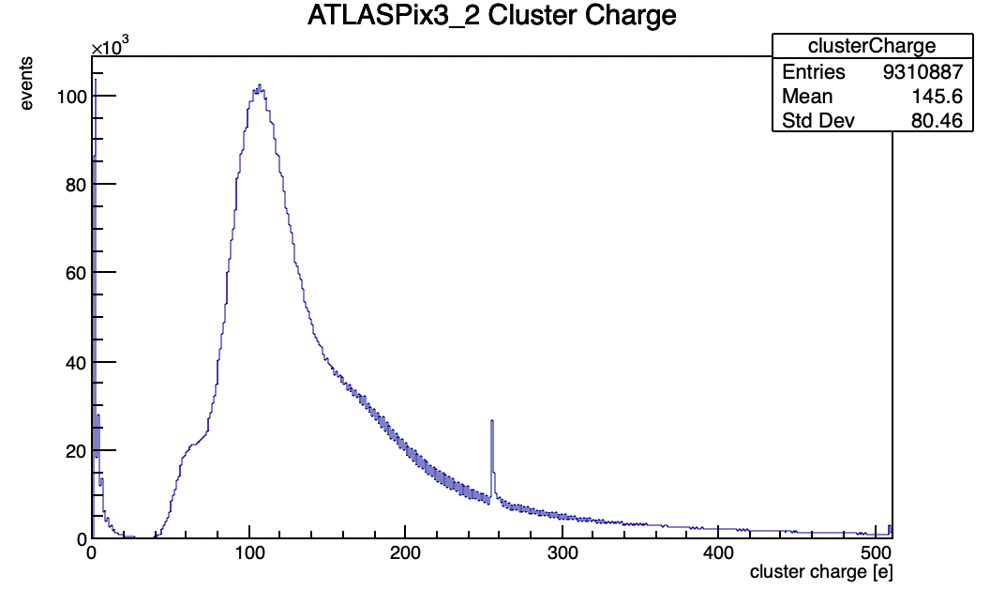
Recap
UDP
USB
similar ToT distribution
better for USB, no uniform basis and no discontinuity
much crosstalk
CMOS Meeting
R.Zanzottera-Testbeam analysis

Slide 6
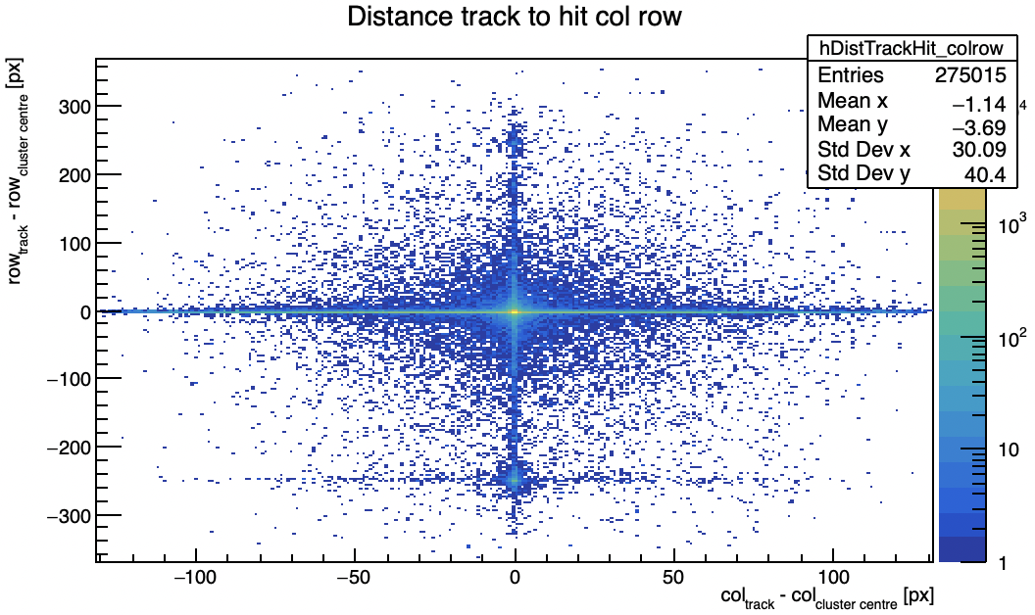
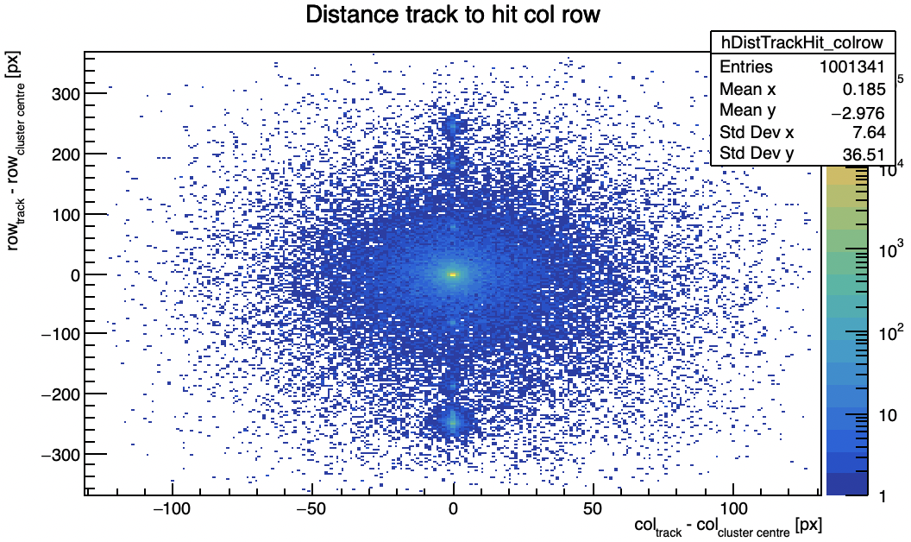
Recap
UDP
USB
distance between tracks and hits
no corrupted columns for USB data
usual pattern for UDP data observed also in other KIT and Lancs runs
wrong row due to crosstalk as already observed
big effect on efficiency (next slides)
CMOS Meeting
R.Zanzottera-Testbeam analysis

Slide 7
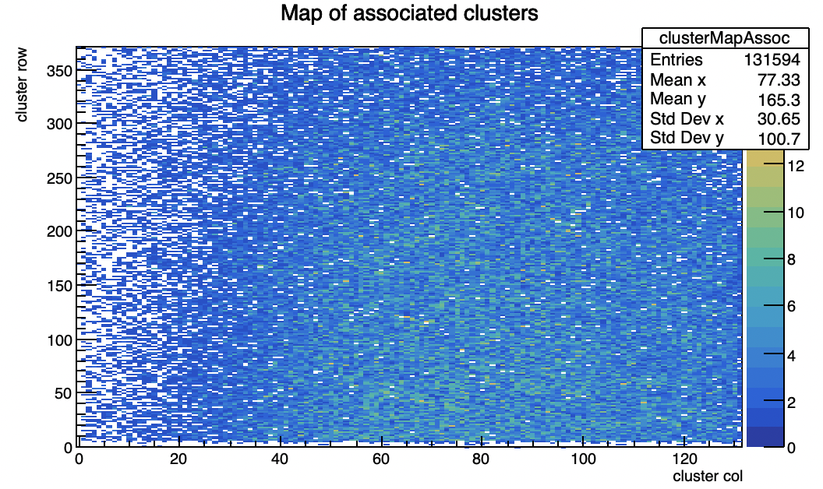
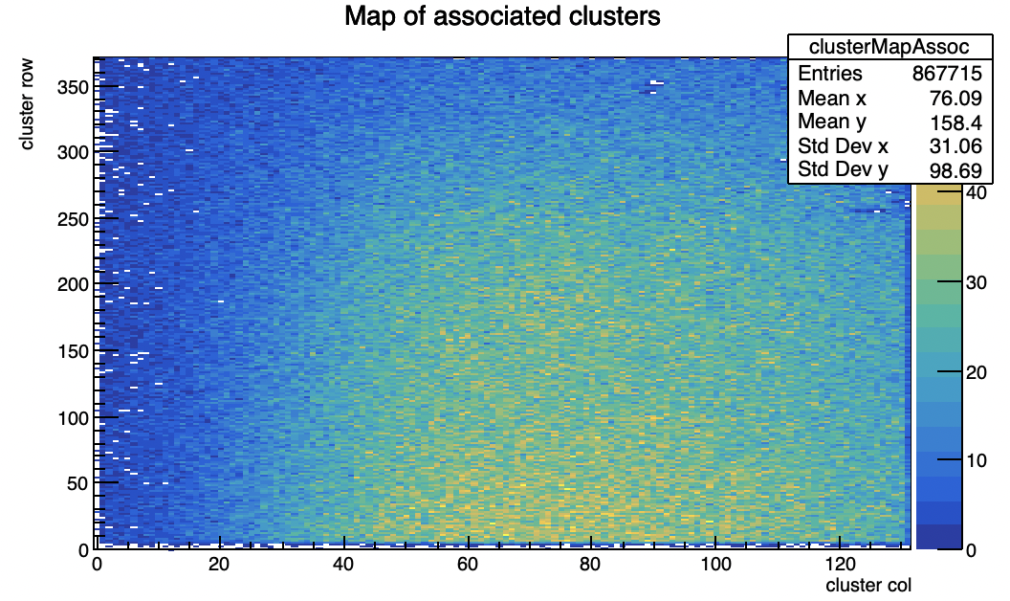
Recap
UDP
USB
same beam spot region
way more associated clusters for USB data
CMOS Meeting
R.Zanzottera-Testbeam analysis

Slide 8
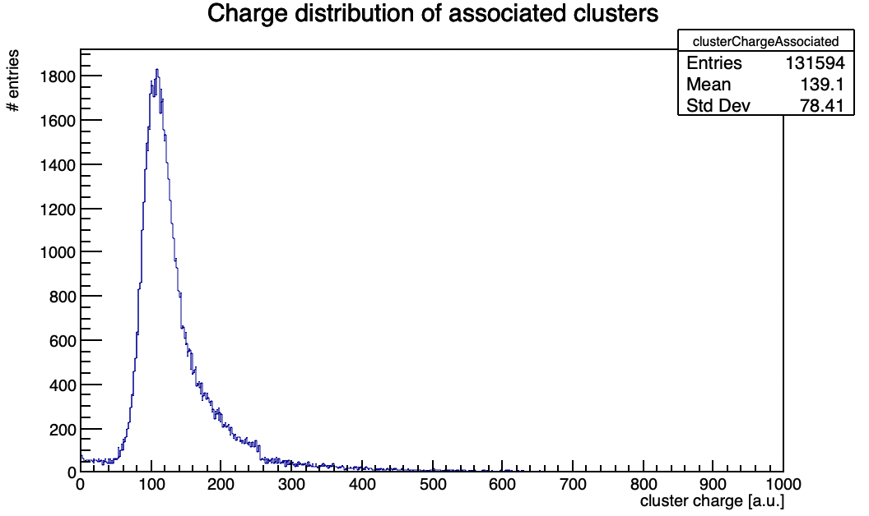
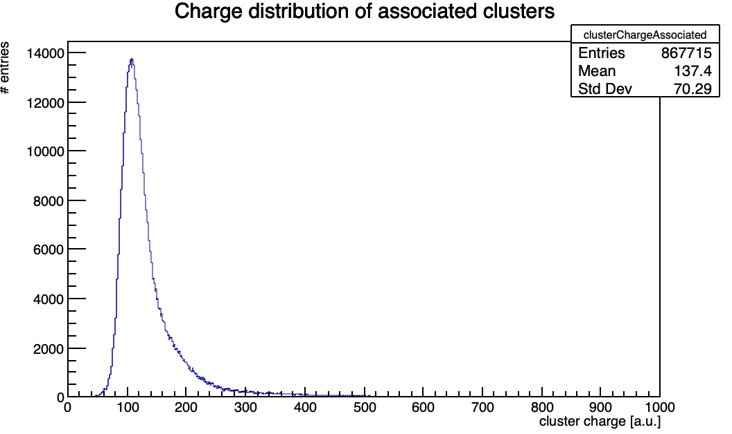
Recap
UDP
USB
similar ToT distribution for associated clusters
better for USB, no discontinuity or small uniform basis
CMOS Meeting
R.Zanzottera-Testbeam analysis

Slide 9
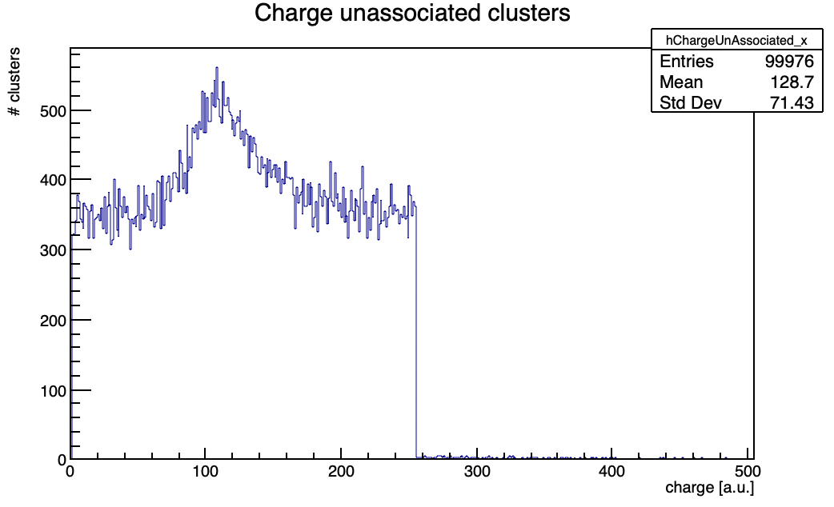
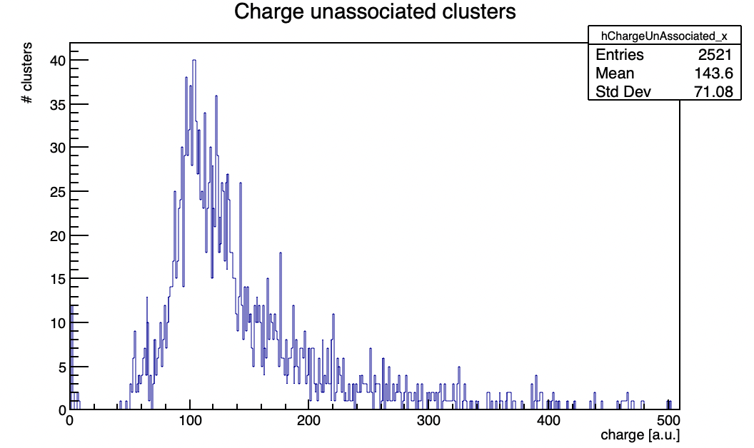
Recap
UDP
USB
unassociated clusters close in row
from UDP have a uniform ToT distribution as for others run
from USB have a Landau distribution
for UDP are due to corruption while for USB are due to some physical effect (see also distance track-hit plot)
CMOS Meeting
R.Zanzottera-Testbeam analysis

Slide 10
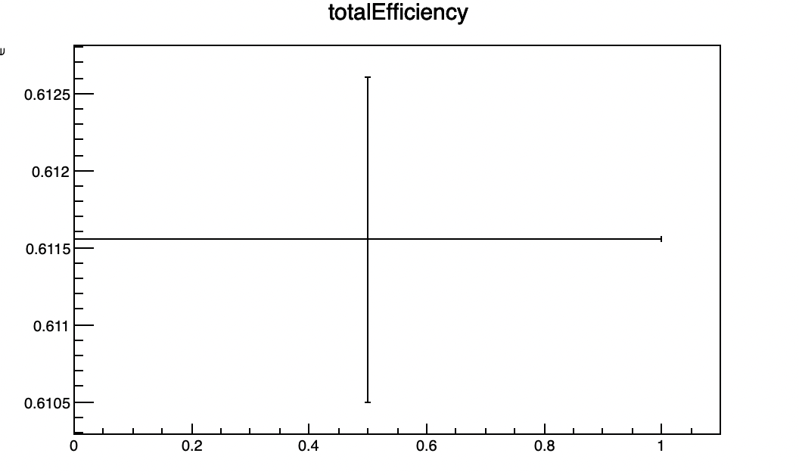
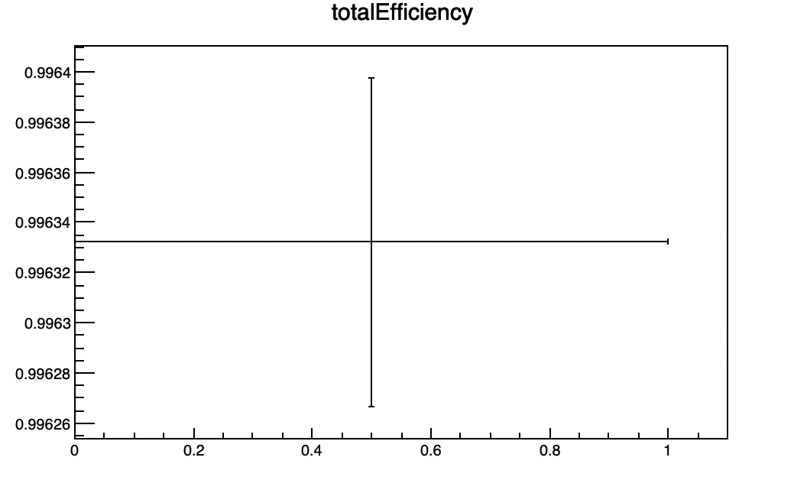
Recap
very different total efficiency
99.6% for USB
61.1% for UDP
CMOS Meeting
R.Zanzottera-Testbeam analysis

Slide 11
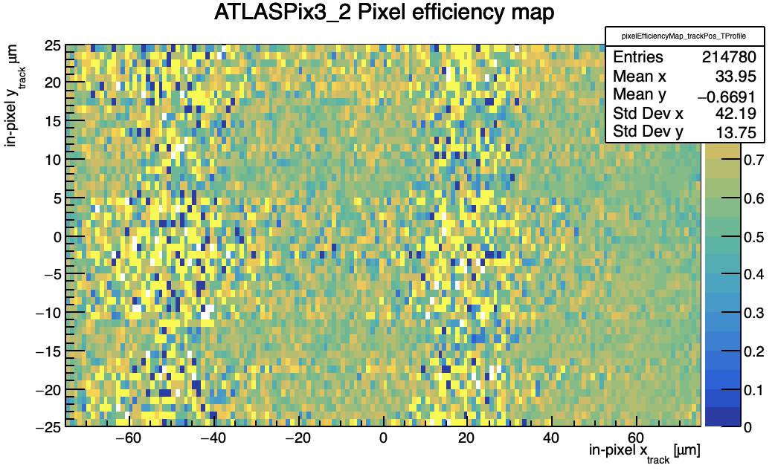
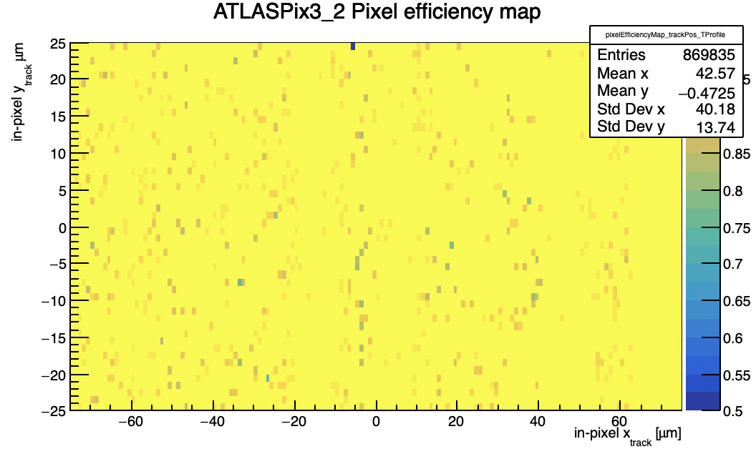
Recap
UDP
USB
very different pixel efficiency
CMOS Meeting
R.Zanzottera-Testbeam analysis

Slide 12
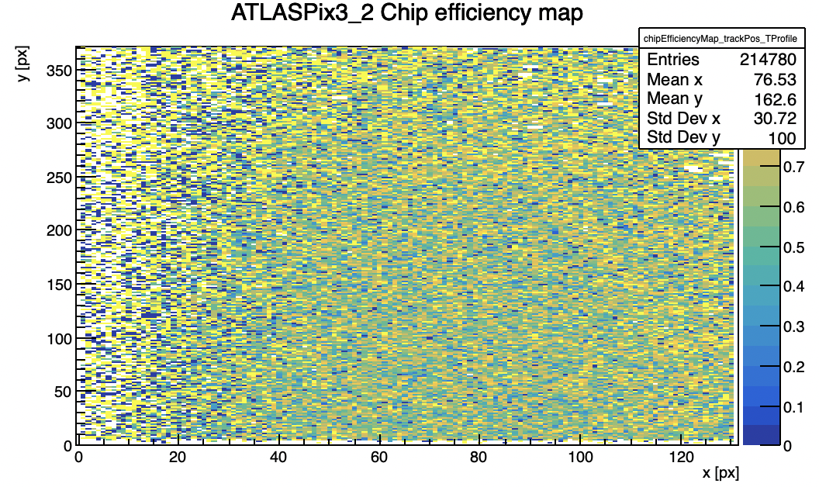
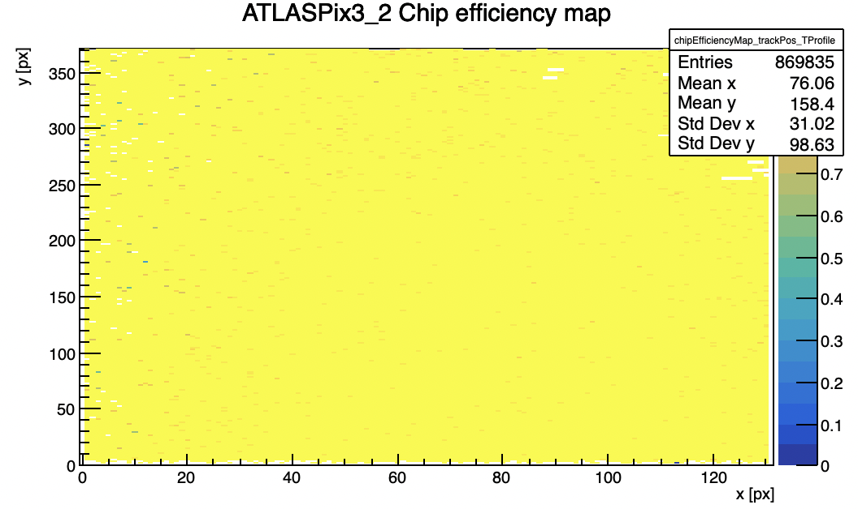
Recap
UDP
USB
very different chip matrix efficiency
CMOS Meeting
R.Zanzottera-Testbeam analysis

Slide 13
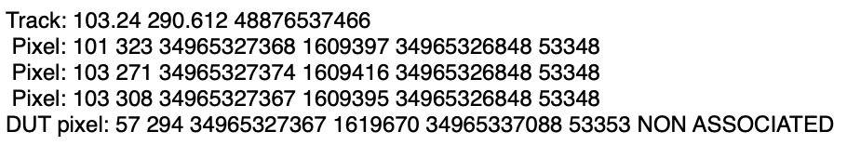
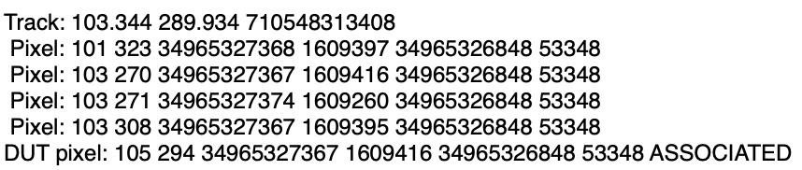
USB and UDP data comparison
compared same tracks reconstructed by the USB and the UDP, for which on the UDP the DUT cluster is not associated due to a corrupted column
not just the column and the ext.TS2 are corrupted but also in this case the trigger index and the trigger timestamp
compared directly in the data file (next slide)
UDP
column
row
ext. TS
ext. TS2
Trigger TS
Trigger Index
USB
CMOS Meeting
R.Zanzottera-Testbeam analysis

Slide 14
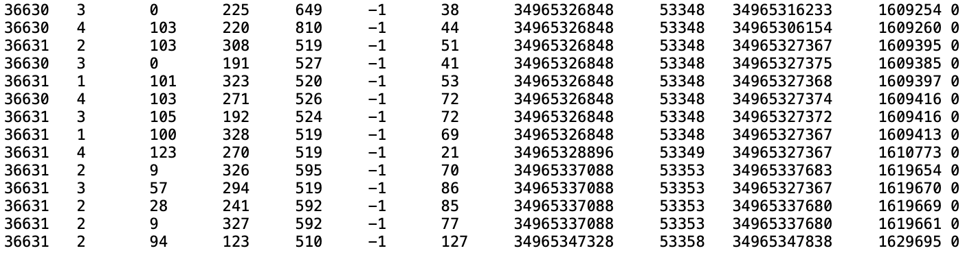
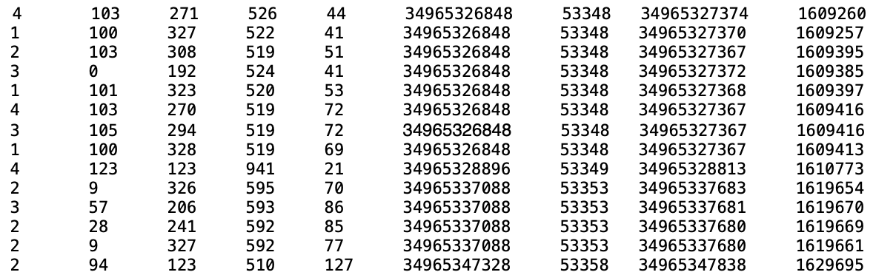
USB and UDP data comparison
example of the track seen before
informations of the hits on the UDP appears to be a mix of the correct hits informations
anyway looking in the binary UDP file these hits looks correct
CMOS Meeting
R.Zanzottera-Testbeam analysis

Slide 15
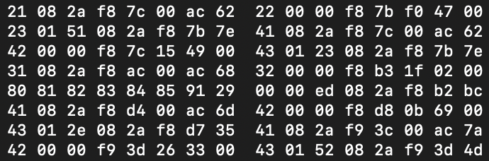
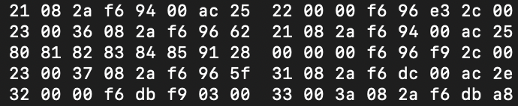
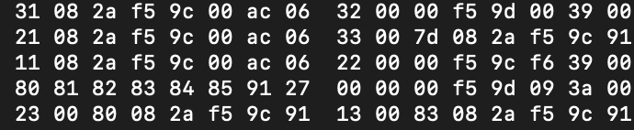
UDP data corruption
when the hitwords of a hit are switched between two different packages the first 8 bits of the hitwords (4-bit layer and 4-bit type of hitword) are corrupted and copy the following 8-bits
the decoding code does not recognize these and starts mixing informations of different hits until the hit is completed
if you look at the last 5 bytes (ext. TS) they are very similar to the other hits third hitword meaning that it is a 33 but with the first 8-bits corrupted
sometimes it can be read as a correct hit but of the wrong type
here a 22 is missing
the other bytes are correct
also a type 1 is sometimes missing
12 is missing
hitword are not ordered but mixed
CMOS Meeting
R.Zanzottera-Testbeam analysis

Slide 16
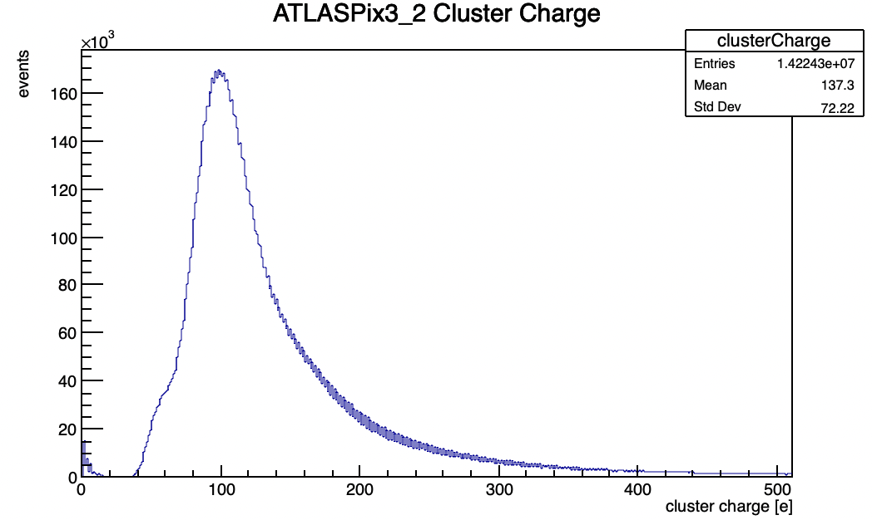
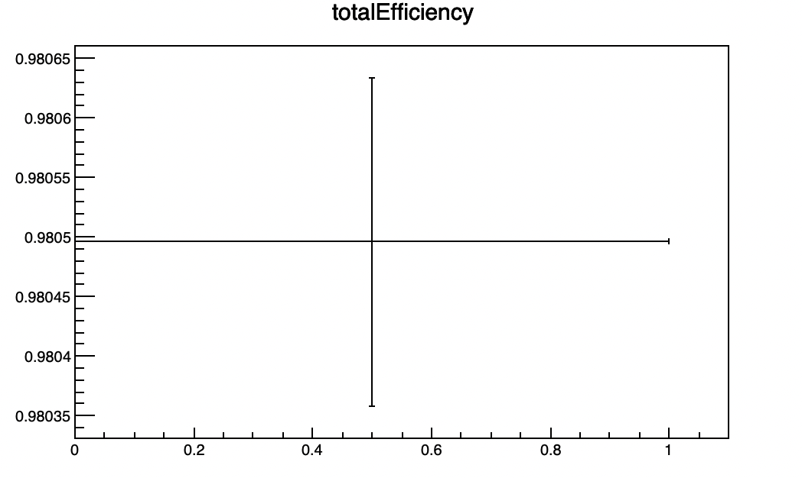
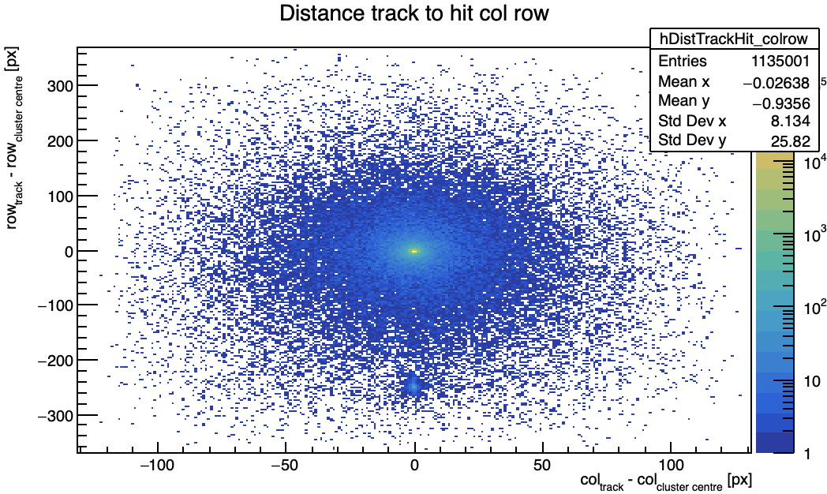
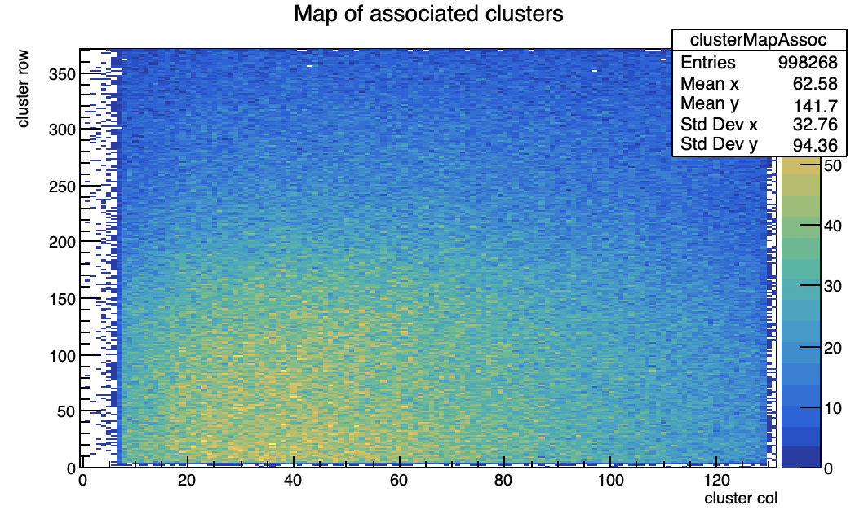
UDP data corruption
my first approach was to modify the decoding code in order to ignore these corrupted hits and reconstruct the others correctly and check what I get
this method lead to the loss of about one hit each 47 hits
all the following plots are for the usual kit run: 202204082012_udp_beamonallquad_Vminus90_6Gev_kit_0.dat
correct ToT Landau distribution, 2.2 million of tracks and 98% efficiency
CMOS Meeting
R.Zanzottera-Testbeam analysis

Slide 17
UDP data recovery
after checking results with the first approach I have implemented the most generic possible algorithm which consent to recover these hits during the decoding independently from the specific problem
End of the package for each layer I have:
1 2 3 4
1 1,2 empty(completed) empty(completed)
If in the next package I encounter one of these hitwords before the beginning of an another hit it is substituted, otherwise it completes the hit with the correct information (since in the corrupted words the first byte is a copy of the second one it can happen that it is 11,12,13 ecc., this is checked and the first byte substituted with 00)
Beginning of the next package I encounter a corrupted hitword beginning with 00 and so I create all the possible hitwords with its informations
12 00 f5 9d 3a 00
23 00 f5 9d 3a 00
31 00 f5 9d 3a 00
41 00 f5 9d 3a 00
00 00 f5 9d 3a 00
CMOS Meeting
R.Zanzottera-Testbeam analysis

Slide 18
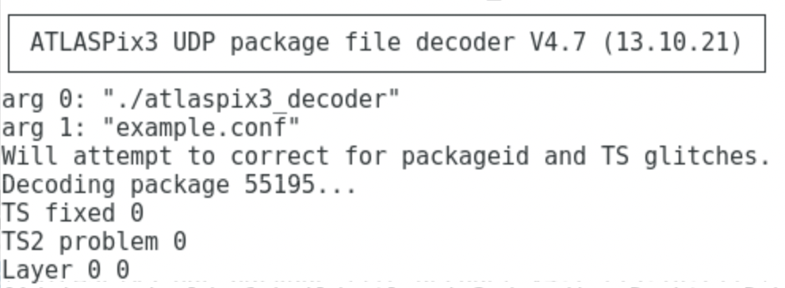
UDP KIT data analysis
new decoding code applied to 202204082012_udp_beamonallquad_Vminus90_6Gev_kit_0.dat
first thing: no more TS or TS2 jumps, negative columns or layer 0
CMOS Meeting
R.Zanzottera-Testbeam analysis

Slide 19
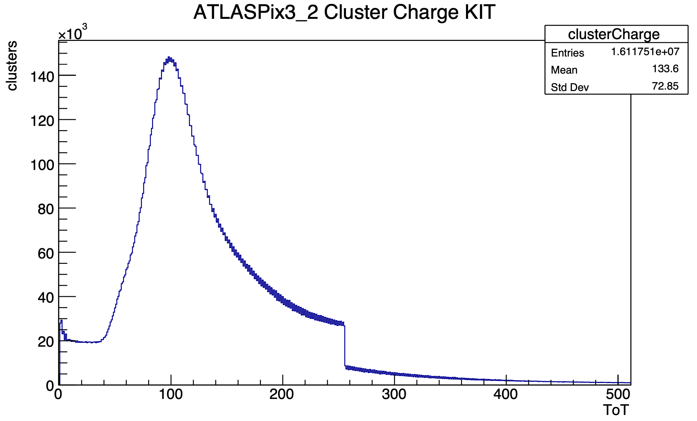
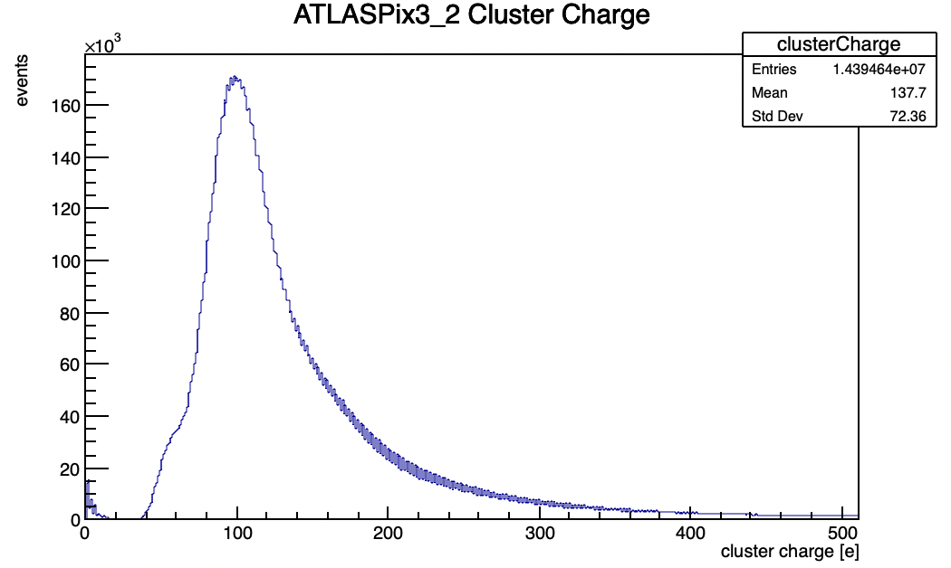
UDP KIT data analysis
BEFORE
NOW
no more uniform basis or shoulder
right Landau distribution
CMOS Meeting
R.Zanzottera-Testbeam analysis

Slide 20
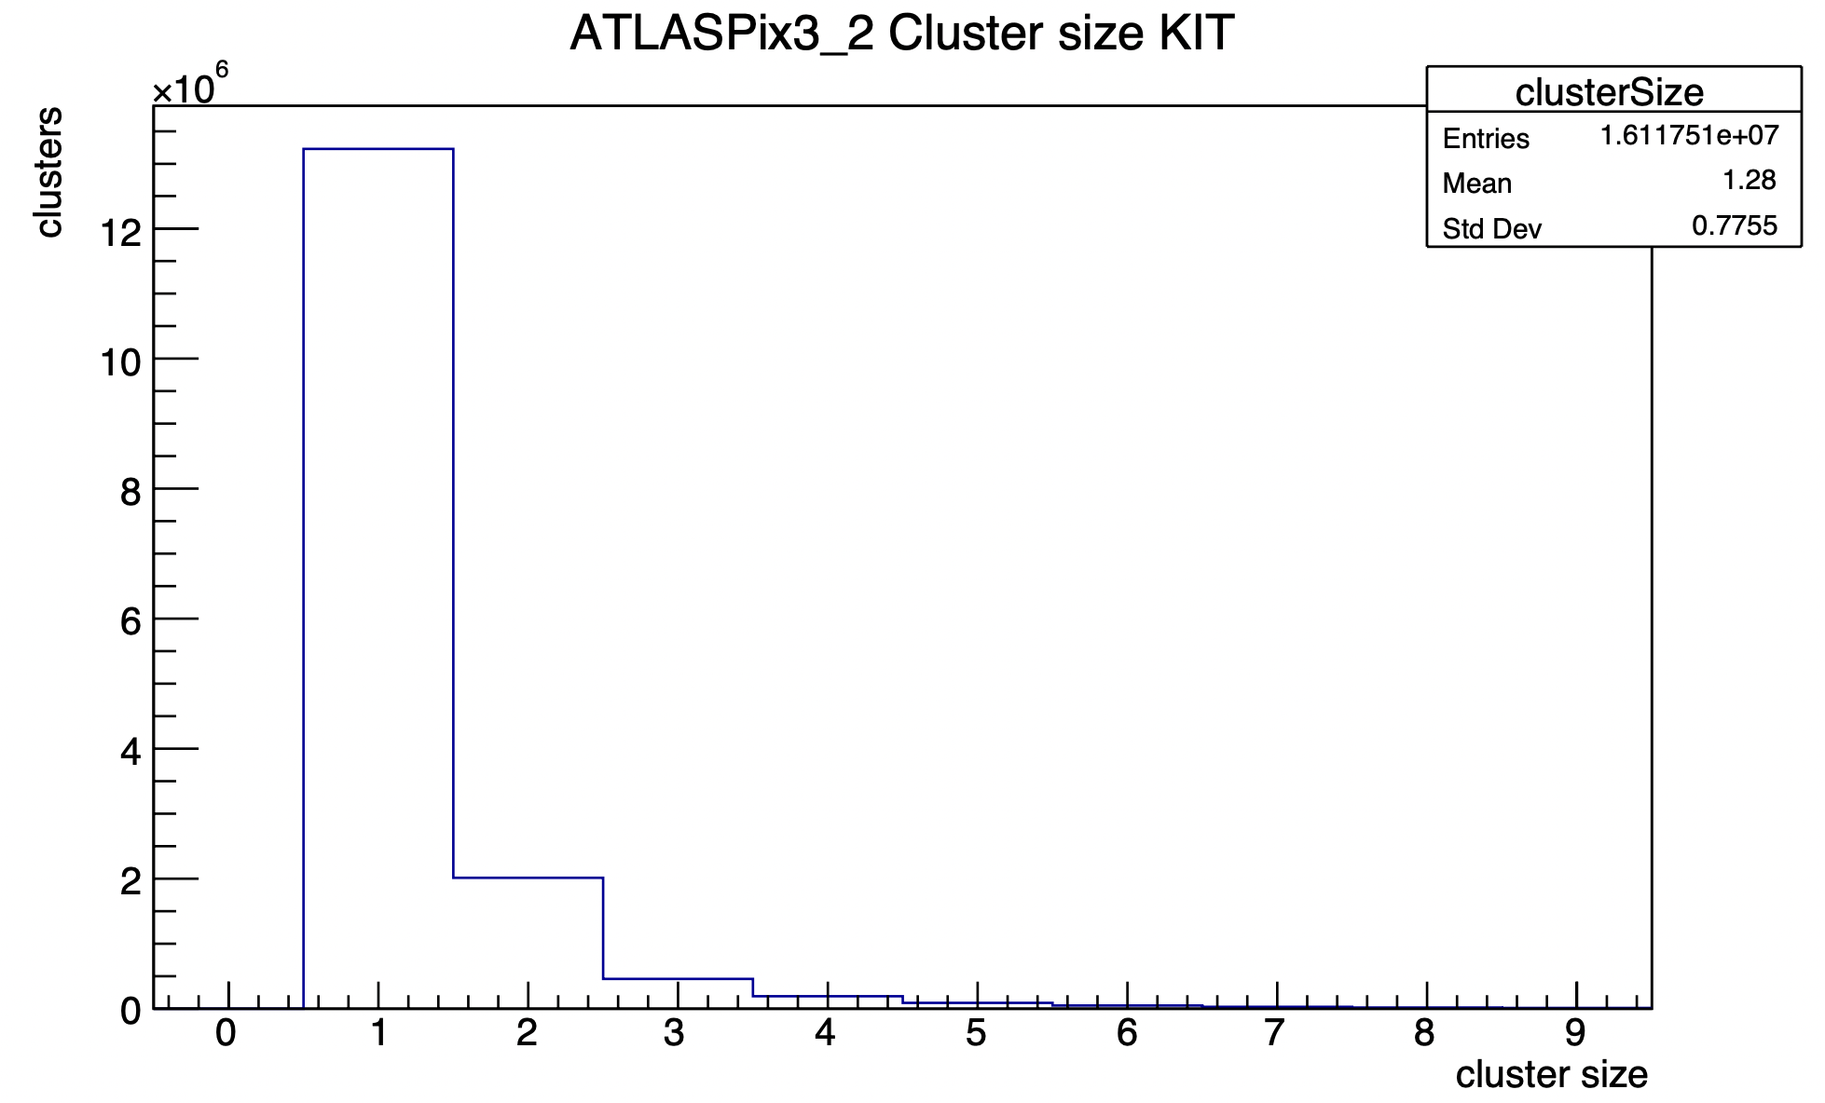
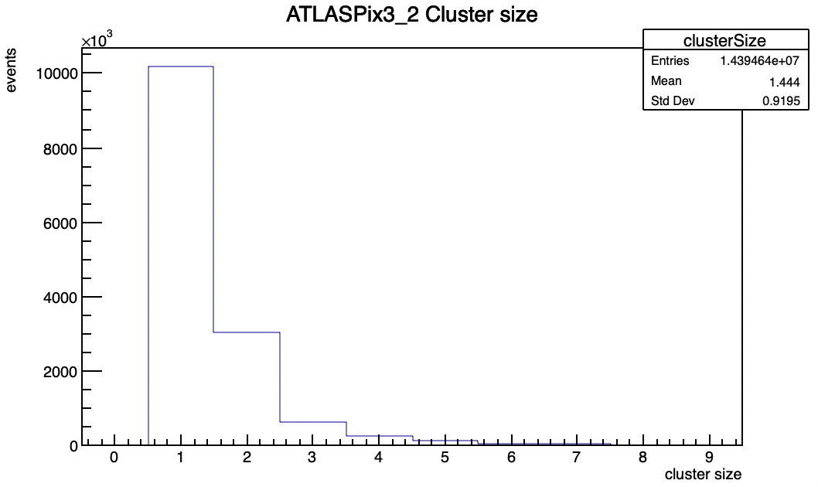
UDP KIT data analysis
BEFORE
NOW
more clusters of size >1
before it could happen that they were split due to a corrupted address of one of the hits
CMOS Meeting
R.Zanzottera-Testbeam analysis

Slide 21
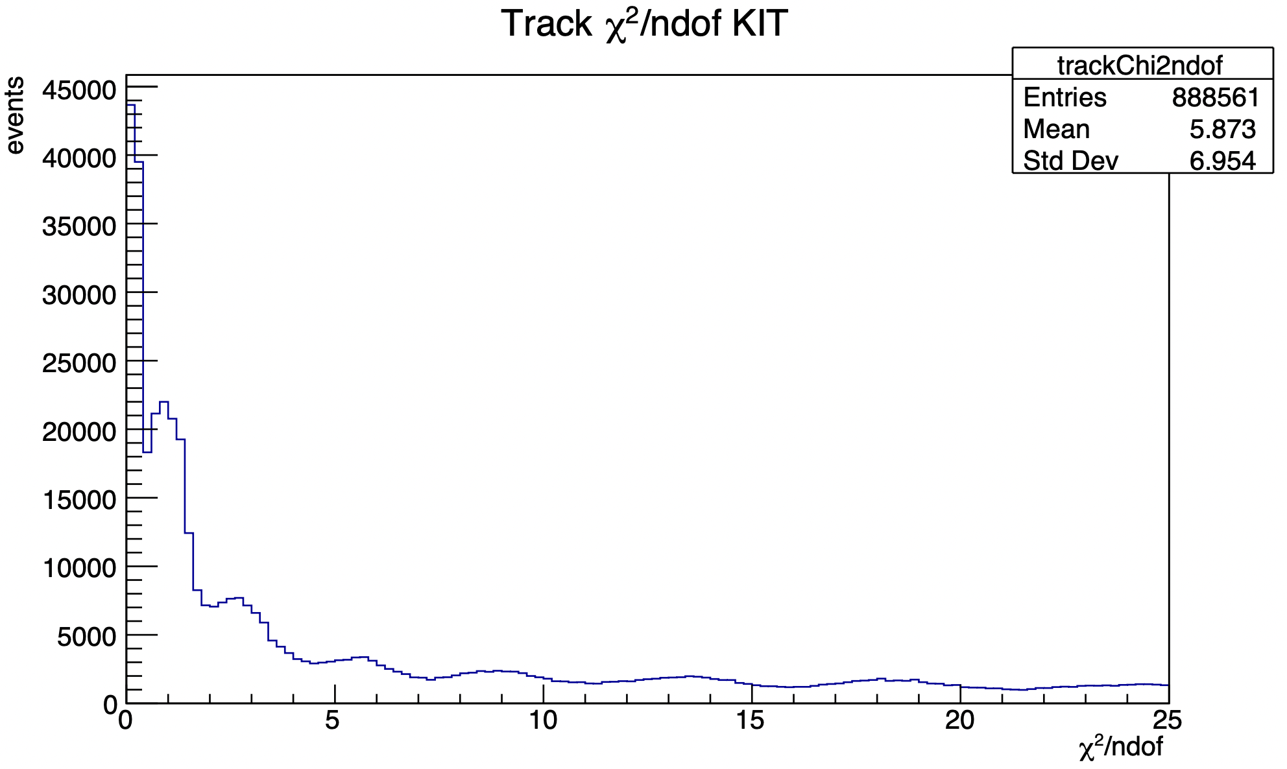
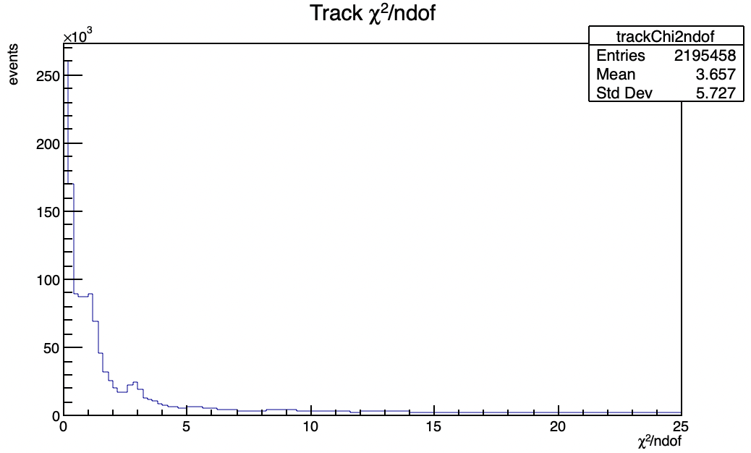
UDP KIT data analysis
BEFORE
NOW
just to underline the number of tracks
they have also a better quality
CMOS Meeting
R.Zanzottera-Testbeam analysis

Slide 22

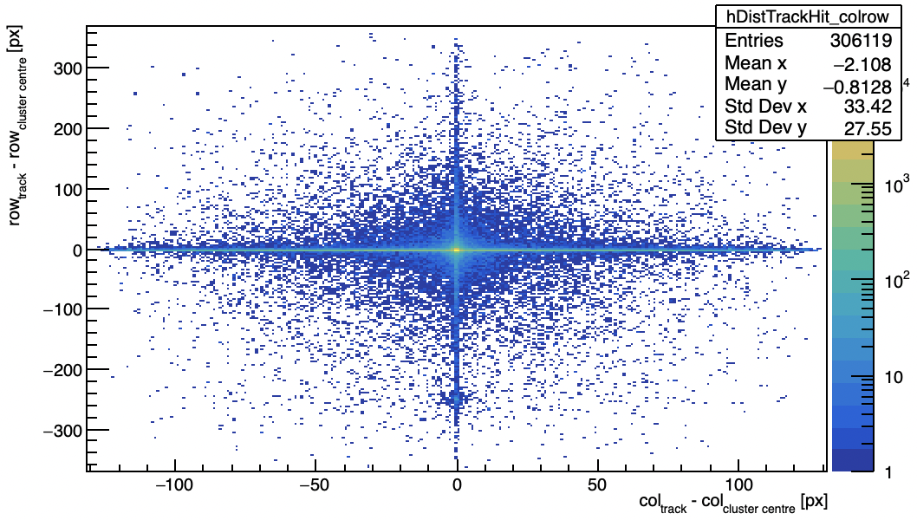
UDP KIT data analysis
BEFORE
NOW
no more corrupted column or rows
CMOS Meeting
R.Zanzottera-Testbeam analysis

Slide 23
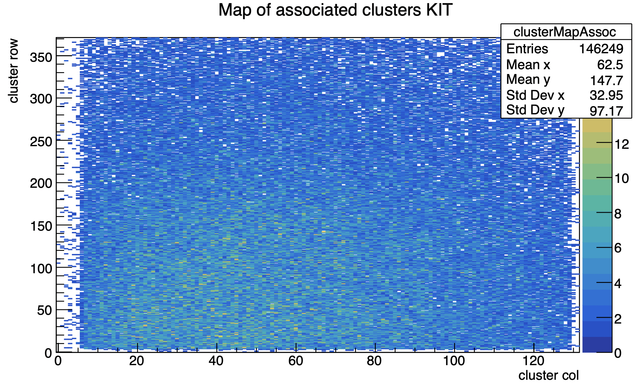
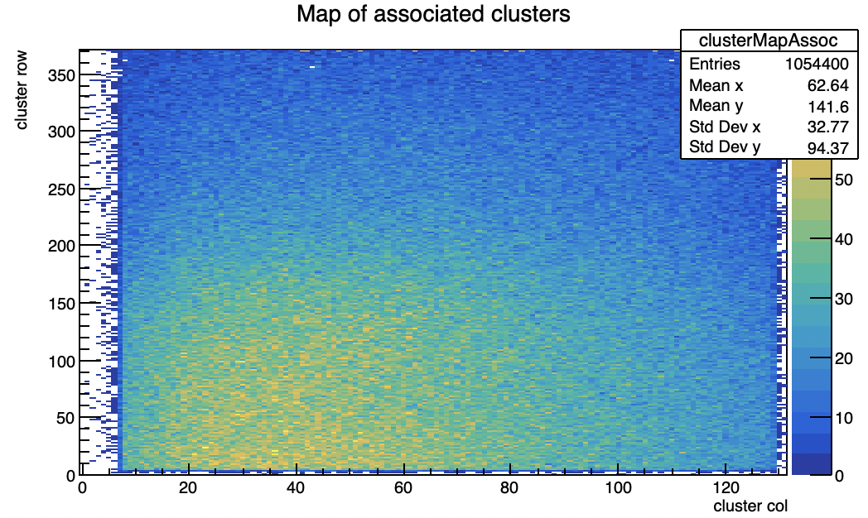
UDP KIT data analysis
BEFORE
NOW
many more associated clusters
beam spot now is clearly visible
CMOS Meeting
R.Zanzottera-Testbeam analysis

Slide 24
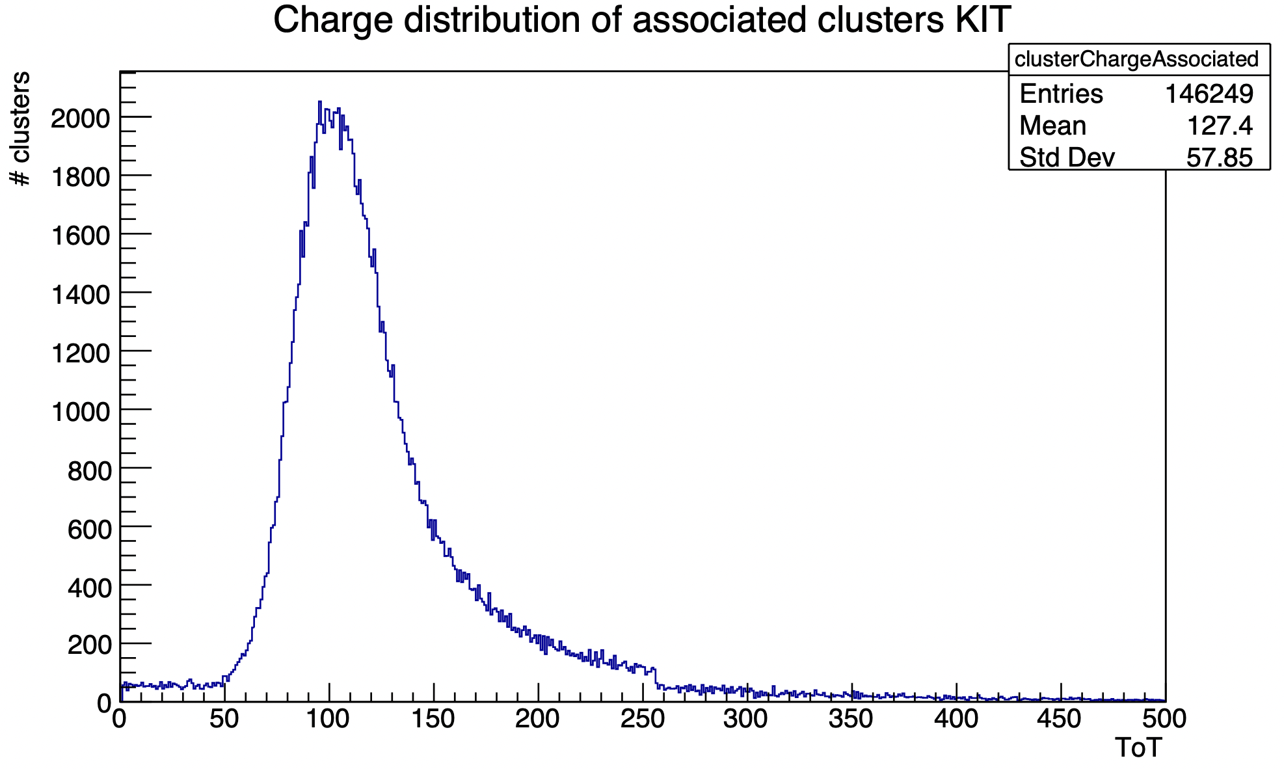
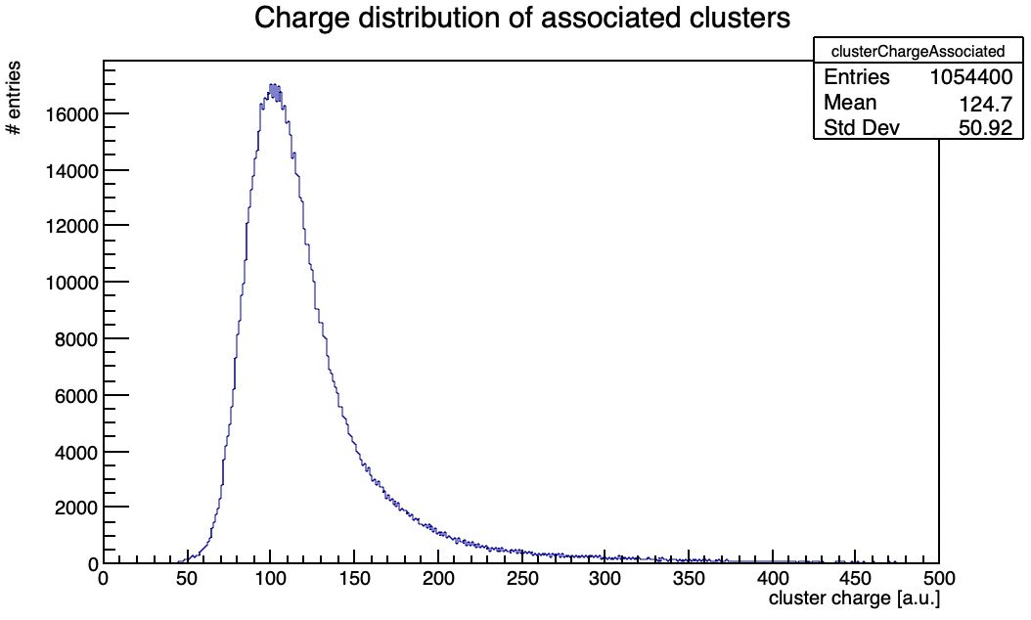
UDP KIT data analysis
BEFORE
NOW
no more uniform basis or shoulder
CMOS Meeting
R.Zanzottera-Testbeam analysis

Slide 25
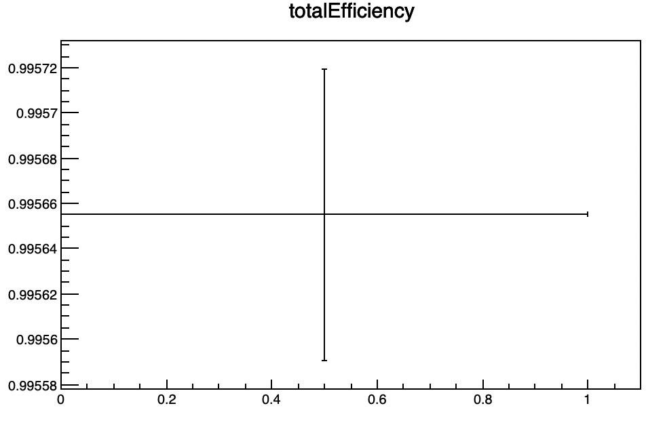
UDP KIT data analysis
total efficiency is now 99.5%
before it was 60% in the same association range
CMOS Meeting
R.Zanzottera-Testbeam analysis

Slide 26
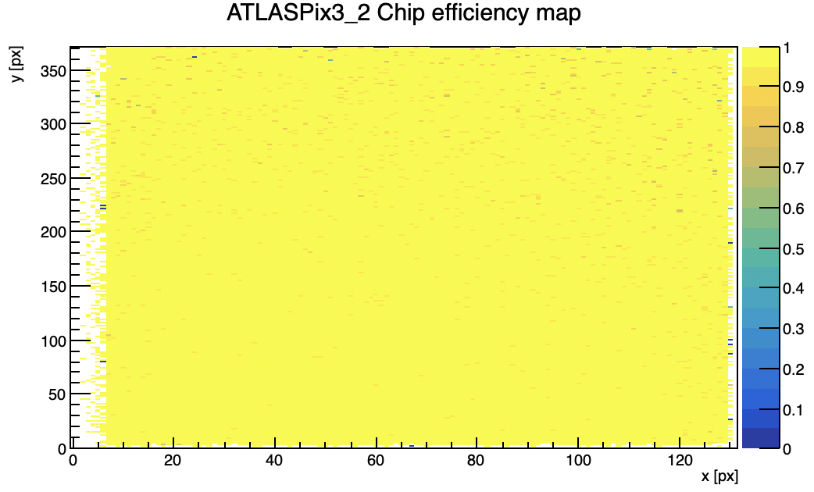
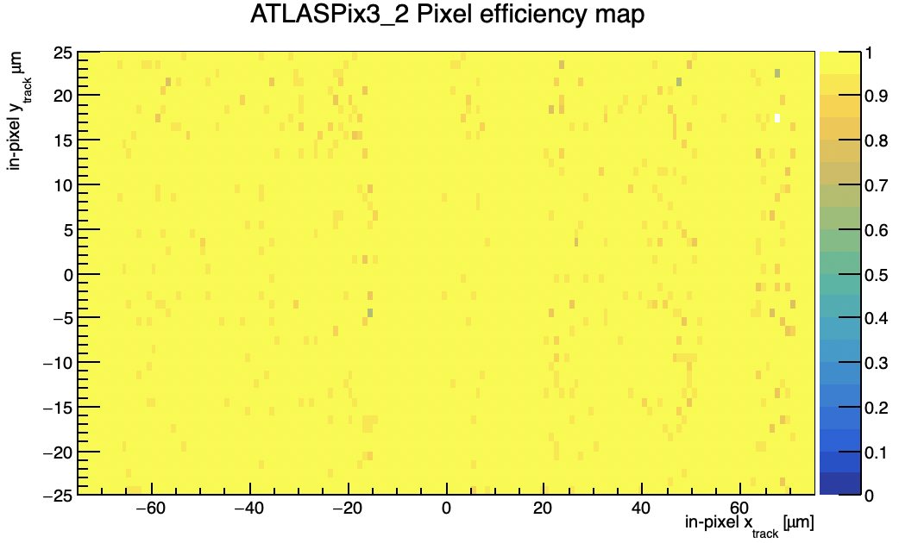
UDP KIT data analysis
chip in-pixel efficiency maps now
CMOS Meeting
R.Zanzottera-Testbeam analysis

Slide 27
Some note
NOTE: sometimes it could happen that a hitword is completely missing and this causes the algorithm for the recovery of the hits to fail and to reconstruct wrong hits, anyway it is a very rare problem, for example in the KIT data file happens only 8 times
NOTE: the part of the data alignment in the decoding has been removed because it cannot deal with corrupted hitwords, this could cause some bad reconstructed hit in case of unaligned data in some package, anyway I tried the new decoding code for both the KIT and Lancs telescopes long runs and this does not happen
CMOS Meeting
R.Zanzottera-Testbeam analysis

Slide 28
#PackageID; Layer; Column; Row; TS; TS1; TS2; TriggerTS; TriggerID; ext.TS; ext.TS2; FIFO overflow;
36597 1 66 108 453 -1 21 32940864512 47881 32940865989 7191061 0

