Slide 1


Testbeam analysis updates
CMOS Meeting
R.Zanzottera-Testbeam analysis

Slide 2
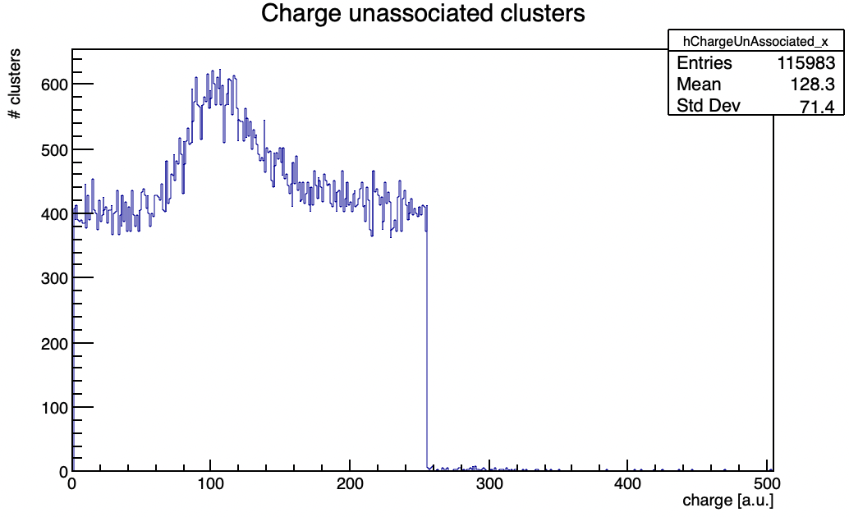
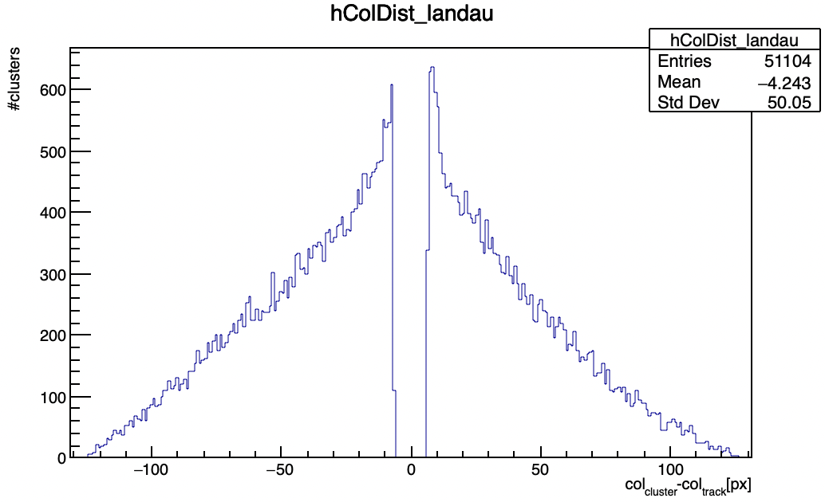
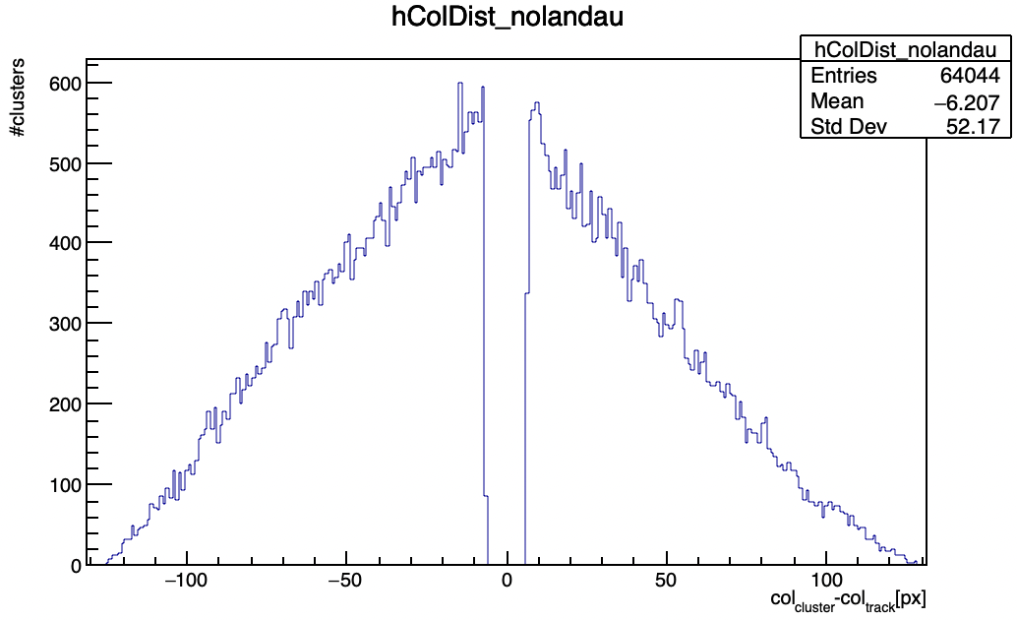
Corrupted column clusters ToT
col-col distance in Landau region and outside
check if the Landau is due to clusters that are distant due to some physical effect
in case of corruption a triangular distribution is expected, for the other case a peaked distribution close to 0 is expected
this can be observed from a first look at the two graphs
CMOS Meeting
R.Zanzottera-Testbeam analysis

Slide 3
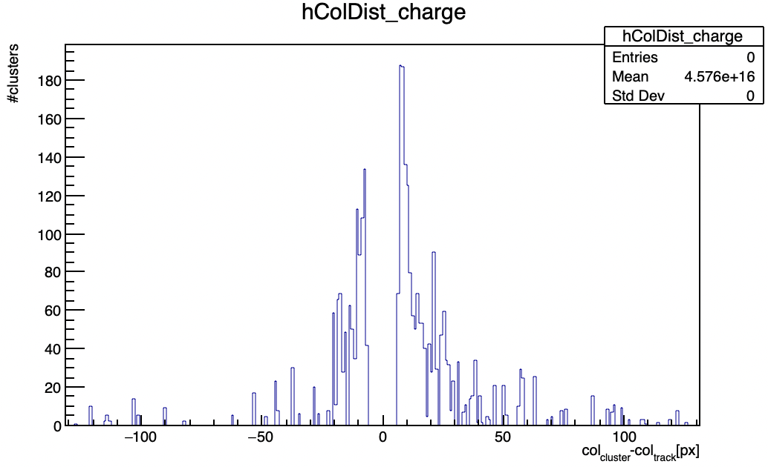
Corrupted column clusters ToT
scaled the two histograms to the same integral and subtracted
if the clusters outside the Landau region are almost all corrupted it is equivalent to subtract the “background” of corrupted clusters from the clusters in the Landau region
obtained distribution suggests that the Landau seen in the ToT distribution is due to non-corrupted hits which sums to the uniform ToT distribution of corrupted hits
corrupted clusters have a completely uniform ToT distribution
CMOS Meeting
R.Zanzottera-Testbeam analysis

Slide 4
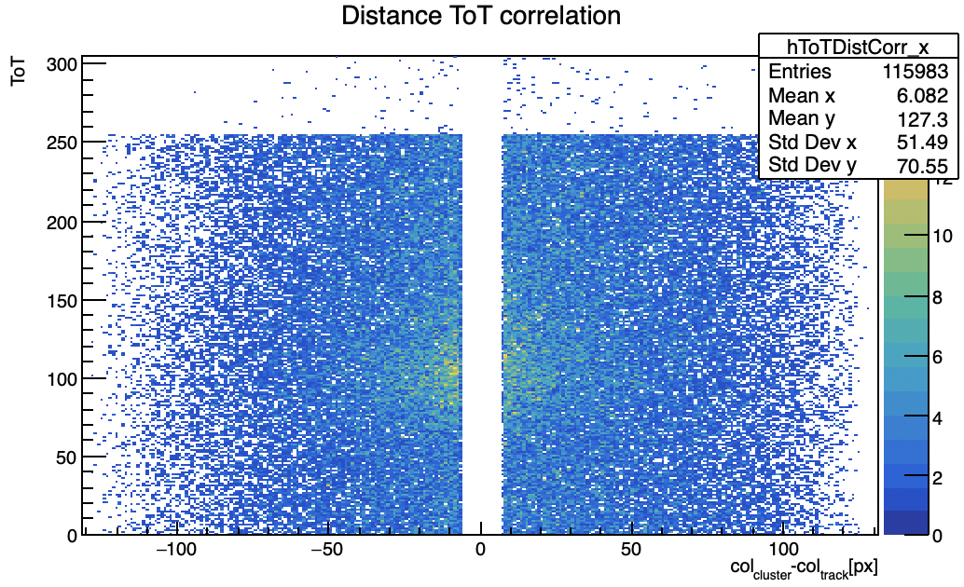
Possible correlations
ToT to col distance correlation
concentration of clusters in Landau peak region at small distances are due to the clusters studied before
no evident correlation between the two
CMOS Meeting
R.Zanzottera-Testbeam analysis

Slide 5
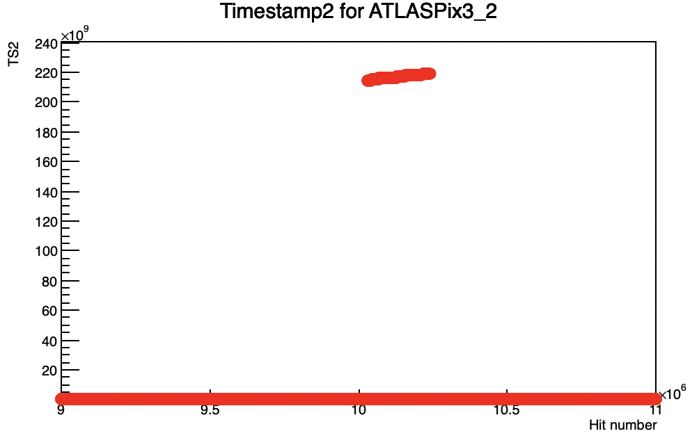
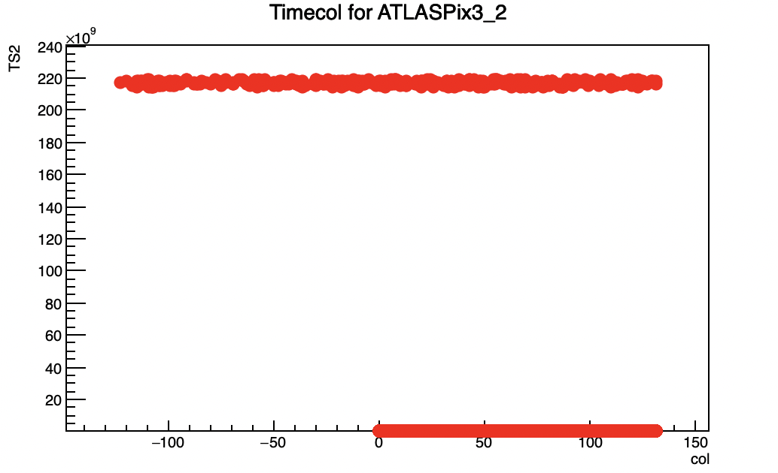
Corrupted column clusters
other possible correlation is with the ext. TS2
software modified to store the ext. TS2 information in the pixels (from which initially short TS2 is calculated as ext.TS2%128)
spotted jumps in the ext.TS2 for which it has values outside its usual range
possible correlation with corrupted columns? For column with a negative address (whose meaning is explained later) the ext.TS2 is always out of range
CMOS Meeting
R.Zanzottera-Testbeam analysis

Slide 6

UDP data format
I have studied the data format sent off the FPGA and ready for the UDP
reconstructed from the decoding code
in white the number of bytes in the line
header of the UDP package (always the same)
PackageID (4 bytes)
HitWord1 = {Layer[4], HitWordID[4], TriggerTS[40], TriggerIndex[16]}
HitWord2 = {Layer[4], HitWordID[4], ext.TS2[40], (131-Column)[8], TriggerIndex[8]} (short TS2 calculated as ext.TS2%128 and negative column because 131-Column is positive but too big)
HitWord3 = {Layer[4], HitWordID[4], Row/FIFOFull[16], ext.TS[40]} (short TS calculated as ext.TS2%1024)
possible correlation between wrong ext.TS2 and wrong column
misreading of the TS or TS2 can cause wrong ToT without affecting the row
possible wrong phase when reading data out of the FPGA by the UDP?
CMOS Meeting
R.Zanzottera-Testbeam analysis

Slide 7
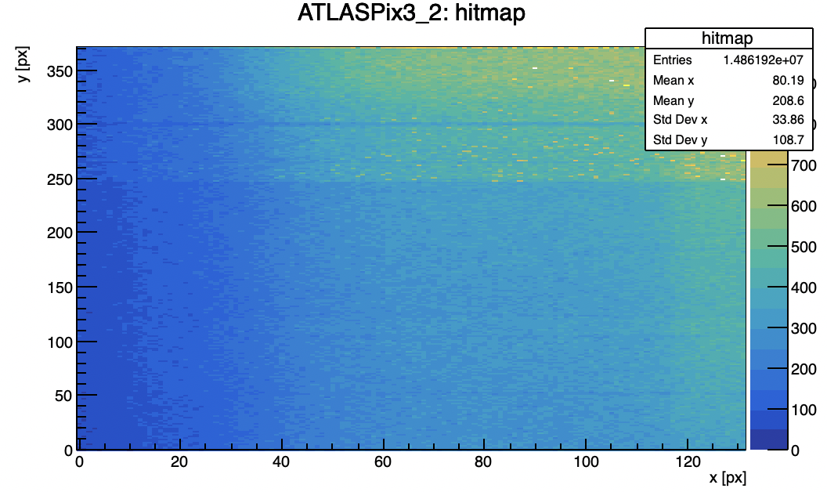

USB and UDP data
based on previous observations I have studied a run taken with both UDP and USB and compared results
basically same number of hits
many crosstalk for both, probably because this run was taken before changing telescope settings
for USB no ext.TS or ext.TS2 jumps (remember that all UDP have been cut for timestamp jumps)
CMOS Meeting
R.Zanzottera-Testbeam analysis

Slide 8
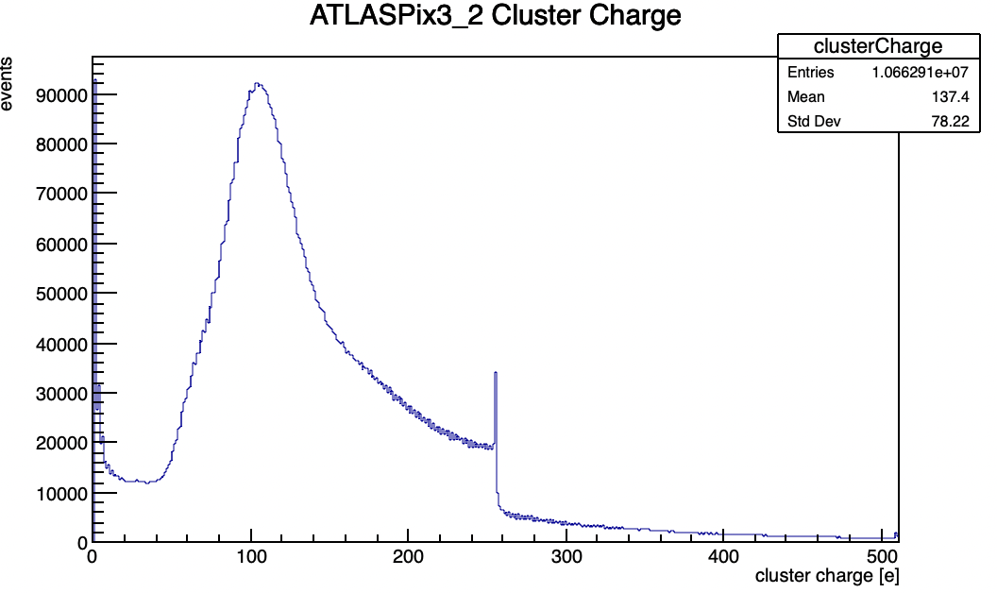
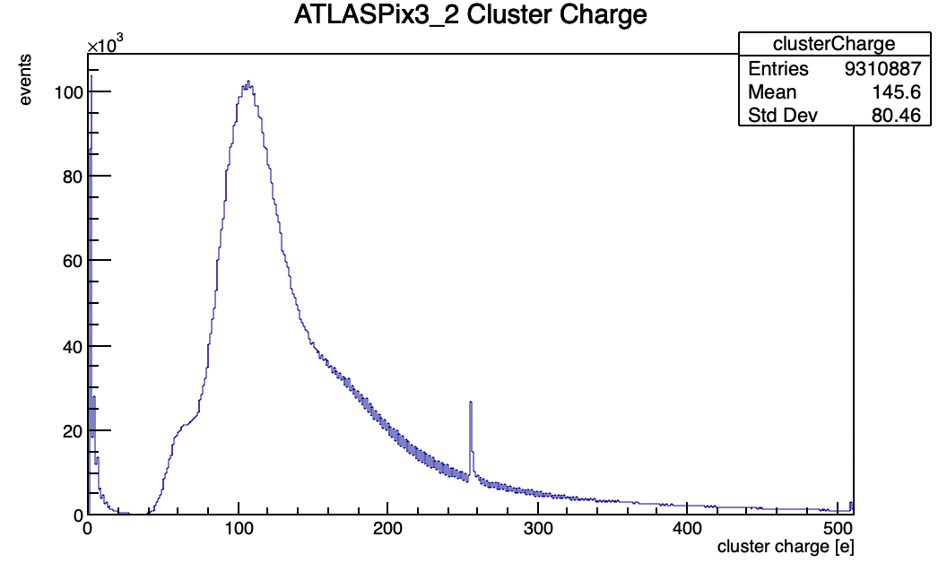
USB and UDP data
UDP
USB
similar ToT distribution
better for USB, no uniform basis and no discontinuity
much crosstalk
CMOS Meeting
R.Zanzottera-Testbeam analysis

Slide 9
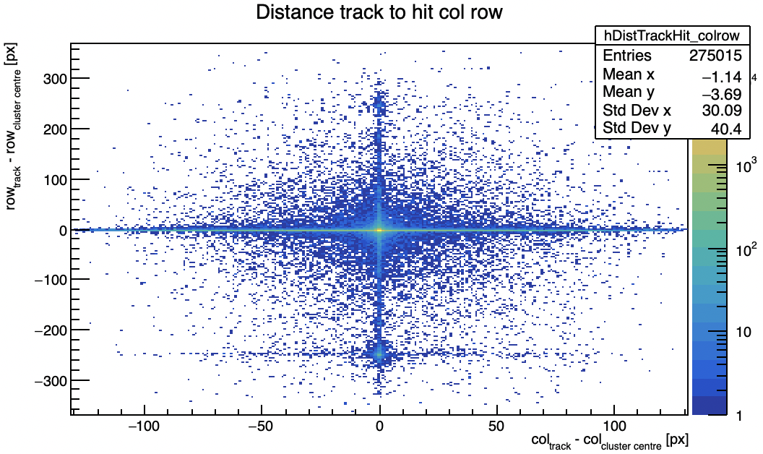
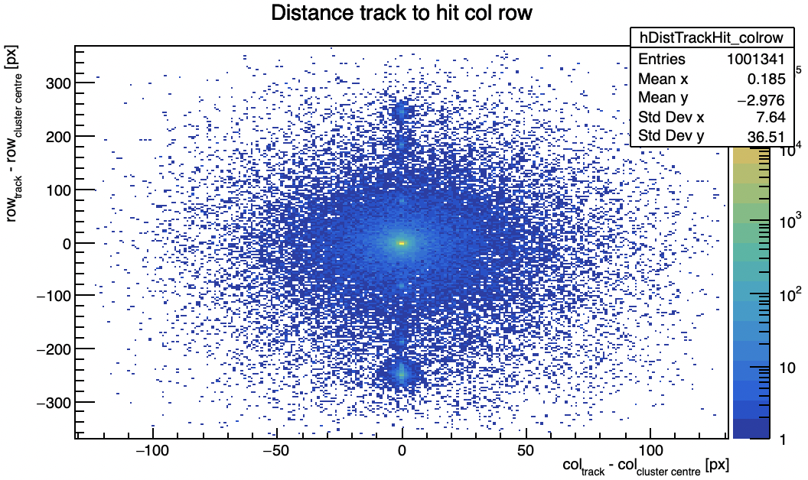
USB and UDP data
UDP
USB
distance between tracks and hits
no corrupted columns for USB data
usual pattern for UDP data observed also in other KIT and Lancs runs
wrong row due to crosstalk as already observed
big effect on efficiency (next slides)
CMOS Meeting
R.Zanzottera-Testbeam analysis

Slide 10
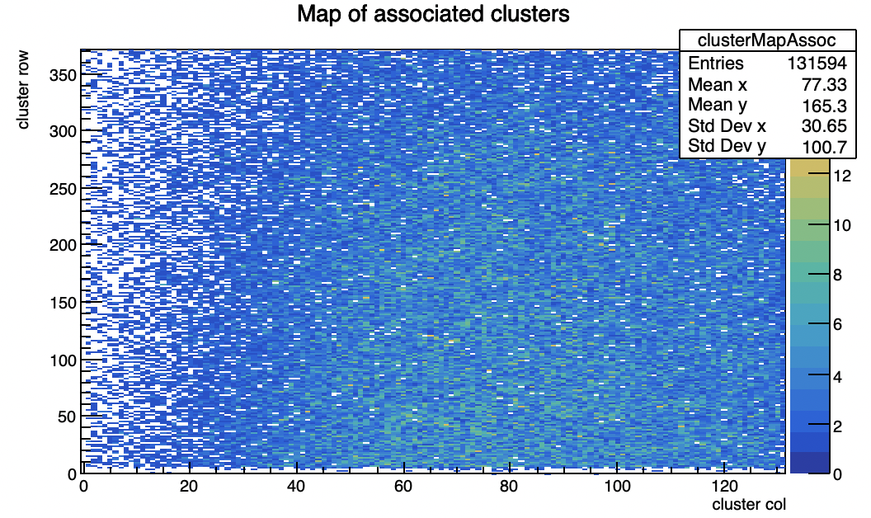
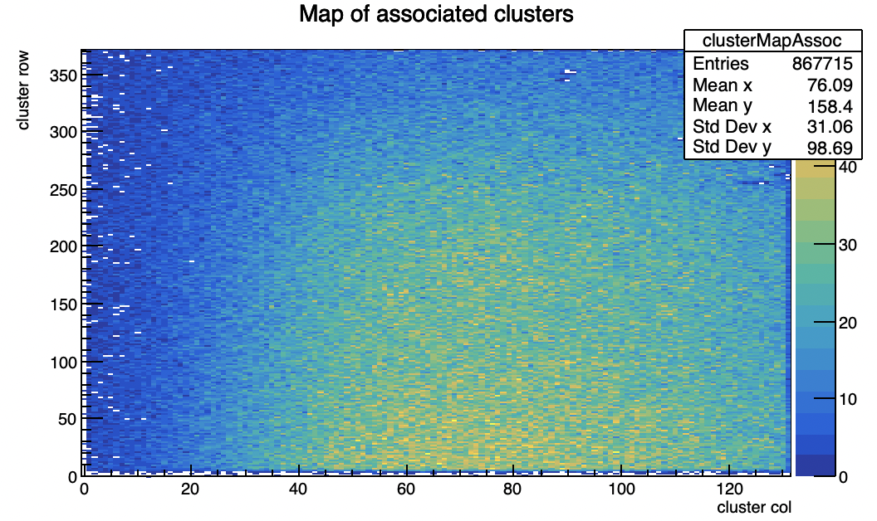
USB and UDP data
UDP
USB
same beam spot region
way more associated clusters for USB data
CMOS Meeting
R.Zanzottera-Testbeam analysis

Slide 11
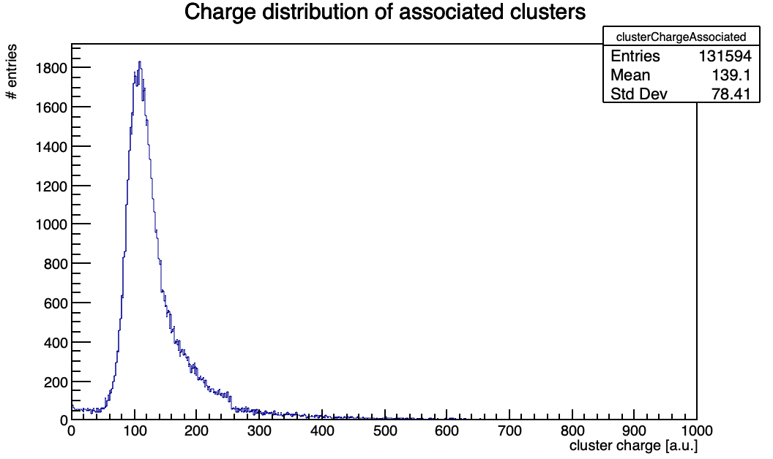
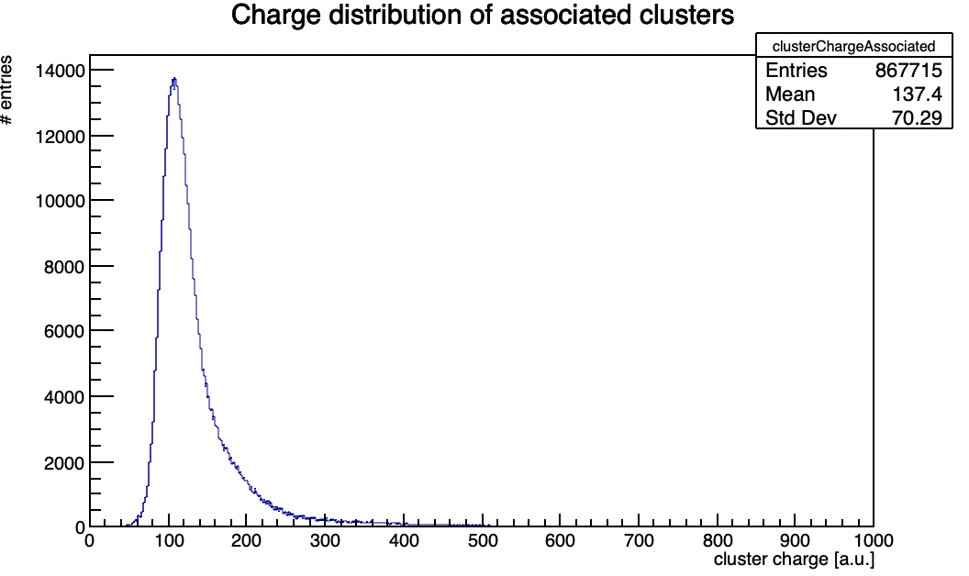
USB and UDP data
UDP
USB
similar ToT distribution for associated clusters
better for USB, no discontinuity or small uniform basis
CMOS Meeting
R.Zanzottera-Testbeam analysis

Slide 12
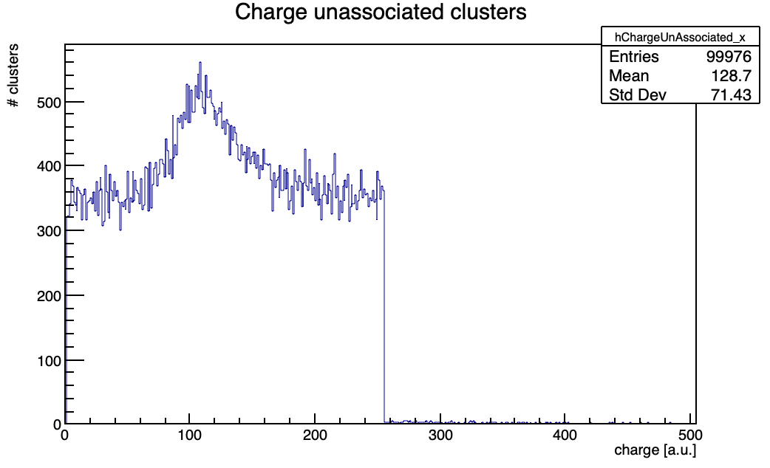
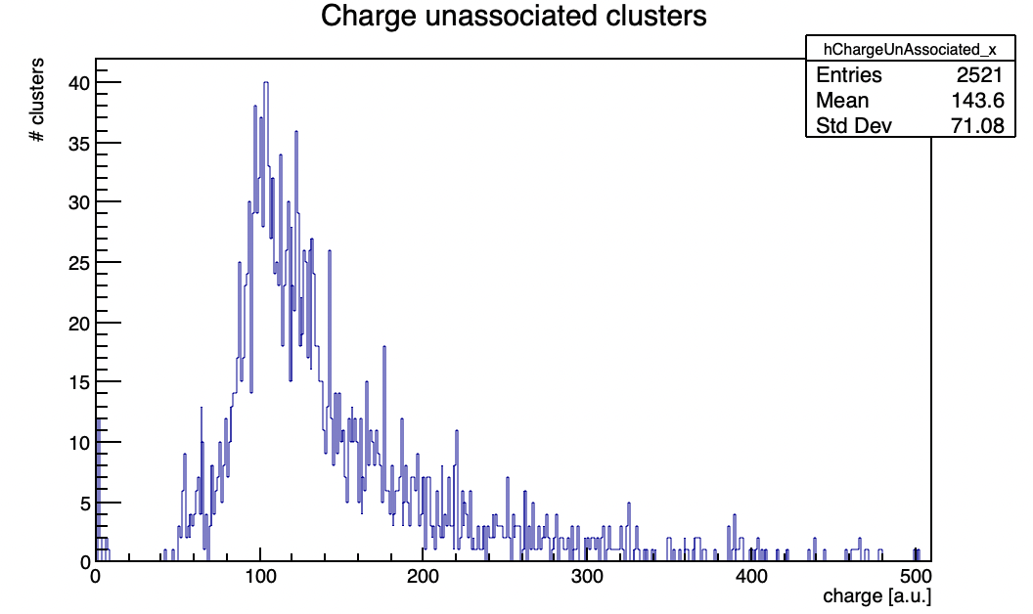
USB and UDP data
UDP
USB
unassociated clusters close in row
from UDP have a uniform ToT distribution as for others run
from USB have a Landau distribution
for UDP are due to corruption while for USB are due to some physical effect (see also distance track-hit plot)
CMOS Meeting
R.Zanzottera-Testbeam analysis

Slide 13
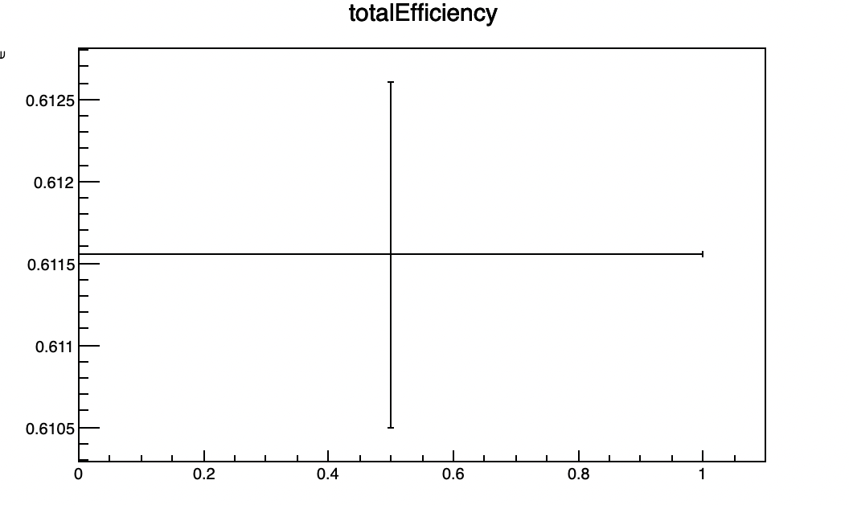
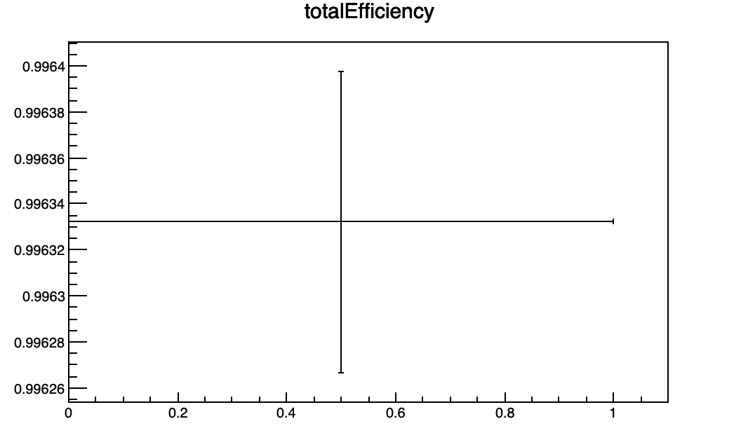
USB and UDP data
very different total efficiency
99.6% for USB
61.1% for UDP
CMOS Meeting
R.Zanzottera-Testbeam analysis

Slide 14
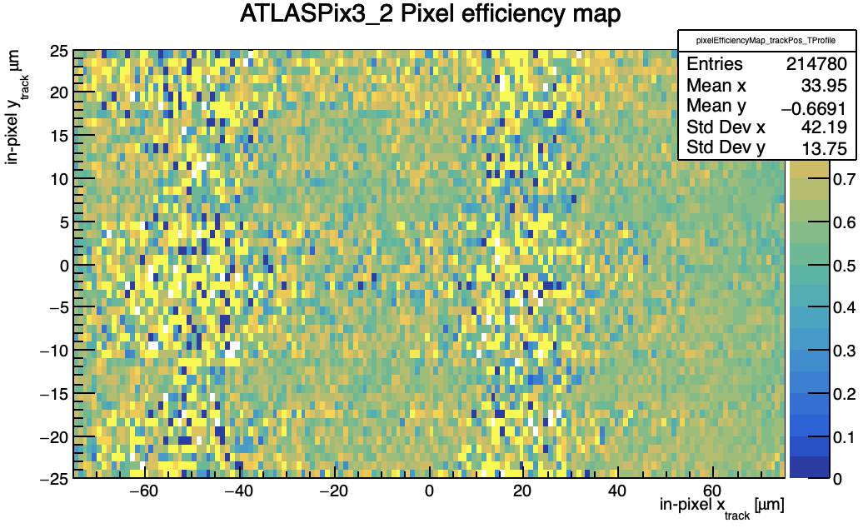
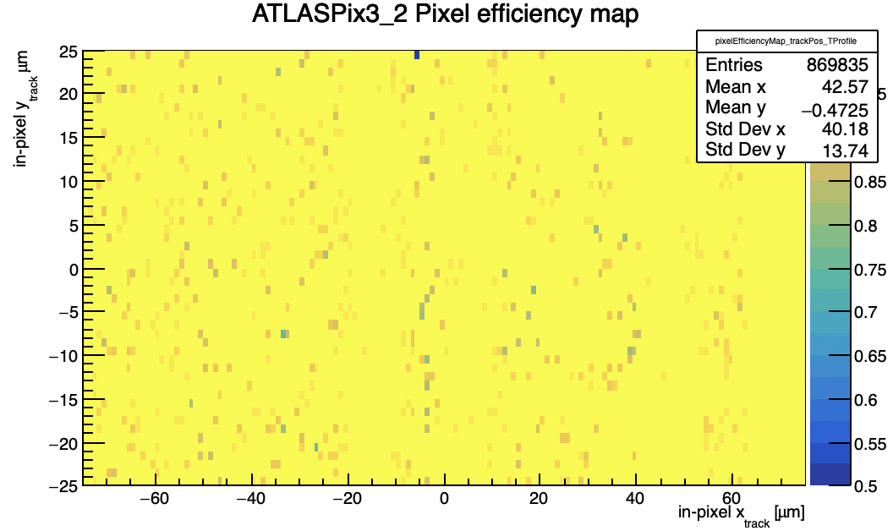
USB and UDP data
UDP
USB
very different pixel efficiency
CMOS Meeting
R.Zanzottera-Testbeam analysis

Slide 15
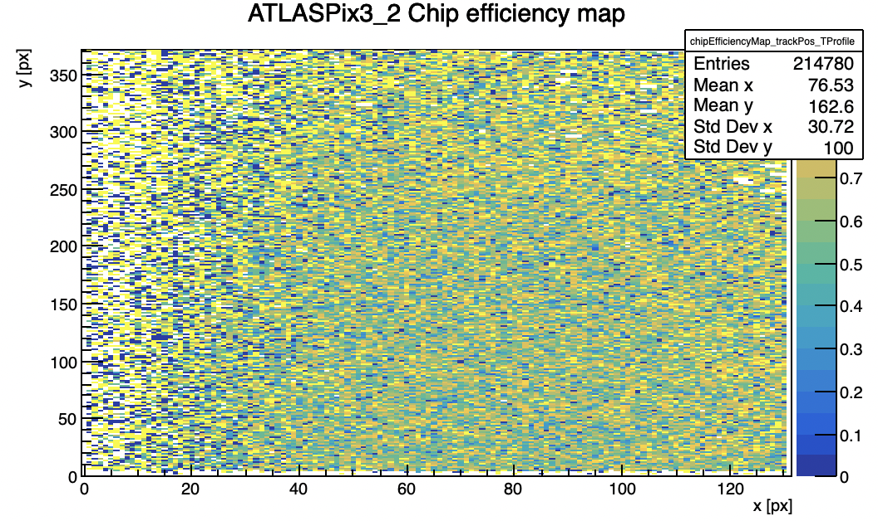
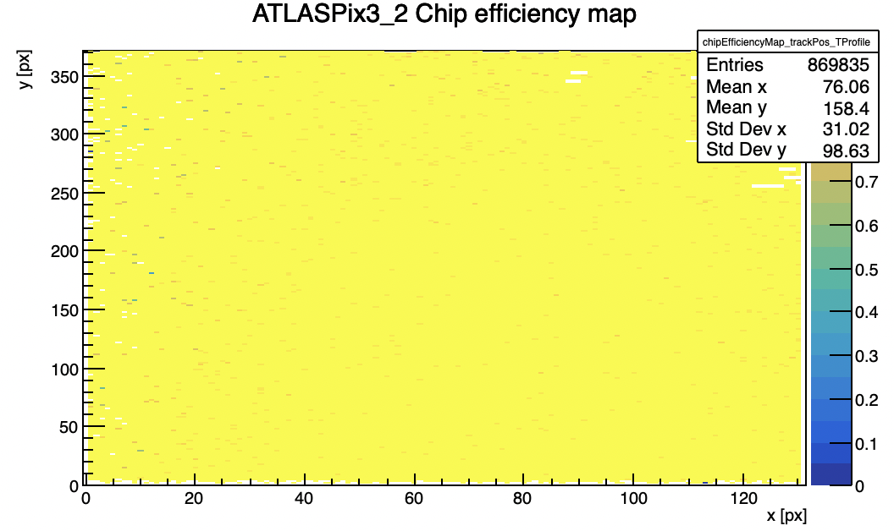
USB and UDP data
UDP
USB
very different chip matrix efficiency
CMOS Meeting
R.Zanzottera-Testbeam analysis

Slide 16
Possible UDP data problems
comparison between UDP and USB shows the possibility of problems on the UDP readout
an hypothesis could be a wrong phase when UDP reads data out of the FPGA considering the data format (see before) a small phase shift could change the column in HitWord2 and the ext.TS in HitWord3 causing a wrong column and a wrong ToT
occasional bigger phase shift could also cause the ext.TS2 jumps or the ext.TS jumps for which the UDP data have been cutted for
in order to start to verify this hypothesis I made a simple simulation which takes associated clusters with their tracks, reconstruct the bit stream of the different HitWords and simulate the bit stream signal and its sampling
in the following slides some very quick results and consideration when adding always the same small phase shift causing the change of the column and ext.TS are showed
more complex situations will be investigated in the future together with other possible hypothesis (suggestions are well appreciated)
CMOS Meeting
R.Zanzottera-Testbeam analysis

Slide 17
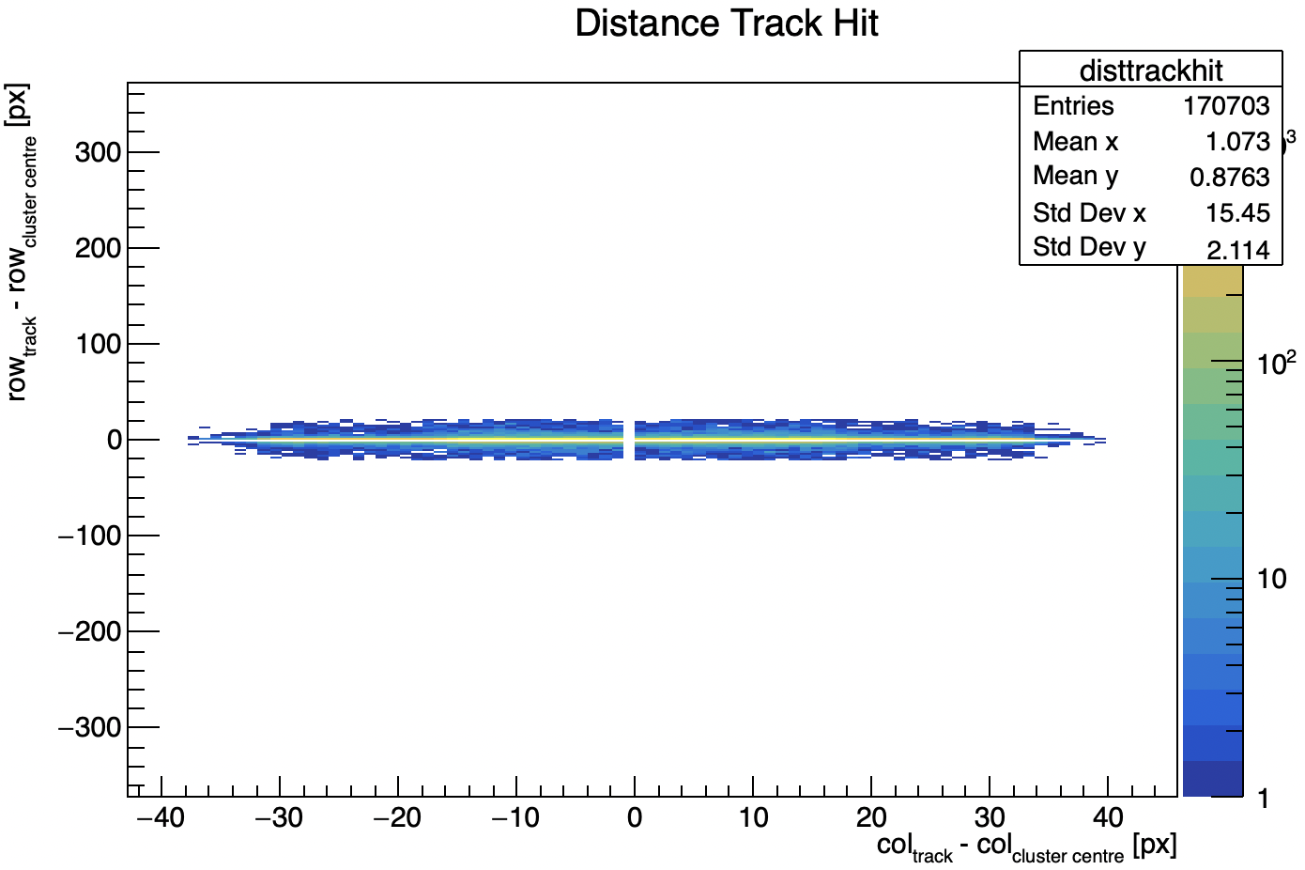
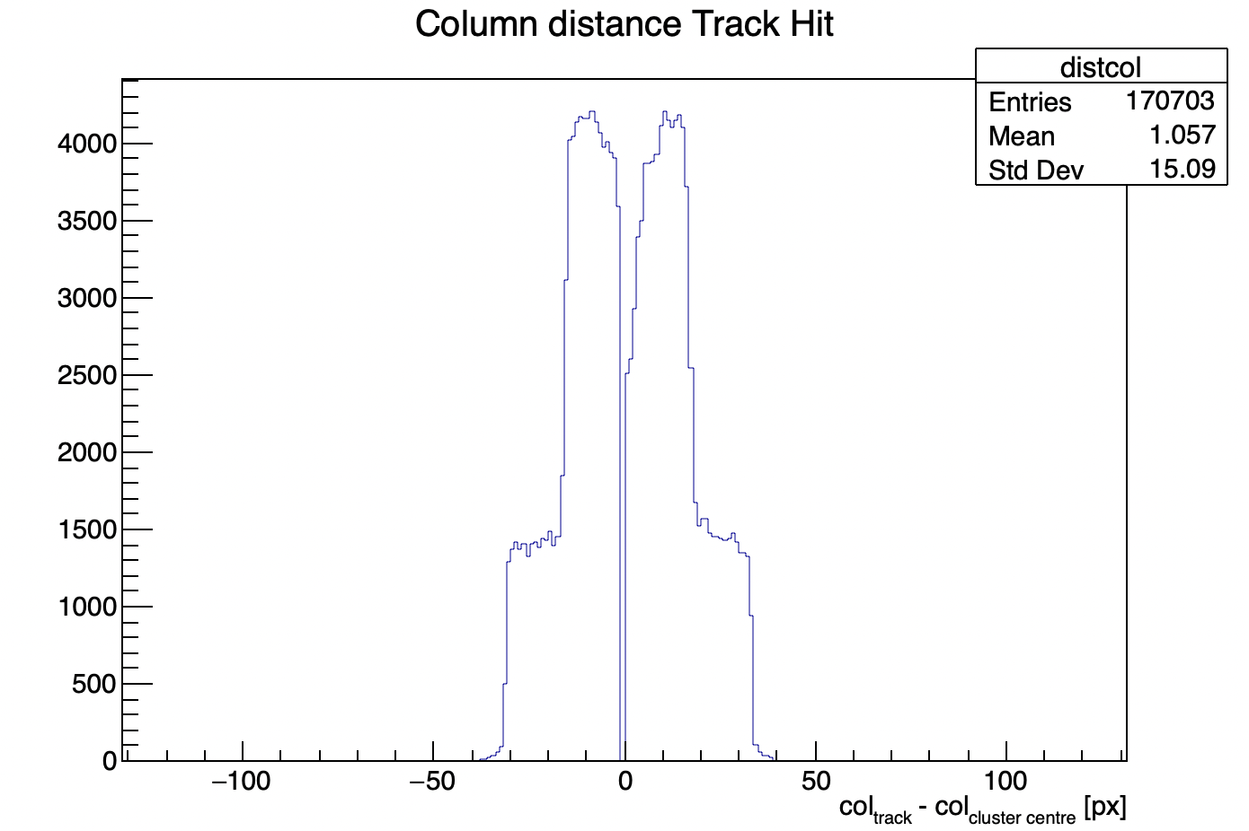
Possible UDP data problems
distance between track and hits in 2D and 1D
its shape resembles the results from UDP data
the distribution is not really triangular (probably because I have used a single phase shift for all data)
CMOS Meeting
R.Zanzottera-Testbeam analysis

Slide 18
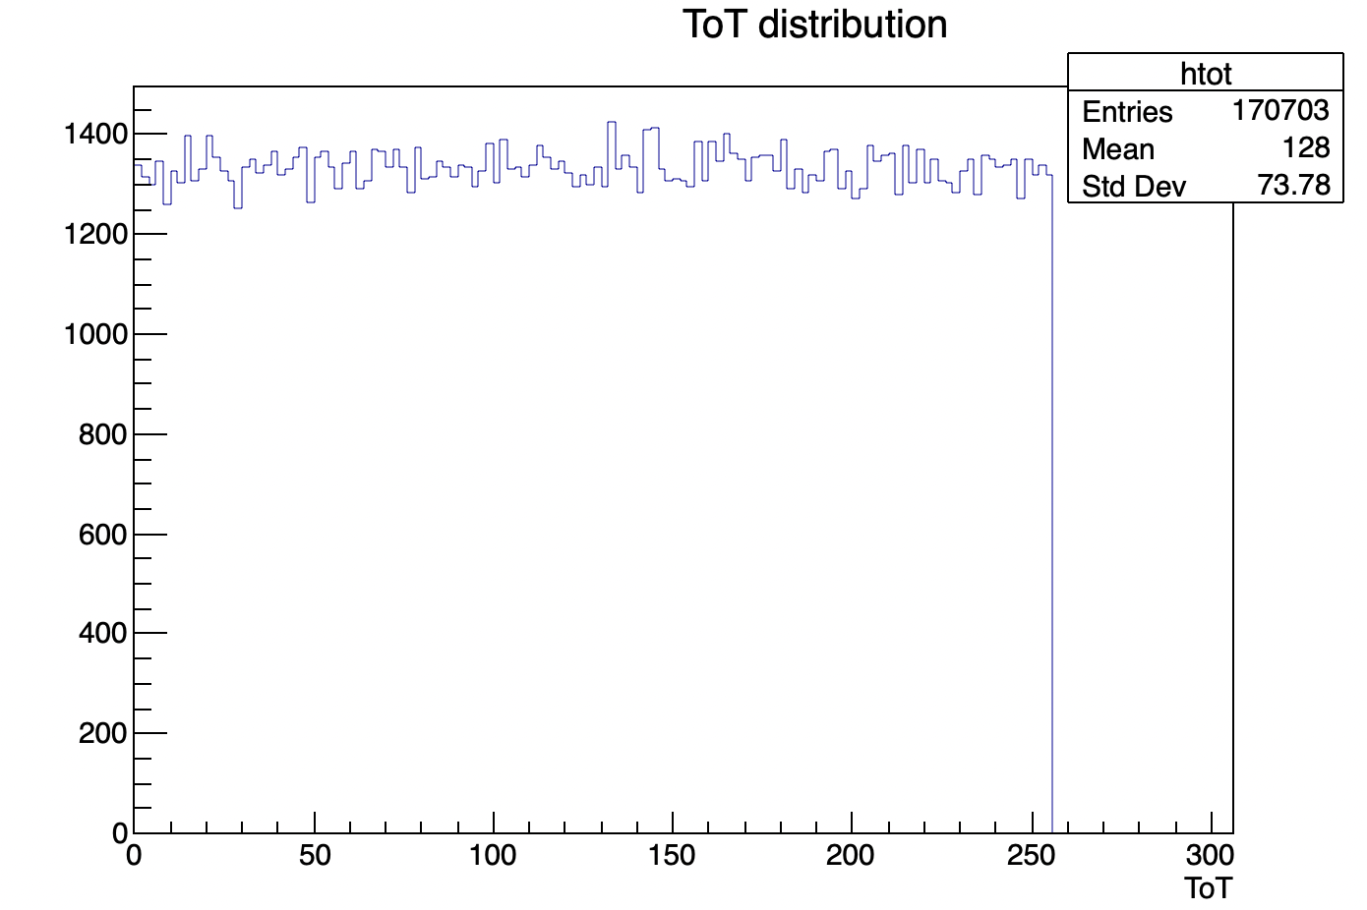
Possible UDP data problems
ToT distribution
uniform distribution as observed in UDP data
CMOS Meeting
R.Zanzottera-Testbeam analysis

Slide 19
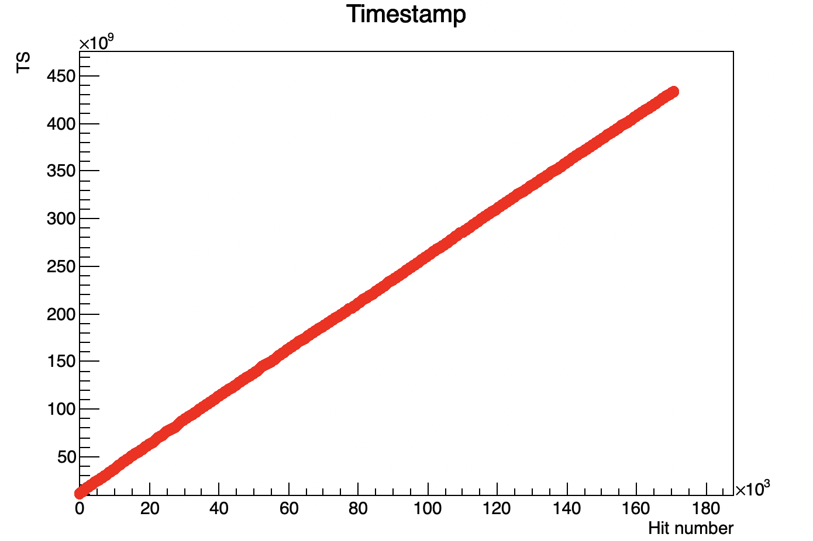
Possible UDP data problems
a small changing of the hits main TS does not influence tracks reconstruction but only the ToT
probably because the rate is so low that between a hit and the following one the TS changes a lot and a small TS corruption does not make a visible effect
CMOS Meeting
R.Zanzottera-Testbeam analysis

Slide 20
Runs
first part usual KIT run: 202204082012_udp_beamonallquad_Vminus90_6Gev_kit_0.dat
second part: 202204061920_udp_beamonall_5p6Gev_kit_0 and 202204061920_usb_beamonall_5p6Gev_kit_0
CMOS Meeting
R.Zanzottera-Testbeam analysis

