Slide 1

Elemental Analysis in NaI Matrix
by ICP-MS
Matrix Effects · Cold Plasma · NH₃ Reaction Gas · Ar Dilution
Strategies for accurate potassium determination in high-NaI matrices
Giovanni Ligrani
LNGS Chemistry Service
ICP-MS Method Development | NaI Matrix | Potassium Determination

Slide 2
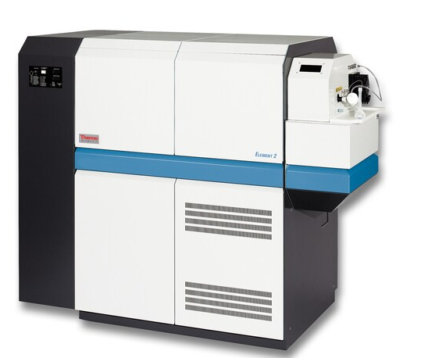
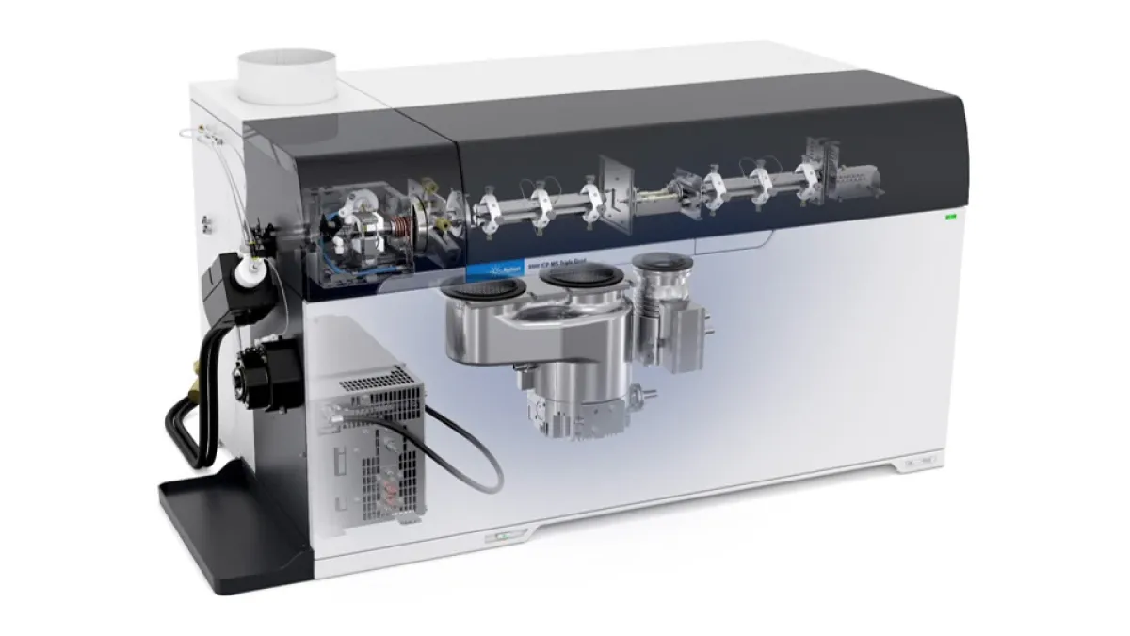
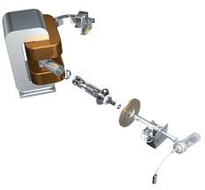
Equipment available to laboratories
Agilent ICP-MS/MS 8900 Series
ThermoFisher Element 2 HR-ICP-MS

Slide 3
Overview: Challenges & Solutions
The Problem
Cold Plasma (~600 W)
Matrix suppression
Reduced RF power prevents Na⁺ and I from ionizing. K (IP 4.34 eV) still ionizes; Na (5.14 eV) and I (10.45 eV) mostly do not.
NaI matrix suppresses K⁺ signal via space-charge effects and ionization competition in the plasma.
External K⁺ contamination
Potassium is ubiquitous: fingerprints, dust, glassware, reagents, and airborne particles are all significant contamination sources. Even trace contact raises the K background, causing a positive bias and poor blanks — especially critical at low ppb levels in a NaI matrix.
NH₃ Reaction Gas (MS/MS)
Triple-quad: Q1 selects m/z 39, NH₃ in q2 removes H₃O⁺ and water cluster ions by proton transfer. K⁺ unreactive.
⚠ Use powder-free gloves, acid-washed plasticware, and K-free reagents. Perform blank subtraction on every analytical run.

Slide 4
Matrix Effect in ICP-MS — NaI Suppression of K⁺
Space-charge effect
Dense Na⁺ cloud between the cones repels low-abundance K⁺, scattering it before reaching the detector.
Ionization suppression
Na and I compete for ionization energy in the plasma, reducing the fraction of K that becomes K⁺.
Result
K⁺ signal is systematically underestimated at the detector → significant negative bias in reported concentration.
Cone geometry: both tips point toward the plasma (left). Ions are extracted through the tip openings into the high-vacuum region between and behind the cones.

Slide 5
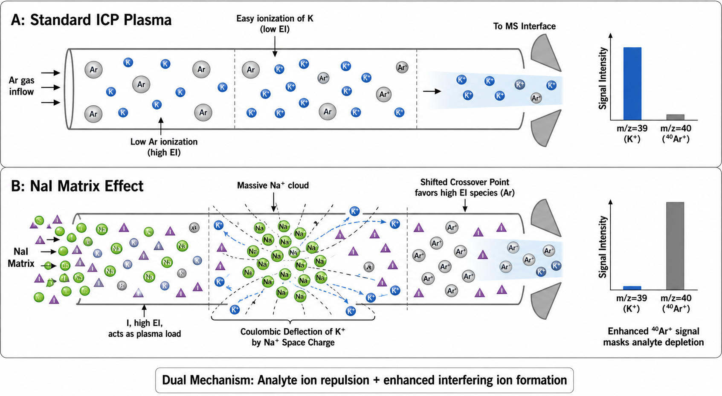
Matrix Effect in ICP-MS — NaI Suppression of K⁺

Slide 6
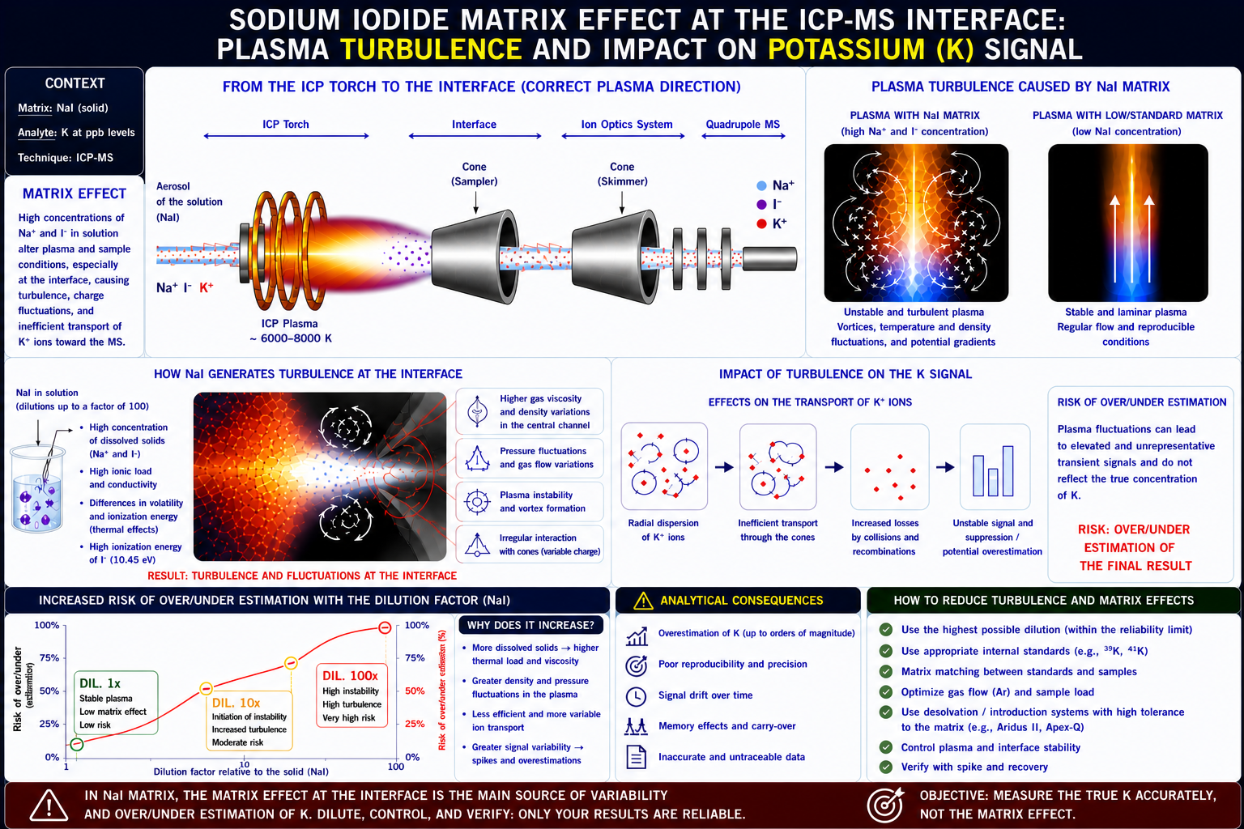

Slide 7
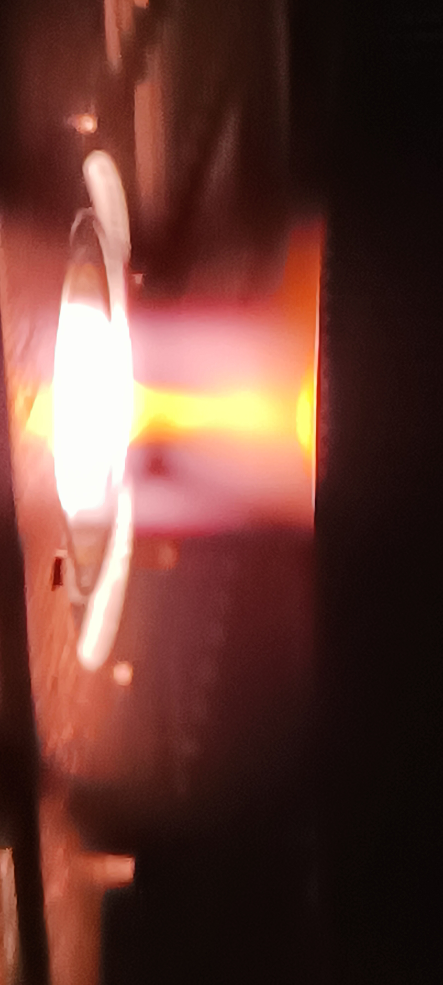
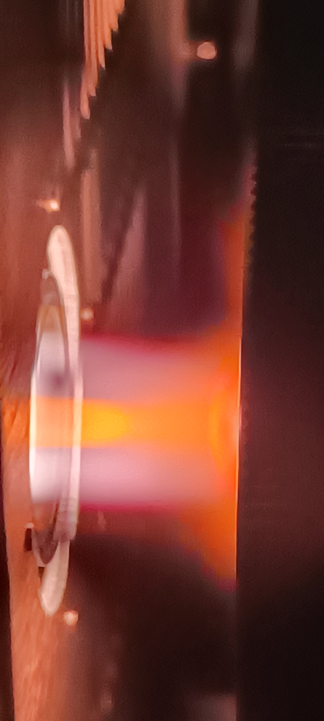
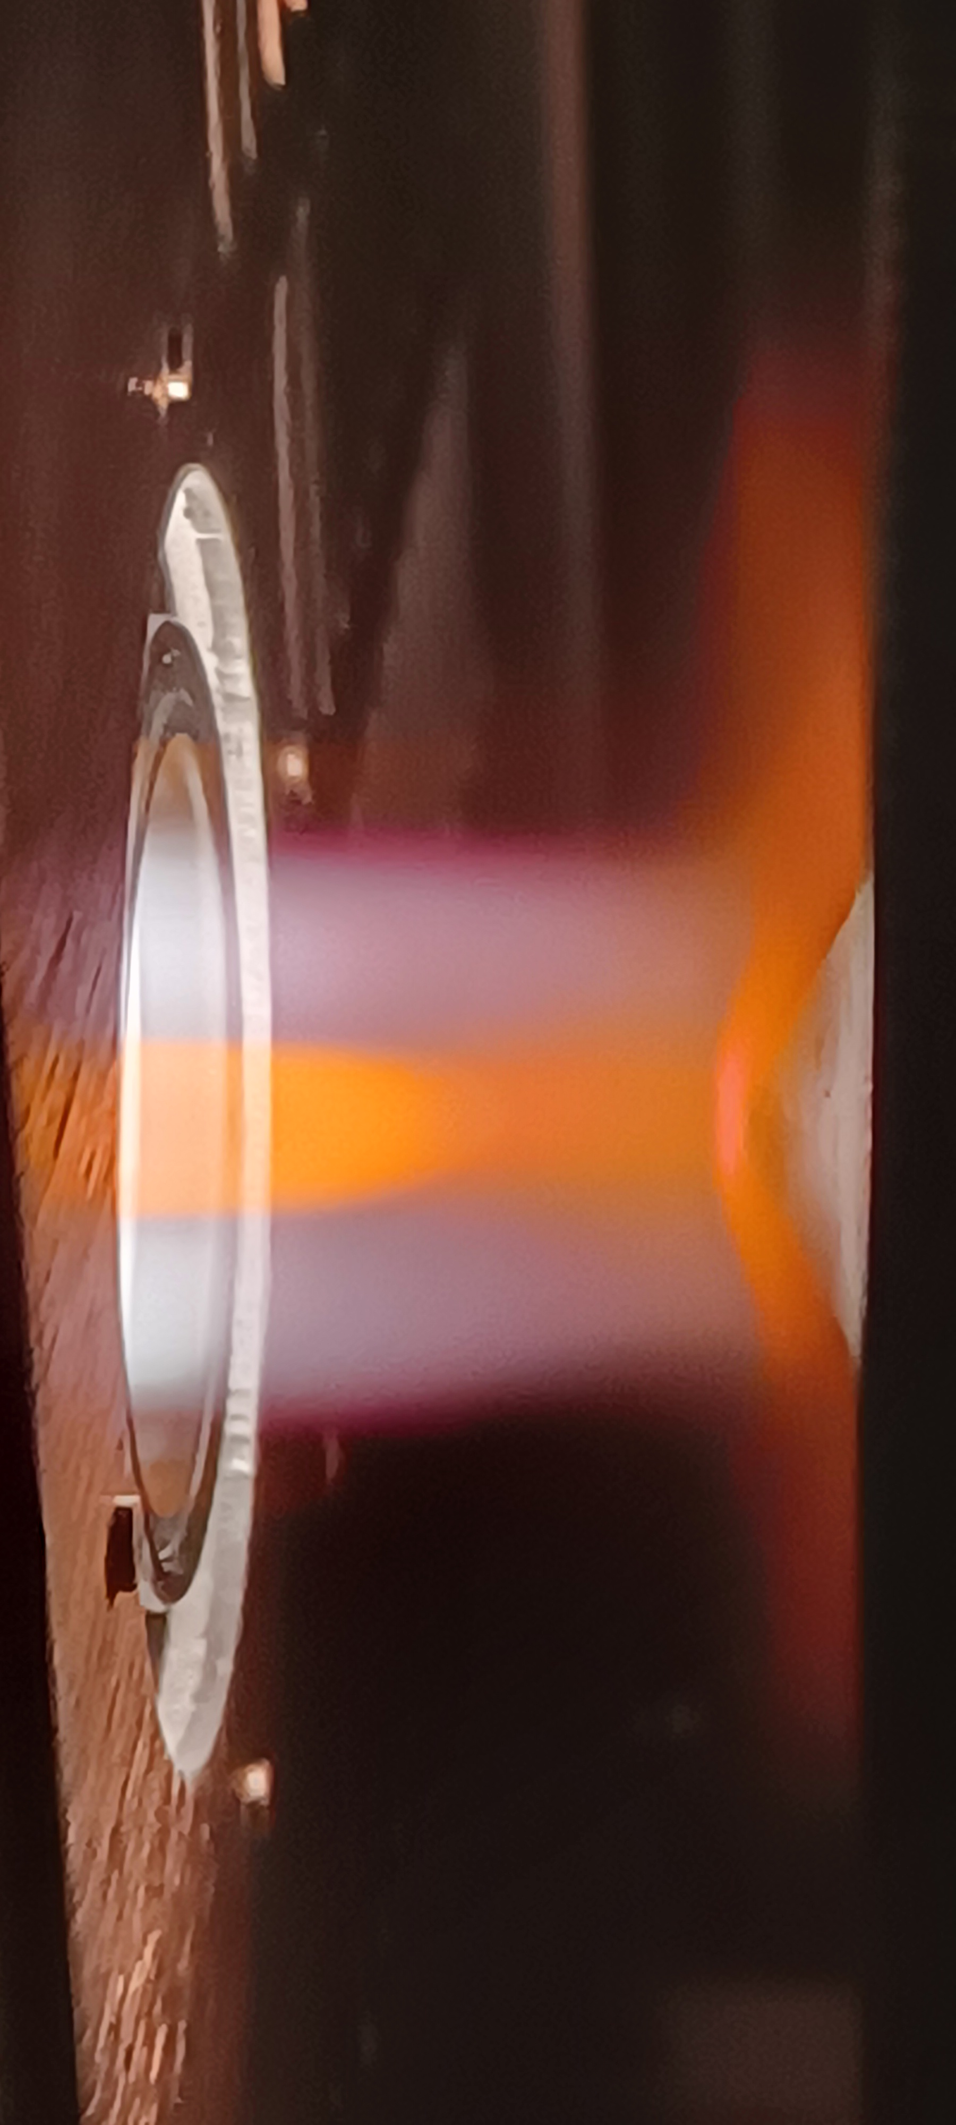
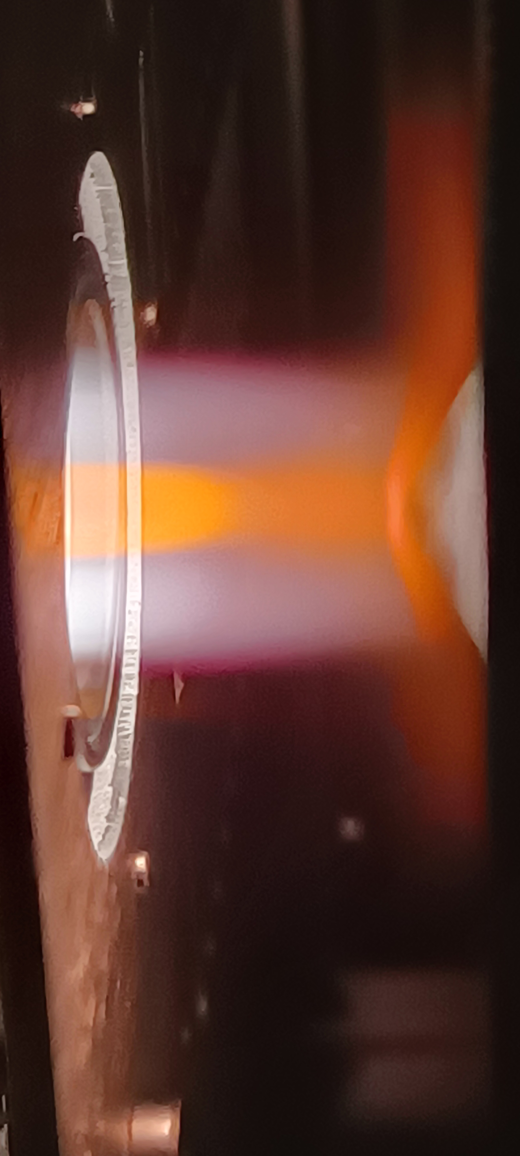
Matrix Effect in ICP-MS — NaI Suppression of K⁺
Plasma Turbulences
Stable Plasma

Slide 8
Cold Plasma Mode
Ionization Potentials
K 4.34 eV ionizes ✓
Na 5.14 eV neutral ✗
I 10.45 eV neutral ✗
Ar 15.76 eV neutral ✗
Threshold ~5 eV in cold plasma. Only K (lowest IP) remains efficiently ionized.
Tradeoff: sensitivity drops for high-IP elements; combine with reaction gas for best results.

Slide 9
NH₃ Reaction Gas — Triple Quad MS/MS
Key reactions in q2: H₃O⁺ + NH₃ → NH₄⁺ + H₂O | (H₂O)·H₃O⁺ + NH₃ → NH₄⁺·H₂O | ³⁸ArH⁺ + NH₃ → NH₄⁺ + ³⁸Ar
K⁺ (low proton affinity) does not react with NH₃ → passes Q3 clean. All interference products shift to m/z 18 (NH₄⁺) → rejected by Q3.
Notes:
High Proton Affinity
Stabile Atomic Kation
Not worked with mass shift but we use direct mass with collisional cell

Slide 10
Ar Gas Dilution in Spray Chamber
Advantage: simple, no reagents, hardware-independent. Calibrate standards at same Ar flow ratio for matched matrix conditions.

Slide 11
Ar Gas Dilution in Spray Chamber
Argon Dilution in the Spray Chamber
ICP-MS matrix effect mitigation strategy
01
Problem: NaI Matrix
High concentrations of Na⁺ and I⁻ reach the plasma, creating a dense ion cloud that repels trace K⁺ before detection (space-charge effect).
02
Ar Dilution Mechanism
Argon gas is introduced directly into the spray chamber. It mixes with the nebulised aerosol, physically diluting the NaI concentration before the plasma.
03
Result at the Plasma
Fewer Na⁺ and I⁻ ions enter the torch. Space-charge suppression decreases, and K⁺ is measured accurately with lower negative bias.
04
Practical Calibration
Signal is also diluted — compensate by preparing calibration standards at the same Ar:nebulizer flow ratio. No reagents or extra hardware required.
Key principle:
Lower [NaI] in plasma → less space-charge suppression → accurate K⁺ signal | Dilution factor controlled by Ar flow ratio (e.g. 1:5 or 1:10)

Slide 12
Summary: Strategy Comparison
Strategy | Mechanism | Removes / Targets | Tradeoff | When to use
Cold plasma ~600 W | Low IP threshold: Na/I not ionized | Na⁺, I⁻ from ion beam | High-IP element sensitivity drops | Matrix > 1000 ppm Na/I
NH₃ reaction gas (Q1·q2·Q3 MS/MS) | Proton transfer: H₃O⁺ → NH₄⁺ | H₃O⁺, water clusters, ArH⁺ at m/z 39/41 | Requires triple-quad; cell optimization needed | Hydronium / water cluster polyatomic overlap on K
Ar spray-chamber dilution | Physical aerosol dilution before plasma | Total matrix load (all matrix ions) | Signal also diluted; recalibrate standards | High-matrix samples; simplest approach
Combined (all three) | Additive suppression of all mechanisms | All of the above | Full method validation required | Very high NaI (scintillator digests, brine)
Notes:
Low ionization potential

Slide 13
Potassium Contamination Sources
⚠ ppb-level
K⁺ analyte
Critical sources of K⁺ background in ICP-MS trace analysis
Breathing & Talking
HIGH
Weighing Spatulas
HIGH
Sample Vials
MEDIUM
Exhaled air carries K⁺-rich aerosol droplets (saliva, mucus). Even normal breathing over an open vessel during sample preparation raises the K background.
Stainless-steel or coated spatulas may carry K⁺ from previous samples, cleaning agents, or finger contact. Residues transfer directly into the weighed solid.
polypropylene vials may leach K⁺ from the borosilicate matrix. Plastic vials can contain K⁺ residues from manufacturing or prior use. Finger contact adds K from skin.
✔ Work with vessel capped or in laminar-flow hood. Never talk over open samples.
✔ Use disposable plastic spatulas or acid-wash metal ones. Always wear gloves.
✔ Use trace-metal-grade vials. Acid-rinse new vials. Handle only with gloves.
5 mL Pipette Tips
MEDIUM
Airborne Dust
MEDIUM
Bare Hands / Gloves
HIGH
Large-volume polypropylene tips leach K⁺ from polymer walls, especially with acidic matrices. Contact with fingers during loading contaminates the inner surface.
Laboratory dust is rich in K⁺ (skin flakes, soil particles, paper fibres). Settling into open vessels during sample prep or dilution adds a variable K blank.
Skin naturally contains high K⁺. Bare-hand contact is a major contamination route. Powdered latex gloves release K-rich powder directly into samples.
✔ Use certified low-K tips. Pre-rinse with sample matrix. Load with gloves only.
✔ Cap vessels immediately. Work in a clean-bench area. Wipe bench with K-free wipes.
✔ Always use powder-free nitrile gloves. Change gloves frequently and after any contact.
Golden rule: every surface, tool, and breath that touches the sample is a potential K⁺ source. Use certified-grade consumables, work capped, and always subtract a procedural blank.

Slide 14
Why 0.2 ppb of Contamination Ruins Your Result
100× dilution factor amplifies solution-level contamination directly into the reported solid-equivalent value
The dilution factor maths
Target:
2 ppb K in solid
Measured (clean):
0.02 ppb in solution ×100 = 2 ppb ✓
+0.2 ppb contam:
0.22 ppb in solution ×100 = 22 ppb ✗
Error:
+20 ppb → +1000% relative error
⚠ At 100× dilution, every 0.1 ppb of K⁺ contamination in solution adds 10 ppb to the reported solid value — 5× the entire true signal.

Slide 15
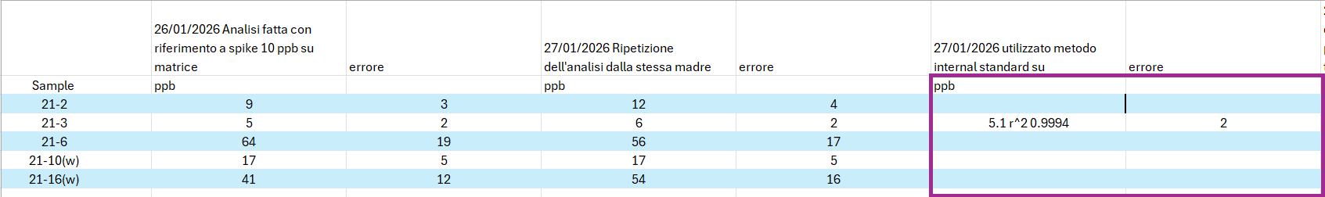
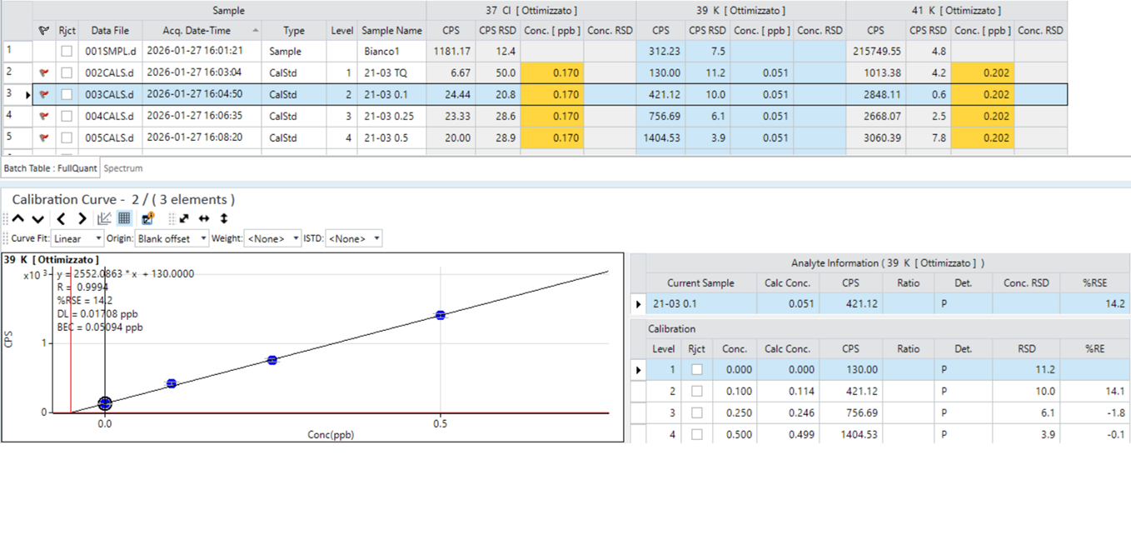
Preliminary Analysis for K January 2026
Notes:
Olga Gileva from ibs

Slide 16
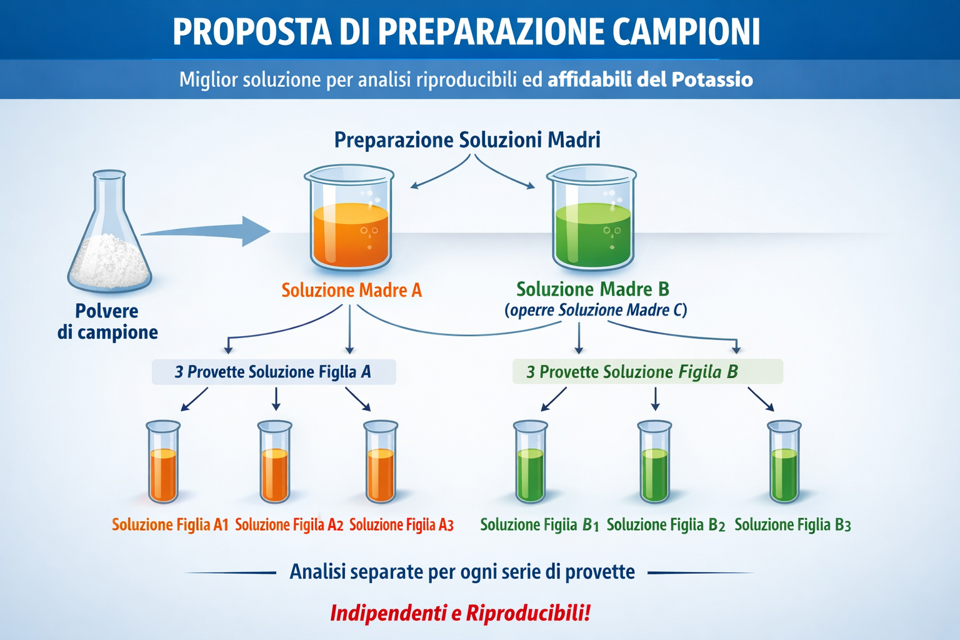
Proposed procedure for samples preparation

Slide 17
Potassium concentration in Samples brought by Olga during the January visit
Sample | Conc (ppb) | Err (±)
21-2 | 11 | 3
21-3 | 5 | 3
21-6 | 11 | 1
21-10(w) | 6 | 2
21-16(w) | 3 | 1
21-17(wms) | 15 | 6
23-1 | 7 | 2
21-18(rm) | 14 | 2
25-1(rm) | 7 | 2
25-2(rm) | 7 | 2

Slide 18
Clear evidences of external contamination
Sample | Instrument | Conc (ppb) | Err (±)
PS_NaI_rec_20-8 | ICP-MS/MS | 22 | 3
Received from USA
Sample | Instruments | LOD (ppb) | LOQ (ppb) | Conc. (ppb) | Err (±)
20-8 | ICP-MS/MS | 0.5 | 2 | 2.9 | 0.8
20-8 | HR-ICP-MS | 0.5 | 2 | 2.2 | 0.6
Same batch received From IBS (Korea)

Slide 19
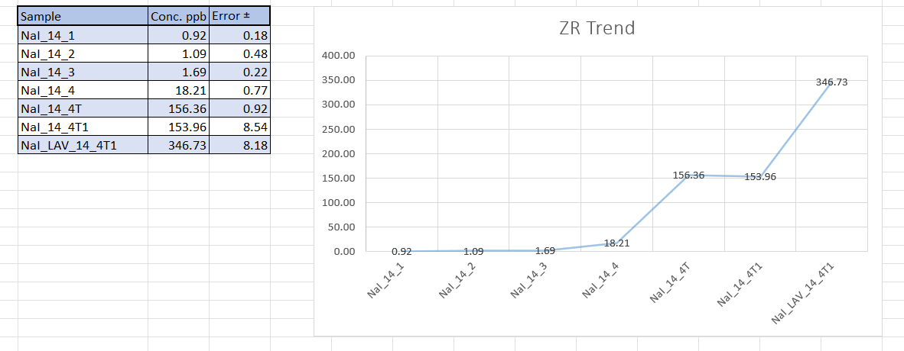
Zone Refining

Slide 20
Zone Refining Analysis (Si-Cl) by HR-ICP-MS
ThermoFisher Element 2 HR-ICP-MS

Slide 21
Drawbacks in Si and Cl measurements by ICP-MS
 | Abundance % | Troubles | Main Isobaric interferences
28Si | 92 | High instrumental Background | 14N14N
29Si | 4,6 | High Instrumental Background | 14N15N
35Cl | 75 | High energy ionization | Double charge, poly-ions
37Cl | 25 | High energy ionization | 36Ar1H

Slide 22
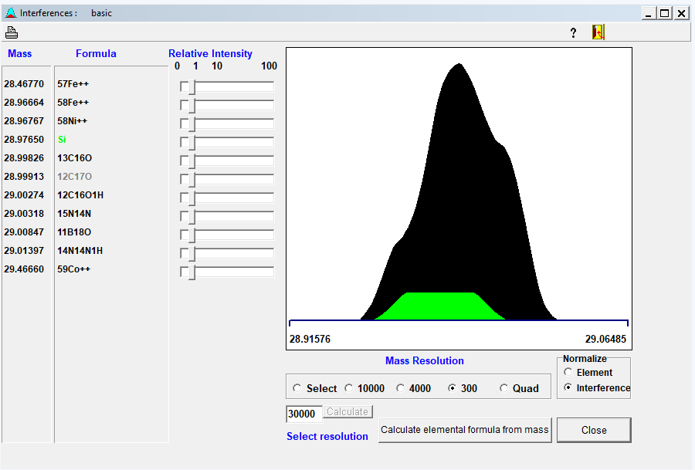
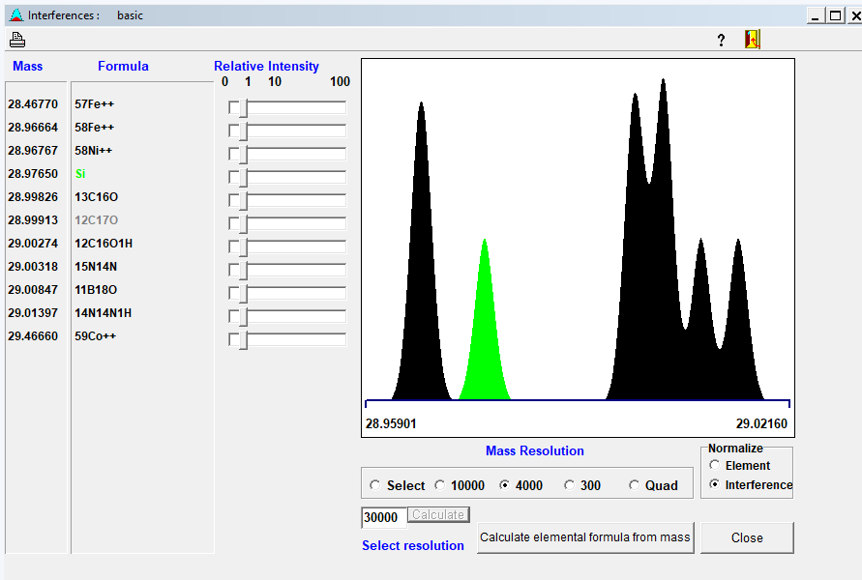
Si interferences
29Si Low Resolution
29Si Medium Resolution

Slide 23
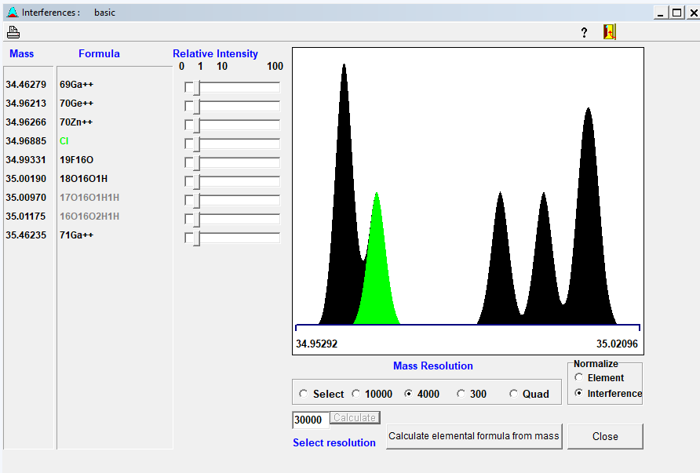
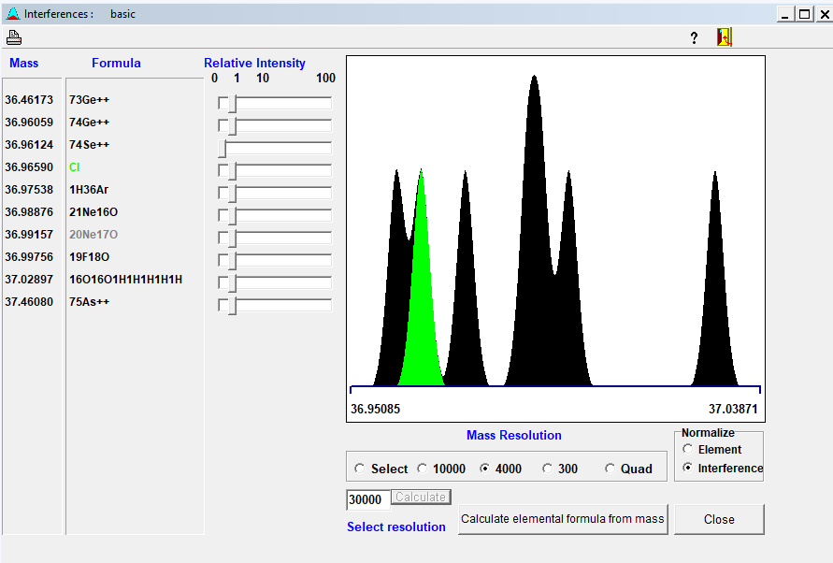
35Cl Medium Resolution
37Cl Medium Resolution

Slide 24
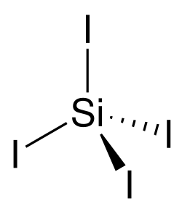

Si and Cl measurements in NaI powder and ingot after ZR
 | NaI coreana 20 8 | NaI coreana 20 8 B | Astrograde (old Batch) | Astrograde NaI ZR14 zona1 | Astrograde NaI ZR14 zona 3 | Astrograde NaI ZR14 zona4 | Astrograde NaI ZR14 zona 4T | Astrograde NaI ZR14 zona 4T1 Ext
 | ppm | ppm | ppm | ppm | ppm | ppm | ppm | ppm
Si28(MR) | 0,52 | 0,8974 | 2,0223 | 0,94 | 1,65 | 0,9991 | 0,9218 | 4,5164
Si29(MR) | 0,48 | 0,8989 | 2,008 | 0,83 | 1,66 | 0,968 | 0,9401 | 4,9994
Cl35(MR) | 5,2 | 0,516 | -3,325 | 370 | 393 | 606,22 | 2080,3 | 2933
Cl37(MR) | 8,3 | 10231 | 35,068 | 378 | 385 | 597,66 | 2002,4 | 2780,9
NaCl Melting point 800 C
Boiling point 1460 C

Slide 25
Si & Cl distribution along ZR axis

Slide 26
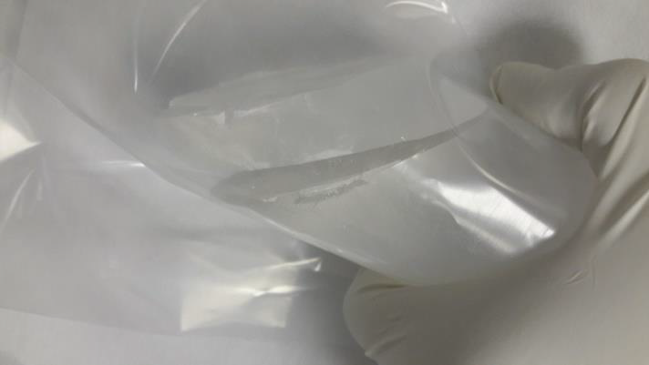
10 years ago…Crystal sampling procedure

Slide 27
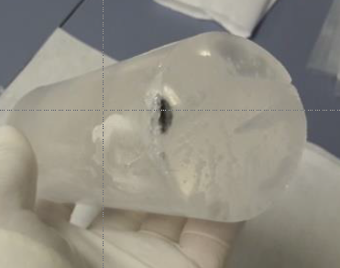
Study of the impurity distribution
Sample | 0 NOSE | 1 | 2 | 3 | 4 | 5 TAIL | 5B
K ppb | 230 | 320 | 360 | 340 | 350 | 1415 | ------
K ppb | <15 | <15 | <15 | <15 | <15 | 120 | 360
Th ppt | <1 | <1 | <1 | <1 | <2 | <1 | 280
U ppt | <1 | <1 | <1 | <1 | <1 | <2 | 130
K ppb | 10.2 | 11.5 | 11.2 | 11.6 | 11.6 | 13.3 | -----
Cry ST Powder
Hot plasma
Cry N1 UP Powder
Hot plasma
Cry N2 UP Powder
Cool plasma
The uncertainty of the reported concentration values is about 10-25 %

Slide 28
Techniques and labs comparison
HR-ICP-MS performance
Detection limit calculated with 3*SD_{BLK6} for NaI solid=3ppb
 | B5 | B5+13.25 | Mesured | Recovery %
ppb | 13.3 ± 2.5 | 26.5 ± 3 | 28 ± 5 | 105 ± 25
Recovery test
Technique | Laboratory | DL [ppb]
HR-ICP-MS | LNGS | 3
ICP-QMS | SICCAS | 10
ICP-OES | Ametek R&D | 5
ICP-QQQ-MS | PNNL | 0.6
Without matrix separation the DLs achieved in different labs using several instrumentation are at ppb level

Slide 29
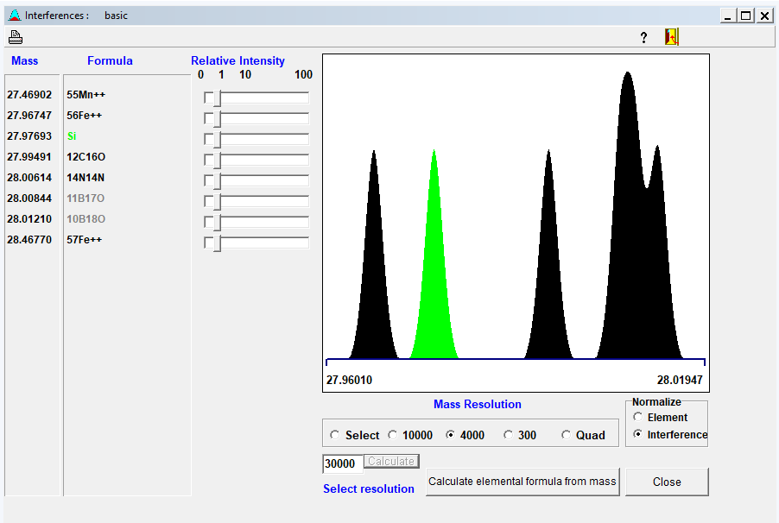

Slide 30


