Slide 1
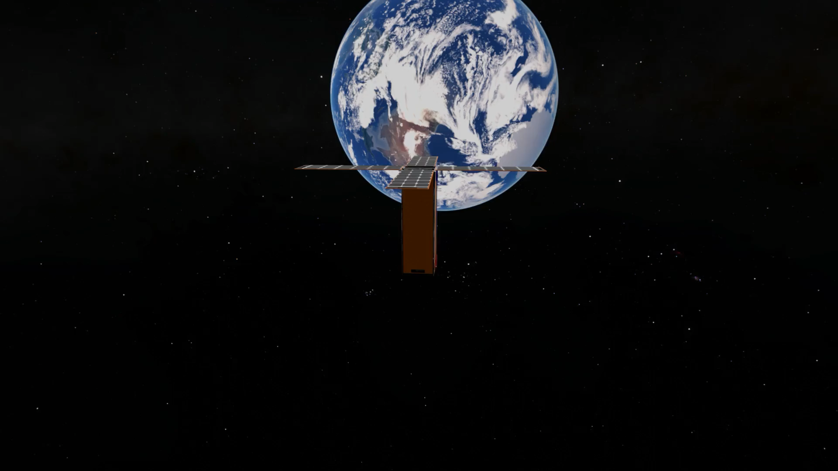
Nanosat_Q
TIFPA Meeting
R. Battiston
May 11 th 2026
UniTn P. Asenov, R. Battiston, D. Bortoluzzi, D. Tabarelli, A. Perinelli, M. Summo, M. Tomasi+…..Team APP
TIFPA D. Corti, C.Manea, E. Ricci, A. Rivetti, C. Zanoni +…..Team APP
UniTo V. Pagliarino
Università Insubria M. Caccia
NLR J. van Es, T. Ganzeboom
Astradyne G. Alessandrino, Regondi, T. Sironi, D.Vittori
2NDSpace D.Rastelli, N.Bellini, S.Naldi

Slide 2
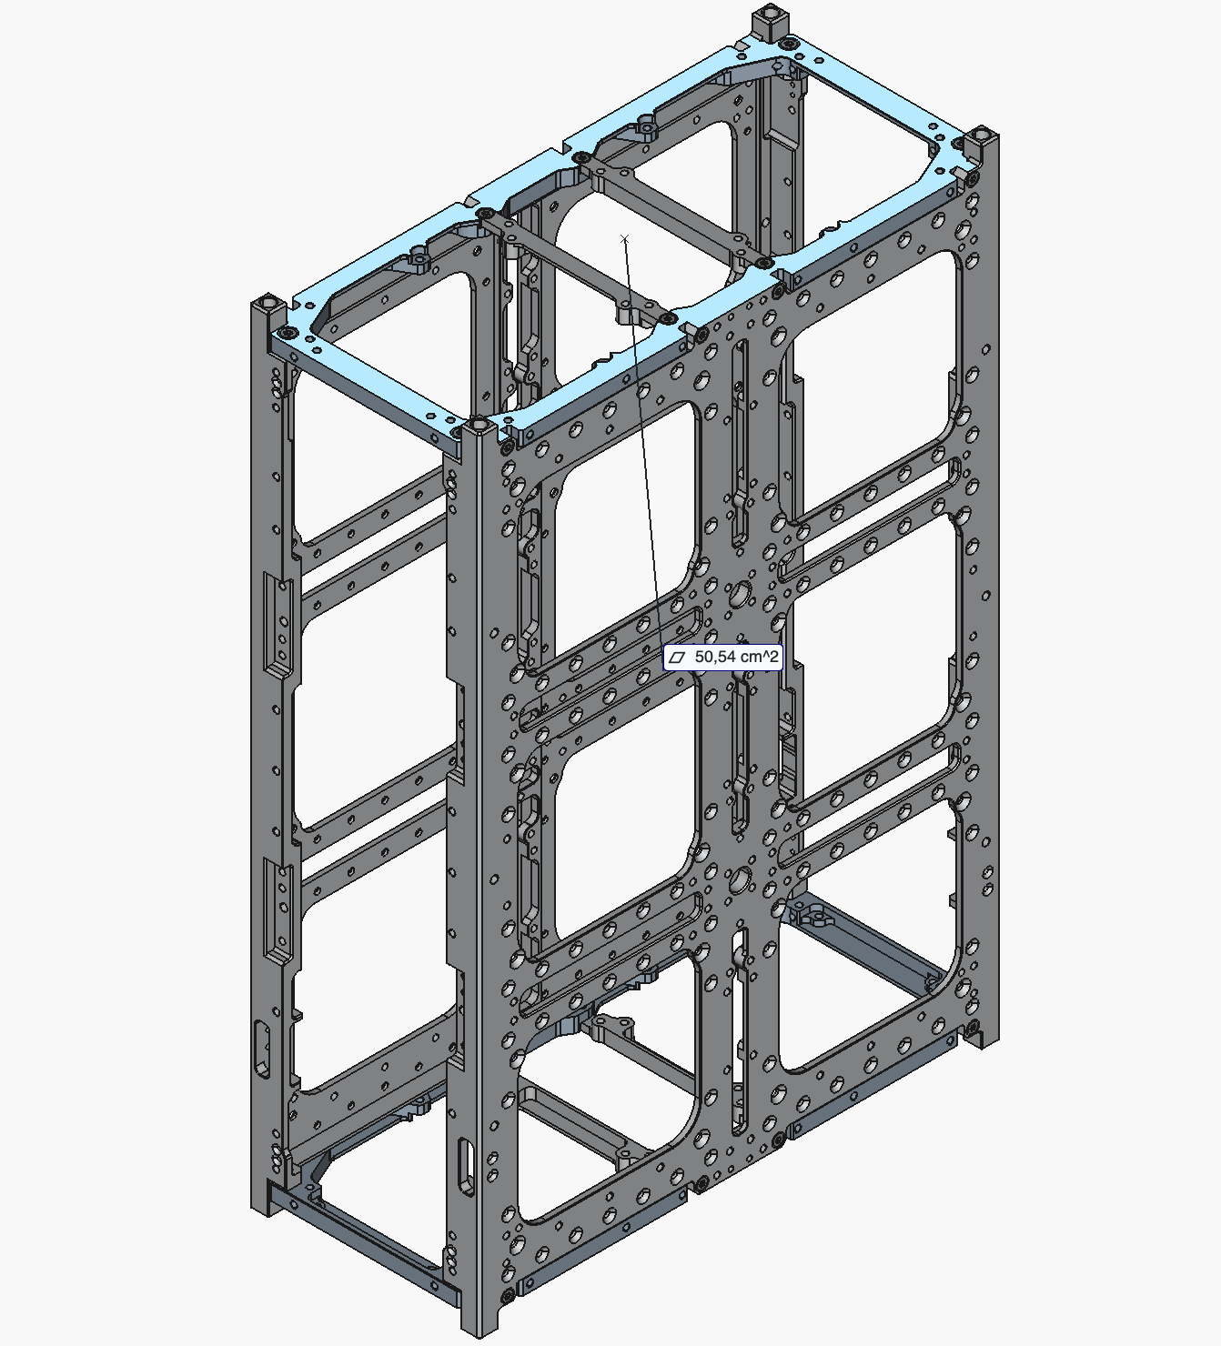
6U nanosat
AstroDyne with 2ND Space
Table 1 – Mission Overview (6U CubeSat)
Mission Type
6U CubeSat
Launch Date
Spring 2027
Payload Delivery Deadline
Fall 2026
Orbit
Sun-Synchronous Orbit (SSO), ~520 km, LTAN 10:30 (preliminary)
Orbital Inclination
98°
Mission Duration
⁠1 year

Slide 3
Radiation Resistant Computing Architecture
by INFN-To & TIFPA

Slide 4


Single-board Payload M² Orbit
Maia & Mizar Orbital Research for Background dosimetry and IC Testing
PRELIMINARY PROPOSAL OF PAYLOAD
V. Pagliarino, A. Rivetti
UniTo & INFN_TO

Slide 5
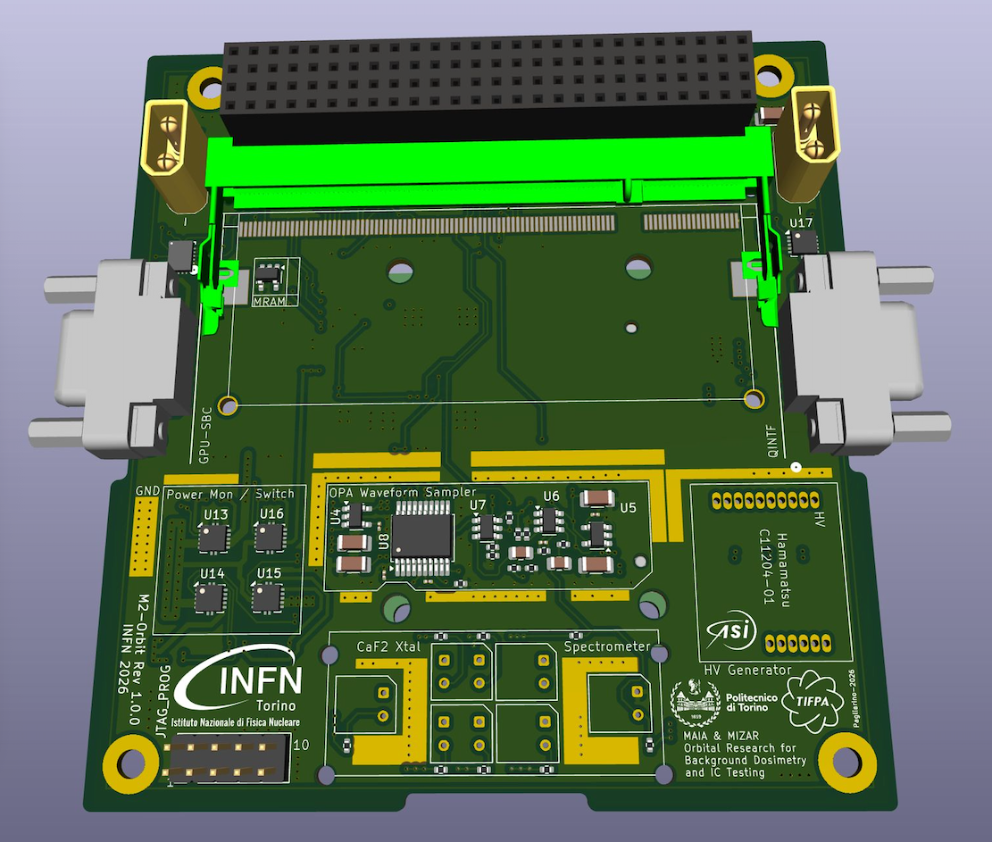

Slide 6
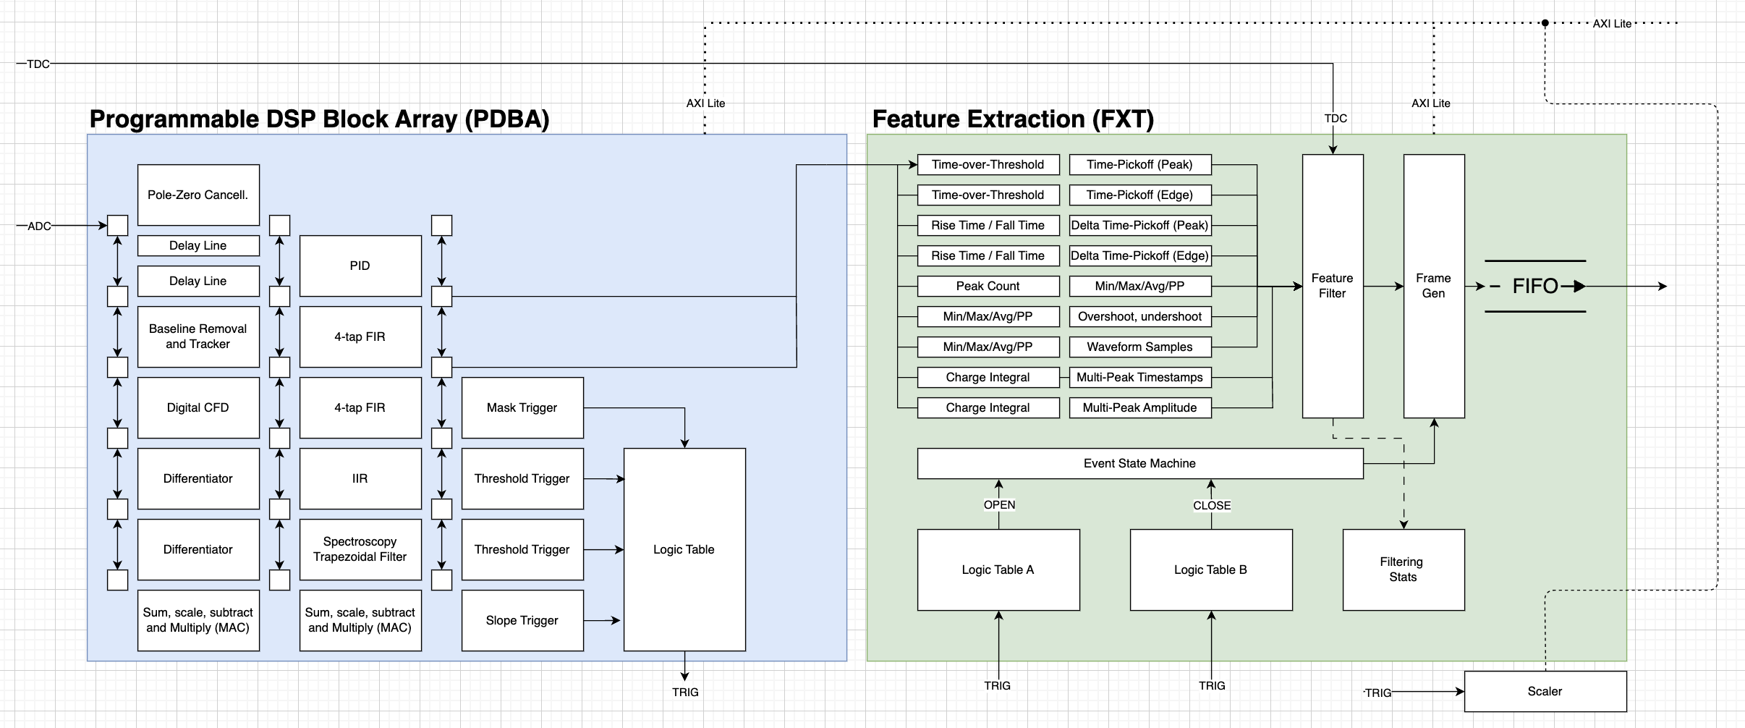
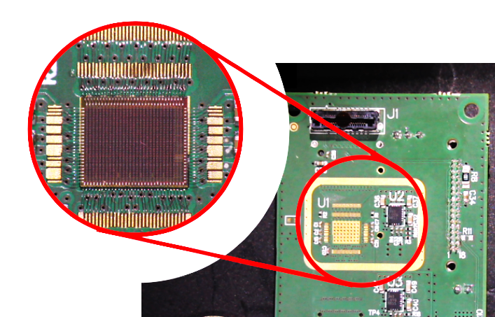
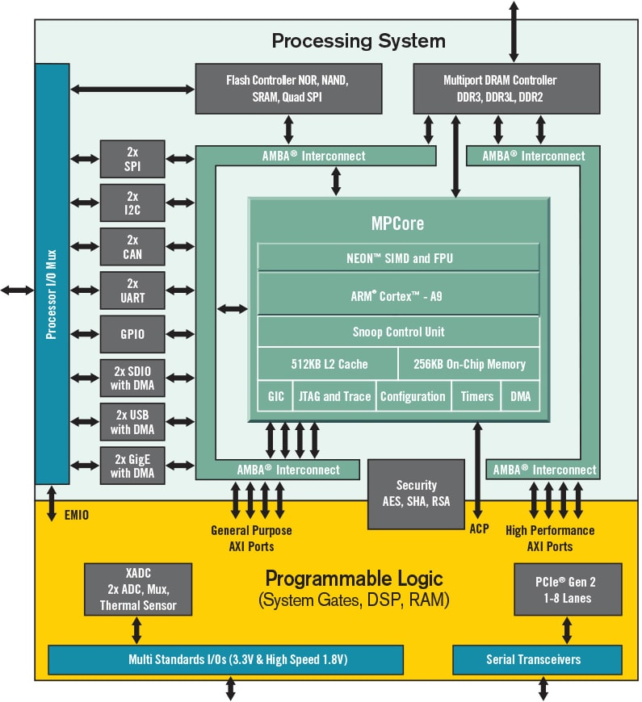
Goals
We need a heat source to test the innovative cooling system… can we produce heat with something scientifically interesting & useful? (TDP of the proposed payload is up to 10 W)
At INFN we have several electronics payloads that would benefit from testing in space:
Testing in space an innovative DSP ASIC for particle & nuclear physics that might be interesting for future satellite-based projects and contains a RISC-V CPU with radiation tolerance. It is planned to be taped out in 28 nm in the last quarter of 2027 with embedded mixed-signal ADC named “MAIA”.
Testing in space a 65-nm a waveform sampling SiPM front-end and data converter ASIC named “MIZAR”
SiPM+scintillators as detector test veichle -> Dosimetric measurements in space, correlations with SEU rate and position in the orbit.
Testing a single-chip (excluding flash memory) solution for programmable logic deployment on low-orbit cubesats that implements partial reconfiguration based on Zynq 7000

Slide 7
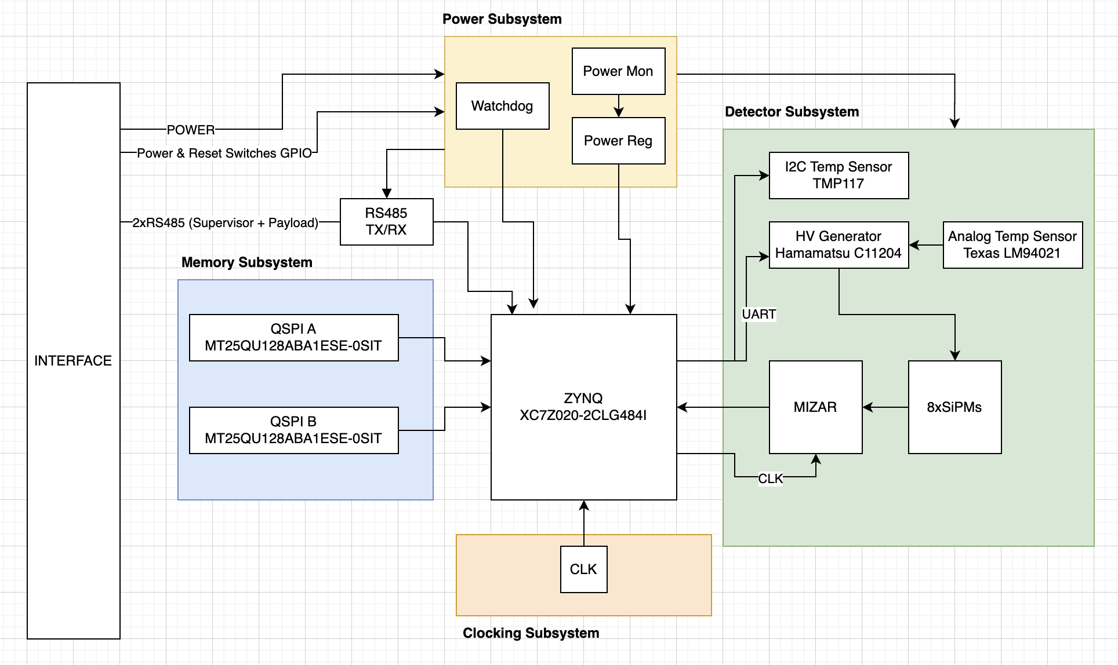
Electronics architecture
0
Golden PS boot image
User PS boot image
Golden Bitstream
Bitstream slot 0
Bitstream slot 1
MAIA SoC Image
USER SPACE
128M
Golden PS boot image
User PS boot image
Golden Bitstream
Bitstream slot 0
Bitstream slot 1
MAIA SoC Image
USER SPACE
256M
Stacked NOR flash chips

Slide 8
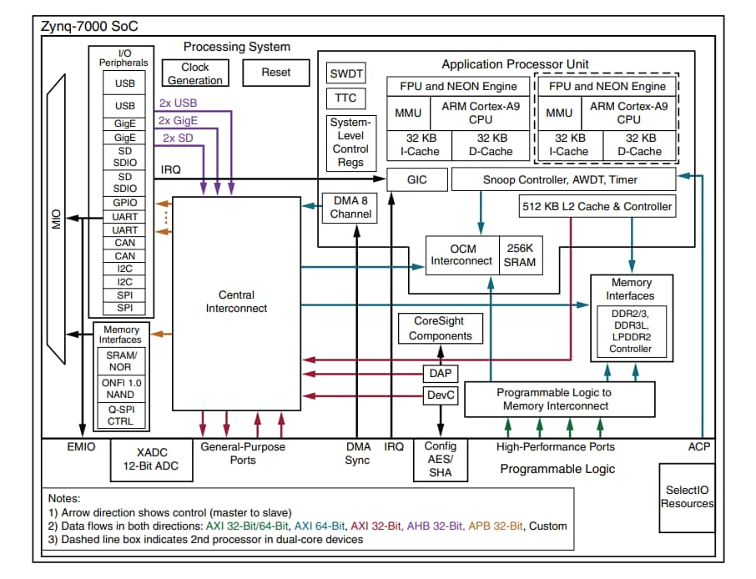
Zynq soc architecture
PS CORE 0: Main scrubber for FPGA and system health monitor
PS CORE 1: FW&MAIA programmer, Mizar configuration, diagnostics, C0 monitor
OCM SRAM: 256K without any external SRAM/DRAM chip
I2C interface to sensors, UART1 interface to HV PSU, GPIOs to power mon, SPI to Mizar, UART0 to the spacecraft
MAIA SoC digital top level, optimized, implemented in the PL

Slide 9
SEE protection Techniques
SEU protected scientific payload logic in the FPGA firmware
Internal scrubbing of the FPGA PL configuration with single-zone correction withouw reset using SEM IP
External scrubbing of the FPGA PL configuration (CRAM) through PCAP from the PS Core 0, against the currently active image
Software-level TMR on core 0 program
Software-level scrubbing (running on core 0) between stacked QSPI chips
Core 1 watchdog on core 0
Core 0 monitoring on core 1
Triplicated Microblaze internal watchdog on core 0
External chip implementing general watchdog
External chip implementing anti-latchup current monitor with fast MOSFET switch

Slide 10
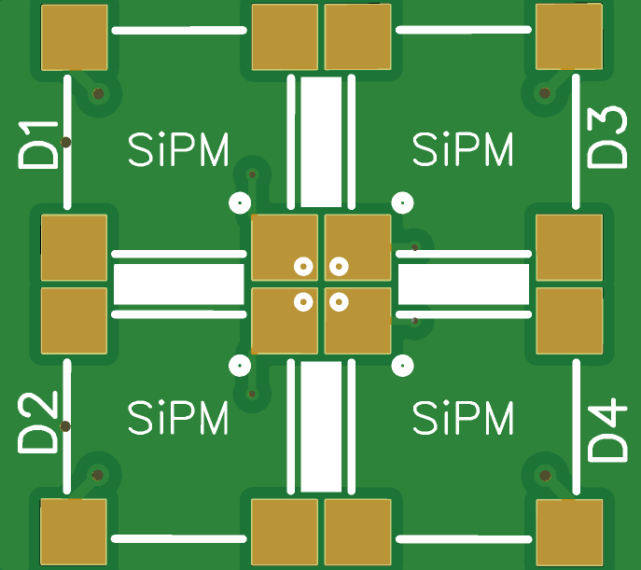
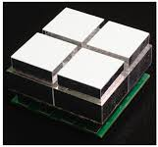
Sipm-based dosimeter
Space dosimetry:
Based on harsh-environment capable scintillators
Very high SNR, threshold well above 1 phe ⇢ DCR suppressed, ideal with very low readout bandwidth
Charged particles detection with coincidence
Soft X and Gamma Rays detection
dE/dx measurements
Dose measurements
Correlation measurements with SEUs
Basic particle identification capabilities using coincidence and dE/dx
4+4 cells
Calcium Fluoride Scintillator
CaF₂ (Eu) - 2x2x3 mm³ –
Non-igroscopic, chemically inert
1 us decay time
435 nm peak emission
Suitable for charged particles, < 100 keV gamma rays, X-rays Suitable for harsh environments
Hamamatsu S13360-2050VE
2x2 mm² – 50 um pitch
53 V typ V_{breakdown}
Glass Epoxy Package
Peak wavelenght 450 nm
10⁶ gain
300 kHz DCR @ 0.5 phe

Slide 11
3. QRNG in SPACE
UniInsubria, TIFPA, UniTN, UniTo

Slide 12
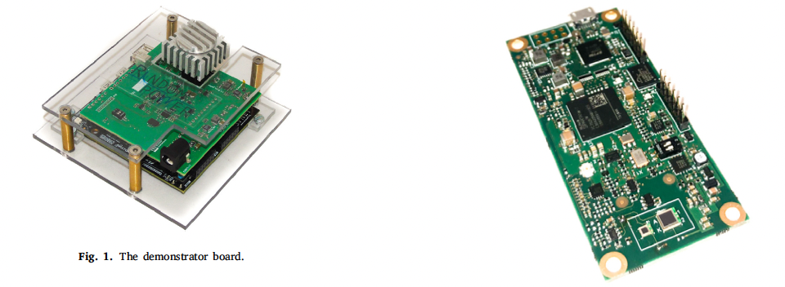
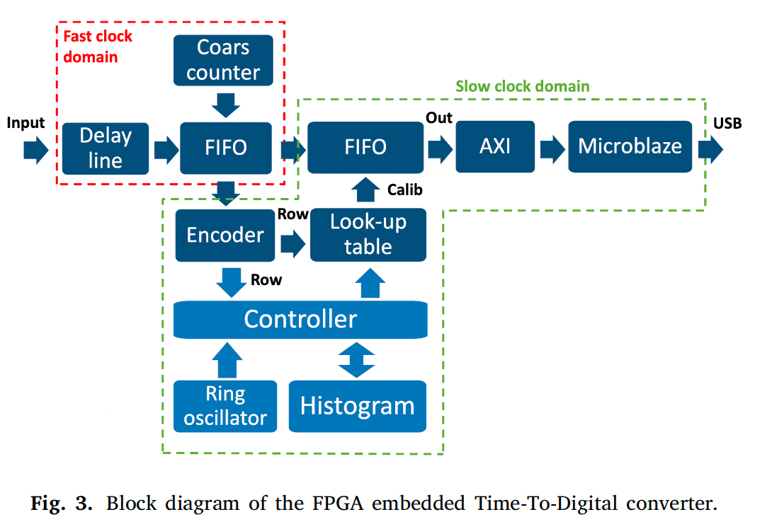
RANDOM POWER QRNG
01
Quantum dark pulses to random bits
Tunneling avalanche pulses in silicon replace the external light source of a photonic QRNG.
SiPM in darkness
Avalanche p–n junctions
Quantum carrier generation
thermal / field / tunnelling
Sub-ns pulse timing
FPGA TDC
Extraction + health tests
raw random stream
The entropy is in the stochastic arrival times, not in a deterministic algorithmic seed.
Poisson-like
40%
>1 Mb/s
ASIC path
arrival-time statistics
reported bit extraction efficiency
prototype board throughput
single-chip integration target
Key design asset for space: the source is internal, compact, electrically readable, and tolerant of rate changes with temperature.
Sources: Caccia et al., Nuclear Instruments and Methods A 980 (2020) 164480; Random Power leaflet 2026.
Notes:
Principle: SiPM dark pulses are time-tagged by an FPGA TDC and processed into raw bits. Caccia et al. report room-temperature pulse rates up to 1 MHz/mm², extraction efficiency around 40%, and prototype throughput above 1 Mb/s. Emphasize this is not a Josephson device and requires no cryogenics.

Slide 13
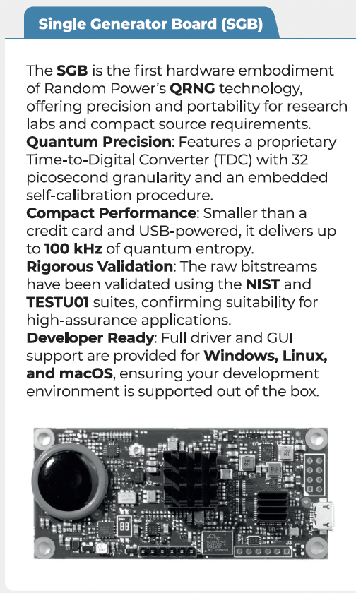
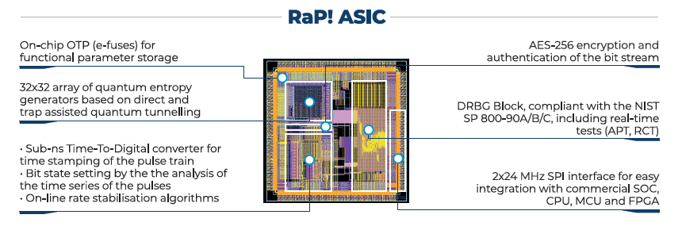
NANOSAT_Q INTEGRATION
02
Payload-to-security integration
A practical route is to fly the board as a supervised technology demonstrator, then expose its entropy to the onboard crypto stack.
Mission role
Integration message: start as a technology payload; only after health monitoring is proven, allow it to feed real secure services.
Non-critical payload during commissioning
Autonomous logging across orbital day/night cycles
Progressive hand-over: from recorded entropy to live key material
RaP SGB / ASIC
quantum entropy source
NANOSAT_Q
payload controller
Entropy manager
health + buffering
On-board crypto
AES + PQC seeds
UHF/S-band link
TM/TC security
Option A — near-term flight board
Option B — follow-on ASIC
Single Generator Board or equivalent engineering model; USB/SPI interface; telemetry of raw timestamps, health flags, temperature, bias and rate.
After board-level validation: smaller mass, lower power, tamper-resistant configuration and direct integration in the spacecraft computer.
Sources: Random Power leaflet 2026; NANOSAT_Q integration concept based on project payload architecture.
Notes:
Recommended integration sequence for NANOSAT_Q: (1) fly the board as payload, (2) acquire timestamps and metadata, (3) run health tests and entropy estimation on ground, (4) then use the stream to seed the onboard cryptographic stack.

Slide 14
IN-ORBIT VALIDATION
03
What the space demo should produce
The scientific output is not only “random bits”, but a reproducible validation dossier under real LEO conditions.
1. Raw evidence
time tags + metadata
2. Environmental map
rate vs T, bias, orbit
3. Statistical dossier
NIST + TestU01 + BoolTest
Minimum validation products
Claim enabled by NANOSAT_Q
Compare flight stream with ground reference model
Quantify min-entropy and autocorrelation over orbit segments
Correlate failures or rate shifts with radiation, thermal and mode changes
Demonstrate unattended reboot, calibration and health-test continuity
First in-orbit validation of the Random Power dark-pulse / silicon-tunnelling QRNG approach, with a space-relevant board/chip architecture and a traceable entropy model.
Important caveat: QRNGs have already flown on nanosatellites; the novelty here is this specific in-silico SiPM/ASIC approach.
Sources: Caccia et al. 2020; Reezwana et al., Communications Physics 2022 on SpooQy-1 QRNG in LEO.
Notes:
The product should be a flight-data package: raw pulse timestamps, housekeeping telemetry, offline entropy certification, and a comparison with the same board operated on ground. A defensible statement is first in-orbit validation of this specific Random Power/SiPM dark-pulse approach, not first QRNG in space.

Slide 15

QUANTUM-SEEDED SATELLITE SECURITY
05
Quantum-seeded satellite encryption
This is not QKD by itself. It is a practical path to make every onboard key depend on local quantum entropy.
QRNG
quantum entropy
Entropy pool
health tested
Session keys
per contact / orbit
Authenticated encryption
telemetry + commands
Ground segment
secure operations
Operational concept
Value of the demo
NANOSAT_Q can become a pathfinder for quantum-resilient satellite operations: the satellite is not just carrying a QRNG, it is demonstrating how quantum entropy hardens an entire spacecraft cyber layer.
Refresh link-layer keys at each pass or operational mode change
Use PQC key exchange / signatures for authentication and key agreement
Use QRNG as the private local seed, not as a public downlink key
Export only certified randomness reports or public beacon data when desired
Takeaway: fly the QRNG as a payload, validate it as an entropy source, then promote it to a spacecraft security primitive.
Sources: Random Power leaflet 2026; standard cryptographic architecture interpretation.
Notes:
Do not claim full quantum communication or QKD unless a quantum optical channel and protocol are added. The immediate implication is quantum-seeded conventional/PQC cryptography for all telemetry and telecommand.

Slide 16
3. HPC in SPACE 2
by Astrodyne
GPU Test Board

Slide 17
4. Advanced two phase cooling
by NLR (Holland)

Slide 19
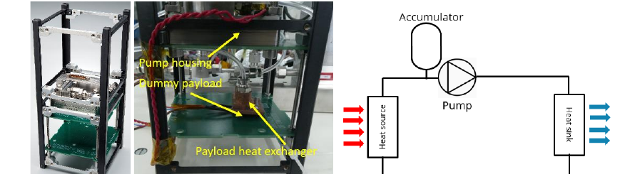
Mini-MPL for CubeSat thermal control
Design and modelling of a compact mechanically pumped loop
Proposes a compact active thermal-control loop for CubeSats, intended for missions where passive solutions become insufficient above roughly 20 W.
Core ideas are the multi-parallel micro-pump, flexible tubing, and a heat-switch function that limits over-cooling during eclipse.
The demonstrator integrated in a 2U structure showed 20 W steady-state heat transport and about 10 W orbit-independent capability, with future iterations targeting higher margins.
Takeaway: system-level paper moving from concept to integrated prototype.
Integrated mini-MPL prototype and schematic (from Figure 10).
Notes:
[Sources] - Claims and image: ICES-2021_039_Mini_MPL_Design_and_modelling.pdf, pp. 4, 11-12. - Key facts used: compatibility with CubeSats, heat-switch function, 20 W steady-state transport, ~10 W orbit-independent transport, and future higher-capacity iterations. [/Sources]

Slide 20
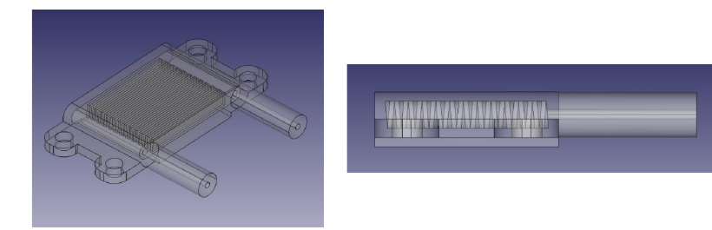
Miniature heat exchanger for the mini-MPL
Component-level design, modelling, and validation
Focuses on the payload heat exchanger of the loop, optimized for small CubeSat footprints, low mass, and low pressure drop in the 10-100 W range.
Compares several internal geometries; offset strip fins perform best in the trade-off study, while triangular and trapezoidal channels are also retained as promising options.
Metal 3D-printed prototypes are then tested, showing that the modelling approach can support practical miniaturization of the thermal-control system.
Double Triangle heat-exchanger CAD views (from Figure 7).
Takeaway: component paper validating manufacturable mini heat exchangers.
Notes:
[Sources] - Claims and image: ICES-2022-182.pdf, pp. 2-3, 6-8, 11. - Key facts used: design requirements for CubeSat heat exchangers, 10-100 W target range, offset strip fin performance, promising triangular/trapezoidal channels, and experimental validation of prototypes. [/Sources]

Slide 21
MILESTONES
15th April
15th June
30th July
30th September
Specs
Integration & Testing
PCB & Mechanical design
PCB & Mechanical fabrication
System controller & scrubber SW design
Payload FW design

