Slide 1

A pedagogical Introduction to FLUKA + hands-on tutorial
Daniele Calzolari (CERN SY-STI-BMI)
with material from previous lectures by G. Lerner, A. Lechner, F. Salvat Pujol, F. Cerutti
An overview of FLUKA
https://agenda.infn.it/event/51984/
Roma 4/5/2026

Slide 2
1. Get FLUKA & Flair to work

Slide 3
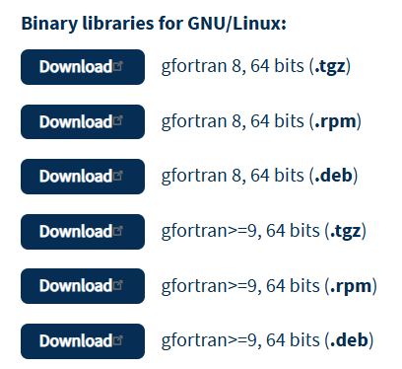
Step 0: get FLUKA
After a successful registration, you can download the binaries or FLUKA from the official website (https://fluka.cern/download/latest-fluka-release)
I chose this for my machine!
(Ubuntu 24.04.3 LTS via WSL)

Slide 4
Step 0: get FLUKA (… and a lazy one-liner)
wget https://flair.cern/download/flair-3.4-5.2.tgz
wget https://flair.cern/download/flair-geoviewer-3.4-5.2.tgz
tar xzvf flair-3.4-5.2.tgz
tar xzvf flair-geoviewer-3.4-5.2.tgz
rm flair-geoviewer-3.4-5.2.tgz
rm flair-3.4-5.2.tgz
cd flair-geoviewer-3.4
make -j 8
make install DESTDIR=../flair-3.4
cd ..
tar -xvf fluka-4-5.1.x86-Linux-gfor9.tgz
cd fluka4-5.1/src/
make -j 8
cd ../
wget https://flukafiles.web.cern.ch/flukafiles/neutron/fluka_pw_jeff-3.3-1-1.tar.gz
tar xvfz fluka_pw_jeff-3.3-1-1.tar.gz
rm fluka_pw_jeff-3.3-1-1.tar.gz
cd ..
# Can be useful to have an alias like this:
alias myflair=$(pwd)/flair-3.4/flair
Download, extract and install flair
Compile FLUKA and download neutron cross section
Consider doing it for your laptop!

Slide 5
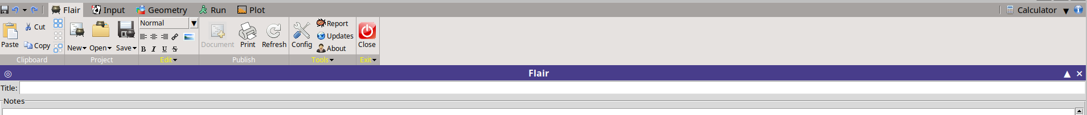
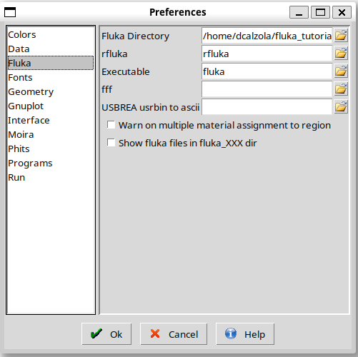
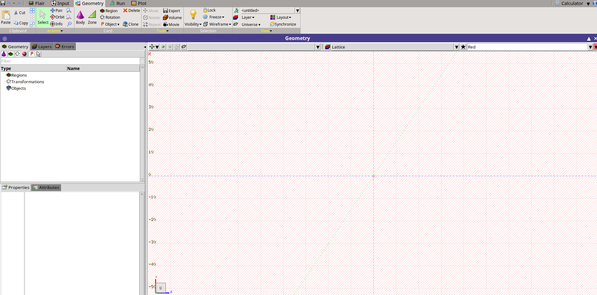
Flair: the first rendezvous
If all of that was successful, you can invoke flair, and it should open. First sanity checks:
  The geoviewer works
  The Flair (and FLUKA) versions are correct
The first time you open flair, you should check that the FLUKA path is correct
Geometry is not complaining!
Check the Fluka Directory

Slide 6
1. Objectives of today

Slide 7
How we are going to work
On your computer you should be able to access to a working FLUKA and a (obsolete) Flair version.
We will go through an example at the time together. Do not spoil yourself the solutions just yet.

Slide 8
Tasks
Today we will try to perform some simple simulations:
  Proton Bragg peak: setup from scratch & visualization (~15 min)
  Other particles & energies: particle fluence comparisons (~15 min)
  Target activation: measuring induced radioactivity (~15 min)
Interesting topics I will not talk about:
  User routines (but you can find more information in the last advanced course)
  Advanced physics options (photonuclear, electronuclear, …)
  Event by event scoring
  EM fields
  Biasing

Slide 9
1. Bragg peak simulation

Slide 10
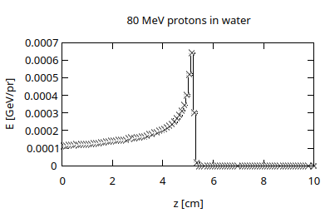
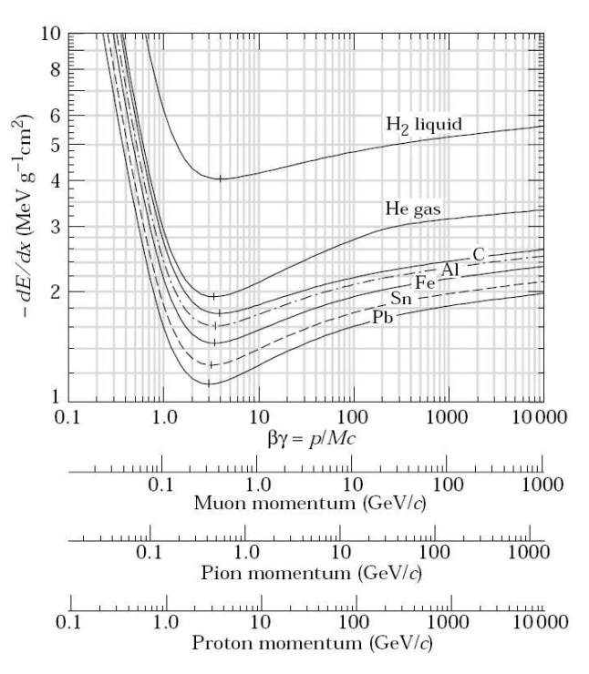
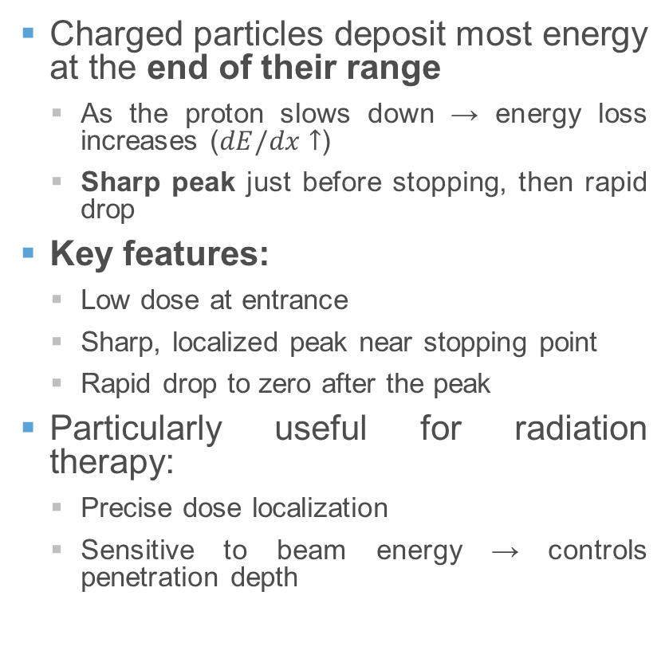
1. What is the Bragg peak
Charged particles deposit most energy at the end of their range
  As the proton slows down → energy loss increases ($dE/dx↑$)
  Sharp peak just before stopping, then rapid drop
Key features:
  Low dose at entrance
  Sharp, localized peak near stopping point
  Rapid drop to zero after the peak
Particularly useful for radiation therapy:
  Precise dose localization
  Sensitive to beam energy → controls penetration depth

Slide 11
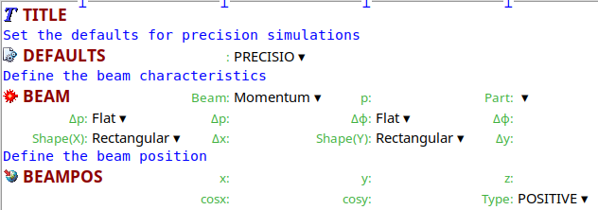
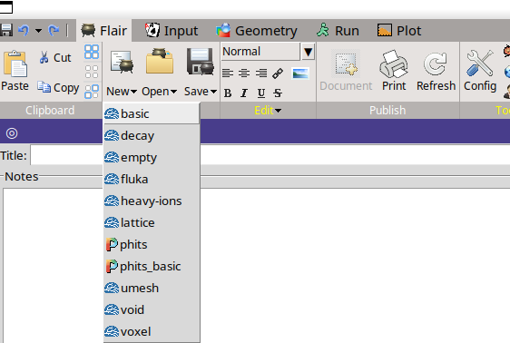
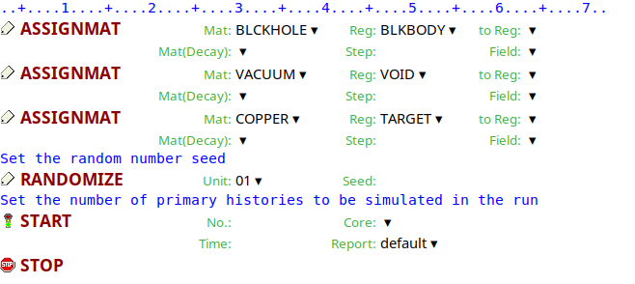
1. Bragg peak simulation: setup
Non-geometry cards
Flair helps us here: let’s create a new inputfile ‘basic’

Slide 12
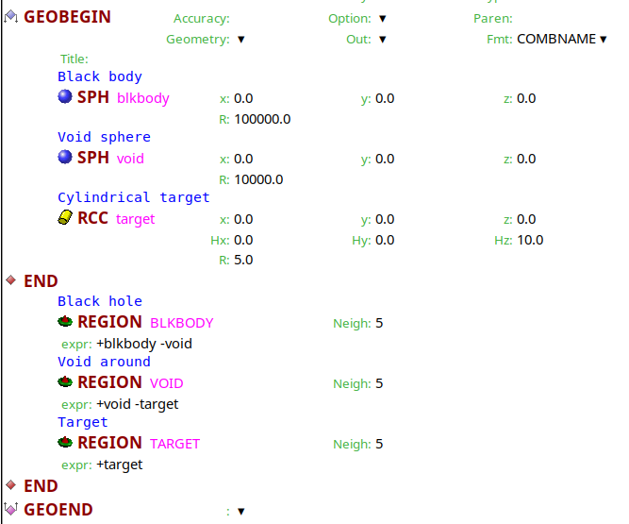
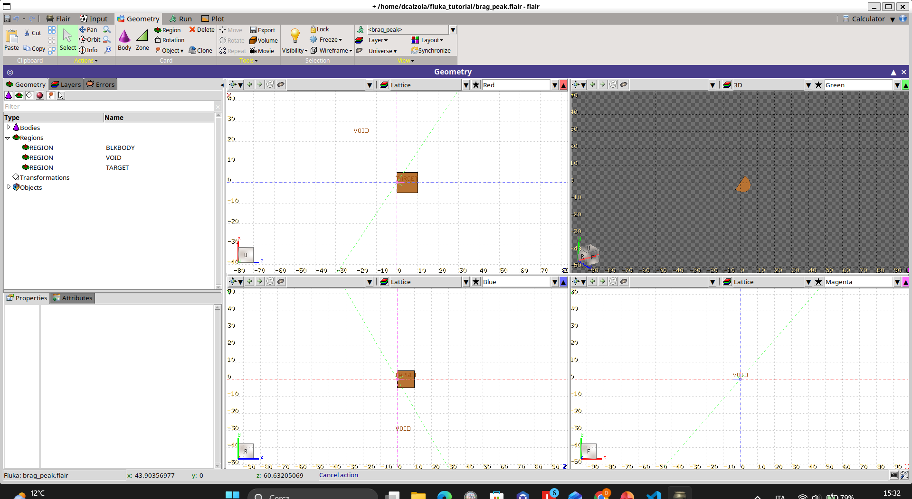
1. Bragg peak simulation: geometry
Extremely simple geometry: cylinder in vacuum
No need to change it for this example
Geometry cards

Slide 13
1. Bragg peak simulation: finalize inputfile
Few actions are needed before launching the simulation:
  Set up the correct beam with BEAM card. We want to start with 80 MeV protons (hint: FLUKA uses GeV as unit of measure of energy)
  Check that we are happy with the default PRECISIOn
  Modify target material to water
  Add scoring. For this, we want to score on a grid the energy deposition. Use a USRBINs scoring

Slide 14


1. Bragg peak simulation: finalize inputfile
Few actions are needed before launching the simulation:
  Set up the correct beam with BEAM card. We want to start with 80 MeV protons (hint: FLUKA uses GeV as unit of measure of energy)
  Check that we are happy with the default PRECISIOn
  Modify target material to water
  Add scoring. For this, we want to score on a grid the energy deposition. Use a USRBINs scoring
Modified BEAM card
Added USRBIN

Slide 15
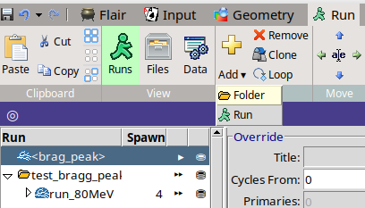
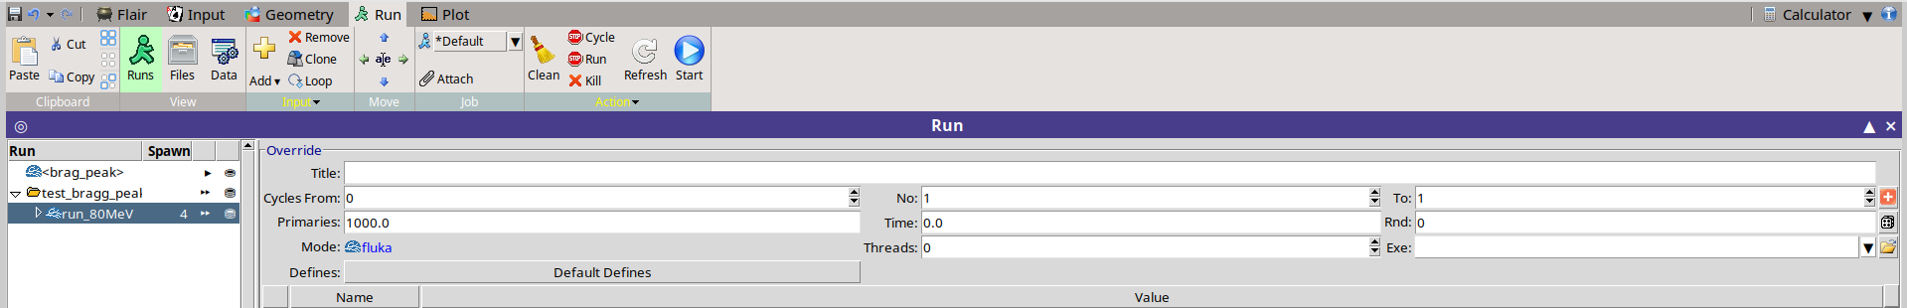
1. Bragg peak simulation: run
We will run FLUKA directly from Flair. I suggest those 2 optional passages:
  Create a folder where you want to run this set of simulations
  Create the Run specifying 1000 primaries in 4 spawns (or cycles)
Spawn: independent simulations (in parallel)
Cycles: sequence of simulations

Slide 16
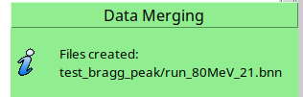
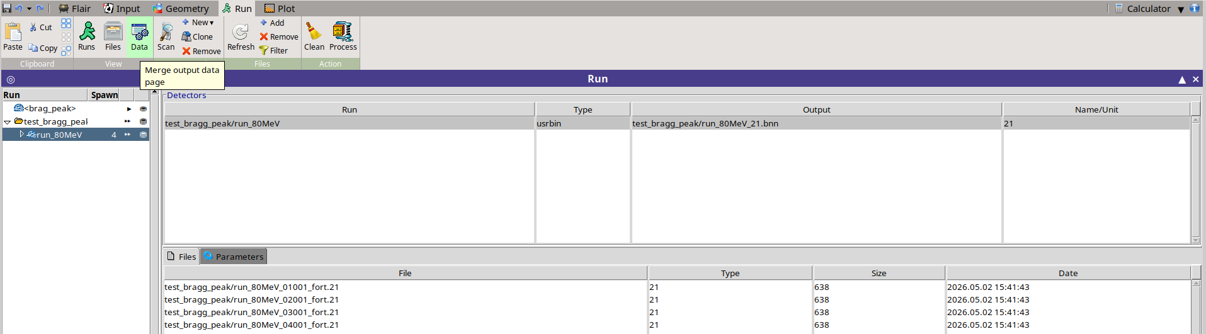
1. Bragg peak simulation: process
After pressing run, the simulation hopefully finishes smoothly. You have now to process the data
Just click on Process
In Data Flair automatically picks up your scorings

Slide 17
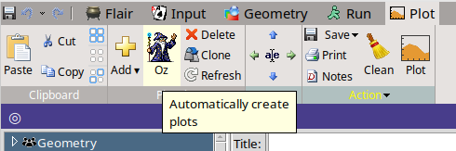
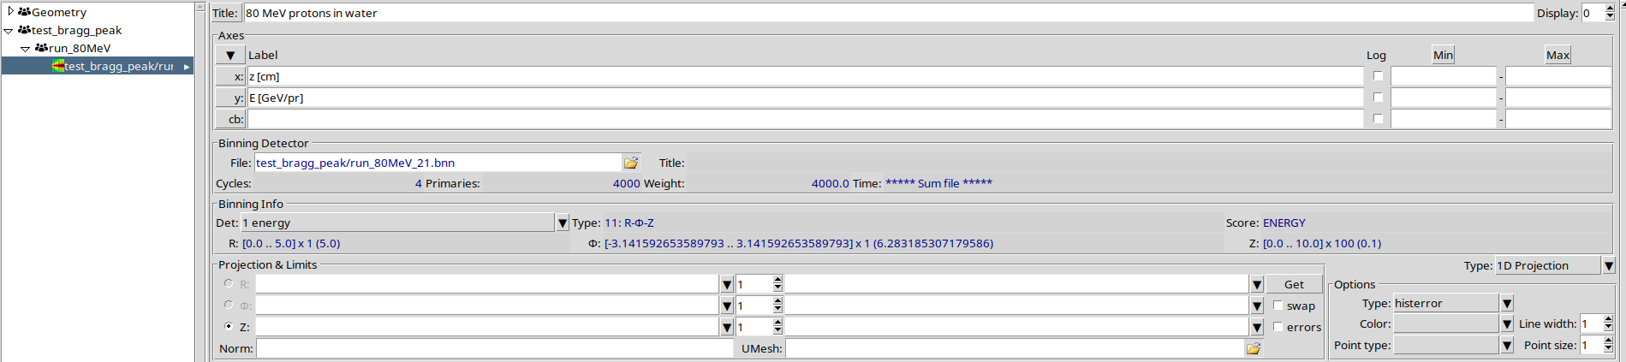
1. Bragg peak simulation: plot
With the final *.bnn binary data, you want to plot the longitudinal profile
The Oz wizard can help us (remember to finalize his guessing)

Slide 18
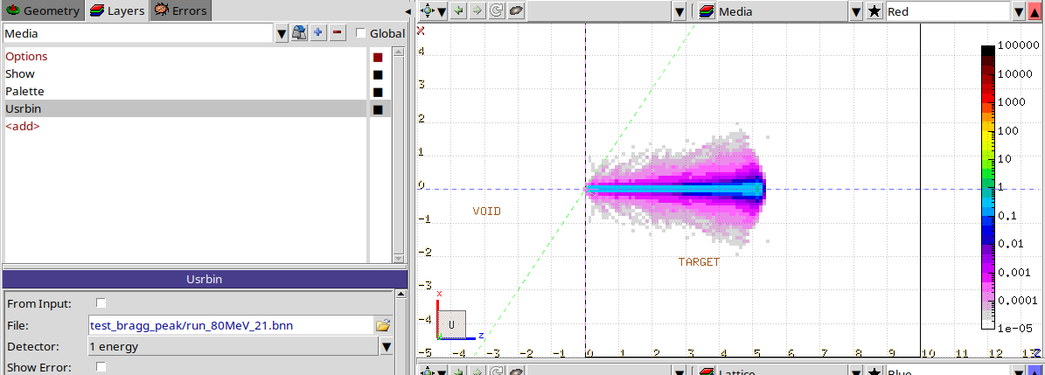
1. Bragg peak simulation: plot
It is also possible to superimpose the USRBIN results to the geometry viewer

Slide 19
1. Bragg peak simulation: some homework
We scored and plotted the Bragg peak by proton in water. Some interesting topics can be also checked:
  Compare the proton range against the pstar reference
  Check how it moves with proton energy/target material
  Start with realistic beam sizes/divergences
  Think of a way of generating a SOBP (Spread Out Bragg Peak) if you want to distribute the dose in a certain volume

Slide 20
2. Other particles/energies

Slide 21
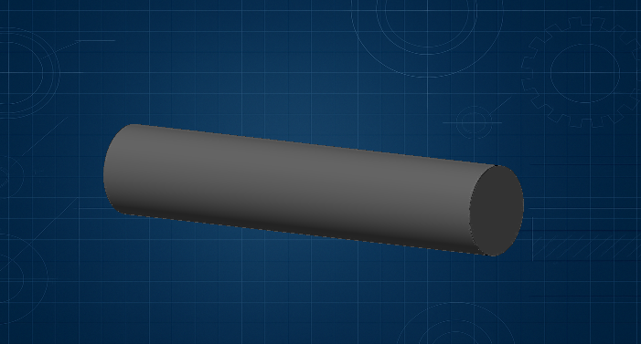
2. Other particles/energies
In this second part of simulation, we are going to use high energy protons and electrons
Change the geometry to a 6 m long Carbon target (we can imagine this as being a beam dump)
6 m
1,2 m

Slide 22
2. Other particles/energies: preprocessor directives
So far, all information were hardcoded. We want more flexibility to run a set of simulations:
  If/else statement to select protons or electrons
  Energy variable to scan across

Slide 23
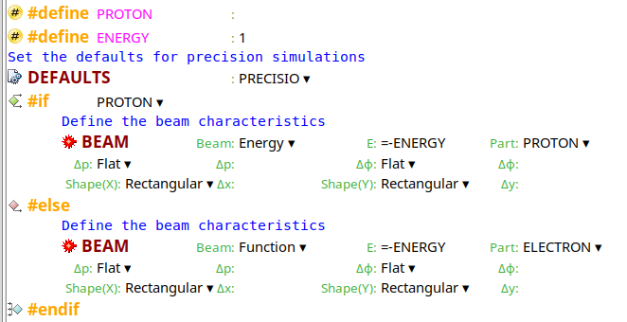
2. Other particles/energies: preprocessor directives
So far, all information were hardcoded. We want more flexibility to run a set of simulations:
  If/else statement to select protons or electrons
  Energy variable to scan across
PROTON: used to select which card to use
ENERGY: variable used inside card’s WHATs

Slide 24
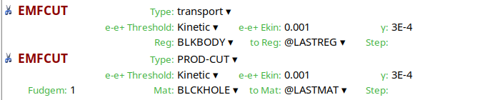
2. Other particles/energies: energy cuts
To ran the simulation in less time, let’s increase the energy thresholds. Set them at 1 MeV for e^{+/-} and 300 keV for photons
Production and transport cut should be the same
FUDGEM parameter. This parameter rules the contribution of atomic electrons to multiple scattering

Slide 25
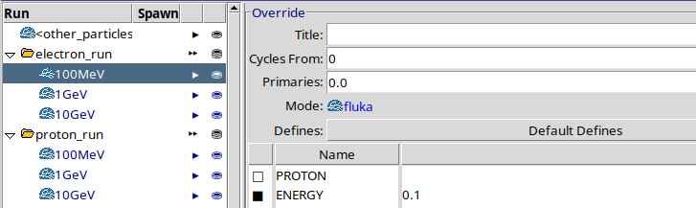
2. Other particles/energies: high energy p & e^{+/-}
Create a folder for protons and one for electrons. Ran simulations with energies ranging from 100 MeV to 10 GeV
How varies the CPU time?

Slide 26
2. Other particles/energies: high energy p & e^{+/-}
Plot the results. How the energy distribution looks like?
Why the Bragg peak disappears with high energy protons?

Slide 27
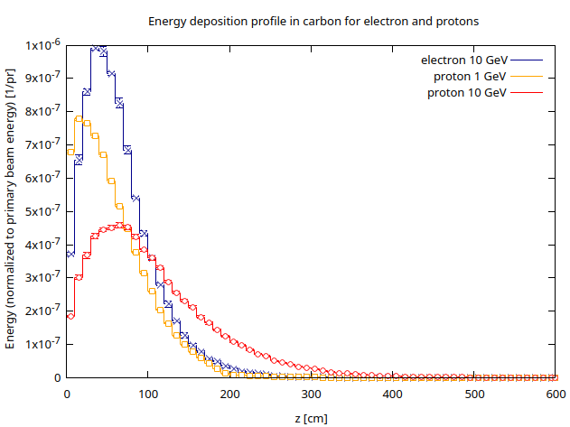
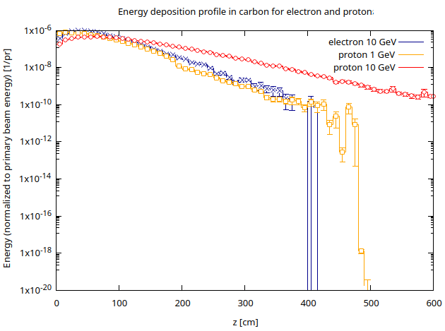
2. Other particles/energies: high energy p & e^{+/-}
Is it more difficult to shield protons or electrons?
How to explain the tail in the distribution?
log scale

Slide 28
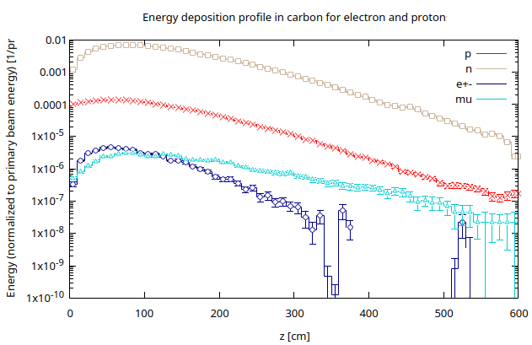
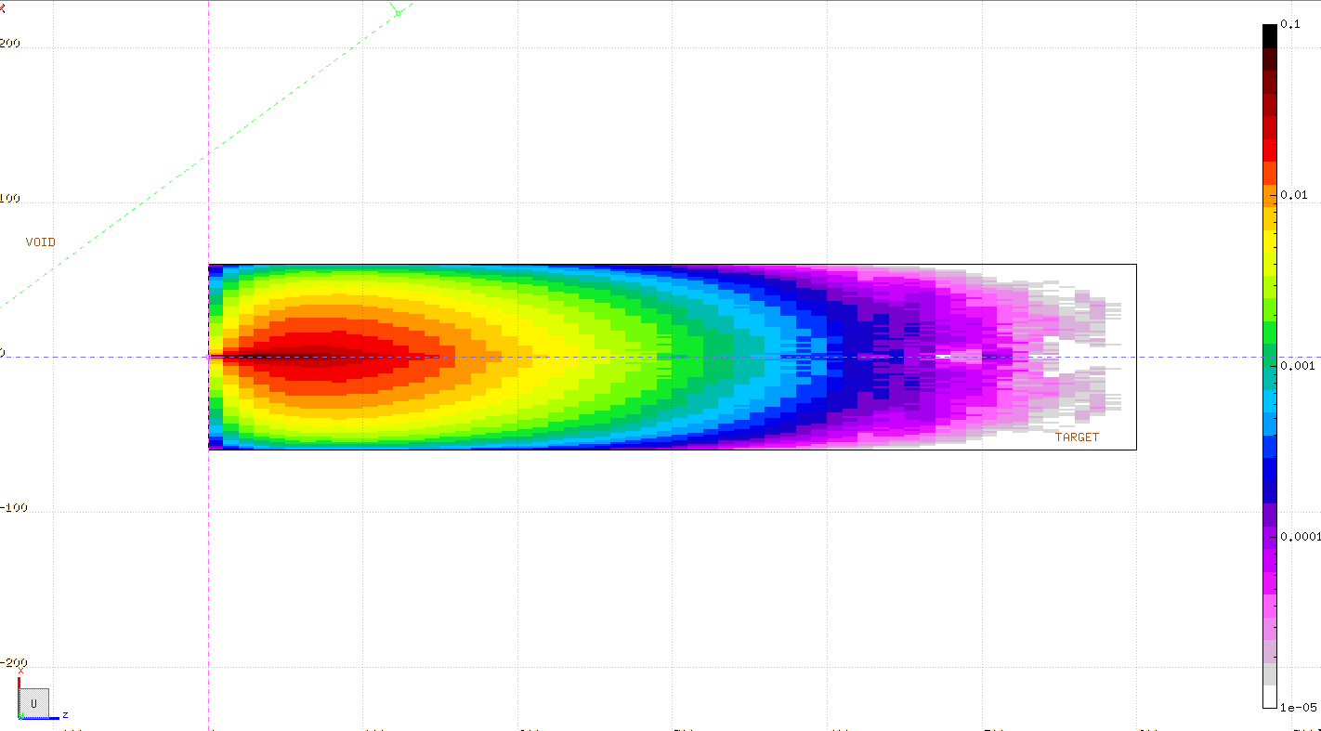
2. Other particles/energies: observe particle fluences
Let’s consider the 10 GeV proton case.
With USRBIN scorings check the particle fluence in the volume (e^{+/-}, neutrons, protons, pions and muons)
Are we leaking neutrons? Check the spectrum exiting the dump via USRBDX
Neutron fluence

Slide 29
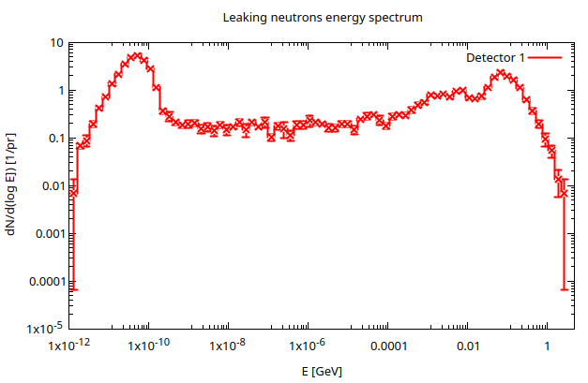
2. Other particles/energies: observe particle fluences
Let’s consider the 10 GeV proton case.
With USRBIN scorings check the particle fluence in the volume (e^{+/-}, neutrons, protons, pions and muons)
Are we leaking neutrons? Check the spectrum exiting the dump via USRBDX
Can you explain the spectrum shape?
Neutron fluence

Slide 30
3. Activation

Slide 31
3. Activation: why is important
Induced radioactivity is an integral part of many Radiation Protection assessments
Total and/or specific (mass) activity for all the various radionuclides
Basic Scoring options in FLUKA:
  RESNUCLEi - Region based: gives access to full inventory information (radionuclide specific incl. isomeric states)
  Other options: FLUKA Advanced course

Slide 32
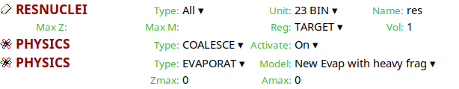
3. Activation: how to enable it
To appropriately score the residual nuclei, we need to enable:
  The coalescence treatment
  The evaporation of heavy fragments
Please remember to run with flukadpm or to link RQMD and DPMJET if producing a custom executable

Slide 33
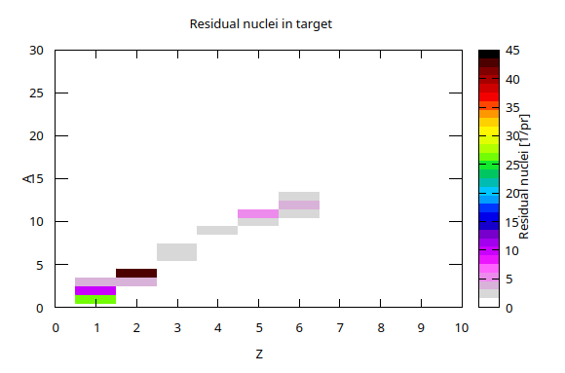
3. Activation: results with our geometry
With pure carbon the residual activation is minimal
We see elements up to Z and A of the target material
Some reactions:
  Fragmentation
  Fission (maybe not with carbon…)
  Capture
What would happen with a lead target? Let’s simulate it
Residual nuclei in C

Slide 34
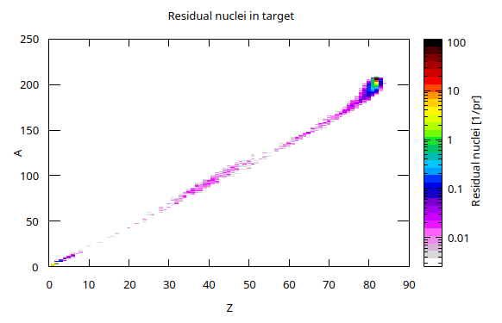
3. Activation: results with our geometry
High energy particles + heavy target → whole periodic table!
Residual nuclei in C
Residual nuclei in Pb

Slide 35
Conclusions
Today we barely scratched the surface of the FLUKA capabilities
FLUKA is incredibly powerful, and the standard de-facto for many applications (industrial, medical and research)
With a personal license you can continue to expand on the simple example I brought you today. It could be part of your job tomorrow!
If you want to dig deeper, many channels are open:
  FLUKA forum, where most Q&A takes place
  FLUKA courses
  …or just send me an email!

Slide 36
Thank you for your attention!

