Slide 1

An overview of FLUKA
Daniele Calzolari (CERN SY-STI-BMI) with material from previous lectures by G. Lerner, A. Lechner, F. Salvat Pujol, F. Cerutti
An overview of FLUKA https://agenda.infn.it/event/51984/
Roma 4/5/2026

Slide 2
Where we come from
FLUKA was born in the 60s at CERN with Johannes Ranft
It was further developed in the 70s and 80s in a collaboration between Leipzig University, CERN and Helsinki University of Technology for applications, e.g. at CERN’s high energy accelerators, and in the 90s with INFN, among others for the design of SSC and LHC
From 2003 until August 2019 maintained and developed under a CERN & INFN agreement
From December 2019, new CERN distribution aiming to ensure FLUKA's long-term sustainability and capability to meet the evolving requirements of its user community, welcoming contributions by both established FLUKA contributors as well as new partners within an international collaboration.
Presently a joint development & management team based in the CERN Accelerators and Technology Sector and Radiation Protection Group and at ELI-Beamlines (Prague) and FNAL, with contributors from the CERN Research and Computing Sector, JRC-Geel, ANL, BNL, and STFC, is in place.

Slide 3
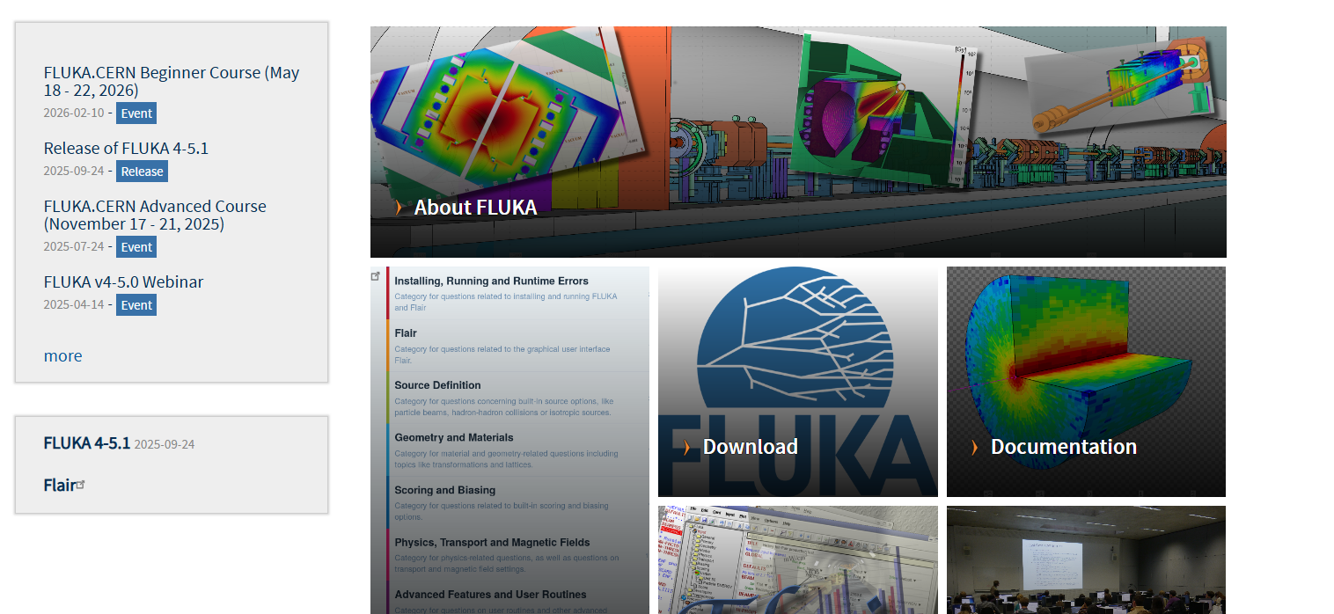
FLUKA.CERN distribution
https://fluka.cern

Slide 4
Licensing scheme
Licenses are free except for commercial use
They are granted for non-military use only
For central FLUKA installations on computing clusters of universities/institutes it is not necessary to obtain an Institutional FLUKA Licence. However, it is mandatory that all FLUKA users register on the fluka.cern website and accept the Single User Licence Agreement.
Registration options | access to
FLUKA Single User License Agreement | binary code
Affiliates of institutes with a FLUKA Institutional License Agreement | source code too
CERN Staff members and Fellows
Affiliates of institutes which signed the FLUKA Memorandum of Understanding | development version (binary and source code)
Companies which purchased a FLUKA Commercial License Agreement | binary code

Slide 5
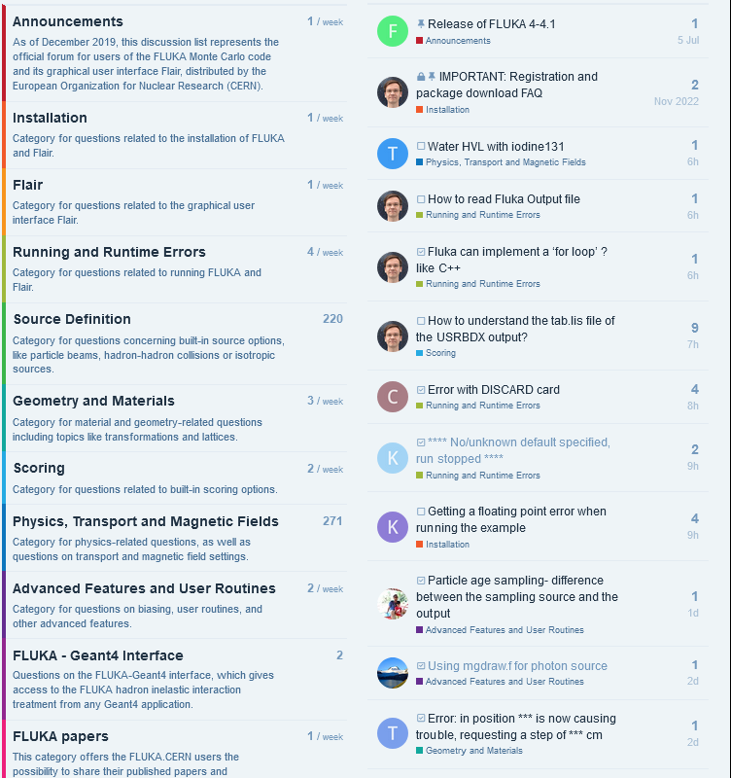
User support
FLUKA user forum
https://cern.ch/fluka-forum
Note: an independent one-time registration is required to be able to participate
FLUKA training
https://indico.cern.ch/category/9178
Beginner and advanced courses are held on a regular basis across the world
The first topical course (on Radiation Protection) was held in November 2024

Slide 6
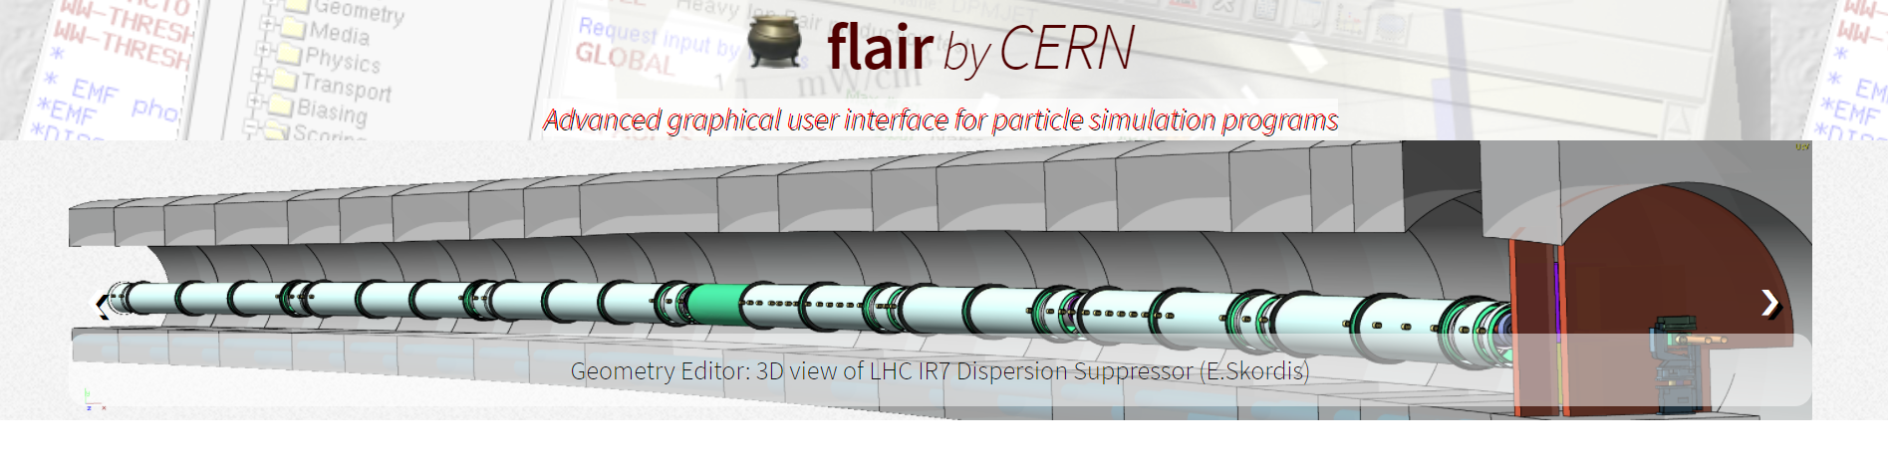
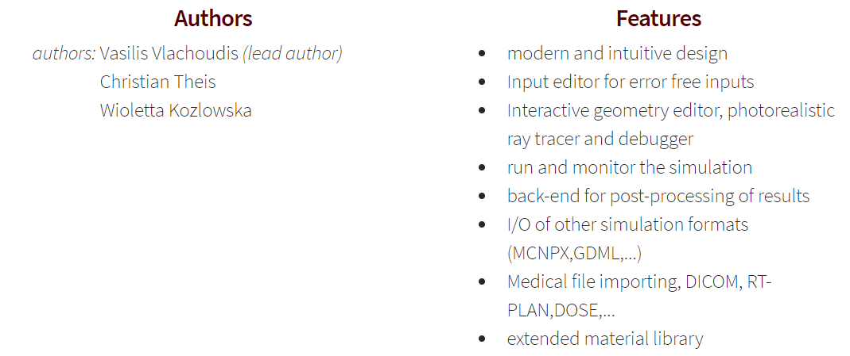
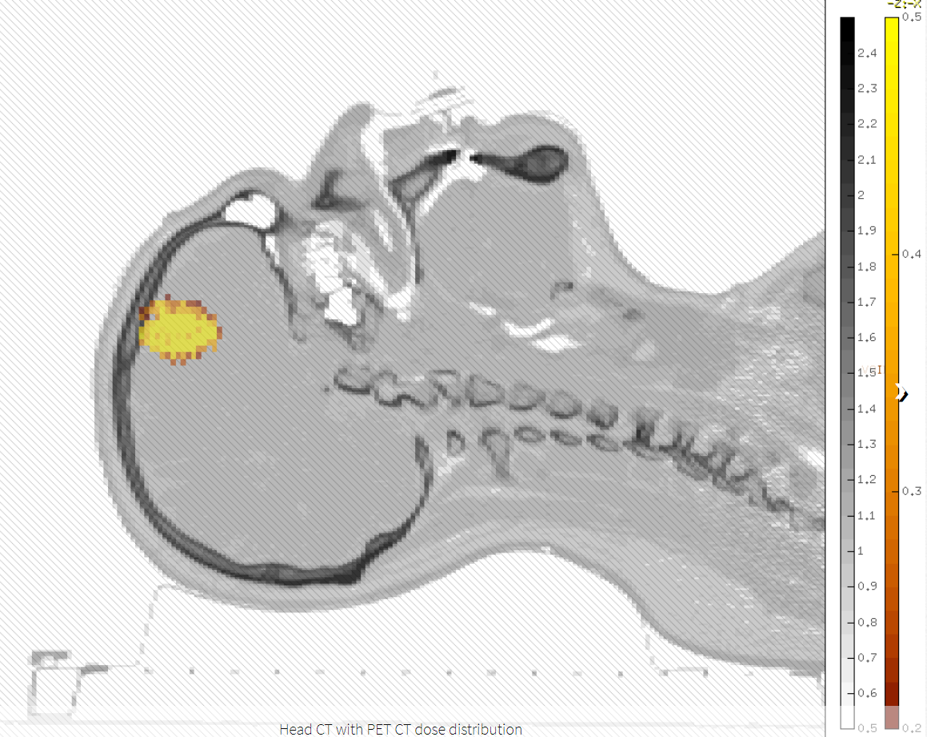
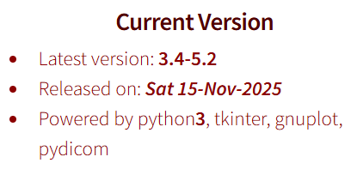
Flair
https://flair.cern

Slide 7
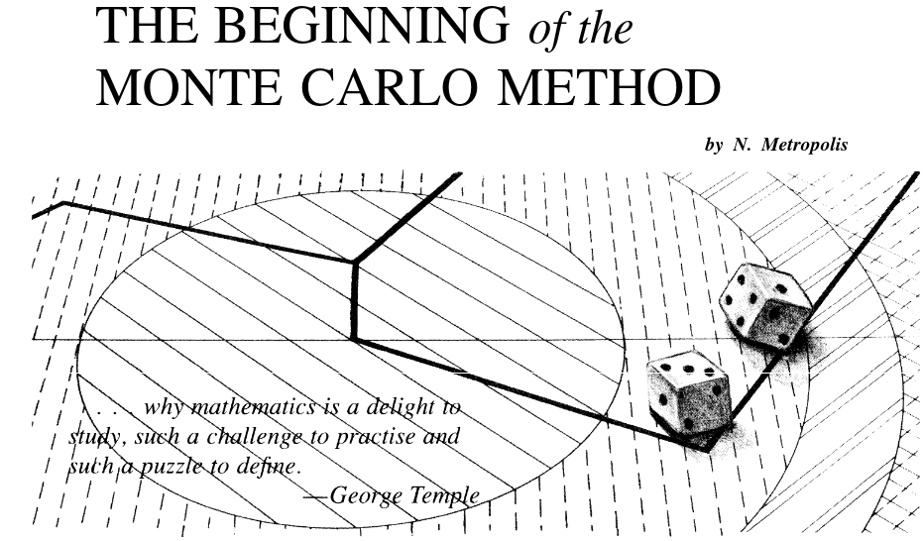
1. The transport problem

Slide 8
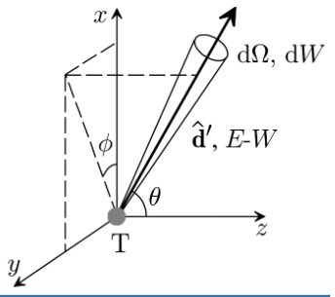
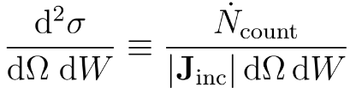
Monte Carlo methods: history
First experiments by Fermi (~1930) to study neutron diffusion, no publications
Extensive use for neutronics in nuclear weapons applications. First proposal by Stanislaw Ulam, with contribution by Metropolis and Neumann
The transport problem
Radiation source
Propagation in matter
Scoring
Neutrons: best example (no continous Coulomb scattering)
… but also other particles (p, e^{+/-}, photons, pions, muons etc.)
Radioactive elements decay
Interaction described as cross sections: likelihood of interaction per unit quantity of interest (solid angle, energy, ...)
Any quantity related to the particle fluences, energy deposition or interaction events
Non trivial problem!

Slide 9
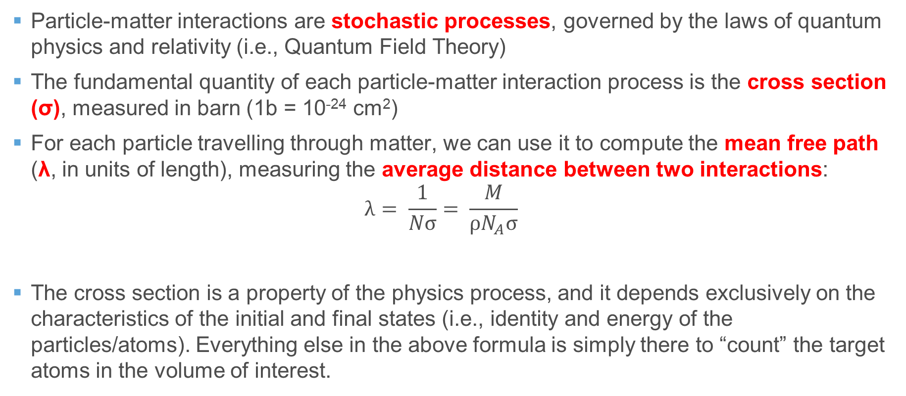
Particle interactions: cross section and mean free path
Particle-matter interactions are stochastic processes, governed by the laws of quantum physics and relativity (i.e., Quantum Field Theory)
The fundamental quantity of each particle-matter interaction process is the cross section (σ), measured in barn (1b = 10⁻²⁴ cm²)
For each particle travelling through matter, we can use it to compute the mean free path (λ, in units of length), measuring the average distance between two interactions: $λ= \frac{1}{Nσ}= \frac{M}{ρN_{A}σ}$
The cross section is a property of the physics process, and it depends exclusively on the characteristics of the initial and final states (i.e., identity and energy of the particles/atoms). Everything else in the above formula is simply there to “count” the target atoms in the volume of interest.
Molar mass (mass/mol)
Atomic density (1/volume)
Avogadro’s number (6.022∙10²³ mol⁻¹)
Material density (mass/volume)

Slide 10
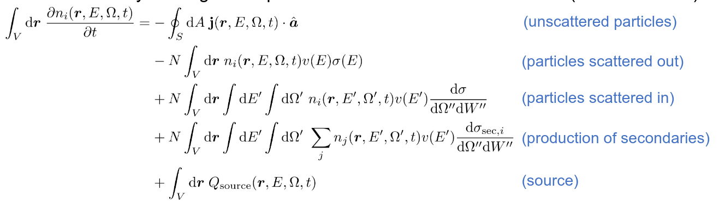

Application: transport problem
Given a particle density n₀(r,E,Ω,t=0), determine the radiation field of any given particle species, with different energies E, and directions Ω
Source particle
Sample step until next interaction
Sample nature of interaction
Sample final state of generated particles

Slide 11
…and charged particles?
Source particle
Sample step until next interaction
Sample nature of interaction
Sample final state of generated particles
Coulomb scattering & ionization losses: charged particles lose energy and interact almost continuously
Typical Monte Carlo solution → condensed history:
Moliere theory of multiple Coulomb scattering: the cumulated effect of several scattering events is condensed in a distribution
Ionization losses (below the δ-ray threshold) distributed on the track length

Slide 12
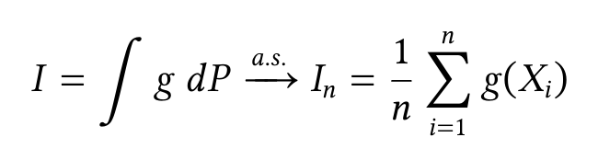
How to solve the transport problem?
Several solution strategies for the transport problem:
Analytical: only restricted geometries and interaction models
Spectral: with symmetries, expand in appropriate basis functions. Restricted cases
Numerical quadrature integration: inefficient in high-dimensional integrals
Monte Carlo: general, efficient for arbitrary geometries and radiation fields
Generic Monte Carlo problem: P is a probability measure, g is a function of the random variable
Sample X_{i} from the correct distribution (not trivial!) given a pseudo random number
Calculate the g(X_{i}) quantity of interest
Obtain the integral as the mean

Slide 13


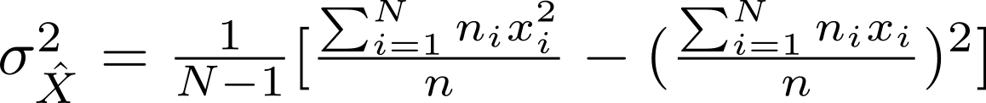
Application: scoring & estimation
The typical applications require the scoring of fluence/star related quantities (energy deposition, number of interactions, etc)
Any physical observable is the average of the contribution of all particles in the field. The estimator chosen is the sample mean, under the assumption that the CLT can be applied
In FLUKA, the choice made is to adopt a batch analysis (instead of history by history). Assuming N batches, with ni primary particles and average scoring xi in the i-th batch, the estimator and uncertainty are:

Slide 14
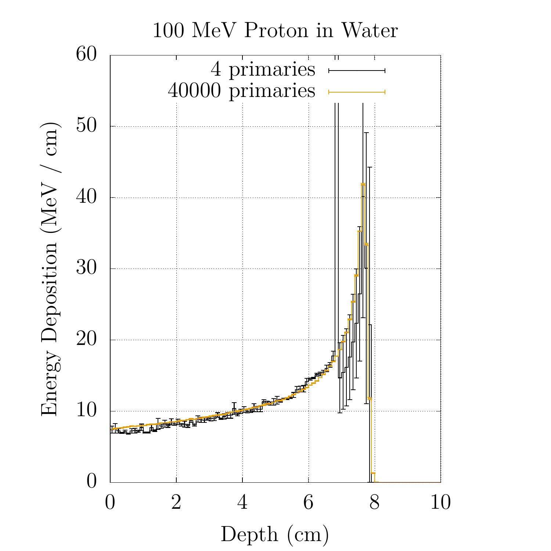
Uncertainty and statistics
*biasing is an effective alternative solution
How many primaries? The more, the better*. In general, as rule of thumb:
This does not include systematic errors, such as:
Physics
Algorithm artifacts
Missing (or uncertain) data
Material & geometry composition
Uncertainty on the source terms (beam losses estimation)
Relative error | Estimator quality
>50 % | Garbage
20 – 50 % | Order of magnitude
10 – 20 % | Questionable
<10 % | Reliable (generally)

Slide 15
2. Geometries in Monte Carlo

Slide 16
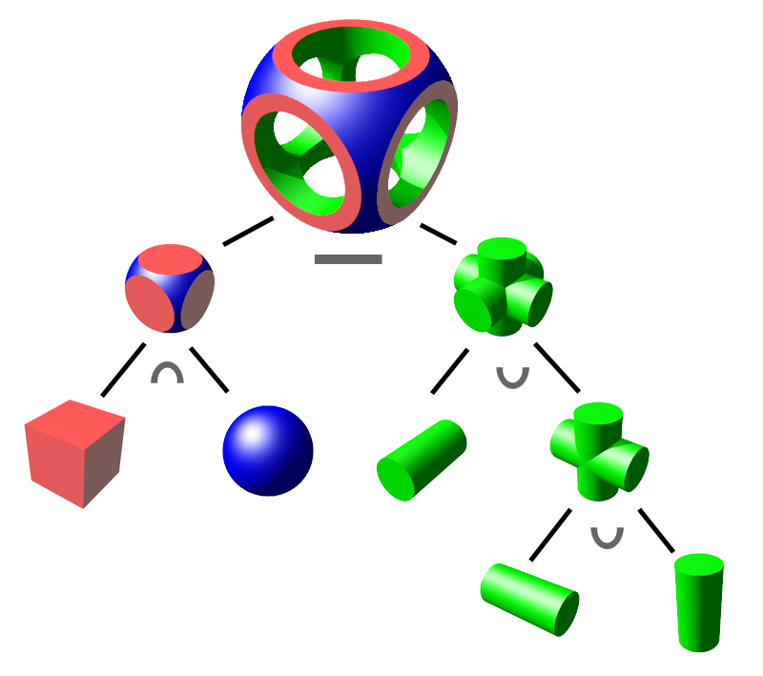
Geometries in Monte Carlo
When following the particles, the code continuously ask:
Where am I?
Where am I going?
How far can I travel before an interface?
The geometry implementation in the codes (FLUKA, GEANT, …) needs to be fast and versatile.
Most recent codes allow to use CAD imported assemblies with tesserated solids
FLUKA: Constructive solid geometry
GEANT: Hierarchical
Simple and extremely fast
Employs lattice and replica capabilities
Each volume has a “mother”
More complicated to implement ex-novo
Lot of geometry shapes available

Slide 17
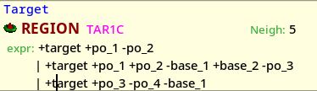
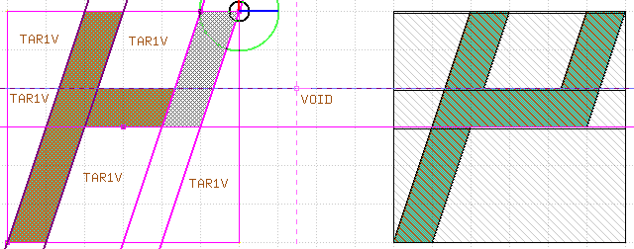
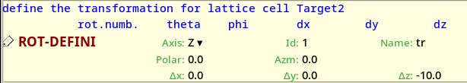

Geometries in FLUKA
Four fundamental concepts:
Body: basic geometry object (finite or infinite: planes, spheres, …).
Zone: sub-region composed by intersection and subtraction of bodies.
Region: union of zones
Lattices: duplication of existing regions confined in a container volume

Slide 18
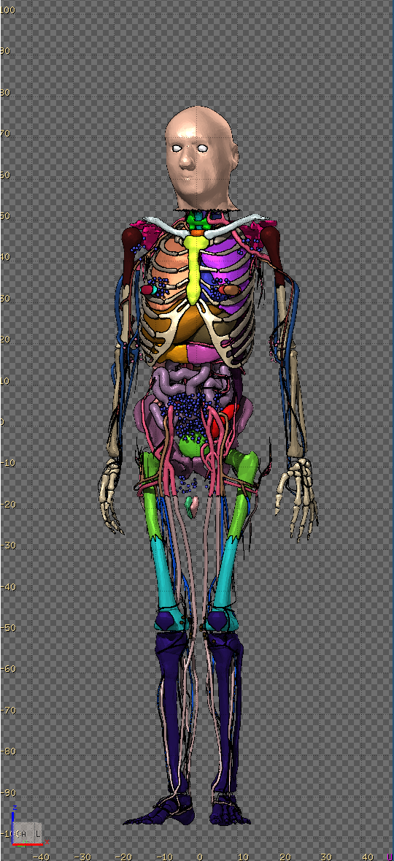
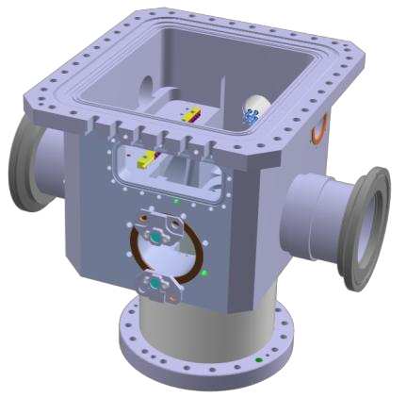
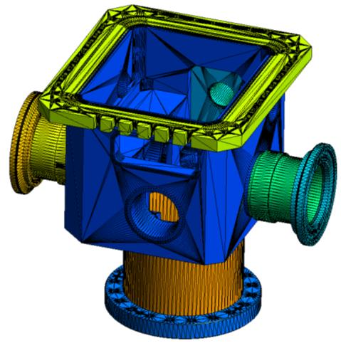
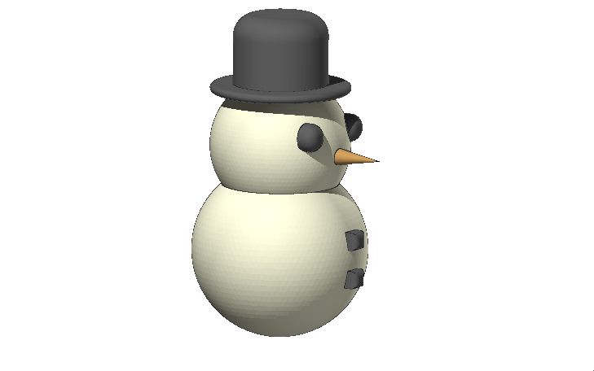
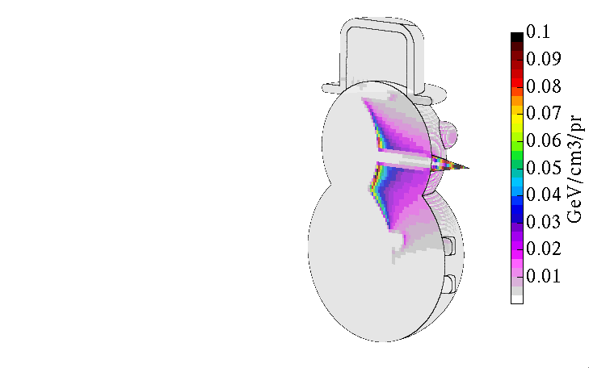
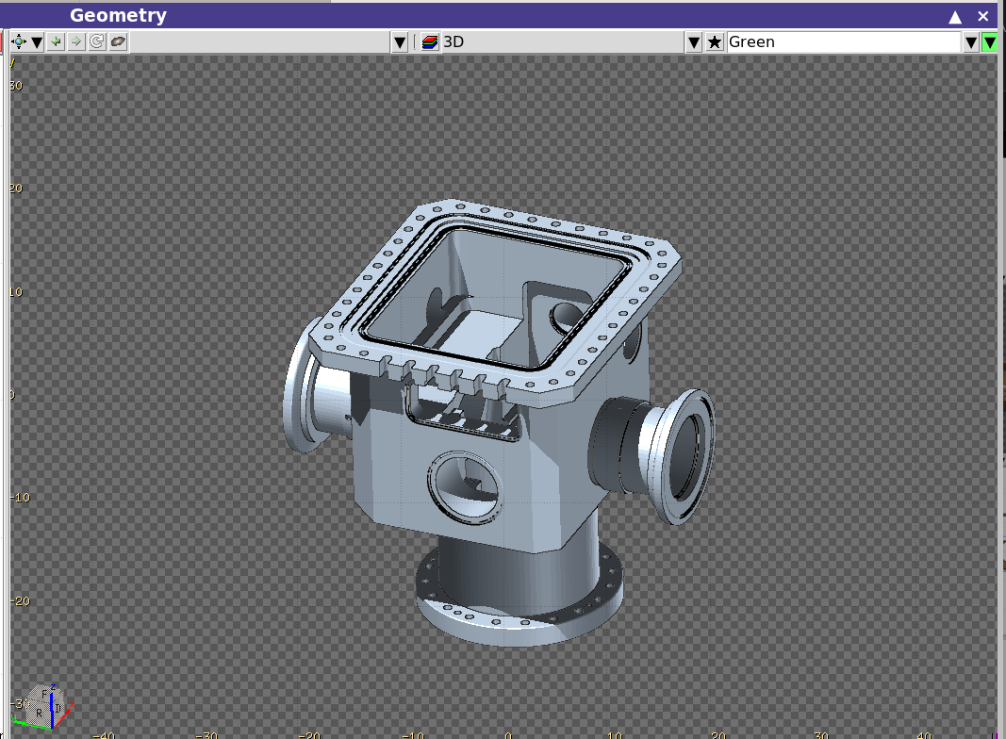
CAD / unstructured meshes
Geometries can be described also using unstructured meshes:
More precise geometry descriptions (including gaps, penetrations, details)
...but more complicated to perform parametric scans (varying a single element in the geometry)
ICRP P145 phantom
(initialization < 10 s)
CAD
MESH
FLUKA
30 MeV
protons

Slide 19
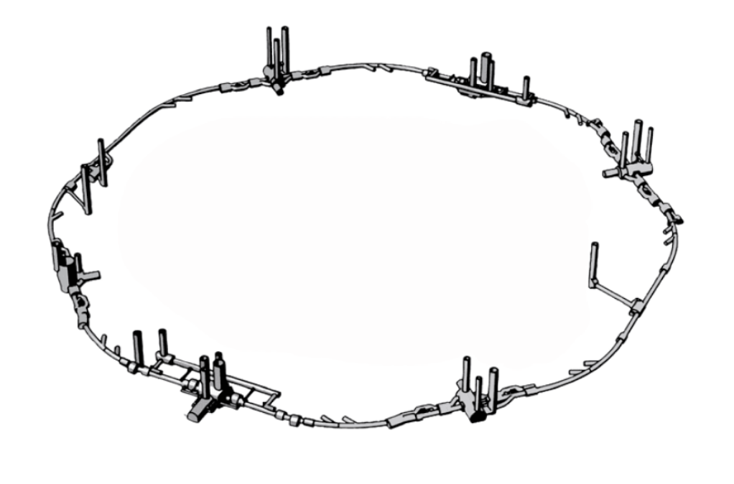
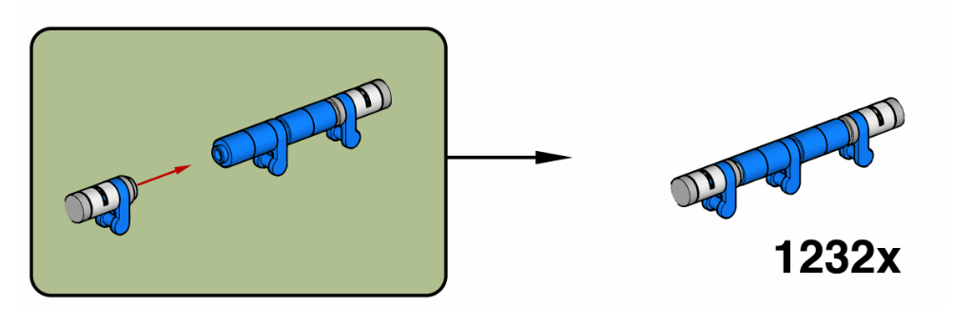
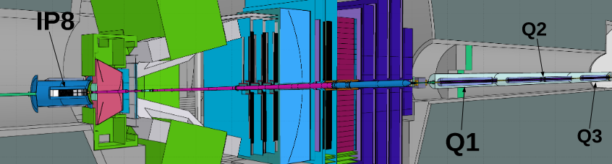
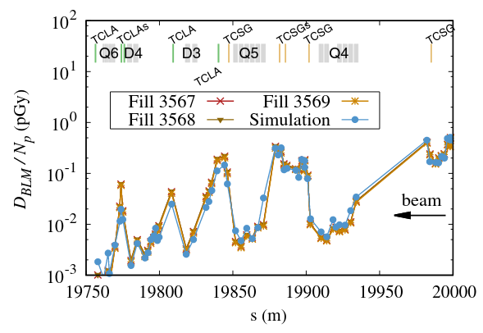
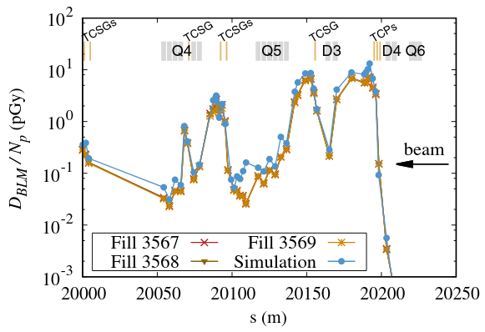
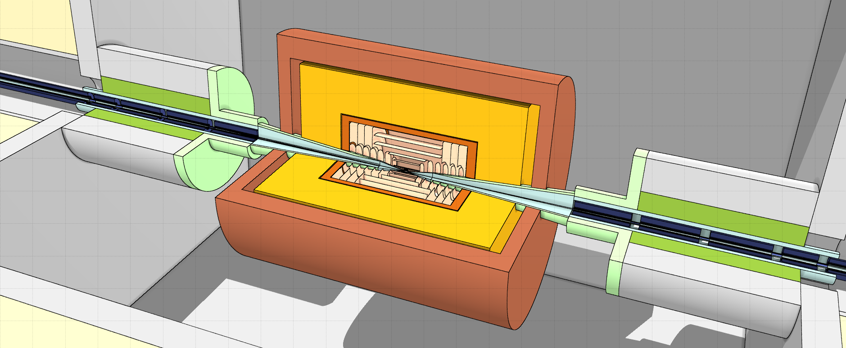
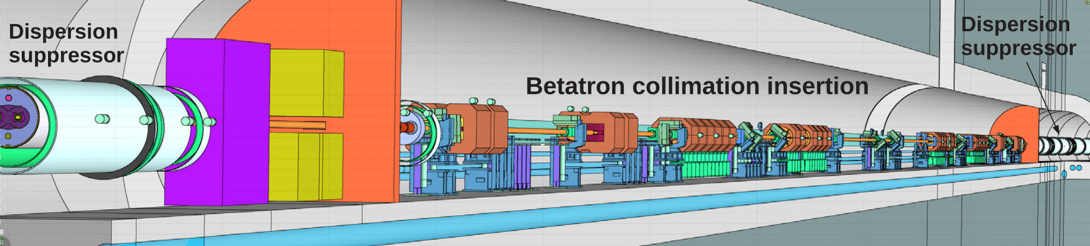
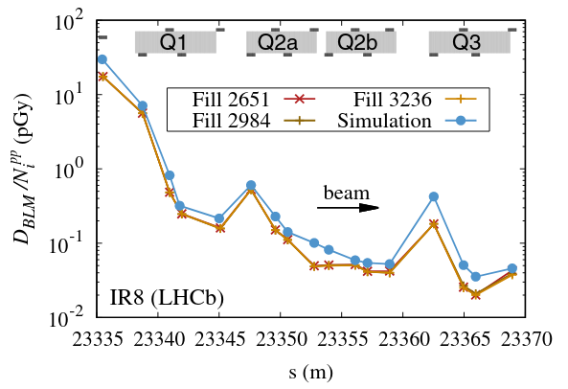
Linebuilder: a specific accelerator solution
Elementary models + instruction set
Together with FEDB (FLUKA Element DataBase), organize all the necessary information for creating complex, modular and detailed geometry
Build beamlines in 3D
Automatically handles the scorings (USRBIN)
Now public here!
Muon collider MDI geometry
pp collision debris
Betatron halo collimation
A. Lechner et al., Phys. Rev. Accel. Beam (22), 071003, 2019.

Slide 20
3. Main interaction models

Slide 21
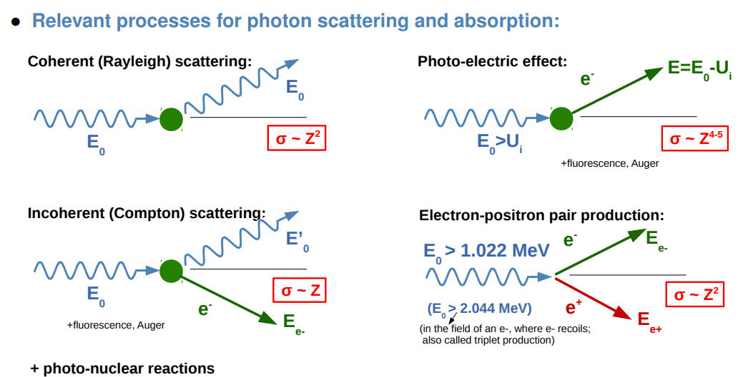
Photon interactions basics
Photons can be produced by many different mechanisms:
Bremsstrahlung emission
Gamma de-excitation after nuclear reactions
Radiative neutron capture
Electron-positron annihilation
Particle decay (e.g., π⁰)
Their interaction mechanisms vary depending on the photon energy and on the target material:

Slide 22
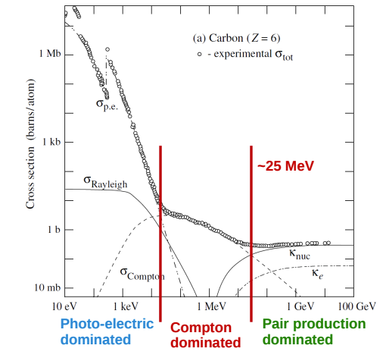
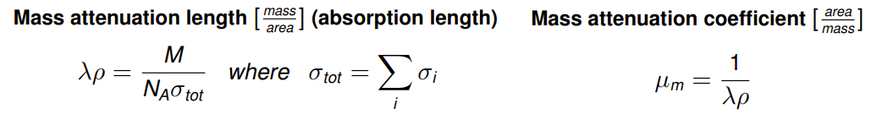
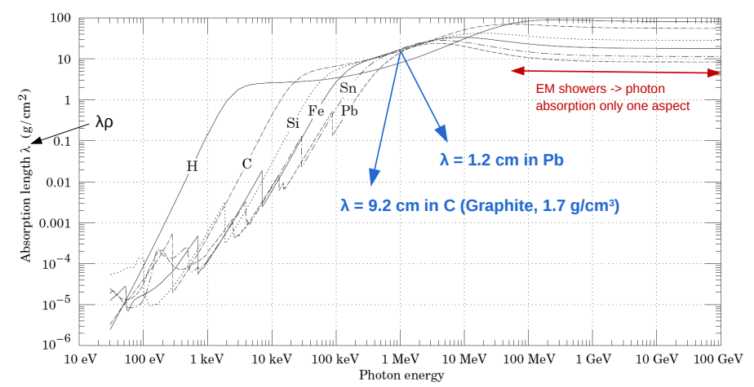

Photon interactions cross sections
Extra: photonuclear reactions (lower cross sections)

Slide 23
Charged particle interactions with electrons and nuclei
Coulomb interactions with atomic electrons
Coulomb interactions with atomic nuclei
Radiative processes
Lead to the emission of photons from the interaction between the particle and the field of the atomic nuclei
Dominant energy loss mechanism for high-energy projectiles*
Leads to the ionization (or excitation) of the atoms, with the production of knock-off electrons (δ-rays if high-E)
Most relevant energy loss mechanism up to:
Tens of MeV for e^{+/-}
Hundreds of GeV or more for μ^{+/-} and charged hadrons*
Causes energy deposition in the material → heating
Dominant source of angular deflections for charged particles
The associated energy loss is referred to as Non-Ionizing Energy Loss (NIEL)
In general, NIEL is less relevant than atomic electron losses, except for low-energy heavy ions
*for high-energy hadrons, nuclear interactions play a major role in the energy loss mechanisms

Slide 24
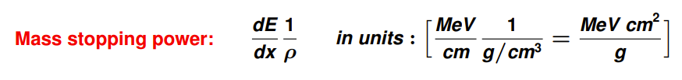
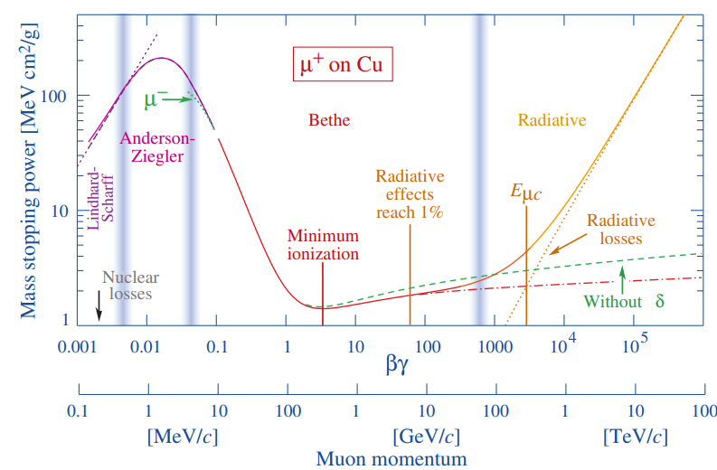
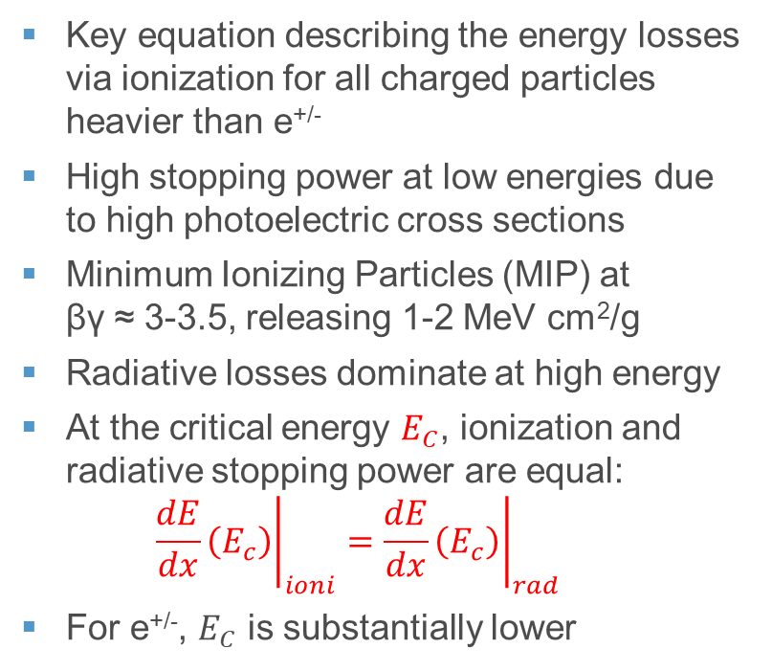
Coulomb interactions with atomic electrons: Bethe formula
Key equation describing the energy losses via ionization for all charged particles heavier than e^{+/-}
High stopping power at low energies due to high photoelectric cross sections
Minimum Ionizing Particles (MIP) at βγ ≈ 3-3.5, releasing 1-2 MeV cm²/g
Radiative losses dominate at high energy
At the critical energy $E_{C}$, ionization and radiative stopping power are equal: ${\left.\frac{dE}{dx}\left(E_{c}\right)\right|}_{ioni}={\left.\frac{dE}{dx}\left(E_{c}\right)\right|}_{rad}$
For e^{+/-}, $E_{C}$ is substantially lower

Slide 25
Nuclear interactions: introduction
In nuclear interactions, the strong force plays a major role (but electroweak processes also take place)
ELASTIC INTERACTIONS
INELASTIC INTERACTIONS
Do not modify the internal structure of the particles involved in the interaction, i.e., the initial and final states are the same
They “only” yield energy transfer (including the recoil of target nuclei in projectile-nucleus reactions) and angular deflections
There are no energy thresholds
They are highly relevant for neutral projectiles (e.g., neutrons) at low energy. For charged projectiles, they compete with Coulomb scattering.
The internal structure of the particles is modified in the interaction, and/or new particles are produced
Energy thresholds are usually present, because typically one needs a minimum amount of energy to “break” the incoming particles/nuclei, produce new particles (e.g., pions), and/or excited nuclear states.
Exception: neutron capture (inelastic interaction with no threshold)

Slide 26
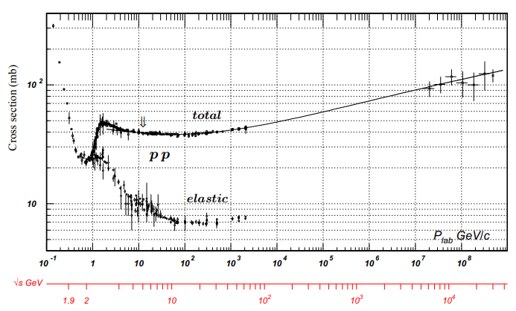
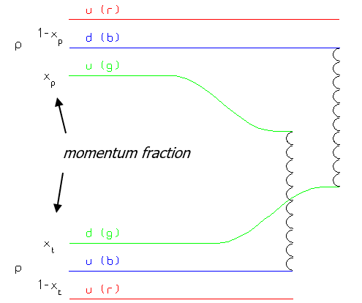
Nuclear interactions: nucleon-nucleon cross sections
Nucleon-nucleon cross sections are the basis to understand more complex cross sections with nuclei.
At low energies, elastic interactions are dominant. At intermediate energies, the reactions proceed through intermediate resonant states (e.g., Δ(1232))
At high energies, the cross section is driven by inelastic processes involving single partons (quarks/gluons), and it reaches a constant value for both pn and pp reactions.

Slide 27
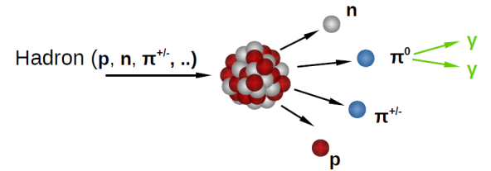
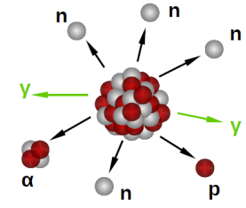
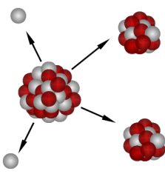
Inelastic hadron-nucleus reactions
FAST STAGE (10⁻²² s)
The projectile interacts with nucleons, producing secondaries (mainly π, but also, other hadrons, γ…) with high multiplicity (≈log[E])
The more energetic secondaries leave the nucleus and develop a forward-directed hadronic cascade (see next slides)
The less energetic secondaries can deposit energy within the nucleus, leaving it into an excited state
SLOW STAGE (10⁻¹⁶ s)
In summary, one gets:
An energetic hadronic shower from the fast stage*
MeV-scale fragments and photons
Optionally, fission products (that may be radioactive, as the residual nuclei)
MeV-scale light fragments from evaporation and photons from γ-deexcitation
Heavier fragments from fission (when possible)
*if the projectile has enough energy

Slide 28
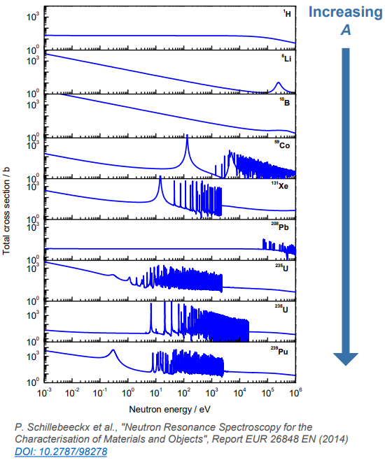
Focus on neutron interactions
Neutrons are hadrons with unique features:
Long half-life (>10 minutes) → effectively stable
No charge → no Coulomb force
They travel long distances through matter, and they undergo a moderation process, i.e., they progressively lose their energy via a sequence of elastic nuclear interactions
Eventually they can thermalize, i.e., their kinetic energy can drop to the thermal scale (≈25 meV at room temperature)
TYPICAL NEUTRON CROSS SECTION PATTERN:
Low-E (≲ eV)*
eV-MeV range*
High-E (>MeV)*
Resonances are present, varying with the target nucleus (difficult to model)
The behaviour becomes similar to the one of the other hadrons
σ decreases with E (σ≈1/v), n capture reactions take place
*highly variable with A
>MeV region not shown

Slide 29
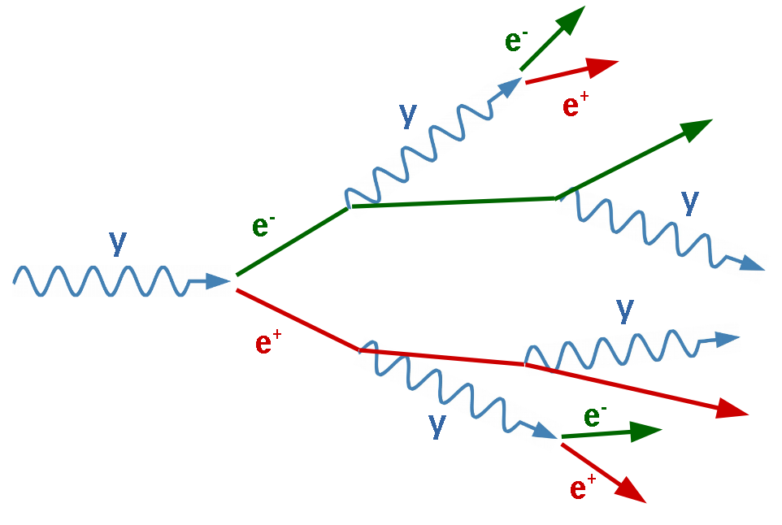
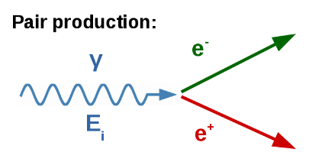
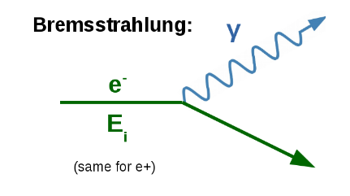
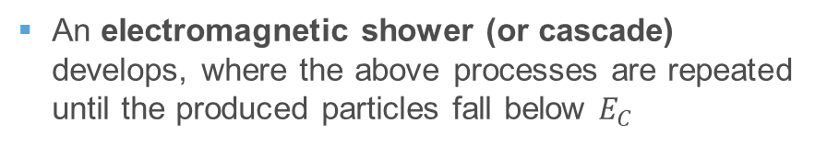
High-energy e^{+/-}, γ: electromagnetic (EM) showers
When the projectiles are above the previously introduced critical energy $E_{C}$, the dominant interaction mechanisms in matter are:
An electromagnetic shower (or cascade) develops, where the above processes are repeated until the produced particles fall below $E_{C}$
The key parameter is the radiation length X₀:
Mean distance over which the energy of e^{+/-} is reduced to 1/e
7/9 of the photon Bremsstrahlung mean free path
X₀ represents the characteristic length of the EM shower steps
Note: neutrons can also appear (with relatively low abundance) from photonuclear reactions

Slide 30
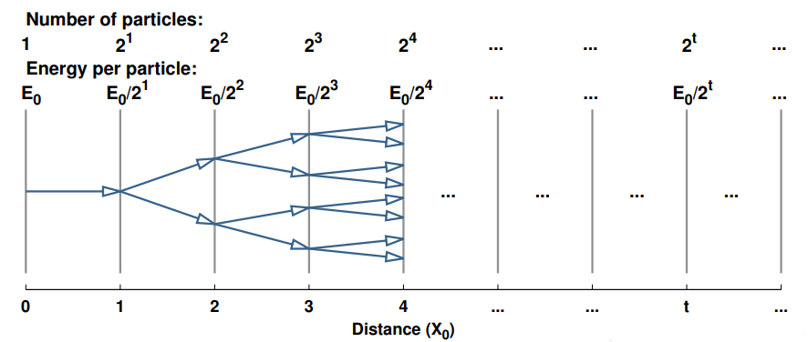




EM showers: key features and energy deposition
EM shower evolution vs depth, in units of X₀ (t = z/X₀):
X₀ by material, where $\frac{X_{0}}{ρ}∝\frac{A}{Z^{2}}$
Maximum number of particles at depth t_{max}: $t_{max}∝\ln\left(\frac{E_{0}}{E_{C}}\right)$
The peak energy deposition in the target material (important to assess the impact of the shower!) is typically right before t_{max}
(typically a few X₀ depending on projectile energy and material)

Slide 31


Hadronic showers
We have seen that the interaction cross section of high energy hadrons tends to stabilize → we can define a nuclear interaction length λ_{I}, i.e., the mean distance travelled between two inelastic interactions
High energy hadrons generate showers similarly to the electromagnetic ones, but they involve sequences of hadronic interactions
λ_{I} is the key parameter of hadronic showers and it’s typically longer than X₀
The particle content of hadronic showers is richer compared to EM ones
Neutral pions decay into two photons, leading to the generation of secondary EM showers within the hadronic shower itself!
The fraction of energy that goes into EM particles varies stochastically between showers

Slide 32
4. FLUKA main capabilities

Slide 33





Physical processes: continuous and discrete
Main assumption: particle scattering occurs on a single target
Typical inter-atomic distances are ~1Å. MC simulation of electron transport << 100 eV is generally questionable
Discrete processes: simple!
De Broglie wavelength
Coulomb scattering & ionization: continuous

Slide 34
Physical processes: continuous and discrete
Main discrete interaction mechanisms
hadron-hadron and hadron-nucleus interactions
nucleus-nucleus interactions (including deuterons)
photon interactions (>100 eV)
electron interactions (> 1 keV; including electronuclear)
muon interactions (including photonuclear)
neutrino interactions
low-energy (<20 MeV) neutron point-wise interactions
particle decay
synchrotron radiation emission
Simple algorithm: the particles are unaffected between interactions
Source particle
Sample step until next interaction
Sample nature of interaction
Sample final state of generated particles

Slide 35

Physical processes: continuous
e⁻ in Al
Elastic scattering of charged particles on screened electrostatic potential of target atoms (Coulomb scattering)
Collisions of charged particles with target electrons: continuous energy loss along the particle step
EMFP: mean free path between Coulomb interactions
IMFP: mean free path between ionization losses
1 MeV e⁻ ≈ 10⁴ interactions
Typical solutions: condensed history for ionization losses, and Molière theory for multiple Coulomb scattering
Warning: in residual gas or thin geometries (few elastic collisions) single Coulomb scattering shall be adopted

Slide 36


Scoring & estimators
The result of the Monte Carlo experiment is called estimator. The main types used in the MDI are:
Star like quantities: energy deposition, ionizing dose, displacement damage
Fluence like quantities: e^{+/-} fluence, 1 MeV n eq. in Si
Double differential distribution (angle/energy) of particles crossing a boundary
Particle spectra in volumes
When the full phase-space is required to transmit information, the data are stored in particle lists

Slide 37


Biasing
Biasing is a variance reduction technique which distort distribution to minimize the variance.
Figure of merit: σ²t
Among the various techniques, the most important ones are:
Region importance biasing: applied when a particle crosses a boundary between two region with different importance
Mean free path: the cross sections are scaled by a factor to enhance the rare interactions

Slide 38
5. Radiation Quantities

Slide 39

What happens in case of LHC beam losses?
Air
Magnet
Rock/soil
Tunnel walls
Water supply lines
Considering again a single 450 GeV proton that interacts with an LHC magnet
FLUKA geometry: section (x-y) of the LHC tunnel showing a dipole magnet

Slide 40

What happens in case of LHC beam losses?
Air
Magnet
Rock/soil
Tunnel walls
Water supply lines
Large radiation shower developing both within the magnet and in the surrounding tunnel!
FLUKA geometry: section (x-y) of the LHC tunnel showing a dipole magnet

Slide 41

Accidental loss: historical example from SPS (2004)
In the pre-LHC phase, an incident occurred at the SPS during the extraction of an LHC-like beam (450 GeV protons, 3.4∙10¹³ p, 2.5 MJ)
Major damage to the vacuum chamber, requiring a magnet replacement (weeks of downtime)
CERN-AB-Note-2005-014

Slide 42

Energy deposition in SC magnets: quenches
Maximum temperature increase that LHC dipole coils can sustain without losing their superconducting (SC) state:
Figure of merit: Heat deposition
There are regions where the margin is a mere increase of 2 K
An instantaneous energy deposition of O(mJ/cm³) can lead to a quench
After a quench, it can take ~1/2 day to recover (cryogenics)
Systems are in place to protect SC magnets from quenching

Slide 43




Material degradation from TID
A key observable linked to energy deposition is the Total Ionizing Dose (TID), i.e., the energy deposition per unit material mass:
Magnet insulation (P. Fessia)
$TID= {E_{dep}}/M$, in units of Gy = J/kg
TID can alter the mechanical, electrical, and optical material properties of organic materials, compromising the integrity and the functioning of the accelerator equipment
Damage to magnets coils and insulation is particularly critical, but TID affects also cables, lubricants, etc.
Figure of merit: Dose
Grease, lubricants (M. Ferrari)
LEP damage to cables and magnet insulation (NIM B)

Slide 44

Displacement Damage (DD) and DPA
Non-Ionizing Energy Loss (NIEL) can cause material damage by displacing atoms from their reference position in the lattice
Quantified by the Displacement Per Atom (DPA):
Number of atomic displacements from the reference position in the lattice (e.g., DPA=0.1 means that ~10% of the atoms have been displaced)
Relevant for radiation damage studies to superconductors, with interesting cross-disciplinary links (e.g., fusion magnets)
A. Lechner
 | SC type | Radiation source | Shielding inserts (Δr) | Scenario | DPA-NRT | Ionizing dose
HL-LHC final focus quadrupoles | Nb₃Sn | Proton-proton collision debris | 1.6 cm W-alloy | 3000 fb⁻¹ (10 years) | 1.5x10⁻⁴ | 20-30 MGy
FCC-hh final focus quadrupoles | Nb₃Sn / REBCO | Proton-proton collision debris | 4 cm W-alloy | 30 ab⁻¹ (20 years) | 4-5x10⁻³ | 60-80 MGy
Muon Collider (10 TeV) arc magnets | Nb₃Sn / REBCO | Muon decay | 3 cm W-alloy | 10 ab⁻¹ (5 years) | 5x10⁻⁵ | 20 MGy
Muon Collider target solenoid | REBCO | Proton beam on target | 35 cm W-alloy +H20+BC layer | 10 ab⁻¹ (5 years) | 5x10⁻³ | 50 MGy

Slide 45


Displacement Damage (DD) and DPA
Non-Ionizing Energy Loss (NIEL) can cause material damage by displacing atoms from their reference position in the lattice
Quantified by the Displacement Per Atom (DPA):
Number of atomic displacements from the reference position in the lattice (e.g., DPA=0.1 means that ~10% of the atoms have been displaced)
Relevant for radiation damage studies to superconductors, with interesting cross-disciplinary links (e.g., fusion magnets)
Not only colliders!
10⁻³ DPA → Loss of superconductivity
0.1 DPA → Loss of thermal conductivity
~1 DPA → Embrittlement and hardening
~10 DPA → Swelling
Structural materials for fission & fusion energy.
Steven J. Zinkle, Jeremy T. Busby

Slide 46
How (and why) FLUKA?

Slide 47


The “naked” inputfile
FLUKA’s story began a long time ago (1970s)…
…no graphical interfaces, input and output via text file
Input files:
can be very long > 50k lines
based on “cards”: .inp file
Each card has 1 name, 6 values (called WHATs), 1 string (called SDUM)
BEAMPOS 4750.5 130.0 4866.5 NEGATIVE
BEAM -0.4 0.2 5.0 1.E-4 1.E-4 ELECTRON
Card name
WHAT(1)
WHAT(2)
WHAT(3)
WHAT(4)
WHAT(5)
WHAT(6)
SDUM

Slide 48

Flair: the GUI
Flair ≠ FLUKA
In 2006, Flair was born! It is a layer between the user and FLUKA
How are the cards grouped?
Alphabetical listing
also available
Input file tree
Cards grouped according to
their “field of action”

Slide 49

Flair: the GUI
Flair ≠ FLUKA
In 2006, Flair was born! It is a layer between the user and FLUKA
Online geometry view and editing!
Many other advantages such as:
Parametric scan capability
Automatic postprocessing
Plotting

Slide 50


(Some) possible sources of radiation
The basic sources FLUKA considers are:
Beam-like: one or multiple beams starting from fixes positions
Volumetric: uniformly distributed in volumes
Special sources available in FLUKA
Colliding beams
Cosmic rays
USRBIN source
… or program your own custom sources (Source routine)!

Slide 51


Geometry and materials
FLUKA employs a combinatorial geometry (described few slides ago…)
Materials are assumed homogeneous (except for crystals!) → only the stoichiometry and the density matter
A set of base elements and compounds is provided by standard. It includes:
VACUUM → obvious definition (electric field is allowed only here!)
BLCKHOLE → particles are stopped. This must surround your whole geometry
Element definition
Compound definition

Slide 52


Physics & transport
FLUKA is not a toolkit
Users can select the lower energy thresholds for production and transports
Some interaction are not on by default (e.g. photonuclear). If needed, they need to be requested
The production (and tracking) of low energy electrons and photons is one of the most CPU expensive tasks. Users should set the lowest value compatible with their simulation
Basic idea: put transport threshold at energy such that the range is smaller than the bin length

Slide 53
FLUKA scoring
What?
Energy deposition and derivatives (dose), fluence or current versus energy, angle or other kinematic variables, time, DPA, residual activity…
Where?
In regions, across boundaries, on region-independent grids
When?
At the end of each cycle or at each event
Output?
Saved in [inputname]nnn_fort.## files, where nnn is the cycle number & ## is the logical unit number chosen by the user
Results?
Post-processing utilities merge cycles, calculate average and rms, provide data files for plotting. Available via Flair
User code needed for processing of custom scoring!
Results normalised per primary

Slide 54
FLUKA scoring
Energy deposition
USRBIN
EVENTBIN
On a grid or in selected regions
vs. position
USRBIN
On a grid
Energy-integrated
USRTRACK USRCOLL
In a region
Single-differential
Fluence
vs. energy
USRBDX
Double-differential E,θ_{surf}
On a surface
Double-differential, single interval on 2nd variable.
If angle, wrt θ_{beam}
vs. energy or other
On a surface
USRYIELD
At interaction
vs. nuclide
RESNUCLEi
In a region
Activation
vs. position
USRBIN
On a grid or in selected regions

Slide 55
Some case studies

Slide 56




Muon collider: target
…decaying in μ+ and μ-
p impacting on a target, producing π⁺⁻
Muon yields
Radiation damage in superconducting solenoid
Tentative extraction
(spent proton beam)

Slide 57



Muon collider: detectors
Table: radiation load for each magnet in the final focus

Slide 58


Inner triplet W shielding for HL-LHC
Dose < 30 MGy
Beam loss / radiation source
MC simulation
Mitigation strategy

Slide 59


Beam-gas collisions in LHC
Despite the vacuum system, the beam can interact with residual gases, causing radiation showers
There are also beam instruments that exploit local injections of gas to perform specific measurements (e.g., Beam Gas Curtain monitor) causing local showers with higher intensity
scattered particles
beam
gas
D. Prelipcean

Slide 60



FCC-ee dipole shielding
SR photons are intercepted by photon stoppers all around the FCC-ee arcs
For the high-energy beam modes (with higher SR E_{c}) massive shielding is required to mitigate the resulting radiation levels in the tunnel → shielding is an important (and expensive) design element for the FCC-ee!
B. Humann
Baseline material: Pb94Sb6 (10.88 g/cm³)
W-alloys (17-19 g/cm³) discarded for cost reasons

Slide 61
Other applications (selection)
High-energy physics & accelerators: beam-induced background (BIB), energy deposition in magnets and detectors, machine protection, system design (collimation, beam dump, etc.)
Radiation protection: dose calculations, shielding optimization for accelerators and facilities, residual activation and environmental impact studies
Medical physics: proton and heavy-ion therapy simulations, patient dose distributions, treatment planning verification, radiobiology studies
Space & aerospace: cosmic ray interactions, astronaut dose assessment, spacecraft shielding design, single-event effects in electronics
Nuclear engineering & activation: radionuclide production, material activation, decay heat, waste and transmutation studies
Detector design & experiments: background estimation, radiation damage to the detectors
Industrial & applied physics: radiation effects on electronics (SEE, TID), irradiation facilities, sterilization, non-destructive testing and material analysis

Slide 62
Thank you for your attention!

