Slide 1
Status of the I-Tracker Hardware
F. Grancagnolo
June 26, 2012

Slide 2
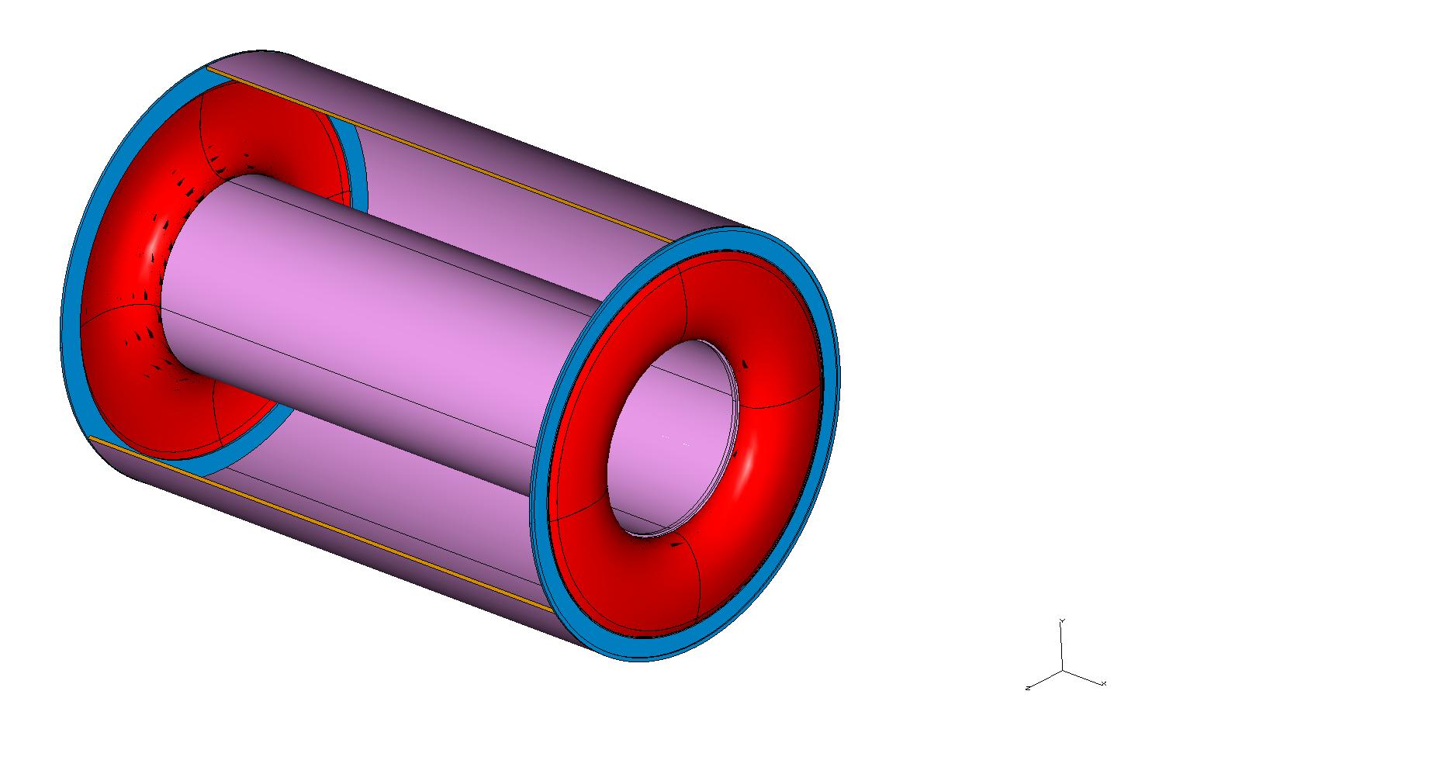
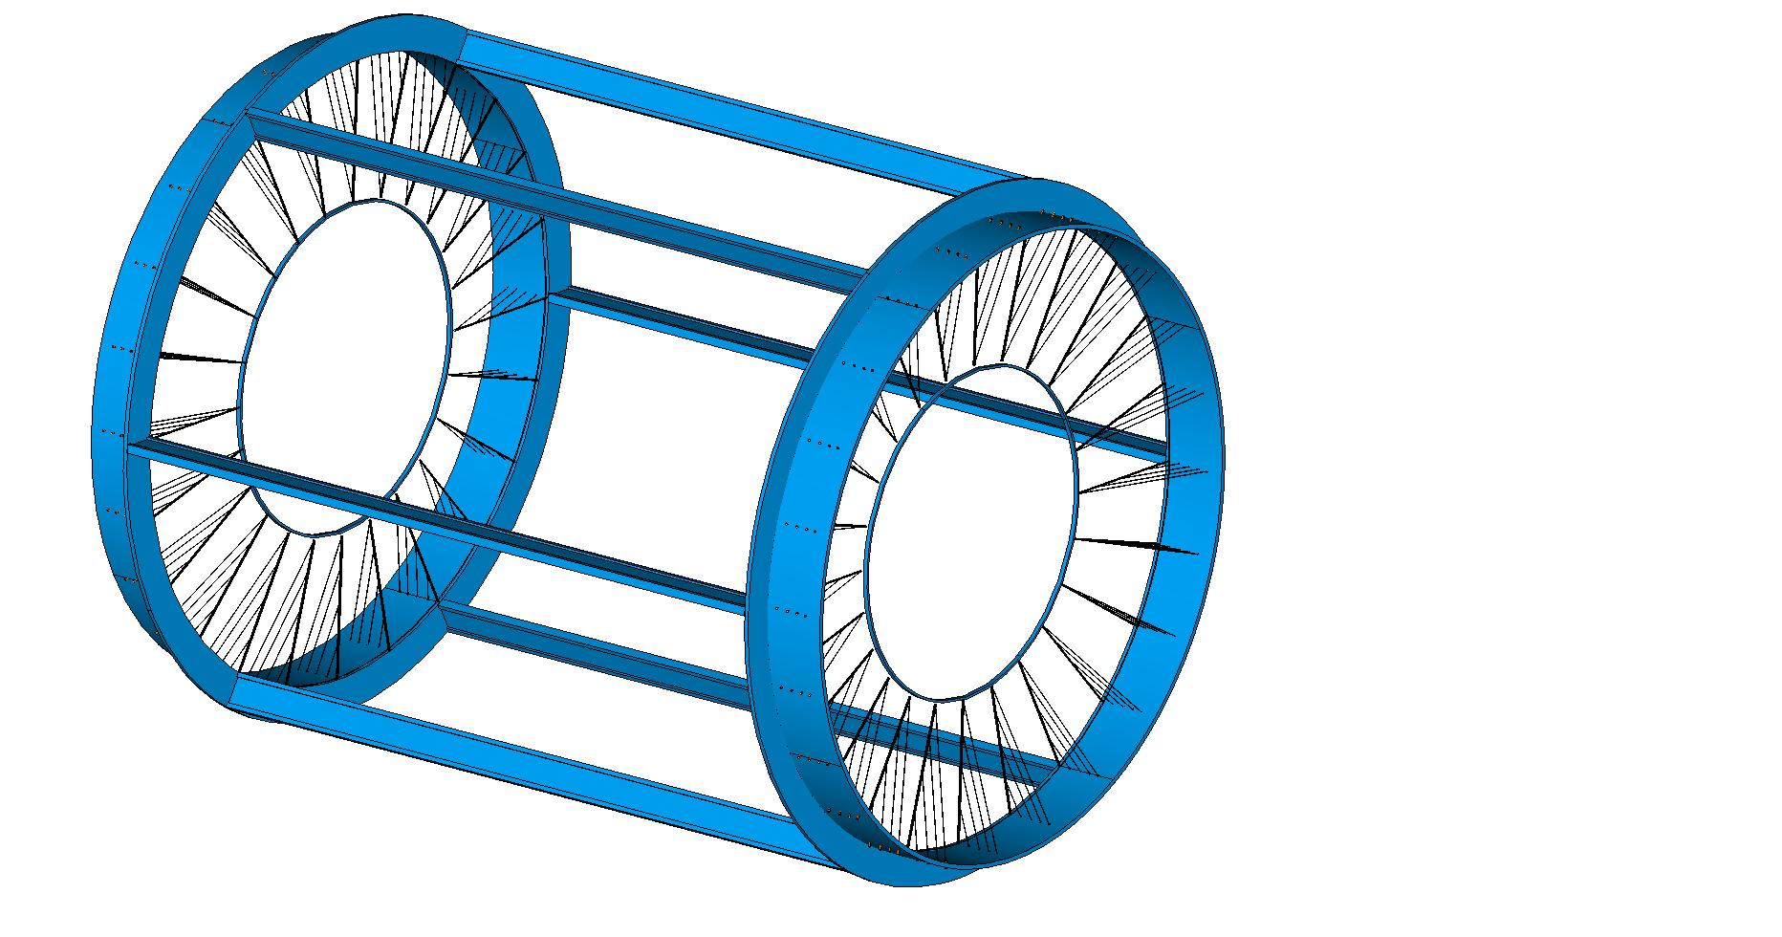
Separation of functions
Gas containment
Wire support
Gas vessel can freely deform without affecting
the internal wire position and tension.
Wire support structure not subject to differential
pressure can be light and feed-through-less.
Gas vessel
Wire cage

Slide 3
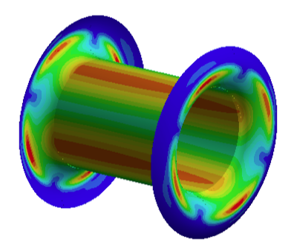
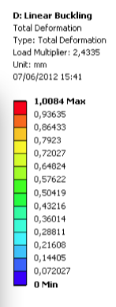
Gas Vessel
Solve buckling instabilities
load multiplier = 2.4
Inner cylinder sandwich:
2 C-fiber skins, 2-ply each,
HM M30S 53 ET443 51%
+ C-foam core, 5 mm total
Grafoam® FPA-10
(0.100 g/cm² total)
End plates: 4-ply
orthotropic (0-90-90-0)
HM M30S 53 ET443 51%
60 μm/ply - 0.0053 g/cm²
(0.021 g/cm² total)

Slide 4
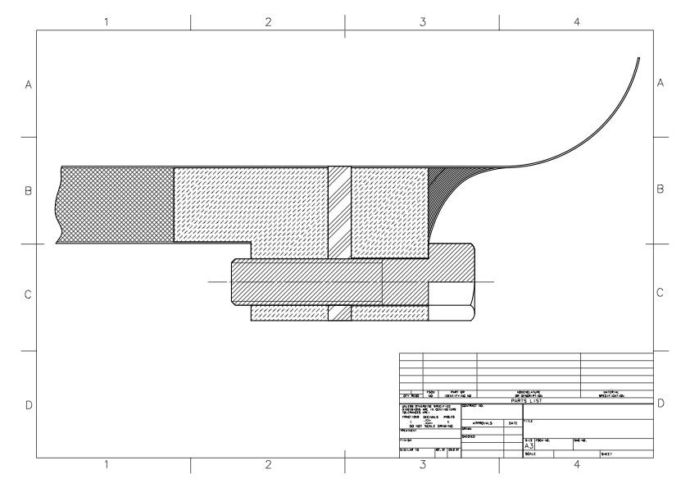
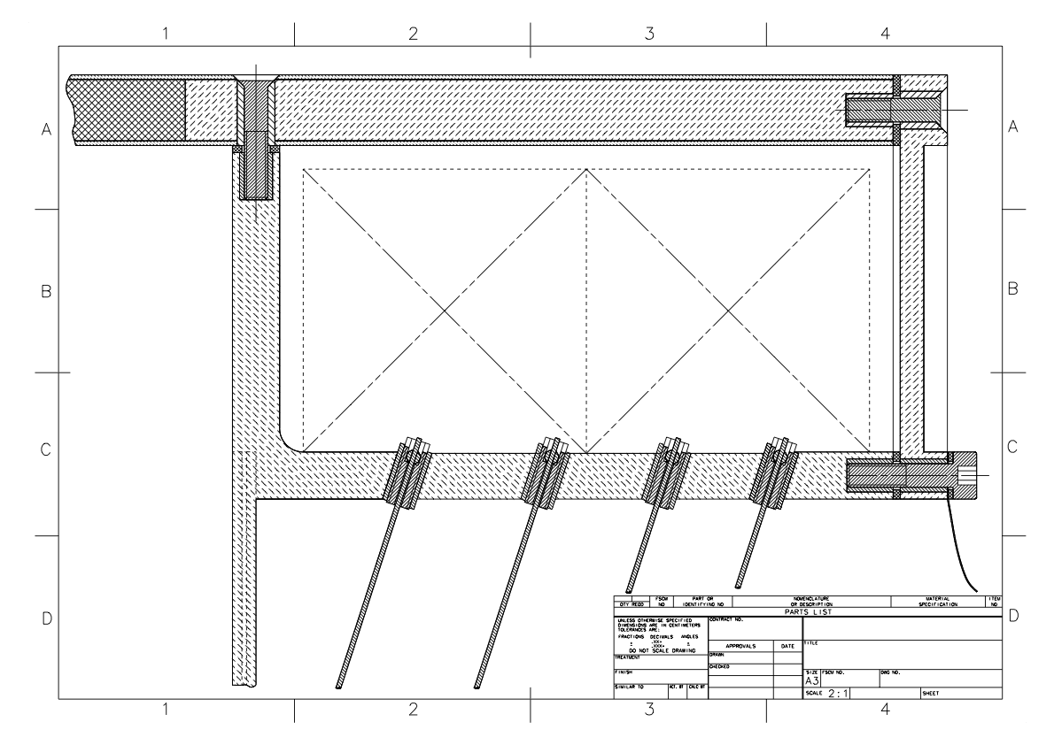
Gas Vessel
inner joint
outer joint

Slide 5
Gas Vessel
Coupling of end plates with inner cylinder
conceptual drawing
27 MPa
1 screw/cm²
(240 screws)
2700 N/screw
breaking load
> 9000 N
(class 10.9)
inner cylinder section
machined insert ring
machined insert ring
end-plate
membrane
Inner cylinder
C-foam sandwich
carbon fiber screw
M4
gasket
5 mm

Slide 6
Gas Vessel
Coupling of end plates with outer cylinder
s. steel
insert
conceptual drawing
gasket
C-fiber/C-foam
sandwich
C-foam
outer cylinder C-insert
s. steel
insert
gasket
36 6x12 cm² front end cards
10 mm
s. steel
insert
gasket
end-plate
membrane
spoke
stays

Slide 7
Gas Vessel
Material budget
 | type | # of ply - thick | [g/cm²] | X₀ [10⁻³] | [Kg]
Inner Cylinder | HM M30S 53 ET443 Grafoam® FPA-10 HM M30S 53 ET443 | 2 ply – 120 μm 4.76 mm 2 ply – 120 μm | 0.011 0.079 0.011 | 1.95 | 4.50
Inner ring | C-fiber inserts (2.3%) | 10 mm 232.5 cm² 60 cm³ | 1.700 0.040 | 39.81 0.92 | 0.10
End plates | HM M30S 53 ET443 | 4 ply – 240 μm | 0.021 | 0.41 | 0.26
Outer ring | C-fiber inserts
Outer Cylinder | … Grafoam® FPA-20 … | 32 ply – 2.5 mm 10 mm 32 ply – 2.5 mm | 0.325 0.324 0.325

Slide 8
Gas Vessel
Possible improvements
Running the drift chamber gas mixture at low pressure:
i.e. He / iC₄H₁₀ = 80/20 at 500 mbar (see ref. ………)
besides reducing the gas contribution to multiple
scattering, allows for using lighter C-fiber and C-foam:
Areal mass and X₀ may then become, respectively,
0.051 g/cm² (0.100) and 1.0×10⁻³ X₀ (1.95×10⁻³)
for the inner cylinder and
0.012 g/cm² (0.021) and 2.3×10⁻⁴ X₀ (4.1×10⁻⁴)
for the end plates.

Slide 9
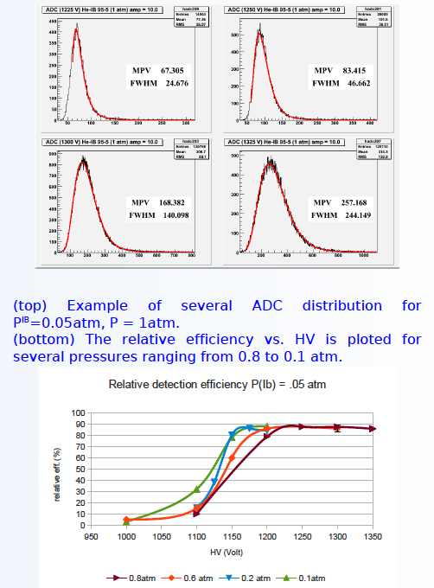
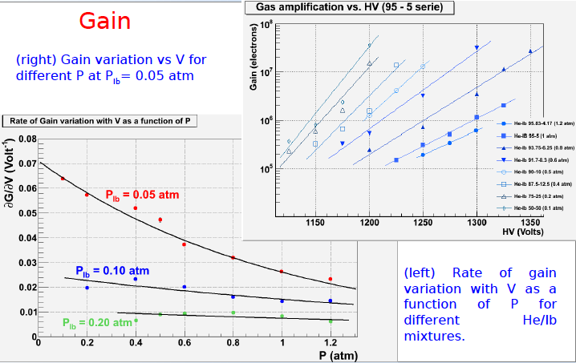
Gas Vessel
M. Cascella et al.
contribution to the
Elba Conference, May 2012

Slide 10
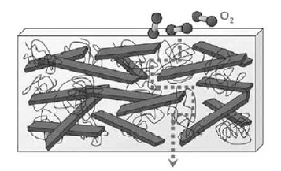
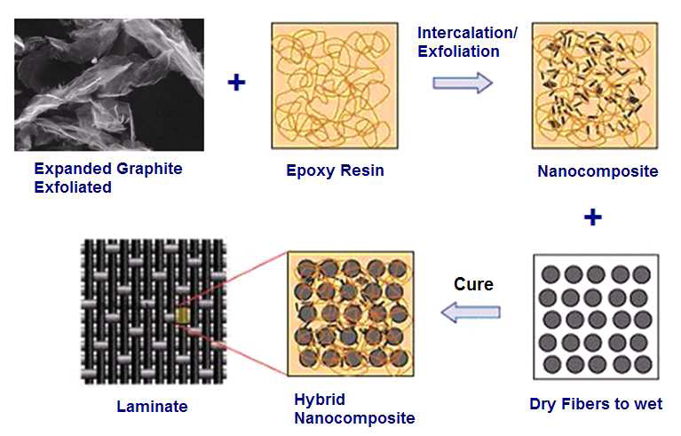
Gas Vessel
Graphene loaded C-fiber
(avoids the need of a metal sheet)
gas containment
electrostatic shielding
electromagnetic shielding
Formation of a ‘tortuous path’ of platelets inhibiting diffusion of gases through a polymer
composite (Nielsen Model)

Slide 11
Wire Layout
36 co-axial layers of para-axial wires in 24 azimuthal sectors;
stereo angles from ±100 mrad to ±180 mrad;
384 square drift cells per layer (16 per sector);
cell size ranging from 6.27 mm at the innermost layer, to 11.12 mm at the outermost one;
ratio of field wires to sense wires = 5 : 1;
13824 sense wires – 69120 field wires – 3072 guard wires;
sense wires 20 μm diameter gold plated W (30 g /100 μm);
field wires 40 μm diameter gold plated Al (25 g /100 μm);
total wire tension 2220 Kg.

Slide 12
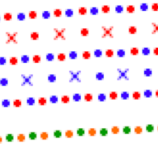
Drift Cell Layout
+ stereo angle
- stereo angle
guard layer
field and guard wires: 40 μm diameter Au-plated Al
sense wires: 20 μm diameter Au-plated W

Slide 13
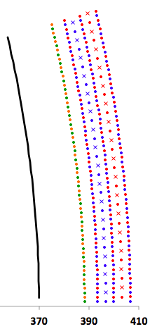
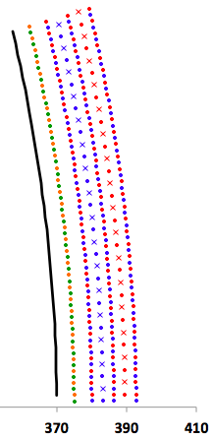
Inner layers layout
@ z = ±L/2
guard wires
layer
inner cylinder
@ z = 0
inner cylinder
r =

Slide 14
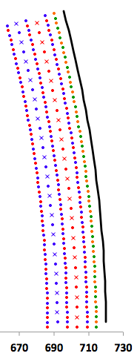
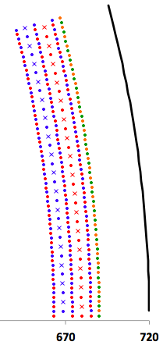
Outer layers layout
outer cylinder
@ z = ±L/2
outer cylinder
@ z = 0
guard wires
layer
r =

Slide 15
Chamber layout
Radii (at z = 0)
Inner Cylinder | 370.0 | mm
Guard wires layer | 375.0 | mm
First active layer | 380.0 | mm
Last (36th) active layer | 685.0 | mm
Guard wires layer | 690.0 | mm
Outer Cylinder | 720.0 | mm
Radii (at end plate)
Inner Cylinder | 370.0 | mm
Guard wires layer | 388.2 | mm
First active layer | 393.5 | mm
Last (36th) active layer | 709.1 | mm
Guard wires layer | 714.3 | mm
Outer Cylinder | 720.0 | mm
Active length | 2000 | mm
Number of layers / of stereo sectors | 36 / 24
Number of cells per layer / per sector | 384 / 16
Cell size (at z=0) | 6.27 ÷ 11.12 | mm
2α angle | 30°
Stereo angle | 100 ÷ 180 | mrad
Stereo drop | 13.5 ÷ 24.1 | mm
sense wires | 13824
field wires | 69120
guard wires | 3072

Slide 16
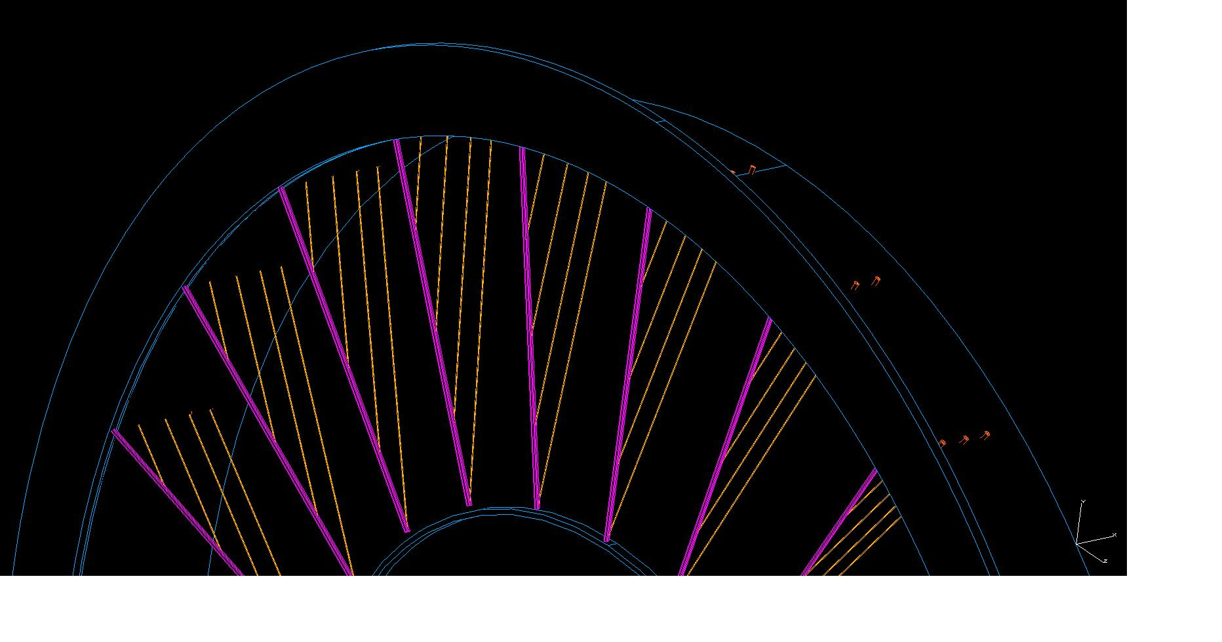
The Wire Cage Assembly
Assembly strategy
Constrain the end rings at the
outer radius to a rotating jig
able to withstand the wire
tension.
Remove the struts.
Buildup the layers by rotating
the jig.
Recover the wire tension by
pulling on the stays for each
sector.
Mount the struts
Insert inner cylinder
Close with the outer panels

Slide 17
Layers buildup

Slide 18
Layers buildup

Slide 19
Layers buildup

Slide 20
Layers buildup

Slide 21
Layers buildup

Slide 22
Layers buildup

Slide 23
Layers buildup

Slide 24
Layers buildup

Slide 25
Layers buildup

Slide 26
Layers buildup

Slide 27
Layers buildup

Slide 28
Layers buildup

Slide 29
Layers buildup

Slide 30
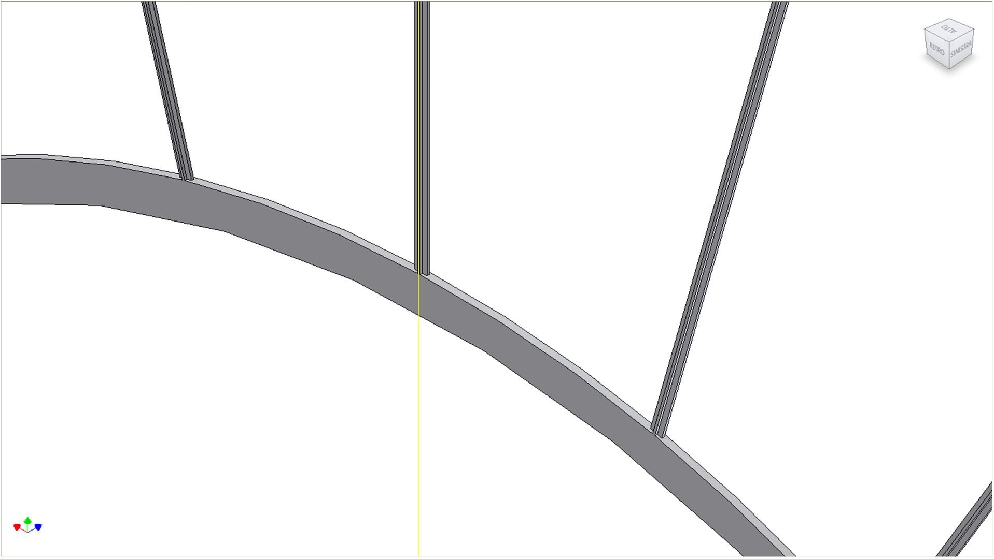
Layers buildup

Slide 31
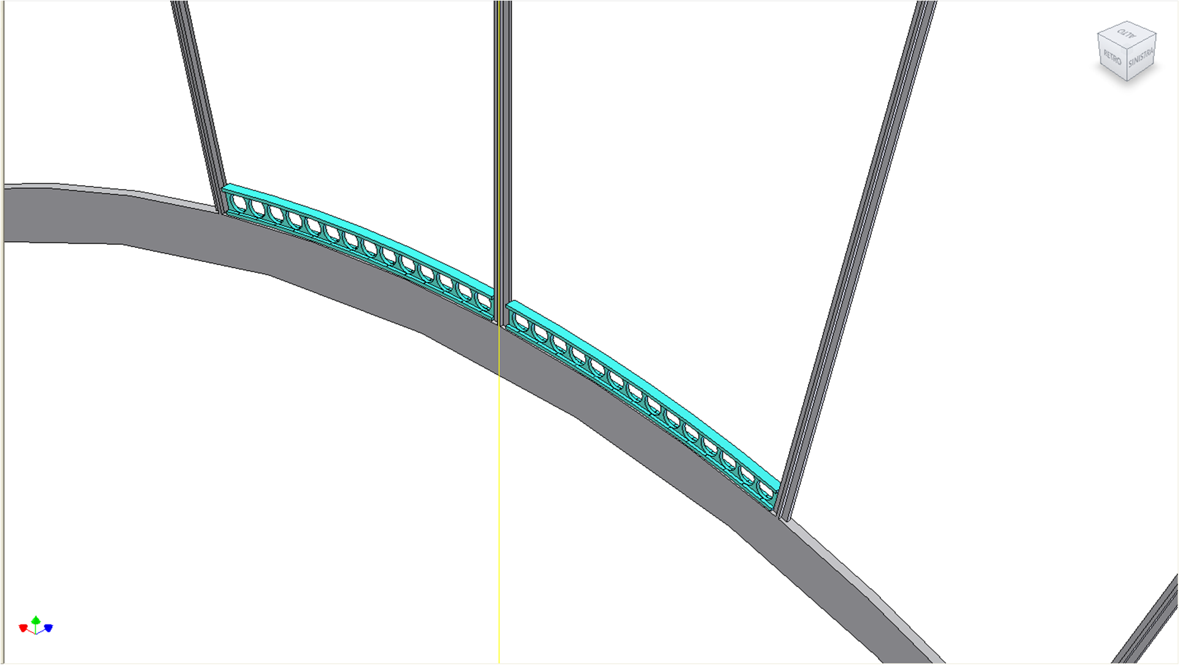
Layers buildup

Slide 32
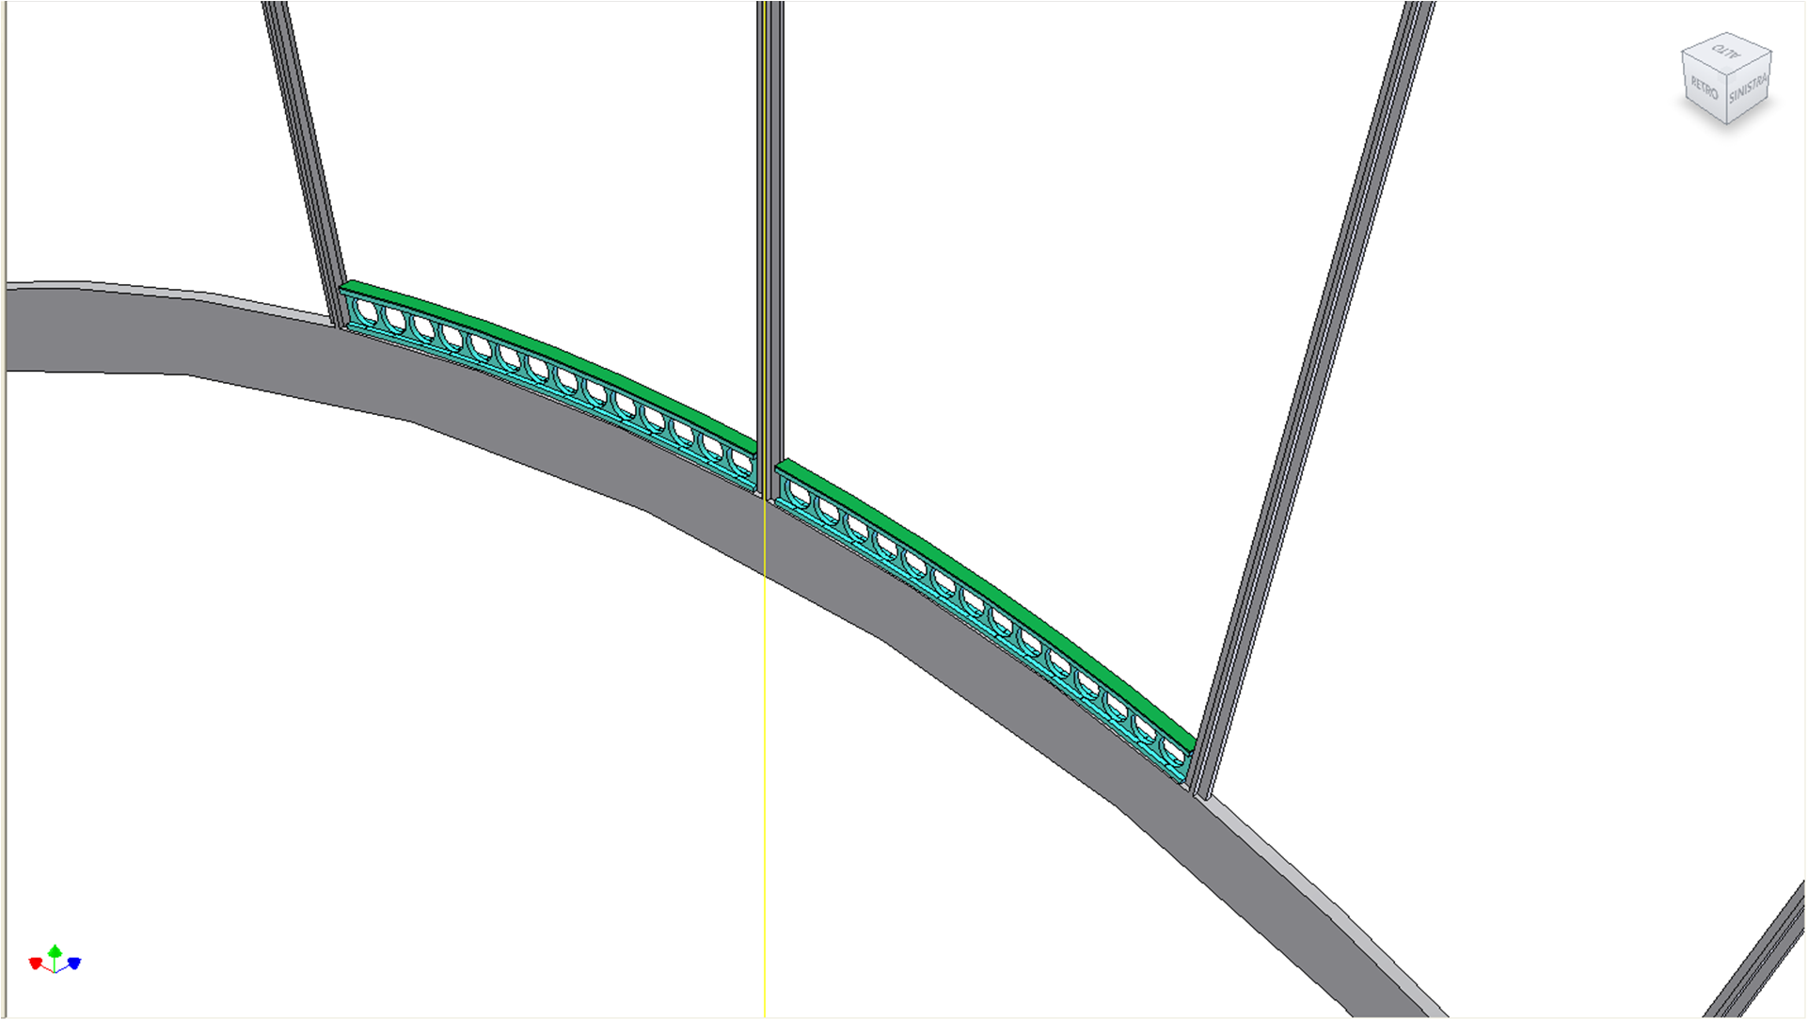
Layers buildup

Slide 33
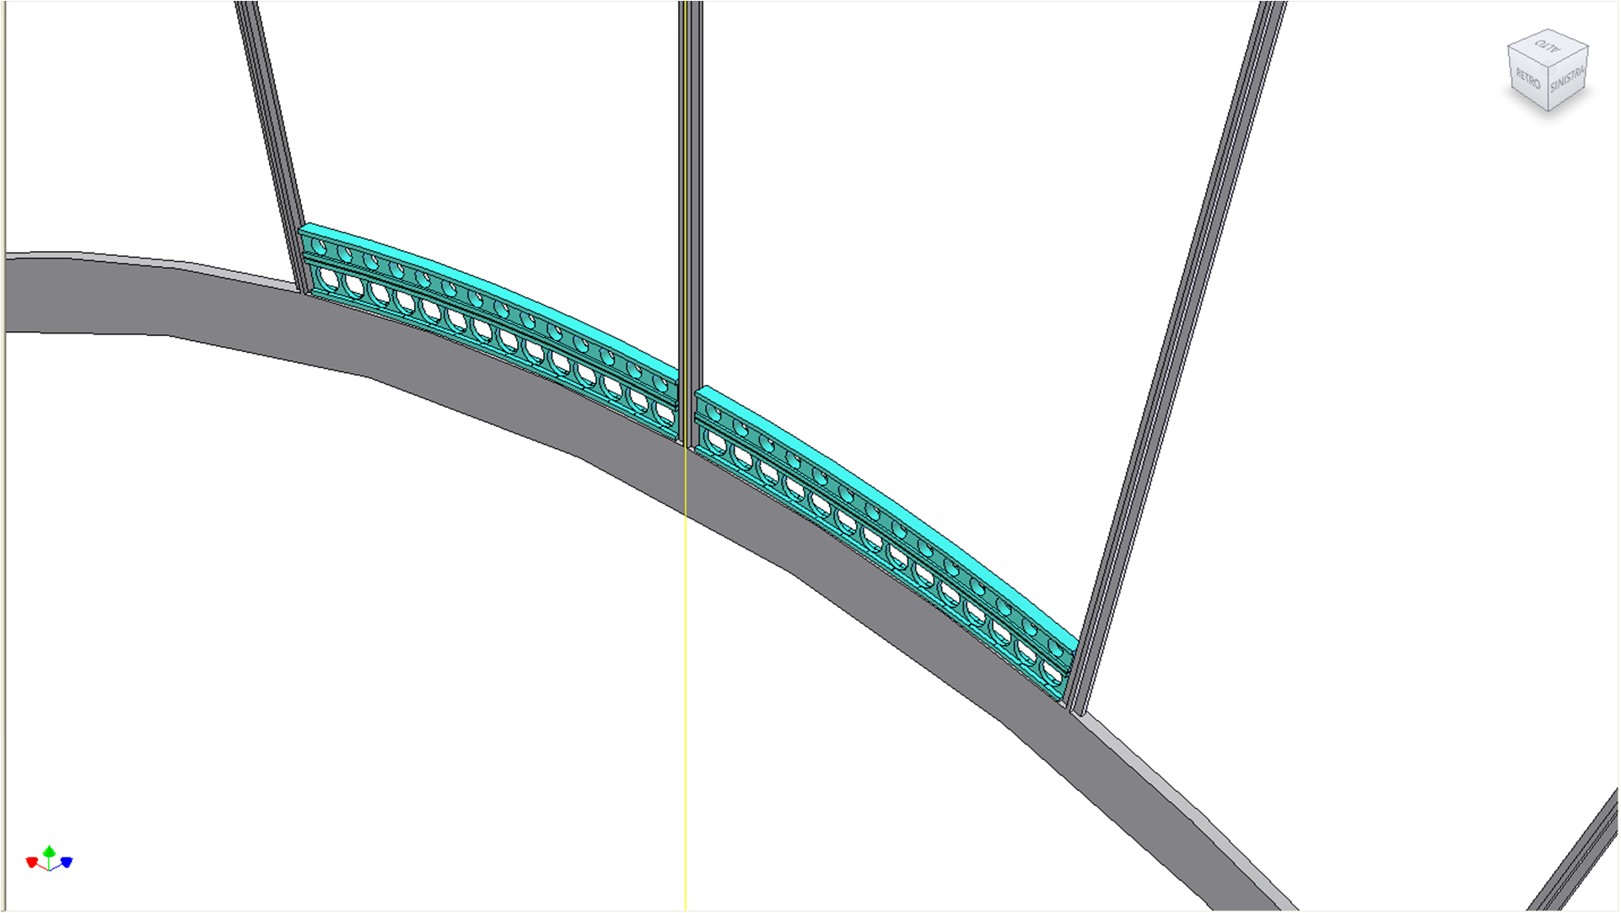
Layers buildup

Slide 34
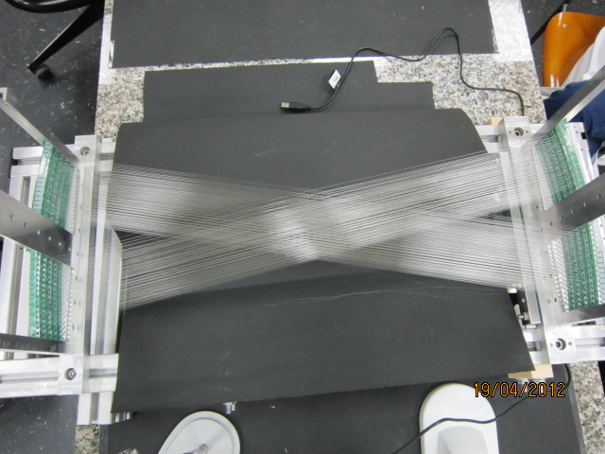
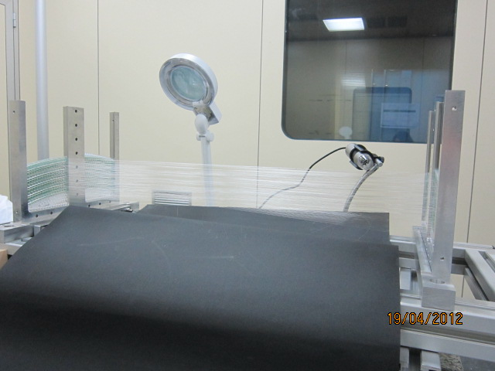
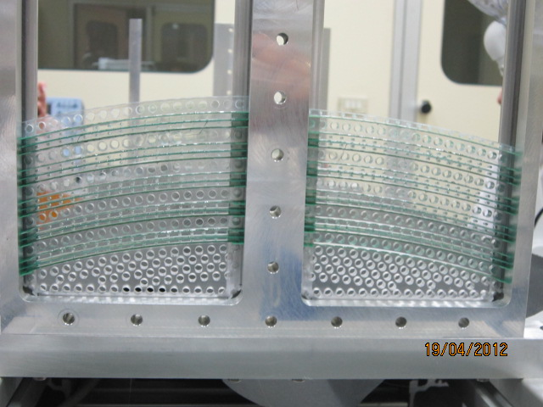
The Prototype
Half way through
Scheduled to be completed
by end of summer

Slide 35
Wire Cage Materials

Slide 36
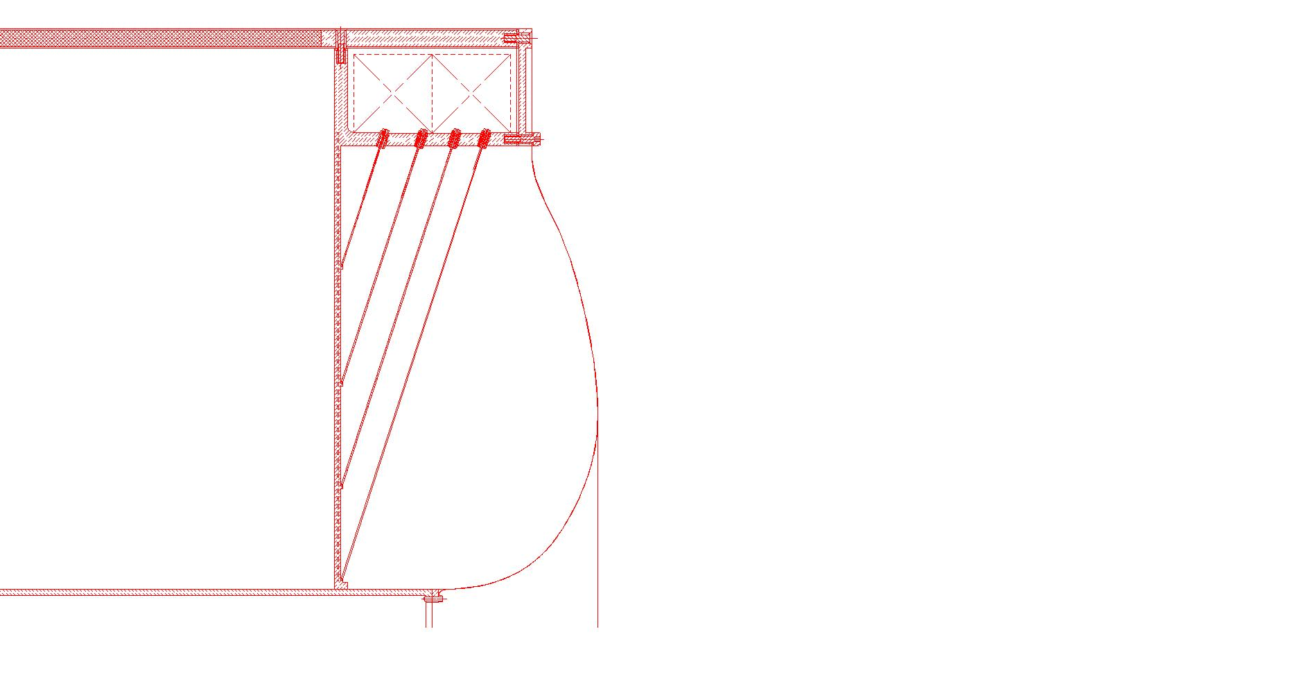
Wire Cage
outer cylinder
load on spokes:
2220 Kg
24+24
= 50 Kg/spoke
spoke
or 1.7 Kg/cm
stays
active
area
load on stays:
6.25 Kg/stay
cos(64°)
50 Kg/8 =
end-plate
membrane
or 14.3 Kg/stay
inner cylinder

Slide 37
Spokes
3x5 mm² unidirectional C-fiber
max displacement < 6 mm under 500 N

Slide 38
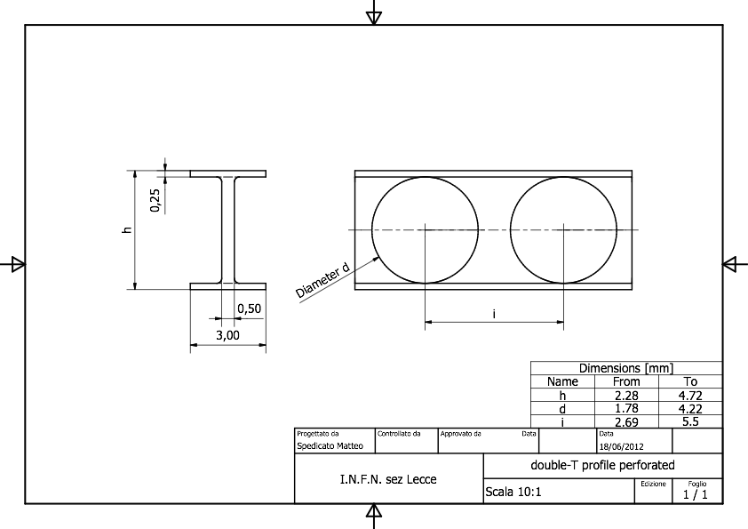
Spacers
polycarbonate

Slide 39
Field wire boards

Slide 40
Sense/Field wires board (signal side)
16
channels
signal connector or
soldered signal cable

Slide 41
Sense/Field wires board (HV side)
16
channels
HV connector or
soldered HV cable

Slide 42
Wire cage
Material budget
 | [g/cm²] | X₀ [10⁻³] | Hit probability | [g/cm²] | X₀ [10⁻³]
Spokes | 0.397 | 9.30 | 0.0225 | 0.009 | 0.2
Stays | 0.009 | 0.19 | 0.00775
Spokes connecting ring | 0.850 | 19.9 | 0.023 | 0.019 | 0.5
Spacers | 0.074 | 1.80 | 0.878 | 0.065 | 1.6
field wires board | 0.720 | 2.64 | 0.05 | 0.036 | 1.3
sense wire board | 1.800 | 6.59 | 0.024 | 0.045 | 1.6
R/O board components |  |  |  | 0.027 | 1.2
HV board components |  |  |  | 0.047 | 2.0
R/O cables |  |  |  | 0.001 | 0.0
HV cables |  |  |  | 0.019 | 1.2

Slide 43
Total Material Budget
 |  | Wire Cage |  | Gas Vessel |  | TOTAL
 |  | [g/cm²] | X₀ [10⁻³] | [g/cm²] | X₀ [10⁻³] | [g/cm²] | X₀ [10⁻³]
Upstream End-Plate | Spokes + Stays | 0.009 | 0.2 | 0.021 | 0.4 | 0.203 | 6.3
 | Spacers | 0.065 | 1.6
 | Wires board | 0.081 | 2.9
 | R/O components | 0.027 | 1.2
Downstream End-Plate | Total above | 0.182 | 5.9 | 0.021 | 0.4 | 0.297 | 10.7
 | R/O + HV comp. | 0.074 | 3.2
 | R/O + HV cables | 0.020 | 1.2
Inner Cylinder | Connecting rings |  |  | 0.107 | 2.5 | 0.208 | 4.4
 | Sandwich |  |  | 0.101 | 1.9

Slide 44
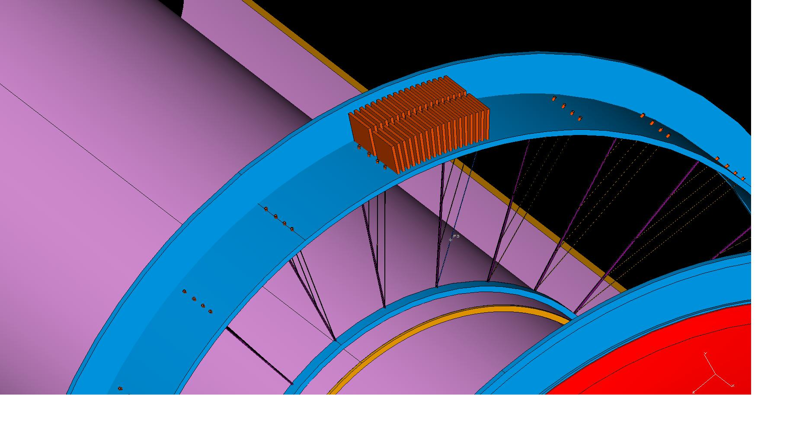
Front-end Electronics
F. Grancagnolo - The I-Tracker
44

Slide 45
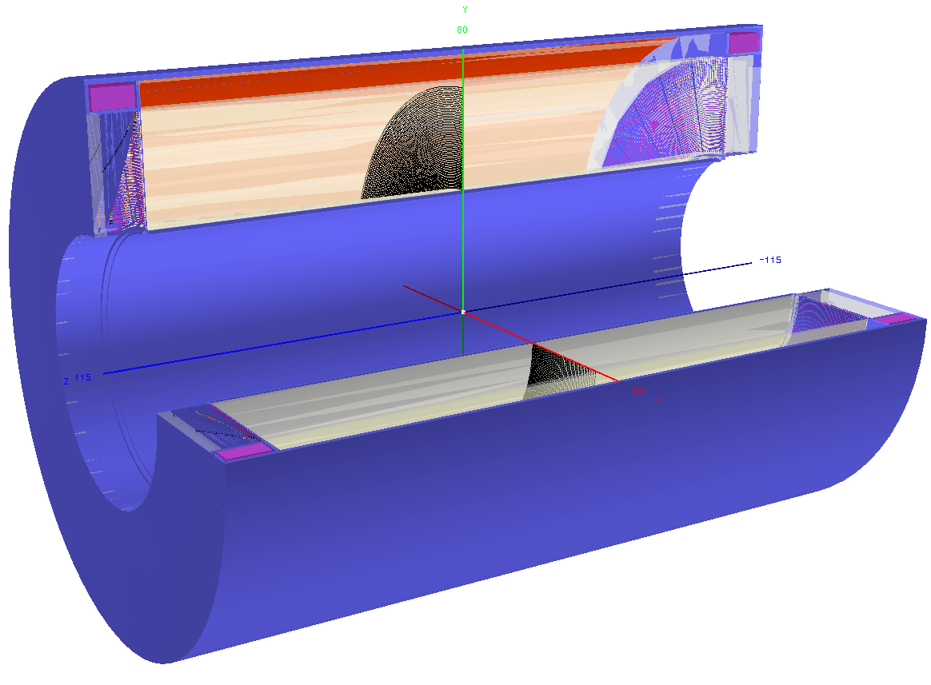
The actual geometry implementation reproduce in a detailed way the description of the new configuration (see F. Grancagnolo talk).

Slide 46
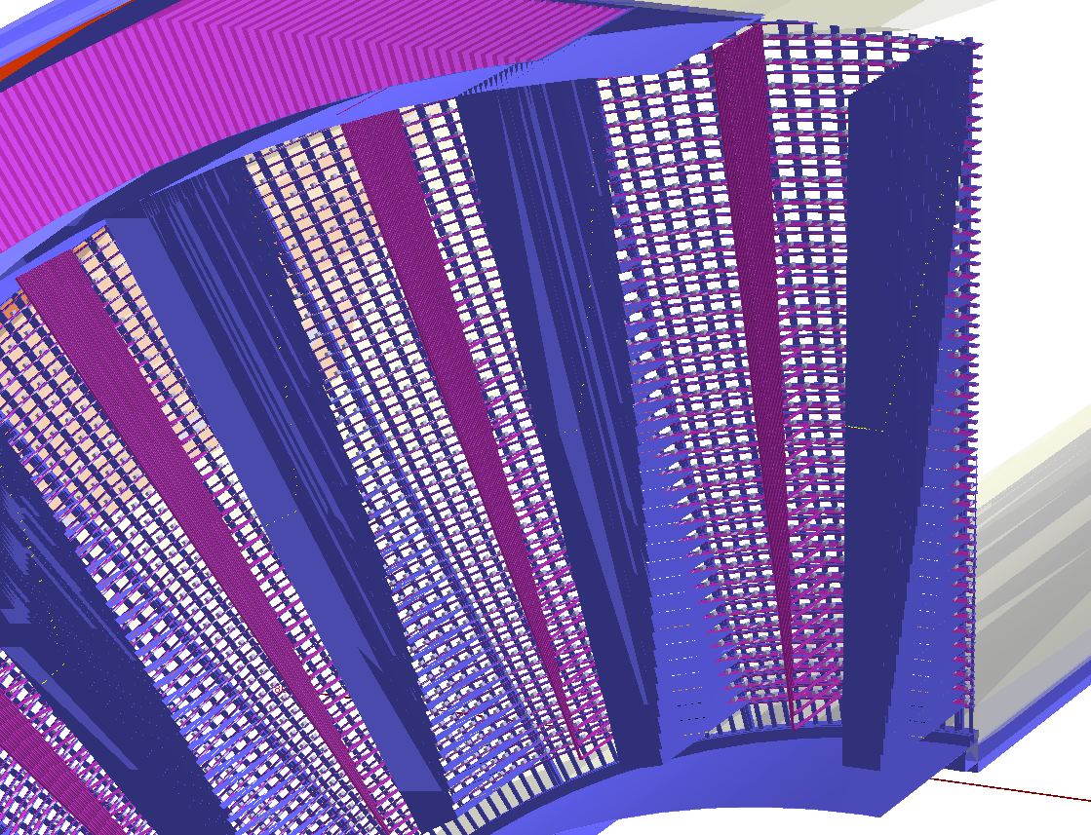
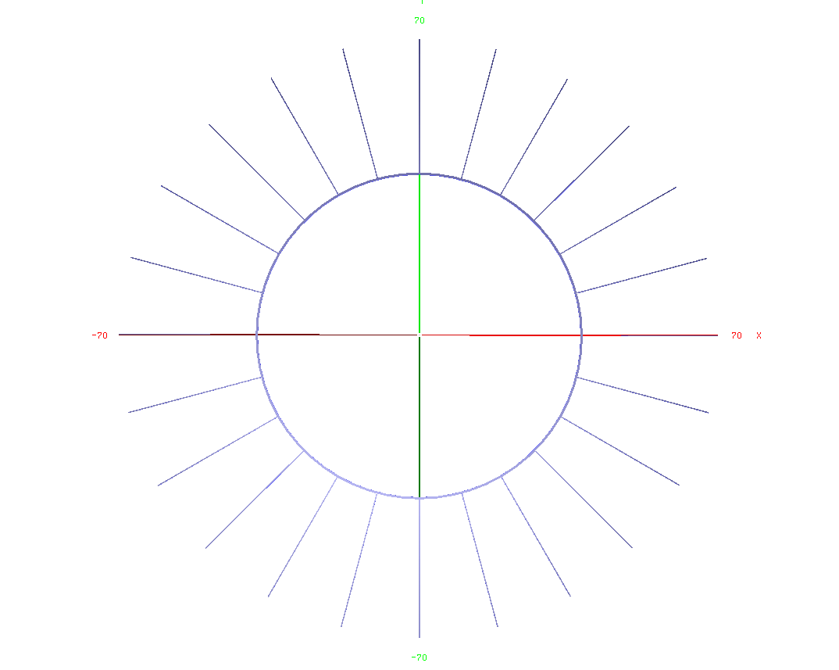
Electronics boards: 12 cm x 6 cm x 3mm G10 (FR4);
signal cables (only downstream): 2.032 cm x 25 µm Kapton + 40 µm 16 pairs of Copper wires;
HV cables (only downstream): 500 µm Copper wire + 500 µm Teflon insulation;
Wire anchoring (see next slide);
Carbon fiber wire support.
Connecting ring is described as a circular layer: 1.0 cm x 1.5 cm Carbon fiber

Slide 47
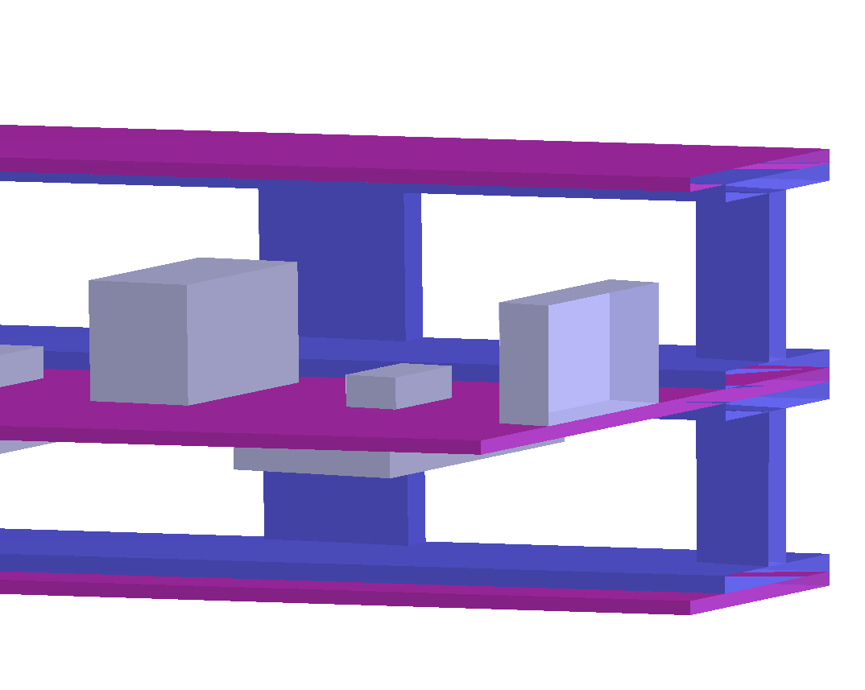
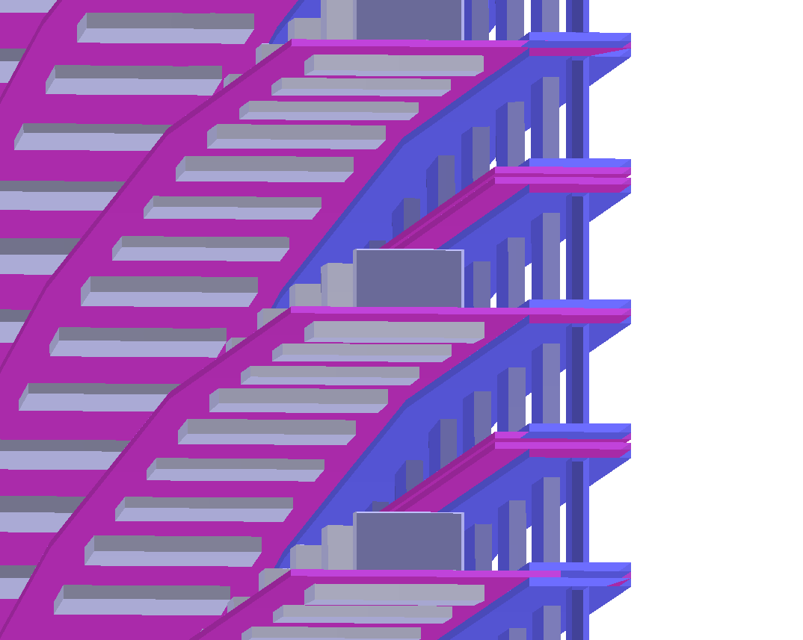
The wire anchoring system:
FWboard
Field wire board: 4 mm x 200 µm G10(FR4);
Spacer: (see F. Grancagnolo talk for details) made of polycarbonate, instead of holes it is drawn with spokes but with the same area ratio.
Sense wire board: 1 cm x 200 µm G10(FR4) plus components: 1) termination resistance: 1.6 mm x 800 µm x 450 µm Aluminum; 2) HV Capacitance: 3.17 mm x 1.57 mm x 1.7 mm Aluminum; 3) HV resistance (only downstream): 5 mm x 2.5 mm x 550 µm Aluminum.
Spacer
SWboard
Spacer
FWboard

Slide 48
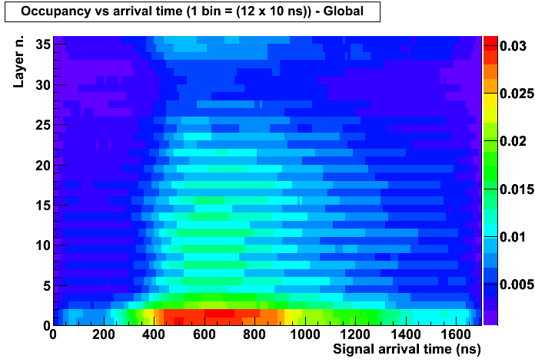
Backgrounds from stopping target
Average single cell occupancy integrated over 120 ns vs time within a mircobunch
All contributions together

Slide 49
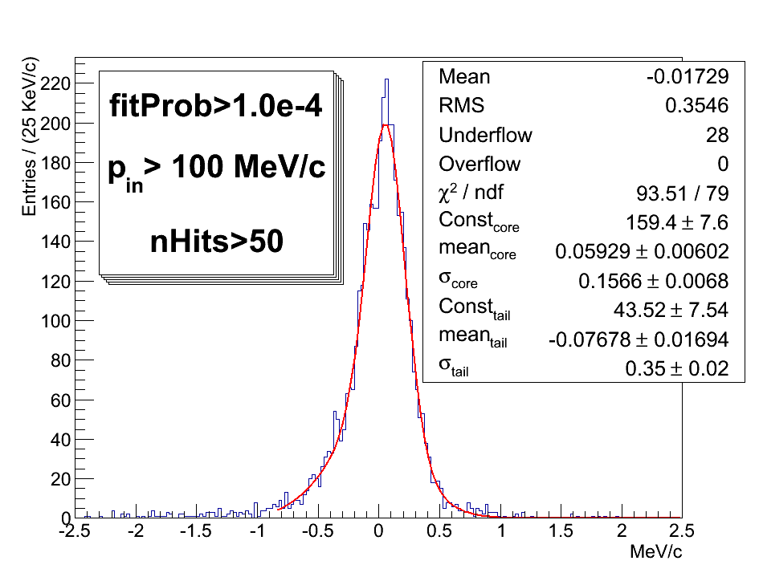
Performance (momentum resolution)
σ ~ 155 keV/C
Shift ~ 60 keV/C
eff ~ 90%
cut_{acc}~ 43%

Slide 50
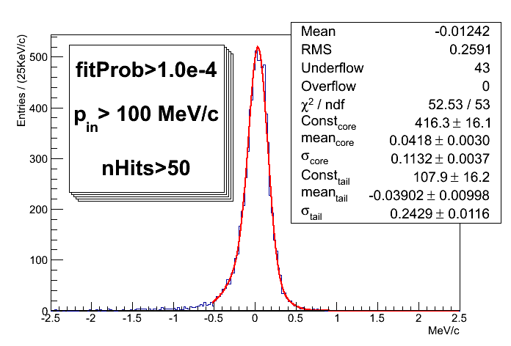
Performance (momentum resolution)
In case of gas at lower pressure an a inner wall made of two 80µm C-fiber skins and 3mm C-foam @ 80 mg/cm³
σ ~ 110 keV/C
Shift ~ 40 keV/C
eff ~ 90%
cut_{acc}~ 43%

Slide 51
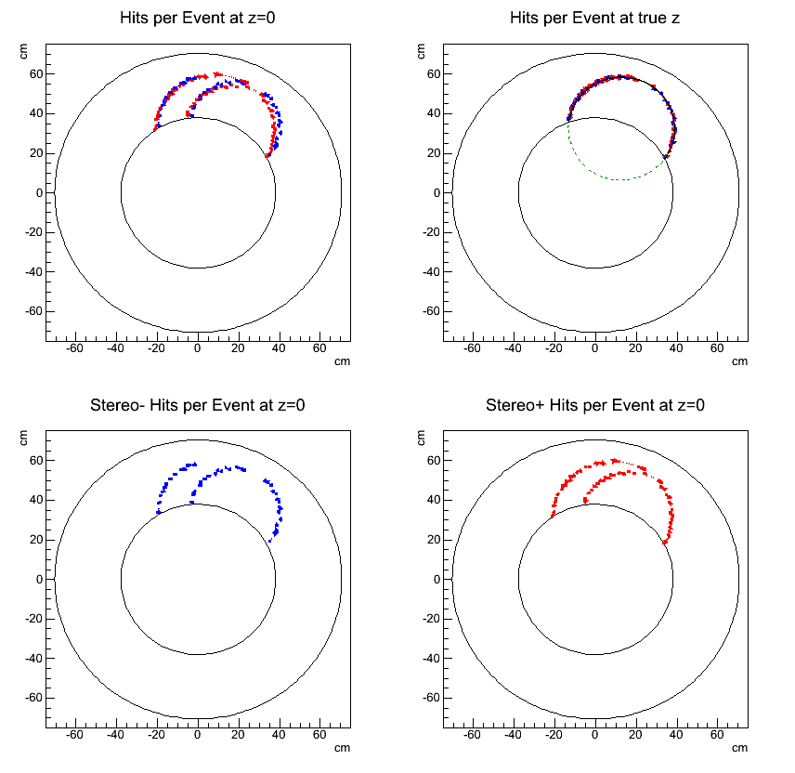
At the current stage we have a basic pattern recognition that we used to test and train the chain of Pattern Recognition an Kalman filter.
The basic ideas of this pattern recognition are:
Identify cluster of contiguous cells per layer;

Slide 52
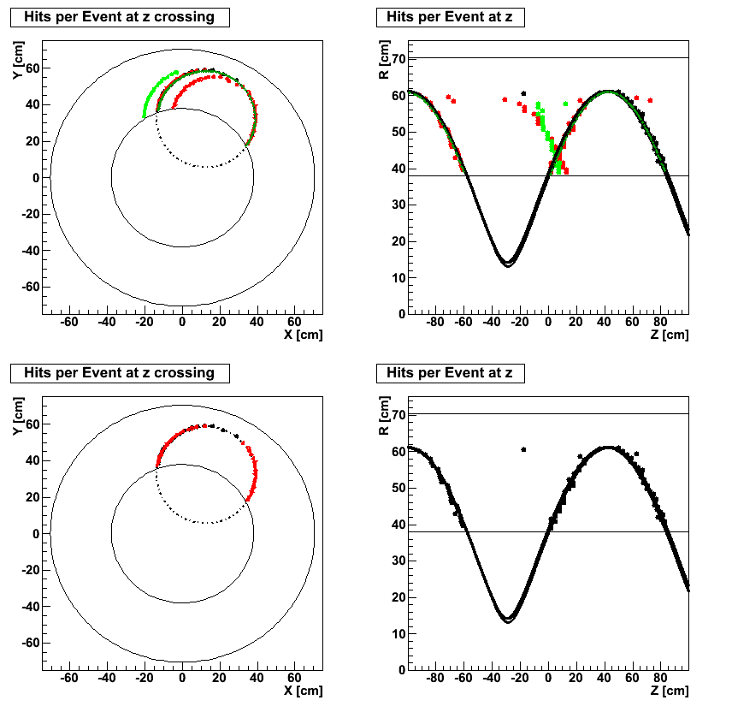
Start by the larger cluster at the outermost radius;
Define a point in space as the crossing points between the extreme hit of the selected cluster with the extreme hits of the clusters at the lower layer;
continue to go down (in layer) until there are potential crossing point;
With the all potential 3D points, use robust helix fit of the TT.

