Slide 1
BARI 21
Membri:
Luigi Delle Rose,
Mirko Serino,
Antonio Quintavalle
C.C.
Membri precedenti:
Antonio Mariano (Salonicco),
Roberta Armillis (EPFL-Losanna)
Marco Guzzi (DESY Amburgo)
Giovanni Chirilli (Berkeley)
Emanuela Dimastrogiovanni (Perimeter Institute, CA)
Attivita’ di ricerca:
Applicazioni della teoria dei campi al Modello Standard e fisica astroparticellare.
In particolare:
1) Studio di estensioni specifiche del Modello Standard (modelli abeliani anomali)
e relative applicazioni cosmologiche (materia oscura assionica)
2) Studio dei gradi di liberta’ effettivi prodotti da interazioni con anomalie conformi
3) Collider Physics

Slide 2
Effective degrees of freedom in the Anomalous effective action of the Standard Model
(dilaton). The dilaton can accompany the Higgs at the LHC

Slide 3
1. Effective Dilaton Interactions from the Anomalous Breaking of Scale Invariance of the Standard Model.
Claudio Coriano, Luigi Delle Rose, Antonio Quintavalle, Mirko Serino. Jun 2012. 47 pp. Note: * Temporary entry *; 47 pages, 9 figures
e-Print: arXiv:1206.0590 [hep-ph]
2. Graviton Vertices and the Mapping of Anomalous Correlators to Momentum Space for a General Conformal Field Theory.
Claudio Coriano, Luigi Delle Rose (Salento U. & INFN, Lecce), Emil Mottola (Los Alamos), Mirko Serino (Salento U. & INFN, Lecce). Mar 2012. 57 pp. Note: 57 pages, 7 figures. Refs added
e-Print: arXiv:1203.1339 [hep-th]
Non gaussianities in the early universe

Slide 4
3. Comments on Anomaly Cancellations by Pole Subtractions and Ghost Instabilities with Gravity.
Roberta Armillis (Salento U. & INFN, Lecce & Aristotle U., Thessaloniki), Claudio Coriano, Luigi Delle Rose (Salento U. & INFN, Lecce), A.R. Fazio (Colombia, U. Natl.). Mar 2011. 18 pp. Note: 18 pages. Revised version. To appear in 'Classical and Quantum Gravity'
Published in Class.Quant.Grav. 28 (2011) 145004
e-Print: arXiv:1103.1590 [hep-ph]
References | BibTeX | LaTeX(US) | LaTeX(EU) | Harvmac | EndNote
Abstract and Postscript and PDF from arXiv.org; Journal Server - Class.Quant.Grav.
Detailed record
4. Gravity and the Neutral Currents: Effective Interactions from the Trace Anomaly.
Claudio Coriano, Luigi Delle Rose, Mirko Serino (Salento U. & INFN, Lecce). Feb 2011. 68 pp. Note: 69 pages, 17 figures. Section 4 extended/ some comments added in section 7. Final version to appear in Phys. Rev. D
Published in Phys.Rev. D83 (2011) 125028
e-Print: arXiv:1102.4558 [hep-ph]

Slide 5
5. The Conformal Anomaly and the Neutral Currents Sector of the Standard Model.
Claudio Coriano, Luigi Delle Rose, Antonio Quintavalle, Mirko Serino (Salento U. & INFN, Lecce). Jan 2011. 13 pp. Note: 19 pages, 10 figures. Extended version, To appear in Phys. Lett. B
Published in Phys.Lett. B700 (2011) 29-38
e-Print: arXiv:1101.1624 [hep-ph]

Slide 6
Assioni di gauging (axion like particle)
Anomalous extra Z primes.
In supersymmetric firmulations dark matter is composed of
Neutralinos and axions

Slide 7
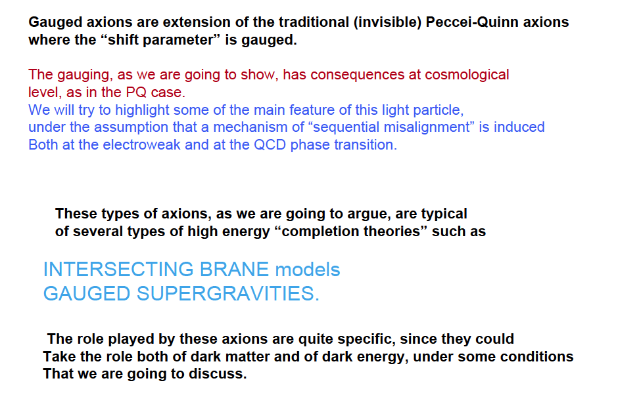

Slide 8
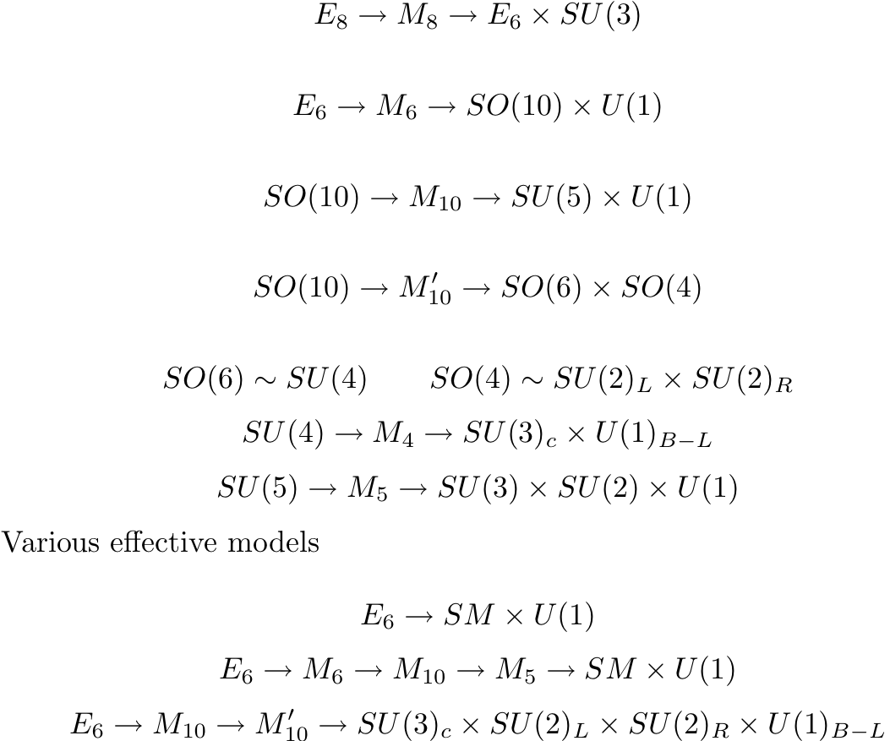
….Plenty of U(1)’s also in anomaly-free constructions
The question is: if we find extra neutral currents at the LHC
how do we discover if a different mechanism of anomaly cancelation is at work?

Slide 9
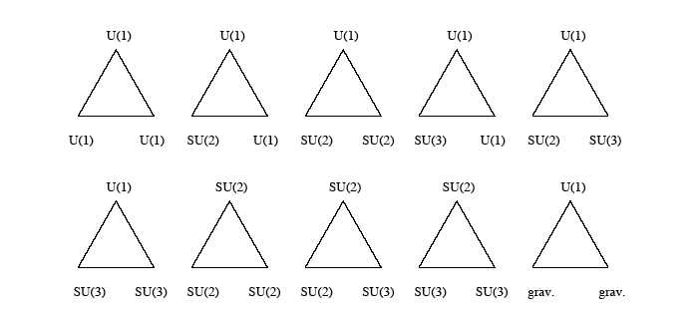
Standard Model Anomalies
They cancel generation by generation

Slide 10
Anomalous U(1)’s have found applications in the context of
neutrino mass matrices (Irges, Lavignac, Ramond)
For the rest they have not found other phenomenological applications.
An anomalous U(1) symmetry is characterized, however,
by several distinctive features
New trilinear gauge interactions mediated by an anomalous
extra Z prime
2) Extra contact interactions (Chern Simons terms)
3) an axion like particle (under certain conditions)

Slide 11
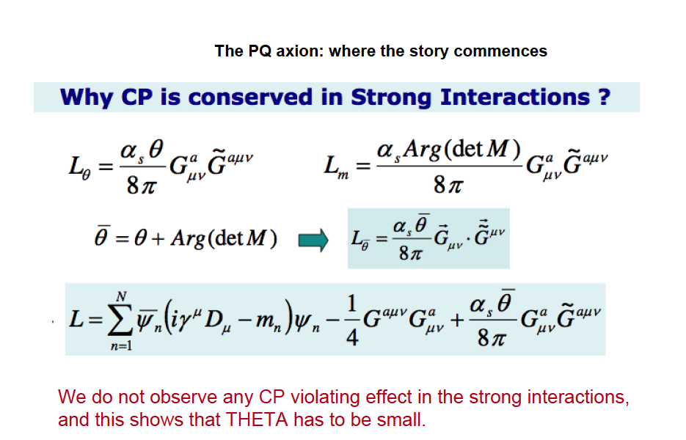
Global U(1) Anomalies

Slide 12
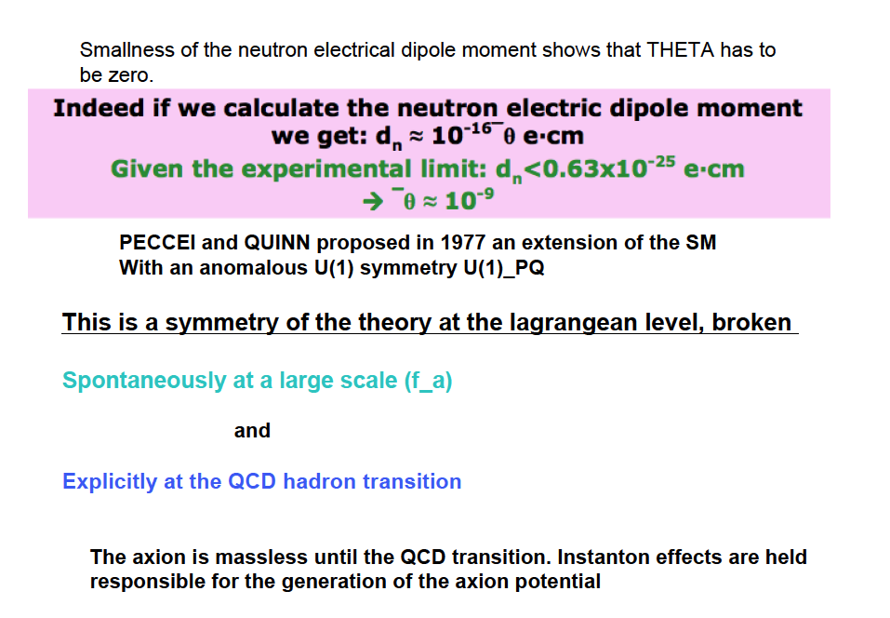

Slide 13
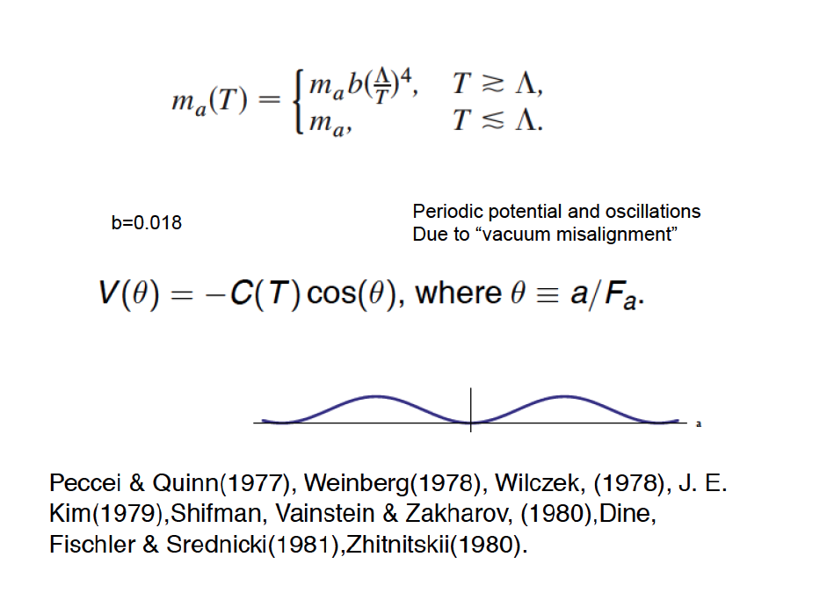
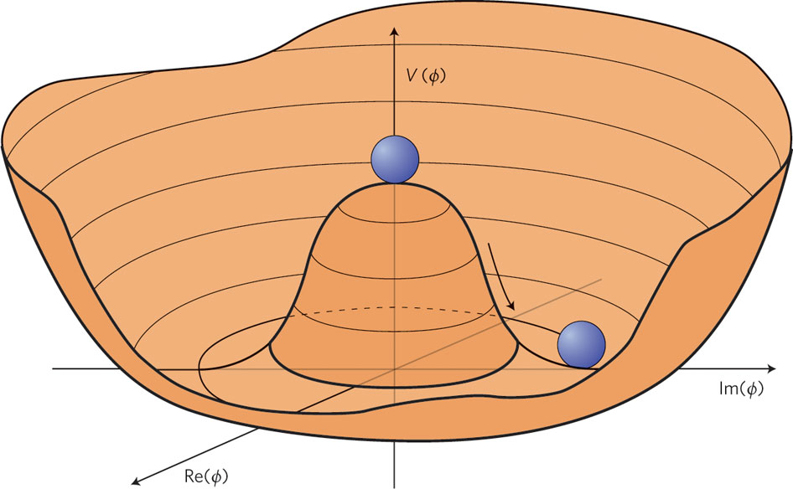
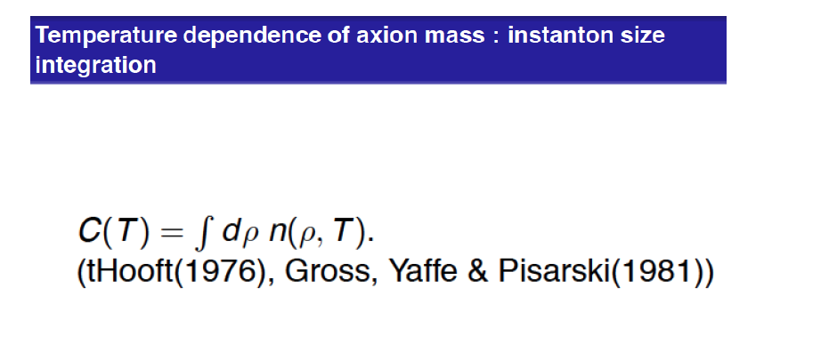
A periodic potential is generated at the QCD hadron transition
The breaking of the PQ symmetry
takes place at a large scale f_a, but
The wiggling of the PQ potential
Occurs much later, at the QCD phase
transition

Slide 14
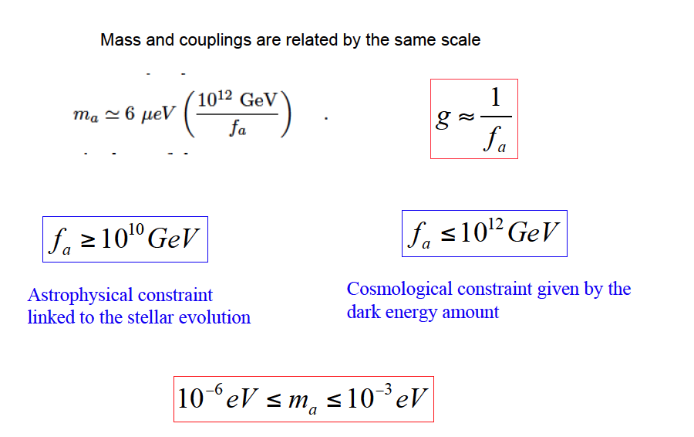
The PQ axion remains a massless Goldstone mode until the QCD phase transition,
after which it develops a small mass. The size of the periodic potential
is important in order to fix the size of the mass.

Slide 15
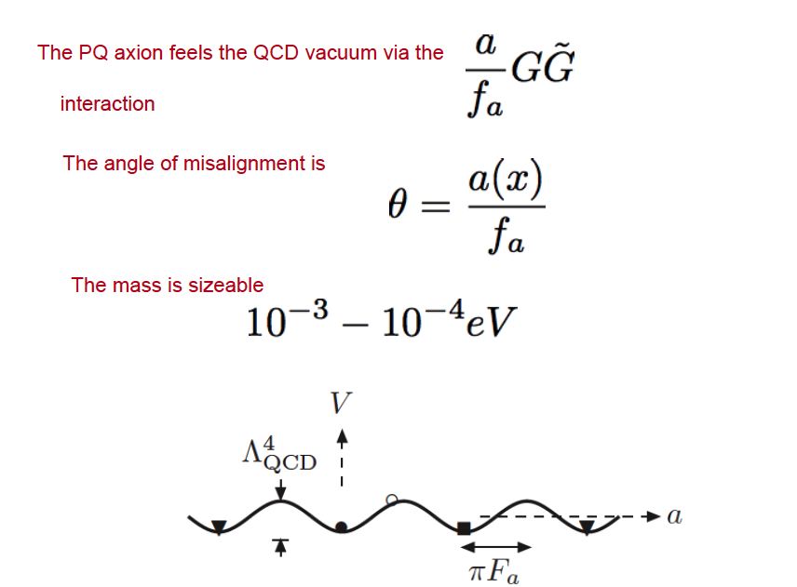
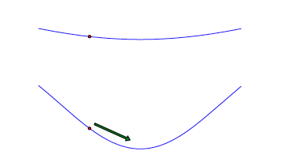
If an axion has charges both
under SU(3) and SU(2)
we could consider the
possibility of sequential
misalignments. The dominant
misalignment clearly comes
from the largest potential

Slide 16
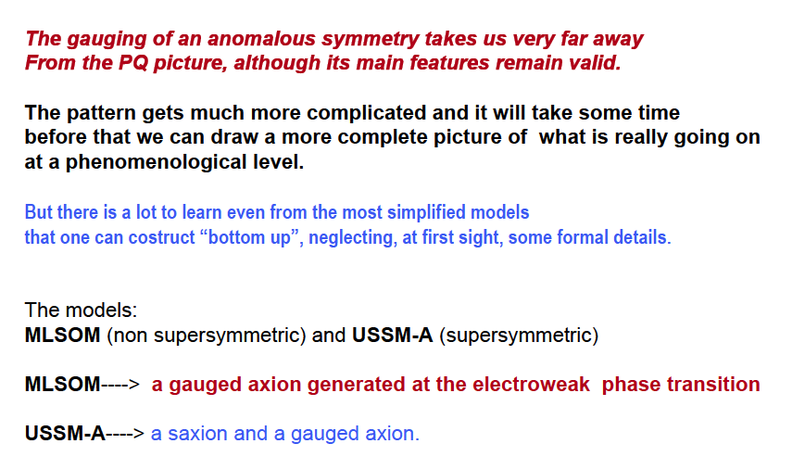
Mariano, Guzzi, C.C.

Slide 17
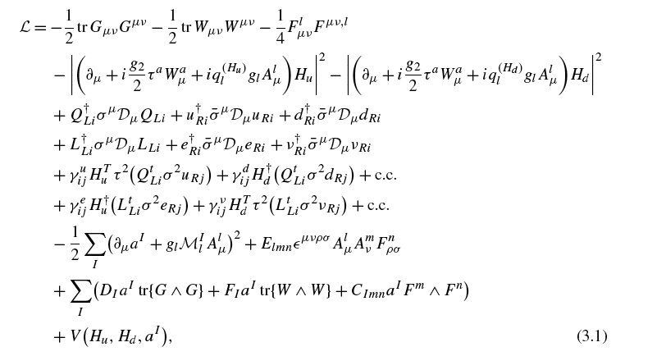
The SU(3)xSU(2)xU(1)xU(1) Model
kinetic
Higgs doublets
L/R fermion
CS
GS
Higgs-axion mixing
Irges, Kiritsis, C.
Stueckelberg

Slide 18
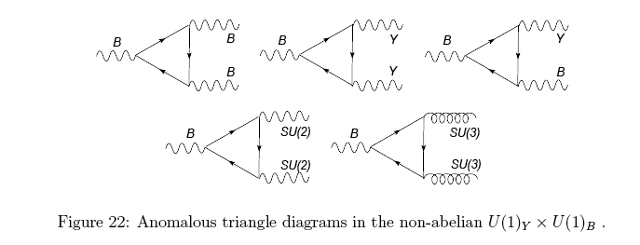
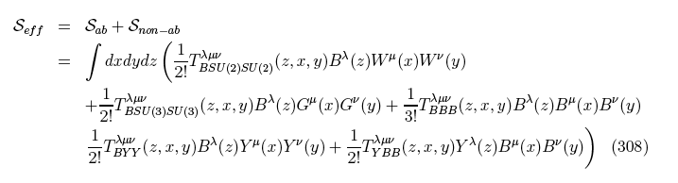
Gauge sector

Slide 19
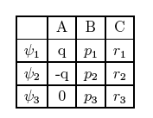

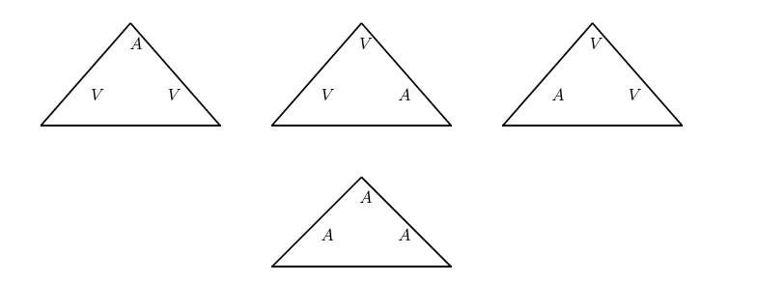

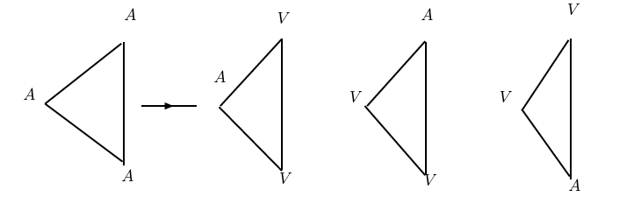

Other important feature
Chern-Simons contributions
A, vector-like
B, C axial
CS contributions are irreducible when there are 2 U(1)’s (Armillis, Guzzi, C.C.)

Slide 20
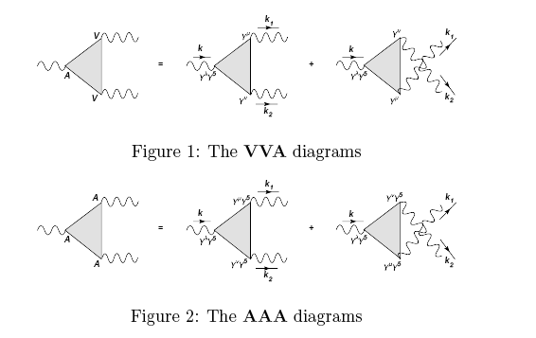
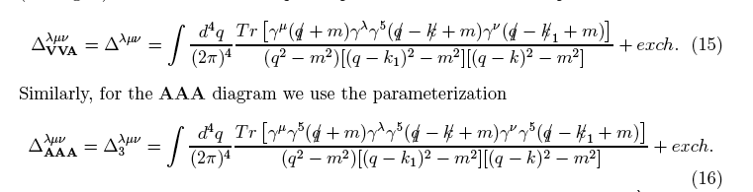
STRUCTURE OF THE ANOMALOUS CONTRIBUTIONS
CHERN SIMONS INTERACTIONS

Slide 21

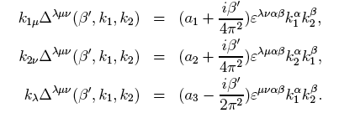
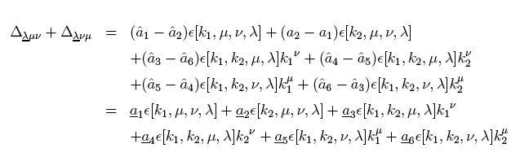
Momentum shifts in the loop generate linear terms in the independent momenta
redistribute
the anomaly.
Their sum is fixed
These two invariant amplitudes correspond to CS interactions and can be defined by
external Ward Identities. In the Standard Model one chooses CVC, but this is not necessary
because of traceless conditions on the anomalies

Slide 22
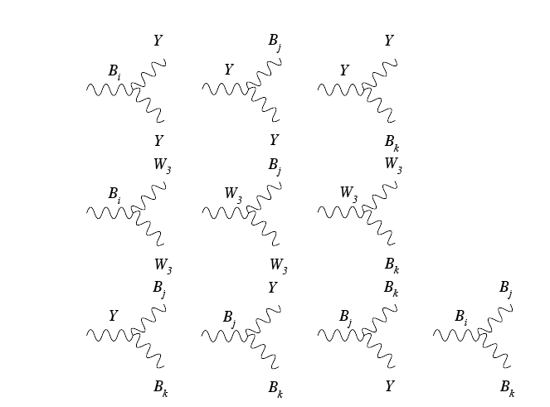
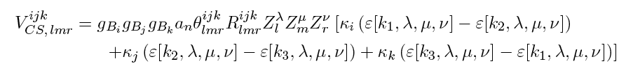
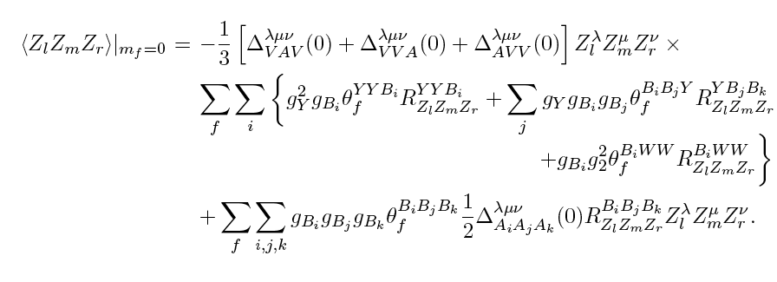
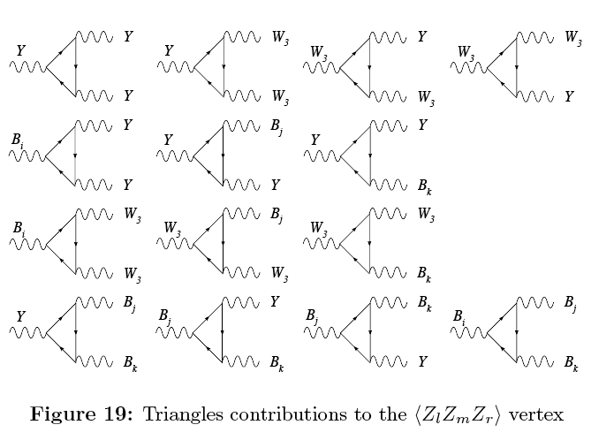
Wess-Zumino case. Trilinear gauge interaction
CS terms
Armillis, Guzzi, C.C.

Slide 23
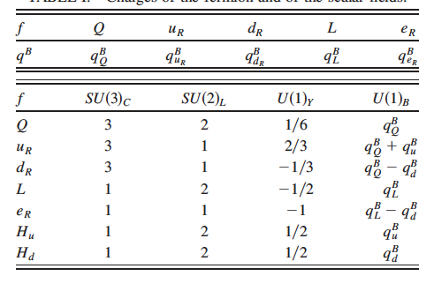
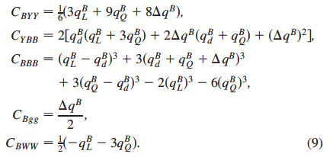
Anomalies to be cancelled
By a single Stuckelberg axion

Slide 24


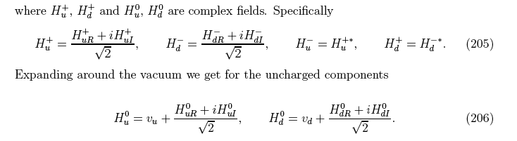
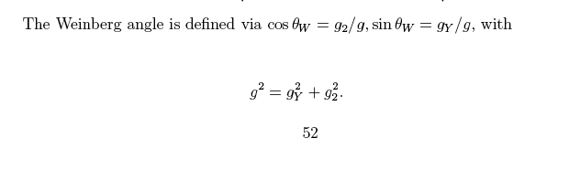
The VERY MINIMAL MODEL
2 Higgs doublets

Slide 25

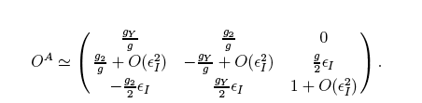
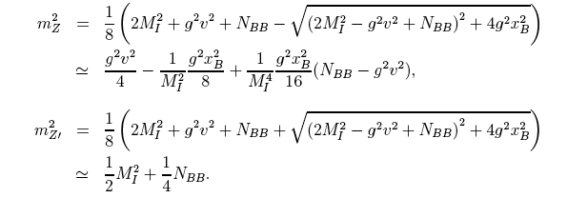

No v/M corrections on first
row
SM-like
1/M
O(M)

Slide 26
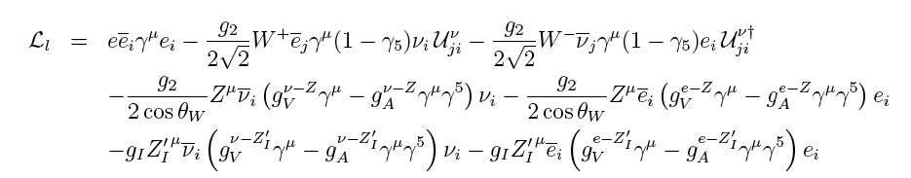
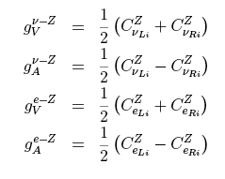
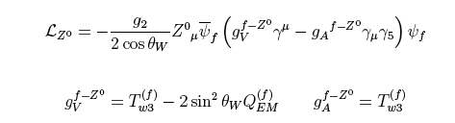
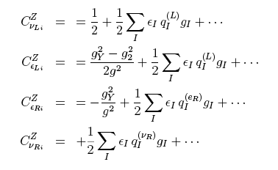
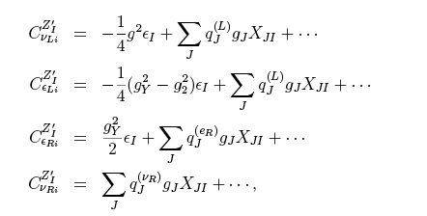
Fermionic sector
Fermion interactions of the extra Z’
Decoupling as v/M--->0

Slide 27


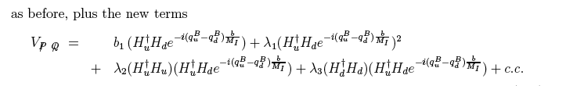
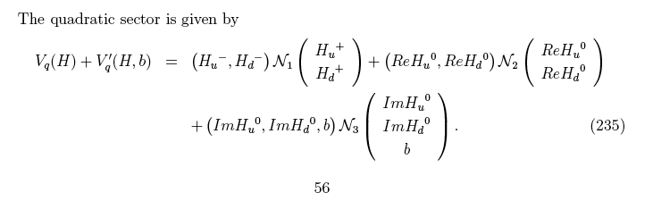
CP even
CP odd

Slide 28
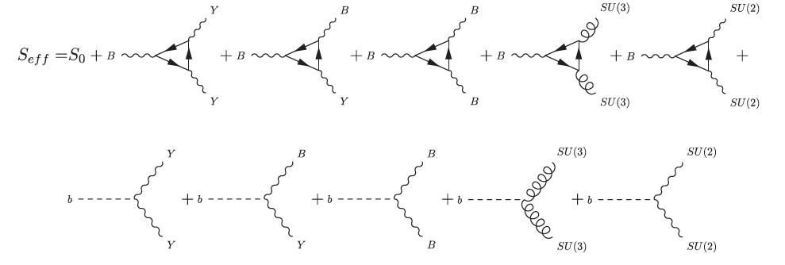
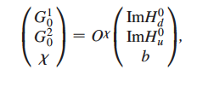
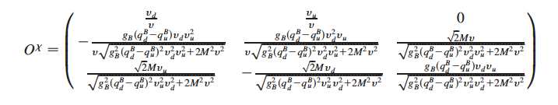
Effective action
Rotation onto the
physical axi-Higgs

Slide 29
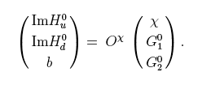
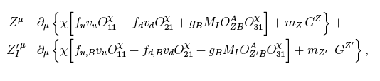
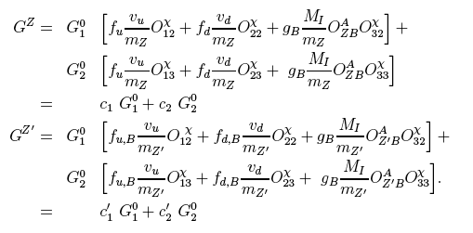
CP odd Sector. Where the physical axion appears
2 Goldstones
We need to identify the goldstones of the physical
gauge bosons
These have to vanish
You need some rotations
among the gapless excitations
to identify the goldstones

Slide 30
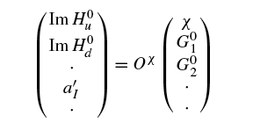

Independently from the number of
anomalous U(1)’s, we have only a single axion
1 physical axion,
The Axi-Higgs
GS Axions
N Nambu-Goldstone modes

Slide 31
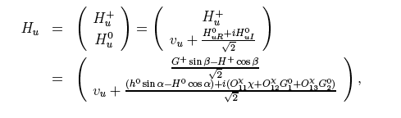
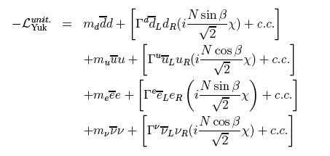
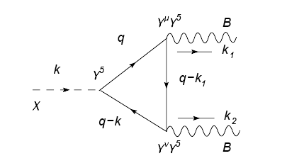
Some properties of the axi-Higgs: Yukawa couplings
Induces the
decay of the
Axi-Higgs,
similar to Higgs decay

Slide 32
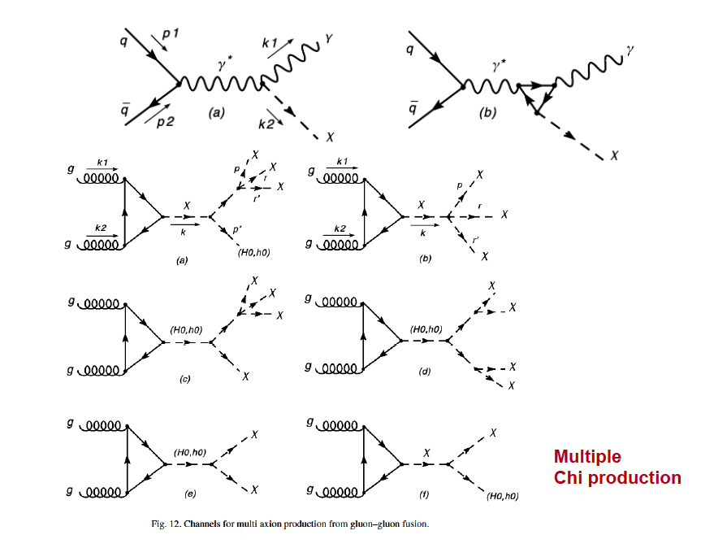
Collider applications: LHC
R. Armillis, M. Guzzi, C.C.

Slide 33
Anomalous abelian models predict an extra Z prime in the spectrum of the neutral currents which has been studied at the LHC
Altre applicazioni: anomalous extra Z prime at the LHC

Slide 34

Drell Yan: Anomalous extra Z prime

Slide 35


Slide 36

.
Double prompt photons at the LHC

Slide 37
Supersymmetric extensions of these models come in two basic formulations
MSSM based extensions (with an extra anomalous U(1) symmetry)
based on the MSSM superpotential. The CP-odd scalar sector does not
allow a mixing between the Higgses and the Stuckelberg axion. There is
No axi Higgs nor the Higgs-Stuckelberg phase. The anomalous gauge boson
gets its mass uniquely from the Stuckelberg field
(Anastasopoulos, Fucito, Leonetto, Pradisi, Stanev)
2) USSM-A (Guzzi, Mariano, C.C.)
This second model has Higgs-axion mixing and an axi-Higgs in the spectrum.
It is based on the Next-to Minimal MSSM (NMSSM) augmented by an extra
U(1) anomalous symmetry and massive a la Stuckelberg.
In both cases we need an axion supermultiplet (Stuckelberg supermultiplet)
In order to erase the anomalous variation of the effective action.

Slide 38



USSM-A
USSM-A
NMSSM +
Extra U(1)
with an anomaly
And
A gauged axion
supermultiplet
Mariano, Guzzi, C.C.

Slide 39



Using gauge invariance the anomaly equations take the form
Their independent variation allows to scal the entire class of models of this type
With no reference to specific realizations.

Slide 40

Kinetic saxion
Axino-gaugino
Stuckelberg kinetic
Peccei Quinn
Saxion FF

Slide 41





The potential
The saxion has tree level mass M_st.
The potential modifies this mass
which can be fixed by requiring
Flatness on

Slide 42

Saxion interactions

Slide 43



The saxion decays very fast.

Slide 44

Long lived axi-Higgs

Slide 45





Sequential Misalignment
The angle of misalignment depends both on
The axion field and on the second CP odd Higgs
(H_0^4). Left panel: SU(2) coupling, Right panel: QCD transition
Mariano, Guzzi, C.C.

Slide 46

Singlino dominance of the neutralino
At large tanBeta the neutralino tends to become very light as the Stuckelberg mass
grows. This is responsible for an overproduction of neutralinos and large relic
densities which need to be made compatible with WMAP.

Slide 47

Guzzi, Mariano, C.C., 2011

Slide 48
The computation of the neutralino relic densities
We have both an axion and a neutralino in the spectrum
The axion will decouple pretty fast (non thermally) while the
neutralino will decouple thermally. In this second case the
evolution of the relic densities will follow the usual pattern
Typical of heavy dark matter relics: the Boltzmann equations
Con Antonio Mariano

Slide 49




Axion relic densities

Slide 50



Large Scale simulations. Several hundreds of different 2-to-2 cross ections
Correlations between relic densities and tan beta.
Comparison with WMAP data.
A.M., C.C., PRD 2012

Slide 51
Dilatons and Gravitons and the anomalous breaking of scale invariance in the Standard Model
(The dilaton of the Standard Model)
1. Effective Dilaton Interactions from the Anomalous Breaking of Scale Invariance of the Standard Model.
Claudio Coriano, Luigi Delle Rose, Antonio Quintavalle, Mirko Serino. Jun 2012. 47 pp.
e-Print: arXiv:1206.0590 [hep-ph]

Slide 53
Graviton Vertices and the Mapping of Anomalous Correlators to Momentum Space for a General Conformal Field Theory.
Claudio Coriano, Luigi Delle Rose (Salento U. & INFN, Lecce), Emil Mottola (Los Alamos), Mirko Serino (Salento U. & INFN, Lecce). Mar 2012. 57 pp.
e-Print: arXiv:1203.1339 [hep-th]
Gravity and the Neutral Currents: Effective Interactions from the Trace Anomaly.
Claudio Coriano, Luigi Delle Rose, Mirko Serino (Salento U. & INFN, Lecce). Feb 2011. 68 pp.
Published in Phys.Rev. D83 (2011) 125028
e-Print: arXiv:1102.4558 [hep-ph]
Trace Anomaly, Massless Scalars and the Gravitational Coupling of QCD.
Roberta Armillis, Claudio Coriano, Luigi Delle Rose (Salento U. & INFN, Lecce). May 2010. 25 pp.
Published in Phys.Rev. D82 (2010) 064023
e-Print: arXiv:1005.4173 [hep-ph]
. Conformal Anomalies and the Gravitational Effective Action: The TJJ Correlator for a Dirac Fermion.
Roberta Armillis (Salento U. & INFN, Lecce), Claudio Coriano (Salento U. & INFN, Lecce & Crete U.), Luigi Delle Rose (Salento U. & INFN, Lecce). Oct 2009. 43 pp.
Published in Phys.Rev. D81 (2010) 085001
e-Print: arXiv:0910.3381 [hep-ph]

Slide 54
The Standard Model has an interpolating state
which is a Nambu Goldstone mode of anomaly broken
scale invariance (due to the trace anomaly).
This massless state can be extracted from a direct
perturbative analysis of the correlation function JVV,
where J is the dilatation current.
It is the same state appearing in the TVV diagram in the
Neutral currents sector of the Standard Model when this
interacts with gravity.
Since a massless effective dilaton is not found, this state
should take a mass nonperturbatively.
There is no way that we can exclude such a state
From the spectrum

Slide 55





QED (massive off shell)
Giannotti and Mottola
Armillis, Delle Rose, C.C. 20010
➔

Slide 56




qcd
Armillis, delle Rose, C.C.

Slide 57




QCD has a conformal anomaly pole!
Armillis, Delle Rose, C.C., 2009
This pole is infrared coupled. In the fermion sector the pole is screened.

Slide 58




Flat background limit
Giannotti and Mottola
The Lagrangian coincides with the explicit perturbative computation

Slide 59




Anomaly poles are predicted by anomaly induced actions
Anomaly-induced action for the trace anomaly:
given an anomaly, try to find an action which reproduces the anomaly
(Reigert, 80’s)

Slide 60







fermion
Higgs

Slide 61



Slide 62




DILATATION CURRENT: inheriting the anomaly pole

Slide 63






Partially Conserved Dilatation Current (PCDC)

Slide 64



Dilaton Interactions (linear)
QCD
EW

Slide 65



Slide 66





Dilaton-graviton graviton vertex
Dilaton cubic vertex

Slide 67
Applications: Dilaton/Higgs phenomenology a the LHC
Embedding of this result into Technicolor models.
Compared to the standard Higgs interaction,
We have a direct coupling to the anomaly

Slide 68



Slide 69


Luigi Delle Rose, Mirko Serino, C.C., in progress

Slide 70



Slide 71
Other implications
Computations of the TTT and TTTT are important (in D=3) in the study of the
Scalar and tensor perturbations in the early universe, which lead to the
Development of NON GAUSSIANITIES in the CMB
Computations of the bispectrum and trispectrum during inflation are
underway
(Delle Rose, Serino)
Master level students involved
Carlo Marzo,
Antonio Costantini.

Slide 72
Talks:
Bari, April 2012, Luigi Delle Rose
Bologna April 2012, (C.C.)
Vienna, June 2012 (C.C.)
Bari, May 2012 (C.C.)
QCD@work (2 poster and talk presenations) Luigi Delle Rose and Mirko Serino
International Collaborations
Emil Mottola, (Los Alamos)
A. Djouadi (CERN)
L. Perivolaropoulos and A. Dedes (Ioannina)
G. Lazarides (Tessaloniki)
University of Crete (Kiritsis, Tomaras)
Roberta Armillis (EPFL Lausanne)
L. Trentadue (Parma)
P. Colangelo (Bari).

Slide 73
CONCLUSIONS and PERSPECTIVES
We have shown that the dilatation current has an anomaly pole
generated by the trace anomaly.
This corresponds to the presence of effective interactions mediated
by an interpolating field which is dilaton-like
The proof is rigorous. One has to show
that a pole like this is either removed from the spectrum or,
If it is there, has to be found.
Other implications and possible developments (in several contexts)
Anomaly poles should be present in the entire anomaly supermultiplet of
SYM theory, since the trace of the EMT, the U(1)_R anomalous current and the
Gamma -trace of the susy current are part of the same multiplet.
Poles should be present in all three sectors.
Computation of the TTTT contributions (4 graviton vertex) for the determination
of the quartic contributions to the dilaton interaction from perturbation theory.

