Slide 1
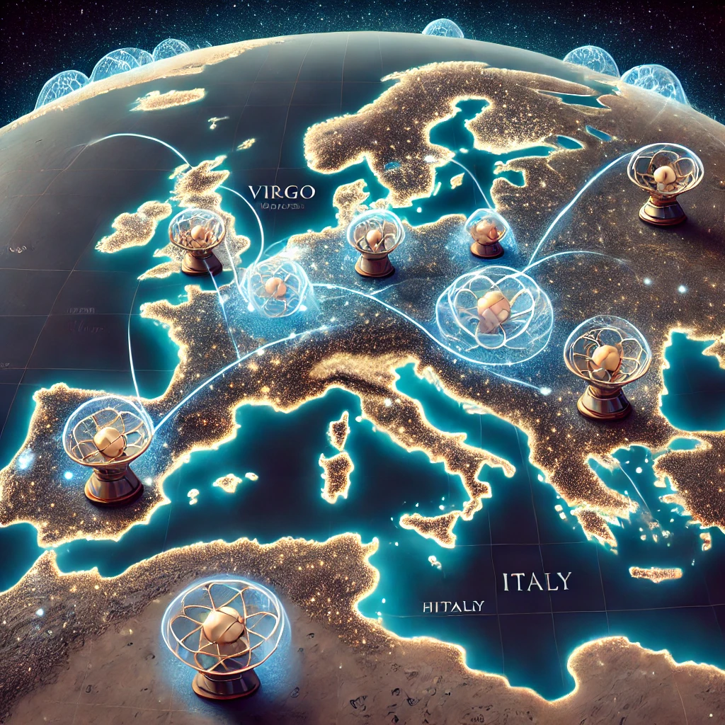



GravNet
Claudio Gatti
71th LNF Scientific Committee – May 2026

Slide 2


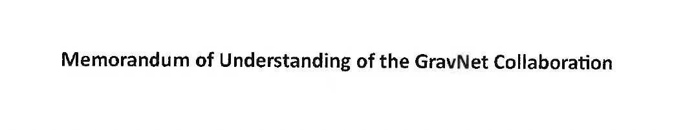
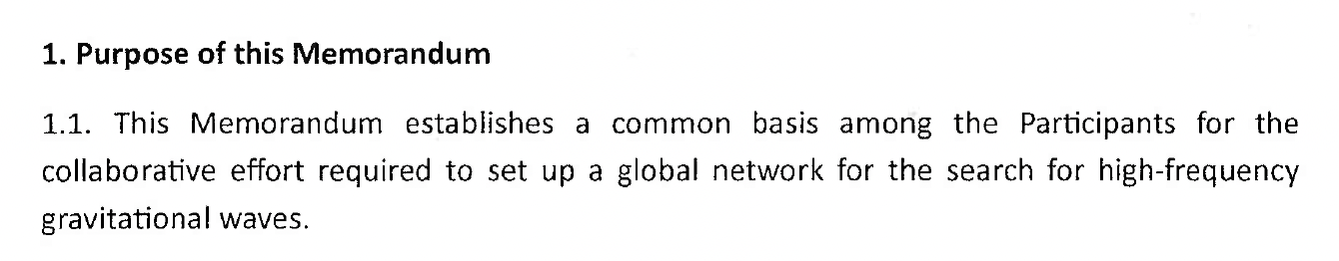
GravNet A Global Network for the Search of High Frequency Gravitational Waves
This MoU aims to extend the network beyond ERC participants.
Initial sites: Mainz, Bonn, Frascati
Radio haloscope
Quantum Sensing
GravNet is now a Recognized Experiment at CERN
X-band haloscope

Slide 3
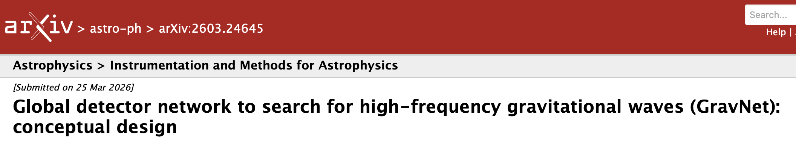
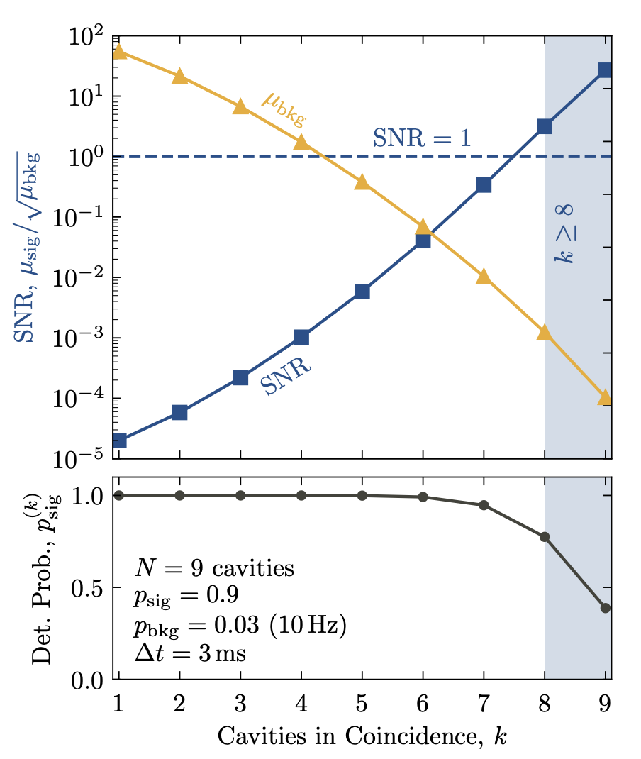
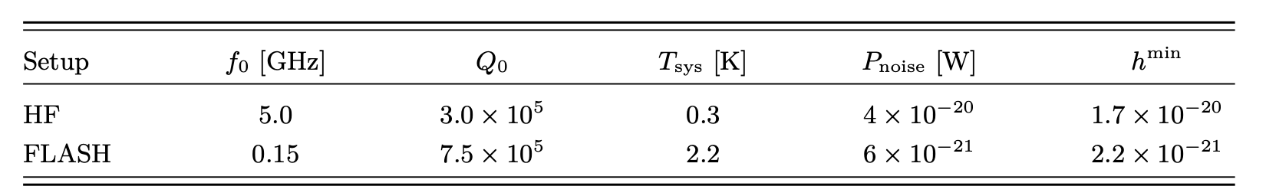
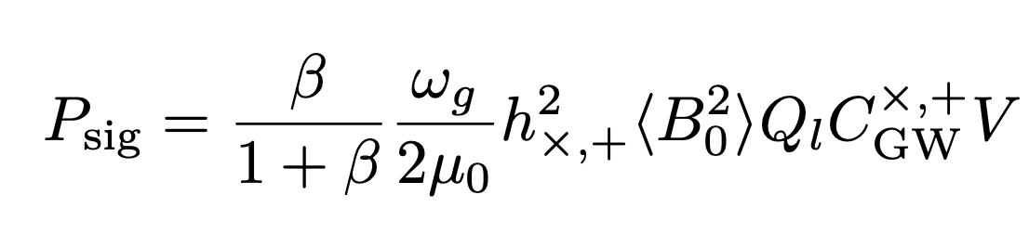
GravNet CDR - available on arXiv
C-band
Radio
GravNet-CAPP Collaboration:
Y. Kim et al. “Search for high-frequency gravitational waves via reanalysis of cavity axion data,” PHYSICAL REVIEW D 113, 072015 (2026).

Slide 5
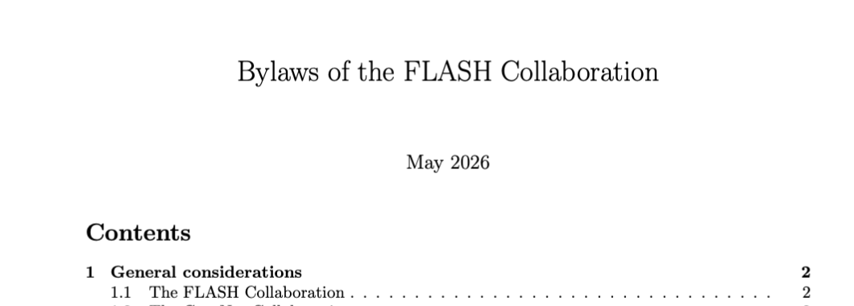
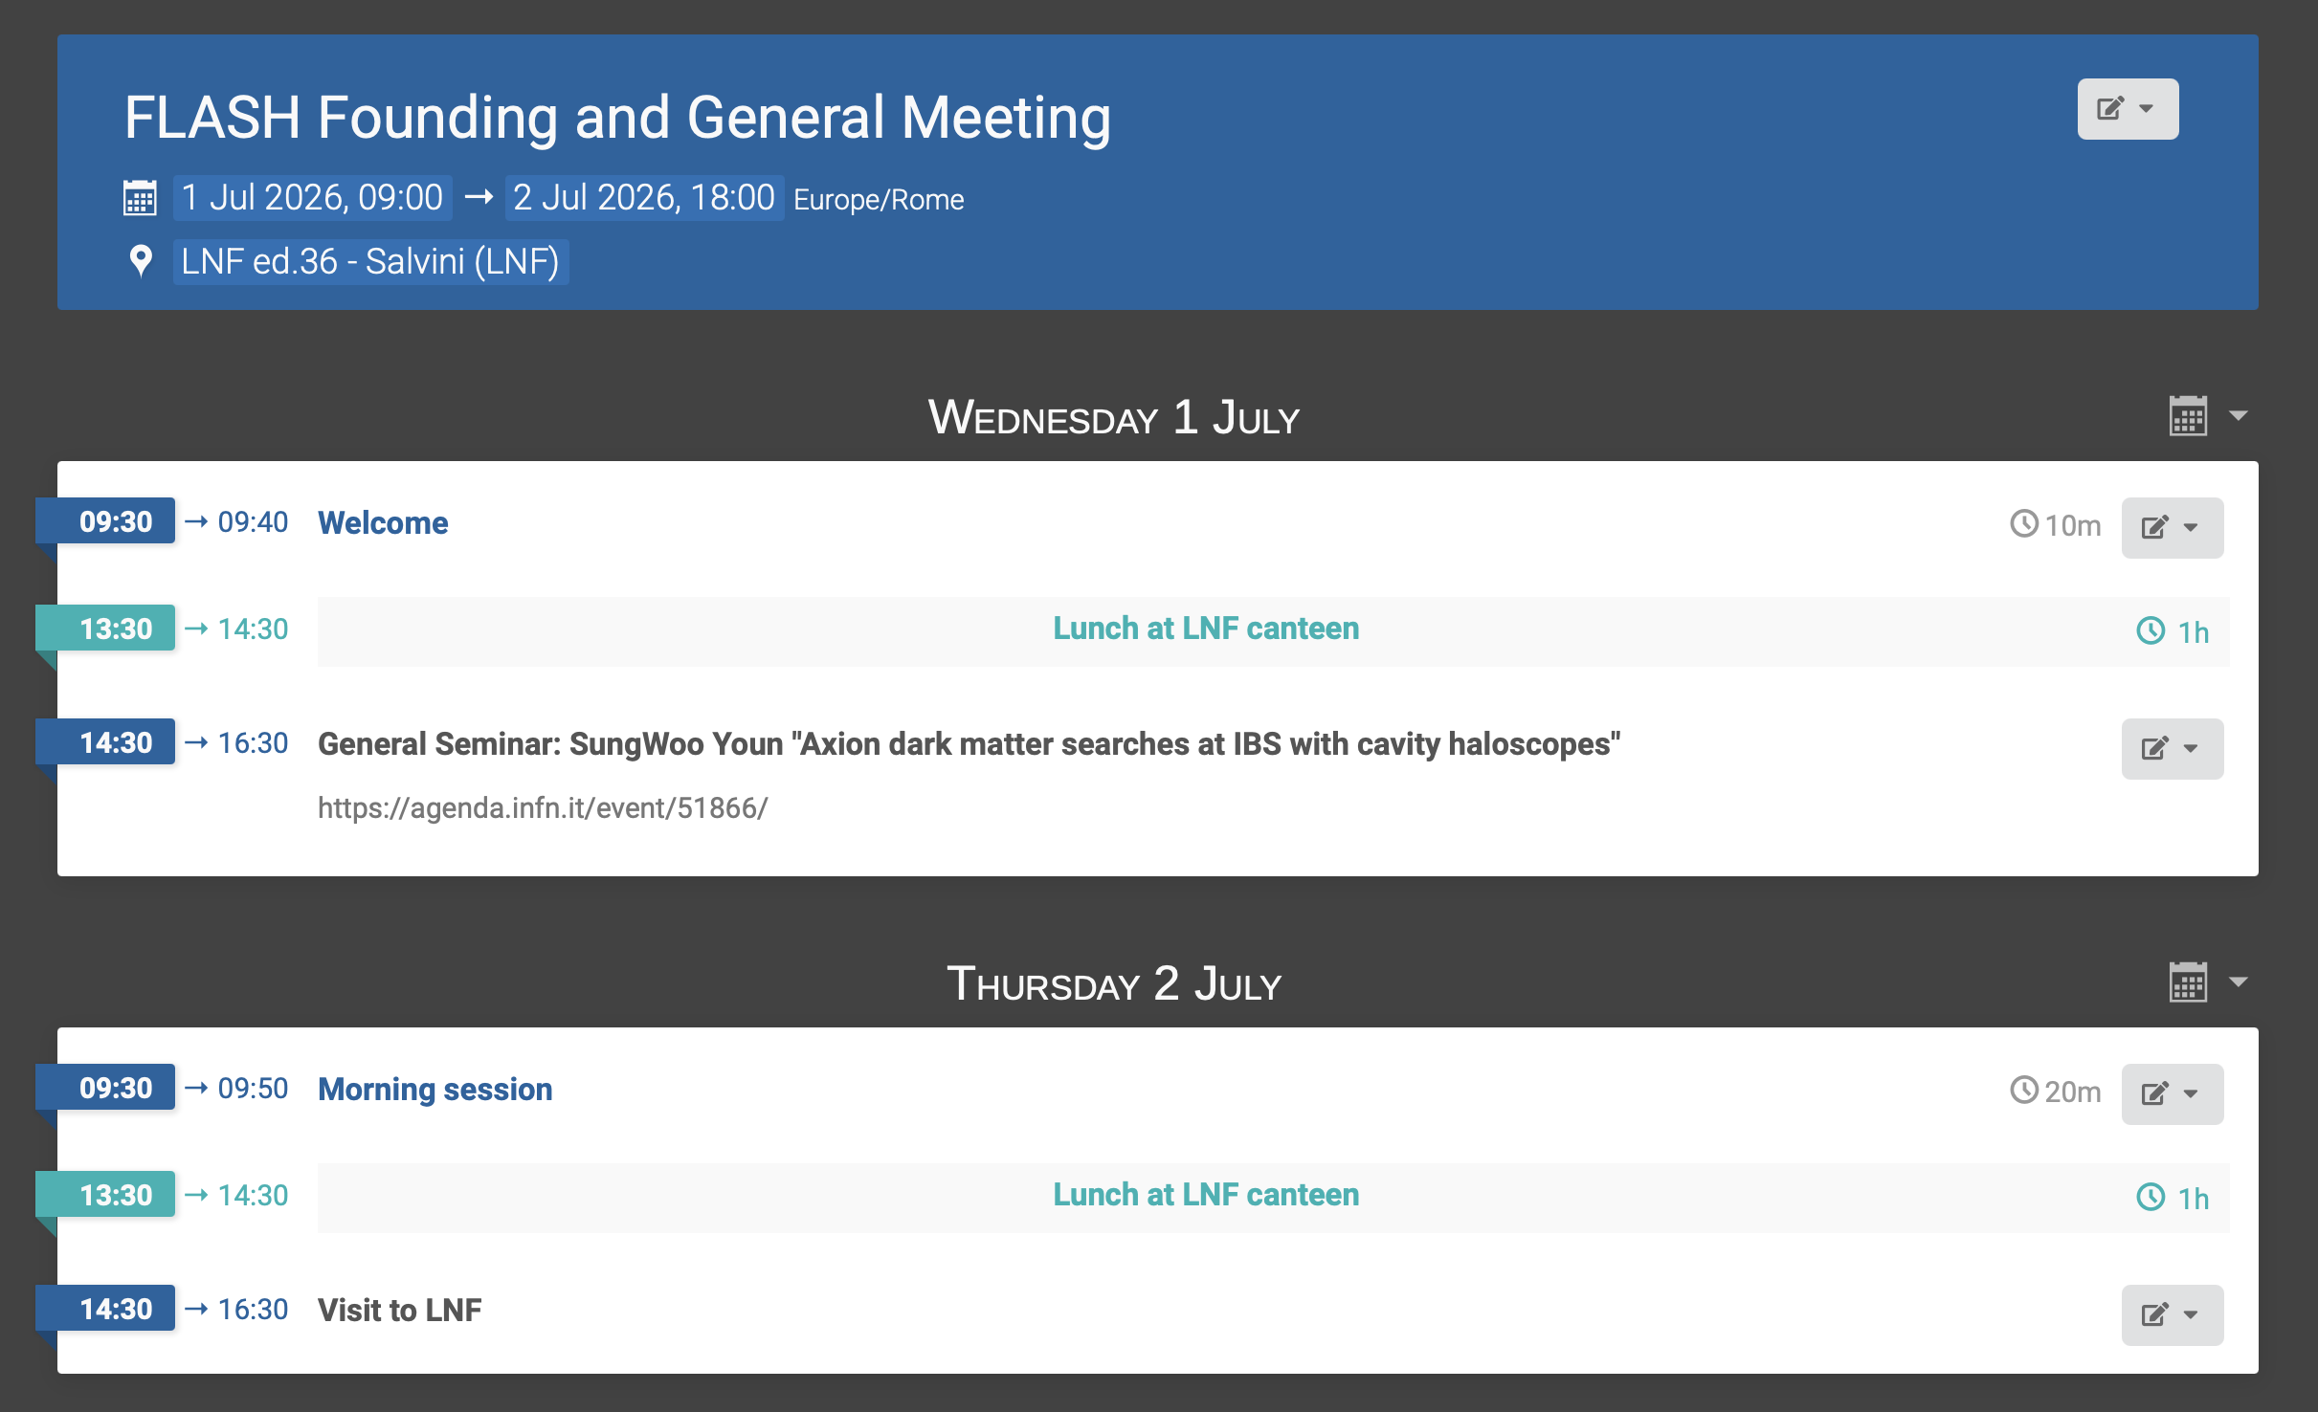



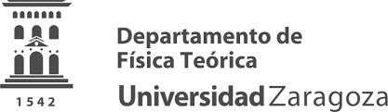










FLASH Founding Meeting
The FLASH founding meeting will be held in July to formalize the collaboration.

Slide 6

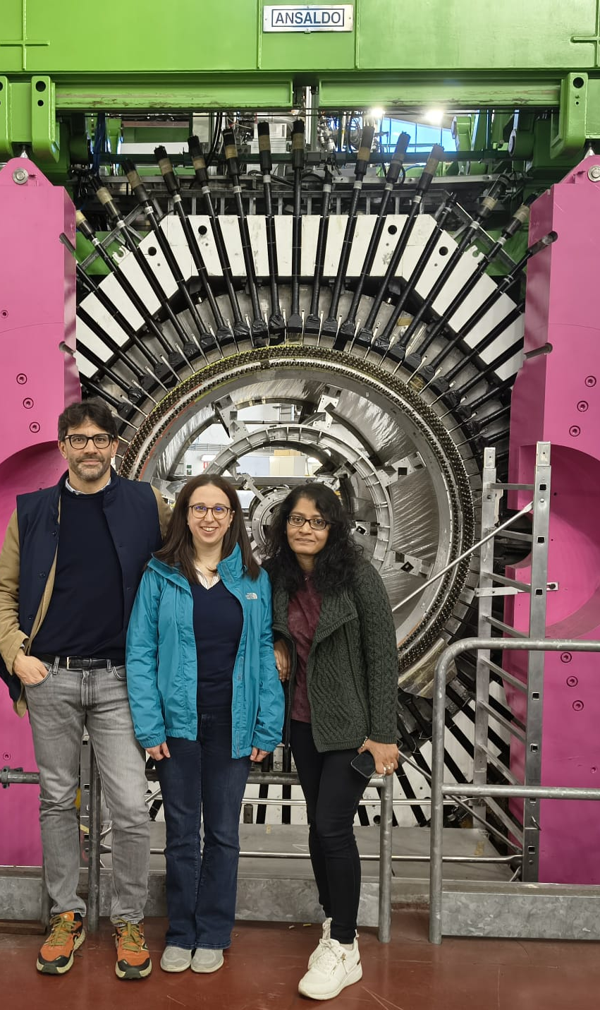
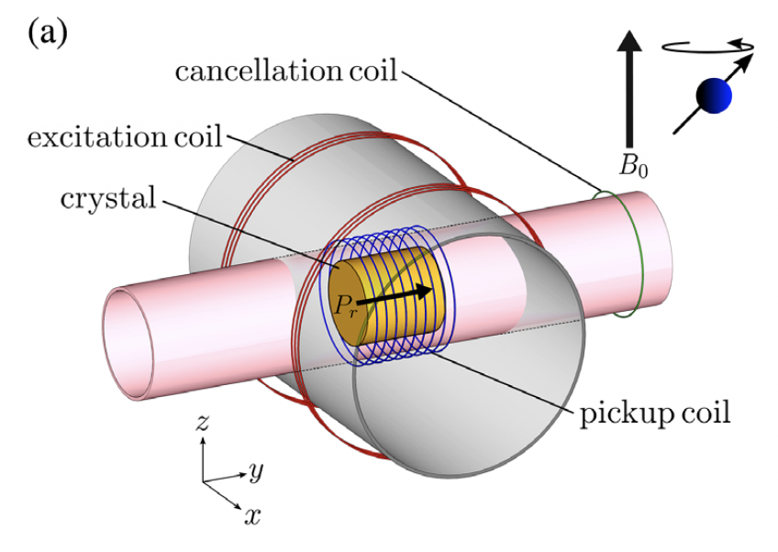
WP1 Physics Reach (L. Visinelli and F. Mescia)
“Cross correlation”
What do we gain if we correlate “axion” signals measured at the same frequency with NMR and cavity experiments within one De Broglie wavelength (10Km)? (Sreemanti Chakraborti)
NMR axion experiment: Deniz Aybas (Bilkent University); R&D in Uni Camerino cryostat at 1.5K in a 12T magnet (J. Rezvani).

Slide 7
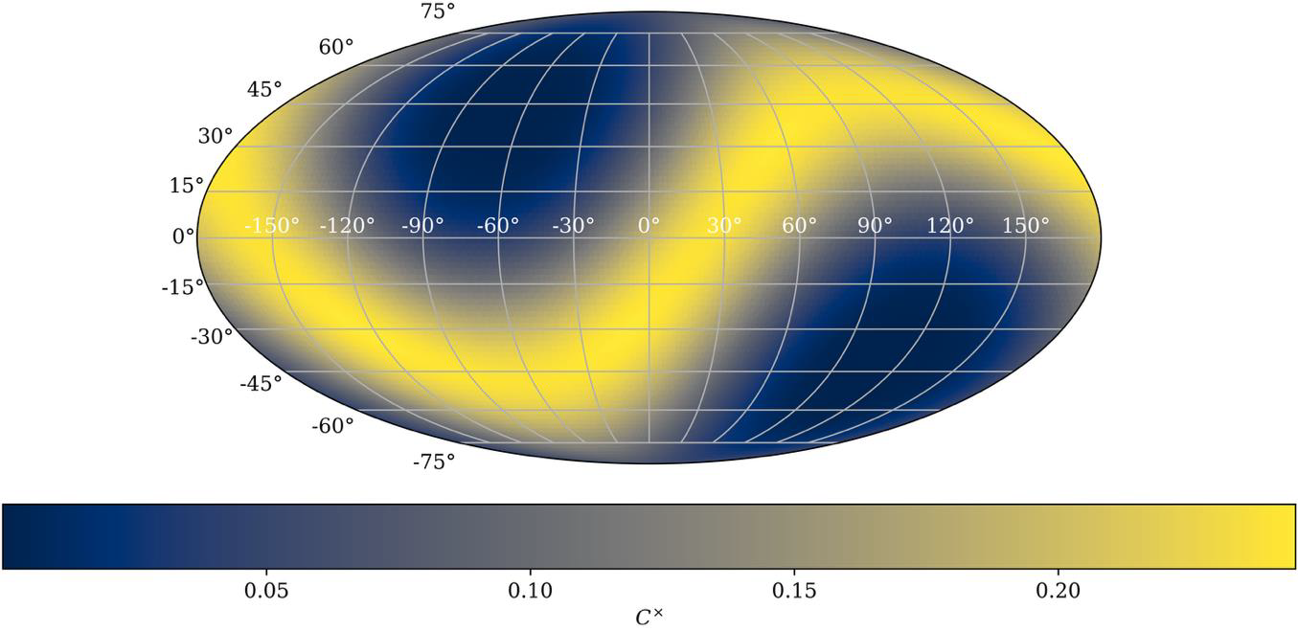
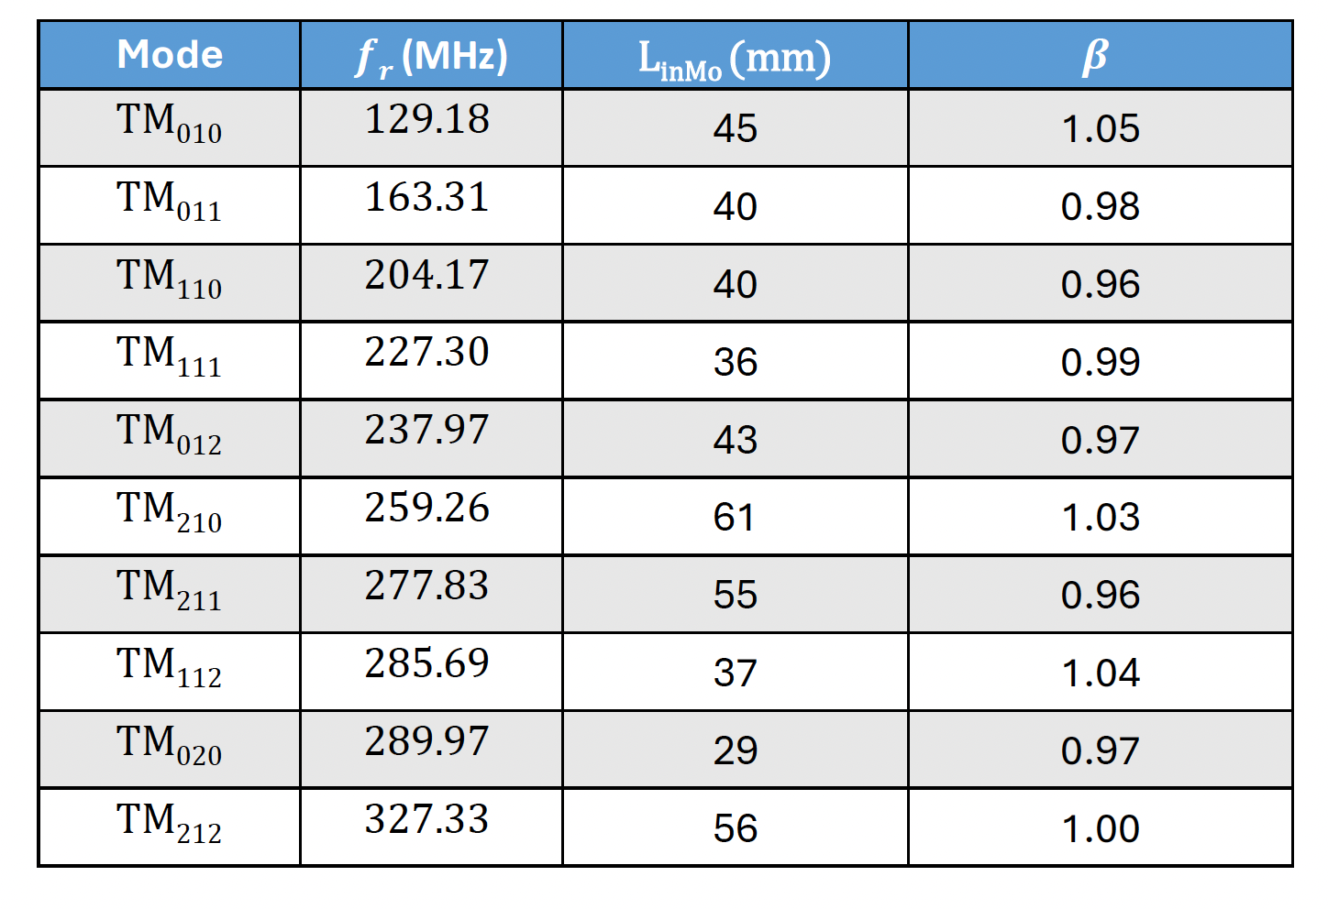
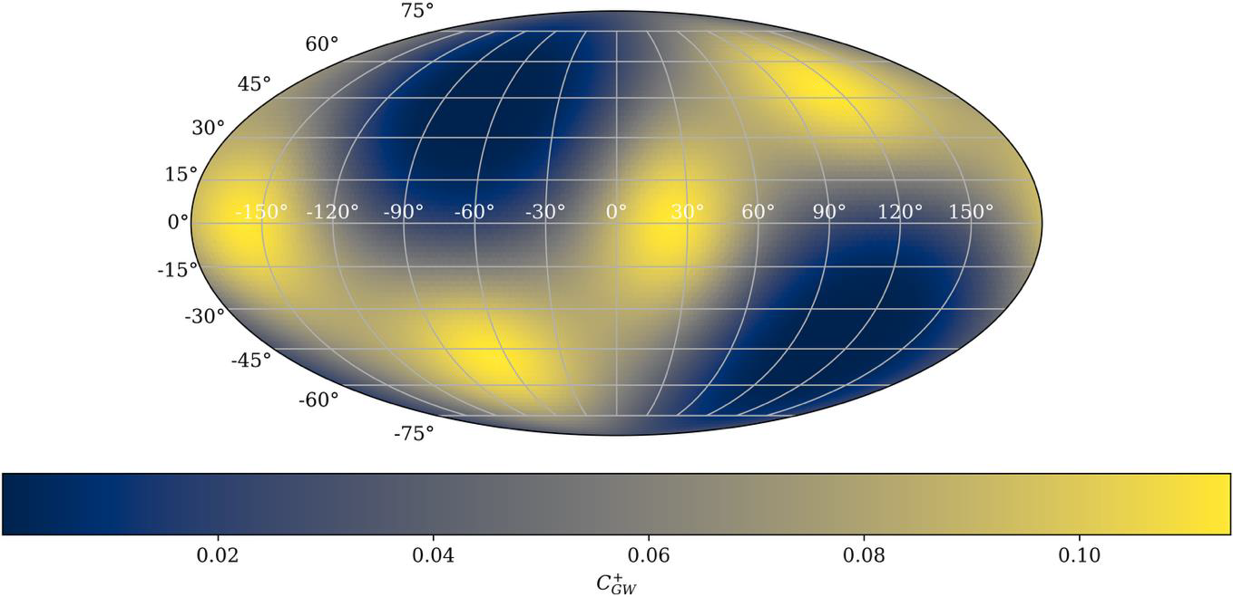
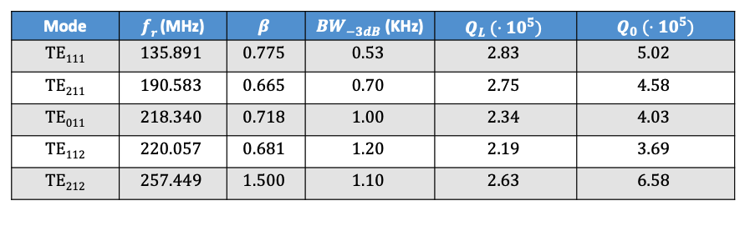
Physics Reach for FLASH TDR
For the TDR writing, we are simulating the cavity modes with the new geometry and recalculating the couplings.
Axion, Dark Photons, HFGW
HFGW
TM010
Axion, Dark Photons
HFGW
Scalars
TE011
HFGW
Chameleons,
HFGW, Scalars
Credit Younggeun Kim (Mainz)
Credit Adrián Muñoz Urán (UPCT Cartagena)

Slide 8
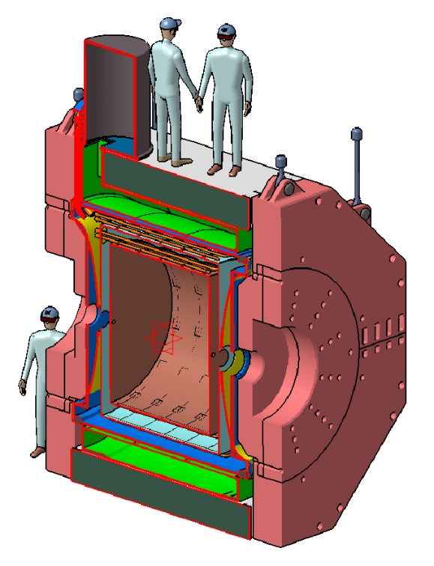
WP2 Cryogenic Design (C. Ligi)
Definition of the RF cavity cryostat general layout details
Cryostat cryo/mechanical design of
RF cavity
vacuum shield
70 K radiation shield
Cryogenic turret cryo/mechanical design
Cryogenic transfer lines design
4K cryostat for the prototype
Credit C. Capoccia

Slide 9
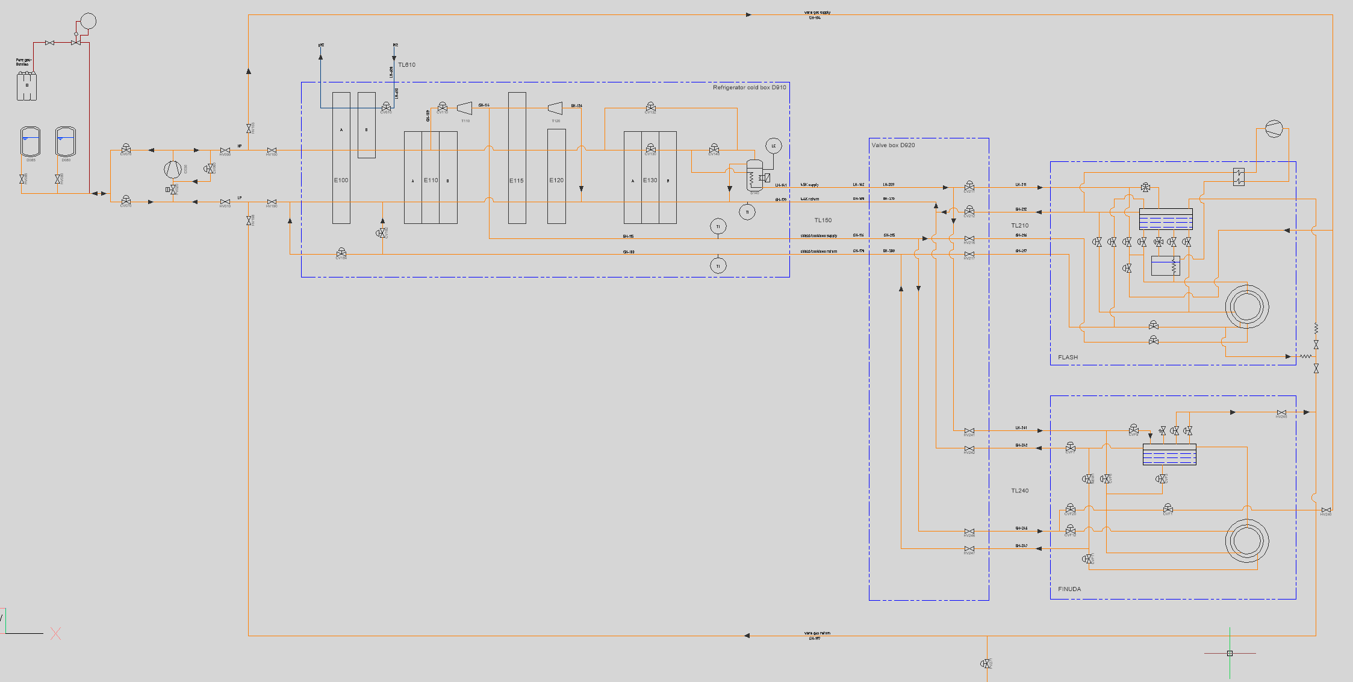
P&ID for the FLASH Plant
Valve Box
FLASH
Update of the
existing cryoplant and
Integration of the
proposed FLASH
cryo-turret in a digital
P&ID
DAFNE Cryo plant
FINUDA Magnet
Credit C. Ligi, R. Nikam

Slide 10
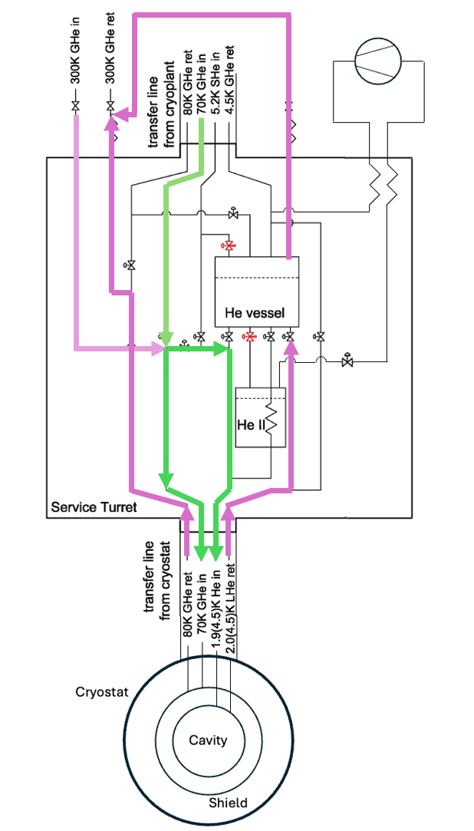
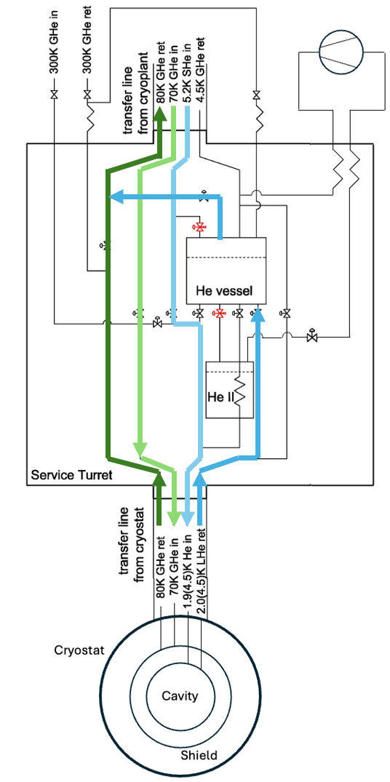
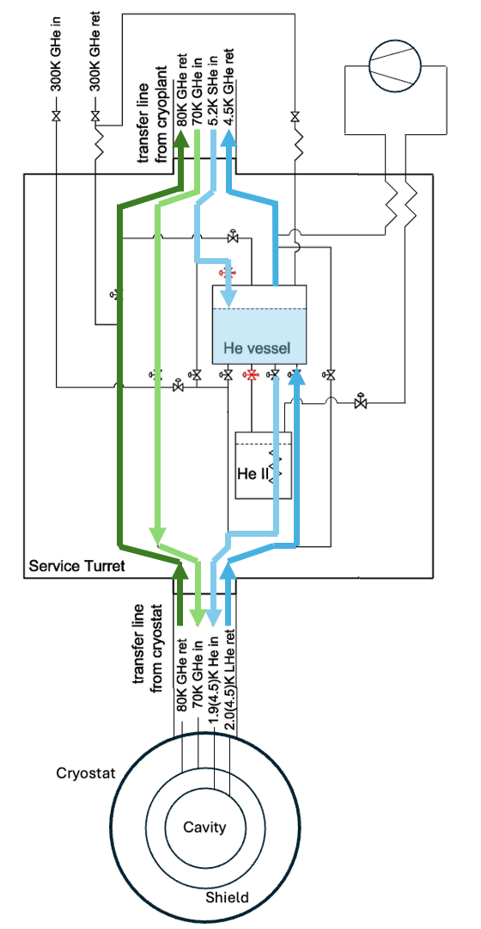
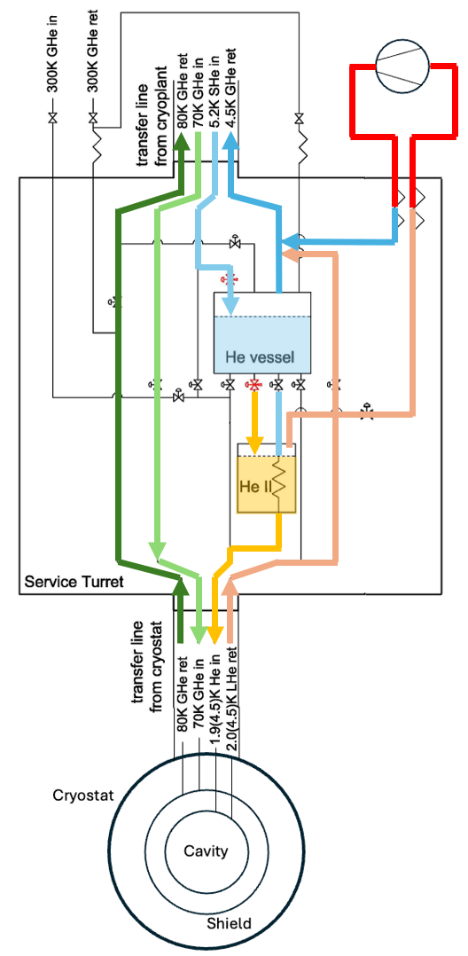
PFD for the FLASH Turret
Initial scheme for the FLASH cryoturret – validation and review in progress with CERN experts
Turret
FLASH Cryostat
70K
5K
4.2K
2K

Slide 11
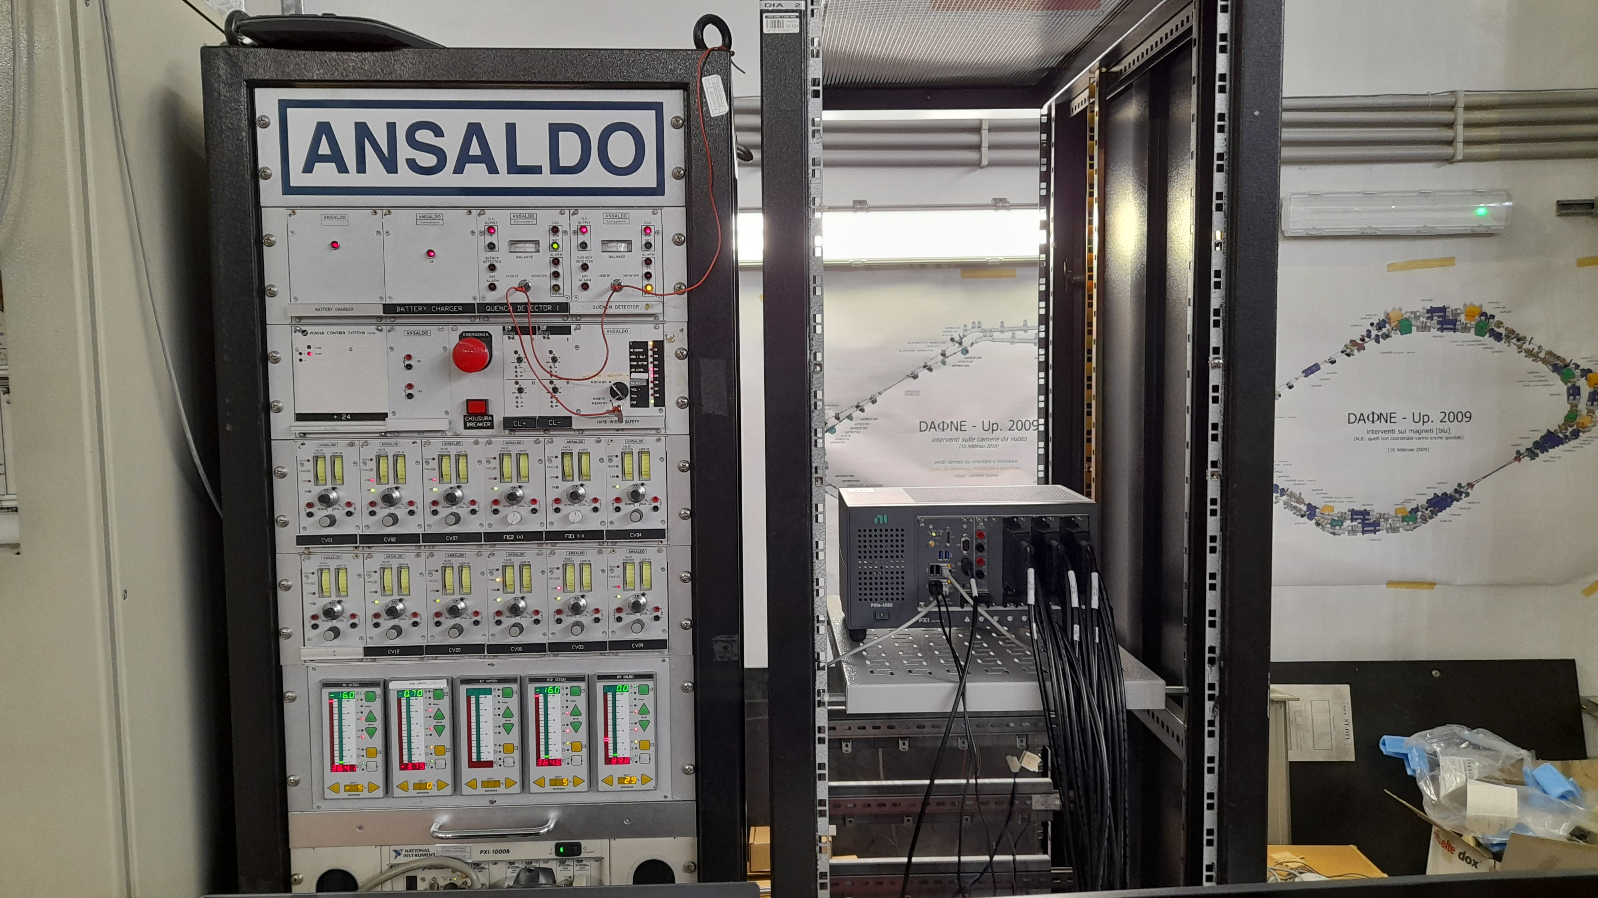
New Magnet Cryogenics Control System
The new FINUDA Magnet cryogenics control system (NI compact RIO – 9045) was delivered last month
Technicians are working in these weeks to
Move the wiring (some hundreds of wires) from the old control system to the new one – A new flange needed with several connectors (purchase order in progress).
Update the old Labview software to the new 2025 version on the new PLC
Credit L. Capuano, L. Petrucciani, G. Di Pirro

Slide 12
FLASH Cryogenic Plant - Infrastructure Status and Open Items
PED (pressure equipment directive) Certification
Cold box opening scheduled for May for inspections and non-destructive tests.
Includes recertification of more than 20 safety valves from the cryogenic plant and FINUDA magnet turret — offer requested. (In progress — pending budget approval for valves)
Plant Maintenance (Vorbuchner Company - Germany) Quote received — maintenance feasible by end of 2026 or early 2027. (Order to be placed upon budget confirmation)
Water Cooling Infrastructure The cryogenic compressor (200 kW) and ancillary systems require dedicated water cooling. Three open items:
Compressor cooling tower: damaged — evaluating replacement. Study ongoing.
FINUDA magnet power supply: former DAΦNE cooling circuit no longer available — dedicated solution required. Study ongoing.
Turbomolecular pumps: new chiller to be procured.
Plant Control System (Siemens Simatic S7-400 PLC) Full replacement exceeds current budget. Existing system maintained with available spare boards.

Slide 13
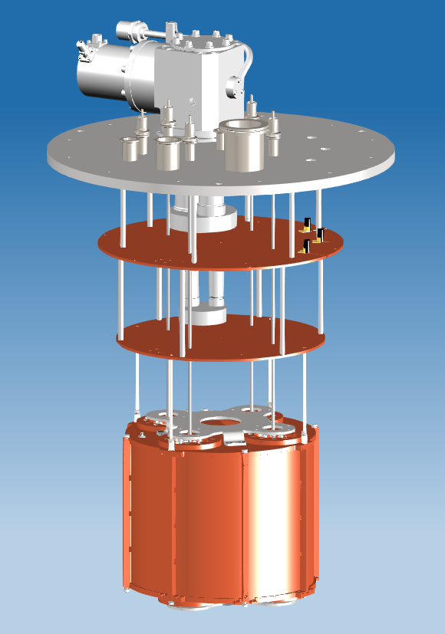
4K Cryostat for the Cavity Prototype
The design of the cryostat for the prototype is almost completed
Pulse Tube refrigerator
Feedthroughs for cavity tuning
300K Stainless Steel Flange
300K SS flange design is complete – it will be machined by an external company (waiting for budget to be available)
The rest will be machined at LNF’s mechanical workshop
Rotary/linear Feedthroughs to be purchased from Pfeiffer (same as above for budget)
Wiring:
4 RF lines
54 DC wires
50K Copper Flange (+ Al Shield)
4K Copper Flange
Cavity prototype
Credit C. Ligi and G. Chiaraluce

Slide 14
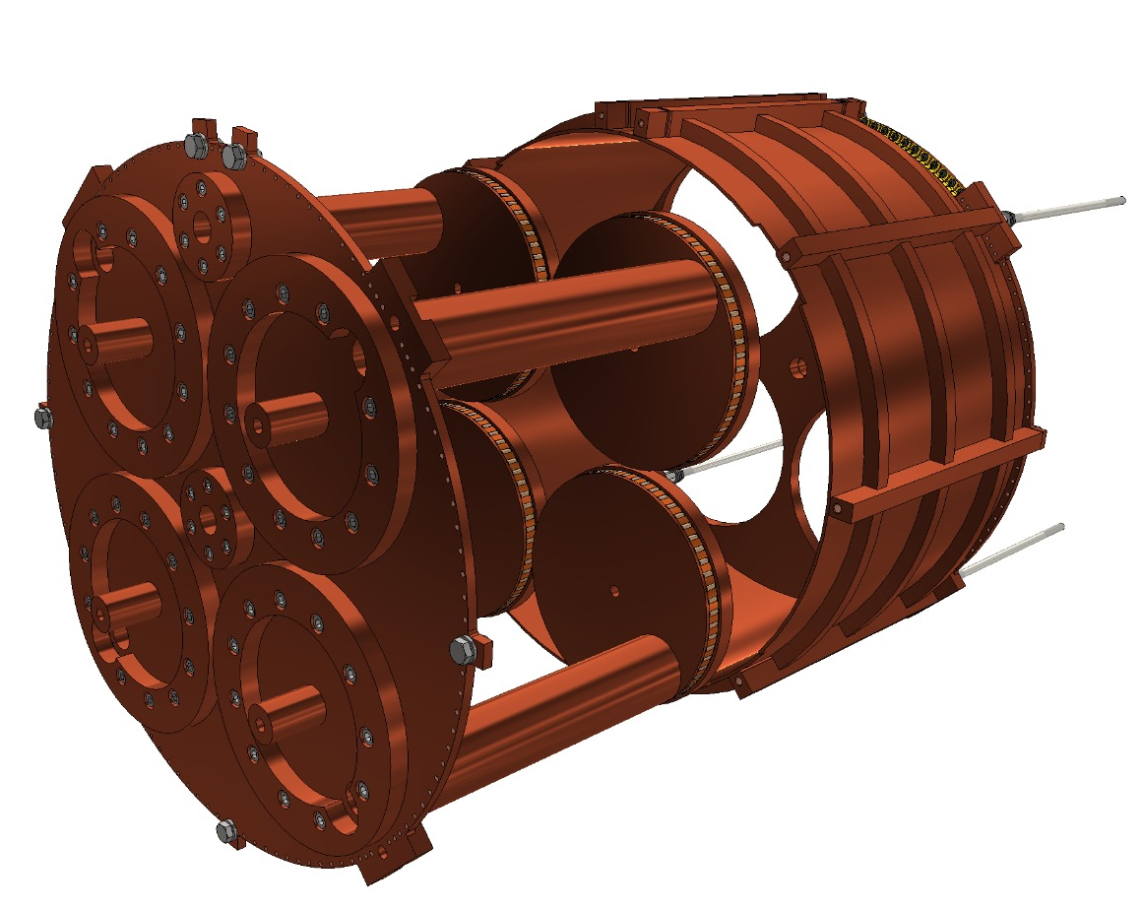
WP3: RF Cavity (S. Tocci and A. Diaz)
Loop Antenna (TE mode)
Tuner
Rotating disk
Cooling/connection rods for prototype only
Cavity Prototype
Monopole Antenna (TM mode)
Cooling manifold is not needed for prototype
S. Tomassini
S. Tocci

Slide 15
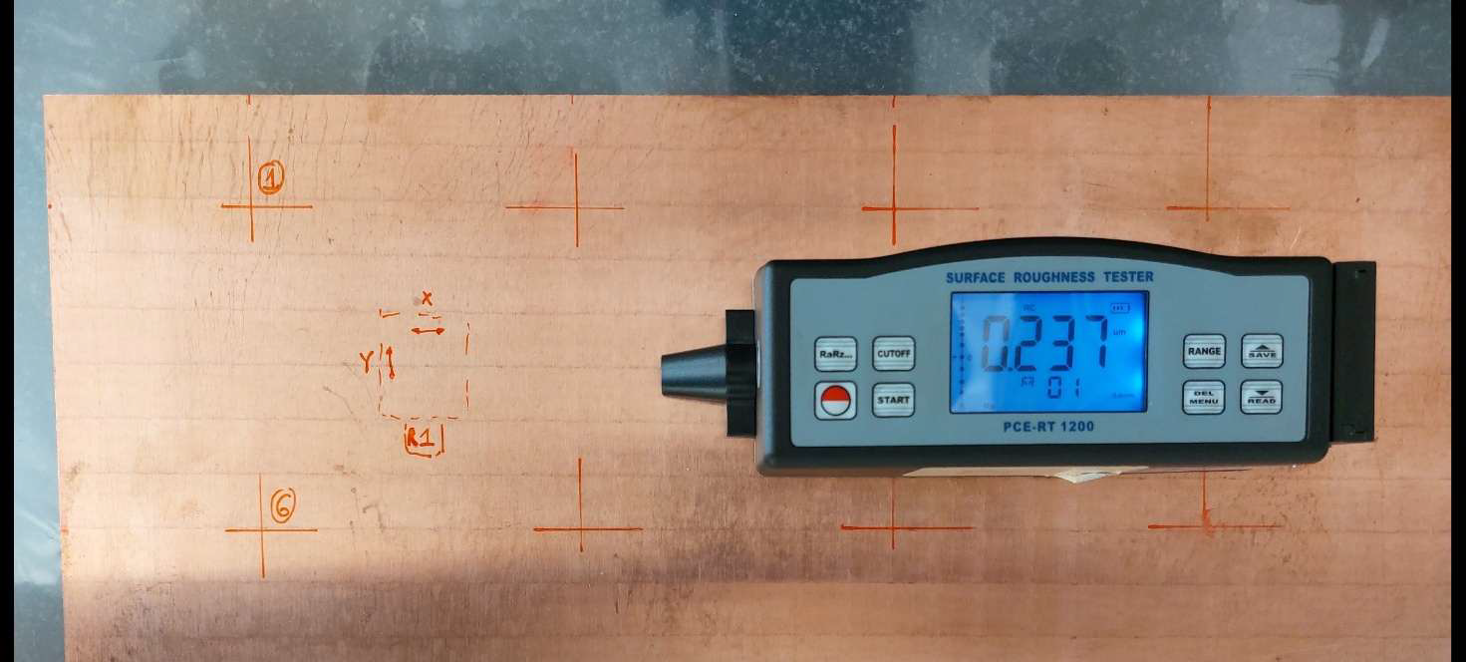
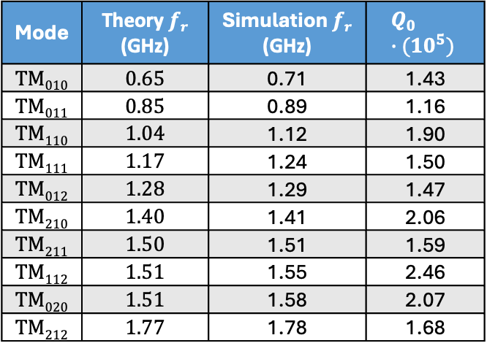
Status of Cavity Prototype
Mode | Theory $fr$ (GHz) | Simulation $fr$ (GHz) | $$Q_{0} ∙({10}^{5})$$
TM₀₁₀ | 0.65 | 0.71 | 1.43
TM₀₁₁ | 0.85 | 0.89 | 1.16
TM₁₁₀ | 1.04 | 1.12 | 1.90
TM₁₁₁ | 1.17 | 1.24 | 1.50
TM₀₁₂ | 1.28 | 1.29 | 1.47
TM₂₁₀ | 1.40 | 1.41 | 2.06
TM₂₁₁ | 1.50 | 1.51 | 1.59
TM₁₁₂ | 1.51 | 1.55 | 2.46
TM₀₂₀ | 1.51 | 1.58 | 2.07
TM₂₁₂ | 1.77 | 1.78 | 1.68
RF Simulations completed
Mechanical design completed
Copper purchased
Copper roughness measured (Ra <0.6 micron)
Chemical solution for surface treatment tested on a Cu sample at LNL (target Ra<0.4 micron)
Cu packed and ready to be shipped (with many delays!) to Bonn for fabrication. Then to LNL for surface treatment and back to LNF for measurements.
Credit Adrián Muñoz Urán
Credit F. Quattrociocchi

Slide 16
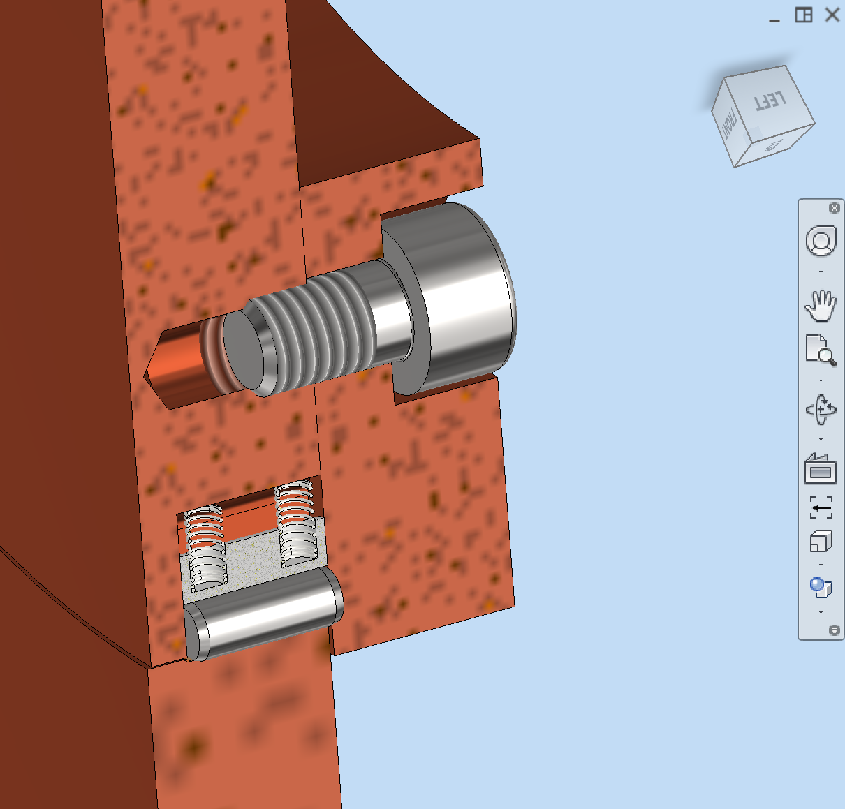
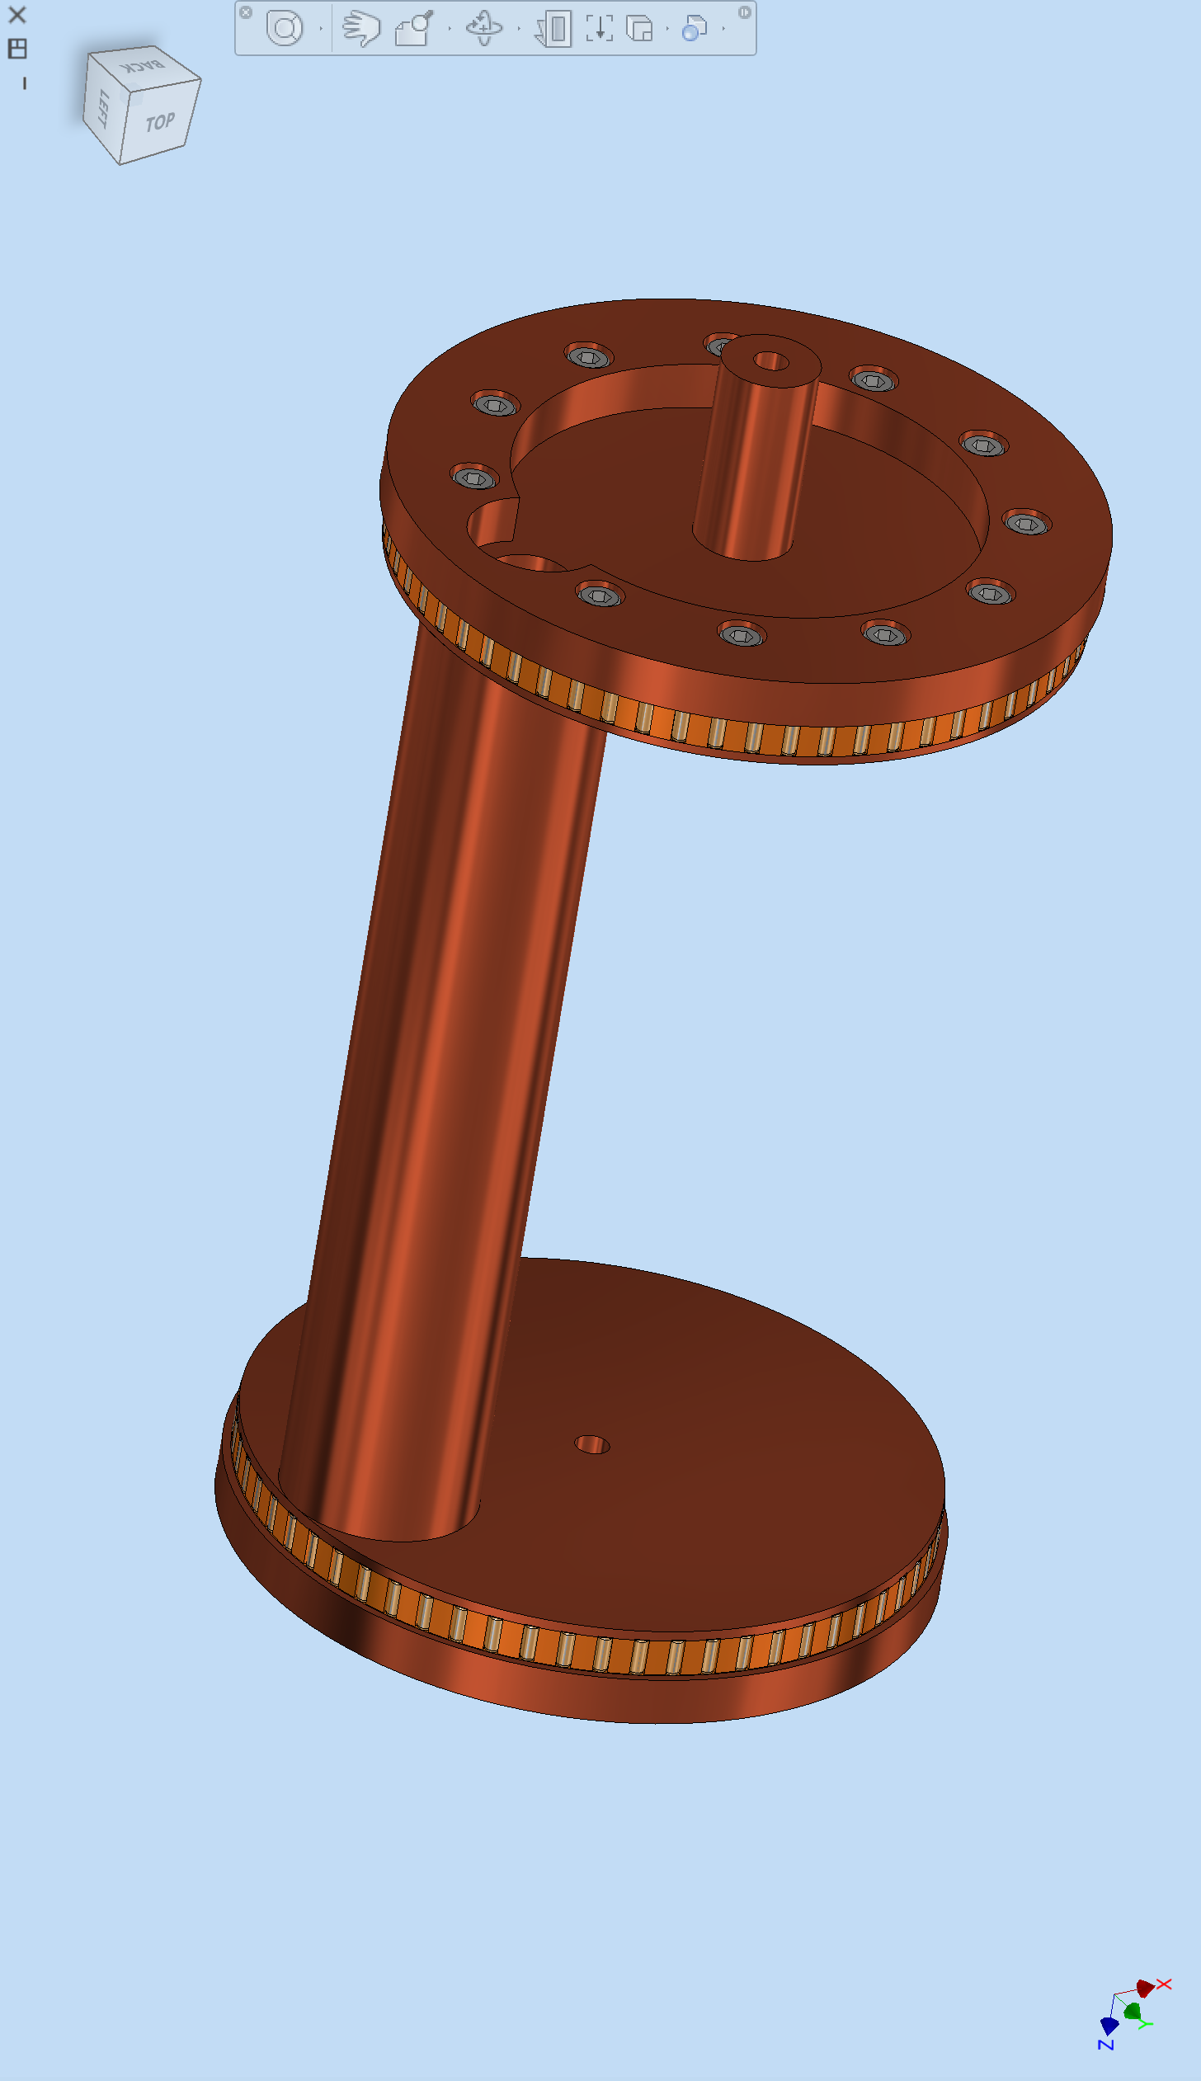
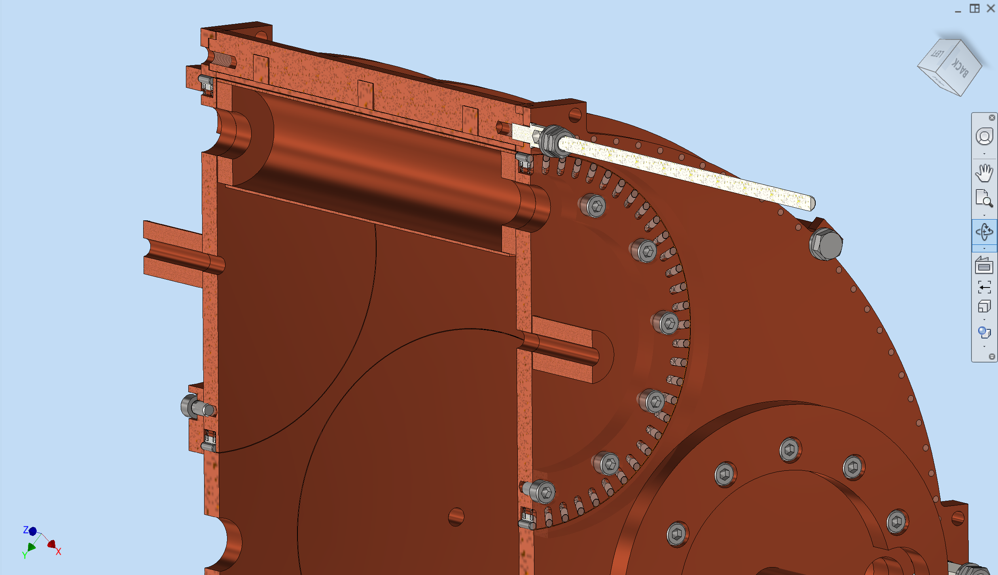
Measurement of Friction in the FLASH Tuning System
Springs
Metal contact
RF sliding contact
Vacuum Hole
Tuner
Rotating disk
Credit S. Tomassini

Slide 17
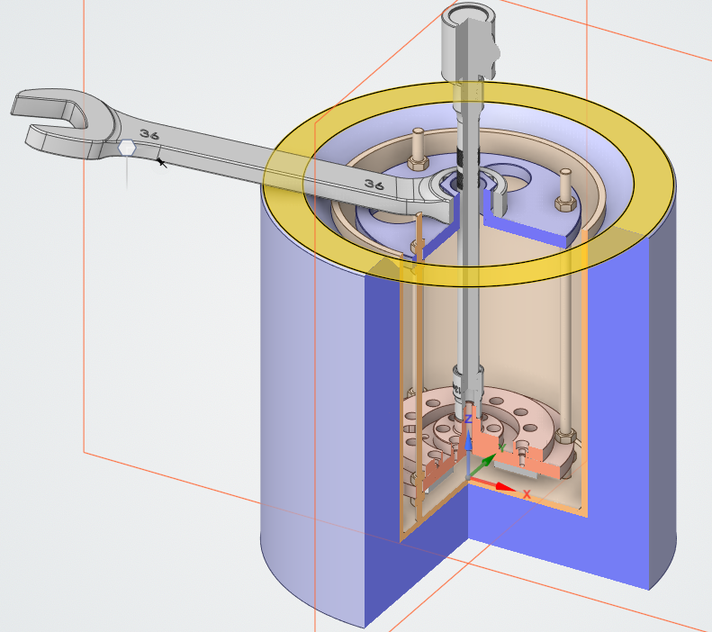
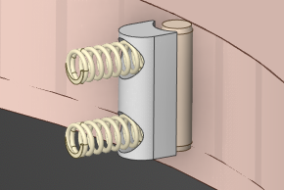
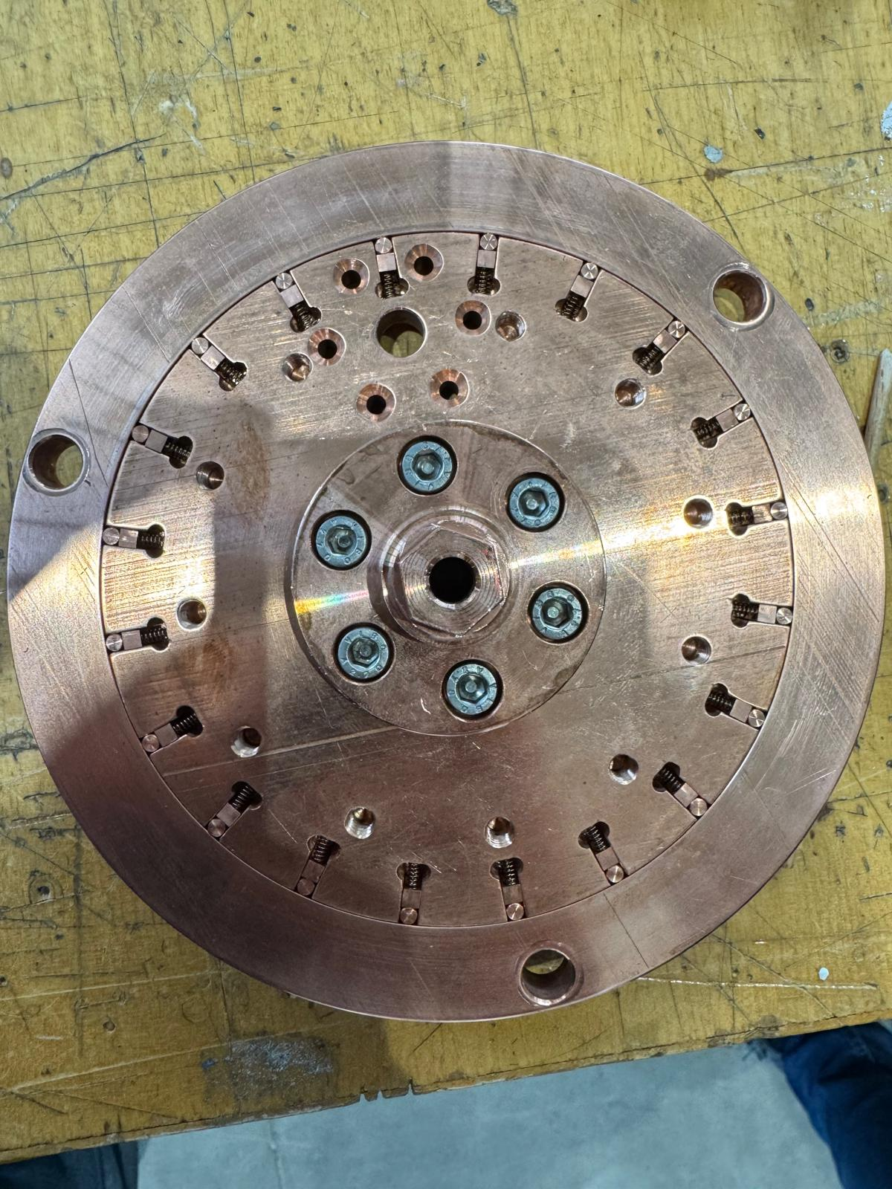

Measurement of Friction in the FLASH Tuning System
$$F_{n}$$
T
R
N
Credit R. Doglia, A. Santoni, S. Tomassini

Slide 18
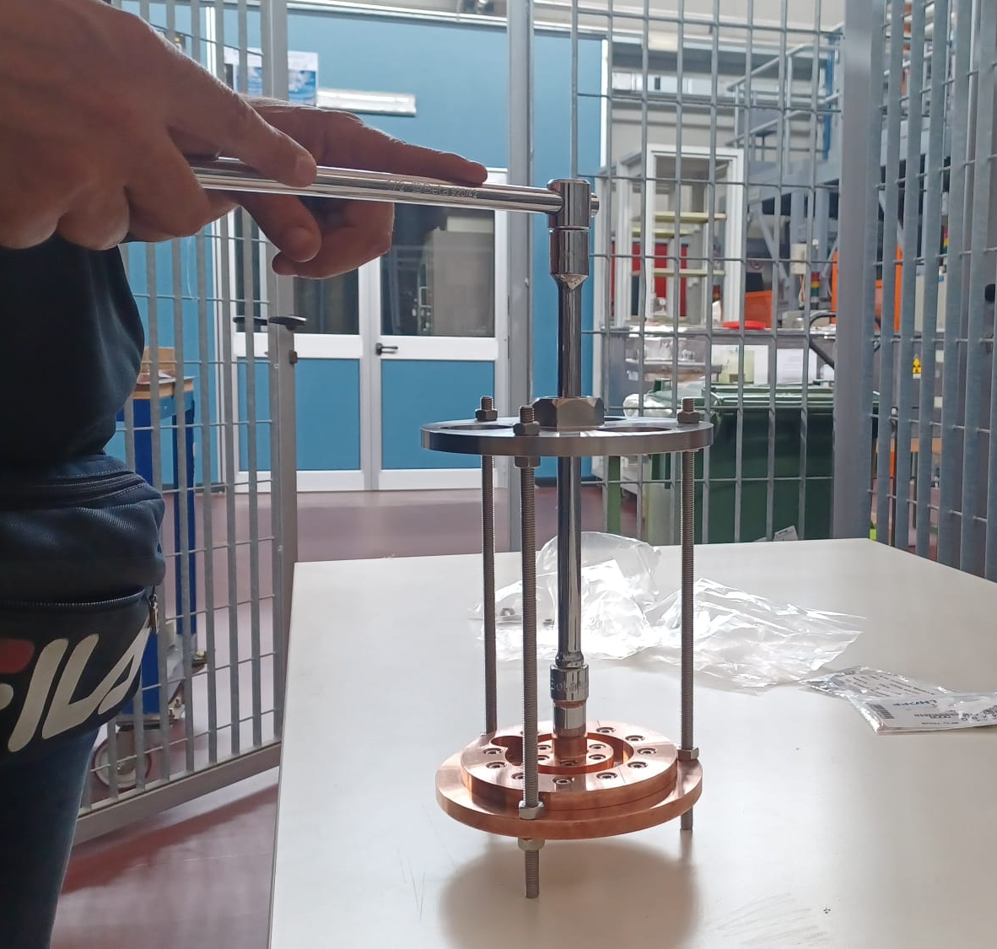
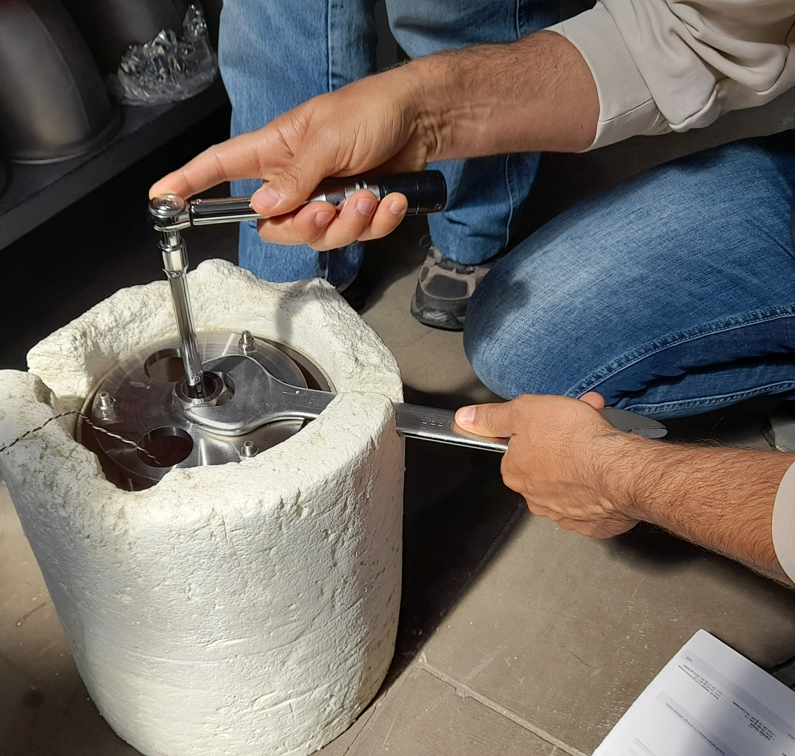
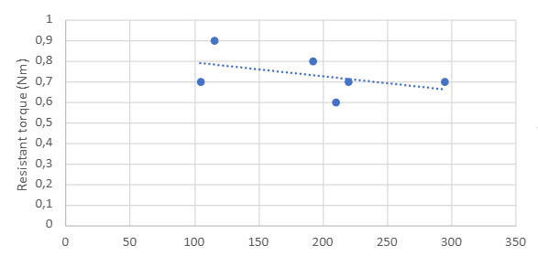
Measurement of Friction in the FLASH Tuning System
Preliminary results in liquid nitrogen compatible with expectations.
Tests will be repeated in vacuum.
Temperature (K)

Slide 19
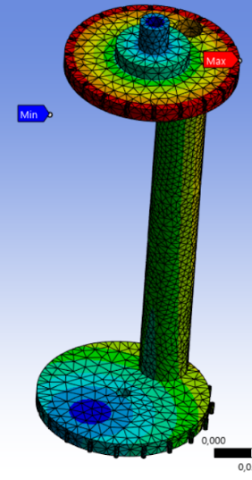
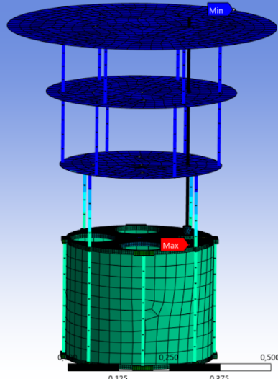
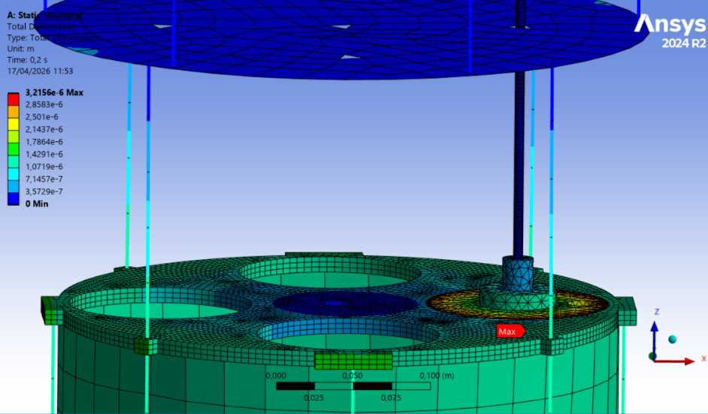
Impact of Friction on Torsional Deformations
Ongoing simulations to understand the impact of the measured torque on the tuning system and the impact on the cavity tunability.

Slide 20
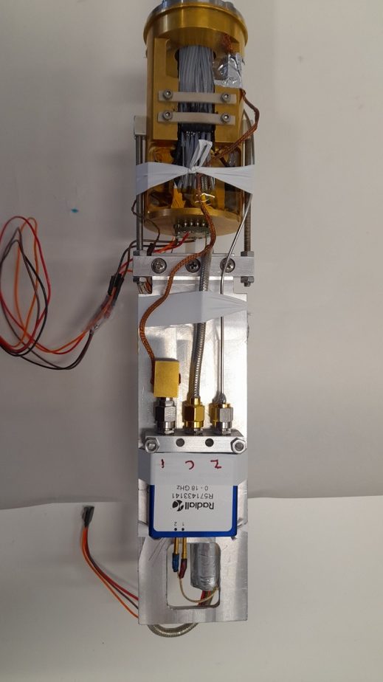
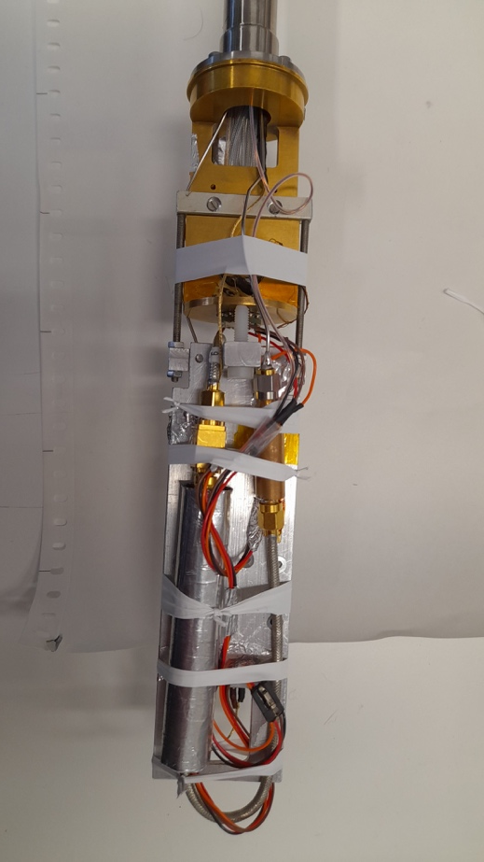
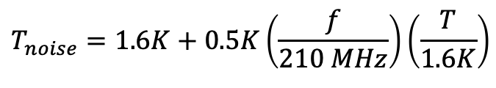
WP4: Signal Amplification and Acquisition (P. Falferi and G. Lamanna)
Setup in Camerino University
Cryostat temperature T=1.6 K
$$T_{noise}=1.6K+0.5K\left(\frac{f}{210 MHz}\right)\left(\frac{T}{1.6K}\right)$$
Similar results obtained in Trento by P. Falferi
We now expect 2.2 K total noise in FLASH at 120 MHz.
No need to cool SQUID to lower T (e.g. 300 mK)!
Credit J. Rezvani, N. Pinto (Camerino) and T. Jameson, P. Beltrame (Liverpool)

Slide 21
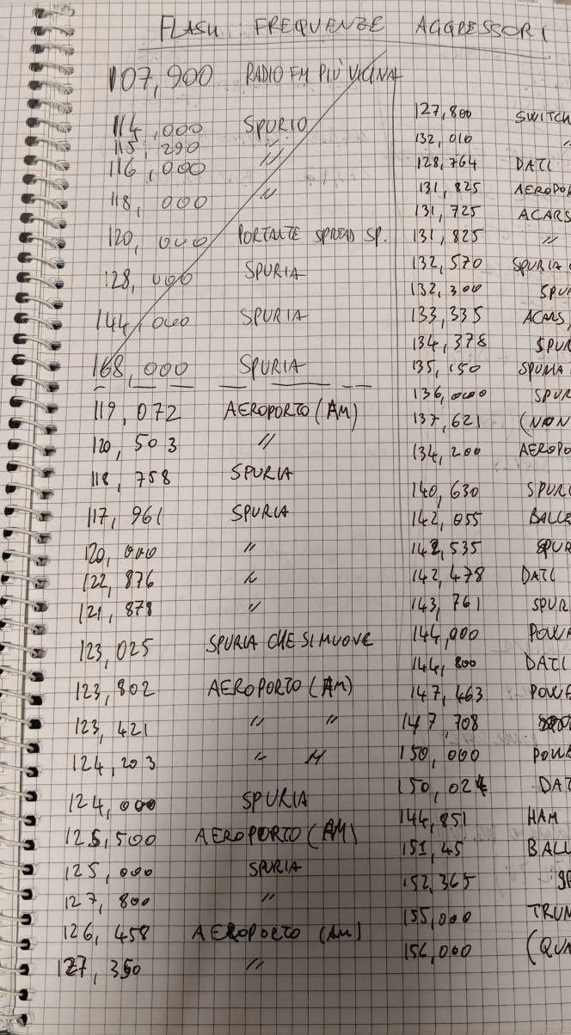
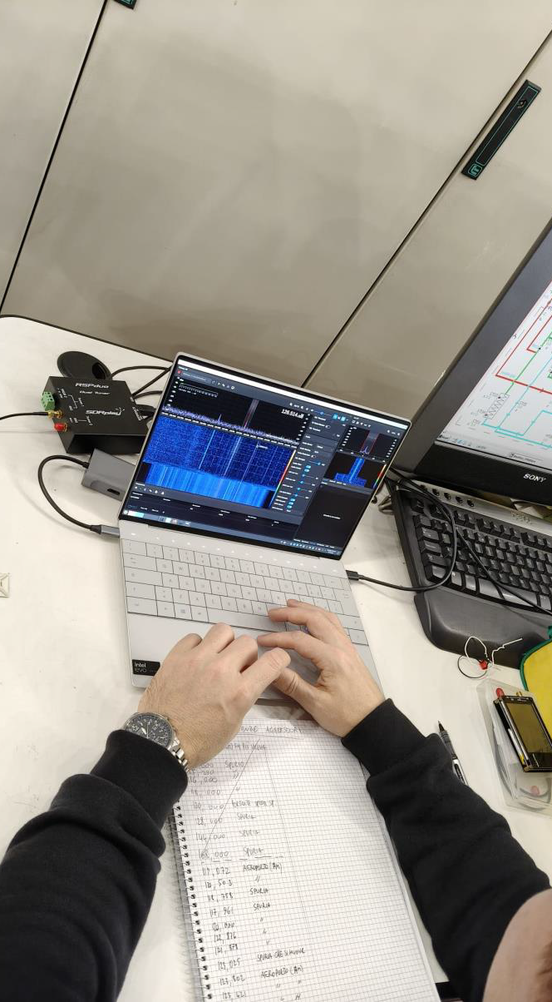
RF Interference Survey of the DAFNE/FLASH Hall
Credit L. Calligaris (Uni Pisa)

Slide 22
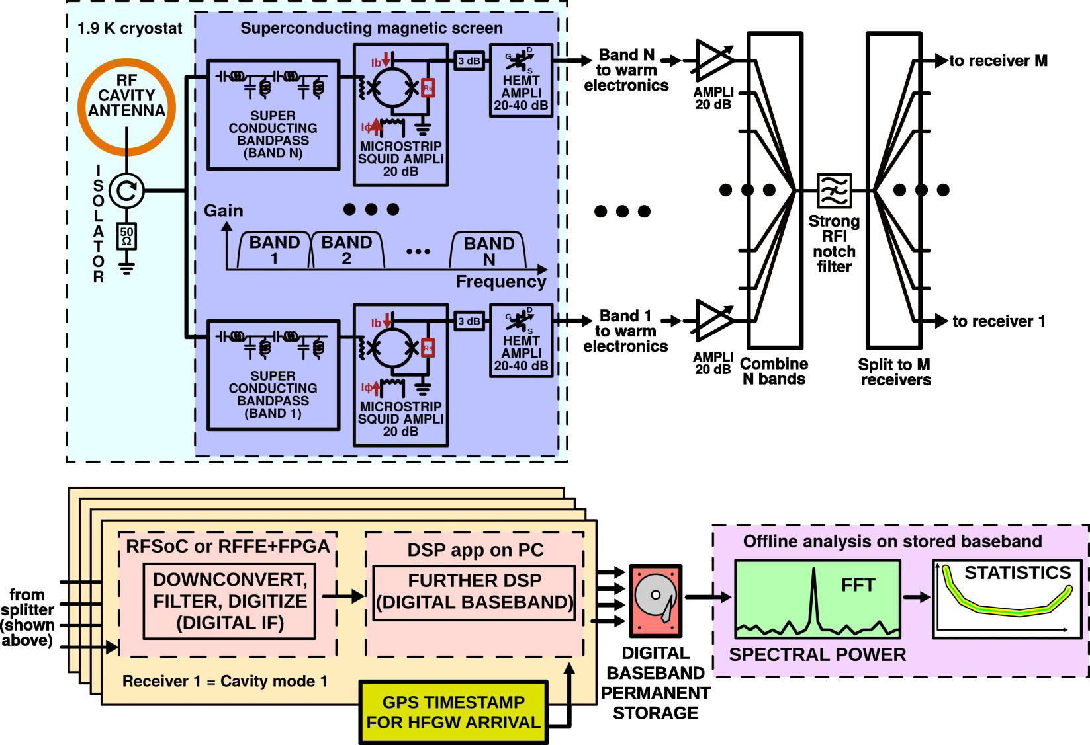
Readout Electronics Scheme
RF signal from cavity antennas are multiplexed to proper SQUID and amplified
Several options for room temperature electronics are considered to take into account requirements on: number of channels; tunability; bandwidth.
Plan to test it on the prototype.
Credit L. Calligaris

Slide 23
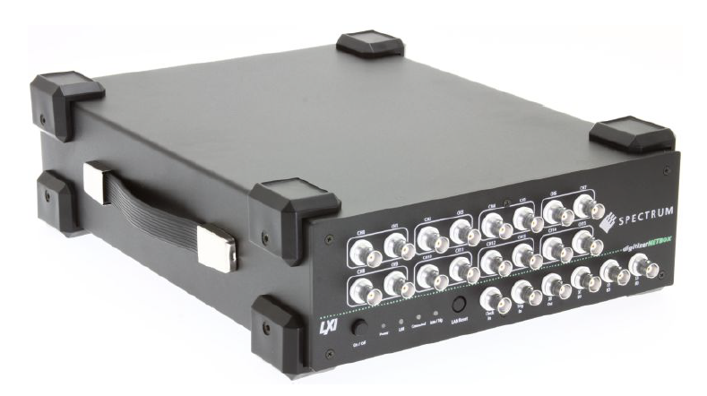
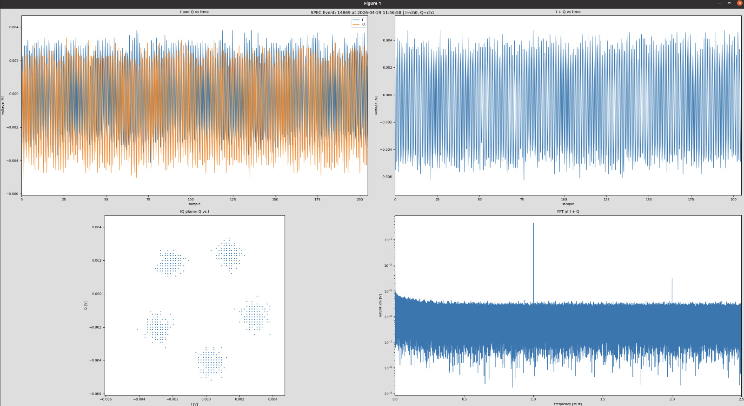
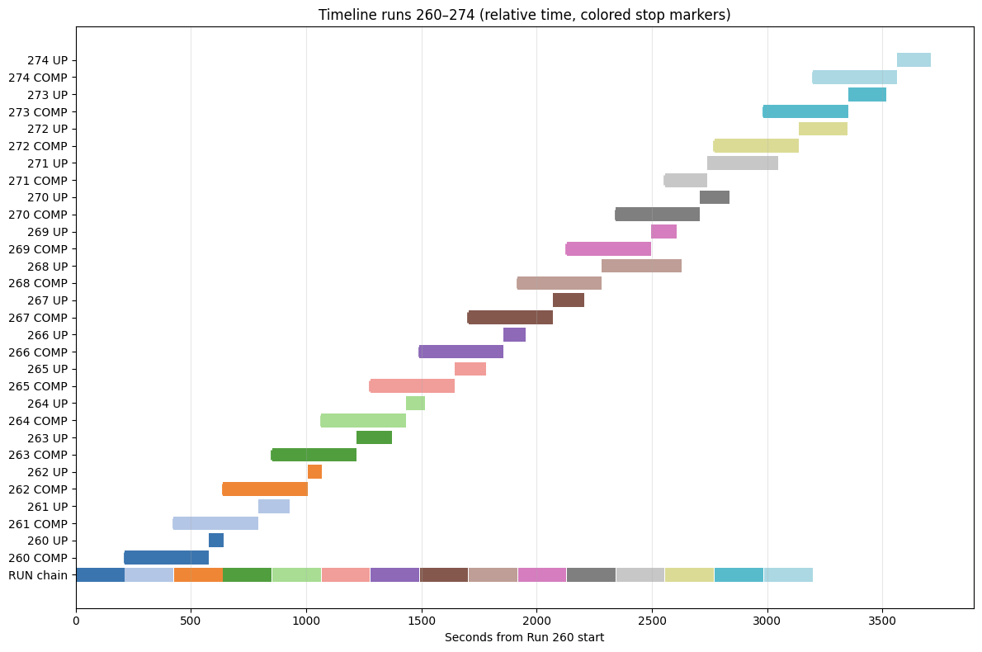
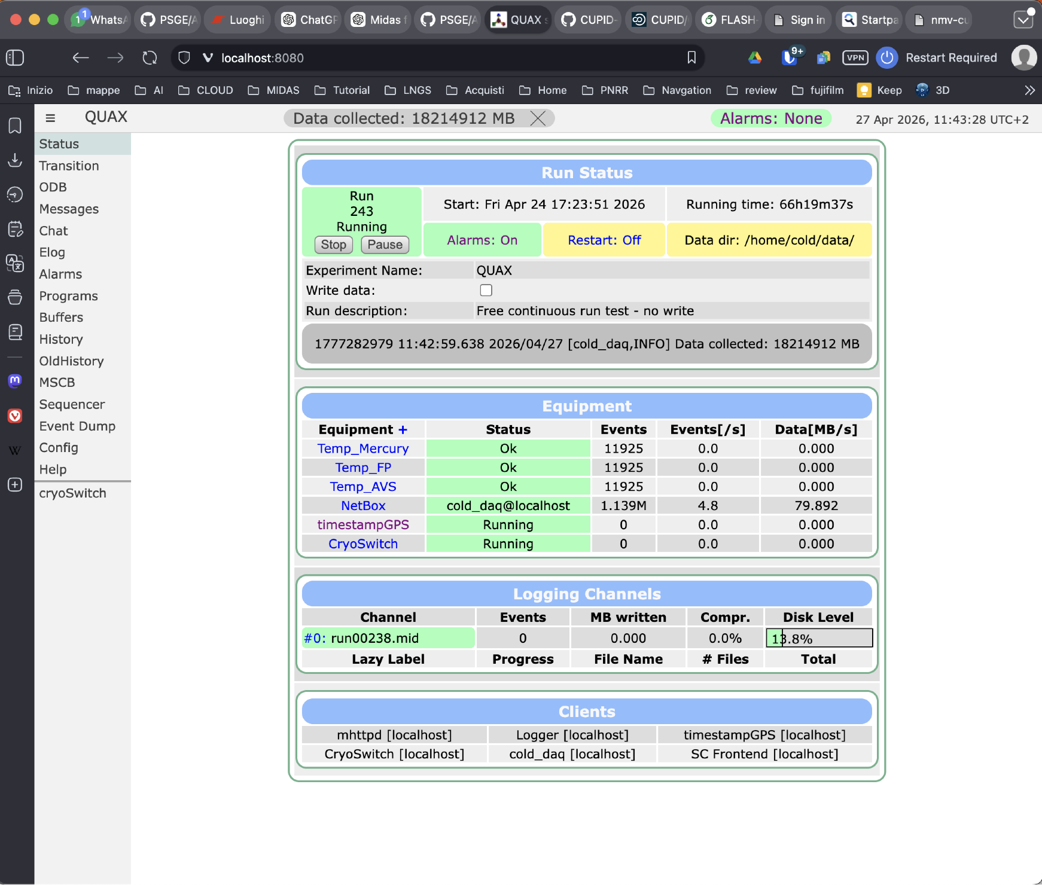
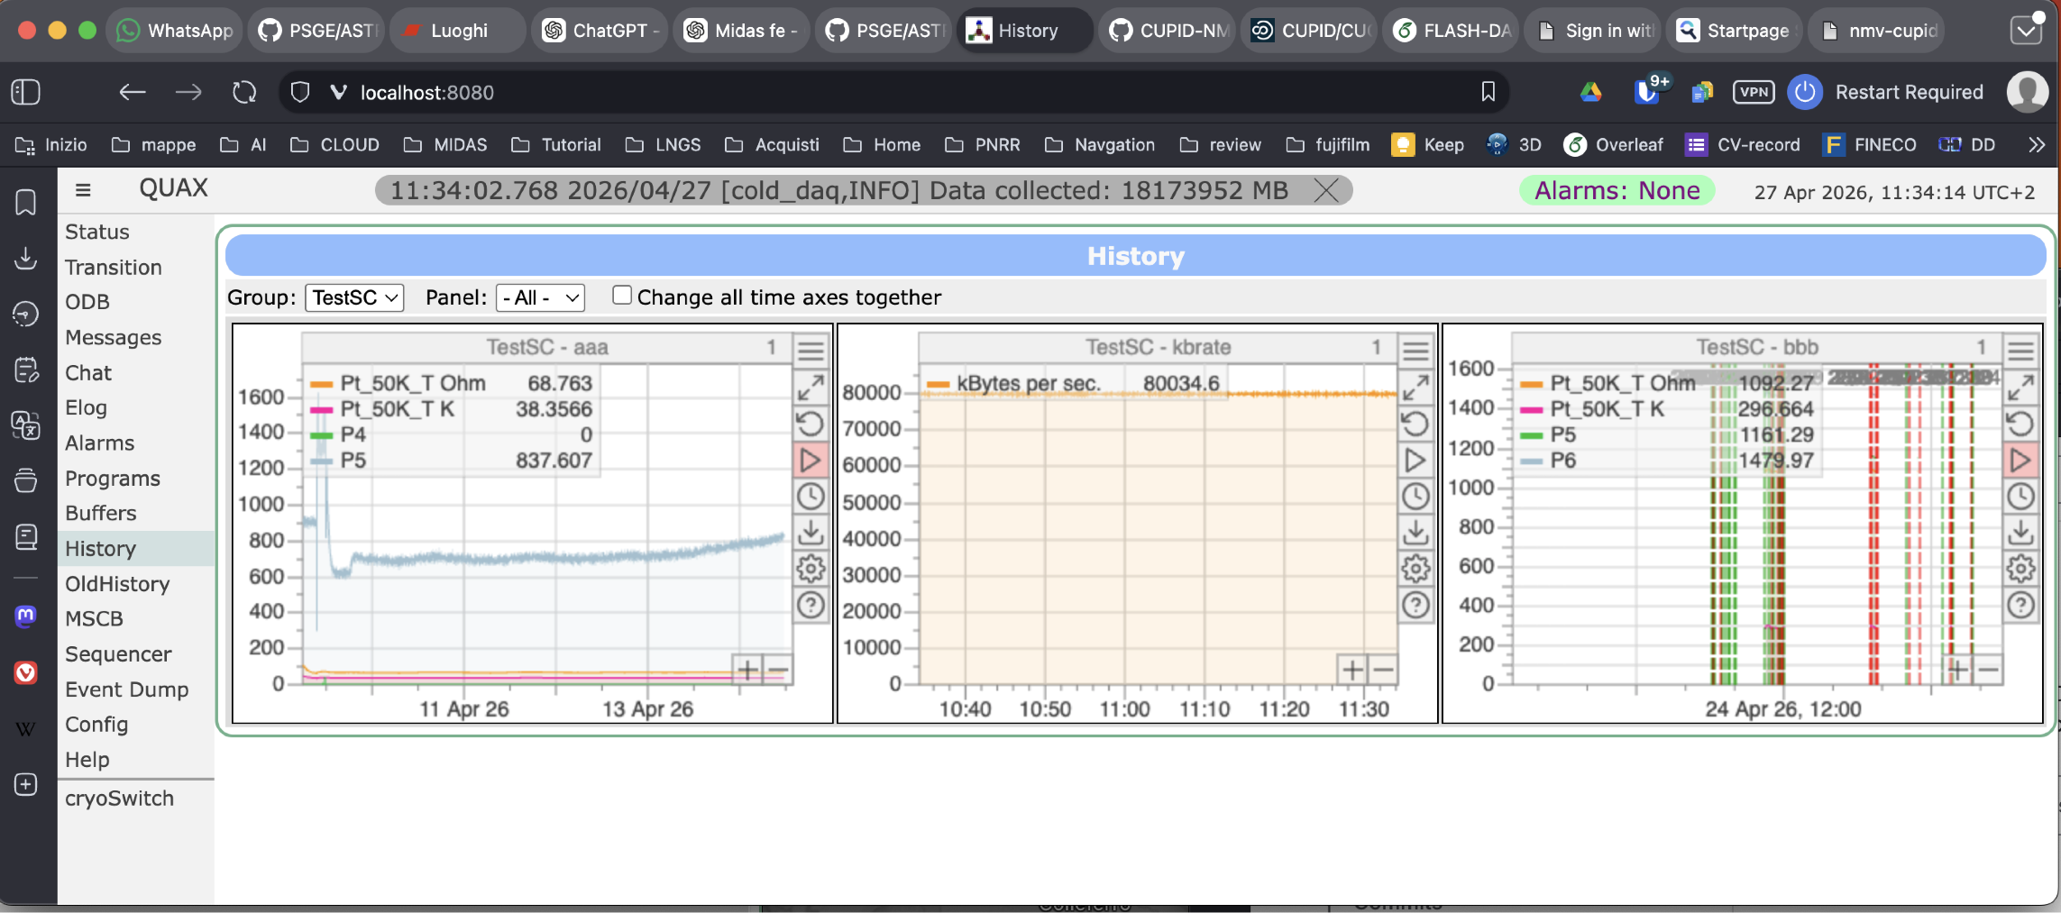

WP5: Data Analysis and Computing (K. Schmieden and G. Mazzitelli )
Spectrum digitizer successfully integrated into the FLASH/QUAX DAQ, together with all required auxiliary equipment (thermometers, cryogenic switch, etc.).
DAQ pipeline optimised strongly reducing the latency.
Storage and tape for the experiment are now available and ready to be used (handled by RUCIO)
Slow control of auxiliary variables are being integrated
Online monitor and GPS have been introduced
Ready for next QUAX run
Credit A. Rettaroli, G. Mazzitelli and G. Dho

Slide 24



WP6: FINUDA Decommissioning and FLASH Commissioning (S. Gazzana)
This monday
Credit C. Capoccia and F. Rosatelli

Slide 25





Refurbishment of Extraction Tools
Original FINUDA assembly tools retrieved from outdoor storage near the DAFNE area
Tools had to to be checked for corrosion and structural integrity

Slide 26





Refurbishment of Extraction Tools
Work entrusted to an external company
Tools refurbishing 80% completed
Survey to establish reference geometry for tools alignment done!

Slide 27


Work is underway to complete the “Clessidra” extraction by summer.

Slide 28

Safety Analysis
What we are doing:
Mapping all risks of the FLASH+FINUDA integrated system
Ranking them by severity: direct safety risks, equipment protection, operational issues
Using the well-established FINUDA safety architecture as our starting point
How we are doing it:
Preliminary Hazard Analysis (done) — first screening of all potential hazards, filtering out non-credible scenarios
HAZOP — systematic review of how the system can deviate from normal operation and what the consequences are
Fault Tree Analysis — detailed logic analysis of the most critical scenarios to understand root causes and verify that barriers are adequate
Consultancy contract currently underway for the preparation of a Risk Analysis (RA) relating to the FLASH experiment
Credit S. Gazzana

Slide 30






QUAX@LNF
Successful test of new tuning system (T=4K)
Heat switch repaired and installed
Improved calibration of HEMT and TWPA amplifiers with cryogenic noise-source
Successful test of TWPA with B=8.5T
Test of multi-mode acquisition for HFGW
Anti-vibration jaw (G. Pileggi)
If no further problems arise, we plan to begin data taking by the end of May!

Slide 31



Successful test of TWPA with B=8.5T
Credit A. Rettaroli, V. Spasiano, T. Jameson, P. Beltrame

Slide 32


Slide 33







COLD Lab Expansion Completed
Office
HFGW and Axion experiment
Storage Room
LHe 8T cryostat
SC cavities
BF DR for qubit tests
4K cryostat for FLASH prototype
NbSe2 qubit Lab

Slide 34



New BlueFors Dilution Refrigerator in Operation
Testing now new qubit production from CNR IFN
Purchasing qubits from ConScience (Chalmers)

Slide 35


In summary
RELIC
A new lab class on light dark matter
With M. Vignati and A. Cruciani
Next steps in 2026:
Start QUAX Run as soon as possible (50 MHz scan)
Extraction of FINUDA “Clessidra” before summer
FLASH Prototype fabrication within summer
Quantum sensing experiments within fall
FLASH TDR by the end of the year
Pros:
New Staff positions (Tocci, Dho(50% FLASH))
New PostDoc positions (Rettaroli, D’Elia, Nikam)
PhD Student (Santoni )
New Undergrad. students (Spasiano, Doglia)
Cons:
Too much bureaucracy
Too much “bad” digitalization
→ Too many delays (lost 4 months of COLD activity) and higher costs

