Slide 1
SVT – Activities 2012 - 2013
Mauro Citterio, Nicola Neri
--------
INFN Milano

Slide 2
Status
Capitolo | Descrizione | Note | Assegnato (keuro) | Utilizzato June 2012 (keuro) | Still to be done
Missioni Interne | Contatti con altre sedi |  | 9.00 +10.00 da storni ME | ~ 11.00
Missioni Estere | Contatti Cern +Test Beam + Dallas |  | 23.00 -10.00 stornati | ~ 3.00
Consumo | Fanout Layer 0 | Layout ready to be submitted | 12.00 |  | Submission ~ now (CERN, cost unknown)
 | Tails “quasi finali” | Layout in progress | 5.00 |  | Goal: a submission in September (CERN)
 | Prototipi meccanici (cooling e supporto per transition cards) | Design almost completed, test board for power dissipation studies | 5.00 |  | Construction will begin shortly
 | Metabolismo | Acquired few components | 5.5 | ~ 2.50 (cables + connectors)
Apparati | HDI “quasi finale” + componenti + test setup | HDI ancora “generico”. Test setup solo per misure Z | 20.00 | ~ 4.00 (sonda a Z controllata) | Slow progress
 | Transition card “II iterazione” | Acquistata FPGA, Trattavive su GBT e optical package, scheda con forma “realistica” in progress | 4.00 |  | Goal: submission of the PCB in late September to have a real full data chain by end of the year
 | Aluminum Bus “II iterazione” | Still awaiting 1st iteration | 8.00 |  | Goal: a new submission before end of the year

Slide 3
FE design for layers 4-5 of SVT
Activity carried out up to June 2012
Design of the readout architecture (preamplifier, shaper, TOT)
Noise simulations
Studies of the Efficiency of SVT outer layers
Activity foreseen in second half of 2012
Design and layout of a first prototype of FE analog channel
Submission of design in the IBM run of November 2012
No specific budget was assigned in 2012
Submission costs together with other INFN sections

Slide 4
Same items in 2013
Capitolo | Descrizione | Note | Richieste 2012 (keuro) | Assegnate 2012 (keuro) | Richieste 2013
Missioni Interne | Contatti con altre sedi |  | 35.00 | 9.00 | ?
ME | Contatti Cern + other |  | 57.00 | 23.00 | ?
Consumo | Fanout Layer 0 | New prototype via CERN if needed + NEW SOURCE !!! | 16.00 | 12.00 | ~ 20.00
 | Tails | Final prototypes | 7.00 | 5.00 | 7.00
 | Meccanica | Final prototypes (including cooling) | 8.00 | 5.00 | 15.00
 | Metabolismo | Based on FTEs | 9.00 | 5.5 | ~ 9.00
 | IC testing | Test of prototypes produced in 2012 | 7.5 | 0 | 15.00
Apparati | HDIs | Depends from IC | 25.00 | 20.00 | ??
 | Transition Card | Expect to have a final architecture. Final prototype | 4.00 | 4.00 | 4.00
 | Aluminum Bus | Depends from 2012 results, expected another submission | 9.00 | 8.00 | 9.00
 | FE IC submission | Submission of a full readout chip for layers 4-5 |  |  | Some budget assigned to Milan, but decided as a group
 | Serializer IC | Design + first submission | 36.00 | 0.00 | 36.00

Slide 5
Summary
Estimate based on the continuation of the present activity
Some numbers can be validated soon
Ex. Fanout and Tails
HDI estimate is still critical
An almost final layout onlu after IC acceptance
Serializer on HDI?
Tails testing has to be completed and power filtering agreed upon
Important to give budget space to IC testing and design
No Production yet in 2013

Slide 6
Back-up

Slide 7
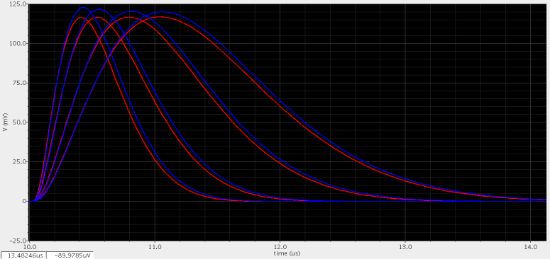
Readout architecture and Studies of the Efficiency of SVT outer layers
Readout architecture
Digital control:
4 selectable peaking time (1000, 750, 500, 375 ns)
2 polarity (n-strip, p-strip)
2 gain setting (nominal gain, +30%)
N-strip
P-strip
Charge preamplifier with continuous reset
Third order complex-pole shaping
Time-over -threshold amplitude measurement
Efficiency simulation using TOT
Monte-carlo time-domain simulations with hits energy distribution according to the expected background spectrum.
Efficiency for L4 and L5:
> 97% (nominal background rate, long peak-time)
> 92% (x5 background rate, short peak-time)

Slide 8
Studies of the Noise performances of SVT outer layers
Long-Strip detector model including:
Strip resistance and Cap.
Fan-out parasitic
Radiation damage
Noise Estimation
Strip side | Layer | Peaking time (ns) | S/N At startup | S/N after 7.5 years Nomonal background | S/N after 7.5 years 5x Background
Phi | 4 | 250 | 20 | 18 | 15
 |  | 375 | 21 | 19 | 14
 |  | 500 | 22 | 19 | 13
 |  | 750 | 23 | 19 | 12
Z | 4 | 250 | 24 | 22 | 17
 |  | 375 | 28 | 23 | 15
 |  | 500 | 29 | 23 | 14
 |  | 750 | 31 | 22 | 13
Phi | 5 | 375 | 19 | 18 | 16
 |  | 500 | 20 | 19 | 16
 |  | 750 | 22 | 20 | 16
 |  | 1000 | 22 | 20 | 15
Z | 5 | 375 | 26 | 25 | 21
 |  | 500 | 28 | 26 | 20
 |  | 750 | 30 | 26 | 19
 |  | 1000 | 30 | 26 | 18
Better performance achieved with shorter peaking time after radiations damage.
S/N still low with 5x safety on BKG. (Improve cooling!)

Slide 9
Studies of the Timing performances of SVT outer layers
Residual error of time-stamp and time-walk correction
Time jitter:
Depends on:
S/N ratio
Peaking time
Signal amplitude (worst case 0.3 MIP)
Time error due to:
Time stamp clock (33 MHz)
Time walk, corrected with TOT amplitude
Effect of TOT error (TOT clock)
250ns
Expected Timing Resolution
Peaking time (ns) | TOT bit | TOT clock (Mhz) | TS and Time walk error rms (ns) | Jitter for 0.3 MIP (ns) | Time resolution (ns) | Example Offline window (ns)
375 | 4 | 11.3 | 33 | 35 | 48 | 290
 | 6 | 47.5 | 15 |  | 38 | 230
500 | 4 | 8.5 | 41 | 43 | 59 | 360
 | 6 | 35.7 | 17 |  | 46 | 280
750 | 4 | 5.66 | 56 | 60 | 82 | 500
 | 6 | 23.8 | 21 |  | 64 | 380
1000 | 4 | 4.25 | 72 | 78 | 106 | 640
 | 6 | 17.8 | 25 |  | 82 | 500
Both contributions important for the outer layer
Better performance achieved with 6-bit TOT.
Prefer short peaking time when possible (same S/N)!

Slide 10
FE design for layers 4-5 of SVT
Activity proposed for 2013
Test of prototypes produced in 2012
Submission of a full readout chip for layers 4-5

Slide 11
Feedback of CERN Meeting
The power distribution(DCDC converter) may be done in two steps
External Card per module
Internal within the chip
Some IP blocks are used from CERN as:
Bandgap references, DAC, Voltage buffer
Alignment of a hint in different layers should be considered
There is no special benefit using triple well for NMOS: In Pixel detector it is necessary to use them, but in strip detectors, the distance between analog and digital parts is not so close.
The date of submission is not clear according to CERN and most probably we should go through MOSIS schedule

