Slide 1
EXOTIC - 2012
1) Study of the reaction mechanisms and the structure of weakly bound stable and exotic nuclei (PD)
2) Measurements of astrophysical interest with RIBs (MI)
  3) Collective modes: Dynamical Dipole
Study of the pre-equilibrium dipole γ ray emission in dissipative heavy-ion reactions (NA)
02/07/2012

Slide 2
Outline
1) Facility EXOTIC at LNL and Upgrade
2) Detector Development: EXPADES
3) Status of the Experiment and Data Analysis
4) Attività Prevista nel 2013

Slide 3
Facility EXOTIC at LNL and Upgrade

Slide 4
The Facility EXOTIC at LNL
EXOTIC facility @LNL: in-flight production of light Radioactive Ion Beams through inverse-kinematics reactions, induced by high intensity heavy-ion beams delivered from the LNL-XTU Tandem accelerator impinging on a gas target, which can be filled with H, D, ^{3,4}He.
The research fields accessible to the facility:
investigation of the exotic isotope structures;
interactions at energies around the Coulomb barrier;
measurements of astrophysical interest.
Typical quantities to be measured: elastic scattering, breakup, transfer, fusion cross sections.
Commissioning of the EXOTIC facility in 2004
F. Farinon et al., NIM B 266, (2008) 4097, M. Mazzocco et al., NIM B 266, 4665 (2008)
First “beam for experiment” (¹⁷F) in 2006
D. Pierroutsakou et al., EPJ ST 150, (2007) 47, C. Signorini et al., EPJ A 44, 63 (2010)

Slide 5
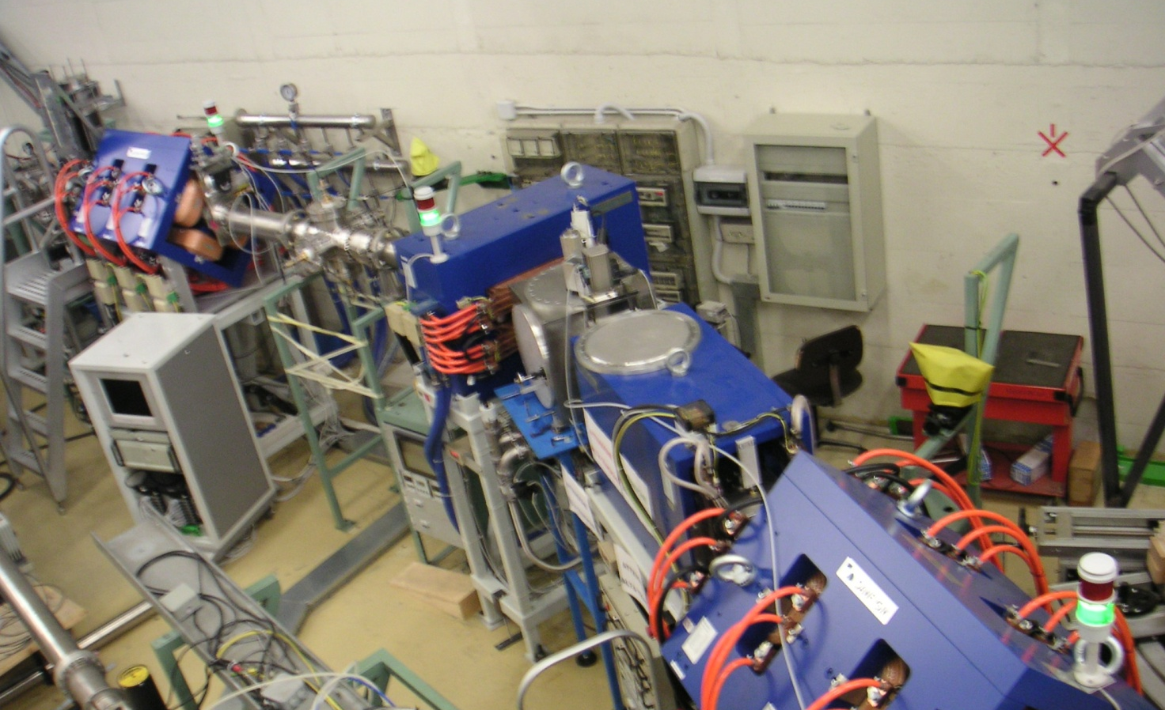
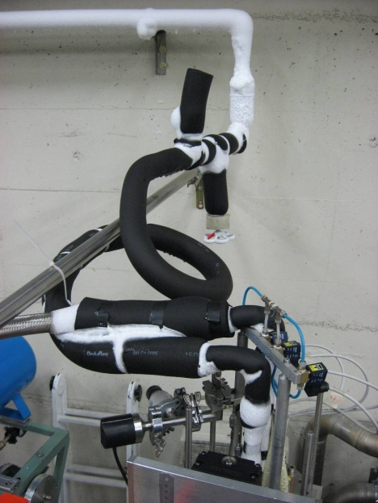
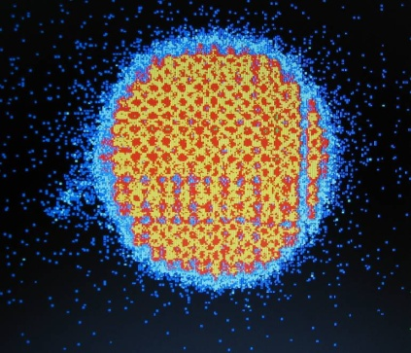
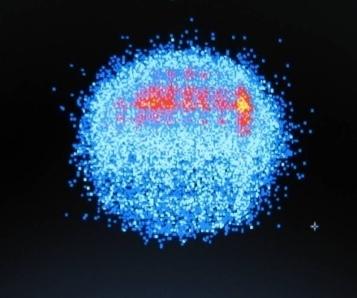
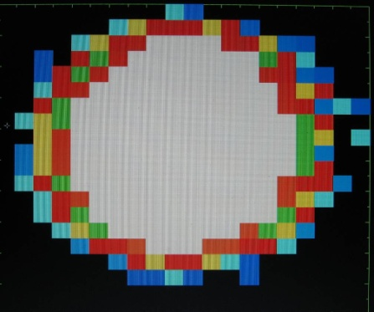
The Facility EXOTIC at LNL
Cryogenic Target
Gas Target
1st Quadrupole triplet
Dipole magnet
Wien filter
2nd quadrupole triplet
Slit systems
Beam-Tracking
15 mm
PPAC A
PPAC B
Reconstruction on the target

Slide 6
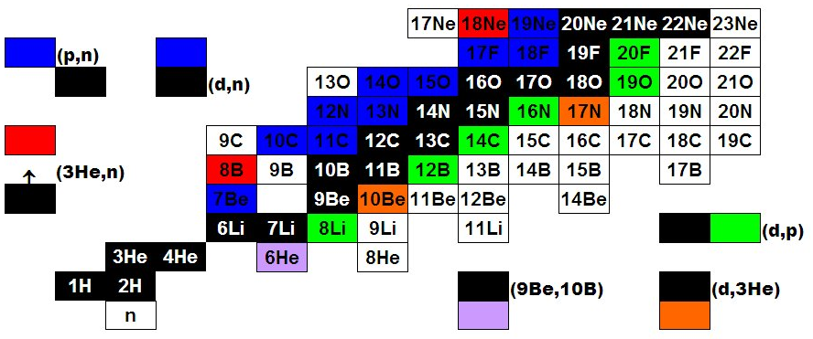
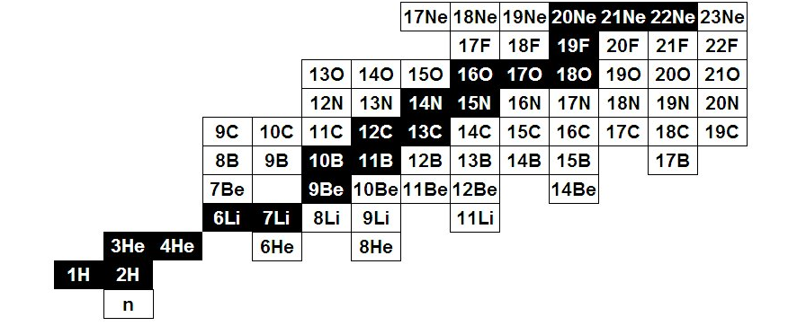
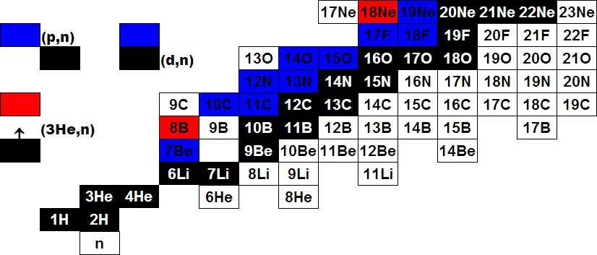
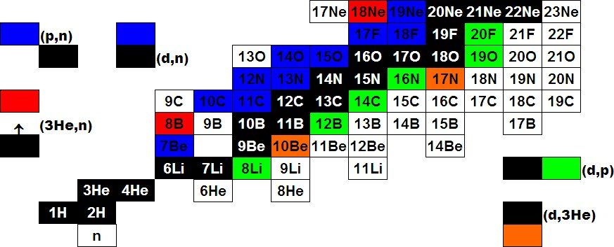
Light RIBs at EXOTIC
¹⁷F E = 3–5 MeV/u Purity: 93-96 % Intensity: ~ 10⁵ pps
⁸B E = 3-5 MeV/u Purity: 30-40 % Intensity: 1.5*10³ pps
⁷Be E = 3 MeV/u Purity: 99 % Intensity: 2-3*10⁵ pps

Slide 7
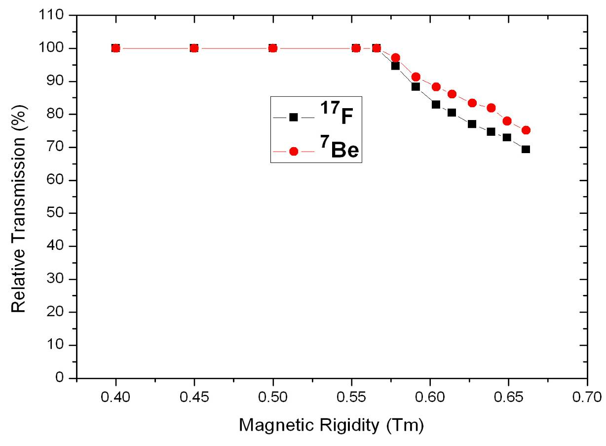
EXOTIC facility upgrade
(financed by FIRB, MIUR and CSN3, INFN)
V_{b} ¹⁷F + ⁵⁸Ni
V_{b} ⁷Be + ²⁰⁸Pb
V_{b} ⁷Be + ⁵⁸Ni
V_{b} ¹⁷F + ²⁰⁸Pb
The transmission is limited by the maximum magnetic field applicable to the pole-tips of the middle quadrupoles of both triplets (shipped last week to Danfysik).
The upgrade (financed within the project FIRB cod. RBFR08P1W2_001) will increase the RIB maximum magnetic rigidity by + 15 %, thus providing:
Higher Transmission (and secondary beam intensity)
B-scaling of all ion-optical elements

Slide 8
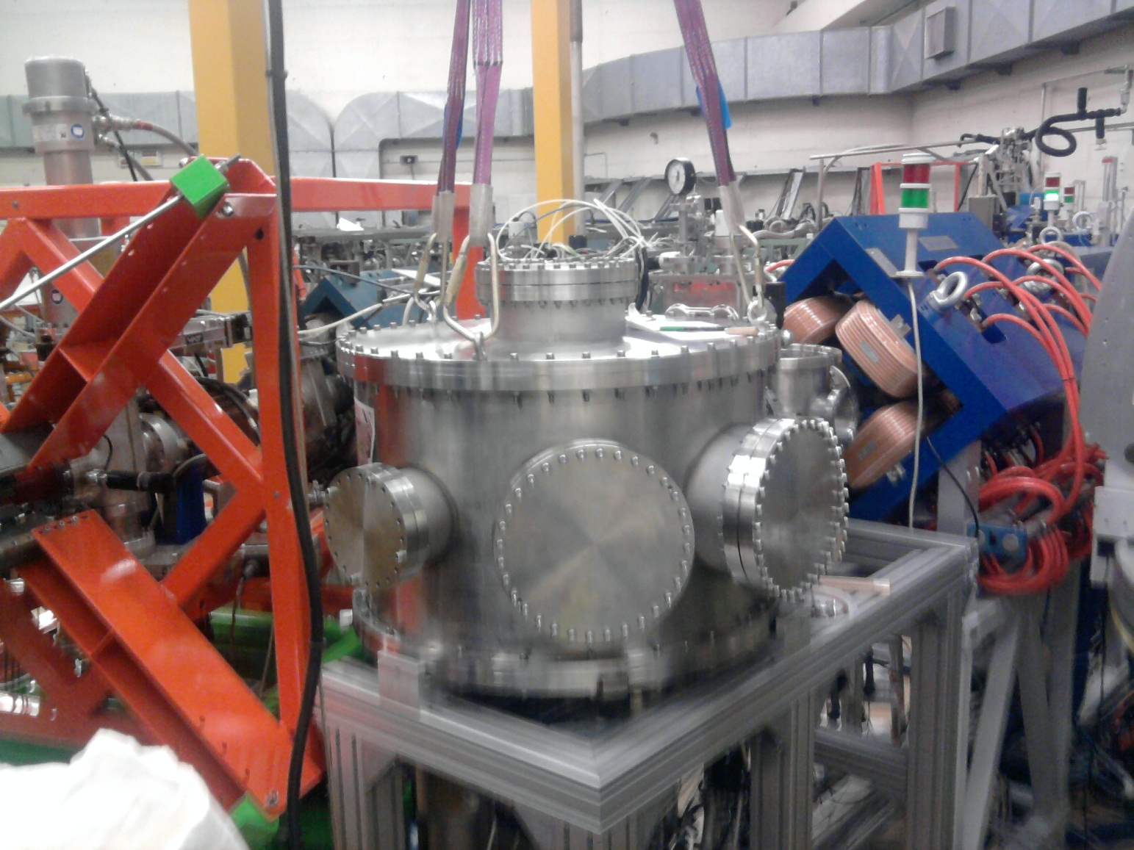
EXOTIC facility upgrade and new scattering chamber
During 2011, two y-steerers were added after the first quadrupole triplet.
A new scattering chamber was installed for the new experimental set up

Slide 9
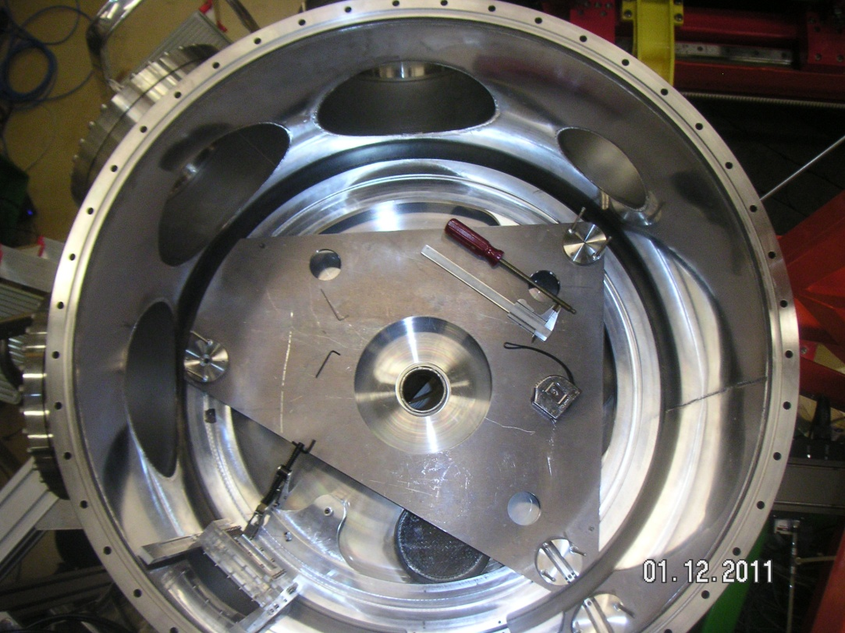
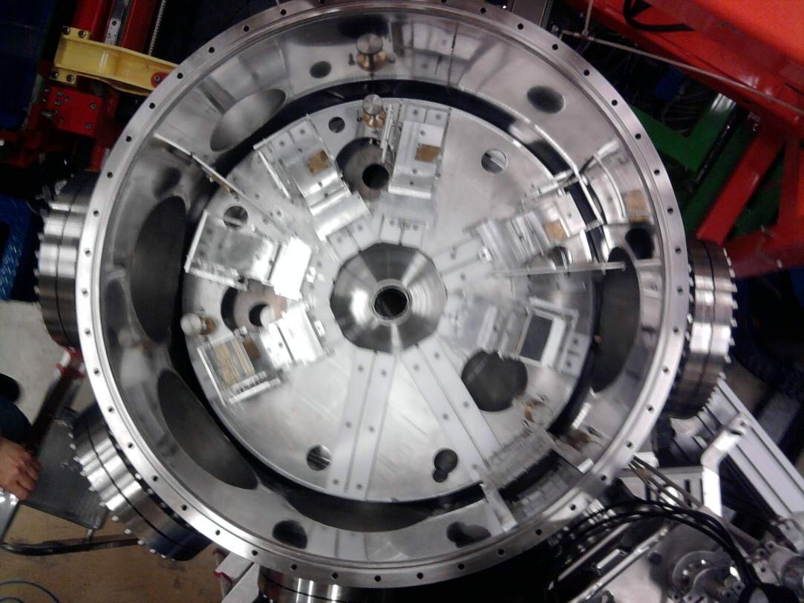
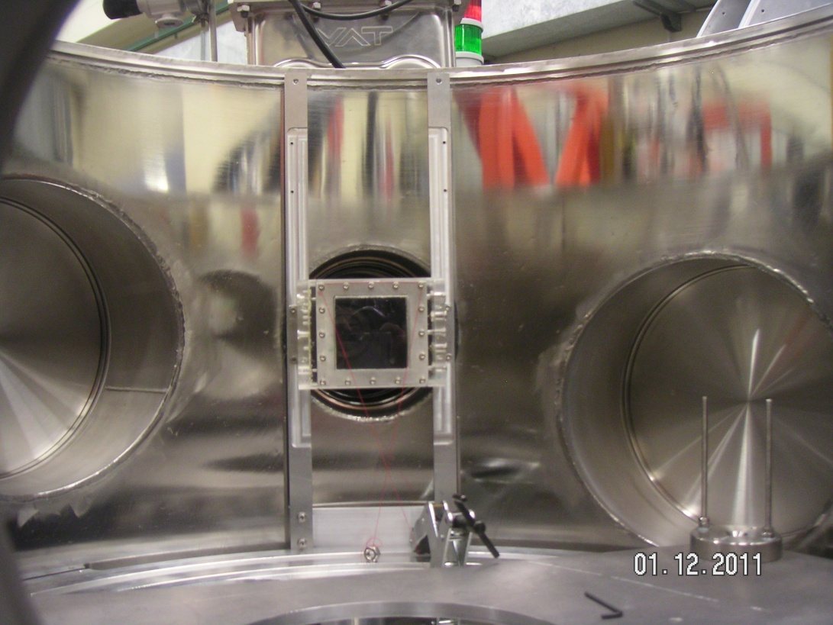
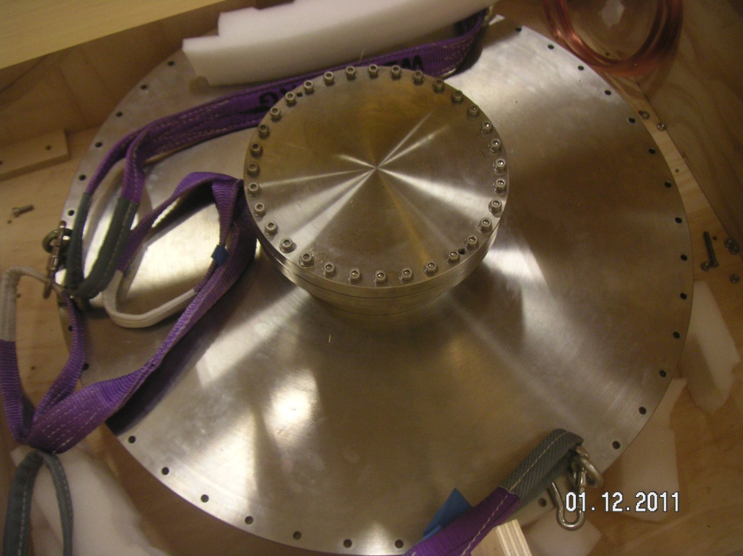

Slide 10
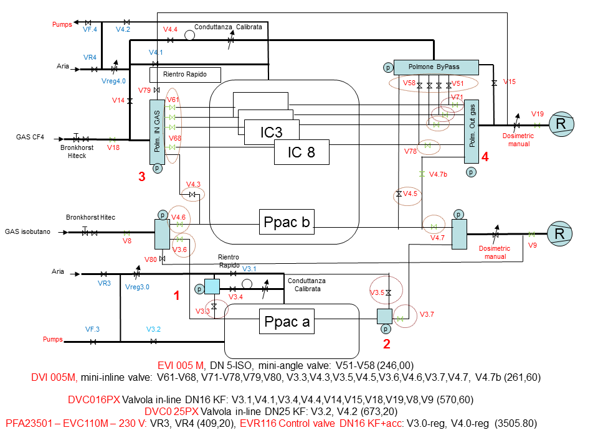
EXOTIC beamline: vacuum, venting and gas flow control (to be completed by March 2013, NA+PD)

Slide 11
Detector Development: EXPADES

Slide 12
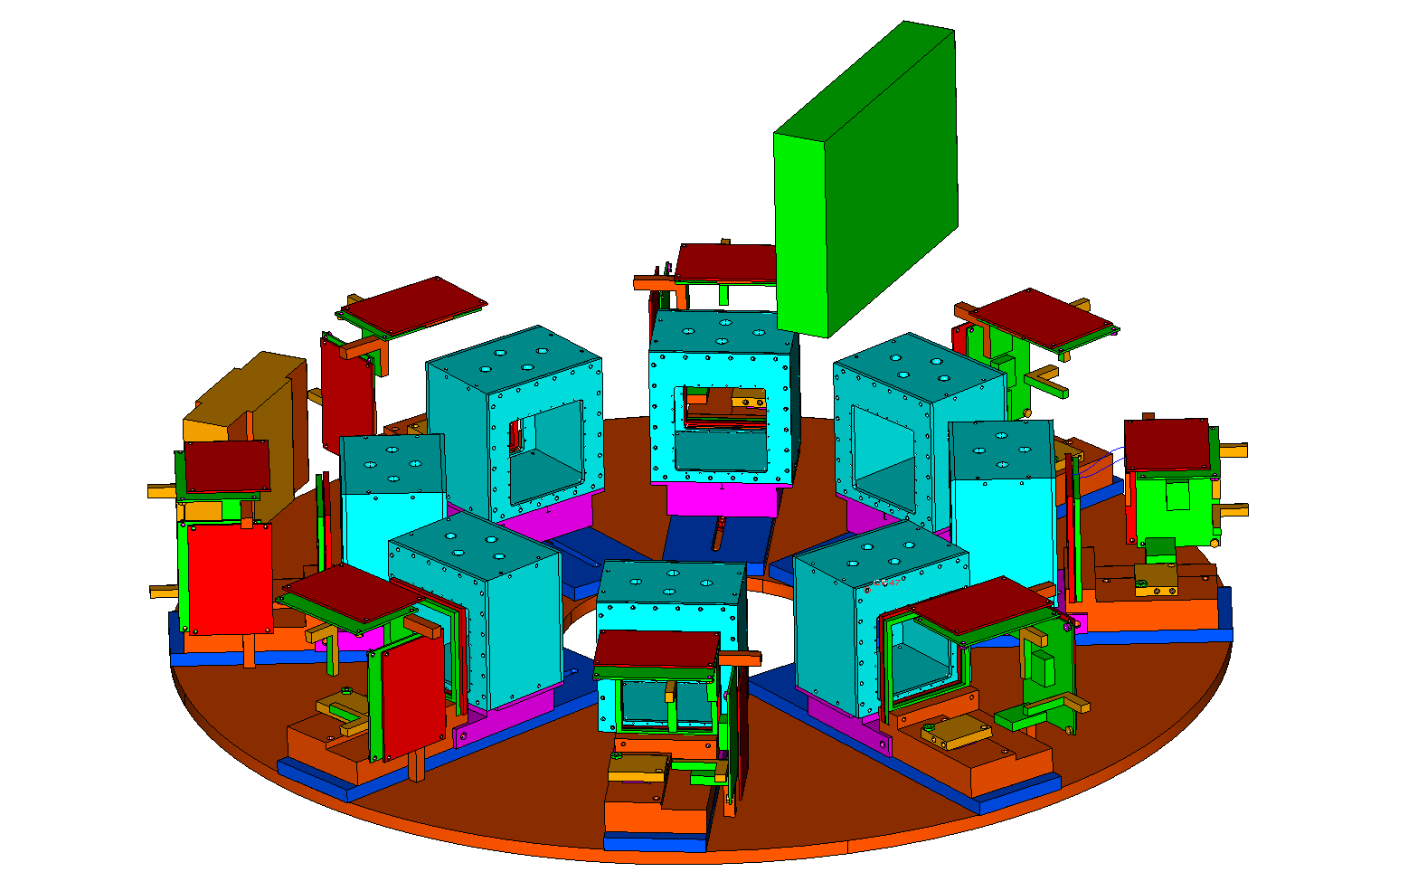
EXOTIC new apparatus for measurements with RIBs
(commissioning by the end of 2012)
Motherboard
ΔE - E
PPAC_B
BEAM
Ionization Chamber (ΔE)
8 Telescopes each one consisting of:
ΔE – Ionization Chamber
ΔE(40 μm) + E (300 μm)
Double Sided Silicon Strip Detectors
62.5 x 62.5 mm² active area
32 x 32 strips (2 mm) Δθ=0.8 ° at d=15 cm
3rd stage: 500 μm Silicon (single pad) from the EXODET set up.
Readout electronics of the ΔE stage based on home-made traditional electronics
Readout electronics of the E stage based on ASIC chips manufactured by IDEAS-GM (Norway)
Cooling system with Peltier cells and water

Slide 13
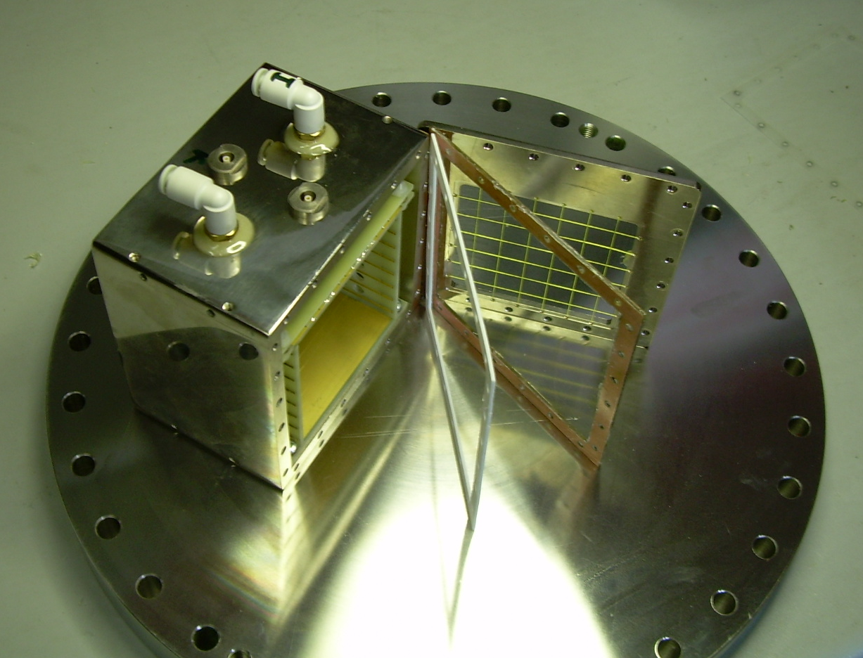
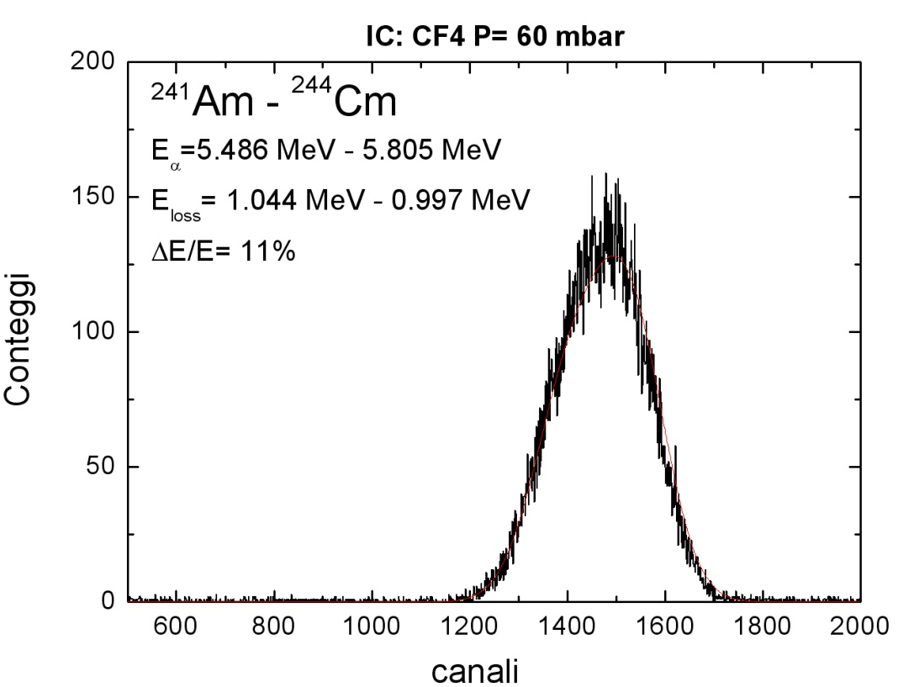
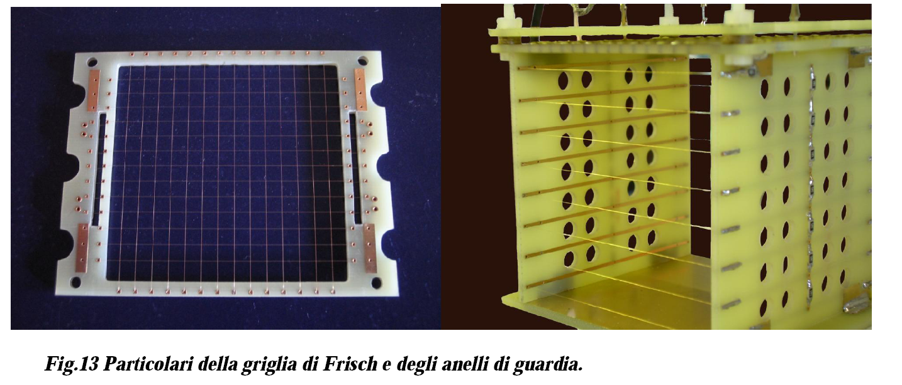
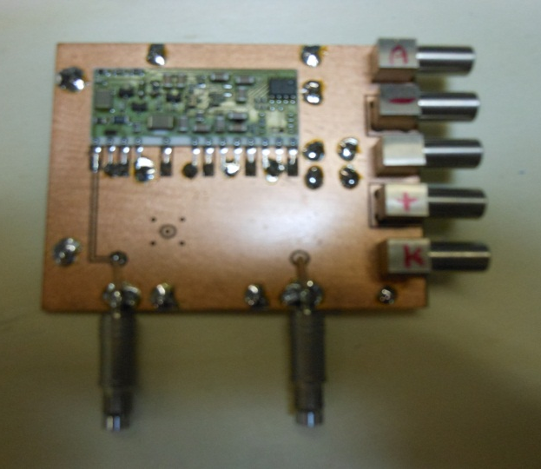
ΔE stage: Ionization Chambers (NA)

Slide 14
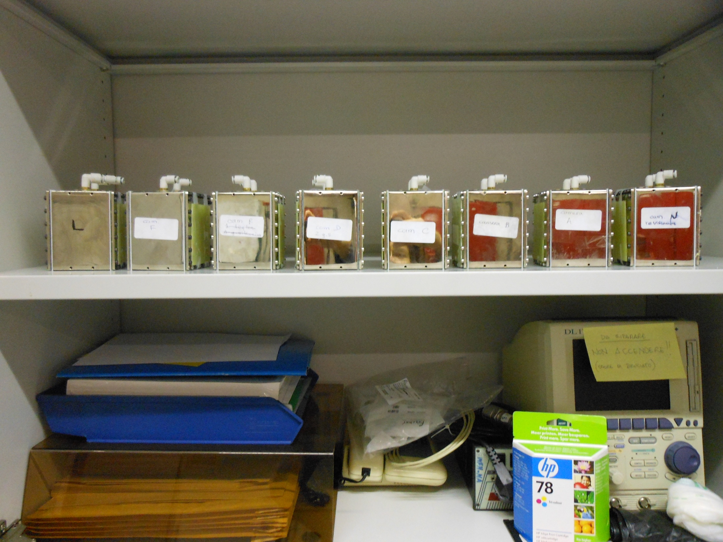
8 ICs assembled (NA)

Slide 15
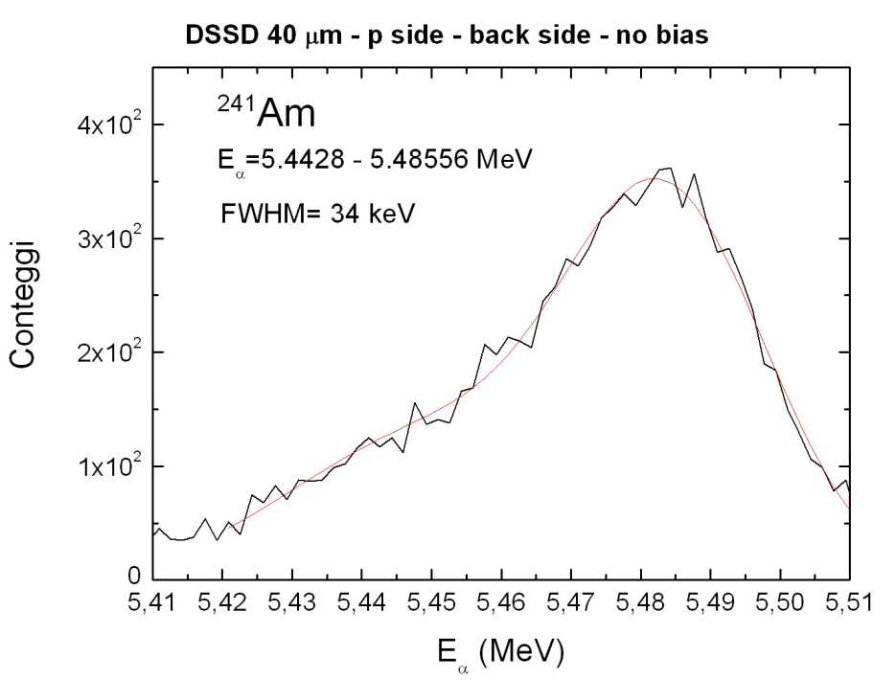
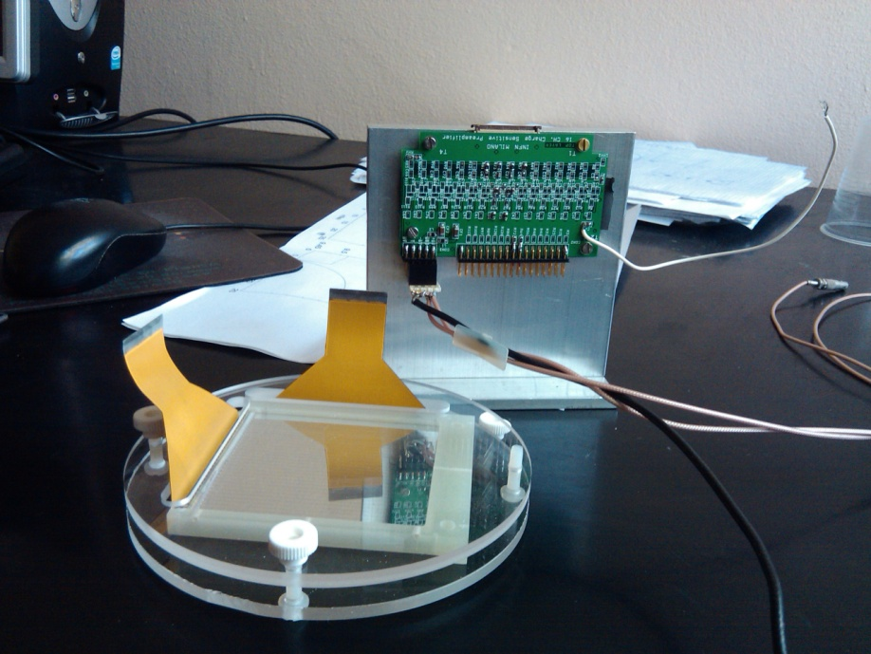
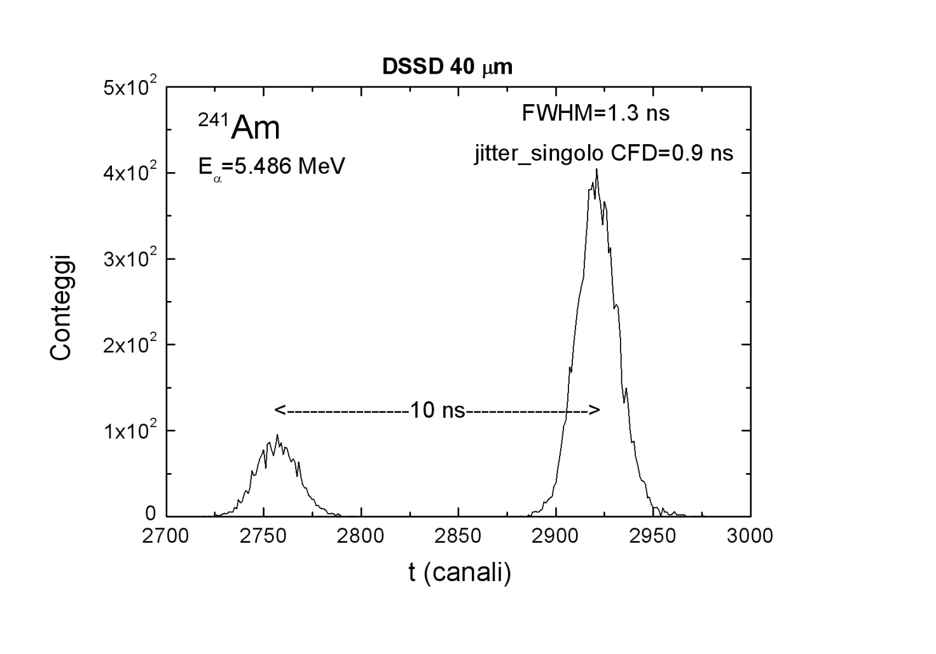
Δ E stage: DSSD 40μm (MI)
Readout traditional electronics
16 channel pre–amplifier boards
16 channel (SA+CFD+TAC)
Commissioning of the electronics completed. Prototype ready.
4(/8) detectors delivered
ΔE (FWHM): 34 keV
Δt (FWHM): 0.9 ns (0.1 ns intrinsic)

Slide 16
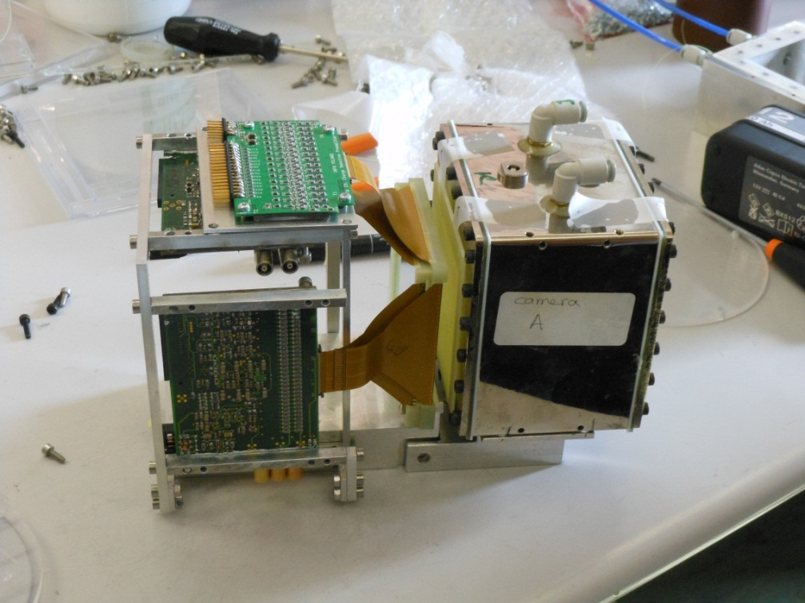
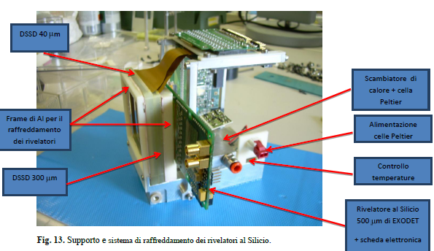
Assembling Telescopes (NA)
IC
DSSD 40 μm
DSSD 300 μm
Single PAD 500 μm (EXODET)
Test for the cooling of the telescopes with Peltier cells and water completed.

Slide 17
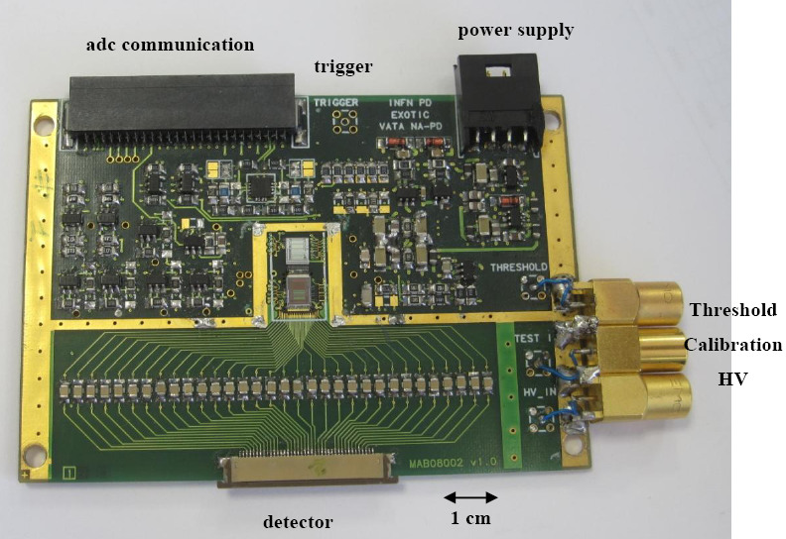
E stage: DSSD 300 μm (PD)
8 modules: 300 μm DSSSD
Active area: 62.5 mm x 62.5 mm; 32 strips x 32 strips:
Innovative readout electronics by means of two ASIC chips.
The board to interface the two chips and the ADC (VATA boards) was entirely designed and built by INFN-PD.
Prototype ready (end of 2010). We are now proceeding to a fine characterization of all the detectors and all the VATA boards.

Slide 18
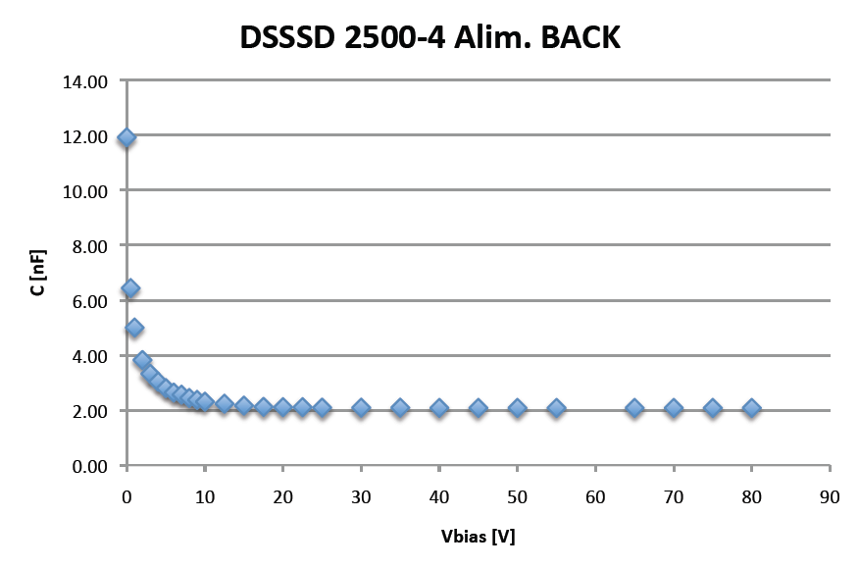
Detector Characterization: Body Capacitance

Slide 19
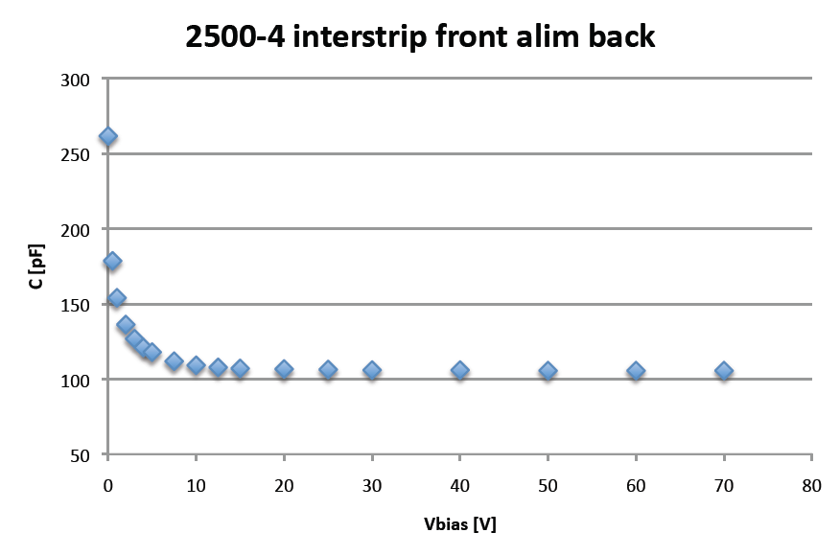
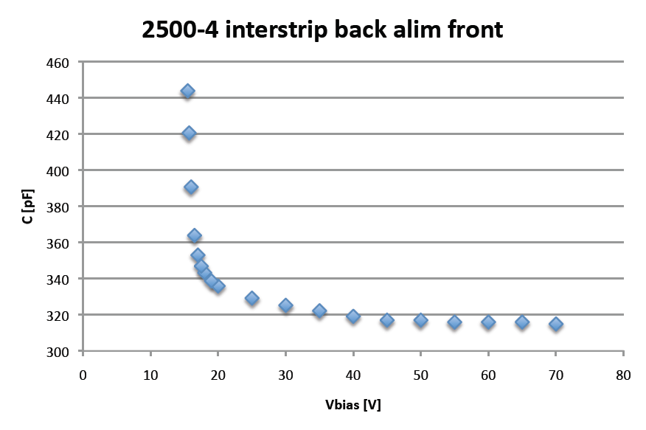
Detector Characterization: InterStrip Capacitance

Slide 20
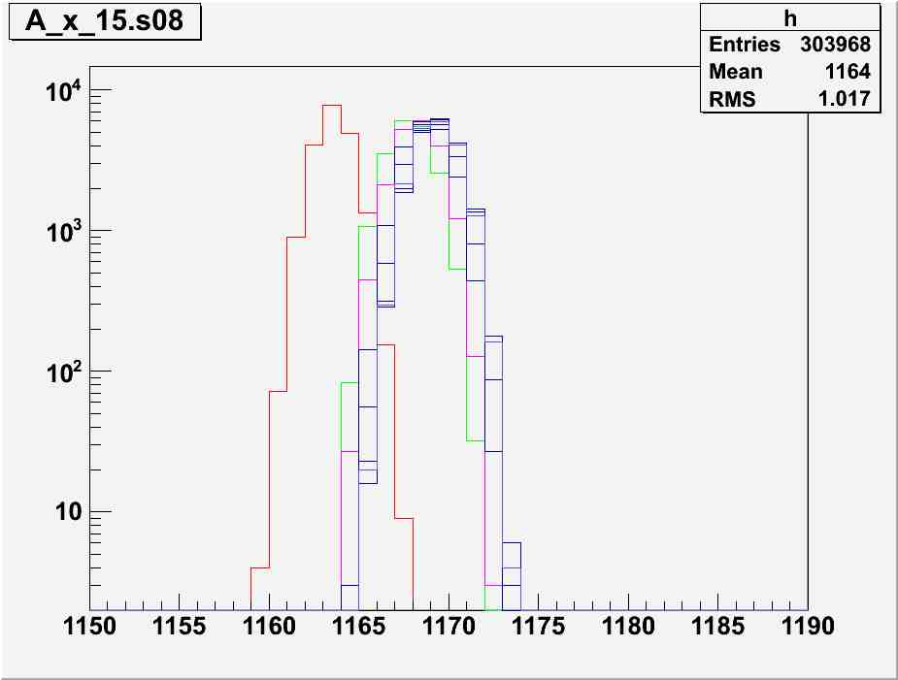
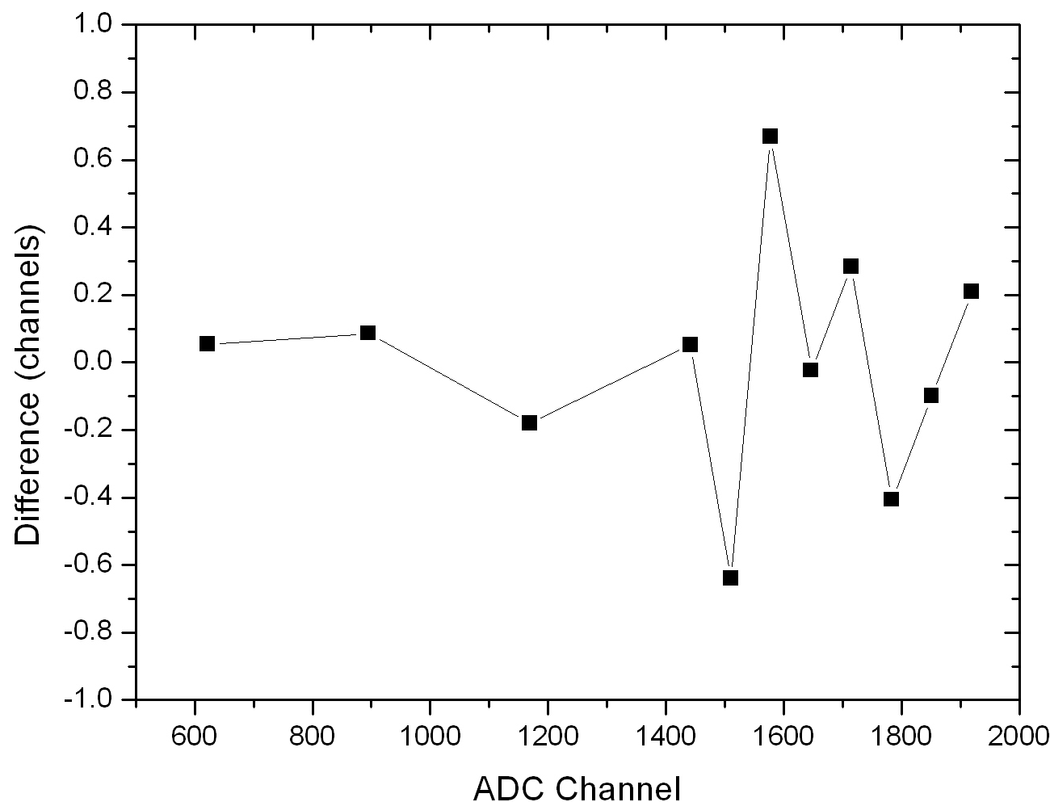
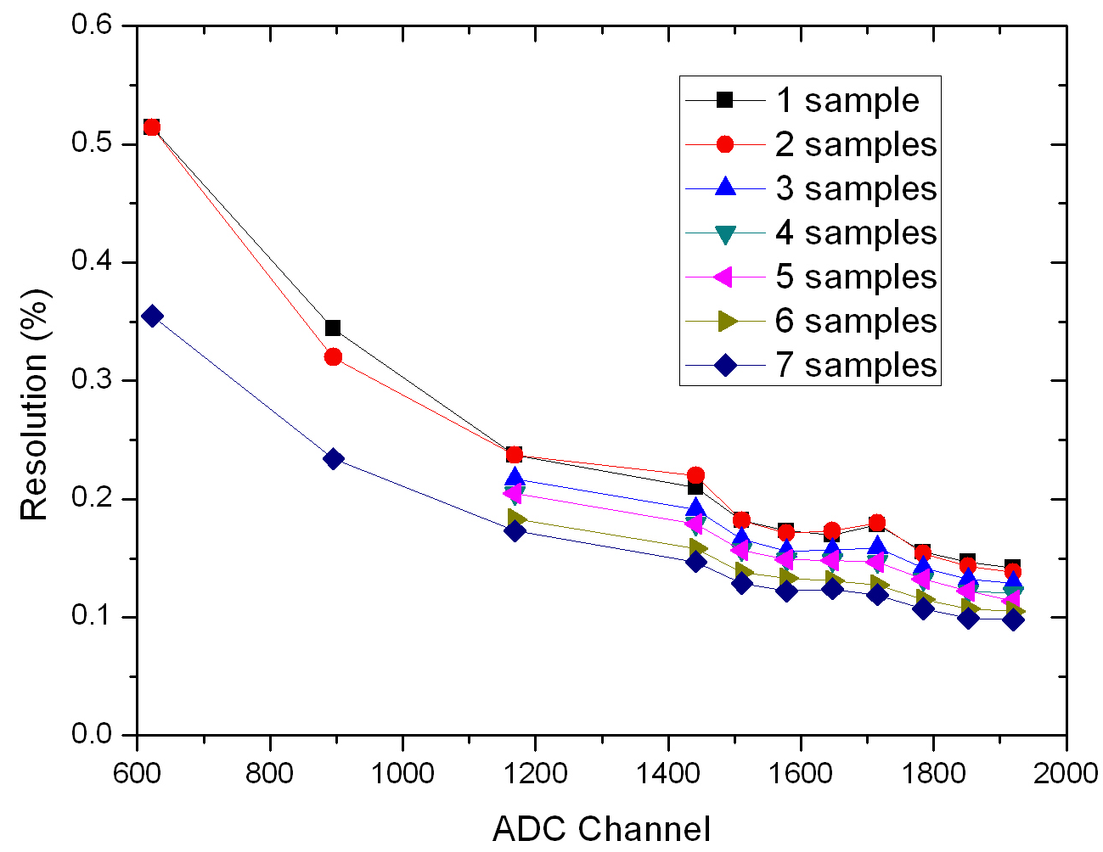
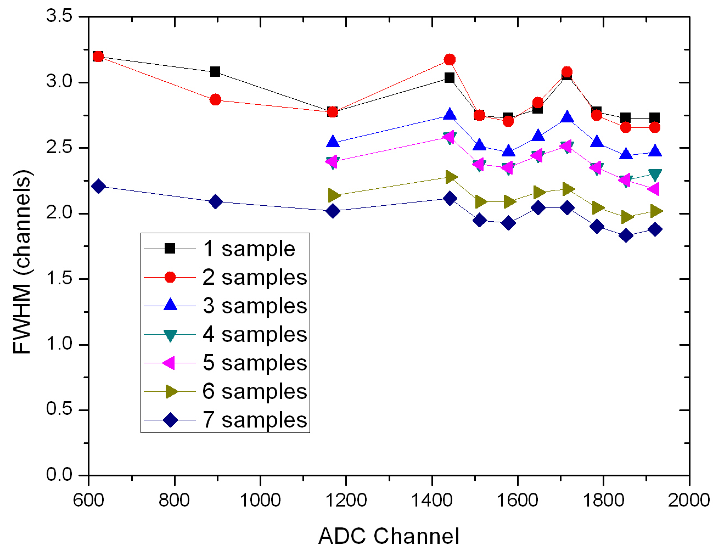
Read-out: Linearity and Resolution

Slide 21
Next Steps
1) Linearity and Resolution tests for 25-30 VATA boards.
2) Connection to the Detector: Linearity and Resolution test (starting from next week).
3) Resolution Test with Alpha Particels.
4) Resolution Tests for different Deplation Voltages (40, 50, 60 V) and Temperatures (20°, 10°, 0°, -10° C).
5) Investigation of Interstrip Events in the Front and in the Back sides of the Detectors.
6) Test with different alpha source intesitity.
7) In-Beam Test of two Telescopes (Oct-Nov 2012)
8) Final Assembling of 8 Telescopes.

Slide 22
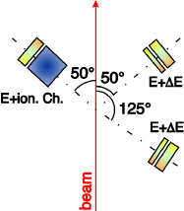
¹⁷O+²⁸Ni,²⁰⁸Pb (PAC 2012, to be done in Oct-Nov 2012)
1) Commissioning of the whole telescope of EXOTIC and the relative electronics:
2 telescopes 40 μm +300 μm at θ=50 ° and θ=125°
1 telescope of IC+ 300 μm at θ=-50 °
2) Study of the elastic scattering and reaction cross section for the ¹⁷O+⁵⁸Ni,²⁰⁸Pb systems and of the ¹⁷O+²⁰⁸Pb → ¹⁶O+²⁰⁹Pb breakup/transfer reaction cross section at different energies around and above the Coulomb barrier

Slide 23
Status of the Experiments and Data Analysis

Slide 24
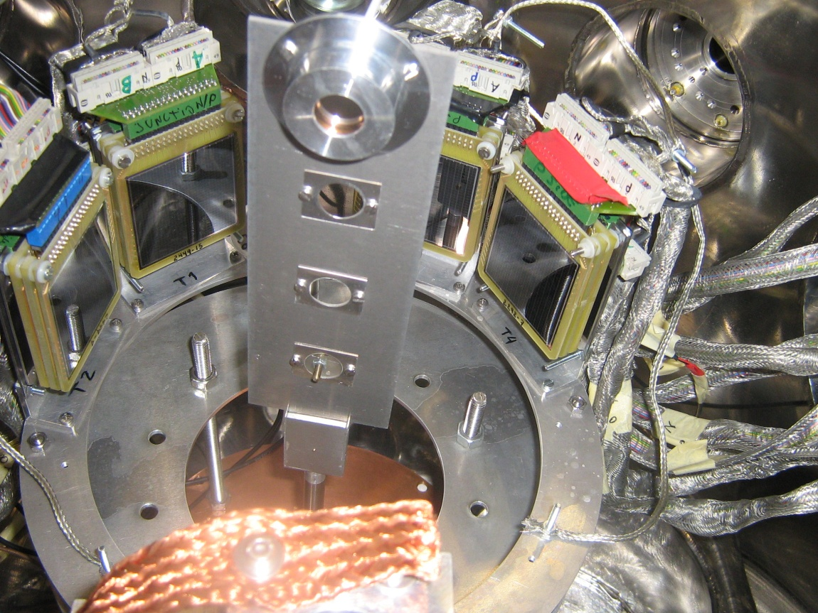
¹⁷F+p (PAC II 2009, 11/2009)
Elastic and inelastic scattering angular distributions (20°-160°) in inverse kinematics at E_{lab}= 3.33 and 4.35 MeV/u to determine the ¹⁷F+p potential.
(Spokesperson: A. Pakou, University of Ioannina, Greece) in collaboration with the University of Huelva. N.Patronis et al, Phys. Rev. C 85 (2012) 024609
The obtained total reaction cross sections are larger by 15-20% than those obtained using the standard one barrier penetration model indicating a proton skin structure of the ¹⁷F nucleus.

Slide 25
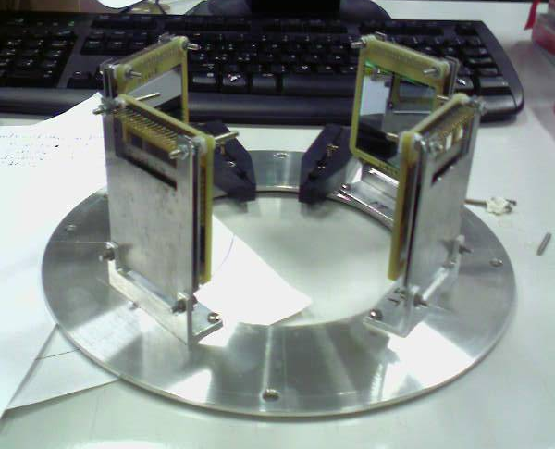
⁷Be+⁵⁸Ni (PAC II 2010, 05/2010)
In May 2010, we produced for the first time a rather intense (2-3 * 10⁵ pps) and nearly 100%-pure ⁷Be secondary beam of E_{lab}=18.7 MeV with FWHM= 0.97 MeV and E_{lab}=22.8 MeV with FWHM= 0.725 MeV by using the p(⁷Li, ⁷Be)n reaction. Secondary beam spot on target (σ_{x} = 3 mm; σ_{y} = 4 mm);
This RIB was employed to study the reaction dynamics induced on the proton shell closed ⁵⁸Ni target at two energies around the Coulomb barrier with the Spanish detector array DINEX (the detector energy resolution (0.75-1.4 %).
DINEX

Slide 26
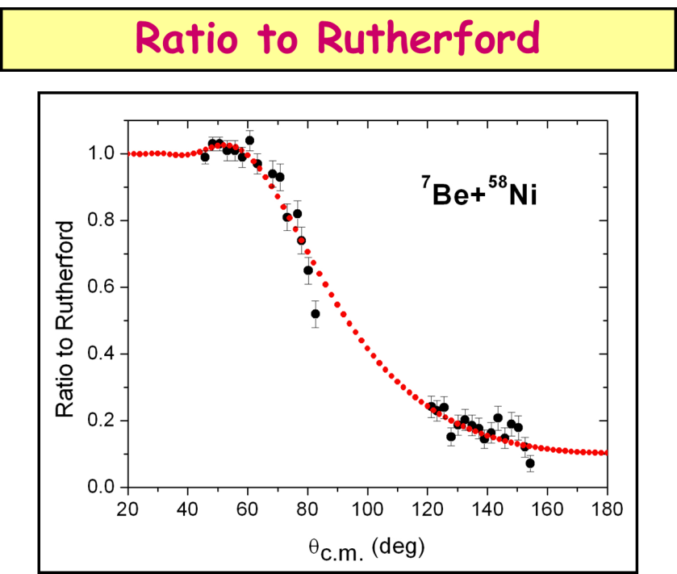
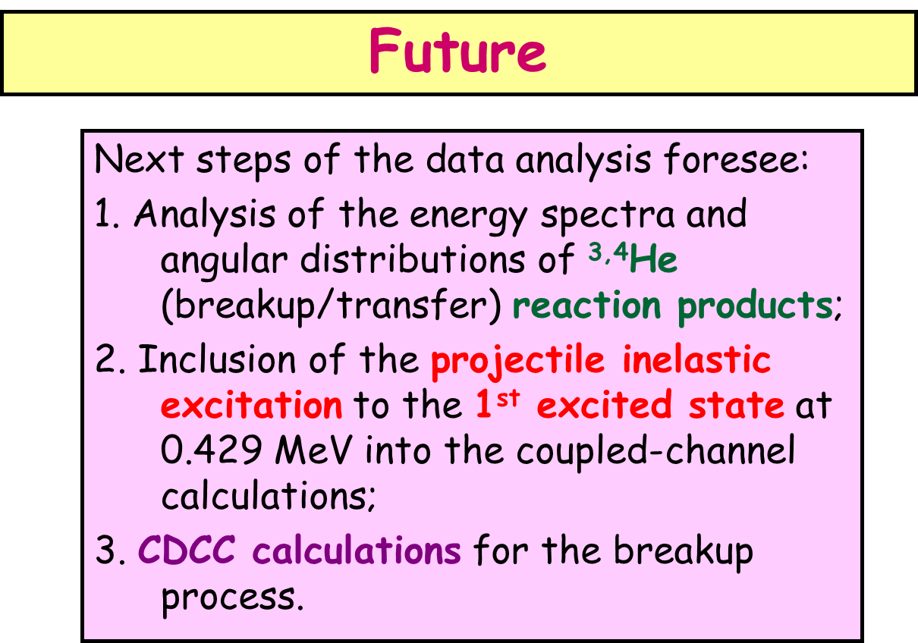
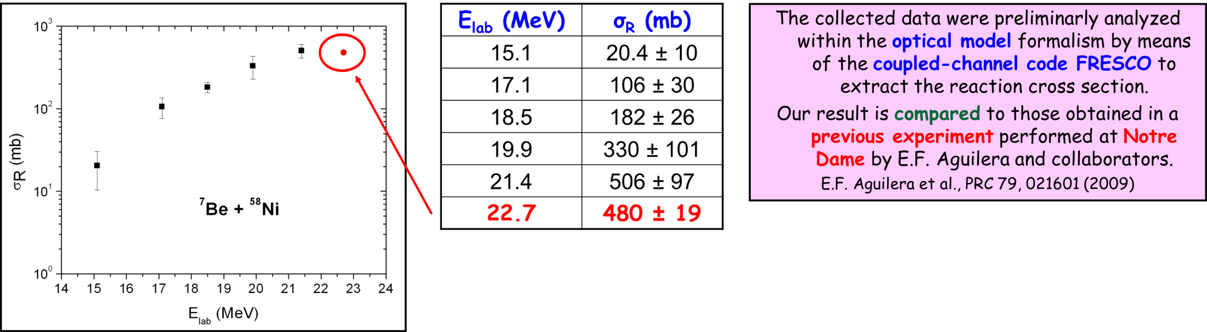
⁷Be+⁵⁸Ni: First results

Slide 27
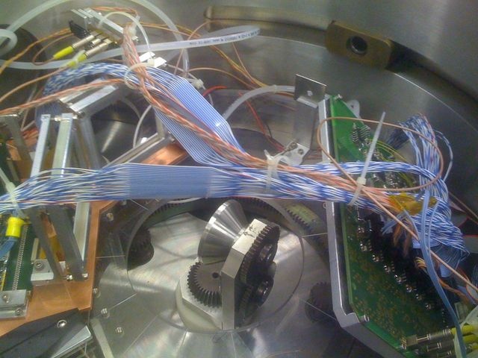
¹⁷O + ⁵⁸Ni, ²⁰⁸Pb (PAC I 2011, 04/2011)
New experimental set up:
First Experiment: Apr 2-5 2011
BEAM
BEAM
ΔE: 40 μm Silicon (32 x 32 strips) or Ionization Chamber;
E_{res}: 300 μm Silicon (32 x 32 strips);
Possible 3rd stage: 500 μm Silicon (single pad).
2 E_{res} modules (32 x 32 strips);
1st detector: 35° ≤ θ_{lab} ≤ 70°;
2nd detector: 80° ≤ θ_{lab} ≤ 110°;
¹⁷O and ¹⁷F are mirror nuclei with similar nuclear structures but very different binding energies

Slide 28
¹⁷O + ⁵⁸Ni, ²⁰⁸Pb (preliminary)
Primary Beam: ¹⁷O⁴⁺
Intensity: 1-4 enA
Energy: 42.5-55 MeV in 2.5-MeV steps
Strip-by-strip analysis.
Normalization problems at forward angles (→ pixel-by-pixel analysis).
PRELIMINARY
M. Mazzocco et al., Proc. Inter. Conf. FUSION11,
C. Signorini et al. NN2012, Texas

Slide 29
“Reduced” Reaction Cross Sections
⁸B S_{p} = 0.1375 MeV ¹⁷F S_{p} = 0.600 MeV
¹⁷O S_{n} = 4.134 MeV ¹⁶O S_{α} = 7.162 MeV
E.F. Aguilera PRC 79 (2009), M. Mazzocco PRC 82 (2010), N. Keeley NPA 582 (1995)
Similar reduced cross section of the ¹⁷F+⁵⁸Ni system with those of the “reference” stable systems ^{16,17}O+⁵⁸Ni: small influence of the low binding energy in the reaction dynamics (coulomb and centrifugal barrier for the weakly bound proton)
In agreement with our previous findings on ¹⁷F+²⁰⁸Pb system at subbarrier energy (EPJA 44 (2010) 63)

Slide 30
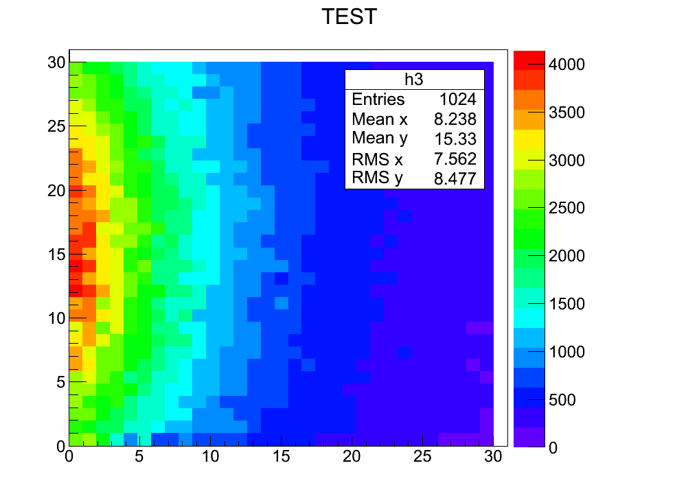
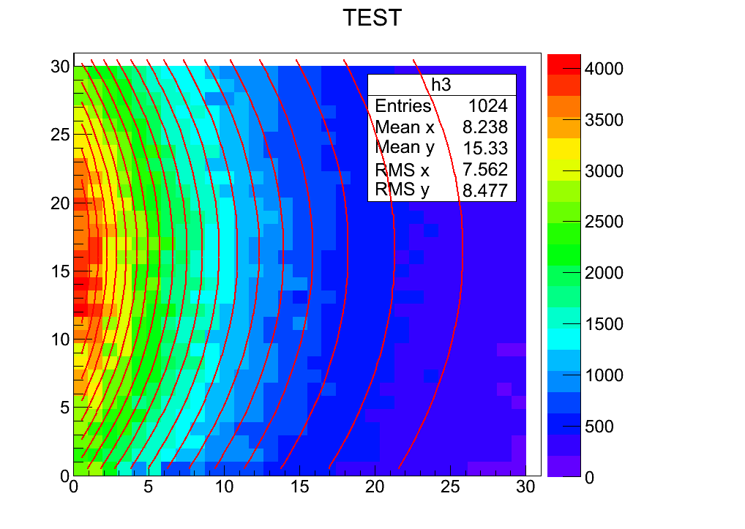
Pixel-by-Pixel Analysis

Slide 31
⁸B+²⁸Si (PAC II 2011, 03/2012) first run in the new scattering chamber
  ⁸B (770 ms) production via the inverse kinematics reaction
  ⁶Li (³He, n)⁸B I (⁶Li) = 150 pnA , I (⁸B) = 1.2 kHz
  ⁸B + ²⁸Si: total reaction cross section of ⁸B (E_{lab}=12.6-36 MeV) of ⁷Be and of ⁶Li nuclei on a ²⁸Si target to obtain complementary information to that of elastic scattering about the absorption at barrier and about the ⁸B nuclear structure.
  (Spokesperson: A. Pakou, University of Ioannina, Greece)
  Experimental setup: ΔE 45 μm + ΔE 45 μm + E 3000 μm set at 0° degrees which will used both as a target and as a detector. Reaction events will be separated from non reaction events from their energy.
  Pile up rejection (challenging)

Slide 32
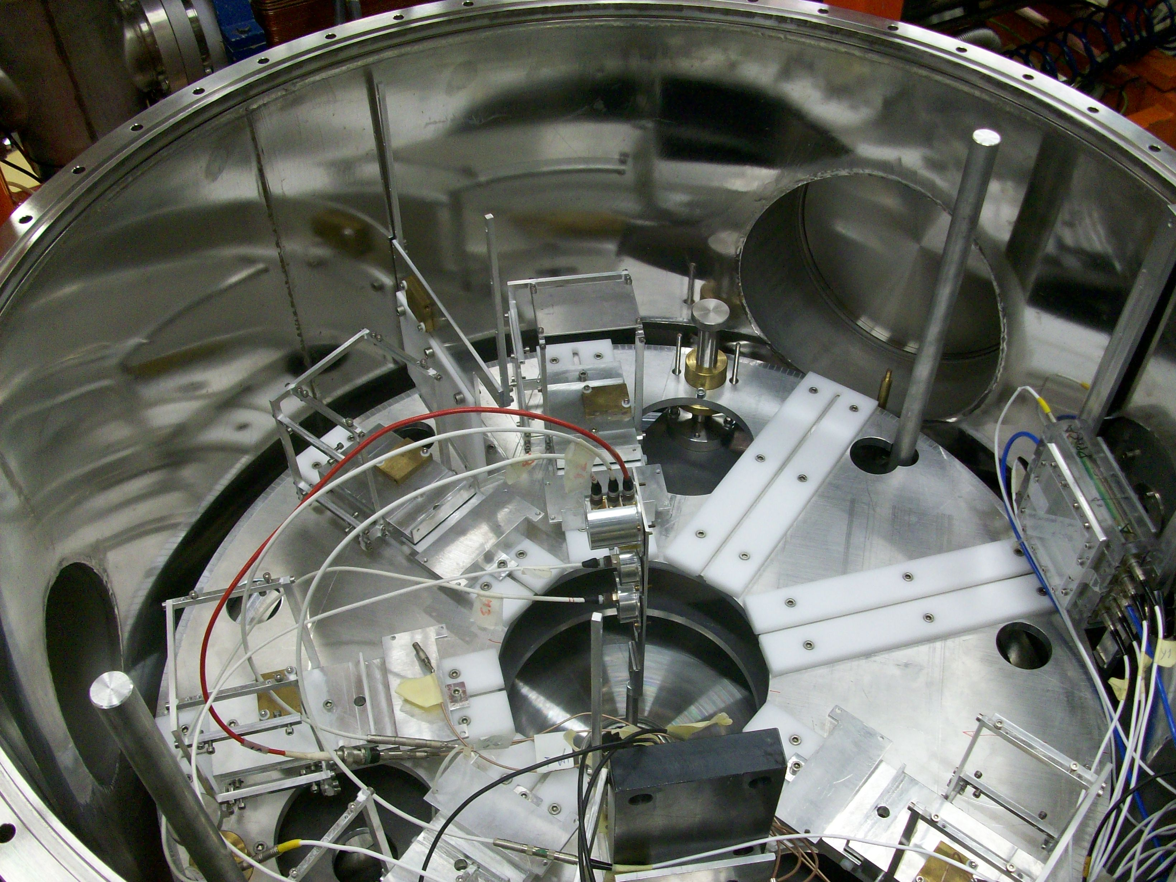
⁸B+²⁸Si: set up

Slide 33
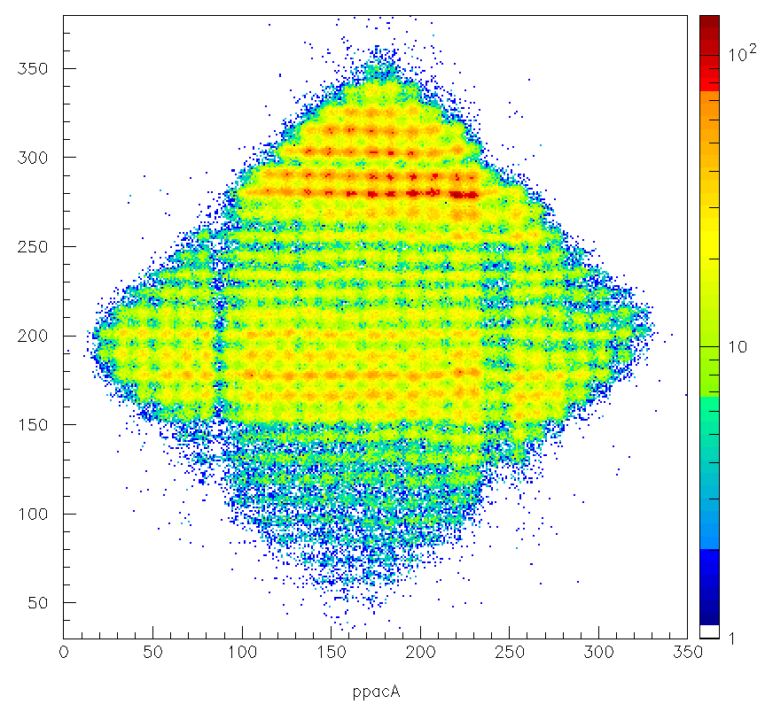
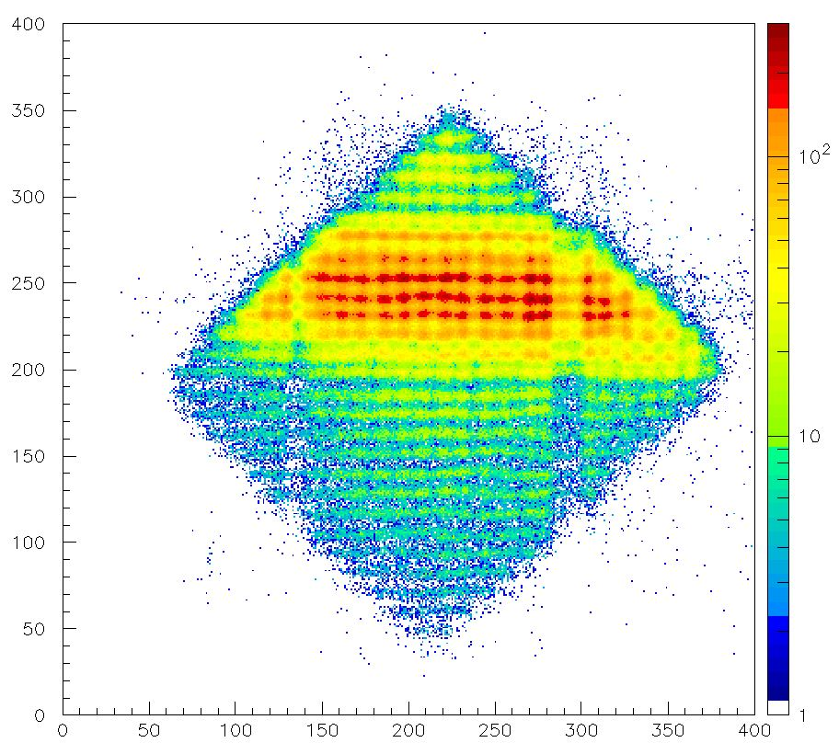
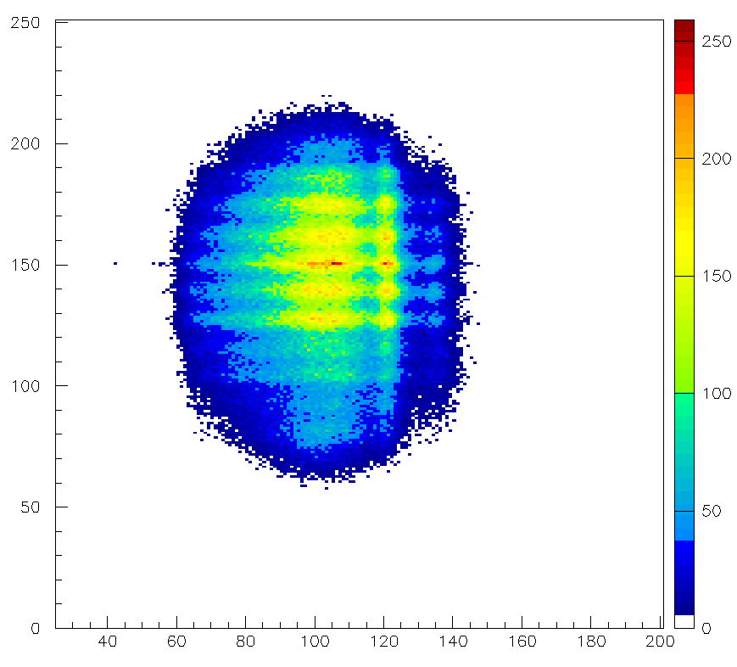
⁸B+²⁸Si: beam profile
PPACA: ⁸B E=27.5 MeV
PPACA: ⁸B E=35.15 MeV
PPACB: ⁸B E=35.15 MeV

Slide 34
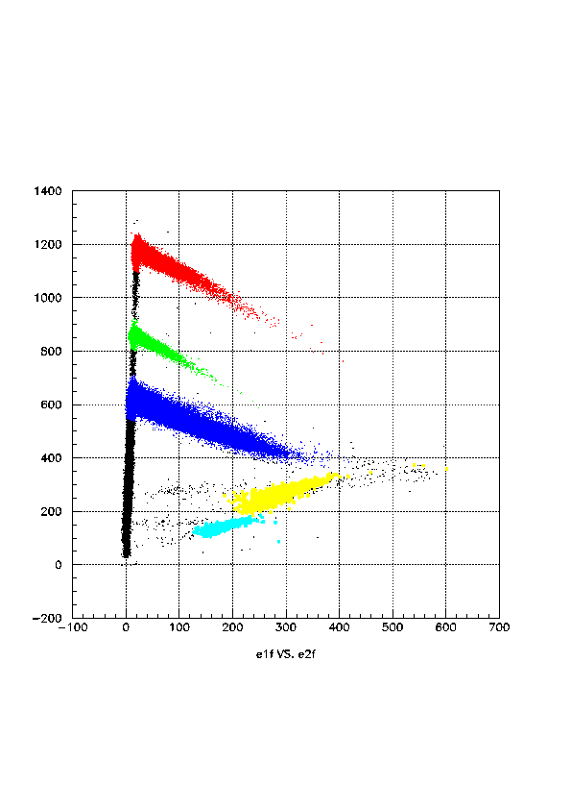
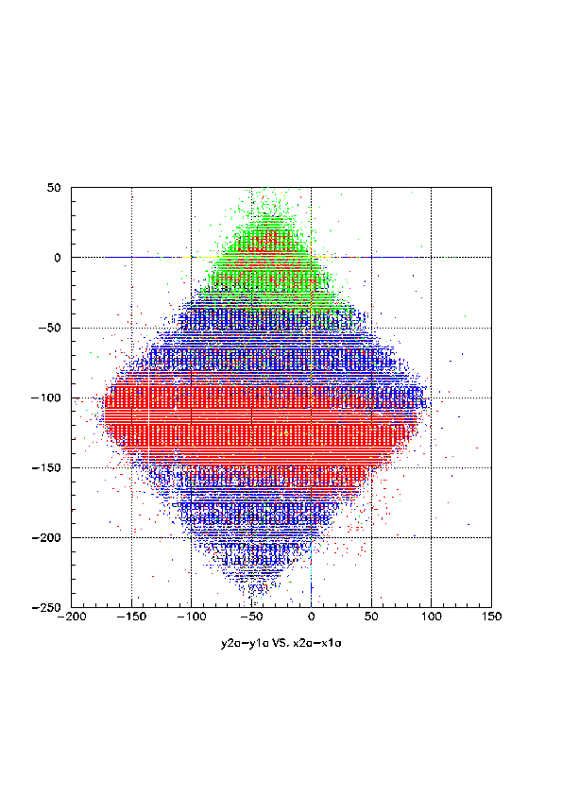
⁸B+²⁸Si
Target stack
C: 45 μm
D: 45 μm
E: 3000 μm
⁸B
Energy_C
⁷Be
⁶Li
⁸B
y₂-y₁ vs x₂-x₁
Energy_D

Slide 35
Attività Prevista nel 2013

Slide 36
EXOTIC Collaboration
Milano (0.4 FTE)
A. Guglielmetti
Napoli (1.5 FTE)
M. La Commara, D. Pierroutsakou
Padova (4.5 FTE)
M. Mazzocco, C. Parascandolo, C. Signorini, F. Soramel, E. Strano, D. Torresi

Slide 37
Attività Prevista nel 2013
Presentazione al PAC dei LNL di 2-3 proposal scientifici per lo studio delle reazione ¹⁷F + ⁵⁸Ni e ⁷Be + ⁴He con l’apparato sperimentale EXPADES
Proposal per lo sviluppo di due nuovi fasci radioattivi:⁶He e ¹⁸Ne
Completamento analisi dati per le reazioni ⁷Be + ⁵⁸Ni e ¹⁷O + ⁵⁸Ni
Sottomissione dei relativi articoli per la pubblicazione
Completamento di 8 telescopi dell’apparato sperimentale EXPADES
Realizzazione del run ⁸B+²⁰⁸Pb a CRIB, Giappone (proposal approvato)
Realizzazione di un secondo target criogenico e di un pick-up capacitivo per la misura (relativa) in-beam dell’intensità del fascio primario incidenti sul gas target della linea di fascio EXOTIC.

Slide 38
EXOTIC: Richieste di supporto Servizi Tecnici
Officina Meccanica: (ca. 6 mesi/uomo)
Realizzazione del secondo target criogenico
Realizzazione di un pick-up capacitivo per misure di intensità di corrente
Test di tenuta di nuovi rivelatori a gas PPAC per assicurare migliore tenuta del corpo
Allineamento della linea di fascio Exotic
Laboratorio di Elettronica: (ca. 3 mesi/uomo)
Assistenza nell’assemblaggio degli 8 rivelatori di EXPADES e nel montaggio nella camera di scattering. Completamento dell’elettronica e spare parts.
Assistenza e supporto per turni di misura a LNL
Assistenza e supporto per l’esperimento a CRIB (Giappone)
Progettazione: (ca. 1 mese/uomo)
Completamento del sistema per il controllo automatico delle procedure di vuoto, rientro e flussaggio per i rivelatori a gas di tracking e per le camere a ionizzazione (nel caso in cui questo progetto non venga completato nel 2012)
Servizio di Calcolo: (Nessuna richiesta)

Slide 39
EXOTIC: Richieste finanziarie Padova (k€)
Descrizione | Capitolo | PD
Aggiornamento linea EXOTIC | CA | 6
PC spare per DAQ a LNL/Data Storage | CA | 2
Manutenzione e Implementazione linea EXOTIC | MAN | 1
Isotopi Arricchiti, Havar | Cons | 10
Componenti di Elettronica (Cavi Kapton) | Cons | 5
Rivelatori Spare EXPADES | Cons | 15
Linear FIFO | INV | 1
Alimentatore Ortec 4-vie | INV | 7
Missioni Interno | MI | 9
Missioni Estero | ME | 13
Totale |  | 69

Slide 40
EXOTIC: Publicazioni 2011-2012
1) "Sub-barrier fusion of ⁶He with ²⁰⁶Pb“, Eur.Phys.J. A 47, 111 (2011)
2) "Investigation of the Dynamical Dipole Mode in the ¹⁹²Pb Mass Region“, Acta Phys.Pol. B42, 629 (2011)
3) "Mass Measurements of Very Neutron-Deficient Mo and Tc Isotopes and Their Impact
on rp Process Nucleosynthesis“, Phys.Rev.Lett. 106, 122501 (2011) )
4)“Decay of excited nuclei produced in ^{78,82}Kr+⁴⁰Ca reactions at 5.5 MeV/nucleon”, Phys. Rev. C 83, 054619 (2011)
5) “Probing the ¹⁷F+p potential by elastic scattering at near-barrier energies“, Phys. Rev. C 85 (2012) 024609
6)"Scattering of ⁸He on ²⁰⁸Pb at energies around the Coulomb barrier", Acta Polonica B 43 (2012) 239-245
7) “Experimental study of the decays of ¹¹²Cs and ¹¹¹Xe”, Phys. Rev. C 85 (2012) 014312

Slide 41
EXOTIC: Conference Proceedings 2011 - 2012
1) "Dynamical Dipole mode in heavy-ion fusion reactions by using stable and radioactive beams“, EPJ Web Conf.v.17 (2011), Proc.5th International Conference of Fusion11: Saint-Malo, France, May 2-6, 2011, Ch.Schmitt, et al. Eds. p.10006 (2011)
2) "Fusion of ⁸He with ²⁰⁶Pb around Coulomb barrier energies“, Proc.5th International Conference of Fusion11: Saint-Malo, France, May 2-6, 2011, Ch.Schmitt, et al. Eds. p.16009 (2011); EPJ Web Conf. v. 17 (2011)
3) "Does the breakup process affect the reaction dynamics for the systems ¹⁷O, ¹⁷F + ⁵⁸Ni at Coulomb barrier energies?“, Proc.5th International Conference of Fusion11: Saint-Malo, France, May 2-6, 2011, Ch.Schmitt, et al. Eds. p.13005 (2011); EPJ Web Conf. v. 17 (2011)
4) “Strong reaction channels for the system ¹⁷F + ⁵⁸Ni at Coulomb barrier energies”, Proceedings della Int. Conference INPC 2020, University of British Columbia, Vancouver BC
(Canada) July 4-9, 2010, J. Phys.: Conf. Ser. 312, 082032 (2011)
5) "Search for the Dynamical Dipole mode in the ¹⁹²Pb mass region" , Proceedings della Int. Conference INPC 2020, University of British Columbia, Vancouver BC (Canada) July 4-9, 2010, J. Phys.: Conf. Ser. 312, 082039 (2011)
6) “Collective modes: Dynamical dipole excitation in dissipative heavy-ion reactions», AIP Conf. Proc. 1423 (2012) 59

Slide 42
Talks+posters ( 2009-…)
EXOTIC: Talks 2011 - 2012
1) M. Mazzocco, talk, 5th International Conference FUSION11 St. Malo (Francia) 2-6 May 2011, “Reaction Dynamics Studies with the Facility EXOTIC at LNL: the systems ¹⁷F,¹⁷O + ⁵⁸Ni”
2) M. Mazzocco, talk, Selected Topics in Nuclear and Atomic Physics, Fiera di Primiero (TN), 30 September - 4 October 2011, “Reaction Dynamics Studies with the Facility EXOTIC at LNL”
3) M. Mazzocco, First Spes School on Experimental Techniques with Radioactive Beams INFN-LNS, Catania, 8-11 November 2011, “RIB In-Flight Production: the Facility EXOTIC at LNL”
4) D. Pierroutsakou, 5th International Conference FUSION11, May 6th 2011, “Dynamical Dipole Mode in heavy-ion fusion reactions by using stable and radioactive beams”
5) D. Pierroutsakou, invited talk, IX Latin American Symposium on Nuclear Physics and Applications, 18–22 July 2011, Quito, Ecuador, "Collective modes: Dynamical dipole excitation in dissipative heavy-ion reactions"
6)C. Parascandolo, talk al XCVII Congresso della Società Italiana di Fisica, L'Aquila 26-30 settembre 2011, "Studio del Dipolo Dinamico nella regione di massa del Pb "
7) C. Parascandolo, talk, Extremes of the Nuclear Landscape, Zakopane Conference in Nuclear Physics, 27 August- 2 Septembre 2012, “Dynamical Dipole mode: a “collective” tool to understand reaction dynamics by using stable and radioactive beams”
8) C. Parascandolo, talk, EXON 2012, International Symposium on Exotic Nuclei, Vladivostok, 1-6 october 2012, “Dynamical dipole mode in fusion heavy-ion reactions by using stable and radioactive beams”
9) M. Mazzocco, invited talk, SIF, 17-21 September 2012, Naples
10) M. Mazzocco, invited talk, Extremes of the Nuclear Landscape, Zakopane Conference in Nuclear Physics, 27 August- 2 Septembre 2012

Slide 43
Talks+posters ( 2009-…)
EXOTIC: Posters 2011 - 2012
1) C. Parascandolo, poster, EBSS2011, East Lansing, Michigan 25-30 luglio 2011, "Investigation of the dynamical dipole radiation in the ¹⁹²Pb mass region “
2) N. Patronis, poster, Advances in Radioactive Isotope Science -ARIS 2011, 29 May-3 June 2011
“Probing the ¹⁷F+p potential by means of elastic scattering measurements at near barrier energies“
3) C. Signorini, poster, Advances in Radioactive Isotope Science - ARIS 2011
Leuven, Belgium, 29 May - 03 June 2011, "Researches with radioactive beams at the LNL laboratory "
3) C. Signorini, poster, 11th International Conference on Nucleus Nucleus Collisions, Hyatt Regency San Antonio Texas, 27 May-1 June 2012, “Elastic Scattering Measurement for 17O+58Ni at Coulomb barrier with silicon strip detectors exploiting ASIC electronics”
4)M. Mazzocco, poster, 11th International Conference on Nucleus Nucleus Collisions, Hyatt Regency San Antonio Texas, 27 May-1 June 2012, ”Elastic Scattering for the System ⁷Be + ⁵⁸Ni at 22.7 MeV beam Energy “

Slide 44
EXOTIC: Tesi 2011 - 2012
" Sezione d'urto di diffusione elastica del fascio radioattivo di ⁷Be su un bersaglio di ⁵⁸Ni ad energie attorno alla barriera Coulombiana ", N. Fierro, 26/04/2012, Padova

