Slide 1
GAMMA x 2013

Slide 2
GAMMA-PD 2012
Dimostratore di AGATA → GSI
  Spostamento e reinstallazione → Meno coinvolti nella gestione
Realizzazione GALILEO
  Realizzazione della struttura di supporto
  Allestimento del punto misura
  Produzione 2 prototipi dei criostati tripli
  Elettronica di processamento per 60 canali Ge + 90 canali AC
  Allestimento DAQ
  Produzione nuovi preamplificatori per rivelatori GASP e i cluster tripli (Milano)
  Realizzazione della camera di reazione (Milano)
  Produzione dell’elettronica di campionamento 60+90 canali (Milano)
Produzione elettronica per 10 rivelatori AGATA (400 canali)
Esperimenti al GSI, GANIL, MSU, Bucarest, Orsay
13 Ricercatori (10.3 FTE) 2 Tecnologi (1.1 FTE) 3 Tecnici (1.9 FTE)
Richieste ~500 kE → Assegnazioni 350 kE

Slide 3
GAMMA-PD 2013
Dimostratore di AGATA a GSI
  Sperimentazione, supporto
Realizzazione GALILEO
  Produzione 10 criostati tripli
  Produzione 10 schermi anti–Compton
  Produzione collimatore di Pb
  Sviluppo sistema porta target
  Integrazione di rivelatori ancillari (EUCLIDES, TRACE, …)
  Allestimento DAQ
  Meccanica per RFD (Milano)
  Produzione camera di reazione (Milano)
Sviluppo scheda processore del trigger per AGATA
Esperimenti al GSI, GANIL, MSU, RIKEN
13 Ricercatori (10.3 FTE) 2 Tecnologi (1.1 FTE) 3 Tecnici (1.9 FTE)
Richieste ~400 kE

Slide 4
AGATA

Slide 5
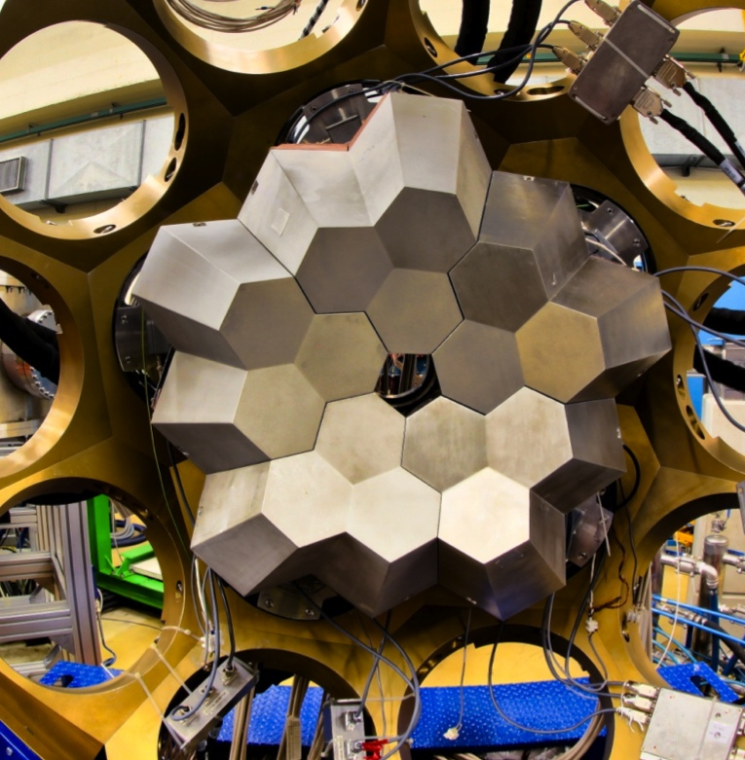
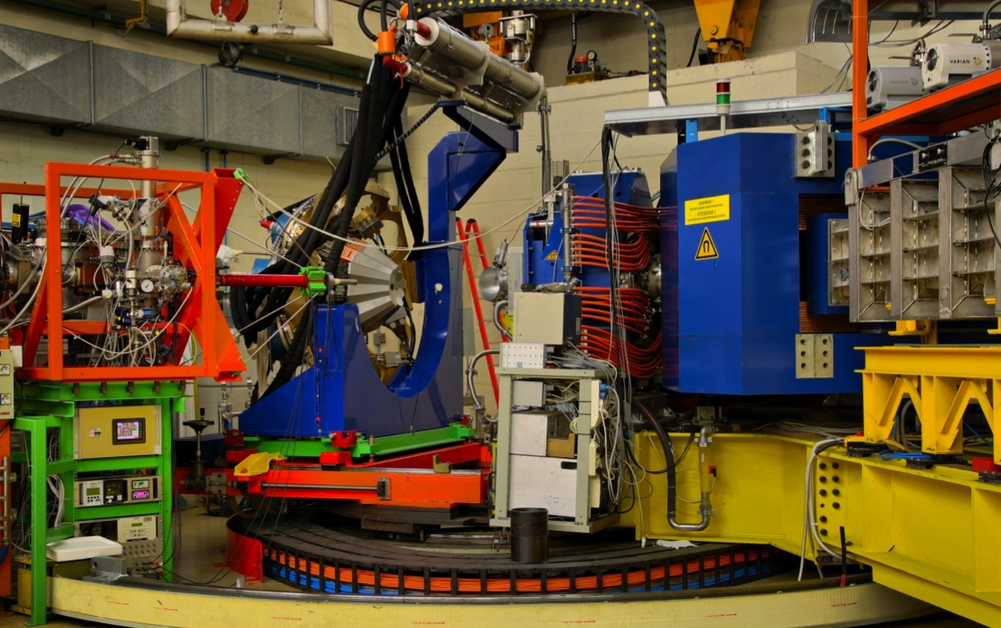
The AGATA Demonstrator
AGATA Demonstrator
@ LNL
5 asymmetric triple-clusters (May 2011)
36-fold segmented crystals
555 digital-channels
Eff. 3 – 8 % @ M_{γ} = 1
Eff. 2 – 4 % @ M_{γ} = 30
Full EDAQ with on line PSA and γ-ray tracking
In beam Commissioning
First installation site: LNL
Main issue is Doppler correction capability
coupling to beam and recoil tracking devices
PRISMA: large acceptance magnetic spectrometer providing event–by–event Z, A identification as well as velocity for the ions entering the device
Notes:
Powerful array in its own right
Still to decide where to site
Still to decide the key test experiments

Slide 6
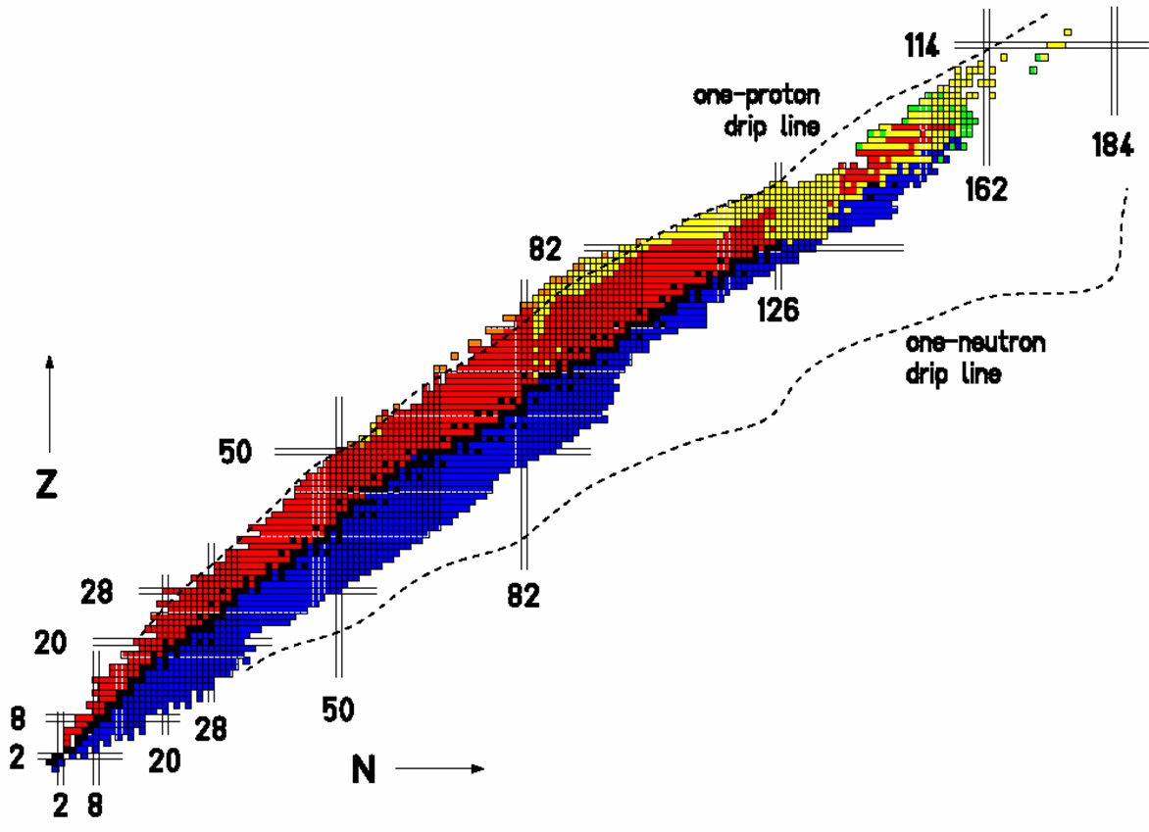
Experimental Campaign at LNL
Octupole-deformed
Ra and Th nuclei
Neutron-rich nuclei in
the vicinity of ²⁰⁸Pb
High-lying states
in ¹²⁴Sn and ¹⁴⁰Ce
n-rich Th and U
Pygmy and GQR states
Neutron drip-line
Isospin Mixing
in ⁸⁰Zr
g.s. rotation
in Dy, Er, Yb
Shape transition
in ¹⁹⁶Os
Molecular structure of ²¹Ne
Proton drip-line
n-rich nuclei
Order-to-chaos
transition in ¹⁷⁴W
Lifetime
of ¹³⁶Te
protons
Coulex
of ⁴²Ca
N=84 isotone
¹⁴⁰Ba
N=51 nuclei
Neutron-rich nuclei populated by fission
20(+3) exp.
148 days
Lifetimes in n-rich
Ni, Cu and Zn isotopes
Lifetimes near the
island of inversion
Lifetimes of the
n-rich Cr isotopes
neutrons
Lifetime of the
6.792MeV state in ¹⁵O

Slide 7
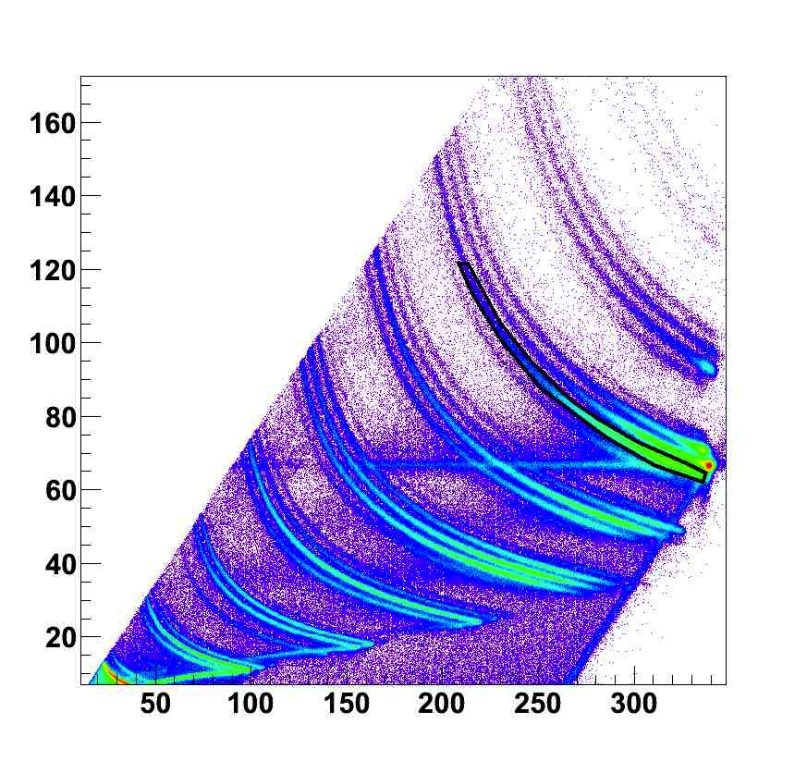
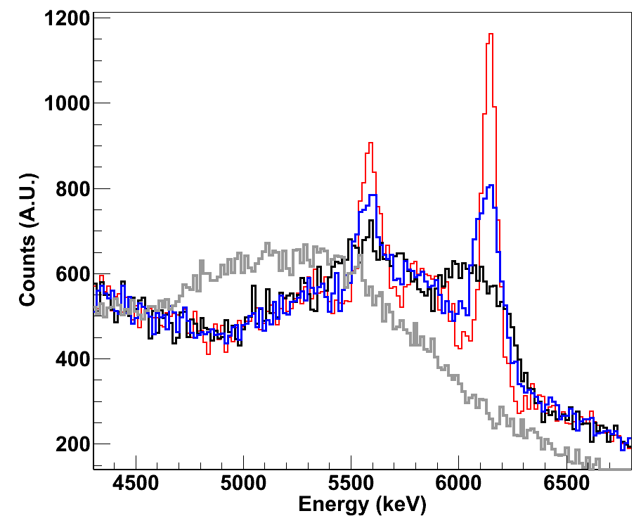
Doppler Correction Capability
Inelastic scattering
¹⁷O @ 20 MeV/u on ²⁰⁸Pb
¹⁶O
β≈20%
TRACE
F
No Dopp Corr
Crystal Centers
Segment Centers
PSA+Tracking
O
dE (MeV)
N
C
FEP
SEP
B
Be
Li
α
TKE (MeV)
D.Mengoni, R.Nicolini, F.Crespi

Slide 8
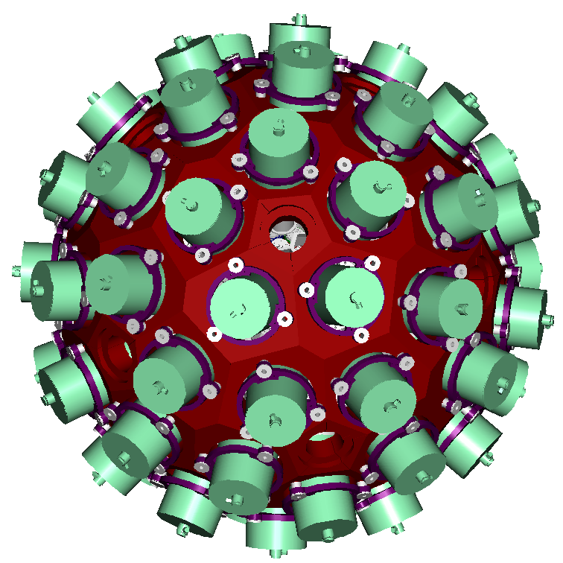
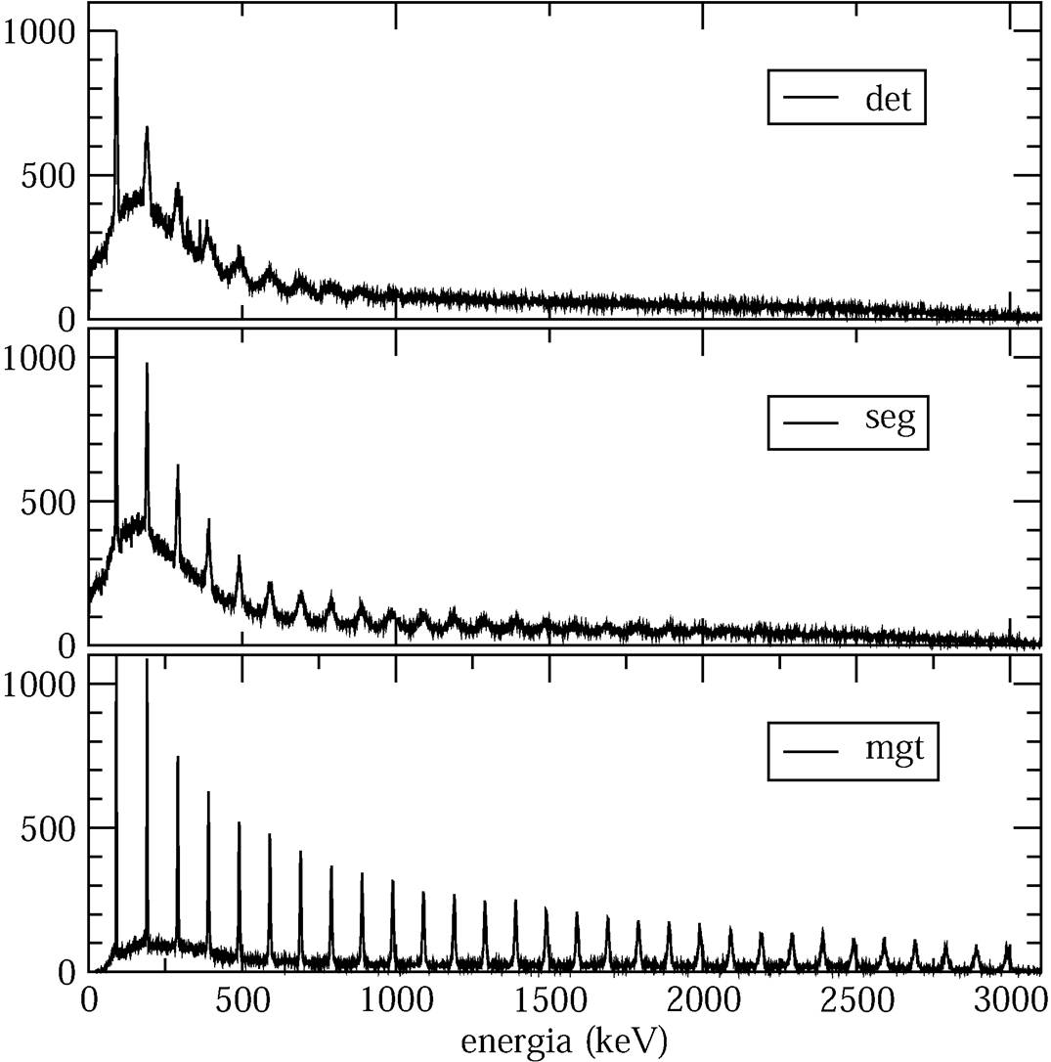
Doppler Correction Capability – Simulations
v/c = 50%
Conventional array
Segmented detectors
The innovative use of detectors in position-sensitive mode (combining digital DAQ, pulse shape analysis, γ-ray tracking) will result in high efficiency (~40%) and excellent energy resolution, making AGATA the ideal device for spectroscopic studies of weak channels.
γ-ray tracking
Energy (keV)
The effective energy resolution is maintained also at “extreme” v/c values

Slide 9
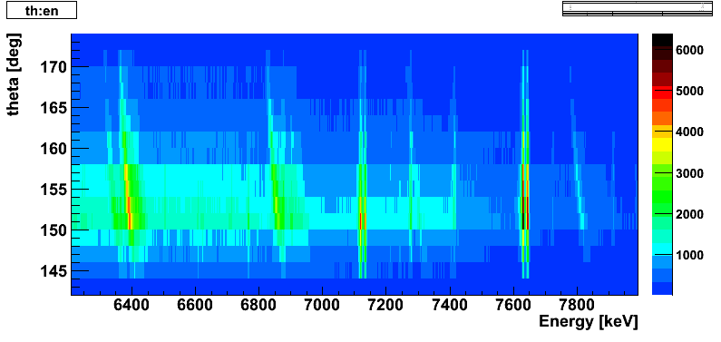
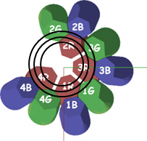
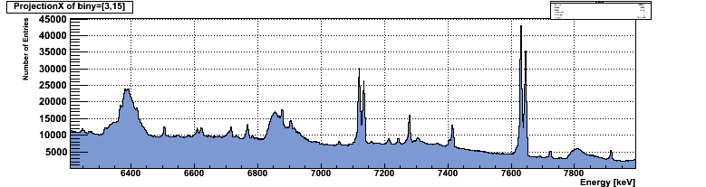
Femtosecond Lifetime Measurement in ¹⁵O
¹⁴N(²H,n)¹⁵O and ¹⁴N(²H,p)¹⁵N reactions @ 32 MeV (XTU LNL Tandem)
Direct lifetime measurement DSAM with 4 ATCs at backward angles
Astrophysical interest – CNO cycle burning rate
¹⁵O 6.79 MeV
τ??
source(*)
¹⁵N 7.3 MeV
τ=0.65 fs
(*)
¹⁵N 8.3 MeV
τ=2 fs
C.Michelagnoli – PhD

Slide 10
Femtosecond Lifetime Measurement in ¹⁵O
¹⁴N(²H,n)¹⁵O and ¹⁴N(²H,p)¹⁵N reactions @ 32 MeV (XTU LNL Tandem)
Direct lifetime measurement DSAM with 4 ATCs at backward angles
Astrophysical interest – CNO cycle burning rate
Detected gamma-rays can be sorted in few degrees θ “slices” with a “continuous” distribution
¹⁵O 6.79 MeV
τ??
source(*)
¹⁵N 7.3 MeV
τ=0.65 fs
(*)
¹⁵N 8.3 MeV
τ=2 fs
C.Michelagnoli – PhD

Slide 11
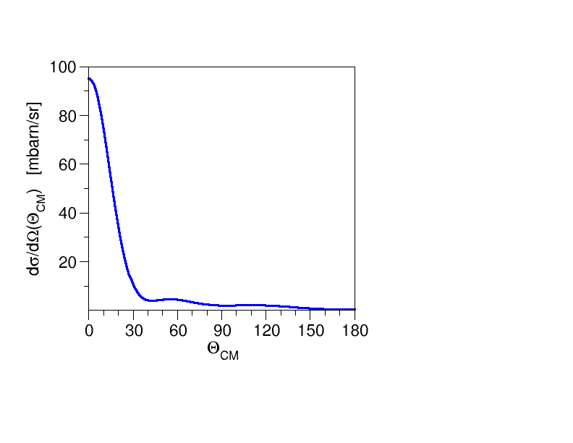
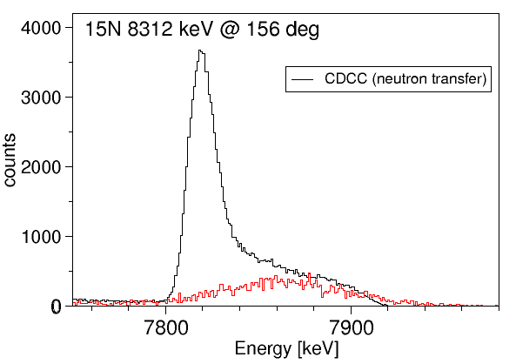
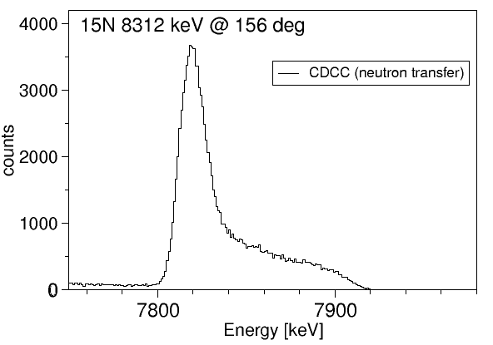
Femtosecond Lifetime Measurement in ¹⁵O
Lineshapes defined by the lifetime, reaction kinematics and stopping power
Excited states in ¹⁵O and ¹⁵N are mainly populated via nucleon transfer reactions
center of mass x-section
transfer to 8.3MeV state in ¹⁵N
¹⁴N
¹⁵N
²H
p
fusion-evap.
CDCC** calculations of the nucleon transfer process by N. Keeley
**Continuum-Discretized Coupled Channels
but also via fusion–evaporation
Developed full GEANT4 simulation of the reaction, stopping in target and γ–ray detection calculated lineshapes
¹⁴N
¹⁶O
¹⁵N
p
²H

Slide 12
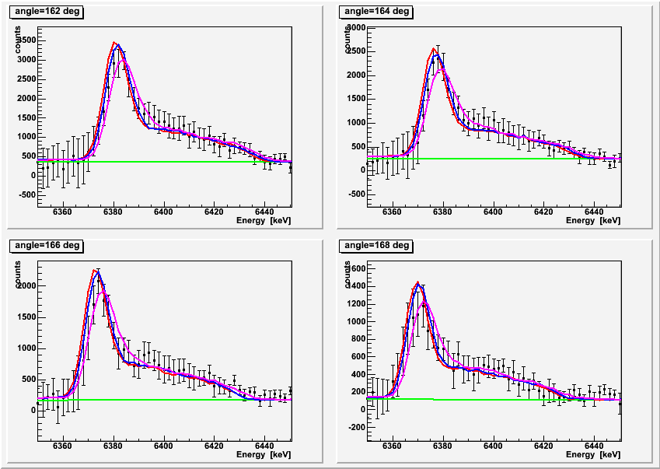
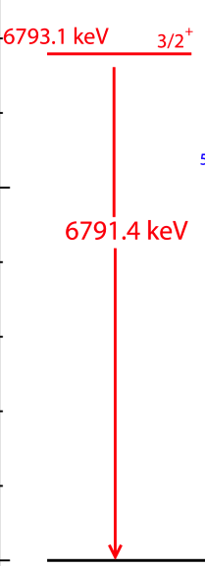
Femtosecond Lifetime Measurement in ¹⁵O
0 fs
1.1fs
¹⁵O
4.1fs
chi-square analysis on all the “theta-slices” ongoing…

Slide 13
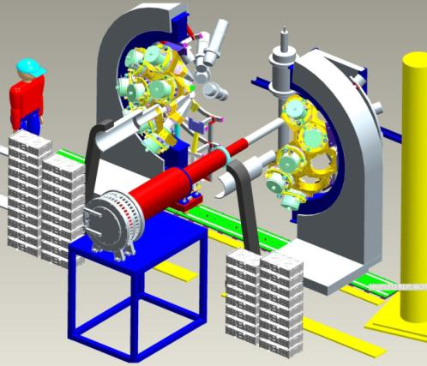
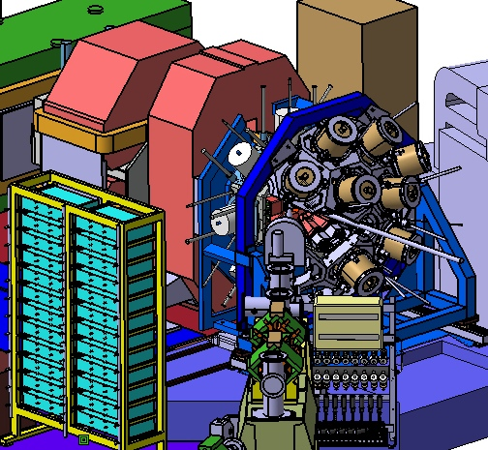
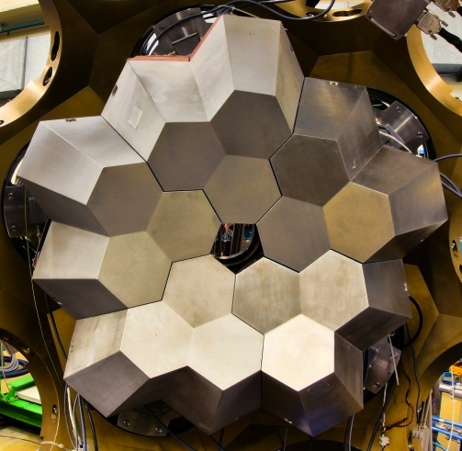
AGATA Demontrator/1π Experimental Program
2010-2011 → LNL
5TC
2012 → GSI/FRS
≥5DC+5TC
2014 → GANIL/SPIRAL2
~15TC
2
3
4
1
5
AGATA D.+PRISMA
AGATA @ FRS
AGATA + VAMOS
+ EXOGAM
Total Eff. ~6%
Total Eff. > 10%
Total Eff. > 20%

Slide 14


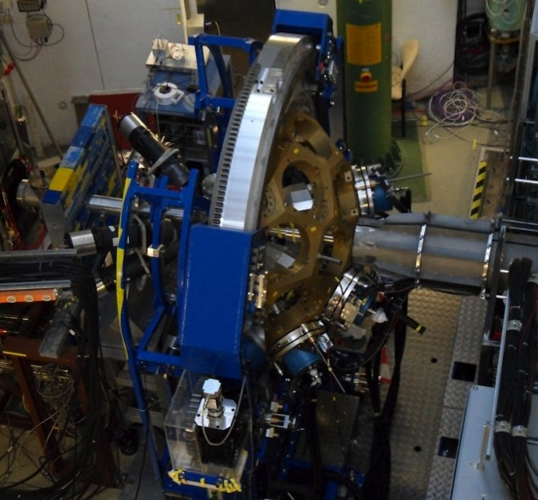
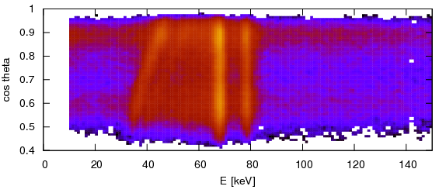
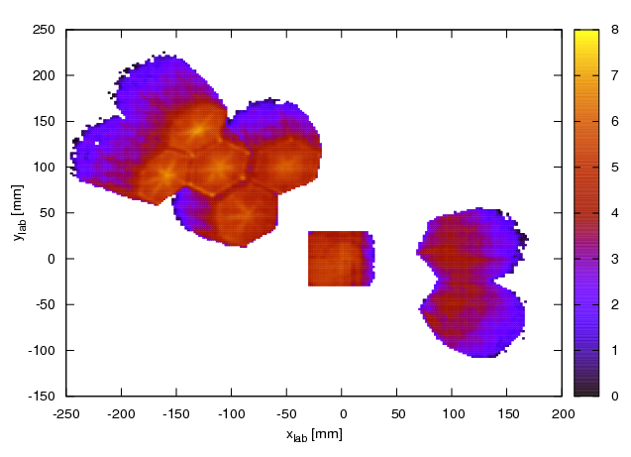
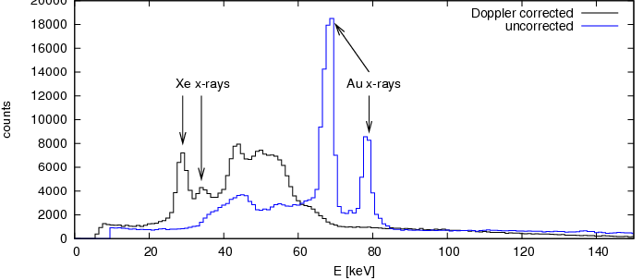
AGATA@GSI Commissioning
HECTOR
¹³⁶Xe (137 MeV/u) + ¹⁹⁷Au
Before Doppler
Correction
AGATA
ATC
ADC
v/c ~ 50%
ADC
10keV
hit pattern of AGATA detectors
Thanks to: M.Reese et al.
and the AGATA and GSI collaborators

Slide 15
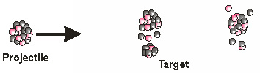
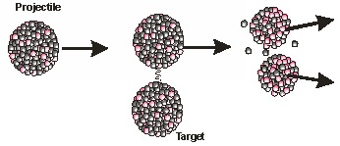
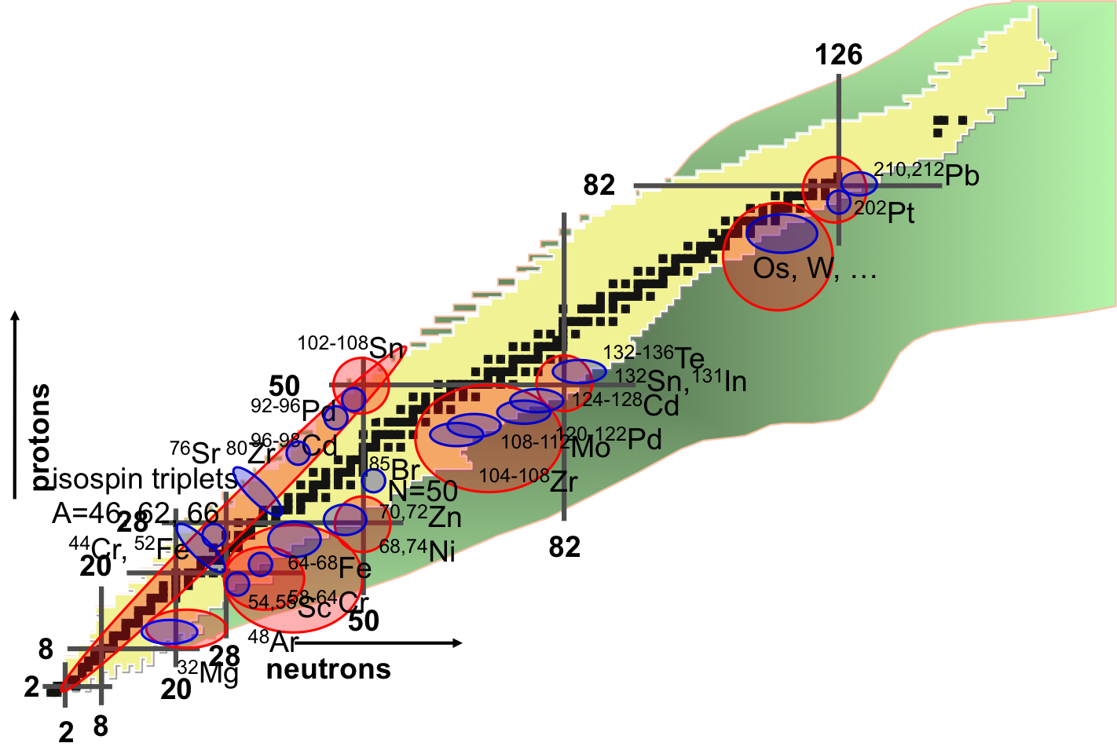
AGATA@GSI–FRS Scientific Program
Primary Beam Fragmentation
40th Meeting of the GSI General Advisory Committee
(G – PAC)
Date/Time: November 23 – 24, 2011
Proposal/Title Spokersperson
S424 Scientific and Technical W.Korten
Commissioning Proposal
for the AGATA – PreSpec
campaign
S426 Relativistic M1 – Coulex of N.Pietralla
85Br
S427 Breaking of isospin symmetry E.Sahin
in the mass 70 region: Sudy
of the Tz=-1 nucleus 70Kr S.Pietri
S428 Shape evolution in neutron–
rich Zr isotopes
S429 Quadratic Evolution of Collectivity D.Rudolph
Arround 208Pb (PRESPEC – AGATA)
S430 The Pygmy Dipole Resonance in O.Wieland
64Fe and the properties of neutron
skin
S431 Proton hole states in 132Sn and P.Boutachkov
N=82 shell structure
S433 Coulomb excitation of the band– A.Gadea
terminating 12+ yrast trap in 52Fe C.A.Ur
S434 Isospin Symmetry Breaking F.Recchia
Transition Ratesand Mirror Energy
Difference in Isobaric Multiplets
Light
target
Primary Beam Fission
Light or heavy target

Slide 16
GALILEO

Slide 17
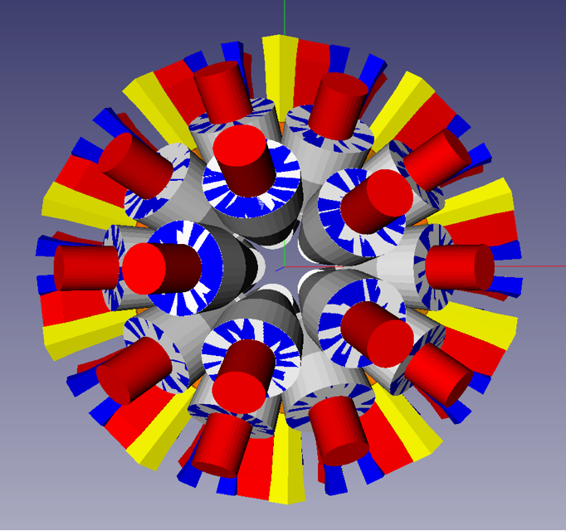
The GALILEO Project
take advantage of the recent technical developments for AGATA
preamplifiers, digital sampling,
preprocessing, DAQ
→ high count rates (30–50 kHz/det)
use of existing detectors
EB cluster detectors capsules
GASP detectors
→ high photopeak efficiency
use beam facilities at LNL
Tandem, ALPI, PIAVE – stable
SPES – RIB
→ production of new nuclei
GEANT4 by E.Farnea
30 GASP detectors @ 22.5cm
5 5 5 5 5 5
29º 51º 59º 121º 129º 151º
10 triple cluster (EB clusters) @ 24cm
90º
ε_{ph} ~ 8% P/T ~ 50%
Start physics campaign in summer 2013

Slide 18
GALILEO – Mechanics
  Triple cluster cryostat
  end–cap, cold finger, dewar
  use of the EB cluster capsules
  Anti–Compton shield for the TC detector
  recover the crystals from the original EB cluster shields
  Holding structure
  highly flexible, space for ancillary detectors
  Pb collimator
  divided in 4 parts
  Reaction chamber
  accomodate different ancillary detectors
  Beam line
  the structure opens along the beam line
  Ancillary detectors
  integration with the holding structure

Slide 19
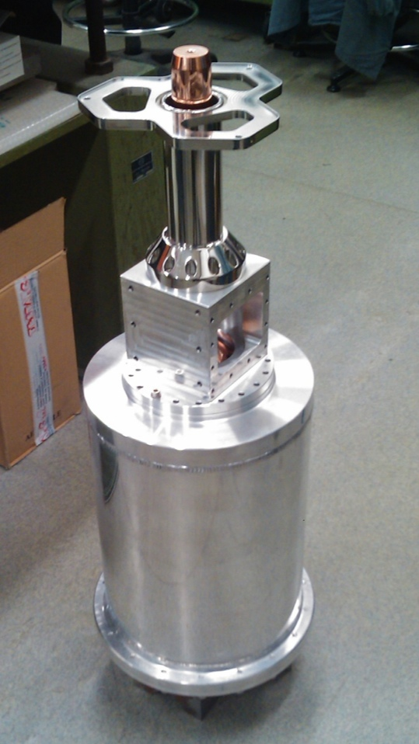
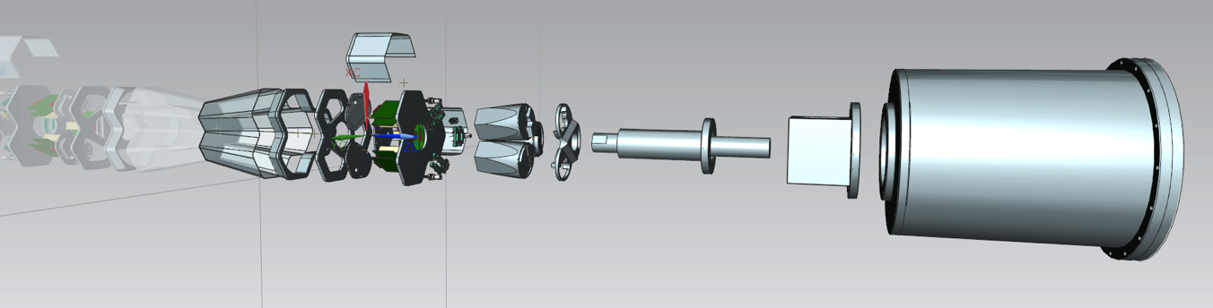
Triple Cluster Detector – First Prototype
front–end electronics
(warm part)
Zeolites container
Design by C.Fanin
end–cap in
Carbon fiber
capsules
cold finger
dewar
Testing
2012 – prototypes
2013 – production 10 cryostats
Mechanical workshops in Padova and Legnaro

Slide 20
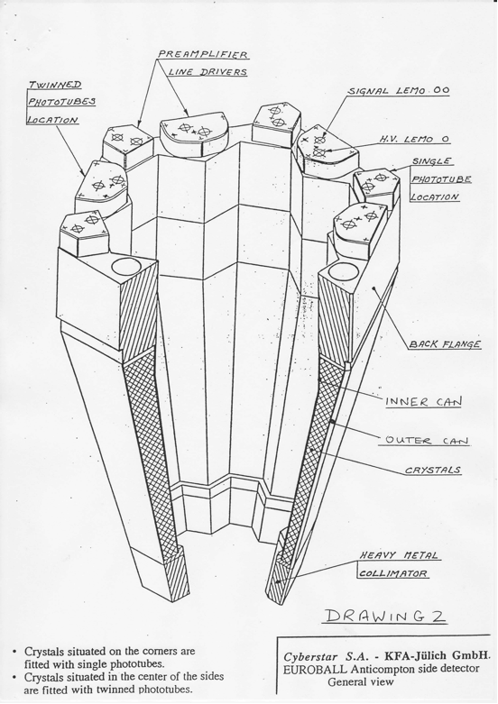
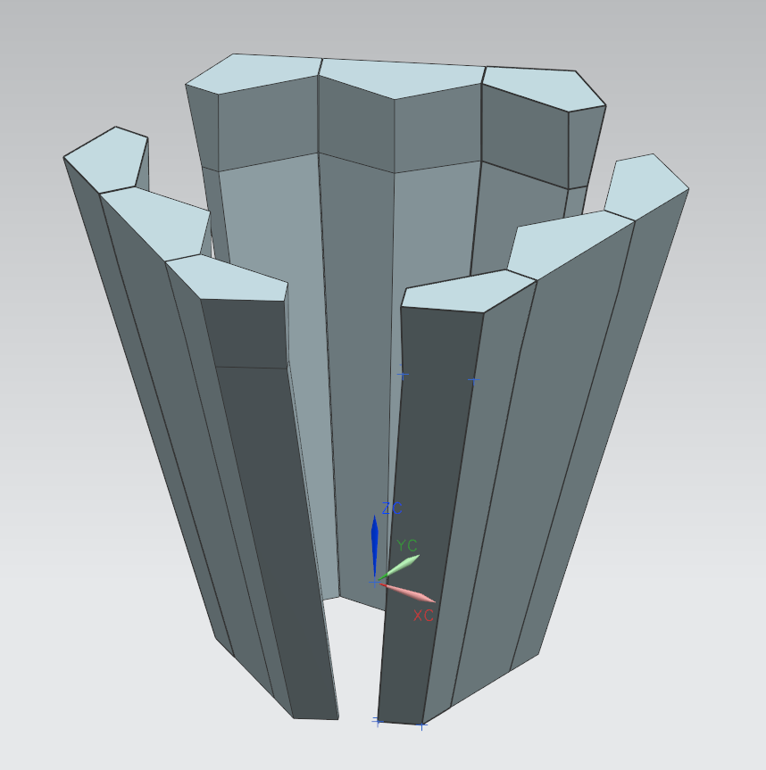
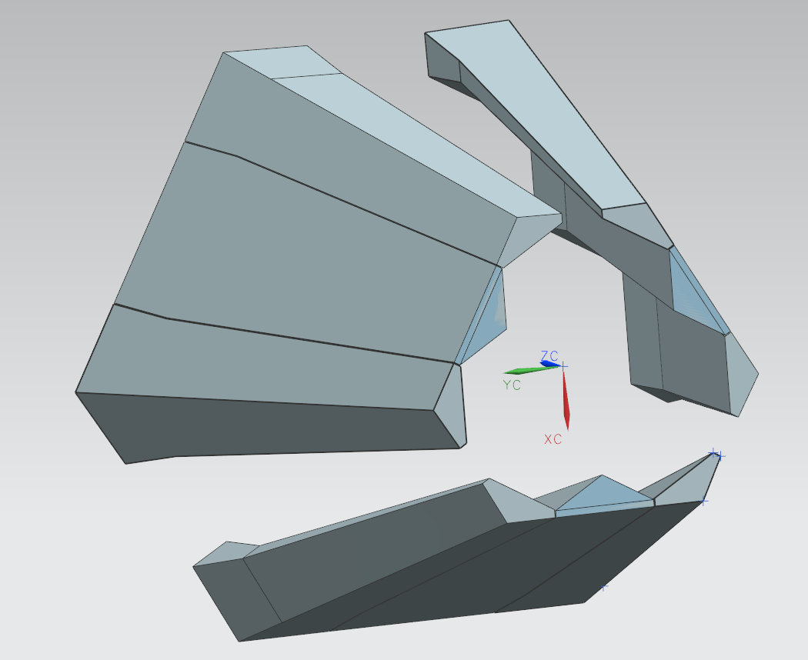
Triple Cluster Detector – AC Shield
EB cluster AC shield
Refurbished AC shield for TC detectors
construction of the triple cluster AC shield out of the individual crystals of the original EB cluster shield
→ requested the EB AC shields
2012 – design (possibility of using carbon fiber enclosure)
2013 – production 10 AC shields

Slide 21
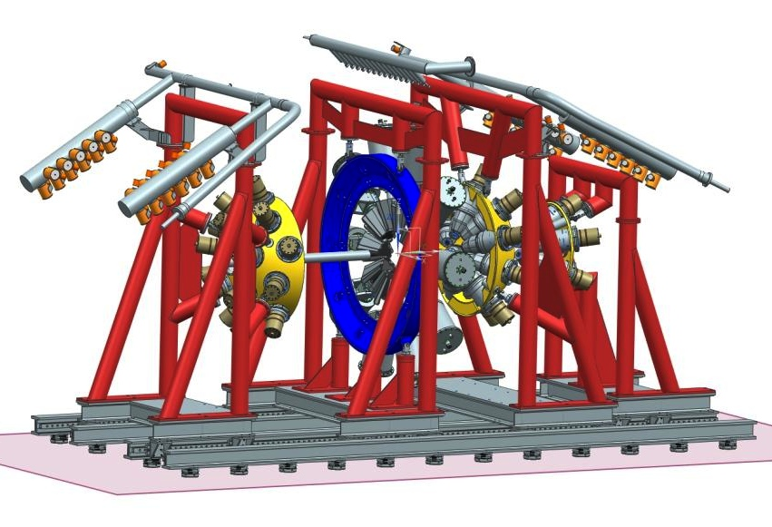
Triple Cluster Detector – AC Shield
Technical Office of Padova: C.Fanin, M.Turcato, M.Rampazzo, M.Romanato

Slide 22
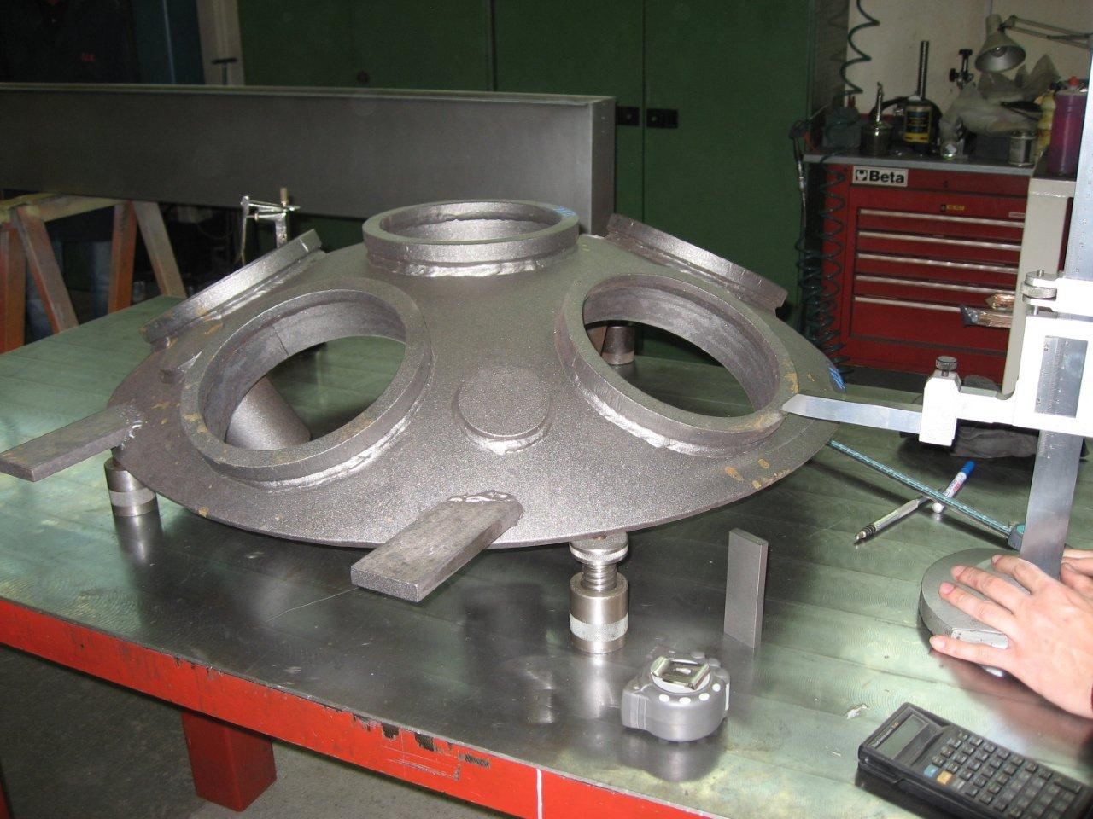
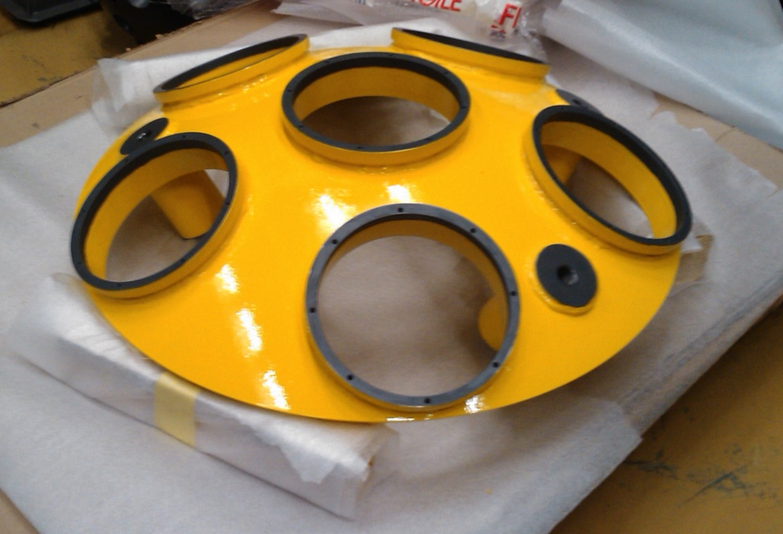
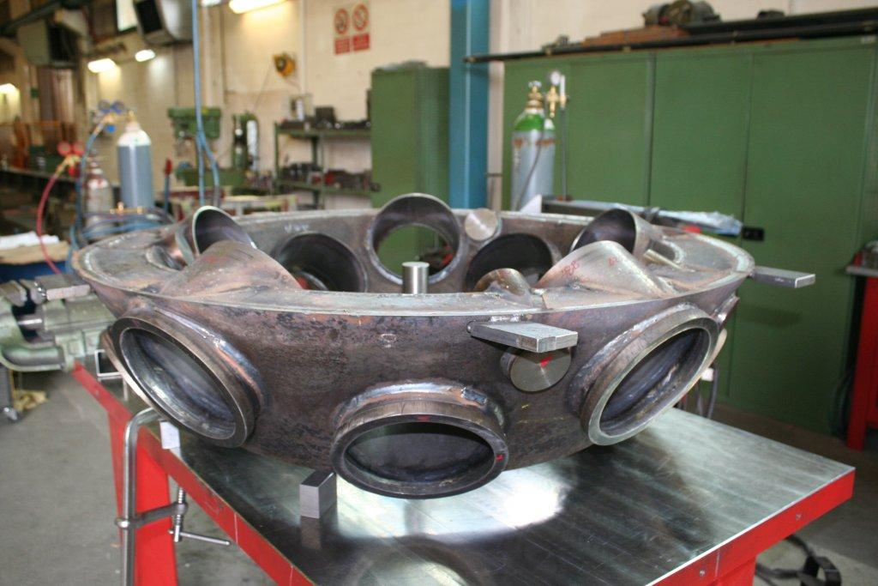
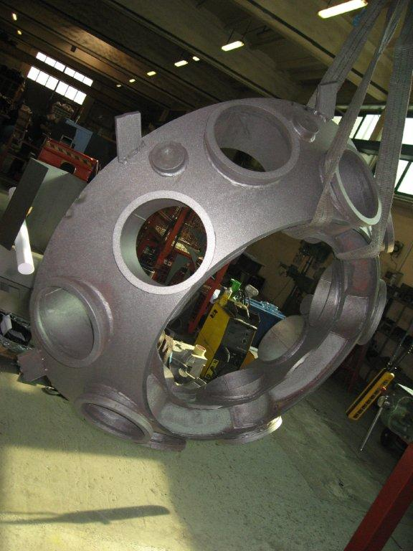
Triple Cluster Detector – AC Shield
SCM
Modena

Slide 23
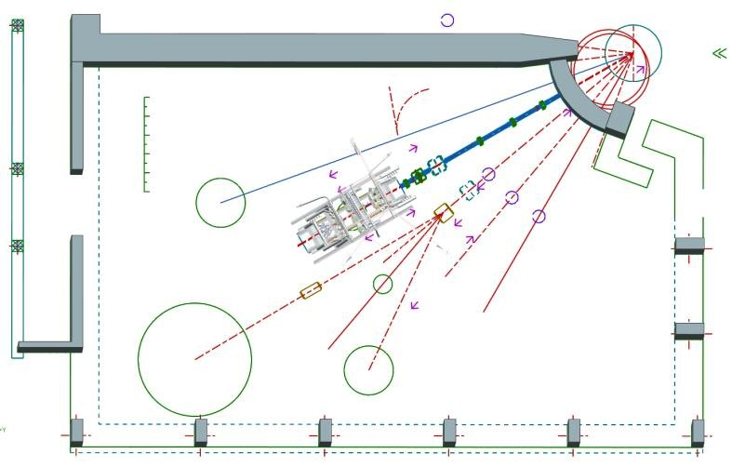
GALILEO – Location
PISOLO
GALILEO
8piLP
RMS
Experimental Hall II – replacing GASP
July 2012 – beam time allocated for the alignment of
the beam line and start installing the bins

Slide 24
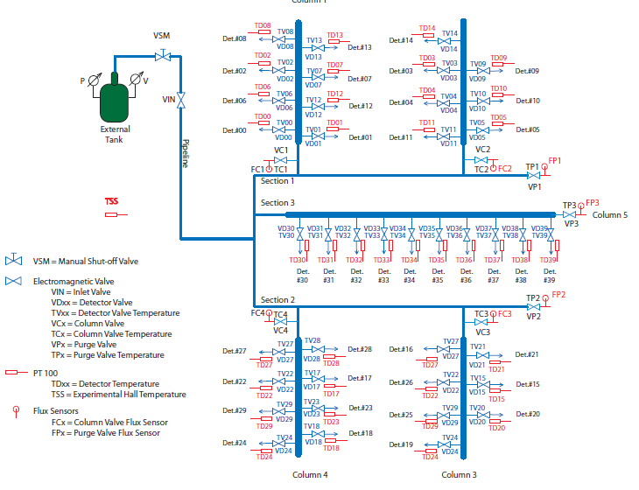
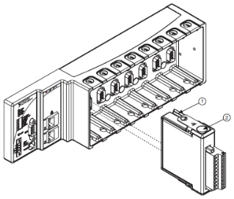
GALILEO – LN₂ Filling System
same logic flow as for GASP and EUROBALL
based on NI CompactRio architecture
Under construction in the electronics lab. of INFN Padova

Slide 25
GALILEO – Electronics & DAQ
  New electronics is being built in close synergy with AGATA
  * low–noise, fast, low–power consumption *
  new cold part (AGATA FET) – to be done
  use solutions already developed for AGATA
    core type preamplifiers – done
    GTS – done
    AGAVA interface with the VME electronics (collab. with Kracow)
  new developments for AGATA and GALILEO
    low power digitizers – prototype test
    readout and preprocessing on PCI express boards – prototype test
  anti–Compton shields signal readout
    digital (similar to the Ge detectors)
  New DAQ
  based on XDAQ developed at LNL – on going

Slide 26
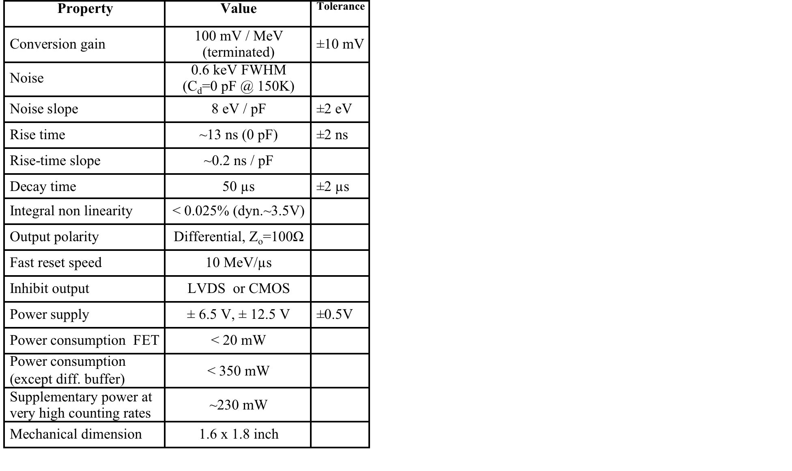
GALILEO – Preamplifiers
a fast low–noise charge sensitive preamplifier based on the core–type AGATA preamplifier
over–threshold fast reset circuitry – to reduce dead–time due to preamp/ADC saturation
ToT signal – recover energy information up to 180 MeV
a fast analog trigger signal can be produced – useful for ancillary detectors
used for both tapered and triple cluster detectors
84 PA already built – tests with det. on-going
A.Pullia, G.Pascovici, C.A.Ur
submitted to IEEE Nuclear Science Symposium
INFN Milano&Padova, User Service LNL

Slide 27
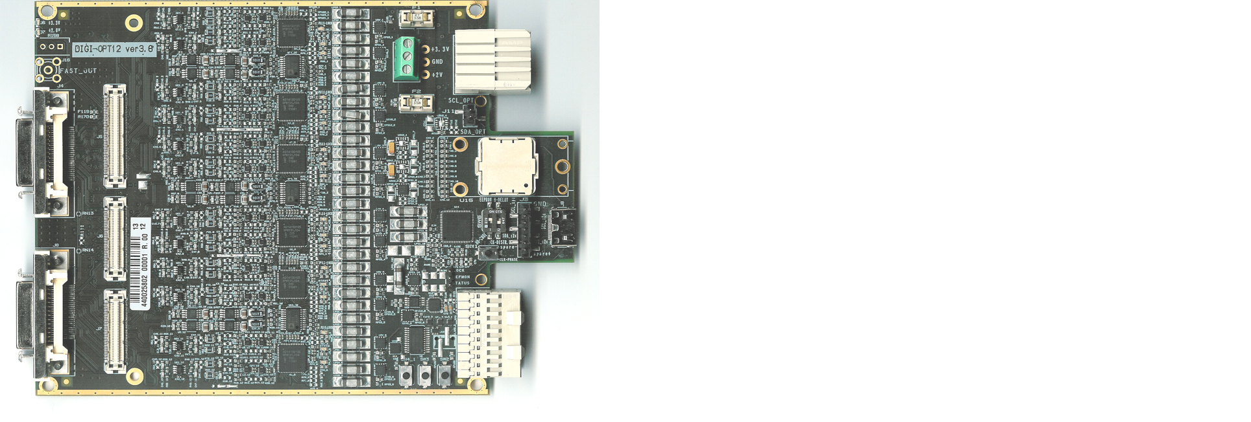
GALILEO – Digital Sampling
Digi-opt12: 12-channel 14/16-bit 100/125-MS/s digitizer with optical output for GALILEO/AGATA
single–ended/differential analog input signals
end termination for both differential– and common–mode components of the input signals
AC or DC coupling to the ADC,
introduction and remotely-controlled adjustment of a differential DC offset, useful for dynamic range maximization
remotely controlled dynamic-range selection,
easily tuned anti-aliasing filter
precise inter-channel time synchronization
optional interleaved mode for equivalent sampling-frequency multiplication
Power consumption < 10 W / board
5 boards built
INFN Milano, Padova, LNL

Slide 28
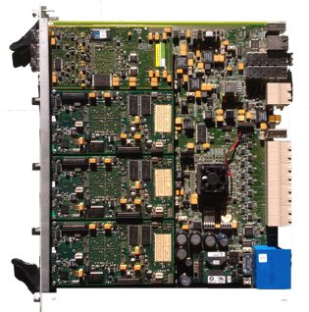
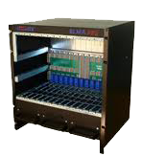
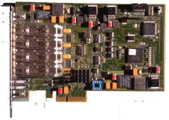
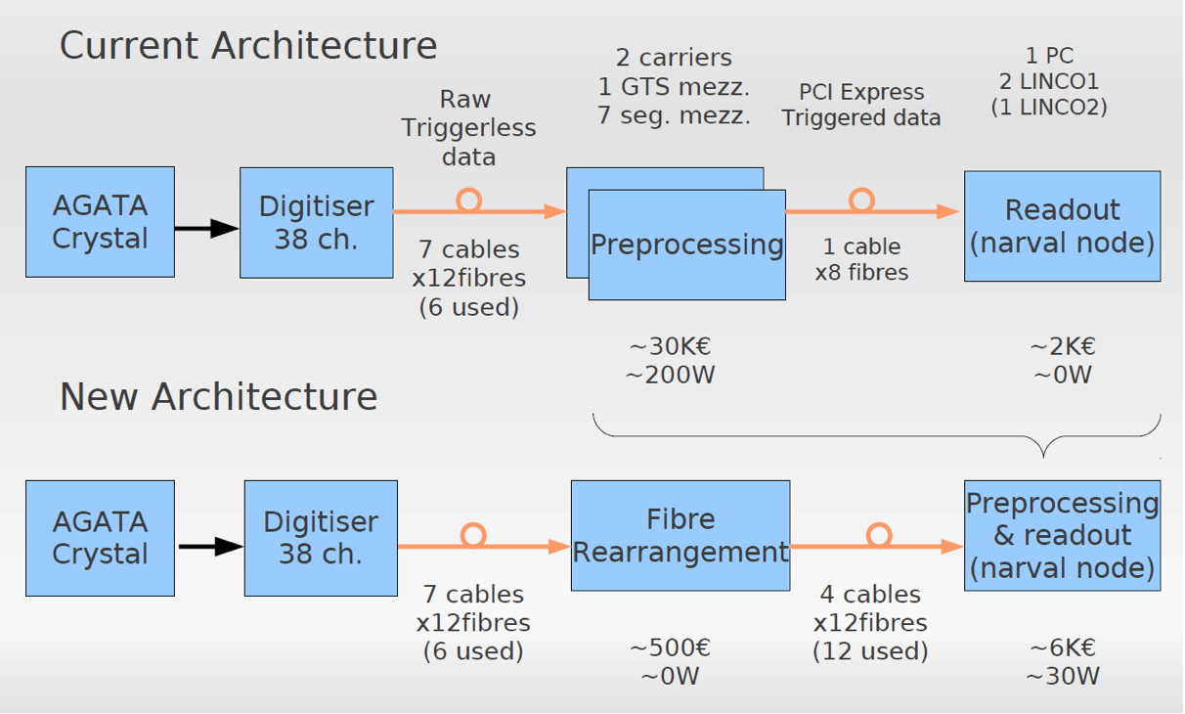
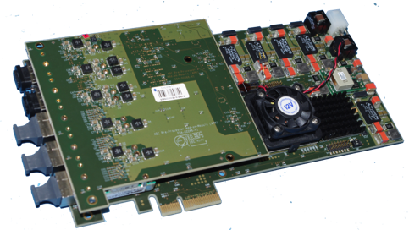
GALILEO – Readout&Preprocessing
~30 k€
~320 W
~7 k€
~60 W
INFN Padova, LNL

Slide 29
Richieste GAMMA 2013 – Stima

Slide 30
Richieste ai Servizi della Sezione
UT 5 MU
  Completamento progetto e disegni tecnici GALILEO
  Progettazione supporto meccanico TRACE
OM 12 MU
  Costruzione criostati GALILEO
  Costruzione schermi AC
  Costruzione supporto meccanico TRACE
LOE 4 MU
  Produzione e test elettronica GALILEO
CALC 1 MU
  Supporto farm di gruppo

