Slide 1
Meeting 6 Giugno 2012

Slide 2
Dal talk di Fabiola di ieri

Slide 3
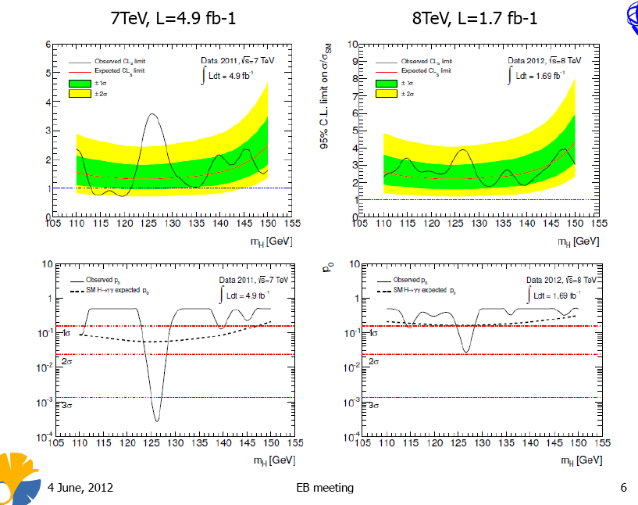
H→γγ
Moving to 2.7 fb⁻¹ today

Slide 4
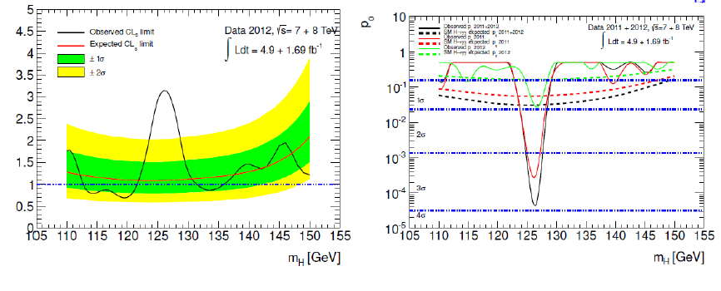
H→γγ – preliminary combination
https://cdsweb.cern.ch/record/1447436 (signal, "June 2" version)
https://cdsweb.cern.ch/record/1447803 (background, "June 3" version)
https://cdsweb.cern.ch/record/1447437 (improved analysis, "June 1" version)
https://cdsweb.cern.ch/record/1453249 (stat, "June 1" version)
https://cdsweb.cern.ch/record/1447438 (7TeV/8TeV summary note, "June 2" version)
June 6th at 16.00 new update of the result.

Slide 5
OTP
 | Da fare | Fatti o prenotati | 2012 – so far allocated
Class 1 | 26 | 17.6 | 70%
Class 2 | 140 | 42 | 30%
Class 3 | 1.95 | ~1.2 | 60%
2012 – Allocated so far
Class 1: ACR Tile: Federico 12*1.3, Vincenzo 2
Class 2: 28 (DQ Leader - Chiara) + 14 (Zenone DQ Valid) = 42
Class 3: 0.4 OFV/Chiara, 0.3 DPL-FTK/Paola, 0.1 FTK/Piendibene, 0.07 Laser/Nino + 0.1 Speaker Comm/Chiara + 0.2 Tau-trg/Zenone + ?/Laser Federico

Slide 6
Novita` e agenda di oggi
Qualificazioni
S.Donati ha iniziato la qualificazione con TDAQ (50% - stesso lavoro di Paola) + FTK (50%)
S.Leone ha intenzione di iniziare presto → individuare il lavoro in TDAQ, Tile o Data Preparation.
Collaboration Board
venerdi` si vota per la nuova Spokeperson

Slide 7
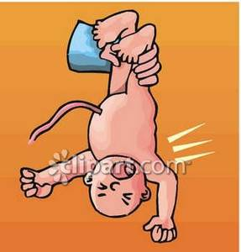
Benevenuta a Marina !

Slide 8
Back-up

Slide 9
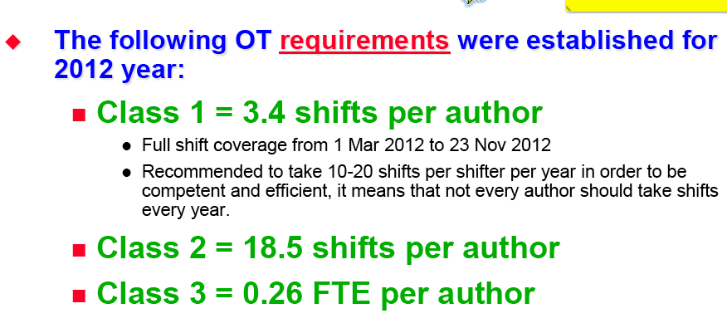
OTP: Operation Task Planner
Ma in effetti quello che significa e` lavoro di servizio
25.5
140
1.95
Pisa in 2012 has 7.5 authors
Class1: Atlas Control Room (ACR) shifts. We normally do Calorimeter, Trigger shifts but there are other possibilities: shift leader, DQ, run control. Shifts at night/we are weighted 1.3 while normal shifts are weighted 0.66.

Slide 10
OTP
Class2: Additional shifts, data quality, computing shifts, remote shifts, on-call shifts. We normally contribute with TileCal DQ shifts, Tile run coordination.
We have to find other areas of contributions: JetEtMiss DQ shifts,…
Class 3: expert work. Contribution: Laser calibration for Tile, OF validation for Tile , expert work for FTK

Slide 11
OTP - aggiornato
 | 2010 | 2011 | 2012 – so far allocated
Class 1 | 130% | 84% | 0%
Class 2 | 173% | 93% | 30%
Class 3 | 99% | 45% | 50%
2012 – Allocated so far
Class proposta 1: Zenone 7 Federico 11 Vincenzo 4 Nino 4
Class 2: 28 (DQ Leader - Chiara) + 14 (Zenone DQ Valid) = 42
Class 3: 0.4 OFV/Chiara, 0.3 DPL-FTK/Paola, 0.1 FTK/Piendibene, 0.07 Laser/Nino + 0.1 Speaker Comm/Chiara

