Slide 1

MIRO – Coll. Meeting – Pisa 27-28/4/2026
WP3.4 Mechanistic Modeling
update
Emanuele Scifoni, Igor Bodrenko, Francesco Cordoni, Giulio Bordieri, Lorenzo Castelli, Marco Battestini, Valentina Tozzini…et al.

Slide 2
Outline
Overview
Minimalistic radiation chemical model
MD model: from DNA to Chromatine
Microdosimery based NTCP model

Slide 3
Milestones
M3.8 Final results on Modeling of the relationship between beam parameters and experimental findings

Slide 4
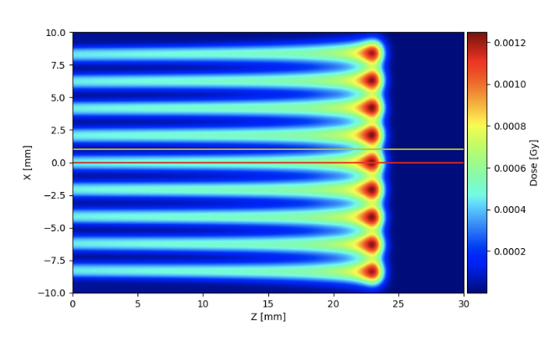
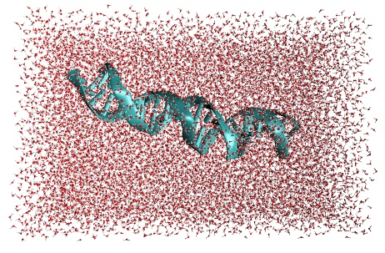
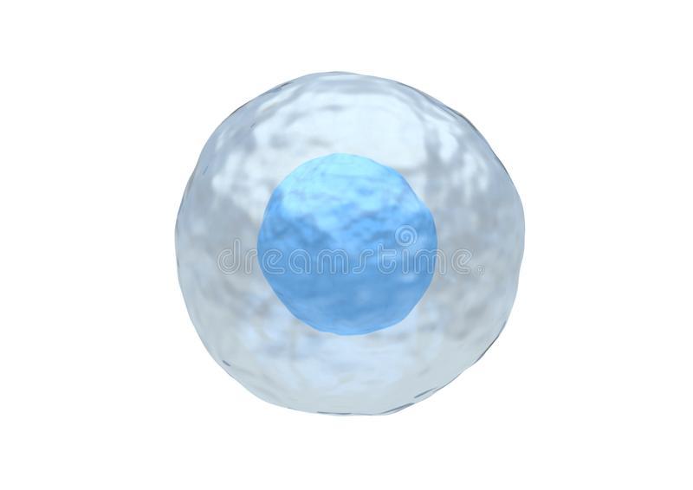
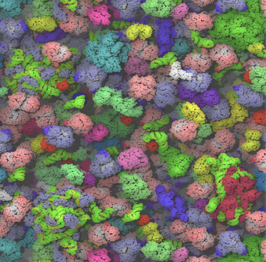
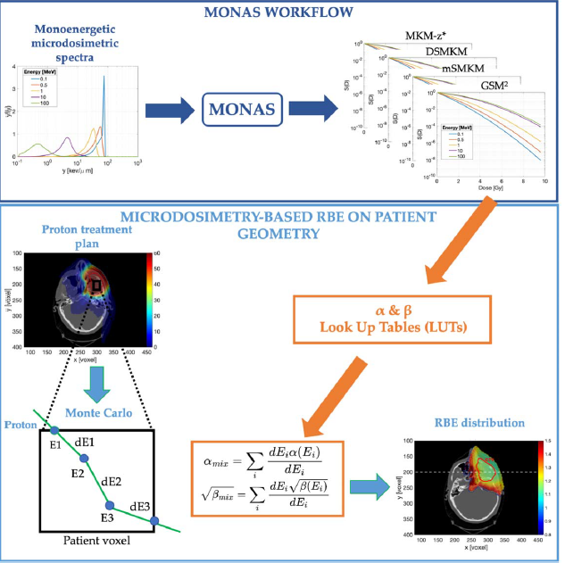
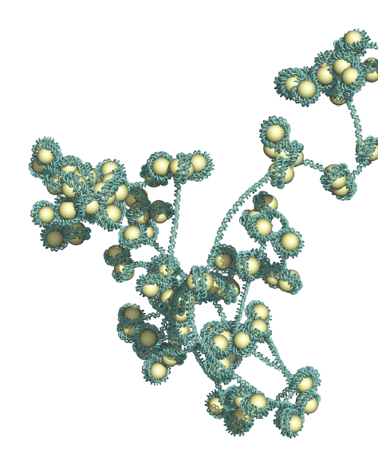
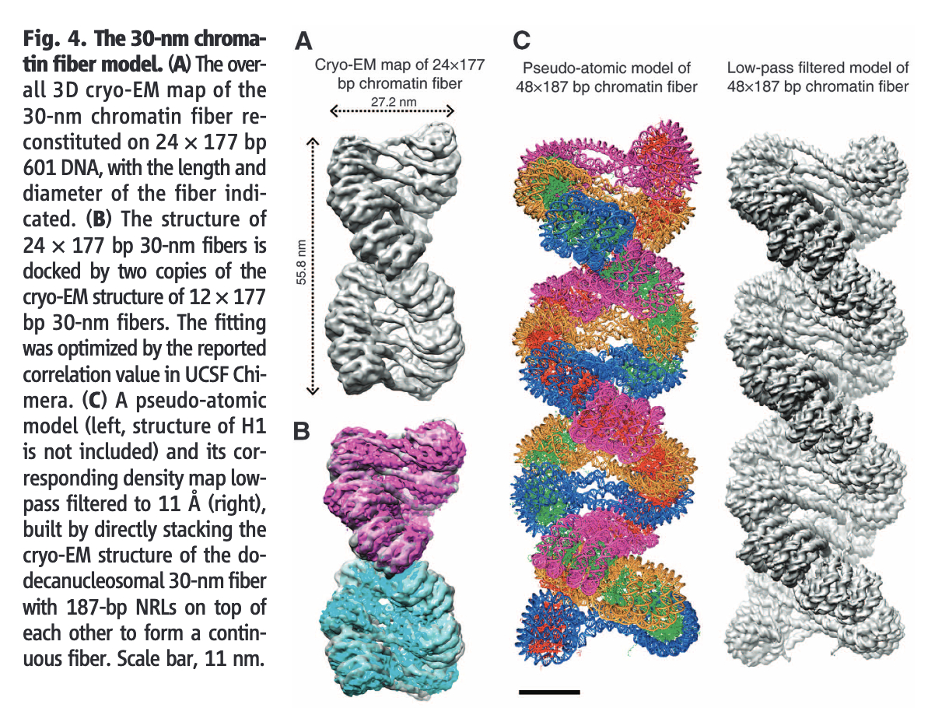
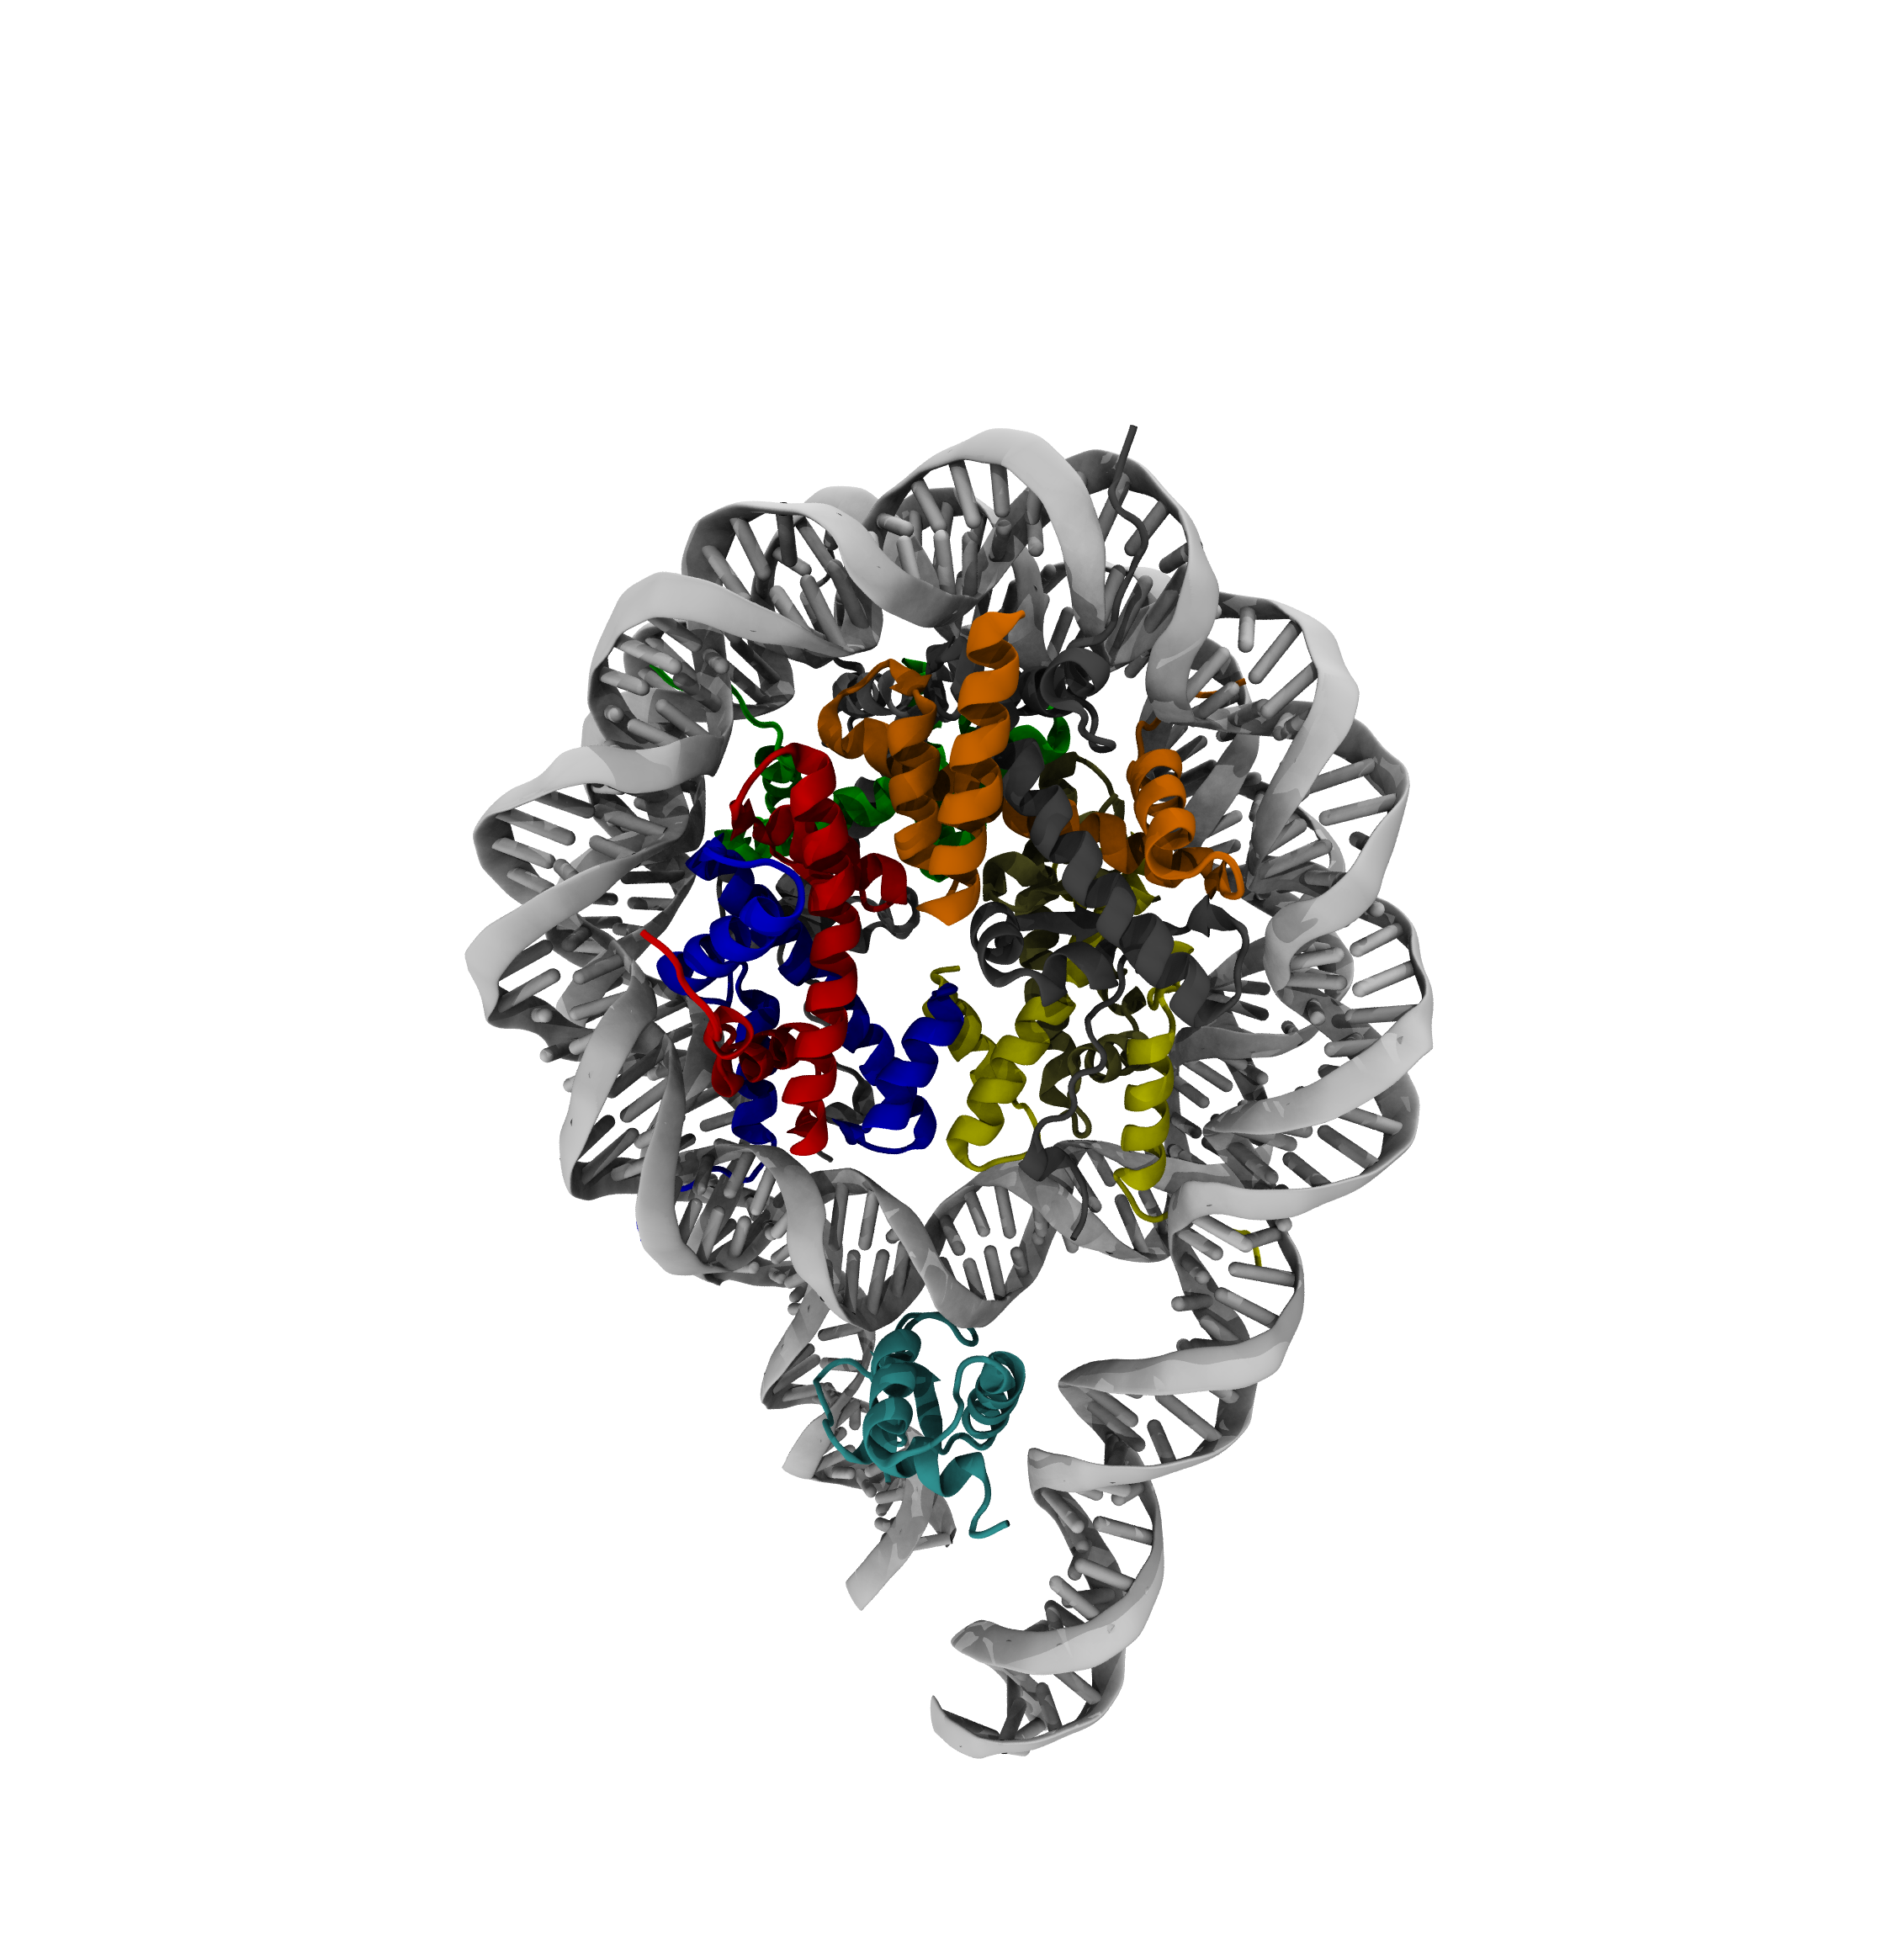
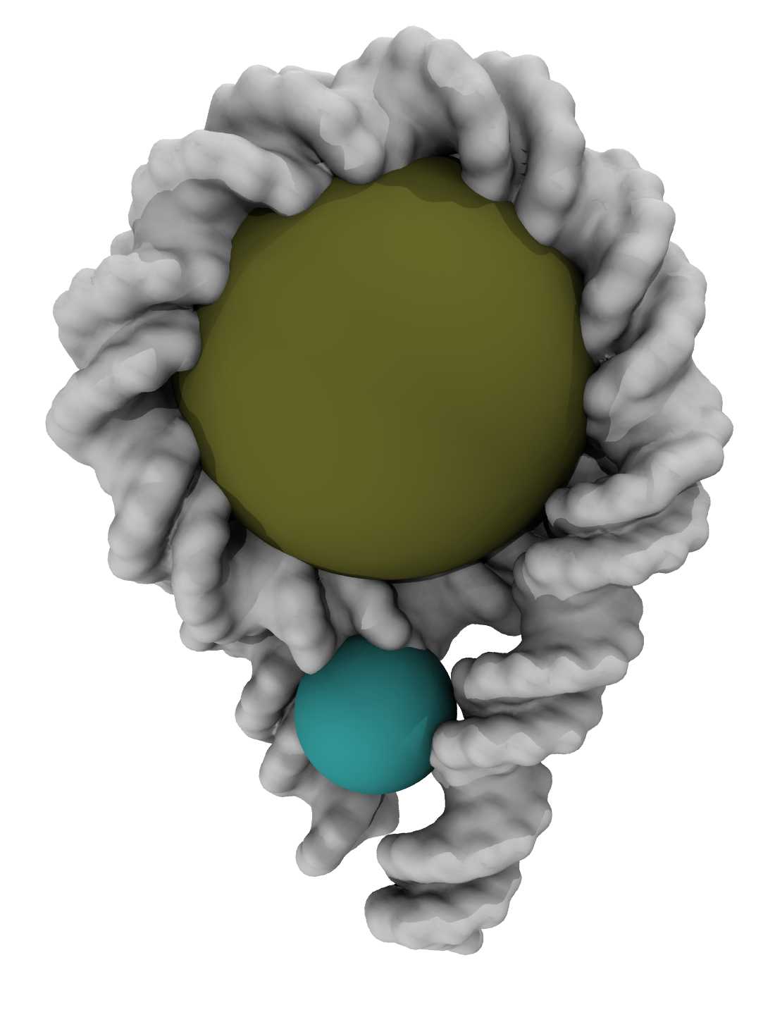
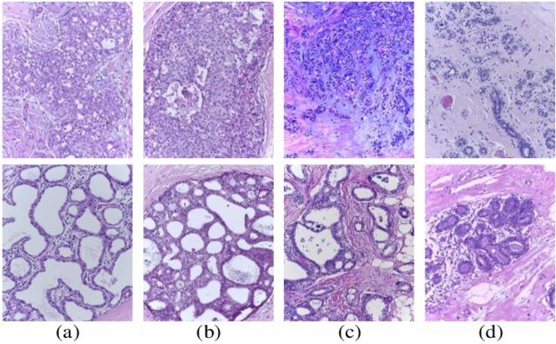
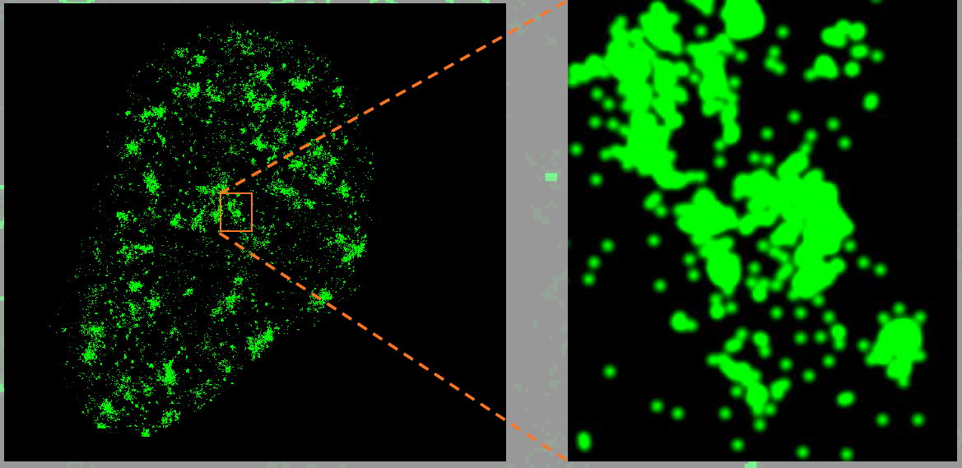
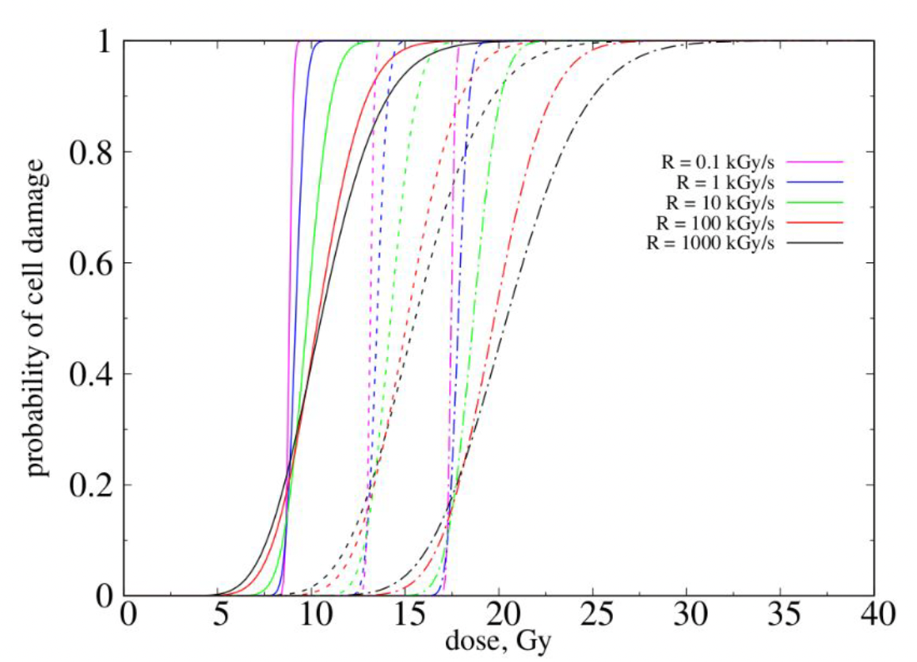
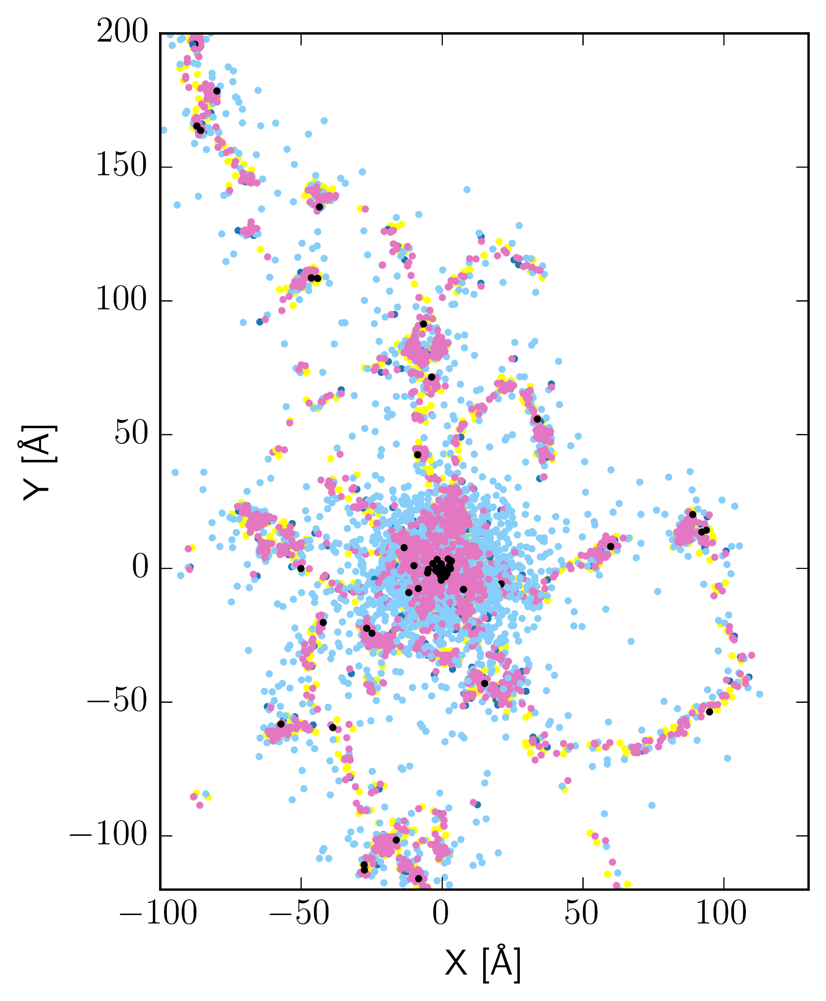
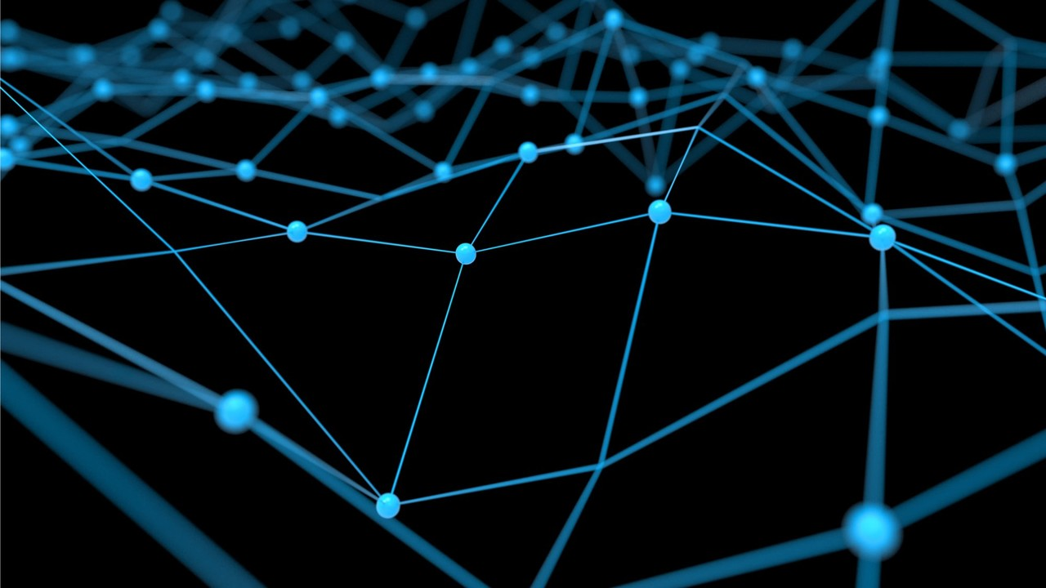
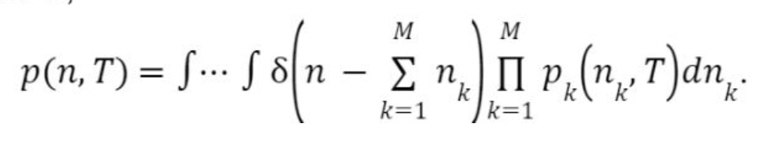
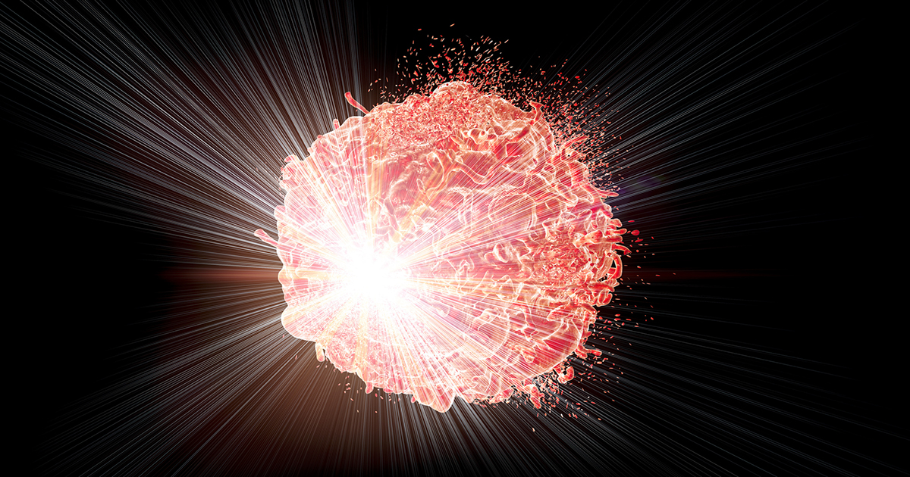
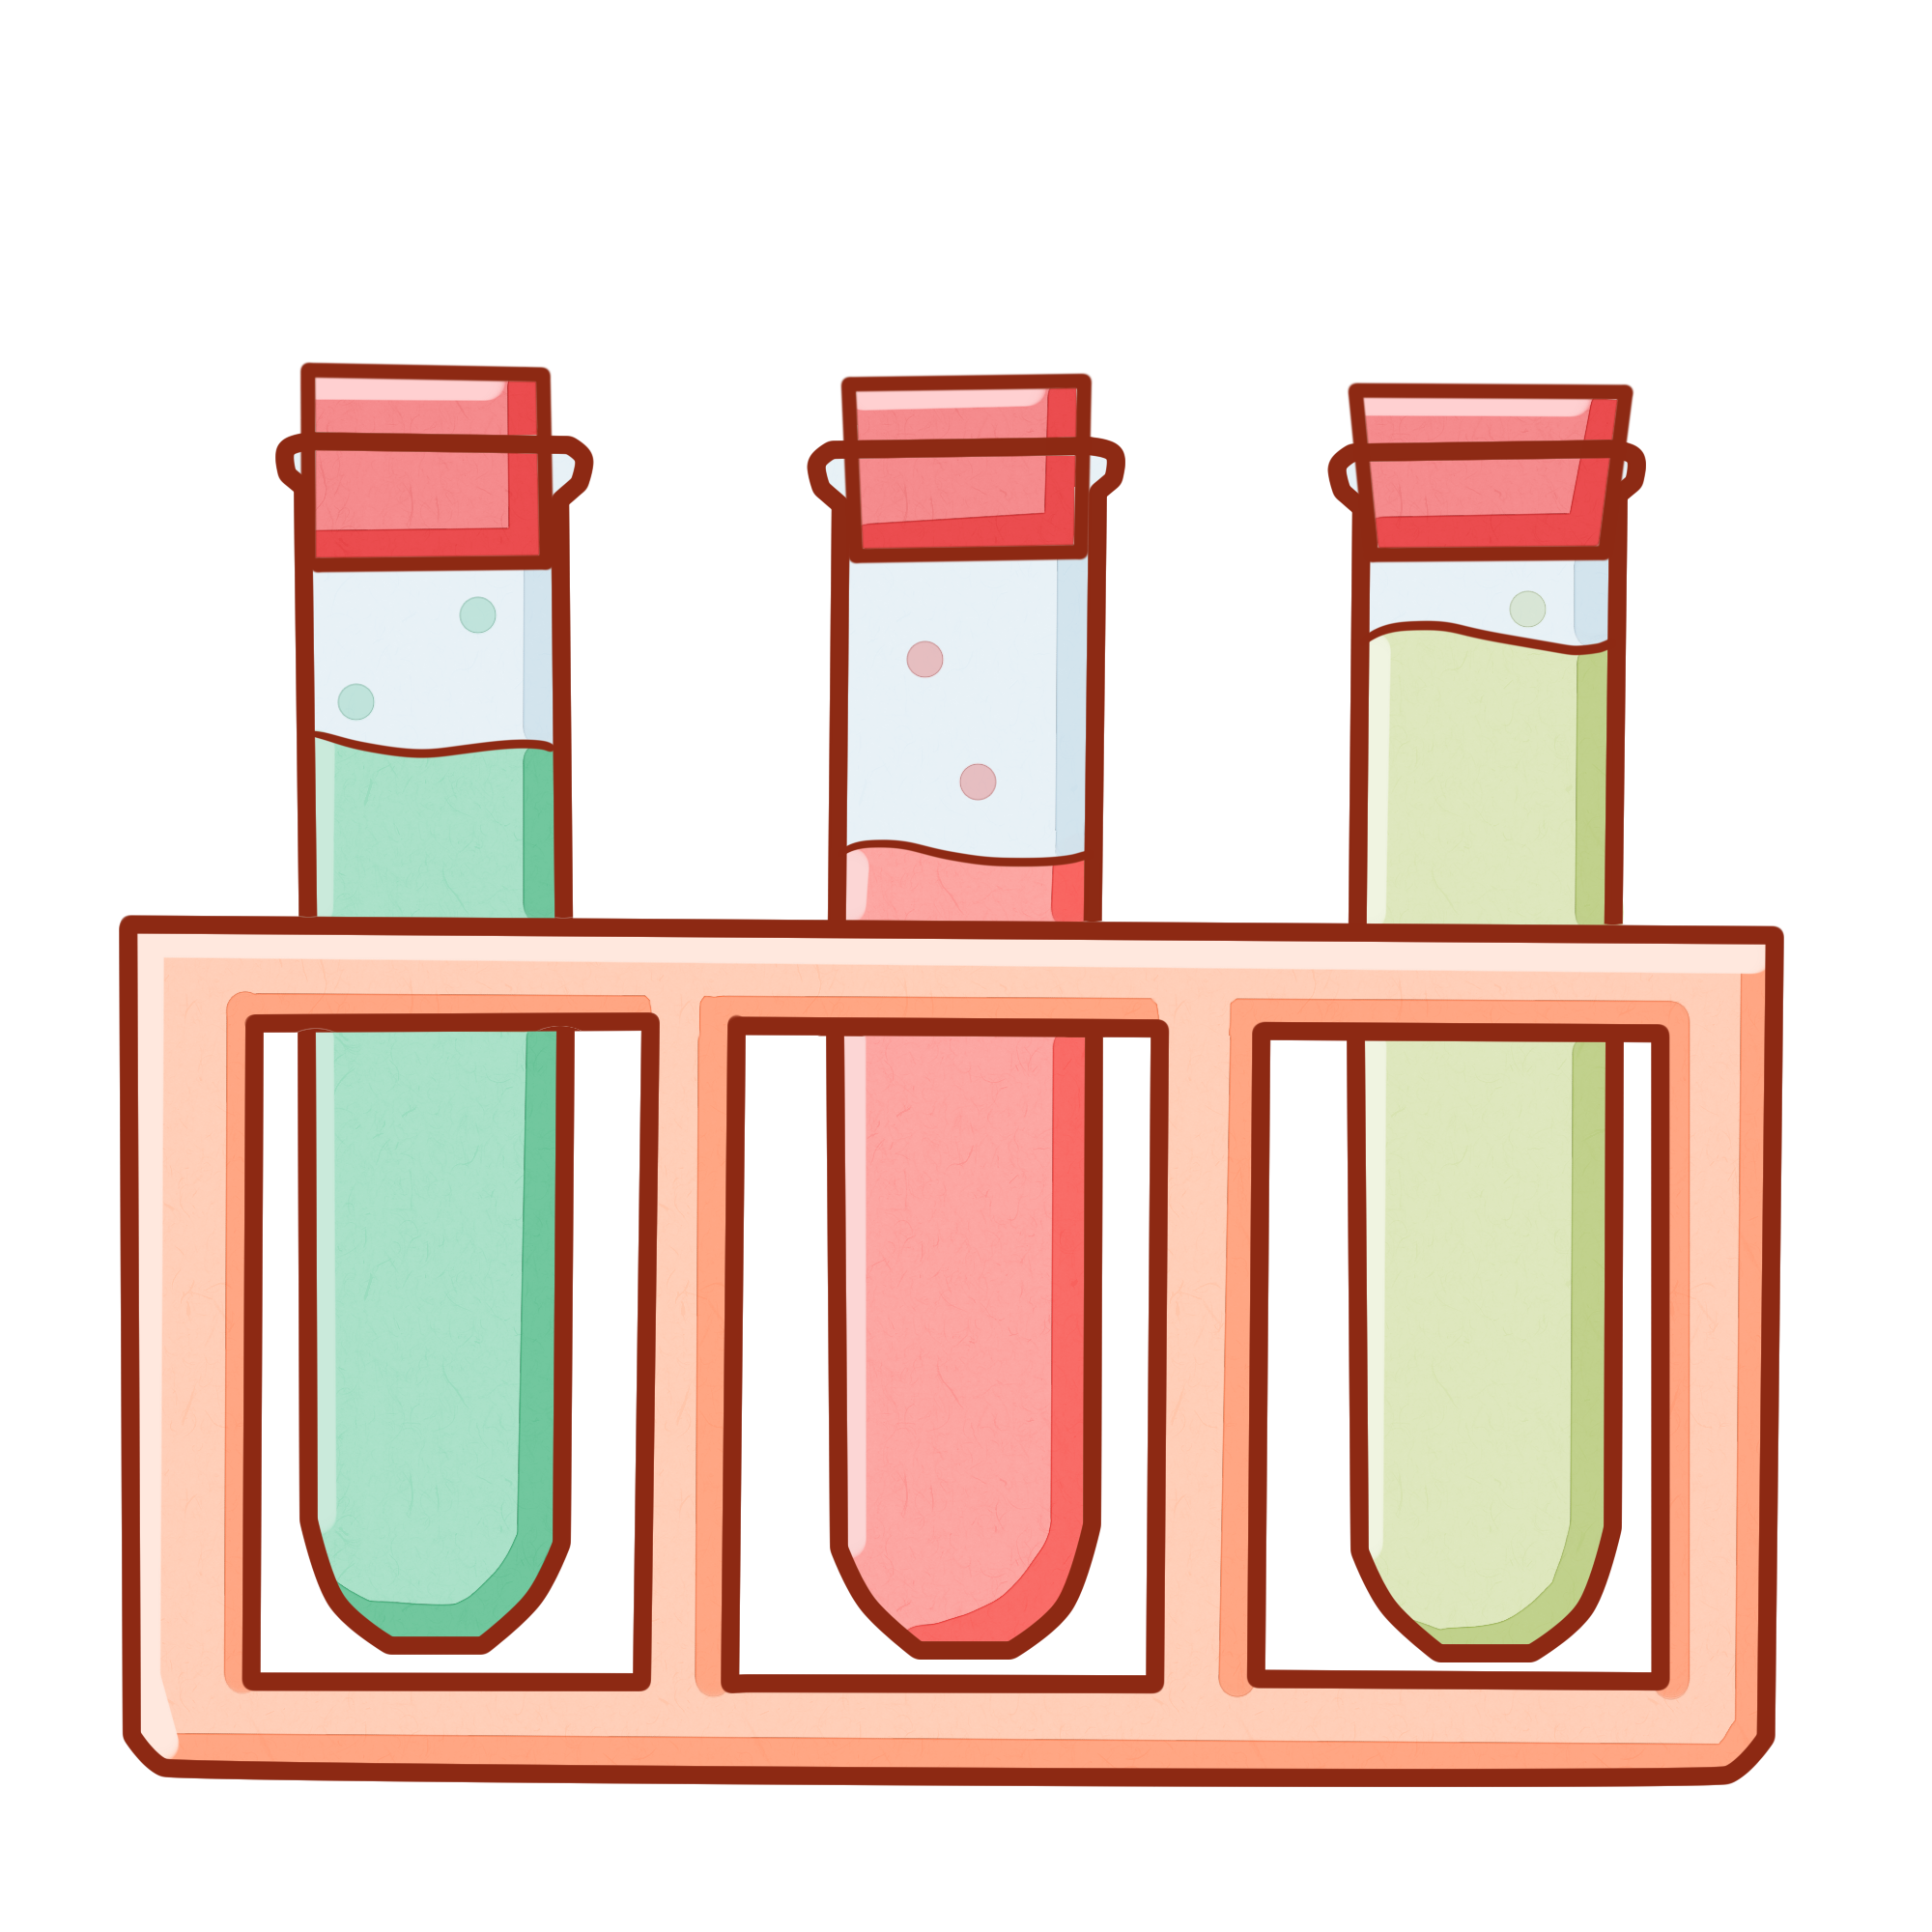

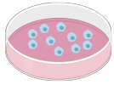

Elaboration platform
Molecular mechanisms
Microdosimetry based
modeling
Multi-scale molecular dynamics
Prediction of effects on tissues
Radiation chemistry based modeling
Modeling
Data
Machine learning
Modifying factors
Radiobiological effects
descriptors
Database

Slide 5
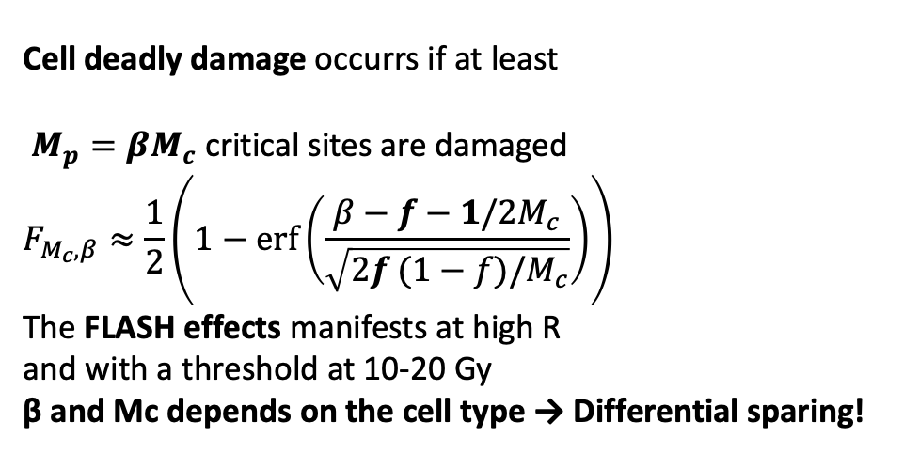
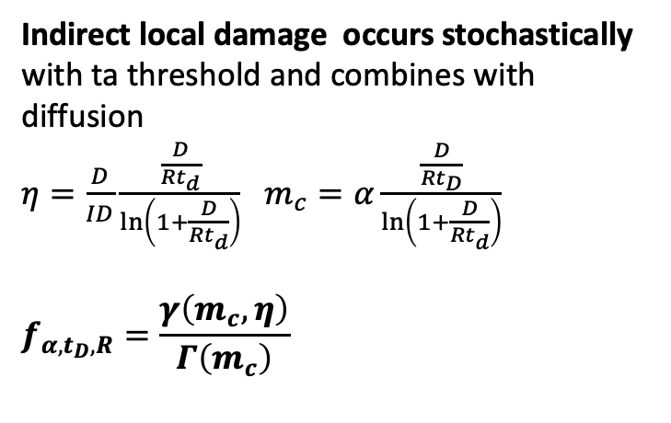
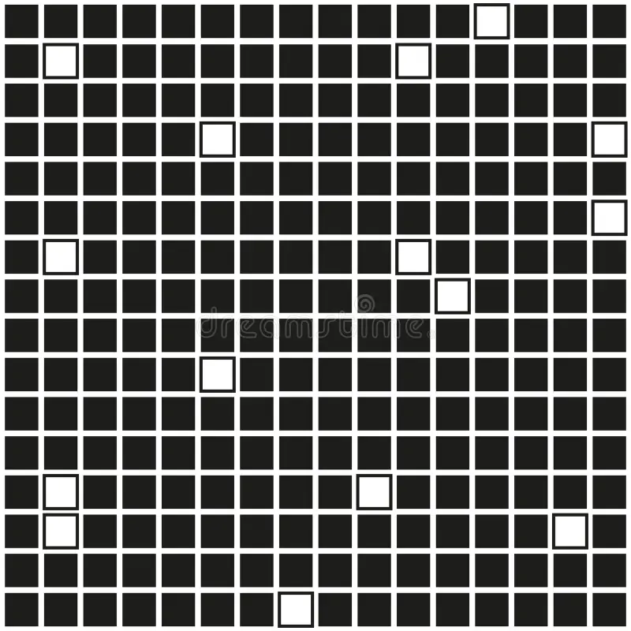
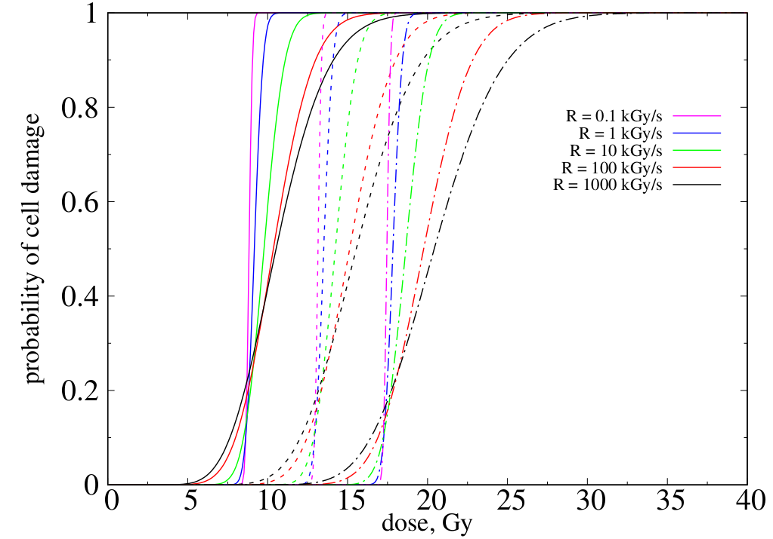
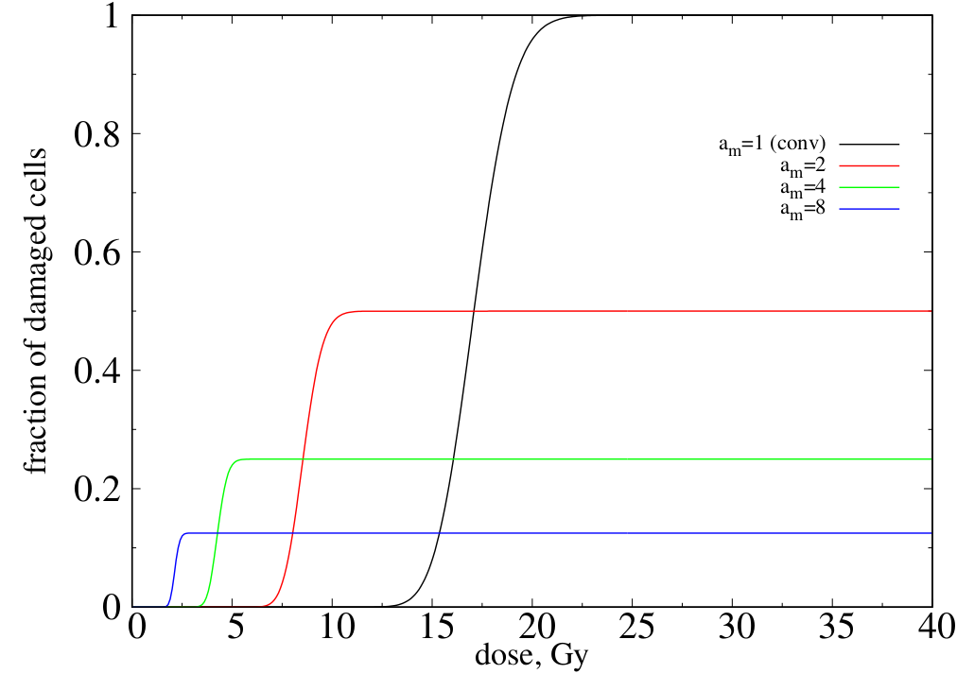
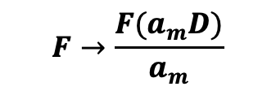

Minimalistic Stochastic model
See I.Bodrenko talk@PMBT
M_{c} sensitive loci
2R_{t}
FLASH effect appears locally as an interplay between the dose rate and diffusion and is modulated by the amount and sensitivity of critical sites in the cell
α=4
α=3
α=2
β=0.8
Mini/microbeam effect (volume, irradiated area A, A_{m})
The ideal (zero dose on valley) minibeam irradiation effect is saturated due to overkilling on peak regions. It can be stronger or weaker than CONV depending on the dose. => response curve is necessary to fit the parameters of the model.

Slide 6
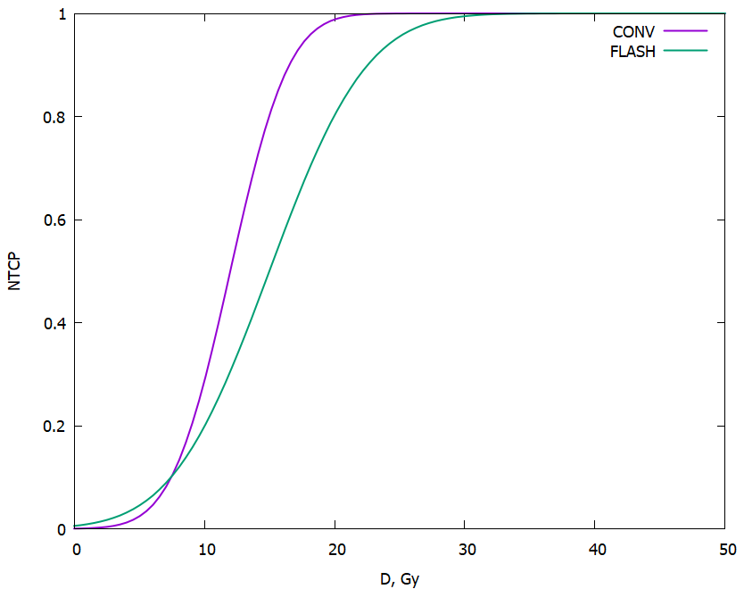
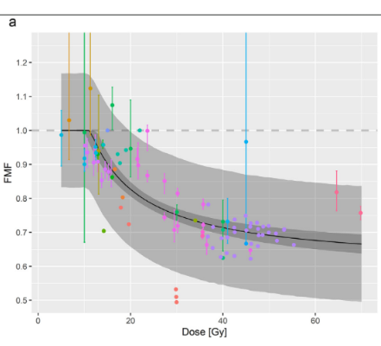
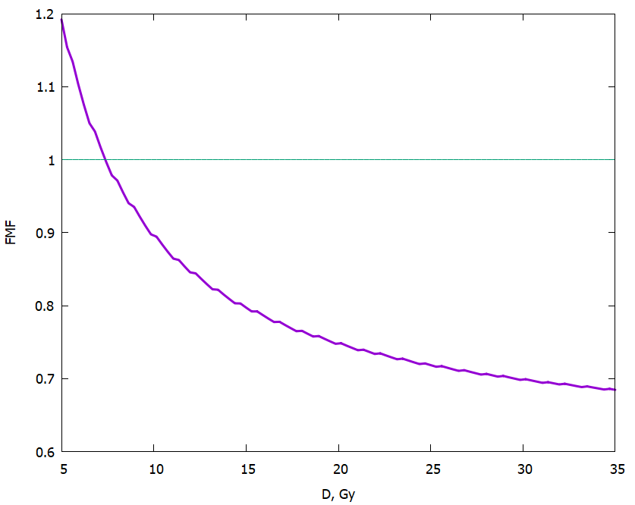
FLASH effect in Normal Tissue Complication Probability
Qualitatively agrees with exp data [Boehlen et.al, 2022]
Search for similar
Systematico collection for
MiniBeam effect

Slide 7
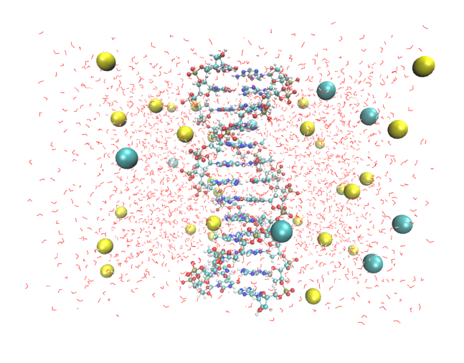
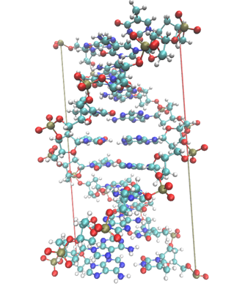
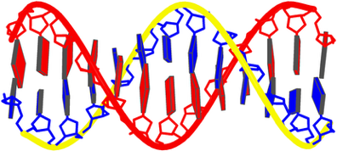
P-DNA in Reaxff: 1 to 4 input-workflow
1. pdb without H atoms from 3DNA (13bp)
2. from pdb to pdb and psf files with H and added bonds, angle dihedral terms (reduced to 10bp)
3.- 4. add water molecule and ions such that the charge is neutralized + salt concentration (0.5 mmol)
Castelli et al. FRPT 2025 Oral poster

Slide 8
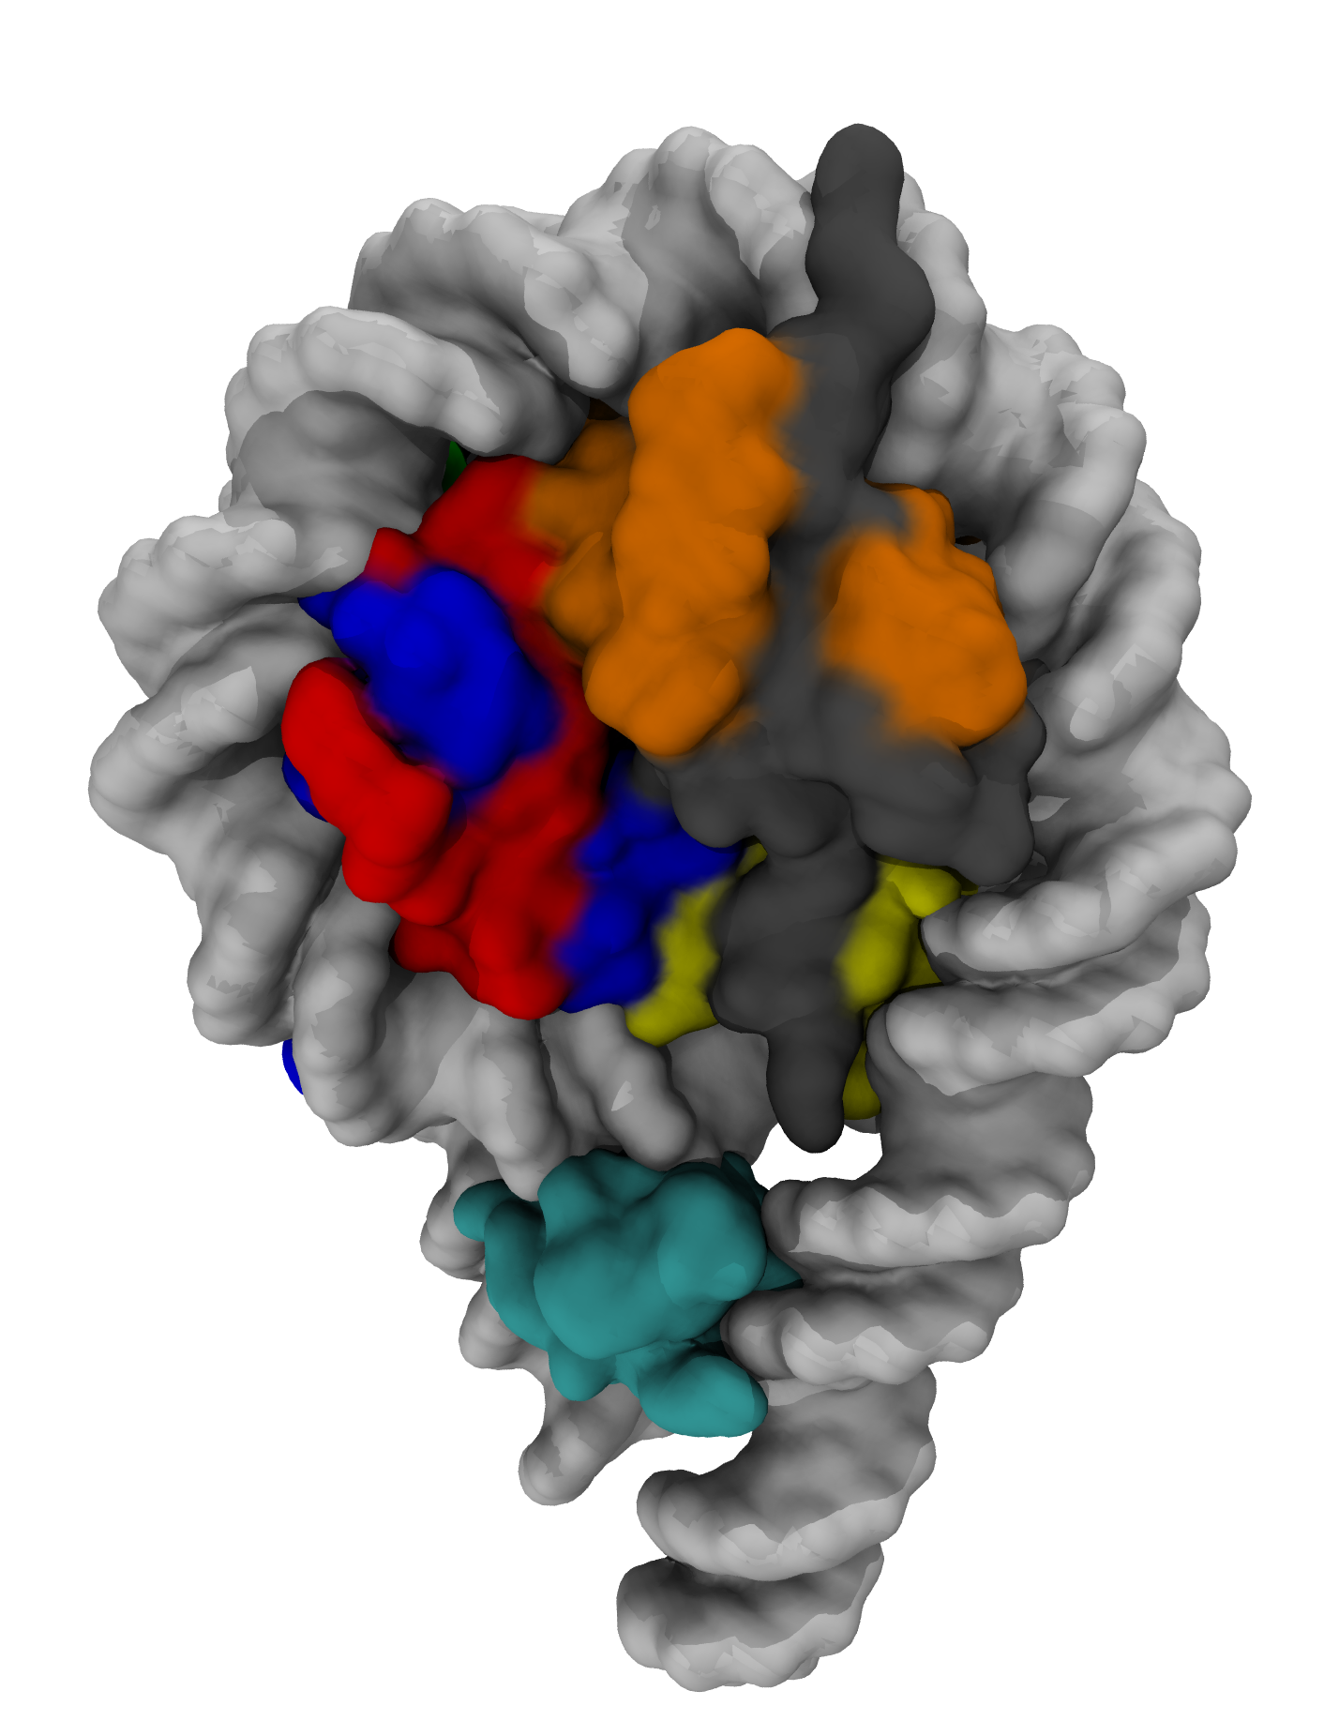
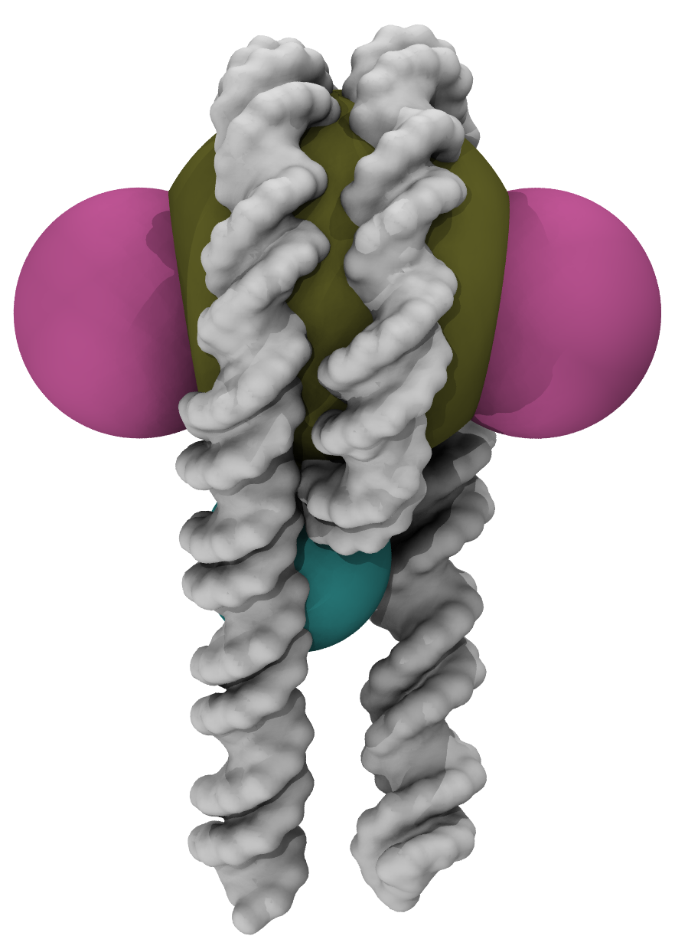
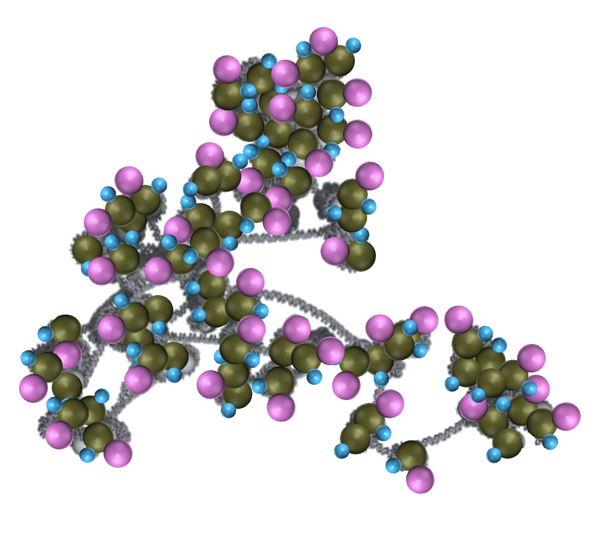
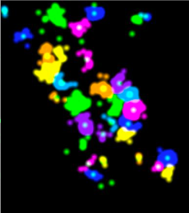
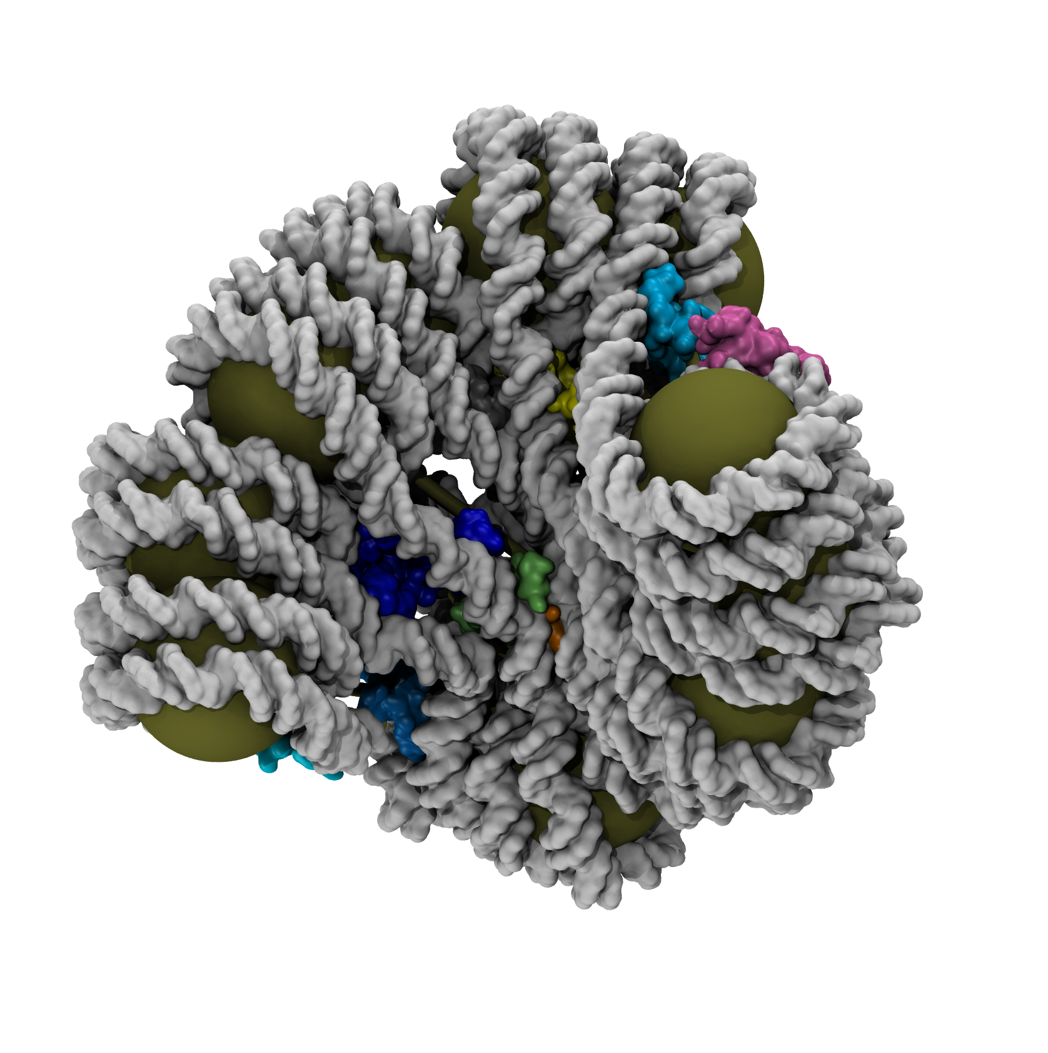
Mechanistic model of local damage distribution at the chromatine:
nucleosome
damage,
phospohorilation
& clustering
Coarse graining
dynamics & compaction
From left to right:
Starting from the known structures of nucleosomes and local structure of chromatin, we build a nucleosome level coarse grained model of the chromatin r
produce the structure of the undamaged chromatin
model the dynamic and structure of phosphorylated chromatin and its clustering
Emulate the fluorescence microscopy images
The model is under development, preliminary steps were done (see next)

Slide 9
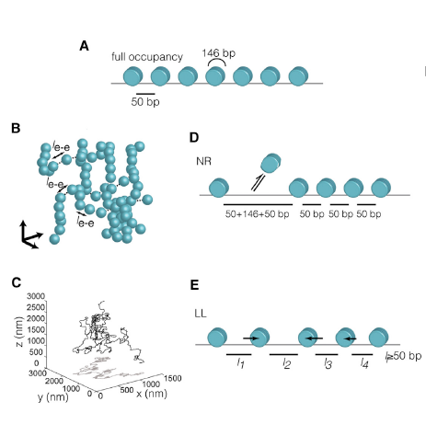
Available model for chromatin and its improvement
https://www.cell.com/fulltext/S0092-8674(15)00132-4
Ricci et al 2016, the model
Basic model
Step B-C is replaced by MD simulations of a Ricci-like bead linker model, with random length linkers (at given occupancy), 10nm beads (with morse vdw like potential) and different linker potentials mimiking the effect of persistence length (quartic implemented in dlpoly will work).
Worm-like chain potential
Further steps must be added, accounting for the random distribution of the damage caused by radiation. For this part, assumption must be done in accordance with stochastic model of Igor.
Improved model: RICCI assumes that 30 nm chromatin fibers
completely loose the local order and use a 10 nm simple model
fiber (euchromatin)
We re-include the local structure of chromatin
fibers before irradiation, and simulate the swallowing due to strand damage and antibody binding.
This can be done by first adding a single bead representing the histone H1 (or the harm crossing) and then re-including the helical structure of chromatin fiber locally where the nucleosomes are compact enough. The model will therefore have regions of ordered 30 nm fibers and regions of 10 nm fibers (as those of RICCI), also depending on the level of nucleosomes present: if nucleosomes are near enough, they will tend to order, otherwise, they will form 10nm fibers. The two conditions can cohexist in different parts of the chromatin
Antibodies can then be added, and an additional swallowing observed.
Useful parameters include into the model:
1. a priori known level of nucleosome occupancy, BEFORE irradiation. Should be known based on the structure of pre-irradiated chromatin, or based on the histone 1 presence amount. This fixes the average amount of 30nm fibers vs 10 nm fibers
2. State of the chromatin, percentage of compaction BEFORE damage.3. Percentage of andibody binding to phosphorilated histones

Slide 10
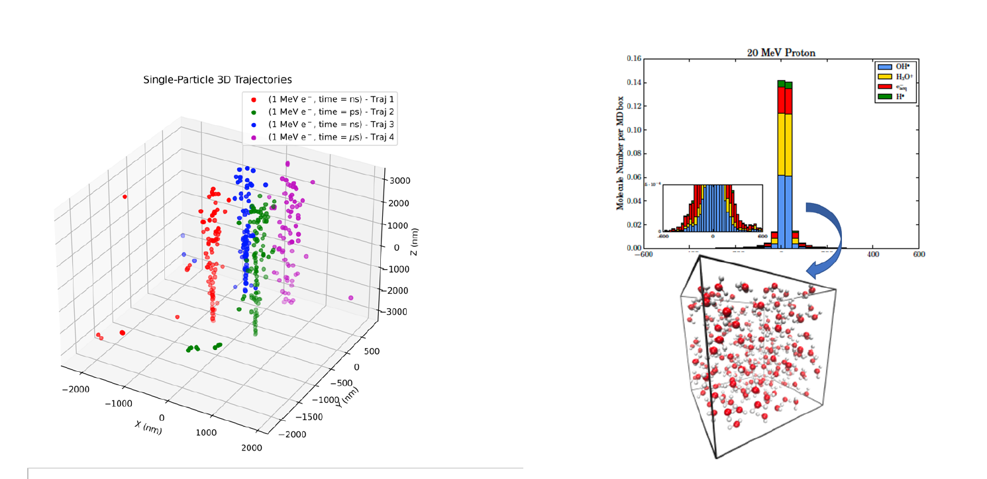
L. Castelli

Slide 11
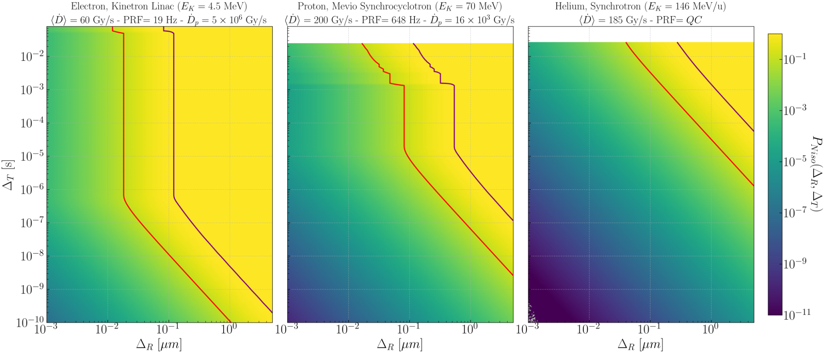
(Results) UHDR experimental conditions and ranges
See L.Castelli talk@PMBT
8
Notes:
Figura esempio, rifare

Slide 12
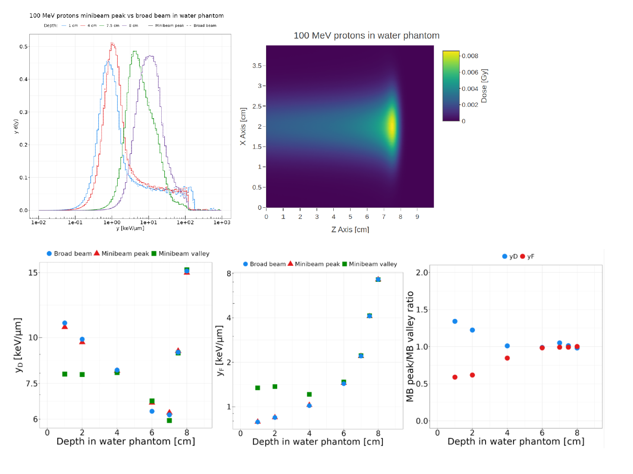
Microdosimetry based modeling

Slide 13
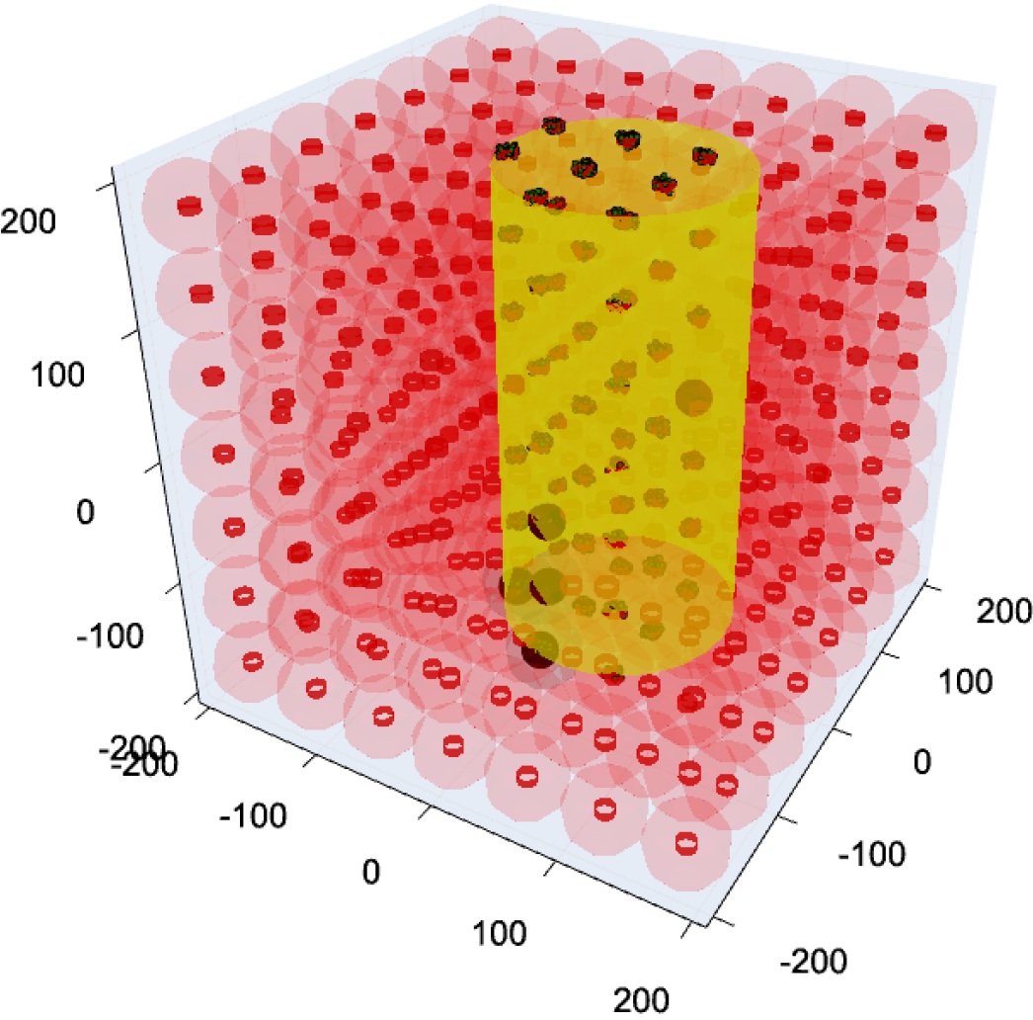
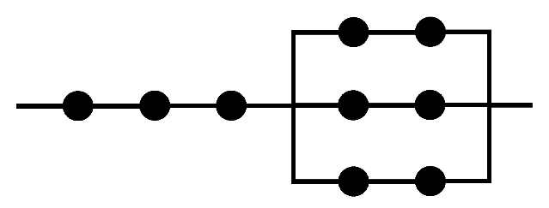
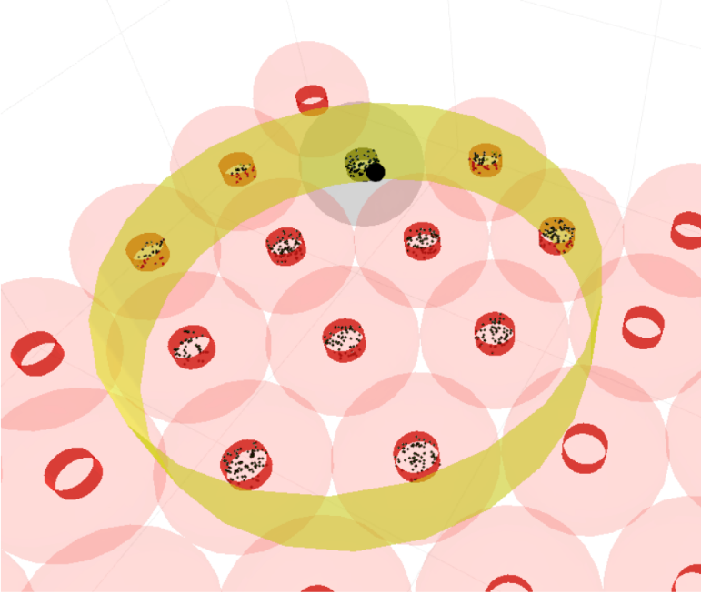




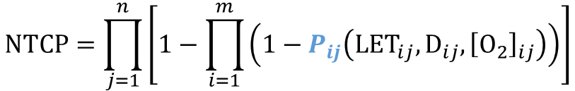

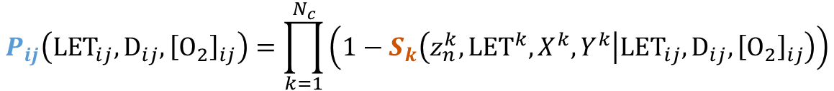
The GSM² -based NTCP model
Functional sub-units (FSUs)
response
GSM² surviving probability
$$P_{ij}\left({LET}_{ij},D_{ij},{\left[O_{2}\right]}_{ij}\right)=\prod_{k=1}^{N_{c}}{\left(1−S_{k}\left(z_{n}^{k},{LET}^{k},X^{k},Y^{k} | {LET}_{ij},D_{ij},{\left[O_{2}\right]}_{ij}\right)\right)}$$
beam
probability FSU dies
$$m$$
$$P_{ij}$$
FSU
$$n$$
GSM²
FSU
$$P_{ij}$$
$$S_{k}$$
Normal Tissue Complication Probability (NTCP)
$$NTCP=\prod_{j=1}^{n}{\left[1−\prod_{i=1}^{m}{\left(1−P_{ij}\left({LET}_{ij},D_{ij},{\left[O_{2}\right]}_{ij}\right)\right)}\right]}$$
cell nucleus
DNA damages
G. Bordieri
M. Battestini
F. Cprdoni
J. Morand
Kallman, P. et.al. Int. J. Radiat. Biol. (1992)

Slide 14
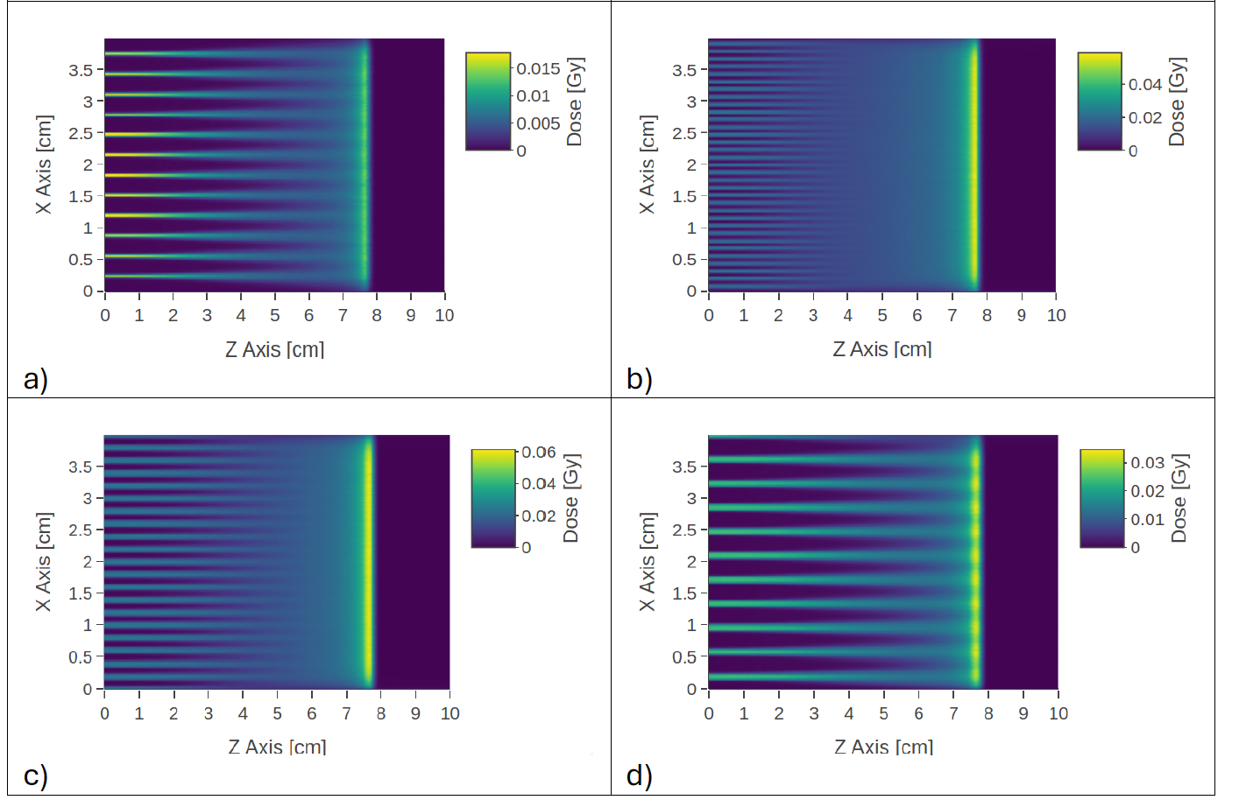
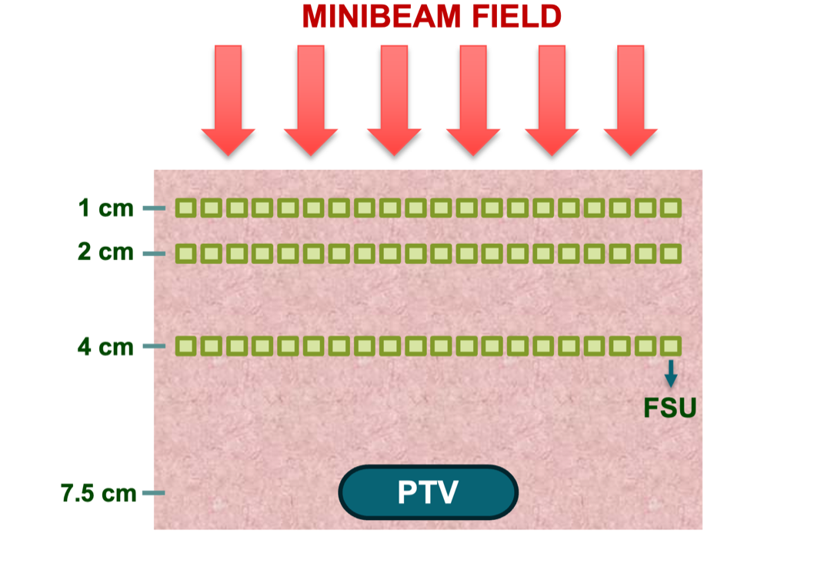
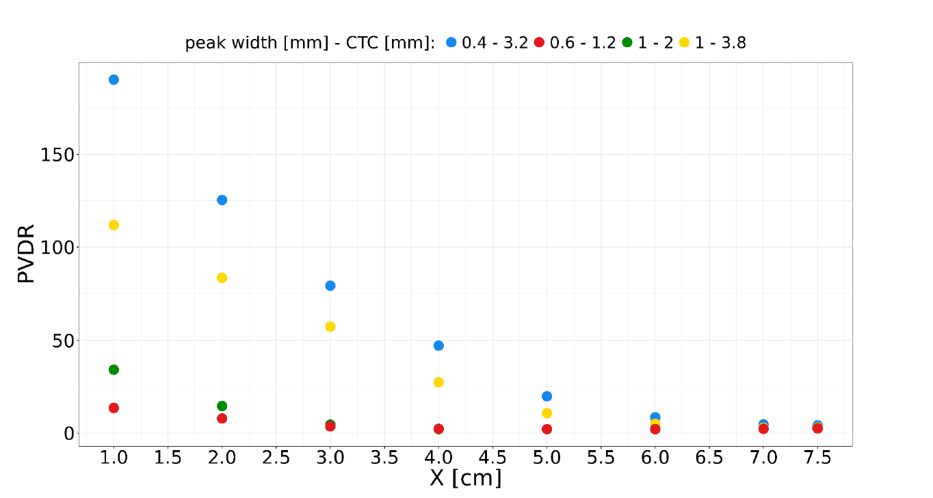
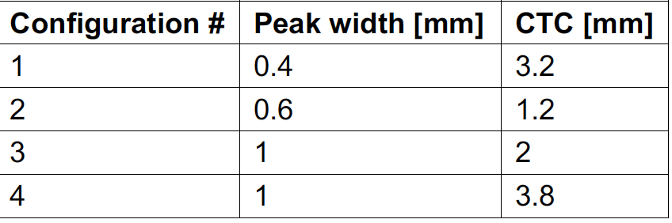
Simulation setups

Slide 15
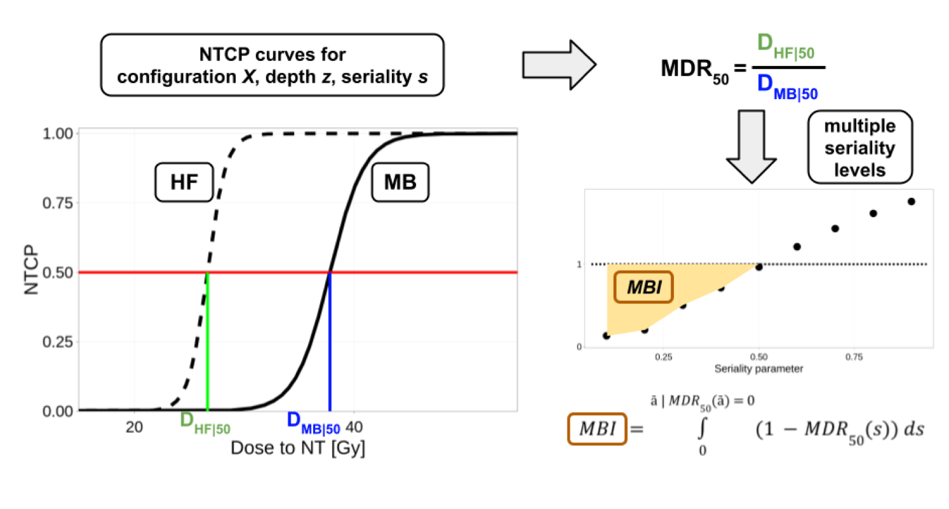
NTCP and MB effect quantification

Slide 16
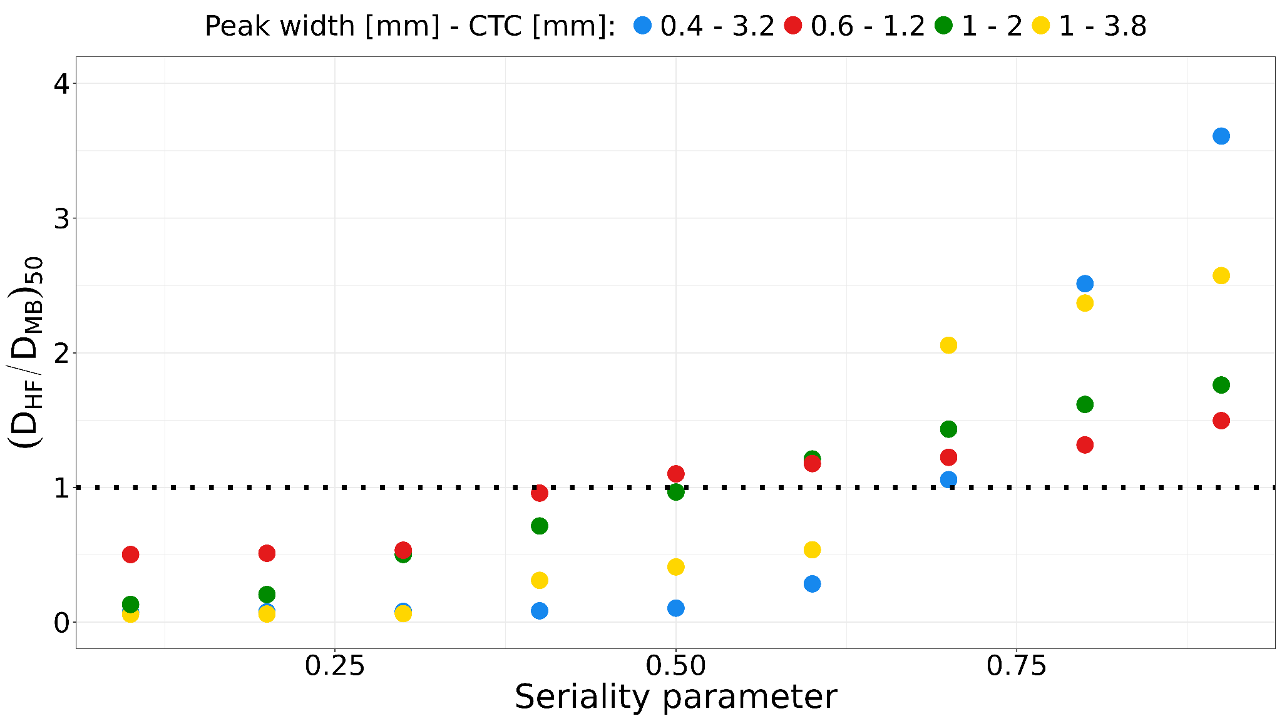


Seriality parameter dependence
1cn
2cn
4cn
• s = 0: fully parallel organ (organ fails only if all FSUs are inactivated),
• s = 1: fully serial organ (organ fails if even one FSU is inactivated).

Slide 17


PVDR dependence
Bordieri et al. subm to IJROBP.
See F. Cordoni talk@PMBT

Slide 18
Summary
Radiation Chemistry part advanced through a minimalistic model, beside the Monte Carlo full simulaition framework.
Molecular scale simulations, realized DNA olygomer target, currently extending toward full chromatine domains
Micordosimetry based model allows to predict MB sparing as a function of seriality of the organ and PVDR

Slide 19
Thanks!
Francesco Cordoni
Giulio Bordieri
Lorenzo Castelli
Marco Battestini
Valentina Tozzini
Igor Bodrenko

Slide 20


https://4thflashworkshop.unitn.it

Slide 21
Discussion Slides

Slide 22


Slide 23







PRESTO
PRoton therapy Enhancement by
Spatially fractionated Treatment Optimization

Slide 24

Over 700 participants
FRPT-SFRT combined conference
With specific Minibeam workshop

Slide 25
MIRO WP3.4-Multiscale & AI Modeling
Radiation Chemistry
  -> Evaluation of spatiotemporal radical species evolution as potential mechanism
Microdosimetry based modeling
  -> Comparison of GSM2/MKM predictions with spatially resolved DNA damage measurements
  (from Task 3.2)
Molecular Dynamics
  -> Multiscale models of DNA damage
  evolution following information of high
  resolution spectroscopy data
Machine Learning
  ->AI driven analysis of bio data collected
  in the project and in the literature,
  for prediction and explainability
-> Giulio Bordieri
-> Valentina Tozzini
-> Camilla Scapicchio
Involved Units: PISA,TIFPA(+RM3)

Slide 26





Towards NTCP-> from cell to populations
NTCP
TCP
Courtesy of N.Bassler
Under review (adapted)

Slide 27




PART 2: available CG models for chromatin. Digression: the WMLC model potential
The linker potential could be described by a WML-like potential, e.g, a double well potential with one well in 0 and the second in r_{b} depending on the ration L/L_{p.} The parameterization with double well quartic is good, thought not perfect, at any length (see graphs below).
Can be done better, this is just to begin
N=L/(2Lp) | Beta=L/Lp | L (Lp=51nm = 150 pb) | rb/L (ra=0) | pb | Pa (l3G(o) | Pa/pb | -kt ln(pa/pb)= delta Ub-Ua=Rb**2 (ka-kb)/ 12 (kcal/mole)
0.3 | 0.6 | 30 | 0.9 | 1 | 0 ? | 0? | ?
1.1 | 2.2 | 112 | 0.8 | 0.5 | 0.1 | 0.2 | -0.96
1.9 | 3.8 | 194 | 0.7 | 0.5 | 0.5 | 1 | 0
2.7 | 5.4 | 275 | 0.6? | 0.5? | 1.1 | 2.2 | +0.47
3.5 | 7.0 | 357 | < =0.5? | 0.5? | 1.8 | 3.9 ? | +0.81
Above: data from the solution of WMLC model
In Mehraeen et al PRE 77 (2008)
Aside: potential u (quartic) for the 4 lengths in the table and corresponding distribution probabilities
They should superimpose to that of the paper. They are not perfect, but the parameterization can be adjusted.

